Slide 1
ET-PP annual meeting: administrative details
Project: 101079696 — ET-PP — HORIZON-INFRA-2021-DEV-02
Horizon Europe: Coordination
and Support Actions
17/06/2024
Grant agreement: Nº 101079696

Slide 2
Outline
1) Status of the project
2) Budget Monitoring
3) Amendment
4) Next steps

Slide 3
Status of the project
Starting date: 01/09/2022
Ending date: 31/08/2026
Project duration: 48 months (now, M22).
RP1 reporting – submitted. Waiting for the Commission approval

Slide 4
Reporting periods:
Reporting periods | Type | Month from | Month to | Deadline | Project reviews (timing month)
1 | Periodic report | 1 | 12 | 31/10/2023 | 14
2 | Periodic report | 13 | 30 (28/02/2025) | 30/04/2025 | 32
3 | Final report | 31 | 48 | 31/10/2026 | 49
-Technical report (template provided by the EC + continuous reporting portal)
-Financial report (done in the Funding and Tenders Portal)
Electronic submission via the Funding & Tenders Portal

Slide 5
PAYMENTS
Total Budget: maximum grant amount 3,450,000.00 € (made to the coordinator, distribute the amounts to the beneficiaries)
Prefinancing payment: 1,839,885.00 € (53.3 %) distributed between partners in two payments following provisions of the CA
Interim payment from de Commission:
The payment was suspended, due to required corrections of the Data Management Plan
The Deliverable and the Report have been re-submitted. Pending on the approval and Payment Letter
Next payments based on the interim payments received, taking into account the 85% ceiling.
Partner | Pre-financing received (in two payments) | To be paid until the end after two payments (85% ceiling) | RP1 declared (still need EU approval) | 3rd payment
BSC | 111,763.13 | 84,799.38 | 92,267.61 | 84,799.38
INFN | 333,221.50 | 291,528.50 | 12,956.80 | 12,956.80
UW | 80,952.75 | 61,422.25 | 8,392.71 | 8,392.71
CNRS | 438,594.75 | 332,780.25 | 57,845.19 | 57,845.19
NIKHEF | 352,204.88 | 267,232.63 | 201,611.49 | 201,611.49
UCL | 27,185.63 | 20,626.88 | 9,516.95 | 9,516.95
ANTW | 7,249.50 | 5,500.50 | 0 | 0
EGO | 80,000.00 | 22,000.00 | 3,576.28 | 3,576.28
DESY | 30,206.25 | 22,918.75 | 0 | 0
WIGNER | 7,249.50 | 5,500.50 | 5,030.50 | 5,030.50
MUL | 39,872.25 | 30,252.75 | 10,935.68 | 10,935.68

Slide 6
2) BUDGET Monitoring

Slide 7
2) BUDGET Monitoring

Slide 8
2) BUDGET Monitoring
Partner | PMs in Anex I | PM declared to date | RP1+RP2 (forecast) | % to date | % RP1+RP2
IFAE | 50 | 32,6 | 46,1 | 65% | 92%
BSC | 36 | 24,8 | 35,8 | 69% | 99%
INFN | 80 | 6,0 | 10,0 | 8% | 13%
UW | 24 | 6,1 | 14,9 | 25% | 62%
CNRS | 108 | 39,8 | 66,8 | 37% | 62%
NIKHEF | 53 | 44,6 | 58,1 | 84% | 110%
UCL | 6 | 3,2 | 5,2 | 53% | 87%
ANTW | 0 | 0,0 | 0,0
EGO | 18 | 3,0 | 9,6 | 17% | 54%
DESY | 9 | 0,0 | 0,0 | 0% | 0%
WIGNER | 0 | 0,0 | 0,0
MUL | 12 | 3,6 | 6,6 | 30% | 55%

Slide 9
3) List of third parties to be included in the GA (existing ones (AGAIN) + new ones)
3) AMENDMENT
1) Revision of due dates of deliverables/milestones in long-term
2) Change in the budget (own resources planification) and PMs (modification of Budget in Annex II of GA)
Last meeting: discussion on the including third parties in the GA to facilitate the monitoring of their contributions to the project
Proposal: to do that only of various of TPs require to be part of the GA → discussion with the PO if it is possible including only few of them.

Slide 10
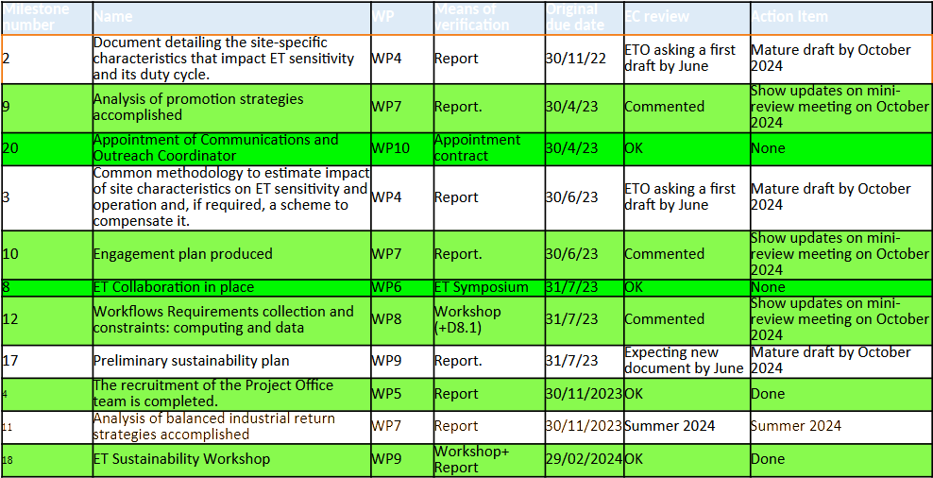
Milestones up to date

Slide 11
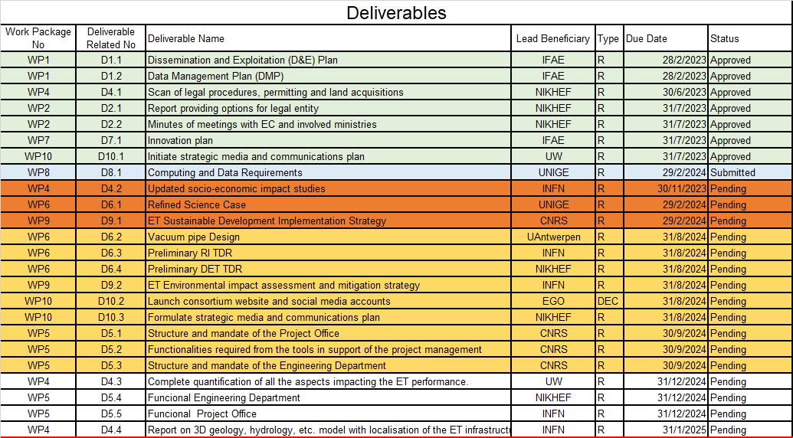
Deliverables up to RP2
Procedure for the Review of Deliverables and Milestones: 1) Consortium; 2) Coordinator; 3) ET management; 4) F&T Portal

Slide 12
4) NEXT COMING STEPS
DISCUSSION with the Project Officer on the project modifications. If necessary → launching of the request for amendment
ACTIONS:
Discussion on the delays in the work packages
Possible causes and Impact on the project goals
New due dates and Action Plan
Meeting with the Project Officer
Amendment (if required)
2nd period reporting (March - April 2025)

Slide 13
ET-PP annual meeting: administrative details
Project: 101079696 — ET-PP — HORIZON-INFRA-2021-DEV-02
Horizon Europe: Coordination
and Support Actions
17/06/20234
Grant agreement: Nº 101079696

