Slide 1
WP 9: Deliverables and milestones
 | Deliverable | Lead participant | Type | Delivery date (months)
D9.1. | ET Sustainable Development of Implementation Strategy | CNRS | Report | 18 - 29/02/2024
D9.2. | ET Environmental impact assessment and mitigation strategy | INFN | Report | 24 - 31/08/2024
D9.3 | ET CO2 footprint ET assessment and mitigation strategy | EGO | Report | 36 -31/08/2025
 | Milestone | Delivered | Status | Note
M9.1 | Preliminary Sustainability Plan (PSP) | October 2023 | Under revision | June 2024 - new version for internal review October 2024 – Delivery to EC
M9.2 | ET sustainability workshop | November 2023 | Writing report | Anticipated respect to timing (feb 2024) All the material already available

Slide 2
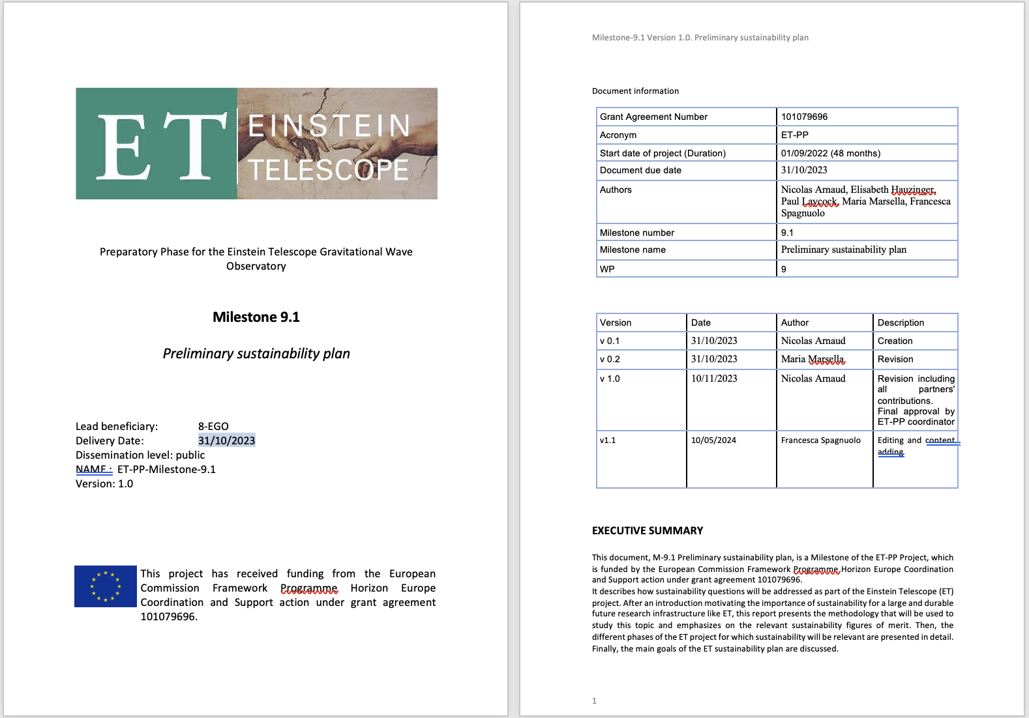

Slide 3

Preliminary Sustainability Plan- PSP (M9.1 - Milestone)
The Plan cannot include a quantitative assessment of indicators/parameters
On-going activity (EGO, INFN) to improve and broaden the content of the draft version of the PSP, available here for inputs and suggestions: https://docs.google.com/document/d/1MR1LsPOO16LiG0pWmx0yxI6Y0RhQsPWr/edit
Internal deadline for revision by experts/professionals (CERN or external consultant) is June 24
New delivery date to EU is October 24

Slide 4
WP 9: Outlook and perspectives
Actions in place (June 2024)
EGO open a call for position on a sustainability expert and will recruit in 2024 – INFN is recovering the budget assigned to the vacant position to issue a 1.5/2 year contract on smart energy solution (shared with WP5)
Additional in-kind people involved within ET-PP and the collaboration (link to ETO and local teams, help building a background knowledge for the future
Established links other WPs and attracted more people
Preparing specification for a contract assignment - 2 step activity: 1. review and identify weakness - 2. support the develop of the final plan) to be proposed by INFN
Action identified in 2023 Annual meeting
Dedicated person to be recruited
Involvement of more people within ET-PP, ETO and the ET collaboration (including research units) -
Liaisons with other WPs (starting with computing), departments/working groups (engineering), technical and scientific boards
WP9 periodic meetings - Thursday at 10 (Rome time)
ZOOMhere https://us02web.zoom.us/meeting/tZAtfu6hqzIjGtffZNLw7PSDOvC8ARJK5k0X/ics?icsToken=98tyKuGsrjItE9GcuRmERpwIAor4KPPwmFhEjbdbmiXLLzcEUjDSGfRhapNNOvOF

