Slide 1
ET-PP INFRA-DEV Annual Meeting
17-18 June 2024
Parallel Session on WP9 - Annual Meeting
17 June 2024

Slide 2
Parallel Session on Sustainability
16 June 2024
How to reach a quantitative approach for the indicators/parameters to be included in the Preliminary Sustainability Plan ?
Discuss the content and deadline(s) for the delivery of the ET Sustainable Development Implementation Strategy (D9,1, CNRS)
Propose a meeting with CERN (attendees; content; possible dates) to discuss sustainability issues and identify /involve a contacts

Slide 3
What we are doing @EGO
Coordinating the revision to improvr the initial sustainability plan to be resubmitted in October 2024
Organize weekly WP9 internal meetings to discuss progress and problem within the WP
call for interest for a sustainability expert @EGO focused on the assessment of the CO2 footprint of the future RI and the mitigation strategy to minimize its environmental impacts https://www.ego-gw.it/blog/2024/05/09/et-pp-sustainability-expert/
Notes:
In questa slide, inserisco le principali attività che stiamo svolgendo ad EGO

Slide 4
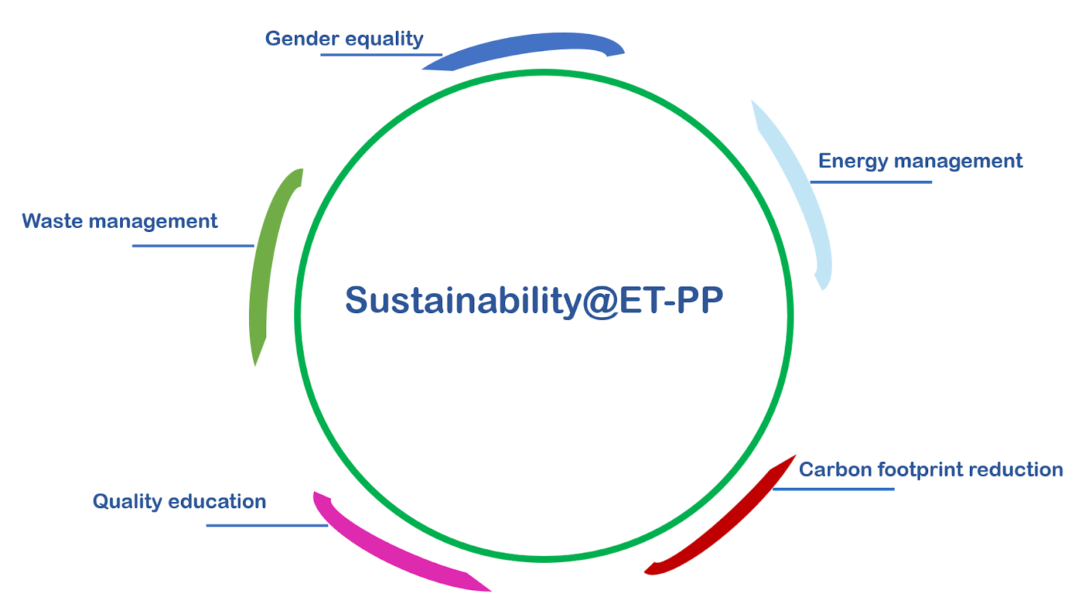
Actions in ET- Phase 1
Energy management - design an energy-efficient infrastructure; promote the use of renewable energy and the adoption of clean and environmentally sound technologies
Carbon Footprint Reduction - integrate carbon footprint measures into ET planning and policies (e.g. adopt sustainable travel policies: limit in-person meetings; travel by train; offset Co2, etc.)
Waste management - reduce waste generation through prevention, reduction, recycling and reuse
Adopt and implement a Gender Equality Plan -ensure women’s full and effective participation and equal opportunities for leadership (EGO implementation plan)
Quality education - support quality education in schools and universities and promote citizen science
Notes:
In questa slide sono inserite azioni fattibili e anche concrete, che possono essere intraprese sia nella fase di design e progettazione che in quella successiva di costruzione e operatività dell’infrastruttura. Alcune di queste noi le stiamo già adottando ad EGO, per essere il gender equality plan. Si potrebbe pensare, persino di dotare ET di una certificazione ISO sulla parità di genere, volendo.

Slide 5
ET Long-Term Sustainability
long-term sustainability
scientific excellence
funding
socio-economic impact
innovation
capacity to remain operative, effective and competitive
expected to deliver both scientific and socio-economic goals >
Including contribution to the UN SDGs
Notes:
In questa prima slide ho riassunto alcuni concetti principali discussi al workshop su sostenibilità ad Orsay. Partendo dalla definizione di long-term sustainability, come capacity to remain …
Scientific excellence, funding, etc. sono gli elementi principali di questa nozione e nell’immagine a destra li vedi articoli in alcuni elementi principali
In quanto very large research infrastructure, da ET ci si aspetta che sia in grado di produrre sia obiettivi scientifici che socio-economici, incluso contribuire agli obiettivi di sviluppo sostenibile definiti dalle Nazioni Unite

Slide 6
What we are doing @CNRS
ET Sustainability Workshop - Done in Paris ET-syposium - Report in a .pdf format and ET-PP project template to be uploaded in the SEDIA portal by October
Lead the sustainable development implementation Strategy
Enforce the collaboration with WP8 (meeting organized in Napoli to discuss computing sustainability (CNRS)
Notes:
In questa slide, inserisco le principali attività che stiamo svolgendo ad EGO

Slide 7
D9.1 - ET Sustainable Development was due in February 2024
ask for a new delivery date and start to work on it
Who/What/When to be defined
Goals
Development of a collective methodology to define and sustain ET sustainability plan
Implementation/adaptation of a tool for the estimation of energy consumption and the assessment of environmental, social, and territorial impact.

Slide 8
What we are doing @INFN
Work on sustainability aspects topics relevant for E T different phases: the design construction phase; operation phase, (including various upgrades along the years. Contribute to the strategy for excavated material
Development of a collective methodology to implement ET sustainability plan (smart energy, environmental, social, and territorial impact) - Liaisons with the socio-economic impact analysis
Analyse measurable values, helping to calculate the sustainable and environmental impact of a business (KPI, ESG, DNSH, )
Notes:
In questa slide, inserisco le principali attività che stiamo svolgendo ad EGO

Slide 9
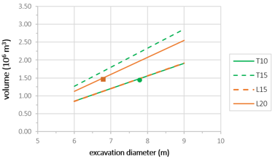
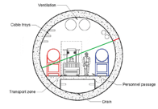
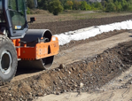
Management of excavation material
TRS must be declared as a by-product in order to be reused (new decree coming).
well-known and widely used solutions: fills, landscaping, slope stabilization;
Fully feasible solutions with optimization possibilities: fillers and aggregates for concrete mixtures and road pavement, pea gravel;
solutions which are still pioneering: production of binders.
Innovative approaches to optimizing the treatment, management and re-use of excavation material to be included in the sustainability plan for discussion and approval by local regions and stakeholders.

Slide 10
Collaboration with other WPs
WP10 - Drafting of the texts for the new EGO website page "Sustainability for ET”
WP8 - Link established at Sustainability Workshop, renewed at Maastricht 2024 Symposium, next WP8 meeting in Naples July, 9 2024
WP5 - ETO Civil and mechanical engineering (framework study for setting up an environmental and energy due diligence for whole ET RI; identification of environmental mitigation measures in construction and operation phases; etc.)
WP7 - Innovation and Industrial engagement – Organize a joint meeting on sustainability to enforce industrial engagement
Notes:
In questa slide, inserisco le principali attività che stiamo svolgendo ad EGO

Slide 11
Competitive advantages for industries
Internal Adjustment:
Training specialist staff to manage and implement DNSH, ESG, CAM and LCA policies
Review of internal procedures to ensure compliance with indicators and analysis of the life cycle of products
Development of Good Practices:
Implementing sustainable and responsible practices to adopt and suggest to other companies
Use of LCA to identify and reduce environmental impacts throughout the value chain
Increasing investment by firms specialized in R&D and training
Assessment of undertakings:
Use of DNSH, ESG, CAM and LCA criteria to select companies in public and private tenders
To support companies that demonstrate a concrete commitment to sustainability and social responsibility, by assessing the entire life cycle of their products
Benefits for Research Infrastructure:
Collaboration with companies adopting high standards, improving the quality and visibility of research infrastructure
Promoting the growth and cultural development of businesses by increasing their competitiveness at national and international level
Being compliant with DNSH, ESG, CAM and LCA not only ensures regulatory compliance, but also provides a competitive advantage for businesses
Companies investing in these areas are better placed to win races and operate in a sustainable and responsible manner
Notes:
Criteria defined by the Italian government to ensure environmental sustainability in public procurement. The criteria include technical specifications to reduce the environmental impact of products and services purchased by public authorities

Slide 12
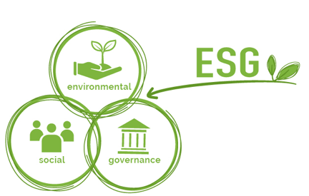
ESG Factors - Environmental, Social and Governance
Describe a company according to non-financial parameters, enhancing its social and environmental reach
A sustainable and responsible enterprise is mindful of:
Environmental factor if it reduces greenhouse gas emissions; is efficient in the use of energy and natural resources (water, raw materials, forests...); does not pollute; protects biodiversity etc.
SOCIAL FACTOR if it ensures quality of the working environment and supply chain; development of human resources; attention to gender equality, diversity and inclusion; corporate social responsibility in the broad sense.
GOVERNANCE covers ethics and transparency; control policies and procedures; in the case of public limited companies, the rights of shareholders, the composition, independence and remuneration of the board of directors, etc.
Factors
Notes:
The concept of ESG (Environmental, Social, and Governance) has a history that has developed over several decades, with significant contributions from various global actors. Building on ethical and social considerations in investment, a globally recognized and structured framework for assessing sustainability and corporate responsibility has been developed, with a growing awareness of the need to manage environmental, social and governance risks to ensure the long-term resilience and sustainability of companies and financial markets.

Slide 13
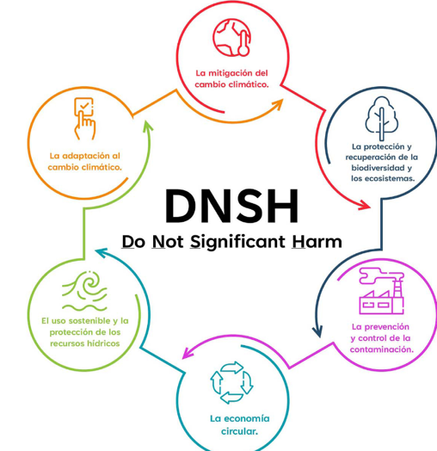
Mitigation of climate change
‘Do No Significant Harm’ (DNSH)
Protection of biodiversity and ecosystems
Adaptation to climate change
Protection of water and marine resources
Pollution prevention and control
Circular economy transition
The DNSH principle ensures that economic activities contribute significantly to environmental objectives without significantly damaging other environmental objectives
Notes:
Closely linked to the ESG concept, the DNSH principle is a key element of the European Union Taxonomy Regulation, a framework that helps financial markets identify and invest in sustainable projects (a classification system for sustainable economic activities with the aim of overcoming the lack of shared definitions and thus fostering transparency and comparability of information on sustainable investments by investors).

Slide 14
Performance indicators (KPIs)
Concretely measurable values, helping to calculate the sustainable and environmental impact of a business
Example:
ESG1 ‘energy efficiency’
To be reported by enterprises of all sectors
GENERAL
INDUSTRY-SPECIFIC
Example:
ESG12 ‘waste’
- only applicable for certain sectors (oil and gas producers, chemistry, paper, etc)
General ESG
Areas to be covered by all sectors
Sectoral ESG
Areas on which only specific sectors need to report
Thematic areas = ESG
Measurable elements = KPI
Example:
ESG1 ‘energy efficiency’ has the following KPIs:
- total energy consumption
- specific energy consumption (intensity);
Options: per unit of turnover, per employee, per unit of production.
All companies must report all KPIs for each general ESG
List of KPIS
For all sectors
List of individual ESG KPIs
suited to the needs of the specific sectors
Example:
ESG12 ‘waste’ has the following KPIs:
- waste per unit produced
- % recycled waste
Companies in the specific sectors to which the specific ESGs apply must report at least at KPI level 1
Einstein Telescope Infrastructure Consortium (ETIC - IR000004)
PNRR MISSION 4, COMPONENT 2, INVESTMENT 3.1
Notes:
KPIs are metrics used to measure an organization's performance against its strategic objectives.

Slide 15
CAM CRITERIA - Minimum Environmental Criteria
Environmental requirements, defined for the different stages of the purchasing process, aiming at identifying the best design solution, product or service in environmental terms throughout the life cycle, taking into account market availability
Examples:
Use of recycled materials
Energy Efficiency
Reduction in the use of hazardous substances
Notes:
Criteria defined by the Italian government to ensure environmental sustainability in public procurement. The criteria include technical specifications to reduce the environmental impact of products and services purchased by public authorities

Slide 16
Preparedness on aspects of sustainability non recovery or mitigation (e.g. CERN)
Long-term vision for a research infrastructure from which to learn and transfer
Notes:
Criteria defined by the Italian government to ensure environmental sustainability in public procurement. The criteria include technical specifications to reduce the environmental impact of products and services purchased by public authorities

