Slide 1
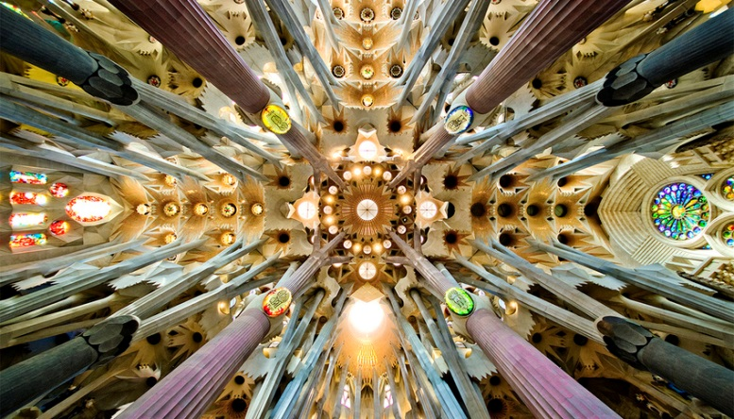
FCC-ee STATUS – selected Highlights
Alain BLONDEL CNRS and UNI-GVA
CEPC meeting Barcelona June 2025

Slide 2
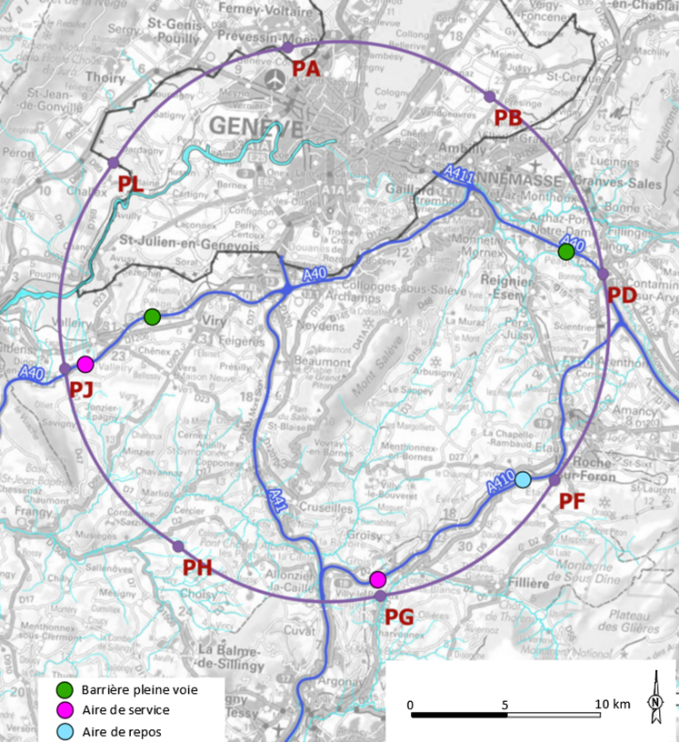









FCC STATUS
Recent events and references
-- FCC feasibility study report https://indico.cern.ch/event/1534205/
& input to ESPPU2025
-- FCC week in Vienna https://indico.cern.ch/event/1408515/
-- FCC-ee physics manifesto https://arxiv.org/pdf/2504.02634
Today in 30’ : very selected highlights of the progress.
http://cern.ch/fcc
Work supported by the European Commission under the HORIZON 2020 projects EuroCirCol, grant agreement 654305; EASITrain, grant agreement no. 764879; iFAST, grant agreement 101004730, FCCIS, grant agreement 951754; E-JADE, contract no. 645479; EAJADE, contract number 101086276; and by the Swiss CHART program

Slide 3
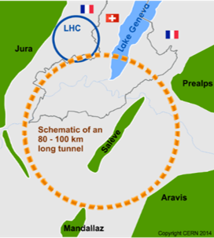
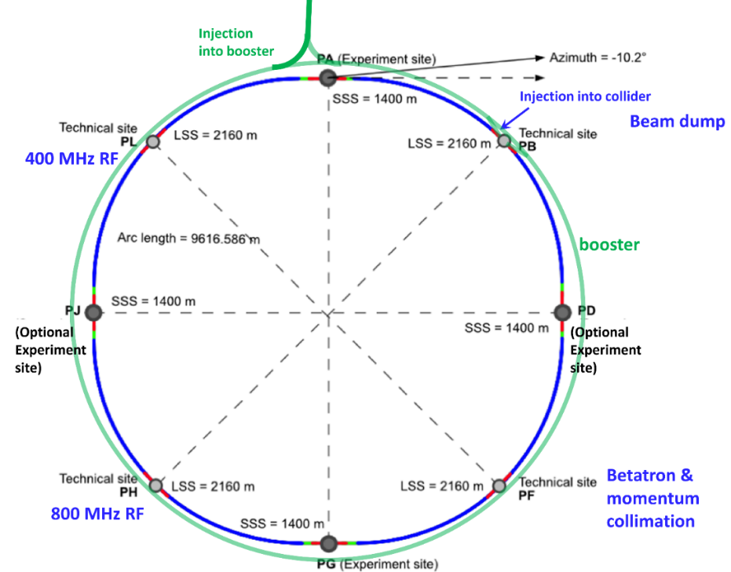
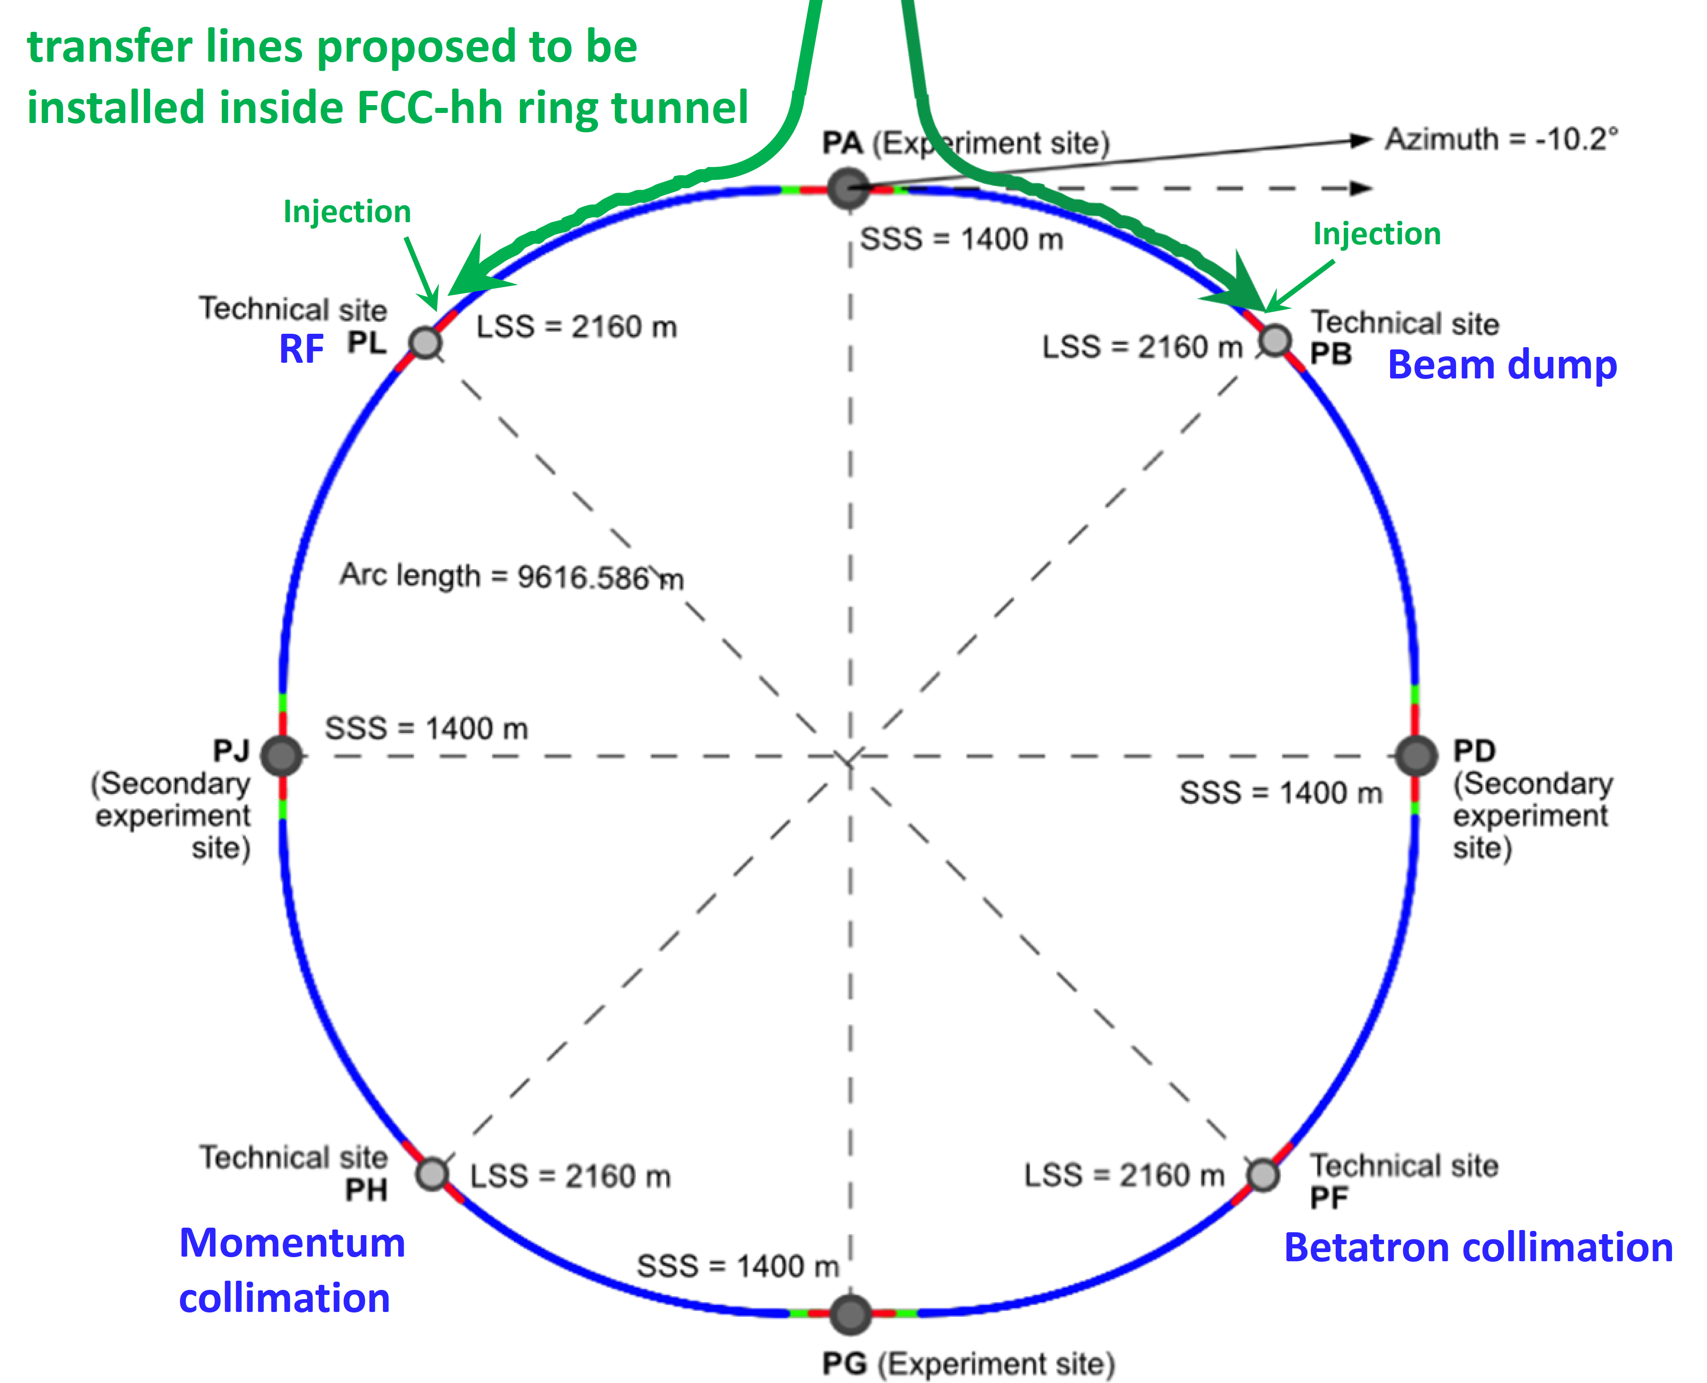
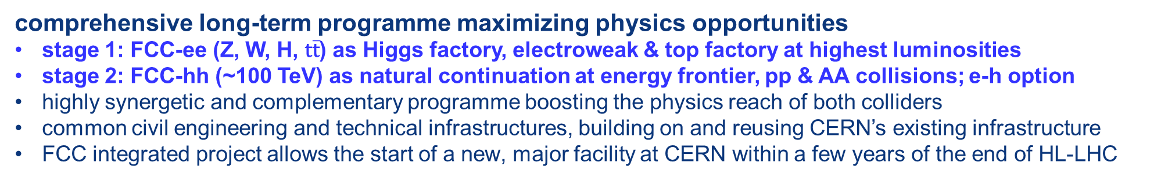
FCC integrated programme
comprehensive long-term programme maximizing physics opportunities
stage 1: FCC-ee (Z, W, H, $\text{t}\overline{\text{t}}$) as Higgs factory, electroweak & top factory at highest luminosities
stage 2: FCC-hh (~100 TeV) as natural continuation at energy frontier, pp & AA collisions; e-h option
highly synergetic and complementary programme boosting the physics reach of both colliders
common civil engineering and technical infrastructures, building on and reusing CERN’s existing infrastructure
FCC integrated project allows the start of a new, major facility at CERN within a few years of the end of HL-LHC
FCC-ee
FCC-hh
2020 - 2045
2045 - 2065
2070 -
a similar two-stage project CEPC/SppC is under study in China

Slide 4
FCC Feasibility Study (2021-2025): high-level objectives
demonstration of the geological, technical, environmental and administrative feasibility of the tunnel and surface areas and optimisation of placement and layout of the ring and related infrastructure;
pursuit, together with the Host States, of the preparatory administrative processes required for a potential project approval to identify and remove any showstopper;
optimisation of the design of the colliders and their injector chains, supported by R&D to develop the needed key technologies;
elaboration of a sustainable operational model for the colliders and experiments in terms of human and financial resource needs, as well as environmental aspects and energy efficiency;
development of a consolidated cost estimate, as well as the funding and organisational models needed to enable the project’s technical design completion, implementation and operation;
identification of substantial resources from outside CERN’s budget for the implementation of the first stage of a possible future project (tunnel and FCC-ee);
consolidation of the physics case and detector concepts for both colliders.
Results are summarised in the Feasibility Study Report released March 2025 → ESPPU 2025

Slide 5
F. Gianotti

Slide 7
We have gone a long way!
2010-11-12 : ideas, wishes, basic concepts, (VHE-LHC, LEP3, TLEP), Higgs discovery
grassroots studies in EU context; «Higgs factory» in LHC, first, then in new 100km tunnel
LEP3 and TLEP submitted to ESPP2012 {TLEP + VHE-LHC ~FCC}
2013 ESPP2013 wants «ambitious post-LHC accelerator projet »
2014-02 Kick-off meeting of FCC design study FCC ee-ep-hh
ESPP contributions and CDR submitted
➔ FCC can be done! Starting with the e+ e- collider
-2020 ESPP2020 long term vision: a 100 TeV pp collider
shorter term priority ‘Higgs Factory’
recommends Feasibility study of 100km facity
Many new physics opportunities discovered esp. for O(10¹³) Z factory!
Great complementarity between
ee and pp programmes
Europe, together with its international partners, should investigate the technical and financial feasibility
of a future hadron collider at CERN with a centre-of-mass energy of at least 100 TeV and
with an electron-positron Higgs and electroweak factory as a possible first stage.
Such a feasibility study of the colliders and related infrastructure should be established as a global endeavour
and be completed on the timescale of the next Strategy update.

Slide 8
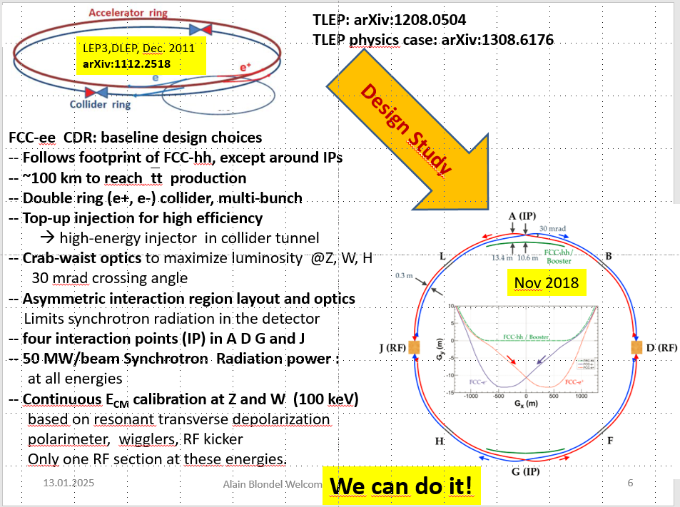
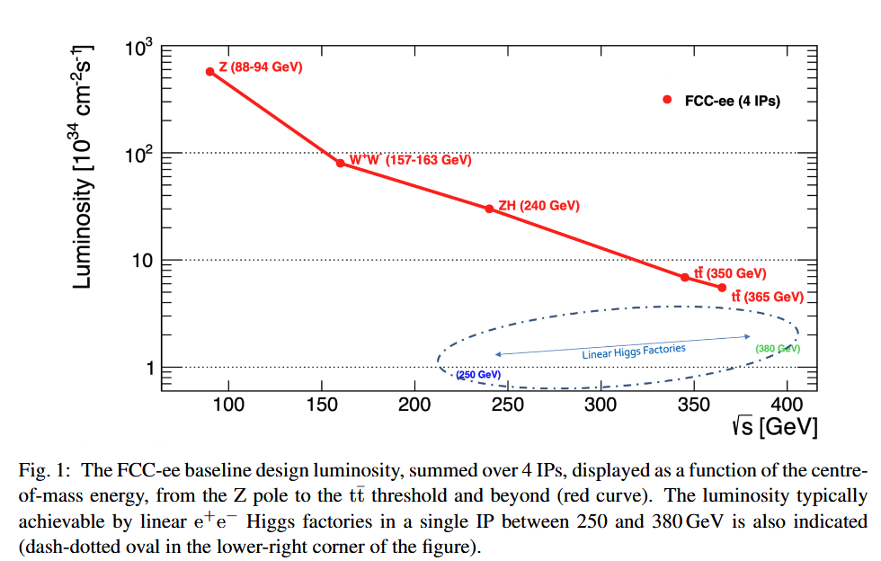
Feasibility Study
Event statistics :
E_{CM} errors:
Z peak E_{cm} : 91 GeV 6 10¹² e+e- → Z
WW threshold E_{cm} : 161 GeV 2.5 10⁸ e+e- → WW
ZH threshold E_{cm} : 240 GeV 2.4 10⁶ e+e- → ZH
‾tt threshold E_{cm} : >350 GeV 2 10⁶ e+e- →‾tt
LEP x 3 10⁵
LEP x 2.10³
Never done
Never done
100*/20 ptp keV
300 keV
<1 MeV
<2 MeV
Great energy range for the heavy particles of the Standard Model.

Slide 9
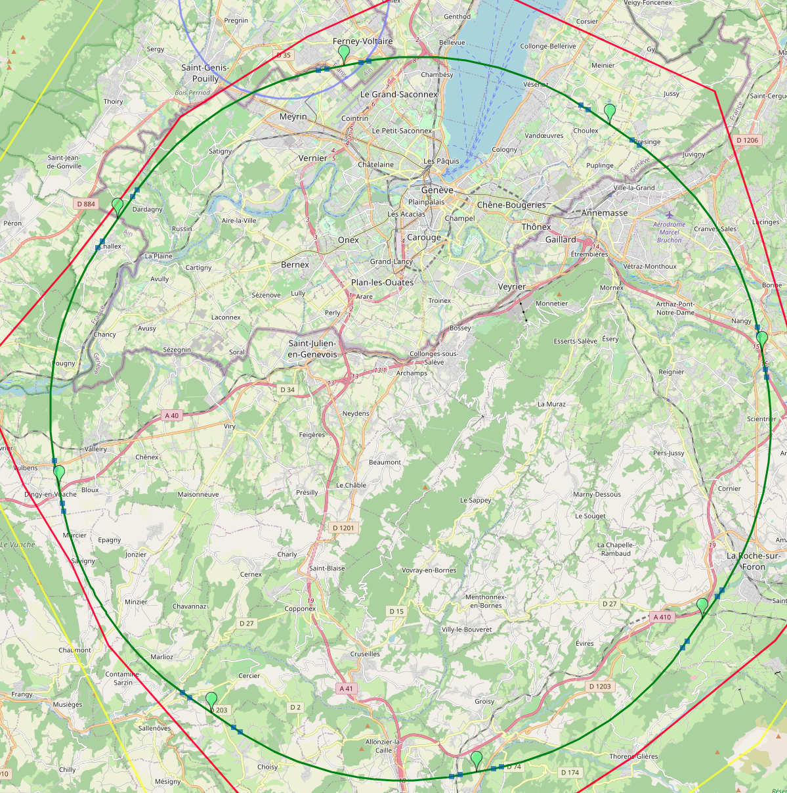
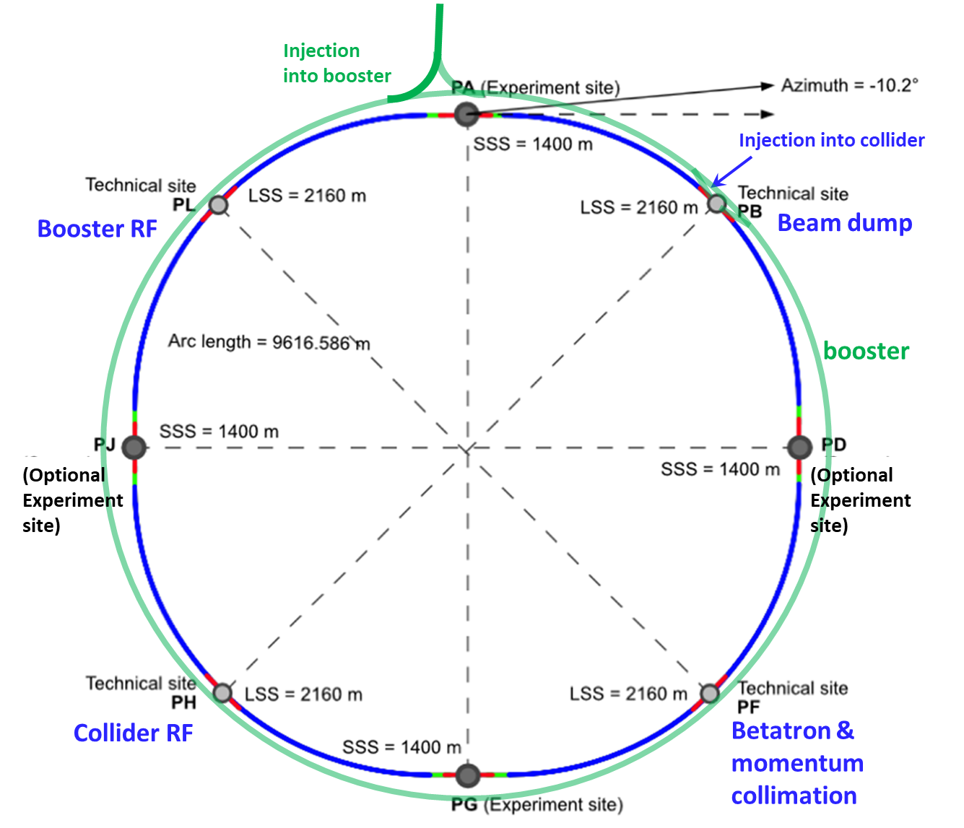
Reference layout and implementation: PA31 - 90.7 km
V. Mertens,
J. Gutleber
Layout chosen out of ~ 100 initial variants, based on geology and
surface constraints (land availability, access to roads, etc.), environment, (protected zones), infrastructure (water, electricity, transport), machine performance etc.
“Avoid-reduce-compensate” principle of EU and French regulations
PA: Experiment
PB: technical
PL: technical
Overall lowest-risk baseline: 90.7 km ring, 8 surface points,
4-fold symmetry
Number of surface sites | 8
Surface requirements | ~40 ha
LSS@IP (PA, PD, PG, PJ) | 1400 m
LSS@TECH (PB, PF, PH, PL) | 2032 m
Arc length | 9.6 km
Sum of arc lengths | 76.9 m
Total length | 90.7 km
PD: experiment
PJ: experiment
PF: technical
PH: technical
9
PG: experiment

Slide 11
Progress towards operational and energy efficiency
-2-cell 400 MHz SRF system for Z, W and ZH,
entire system installed at operation start.
-Flexibility for switching between Z, WW, ZH operation
-Suppression of the single-cell 400 MHz system
-Reduced R&D, installation, commissioning,
-6-cell 800 MHz SRF system for ttbar operation and booster at all modes (more Volts and less power)
+ high efficiency power sources (>90%)

Slide 12
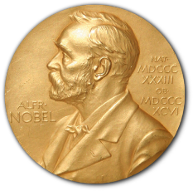
Physics at FCC-ee
HIGGS FACTORY
Higgs provides a very good reason why we need e+e- (or μμ) collider
2. ELECTROWEAK PRECISION ( 10⁻³ today → 10⁻⁵)
Z + WW + top required!
High precision determination of centre-of-mass (20-100 keV)
Test of the completeness of the SM
3. Z FACTORY
(5 10¹² Z i.e. 1.5 10¹¹ ee, μμ, ττ ; ~0.7 10¹² uu,dd,ss,cc,bb ; 10¹² νν)
High statistics for Heavy Flavours, QCD
Search for Feebly Coupled Particles
Possible insight on Higgs coupling to neutrinos if HNL (right-handed neutrino) discovery
The place for ‘direct discovery’
Aussi the most challenging for experiments!
+ comments on the synergy and complementarity of FCC-ee hh and eh

Slide 13
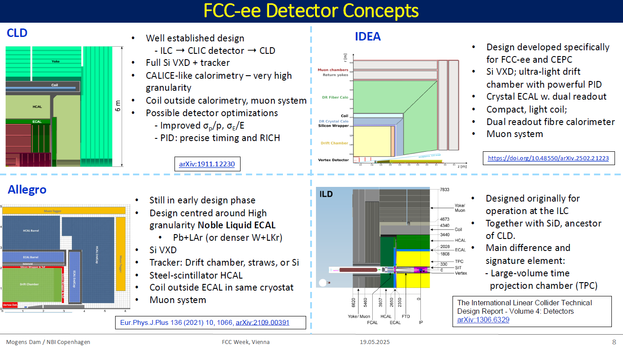

Slide 14
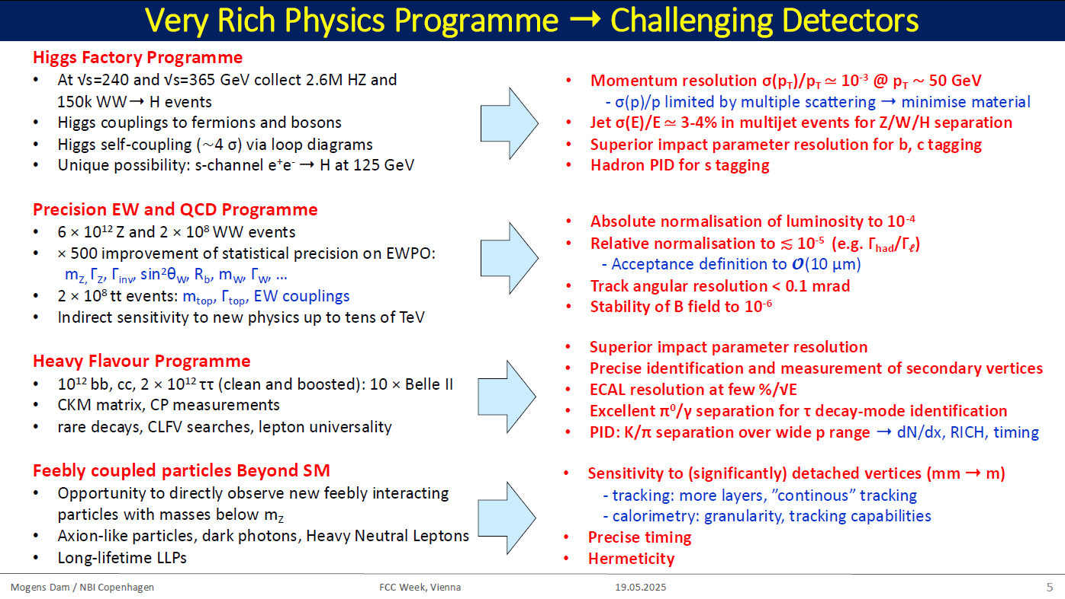
2 10⁻⁵ using γγ

Slide 15
Complementarity: Higgs Physics at FCC
  FCC-ee → g_{HZZ} to <±0.2% from σ_{ZH}
  (model-independent standard candle)
  and Γ_{H}, g_{Hbb} , g_{Hcc} , g_{Hττ} , g_{HWW}
  →fixes all HL-LHC / FCC-hh couplings
  FCC-hh produces over 210¹⁰ Higgs bosons
  use g_{HZZ} from FCC_{ee} will give g_{Hμμ} , g_{Hγγ} , g_{HZγ} , Br_{inv}
  FCC-ee also measures top EW couplings (e⁺e⁻ ➝ tt)
  FCC-hh produces 10⁸ ttH and 2. 10⁷ HH pairs
    ➝ g_{Htt} and g_{HHH}, model-independent & precise!
FCC-ee / FCC-hh complementarity is outstanding
}
ee
}
hh
κ_{λ} +.29-.26 0.2-0.3 0.03
30-50
ee
hh
ee
Comparison with other e+e- colliders
ee only
LHC+ee
FCC-ee+hh+ep
(ep → WW mostly)

Slide 16
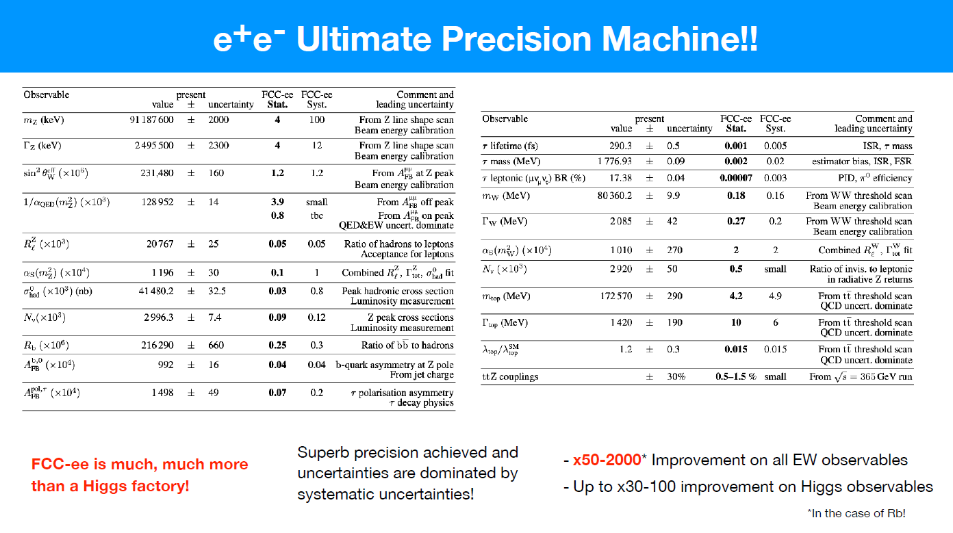

Slide 17
Message 1. many new particles correspond to the D6 EFT operators within SMEFT. Particles which do not couple to SM at tree level will couple at 1 loop. Hardly anyone escapes!
Message 2. particles that mix with SM: Z’, HNL, etc. might be visible, in different ways than above
Message 3. different observables intervene
A_{e}(sin²θ_{W}^{eff}), R_{τ}, m_{W} , Γ_{Z} , G_{F}(τ_{μ}) and τ_{τ} , etc.
Tests of universality!
Allwicher, Mccullough, Renner, JHEP02(2025)164

Slide 18
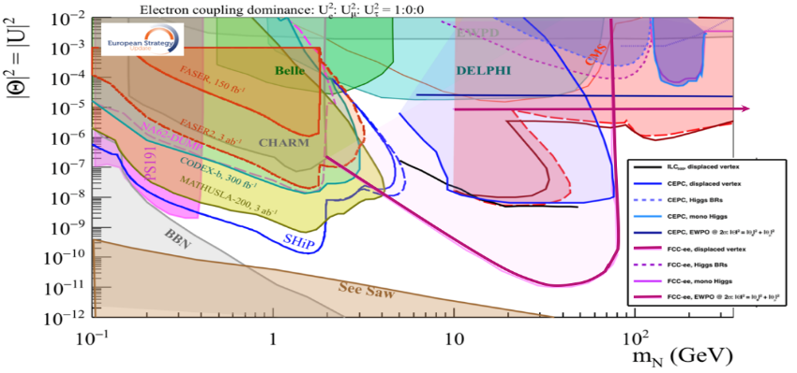
Vectors
Fermions
HNL (ν_{R})
to >10³ TeV
Scalars
arxiv:2011.04725

Slide 19
ν_{τ}
ν_{e,μ}
HNL (ν_{R})
to >10³ TeV
arxiv:2011.04725

Slide 20
Precision measurements as signal of new physics
History repeats itself…
The measurements of A_{e}( equiv. sin²θ_{W}^{eff}) and m_{W} rely,
for interpretation as New Physics (NP), on parameters
α_{QED} (m_{Z})≡ 1/(1-Δα), m_{top}, and m_{Z} :
(CERN archives about muon g-2):
la seconde expérience, qui démarra en 1966, alla encore plus loin en obtenant un résultat 25 fois plus précis que les valeurs précédentes. La sensibilité accrue révéla une différence quantitative entre les valeurs expérimentales et la théorie, ce qui amena rapidement les théoriciens à recalculer leurs modèles
Blind
procedure!
The great virtue of FCC-ee as an Electroweak Factory is that
it provides these three parameters with excellent precision
Neither LC (no Δα, ?m_{Z} ) nor LEP3 (no m_{top}) could do all of them
The g-2 story illustrates how much one would wish
to have a direct measurement of α_{QED}(m_{μ})!

Slide 21
Single Jet tagging efficiencies
arXiv:2202.03285v1
Jet Flavour Tagging for Future Colliders with Fast Simulation
F Bedeschi , L Gouskos, M Selvaggi
It is possible to achieve high purity (99%) for s quarks with an efficiency of more than 10%
THIS IS STILL 1.5 10¹² X 0.22 X 0.2 =
6 10¹⁰ single tag events and
3 10⁹ double tag ss events
(5 orders of magnitude better than
ALEPH bb analysis )
All of this ➔ s‾s much more precise than the
ALEPH bb analysis by factor sqrt(10⁵)
and 15 times smaller impurity

Slide 22
RECENT RESULT on α_{QED} (m_{Z})
1. Direct determination of α_{QED} (m_{Z}) (Unique to circular machines, since it requires >>10¹² Z and line shape scan)
1.1 so far determined from the slope of A_{FB}^{μμ} vs √s → ±3 10⁻⁵ (P. Janot 2015)
1.2 recent paper by Marc Riembau uses both s and t- channel e+e- → e+e- and μ+μ- at the Z pole ±0.6 10⁻⁵
expect 5 times more precise Δα/α= 0.6 10⁻⁵ (very important result, to be scrutinized further)
Can this be improved by using tau final states, etc…?
arXiv:2501.05508v1
Di-lepton distributions are statistics limited
requirements on tracker to be verified,
double tag and alignments essential
Stated concern about efficiency vs polar angle
being possibly different for e and μ
is addressed in
https://doi.org/10.17181/sq5pm-c8334 (AB)
➔ Efficiencies will be measured well enough!

Slide 23
Progress on energy calibration for Z mass, width and asymmetries, and for W mass
en route towards matching the experimental errors (4keV)
Use resonant depolarization RDP for beam energy calibration ν_{s}=E_{b} (GeV)/0.440648 -- so far 100 keV (LEP). First studies of RDP in FCC-ee (Nikitin, Yi Wu)
indicate method accuracy O(10-20 keV) NB: will be repeated 10⁴ times
-- studies of relationship with true energy (affected by alignment errors, etc)
indicate < 2 keV for 50 micron misalignements
-- now: study more imperfections and machine statistics
-- develop in parallel spin precession measurement technique
Develop dedicated damping ring so as to inject polarized pilot bunches
Transfer line and booster ring need to be spin matched (at least well enough)
Improvement in operation efficiency! Work at Z, see if it works at WW or later
(J. Wenninger)
Δν =10⁻⁴ ➔ σ(E_{b}) = (Δν x45.2GeV/103.5)/√12
12.5 keV (rms)
Point-to-point uncertainties can be verified using muon pair inv. mass
at running points (20 keV on each point) E. Perez → 11 keV on Z width
https://repository.cern/records/h34ka-06y15
*not an absolute energy measaurement*!

Slide 24
RECENT RESULTS: Flavour tagging and Flavour EWPOs
in IDEA arXiv:2202.03285v1
Jet Flavour Tagging for Future Colliders with Fast Simulation
IDEA has a drift chamber tracker (dE/dx)
silicon vertex detector and wrapper
uses the Vertex detector and wrapper as TOF with resolution O(30ps)
achieve e.g.
b tagging with 75% efficiency for 10⁻³ charm contamination (single jet)
c 60% 2 10⁻³ b contamination
s 10% efficiency 2 10⁻³ u,d contamination
Thanks to combination of small beam size and beam pipe, vertex detector resolution, dE/dx and TOF, huge statistics, all combined with AI algorithm.
This is a huge breakthrough w.r.t. LEP where efficiencies of 10-15%/jet and contamination of 15% was the best achieved for b-tagging
➔ High precision of b,c,s branching fractions and jet charge asymmeries.

Slide 25
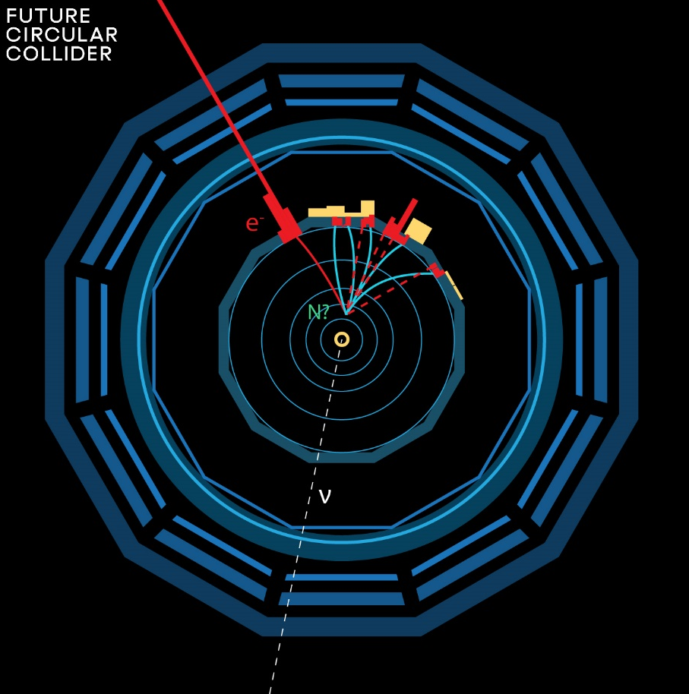

This picture is relevant to Neutrino, Dark sectors and High Energy Frontiers.
FCC-ee (Z) compared to the other machines for right-handed (sterile) neutrinos
How close can we get to the ‘see-saw limit’?
-- the purple line shows the 95% CL limit if no HNL is observed. (here for 10¹² Z),
-- the horizontal line represents the sensitivity to mixing of neutrinos to the dark sector,
using EWPOs (G_{F} vs sin²θ_{W}^{eff} and m_{Z}, m_{W}, tau decays) which extends sensitivity
to 10⁻⁵ mixing all the way to very high energies (500-1000 TeV at least). arxiv:2011.04725

Slide 26
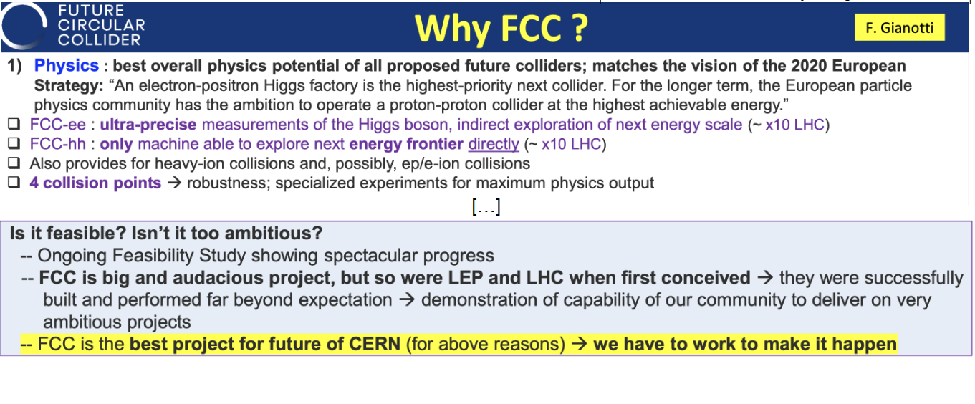

Slide 27




Expected time line till start of construction
2024 |  |  |  | 2025 |  |  |  | 2026 |  |  |  | 2027 |  |  |  | 2028 |  |  |  | 2029 |  |  |  | 2030 |  |  |  | 2031 |  |  |  | 2032 |  |  |  | 2033
Q1 | Q2 | Q3 | Q4 | Q1 | Q2 | Q3 | Q4 | Q1 | Q2 | Q3 | Q4 | Q1 | Q2 | Q3 | Q4 | Q1 | Q2 | Q3 | Q4
Feasibility Study
Pre-TDR Phase
TDR Phase
Construction →→→
FS Report
cost update
ESPPU
2025/26
pre TDR
cost update
TDR
cost update
Project Decision
accelerator design, technical infrastructure design, R&D, towards TDR
engineering design →
Environmental Impact study & Authorization Process
Phase 1 Site Investigations
Phase 2 Site Investigations
CE Concept Design update
CE Tender Design
Construction Design
Start construction
Detector EOI submissions
FC³ formation, call for CDRs
Detector CDRs submitted to FC³

Slide 30
OUTLOOK
Circular colliders have been designed in response to the very specific physics landscape after the discovery of the Higgs boson at 125 GeV. (Higgs and nothing else… yet?)
In this context where the existence of new physics is certain, but its nature, (couplings and mass scale) is unknown, a new, broad exploration is called for, through
-- high sensitivity searches (TeraZ)
-- high precision measurements (EWPO, flavour, QCD) (from Z to top)
-- high energy (100TeV-class hadron collider)
No alternative project offers this much, this well, and this efficiently.
The 2020 ESSPU has clearly expressed a preference for the FCC-ee+hh scheme, provided its feasibility is demonstrated.
-- Technically the FCC-ee is well ready
-- Financial schemes have been developped (council to deliberate on this)
-- and there are many opportunities to make significant contributions in the next few years!

Slide 31
Complementary slides to show the great progress on the accelerator
and infrastructure

Slide 32

edited by Mario Draghi, and officially handed over to Ursula von der Leyen in September 2024
EU competitiveness report
“One of CERN’s most promising current projects, with significant scientific potential, is the construction of the Future Circular Collider (FCC): a 90-km ring designed initially for an electron collider and later for a hadron collider..
Refinancing CERN and ensuring its continued global leadership in frontier research should be regarded as a top EU priority, given the objective of maintaining European prominence in this critical area of fundamental research, which is expected to generate significant business spillovers in the coming years.”
https://commission.europa.eu/topics/strengthening-european-competitiveness/eu-competitiveness-looking-ahead_en

Slide 33


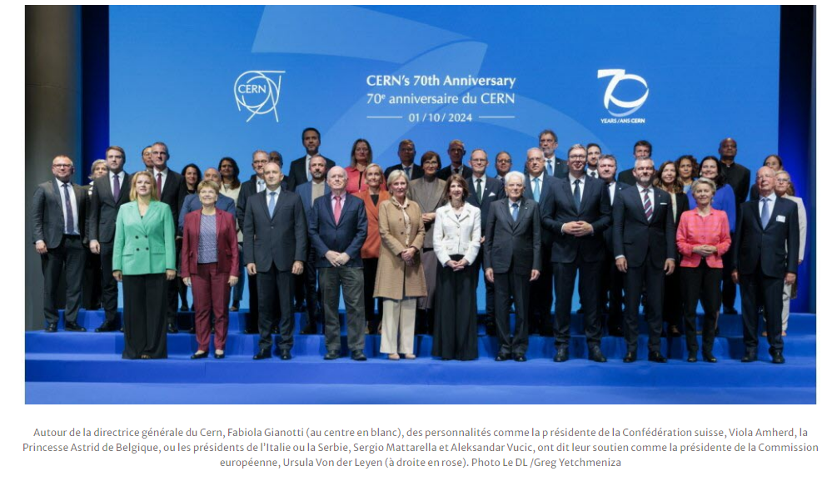
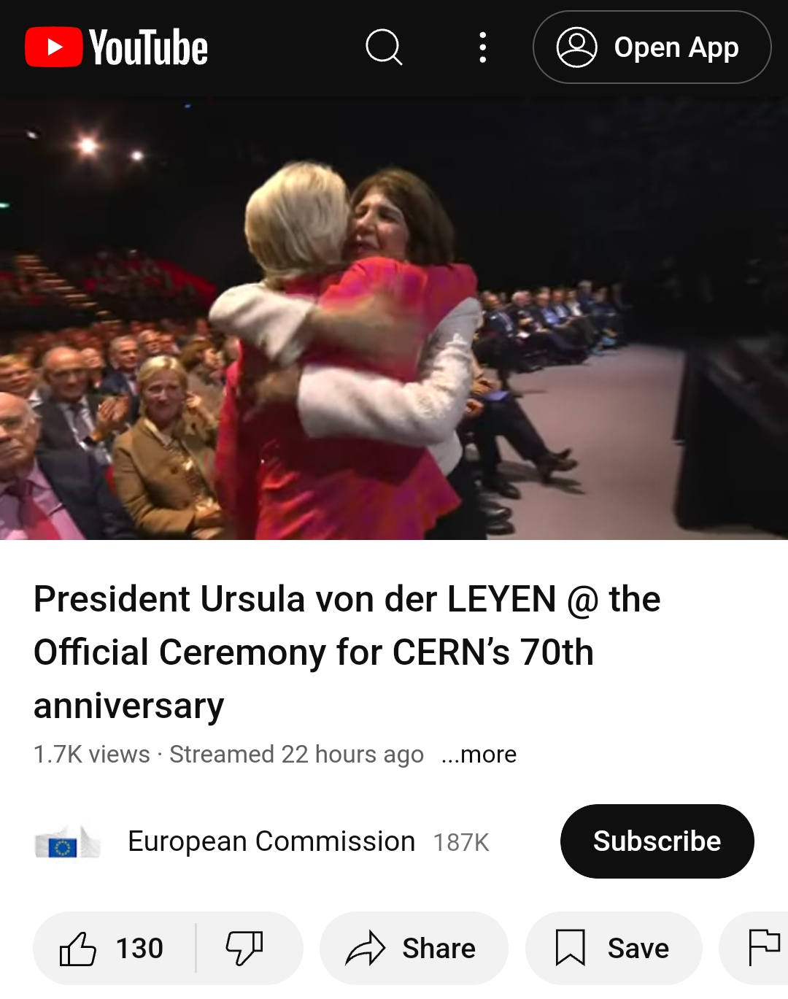
CERN 70th anniversary, 1 October 2024

Slide 34
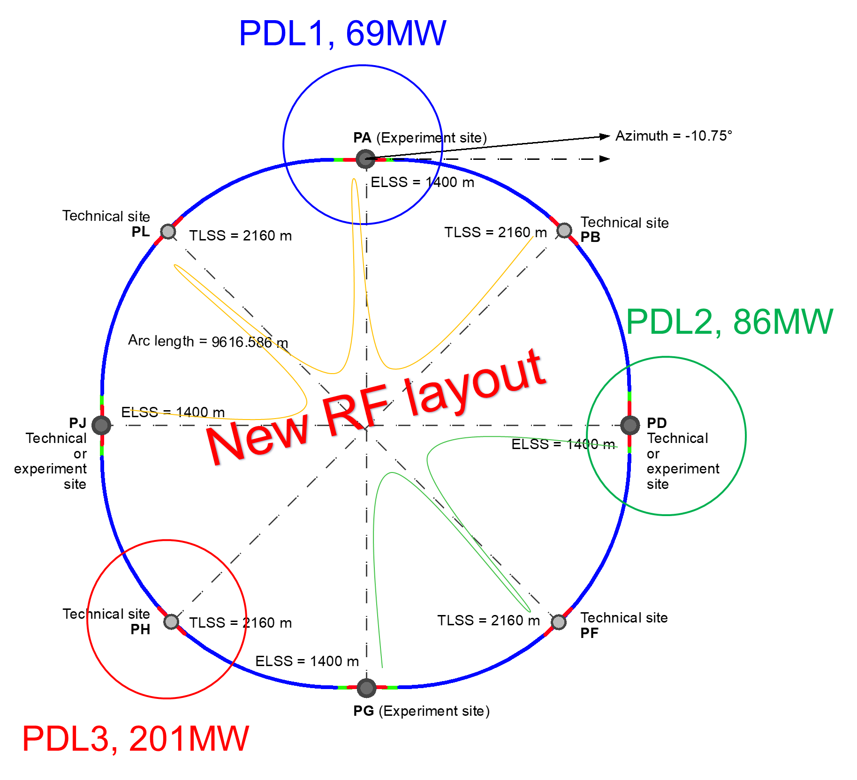
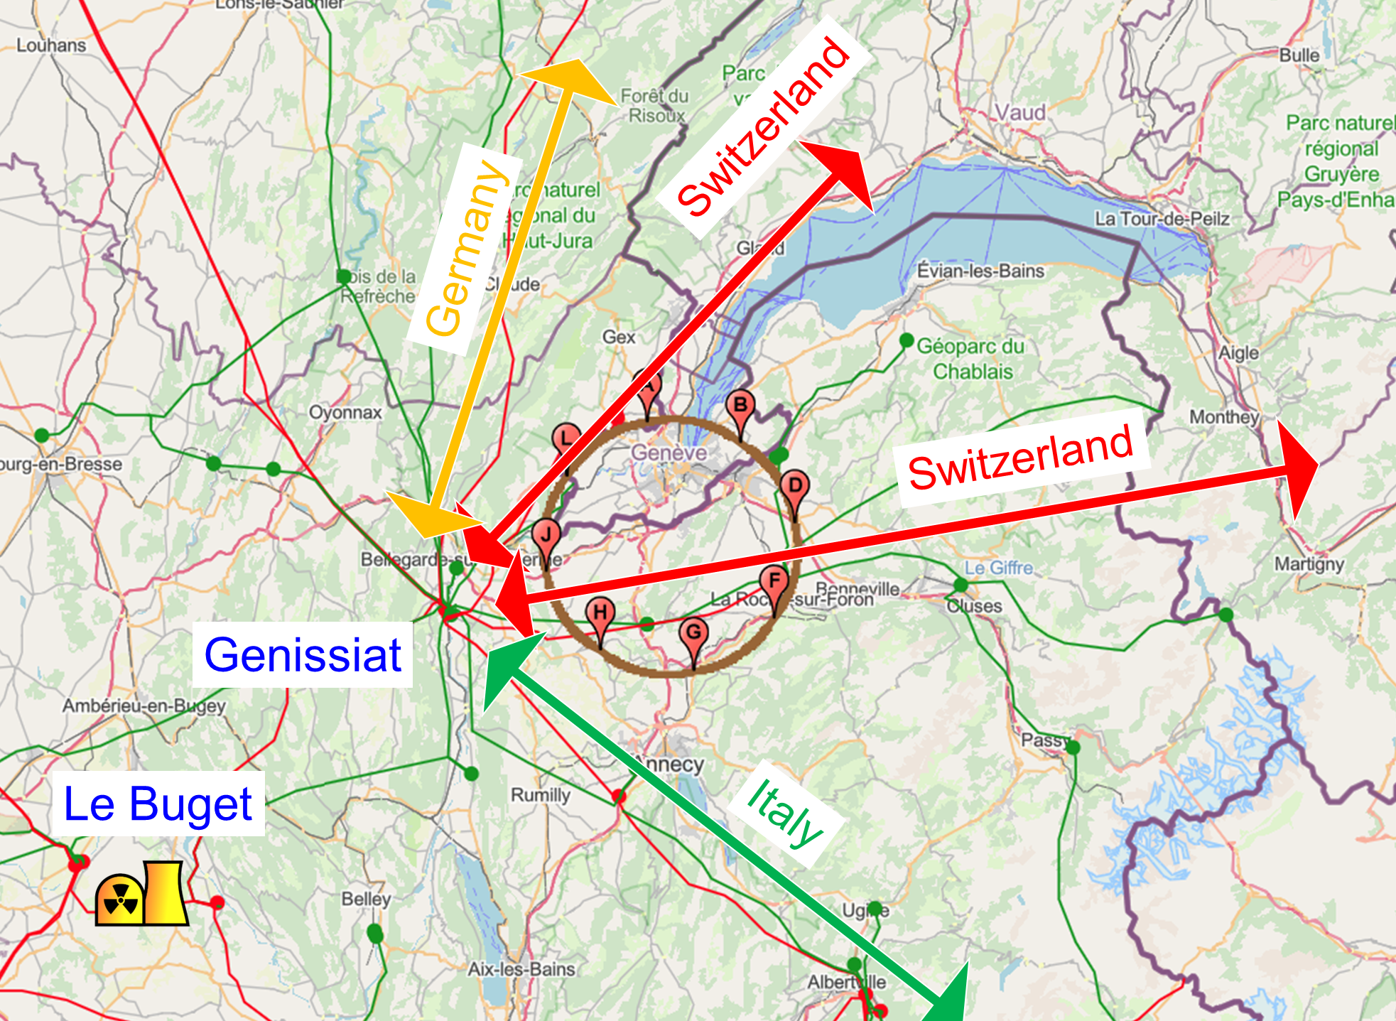
Integration with regional infrastructures
Road accesses developed for all 8 surface sites
Four possible highway connections defined
Less than 4 km of new roads required
Connections to
French electricity grid
connections with
highway network
Electrical connection concept developed with RTE (French electricity grid operator)
Three HV supply points, two new stations & CERN Prevessin
➔ requested loads have no significant impact on grid
R&D efforts aiming at reducing the energy consumption of FCC-ee and FCC-hh

Slide 35
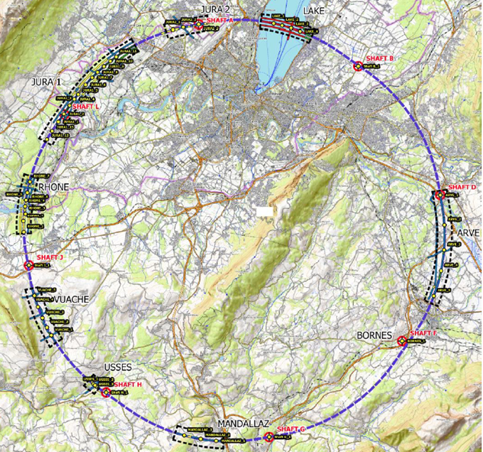
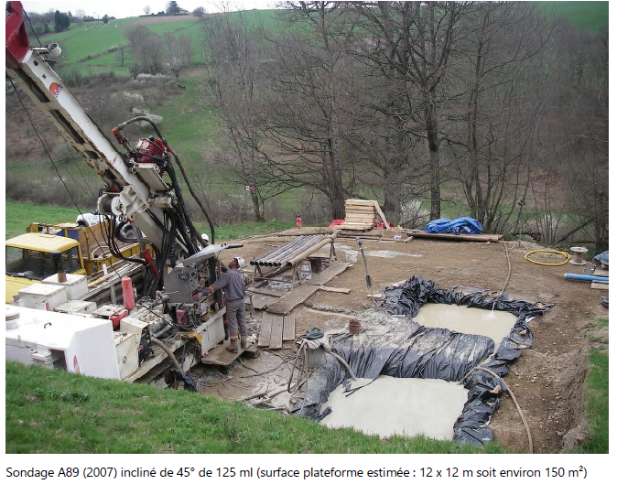
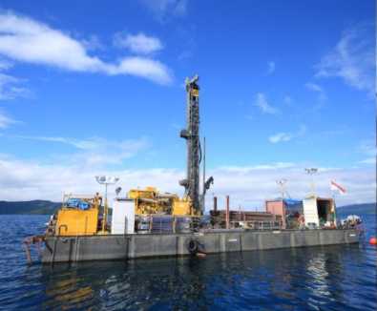
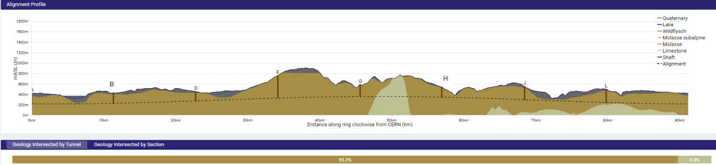
First series of site investigations
Site investigations to identify exact location of geological interfaces:
Molasse layer vs moraines/limestone
~30 drillings and ~100 km seismic lines
→ Vertical position and inclination of tunnel
Drilling works on the lake

Slide 36
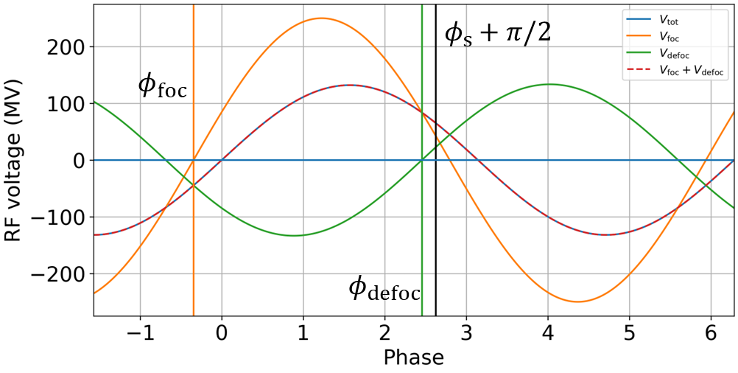
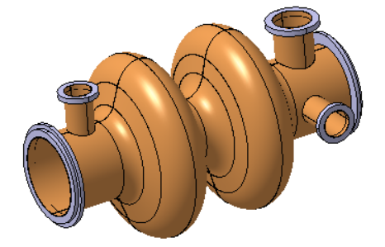
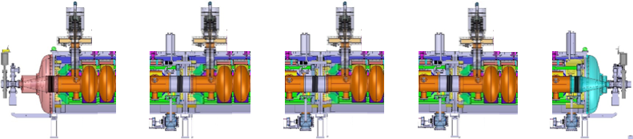
400 MHz SRF progress – one system for 3 energies
Same two-cell RF cavities for Z, WW and ZH operation with constant cavity coupling thanks to reverse phase operation: (1) experimentally verified w high beam loading at KEKB (Y. Morita et al., 2009), (2) Baseline solution US EIC
No longer any 1-cell 400 MHz cavities
Reduced installation time
Reduced commissioning effort
Fast switching between Z, WW and ZH operation
RF waves
400 MHz cavities
Z, W, ZH
cryomodule
X 264
X 66
LEP
400 MHz 2-cell cavity
Niobium thin film on Copper,
Operation at 4.5 Kelvin
Max. accel. gradient E_{acc} = 13 MV/m
Quality factor Q₀ = 3.3 x 10⁹
400 MHz cryomodule, ~12 m long

Slide 37
FCC-ee main machine parameters
Parameter | Z | WW | H (ZH) | ttbar
beam energy [GeV] | 45.6 | 80 | 120 | 182.5
beam current [mA] | 1270 | 137 | 26.7 | 4.9
number bunches/beam | 11200 | 1780 | 440 | 60
bunch intensity [10¹¹] | 2.14 | 1.45 | 1.15 | 1.55
SR energy loss / turn [GeV] | 0.0394 | 0.374 | 1.89 | 10.4
total RF voltage 400/800 MHz [GV] | 0.120/0 | 1.0/0 | 2.1/0 | 2.1/9.4
long. damping time [turns] | 1158 | 215 | 64 | 18
horizontal beta* [m] | 0.11 | 0.2 | 0.24 | 1.0
vertical beta* [mm] | 0.7 | 1.0 | 1.0 | 1.6
horizontal geometric emittance [nm] | 0.71 | 2.17 | 0.71 | 1.59
vertical geom. emittance [pm] | 1.9 | 2.2 | 1.4 | 1.6
vertical rms IP spot size [nm] | 36 | 47 | 40 | 51
beam-beam parameter x_{x} / x_{y} | 0.002/0.0973 | 0.013/0.128 | 0.010/0.088 | 0.073/0.134
rms bunch length with SR / BS [mm] | 5.6 / 15.5 | 3.5 / 5.4 | 3.4 / 4.7 | 1.8 / 2.2
luminosity per IP [10³⁴ cm⁻²s⁻¹] | 140 | 20 | ≥5.0 | 1.25
total integrated luminosity / IP / year [ab⁻¹/yr] | 17 | 2.4 | 0.6 | 0.15
beam lifetime rad Bhabha + BS [min] | 15 | 12 | 12 | 11
Design and parameters to maximise luminosity at all working points:
allow for 50 MW synchrotron radiation per beam
.
Independent vacuum systems for electrons and positrons
full energy booster ring with top-up injection, collider permanent in collision mode
Improvements:
x10-50 on all EW observables
up to x 10 on Higgs coupling (model-indep.) measurements over HL-LHC
x10 Belle II statistics for b, c, τ
indirect discovery potential up to ~ 70 TeV
direct discovery potential for feebly-interacting particles over 5-100 GeV mass range
Up to 4 interaction points
→ robustness, statistics, possibility of specialised detectors to maximise physics
4 years
5 x 10¹² Z
LEP x 10⁵
2 years
> 10⁸ WW
LEP x 10⁴
3 years
2 x 10⁶ H
5 years
2 x 10⁶ tt pairs
F. Gianotti

