Slide 1
A Future Hadron Collider in Europe FCC-hh
Martin Aleksa
Based on material from:
FCC Week Vienna 2025: https://indico.cern.ch/event/1408515/
FCC Feasibility Study Report 2025: https://indico.cern.ch/event/1534205/
FCC CDR Summary Volumes: https://fcc-cdr.web.cern.ch/, EPJ ST 228, 4 (2019) 755-1107

Slide 2
Introduction

Slide 3
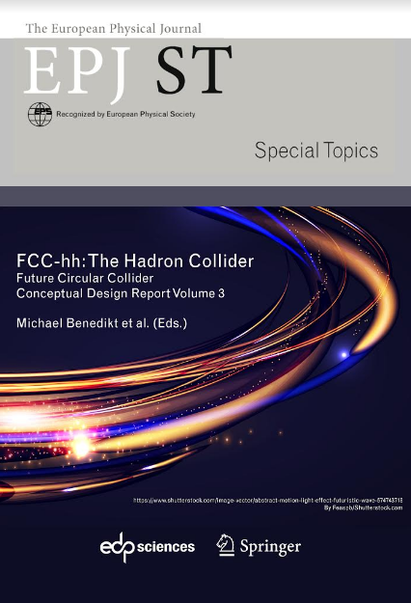
ESPPU 2019/20 and Start of FCC FS
FCC Collaboration delivered 4 volumes Conceptual Design Reports as input to ESPPU 2019/20
Vol 1 Physics, Vol 2 FCC-ee, Vol 3 FCC-hh, Vol 4 HE-LHC
CDRs published in European Physical Journal C (Vol 1) and ST (Vol 2 – 4)
EPJ C 79, 6 (2019) 474 , EPJ ST 228, 2 (2019) 261-623 ,
EPJ ST 228, 4 (2019) 755-1107 , EPJ ST 228, 5 (2019) 1109-1382
2020 Update of European Strategy for Particle Physics:
“Europe, together with its international partners, should investigate technical and financial feasibility of a future hadron collider at CERN with a centre-of-mass energy of at least 100 TeV and with an electron-positron Higgs and electroweak factory as a possible first stage.”
➔ Launch of the FCC Feasibility Study (FS) mid 2021

Slide 4
Feasibility Study Report Published in March 2025
Structure:Three Volumes
Vol. 1: Physics, Experiments and Detectors
Vol. 2: Accelerators, Technical Infrastructures, Safety Concepts
Vol. 3: Civil Engineering, Implementation & Sustainability
Three FSR volumes & other FCC-related input to 2025/26 European Strategy Update posted at https://indico.cern.ch/event/1534205/
Input for the Update of European Strategy for Particle Physics
prepared with Overleaf submitted for publication to EPJ (Springer-Nature) – FCCIS members

Slide 5
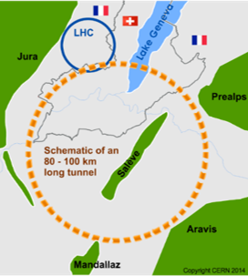
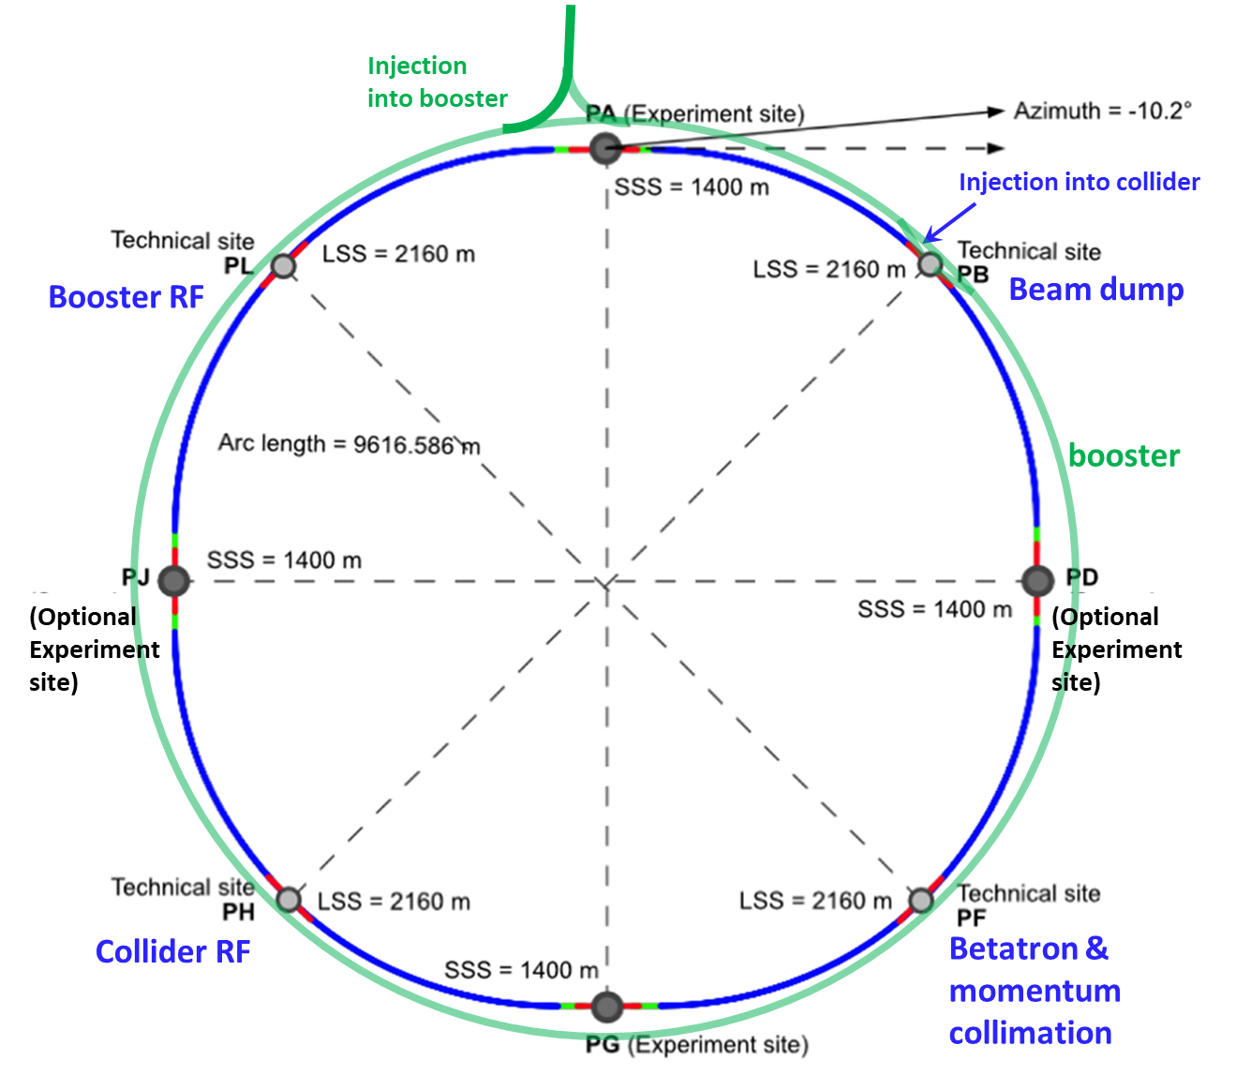
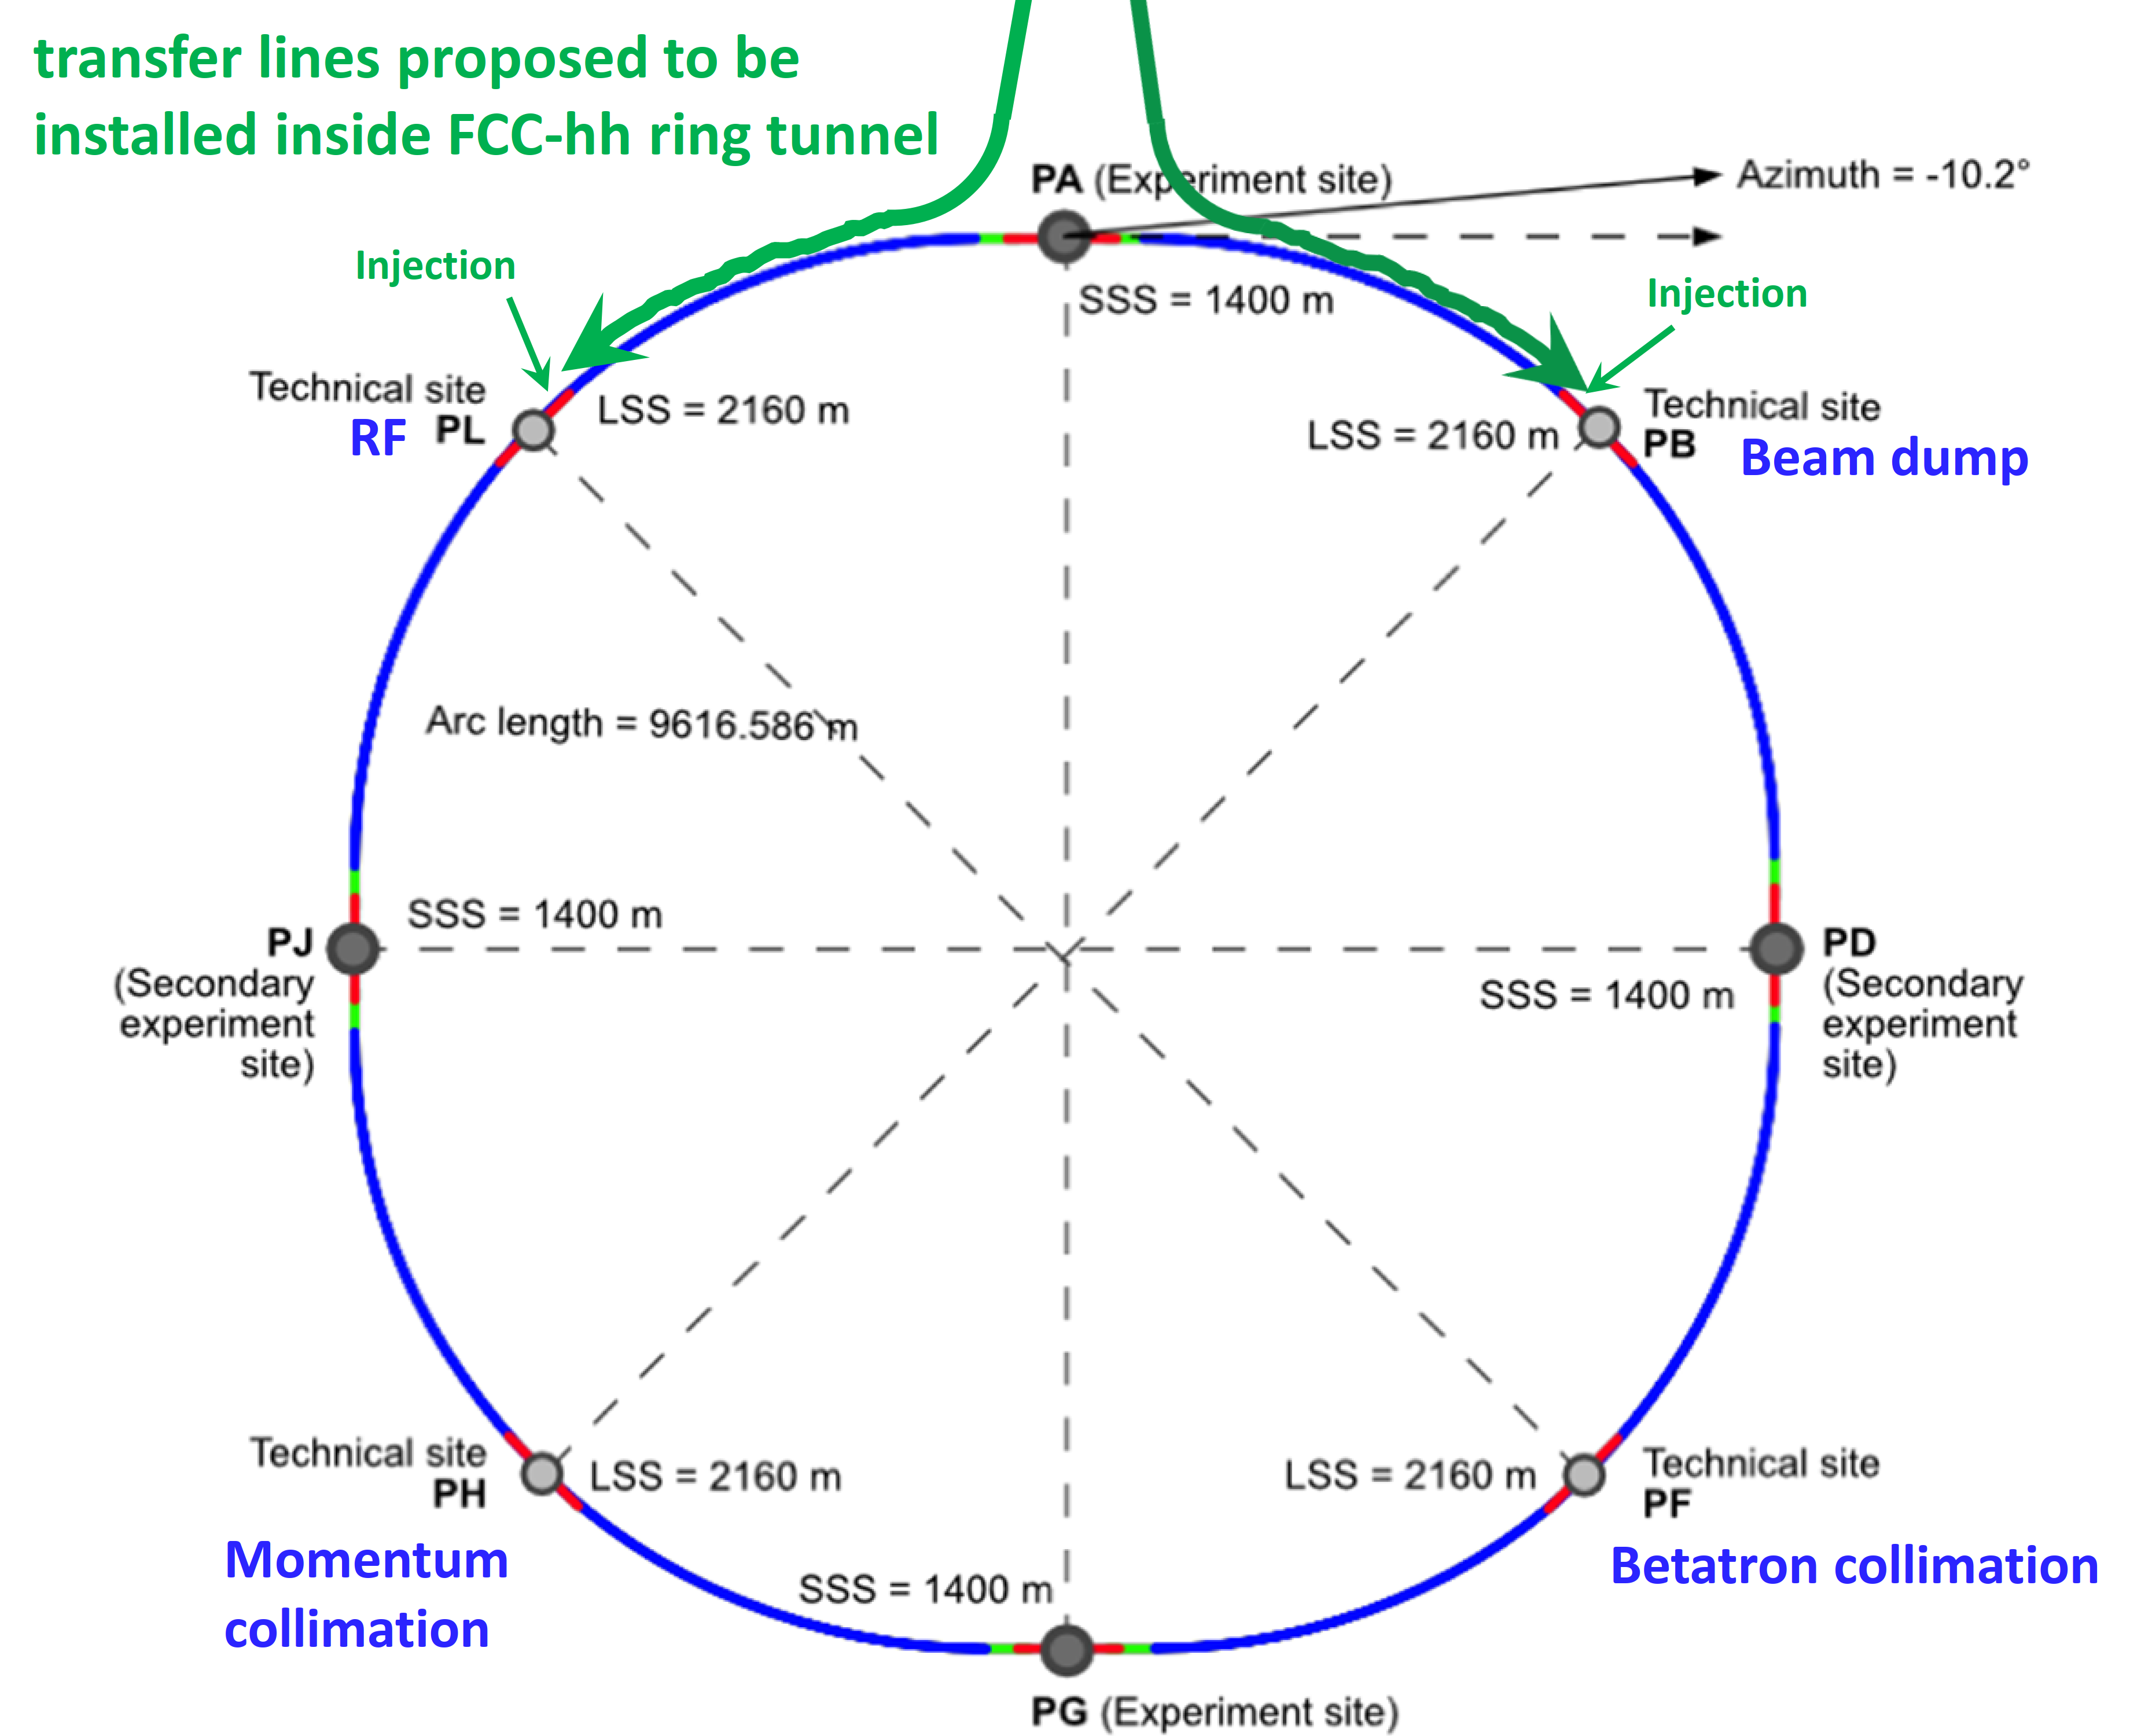
FCC Integrated Program – Scope and Timeline
Stage 1: FCC-ee (Z, W, H, $\text{t}\overline{\text{t}}$) as Higgs factory, electroweak & top factory at highest luminosities
Stage 2: FCC-hh (~100 TeV) as natural continuation at energy frontier, pp & AA collisions; eh option
Highly synergetic and complementary programme maximising the physics opportunities
Common civil engineering and technical infrastructures, building on and reusing CERN’s existing infrastructure
FCC integrated project allows start of a new, major facility at CERN within a few years of the end of HL-LHC
FCC-ee
FCC-hh
2020 - 2045
2045 - 2065
2070 - 2100

Slide 6
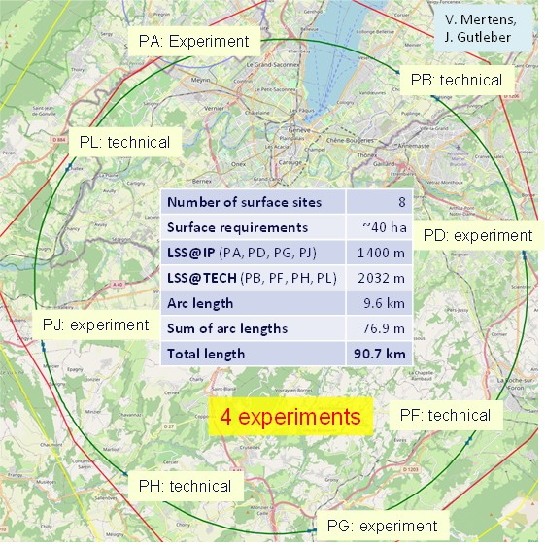
Reference Layout and Implementation: 90.7 km
Layout chosen out of ~ 100 initial variants, based on geology and surface constraints (land availability, access to roads, etc.), environment, (protected zones), infrastructure (water, electricity, transport), machine performance etc.
Overall lowest-risk baseline:
90.7 km ring, 8 surface points,
4-fold symmetry
Reference layout was the basis for:
Surface sites optimisation and land reservation with host states CH and FR
Environmental initial-state study

Slide 7
Optimum Placement of FCC Tunnel and Geology
FCC inclined at 0.5% gradient to minimise depth of point F
Limestone unavoidable between G-H
FCC above limestone
FCC passes below Lake Geneva moraines
Tunneling mainly in moraine layer (soft rock), well suited for fast, low-risk TBM construction.
6 million m³ excavated volume → 8.5 million m³ excavation material on surface
CE Designs of all underground structures developed
Average shaft depths ~240 m
To fix the vertical position of the tunnel, interfaces between geological layers have to be known

Slide 8
Future Hadron Collider – FCC-hh

Slide 9
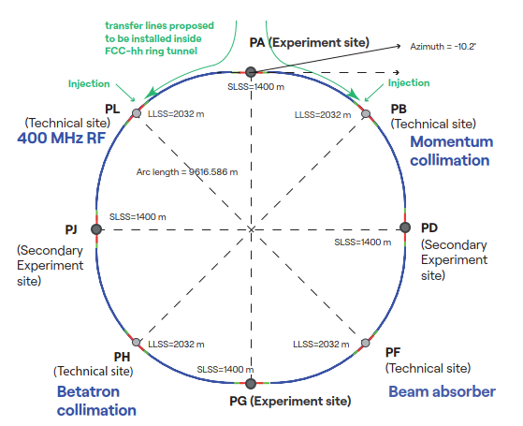
Hadron Collider FCC-hh
Parameter optimization to lower electricity consumption (~max. consumption of FCC-ee)
Magnetic field considered realistic with today’s technologies (Nb₃Sn, ~14T, 1.9 K)
Main parameters FSR 2025
FCC-hh functional layout
Parameter | FCC-hh | FCC-hh CDR | HL-LHC
Collision energy cms [TeV] | 85 | 100 | 14
Dipole field [T] | 14 | 16 | 8.33
Circumference [km] | 90.7 | 97.8 | 26.7
Beam current [A] | 0.5 | 0.5 | 1.1
Synchr. rad. per ring [kW] | 1200 | 2400 | 7.3
Peak luminosity [10³⁴ cm⁻²s⁻¹] | 30 | 30 | 5 (lev.)
Events/bunch crossing | 1000 | 1000 | 132
Stored energy/beam [GJ] | 6.5 | 8.3 | 0.7
Integr. luminosity / IP [fb⁻¹] | 20000 | 20000 | 3000

Slide 10
New FCC-hh Baseline and Power Consumption
Technical system choices and areas for optimisation:
Accelerator optics design to increase arc dipole filling factor and maximize beam energy
Cold mass either at 1.9 K with superfluid He (studied in CDR, cf. LHC) or with 4.5 K with forced flow
Temperature of beam vacuum system (beam screen)
Cryogenics eco mode during shutdowns
 | FCC-hh 90.7km Nb₃Sn 14T | FCC-hh 90.7km Nb₃Sn 14T
Magnet temperature | 1.9 K | 4.5 K
Yearly electricity consumption | < 2.5 TWh | < 2.0 TWh
Significant reduction of electrical power consumption (close to factor 2!) compared to CDR version 2019 (CDR value: ~4TWh, current CERN consumption: 1.2TWh)
Potential for further reduction with design optimisation and R&D on 4.5 K operation
Long term R&D towards accelerator magnets based on high-temperature superconductor materials, targeting higher fields and reduced electricity consumption

Slide 11
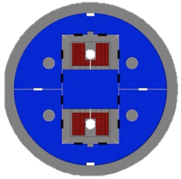
FCC-hh High-Field Magnet Nb₃Sn and HTS R&D
Nb₃Sn:
12- and 14-T short demonstrators
Different coil geometries
Tests scheduled for 2026
Hybrid Nb₃Sn/NbTi for 14T (reduced cost)
HTS R&D in various domains:
REBCO and IBS Conductor R&D
Racetrack coil developments
Hybrid Nb₃Sn/HTS up to 16T
See next talk by L. Bottura

Slide 12
FCC-hh Scenarios & Possible Parameter Range
With present layout of the FCC, after optimization, the following energies can be reached as a function of the dipole field:
Dipole field [T] | c.m. energy | Comment
12 | 72 | not far above peak field of HL-LHC Nb₃Sn quadrupoles
14 | 84 | Nb₃Sn or HTS
17 | 102 | HTS
20 | 120 | HTS
Increasing the c.m. energy beyond ~100 TeV, we will assume that the synchrotron-radiation power could not increase, beyond a total of about 4 MW (which must be removed from inside the cold magnets) → F17 and F20
On the other hand, when decreasing the beam energy, one can hold either the synchrotron-radiation power (increasing current up to HL-LHC values, F12HL) or the beam current constant (F12LL). Also, the pile-up might need to be limited, e.g. to ~1000 events/crossing (F12PU). We thus consider three scenarios for 12 T: 0.5 A (F12LL) and 1.12 A (F12HL) beam current, the latter without or with pile-up levelling (F12PU).
Finally, further overall lowering the synchrotron radiation power, by reducing the number of bunches, in order to restrict the total power consumption of the future FCC-hh, would decrease peak and integrated luminosity by the same factor.

Slide 13
Scenarios (90.7km ring)
Parameter | Unit | F12LL | F12HL | F12PU | F14 | F17 | F20 | (HL-)LHC
c.m. energy | TeV | 72 | 72 | 72 | 84 | 102 | 120 | 14
dipole field | T | 12 | 12 | 12 | 14 | 17 | 20 | 8.33
beam current | A | 0.5 | 1.12 | 1.12 | 0.5 | 0.5 | 0.2 | (1.12) 0.58
bunch popul. | 10¹¹ | 1.0 | 2.2 | 2.2 | 1.0 | 1.0 | 0.4 | (2.2) 1.15
bunches/beam |  | 9500 | 9500 | 9500 | 9500 | 9500 | 9500 | (2760) 2808
rf voltage | MV | 30 | 30 | 30 | 35 | 43 | 50 | (16) 16
longit. emit. | eVs | 6.9 | 6.9 | 6.9 | 8.1 | 9.7 | 11.4 | 2.5
norm. tr. emit. | μm | 2.5 | 2.5 | 2.5 | 2.5 | 2.5 | 2.5 | (2.5) 3.75
IP beta* | m | 0.22 | 0.22 | 0.65 | 0.26 | 0.31 | 0.37 | (0.15) 0.55
initial σ* | μm | 3.8 | 3.8 | 6.5 | 3.8 | 3.8 | 3.8 | (7.1 min) 16.7
initial L | nb⁻¹s⁻¹ | 175 | 845 | 286 | 172 | 209 | 39 | (50, lev’d) 10
initial pile up |  | 580 | 2820 | 955 | 590 | 732 | 141 | (135) 27
ΔE / turn | MeV | 1.3 | 1.3 | 1.3 | 2.4 | 5.3 | 10.1 | 0.0067
SR power/beam | kW | 650 | 1450 | 1450 | 1200 | 2670 | 2020 | (7.3) 3.6
tr.ε damp’g time | h | 0.68 | 0.68 | 0.68 | 0.43 | 0.24 | 0.15 | 25.8
init p-burnoff time | h | 5.1 | 2.3 | 6.9 | 5.1 | 4.0 | 8.4 | (15) 40
Courtesy F. Zimmermann (link)

Slide 14
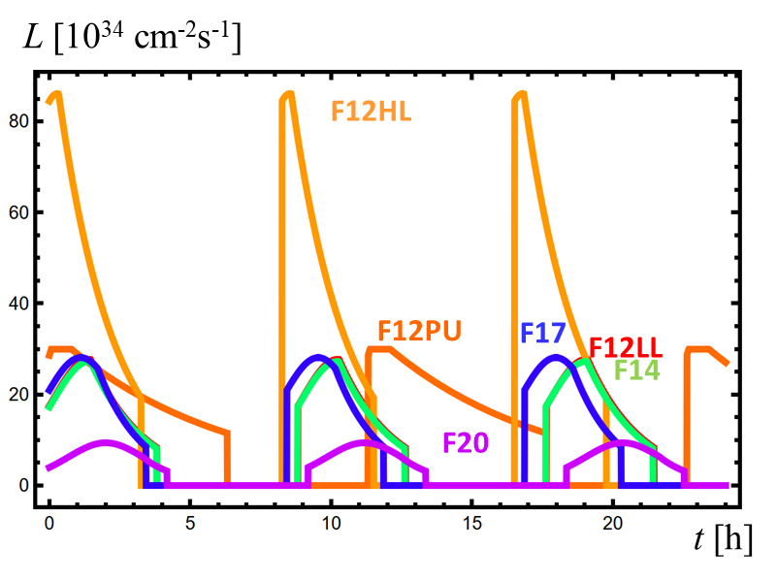
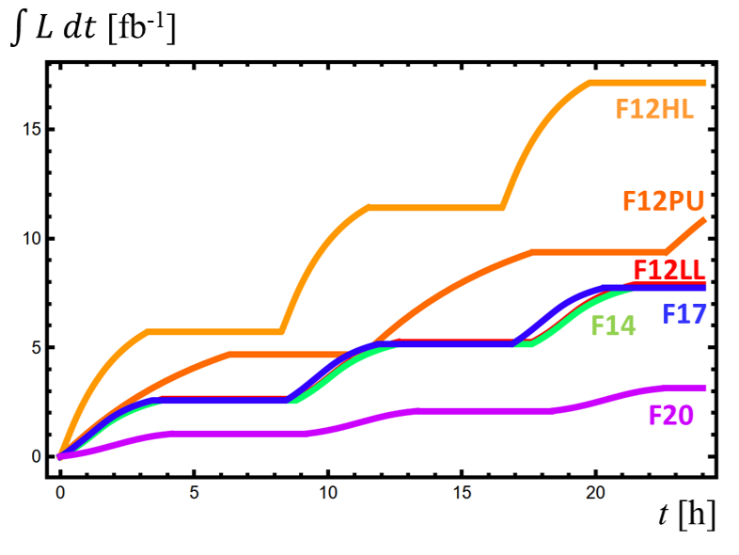
Instantaneous and Integrated Luminosity
Simulation incl. beam-beam effects and optimal fill length for 5 hours interfill (F. Zimmermann)
<µ> = 2820
<µ> = 955
Courtesy F. Zimmermann (link)
Parameter | Unit | F12LL | F12HL | F12PU | F14 | F17 | F20 | (HL-)LHC
ideal $\int{L}dt$ /day | fb⁻¹ | 7.9 | 17.1 | 10.8 | 7.7 | 7.7 | 3,1 | (1.9) 0.4
$\int{L}dt$ / year | fb⁻¹ | 950 | 2000 | 1300 | 920 | 920 | 370 | (240) 55

Slide 15
CDR Parameter Table (100km, 100TeV)
VBF jets η-distr.
HL-LHC
FCC-hh
Unprecedented particle flux and radiation levels
10 GHz/cm² charged particles at 2.5cm
≈ 10¹⁸ cm⁻² 1 MeV-n.eq. fluence for 30ab⁻¹ (1st tracker layer, fwd calo)
“Light” SM particles produced with increased forward boost
→ spreads out particles by 1-1.5 units of rapidity
FCC 80 TeV
Parameters shown for the scenario presented in the FCC CDR
→ Minimal changes only for 80TeV, but fluxes scale with luminosity!

Slide 16
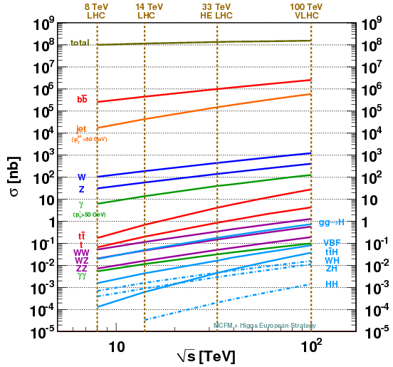
Cross-Sections for Key Processes
Total cross-section and Minimum Bias Multiplicity show only a modest increase from LHC to FCC-hh.
The cross-sections for interesting processes, however, increase significantly (e.g. HH x 50!)!
Higher luminosity to increase statistics → pileup of 140 at HL-LHC to pileup of 1000 at FCC-hh → challenge for triggering and reconstruction
𝓛 = 30x10³⁴cm⁻²s⁻¹:
100MHz of jets p_{T}>50GeV,
400kHz of Ws,
120kHz of Zs,
11kHz of ttbars
200Hz of gg→H
3 GHz
30 MHz
300 kHz
3 kHz
30 Hz
Rates for 𝓛 = 30 10³⁴cm⁻²s⁻¹
HH cross-section down by ~30% for 80 TeV compared to 100 TeV!

Slide 17
FCC-hh Detector

Slide 18
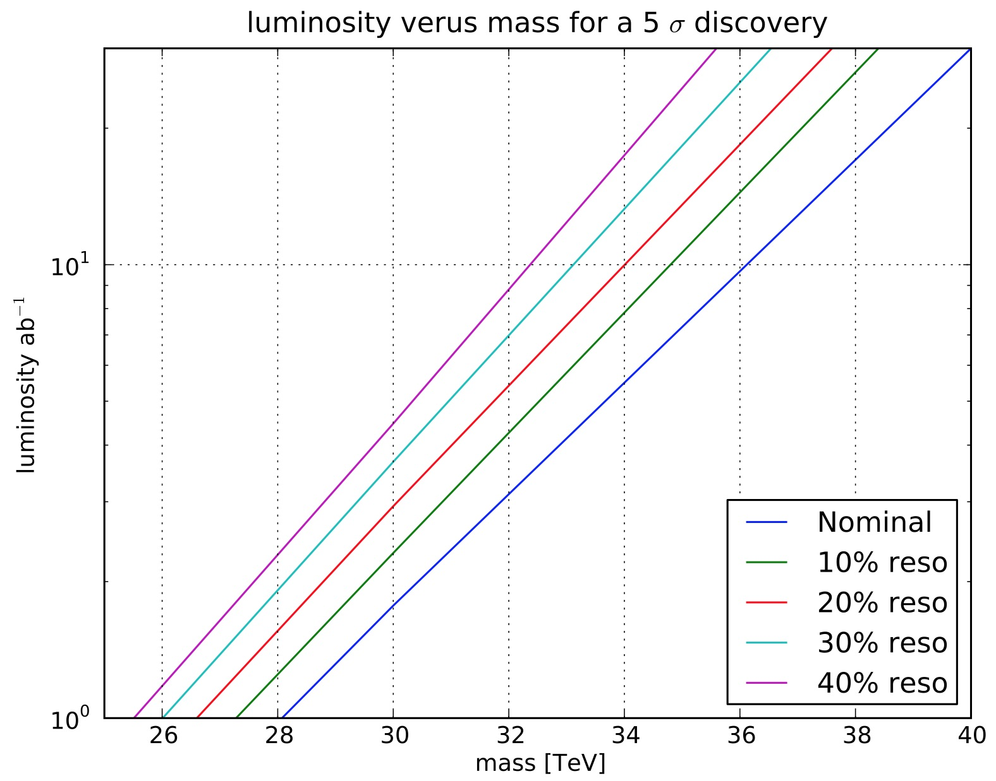
Physics Benchmarks – Detector Requirements
Physics at the 𝓛σ-limit
Exploration potential through higher energy, increased statistics, increased precision
Example: Z’_{SSM} discovery
Tracking – Resolution degrading with higher momentum!
luminosity versus mass for a 5σ discovery
20 ab⁻¹
6 ab⁻¹
→ Have to improve on
σ_{pos}: difficult
Magnetic field B: go from 2T (ATLAS) to 4T (FCC-hh)
Lever arm L: magnet cost scales with ≈ volume^{2/3} → very quickly very expensive
4 TeV
Muon momentum resolution:
O(5%) at 10TeV.
Compare to 10% at 1TeV spec. at LHC

Slide 19
Physics Benchmarks – Detector Requirements
Calorimetry – Improving resolution with higher energy!
Higgs self-coupling δλ/λ = 7% for Δm_{𝛾𝛾} < 3GeV
→ EM-calorimeter resolution
sampl. term a ≈ 10% and noise term b < 1.5GeV (including pile-up)!
Di-jet resonances: HCAL constant term of c = 3% instead of 15%: extend discovery potential by 4TeV (or same disc. pot. for 50% lumi)
→ full shower containment is mandatory!
→ Large HCAL depth (~ 12 λ_{int})!
Better detector performance could compensate decreased HH statistics at 80 TeV

Slide 20
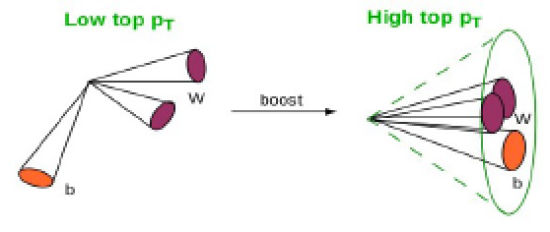
Requirements for FCC-hh Detector
ID tracking target: achieve σ_{pT} / p_{T} = 10-20% @ 10 TeV
Muon target: σ_{pT} / p_{T} = 5% @ 10 TeV
Keep calorimeter constant term as small as possible (and good sampling term)
Constant term of <1% for the EM calorimeter and <2-3% for the HCAL
High efficiency vertex reconstruction, b-tagging, τ-tagging, particle ID!
Pile-up of <µ>=1000 → 120µm mean vertex separation
High granularity in tracker and calos (boosted obj.)
Pseudorapidity (η) coverage:
Precision muon measurement up to |η|<4
Precision calorimetry up to |η|<6
→ Achieve all that at a pile-up of 1000! → Granularity & Timing!
On top of that radiation hardness and stability!
Used in Delphes physics simulations
VBF jets η-distr.

Slide 21
A Possible FCC-hh Detector – Reference Design for CDR
Barrel ECAL: σ_{E}/E≈10%/√Ē⊕0.7%
Tracker: σ_{pT}/p_{T}≈10-20% at 10TeV (1.5m radius)
Central Magnet:
B=4T, 5m radius
9m
Converged on reference design for an FCC-hh experiment for the FCC CDR
Goal was to demonstrate, that an experiment exploiting the full FCC-hh physics potential is technically feasible
Input for Delphes physics simulations
Radiation simulations
This is one example experiment, other choices are possible and very likely → A lot of room for other ideas, other concepts and different technologies
23m
Forward detectors up to η=6
Barrel HCAL: σ_{E}/E≈50%/√Ē⊕3%
Muon System:
σ_{pT}/p_{T}≈5% at 10TeV

Slide 22
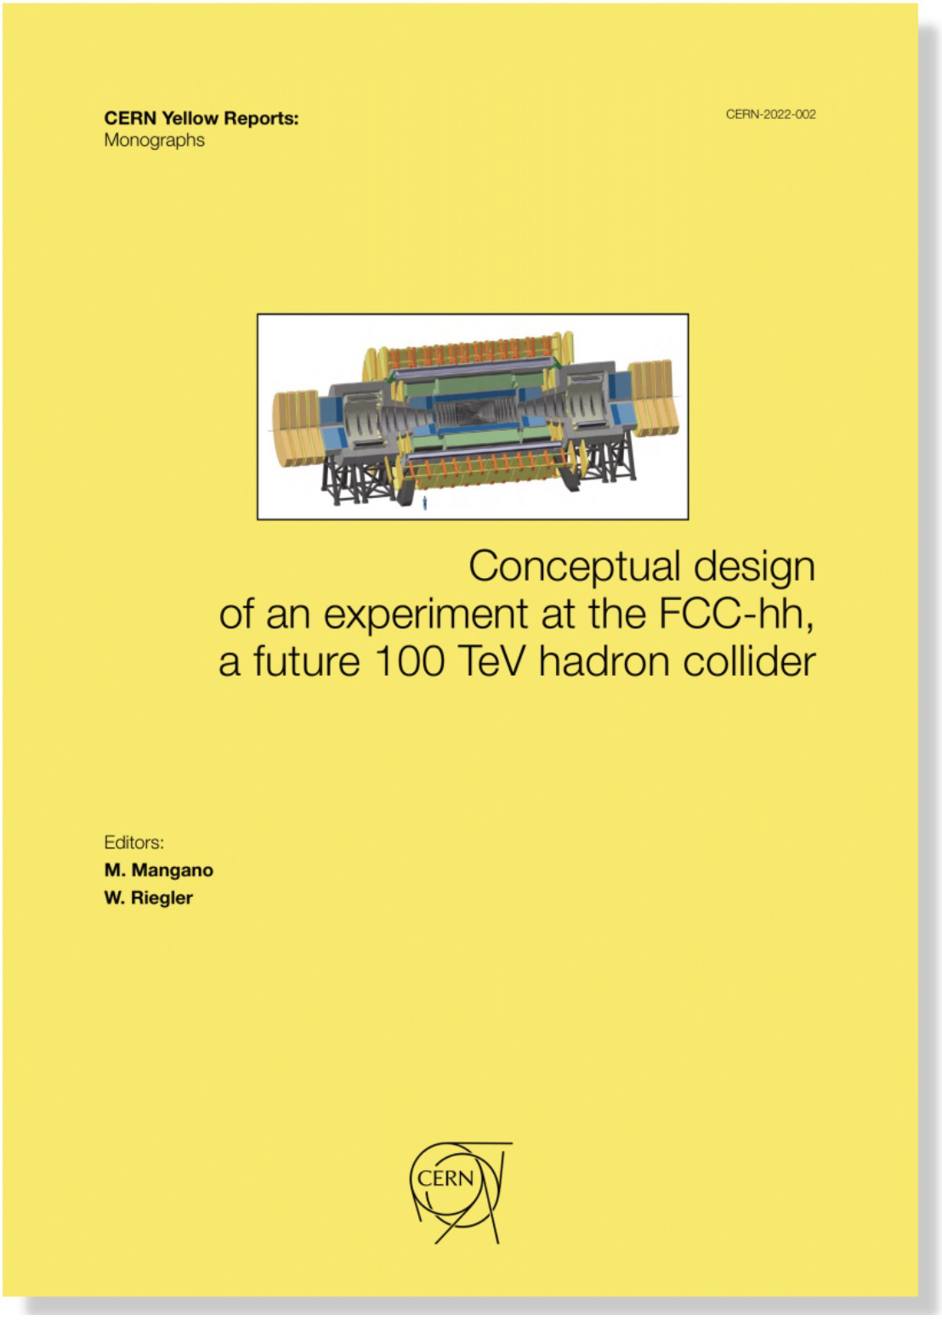
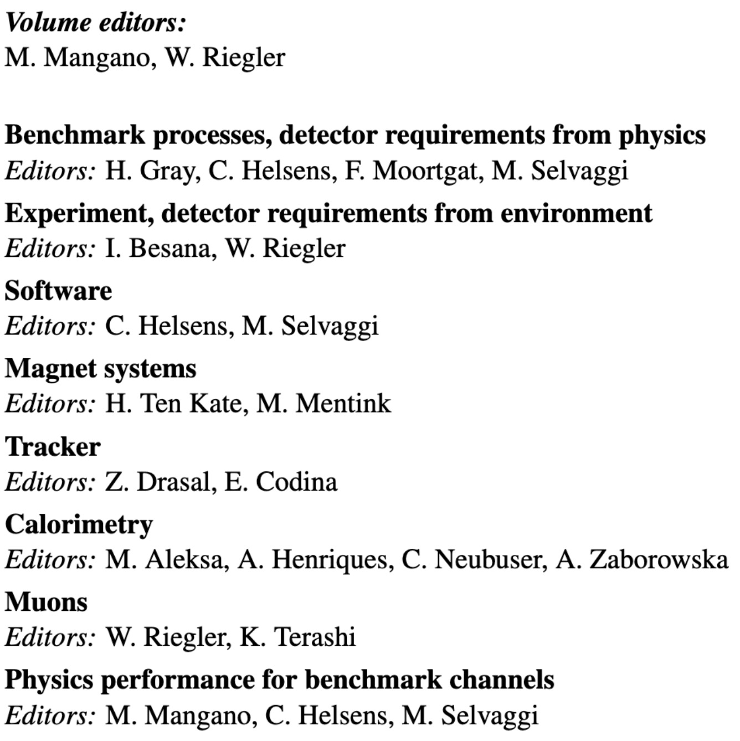
Documentation
FCC CDR (link) & Yellow report (link)

Slide 23
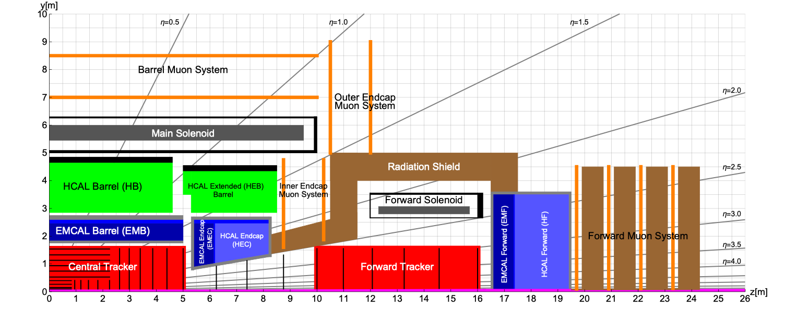
Reference Design for CDR
Forward solenoid adds about 1 unit of η with full lever-arm
Forward solenoid requires additional radiation shield to connect endcap and forward calorimeter

Slide 24
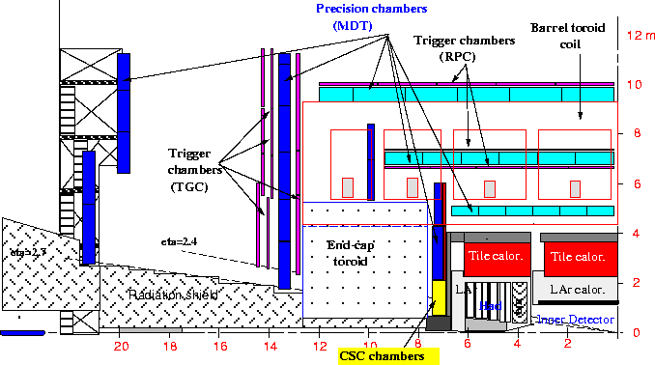
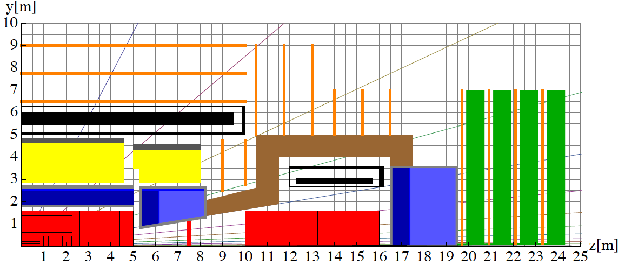
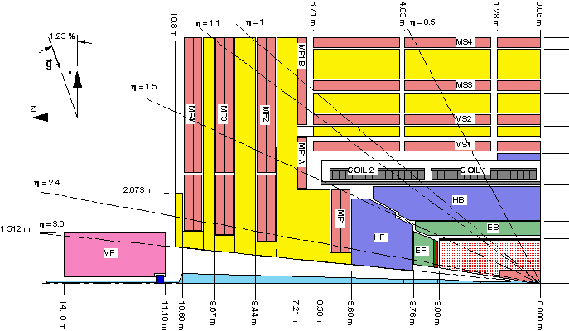
FCC-hh Detector: Comparison to ATLAS & CMS
ATLAS
FCC-hh Reference Detector
CMS

Slide 25
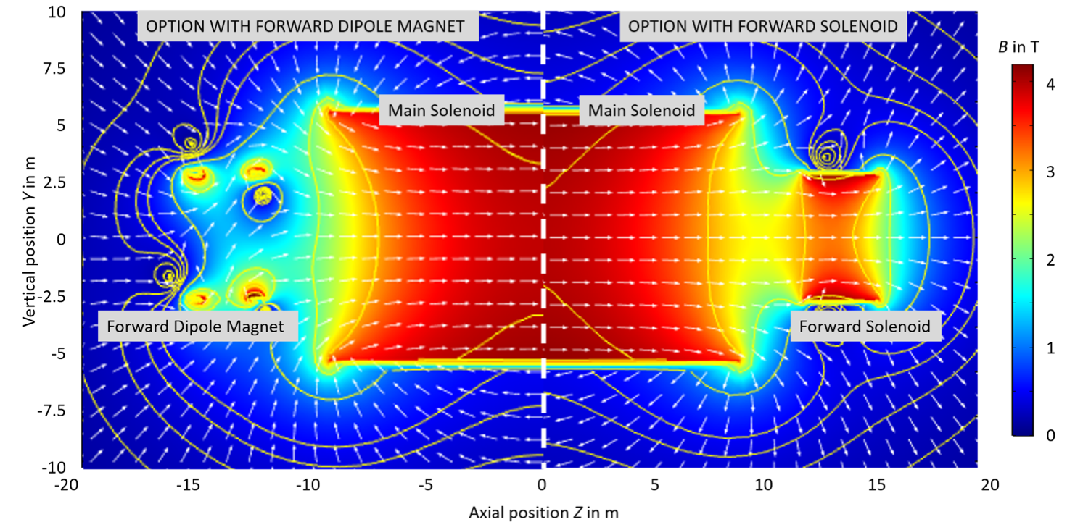
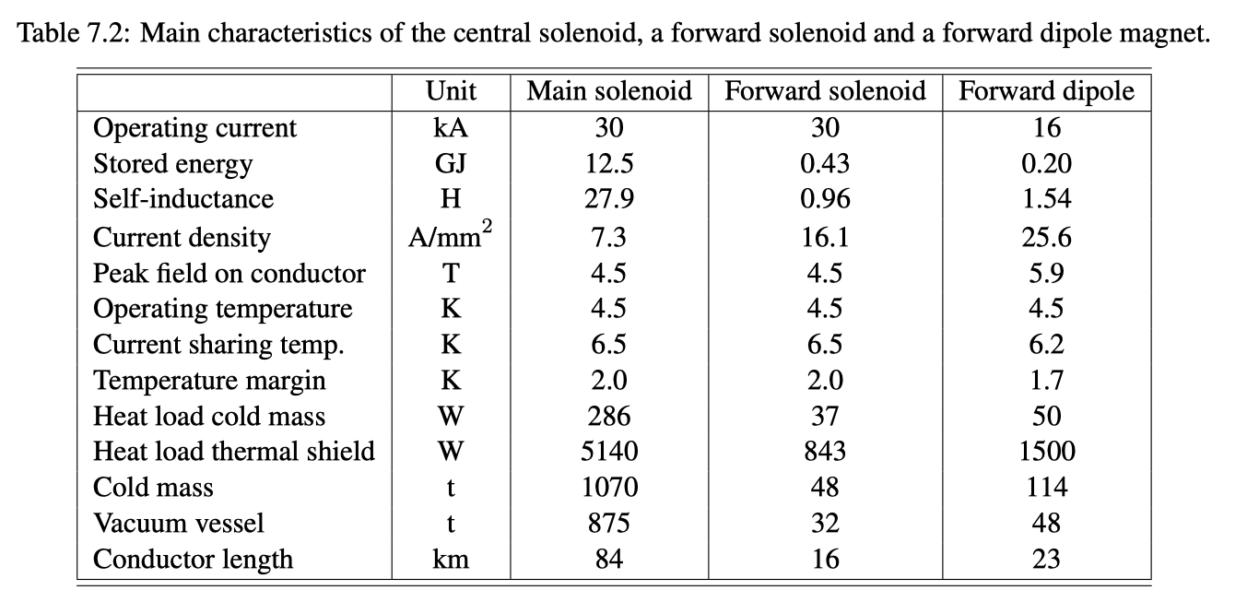
FCC-hh Magnet System
ATLAS Magnet System 2.7 GJ
CMS Magnet System 1.6 GJ
FCC-hh: ~13 GJ, cold mass + cryostat around 2000 tons.
Possible alternative solutions: Ultra-thin solenoid positioned inside the calorimeter (difficulty: muon measurement!)

Slide 26
1 MeV Neutron Equivalent Fluence for 30ab⁻¹
Generally ~10-30 times worse than HL-LHC
Exception: Forward calorimeter goes to higher η → bigger factor
Barrel calorimeter:
EM-calo: 4 10¹⁵ cm⁻²
HAD-calo: 4 10¹⁴ cm⁻²
End-cap calorimeter:
EM-calo: 2.5 10¹⁶ cm⁻²
HAD-calo: 1.5 10¹⁶ cm⁻²
Central tracker:
first IB layer (2.5 cm ): ~5-6 10¹⁷ cm⁻²
external part: ~5 10¹⁵ cm⁻²
Calorimeter gap:
from 10¹⁶ cm⁻² to 10¹⁴ cm⁻²
Forward calorimeters:
~5 10¹⁸ cm⁻² for both the EM and the HAD-calo

Slide 27
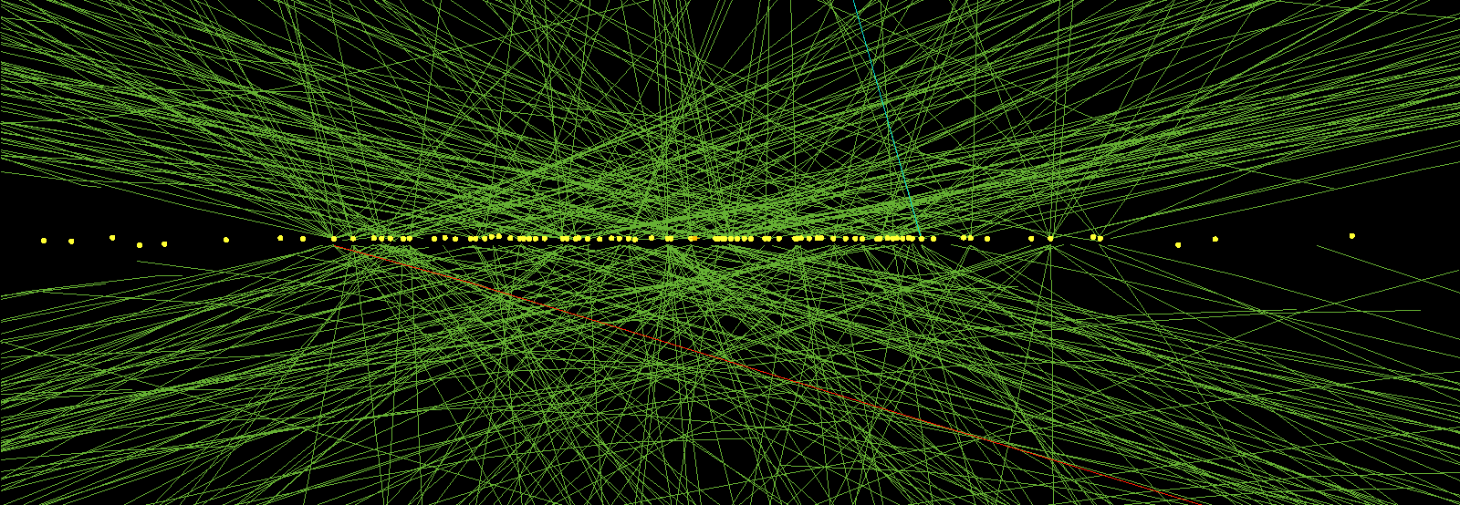
The Challenge of <µ> = 1000 Pile-Up
HL-LHC average distance between vertices at z=0 is
≈ 1mm in space and 3ps in time.
→ For 6 times higher luminosity and higher c.m. energy at FCC-hh:
≈ 120 μm in space and 0.4ps in time
→ Future trackers will need to use both, position resolution and timing to identify the correct vertex!
Multiple scattering in the beam pipe:
→ Even with a perfect tracking detector, the error due to multiple scattering in the beampipe is significant for low energetic particles
θ₀
δz₀ = 120µm
→ Timing meas. or clever new ideas …
Beampipe
r = 2.5cm
η
Beam
δz₀

Slide 28
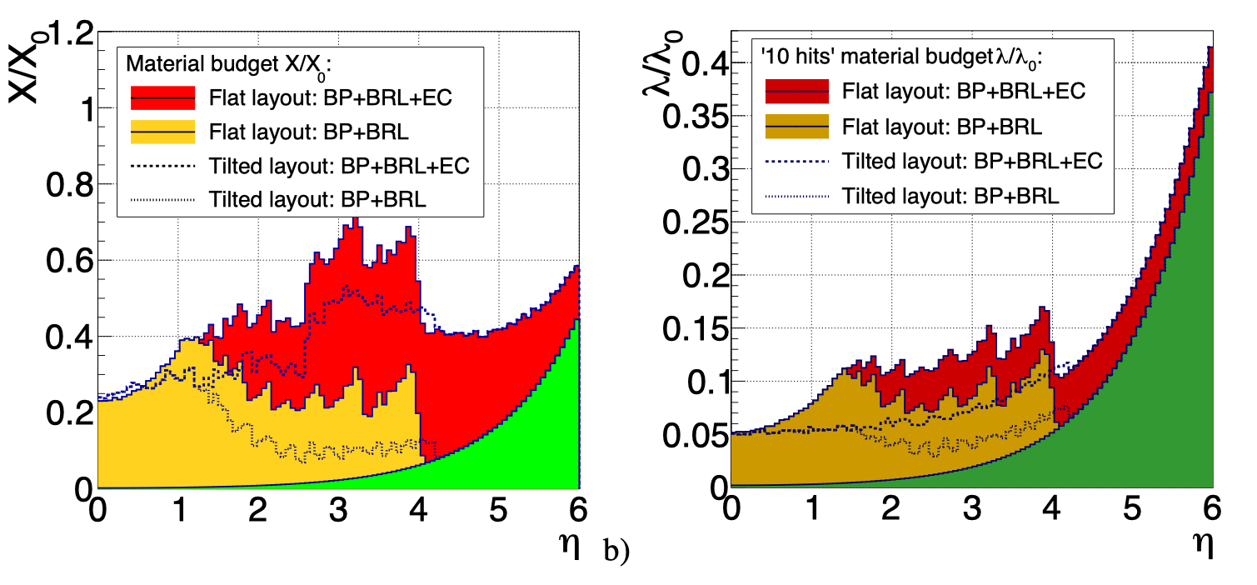
FCC-hh Tracker
Tilted layout
390m² of silicon
Flat layout 430m² of silicon
forward solenoid
central
solenoid
forward solenoid
Assuming an r-phi resolution of
7.5-9.5μm per detector layer
δp_{T}/p_{T} ≤ 10% for
≤ 10 GeV/c and η ≤ 5.8
≤ 1 TeV/c and η ≤ 4.0
δp_{T}/p_{T} = 20% for 10 TeV/c in the central region
Momentum resolution dominated by multiple scattering up to 250GeV (limit at δp_{T}/p_{T} = 0.5%) → low material tracker!!

Slide 29
FCC-hh Calorimetry
Good intrinsic energy resolution
Radiation hardness
High stability
Linearity and uniformity
Easy to calibrate
FCC-hh Calorimetry
„conventional calorimetry“ optimized for particle flow
High granularity
Pile-up rejection
Particle flow
3D/4D/5D imaging
→ Proposed:
Highly granular LAr/Pb ECAL
Scintillator/Steel HCAL
FCC-hh Calorimetry studies have been published at https://arxiv.org/abs/1912.09962

Slide 30
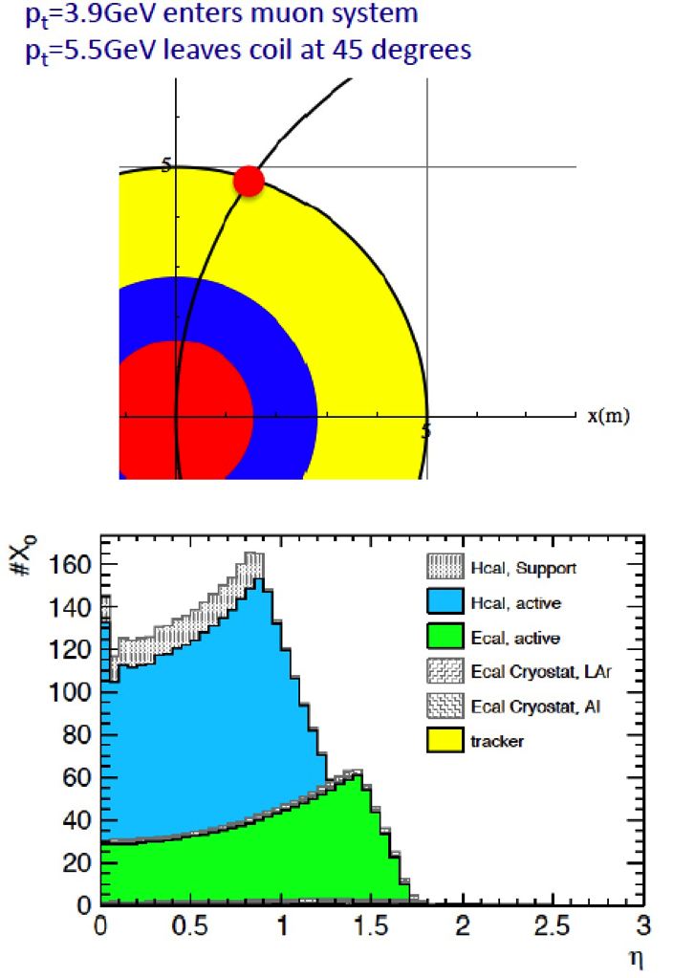
FCC-hh Muon System
With 50µm position resolution and 70µrad angular resolution we find (η=0):
≤10% Δp_{T}/p_{T} standalone up to 4TeV/c
≤10% Δp_{T}/p_{T} combined up to 20TeV/c
Standalone muon performance not relevant, the task of muon system is triggering and muon identification!
Muon rate dominated by c and b decays → isolation is crucial for triggering W, Z, t!
Δp_{T}/p_{T}
10%
Multiple scattering (Calo!)
material assumed for multiple scattering
4TeV/c
20TeV/c
Muon detection in forward region:
Excpected rates up to 500kHz for r > 1m
→ HL-LHC muon system gas detector technology will work for most of the FCC detector area
Muon barrel: Rates of up to ~500Hz/cm² expected

Slide 31
Conclusions
Feasibility Study Report published in March 2025
Presents FCC reference layout and implementation for 90.7 km tunnel
Assuming 14T dipole magnets that leads to a c.o.m. energy of FCC-hh of 85 TeV
→ Reduction of power needs by almost a factor 2 with respect to the CDR parameters
→ Other scenarios under study assuming 16T (Nb₃Sn, HTS) or higher field (HTS) magnets
Detector Requirements for Future High-Energy Hadron Colliders extremely challenging!
An FCC-hh Reference Detector has been introduced that could fulfill physics requirements, but intense detector R&D necessary to achieve very ambituous design goals
Main challenges: Radiation hardness, precision timing, huge data rates, low-power read-out electronics and links, low material for support structures, power and cooling
Expecting to profit from R&D for HL-LHC
Detector R&D collaborations have been set-up to address these challenges, see arXiv:2408.17094v1!
Join in and contribute!

Slide 32
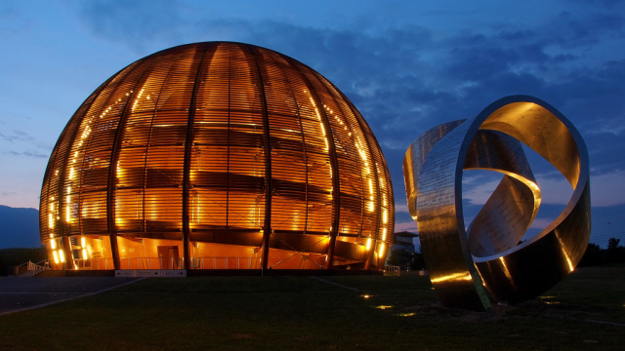
Thank You for Your Attention!

Slide 33
Back-Up

Slide 34
From ESPPU 2020 Document
Under “3. High-priority future initiatives”:
“Europe, together with its international partners, should investigate the technical and financial feasibility of a future hadron collider at CERN with a centre-of-mass energy of at least 100 TeV and with an electron-positron Higgs and electroweak factory as a possible first stage. Such a feasibility study of the colliders and related infrastructure should be established as a global endeavour and be completed on the timescale of the next Strategy update.”
Under “4. Other essential scientific activities for particle physics”:
“Detector R&D programmes and associated infrastructures should be supported at CERN, national institutes, laboratories and universities. Synergies between the needs of different scientific fields and industry should be identified and exploited to boost efficiency in the development process and increase opportunities for more technology transfer benefiting society at large. Collaborative platforms and consortia must be adequately supported to provide coherence in these R&D activities. The community should define a global detector R&D roadmap that should be used to support proposals at the European and national levels.”
https://europeanstrategyupdate.web.cern.ch/resources

Slide 35
627 Pages
FCCee: 498 pages
Estimated investment costs in 2024 Swiss Francs.
The investments are distributed over a time frame of about 15 years.
The investments are distributed over a time frame of about 15 years.

Slide 36
CDR: FCC-hh Parameter Table (100km, 100TeV)
E_{cm} = 100 TeV
~100 km circumference
𝓛 = 30 x 10³⁴ cm⁻²s⁻¹
∫𝓛 = 30 ab⁻¹
31 GHz pp collisions
Pile-up <µ> ≈ 1000
4 THz of charged tracks
Parameters for the scenario presented in the FCC CDR
As shown before now there are several different scenarios
Exact values will depend on the chosen scenario

Slide 37
Timing Information for Vertex Reconstruction
Goal is to identify the primary vertex!
Effective pile-up: number of vertices compatible with reconstructed tracks (95%CL)
Eff. pile-up = 1: Indication for unambiguous primary vertex identification
Example: eff. pile-up = 1 for p_{T} = 5GeV:
η < |2| without timing (---)
η < |3.5| with 25ps timing accuracy (---)
η < |4.5| with 5ps timing accuracy (---)
→ Very challenging!
ATLAS HL-LHC

Slide 38
Challenges for the Tracker – R&D Needs
Radiation hardness:
Radius > 30cm: Existing technologies are applicable
Radius < 30cm: Radiation challenge has to be solved
Ultra-rad. hardness of sensors and chip: up to 10¹⁸cm⁻² 1 MeV n.eq. fluence, TID of 300MGy
Timing of tracks at the <10ps level
Either timing measurement of each pixel or dedicated timing layers
LGAD for timing O(30ps) achieved, ultra-thin LGADs ≤ 10ps
Improve rad. tolerance, now up to 2x10¹⁵ n/cm² (esp. gain layer, admixture of doping elements)
Limited to relatively large cells due to inefficient collection at pad edges → smaller cell sizes
3D Pixel technology → radiation tolerance up to 3x10¹⁶ neutrons/cm² demonstrated, timing O(30ps)
R&D on new technologies to achieve <10ps timing resolution
Low material
Monolithic designs with integrated sensor and readout (e.g. MAPS)
→ R&D on improving radiation hardness to make it compatible with outer layers of future tracker.
Outer layers: waver scale CMOS sensors (potential to reduce power consumption and low-material)
Integration problems to be solved:
Huge amount of data produced (1000TByte/s)
Power needs of sensors, FE-chips and optical links critical
Low-mass detector system integration: integrated services, power management, cooling, data flow, and multiplexing.
New sensor materials? E.g. to work at room temperature?
Far future: R&D on mass-minimized, or irreducible-mass tracker → mass budget is reduced to the active mass of the sensor
3D Pixel (arXiv:1806.01435)
LGAD

Slide 39
Challenges for the Magnet System – R&D Needs
New orders of magnitude of stored energy!
R&D needs (4T, r = 5m, length ≈ 20m): Conductor development, powering and quench protection, coil windings pre-stressing, conduction cooling techniques and force transfer to cryostat and neighbouring systems.
R&D needs for the ultra-thin and radiation transparent solenoids: Study the limits of high yield strength Al stabilized NbTi/Cu conductor and its cold mass technology affecting the feasibility of the concept of such a challenging magnet.
Low material cryostats, Al-alloy honeycomb or composite material (carbon-fibre)

Slide 40
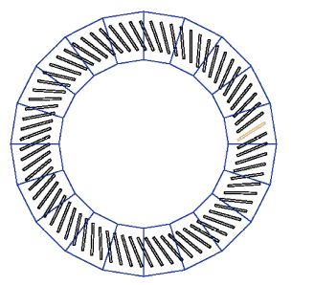
Electromagnetic Calorimeter (ECAL)
ZOOM
CDR Reference Detector: Performance & radiation considerations → LAr ECAL, Pb absorbers
Options: LKr as active material, absorbers: W, Cu (for endcap HCAL and forward calorimeter)
Optimized for particle flow: larger longitudinal and transversal granularity compared to ATLAS
8-10 longitudinal layers, fine lateral granularity (Δη x Δφ = 0.01 x 0.01, first layer Δη=0.0025),
→ ~2.5M read-out channels
Possible only with straight multilayer electrodes
Inclined plates of absorber (Pb) + active material (LAr) + multilayer readout electrodes (PCB)
Baseline: warm electronics sitting outside the cryostat (radiation, maintainability, upgradeability),
Radiation hard cold electronics could be an alternative option
Required energy resolution achieved
Sampling term ≤ 10%/√Ē, only ≈300 MeV electronics noise despite multilayer electrodes
Impact of in-time pile-up at <µ> = 1000 of ≈ 1.3GeV pile-up noise (no in-time pile-up suppression)
→Efficient in-time pile-up suppression will be crucial (using the tracker and timing information)
Precision on Higgs self coupling 𝜆:
δ𝜆/𝜆 ≈7%

Slide 41
Hadronic Calorimeter (HCAL)
Barrel HCAL:
ATLAS type TileCal optimized for particle flow
Scintillator tiles – steel,
Read-out via wavelength shifting fibres and SiPMs
Higher granularity than ATLAS
Δη x Δφ = 0.025 x 0.025
10 instead of 3 longitudinal layers
Steel –> stainless Steel absorber (Calorimeters inside magnetic field)
SiPM readout → faster, less noise, less space
Total of 0.3M channels
Combined pion resolution (w/o tracker!):
Simple calibration: 44%/√Ē to 48%/√Ē
Calibration using neural network (calo only):
Sampling term of 37%/√Ē
Jet resolution:
Jet reconstruction impossible without the tracker @ 4T → particle flow.
Endcap HCAL and forward calorimeter:
Radiation hardness!
LAr/Cu, LAr/W
TileCal: e/h ratio very close to 1 → achieved using steel absorbers and lead spacers (high Z material)

Slide 42
Challenges for Calorimetry – R&D Needs
Radiation hardness:
Forward calo: 5 10¹⁸ n_{eq}/cm², 5000MGy
Noble liquid calorimetry – intrinsic radiation hardness (of active material), other components (e.g. read-out electrodes!) need to be well chosen and tested. Electronics well shielded behind calorimeter outside the cryostat.
Barrel and endcap ECAL: 2.5 10¹⁶ n_{eq}/cm²
Noble liquid calorimetry,
Si as active material maybe possible in the barrel ECAL → need to increase radiation tolerance by factor 3-5
Inorganic crystal scintillators: e.g. Cerium doped LYSO
SPACAL-type calorimeter with crystal fibres (e.g. YAG or GAGG) → need to increase radiation tolerance by factor 5
Barrel HCAL: 4 10¹⁴ n_{eq}/cm², <10kGy
Organic scintillator/steel possible in the barrel HCAL (R&D on radiation tolerance) → read-out by SiPMs or wavelenght shifting fibres + SiPMs
Many other existing technologies would also be applicable
Possible technologies – R&D needs
Noble liquid calorimetry: Development of highly granular read-out electrodes and low-noise read-out, high-density signal feedthroughs, low-material cryostats (composite or Al-alloy honeycomb)
Scintillator based calorimetry: Radiation hardness of scintillators and SiPMs. R&D on radiation hard inorganic scintillators, crystal fibres (SPACAL type)
Si-based calorimetry: Radiation hardness, cost- and material reduction through monolithic designs with integrated sensor and readout
For all technologies: Timing resolution at the O(25ps) level or better would help to reduce pile-up

Slide 43
Challenges for Calorimetry – R&D Needs
High granularity (lateral cell sizes of ≤2cm, like for the proposed reference detector LAr calorimeter)
Particle flow (measure each particle where it can be best measured)
5D calorimetry (imaging calorimetry, including timing) → use of MVA based reconstruction (Neural Networks, …)
Pile-up rejection
Efficient combined reconstruction together with the tracker
Timing for pile-up rejection, 5D calorimetry:
O(25ps) to reduce pile-up by factor 5 (<µ> = 1000 → 200) → LGADs, 3D pixel sensors → R&D on pad sizes and rad. hardness
O(5ps) to reduce pile-up by factor 25 (<µ> = 1000 → 40) → ultra-fast inorganic scintillators, ultra-thin LGADs
Data rates – Triggering
Noble-liquid calorimetry + scintillator/Fe HCAL: O(3M) channels 200 – 300TB/s
Si option: many more channels, zero suppression on-detector necessary
Crazy ideas for the future: Possible “maximal information” calorimeter: divided into small detection volumes (voxels) that measure ionization, time, and Cherenkov and scintillation light simultaneously – e.g. noble liquid calorimetry

Slide 44
Reading Out Such a Detector → Trigger/DAQ
Example ATLAS:
ATLAS Phase II calorimetry will be digitized at 40MHz and sent via optical fibers to L1 electronics outside the cavern at 25TByte/s to create the L1 Trigger.
Muon system will also be read out at 40MHz to produce a L1 Trigger.
FCC-hh detector:
calorimetry and muon system at 40MHz will result in 200-300 TByte/s, which seems feasible.
40MHz readout of the tracker (using zero-suppression) would produce about 800TByte/s.
FCC-hh trigger strategy question:
Can the L1 Calo+Muon Trigger have enough selectivity to allow readout of the tracker at a reasonable rate of e.g. 1MHz?
Difficult: 400kHz of W’s and 100MHz of jets (p_{T} > 50GeV)
Or: un-triggered readout of the detector at 40MHz would result in 1000-1500TByte/s over optical links to the underground service cavern and/or a HLT computing farm on the surface.

Slide 45
Challenges for Read-Out Electronics & Trigger
Huge amounts of data produced (e.g. O(1000TByte/s ≈ 10Pbps) for zero-suppr. tracker)
Streaming:
Read-out everything → need fast low power radiation hard optical links
Alternative: summarize received data by higher-level quantities and only transmit and store those
Triggered: Read-out interesting events → challenge to achieve a data reduction of factor O(10) (HL-LHC aims for factor 40) with much higher pile-up
→ need efficient triggering – intelligent decision as close to the sensor as possible (ML or AI on front-end, programmable ASICs, FPGAs?)
→ radiation hard buffering/storage
→ High bandwidth, low power, radiation hard data links
Industry at link speeds of 400Gbps, need to be adapted to radiation hardness, low power, low material and distributed data sources
Rad. hard link R&D targeting 25Gbps has started at CERN, but will need 50-100Gbps links to fulfil FCC-hh requirements
Low-power: 10Pbps = 1 million lpGBTs (~500mW) → 500kW for the links alone!
Cooling needs cause large amounts of dead material → minimize cooling needs
New technologies: CMOS with integrated photonics (Silicon Photonics)

Slide 46
Challenges for Read-Out Electronics & Trigger
Wireless read-out systems:
Potential to reduce material – interesting if wireless transmission can fulfil the low-power requirement
But main material contribution coming from power and cooling needs (and not from optical fibers)
Analogue to digital conversion will be located at the front-end
Already the case for all HL-LHC upgrades, e.g. analogue calorimeter trigger Run1 and Run2 → digitization at the front-end for Run 3 and HL-LHC
Advantages: low noise, standardised and efficient digital transmission
But needs radiation hard and low-power ADCs and ASICs (300MGy, 10¹⁸neutrons/cm²)
For comparison: HL-LHC factor 30 less, 65nm ok up to O(3MGy)
Develop radiation hard power management blocks (DC/DC converters, regulators)
Develop precision clock and timing circuits (PLL, DLL, Timing Discriminators, Delay Lines, Picosecond TDCs)
Timing distribution with pico-second synchronization

Slide 47
Total Ionizing Dose for 30ab⁻¹
Dose of 300 MGy (30 Grad) in the first tracker layers.
< 10 kGy in HCAL barrel and extended barrel.

Slide 48
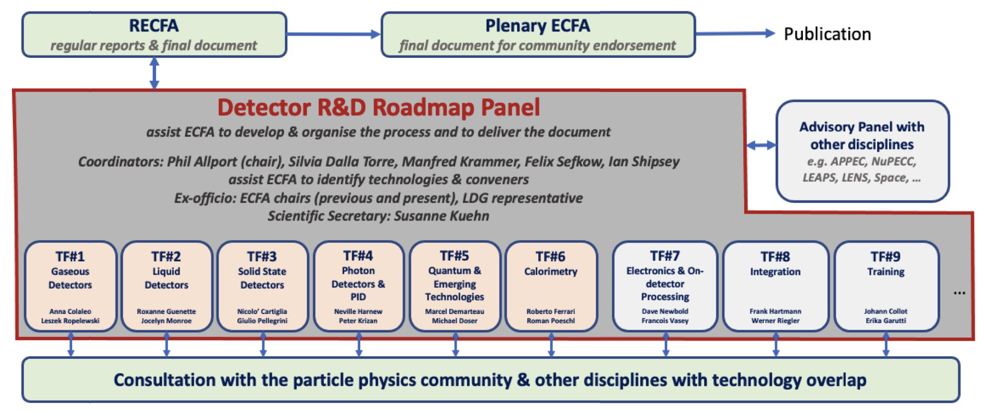
DRD Collaborations
arXiv:2408.17094v1
European Strategy for Particle Physics (ESPP, link) encouraged the community to define a Detector R&D Roadmap identifying the most important technological developments in the domain of particle detectors required to reach the goals defined in the ESPP
In autumn 2022, CERN SPC endorsed the Detector Roadmap Implementation Plan which foresees the formation of Detector R&D Collaborations hosted at CERN
DRD Collaborations have been set-up and started working (approvals in Dec. 2023 and June 2024)

