Slide 1




CEPC booster and damping ring studies in EDR
Dou Wang (IHEP)
on behalf of CEPC AP group
The 2025 European Edition of the International Workshop on CEPC, 16-19 June 2025, Barcelona, Spain

Slide 2
Content
EDR progress of CEPC Booster
  Feasibility study of the combined dipole magnets
  Progress of beam loading study
  Progress of polarization study
EDR progress of CEPC positron damping ring
  DR TDR design status
  Polarized DR study
  TF design status -- LPA multi-function ring
CEPC timing issue and detector performance
Summary

Slide 3
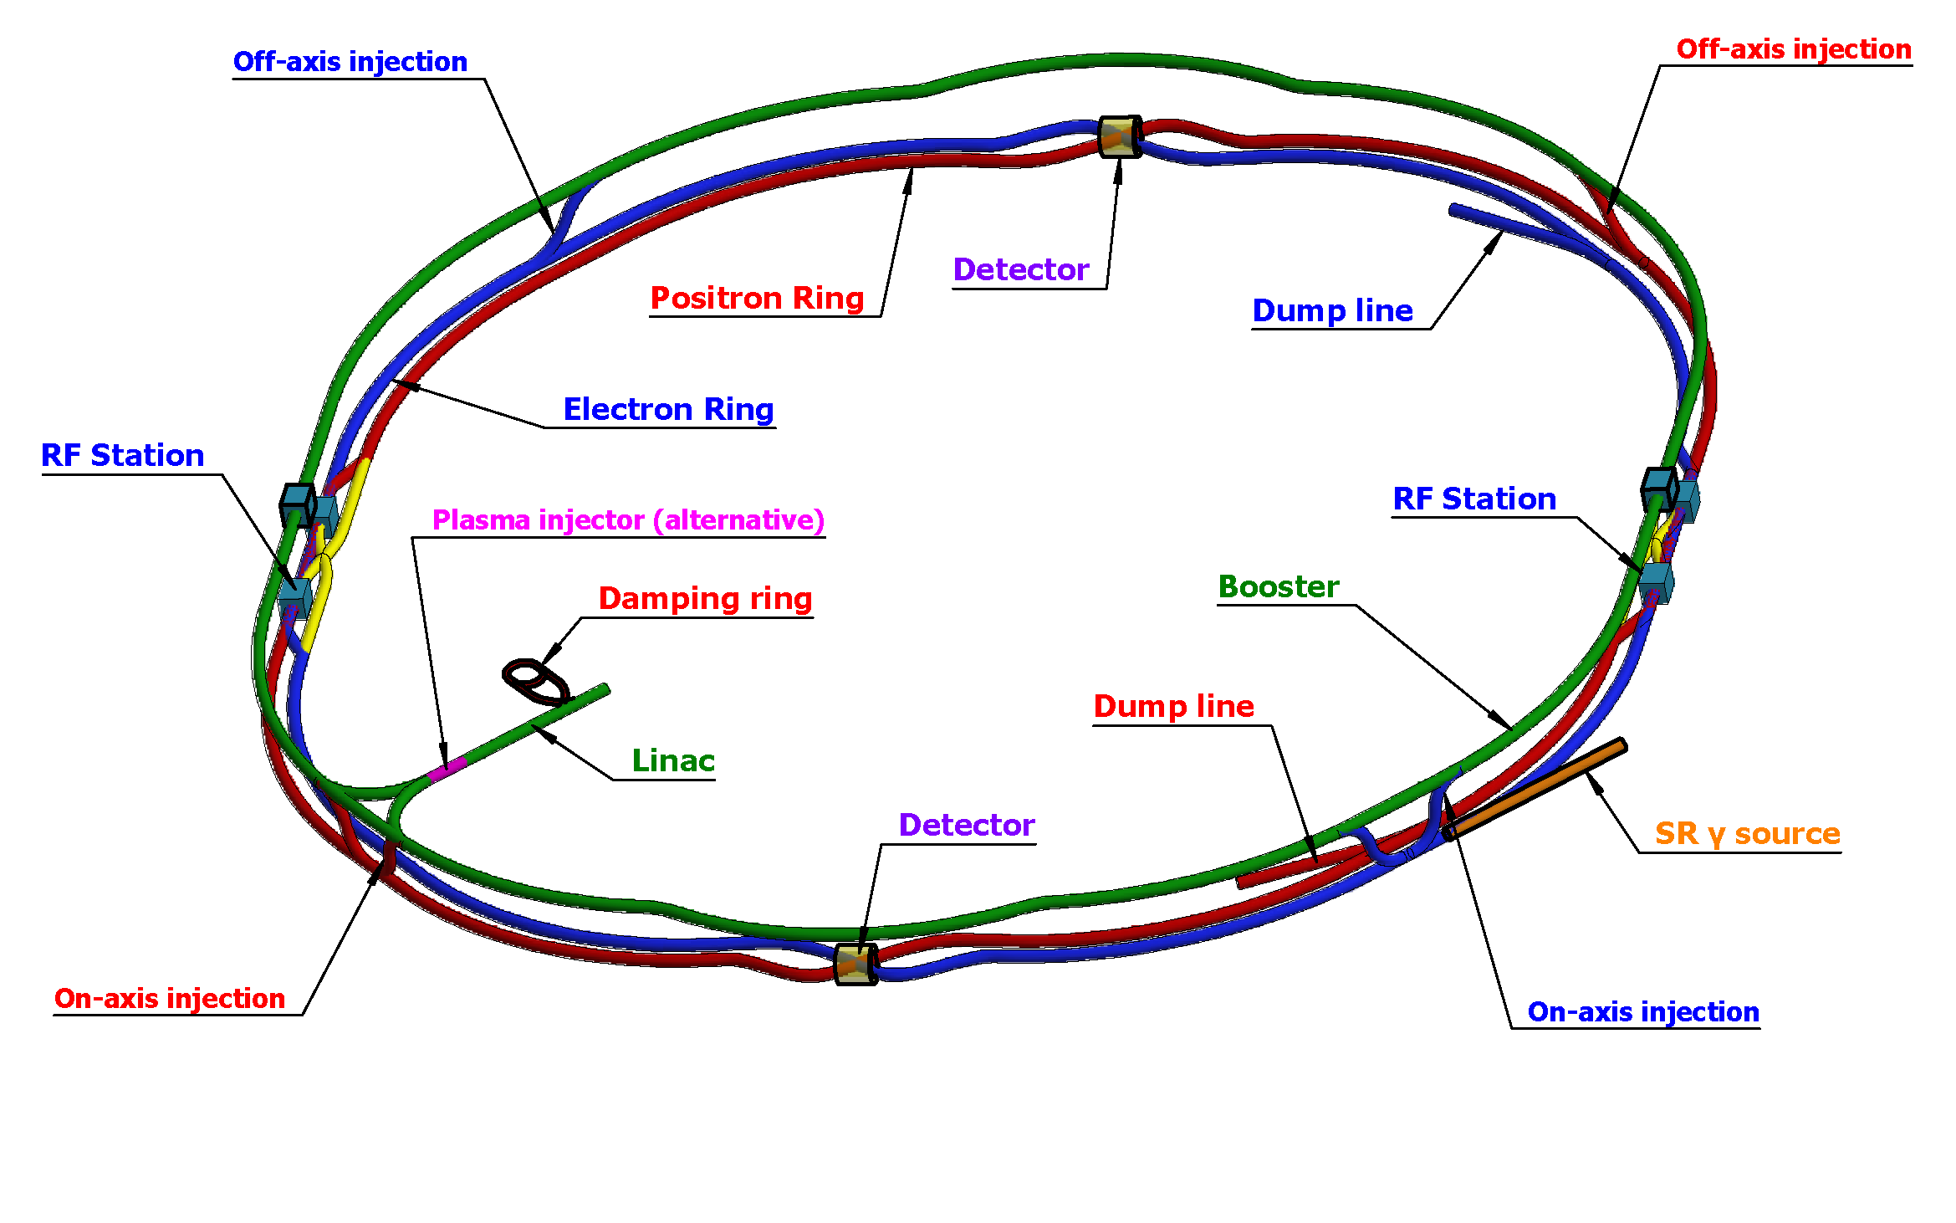
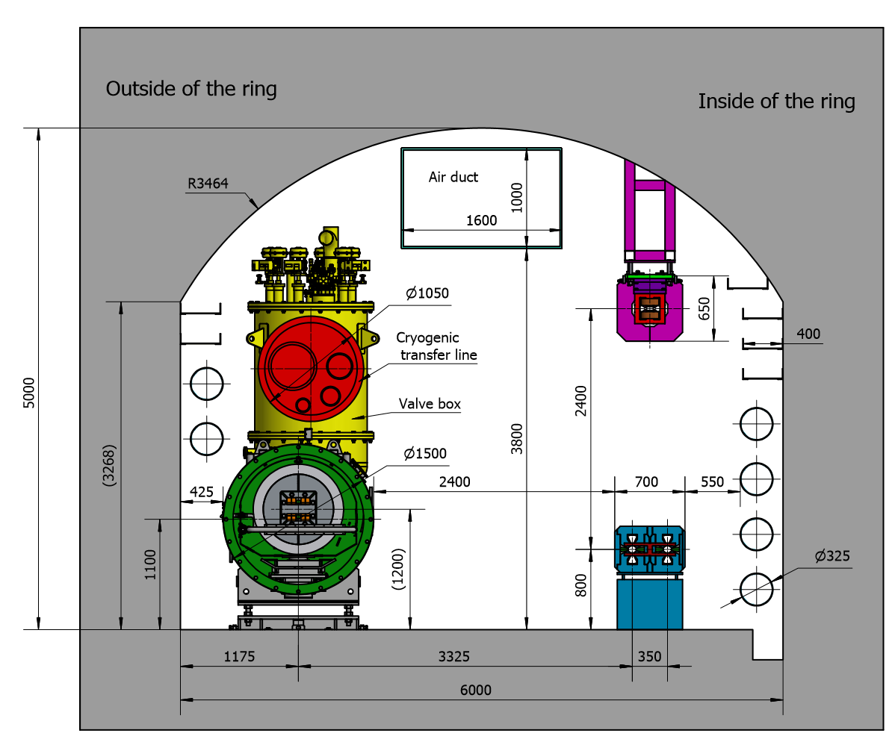
CEPC layout and injector chain
30→180GeV
30GeV
2 RF stations
2 Inj. (Linac to Booster)
2 Inj. (Collider to Booster)
4 Ext. (Booster to Collider)
2 Ext. (Booster to Dump)
100km
30 GeV linac provides electron and positron beams for booster.
Top up injection for collider ring ~ 3% current decay
Booster is in the same tunnel as collider ring, above the collider ring, bypass in IRs (same circumference).
Budget for transfer efficiency 90%: 95% for booster + 95% for transport lines (inj. to collider).
Beam current threshold in booster is limited by RF system.
Feedback systems (Transverse & longitudinal) are need to damp the instability at low energy.

Slide 4
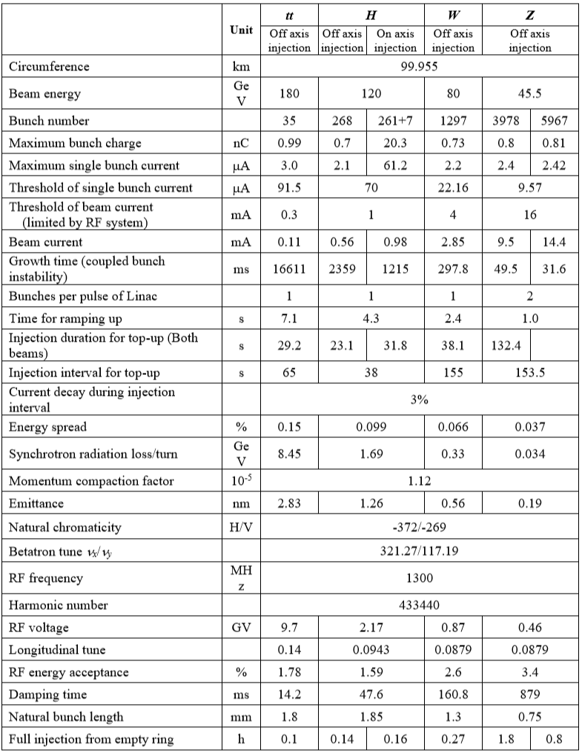
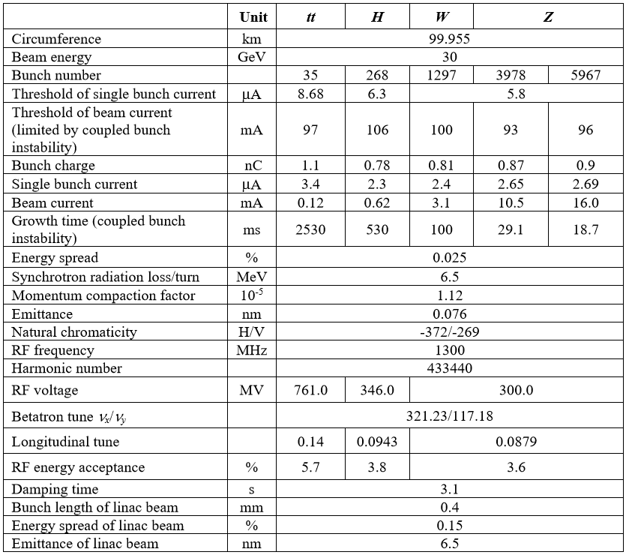
Booster TDR parameters
Energy: 30GeV → 180GeV
Lower emittance ─ new lattice (TME)
Extraction
Injection
*Diameter of beam pipe is 56mm for re-injection with high single bunch current @120GeV.

Slide 5
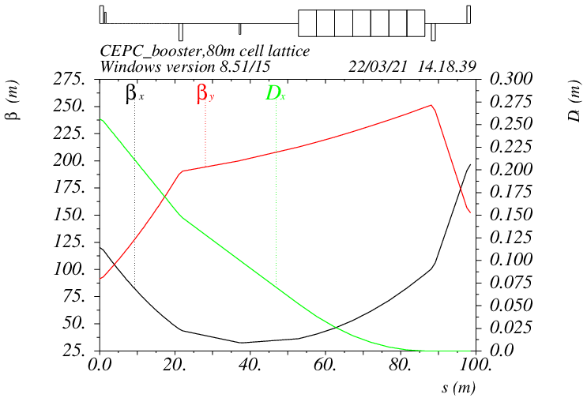
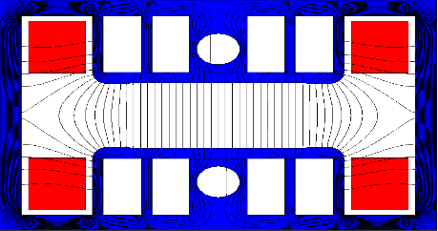
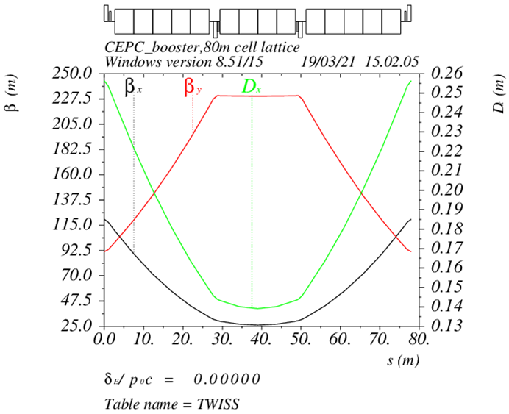
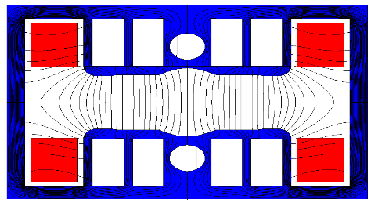
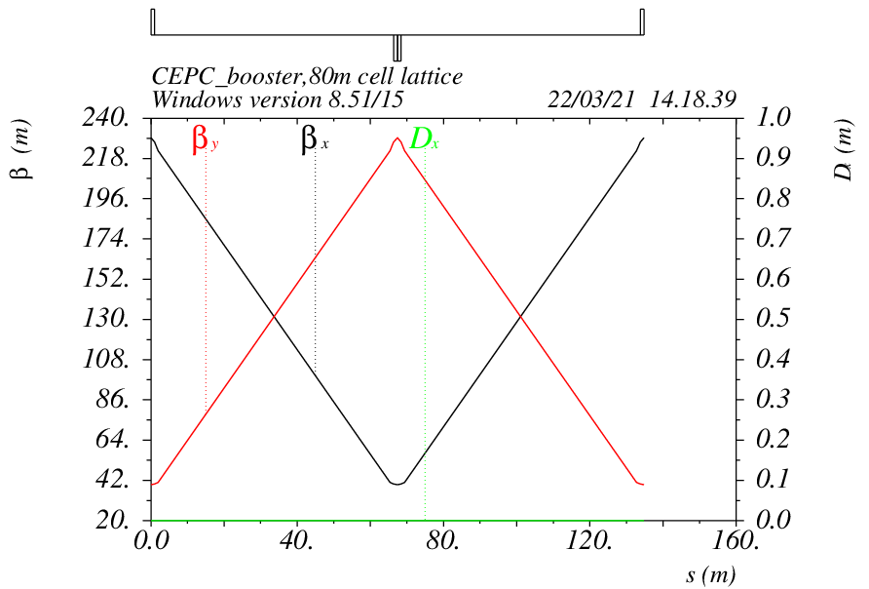
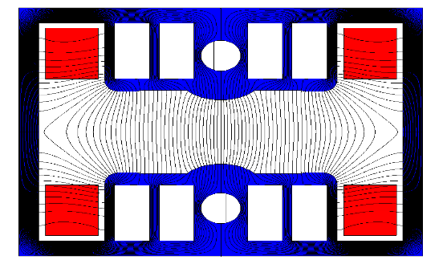
Booster TDR optics
D. Wang, C. H. Yu, D. H. Ji, Y. M. Peng, X. H. Cui,…
Arc: TME like structure (cell length=78m)
Interleave sextupole scheme
Emittance@120GeV=1.26nm
Overall idea: uniform distribution for the Q
Combined magnet (B+S) scheme + 100 sextupoles
Phase advance/cell: 100° (H) / 28° (V)
pure dipole
Dispersion sup.
dipole-SF
Arc cell
Straight cell
dipole-SD
Ref: D. Wang, et al., “Low emittance optics design for CEPC booster”, NIMA, 1062 (2024) 169159.

Slide 6
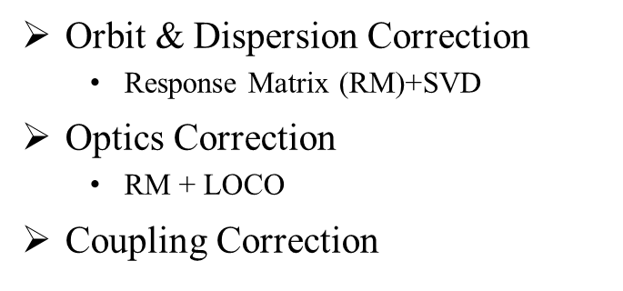
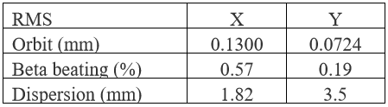
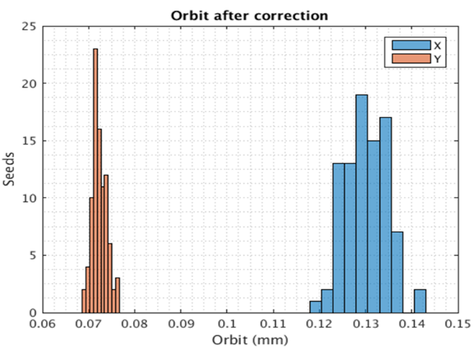
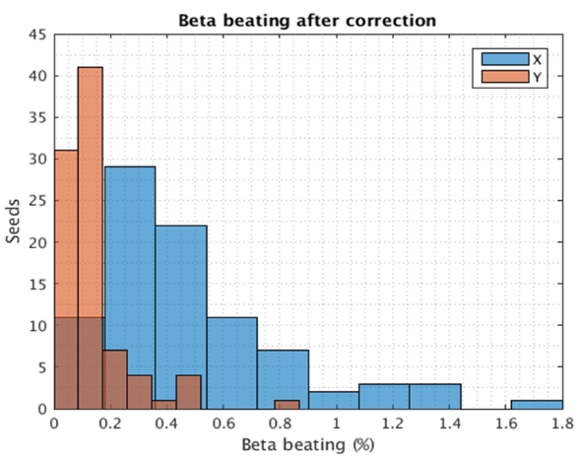
Booster error setting and correction in TDR
Gaussian distributions are used for the errors, and they are truncated at 3σ.
D. H. Ji
 | Dipole | Quadrupole | Sextupole
Transverse shift X/Y (μm) | 100 | 100 | -
Longitudinal shift Z (μm) | 100 | 150 | -
Tilt about X/Y (mrad) | 0.2 | 0.2 | -
Tilt about Z (mrad) | 0.1 | 0.2 | -
Nominal field | 1e-3 | 2e-4 | 1e-3
 | Accuracy (um) | Tilt (mrad) | Gain | Offset w/ BBA(um)
BPM(10Hz) | 0.1 | 10 | 5% | 30
(100 seeds)
(93 seeds)
Include multipole errors
Residual errors after correction with 100 random seeds
dipole | quadrupole
B1/B0 ≤ 2×10⁻⁴
B2/B0 ≤ 5×10⁻⁴ | B2/B1 ≤ 3×10⁻⁴
B3/B0 ≤ 2×10⁻⁵ | B3/B1 ≤ 2×10⁻⁴
B4/B0 ≤ 8×10⁻⁵ | B4/B1 ≤ 1×10⁻⁴
B5/B0 ≤ 2×10⁻⁵ | B5/B1 ≤ 1×10⁻⁴
B6/B0 ≤ 8×10⁻⁵ | B6/B1 ≤ 5×10⁻⁵
B7/B0 ≤ 2×10⁻⁵ | B7/B1 ≤ 5×10⁻⁵
B8/B0 ≤ 8×10⁻⁵ | B8/B1 ≤ 5×10⁻⁵
B9/B0 ≤ 2×10⁻⁵ | B9/B1 ≤ 5×10⁻⁵
B10/B0 ≤ 8×10⁻⁵ | B10/B1 ≤ 5×10⁻⁵

Slide 7
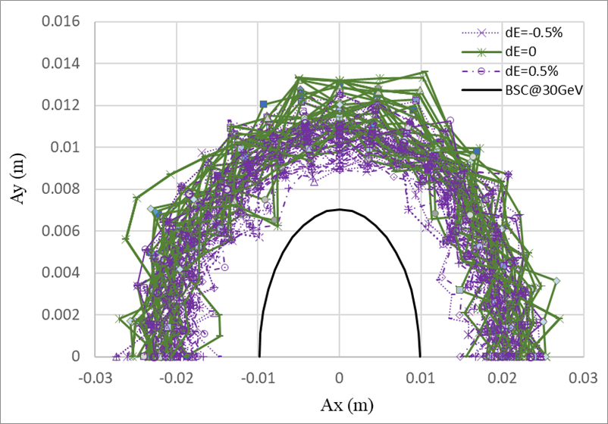
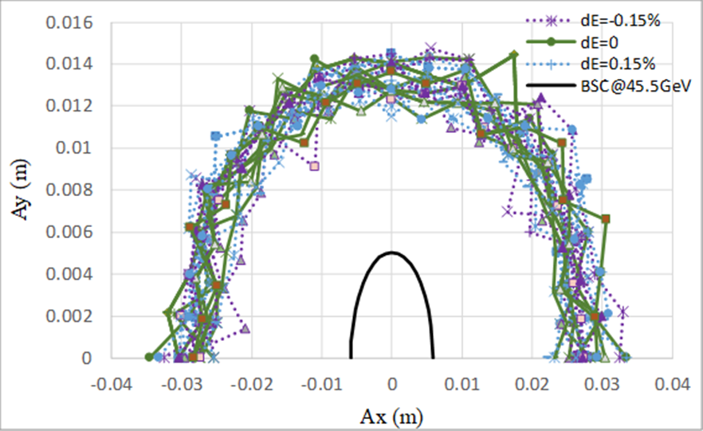
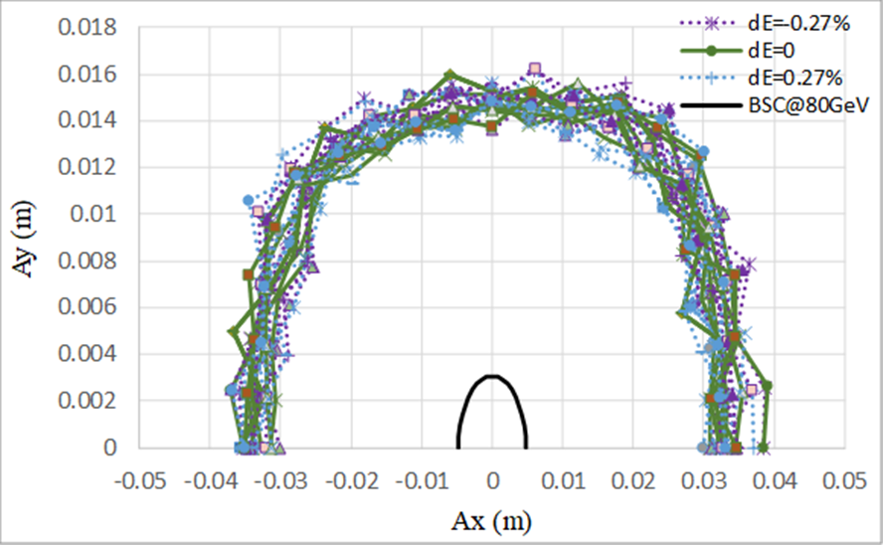
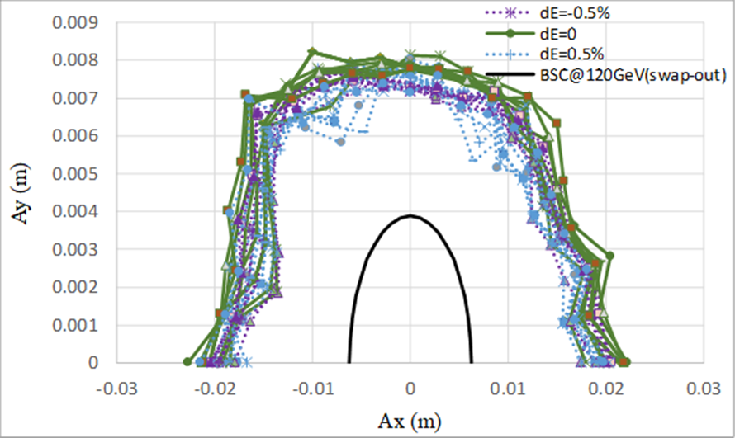
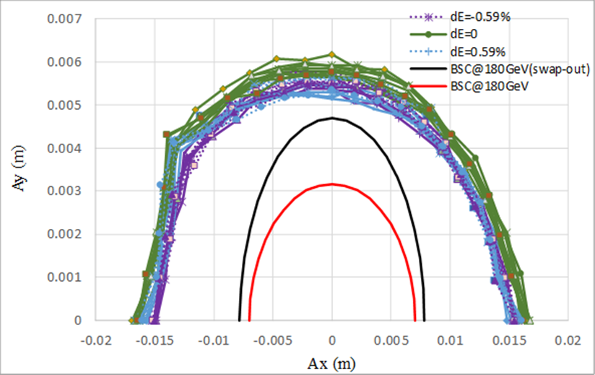
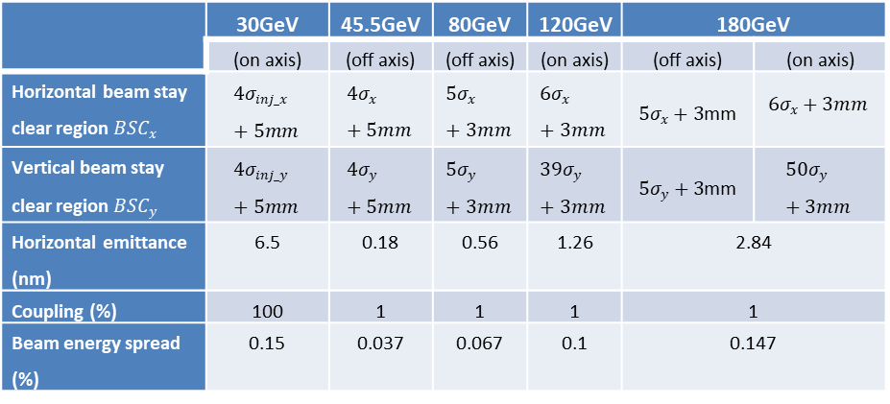
Booster DA with error correction & SR
D. Wang, D. H. Ji
30GeV
45GeV
80GeV
120GeV
180GeV
The definition of beam stay clear region at different energies
TDR error setting meet the requirement of beam dynamics.
Ref: D. Wang, et al., “Low emittance optics design for CEPC booster”, NIMA, 1062 (2024) 169159.

Slide 8
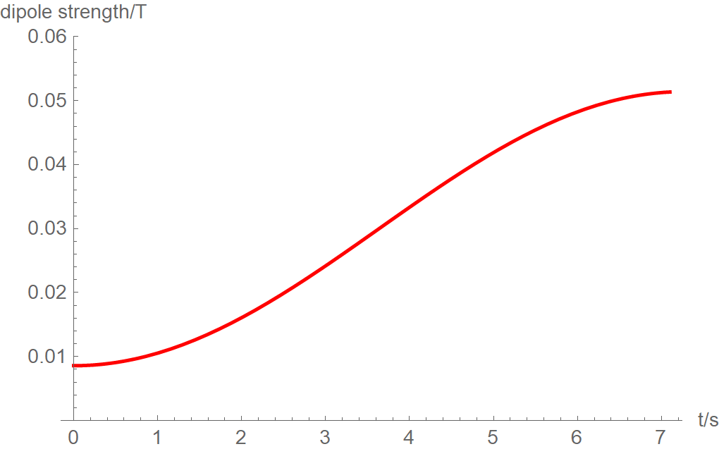
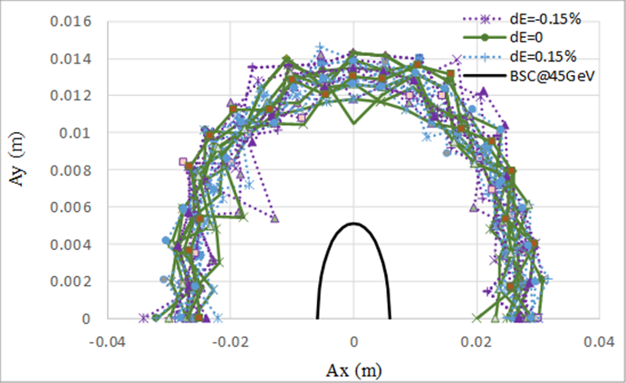
Booster DA with Eddy current effect
Dedicated ramping curve to control the maximum K2.
Dou Wang, Yuemei Peng, Daheng Ji
Al beam pipe (round shape)
- inner diameter: 56mm, thickness: 2mm
Dynamic chromaticity is not corrected.
- Show the worst case
Tracking DA at 45 GeV with SR, error, and eddy current
Analytical estimation for eddy effect*
K2 reaches max at 45GeV.
Max K2=0.000029 (m⁻³)
*Yuan Chen et al., Analytical expression development for eddy ﬁeld and the beam dynamics eﬀect on the CEPC booster, IJMPA, Vol. 36, No. 22 (2021) 2142010

Slide 9
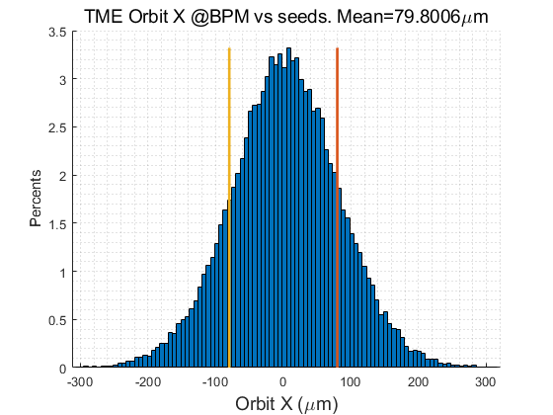
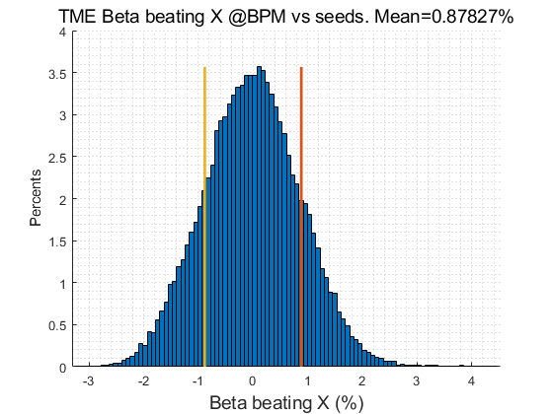
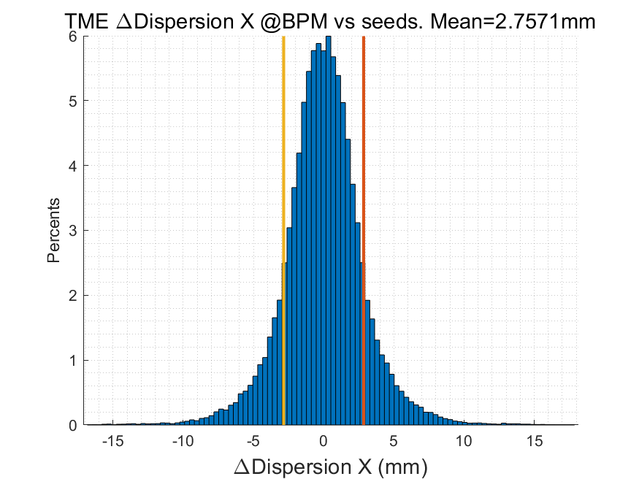
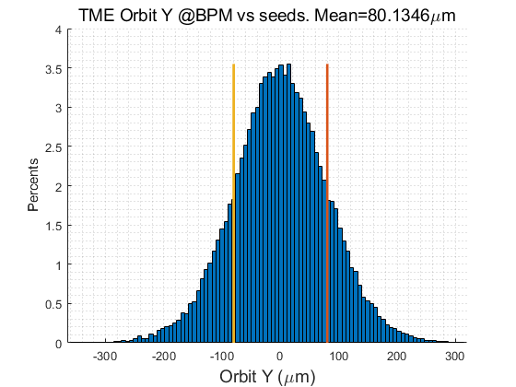
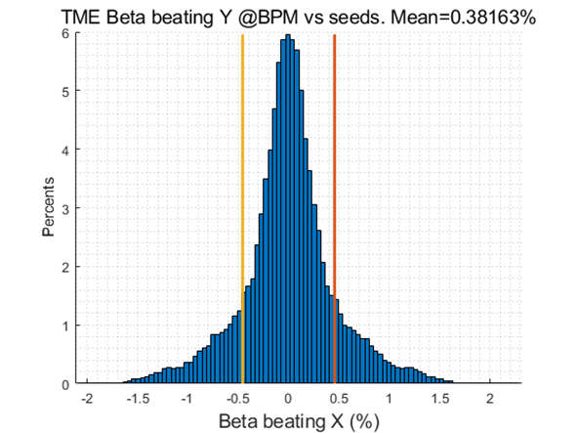
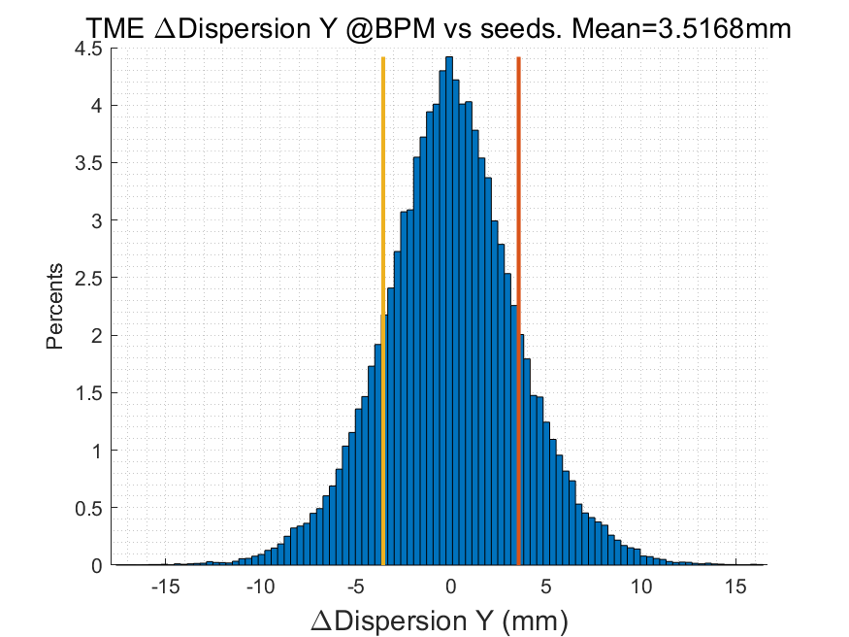
Error study for polarization scheme in EDR
Daheng Ji
Orbit Correction + Horizontal dispersion
  Response Matrix
  2-level iteration：
    1st Loop: 20%~100% Corrector
    2nd Loop：30%~80% Singular Value
  Dispersion correction
  Energy adjustment by corrector
  80um RMS in both plan
Optics correction
  RM + LOCO
  Based on 30GeV simulation
  All quadrupole independent
  Dispersion correction included
Coupling and vertical dispersion correction
  Mainly used for the simulation of beam polarization. (Z. Duan)
  Skew quadrupole magnets are arranged in both the dispersion free section and the arc section to correct coupling and vertical dispersion independently.
  the coupling control target being better than 0.5%
RMS@30GeV | X | Y
Orbit (mm) | 0.080 | 0.080
Beta Beating(%) | 0.8 | 0.38
Δ Dispersion(mm) | 2.7 | 3.5
  #BPM~2400
  #Corrector~1200

Slide 10
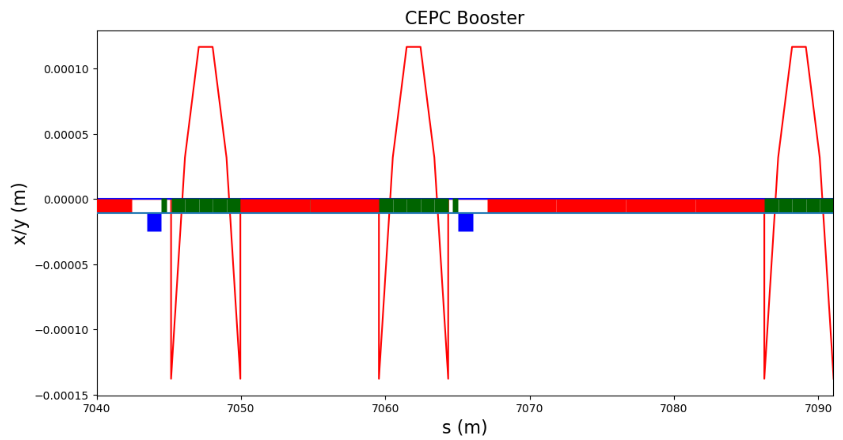
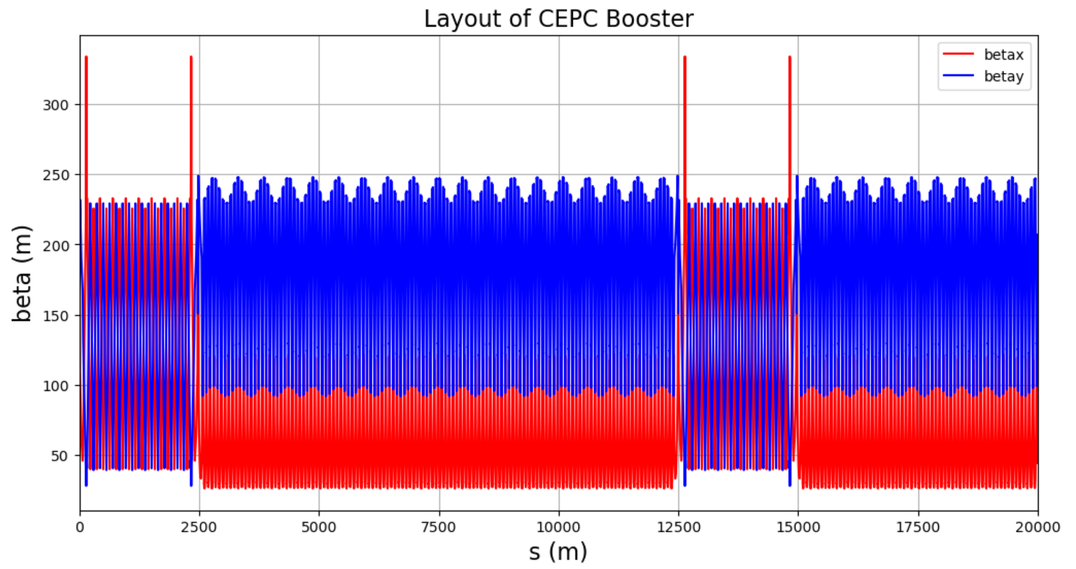
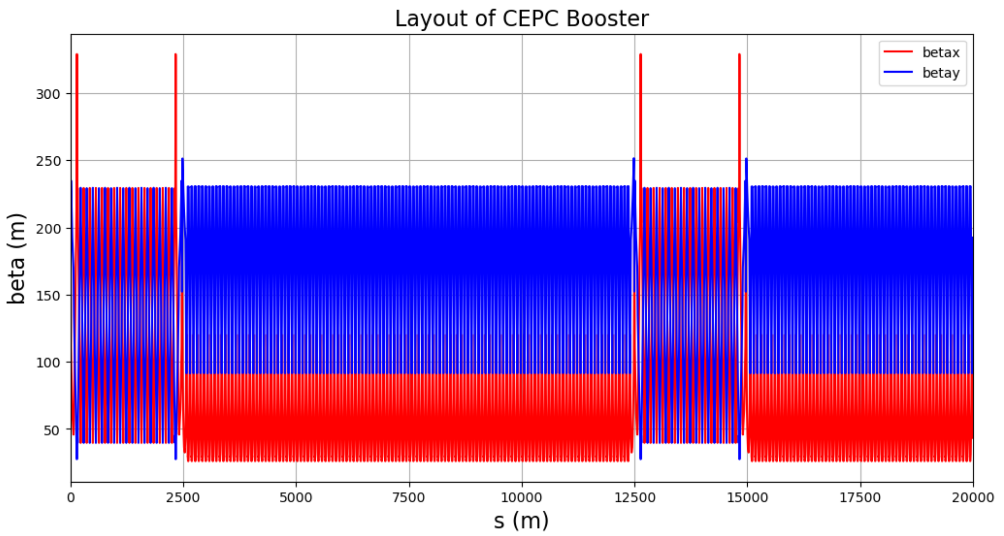
Careful model for combined dipoles by APES
APES: Accelerator Physics Emulation System
Particles trajectory is a curve.
The sext. center is a line along the center of the dipole.
The off-center trajectory will introduce extra quadrupole field and beta oscillation.
The position of sext. center is optimized with zero integrated quatrupole field.
Weibin Liu, Yuan Zhang, Dou Wang
Closed orbit in the combined dipole
W/O optimization
W. optimization
The 2025 European Edition of the International Workshop on CEPC

Slide 11
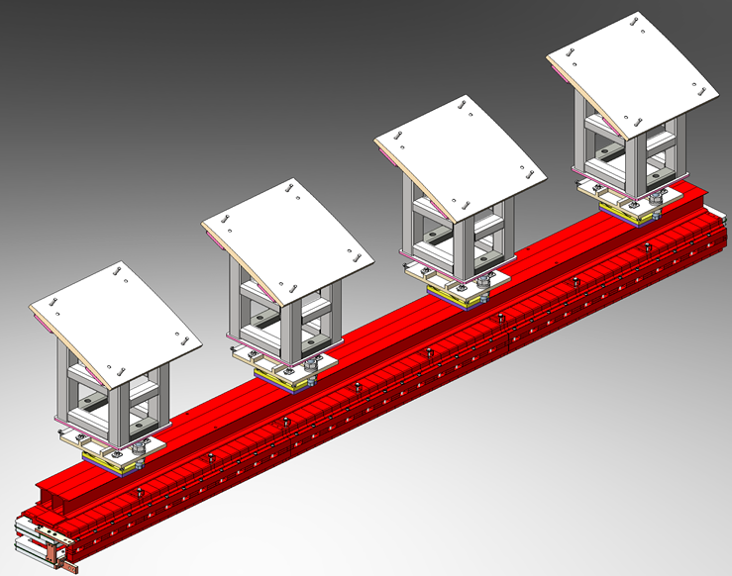
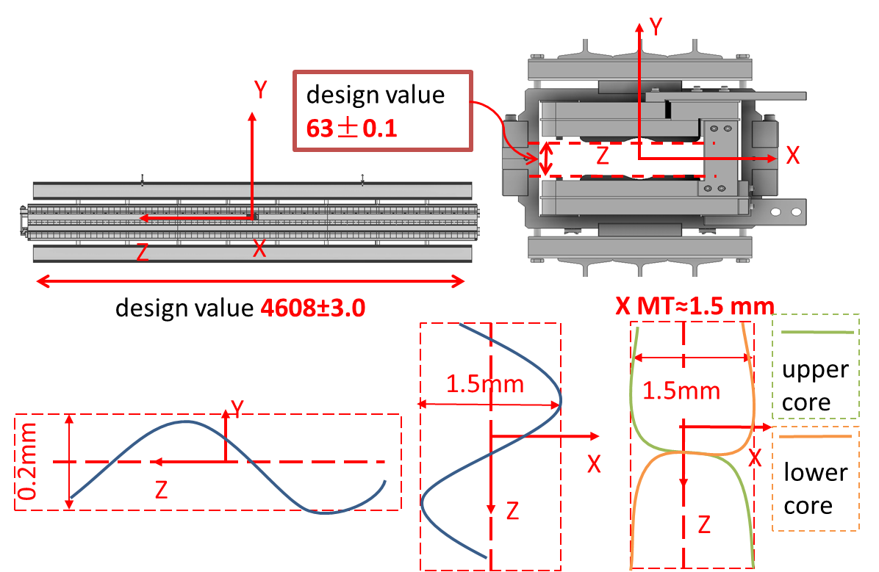
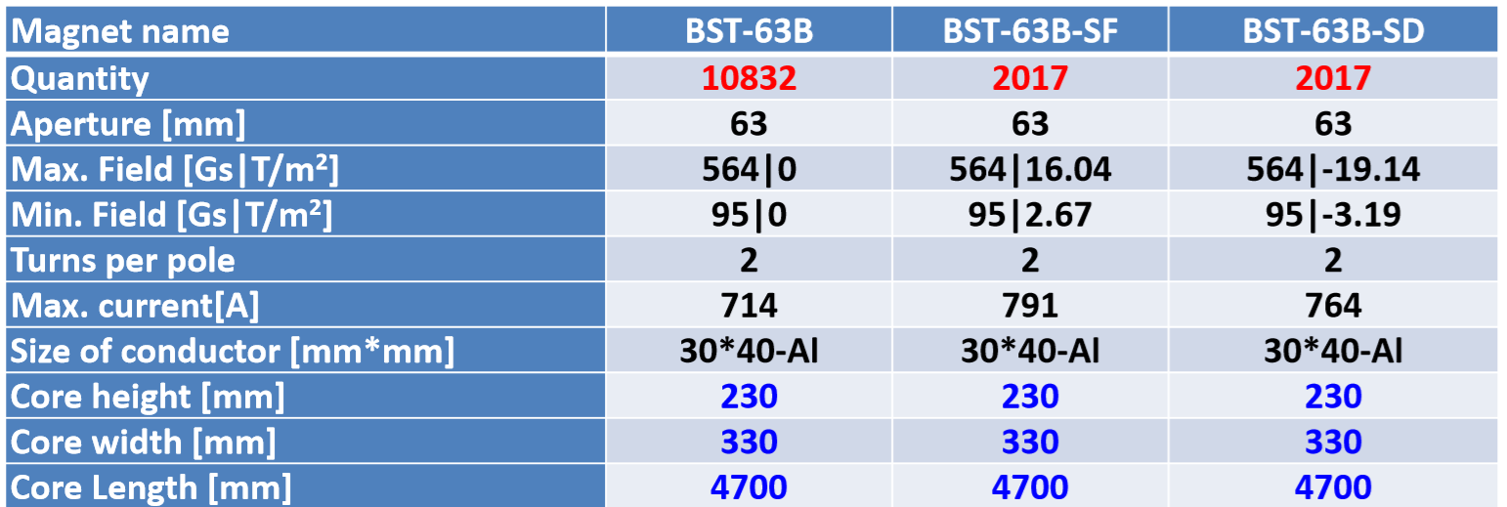
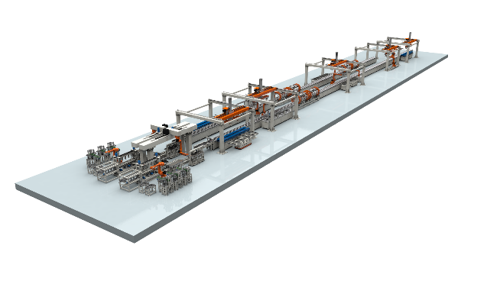
Booster dipole mass production preparation in EDR
Wen Kang, Zhihui Mu
All the booster dipole magnets including the combined dipoles will be produced by the automatic fabrication lines in order to reduce the cost.
Three fabrication lines will be required to produce the required 15,000 dipole magnets within 5 years (4 dipole magnets per day).
Production error: combining machining error, assembly error,
welding deformation, lifting deformation
Y straightness along z=0.2 mm
X straightness along z=1.5 mm
BST-63B: booster pure dipole; BST-63B-SF: dipole-SF combined magnet; BST-63B-SD: dipole-SD combined magnet.

Slide 12
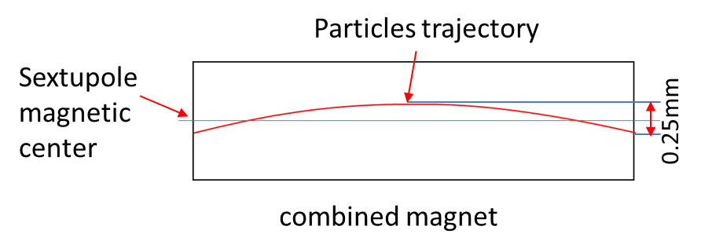
Alignment scheme for the combined dipole in EDR
Xiaolong Wang
The booster dipole-sextuple combined magnet alignment will be based on its integrated sextupole center.
Align the combined magnet to the position where the integral of the quatrupole magnetic field along the particle’s trajectory is zero.
The alignment scheme based on mechanical center will be adopted.
Arc deviation
The integrated sextupole center is moved to outside of the beam inlet/outlet points (offset: ~140 um).
 | Transversal X/mm | Vertical Y/mm | Roll θ_{z} /mrad | Pitch θ_{x} /mrad | Yaw θ_{y} /mrad
Based on mechanical center | 0.1 | 0.102 | 0.29 | 0.019 | 0.019
Based on magnetic center | 0.407 | 0.408 | 0.29 | 0.023 | 0.023

Slide 13
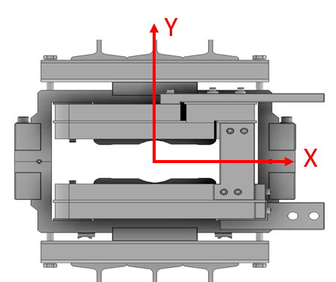
Dipole (D+S) error tolerance study in EDR
Daheng Ji, Dou Wang
The transverse offset error of the combined dipoles were scanned with100um (RMS), 300um (RMS), 400um (RMS) and 500um (RMS) to see the tolerance from the view of beam dynamics, while all the other errors keep same as TDR error table.
After horizontal closed-orbit correction, the orbit RMS is approximately 100~200 μm. When the misalignment of the combined magnet exceeds this level, the feed-down effect of the beam in the sextupole field increases more significantly, leading to larger optics errors in the corrected beam.
The combined dipole magnets were shifted Integrally without inner distortion.
Both dynamic aperture and emittance growth are checked after error correction.
Assume the error is Gaussian distribution, and are truncated at 3σ.
Dynamic aperture was tracked by SAD.
Emittance was calculated by both SAD and AT.

Slide 14
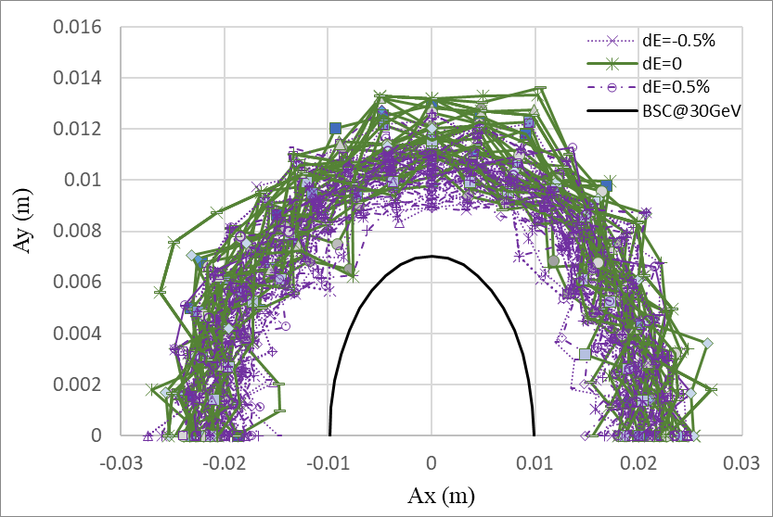
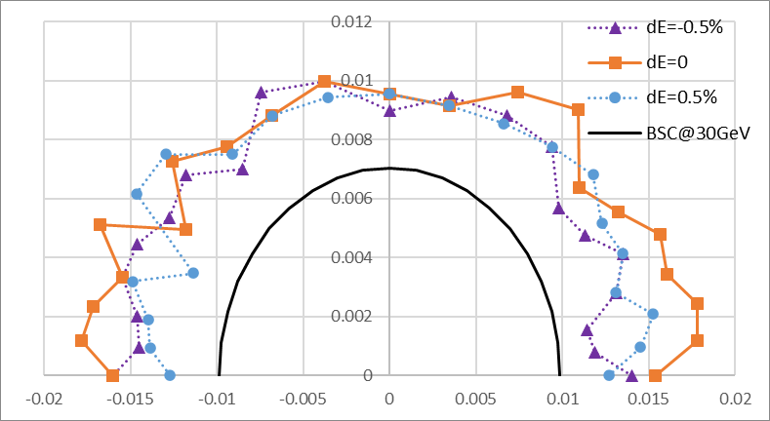
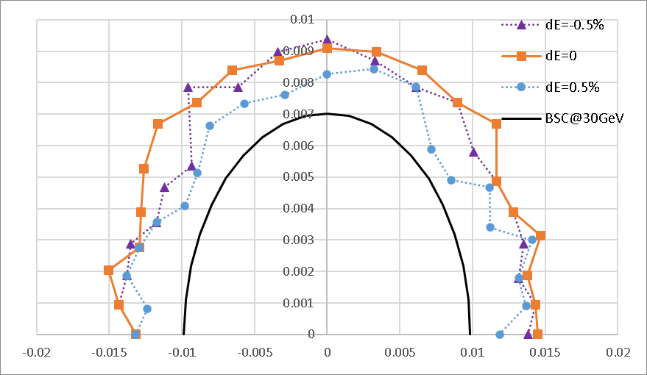
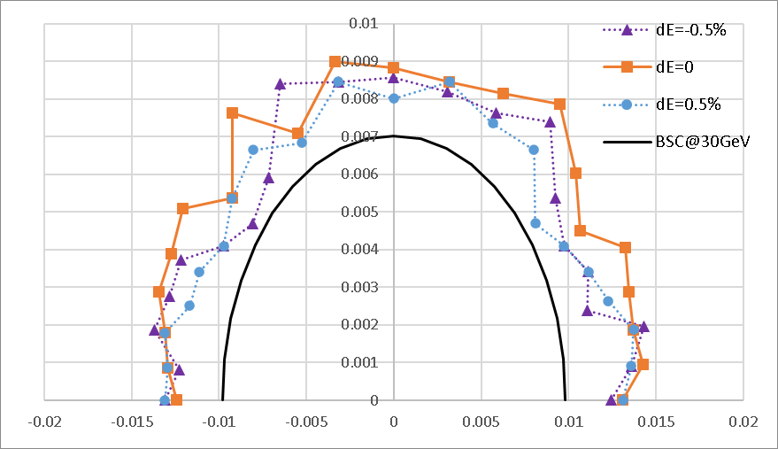
Booster DA results@30GeV
Daheng Ji, Dou Wang
30 GeV is the most critical energy among other energy modes according to TDR study.
100um
300um
400um
500um
Maximum integral transverse offset of whole magnet: 1.5mm (rms: 500um)

Slide 15
Emittance growth @120GeV
Daheng Ji, Dou Wang
Emittance growth at extraction energy should be controlled to make sure the injection efficiency to collider ring.
Horizontal emittance growth is very small.
Vertical emittance growth can be controlled by 8 skew quadrupoles and vertical dispersion correction.
- Coupling design goal: ≤ 1%
Trans. offset of com. Dipole (RMS) |  | 100um | 300um | 400um | 500um
Hor. Emit. growth (%) |  | <0.5 | <0.8 | <1.5 | <2
Coupling (%) | w/o coupling correction | 0.59 | 0.98 | 1.24 | 1.30
Coupling (%) | w coupling correction |  | 0.57 | 0.89 | 1.08

Slide 16
Comparison between requirements and achievement
Requirements from accelerator physics
Offset of Integrated sextupole center (RMS): ≤ 150um (Horizontal) / 150um（Vertical)
Magnet straightness along z (MAX): ≤ 1.5mm（Horizontal) / 1.0mm（Vertical)
Status of magnet production
Magnet straightness along z (MAX): ≤ 1.5mm（Horizontal) / 0.2mm（Vertical)
Status of alignment/installation
Offset of Integrated sextupole center (RMS): ≤ 100um (Horizontal) / 102um（Vertical)

Slide 17
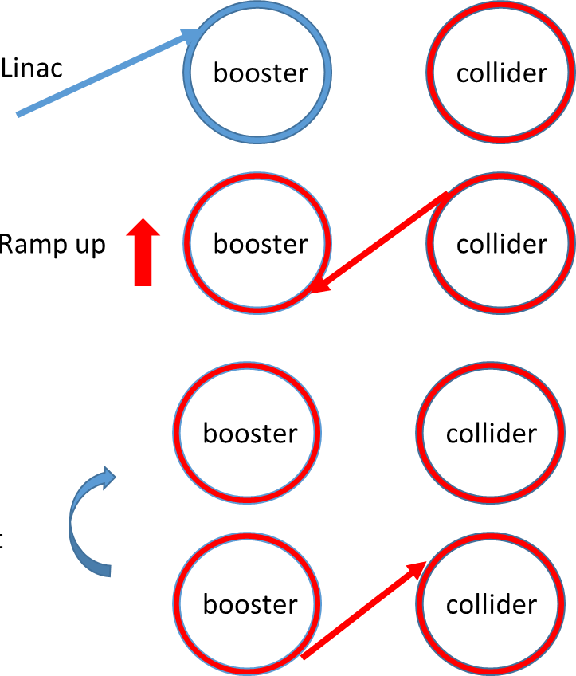

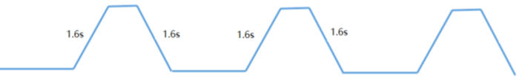
Booster ramping & injection scheme
Dou Wang, Xiaohao Cui
0.035s
On-axis injection @Higgs
tt
7.1s
7.1s
0.35s+7.1s+0.035s+7.1s=14.6s
1 cycles/beam
0.35s
0.27s
4.7s damping
Higgs
4.3s
4.3s
4.3s
4.3s
1 cycles/beam
2.7s
off-axis
2.7s
on-axis
2.7s+4.3s+4.7s+4.3s=16.0s
1.3s
W
2.4s
2.4s
1 cycles/beam
12.97s+2.4s+1.3s+2.4s=19.1s
12.97s
0.05s
Z
1.0s
1.0s
1.0s
(19.9s+1.0s+0.05s+1.0s)*3=65.9s
1.0s
19.9s
19.9s
3 cycles/beam
19.9s

Slide 18
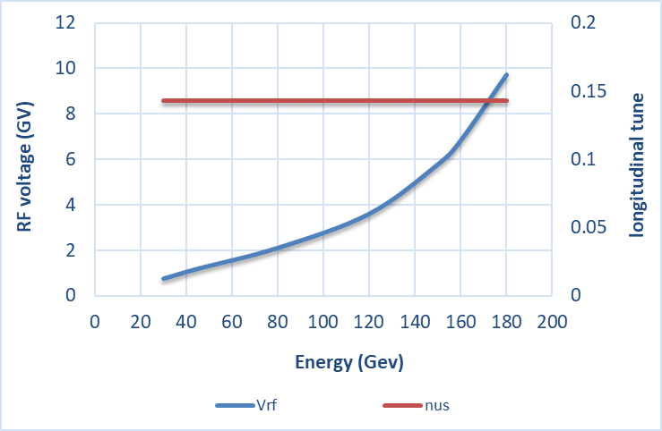
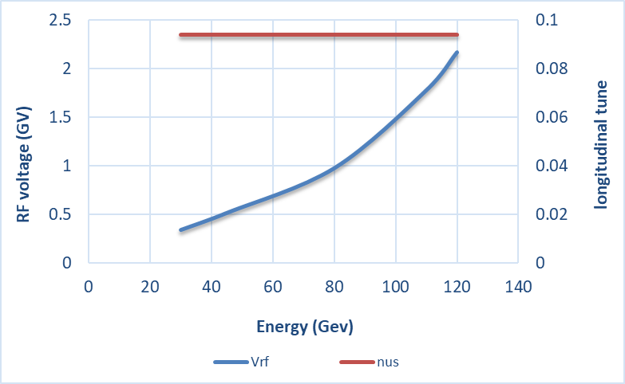
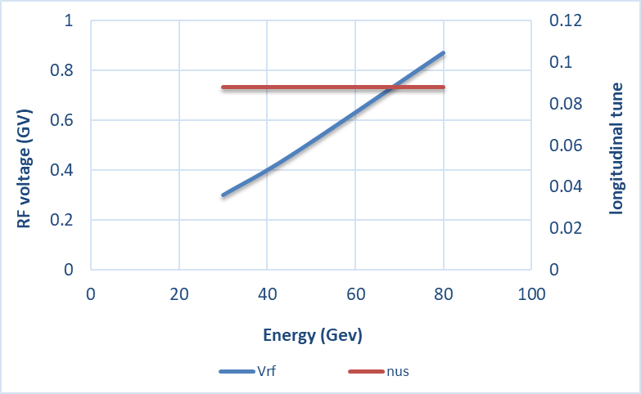
RF ramping curve
Different RF ramping curve for each energy mode (constant νs )
D. Wang, J.Y. Zhai
νs for tt: 0.14
νs for Higgs: 0.094
νs for W & Z: 0.088
tt
Max RF voltage @tt determined by longitudinal quantum lifetime & DA.
η_{RF}: ~ 12 ×δ
VRF (180GeV)=9.8GV
Higgs
W &Z

Slide 19
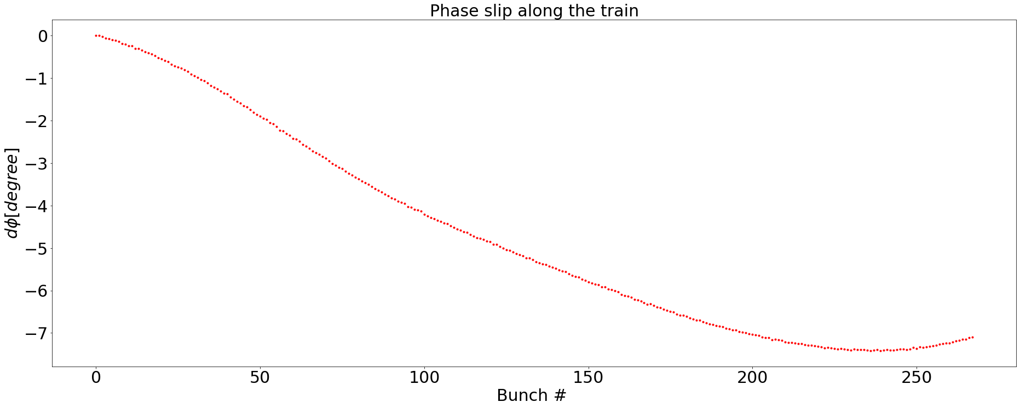
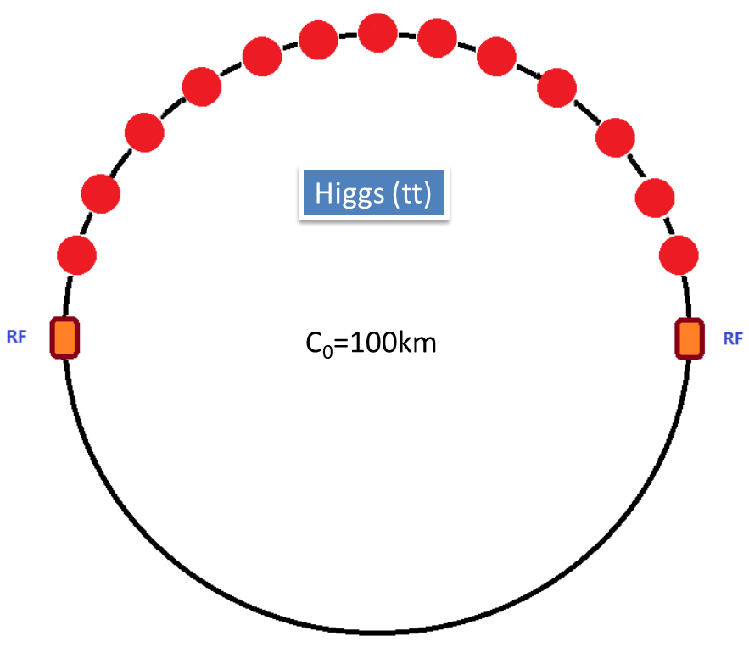
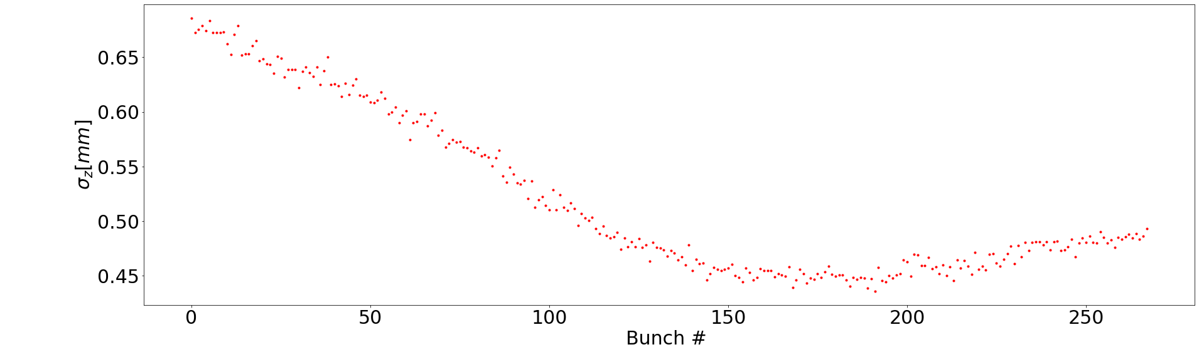
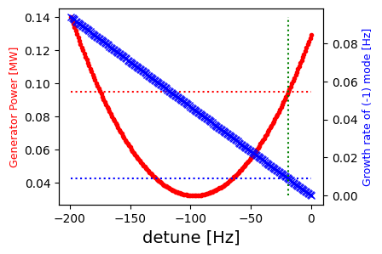


RF beam loading effect @ 30 GeV
T. M. Xin, J. Y. Zhai
Transient beam loading due to half filled ring in Higgs mode.
The radiation dampping rate at 30 GeV is only 0.67 Hz.
The dampping rate with bunch by bunch feedback is 8 Hz.
We are looking at two figures of merit at detune freuquency optimized for top energy:
  The growth rate of -1 mode;
  The power requirement at given detune.
Higgs
Higgs
Mode | Growth rate [Hz] | Power required [MW] | Power Available [MW]
Higgs | < 0.01 | 0.095 | 2.40
W | 0.88 | 0.61 | 1.15
Z | 3.7 | 1.14 | 0.64
Z with df = -840 Hz | 4.6 | 0.60
Higgs
W
Z
df = -19.4 Hz
df = -216 Hz
df = -752 Hz
Pg = 0.095 MW
Growth rate = 3.7 Hz
Pg = 0.61 MW
Pg = 1.14 MW
Growth rate < 0.01 Hz
Growth rate = 0.88 Hz

Slide 20



Transient Beam Loading during the on-axis Injection @ H
T. M. Xin, J. Y. Zhai
During the on-axis injection process in Higgs mode, 7 to 13 large bunches will be back injected from the Storage ring;
The change of beam pattern will cause different transient phase slip compare to the normal half fill pattern (Doubled total phase slip between head and tail and jumps between the small trains);
After several synchrotron oscillations, the large bunch will be completely merged with the small existing bunches. Then the large bunches will be injected into the storage ring again;
The bunch pattern again will change because of the vacancies and a new transient phase pattern will occur.
No apparent instability detected during the whole process.
Before
During
After

Slide 21
Beam Loading Study Plan in EDR
T. M. Xin, J. Y. Zhai
Check rest of the parts in the full cycle:
  Confirm the phase stability during the rampping process;
  Estimate the thermal load and tuning requirement;
  Investigate the solution for the possible power shortage in Z mode;
Run the full cycle simulation
Legend:
checked
Injection from the LINAC
not yet
Energy rampping
Injection into the Storage Ring
Back injection from the Storage Ring
Replenish the Storage Ring.

Slide 22



Progress of polarization study in EDR
The TDR lattice suffers from superstrong resonances before Z energy
  Injected vertical emittance 6.5nm -> Polarization trans. ~ 50% @ Z & W, 20% @ Higgs
  Injected vertical emittance 1.5 nm -> Polarization trans. ~ 80% @ Z & W, 30% @ Higgs
Potential optimization:
  Move the location of superstrong resonances
  Mitigation of imperfection resonances
    Reduce lattice sensitivity
    Harmonic spin matching & partial snakes
Z. Duan
TDR bare lattice
Intrinsic resonance
TDR lattice (one seed)
Imperfection resonance

Slide 23
Content
EDR progress of CEPC Booster
  Feasibility study of the combined dipole magnets
  Progress of beam loading study
  Progress of polarization study
EDR progress of CEPC positron damping ring
  DR TDR design status
  Polarized DR study
  TF design status -- LPA multi-function ring
CEPC timing issue and detector performance
Summary

Slide 24
DR parameters in TDR
Damping with reversed bending magnet
4 (max. 8)-bunch storage, storage time:20 (40) ms
Emittance: 2500→ 166/75 (97/3) mm.mrad
Flexibility for extr. emittance
 | DR V3.0
Energy (Gev) | 1.1
Circumference (m) | 147
Number of trains | 2 (4)
Number of bunches/trian | 2
Total current (mA) | 12.4 (24.8)
Bending radius (m) | 2.87
Dipole strength B₀ (T) | 1.28
U₀ (kev/turn) | 94.6
Damping time x/y/z (ms) | 11.4/11.4/5.7
Phase/cell (degree) | 60/60
Momentum compaction | 0.013
Storage time (ms) | 20 (40)
δ₀ (%) | 0.056
ε₀ (mm.mrad) | 94.4
injection σ_{z} (mm) | 4.4
Extract σ_{z} (mm) | 4.4
ε_{inj} (mm.mrad) | 2500
ε_{ext x/y} (mm.mrad) | 166(97)/75(3)
δ_{inj} /δ_{ext} (%) | 0.18 /0.056
Energy acceptance by RF(%) | 1.8
f_{RF} (MHz) | 650
V_{RF} (MV) | 2.5
Longitudinal tune | 0.0387

Slide 25




DR optics and error study
Cell length: 3m
B=1.28T
θ_{r} /θ₀=0.355
Phase/cell: 60°/60°
Interleave sextupole scheme
2 sex. families
-θ_{r}
B=1.28T
θ₀
Error study
Arc

Slide 26




Alternative design for the DR with polarization
Z. Duan, D. Wang
Produce polarized positron beam for the purpose of energy calibration @ Z & W*.
DR V4.0 | unpolarized e+ | polarized e+
Energy (Gev) | 1.542
Circumference (m) | 145
Number of trains | 2(4)
Number of bunches/trian | 1(2)
Total current (mA) | 12.4
Bending radius (m) | 3.44
Dipole strength B₀ (T) | 1.5
Wiggler strength B₊ (T) | 1.8
Wiggler cell length (m) | 1.5
U₀ (kev/turn) | 190.9
Damping time x/y/z (ms) | 7.77/7.77/3.89
Momentum compaction | 0.015
Storage time | 20 ms | 10 min
δ₀ (%) | 0.072
ε₀ (mm.mrad) | 138
injection σ_{z} (mm) | 6
Extract σ_{z} (mm) | 5.7 | 5.6
ε_{inj} (mm.mrad) | 2500
ε_{ext x/y} (mm.mrad) | 150/15 | 138/14
δ_{inj} /δ_{ext} (%) | 0.18 /0.072
RF acceptance (%) | 1.8
f_{RF} (MHz) | 650
V_{RF} (MV) | 3.95
Longitudinal tune | 0.044
10 min storage → ~20% polarization
arc
Compatible with standard top up operation
Asymmetric wigglers
B₊=1.8T=5 B₋
cell length=1.5m
wiggler
Wiedemann, Particle Accelerator Physics, 4 Edition
16 wigglers

Slide 27


Positron damping/polarizing ring
Optimization of a dual-purpose design
  Bunches stay ~ 20 msec for regular refill
  Bunches stay ~ 10 min to accumulate > 20% polarization for resonant depolarization in the Colliders
Cost and benefit comparison between two schemes
  Higher beam energy without asymmetric wigglers
  Lower beam energy with asymmetric wigglers
Z. Duan
Asymmetric wigglers

Slide 28


PBA TF based on LPA + Storage Ring
A proposed TF
Wei Lu, Dazhang Li, Dou Wang, Zhe Duan , Shiyu Zhou, Cai Meng, Xiaohao Cui, Jinhui Chen…
e+/e- injection @200MeV
~ 1nC in the ring for e+ and e- → off-axis injection
Multi bunch storage
Ring circumference: ~ 100 m
A demonstration for CEPC DR
The 2025 European Edition of the International Workshop on CEPC

Slide 29





Design status of the multi-function ring
60°/60° FODO
Off-axis injection with two kickers
Undulator parameter
Undulator
B_{max}: 1 T
L_cell: 25 mm
L_total: 1.6 m
DA @ 200MeV
Spin rotator→ longitudinal polarization
8 skew quads

Slide 30
Parameters of the multi-function ring
Plan & schedule:
DR V2.0 | 200MeV | 500MeV | 1.2GeV
Circumference (m) | 100.3
Number of bunches | 1 ~ 4
Bunch charge (nC) | 0.001~ 1.0 | 0.1~2 | 1~ 2
Bending radius (m) | 2.65
Dipole strength B₀ (T) | 0.2517 | 0.629 | 1.51
U₀ (kev/turn) | 0.053 | 2.09 | 69.3
Damping time x/y/z (s) | 2.4/2.4/1.2 | 0.157/0.157/0.079 | 0.011/0.011/0.0056
Injection time (min) | 83 (positron) | 0.3 (electron)
Polarization build-up time (h) | 9421 | 96.5 | 1.21
Momentum compaction | 0.04
Storage time (s) | >8 | >0.6 | >0.04
δ₀ (%) | 0.011 | 0.027 | 0.064
γε₀ (mm.mrad) | 2.147 | 33.6 | 463.8
ε₀ (nm) | 5.49 | 34.3 | 197.5
injection σ_{z} (um) | 2000 | 5
Natural σ_{z} (mm) | 0.6 | 2.05 | 7.27
γε_{inj} (mm.mrad) | 2500 | 10
γε_{ext x/y} (mm.mrad) | 2.2/0.2 | 34/3.4 | 464/46
δ_{inj} /δ_{ext} (%) | 2.0 /0.01 | 1/0.03 | 0.064
RF acceptance (%) | 3.27 | 2.45 | 1.63
f_{RF} (MHz) | 500 (650)
V_{RF} (MV) | 2.16 | 2.97 | 3.24
Longitudinal tune | 0.105 | 0.077 | 0.052
Dec. 2025: acc physics design finish
Jul. 2026: construction start
Jul. 2027: electron accumulating
Dec. 2027: see the first light
Jul. 2028: positron accumulating
Dec. 2028: polarization study
The 2025 European Edition of the International Workshop on CEPC

Slide 31
Content
EDR progress of CEPC Booster
  Feasibility study of the combined dipole magnets
  Progress of beam loading study
  Progress of polarization study
EDR progress of CEPC positron damping ring
  DR TDR design status
  Polarized DR study
  TF design status -- LPA multi-function ring
CEPC timing issue and detector performance
Summary

Slide 32
CEPC frequency choice
f (MHz) |  | SHB1 | SHB2 | Linac_S | DR | Linac_C | Booster | Collider
CEPC | Baseline (thermal cathode gun) | 158.89 | 476.76 | 2860 | 650 | 5720 | 1300 | 650
 | Alternative (RF gun) | ⎯ | ⎯ | 2860 | 650 | 5720 | 1300 | 650
CEPC: greatest common divisor=130 MHz
Min bunch spacing @ rings: 7.6923ns
Bunch spacing @ Z: 7.6923×3=23.0769 ns
FCC: greatest common divisor=400 MHz
Min bunch spacing @ rings: 2.5 ns
*D. Wang, et al, “Problems and considerations about the injection philosophy and timing structure for CEPC”, International Journal of Modern Physics A， Vol. 37, (2022) 2246006.

Slide 33


Bunch structure in Booster
tt
H
35 bunches
268 bunches
Train structure @Z
51 train
78 bunch/train
W
Z
1297 bunches
3978 bunches

Slide 34
Bunch structure in Collider
tt
H
35 bunches
268 bunches
Train structure @Z
153 train
78 bunch/train
W
Z
1297 bunches
11934 bunches

Slide 35


TDR Bunch Structures and Circumference
D. Wang, J. C. Wang, X. H. Cui, C. Meng, G. Lei, G. Li, J. H. Chen, W. Wei…
The spacings between adjacent bunches in any CEPC operation mode are integer numbers of 23.08 ns..
The master CEPC clock will be provided by the accelerator to the detector system(s), synchronous to the beam. The CEPC detector system relies on the clock to sample physics signal at the right time.
It is agreed to have the detector frequency of 43.3 MHz = 130 MHz / 3 = 1 / 23.08 ns, which is reasonably good from the detector point of view.
The CEPC collider ring have possible 14,442 bunch positions (14,442 × 23.0769 ns × c = 99.914 km).
SR 30 / 10 MW | H | Z |  | W | $t\overline{t}$
SR power per beam [MW] | 30 | 30 | 10 | 30 | 30
Bunch number | 268 | 11,934 | 3,978 | 1,297 | 35
Bunch spacing* [ns] | 576.9 | 23.1 | 69.2 | 253.8 | 4523.1
[ × 23.08 ns ] | 25 | 1 | 3 | 11 | 196
Train gap [%] | 54 | 17 | 17 | 1 | 53
Luminosity/IP [×10³⁴cm⁻²s⁻¹] | 5.0 | 115 | 38 | 16 | 0.5
SR 50 MW | H | Z | W | $t\overline{t}$
SR power per beam [MW] | 50
Bunch number | 446 | 13,104 | 2,162 | 58
Bunch spacing* [ns] | 346.2 | 23.1 | 138.5 | 2700.0
[ ×23.08 ns ] | 15 | 1 | 6 | 117
Train gap [%] | 54 | 9 | 10 | 53
Luminosity/IP [×10³⁴cm⁻²s⁻¹] | 8.3 | 192 | 26.7 | 0.8
14,442 = 2 × 3 × 29 × 83
It is important that beam collisions are synchronized with a 43.33 MHz clock.

Slide 36


Circumference finetuning and detector performance improvement
D. Wang, J. Gao, J. C. Wang, X. H. Cui, C. Meng, D. P. Jin, G. Lei, J. H. Chen, Y. H. Li, W. Wei, J. B. Ye, Y. W. Wang, J. Y. Zhai, S. S. Sun, …
CEPC will operate in the Higgs and the LL Z modes in the first 10 years.
The bunch spacing for the LL Z mode is 3×23.08 ns. If the bunching spacing for the Higgs mode is an integer number of 3×23.08 ns, e.g. 24×23.08 ns, the detector system could benefit more.
An estimation of the vertex detector using 65nm CMOS sensor shows that the power consumption per sensor chip is reduced from 310 to 165 mW, about 47% reduction. This significantly reduces the material budget, hence improve the physics performance.
14,448 = 24 × 3 × 7 × 43
$14448×23.08ns×c=99955.418m$
SR 30 / 10 MW | H | Z |  | W | $t\overline{t}$
SR power per beam [MW] | 30 | 30 | 10 | 30 | 30
Bunch number | 268 | 11,934 | 3,978 | 1,297 | 35
Bunch spacing* [ns] | 553.85 | 23.08 | 69.23 | 184.62 | 3969.23
Case 14448 [ × 23.08 ns ] | 24 | 1 | 3 | 8 | 172
SR 50 MW | H | Z | W | $t\overline{t}$
SR power per beam [MW] | 50
Bunch number | 446 | 13,104 | 2,162 | 58
Bunch spacing* [ns] | 276.92 | 23.08 | 138.46 | 2584.62
Case 14448 [ ×23.08 ns ] | 12 | 1 | 6 | 112

Slide 37
Key milestones in EDR phase
Complete the CEPC proposal by the end of 2025
2027 (June), finish the study in EDR plan

Slide 38
Summary
The CEPC booster/DR TDR parameter and design optimizations for all four energies (Higgs, W/Z and ttbar) have been studied. The results demonstrate that the physics design satisfies the scientific goals.
CEPC booster/DR development was reported on the TDR international review meeting (June 2023 ), cost review meeting (Sept. 2023) and 1st EDR IARC review meeting (Sept. 2024)
Feasibility evaluation of the combined dipole magnets has been carried out in EDR.
- All the dipoles are planed to be fabricated by the automatic line.
- The combined dipoles will be aligned based on the integrated sextupole center.
- Transverse alignment error(H/V): ~100 um (RMS)/102 um (RMS)
- Based on the evaluation of production error and misalignment error, the combined dipole scheme can fulfill the requirement of accelerator physics.
The timing issue of CEPC has been studied between the accelerator team and the detector team. The circumference of CEPC is slightly changed to 99955.418m to improve the detector performance.

Slide 39
Thanks for your attention!
Welcome to suggestions and comments!

