Slide 1
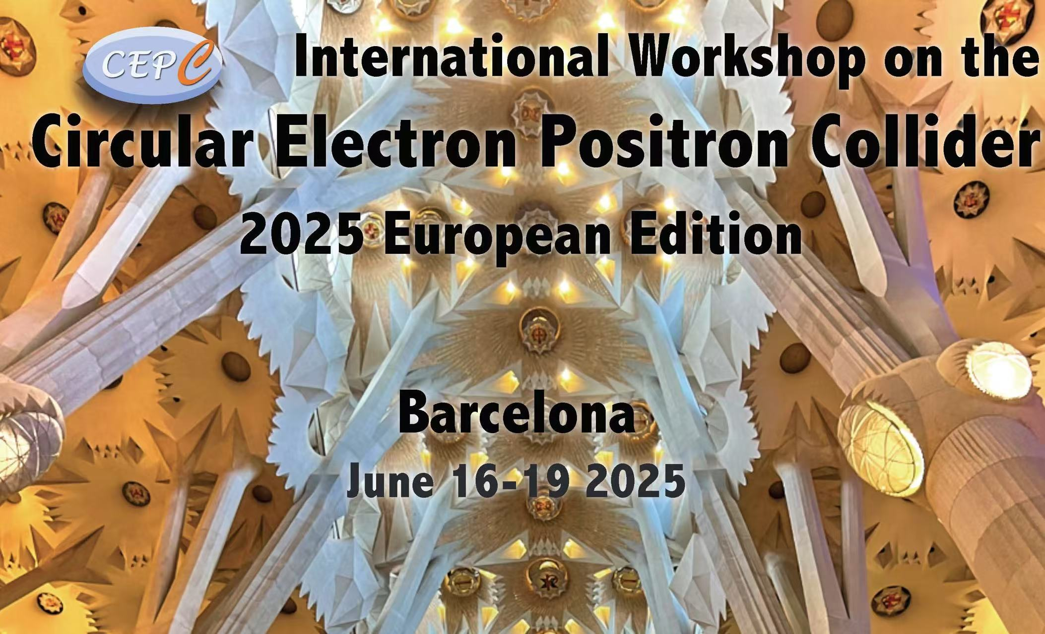
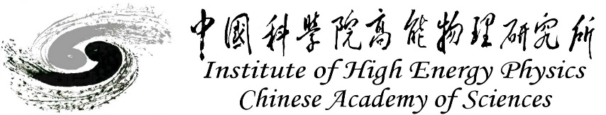
APES Development:
Progress Report & Current Status
Yuan Zhang
zhangy@ihep.ac.cn
On behalf of APES team
June 16-19, 2025, Barcelona, Spain.

Slide 2
Outline
Introduction
Modeling and Optics
Tracking and Simulation
Summary

Slide 3
Motivation
Accelerator Physics Emulation System （APES）
Supported by IHEP Innovation Fund from 2022 to 2024
To meet the requirements of beam dynamics study in CEPC
Modeling complicated lattice easily
  IR, overlapped field, …
Combined effects should be studied self-consistently
  Beam-beam interaction + impedance/feedback/lattice, …
Application of new IT technology
  CPU, Openmp/MPI -> GPU, CUDA
More user-friendly, more accurate, powerful and faster

Slide 4
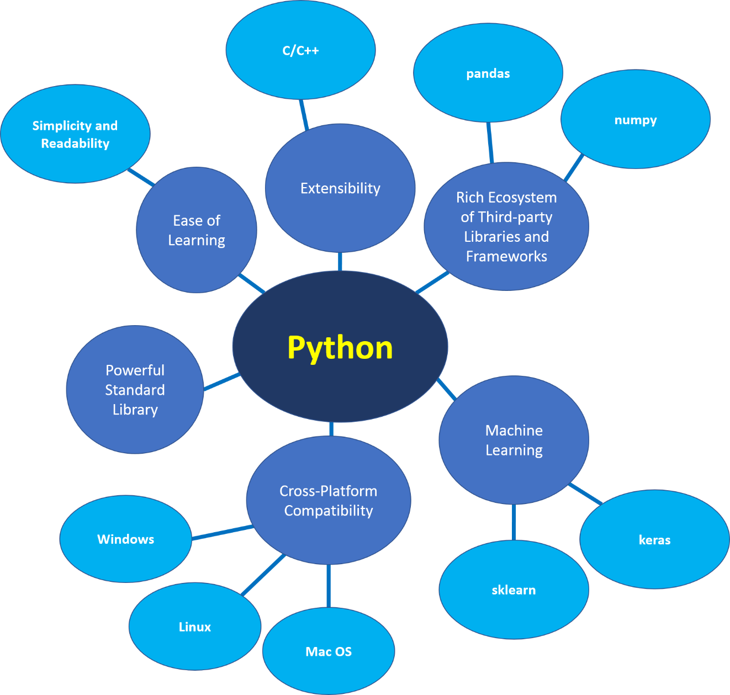
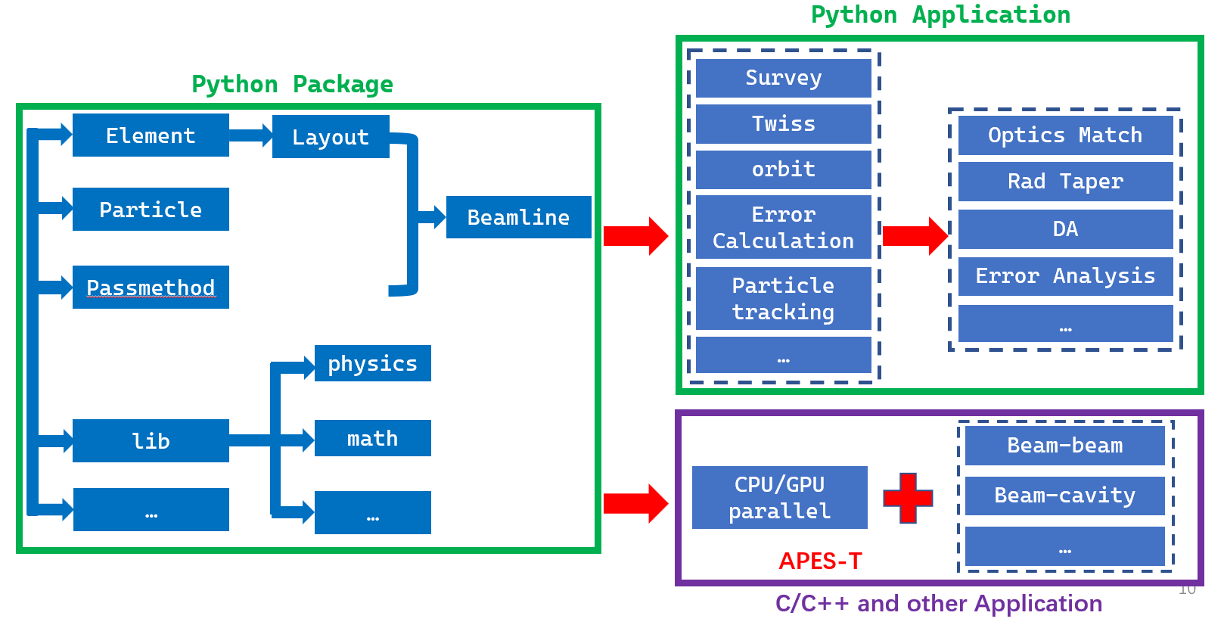
Python, C/C++
Bottom-up and top-down synchronized development
  Python-based modeling, analysis, computation
  High-efficiency Parallel Computing for Multi-Particle Tracking
  Same underlying map

Slide 5
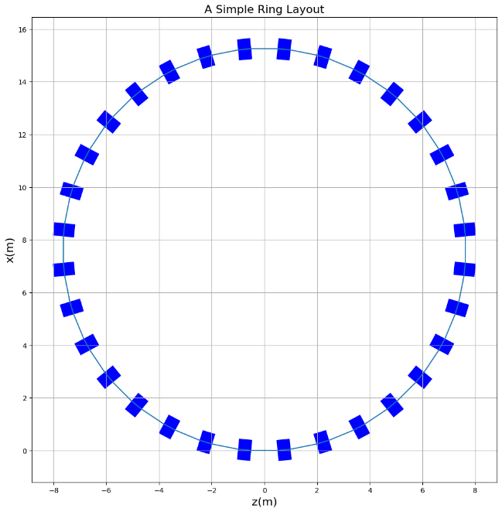
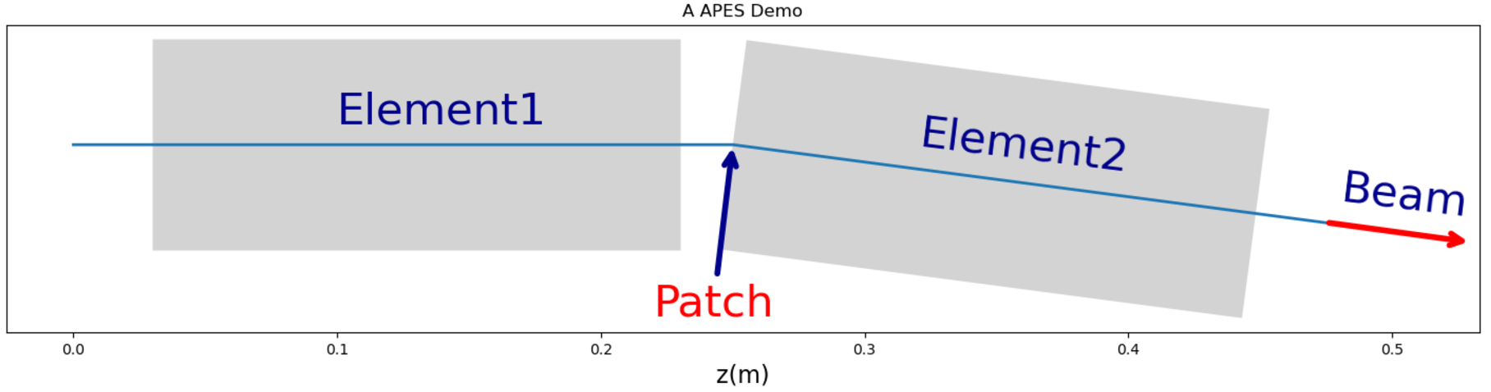
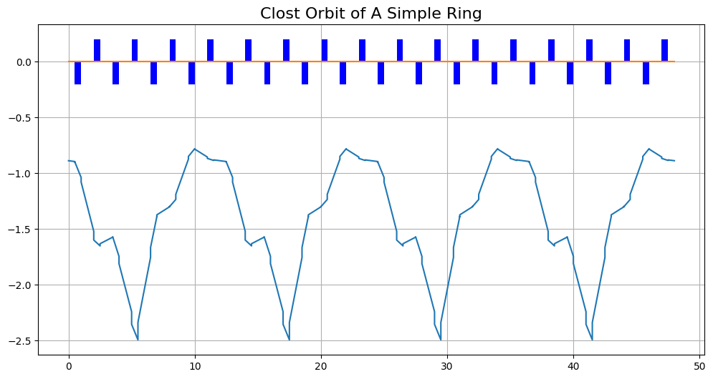
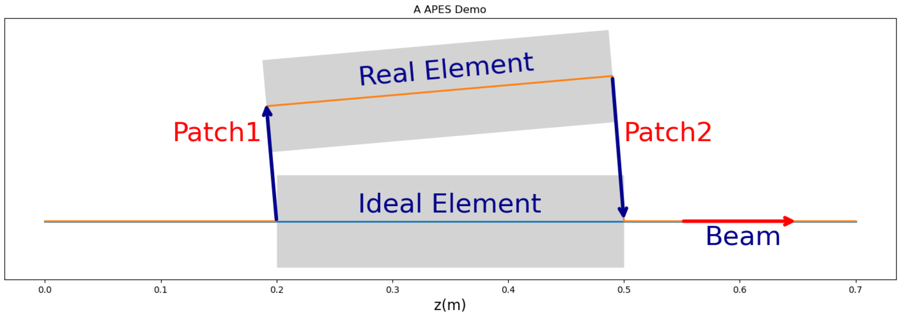
Patch coming from PTC
Mengyu Su, Weibin Liu
A ring with only Quadrupoles
Affine transformation in geometry
Maps in particle tracking
Single “Patch” affects the downstream survey.
Special installation configurations / misalignment
5

Slide 6
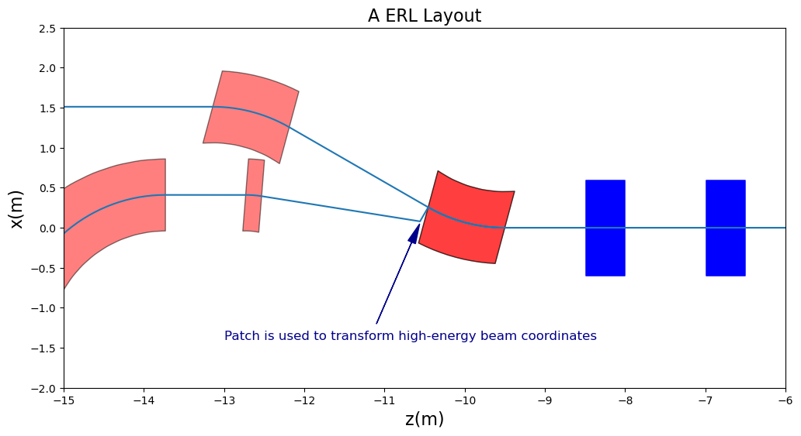
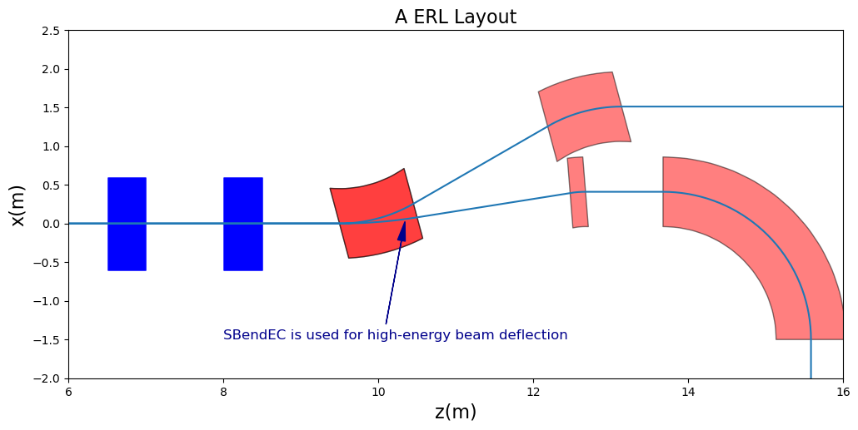
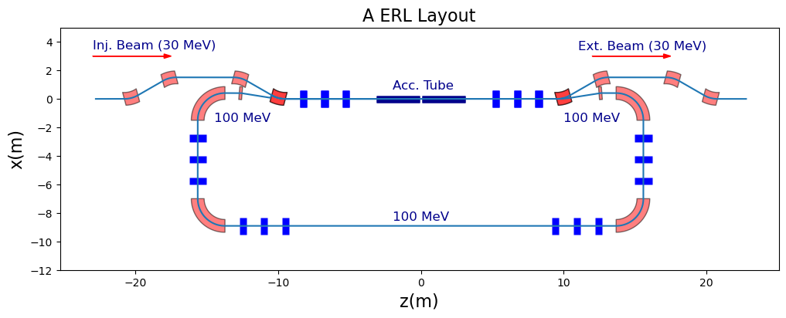
Element Container
Weibin Liu
Encapsule one or more components
Ensemble positional error for co-mounted components
Different beam go through same component
Forward or backward traversal
100MeV beam: Patch + EC
100MeV beam: EC

Slide 7
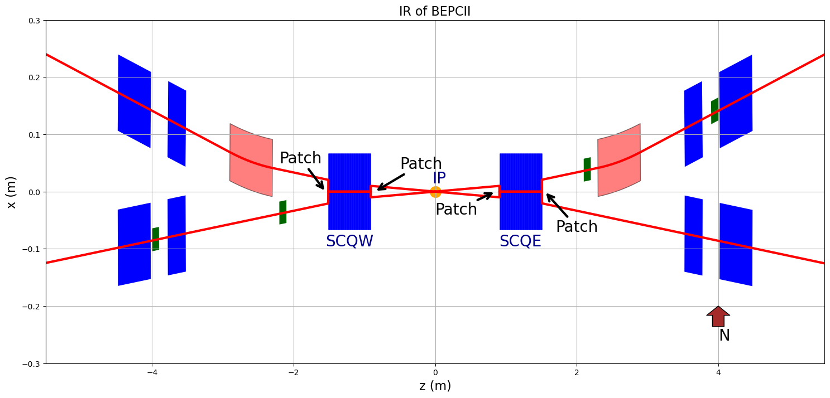
IR modeling of BEPCII
Weibin Liu
Patch1+SCQ+Patch2
e+
e-
e+
e-
e+
e-
e+
e-
SCQW
SCQE

Slide 8
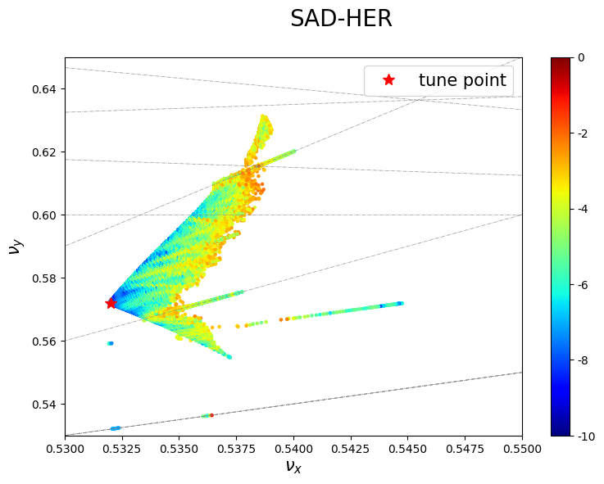
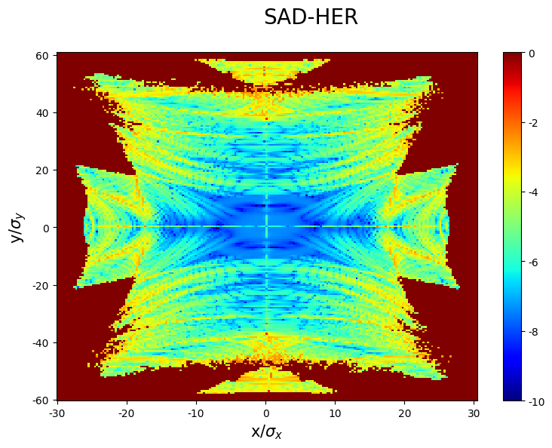
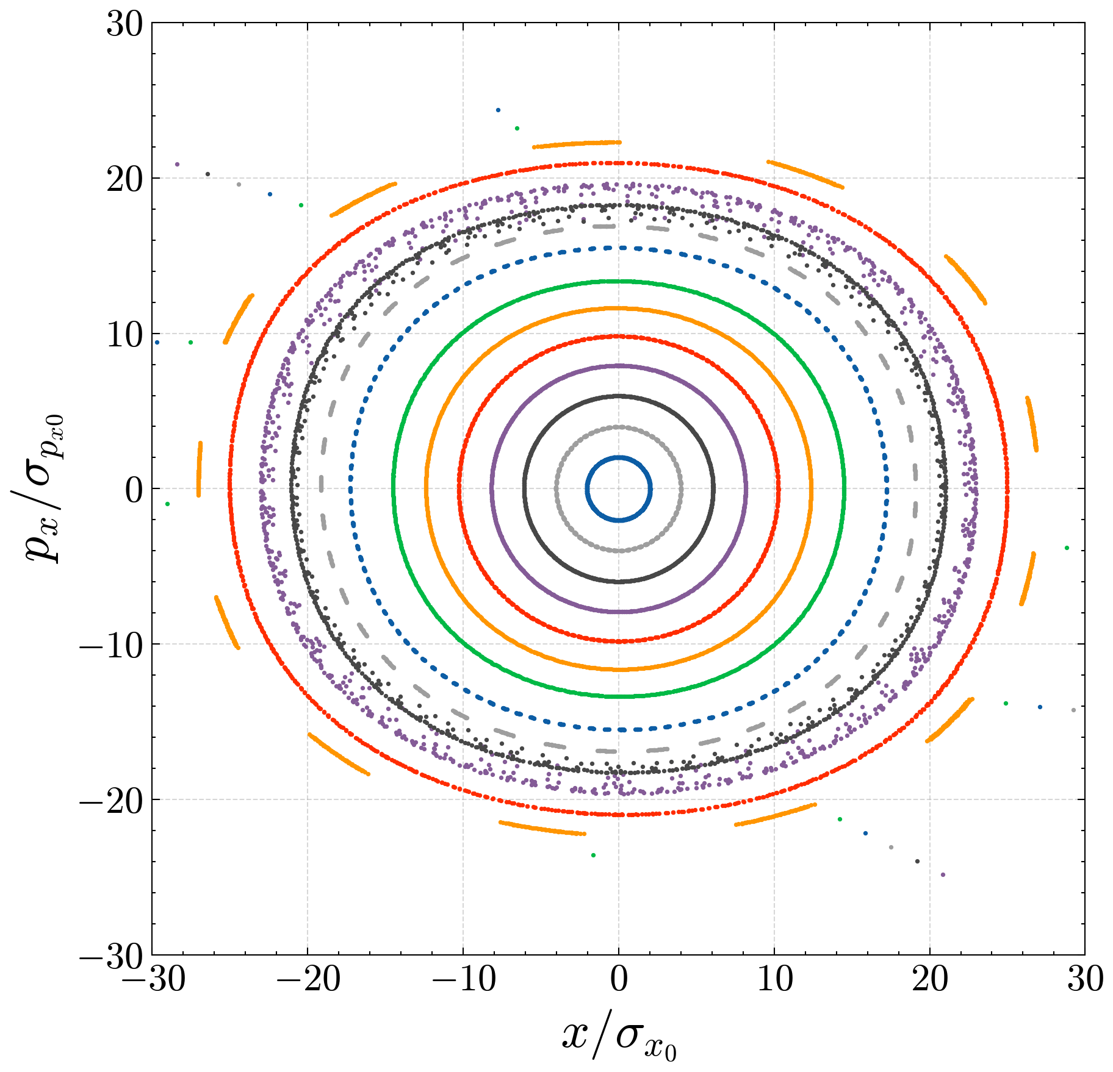
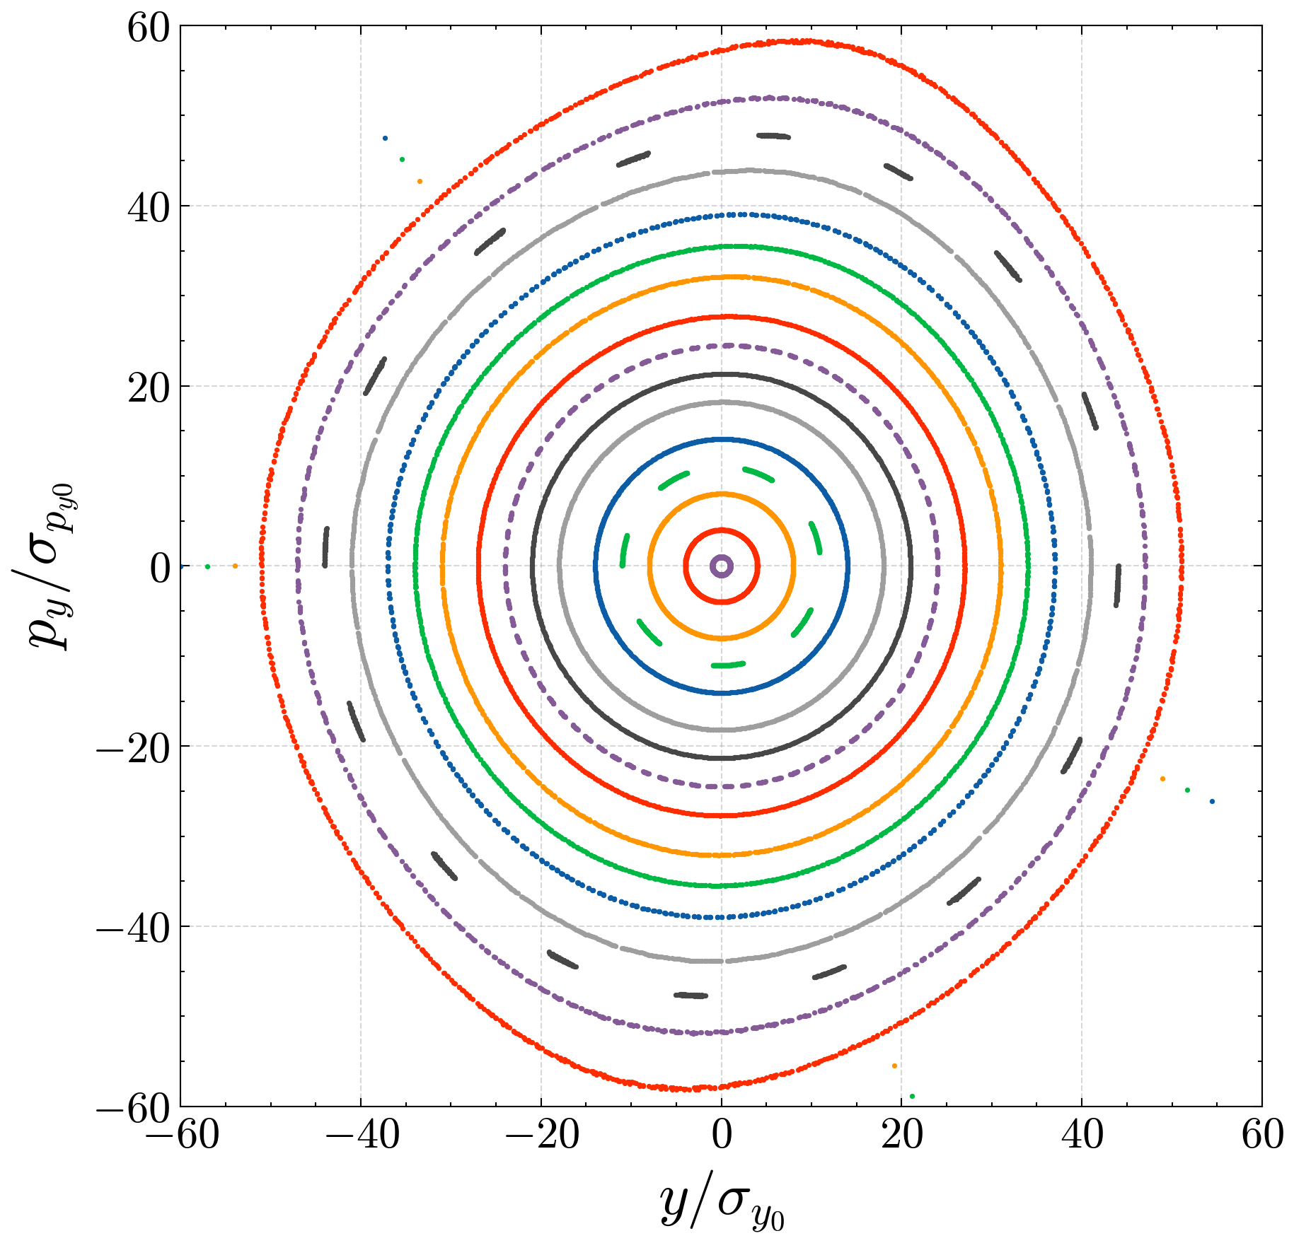
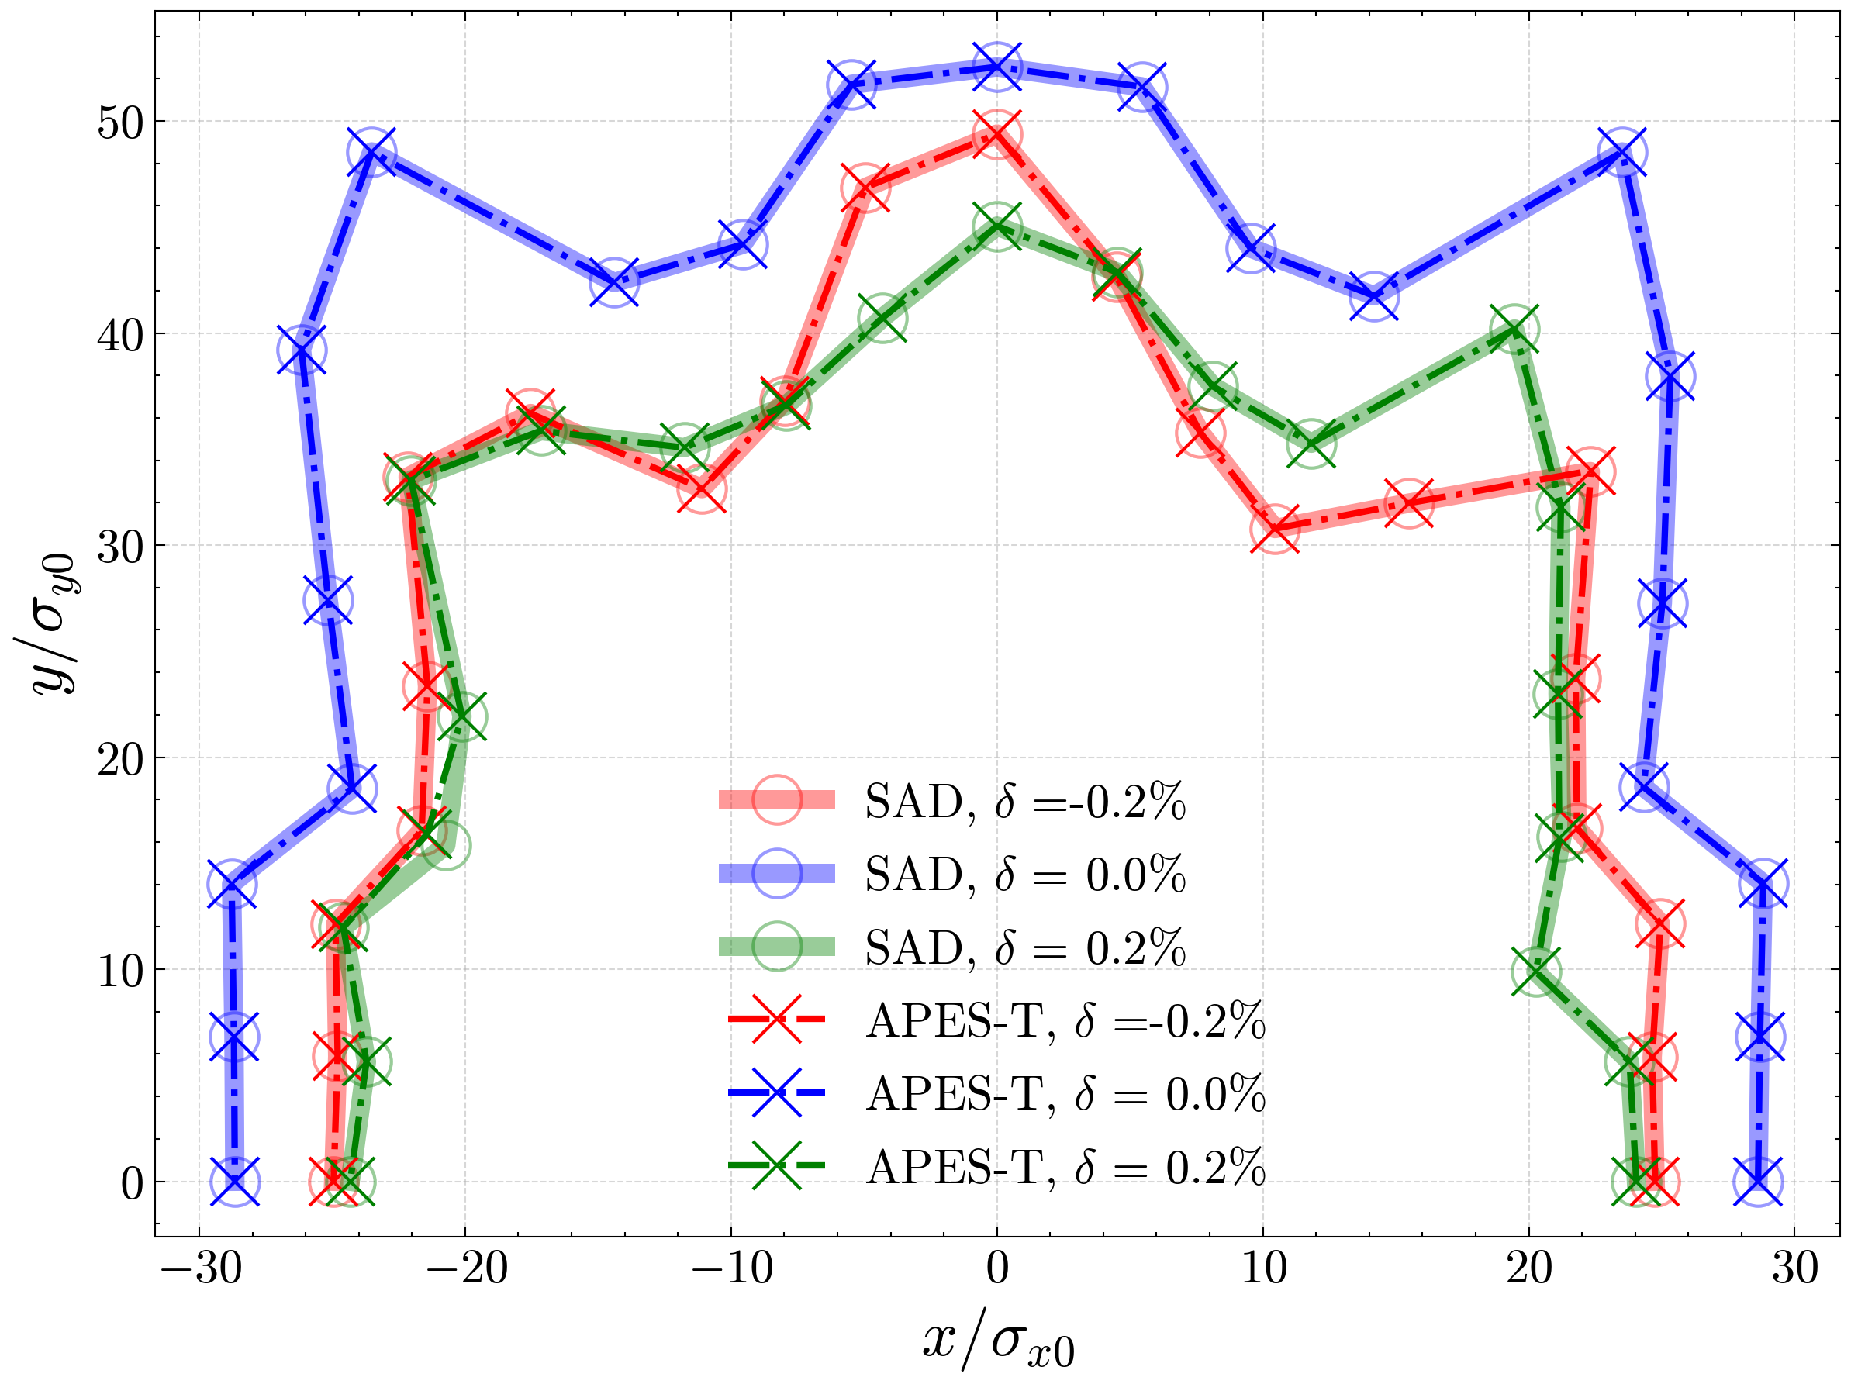

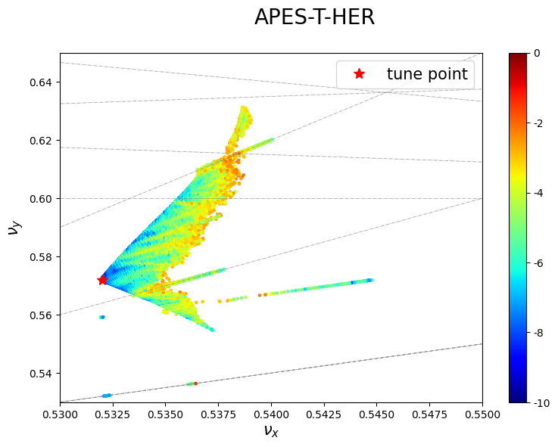
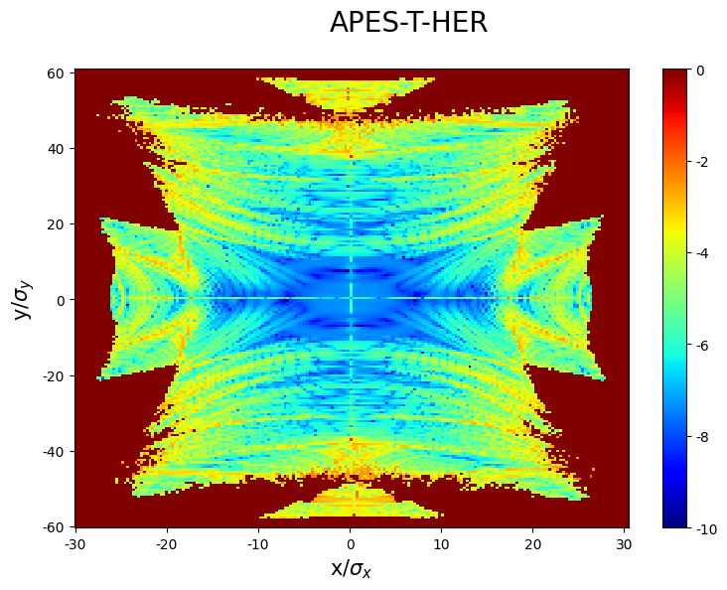
Transfer Map referring to SAD
Zhiyuan Li
6D full-symplectic tracking
Linear soft edge + nonlinear Maxwellian fringe
Field overlap of solenoid and multipoles
Benchmark of single particle tracking with SuperKEKB
Poincare Map
DA
FMA
8

Slide 9
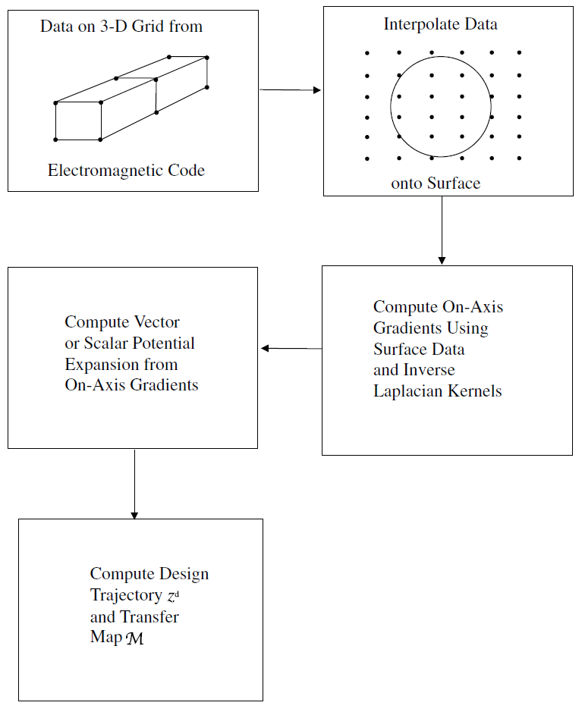
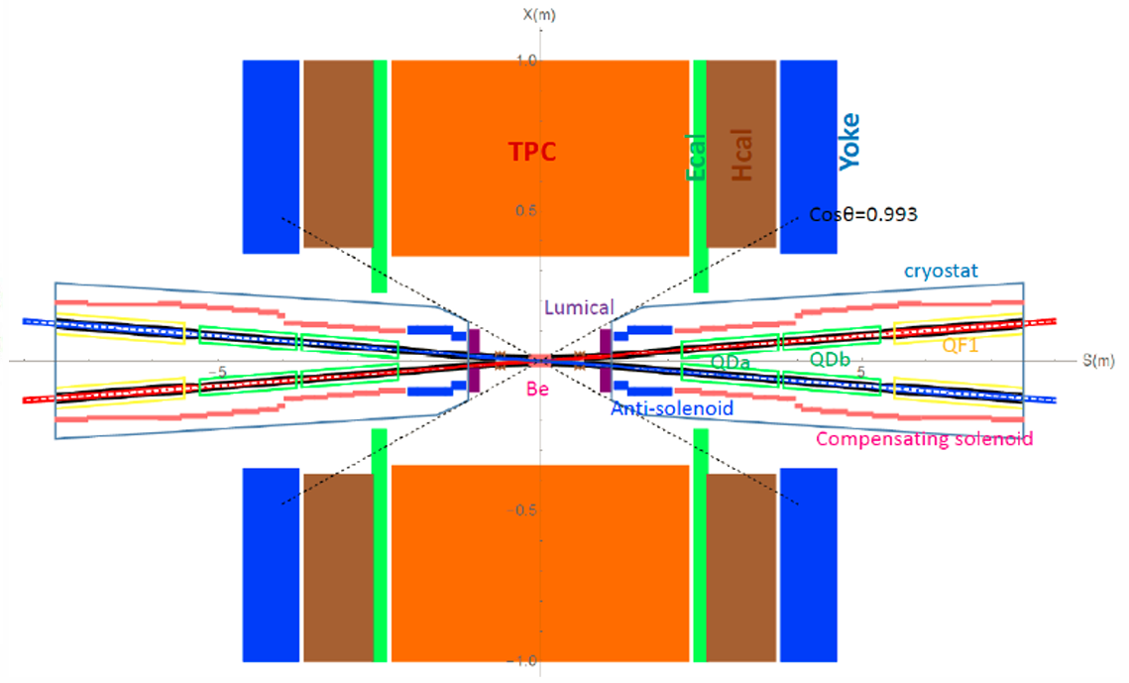
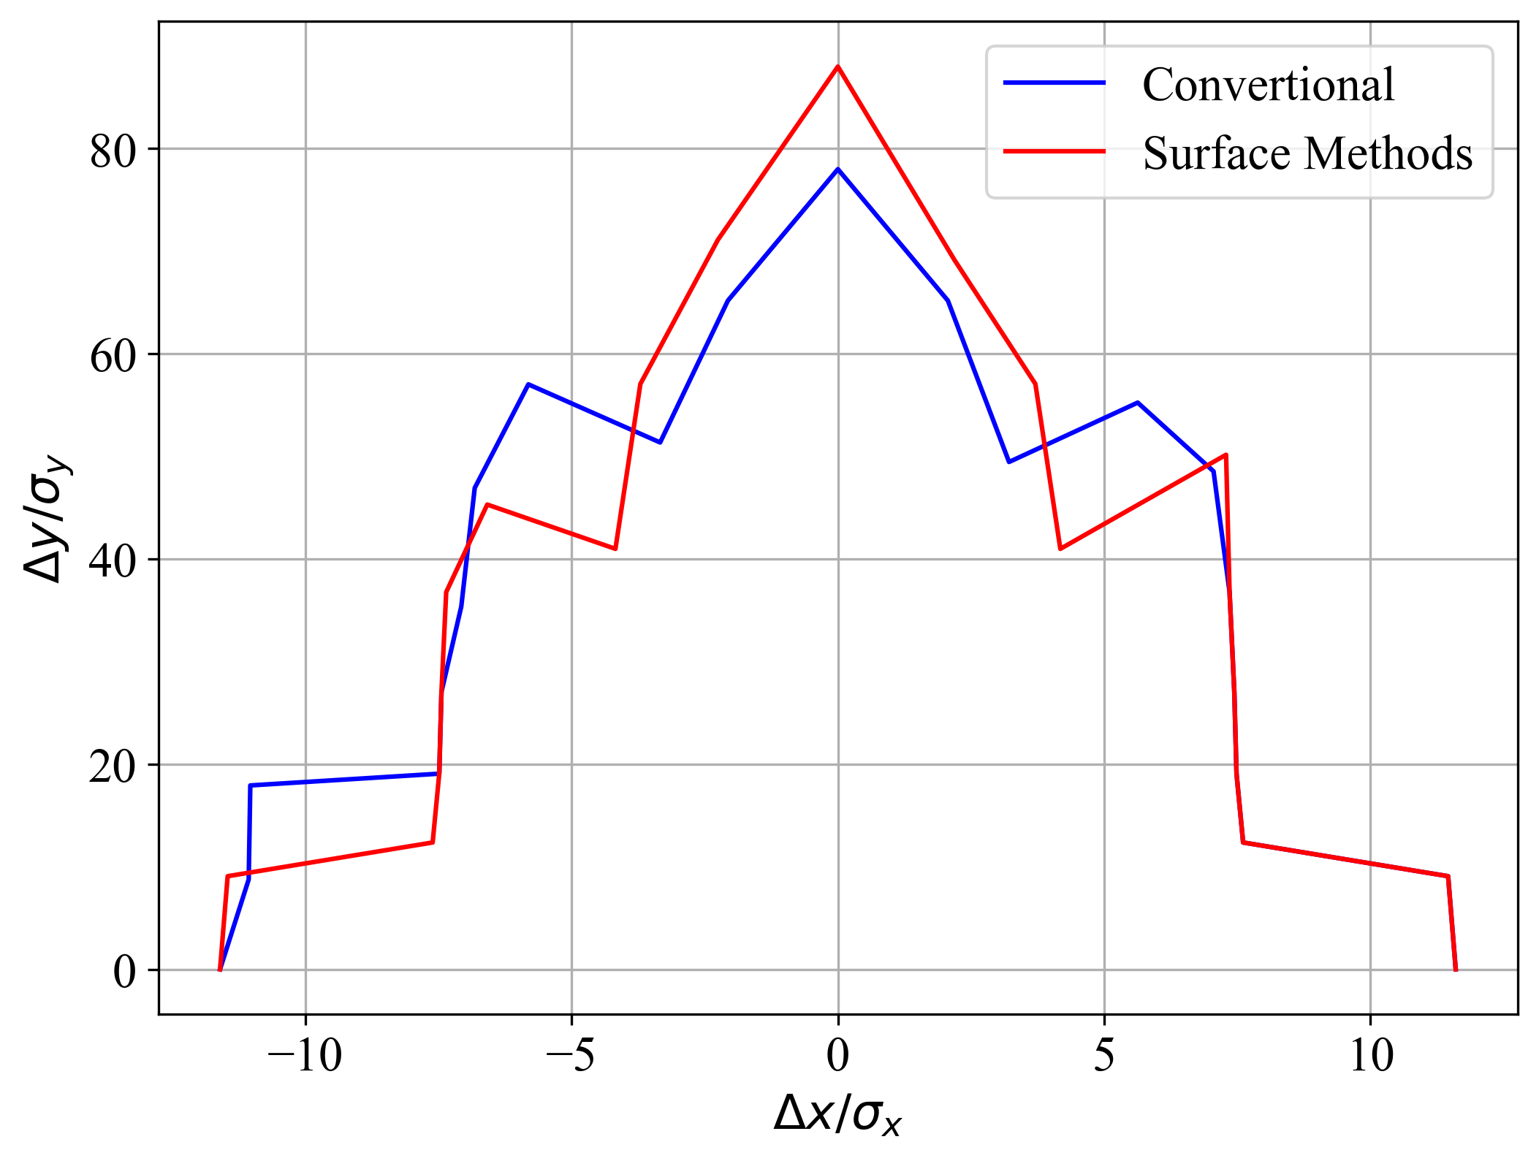
Implementation of Surface Method
Ande Ma
Exact modeling of multipoles and fringe fileld
Inverse Laplacian Kernels help reducing the field noise
Implicit symplectic integrator
Final focus region of CEPC
  6 dual-aperture SC quad
  3 T detector solenoid
  Anti-solenoid
  Dipole corrector and skewQ

Slide 10
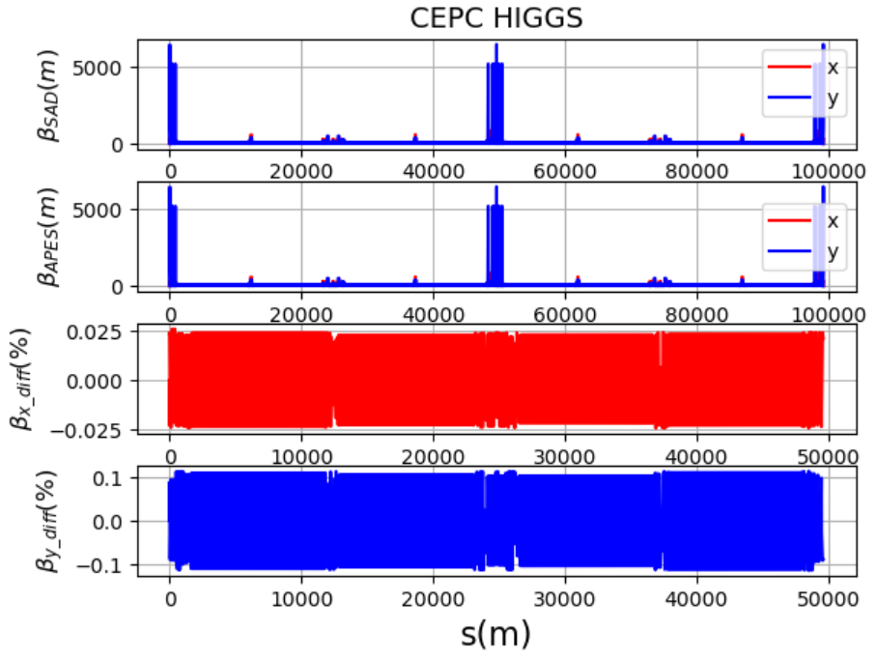
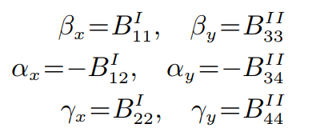
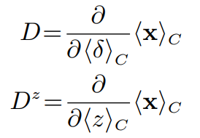


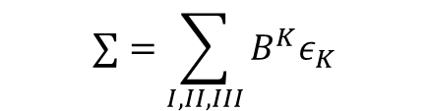
Optics function
Zhennan Chang
4D,5D and 6D with SR damping
General Twiss function
  Closed orbit
  Jacobian Matrix
  Linear Normal Form Analysis
$$∑=\sum_{I,II,III}{B^{K}ε_{K}}$$
Difference from SAD ~ 0.1%

Slide 11
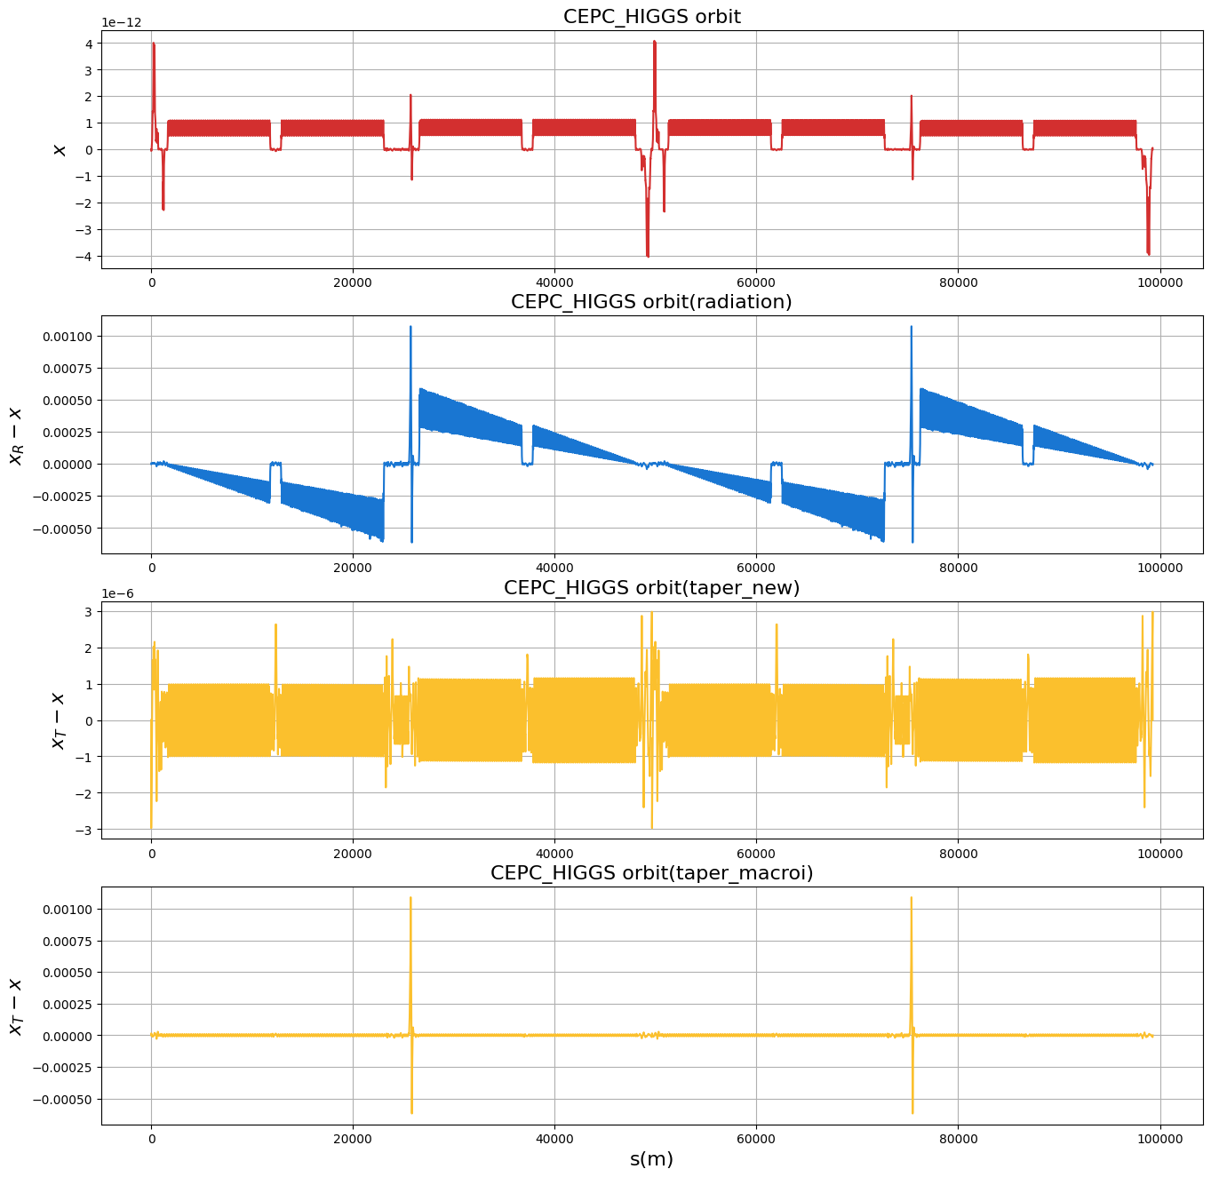
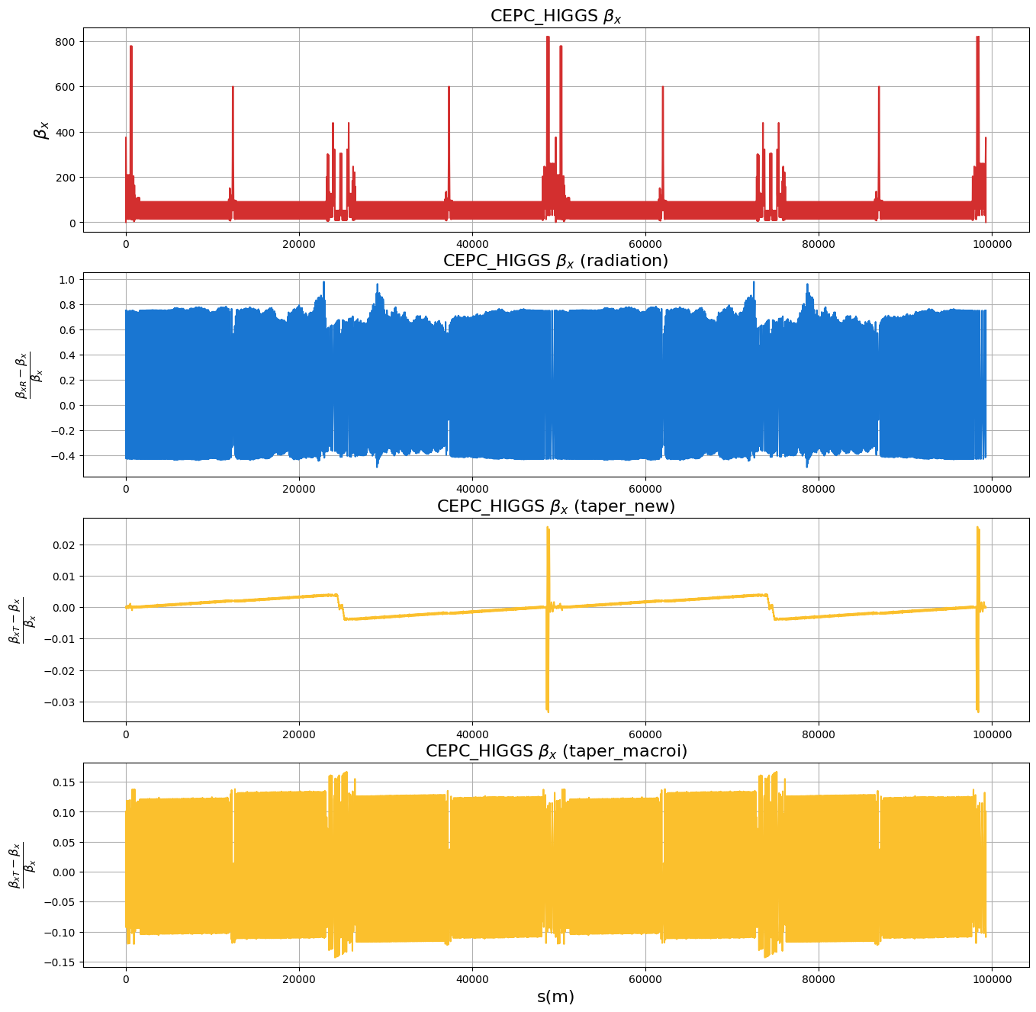








Synchrotron Radiation
Energy deviation along the ring
Magnet tapering mitigate the orbit distortion
Some specific magnets may not be tapered
Yaliang Zhao, Zhennan Chang
w/o SR
${10}^{−12}$ m
$$\frac{Δβ_{x}}{β_{x}}\sim 80\%$$
w/ SR, w/o Tapering
${10}^{−3}$ m
$$\frac{Δβ_{x}}{β_{x}}\sim 2\%$$
w/ SR, w/ Tapering
${10}^{−6}$ m
w/ SR, w/ local Region Un-Tapering
${10}^{−3}$ m
$$\frac{Δβ_{x}}{β_{x}}\sim 10\%$$
Closed Orbit
$$β_{x}$$

Slide 12
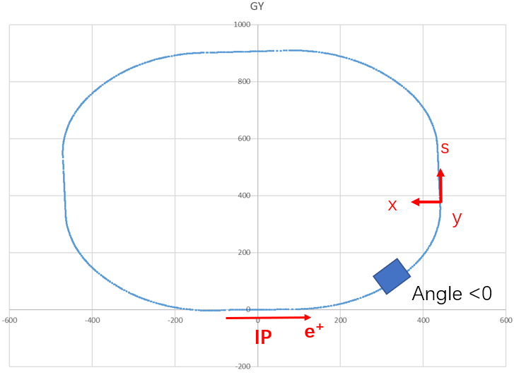
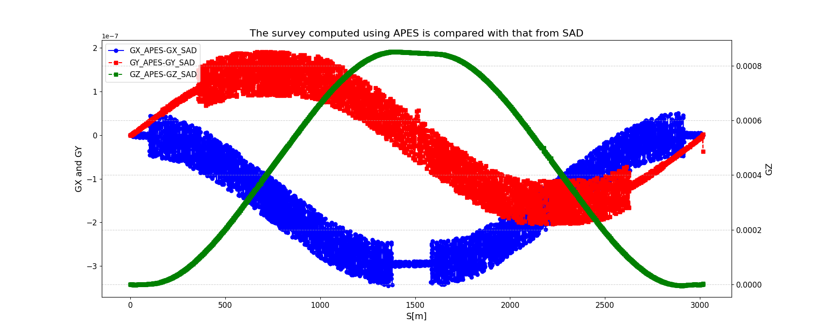
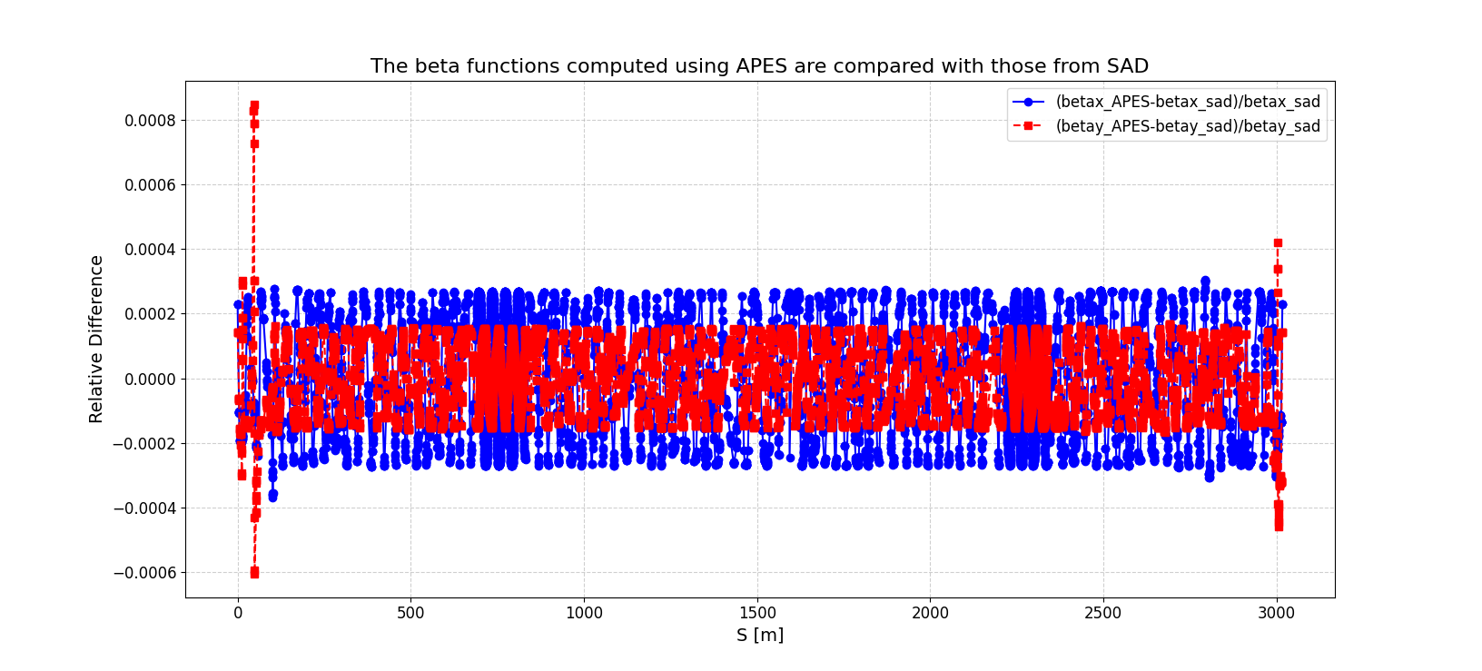

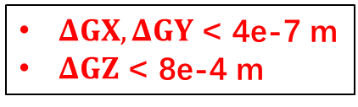
Modeling of SuperKEKB
Both APES and SAD:
(x,y,s)- RHS
But …
Yuanyuan Wei, Weibin Liu
Conversion from SAD to APES:
Opposite sign of particle coordinates (x/x’/y/y’)
Survey defined by solenoid is replaced by Patch
HSBend with ROTATE=-90 -> VSBend
HSBend ANGLE -> -ANGLE
Reverse element with ‘-’ to normal element
Sign change of K0/K2/K4/K6 … and corresponding skew component
APES
SAD
$ΔGX,ΔGY$ < 4e-7 m
$ΔGZ$ < 8e-4 m
$\frac{Δβ_{x,y}}{β_{x,y}}<0.001$, $Δν_{x,y}<0.001$

Slide 13
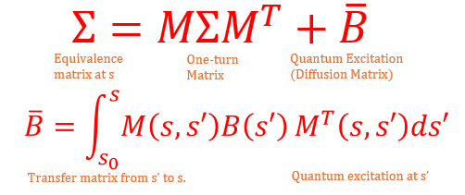
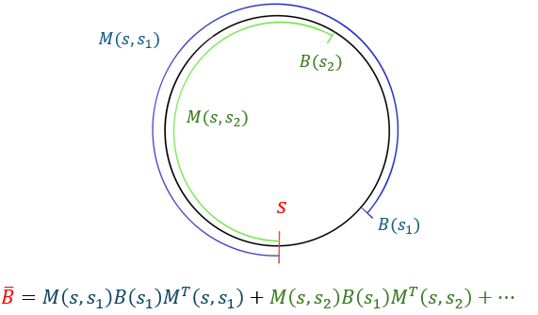
Emittance
Yixian Dai
HEPS | Elegant | APES | Difference
Damping in x | 4.178e-4 | 4.187e-4 | 0.23%
Damping in y | 2.201e-4 | 2.199e-4 | ~0
Damping in z | 2.424e-4 | 2.412e-4 | 0.52%
Emittance x | 3.482e-11 | 3.479e-11 | 0.096%
Energy spread | 1.018e-3 | 1.020e-3 | 0.20%
Ohmi’s envelope method
CEPC HIGGS | SAD | APES | Difference
Damping in x | 7.523e-3 | 7.550e-3 | 0.37%
Damping in y | 7.523e-3 | 7.550e-3 | 0.36%
Damping in z | 1.488e-2 | 1.510e-2 | 1.49%
Emittance x | 6.648e-10 | 6.646e-10 | 0.029%
Energy spread | 1.013e-3 | 1.013e-3 | 0.003%

Slide 14
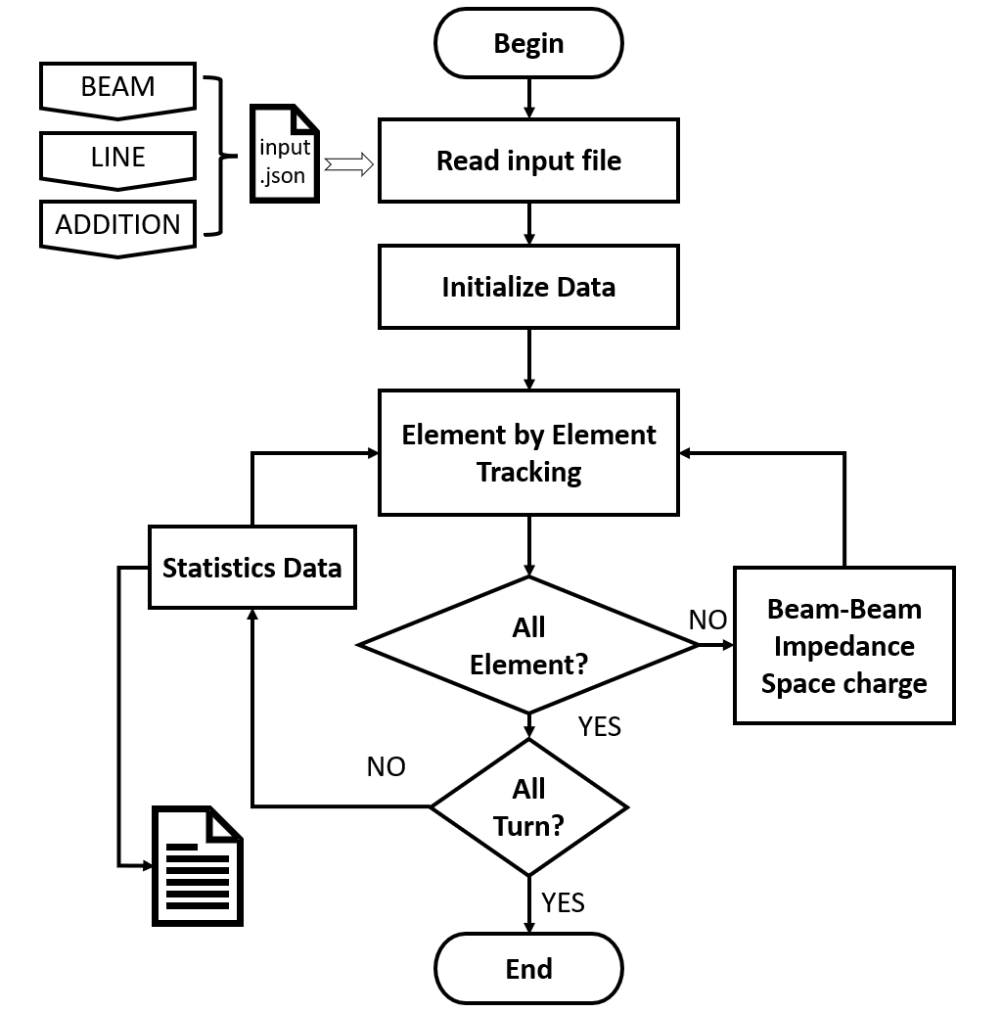
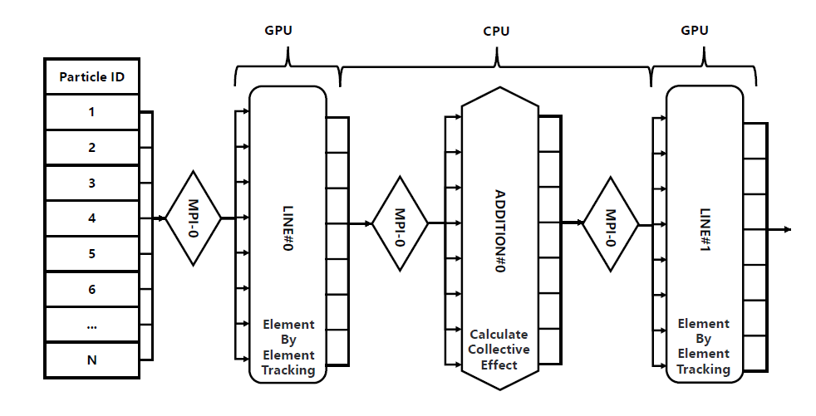
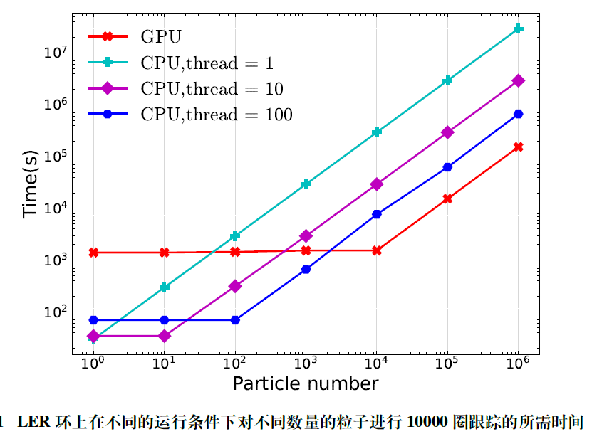
Multi-particle tracking
Zhiyuan Li
Focus on High-performance simulation
Element-by-element in lattice
Synchrotron Radiation
Strong-strong beam-beam interaction
Feedback
Collective effects
  Short-range Wakefield
  Space Charge (Ohmi)
  Beam-Cavity
  Electron Cloud
  Ion effects
  Intra-beam Scattering
  …
CUDA+MPI
GPU: NVIDIA A100 GPU
CPU:2 × Intel(R) Xeon(R) Gold 6348

Slide 15
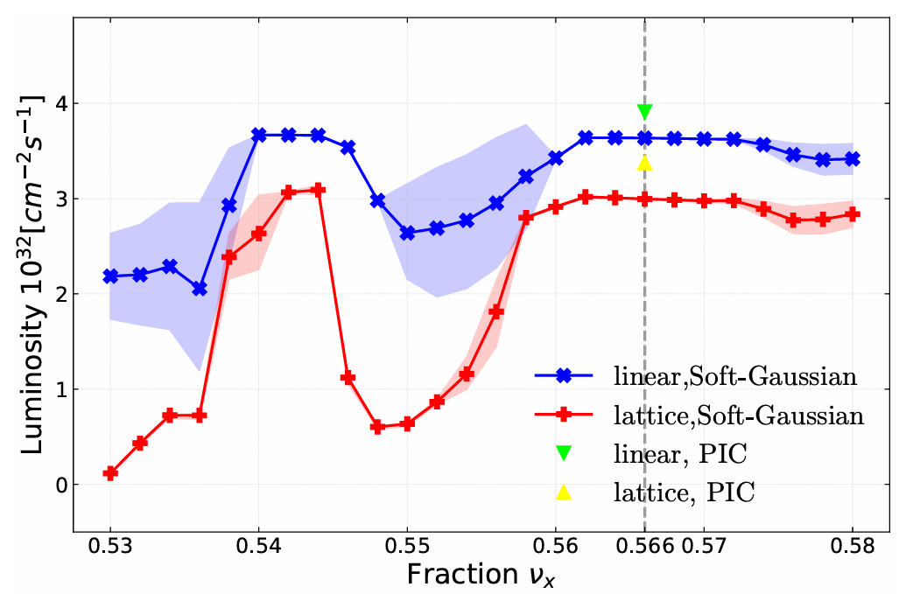
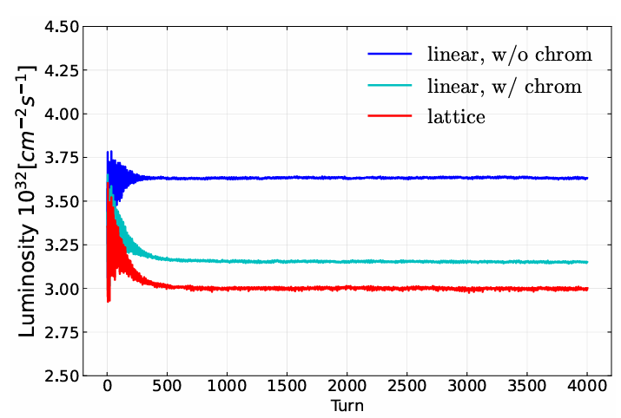
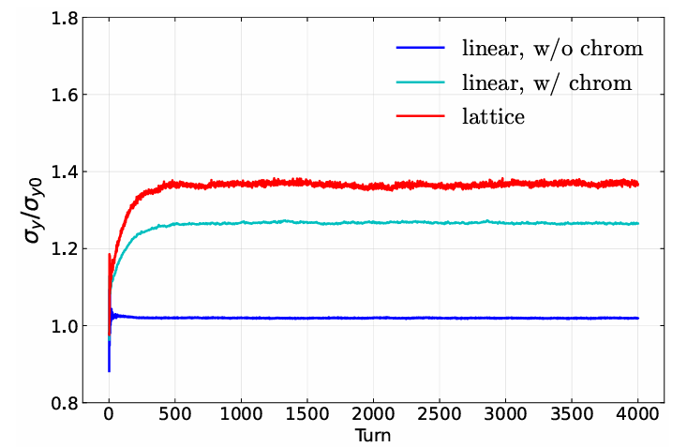
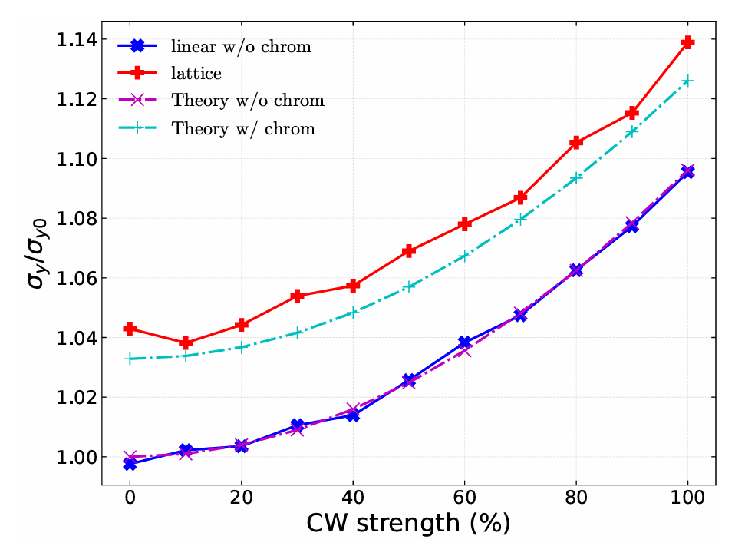

Simulation of CEPC Higgs (symmetric)
Zhiyuan Li etal., NIMA 1064 (2024) 169386
16% luminosity loss due to lattice
chromaticity and crab-waist induce the reduction
w/o collision

Slide 16
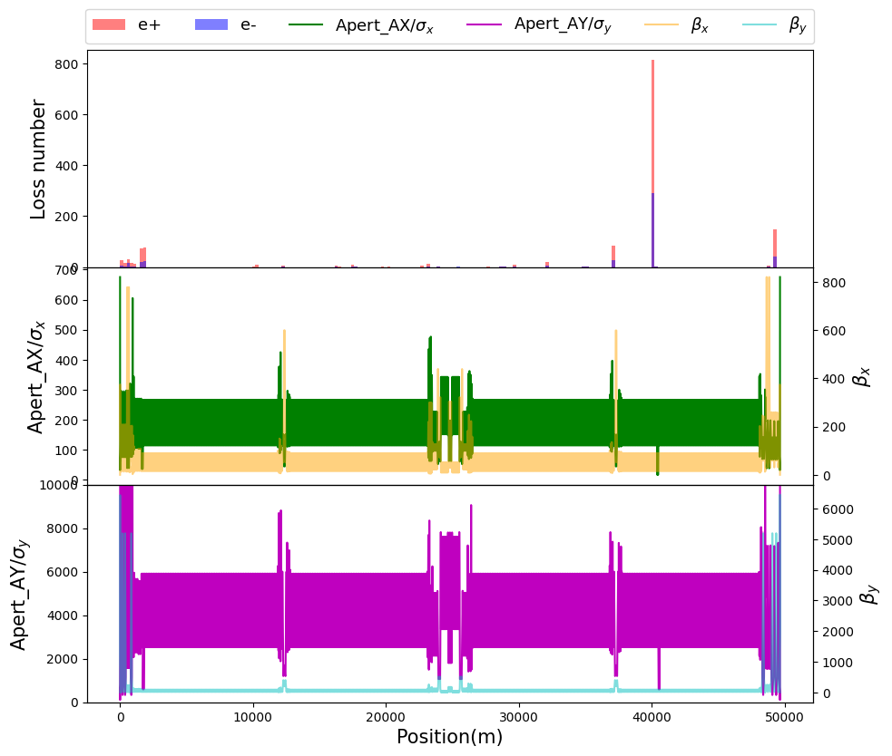
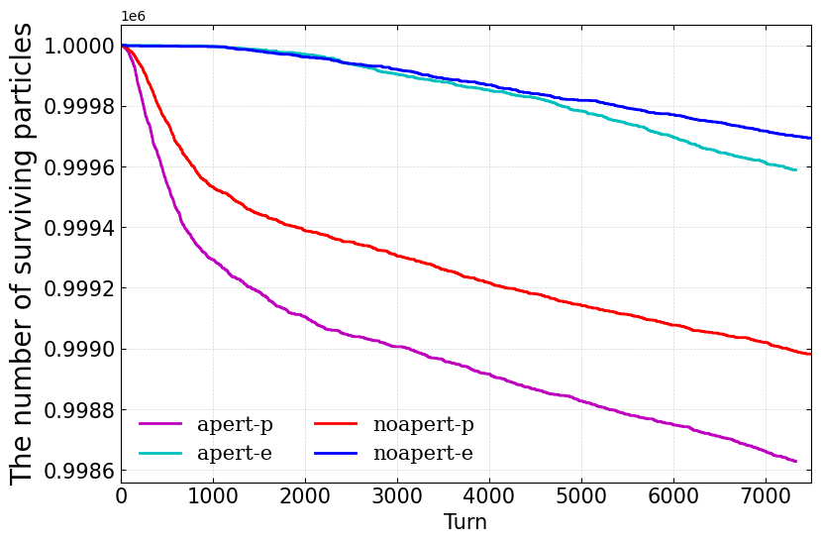
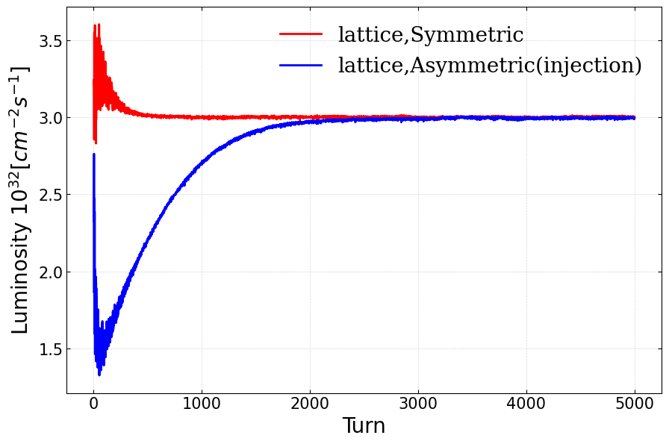
Simulation of Swap-out injection (Higgs)
Zhiyuan Li
Self-consistent simulation of injection !!!
e+(inj.) / e-
w/o apert: 39/42(min)
w/ apert: 29/37(min)
Initial beams: e+ (collider SR equilibrium) vs e- (booster SR equilibrium)
Luminosity: same between symmetric and asymmetric collision
Clear lifetime reduction (e+) with physical aperture

Slide 17
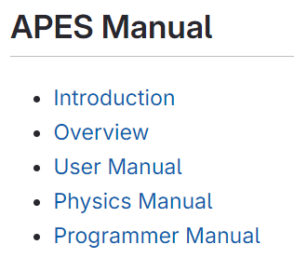
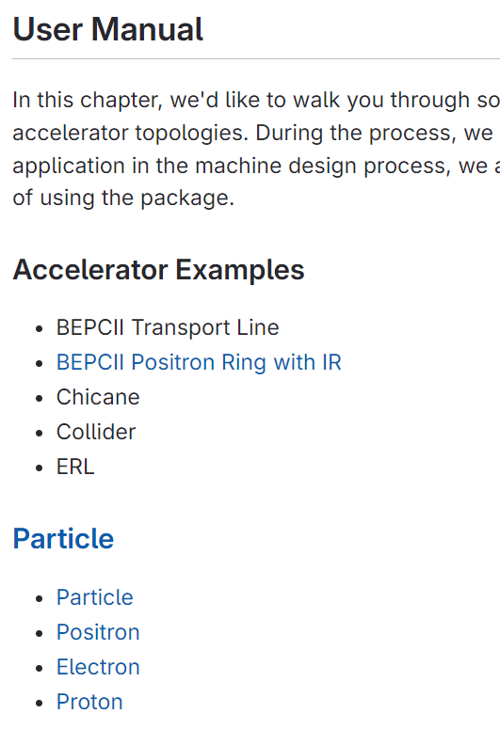
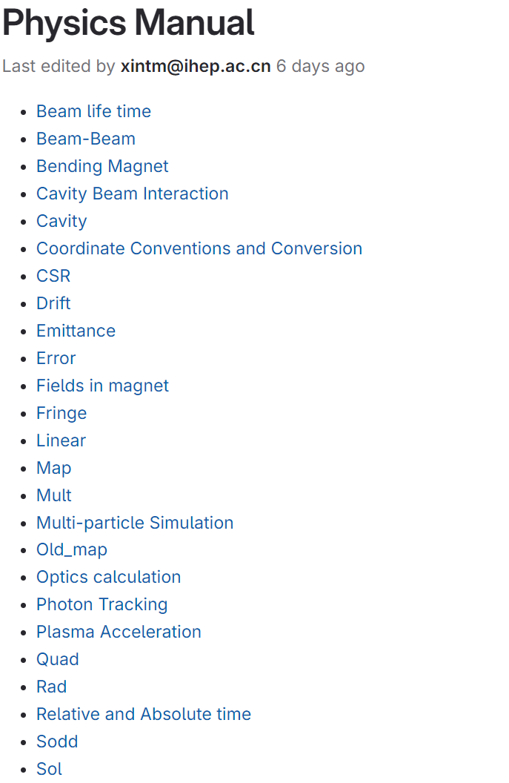

Manual

Slide 18















Team
No full-time staff
1 full-time postdoc (July. 2024-June.2026)
Great help from K. Ohmi, E. Forest, K. Oide and D. Zhou
Weekly meeting (> 3 Years)

Slide 19
What to do next ?
More collaboration with CEPC design team
Optimize the Matching module
Development of More Features
Beyond CEPC

Slide 20
Summary
APES is becoming more and more productive
APES is is under active development
Your usage feedback is greatly appreciated and helpful
Thanks the hard work of APES team!

