Slide 1
Investigation on injection-related beam loss at SuperKEKB
Meng LI
IHEP (Beijing) and IJCLab (Orsay)
Acknowledgements
→ Jie Gao, Dou Wang (IHEP Beijing), Philip BAMBADE (IJCLab Orsay)
Naoko Iida, Yoshihiro Funakoshi, Yukiyoshi Ohnishi, Hiroyuki Nakayama, Hiroshi Kaji, Kenta Uno, Taichiro Koga (KEK Tsukuba)
2025 EU CEPC workshop, Barcelona, Spain, June 16-19, 2025

Slide 2
Outline
Introduction of injection issues at SuperKEKB
Key findings for HER
Conclusions and Outlook

Slide 3
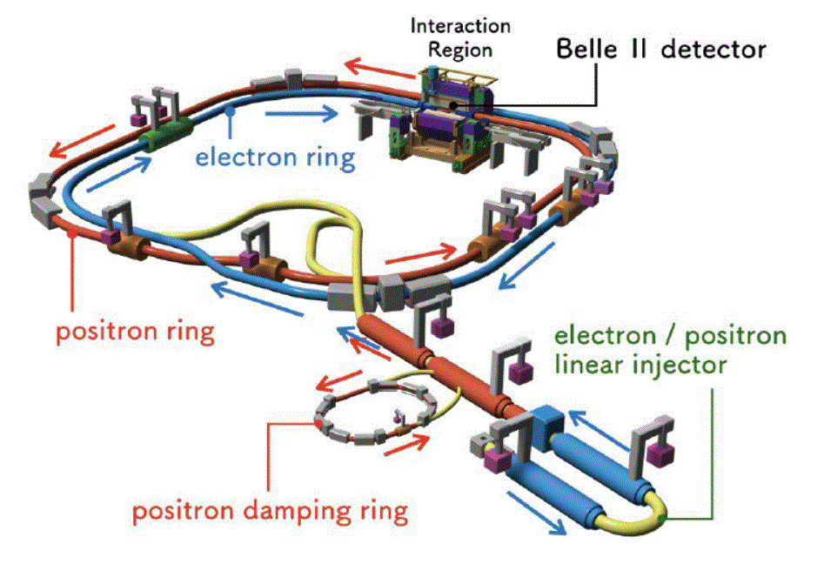
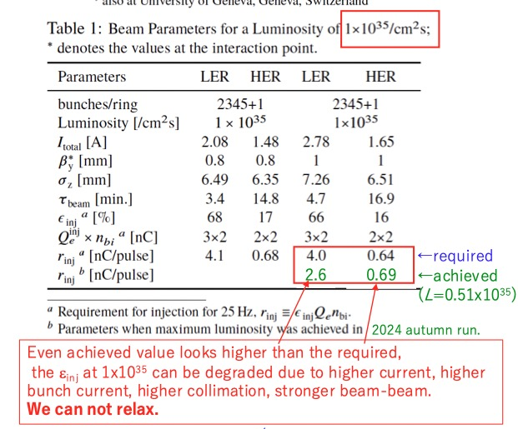
SuperKEKB top-up injection / requirements
N. Iida
high currents → reduced lifetimes → tried during 2024c run
High luminosity
→ Injection may strongly limit higher luminosity
Small $β_{y}^{∗}$ → reduced DA → tried 0.8mm during 2022ab run
3

Slide 4
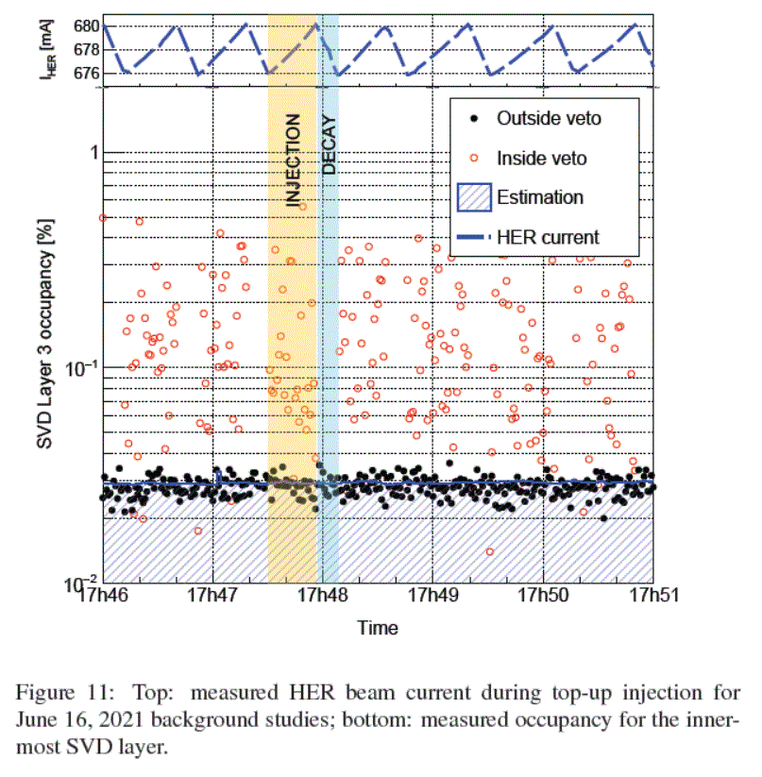
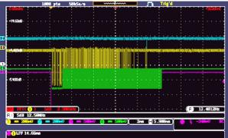
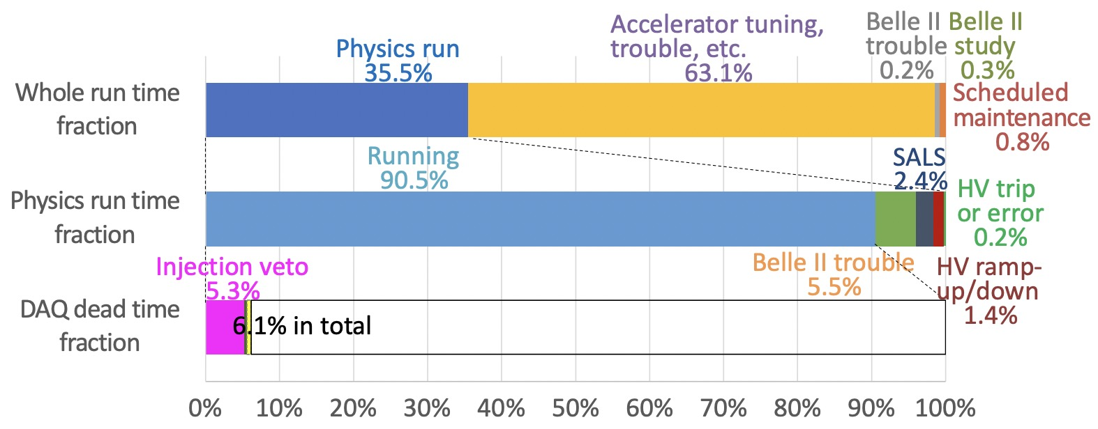
Injection BG and BelleII DAQ
Huge background appear just after beam injection
-Belle II BG level is high every turn(10us) when the injected beam pass through Belle II
-It was not expected that BG duration continues more than 10ms (At belle, it was ~3ms)
To avoid DAQ crash, trigger is vetoed for a while after injection (injection veto)
-by beam injection, instantaneous trigger rate ~100kHz and DAQ crashes
-injection veto causes large DAQ deadtime of 5~15% → it is important to minimize BG duration for data taking efficiency
Injection-related issues are expected to become more severe as the beam intensity increases.
K. Uno
-ECLBG –Injection Veto
～10ms
SVD first layer occupancy
ECLTRG injectionBG duration
Detailed injection-related beam loss and background simulation is essential for improving injection efficiency and BG
-study the time structure of injection losses and their dependence on machine parameters
4

Slide 5
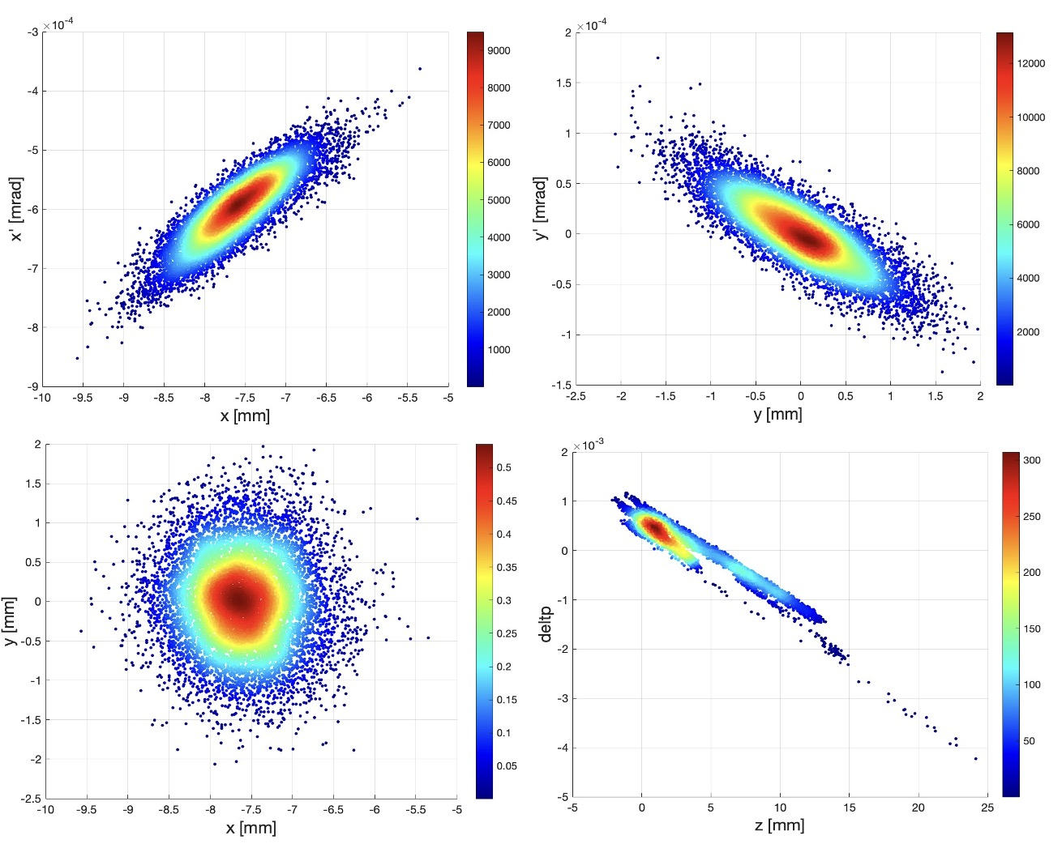
Injection simulation based on realistic operation settings
Lattice: HER_CW60_0.9mm-can_rev.sad: $β_{x}^{∗}=60mm, β_{y}^{∗}=0.9mm, \text{crab} \text{waist}\text{=60\%}$ (from Ohnishi-san)
Injection distribution (from Yoshimoto-san) + emittance adjustments (${γε_{x}}/{γε_{y}={200μm}/{150μm}}$) + injection error (${2J}_{x}=0.58μm$)
Beam-beam(weak-strong model)
$N_{p}=3.31×{10}^{10}→I_{b}=0.5mA→ξ_{y}=0.017, ξ_{x}=0.010$ (based on 2024-6-27 operation emittance and bunch current)
Realistic IR beam pipe setting + Collimator (2024-06-26)
Machine error: sextupole vertical mis-alignment ($55μm Gauss random→$ global coupling: ${ε_{y}}/{ε_{x}=0.6\%}$)
manufactory error from cancel coils(correct leakage field from QC1P in the LER)
Bunch-by-bunch feedback(damping time=0.5ms) $→$ Gaussian stored beam also included
5

Slide 6
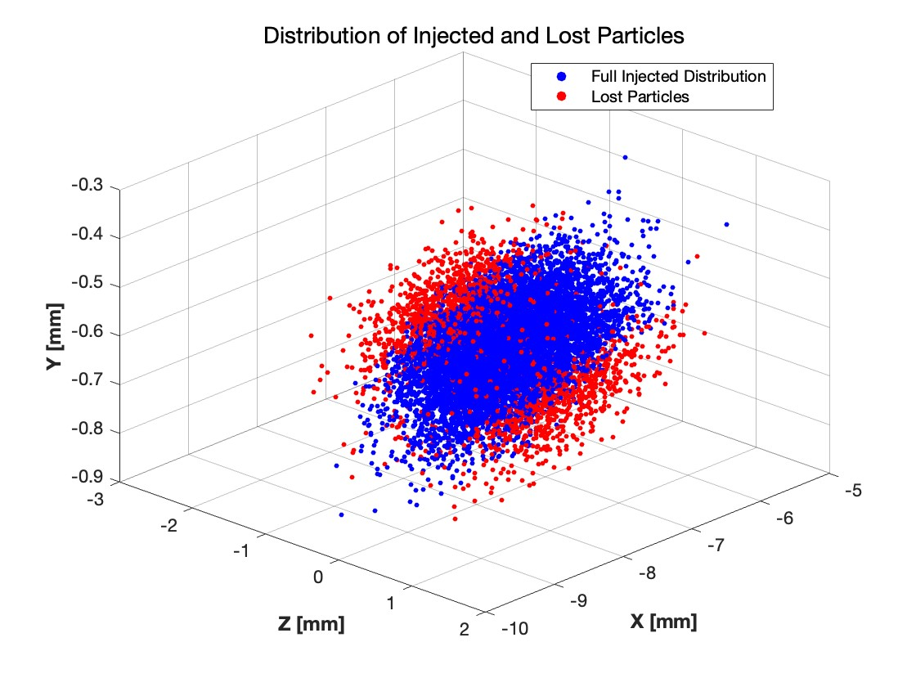
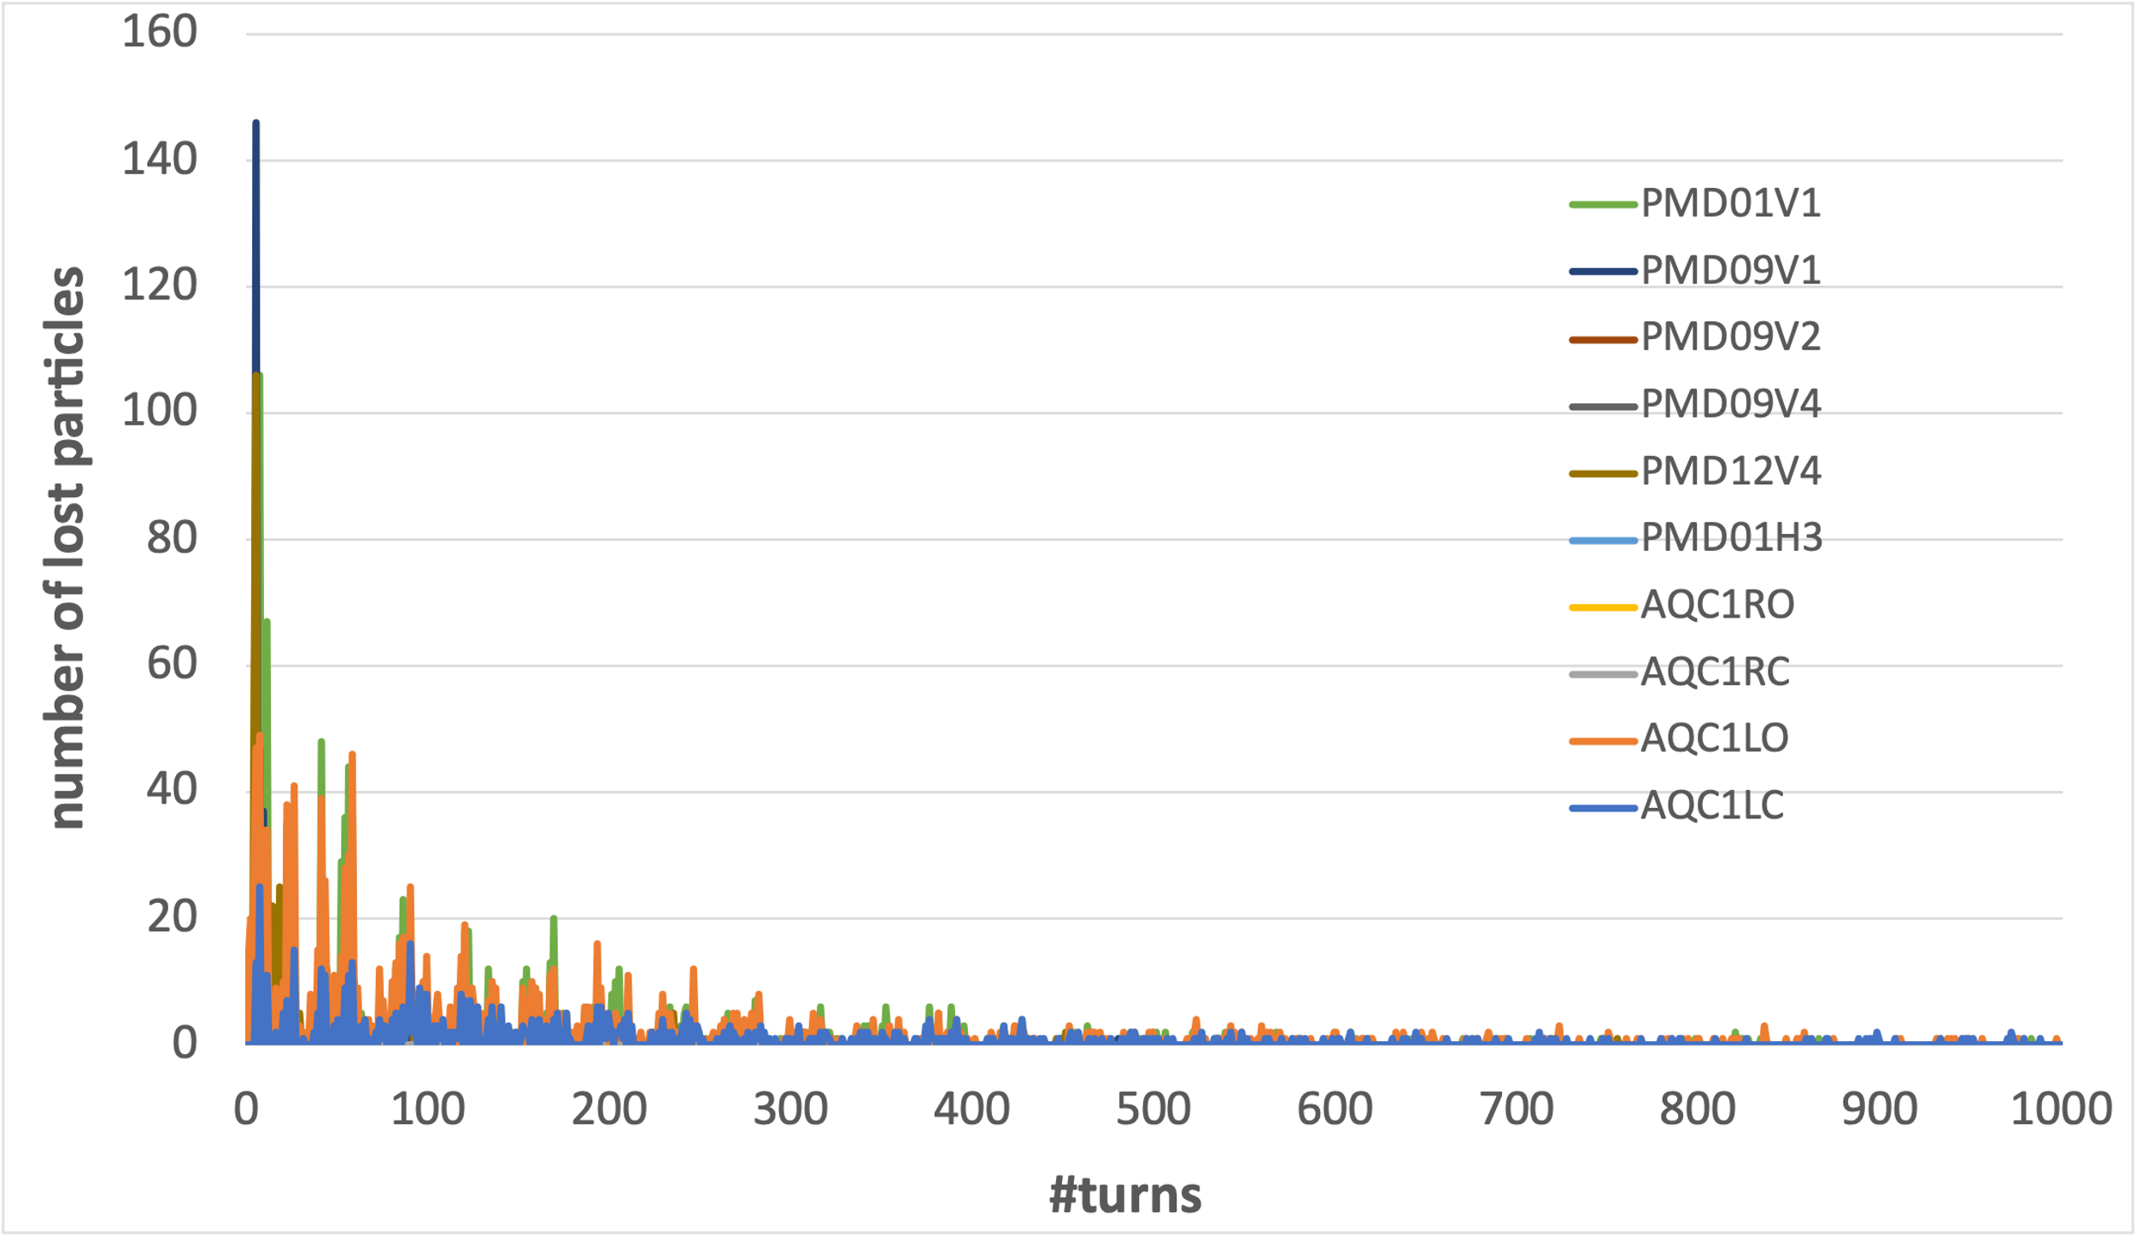
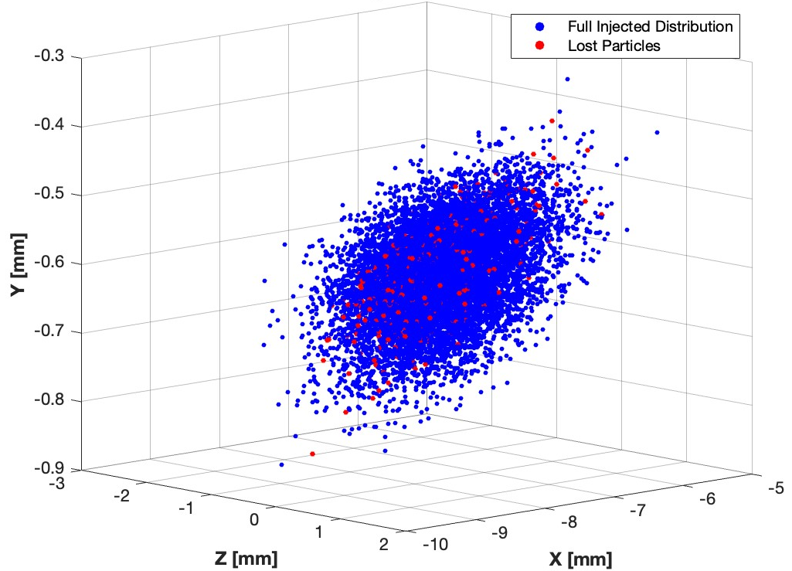
Injection efficiency and beam loss
A: Large rapid beam loss
A: Large rapid beam loss
originate from the edge of bunch
B: Small continuous beam loss
B: Small continuous beam loss
There are 2 different types of beam loss:
1) large and fast beam loss in the first 100 turns(30%) →injection efficiency
2) small and continuous beam loss until 1000 turns(10%) →injection BG duration
originate from the beam core
6

Slide 7
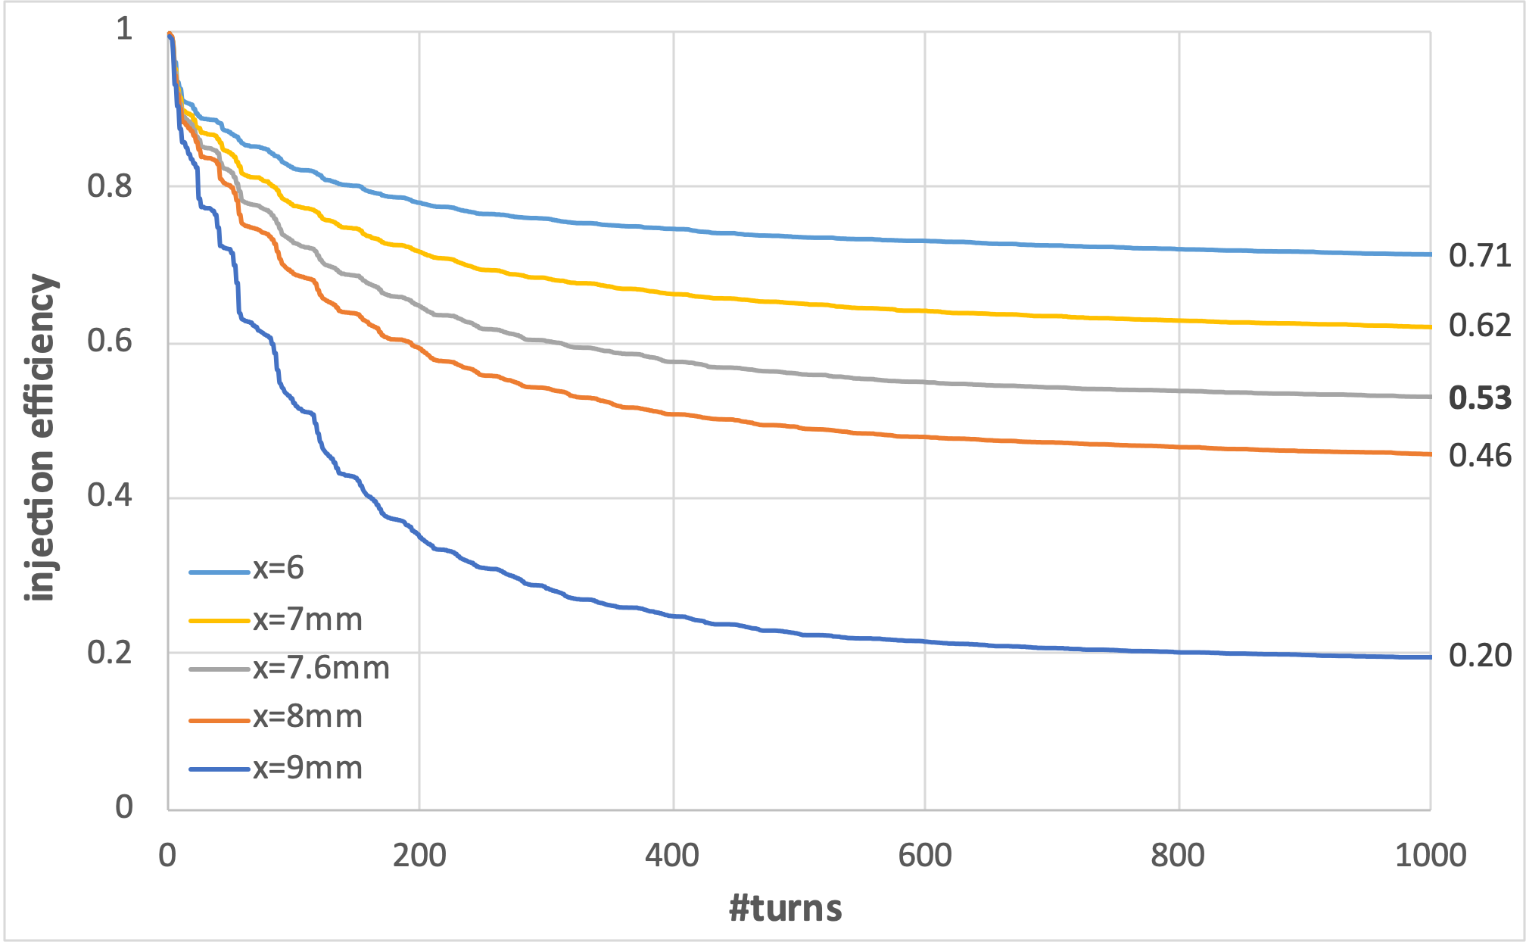
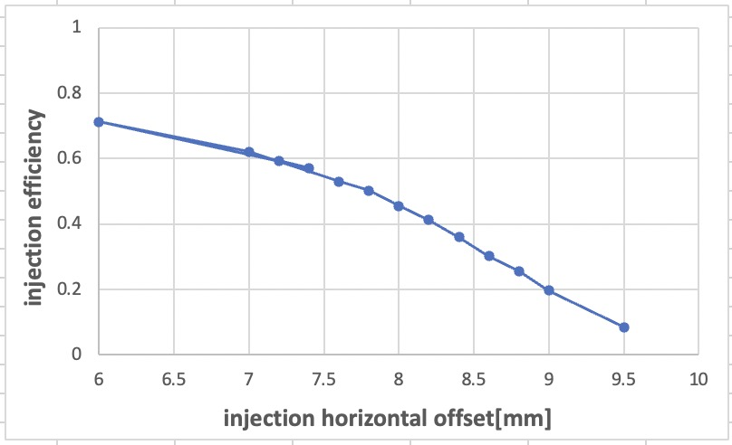
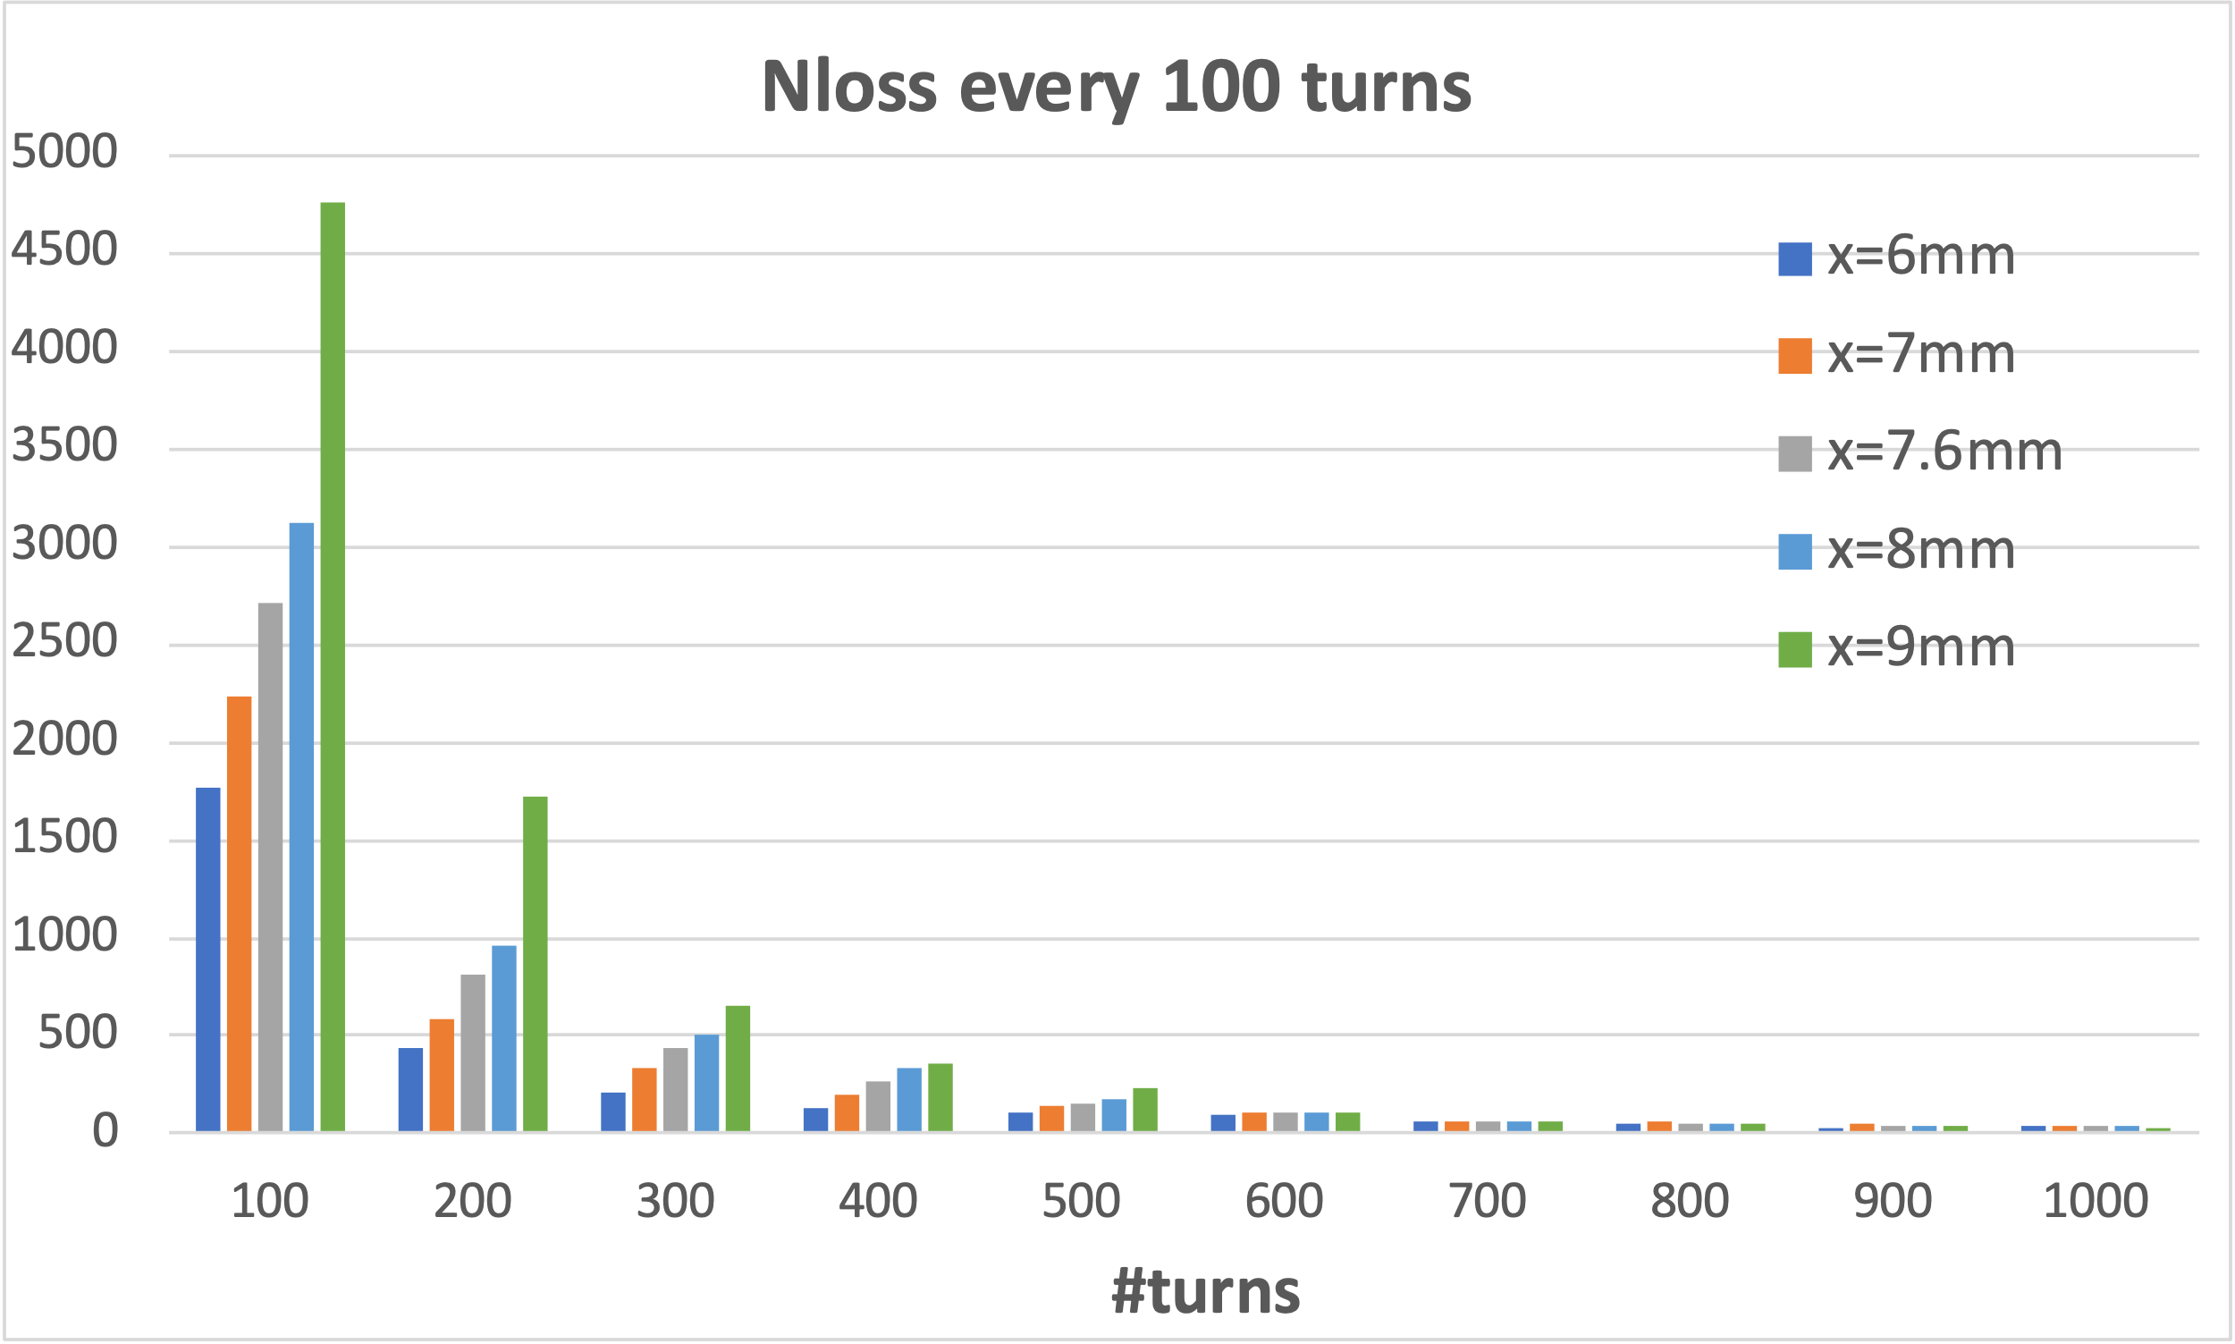
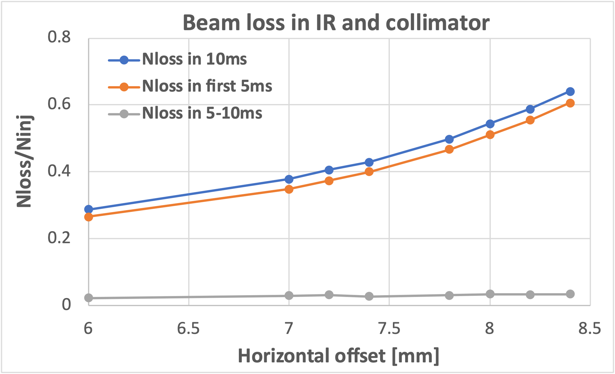
Finding1: Injection errors mainly affect injection efficiency
-> injection offset; injection angle; injected emittance; injection phase; x-y coupling
7

Slide 8
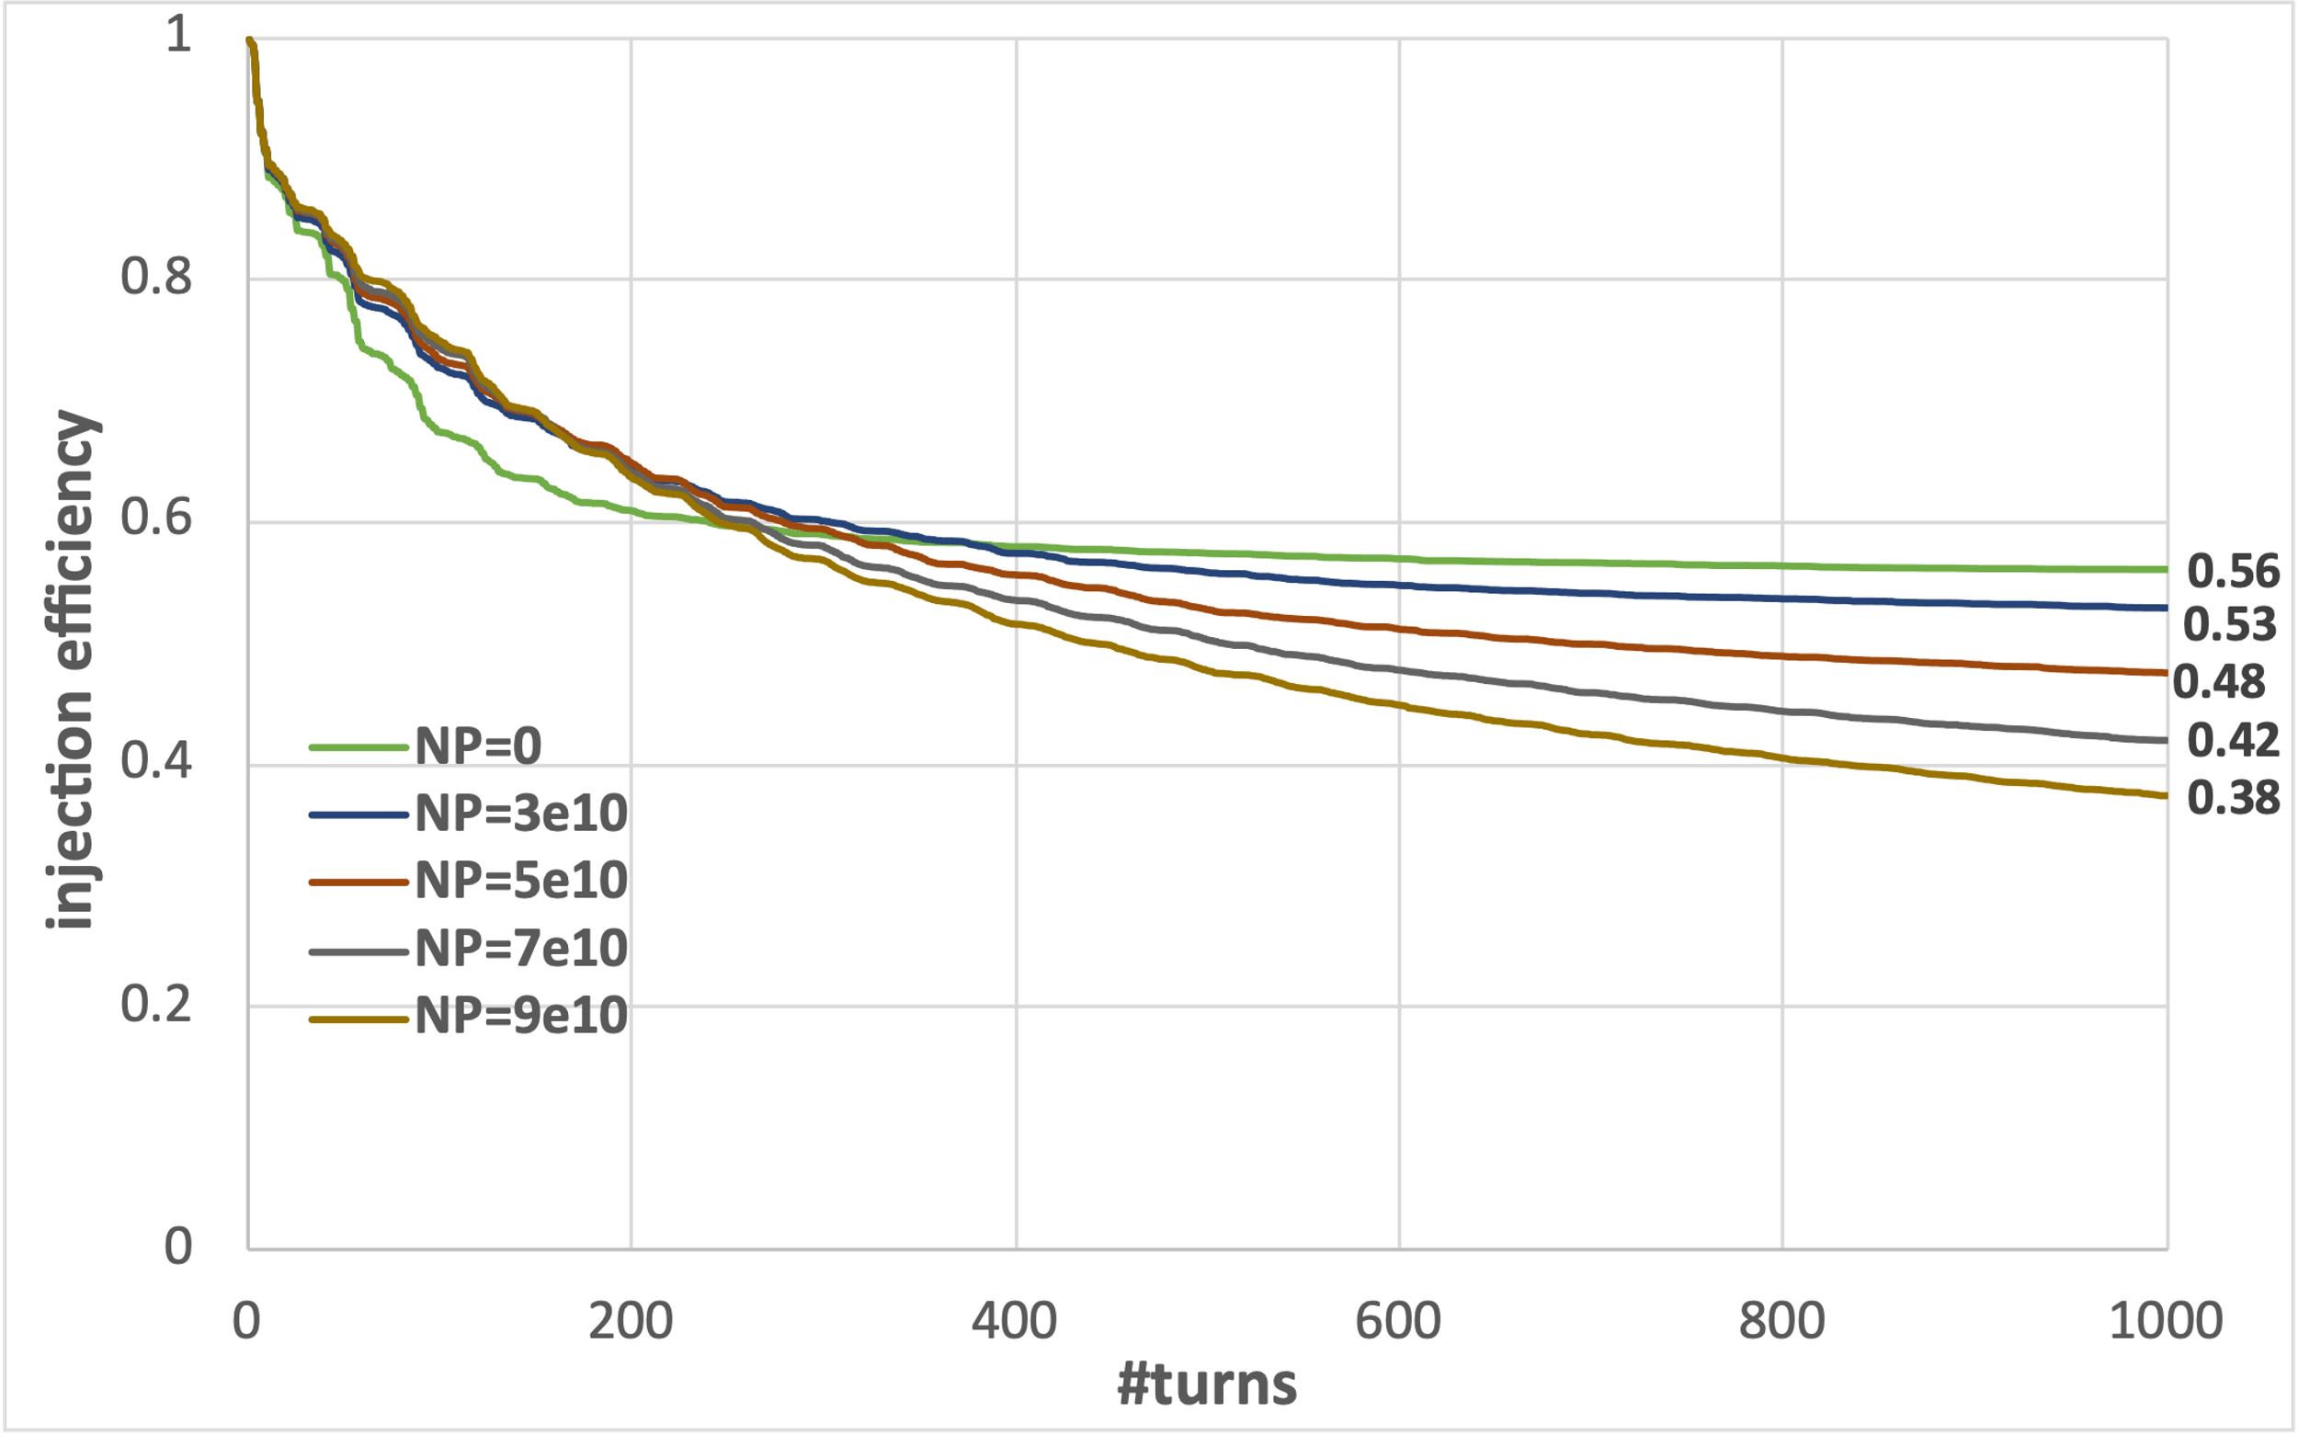
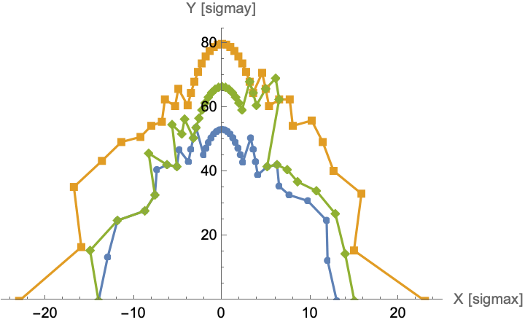
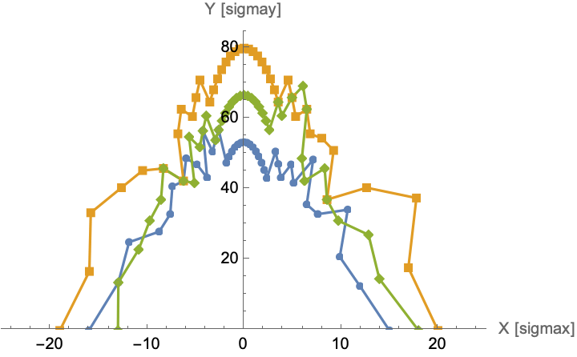
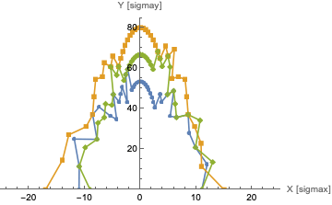
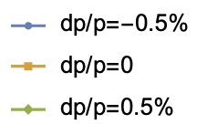
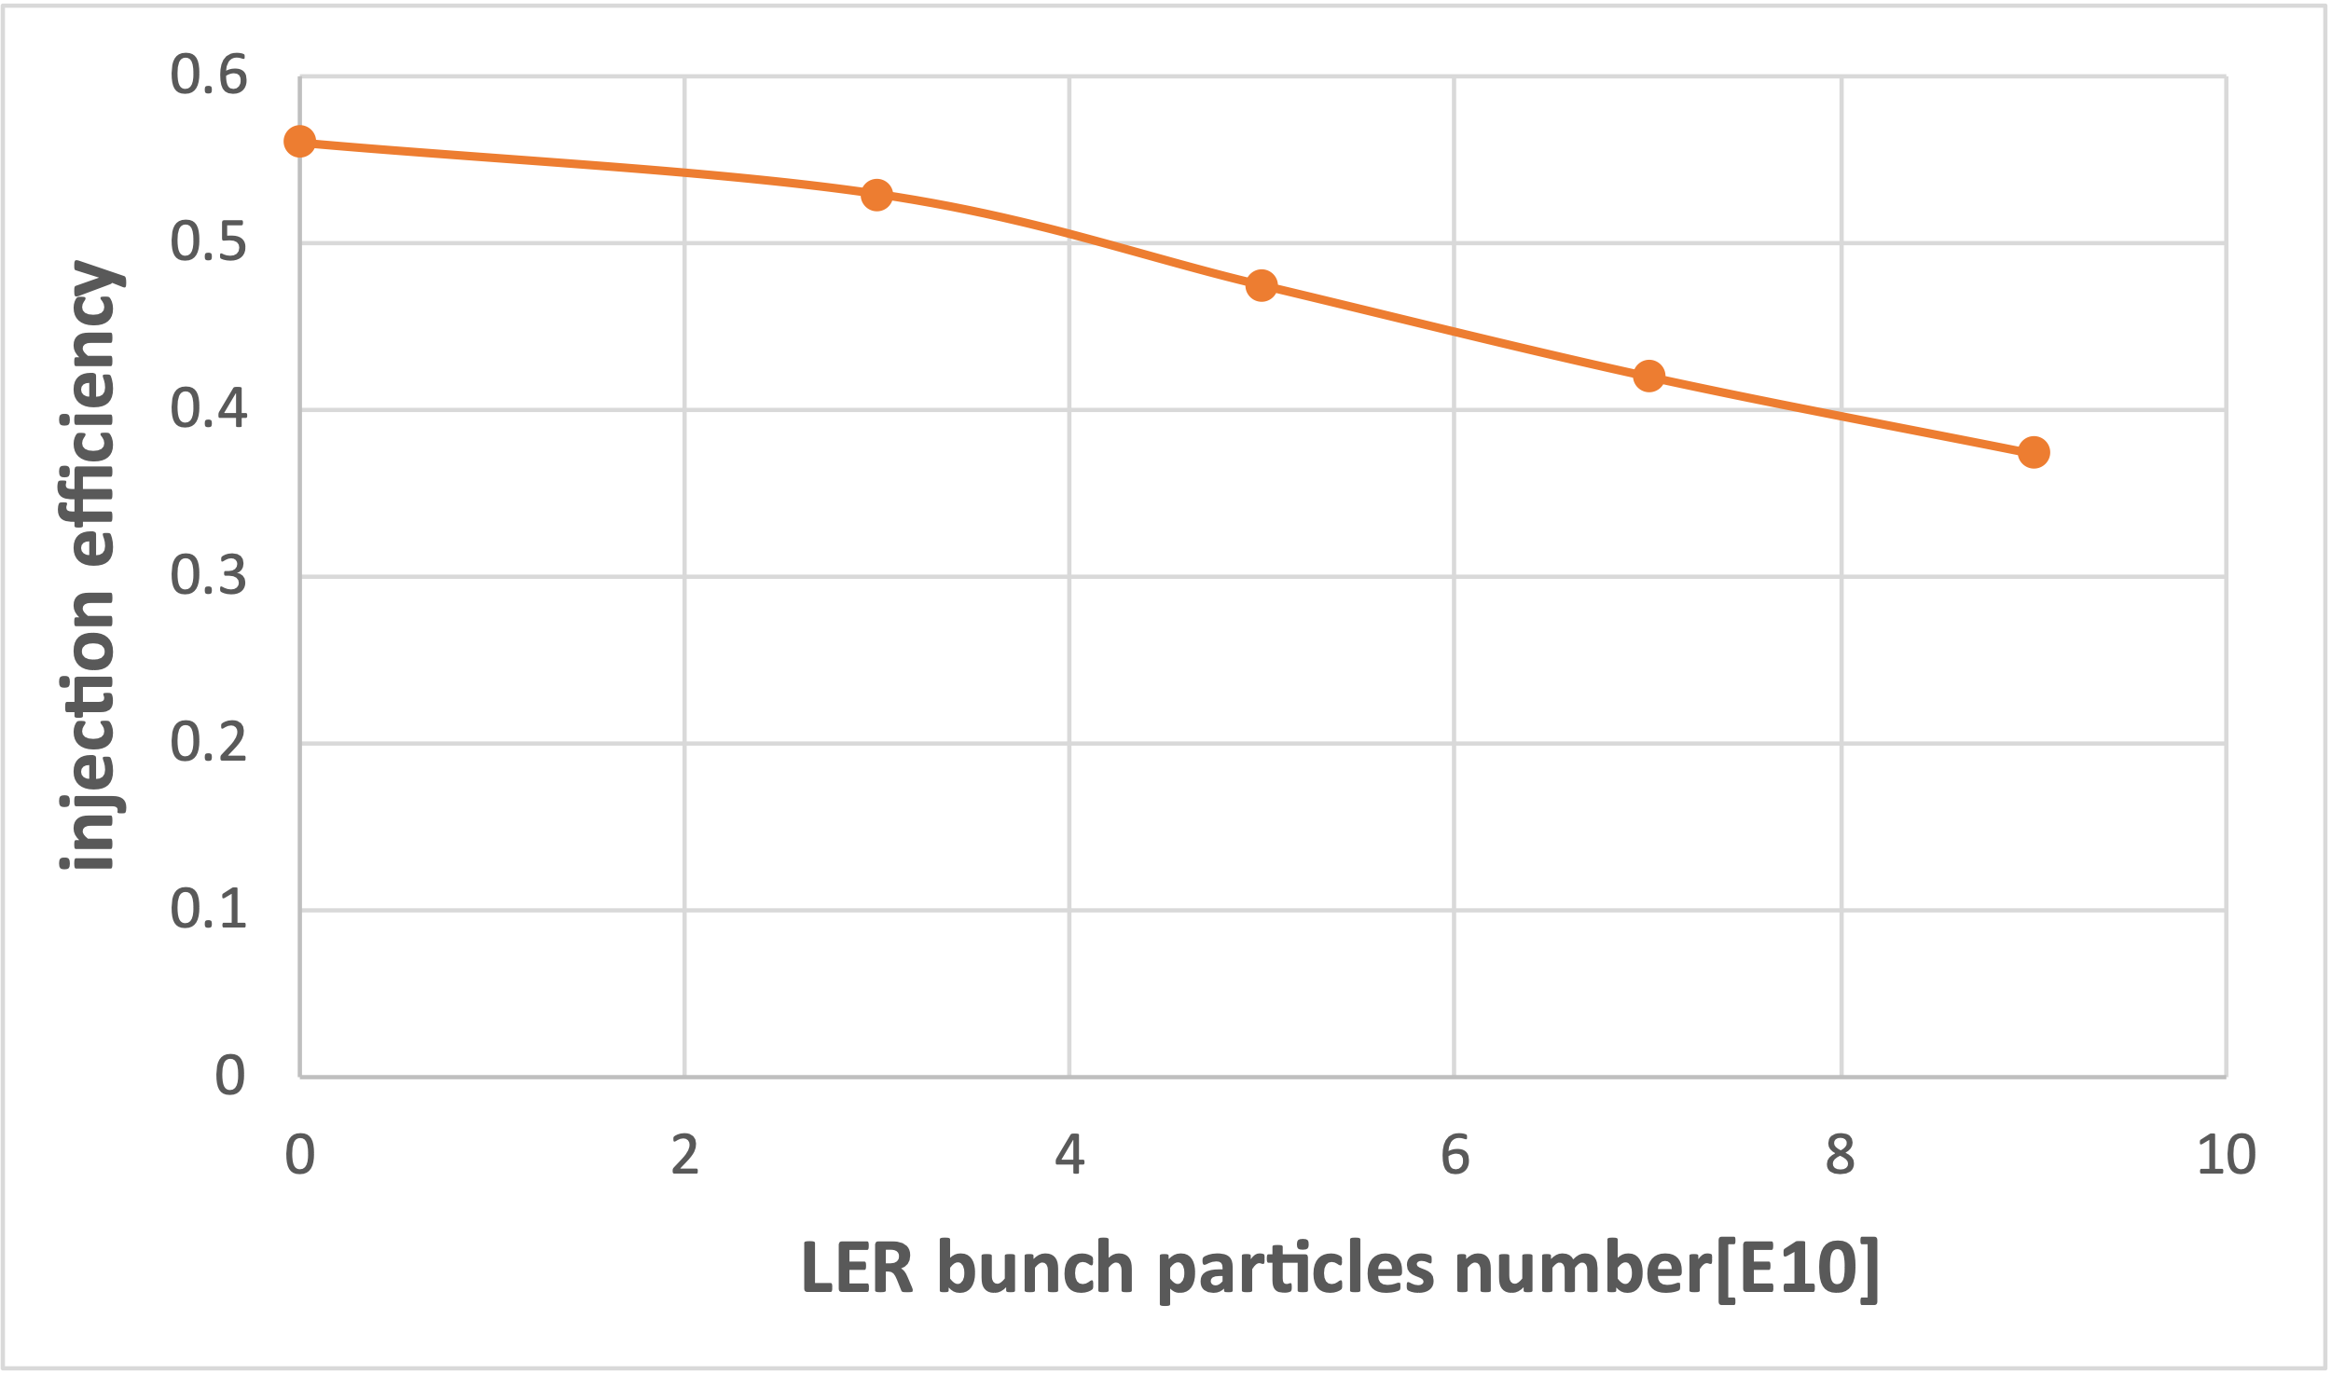
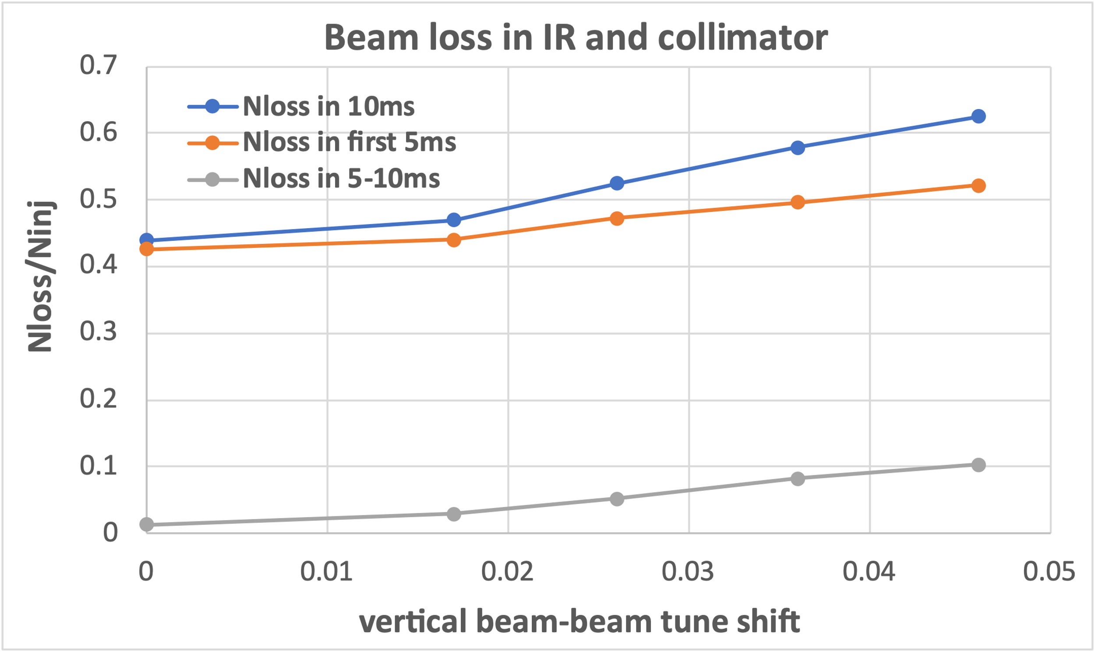
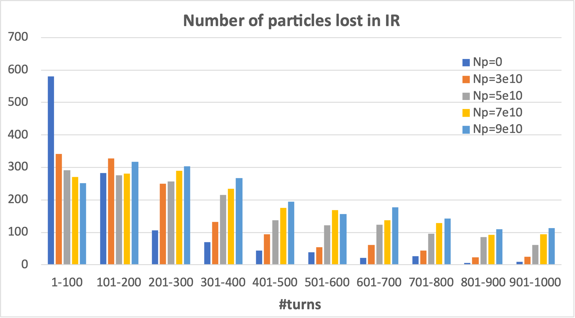
Finding2: Non-linearity in HER lattice affect both efficiency and background
-> Beam-beam effect; cancel coil error; crab waist collision
Beam-beam interaction can reduce the beam loss rate in the first 100 turns but increase the loss rate after 100 turns.
Strengthening the beam-beam interaction decreases DA, lowers injection efficiency, and increases injection background-related beam loss.
$$N_{p}=0→ξ_{y}=0→23σ_{x}$$
$$N_{p}=3.3×{10}^{10}→ξ_{y}=0.017→19σ_{x}$$
$N_{p}=18×{10}^{10}→ξ_{y}=0.092$ $→15σ_{x}$
8

Slide 9
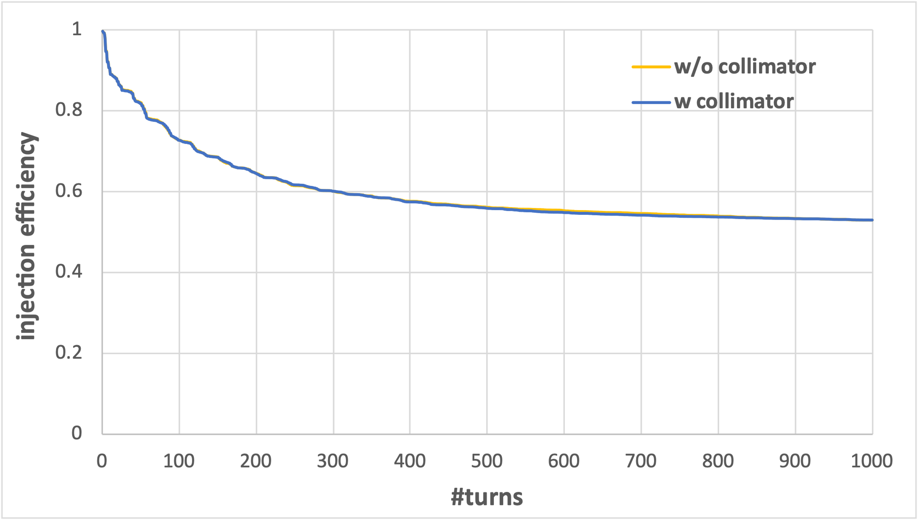
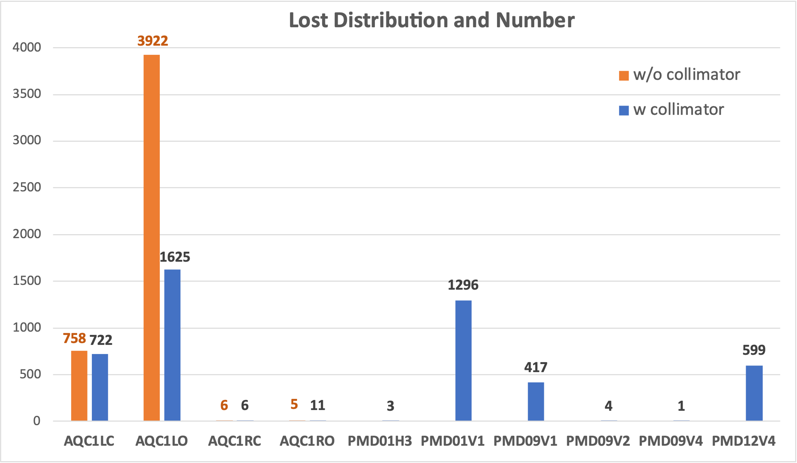
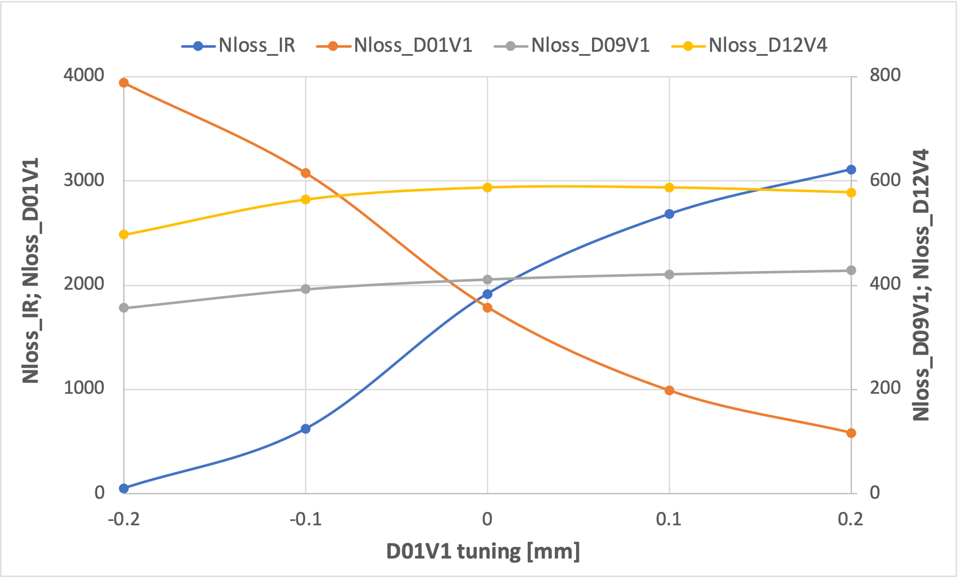
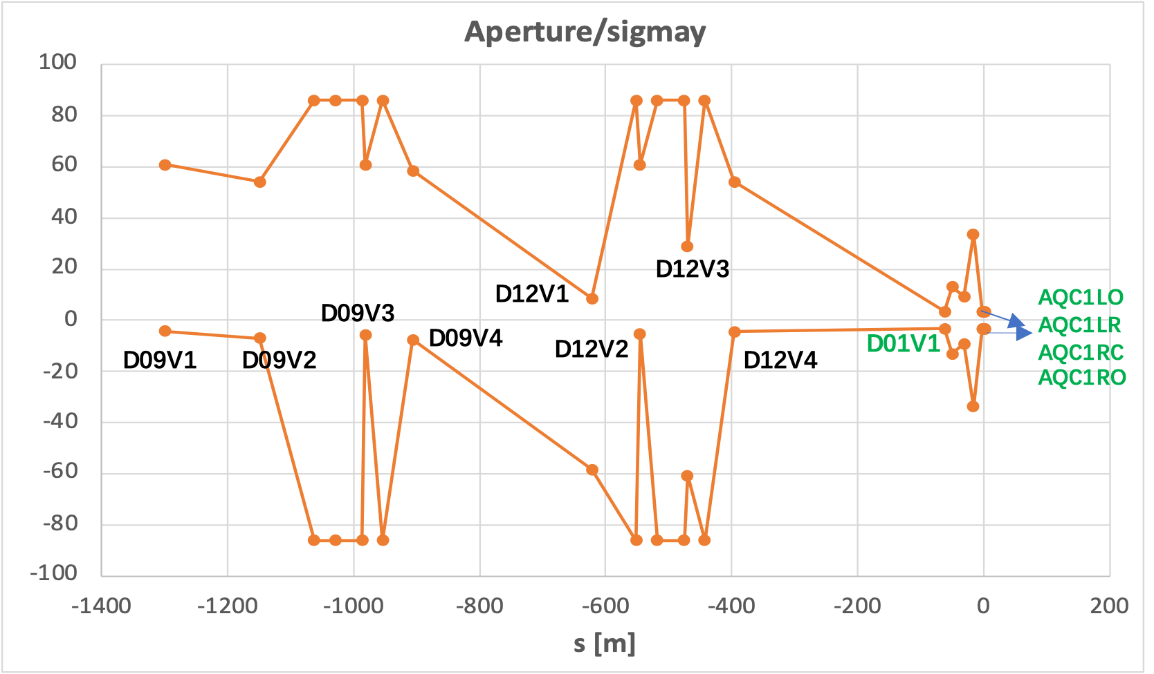
Finding3: IR Beam loss can be suppressed by minor collimator aperture adjustment
Current collimator settings are effective in protecting the IR region, but IR losses remain.
D01V1 plays a major role in this suppression
-relative aperture to the injection beam size of D01V1 is almost the same as that of the IR beam pipe
9

Slide 10
Main findings from HER simulation
A detailed simulation of injected beam losses and related backgrounds was developed
Ø Injection errors mainly affect injection efficiency
-> injection offset; injection angle; injected emittance; injection phase; x-y coupling
Ø Non-linear factors affect both injection efficiency and background
-> Beam-beam effect; cancel coil error; crab waist collision
Ø IR Beam loss can be suppressed by minor collimator aperture adjustment
-> D01V1 plays a major role
p validation experiments were conducted based on the main findings from simulations
-> Injection tolerance measurement ( with N. Iida, Y. Ohnishi)
-> Beam-beam study related to injection BG (with Y. Funakoshi, H. Kaji, T. Koga, U. Bela)
-> Collimator study related to injection BG (with K. Uno, R. Ueki, H. Kaji, T. Koga, U. Bela)
Ø The data show good qualitative agreement with the simulation results.
10

Slide 11
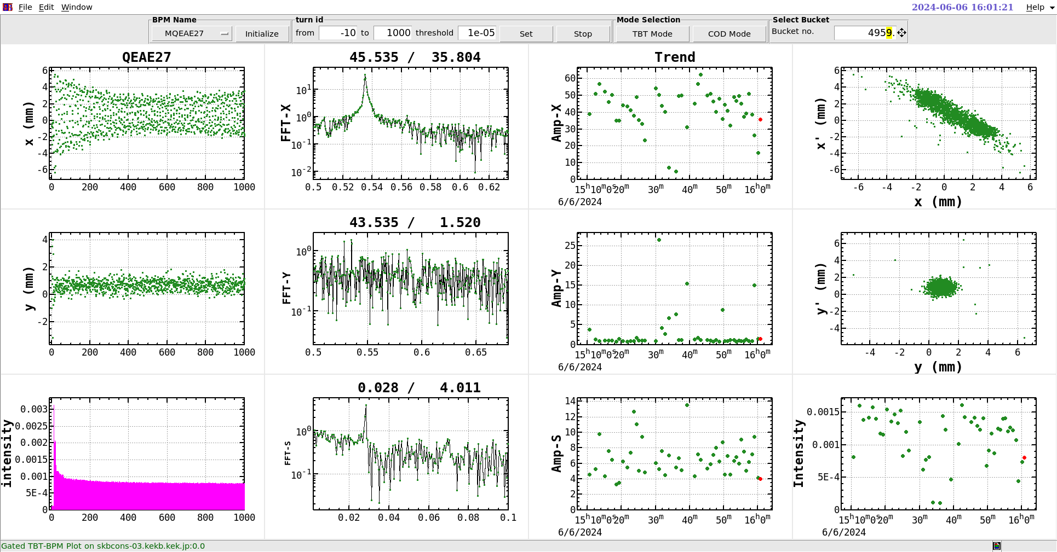
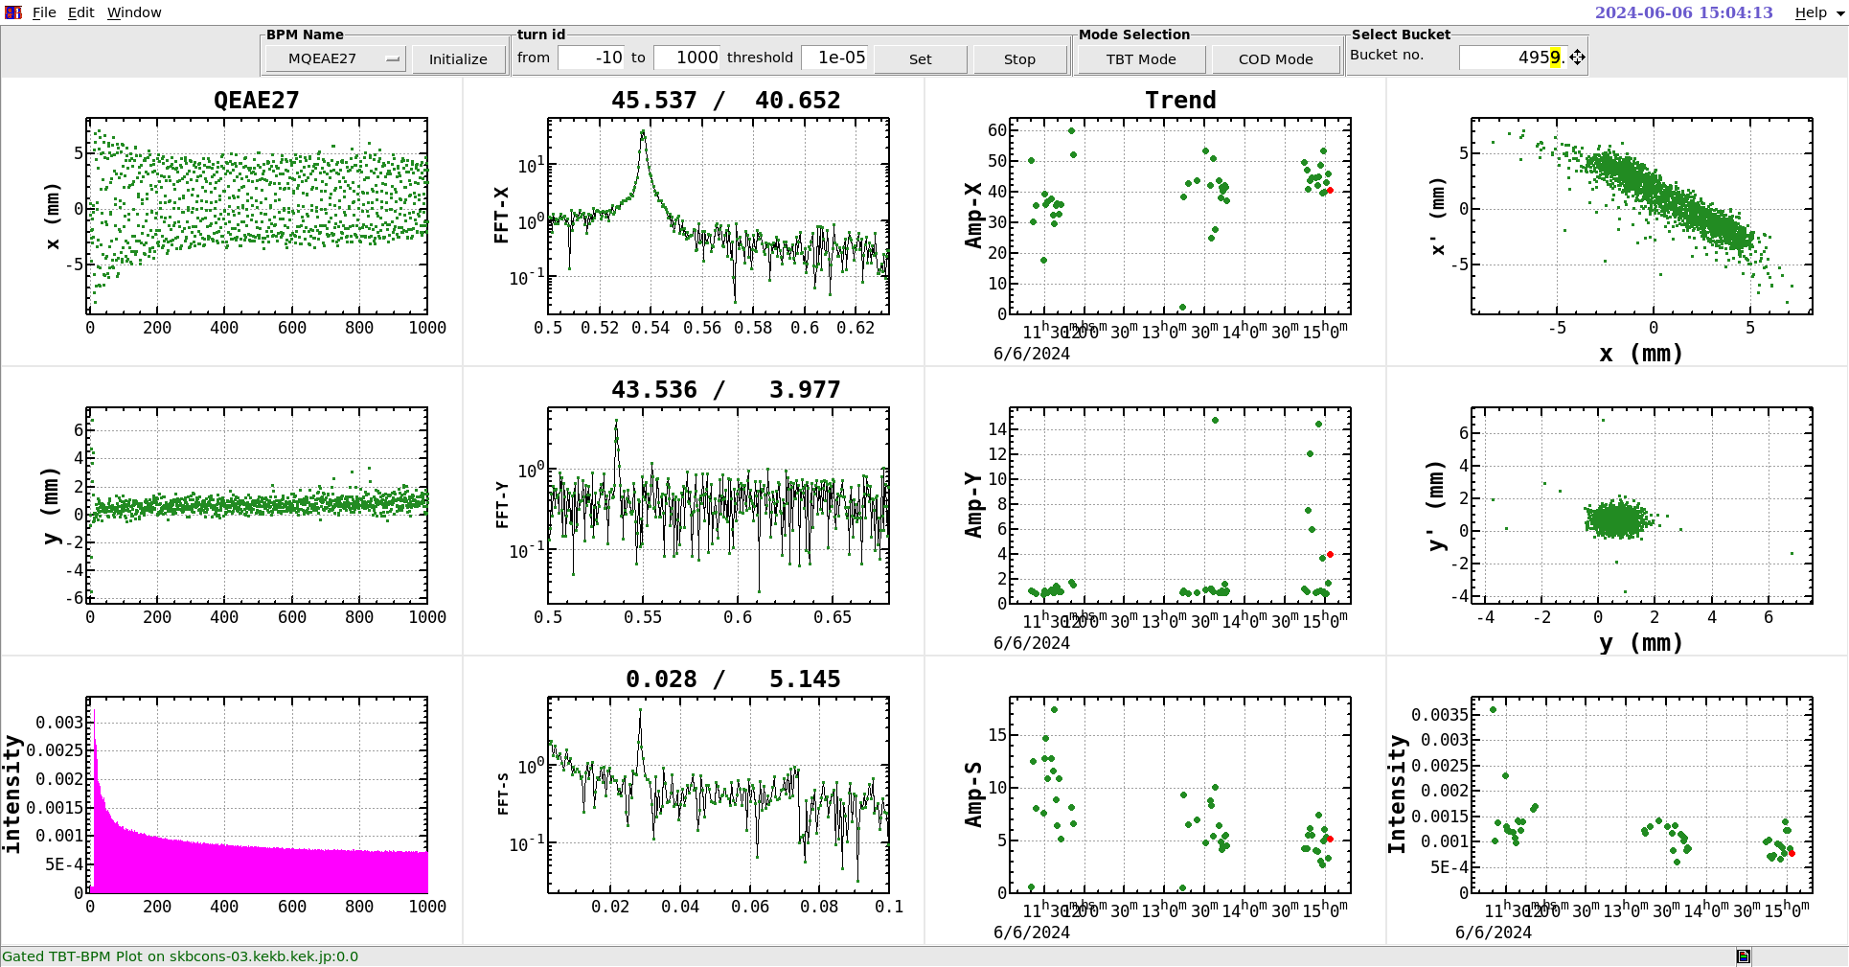
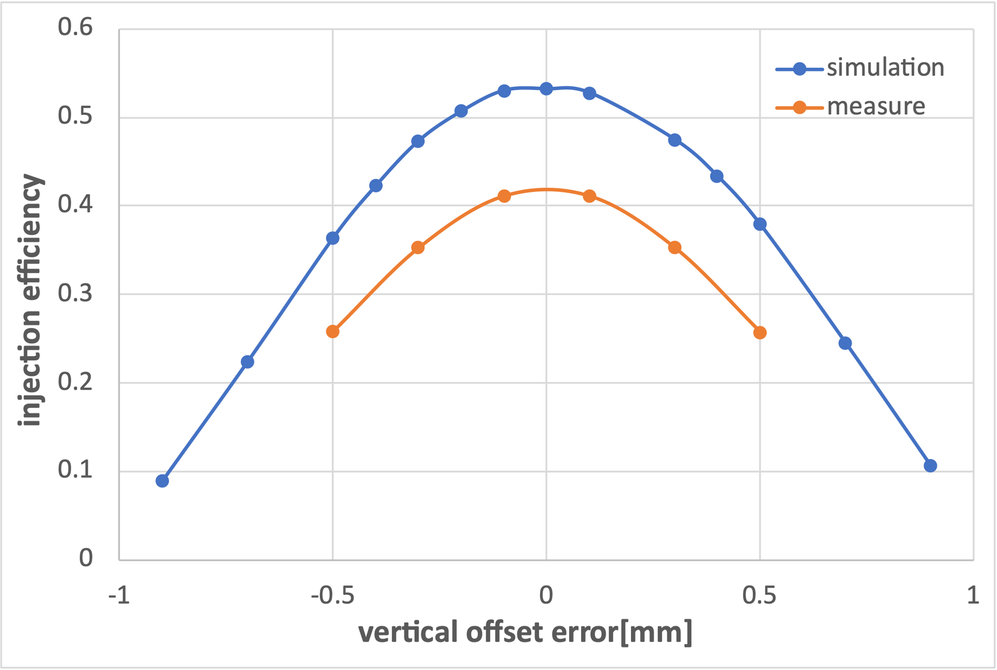
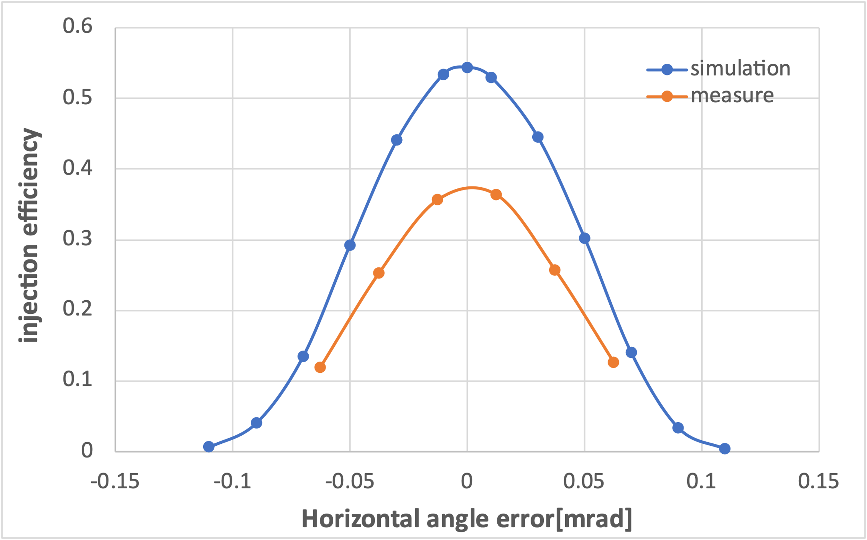
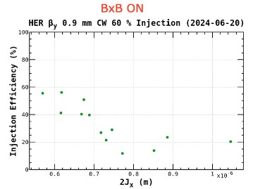
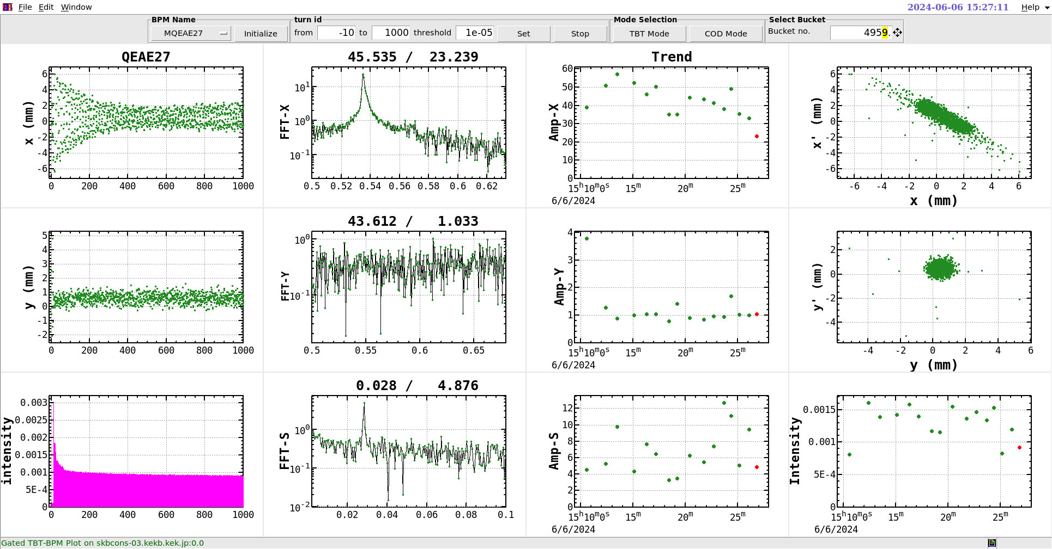
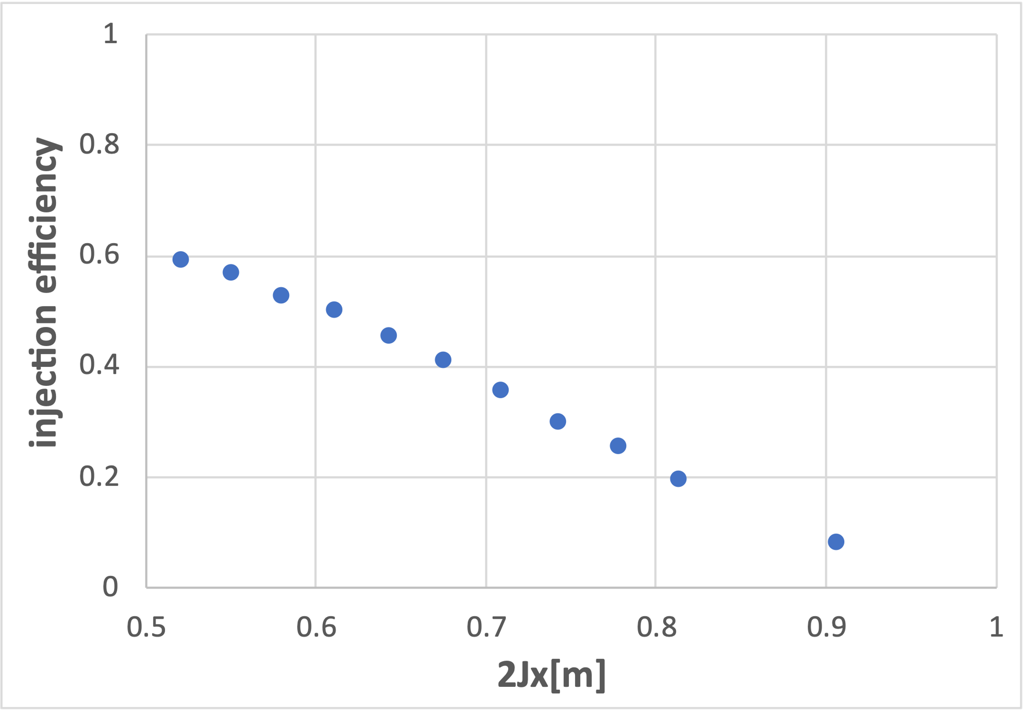
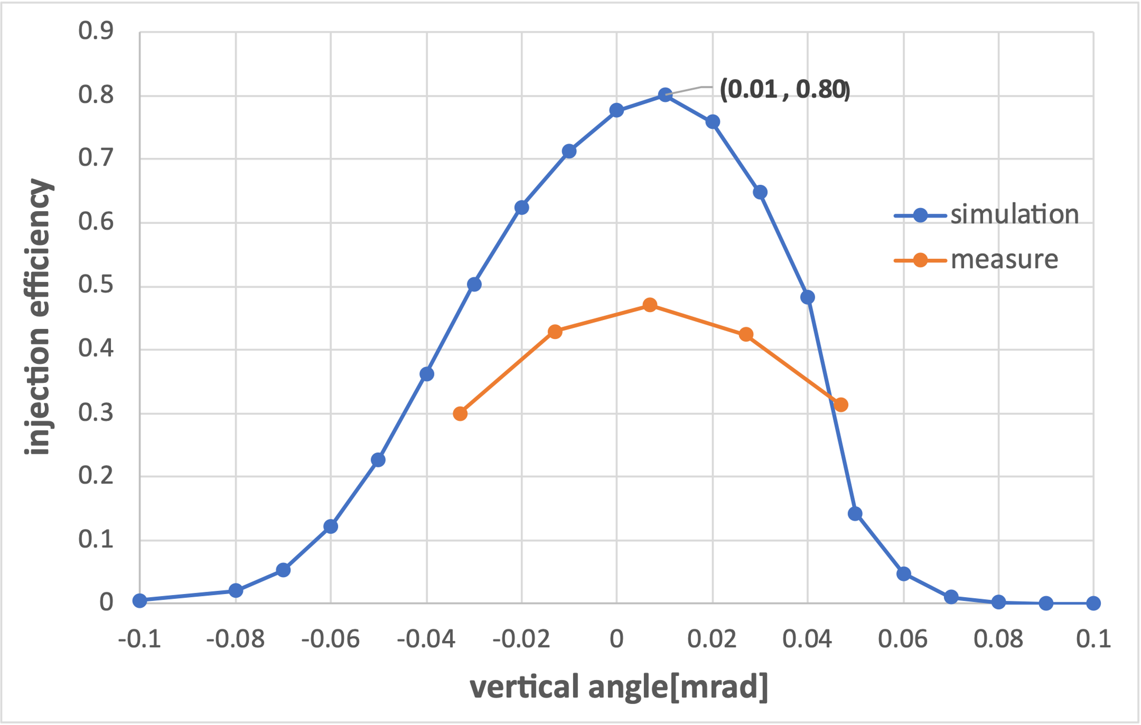
Injection tolerance measurement (2024-06-06)
Vertical Position Scan[mm]:$−0.06→−1.06$
Septum Angle Scan[mrad]:$2.94→3.06$
Septum Position Scan[mm]:$45.1→46.1$
Vertical Angle Scan[mrad]: $0.014→−0.054$
from Onishi-san
The trend of injection efficiency with respect to the variation in error is consistent, but the simulated values are higher than the measured values.
11

Slide 12
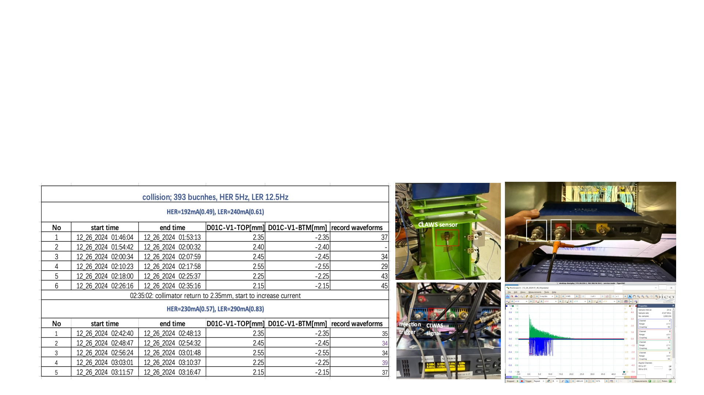
Collimator and beam-beam measurement (2024-12-26)
p Tuning the collimator D01V1 and recording the injection related beam loss and background
Take data with collimator D01V1 position: original, +-100um, +-200um under two different beam current cases
-> LER:240mA, HER:192mA, 393 bunches (corresponds to 1.4A and 1.1A with 2346 bunches) ->current best operation so condition
-> LER:290mA, HER:230mA, 393 bunches (corresponds to 1.7A and 1.4A with 2346 bunches)-> a little future
p Data recording
-> injection efficiency -> TbT monitor
-> beam loss pattern -> CLAWS at D01V1; CsI scintillator + PMT& EMT at D09V3, D12V1
-> injection background duration -> ECLTRG
ECL trigger
signal
Injection
trigger
12

Slide 13
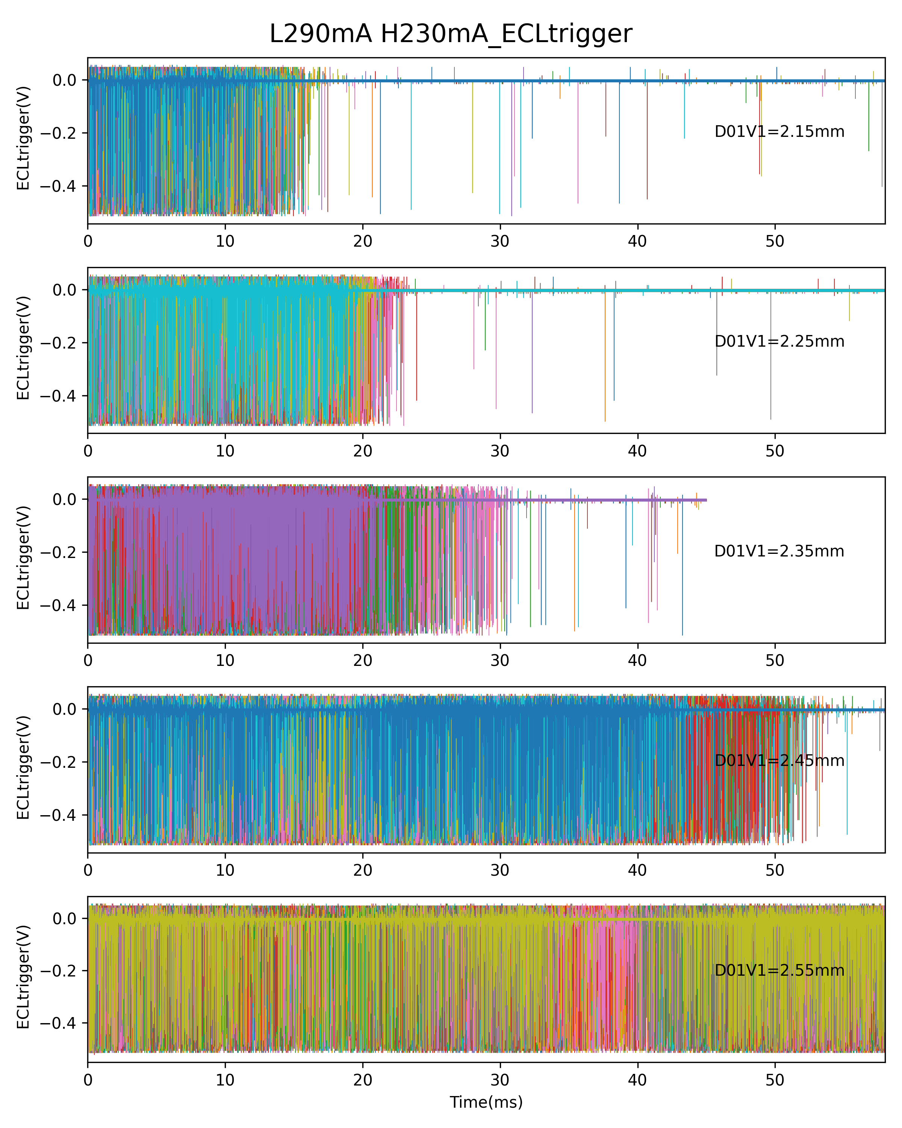
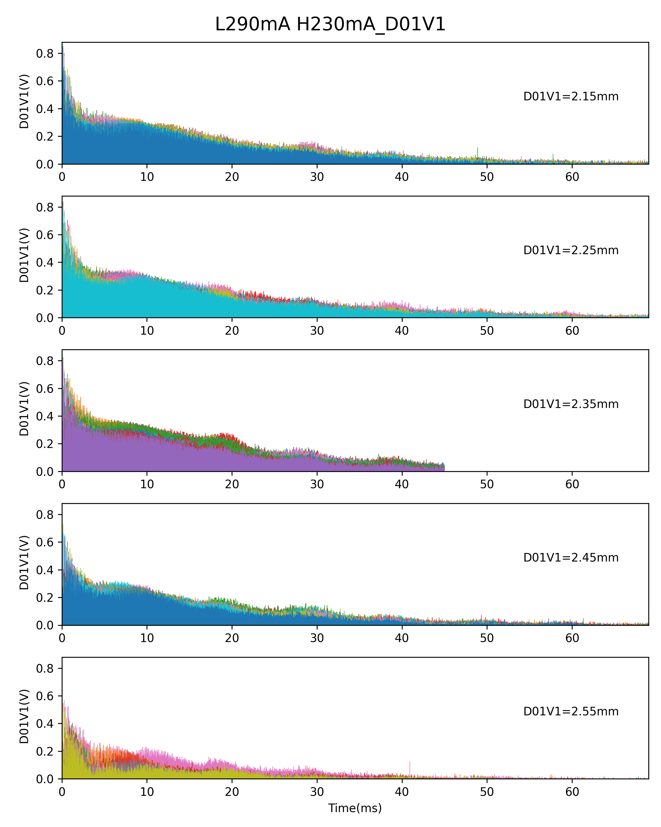
Preliminary analysis
--The injection BG is very sensitive to collimator D01V1 aperture
( close 200um )
( close 100um )
Experiment setting
( open 100um )
( open 200um )
13

Slide 14
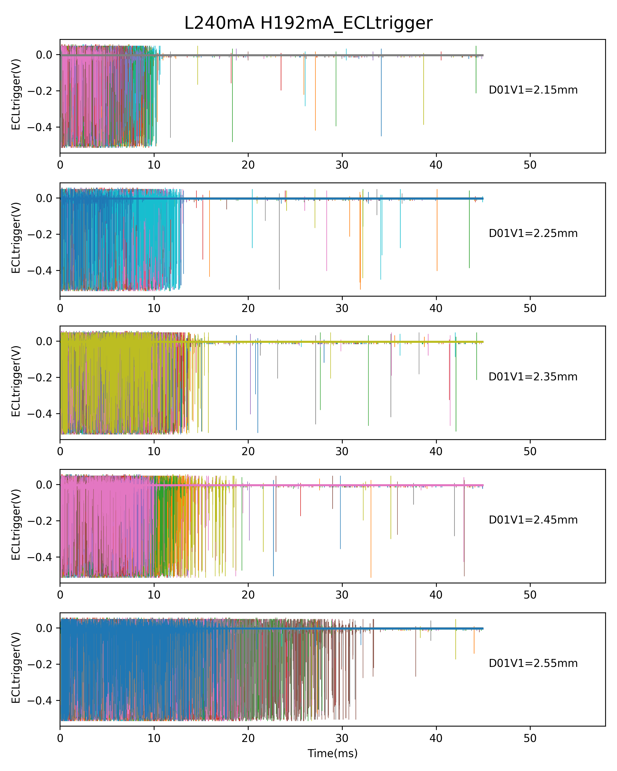
Preliminary analysis
--The injection BG is very sensitive to bunch current(beam-beam strength)
14
( close 200um )
( close 100um )
Experiment setting
( open 100um )
( open 200um )
14

Slide 15
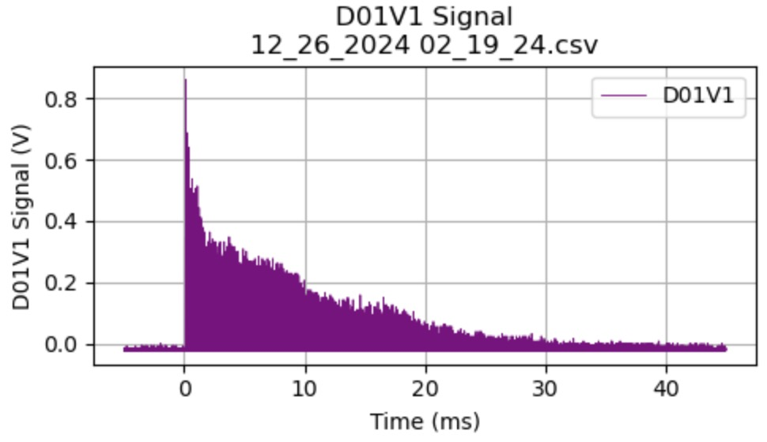
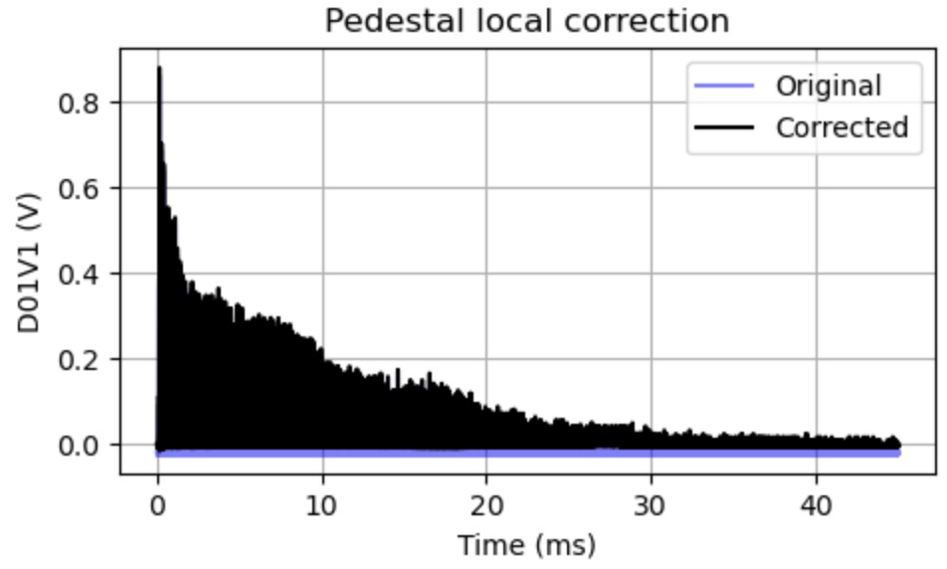
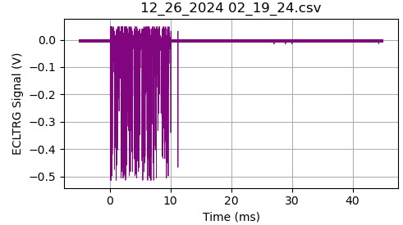
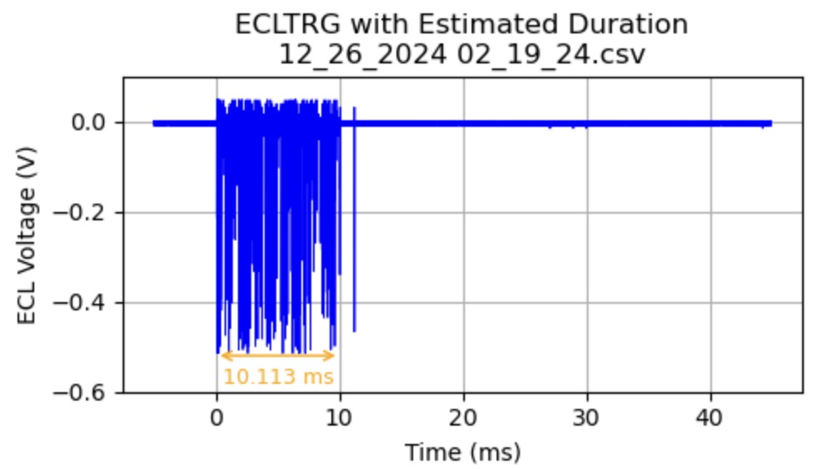
Detailed analysis
Integration of D01V1 signals after 5ms →estimate beam loss on D01V1
Pre-trigger recording
(noise, baseline, shift)
Pedestal is not fixed number
local pedestal correction
Integration=D01v1*sampling_interval
Calculate ECLTRG duration automatically →estimate injection BG duration
15

Slide 16
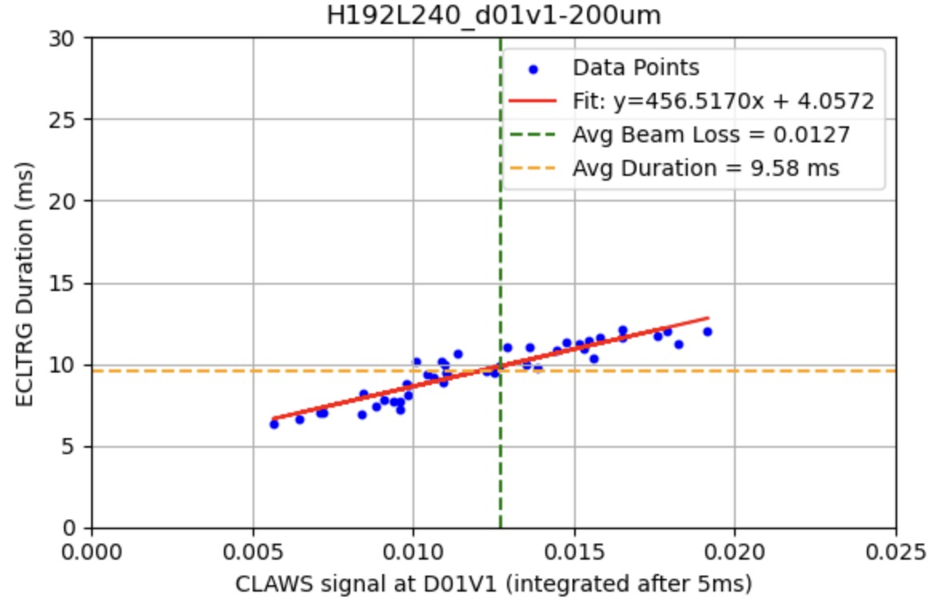
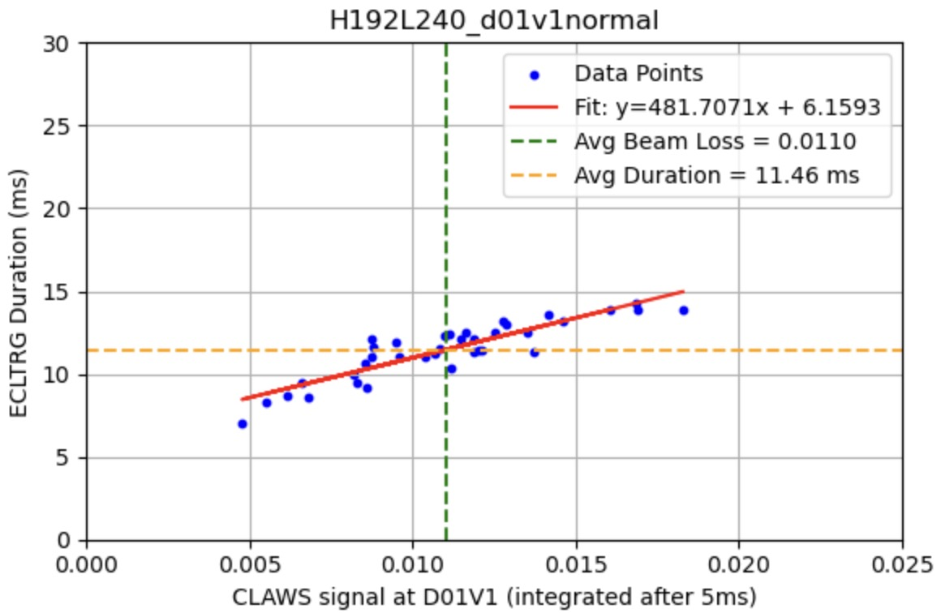
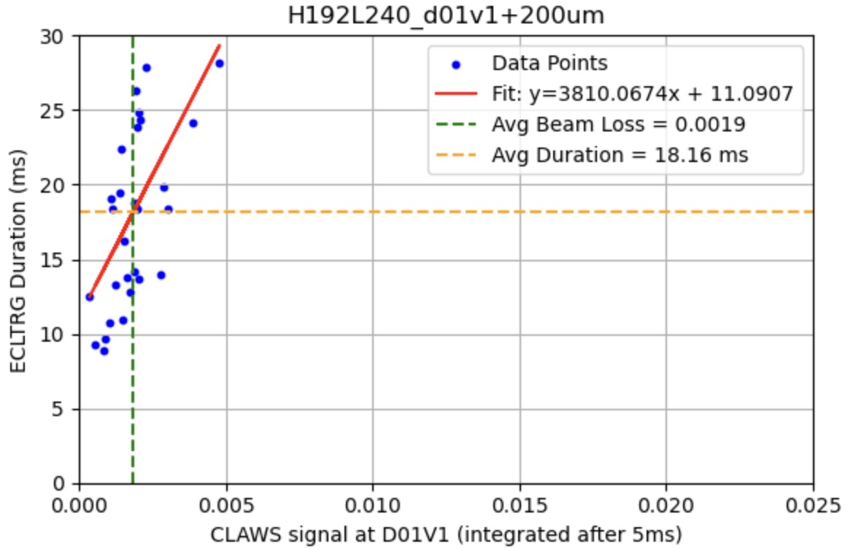
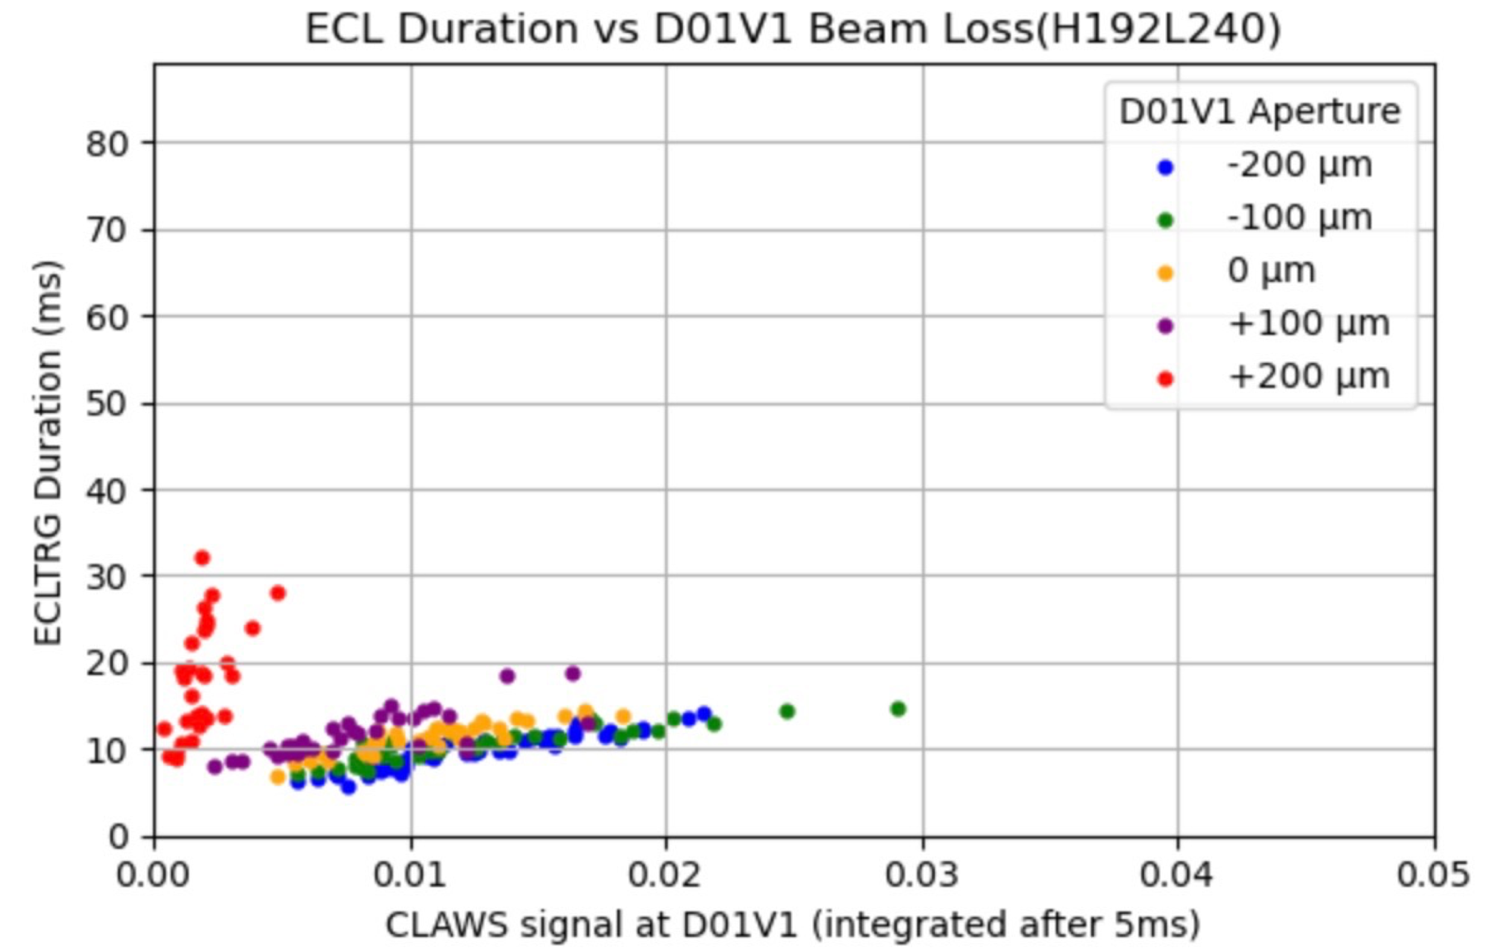
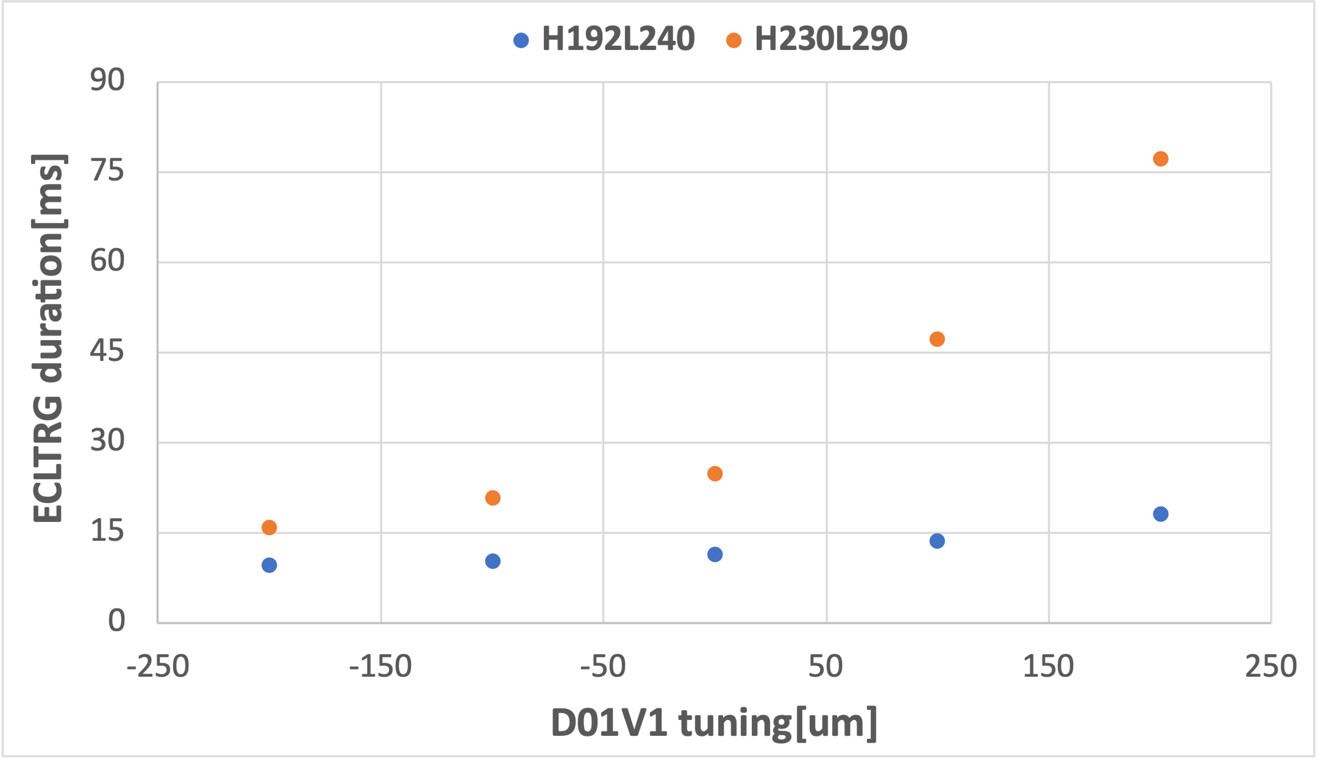
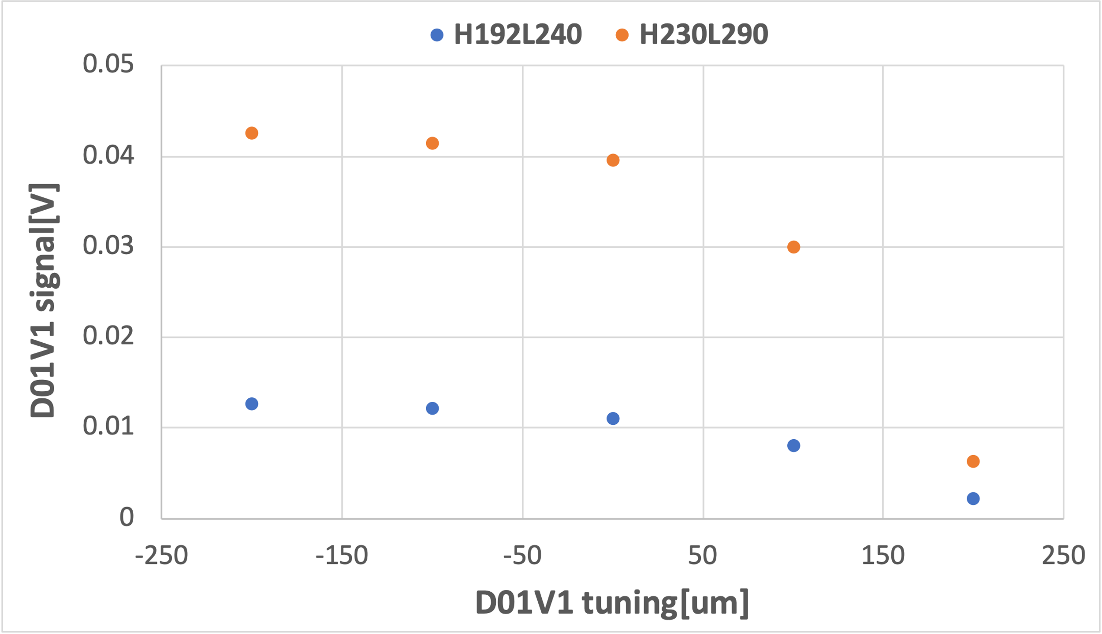
Injection fluctuation is observed in the measurement
Positive linear correlation between beam loss at D01V1 and ECLTRG duration (fixed D01V1 setting).
23.4ms
7.3ms
5.7ms
R² = 0.80
R² = 0.85
R² = 0.32
Closing the D01V1 aperture reduce the average injection BG duration and mitigates the impact of injection fluctuation on IR beam loss
Stronger beam-beam interaction(higher luminosity) increases IR beam loss and BG duration
17

Slide 17
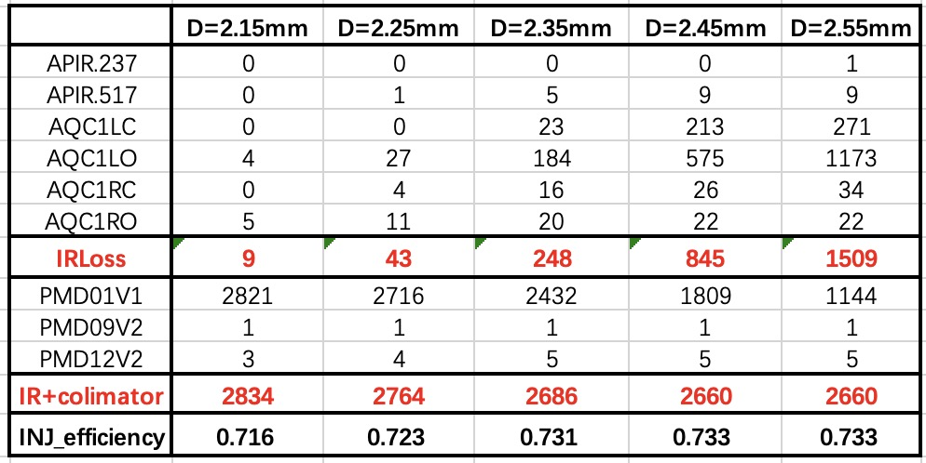
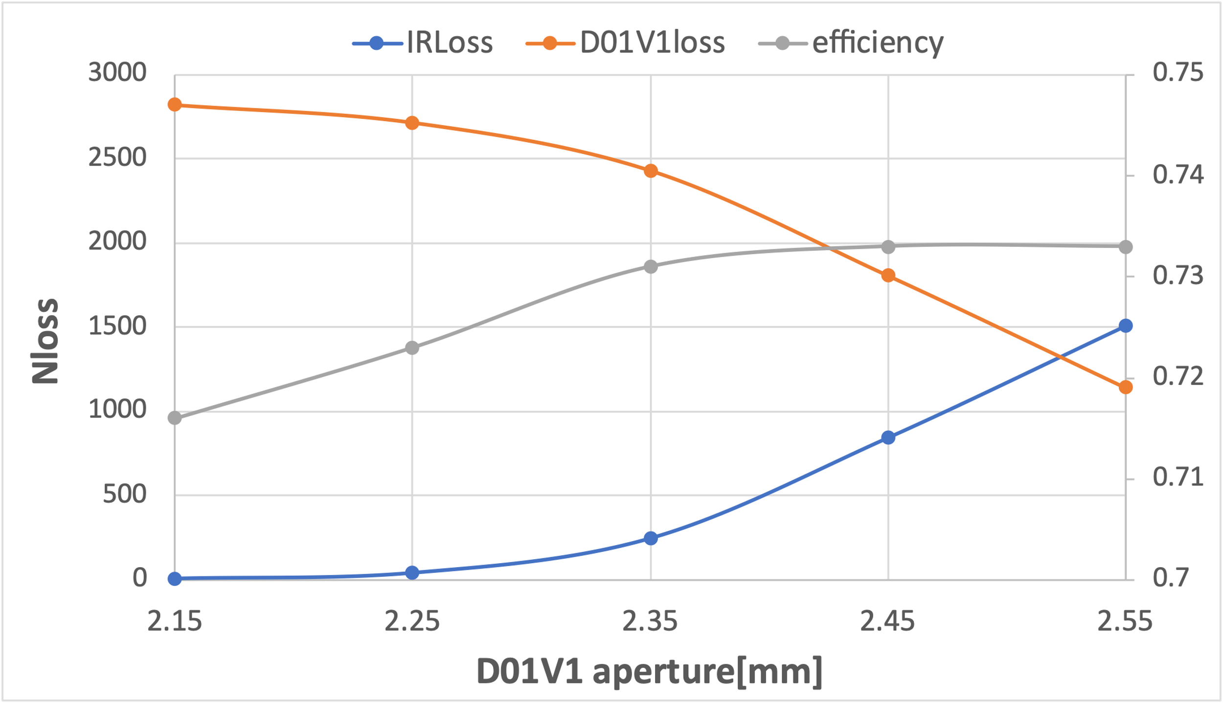
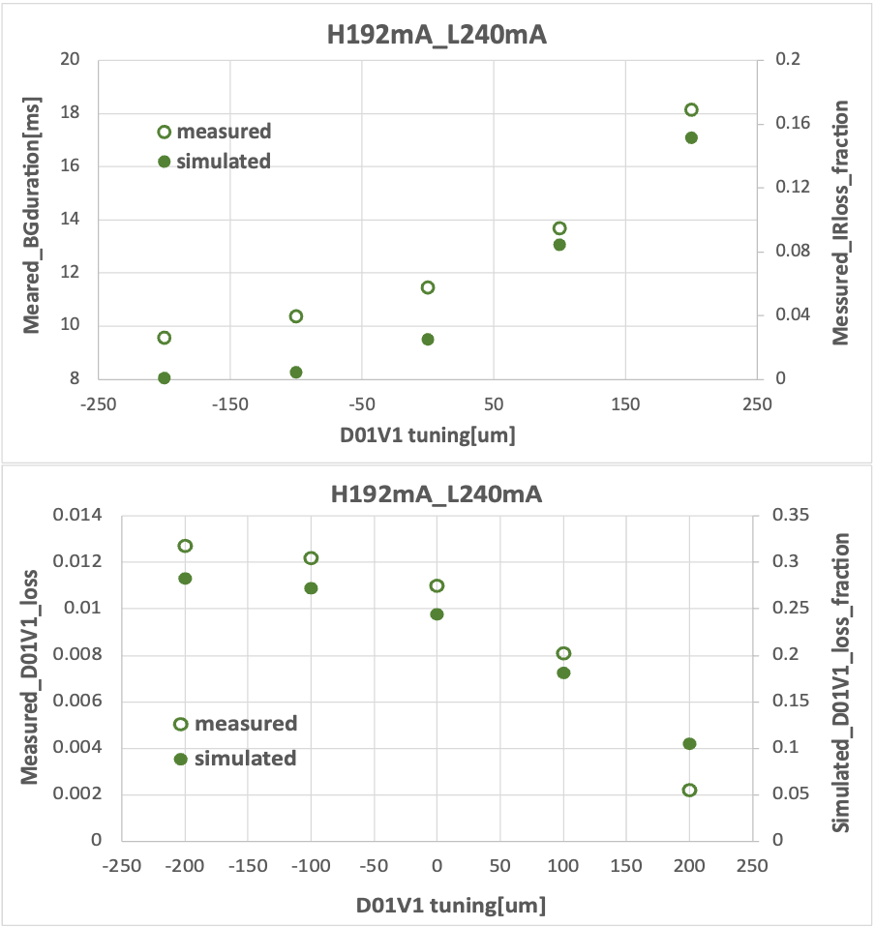
Update simulation match to measurement setting
2024c lattice, cancel coil error, 60% crab waist, beam parameters (beam-beam,, x-y coupling…)
realistic IR aperture+ collimator settings
Qualitatively consistent with measurement
19

Slide 18
Tune Scan Study of Injection Efficiency
Operating point(45. 531,43. 575), 60%
5
Optimum tune(eff>80%)
5
5
5
5
5
5
4
2
4
5
Some tunes with higher injection efficiency were found in the resonance-free region: located far from the 2nd order resonance lines, above the 4th order resonance lines, and between the 5th order resonance lines.
The results are consistent with the simulation by Yasuhiro Yamamoto.

Slide 19
Tune Scan Study of Injection Efficiency
Beam-beam interaction introduces tune shifts as functions of the oscillation amplitudes: $Δν\left(α\right)=ξ\frac{1−e^{−α}I_{0}(α)}{α}$
At vanishing amplitudes, $Δν→ξ$; for very large amplitudes, $Δν→0$
5
5
5
5
G2
5
Y3
5
Y2
Y1
5
K
B2
J
O
B1
Y4
B3
D
G1
B4
F
5
E
G
B
H
I
C
B5
A
4
2
4
4th order resonance and below are dangerous for injection, while 5th order resonance lines may be weaker and have less impact on injection.

Slide 20
Optimum tunes improve both efficiency and related background
Operation tune | INJ_Effi | Nloss(1-300) | Nloss(301-1000)
(45.531, 43.575) | 0.60 | 3558 | 435
K
J
O
D
E
F
G
B
H
I
C
A
A
B
C
D
E
F
G
H
I
J
K
INJ_Effi
0.81
0.82
0.85
0.83
0.83
0.85
0.87
0.87
0.87
0.83
0.83
A, B, C: Improve injection efficiency(20%); but also increase long duration beam loss between 300-1000turns.
D-K: Improve injection efficiency(~25%) and reduce long duration beam loss (15-60%) compared to current operation tune. Especially tunes G(with highest efficiency) and J, K (with largest reduction of long duration beam loss) reduce beam loss every turn.

Slide 21
Conclusions and outlook
A more realistic simulation mechanism for injection-related beam loss has been developed
Verification experiments have been conducted based on its main findings
Qualitative agreement is observed between simulation and experimental data:
- comparison includes raw waveform features and further data analysis
- simulation updated with beam parameters and machine conditions from the measurement day
Tune affect both injection efficiency and related background
Further investigation of injection-related beam loss and background
Tune scan(betatron-synchrotron resonance,…)
Further nonlinearity including fully implemented crab-waist collision
More realistic collimator model including tip-scattering
Assessment for higher luminosity in 2025 and beyond
Connect SAD simulated injection beam loss with Geant4 simulation
More validation experiments (CLAWS at D01V1, ECLTRG,…)
LER simulation
20

Slide 22
Back up

Slide 23
Closing the D01V1 aperture reduce the average injection BG duration
Stronger beam-beam interaction(higher luminosity) increases IR beam loss and BG duration
→ Consistent with simulation
18

Slide 24
Exp/Run 35/1356
Exp/Run 35/1814
1197mA
998mA
1347mA
1247mA
3.4ms
3.6ms
10.6ms
23.6ms
2.3%
4.5%
Dead time seems proportion to BG duration

Slide 25
Exp/Run 35/1815
Exp/Run 35/2194
1037mA
1037mA
1297mA
1297mA
7.2ms
14.0ms
15.9ms
15.4ms
5.1%
9.8%
Dead time seems proportion to BG duration

Slide 26
 | HER | LER | eclh | ecll | deadtime
1 | 760 | 950 | 9 | 12 | 2.5%
2 | 800 | 1000 | 12.0 | 13.2 | 2.7%
3 | 840 | 1050 | 10.4 | 14.9 | 3.0%
4 | 880 | 1100 | 11.6 | 18.3 | 3.2%
5 | 920 | 1150 | 12.3 | 21.0 | 4.6%
6 | 960 | 1200 | 13.3 | 25.3 | 5.3%

Slide 27
Optimum tunes improve both efficiency and related background
Operation tune | Nloss_IR/Ninj | Nloss_IR(1-300) | Nloss_IR(301-1000)
(45.531, 43.575) | 17% | 1418 | 282
K
J
O
D
E
F
G
B
H
I
C
A
A
B
C
D
E
F
G
H
I
J
K
Nloss_IR/Ninj
9.7
9.6
8.6
10.0
10.0
9.7
8.6
7.6
8.0
5.4
6.2
These optimum tunes with higher injection efficiency significantly reduce the IR beam loss by ~50% compared to current operation tune.

Slide 28
Beam–beam effects have minimal impact on injection and background at optimal tunes
$$ℒ→1×{10}^{35}{cm}^{−2}s^{−1}$$
$$ξ_{y}→0.035\sim 0.045$$
K
Increase the beam-beam tune shift, and the tune spread increases, the injection efficiency and background remains nearly unchanged, likely due to similar DA.
J
O
D
E
F
G
B
H
I
C
A
need further checks!
o
A
B
C
D
E
F
G
H
I
J
K
o
A
B
C
D
E
F
G
H
I
J
K

Slide 29
Finding3: IR Beam loss can be suppressed by minor collimator aperture adjustment
13
Current collimator settings are effective in protecting the IR region, but IR losses remain.
Closing all the vertical collimators by 0.1mm, beam loss in IR significantly suppressed, injection efficiency remain.

Slide 30
Finding3: IR Beam loss can be suppressed by minor collimator aperture adjustment
15
D01V1 plays a major role in this suppression
-relative aperture to the injection beam size of D01V1 is almost the same as that of the IR beam pipe
AQC1LO
AQC1LC
D01V1
D01H4
AQC1RO
AQC1RC
D01H3
D01H5

Slide 31
Finding2: Non-linear factors affect both injection efficiency and background
Manufacturing error of cancel coil in HER
Cancel coils in the HER should correct the leakage field from QC1LP and QC1RP in the LER.
Normal winding and skew winding coils correct both normal and skew field by using one power supply.
Skew sextupole and skew octupole increase (not cancelled) due to manufacturing mistake.
Y. Ohnishi

Slide 32
Cancel coil error affect both injection efficiency and background(update)
Nloss | Turn | w/o error | w error | w double error
total | 1-300 | 2443 | 3558 | 3972
 | 301-1000 | 370 | 435 | 712
 | 1-1000 | 2813 | 3993 | 4684
IR | 1-300 | 661 | 1418 | 1870
 | 301-1000 | 94 | 282 | 494
 | 1-1000 | 755 | 1700 | 2364
w/o cancel coil error
w cancel coil error
w double cancel coil error
Cancel coil error degrades the on-momentum DA: $80σ_{y}→65σ_{y}$,
Decrease the injection efficiency: $72\%→60\%$
$22σ_{x}→16σ_{x}$
increases the IR beam loss almost every turn

Slide 33
Injected beam
stored beam
her-initial-particles_1.dat(9972)
Gaussion distribution(9972*2)
beamI0={1,{xi,pxi,yi,pyi,zi,deli,flgi}};
Initial total center of gravity
beamR0={1,{xs,pxs,ys,pys,zs,dels,flgs}};
Initial gravity center of x, px : Gxi0, Ggxi0
Gx0; Gpx0
Initial gravity center of x, px : Gxr0, Ggxr0
start loop
deltGx[1]= -0.02*Gx0;
deltGpx[1]=-0.02*Gpx0;
start loop
beamItrack[n]=TrackParticles[beamI[n-1],start,1];
beamRtrack[n]=TrackParticles[beamR[n-1],start,1];
remove lost particles
Remove lost particles
applied in the next turn
beamI[n]
beamR[n]
add feedback
feedback kick calculated based on beam position from last turn:
deltGx[n+1]=-0.02*Gx[n];
deltGpx[n+1]=-0.02*Gpx[n];
add feedback
beamI[n][2,1]+deltGx[n];
beamI[n][2,2]+deltGpx[n]
beamR[n][2,1]+deltGx[n]; beamR[n][2,2]+deltGpx[n]
beamI[n]
beamR[n]
Gxi[n]; Gpxi[n]
total center of gravity
Gx[n]; Gpx[n]
Gxr[n]; Gpxr[n]
track the injection beam and storage beam at the same time turn by turn, calculate the center of gravity of injected and stored beam, and feedback kick, update the horizontal coordinates of the particles turn by turn.

Slide 34
Beam-beam study related injection BG (2024-12-12)
19
Change the beam-beam strength by changing production of HER and LER bunch current
-> data taking during beam-beam study (high bunch current study)
-> 393 bunches
-> $I^{+}I^{−}=0.1, 0.2, 0.3, 0.35, 0.4, 0.5, 0.6$
-> record 50 injection shots data for each condition
Data recording
-> injection efficiency -> TbT monitor
-> beam loss pattern -> CLAWS at D01V1; CsI scintillator + PMT& EMT at D09V3, D12V1
-> injection background duration -> ECLTRG( no data recorded shot by shot due to memory issue)
D09V3/sigamy=5.8
D12V1/sigamy=8.6

Slide 35
Beam-beam study (2024-12-12)
20
$$I^{+}I^{−} ↑$$
$$ξ_{y}↑$$
Beam loss on D01V1, D09V3 and D12V1 $↑$
Injection BG $↑$
15

Slide 36
Beam-beam study (2024-12-12)
21

