Slide 1
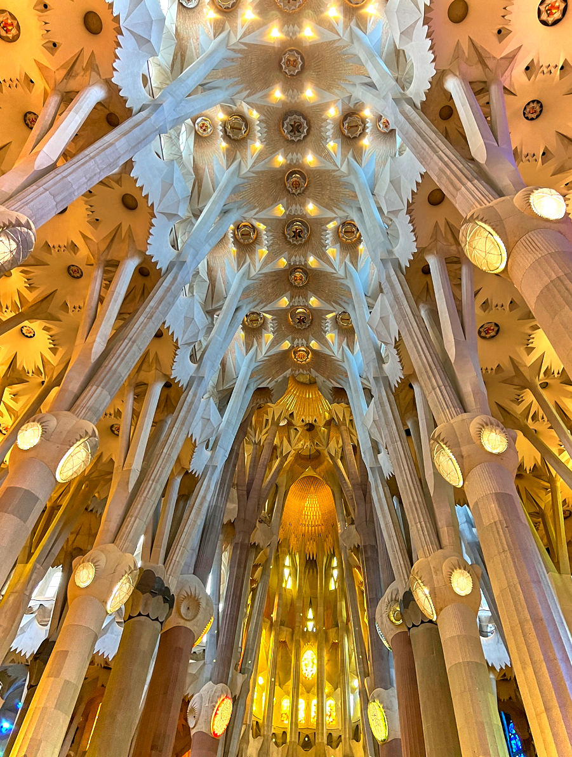
CEPC SRF
Development in EDR
Jiyuan Zhai (IHEP)
International Workshop on the Circular Electron-Positron Collider (CEPC) 2025 European Edition, Barcelona, Spain, June 16-19, 2025

Slide 2
Content
CEPC SRF system design - compare and revisit
EDR SRF R&D status
Summary

Slide 3
RF Design Requirement (CEPC and FCC-ee)
CEPC TDR 50 MW / FCC-ee FSR | Energy (GeV) | Collider beam current (mA) | Collider RF voltage (GV) | Booster beam current (mA) | Booster RF voltage (GV) | Booster duty factor (%)
Z | 45.5 / 45.6 | 1345 / 1292 | 0.1 / 0.09 | 16 (30) / 14.3 | 0.46 / 0.08 | 86 / 30-40
W | 80 | 140 / 135 | 0.7 / 1.05 | 5.3 / 11.8 | 0.87 / 0.4 | 36 / 15-30
H | 120 | 2 x 27.8 / 26.8 | 2 x 2.2 / 2.1 | 1.4 / 2 | 2.17 / 2 | 98 / 20-40
ttbar | 180 / 182.5 | 2 x 5.6 / 5 | 10 / 11.3 | 0.2 / 0.3 | 9.7 / 10.2 | 46 / 45-90
High current
High gradient
Double-ring collider with a full energy booster (20/30 GeV linac injection energy)
High RF voltage (30 GV for three rings) → use common cavities for the two collider rings for H/ttbar, need high gradient and high Q cavity (# cavity, cryogenic cost)
High power (100 MW) → need very high input coupler capacity to reduce # cav and impedance
High current (Z-pole 1.3 A, very low energy beam, 100/90.7 km) → fundamental mode instability and gap transient (cavity stored energy), HOM power and damping (# cell of cav, # cav in CM)

Slide 4
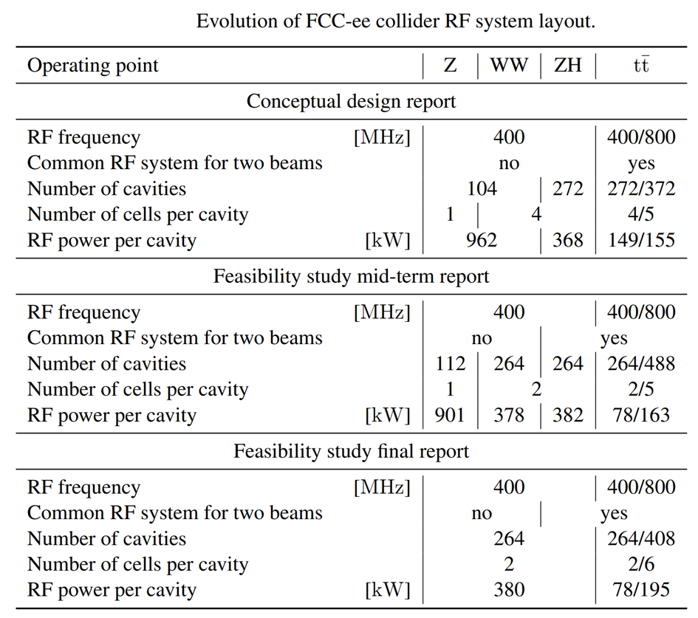
RF Design Evolution
Evolution of CEPC collider 650 MHz RF system layout
Operating point | Z | W | H | ttbar
Preliminary conceptual design report (Pre-CDR, 2015)
Common RF system for two beams |  |  | Pretzel
Number of cavities (54 km, 6.87 GV) |  |  | 384
Number of cells per cavity |  |  | 5
RF power per cavity [kW] (52 MW/beam) |  |  | 280
Conceptual design report (CDR, 2018)
Common RF system for two beams | no | no | yes
Number of cavities (100 km, 2.17 GV) | 120 | 216 | 240
Number of cells per cavity | 2 | 2 | 2
RF power per cavity [kW] (H/W 30 MW per beam, Z 16.5 MW/beam) | 275 | 278 | 250
Technical design report (TDR, 2023)
Common RF system for two beams | no |  | yes
Number of cavities | 100 | 336 | 336 | 336/192
Number of cells per cavity (Z 50/10 MW/beam) | 1/2 | 2 | 2 | 2/5
RF power per cavity [kW] (H/W 50 MW per beam, Z 50/10 MW/beam) | 1000 /200 | 298 | 298 | 118/315
(2019)
(2024)
(2025)

Slide 5
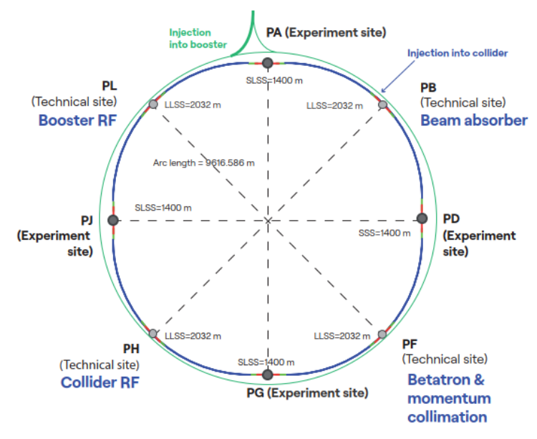
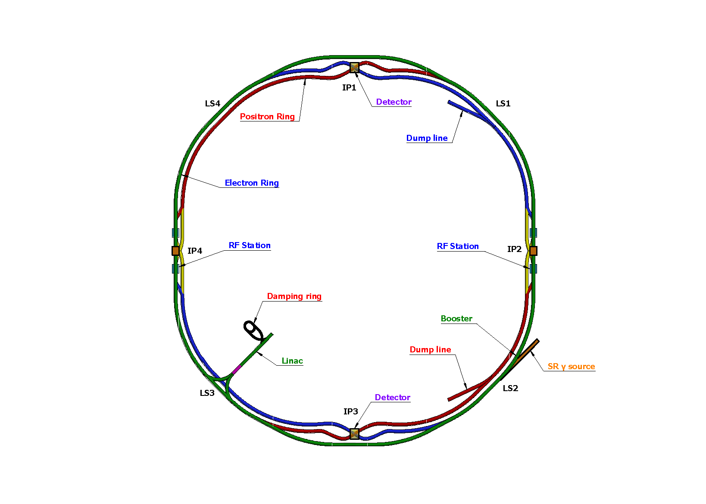
RF Section Location
CEPC: two symmetric RF sections. IP2 and IP4 have the same Collider and Booster RF cavity numbers.
FCC-ee: Collider RF in PH, Booster RF in PL. RF at a single location is for the need of extremely precise energy calibration at Z (FCC FSR vol.2, p135). Also to keep the tunnel diameter of 5.5 m.

Slide 6
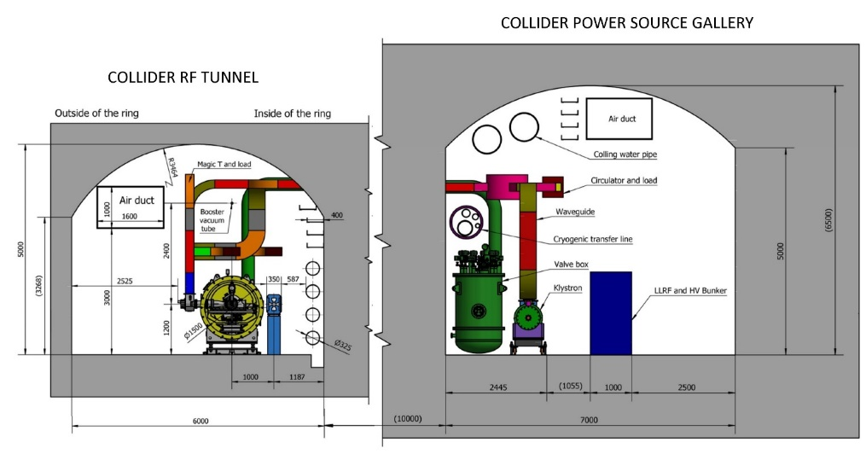
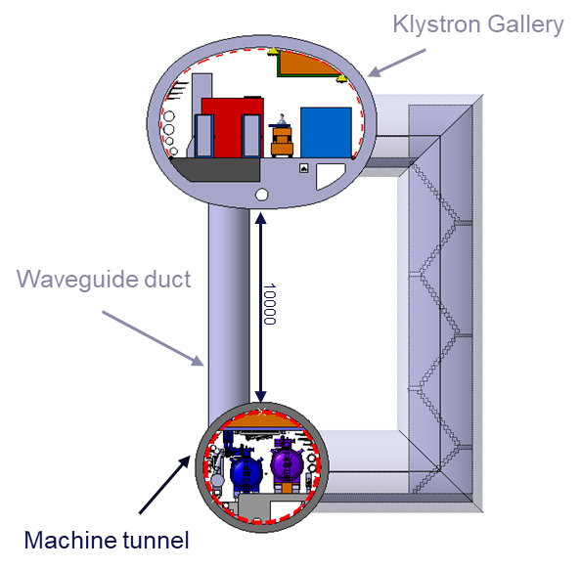
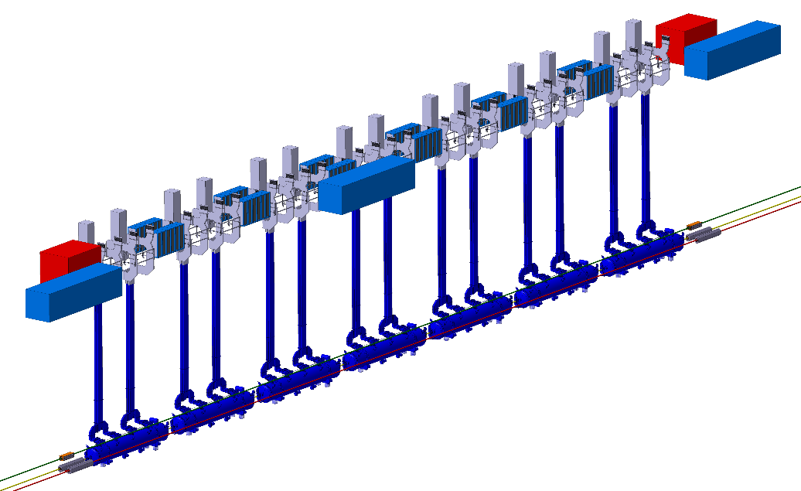
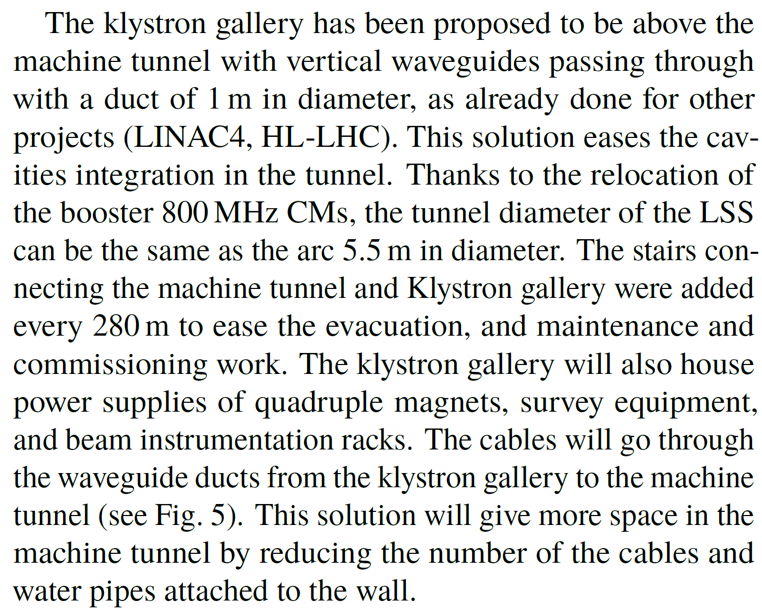
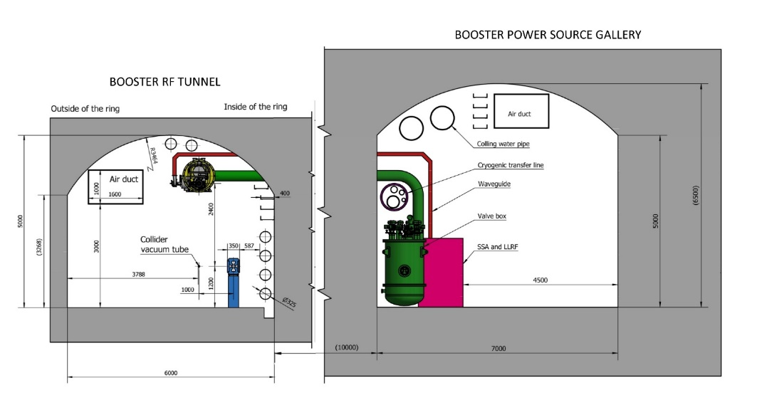
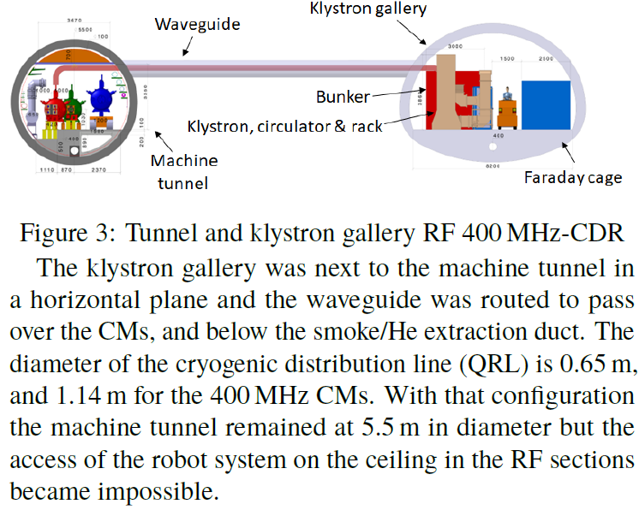
Klystron Gallery Position
650 MHz cryomodules mounted on tunnel floor.
1.3 GHz cryomodules hung from ceiling at a different beamline height and in between collider cryomodule sections.
F. Valchkova-Georgieva, IPAC24
CEPC klystron gallery parallel to main tunnel
in the horizontal plane
FCC-ee klystron gallery above main tunnel

Slide 7
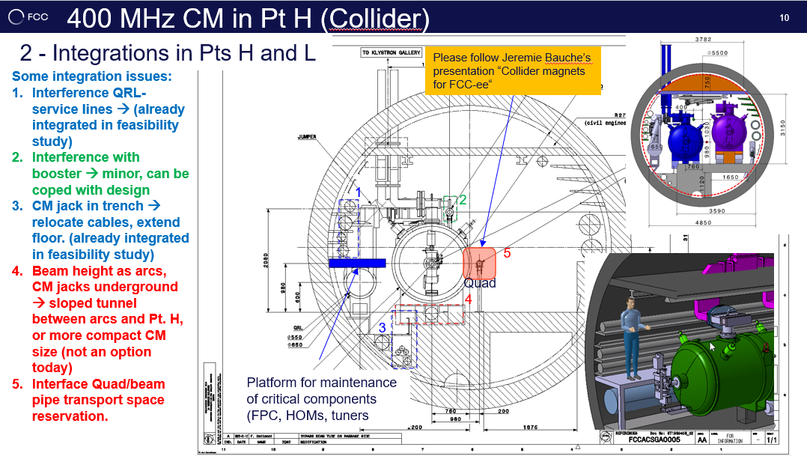

Slide 8
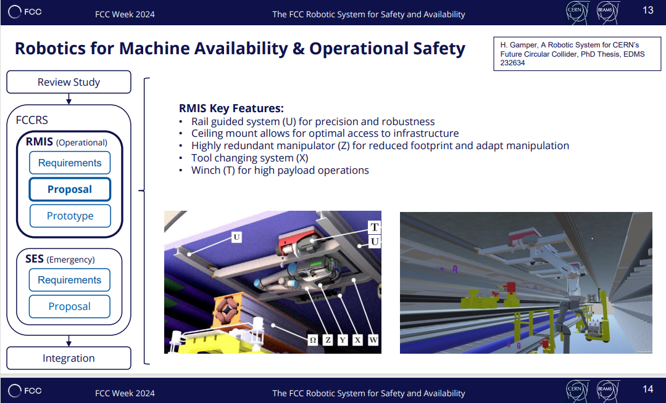

Slide 9
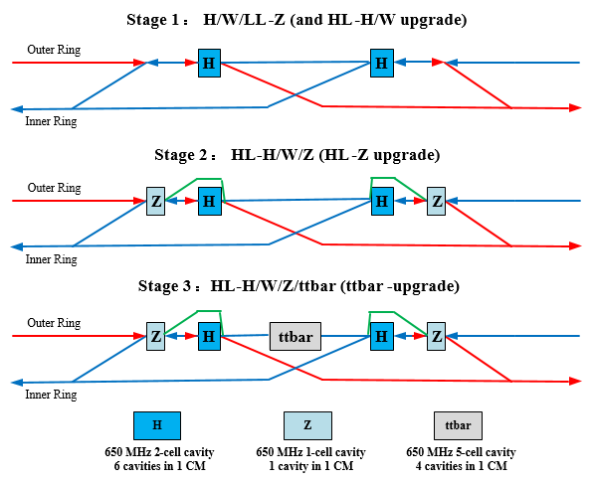
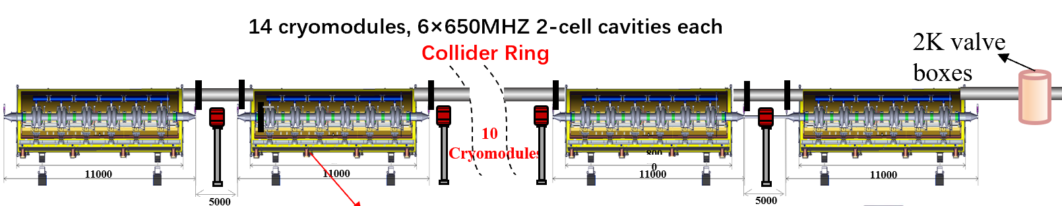
RF Configuration: H-W-LLZ HLZ ttbar (CEPC EDR)
650 MHz 1-cell
650 MHz 2-cell
650 MHz 5-cell
30 MW: 15 CM
50 MW: 25 CM
30 MW: 8 CM (48 CAV)
50 MW: 14 CM (84 CAV)
12 CM (48 CAV)
1.3 GHz
9-cell
1 CM (8 CAV)
3 CM (24 CAV)
8 CM (64 CAV)
Center of IP2/4
Collider RF Staging and Bypass Scheme
2x1.8 km RF section, 3 km RF module footprint, 2 km RF module length
628 650 MHz cavities, 384 1.3 GHz cavities, total 1012 cavities, 5188 cells
Collider and booster RF bypass for mode switch.

Slide 10
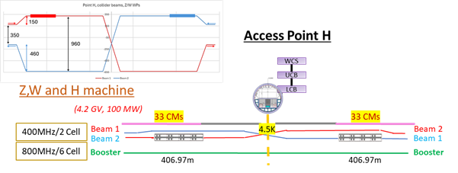
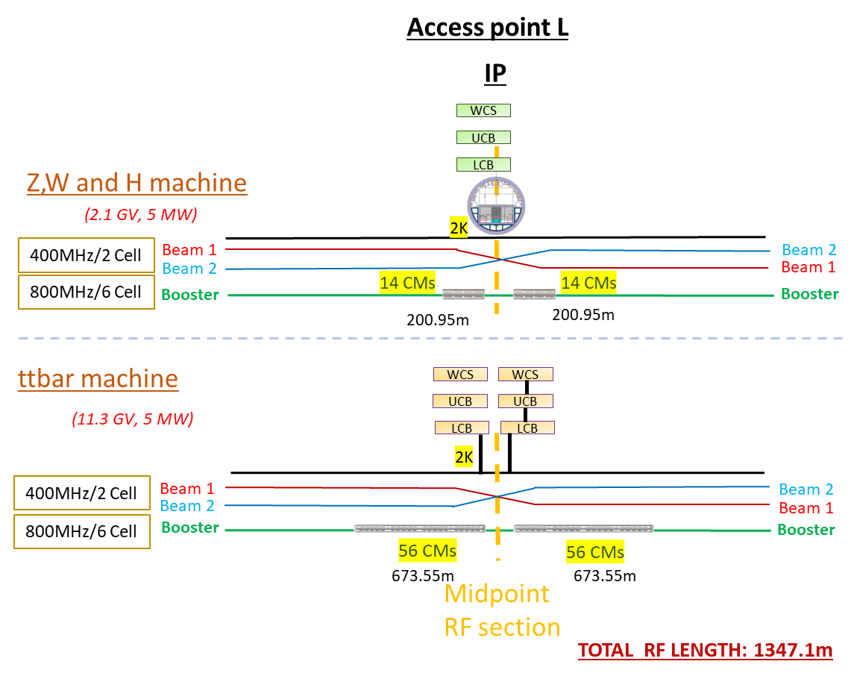
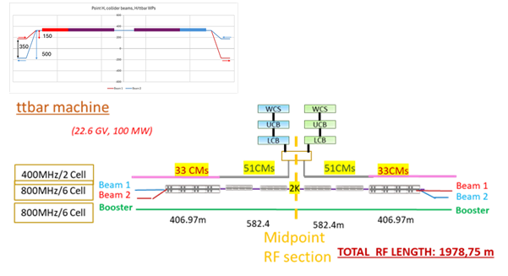
RF Configuration: H-W-Z ttbar (FCC-ee FSR)

Slide 11
RF System Design for H, W, ttbar
Common cavities for the two rings for H and ttbar (low cost)
  Shared cavities for H/ttbar, separate cavities for W/Z
  Save 2.2/10 GV, reduce by half cavities, klystrons, cryogenics construction and operation cost
  Cons: double coupler power, half filling of both collider and booster
RF system optimized for Higgs (Higgs priority)
  Coupler power, cavity and cell number, cavity gradient, HOM power, Qin match, beam-cavity interactions (FM/HOM CBI, RF transient), cavity material, operating temperature, Q₀, number of cavities in a module, module heat load, HOM damper, cavities per klystron, power overhead for LLRF …
  Balance all the parameters with technology maturity, reliability, performance degradation, operational margins, cost, risk and maintenance.
  CEPC and FCC-ee design is converging to ~300 2-cell cavities except the frequency.
RF system for W and ttbar (mode switch and max luminosity)
  Due to wide range of parameters from Z to ttbar, it is impossible to have a single common SRF system for the highest possible luminosity in each mode. A staged SRF complex for both collider and booster is inevitable at least for ttbar.
  W: fully share and use half of the Higgs cavities per ring due to similar beam parameters
  ttbar: reuse Higgs cavities, add new high gradient 5/6-cell cavities. Add more cavities for the booster.
  Add new RF power sources for ttbar

Slide 12
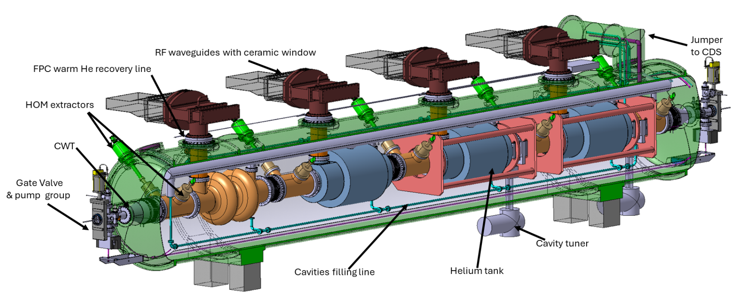
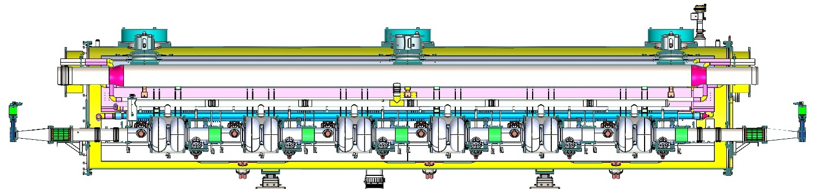
Collider Ring Higgs Cavities
 | CEPC TDR 50 MW | FCC-ee FSR 50 MW
RF freq. and cav. material | 650 MHz, high Q bulk Nb | 400 MHz, Nb film on Cu
Cavity and cryomodule # | 336 2-cell, 56 CM | 264 2-cell, 66 CM
Cavity gradient and Q | 3E10 @ 14.5 MV/m @ 2 K | 2.7E9 @ 10.6 MV/m @ 4.5 K
Cavity dynamic loss @ 4.5 K | 25 W, total 8.4 kW equiv. | 128 W, total 33 kW
Cavity max input power | 298 kW | 378 kW
CEPC
FCC-ee

Slide 13
Dedicated High Luminosity Z Cavities
Highest beam current & lowest RF voltage and beam energy for high luminosity (HL) Z mode
→ 1-cell cavity design is the straightforward and technically optimal choice.
FCC-ee CDR: sequential energy staging
  use 1-cell cav. to run HL-Z for 4 years. 4 cav. in a module (LHC type)
  then uninstall Z cav., add new H, W 2-cell, RF power redistribution
CEPC TDR: Higgs first and mode switch with bypass lines
  install 2-cell cav. to run H, W and low luminosity Z (< 10 MW, half parking) for ~10 years. Leave HL-Z as a possible future upgrade, keep enough tunnel length.
  then, if HL-Z justified, add dedicated Z 1-cell (KEKB/BEPCII type).
  bypass lines to switch H, W, HL-Z if needed.
  100 MW RF power source duplication and cost. RF power transfer from H to HL-Z cavites?

Slide 14
How to Integrate High Luminosity Z to Higgs Cavities?
FCC-ee FSR: universal 2-cell cavity for H, W, Z (HL)
More than 100 x Qe tuning (reverse phase operation, RPO)
Transient beam loading and FM instability: twice R/Q, lower stored energy, RPO will help?
Higher HOM power in multi-cavity cryomodule for Z-pole
4 x impedance for Z-pole HOM damping
CEPC TDR alternative: universal 1-cell cavity for H, W, Z (HL)
2 x 168 1-cell cavities for Z. More cavities than the optimized 2 x 50 1-cell cavities.
Partly solve the HOM issue of Z-pole 2-cell (still huge HOM in multi-cavity CM), but worse for FM than baseline. Detune some cavities? Increase input power for the operating cavities.
Qe tuning range
Cavity gradient increase: FCC-ee 10 → 20 MV/m (Nb/Cu → Nb?), CEPC (50 MW) 15 → 30 MV/m (because of higher freq. and RF voltage than FCC-ee).
Need to double Q₀ at twice the gradient to have same Higgs cavity wall loss heat load.
Combine high Q, high gradient, high current and high power in one cavity. Risk.

Slide 15
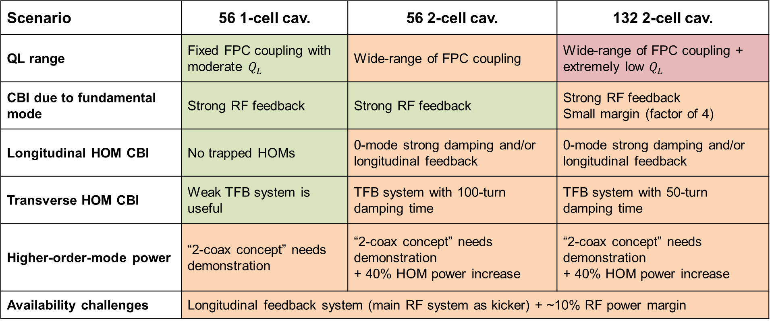
Z 2-cell vs 1-cell (FCC-ee)
Scenario | 56 1-cell cav. | 56 2-cell cav. | 132 2-cell cav.
QL range | Fixed FPC coupling with moderate $Q_{L}$ | Wide-range of FPC coupling | Wide-range of FPC coupling + extremely low $Q_{L}$
CBI due to fundamental mode | Strong RF feedback | Strong RF feedback | Strong RF feedback Small margin (factor of 4)
Longitudinal HOM CBI | No trapped HOMs | 0-mode strong damping and/or longitudinal feedback | 0-mode strong damping and/or longitudinal feedback
Transverse HOM CBI | Weak TFB system is useful | TFB system with 100-turn damping time | TFB system with 50-turn damping time
Higher-order-mode power | “2-coax concept” needs demonstration | “2-coax concept” needs demonstration + 40% HOM power increase | “2-coax concept” needs demonstration + 40% HOM power increase
Availability challenges | Longitudinal feedback system (main RF system as kicker) + ~10% RF power margin

Slide 16
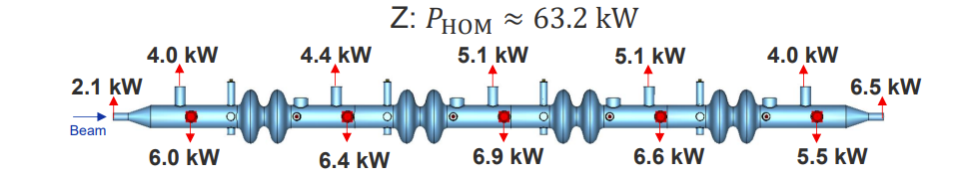
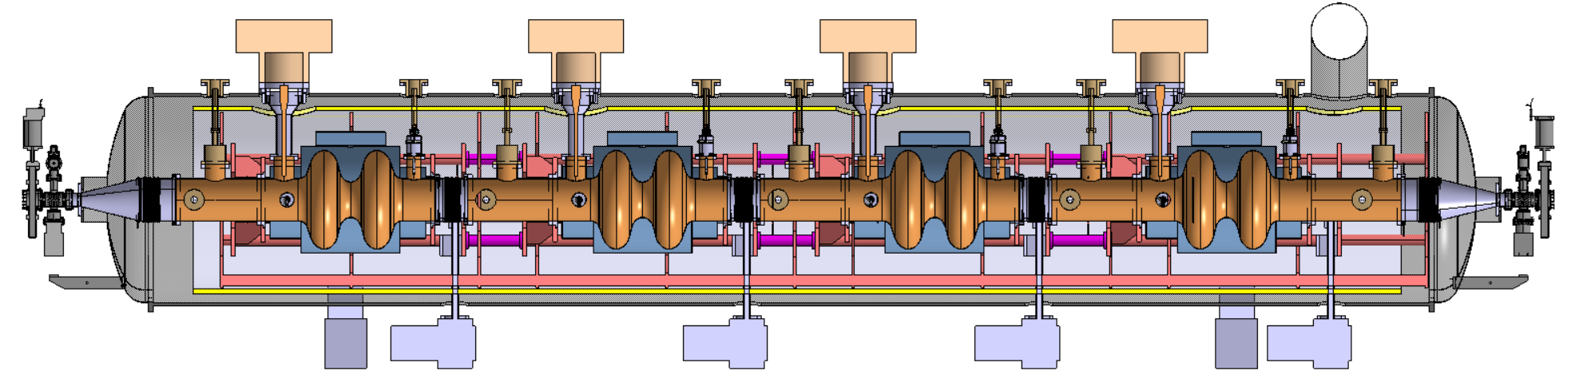
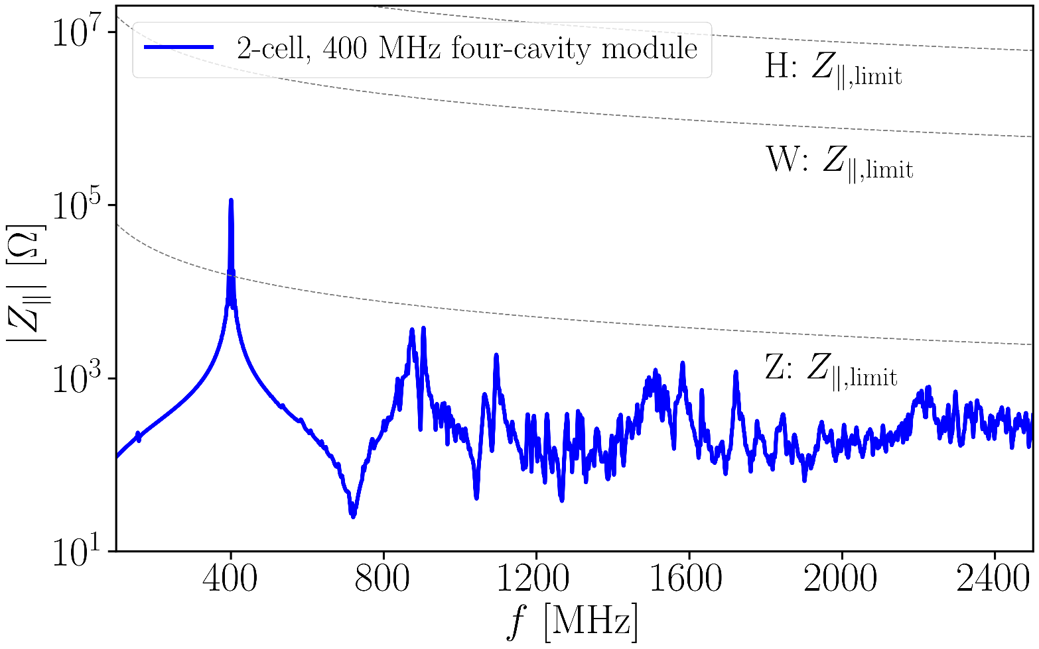
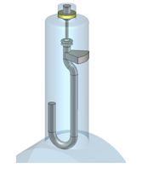
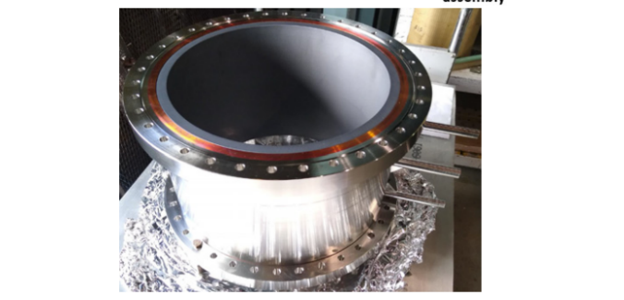
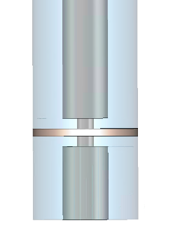
HOM Damping of FCC-ee 400 MHz Cavities
Two hook-type coaxial couplers per cavity used for trapped dipole mode damping. Total numbers: 8×66=528
Two coaxial lines between cavities for high-power HOM extraction. Total numbers: 10×66=660
(possibility of reducing this number should be checked)
BLA between modules to absorb power propagating from modules out. Total numbers=66+1=67
HOM power of all 8 hook-type HOM couplers combined is around 0.7 kW (not shown in the figure above)
CEPC has higher HOM power due to smaller cavity.
BS bunch length control critical to limit HOM power.
Water cooled BLA between modules
Coaxial lines terminated by water-cooled absorbers
Window to separate air and vacuum compromises broadband transmission (design study ongoing)
EIC BLA
Shahnam Gorgi Zadeh, FCC Week 2025

Slide 17
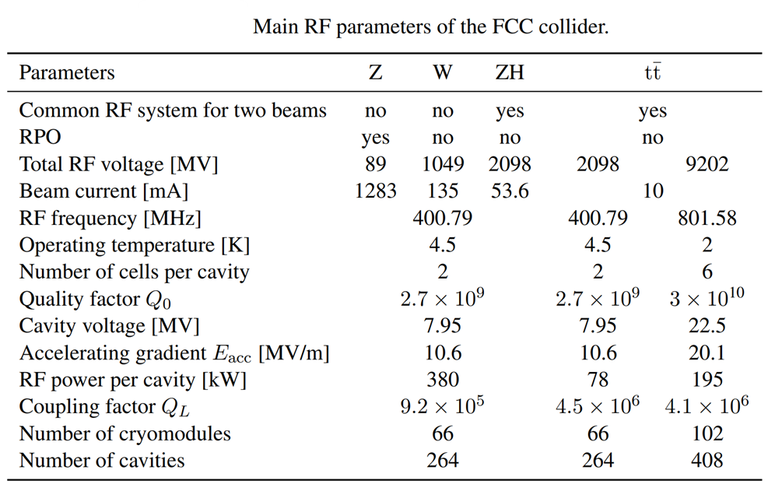
Collider RF Parameters of CEPC TDR and FCC-ee FSR
Main RF parameters of the CEPC collider
Parameters (50 MW/beam) | Z (50/10 MW) |  | W | H | ttbar
Common RF system for two beams | no |  | no | yes | yes
RPO | no |  | no | no | no
Total RF voltage [MV] | 0.12 |  | 0.7 | 2.2 | 6.1 | 3.9
Beam current [mA] | 1345 | 267 | 140 | 2×27.8 | 2×5.6
RF frequency [MHz] | 650
Operating temperature [K] | 2
Number of cells per cavity | 1 | 2 | 2 | 2 | 2 | 5
Quality factor Q₀ | 2E10 | 3E10
Cavity voltage [MV] | 2 | 2.5 | 4.2 | 6.6 | 11.6 | 31.8
Accelerating gradient Eacc [MV/m] | 8.7 | 5.4 | 9.1 | 14.2 | 25.2 | 27.6
RF power per cavity [kW] | 1000 | 206 | 298 |  | 118 | 315
Coupling factor Q_{L} | 3.8E4 | 1.4E5 | 2.7E5 | 6.8E5 | 5.4E6 | 6E6
Number of cryomodules | 100 | 16 | 56 |  |  | 48
Number of cavities | 2×50 | 2×48 | 336 | 336 |  | 192
Optimal detuning [kHz] | 21.7 | 7 | 2 | 0.2 | 0.03 | 0.02
HOM power per cavity [kW] | 6.2 | 1.9 | 1.54 | 0.67 | 0.26 | 0.66
Same cavity voltage and QL for Z/W/H, RPO for Z operation
Reactive waveguide tuning to change QL for ttbar operation
Coupler inner conductor moving to change QL

Slide 18
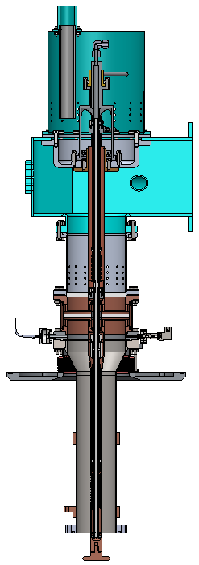
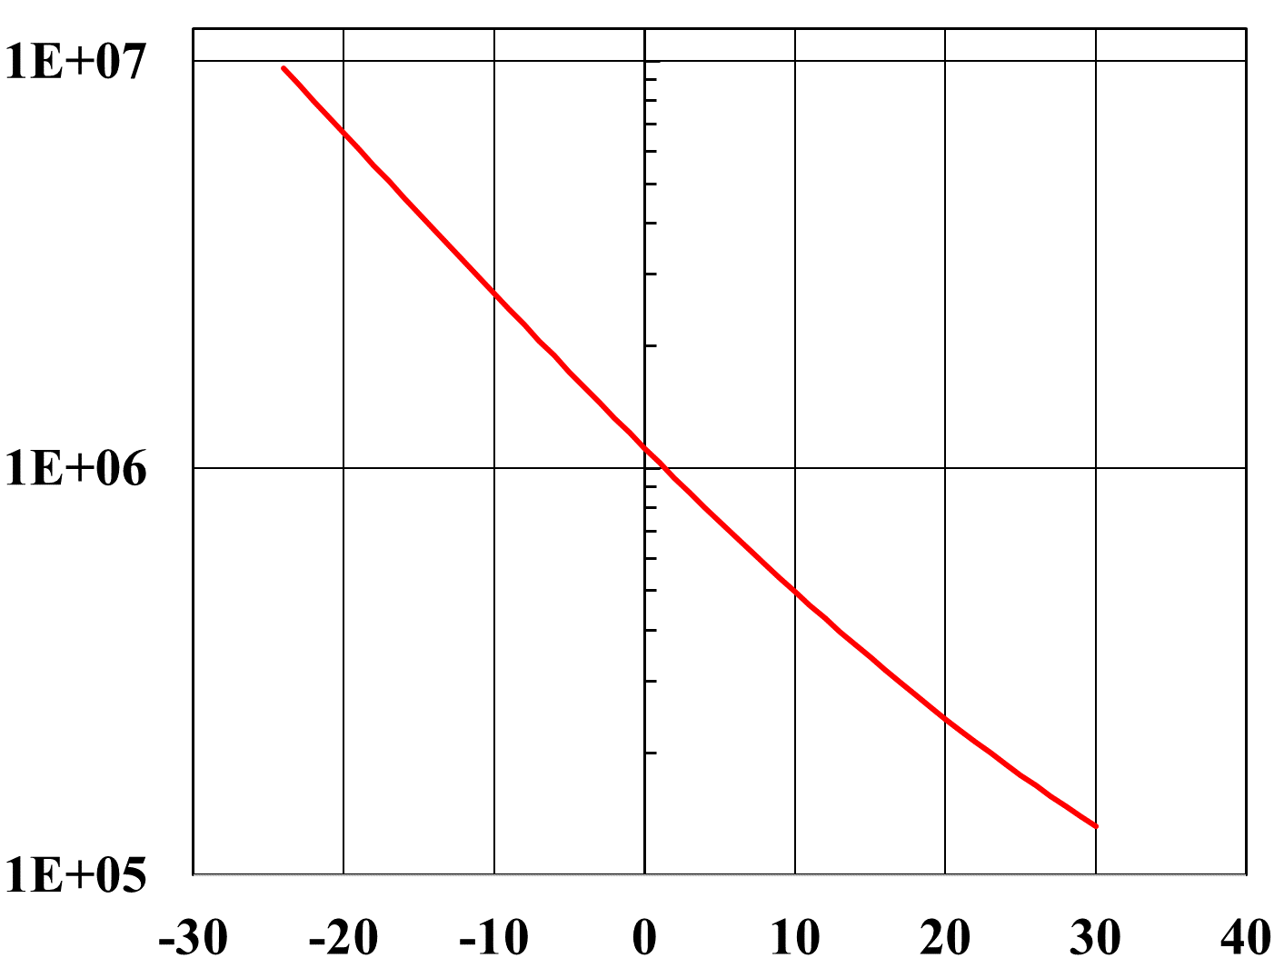
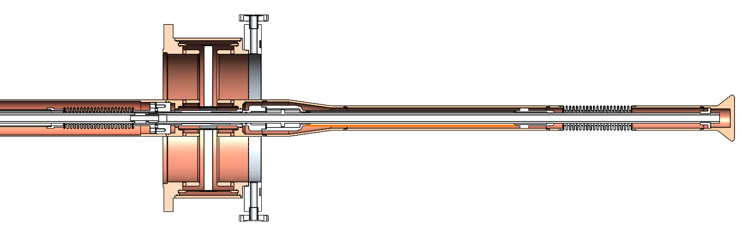
Antenna Penetration Tuning of Coupler Q_{ext} (CEPC)
CEPC prototype input coupler design with two 70 mm bellows: Q_{ext} tuning range x 15 (ΔL = 30 mm), cover 50 MW Higgs to 10 MW Z. Longer bellow (120 mm) will enable Higgs cavity operation for ttbar.
For 50 MW Z, if using Higgs 2-cell and keep 300 kW input power per cavity, Q_{ext} extremely low (~ 5E3), cavity stored energy extremely small (detuning, FM CBI, gap transient...).
Increase cavity voltage and keep the beam dynamics → Reverse Phase Operation (RPO).
Q_{ext} = 1.4E5 ~ 5.4E6 (× 40), ΔL = 47 mm, Bellow length L = 2.5 ΔL = 118 mm (1/4 λ)
Penetrate 30 mm into beam pipe (R = 80 mm)
120 mm bellow with 50 mm tuning range could work stably by adding a guiding structure.
Q_{ext}
Antenna penetration depth into the beam pipe (mm)

Slide 19
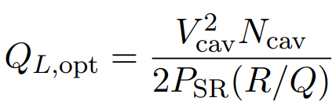
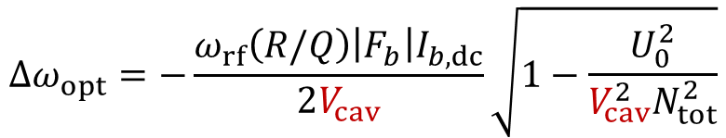
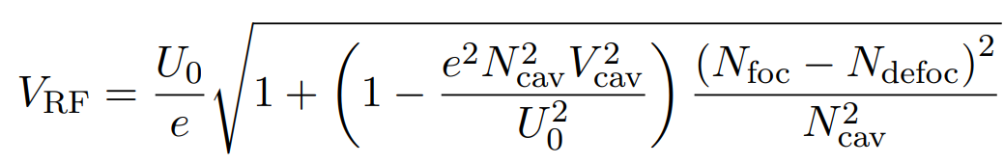
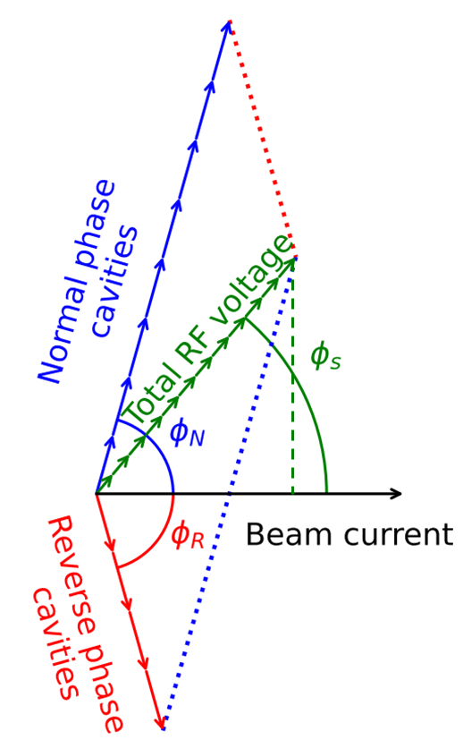
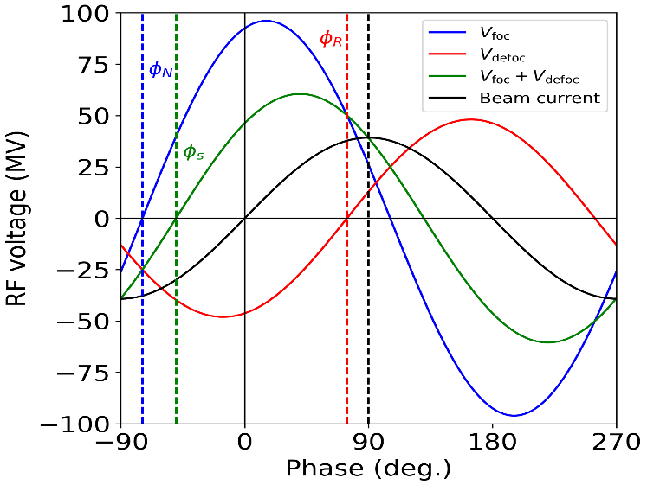

Reverse Phase Operation (FCC-ee)
To operate Z, W, H modes with same cavity, Qext and RF power, avoid a movable fundamental power coupler design
Reverse phase operation (RPO) offers this opportunity:
  allows operation at higher cavity voltages (alleviate FM CBI)
  does not required more RF power (all cavities accelerate the beam)
  experimentally verified at KEKB (Y. Morita et al., SRF2009) and baseline solution for EIC ESR (J. Guo et al., IPAC2022)
  cavity voltage can only be changed in discrete steps of 𝑁_foc−𝑁_defoc = 2, 4,…
Higher cryogenic heat load for Z, W
Static beam loading → New total RF voltage proposed
Transient beam loading → Shorter beam gaps are introduced
Coupled-bunch instabilities → Active and passive damping is sufficient
Higher-order-mode power losses → ~50 % increase wrt 1-cell design
Availability aspects: → Beam can be preserved only in case of a single cavity trip
$\cos\left(φ_{s}+φ_{foc}\right)$= $\cos\left(φ_{s}+φ_{defoc}\right)$
Ivan Karpov, FCC Week 2025

Slide 20
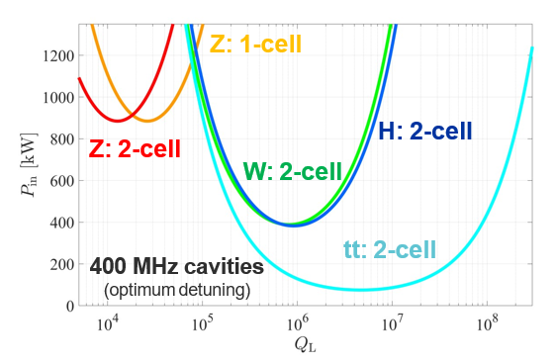
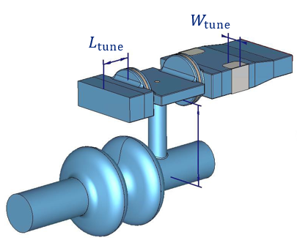
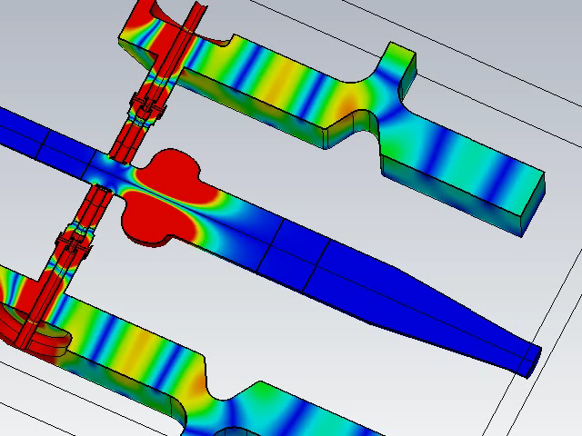
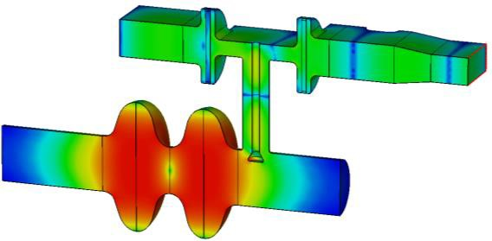
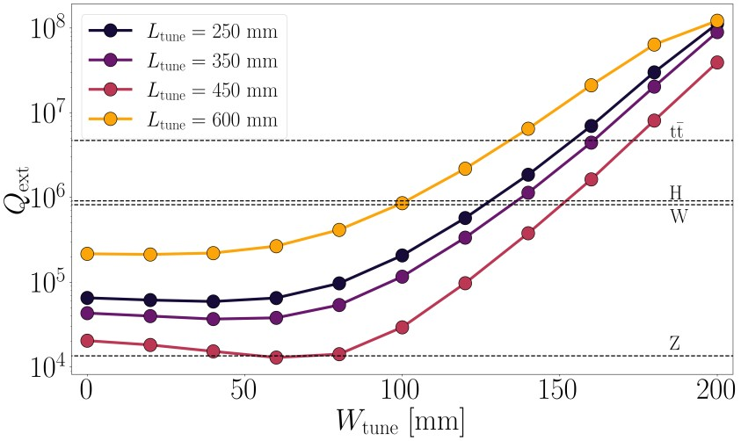
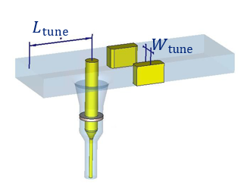

Waveguide Reactive Tuning of Coupler Q_{ext} (FCC-ee)
Cavity input power as a function of loaded Q factor with optimal frequency detuning for beam loading compensation. Operation at optimal QL is mandatory to minimize RF power budget.
EIC and FCC-ee use reactive tuning in the waveguide. FCC-ee: two windows are placed outside the cryomodule, integration challenge after cryostating. A more robust and easier-to-cool down window design.
easier to cover all four working points.
Z
$L_{tune}=450 mm$,
$W_{tune}=55 mm$,
$Q_{ext}=1.33e$4,
$E_{pk−window}=0.18 MV/m$,
$$E_{pk−air}=0.22 MV/m$$
Qe tuning with moving stub (EIC 591 MHz): Qext 100 times with shorted moving stub on matched T, but strong SW and heating (J. Guo, TTC meeting 2023)
Covering of all four working points is challenging.

Slide 21
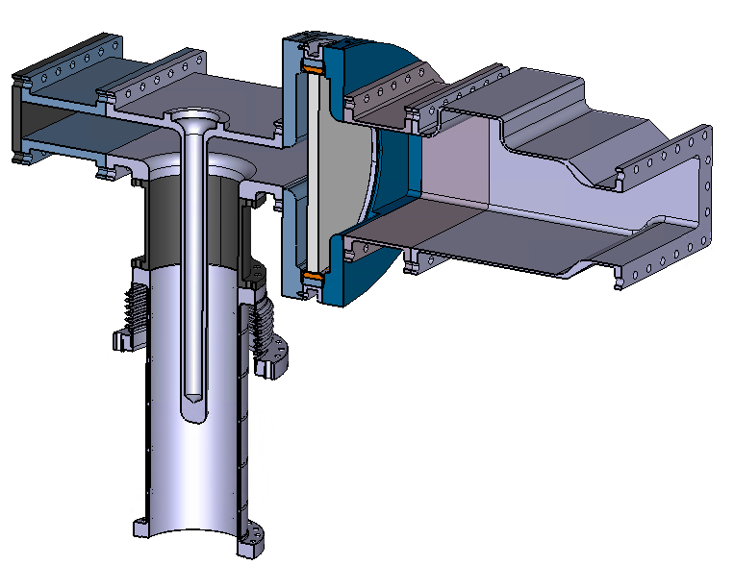
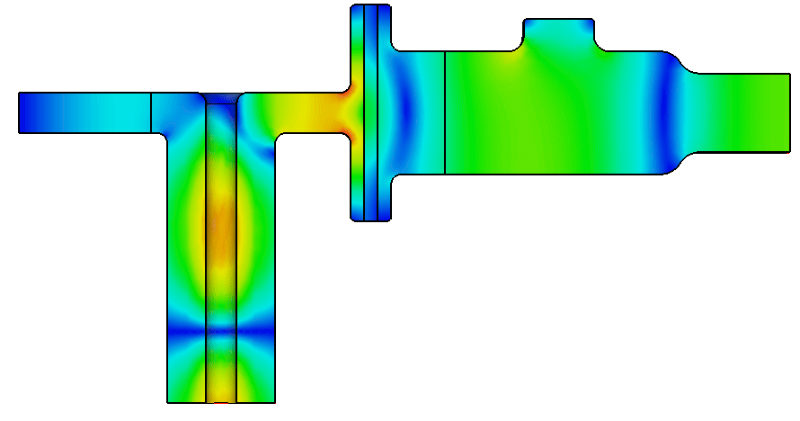
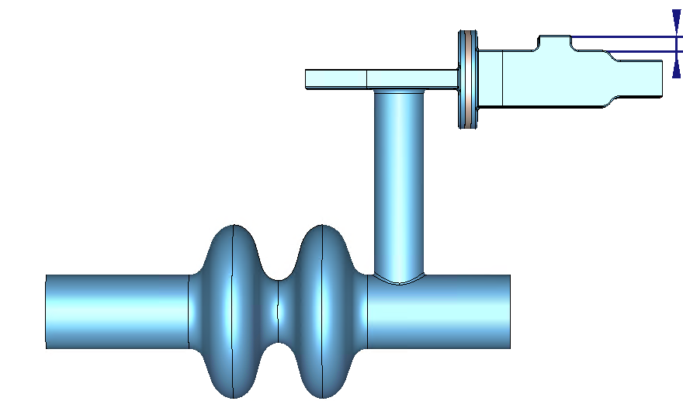
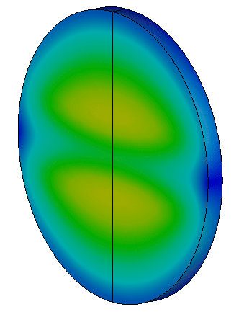
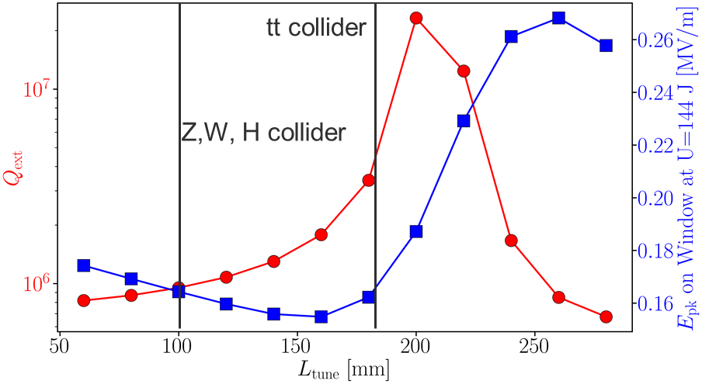
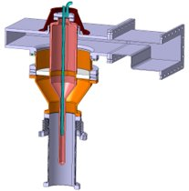


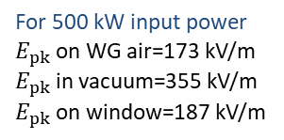
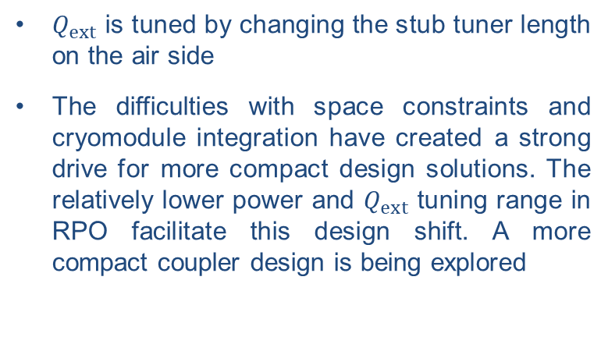
FCC-ee 400 MHz Power Coupler
Half-height WR2300
$$L_{tune}$$
400 mm
Vacuum side
$$Z_{0}=75 Ω$$
For 500 kW input power
$E_{pk}$ on WG air=173 kV/m
$E_{pk}$ in vacuum=355 kV/m
$E_{pk}$ on window=187 kV/m
Air side
200 mm
$Q_{ext}$ is tuned by changing the stub tuner length on the air side
The difficulties with space constraints and cryomodule integration have created a strong drive for more compact design solutions. The relatively lower power and $Q_{ext}$ tuning range in RPO facilitate this design shift. A more compact coupler design is being explored
Shahnam Gorgi Zadeh, FCC Week 2025

Slide 22
Reverse Phase Operation (CEPC)
Use all 2-cell cavities in three operation modes, H, W and Z (all 50 MW per beam).
The Q_ext in all three modes can be kept unchanged.
In H mode, two beams share 336 cavities.
In W and Z mode, each beam gain energy from 168 cavities.
In W and Z mode, we matched the Q_ext to the Q_ext of cavities in H mode as close as possible.
The synchronous voltage of each cavity was kept unchanged.
The quadrature voltage of the cavities were chosen so that the combined quadrature voltage from the focusing and defocusing cavities stay the same as the original design to preserve the longitudinal working point.
Tianmu Xin (IHEP)
Mode | Number of Focusing Cavity | Number of Defocusing Cavity | V_cav _original [MV] | V_cav _new [MV] | V_focus_ original [MV] | V_focus _new [MV] | Phi_focus _original [dgr] | Phi_focus _new [dgr] | Q_opt
H | 336 | 0 | 6.55 | 6.55 | 5.36 | 5.36 | 35.1 | 35.1 | 6.8e5
W | 133 | 35 | 4.17 | 6.50 | 3.58 | 6.14 | 59.3 | 71.0 | 6.7e5
Z | 91 | 77 | 2 | 6.68 | 1.86 | 6.64 | 68.3 | 88.1 | 7.0e5

Slide 23
Content
CEPC SRF system design
EDR SRF R&D status
Summary

Slide 24
EDR Plan of CEPC SRF System
EDR major goal is to prepare for the first stage construction of the CEPC SRF system (30 MW H/W & low-lumi Z):
Complete engineering design of the Collider 650 MHz and Booster 1.3 GHz cryomodule for Higgs 30/50 MW & Z 10 MW (3.8×10³⁵ cm⁻²s⁻¹) in 2025.
Complete Higgs 650 MHz full-scale cryomodule prototyping to achieve TDR specification in 2026.
High Q high gradient cavity and high power RF components R&D.
Collider Higgs 650 MHz Cryomodule Parameters | Spec.
Module operating temperature | 2 K
Cavity vertical test gradient | 28 MV/m
Cavity vertical test Q₀ at 25 MV/m | 3.3E10
Module RF voltage (six 2-cell cavities) | 70 MV
Module average cavity gradient | 25 MV/m
Module average cavity Q₀ at 25 MV/m | 3.0E10
Module total 2 K heat load at 70 MV | 160 W
Input coupler conditioning power | 300 kW
Input coupler Q_{e} adjusting range | 1E5 ~ 1E7
HOM coupler power (cryogenic test) | 1 kW
HOM absorber power (test stand) | 5 kW
CEPC SRF Module EDR (2024-2027) | Preliminary Design | Engineering Design | Full-scale Prototyping | Industrial Preparation
Collider H/W (high Q / G 650 M) |  | √ | √ | √
Collider HL-Z (high current 650 M) | √
Collider ttbar (high G / Q 650 M) | √
Booster H/W (high Q / G 1.3 G) |  | √ | improve | √
Booster Z (high current 1.3 G) |  | √ | R&D

Slide 25
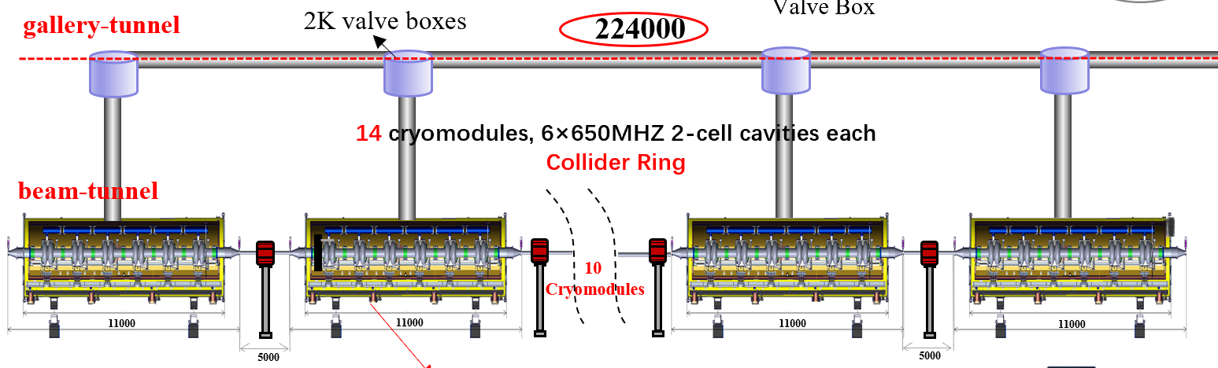
650 MHz Module Connection of CEPC Collider Ring
C
D
R
“Parallel”
cryogenic connection
TDR
“Series”
cryogenic connection
Multi-channel cryogenic transfer lines (CTL) inside cryomodule for TDR module connection scheme. Combines the features of cryomodule, valve box and cryogenic lines. Shared vacuum, make full use of space, low cost.
XFEL/ILC type module connection (all-cold beam line) not suitable for CEPC Collider cryomodules due to cooling requirement of huger HOM power (~ 5 kW per absorber). Water-cooling HOM absorbers in the two ends outside of the cryomodule at room-temperature, and normal conducting quadrupoles outside.

Slide 26


EIC ESR 591 MHz Module with Inside Water Cooling?
591 MHz, 800 kW (2 x 400 kW) per cavity, 2 K, 2 x 1-cell cryomodule.
Two cavities in a module are connected by large beam pipe hosting room-temperature SiC beam line absorber.
BLA (φ274 mm), HOM power of 57 kW
J. Guo, TTC2025
Concept could be used in CEPC high luminosity Z-pole cryomodule design? Or even Higgs module?
Silvia Verdú-Andrés,
FCC Week 2025

Slide 27



650 MHz Cryomodule Design

Slide 28



650 MHz Cryomodule Design
Two 5 ~ 8 K Ø45 pipes for coupler, two 40 ~ 70 K Ø45 pipes for thermal shield, one 2 K Ø273 (inside CM) Ø219 (outside CM) GRP, 3 Bara @ 2.4 K Ø45 pipe for subcooled supply.
Coupler change from horizontal to 15 deg tilt due to off-axis (move downward) and cold mass-vacuum vessel assembly requirement. Coupler length also reduced.
12 coaxial lines for power extraction of 12 HOM couplers (1 kW each).
Remove the ion pump inside the gate valve.
RF shielded bellow between cavities.
Impedance and heat load of cavity flange seal gap to be evaluated.
Cavity support configuration modified from TDR bottom-supported to top suspension, achieving both sufficient NC quadrupole vertical clearance and consistent beamline height with the arc sections.

Slide 29


HLRF System for 650 MHz Module Test
Zusheng Zhou
CEPC 800 kW high efficiency 650 MHz klystron to feed six 2-cell cavities (150 kW SSA as backup).
RF distribution under design for the six 2-cell cavities.

Slide 30



LLRF System for 650 MHz Module Test
Zusheng Zhou
Completed
Amplitude & Phase Control Module Design
Inter-Board Communication: Design & Testing
Tuning Control Module Design
System HW Development & Fabrication
In Progress
Tuning Control Module Testing
Vector Synthesis Module Design
Quench & Interlock Protection Module Design
EPICS Interface Development
Next Steps & Outlook
Complete system integration testing by end of Dec.
Set up a lab test bench for full system validation
Ensure module interoperability and system stability

Slide 31




650 MHz 2-cell Cavity
CEPC 650 MHz CM |  | EDR Specification
650 MHz 2-cell cavity vertical test | E_{acc.max} | 30 MV/m
 | Q₀ | 3.6E10 @ 25 MV/m
Module horizontal test acceptance | E_{acc.max} | 28 MV/m
 | Q₀ | 3.3E10 @ 25 MV/m
Module long term operation | E_{acc.max} | 28 MV/m
 | Q₀ | 3.0E10 @ 25 MV/m
650 MHz 2-cell BCP
20 % margin from vertical test to operation spec.
BCP dressed 2-cell VT: 2E10 @ 25 MV/m, max ~ 26.5 MV/m
BCP 2-cell module test: 2E10 @ 8 MV/m (coupler cooling limited?)
EP + mid-T 1-cell VT: 8E10 @ 25 MV/m, max 31.5 MV/m
Apply 1-cell recipe to 2-cell
650 MHz 1-cell EP mid-T
31

Slide 32





650 MHz 2-cell Cavity Fabrication
Will complete EBW of eight 2-cell cavities in 2025.
Processing, dressing and vertical test until early 2026.

Slide 33













650 MHz 2-cell Cavity EP and Mid-T Bake
EP system aging and maintenance: abrasion and erosion of parts and devices. Sulfur and carbon contaminations inside pipes and pumps. Clean or change most of the parts and devices.
2-cell cavity EP optimization and mid-T for high Q and high gradient

Slide 34






650 MHz Large Grain Cavity R&D
Rolling
Nb ingot (Φ480mm)
LG sheet (Φ540 mm)
Deep-drawing
650 MHz LG SRF cavity
OTIC has bought a new Electron Beam Melting (EBM) furnace, which can make large (Φ > 540 mm) LG sheets.
New 650 MHz LG cavities will be made for CEPC R&D.
Vertical test result of 650 MHz LG 1-cell cavity

Slide 35







650 MHz High Power Input Coupler
CEPC Higgs mode requires variable 313 kW CW 650 MHz input coupler. In the CEPC TDR phase, both fixed and variable couplers are designed, fabricated and tested to CW TW 150 kW (SSA power limit), SW 100 kW.
Six variable couplers in the full-size cryomodule instead of the fixed couplers in test cryomodule for RF power saving in different modes. Eight couplers currently in fabrication. High power conditioning with 800 kW 650 MHz klystron.

Slide 36








650 MHz Coupler Cooling and Heat Load
Evaluate cooling capacity of the thermal anchors on cryogenic lines, avoid cavity low field quench by coupler heating. Compare with helium gas cooling.
Avoid overheating of the bellow on the inner conductor.
Confirm air cooling capacity of the warm part and the window.
 | Heat Load at 313 kW, TW
298 K | 4.2 W
60 K | 29.2 W
7 K | 6.3 W
2 K | 2.7 W

Slide 37






HOM Coupler and Absorber
Robust design of HOM coupler: double-notch, coaxial filter
Fundamental mode (TM010) Qe >1×10¹¹ without tuning
HOM damping verified by the test cryomodule
Custom rigid coaxial line is currently being designed for HOM power handling capacity of 1 kW or more (refer to LHC 1 kW and HL-LHC 5 kW HOM power extraction lines). Cryogenic test on the cryomodule or chechia with cavity HOM freq. Consider to install one or two prototype power extraction lines in the cryomodule.
Two broadband HOM absorbers (5 kW BLA) are under fabrication for the cryomodule.

Slide 38
Summary
RF systems for future circular colliders—CEPC and FCC-ee—face unprecedented scale, complexity, and challenges. After a decade-long evolution, RF designs for both machines are converging toward similar configurations, key differences remain in frequency selection, RF section number, klystron gallery location, cavity technology, and particularly the way to achieve high-luminosity Z.
FCC-ee is implementing and validating reserve phase operation (RPO) and large HOM power extraction for a compact and efficient 2-cell RF system compatible with high-luminosity Z. CEPC may also need to reconsider and simplify its TDR RF configuration for high-luminosity Z, if the physics really justified, without compromising the Higgs priority and the first phase cost and schedule.
Critical R&D efforts are currently underway for the CEPC Engineering Design Report (EDR), focusing on the development and demonstration of a full-size collider 650 MHz prototype cryomodule with high quality factor, high accelerating gradient, and high power handling capabilities.

