Slide 1



CEPC Cryogenic System
Optimization in EDR
Rui Ge
2025 European Edition of the International Workshop on CEPC, Barcelona, Spain, 16~19th June 2025

Slide 2
Content
1. CEPC SRF Cryogenic System Overview
  1.1 CEPC Project Brief Introduction
  1.2 Heat Load Estimation of Cryogenic System
  1.3 General Layout of Cryogenic System
  1.4 EDR scope and plan
2. CEPC SRF Cryogenic System Scheme Design
  2.1 Process Design & Calculation
  2.2 Large Helium Refrigerator
3. Cryomodule R&D Status
  3.1 Collider 650MHz Cryomodule R&D
  3.2 Booster 1.3GHz Cryomodule R&D
4. Summary and Outlook

Slide 3
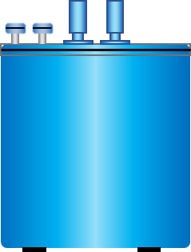
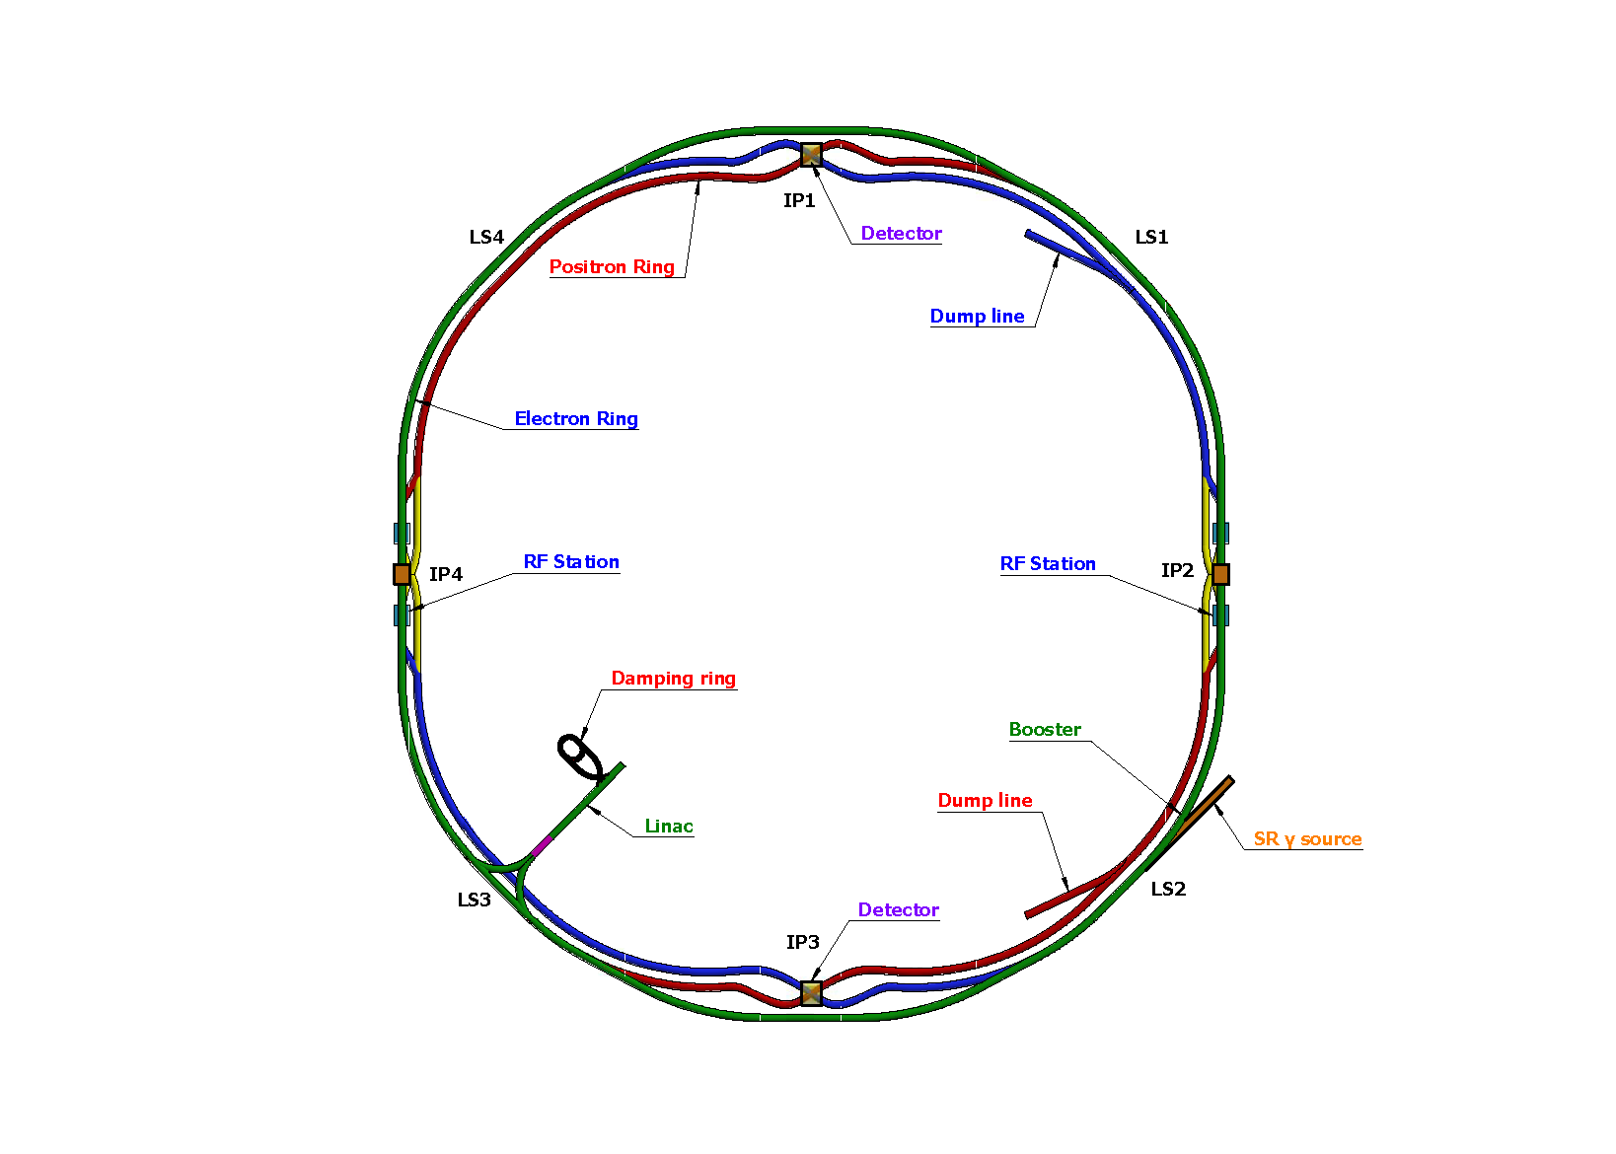
CEPC Cryogenic System Brief Introduction
CEPC is a positron and electron collider, and the beam is accelerated to 30 GeV by linear acceleration section, and then further accelerated to 120 GeV by RF cavities in the Booster and Collider ring.
Cryogenic system is designed to provide a reliable and stable cooling environment (4.5K or 2K) for RF cavities and magnets.
Report focus
SC magnets Cryo-station
  Booster ring:
1.3 GHz 9-cell cavities, 96 cavities
12 cryomodules
3 cryomodules/each station
Temperature: 2K
  Collider ring:
650MHz 2-cell cavities, 240 cavities
32 cryomodules for Higgs 30MW, 56 for Higgs 50MW
8 or 14 cryomodules/each station
Temperature: 2K
  MDI IR magnets:
4 IR magnets, 4 cryostats
Temperature: 4.5K/2K
  Detectors:
2 detector magnets
HeI/Thermosiphon cooling
SRF cryomodule: 4×12kW@4.5K
IR MDI magnets: 2×1kW@4.5K
Detectors: 2×1kW@4.5K
RF
Cryo-station
RF
Cryo-station
SC magnets Cryo-station
Overview of the CEPC cryogenic system
  1. | OVERVIEW | SRF REQUIREMENTS | OVERALL CRYO LAYOUT | | HEAT LOAD ESTIMATION | EDR SCOPE & PLAN |
Notes:
As you may be aware, CEPC is a positron and electron collider. The beam can be further accelerated to higher energy levels through RF cavities. The primary function of the cryogenic system is to provide a reliable and stable cooling environment (4.5K or 2K) for RF cavities and magnets. The entire circumference of CEPC is about 100km, with four cryo-stations located at the west and east points, namely IP 2 and IP 4. Each cryo-station has a cooling capacity of 12kW@4.5K. You might have noticed that the cryo-plant is smaller than TDR, and I will explain the reasons for this improvement in the later part. Additionally, at the north and south points (IP1 and IP3), there are four MDI IR magnets and two detectors, cryo-stations are located in these two points. The focus of this report will be on the SRF cryogenic system design.

Slide 4
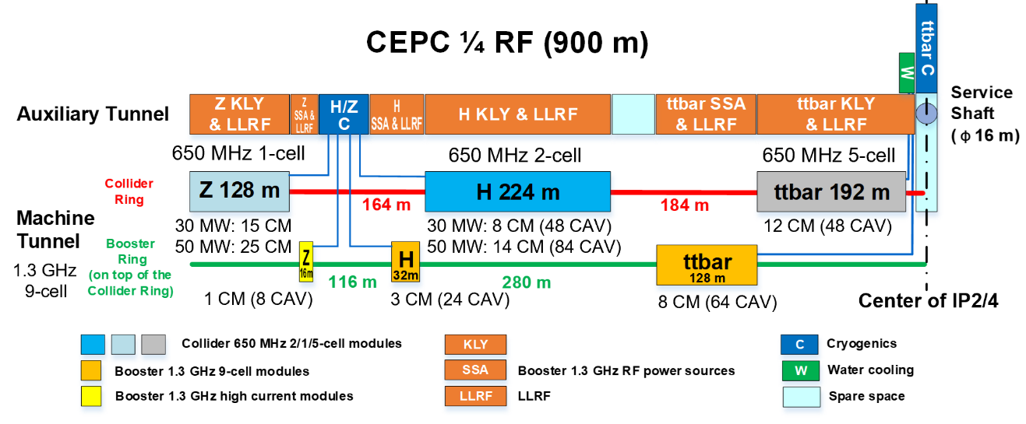
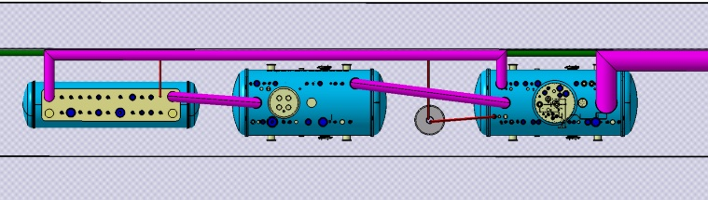
CEPC Cryogenics Auxiliary Tunnel Layout: Long-distance transfer
5m
MDVB
2K CB
LCB (40K-4.5K)
660m
  1. | OVERVIEW | SRF REQUIREMENTS | OVERALL CRYO LAYOUT | | HEAT LOAD ESTIMATION | EDR SCOPE & PLAN |
Notes:
This diagram shows the Auxiliary Tunnel Layout. CEPC one-quarter RF section is 900 meters. The left and right RF zones are centrally symmetric around the shaft center. We have reserved space for the future ttbar mode. Furthermore, for the Higgs Klystron & LLRF, it requires one by one correspondence with the module. Therefore, the Higgs cryogenic equipment, including the lower coldbox and 2K coldbox, should be positioned in the dark blue section. The distance from shaft center to cryo-section is 660m. We refer to FCC design, this length is about 582m, also very long. We need pay more attention to this long-distance transfer in our design.

Slide 5
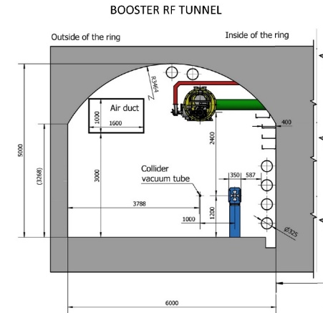
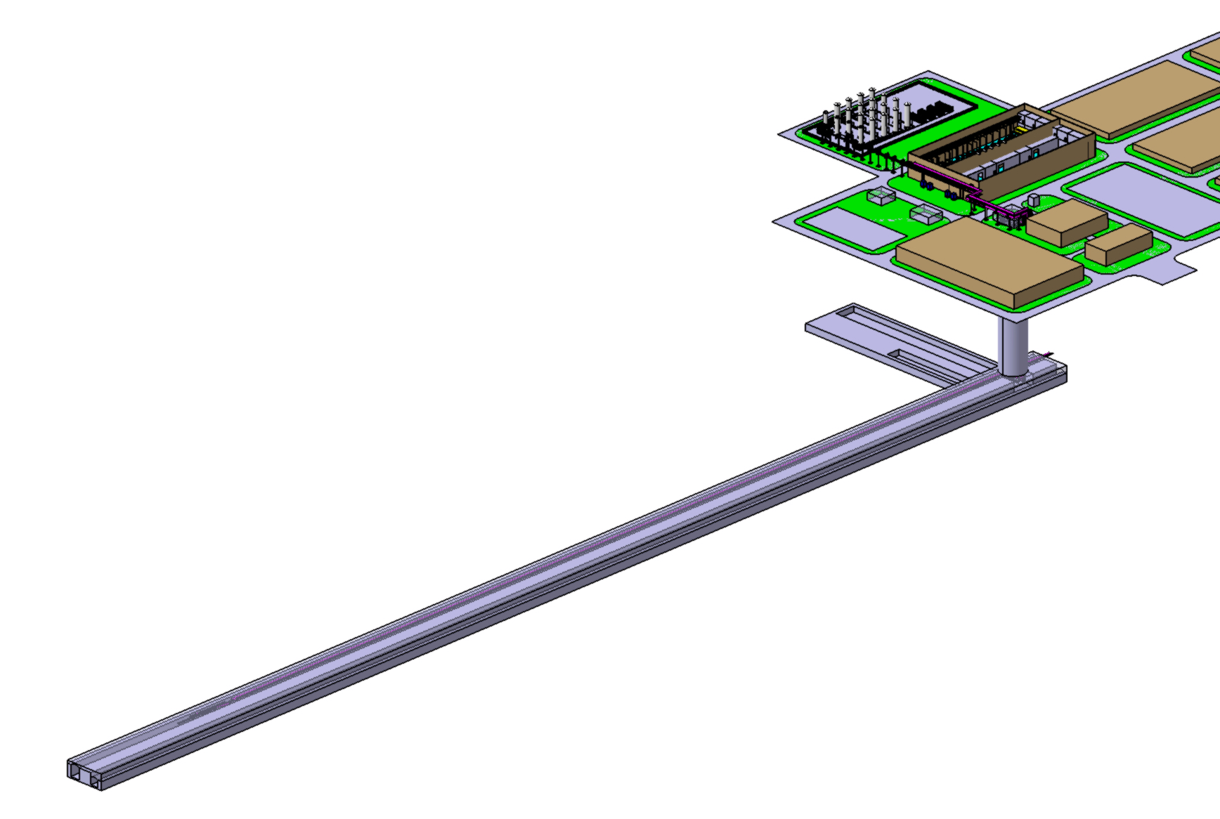
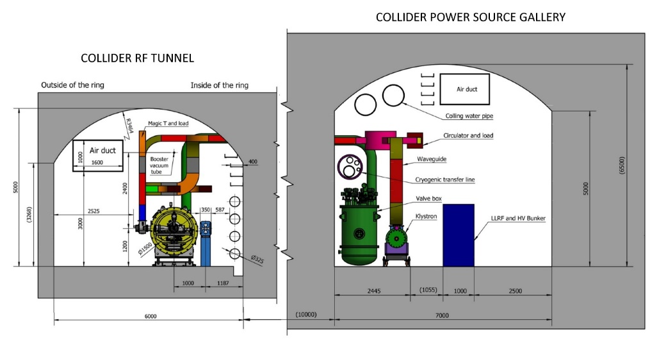
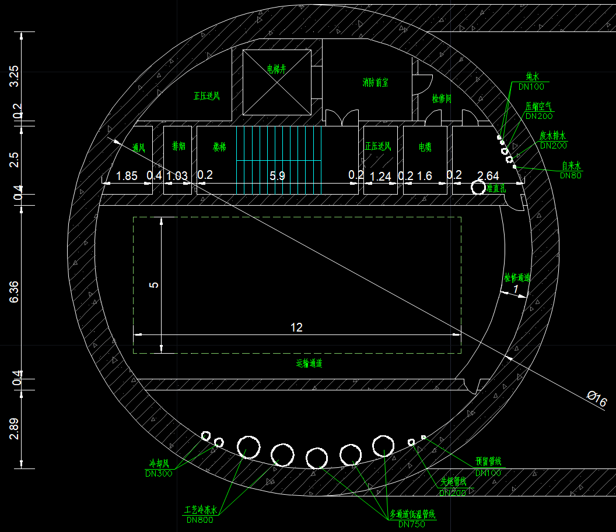
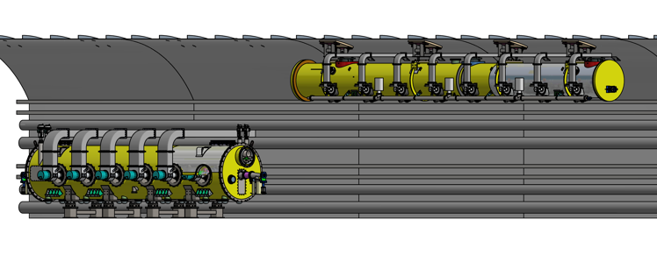
CEPC RF & Cryogenics Tunnel Cross Section Layout
The distance from ground to tunnel is 100m
The shaft size for cryomodule transportation:12m*5m
The size of 1.3 GHz 9-cell cavity cryomodule: OD1160-11500mm
The size of 650 MHz 2-cell cavity cryomodule: OD1650-9293.6mm
Tank zone
Cryogenic hall
Booster 1.3 GHz
cryomodules hung from ceiling at a different beamline.
Cavities operate in
fast voltage ramp mode.
ground
Service shaft
(Φ16m)
Collider 650 MHz cryomodules mounted on tunnel floor.
Cavities operate in CW mode.
tunnel
12m*5m
Higgs 50MW
  1. | OVERVIEW | SRF REQUIREMENTS | OVERALL CRYO LAYOUT | | HEAT LOAD ESTIMATION | EDR SCOPE & PLAN |
Notes:
The Collider's cryomodules are mounted on the tunnel floor, Cavities operate in CW mode.
While the Booster's cryomodules are suspended from the ceiling. Cavities operate in fast voltage ramp mode.
It should be noted that the auxiliary tunnel width needs to be widened (currently 7 meters, which is insufficient), and the sidewall height for the cryo-section must be increased to 8 meters (currently 5 meters). These recommendations have been forwarded and submitted to the design institute.

Slide 6
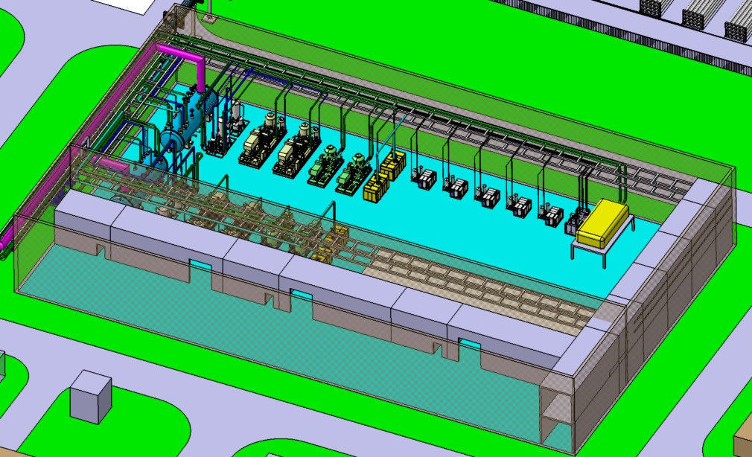
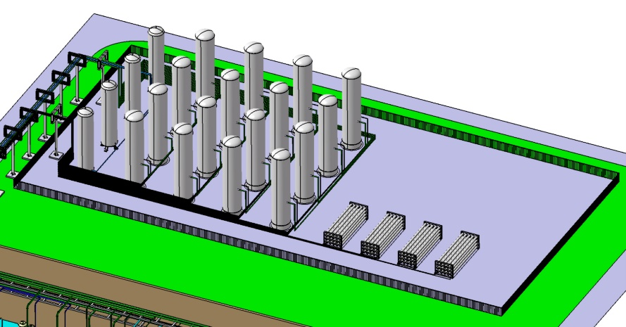
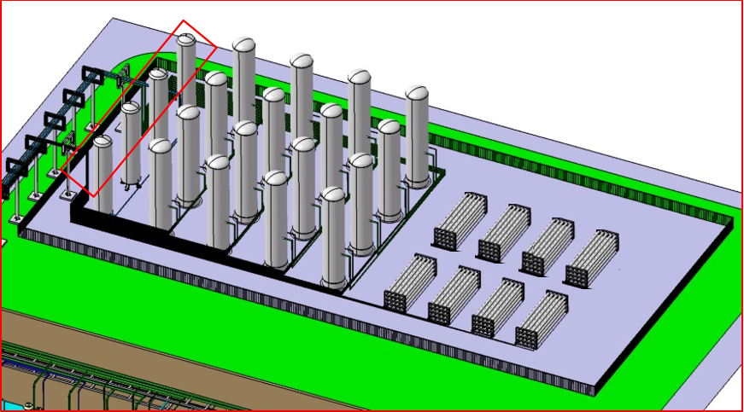
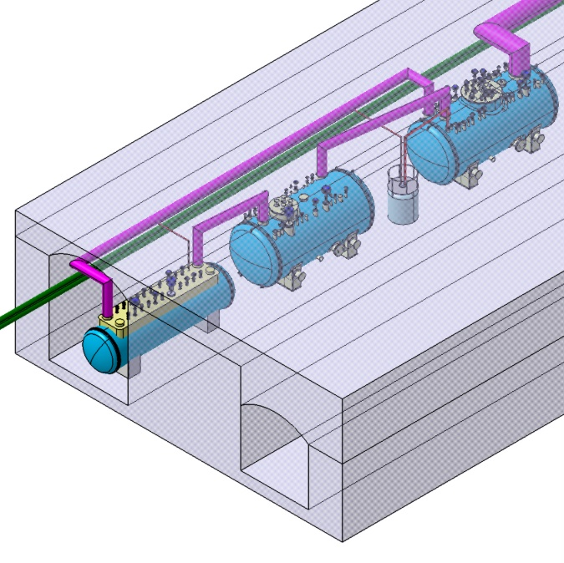
CEPC SRF Overall Cryo-Layout: Long-distance transfer
100m
Tanks zone
Cryogenic hall
UCB (300K-40K)
60m
shaft
Cryogenic hall
Tanks zone
LCB (40K-4.5K)
Ground: tanks zone to shaft: 150m
Shaft length: 100m
Auxiliary Tunnel: shaft to cryo-section 660m
Beam tunnel: Collider 1 to 14 CMs: 304m
Booster 1 to 3 CMs: 52m
Total 2.5km transfer is challenge and primary difficulty, overcoming this difficulty is crucial for achieving an efficient design.
2K CB
MDVB
Auxiliary Tunnel
Beam Tunnel
  1. | OVERVIEW | SRF REQUIREMENTS | OVERALL CRYO LAYOUT | | HEAT LOAD ESTIMATION | EDR SCOPE & PLAN |
Notes:
This diagram provides an overview of the overall Cryo-Layout. The ground surface building is cryogenic hall and tanks zone. The auxiliary tunnel houses the lower coldbox (LCB), 2K coldbox (2K CB), and the main distribution valve box (MDVB). For the CEPC cryogenic system design, we face a big challenge of a 2.5 km transfer line distance. Fulfilling this requirement is crucial for achieving an efficient and effective cryogenic system design.

Slide 7
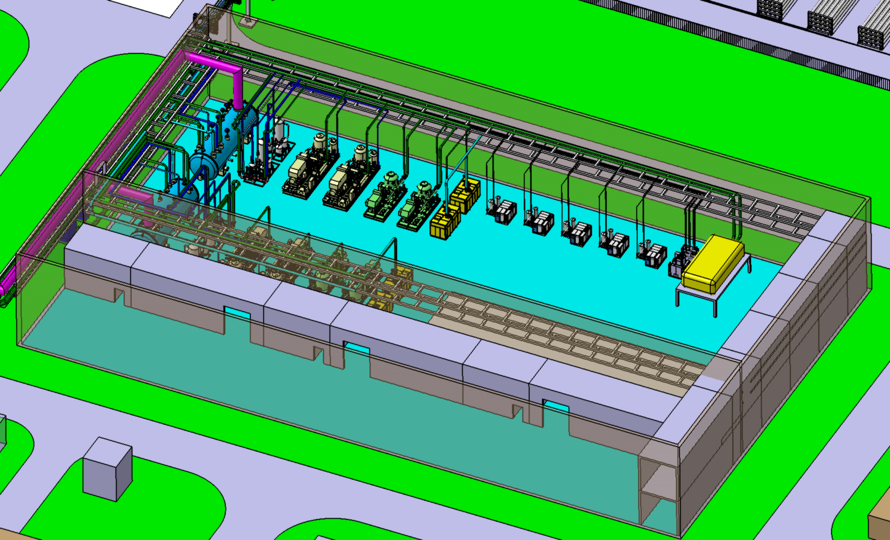
Ground Cryogenic Hall Layout
UCB (300K-40K)
ORS
HP compressor
LP compressor
SP compressor
3 Recycling high pressure compressor
2 Recycling booster compressor
Gas bag
purifier
  1. | OVERVIEW | SRF REQUIREMENTS | OVERALL CRYO LAYOUT | | HEAT LOAD ESTIMATION | EDR SCOPE & PLAN |
Notes:
This diagram provides an overview of the overall Cryo-Layout. The ground surface building is cryogenic hall and tanks zone. The auxiliary tunnel houses the lower coldbox (LCB), 2K coldbox (2K CB), and the main distribution valve box (MDVB). For the CEPC cryogenic system design, we face a big challenge of a 2.5 km transfer line distance. Fulfilling this requirement is crucial for achieving an efficient and effective cryogenic system design.

Slide 8
Ground Tanks Zone Layout
4* Liquid Nitrogen Tanks
16* Medium Pressure (20bara) tanks, among which 14 storage, 2 buffer, 150m3 for each
High Pressure (200bara) GHe Cylinder
  1. | OVERVIEW | SRF REQUIREMENTS | OVERALL CRYO LAYOUT | | HEAT LOAD ESTIMATION | EDR SCOPE & PLAN |
Notes:
This diagram provides an overview of the overall Cryo-Layout. The ground surface building is cryogenic hall and tanks zone. The auxiliary tunnel houses the lower coldbox (LCB), 2K coldbox (2K CB), and the main distribution valve box (MDVB). For the CEPC cryogenic system design, we face a big challenge of a 2.5 km transfer line distance. Fulfilling this requirement is crucial for achieving an efficient and effective cryogenic system design.

Slide 9
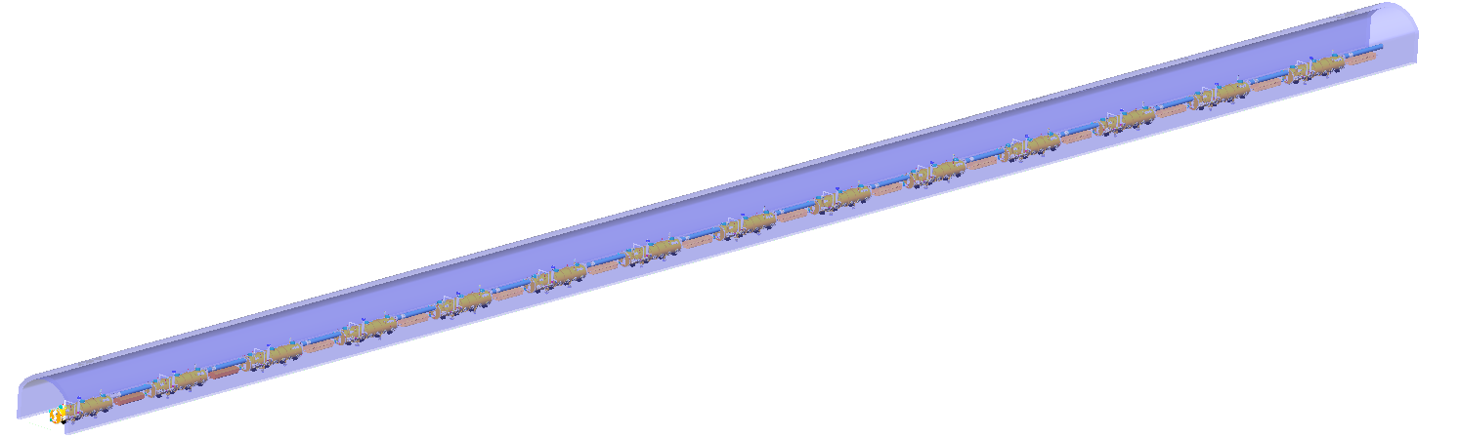
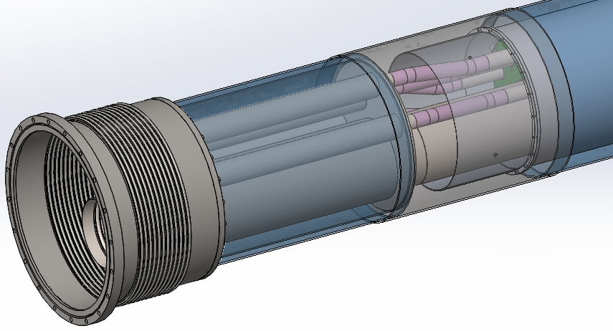
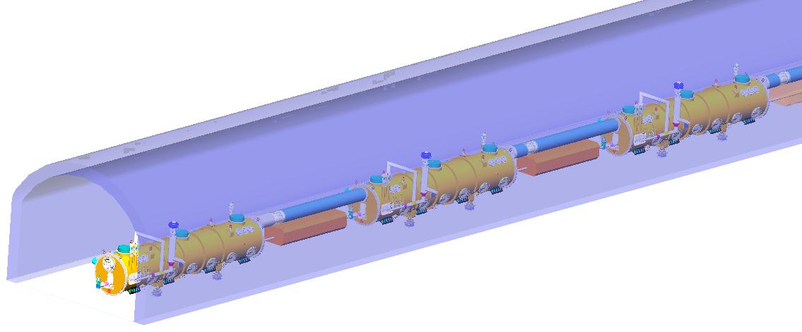
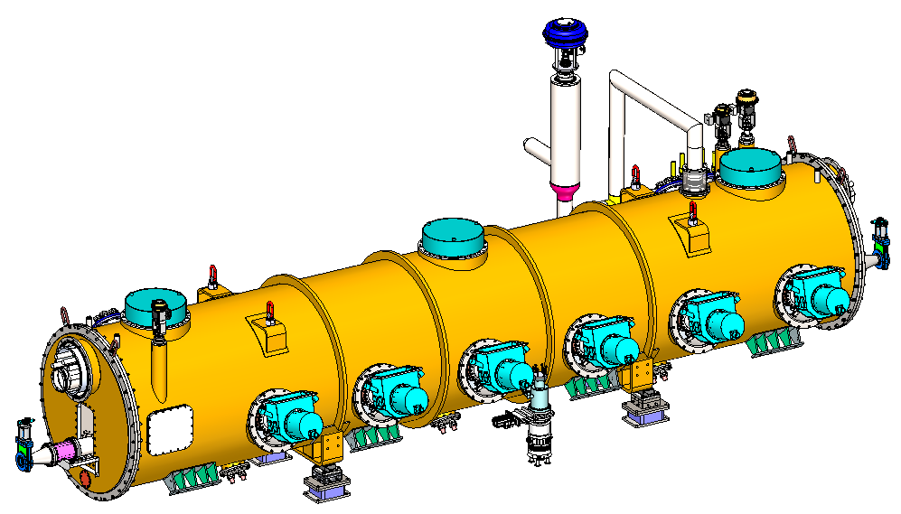
Tunnel Cryo-Layout
Collide 650MHz CMs layout
14 650MHz cryomodules
Set a vacuum barrier per two cryomodules
Vacuum barrier
  1. | OVERVIEW | SRF REQUIREMENTS | OVERALL CRYO LAYOUT | | HEAT LOAD ESTIMATION | EDR SCOPE & PLAN |

Slide 10
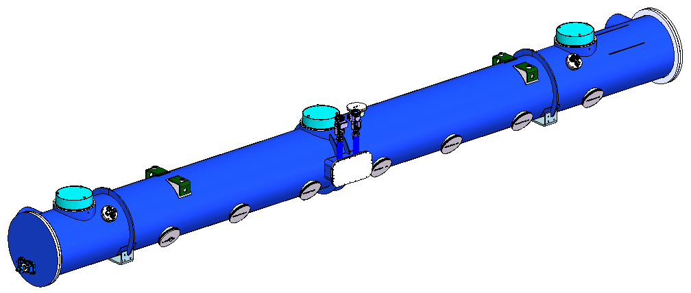
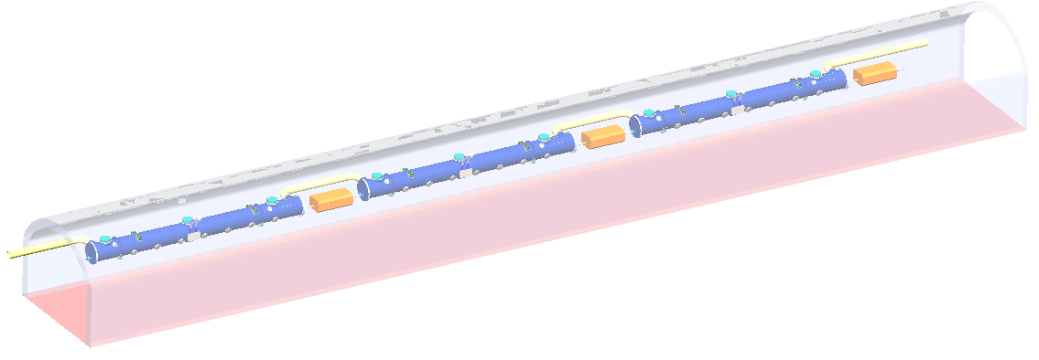
Tunnel Cryo-Layout
Booster 1.3GHz CMs layout
Cryogenic transfer line (CTL)
  1. | OVERVIEW | SRF REQUIREMENTS | OVERALL CRYO LAYOUT | | HEAT LOAD ESTIMATION | EDR SCOPE & PLAN |

Slide 11

EDR-Higgs 30MW Heat Loads
Cavity RF voltage 11.5MV
Higgs Mode 30MW | Unit | Collider |  |  | Booster
 |  | 40-80K | 5-8K | 2K | 40-80K | 5-8K | 2K
Predicted module static heat load | (W/module) | 300 | 60 | 25 | 140 | 20 | 20
Predicted module HOM static heat load | (W/module) | 2.4 | 1.2 | 0.1 | 0 | 0 | 0
Predicted module Input coupler static heat load | (W/module) | 6 | 3 | 0.3 | 16 | 8 | 0.8
Predicted module dynamic heat load (RF) | (W/module) | 0 | 0 | 123.2 | 0 | 0 | 40.9
Predicted module HOM dynamic heat load | (W/module) | 2.9 | 1.4 | 0.2 | 7.1 | 3.6 | 0.6
Predicted module Input coupler dynamic heat load | (W/module) | 90.1 | 22.5 | 3.8 | 208 | 20.8 | 2.6
Cryomodule number | - | 32 | 32 | 32 | 12 | 12 | 12
Total module static heat | (kW) | 9.87 | 2.05 | 0.81 | 1.87 | 0.34 | 0.25
Total module dynamic heat | (kW) | 2.98 | 0.76 | 4.07 | 2.58 | 0.29 | 0.53
Each Module total heat load | W | 401.4 | 88.1 | 152.6 | 371.1 | 52.4 | 64.9
MDVB heat loss | W | 50 | 30 | 10 | 50 | 30 | 10
MDVB number | - | 4 | 4 | 4 | 4 | 4 | 4
Total cryogenic transfer line length | m | 2232 | 2232 | 912 | 1608 | 1608 | 288
cryogenic transfer line heat loss per meter | W/m | 2 | 0.5 | 0.3 | 2 | 0.5 | 0.3
Total cryogenic transfer line heat loss | W | 4464 | 1116 | 273.6 | 3216 | 804 | 86.4
Non-module heat load | (kW) | 4.664 | 1.236 | 0.314 | 3.416 | 0.924 | 0.126
Total predicted heat | (kW) | 17.509 | 4.055 | 5.197 | 7.869 | 1.553 | 0.905
Total predicted mass flow | (g/s) | 83.903 | 126.527 | 245.259 | 37.709 | 48.449 | 42.720
Ideal power based on total estimated heat | (kW) | 80.628 | 192.644 | 800.480 | 36.238 | 73.766 | 139.431
Heat uncertainty factor on static heat (Fus) |  | 1.000 | 1.000 | 1.000 | 1.000 | 1.000 | 1.000
Heat uncertainty factor on dynamic heat (Fud) |  | 1.000 | 1.000 | 1.000 | 1.000 | 1.000 | 1.000
Heat load per cryogenic unit including uncertainty | (kW) | 17.509 | 4.055 | 5.197 | 7.869 | 1.553 | 0.905
Mass flow per cryogenic unit including uncertainty | (g/s) | 83.903 | 126.527 | 245.259 | 37.709 | 48.449 | 42.720
Weighted ideal power | (kW) | 80.628 | 192.644 | 800.480 | 36.238 | 73.766 | 139.431
4.5 K equiv weighted power | (kW) | 1.228 | 2.934 | 12.191 | 0.552 | 1.123 | 2.124
Efficiency (fraction Carnot) |  | 0.280 | 0.240 | 0.220 | 0.280 | 0.240 | 0.220
Operating power based on predicted heat | (kW) | 287.956 | 802.684 | 3638.546 | 129.420 | 307.360 | 633.777
Operating power including uncertainty | (kW) | 287.956 | 802.684 | 3638.546 | 129.420 | 307.360 | 633.777
Overall net cryogenic capacity multiplier |  | 1.540 | 1.540 | 1.540 | 1.540 | 1.540 | 1.540
Heat load per cryogenic unit (Fus, Fud, and Fo) | (kW) | 26.964 | 6.245 | 8.003 | 12.119 | 2.391 | 1.394
Installed 4.5 K equivalent heat loads (1.54 margin) | (kW) | 2.026 | 5.648 | 25.602 | 0.911 | 2.163 | 4.459
Total installed 4.5 K equivalent power (kW) |  | 33.276 |  |  | 7.533
Total 4.5K equiv. heat load with multiplier | kW | 40.808
Installed power (COP(219W/1W)) | MW | 7.287 |  |  | 1.650
  1. | OVERVIEW | SRF REQUIREMENTS | OVERALL CRYO LAYOUT | | HEAT LOAD ESTIMATION | EDR SCOPE & PLAN |
Notes:
This table illustrates the Higgs 30MW Heat Loads and operating power for the Collider and Booster. These precise calculations are necessary in sizing the refrigerator selection.

Slide 12
EDR-Higgs 50MW Heat Loads
Cavity RF voltage 6.5MV
Higgs Mode 50MW | Unit | Collider |  |  | Booster
 |  | 40-80K | 5-8K | 2K | 40-80K | 5-8K | 2K
Predicted module static heat load | (W/module) | 300 | 60 | 25 | 140 | 20 | 20
Predicted module HOM static heat load | (W/module) | 2.4 | 1.2 | 0.1 | 0 | 0 | 0
Predicted module Input coupler static heat load | (W/module) | 6 | 3 | 0.3 | 16 | 8 | 0.8
Predicted module dynamic heat load (RF) | (W/module) | 0 | 0 | 40.1 | 0 | 0 | 40.9
Predicted module HOM dynamic heat load | (W/module) | 4.8 | 2.4 | 0.4 | 9.6 | 4.8 | 0.8
Predicted module Input coupler dynamic heat load | (W/module) | 85.8 | 21.5 | 3.6 | 256 | 25.6 | 3.2
Cryomodule number | - | 56 | 56 | 56 | 12 | 12 | 12
Total module static heat | (kW) | 17.27 | 3.60 | 1.42 | 1.87 | 0.34 | 0.25
Total module dynamic heat | (kW) | 5.07 | 1.34 | 2.47 | 3.19 | 0.36 | 0.54
Each Module total heat load | W | 399 | 88.1 | 69.5 | 421.6 | 58.4 | 65.7
MDVB heat loss | W | 50 | 30 | 10 | 50 | 30 | 10
MDVB number | - | 4 | 4 | 4 | 4 | 4 | 4
Total cryogenic transfer line length | m | 2616 | 2616 | 1296 | 1608 | 1608 | 288
cryogenic transfer line heat loss per meter | W/m | 2 | 0.5 | 0.3 | 2 | 0.5 | 0.3
Total cryogenic transfer line heat loss | W | 5232 | 1308 | 388.8 | 3216 | 804 | 86.4
Non-module heat load | (kW) | 5.432 | 1.428 | 0.429 | 3.416 | 0.924 | 0.126
Total predicted heat | (kW) | 27.776 | 6.362 | 4.321 | 8.475 | 1.625 | 0.915
Total predicted mass flow | (g/s) | 133.103 | 198.490 | 203.917 | 40.613 | 50.696 | 43.173
Ideal power based on total estimated heat | (kW) | 127.908 | 302.211 | 665.547 | 39.028 | 77.187 | 140.910
Heat uncertainty factor on static heat (Fus) |  | 1.000 | 1.000 | 1.000 | 1.000 | 1.000 | 1.000
Heat uncertainty factor on dynamic heat (Fud) |  | 1.000 | 1.000 | 1.000 | 1.000 | 1.000 | 1.000
Heat load per cryogenic unit including uncertainty | (kW) | 27.776 | 6.362 | 4.321 | 8.475 | 1.625 | 0.915
Mass flow per cryogenic unit including uncertainty | (g/s) | 133.103 | 198.490 | 203.917 | 40.613 | 50.696 | 43.173
Weighted ideal power | (kW) | 127.908 | 302.211 | 665.547 | 39.028 | 77.187 | 140.910
4.5 K equiv weighted power | (kW) | 1.948 | 4.603 | 10.136 | 0.594 | 1.176 | 2.146
Efficiency (fraction Carnot) |  | 0.280 | 0.240 | 0.220 | 0.280 | 0.240 | 0.220
Operating power based on predicted heat | (kW) | 456.815 | 1259.211 | 3025.213 | 139.386 | 321.612 | 640.498
Operating power including uncertainty | (kW) | 456.815 | 1259.211 | 3025.213 | 139.386 | 321.612 | 640.498
Overall net cryogenic capacity multiplier |  | 1.540 | 1.540 | 1.540 | 1.540 | 1.540 | 1.540
Heat load per cryogenic unit (Fus, Fud, and Fo) | (kW) | 42.775 | 9.797 | 6.654 | 13.052 | 2.502 | 1.409
Installed 4.5 K equivalent heat loads (1.54 margin) | (kW) | 3.214 | 8.860 | 21.286 | 0.981 | 2.263 | 4.507
Total installed 4.5 K equivalent power (kW) |  | 33.361 |  |  | 7.750
Total 4.5K equiv. heat load with multiplier | kW | 41.111
Installed power (COP(219W/1W)) | MW | 7.306 |  |  | 1.697
  1. | OVERVIEW | SRF REQUIREMENTS | OVERALL CRYO LAYOUT | | HEAT LOAD ESTIMATION | EDR SCOPE & PLAN |
Notes:
Similarly, this table outlines the Higgs 50MW Heat Loads and operating power for the Collider and Booster. Despite the increase in CM numbers for Higgs 50MW, the cavity voltage is approximately half that of Higgs 30MW. According to the equation, the total cooling capacity remains comparable to Higgs 30MW. Therefore, four individual refrigerators, each with a cooling capacity of 12kW@4.5K, still satisfying the requirements.

Slide 13
TDR to EDR—Estimated Heat Loads Reduction Reasons
Initially, the Technical Design Review (TDR) proposed a 15kW @ 4.5K Cryo-plant, mainly having the consideration of selecting a standard series configurations.
Following that, we have conducted the system optimizations and collaboration with the refrigerator manufacturer/supplier, in Engineering Design Review (EDR) stage, it is refined to 12kW @ 4.5K for each cryo-station.
In CEPC SRF Cryogenic System Peer Design Review held on 13th, May, 2025, the experts comments regarding this issue:
Committee was pleased to learn that the detailed and very careful analysis of static and dynamic losses of all components, together with the optimization of valves, transfer lines and distribution systems, led to a reduction of the total cryo-load, directly or indirectly generated by the SRF acceleration systems, which is now 41 kW at 4.5 K. With a margin of 17% it turns out that 4 plants of 12 kW at 4,5 K are sufficient for CEPC, instead of the 4 plants at 15 kW presented in the TDR.
Committee commends and approves the careful and highly professional analysis underlying these results but suggests also considering the option of keeping the size of the 4 croplants at 15 KW, increasing the safety margin that is crucial for cryogenics.
  1. | OVERVIEW | SRF REQUIREMENTS | OVERALL CRYO LAYOUT | | HEAT LOAD ESTIMATION | EDR SCOPE & PLAN |
Notes:
This page explains the differences in heat load calculation between TDR and EDR. In EDR, we have adopted a more reliable equivalent coefficient from 2K to 4.5K, based on the actual utilization of cold compressors to recover cooling capacity, aligning with the ILC TDR. Simultaneously, the installed Power Consumption for one cryo-unit (MW) has been reduced, contributing to the reduction of electricity expenses.

Slide 14
Cryogenic-TDR and EDR Works Summarized table
 | Cryogenic system Composition |  | TDR | EDR
1 | Process flow scheme design and simulation | SRF side | Completed 2K, 5~8K circuit, 40~70K TS Process flow scheme design and calculation; | Finalize the Cryogenic system peer review (before June. 2026)
 |  | SC magnet side | Completed MDI/Detector cryostat preliminary cooling scheme design & calculation | MDI/detector more detailed scheme design & calculation, verification in EDR
2 | Cryomodule/Cryostat design | SRF cavity cryomodule | Completed 1.3GHz high performance cryomodule design, manufacturing and 2K HT test; achieved word-leading results | Need to complete full-size 650MHz cryomodule cryogenic test in 2026.
 |  | SC magnet cryostat | Completed MDI cryostat preliminary structural design, heat transfer design; | MDI/detector mechanical design determination, Assembly process design and alignment considerations, machine key component verification in EDR
3 | Large helium refrigerator |  | The CAS pilot project for 18 kW @4.5K manufacturing has completed in 2024: jointly with FULLCRYO Corporation & TIPC, CAS. | The mega-Watts (18kW @4.5K) is expected to finalize the commissioning test by the mid of 2025, jointly with FULLCRYO Corporation & TIPC, CAS.
4 | Mechanical design |  | Completed preliminary Cryogenic hall, tanks zone and tunnel layout | Need to Complete detailed Cryogenic hall, tanks zone and tunnel layout diagram
5 | JT heat exchanger |  | Completed HX Basic Design and Optimization, test platform design and Manufacturing | CEPC kilowatts-scale 2K HX Cryogenic experiment need to be finished in 2025.
6 | Cryogenic fluid transfer and distribution design | High-performance cryogenic TL | Completed the scheme design, the test platform equipment manufacturing | Need to complete the experimental verification test in EDR
 |  | Distribution valve box | Completed similar equipment design, manufacture and test in PAPS/HEPS project, accumulated experience prepared for CEPC | Continue to design and optimize, collaborate well with the supplier fully prepared for CEPC Continue to design 100km tunnel helium quench protection scheme
7 | Helium recycling and purification system |  | Completed similar helium recovery system design, manufacture and test in PAPS/HEPS project, accumulated experience prepared for CEPC | Continue to design and optimize, collaborate well with the supplier
8 | Liquid nitrogen system |  | Completed similar liquid nitrogen system design, manufacture and test in PAPS/HEPS project, accumulated experience prepared for CEPC | Continue to design and optimize, collaborate well with the supplier
9 | Cryogenic Control system |  | Completed similar Cryogenic Control system design, manufacture and test in PAPS/HEPS project, accumulated experience prepared for CEPC | Continue to design and optimize, collaborate well with the supplier
10 | Cryogenic safety design |  | Completed similar Cryogenic safety design, test in PAPS/HEPS project, accumulated experience prepared for CEPC | Continue to design 100km tunnel helium quench protection scheme
  1. | OVERVIEW | SRF REQUIREMENTS | OVERALL CRYO LAYOUT | | HEAT LOAD ESTIMATION | EDR SCOPE & PLAN |
Notes:
We have compiled a comprehensive table to summarize the works in TDR and EDR for the CEPC cryogenic system. In TDR, we have achieved significant progress, and In EDR, there are still some works need to be fullfilled.

Slide 15
CEPC SRF Cryogenic System EDR plan
No. | SRF Cryogenic system Composition |  | 2024 |  | 2025 |  | 2026 |  | 2027
 |  |  | 1st half | 2nd half | 1st half | 2nd half | 1st half | 2nd half | 1st half | 2nd half
1 | Process flow scheme design and simulation
2 | Collider 650MHz full-size Cryomodule design & 2K Horizontal Test
3 | Large helium refrigerator (cooperated with TIPC, CAS)
4 | Mechanical design
5 | JT heat exchanger
6 | Transfer and distribution | High-performance cryogenic TL
 |  | Distribution valve box
7 | Helium recycling and purification system
8 | Liquid nitrogen system
9 | Cryogenic Control system
10 | Cryogenic safety design
11 | CEPC Proposal of the cryogenic system
12 | EDR documentation
  1. | OVERVIEW | SRF REQUIREMENTS | OVERALL CRYO LAYOUT | | HEAT LOAD ESTIMATION | EDR SCOPE & PLAN |
Notes:
The CEPC SRF Cryogenic System EDR plan outlines the key milestones spanning from 2024 to 2027. Notably, the Collider 650MHz full-size Cryomodule design & 2K Horizontal Test are scheduled for completion in 2026. Additionally, the CEPC cryogenic system proposal is expected to be finalized in the next year. We have also allocated half one year to complete the EDR documentation.

Slide 16
Content
1. CEPC SRF Cryogenic System Overview
  1.1 CEPC Project Brief Introduction
  1.2 Heat Load Estimation of Cryogenic System
  1.3 General Layout of Cryogenic System
  1.4 EDR scope and plan
2. CEPC SRF Cryogenic System Scheme Design
  2.1 Process Design & Calculation
  2.2 Large Helium Refrigerator
3. Cryomodule R&D Status
  3.1 Collider 650MHz Cryomodule R&D
  3.2 Booster 1.3GHz Cryomodule R&D
4. Summary and Outlook
Notes:
My presentation will be structured around five key sections. First, I will provide a comprehensive overview of the CEPC project. Then, I will introduce the details of the project design. Following that, I will discuss the important of Recovery, Storage, Purification and Distribution (RSPD) & Cryogenic Safety Design. Subsequently, I will talk about our Human resources & Industrialization Preparation. Finally, I will conclude with a summary of our achievements and an outlook on our future endeavors. Let us commence with the first section.

Slide 17
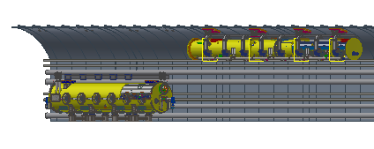
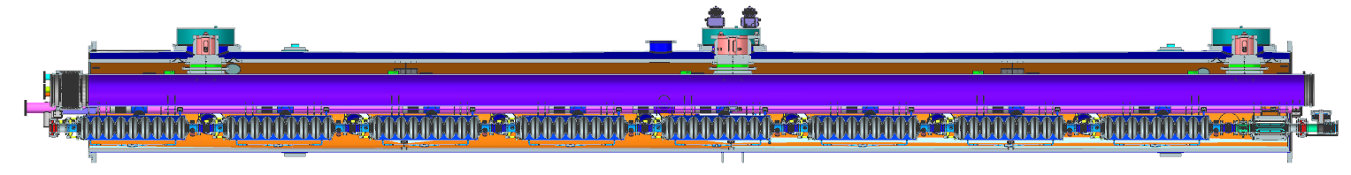
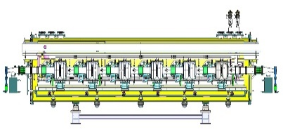
Process Flow Block Diagram of SRF Cryogenic System
Ground equipment
Process flow block diagram is essential in comprehending the interaction of various cryogenic equip. and designing the CM cooling process.
Tanks zone
Upper Cold Box
（300K-40K）
5 K @ 3 bara supercritical helium is subcooled to 4.5 K in the lower coldbox, and then further be cooled to 2.4 K @ 3 bara by a large heat exchanger ( ~ 90 g/s of each, total four HX)
2.4 K @ 3 bara helium is transferred to the beam tunnel, then is throttled by JT valve inside CM to produce the 2 K superfluid helium
Return GHe goes through 2 K HX and cold compressors to recover the cold quantity, then returns to CB and compressors LP side to finalize the whole cycle
RF shaft
Compressor group
Auxiliary tunnel
Lower Cold Box
（40K-4.5K）
2K coldbox
10m
MDVB
12kW@4.5K
Beam tunnel
10m
20m
11000
11000
32m
11000
8000
3 cryomodules, 8 × 1.3 GHz 9-cell cavities each
Booster Ring
12
Cryomodules
Phase seperator
Higgs 50MW
80m
9500
8000
224m
95000
14 cryomodules, 6 × 650 MHz 2-cell cavities each
Collider Ring
  2.1 | EDR PROCESS FLOW DIAGRAM | SRF CM COOLDOWN REQUIREMENTS | PROCESS CALCULATION |
Notes:
Process Flow Block Diagram of SRF Cryogenic System. The process flow design is essential in comprehending the interaction of various components and designing the overall cooling process. The ground surface equipment mainly is the tanks zone and recovery system, along with the upper coldbox (UCB). The auxiliary tunnel houses the lower coldbox (LCB), 2K coldbox (2K CB), and the main distribution valve box (MDVB).

Slide 18
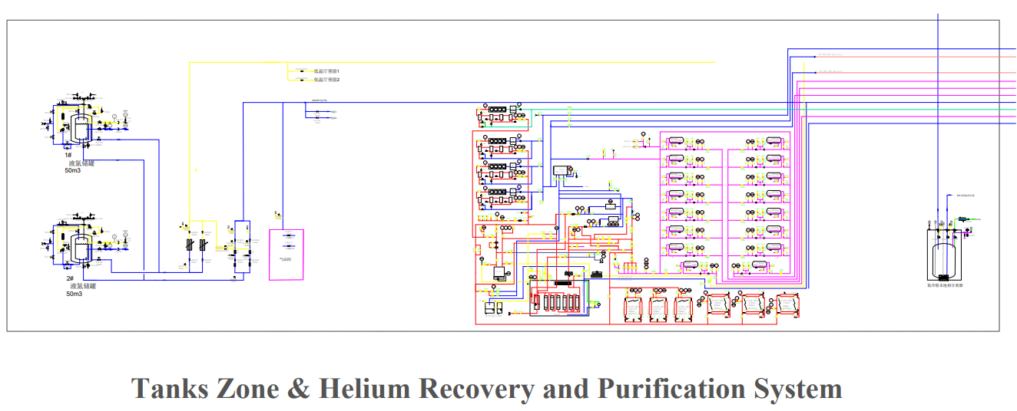
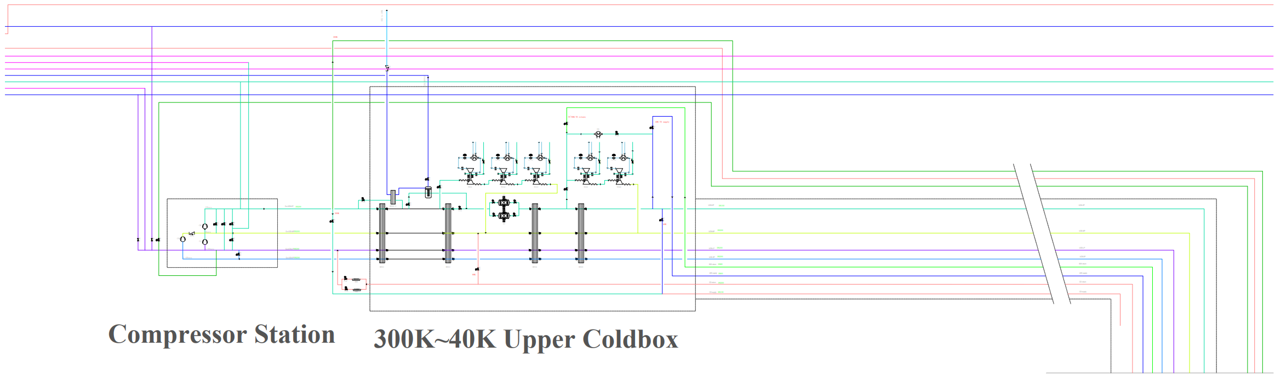
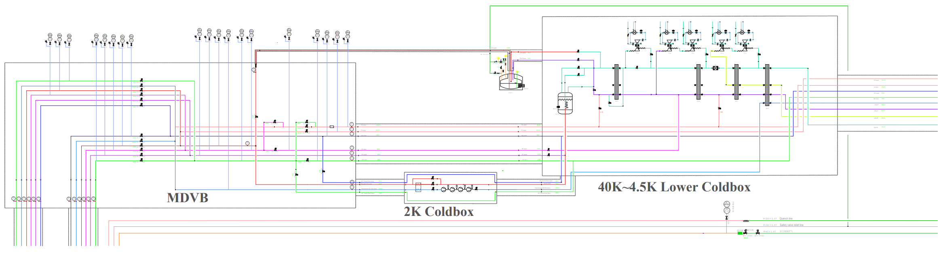
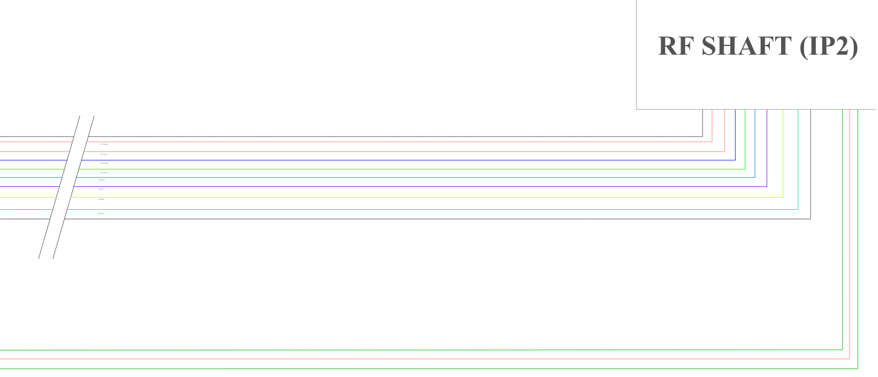
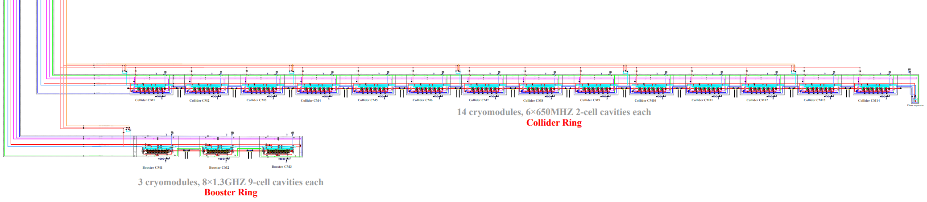
SRF Cryogenic system process flow diagram / IP2 RF1 Section
Tanks Zone & Helium Recovery and Purification System
Compressor station
300K~40K Upper Coldbox
40K~4.5K Lower Coldbox
Main Distribution Valve Box
2K Coldbox
(cold compressor+ 2K HX)
Cryomodules
  2.1 | EDR PROCESS FLOW DIAGRAM | SRF CM COOLDOWN REQUIREMENTS | PROCESS CALCULATION |
Notes:
The EDR—Flow chart of SRF Scheme provides a visual representation of the entire process flow diagram of the SRF cryogenic system. This is ***, This is ***. In the subsequent slides, I will present an enlarged view of each section for a more detailed examination.

Slide 19
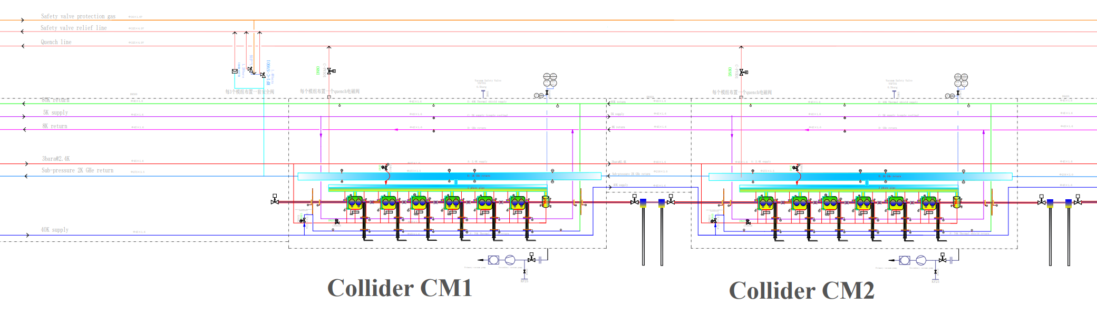
Individual CM Warmup Consideration When Abnormal Conditions
DN420
DN500
Ф45×1.6
Ф45×1.6
Condition 1
Condition 2
When one CM has problem, it can be bypassed(closed CD valve, GHe goes through quench valve) without influence other CMs operation;
It occurs the accident (leakage, vacuum becoming bad, cavities damage, etc. ),we have set the vacuum barrier, to prevent vacuum deterioration spreading to all CMs;
Because of the series connection, all CMs need be warmed up together.
Cavities or one CM performance is not well, we can warm up this CM to 40K using the thin-filmed electrical heater which is attached in the bottom of the helium vessel, then fast cooldown to cross the transition temperature 9.2K → 4.5K directly, following that accumulated the required LHe level, and pump 2K

Slide 20
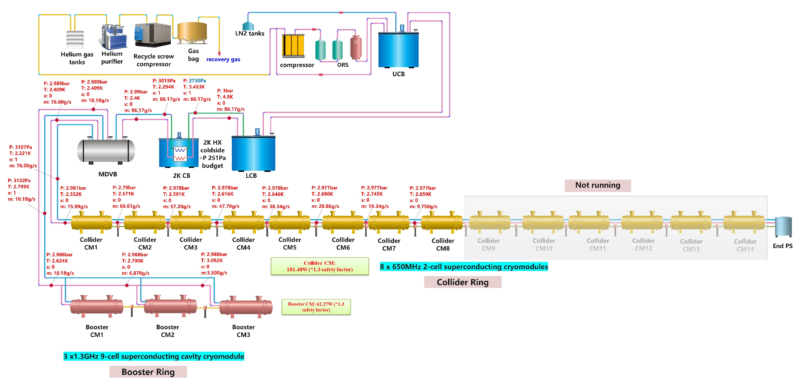
Higgs30MW--2K process calculation and optimization
Item | Higgs 30MW | Higgs 50MW
Heat load per CM (contains 1.2 times margin) | Collider 181.48W Booster 62.27W | Collider 73.45W Booster 63.31W
CM number per Cryo-station | Collider 8 CMs Booster 3 CMs | Collider 14 CMs Booster 3 CMs
2K TL length per Cryo-station/m | Collider: 228m Booster: 72m | Collider: 324m Booster: 72m
Total Mass flow rate 3bara@4.5K/(g/s) | 86.37 | 66.04
Helium gas return pipe (HGRP) diameter | DN250 | DN250
2K HX coldside budget | 251Pa | 286Pa
Total △P from CM to 2K CB Cold-compressor inlet | 400Pa | 400Pa
Not running
Collider: 3bara@2.4K Supply (Φ45*1.6) 2K return (DN250, Φ273*2.0) Booster: 3bara@2.4K Supply (Φ34*1.6) 2K return (DN250, Φ114*2.0) | Supply TL heat loss-0.3W/m (round) Return TL heat loss-0.6W/m (round)
  2.1 | EDR PROCESS FLOW DIAGRAM | SRF CM COOLDOWN REQUIREMENTS | PROCESS CALCULATION |
Notes:
The Higgs30MW--2K process calculation and optimization shows the details about the calculation. The mass flow rate is approximately 86g/s. The total pressure drop (△P) from the CM to the 2K CB cold-compressor inlet is 400Pa, and we have selected a helium gas return pipe diameter of DN250. Under these conditions, the 2K HX coldside budget is 251Pa, ensuring efficient heat exchange and minimizing pressure losses.

Slide 21
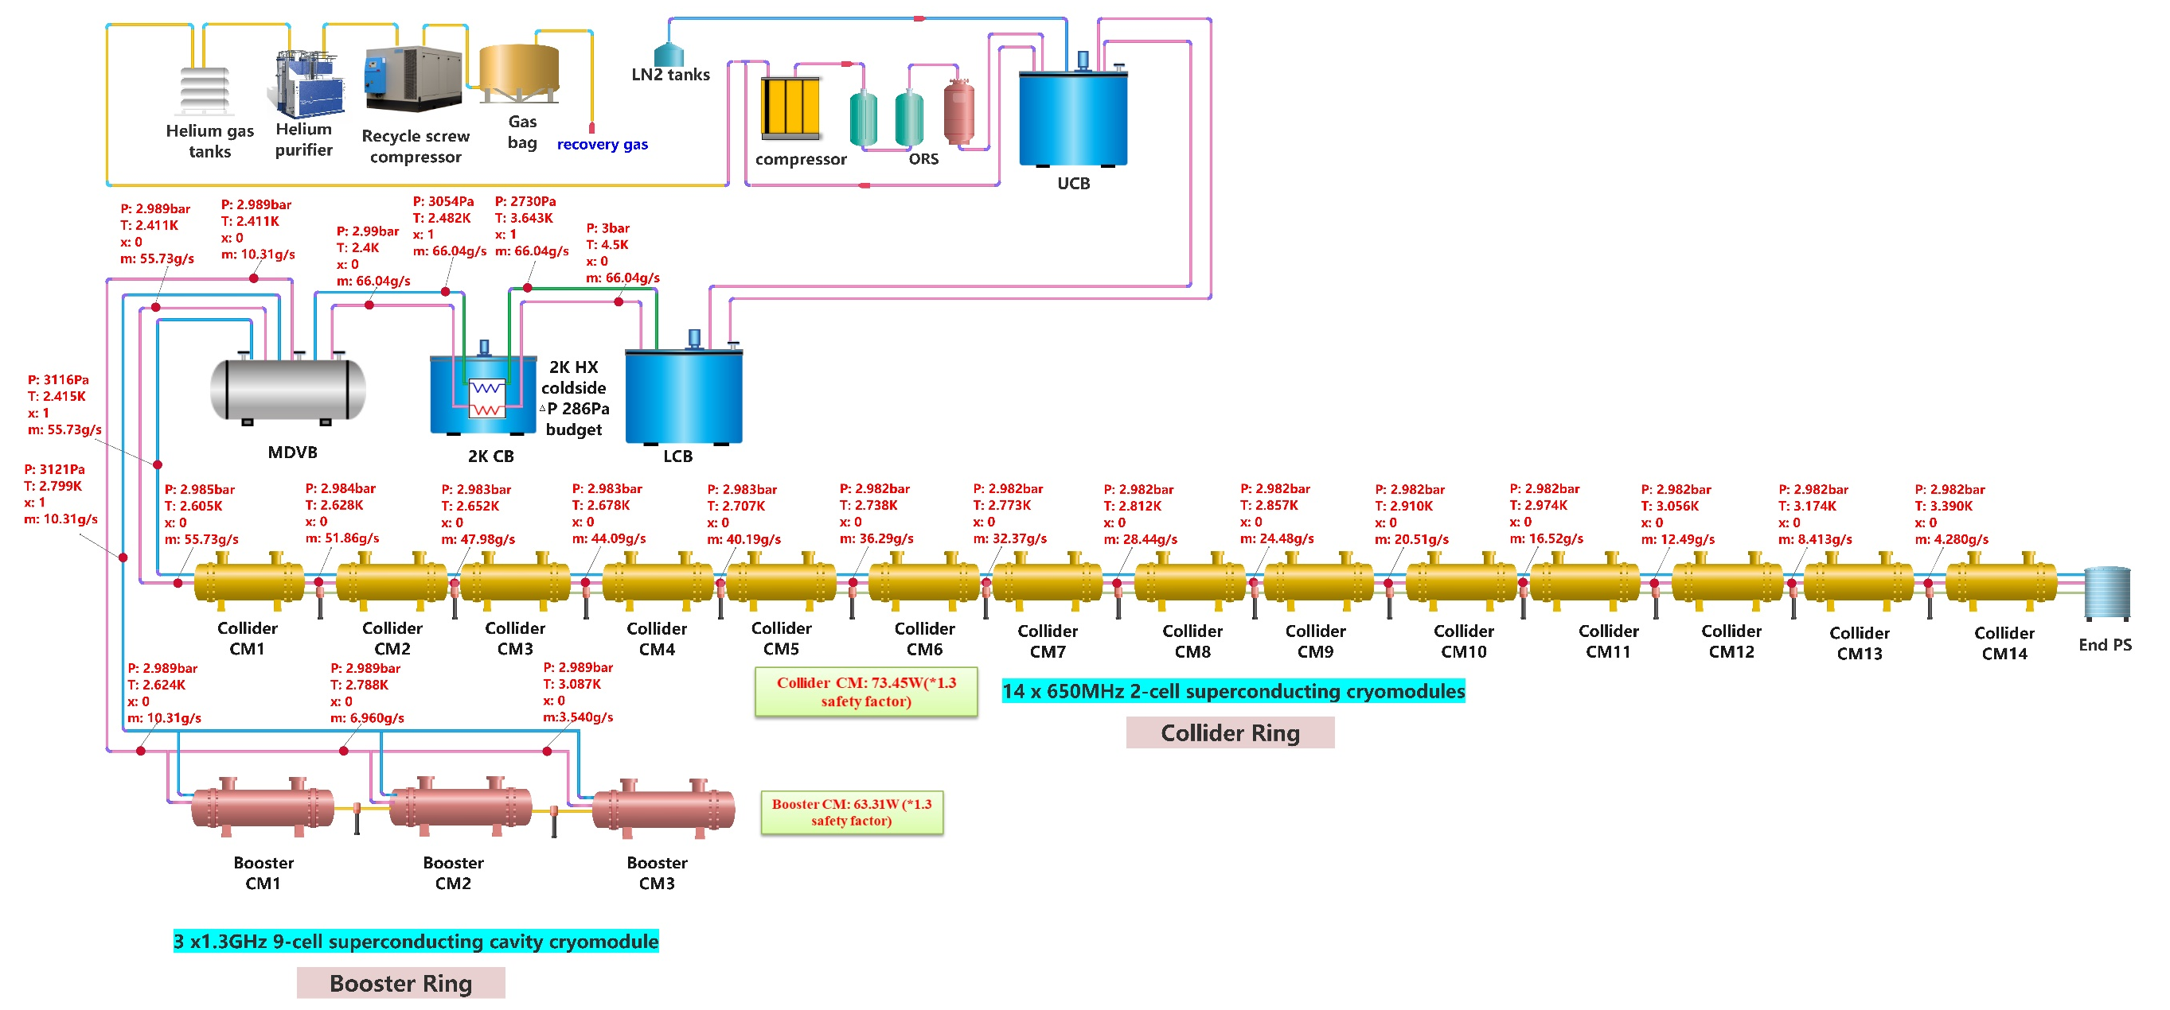
Higgs50MW--2K process calculation and optimization
In Higgs50MW mode, Collider CMs have lower heat loads than 30MW mode, reducing mass flow to ~66g/s. This decreases helium return pressure drop, yielding a favorable 2K HX coldside budget of 286Pa, which is good for HX design.
  2.1 | EDR PROCESS FLOW DIAGRAM | SRF CM COOLDOWN REQUIREMENTS | PROCESS CALCULATION |

Slide 22
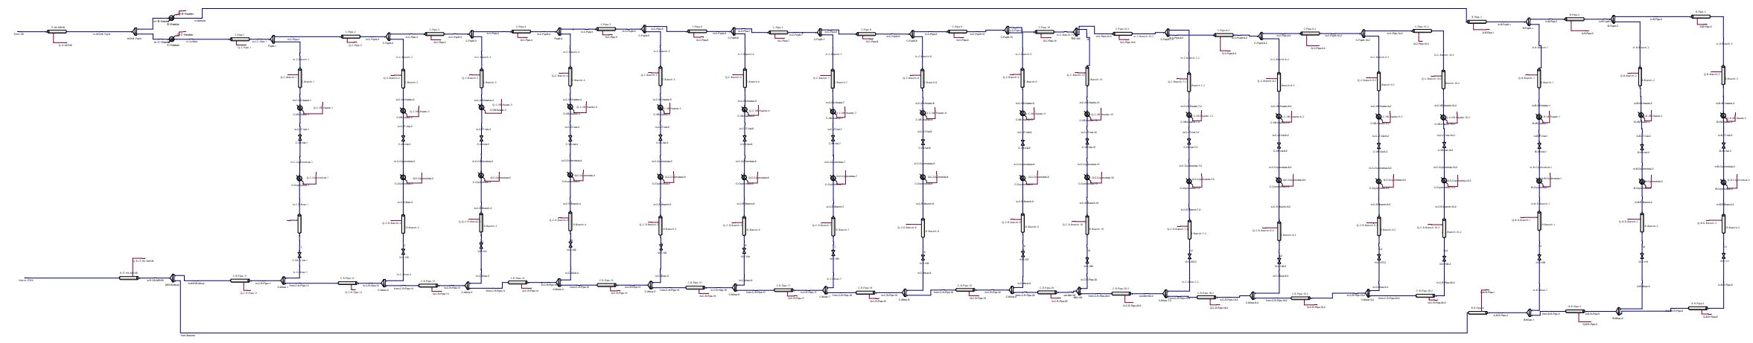
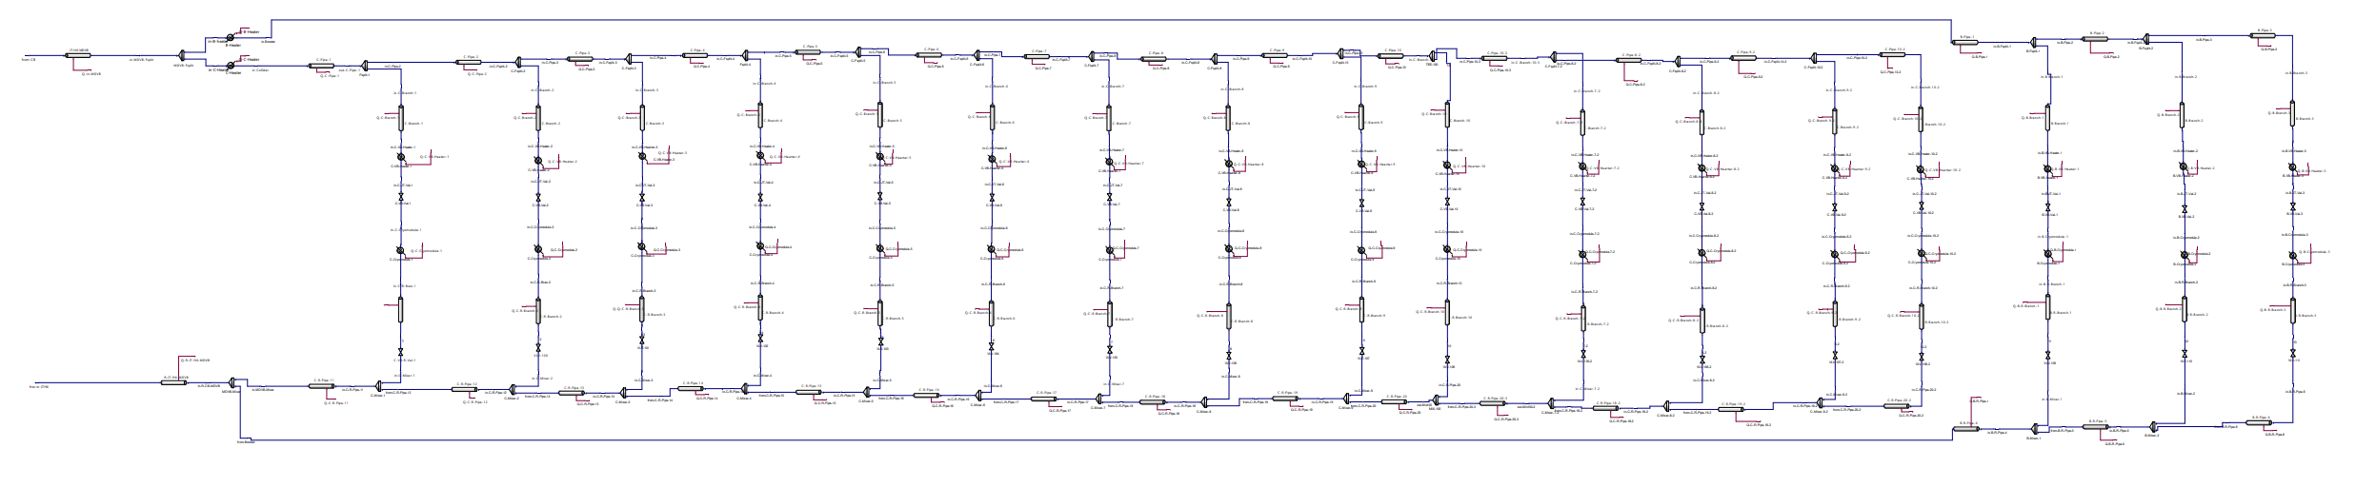
40~80K TS & 5~8K Helium Circuit Calculation
40~80K TS
P: 12.98bar
T: 40.08K
x: 1
m: 7.3g/s
14 cryomodules, 6×650MHZ 2-cell/CM
Collider Ring
3 cryomodules, 8×1.3GHZ 9-cell/CM
Booster Ring
2.5W/m, Φ34×1.6, roughness 5E-5m
Φ34×1.6
P: 16bar
T: 40K
x: 1
m: 58.57g/s
P: 12.98bar
T: 40.08K
x: 1
m: 51.27g/s
P: 14bar
T: 68.79K
x: 1
m: 58.57g/s
Collider CM: 401.4W@40~80K
Booster CM: 371.1W@40~80K
Φ42×1.6 ，roughness 5E-5m
Φ42×1.6 ，roughness 5E-5m
40~80K TS & 5~8K Helium Circuit Calculation are vital for thermal shield design and coupler cooling;
With heat losses of 2.5W/m (TS) and 0.5W/m (5K line) , ensuring minimal energy loss and efficient heat management.
P: 2.999bar
T: 5.012K
x: 1
m: 7.3g/s
14 cryomodules, 6×650MHZ 2-cell/CM
Collider Ring
3 cryomodules, 8×1.3GHZ 9-cell/CM
Booster Ring
0.5W/m, Φ42×1.6, roughness 5E-5m
Φ34×1.6
P: 3bar
T: 5K
x: 0
m: 58.6g/s
P: 2.999bar
T: 5.012K
x: 0
m: 51.3g/s
P: 2.5bar
T: 7.766K
x: 1
m: 58.6g/s
Collider CM: 88.1W@5~8K
Booster CM: 52.4W@40~80K
5~8K Circuit
Φ42×1.6 ，roughness 5E-5m
Φ42×1.6 ，roughness 5E-5m
  2.1 | EDR PROCESS FLOW DIAGRAM | SRF CM COOLDOWN REQUIREMENTS | PROCESS CALCULATION |
Notes:
Modules can realize independent cooling;
Complete superconducting cavity loss of super safety measures;
Throttled liquid yield up to 90%, last 75%, requires slightly higher flow rate, but ensures that the same liquid level is maintained

Slide 23
EDR- CEPC Cryo-layout at RF section- Higgs 30/50MW
Compressor system
Compressor system
① Collider Multiple TL to CMs
He Gas Tanks
Operating parameters | A | B | C | D | E | F
Pressure / [bara] | 3 | 0.031 | 3 | 2.5 | 13 | 10
Temperature / [K] | 2.4 | 2 | 5 | 8 | 40 | 70
Nominal Pipe Size Do × Thick. / [mm] | Φ45×1.6 | Φ273×3.5 | Φ45×1.6 | Φ45×1.6 | Φ45×1.6 | Φ45×1.6
Upper coldbox
LN2 system
LN2 system
Upper coldbox
Ground surface
RF Shaft, Φ16 m
② Booster Multiple TL to CMs
LHe
Dewar
Lower coldbox
Lower coldbox
LHe
Dewar
Operating parameters | A | B | C | D | E | F
Pressure / [bara] | 3 | 0.031 | 3 | 2.5 | 13 | 10
Temperature / [K] | 2.2 | 2 | 5 | 8 | 40 | 70
Nominal Pipe Size Do × Thick. / [mm] | Φ34×1.6 | Φ114×2 | Φ34×1.6 | Φ42×1.6 | Φ34×1.6 | Φ42×1.6
2K valve box
MDVB
MDVB
2K valve box
Auxiliary tunnel
Beam tunnel
10m
10m
DN500
DN420
Phase seperator
Phase seperator
Collider CM
(14 cryomodules, 6×650MHZ 2-cell/CM)
Collider CM
(14 cryomodules, 6×650MHZ 2-cell/CM)
C
A
C
①
②
②
①
B
B
A
D
①
D
②
224m
90m
90m
224m
E
F
E
F
Booster CM
(3 cryomodules, 8×1.3GHZ 9-cell/CM)
Booster CM
(3 cryomodules, 8×1.3GHZ 9-cell/CM)
The design results can well illustrate the tunnel-based cryomodule distribution with their associated transfer line operating parameters (pressure, temperature, pipe dimensions).
32m
30m
30m
32m
  2.1 | EDR PROCESS FLOW DIAGRAM | SRF CM COOLDOWN REQUIREMENTS | PROCESS CALCULATION |

Slide 24
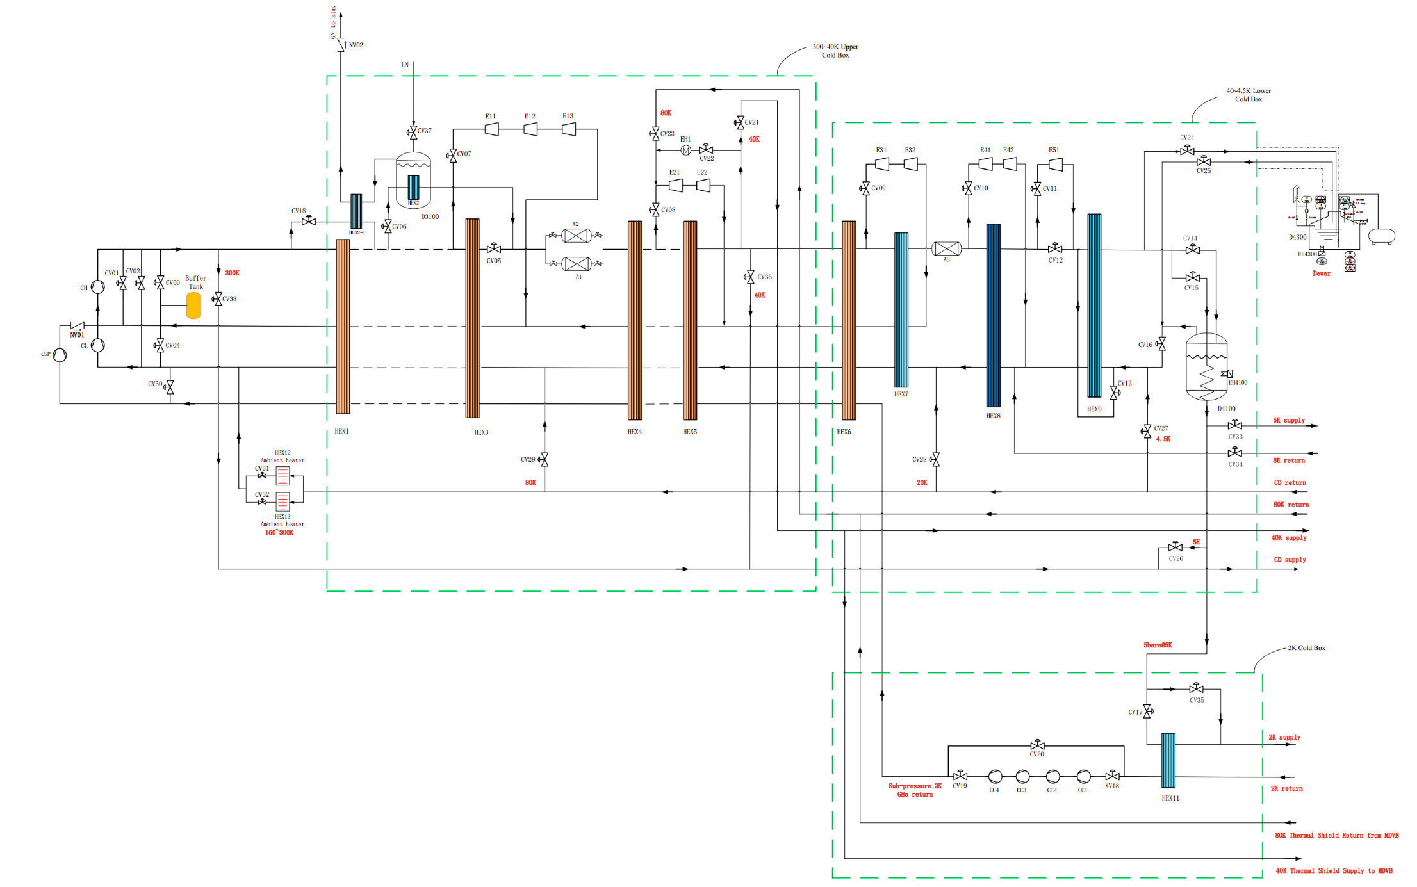
12kW Large Refrigerator PFD diagram
This PFD diagram provides a comprehensive overview of the refrigeration cycle and the interactions between various components, serving as a blueprint for the system's operation and performance.
300K~40K Upper Coldbox
中国科学院理化技术研究所
Technical Institute of Physics and Chemistry
40K~4.5K Lower Coldbox
Compressor station
3000L Dewar
2.0K ≥ 2200W
40~80K ≥13000W
5~8K ≥2200W
>12kW@4.5K
>3000 L/h
2K Coldbox
(cold compressor+ 2K HX)
Maximum capacity
Refrigeration capacity
Liquefaction rate
  2.2 | PFD | MODELING | OVERALL DESIGN PARAMETERS | COMPRESSORS | TURBINES | HX | PIPELINE | ASSEMBLING | R&D

Slide 25
Main Design Results - 12kW refrigerator
These parameters are seriously determined to ensure that the refrigerator meets the required cooling capacity and efficiency standards, providing a reliable foundation for CEPC cryogenic system.
Overall design parameters for single refrigerator
中国科学院理化技术研究所
Technical Institute of Physics and Chemistry
Working temperature | Design requirement |  | Design results
 | Pressure（bar） | Heat load（W） | Pressure（bar） | Temperature（K） | Heat load（W） | Equivalent Heat load (@1.8K)
2.0K | 0.03 | ≥2200 | 0.03 | 1.986 | 2242 | 2031.24
40~80K | 18~16 | ≥13000 | 18.66~16.66 | 39~78K | 13400 | 380.22
5~8K | 5~4 | ≥2200 | 5~4 | 5~8K | 2200 | 630.87
Total equivalent heat load （@1.8K） |  |  |  |  |  | 3042.33
Other parameters | Design target
Liquid nitrogen consumption | 0g/s
Precooling helium gas flow | 60g/s
Overall UA value | 943.9kJ/K·s
Helium gas flow | 1032g/s
Predication power consumption（KW） | 2599
Equivalent energy efficiency ratio for 1.8K: 857.60W/W*
  2.2 | PFD | MODELING | OVERALL DESIGN PARAMETERS | COMPRESSORS | TURBINES | HX | PIPELINE | ASSEMBLING | R&D

Slide 26
Main Design Results - 12kW refrigerator
The cold compressor plays a vital role in the low-temperature stages of the refrigeration cycle, and its design and performance significantly impact the system's ability to achieve and maintain 2K for superconductivity.
Main equipment parameters - cold compressor
中国科学院理化技术研究所
Technical Institute of Physics and Chemistry
Parameter name | 1st stage | 2nd stage | 3rd stage | 4th stage
Mass flow rate (g/s) | 120 | 120 | 120 | 120
Inlet temperature（K） | 3.55 | 6.54 | 10.30 | 14.84
Inlet pressure（kPa，static pressure） | 2.90 | 8.12 | 17.10 | 30.80
Outlet temperature（K） | 6.54 | 10.30 | 14.84 | 20.12
outlet pressure（kPa） | 8.12 | 17.10 | 30.80 | 50.00
Predicated efficiency（%） | 60 | 60 | 60 | 60
Predication power consumption（kW） | 1.86 | 2.34 | 2.83 | 3.29
*：Expected value, internally adjustable
  2.2 | PFD | MODELING | OVERALL DESIGN PARAMETERS | COMPRESSORS | TURBINES | HX | PIPELINE | ASSEMBLING | R&D

Slide 27
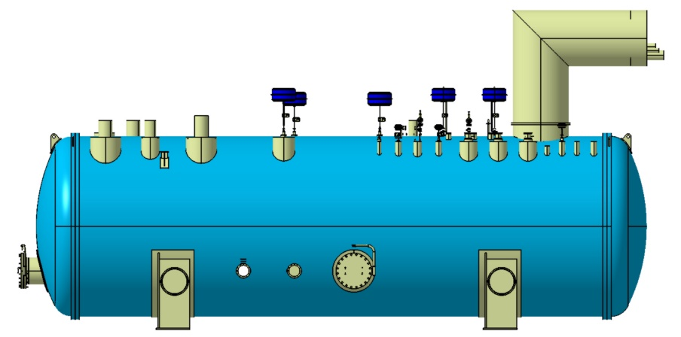
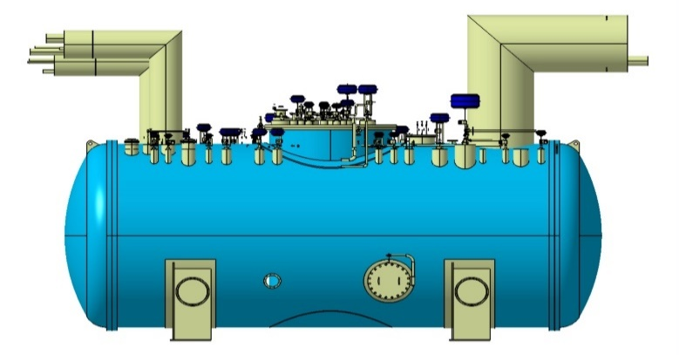
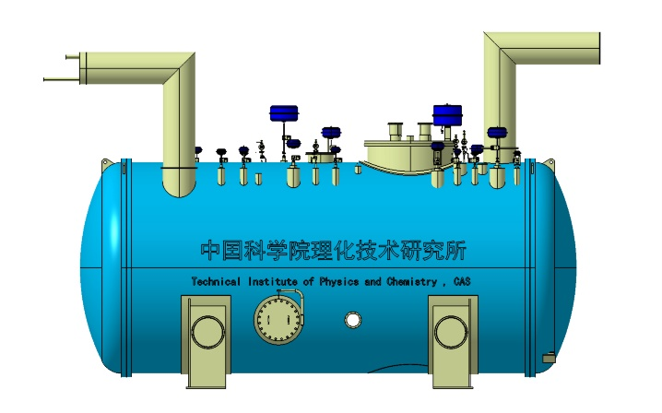
Preliminary design and optimization of cold box integration
Item | Number
Diameter/ m | 4
Length/ m | 15
Width / m | 5
Height / m | 6
Weight / tons | 95
300K~40K Upper ColdBox
Ground surface
Item | Number
Diameter/ m | 4
Length/ m | 10.5
Width / m | 5
Height / m | 6
Weight / tons | 80
40K~4.5K Lower ColdBox
Auxiliary Tunnel
Item | Number
Diameter/ m | 4
Length/ m | 10
Width / m | 5
Height / m | 6
Weight / tons | 80
2K Coldbox
Auxiliary Tunnel
  2.2 | PFD | MODELING | OVERALL DESIGN PARAMETERS | COMPRESSORS | TURBINES | HX | PIPELINE | ASSEMBLING | R&D
Notes:
This design ensures optimal performance, minimal footprint, and efficient utilization of space, while also facilitating the integration of various components and subsystems within the cryogenic plant.

Slide 28
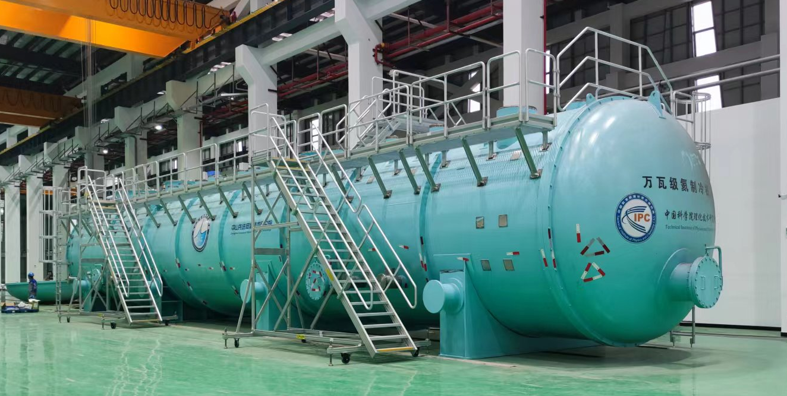
Mega-watts (18kW) Large refrigerator R&D status
TIPC, CAS & Zhongshan Institute of Advanced Cryogenic Technology
18kW@4.5K large refrigerator, reached liquefaction rate >3000L/h
  2.2 | PFD | MODELING | OVERALL DESIGN PARAMETERS | COMPRESSORS | TURBINES | HX | PIPELINE | ASSEMBLING | R&D

Slide 29
Content
1. CEPC SRF Cryogenic System Overview
  1.1 CEPC Project Brief Introduction
  1.2 Heat Load Estimation of Cryogenic System
  1.3 General Layout of Cryogenic System
  1.4 EDR scope and plan
2. CEPC SRF Cryogenic System Scheme Design
  2.1 Process Design & Calculation
  2.2 Large Helium Refrigerator
3. Cryomodule R&D Status
  3.1 Collider 650MHz Cryomodule R&D
  3.2 Booster 1.3GHz Cryomodule R&D
4. Summary and Outlook

Slide 30
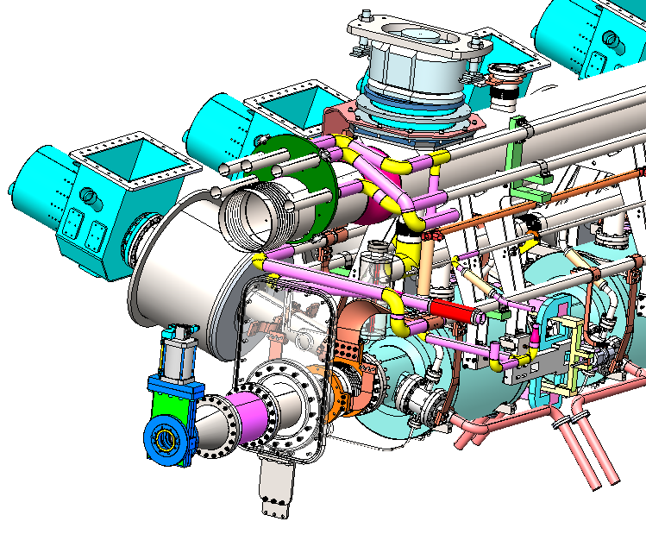
650 MHz full-size cryomodule Design Requirements
Some major requirements in terms of mechanical design:
Structure of cryomodule
  Follow the flow chart
  Quadrupole magnet(room temperature) between two cryomodules
  Tunnel layout (arc section’s beamline height is 0.8m)
  Installation and commissioning
  Independent insulating vacuum
  No external parallel transfer line
Thermal performance in CW operation
  High heat loads, heat transport, helium flow rates
  Low touch thermal resistance
  ( conductive cooling method copper braided tape/copper hoop)
Retention of very high cavity quality factor (Q0)
  Magnetic shielding
  Cool-down constraints
Pressure safety
  Three-level safety protection system: First-level solenoid valve 1.26Bar; Two-stage safety valves (1.28Bar,1.48Bar) Burst disc valve 1.9Bar
  3.1 REQUIREMENTS| CM DESIGN & CONSTRAINT | HORIZONTAL TEST R&D STATUS
Notes:
solenoid英/ˈsɒlənɔɪd; ˈsəʊlənɔɪd/ burst英/bɜːst/

Slide 31
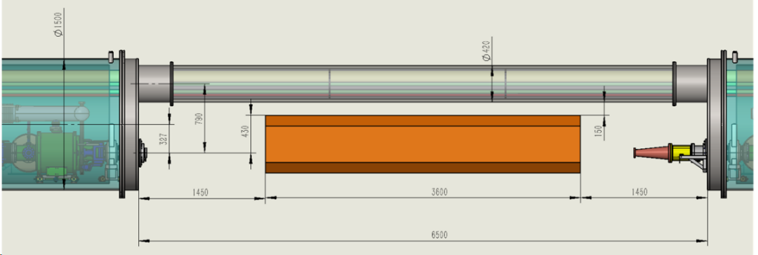
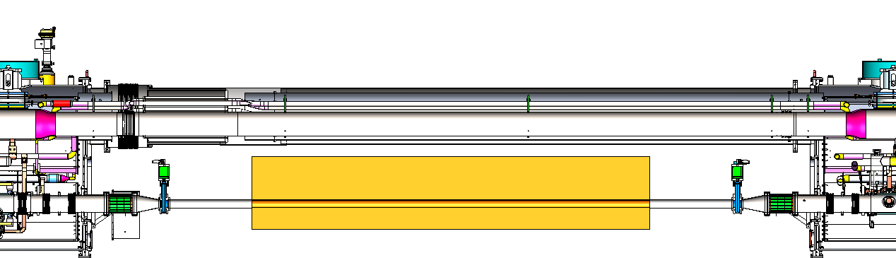
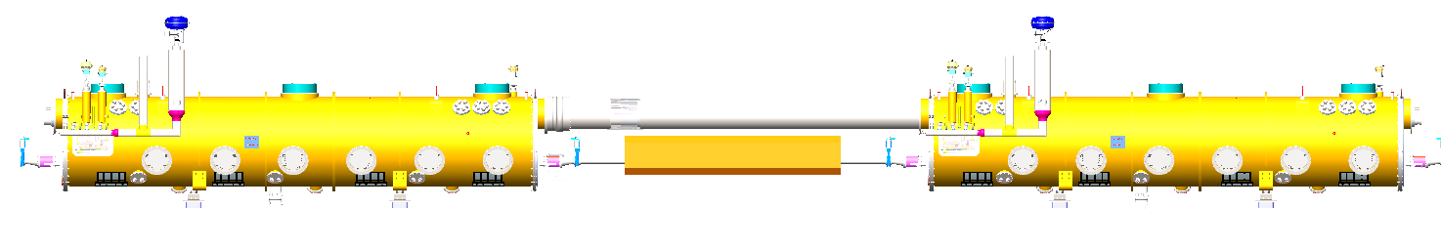
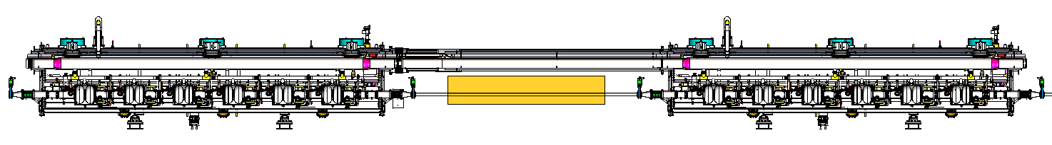
New Constraint on Module Structure
Quadrupole magnet between cryomodules is designed for different energies up to ttbar.
Distance between beam axis and cryogenic pipeline should be fit for the magnet and alignment.
The current space requirement is > 450 mm (300 mm magnet + 150 mm alignment).
Structure of the cryomodule should consider this constraint.
The modified TESLA style is more suitable than strong-back style.
The total pressure drop of GRP is 400 Pa ( pipe and valves 150Pa，2K HX 250Pa).
The minimum distance between CTL and magnet is 100.5 mm.
Vacuum barrier
  3.1 REQUIREMENTS| CM DESIGN & CONSTRAINT | HORIZONTAL TEST R&D STATUS

Slide 32
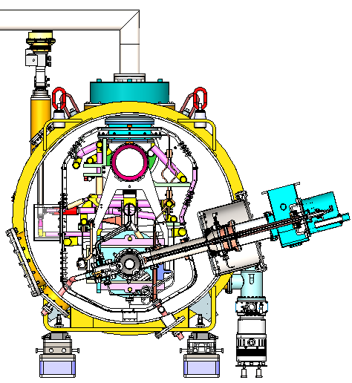
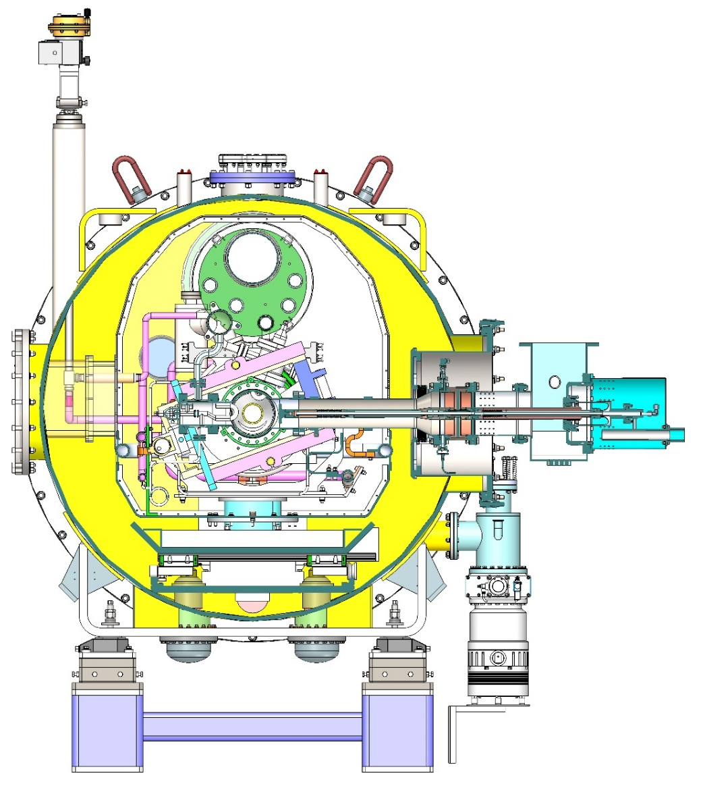
Change from Bottom Support to Top Suspension
Distance between beam axis and CTL: 206 mm (< 450 mm)
Beamline height: 1.2 m
Coupler side transverse dimension from the beam axis: 1.62 m.
Quadrupole spacing: distance between beam axis and CTL 510 mm (> 450 mm) (CTL OD 509 mm)
Beamline height: 0.8 m (same with arc section). Module height: 2.5 m (valve 2.9 m) reduce to 2.1 m.
Advantages:
  Economic (flat ground in the tunnel, transportation and cost)
  Cryogenic pipeline between two cryomodules, without external parallel CTL
  Use the same integrated assembly tooling(low cost and make full use of working space)
  Space requirements(adjustable input coupler’ length )
Height: 2.1 m (valve 2.6 m)
Bottom Support
Top Suspension
  3.1 REQUIREMENTS| CM DESIGN & CONSTRAINT | HORIZONTAL TEST R&D STATUS
Notes:
There are two cross section of two kind cryomodule are showed in this ppt
beam axis美/biːm ˈæksɪs ;transverse英/ˈtrænzvɜːs/

Slide 33
650 MHz full-size Cryomodule Design
This will lead to an uneven ground in the tunnel.
Arc section
RF section
  3.1 REQUIREMENTS| CM DESIGN & CONSTRAINT | HORIZONTAL TEST R&D STATUS
Notes:
And when we do the tunnel layout ,we find the distance between the beam tube at arc section to floor of tunnel is 800mm, but the minimum distance between the beam tube of cryomodule to floor of tunnel is 1200mm，which will lead to an uneven ground in the tunnel ,this will increase the difficulty of transportation and installation at tunnel, it also will increase the total cost of tunnel.

Slide 34
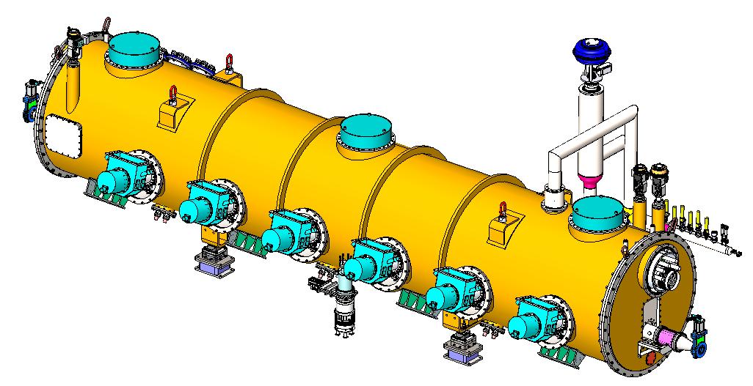
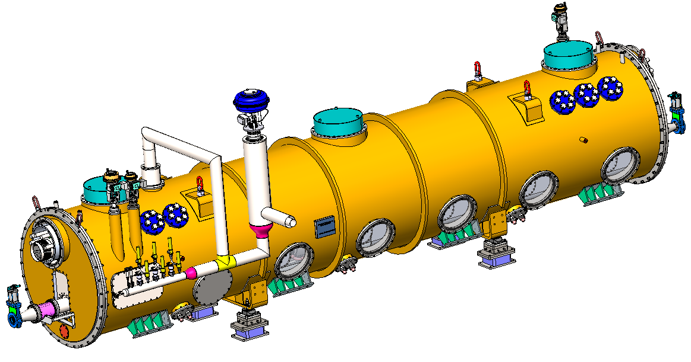
650 MHz full-size Cryomodule Design(Top Suspension)
Main material:
Thermal shield
inlet valve,DN15
Slide POST
Support
component
Fix POST
Support
component
Rings
Quench valve,DN80
Vacuum house：Q345R;
Thermal shield：Aluminum6061-T6+AL1050-A；
Cryogenic pipe：316L；
POST:G10
Copper hoop + copper braided strap：copper，RRR>100。
Gate valve
Welding/
maintenance
Coaxial line
Cryogenic pipeline connectors
CD valve,DN25
JT valve,DN15
Bottom adjustive
component
Vacuum relief valve/vacuum
gauge/Gate valve/
molecular pump
HOM absorber
Coupler
Support for
transportation
Size of vacuum chamber:Φ1500*14-7747.6mm
Total length of beam tube:9293.6mm
Total weight:10334Kg
Beamline height ：800mm
Height of cryomodule：3223.8mm(with quench valve)/2958mm
Alignment
FEEDTHROUGH，
6*CF35
Nameplate
Tuner maintenance
Pressure relief valve
Quench pipe：
Outer pipe Φ141/inner pipe Φ89
Vacuumize/Conditioning
Bursting disc
  3.1 REQUIREMENTS| CM DESIGN & CONSTRAINT | HORIZONTAL TEST R&D STATUS
Notes:
carbon steel ;stainless steel; aluminum英/əˈluːmɪnəm;

Slide 35
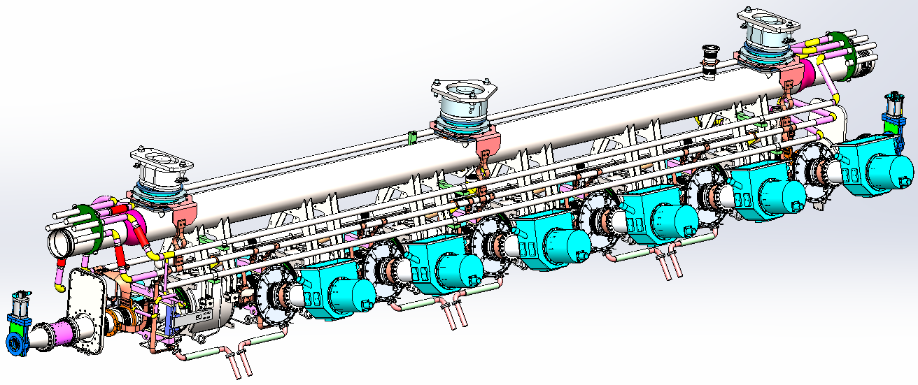
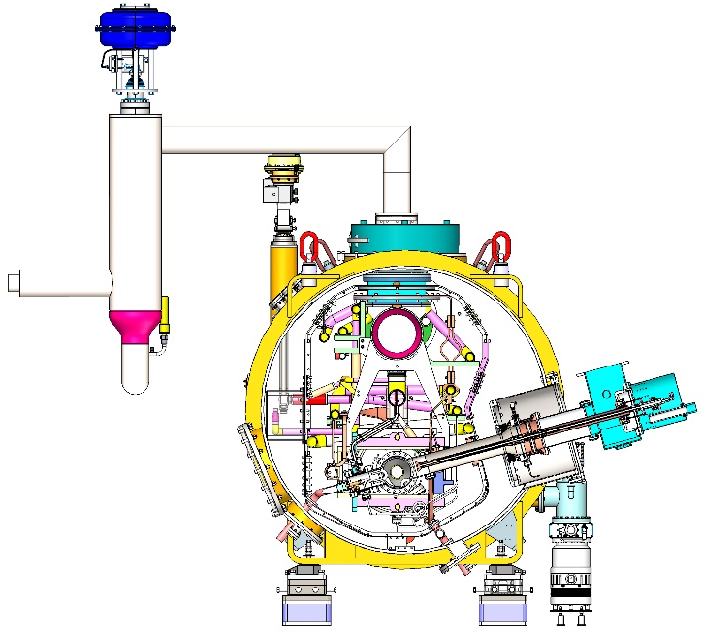
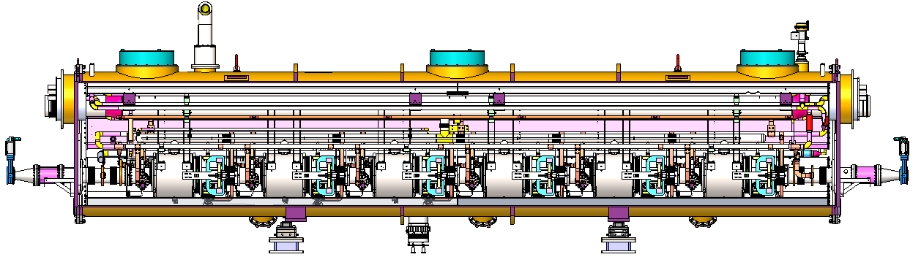
650 MHz full-size Cryomodule Design(Top Suspension)
Two 5 ~ 8 K Ø45 pipes for coupler
Two 40 ~ 70 K Ø45 pipes for thermal shield
One 2 K Ø273 (inside CM) Ø219 (outside CM) GRP
One 3 Bara @ 2.4 K Ø45 pipe for subcooled supply.
Coupler change from horizontal to 15 deg tilt due to off-axis (move downward) and cold mass-vacuum chamber assembly requirement. Coupler length also reduced.
12 coaxial cables for power extraction of 12 HOM couplers (1 kW each).
Set RF shielded bellow between cavities.
Impedance and heat load of cavity flange seal gap to be evaluated.
Two layers of magnetic shielding
slide support
Quench valve
DN80
Fix support
slide support
  3.1 REQUIREMENTS| CM DESIGN & CONSTRAINT | HORIZONTAL TEST R&D STATUS
Notes:
impedance
英/ɪmˈpiːdns/

Slide 36


Horizontal test R&D status
North HTS of PAPS SRF lab. New 2 K valve box and CTL.
Waveguide ports
Transport
path
Old 4K valve box for 166MHz cryomodule
New 2 K valve box for 650MHz cryomodule
  3.1 REQUIREMENTS| CM DESIGN & CONSTRAINT | HORIZONTAL TEST R&D STATUS

Slide 37

650 MHz Module Horizontal Test PID Diagram
  3.1 REQUIREMENTS| CM DESIGN & CONSTRAINT | HORIZONTAL TEST R&D STATUS

Slide 38


Flow chart for Booster 1.3GHz CM
Magnet
Series connection，modified TESLA CM
Three 1.3 GHz cryomodules hung from ceiling at a different beamline
Working temperature:2K
Two-phase flow
300 mm OD helium gas return pipe (GRP) is used as support backbone
Shared thermal insulating vacuum
No external parallel transfer cryogenic pipeline
  3.2 PID DIAGRAM| CM DESIGN | HORIZONTAL TEST R&D STATUS
Notes:
Due to top suspension of Booster 1.3GHz CM, CTL need to pulled out from CM side and then have more difficulties for bending if adopted the parallel connection.
Just 3 CMs in one cryo-station, after evaluation, the parallel connection scheme is chosen.

Slide 39







IHEP High Q 1.3GHz TESLA Type Cryomodules
Details can be referred to Jiyuan Zhai’s talk
World’s first Mid-T Bake High Q 1.3 GHz Cryomodule, Developed for High-repetition-rate FEL project of DALS.
Key criteria for stable and reliable operation include a dependable cryogenic refrigeration system and process design, good thermal insulation, pressure control, temperature uniformity, and quench protection, etc.
  3.2 PID DIAGRAM| CM DESIGN | HORIZONTAL TEST R&D STATUS
Notes:
repetition rate
英
美/ˌrepəˈtɪʃn reɪt/

Slide 40
Content
1. CEPC SRF Cryogenic System Overview
  1.1 CEPC Project Brief Introduction
  1.2 Heat Load Estimation of Cryogenic System
  1.3 General Layout of Cryogenic System
  1.4 EDR scope and plan
2. CEPC SRF Cryogenic System Scheme Design
  2.1 Process Design & Calculation
  2.2 Large Helium Refrigerator
3. Cryomodule R&D Status
  3.1 Collider 650MHz Cryomodule R&D
  3.2 Booster 1.3GHz Cryomodule R&D
4. Summary and Outlook

Slide 41
Summary & Outlook
Comprehensive Design addresses nearly all critical aspects of the CEPC SRF cryogenic system.
Key R&D Milestones:
  Completed 650 MHz cryomodule 2K Horizontal test in 2026.
  Completed CEPC Cryogenic System Proposal in 2026.
  Completed CEPC Cryogenic System EDR Documentation in June, 2027.
Collaboration & Scalability:
  Collaboration with other projects (e.g., SHINE, Ci-ADS, S3FEL, HALF, etc.) and institutions will be maintained to leverage existing experience and expertise.
  Develop AI-driven monitoring for real-time tracking of safety parameters (pressure, temperature).
Long-Term Goals:
  The cryogenic system design aims to support the long-term operation of the CEPC SRF project, with considerations for potential upgrades and future expansion. The system is designed to be flexible and adaptable to evolving requirements.
  Safety and reliability of the cryogenic system will remain a top priority. Continuous monitoring, testing, and validation of safety systems will be conducted to ensure the protection of personnel and equipment.
Thanks for your attention!

