Slide 1


CEPC linac injector development in EDR
Jingru Zhang
On behalf of the CEPC linac team
17 June, 2025
16-19 June, 2025, Barcelona, Spain. EU Edition of the International Workshop on the CEPC

Slide 2
Outline
Introduction
EDR goal, scope and plan
What are finished before EDR
EDR progress status
Summary

Slide 3
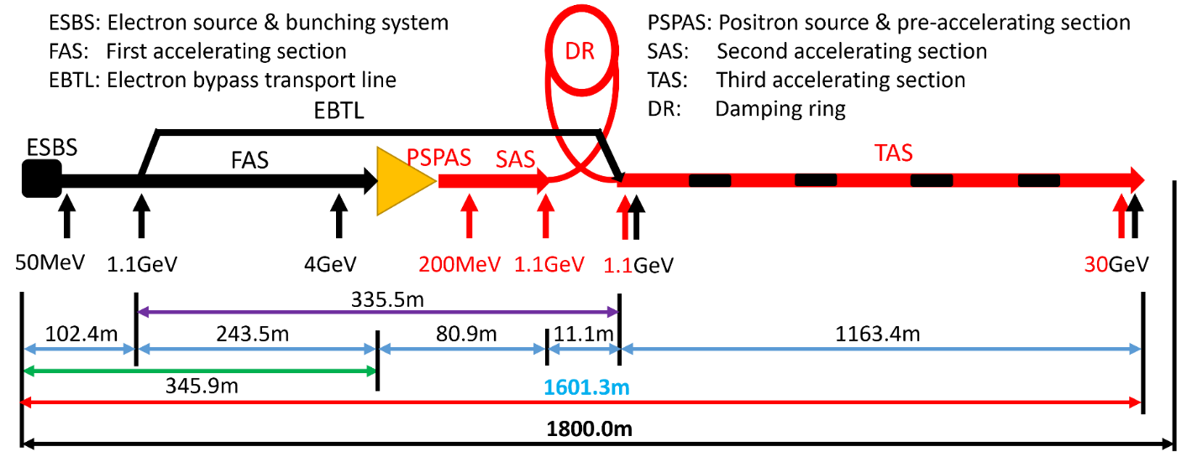
Introduction: CEPC Linac baseline design
Linac design
  Meet requirements
  High availability
  Reserve upgrade potential
High energy electron and positron linear accelerator with S-band and C-band accelerating units
  A large number of C-band accelerator structures (TAS)
This report primarily focuses on the electron and positron sources and the RF system of the linac and DR copper cavity
Design details of the linac RF sources, magnets, and other components are covered in reports by other specialists
Parameter | Symbol | Unit | Baseline
Energy | E_{e-}/E_{e+} | GeV | 30
Repetition rate | f_{rep} | Hz | 100
Bunch number per pulse |  |  | 1 or 2
Bunch charge |  | nC | 1.5 (3)
Energy spread | σ_{E} |  | 1.5×10⁻³
Emittance | ε_{r} | nm | 6.5
Switch time for electron and positron |  | s | 3.0

Slide 4

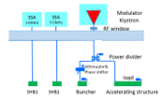
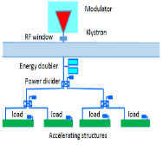
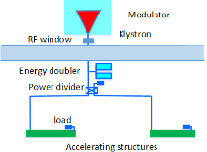
Introduction: CEPC Linac Sources &RF system
Electron gun & positron source & bunching system
RF distribution of the 30 GeV Linac
  S-band, 80 MW klystron, the number of S-band Acc. structure is 93, big hole s-band structure after the positron source is 16. the number of pulse compressor is 33
    1-1(ESBS), 1 accelerating structure, 22MV/m
    1-4 (FAS), 21 sets, 84 standard accelerating structures, with pulse compressor, 22MV/m
    1-2(PSPAS), 8 sets, 16 big hole accelerating structures, 22MV/m, with pulse compressor
    1-2(SAS), 4 sets, 8 accelerating structures, 27MV/m , with pulse compressor
  C-band, 50 MW klystron, C-band structures: 470, with 235 pulse compressors
    1.1GeV-30GeV, 1-2(TAS), 235 sets, 470 accelerating structures, ~40MV/m
Damping ring copper cavity (2)
Transport line S-band ACC. structure (2)
Parameter | Unit | S-band |  | C-band
Frequency | MHz | 2860 |  | 5720
Length | m | 3.1 | 2.0 | 1.8
Cavity mode |  | 2π/3 |  | 3π/4
Aperture | mm | 19~26 | 25 | 12~16
Gradient | MV/m | 22/27 | 22 | 40
Cells (include coupler cells) |  | 86 | 55 | 89
Number of Acc. Stru. |  | 93 | 16 | 470
Number of Klystron |  | 33 |  | 236
Klystron Power | MW | 80 |  | 50

Slide 5
EDR goal: Equipment list & preparation status
Our goals and plan are to make all our hardware prepared
 | Numbers | Designed | High power tested | Operated with beam | Need upgraded
Electron gun | 1 | Yes | Yes | Yes | Two bunch
Positron source | 1 | Yes | Yes | Yes | Power increase
SHBs/Buncher | 2/1 | Yes | Yes | Yes
S-band 3m AS | 93 | Yes | Yes | Yes | The water cooling to 100Hz
S-band PC | 33 | Yes | Yes | Yes | The water cooling to 100Hz
S-band big hole AS | 16 | No→Yes after EDR | No | No
S-band 1m AS | 2 | No→Yes after EDR | No | No
S-band dummy load | 190 | Yes | Yes | Yes
S-band waveguide system | 36 | Yes | Yes | Yes
S-band LLRF | 42 | Yes | Yes | Yes
C-band AS | 370 | Yes | No→Yes after EDR | No
C-band PC | 235 | No→Yes after EDR | No→Yes after EDR | No
C-band dummy load | 706 | Yes | No→Yes after EDR | No
C-band deflector | 1 | No→Yes after EDR | No | No
C-band waveguide system | 236 | Yes | Yes | No
C-band LLRF | 236 | No→Yes after EDR | No→Yes after EDR | No | phase drift compensation
DR copper cavity | 2 | Yes | No | No

Slide 6
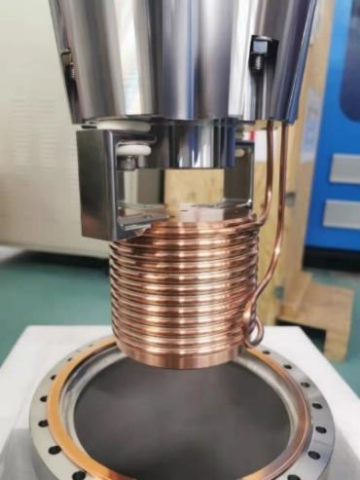
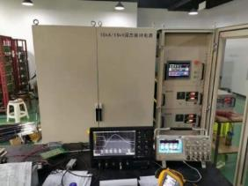
The TDR design review: Sources
Electron source
  Traditional thermionic triode gun
  Mature technology
Design parameters of the EDR
  1.5 nC bunch charge for electron injection
  10 nC bunch charge for positron production
The HEPS and BEPCII design can meet our requirement
Positron source
  Incident electron beam:4GeV/10nC/100Hz
  Fixed Target (tungsten,15mm thickness)
  FLUX concentrator
    Length: 100mm
    Aperture: 7mm→52mm
    Magnetic field: 6.0T → 0.5T
  We have made a prototype of the flux concentrator and it’s power supply and successfully high power tested
Parameter | Unit | Value
Type | - | Thermionic Triode Gun
Cathode | - | Dispenser cathode
Beam current | A | > 10
High voltage of anode | kV | 150
Bunch charge 1 | nC | 3.3 (e– injection)
Bunch charge 2 | nC | 11 (e⁺ production)
Repetition rate | Hz | 100
Pulse duration | ns | 1
The FLUX conentrator
The 15kA solid-state modulator

Slide 7
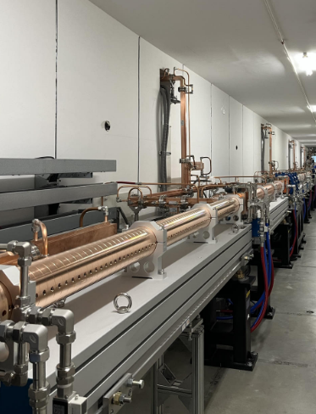
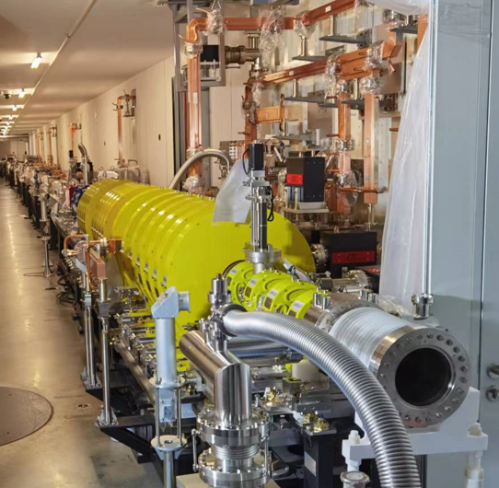
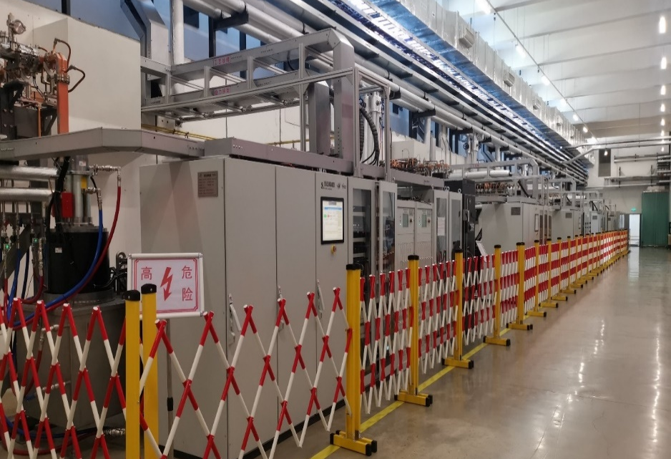
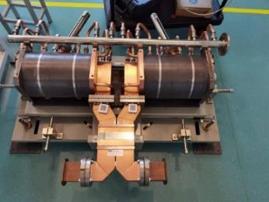
The TDR design review: 500MeV S-band linac
HEPS 500MeV S-band linac including bunching system
  Gun, 2 SHBs, 1 prebuncher, 1 buncher , 9 accelerating structures, 4 SLAC type pulse compressors
  The S-band RF system successfully used in HEPS project and the gradient with beam reached 26 MV/m
HEPS linac tunnel
HEPS equipment hall
HEPS pulse compressor

Slide 8
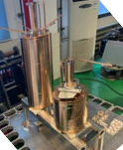
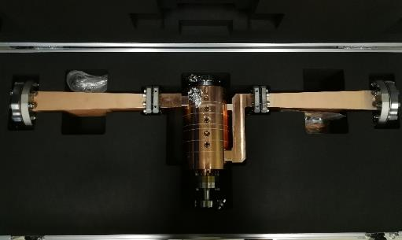
The TDR design review: Bunching cavities
The SHBs & buncher
  Re-entrant SW for SHBs
  TW/CI for buncher
The same as HEPS only the frequency is a little deference
Parameters | Unit | Value
 |  | SHB1 | SHB2
Frequency | MHz | 158.89 | 476.67
Shunt Impedance | MΩ | 1.46 | 2.53
Unloaded Q | - | 8475 | 12431
VSWR | - | < 1.05 | < 1.05
E_{surface, max} @100 kV | MV/m | 6.4 | 6.1
Required power @100 kV | kW | 10 | 7
Parameters | Unit | Value
Frequency | MHz | 2860
Phase advance | - | 2π/3
Cell number | - | 6
Phase velocity | - | 0.75
Group velocity | - | 0.0193
Attenuation constant | Np/m | 0.147
Shunt impedance | MΩ/m | 33.2
Unloaded Q | - | 11083
Bunching voltage (Max) | MV | 1.2
Input power | MW | 6
SHBs for HEPS
Buncher for HEPS

Slide 9
Development in EDR
Upgrade of the S-band RF technology
Using existing HEPS linac, conduct dual bunch acceleration experiments after upgrading e-gun and beam measurement equipment
Build a C-band unit testing bench
R&D of cryogenic copper C-band accelerating structures
Improve the design of DR copper cavity

Slide 10
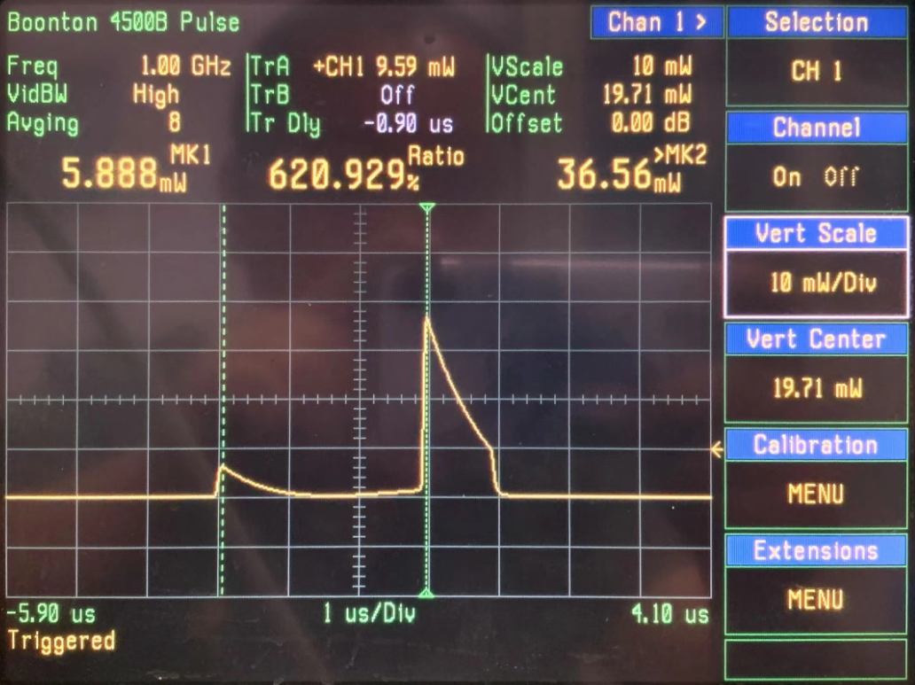
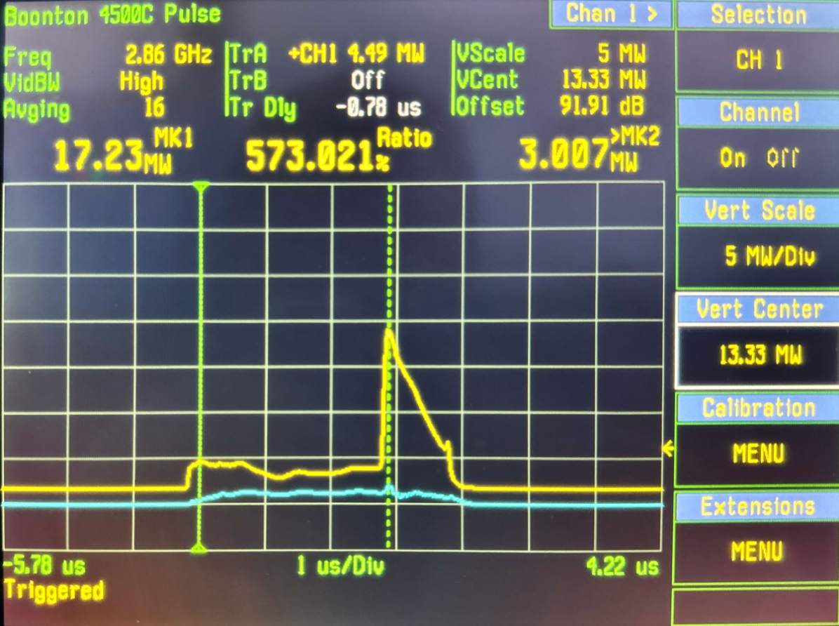
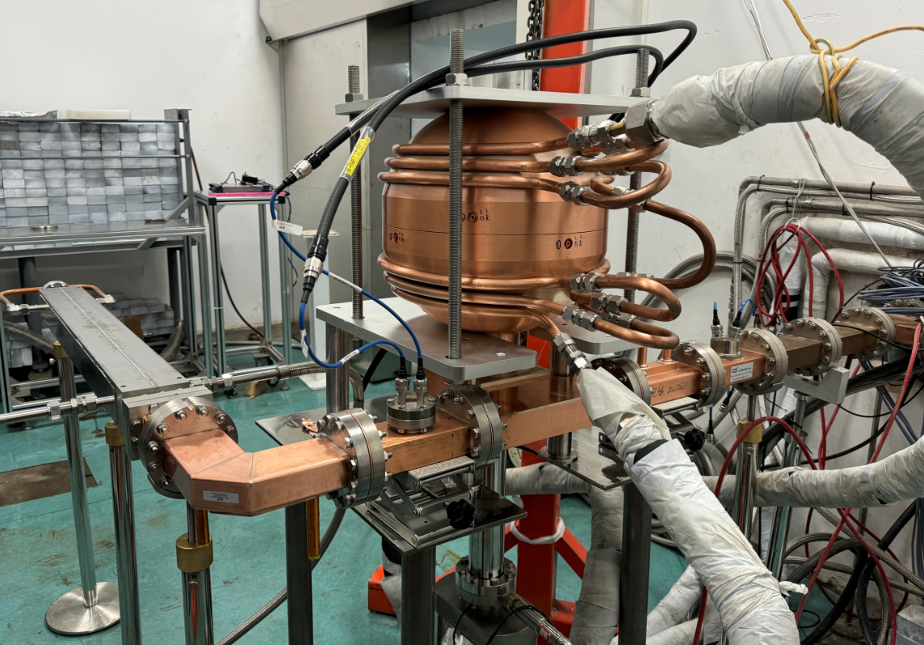
S-band RF technology upgrade：spherical cavity pulse compressor
Completed the design and measurement of the spherical pulse compressor TE₁₁₃ mode
  The cold measured Q₀, peak power gain G_{P}, and energy multiplication factor M are 132003, 4.8, and 1.85, respectively
High power testing was finished
  Use 80MW klystron. (pulse width 4 μ s, repetition rate 50 Hz)
  Experienced to a power of 66.5MW, the maximum energy multiplication factor M=1.8
Measured by network analyzer
High power test waveform
High power test system

Slide 11
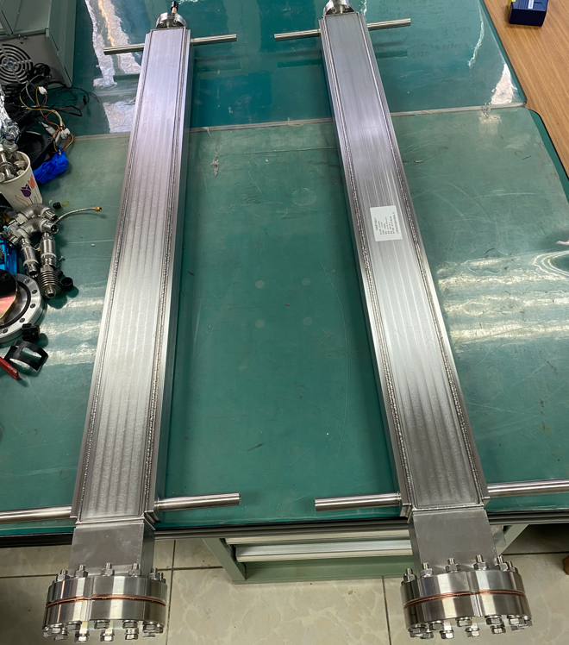
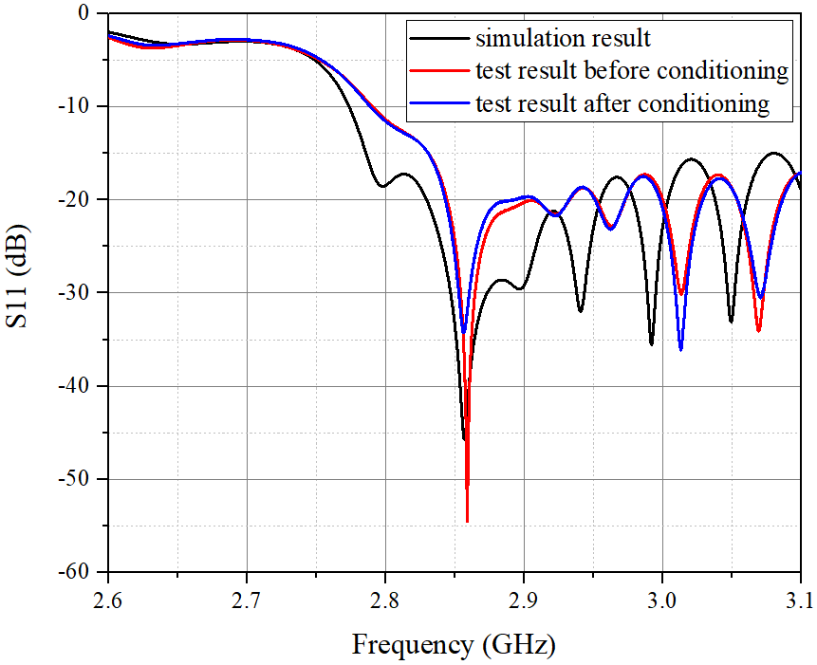
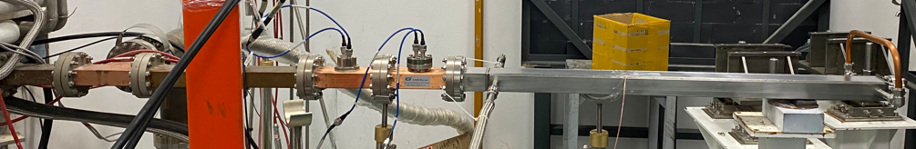
S-band RF technology upgrade：SS430 metal load
The design, processing, and cold testing of the metal load have been completed, and the standing wave ratio is less than 1.1
High power testing of metal loads has been completed, with peak power 42MW under a pulse width of 4us and a repetition rate of 50Hz
High power test system
Metal Load

Slide 12
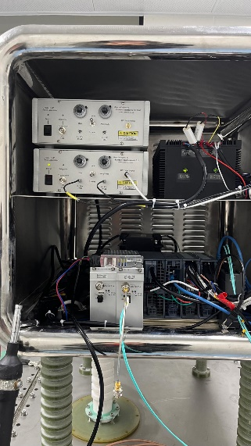
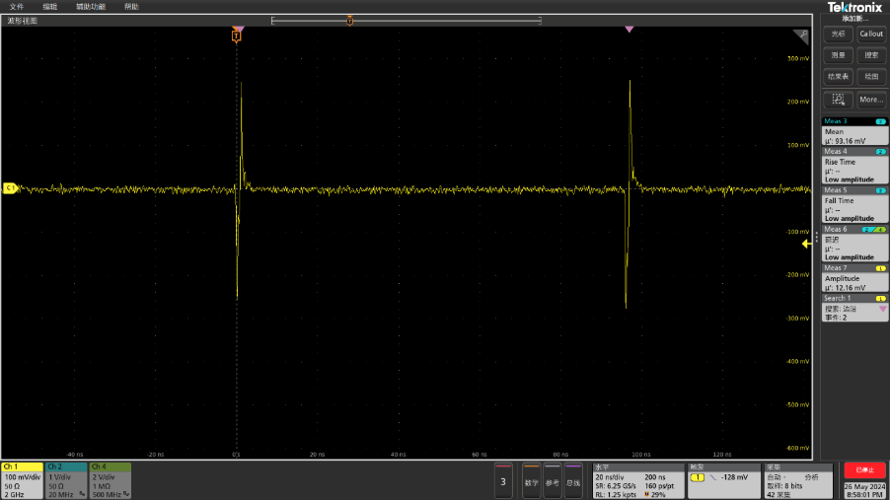
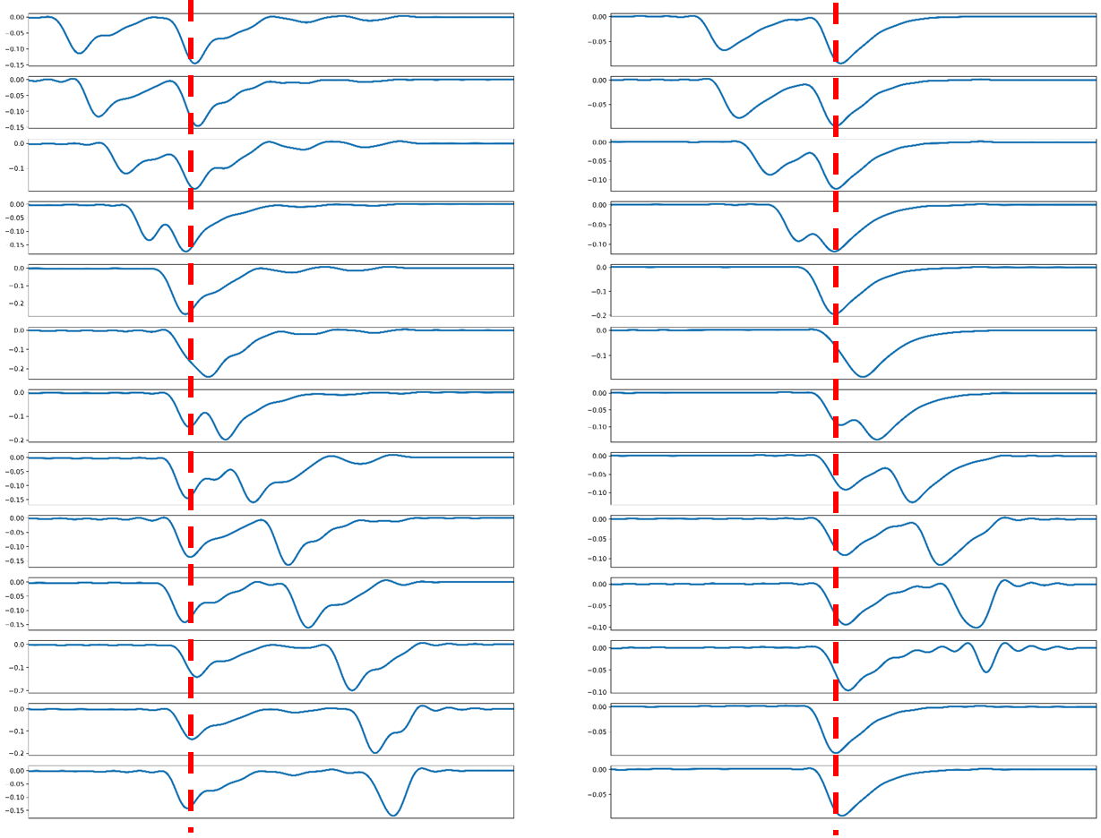
EDR progress status：dual bunch acceleration experiments
    Conduct preliminary double-bunch acceleration beam experiment based on actual conditions. Upgrade the gun from one bunch to double-bunch using existing equipment
Achieved the generation and tuning of double bunches (with an interval of 6ns multiples)
  The gun pulser will continue to be upgraded. When the power combining module is connected, the actual measured pulse amplitude exhibits an attenuation of about 30%
  Accurate measurement of the characteristics of dual bunch requires upgrading the beam measurement system
  The experiment is subject to the availability of machine time!!!
BPM signal
ICT @ Egun exit
ICT@50MeV

Slide 13
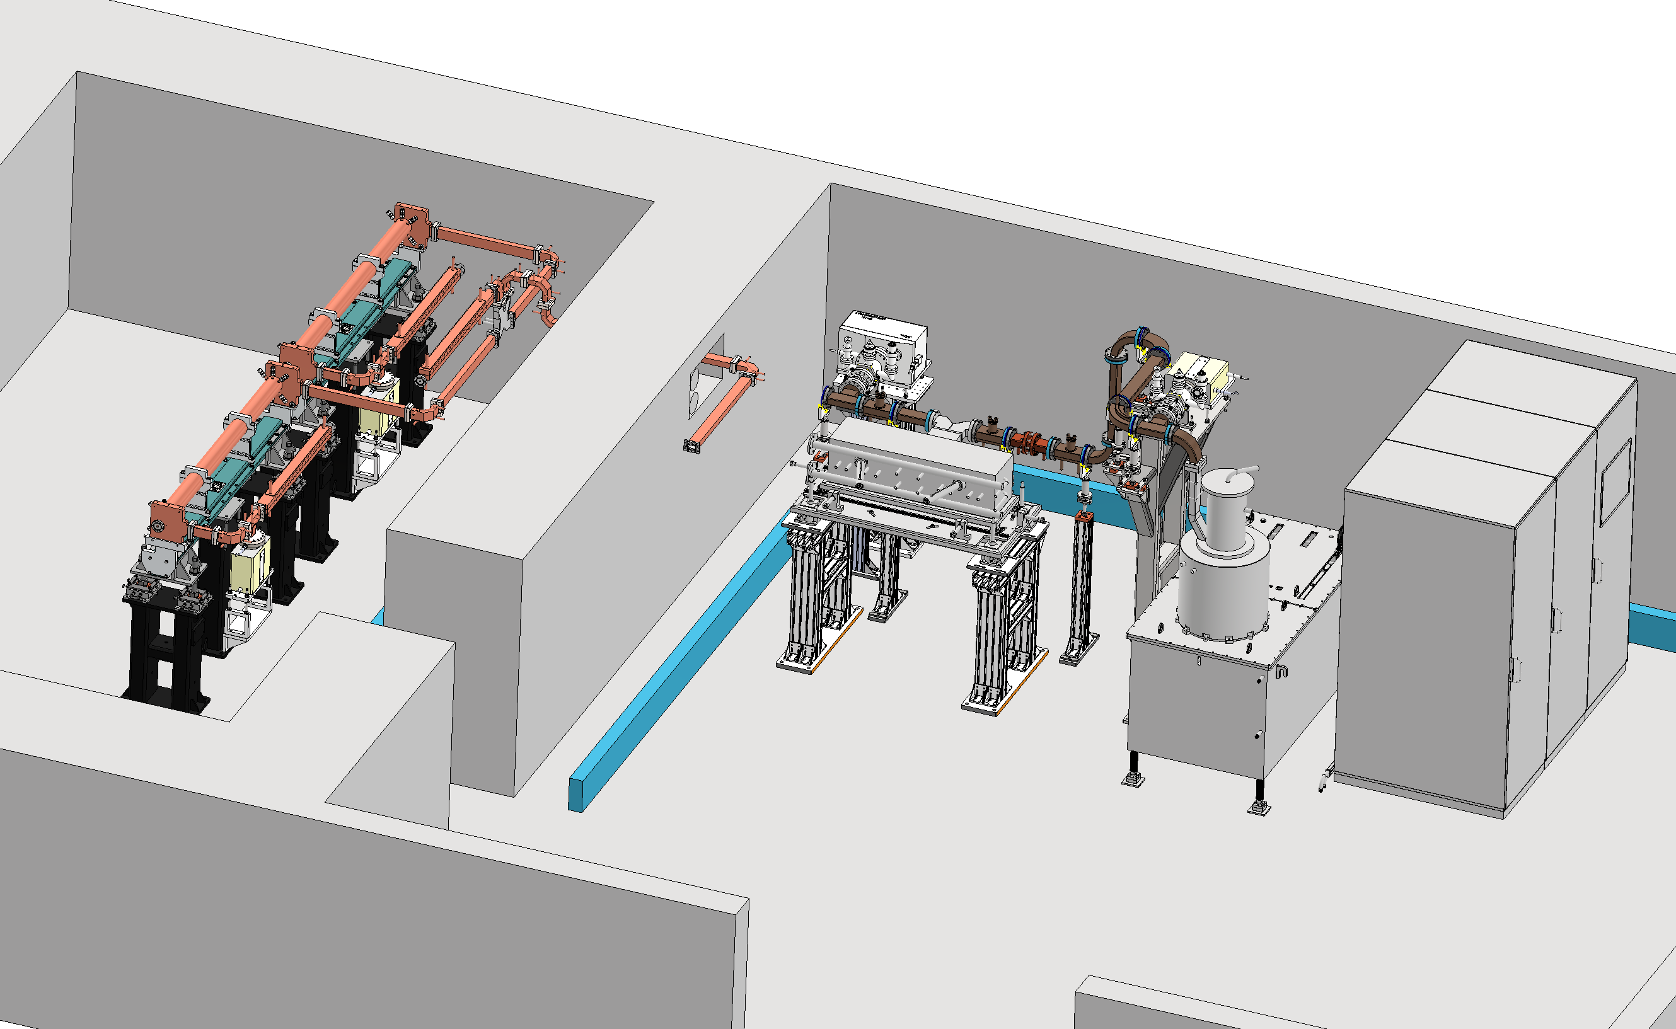
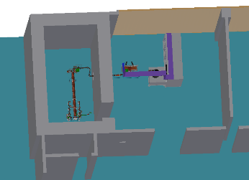
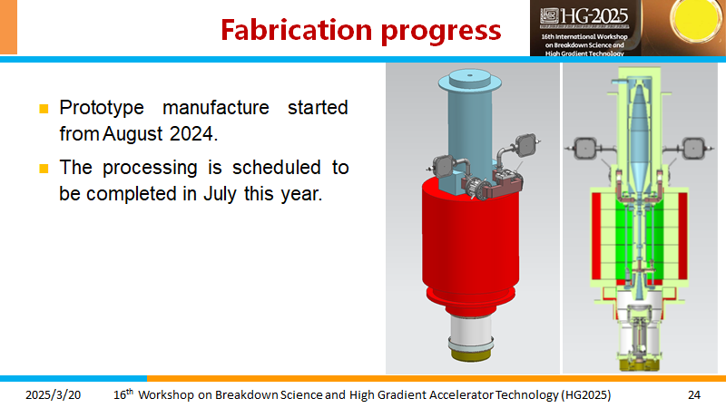
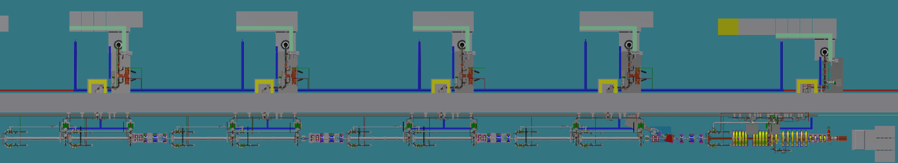
C-band high power test platform plan
A C-band high-power test platform will be established in Huairou Park at IHEP.
CEPC C-band RF frequency is 5720 MHz. For the power source is 5712 MHz, we designed it at 5712MHz. It is easy to change frequency from 5712 MHz to 5720 MHz in the future
The C-band klystron will be completed in July this year.

Slide 14
Status of C-band accelerating structures in the world
The accelerating gradients up to 50 MV/m can be achieved on the test bench
Stabilized operation with beam is about ~40MV/m
 | IHEP | SARI | RIKEN | INFN | PSI | CEPC
Frequency(MHz) | 5712 | 5712 | 5712 | 5712 | 5712 | 5720
Mode | 3π/4 | 4π/5 | 2π/3 | 2π/3 | 2π/3
Length (m) | 1.8 | 1.8 | 2 | 1.4 | 2 | ~1.8
Gradient at high power test bench(MV/m) | - | 50 | 50.1 | 36 | 52
Operating gradient with beam (MV/m) | - | 41.7 (maximum) | 41.4 | 36 | 28 | 40

Slide 15
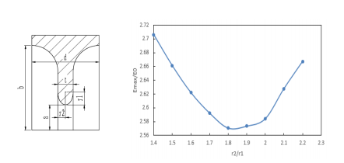
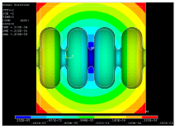
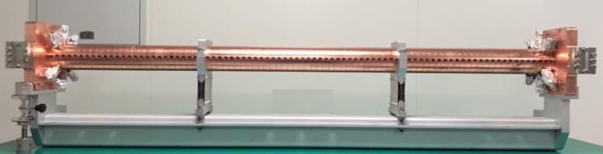
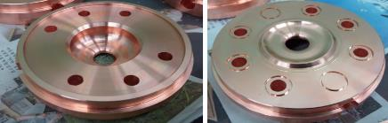
Review of the TDR: C-band accelerating structure
The R&D of C-band Accelerating Structure at IHEP
Constant gradient, operating in 3π/4 mode, extending 1.8 meters (mechanical length inclusive, with an effective length of approximately 1.7m)
A round cavity, featuring an elliptical cross-sectional iris
A racetrack-shaped coupler, embodying symmetrical magnetic coupling
 | IHEP
Frequency: f（MHz） | 5712
No. of Cells | 87+2
Phase advance | 3π/4
Total length(m) | 1.8
Length of cell : d (mm) | 19.675
Disk thickness: t (mm) | 4.5
Average aperture: 2a (mm) | 14.04
Average diameter : 2b (mm) | 45.6
Shunt impedance(average) : Rs (MΩ/m) | 66.05
Quality factor : Q | 11358~11186
Group velocity: Vg/c (%) | 2.8% ~ 0.96%
Filling time : t_{f} (ns) | 350
Attenuation factor : τ | 0.56
Epeak/E0 | 2.57
Cavity shape
The deformation caused by temperature variation

Slide 16
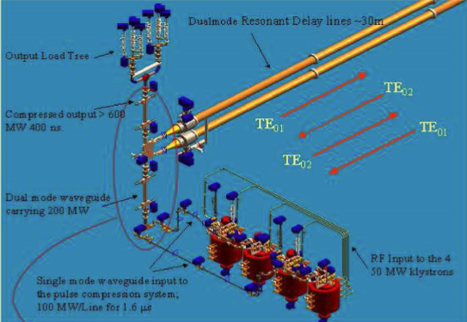
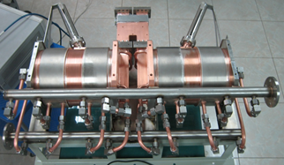
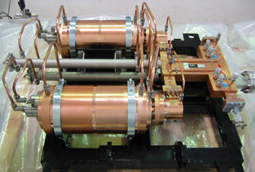
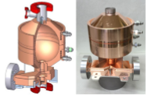
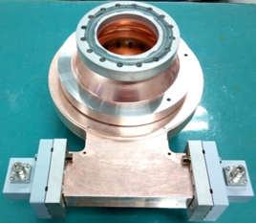
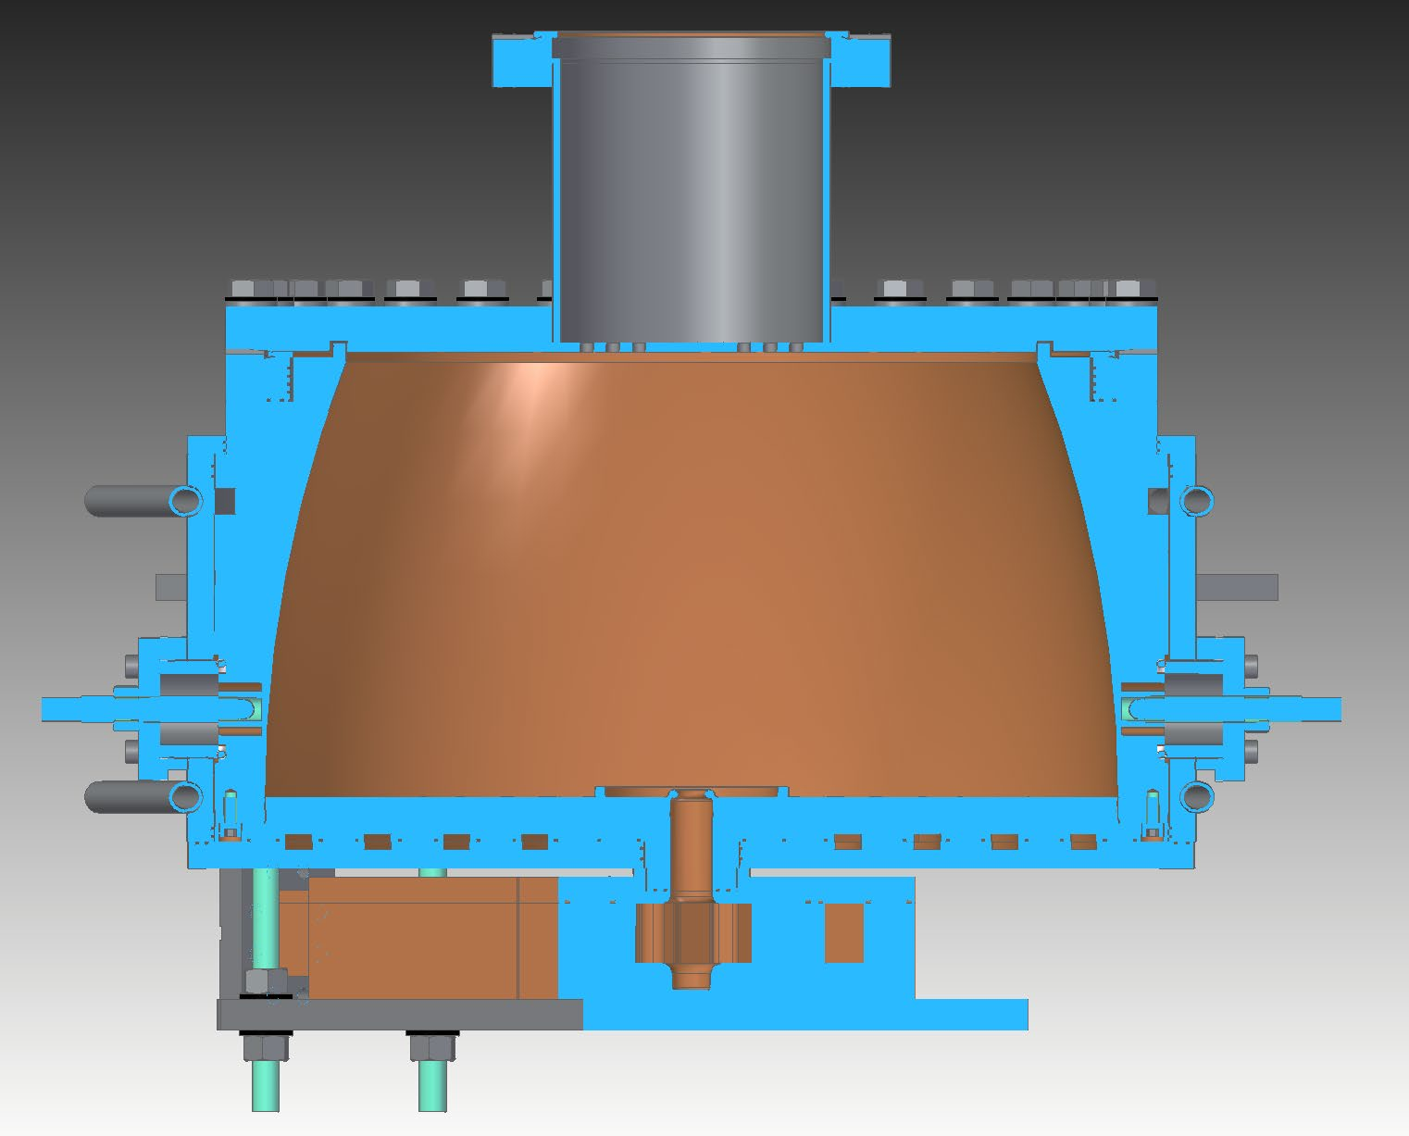
C-band pulse compressor in the world
Types of SLEDII, cylinder cavities types, spherical cavities, BOC types, and a newly designed bowl-shaped open cavity, have all been effectively employed
SLEDII
Cylinder cavities type
Spherical Cavity (SLAC)
BOC type
Bowl-shaped open cavity

Slide 17
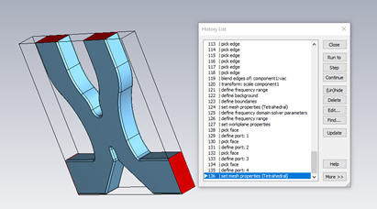
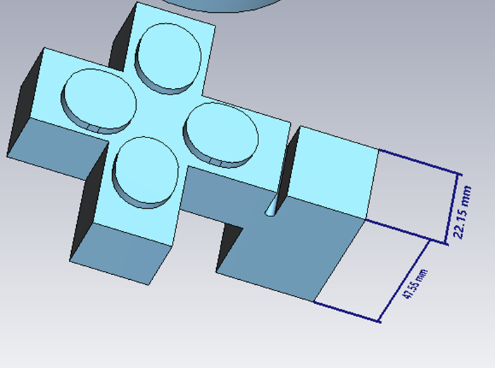
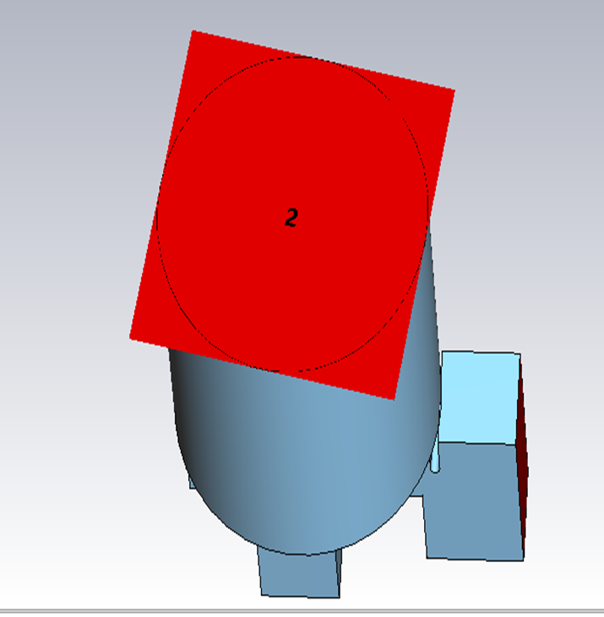
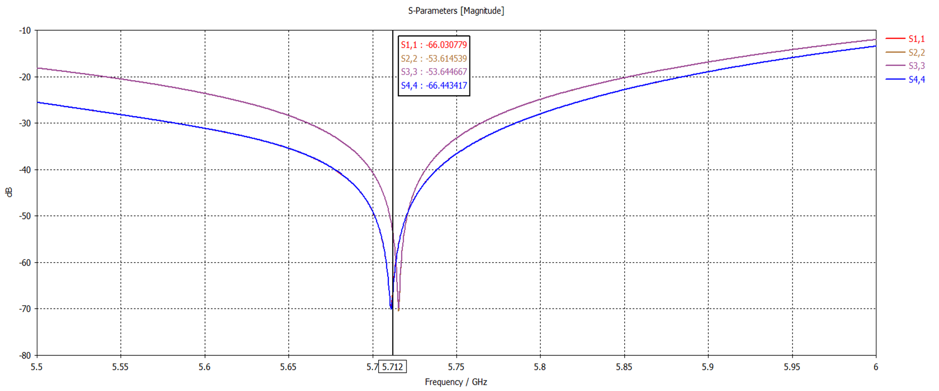
Pulse compressor (1): Cylinder cavities type TE₀₁₁₅
Currently focused on the mode converter design, aiming to optimize matching and reduce reflection losses
The 3-dB power divider has been successfully designed and validated with good simulation results
Further work will integrate the optimized converter with the complete system to evaluate overall efficiency and power multiplication
Reference image of a C-band RF pulse compressor system consisting of two resonant cavities, a 3-dB coupler, and a mode converter.
S-Parameter Results for 3-dB Power Divider (Matching at 5.712 GHz)
CST model showing mode converter geometry, port setup, and meshing.

Slide 18
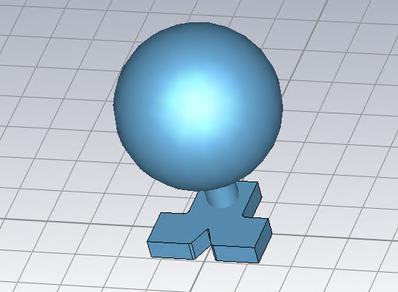
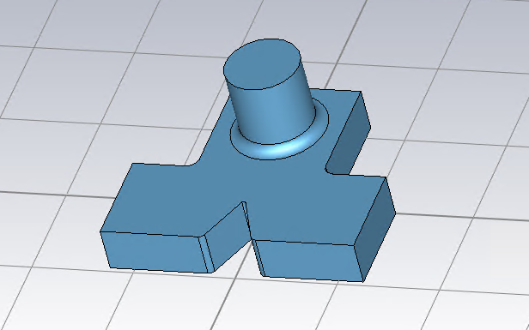
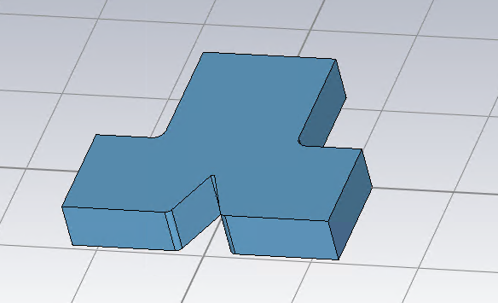
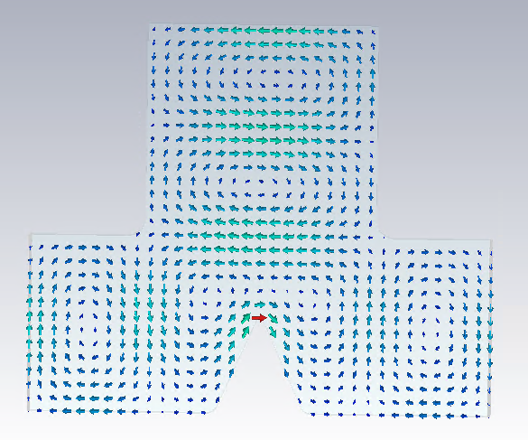
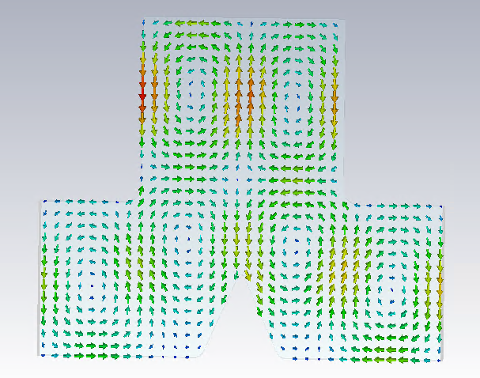
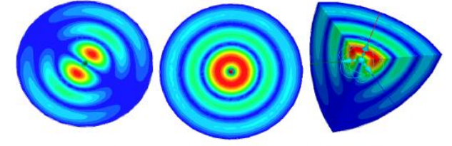
Pulse compressor (2): Spherical Cavity TE₁₁₃
Spherical cavity type has been designed now
Only RF design has just begun
TE₁₁₃ and TE₁₁₄ parameters will be compared before mechanical design
CST model
Mode convertor
Common mode waveguide
TE113
TE10 TE20
Modes in the spherical cavity

Slide 19
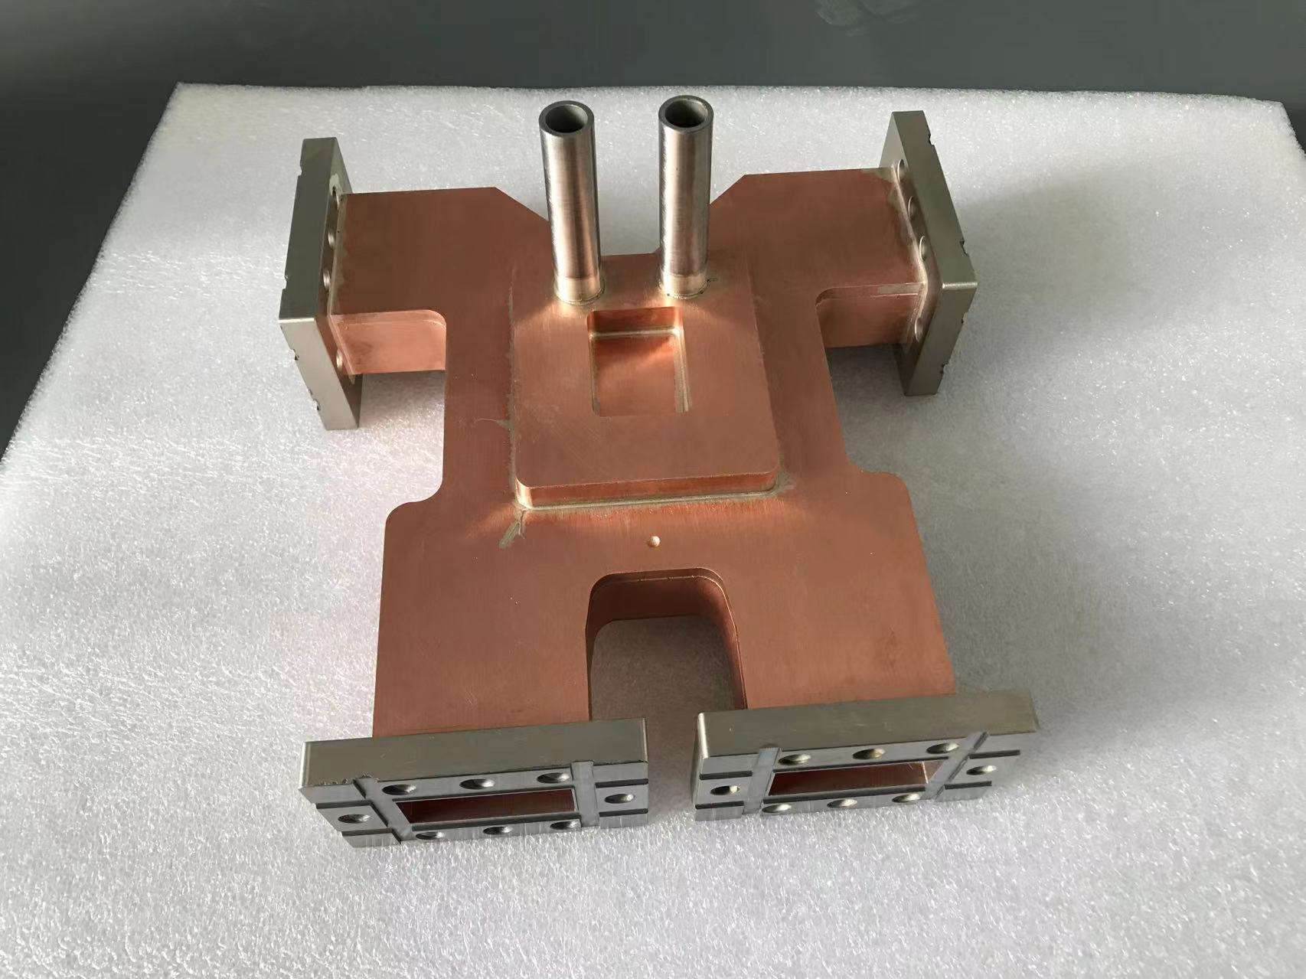
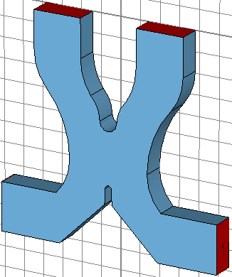
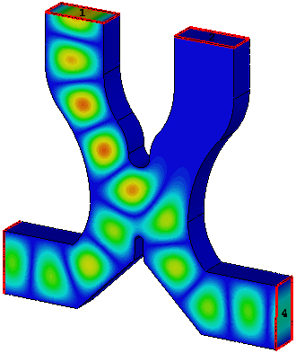
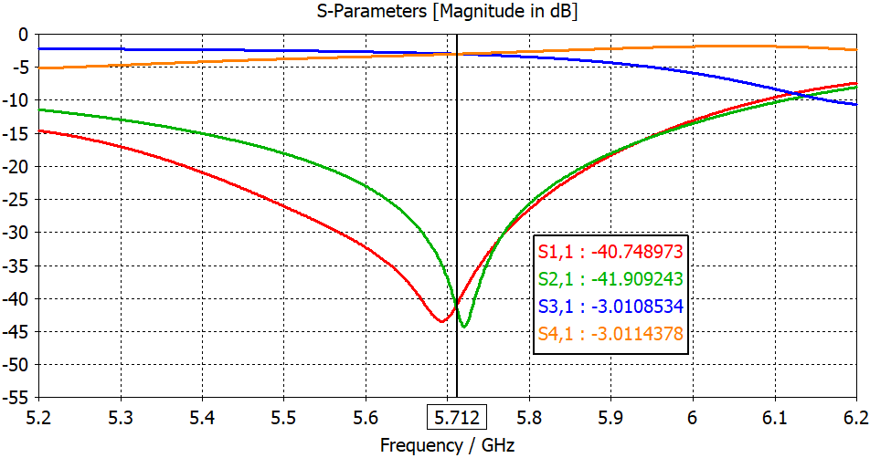
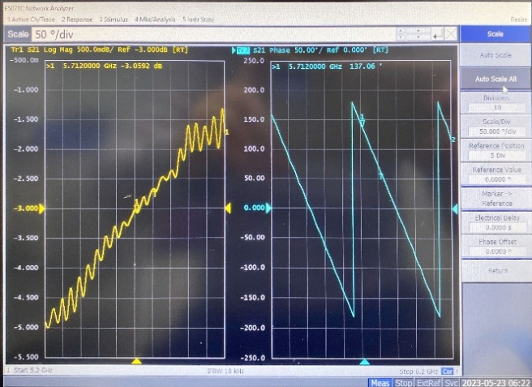



3dB hybrid power divider
VSWR：1.06
Amplitude imbanlance: -0.13dB
Phase imbalance degree: 0.48°
 | Amplitude |  |  |  | Phase
 | S11 | S21 | S31 | S41 | S31 | S41 | Phase difference
Designed | -40.7 | -41.9 | -3.01 | -3.01 | -30.4 | -120.4 | 90
Measured | -20.9 | -42.2 | -3.05 | -3.18 | 137 | -132.5 | 90.48

Slide 20




High directional coupler
Bethy hole type directional coupler
CF35 flage, SMA feedthrough
The coupling is 62dB and the directionality is 41.8dB
SMA feedthrough
CF35 flage
S11 (dB) | S12 (dB) | S13 (dB) | S14 (dB)
-45.9 | 0.016 | -103.8 | -62

Slide 21





Load
Pure SS430 load with BJ48 input port, composed of waveguide taper, match section, regular section and end cavity. 1.02 VSWR in 5712 MHz working frequency, and >400 MHz bandwidth (S11<-20 dB)
Distribution of the electric and magnetic field, Emax ~ 30 MV/m with 300 MW peak input power
Electric field
Magnetic field
Waveguide taper
BJ48
Tmax ~ 185 °C with 10 kW average input power, 30 L/min cooling water flow
End cavity
Match section
Regular section
Distribution of temperature

Slide 22
Cryogenic copper accelerating structures plan
The aforementioned details pertain to the preparation of a C-band normal temperature test bench, specifically tailored for the baseline requirements of the CEPC linac RF system
To achieve higher gradients, we have additionally developed cryogenic copper accelerating structures that operate within liquid nitrogen
We have designed two types of structures, and the development and progress are described below
  Type I : 20cells，a/λ₀=0.05
  Type II : 40cells，a/λ₀=0.1

Slide 23


C-band 20 cells parallel coupling structure design
Type I: The shunt impedance has been determined to be 324 MΩ/m at 77K for the single cavity
Based on the experimental data, the Q₀ value increase by a factor of 2.7 attains 34289
Single cell parameters
RF Parameter | value | Unit
Temperature T | 77 | K
Frequency f₀ | 5712 | MHz
Working mode | π | ----
Aperture 2a | 5.25 | mm
Diameter 2b | 39.687 | mm
Nose distance D | 18.13 | mm
Cell length p | 26.243 | mm
Copper conductivity | 2.7*2.7*5.8*10⁷ | S/m
Quality factor Q₀ | 34289 | ----
Shunt Impedance | 324.7 | MΩ/m
Rs*p /Q₀ | 248.5 | Ω
Filling time T_{f} （0.9） | 2.3 | us
Ep/E₀ | 2.26 | ----
Rsurf | 7.3*10⁻³ | Ω
G=Rsurf*Q₀ | 232 | Ω
a/ λ₀ =0.05
Thermal analysis

Slide 24






C-band 20 cells parallel coupling structure design
When add the coupler, the shunt impedance and the Q is a little change
For the 20 cell structure, the total length is 525 mm
The parameters with coupler
RF Parameter | value | Unit
Coupling coeficient β | 1
Quality factor with coupler Q_{0total} | 34079 | ----
Efficient shunt Impedance with coupler Rs | 323 | MΩ/m
Filling time T_{f} （0.9）with coupler | 2.3 | us
maximum surface magnetic field with coupler Hcoup/Hp | 1.2 | ----
Hcoup*Z₀/E₀ | 1.46 | ----
The 20 cells structure parameters
RF Parameter | value | Unit
Temp T | 77 | K
Frequency f₀ | 5712 | MHz
Working mode | π | ----
Cavity numbers n | 20 | ----
Total length L | 525 | mm
The gradient of the total cavity | 24.8
Cavity with couplers
Field distribution
mechanical design

Slide 25






Cold test results after tuning
Brazing serves as the process for soldering
The frequency error for each cell is within ±15 kHz, and the field distribution exhibits a flatness of over 90%
The structure has been installed within the cryostat
Room temperature measured s parameters
20 cells structure
Electric field distribution after tuning
The structure installed in the cryostat

Slide 26




Preparation for High Power Tests
In the Dongguan branch of the IHEP, there is a C-band test platform
Before connecting to the power source, VNA is utilized for measuring the S parameters
Subsequent to cooling to 77 K, The resonant frequency is recorded at 5711.907 MHz (5694.225MHz@21°C), the S₁₁ value is obtained as 1.13
window
Measured here
Waveguide layout design
Frequency after the cooling

Slide 27




Situation on cooling
The duration for achieving a total cooling to 77K approximates 1.5 to 2 hours
Frost formation was observed on the waveguide port, necessitating upgrade the waveguide connection and the inclusion of a heat insulation design

Slide 28


High power test results
For the window between cavity and the circulator was broken, we stopped the test
At the position of the directional coupler, we tested a power of 20 MW. That is the gradient of the cavity is 92.08MV/m
In mid-July, we will continue with high-power testing

Slide 29






40 cells cryogenic accelerating structure design
Type II: a/λ₀ =0.1 (2a=10.5mm)
The increase of the beam aperture leads to coupling between neighboring cells. Subsequently, the field distribution of the pi-mode is flattened after resizing the two edge cells (reduce about 3um)
The shunt impedance and E_{S}/E₀ both decrease when compared to the structure with 20 cells
The finishing process completed. We prepare to measurement before brazing now

Slide 30



DR copper cavity design
RF cavity with two different pipe apertures were studied
For the damping ring parameters the HOM power are 68.5 w&10 mA&137 w&20 mA and 51.8 w&10 mA&104 w &20 mA for two aperture cavity (Φ=44mm，Φ=90mm)
Based on the simulation of the impedance threshold and HOM power, the 5-cell cavity with an aperture 90 mm is the best choice for RF system in DR
 | DR V3.0
Energy (Gev) | 1.1
Circumference (m) | 147
Number of bunches | 2 (4)
Bunch current (mA) | 6.2
Bending radius (m) | 2.87
Dipole strength B₀ (T) | 1.28
U₀ (keV/turn) | 94.6
Damping time τ_{x}/τ_{y}/τ_{z} (ms) | 11.4/ 11.4/ 5.7
Momentum compaction | 0.013
Storage time (ms) | 20 (40)
Working point (H/V) | 7.7/8.6
RF frequency f_{RF} (MHz) | 650
Bunch length (mm) | 4.4
V_{RF} (MV) | 2.5
Longitudinal tune | 0.0387
Φ44mm
Φ90mm
Longitudinal impedance and threshold for 5-cell copper cavity with different aperture

Slide 31

DR copper cavity design
DR copper cavity design is finished
  The 5-cell cavity of 650 MHz with an aperture 90 mm
  The dissipated power is 60 kW as considering a 20% margin for the accelerating voltage of 1.25 MV
Parameters | Unit | Value
π-mode frequency | MHz | 650
Tuning range | MHz | 649.63~650.78
Q factor |  | 31500
Shunt impedance | MΩ | 32.2
Coupling factor |  | 1
Shunt impedance | MΩ | 32.2
Accelerating voltage | MV | 1.25
Accelerating gradient (Eacc) | MV/m | 1.08
Dissipated power (20% margin) | kW | 60
Cell length | mm | 5*230.61
Beam tube aperture | mm | 90
Peak surface electric field | MV/m | 4.95
Separation of π mode | MHz | 1.98

Slide 32


Refinement of DR copper cavity design
Multipacting effect was analyzed
  The cavity exhibits a weak multipacting effect at the 1.25 MV cavity voltage
  The secondary electron yield (SEY) on the surface of the cavity decreases during the high power practice. Normally, it would be completely disappear when SEY below 1
  For this simulation, the maximum value of the material SEY we used is 2.3. Actually, it can reach around 1.4 after practice, so the secondary electron multiplication effect will diminish
SEY curve for OFE copper The average SEY versus the voltage of a single cell

Slide 33




Refinement of DR copper cavity design
The total length is about 1398 mm
The average velocity of water was approximately 2.5 m/s, while the total water flow amounted to 12 m³/h, and the water temperature was maintain at 30 °C. The calculated temperature distribution of the cavity under an average input power of 60 kW, with the maximum temperature reaching 47.6 °C. Correspondingly, the frequency shift was about 93 kHz, which fell well within the tuning range of 1150 kHz.
The water cooling on the plates and cells
Temperature distribution of the cavity

Slide 34
Manpower in EDR phase
A total of 16 staff members and 8 students (including postdoctoral fellows) were involved
Tasks |  | Manpower
 |  | Employees (16) | postdoctoral fellows and students (8)
Physical design | Beam dynamics, scheme design, experiment, commissioning simulation, et al. | C. Meng, J.Y. LI, L. Du | 4
Microwave technology | Accelerating structure, cavity, microwave devices, microwave transmission, et al. | J. R. Zhang, X. He, H. Shi, O. Z. Xiao | 2
Microwave measurement and control | LLRF, reference line system, et al. | X.P. Ma, N. Gan, Y. J. Mu, Y. Y. Peng, J.D. Liu | 1
Particle source | Positron source, electron gun, et al. | X. P. Li, C. Meng | 1
DR Copper cavity | Physical design, RF design, mechanical design, vacuum design, et al. | Y.D. Liu, H. Shi, S.Y. Chen, O.Z. Xiao, B.Q. Liu | 0

Slide 35
Summary
EDR covers linac particle sources, microwave systems, and copper cavities of DR
S-band RF system continues to focus on new technologies
Preparing to upgrade the existing equipment and conduct dual bunch acceleration experiments
The C-band testing components is currently being designed for high-power testing
Detailed research was conducted on the DR copper cavity

Slide 36

Thank you for your attention!

