Slide 1



CEPC instrumentation and feedback studies in EDR
Yanfeng Sui
On behalf of CEPC BI group
The 2025 European Edition of the International Workshop on the CEPC Barcelona, Spain, June 16th-19th

Slide 2
Content
The introduction of CEPC beam instrumentation
  Booster and collider ring beam instrumentation
  Linac and damping ring beam instrumentation
Instrumentation study in EDR
  Beam position monitor （BPM）system
  Beam feedback system
  Synchrotron light based diagnostics
  Luminosity tuning system
  ……
Summary

Slide 3
Design parameters of Linac & damping ring
 | Item | Method | Parameter | Amounts
Linac | Beam position | Stripline BPM | Resolution ：30um | 150
 | Beam current | ICT | 2.5%@1nC-10nC | 63
 | Beam profile | YAG/OTR | Resolution: 30um | 30
 | Beam emittance | Q+PR | 10% | 3
 | Beam energy & spread | AM+PR | 0.1% | 3
Damping ring | Average current | DCCT | Resolution :50uA@0.1mA-30mA | 1
 | Beam position | Button BPM | Resolution : 20um @ 5mA TBT | 40
 | Tune measurement | Frequency sweeping | Resolution:0.001 | 1

Slide 4
Design parameters of the booster beam instrumentation
Item | Method | Parameter | Amounts
Beam position monitor | Button electrode BPM | Measurement area (x × y)：±20mm×±10mm Resolution：<20um(turn by turn) | 2408
Bunch current | BCM | Measurement range：10mA / per bunch Relatively precision：1/4095 | 2
Average current | DCCT | Dynamic measurement range：0.0~1A Resolution:50uA@0.6-8mA Linearity：0.1 % Zero drift: <0.05mA | 2
Beam size | Double slit interferometer x ray pin hole | Resolution:0.2 µm | 2
Bunch length | Streak camera Two photon intensity interferometer | Resolution:1 ps | 2
Tune measurement | Frequency sweeping method | Resolution:0.001 | 2
 | DDD | Resolution:0.001
Beam loss monitor | Optical fiber | Space resolution:0.6m | 670
Feedback system | TFB | Damping time<=3ms | 2
Feedback system | LFB | Damping time<=35ms（50ms） | 4

Slide 5
Design parameters of the collider beam instrumentation
Item |  | Method | Parameter | Amounts
Beam position monitor | Closed orbit | Button electrode BPM | Measurement area (x × y)：±20mm×±10mm Resolution：<1um Measurement time of COD：< 4 s | 4252
 | Bunch by bunch | Button electrode BPM | Measurement area (x × y)：±40mm×±20mm Resolution：0.1mm
Bunch current |  | BCM | Measurement range：10mA / per bunch Relatively precision：1/4095 | 2
Average current |  | DCCT | Dynamic measurement range：0.0~1A Linearity：0.1 % Zero drift: <0.05mA | 2
Beam size |  | Double slit interferometer x ray pin hole | Resolution:0.2 µm | 4
Bunch length |  | Streak camera Two photon intensity interferometer | Resolution:1ps@10ps | 2
Tune measurement |  | Frequency sweeping method | Resolution:0.001 | 2
 |  | DDD | Resolution:0.001
Beam loss monitor |  | PIN-diode | Dynamic range:120 dB Maximum counting rates≥10 MHz | 5800
Feedback system |  | TFB | Damping time<=1ms | 4
 |  | LFB | Damping time<=12ms | 4

Slide 6
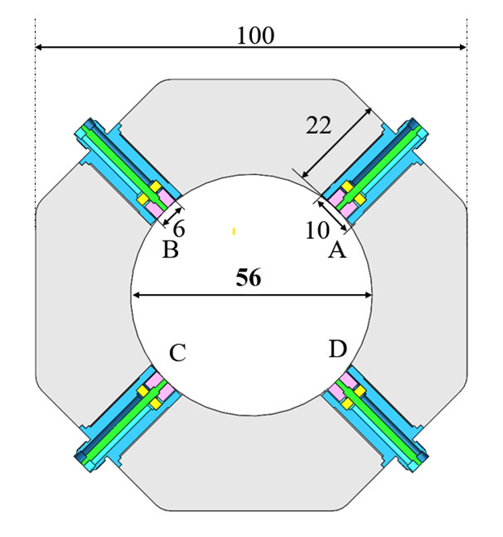
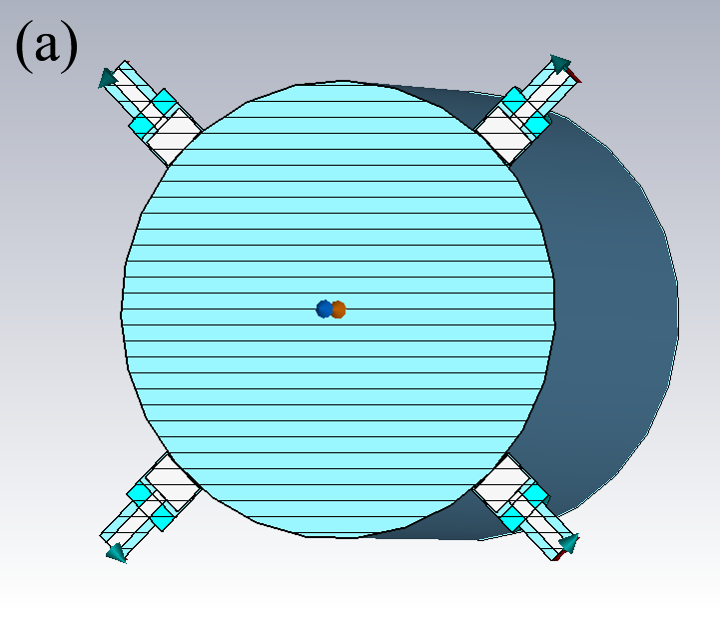
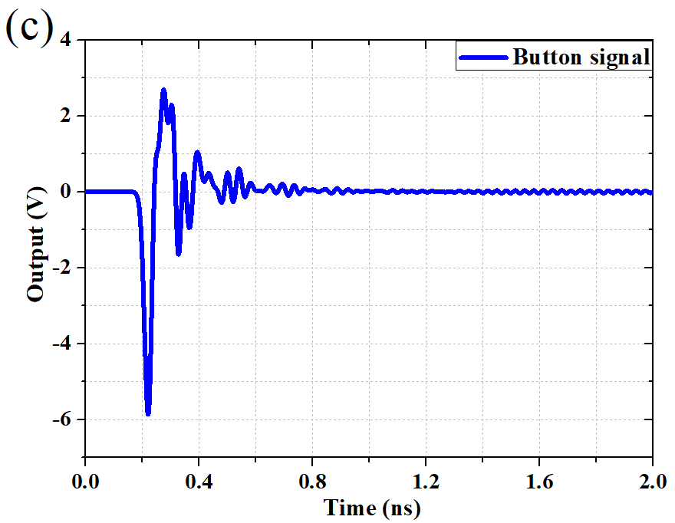
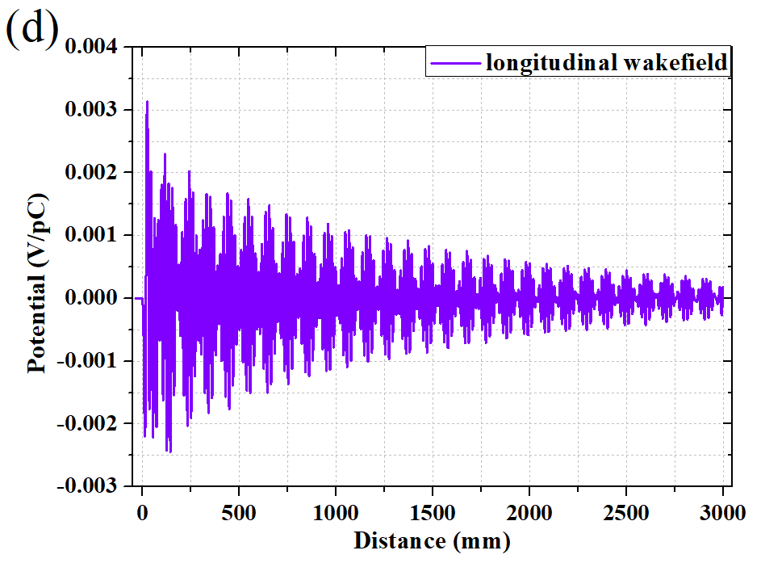
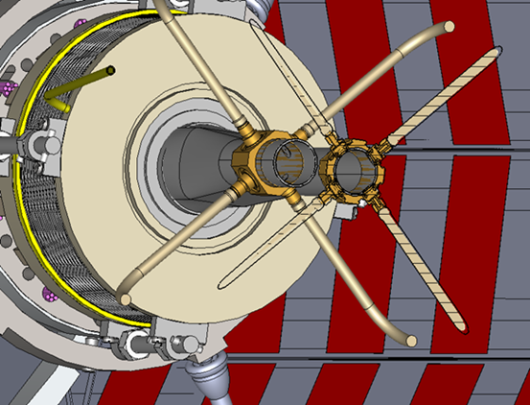
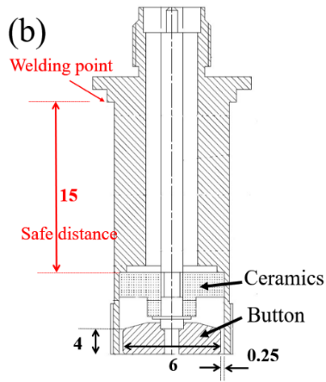
CEPC BPM pick-ups optimization and mass production
With one Beam Position Monitor (BPM) near each quadruple.
The best solution is a capacitive monitor with a button-like electrode.
Based on experience gained form HEPS BPM design, the geometries are refined.
 | ttbar |  | Higgs |  | W |  | Z
 | Real | CST | Real | CST | Real | CST | Real | CST
Charge | 20e10 | 32 nC | 14e10 | 22.4 nC | 13.5e10 | 21.6 nC | 14e10 | 22.4 nC
Bunch length | 2.2/2.9 | 3 mm | 2.3/3.9 | 4 mm | 2.5/4.9 | 5 mm | 2.5/8.7 | 8.7 mm
Vpp | 635V |  | 359V |  | 295V |  | 179V
Z_500M | 0.22Ω |  | 0.22Ω |  | 0.22Ω |  | 0.22Ω
P_500M | -7.3dBm/320mA |  | -12.8dBm/170mA |  | -10.6dBm/216mA |  | -10.4dBm/224mA
Kx=Ky | 19.9mm |  | 19.9mm |  | 19.9mm |  | 19.9mm
Parameters
Bunch | Length | 4.1 mm
 | Charge | 1 nC
Mechanical | r_{b} | 3 mm
 | t_{b} | 4 mm
 | g_{b} | 0.25 mm
 | b | 28 mm

Slide 7
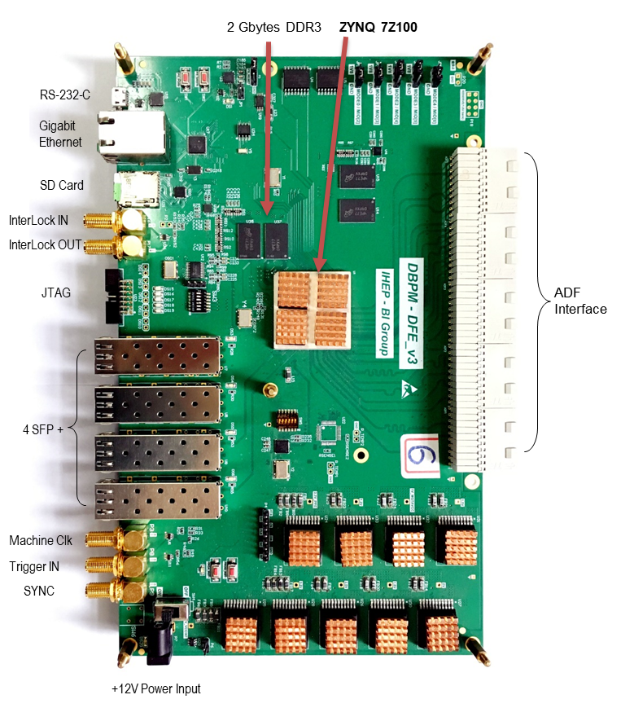
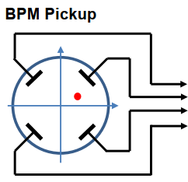
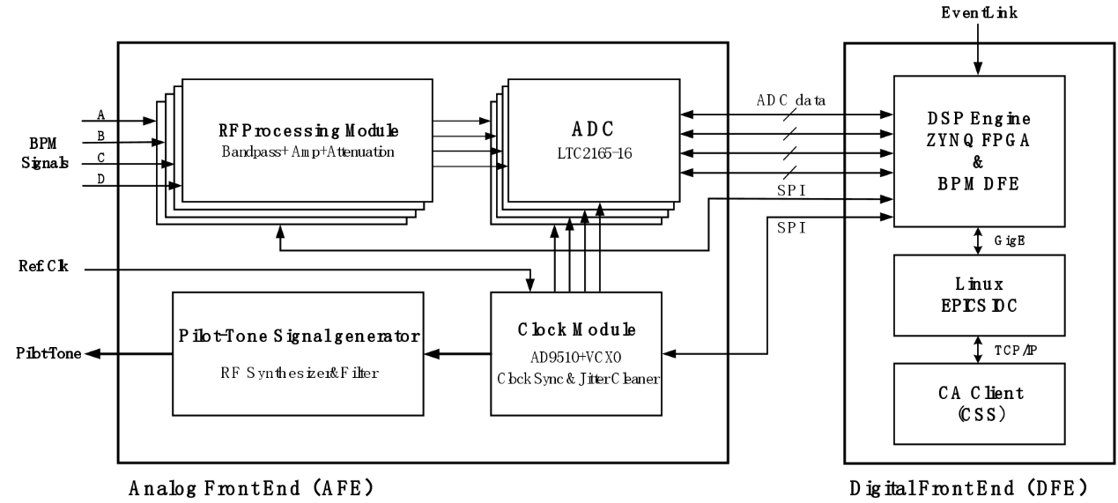
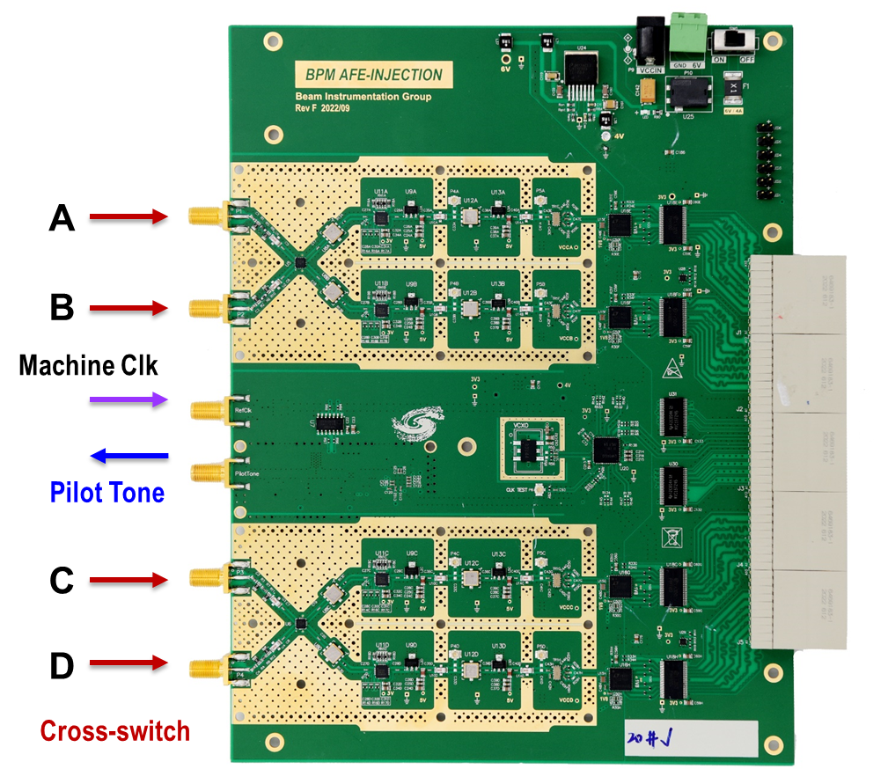
BPM electronics optimization for CEPC
The BPM electronics can be categorized into two main parts: the Analog Front-End (AFE) for radio frequency signal conditioning and the Digital signal processing part (DFE).
Long-term stability research on BPM electronics: cross switch, pilot tone and temperature control on board.

Slide 8
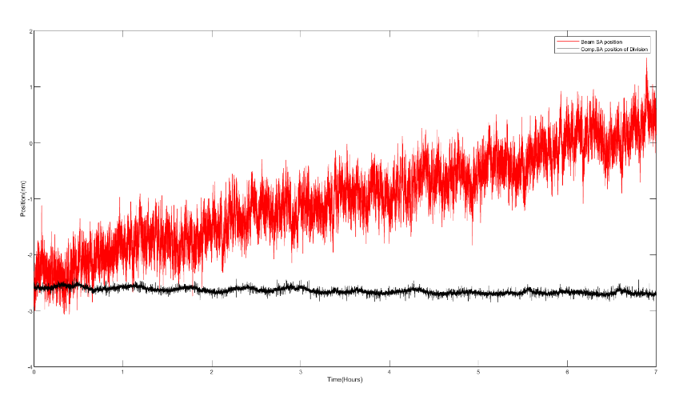
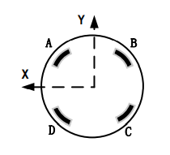
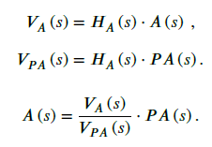
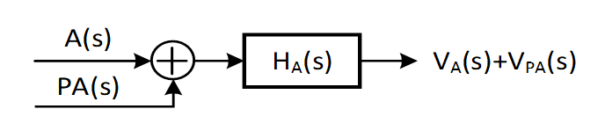
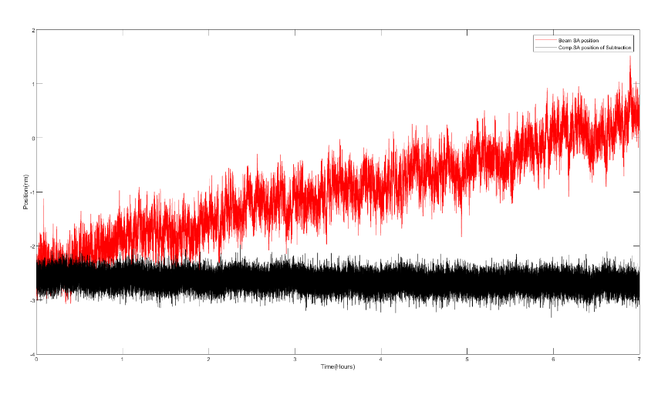
BPM electronics long-term stability with PT
Normalized
4.59 um→0.45 um 8hours
归一化
baseline
减基线
Normalized : Improved resolution, better stability, but less effective correction for large beam variations!
Baseline : Good stability, suitable for correcting large beam variation ranges, with unchanged resolution!
4.59 um→1.35 um 8hours

Slide 9
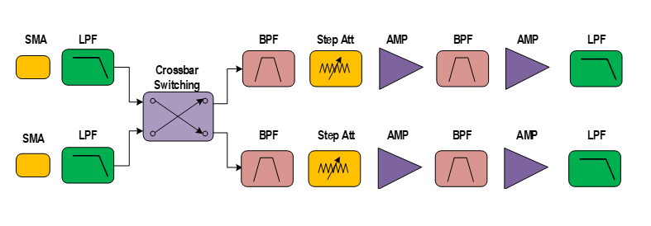
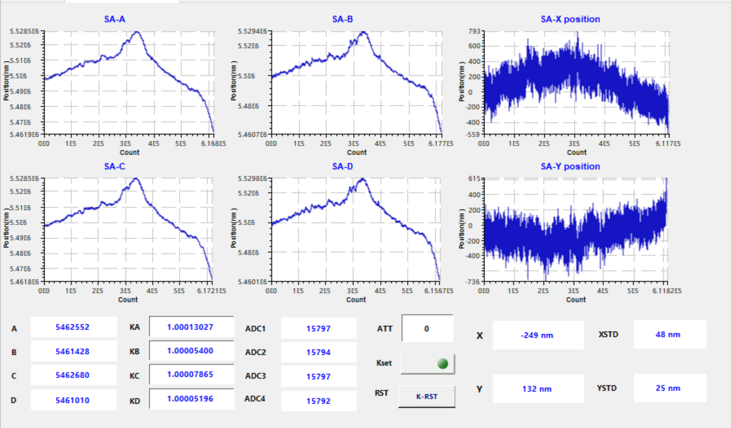
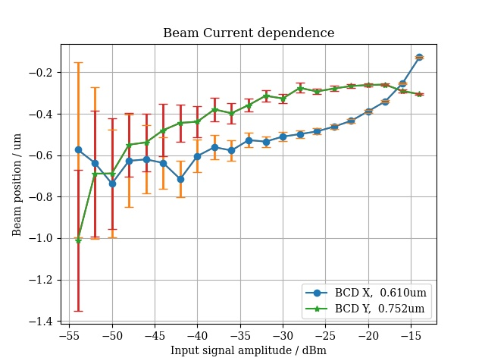
BPM electronics long-term stability with cross-switch
SA: 50nm → 5nm
BCD X = 0.610um
BCD Y = 0.752um

Slide 10
The industrialization of BPM electronics
The industrialized production of BPM electronincs
  HEPS and BEPCII BPM electronics production is still in the laboratory, but for CEPC, there will be an order of magnitude increase. We can’t handle that.
  We need to seek assistance from CIPC member companies or other vendors to carry out batch production.
The automated testing of BPM electronics
  Improve BPM electronics testing efficiency
  Reduce the impact of human factors on test results
  The electronic and automated testing documents

Slide 11
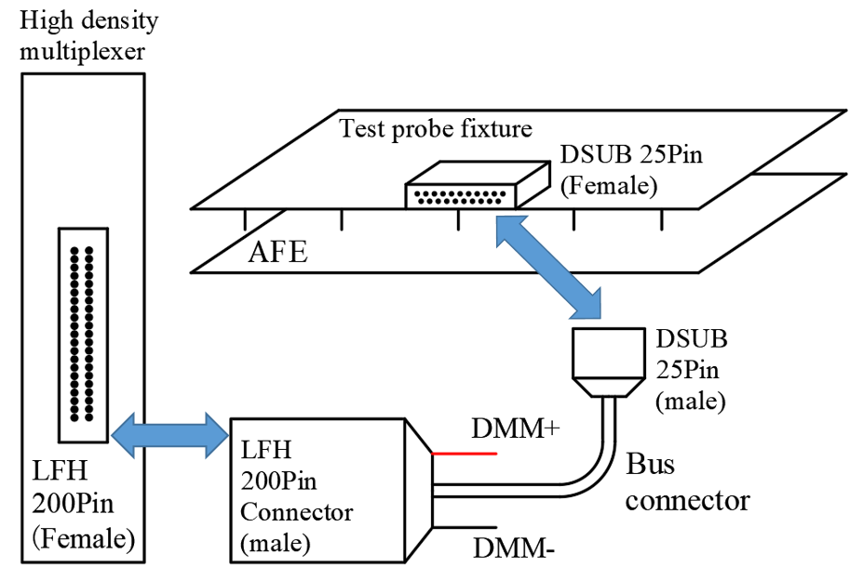
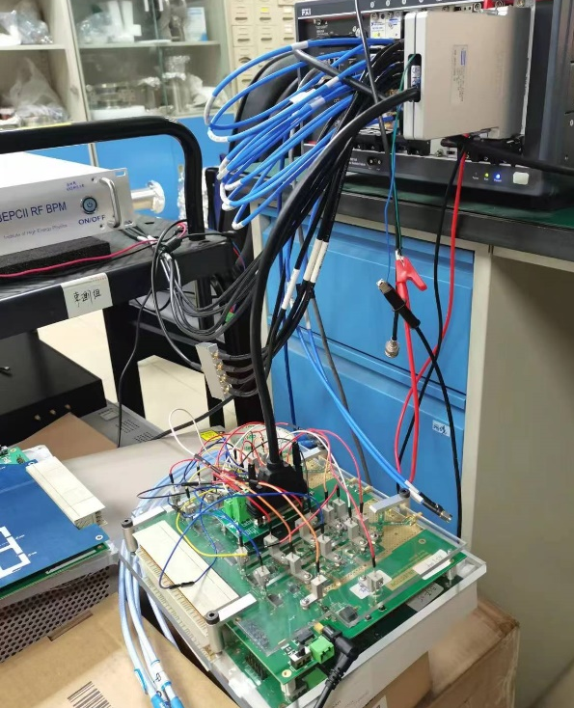
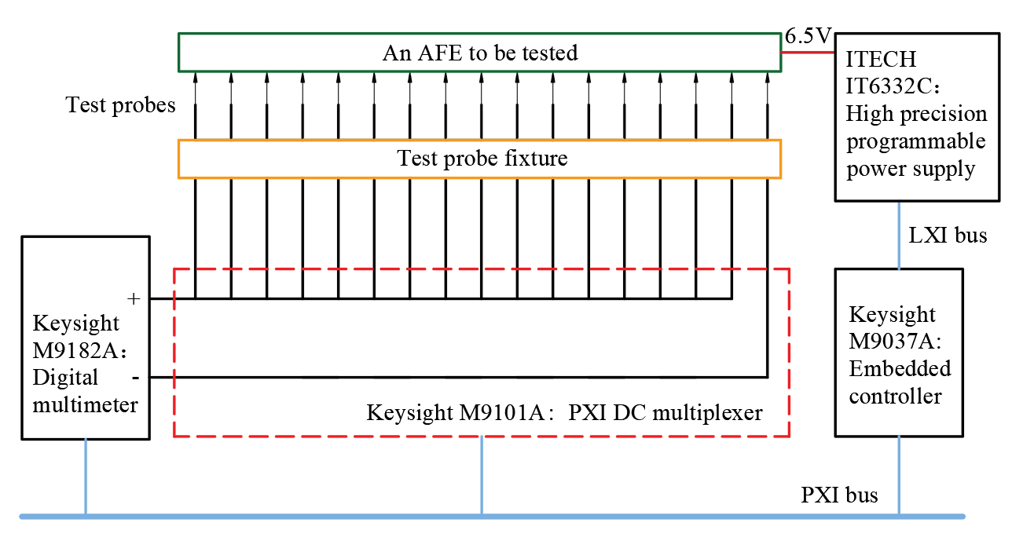
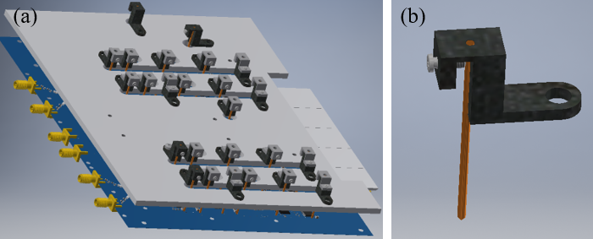
BPM electronics automated test system R&D
Testing of DC performance—hardware
To be tested：
Voltage and resistance of 23 key chips, with voltage values ranging from 1.8V to 6V.
Design of AFE fixture and probe module

Slide 12
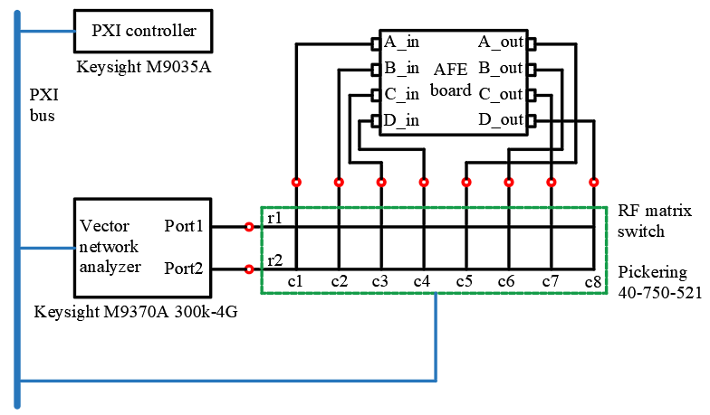
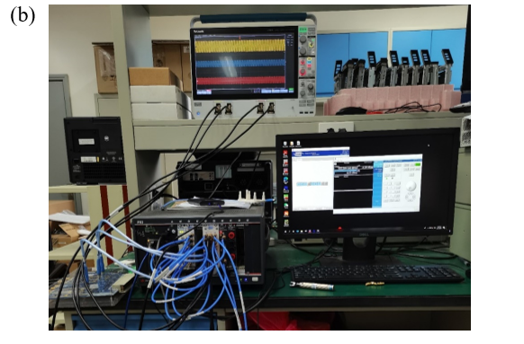
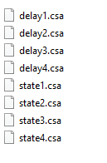
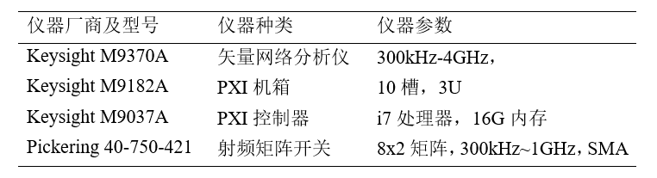
BPM electronics automated test system R&D
RF performance testing—system development
Calibration data
To be tested：
AFE channel filter performance (S21 parameter)
AFE saturation performance (power scan parameters)
AFE group delay
AFE voltage standing wave ratio
RF performance testing stand

Slide 13
The study of synchrotron light based diagnostics
Visible light extraction mirror
  Visible light is used for bunch length measurement with streak camera.
  SR power from dipole is about 4.7kW/mrad. It’s a huge heat load if extract visible light directly with a mirror. Thermal distortion with current due to incident SR will cause measurement error.
  Mirror design and mount, distortion evaluate are key issues for research.
Beam sizes measurement
  Vertical beam size is very small approximately several micrometers. Hard x-ray should be used in order to achieve enough resolution.
  Bending angle of dipole is also small, considering the radius of beam pipe and the magnets geometry, the nearest optical elements should be placed about 50 meters away from the source point, making measurement more difficult. X ray interferometer is considered as measurement method.
  Design of measurement system, fabrication of x-ray double slit, and design of high resolution x-ray camera are key issues for research.

Slide 14
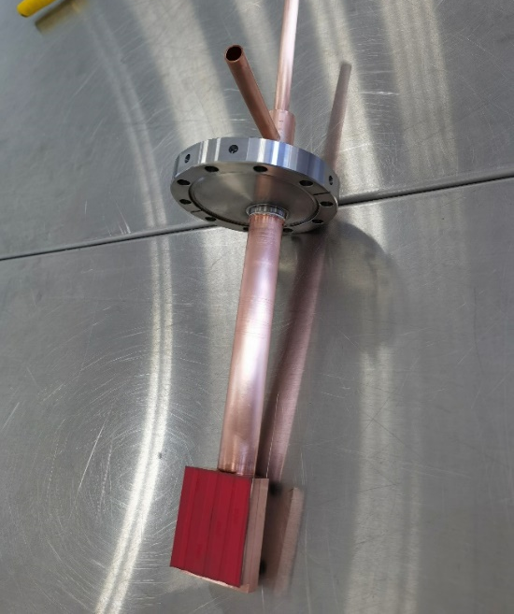
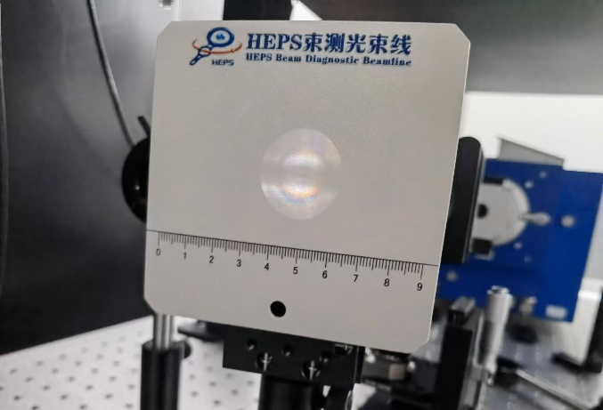
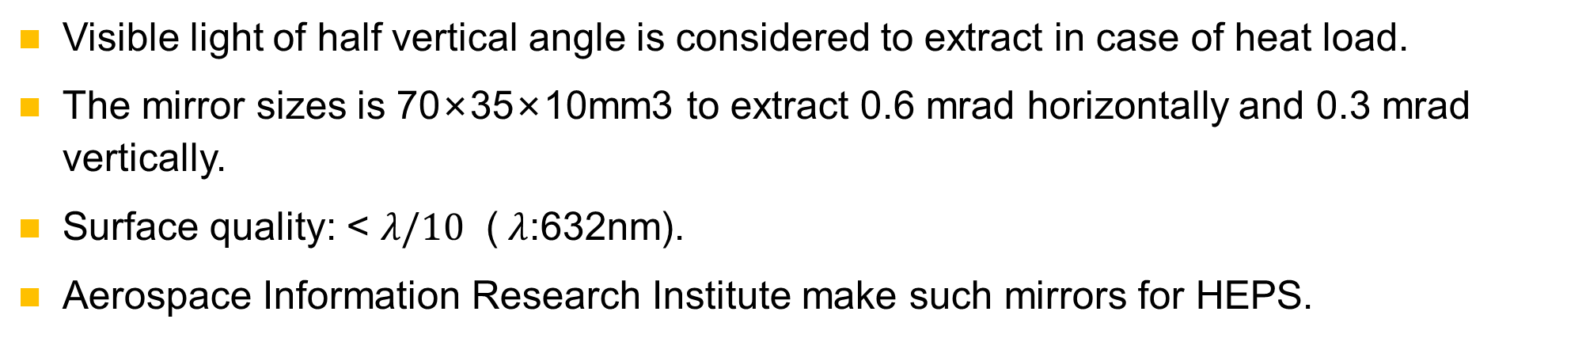
In-vacuum visible light extraction mirror
Visible light of half vertical angle is considered to extract in case of heat load.
The mirror sizes is 70×35×10mm3 to extract 0.6 mrad horizontally and 0.3 mrad vertically.
Surface quality: < $λ/10$ ($λ$:632nm).
Aerospace Information Research Institute make such mirrors for HEPS.
Extraction mirror at HEPS diagnostic beamline
First light at HEPS diagnostic beamline

Slide 15
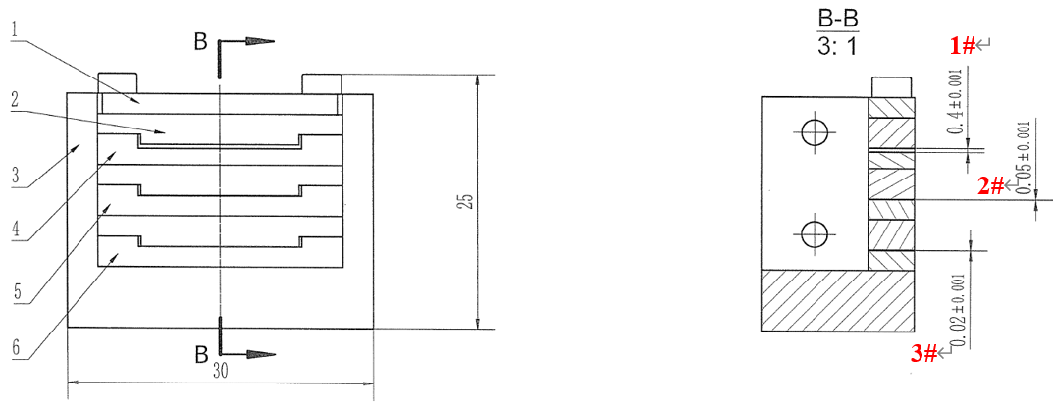
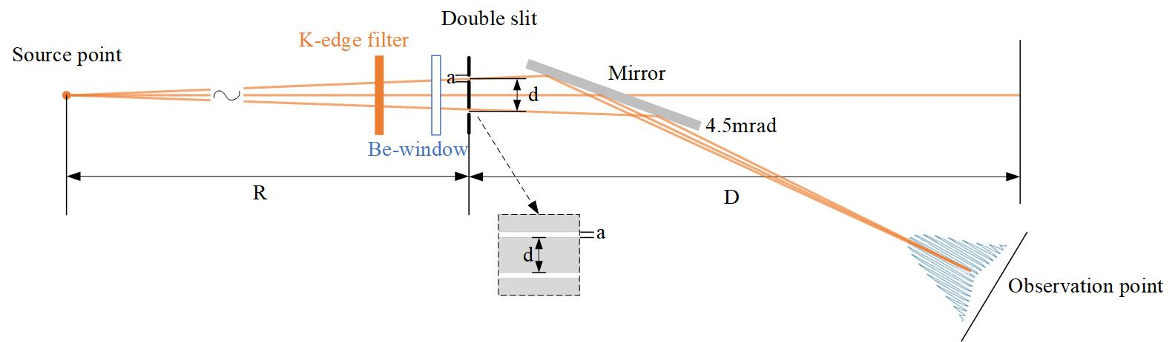
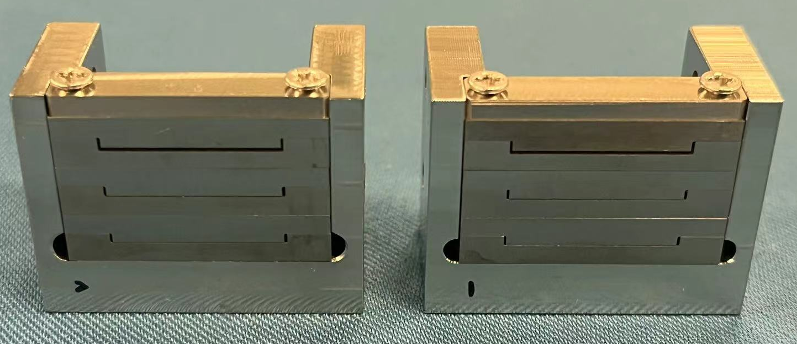
X-ray double slits processing study
Slit parameters
d : 300 µm
a : 8 µm.
20 µm slit at HEPS
Schematic diagram of CEPC X-ray double slit interferometer
We produce 20 µm scale slits by pressing precision machined tungsten sheets together for HEPS.
So it’s possible to make two 8 µm slits with 300 µm distance using the same method.
The preliminary design of double slits is under discussion and the mechanical drawing is in progress.

Slide 16
The integration of feedback system with ML
The damping time provided by the feedback system must be shorter than the growth time of the instability.
The time taken for data acquisition(multi-turn oscillation) and processing by the feedback system will occupy part of the damping time.
The impact of data acquisition can greatly affect the damping time for rings with larger circumferences such as CEPC.
Therefore, machine learning will be applied to the acquisition of beam oscillation signals in the feedback system of CEPC to address the issues above.
Using traditional feedback methods, the time taken for data acquisition will occupy at most 2/3 of the damping time.
0.33ms/turn
2 turns
0.66ms
Study of narrow-band feedback for specific instabilities.
CEPC Damping Time 1ms

Slide 17
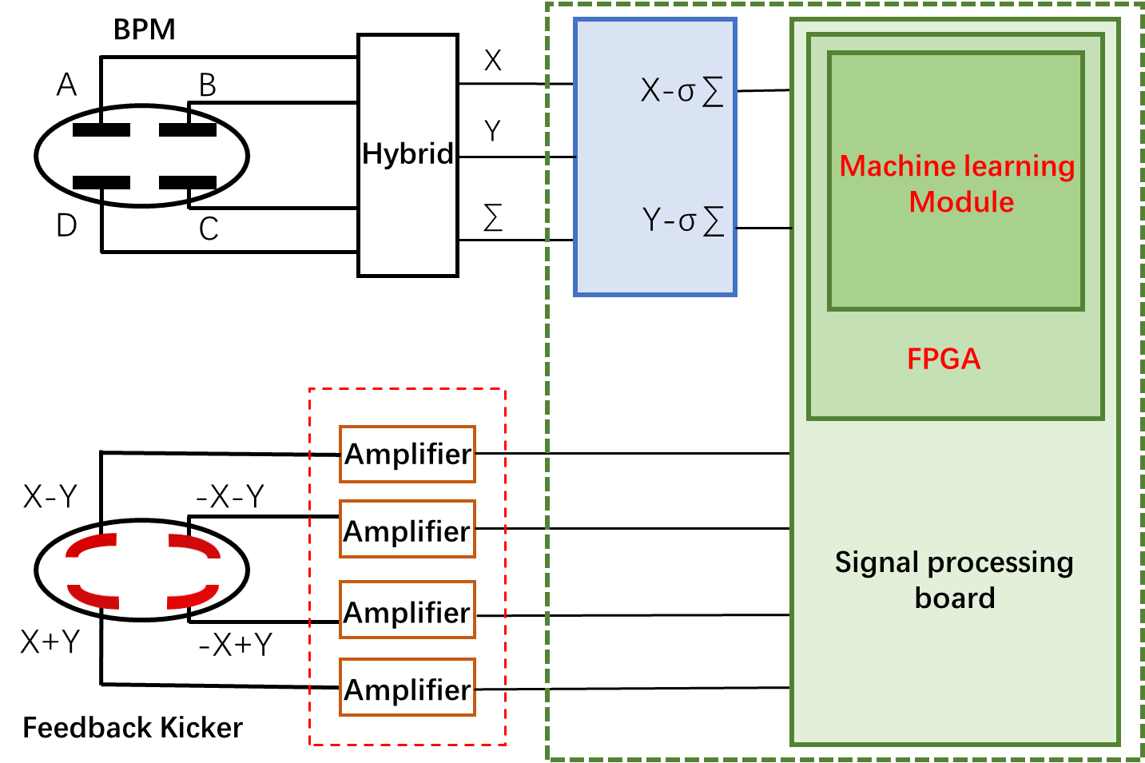
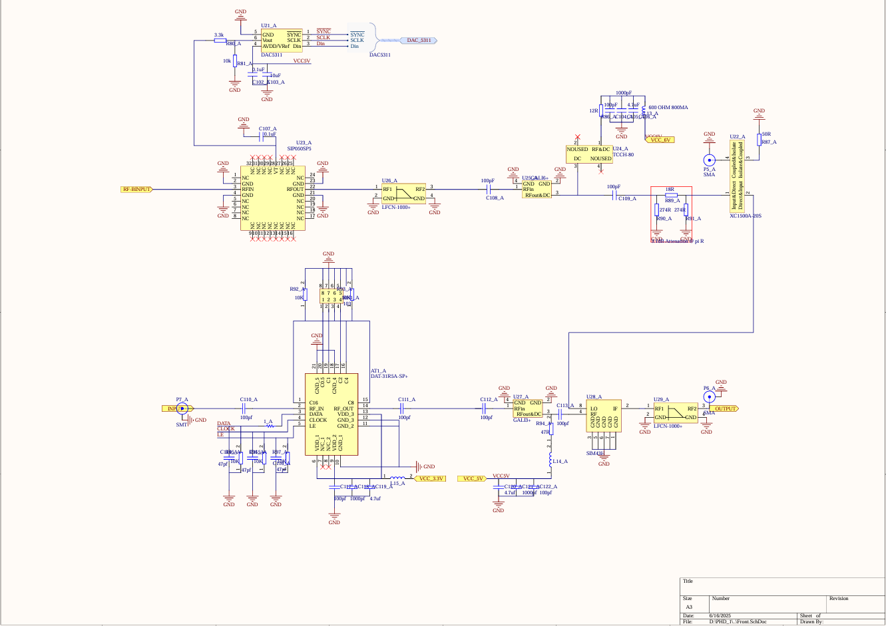
Process of integrating ML with feedback system
Implementation of Closed-orbit Signal Cancellation based on Digital/Analog Circuits
  Performing Circuit Design for Front-End Electronics
Oscillation Information Acquisition Based on Machine Learning
  Data Acquisition and Analysis using HEPS as a model
Debugging of the Signal Processing Card and FPGA Implementation
Optimize the Design Structure and Conduct Testing
Implement the machine learning model in the FPGA
Front-End Electronics Circuit Diagram

Slide 18
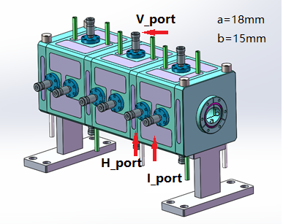
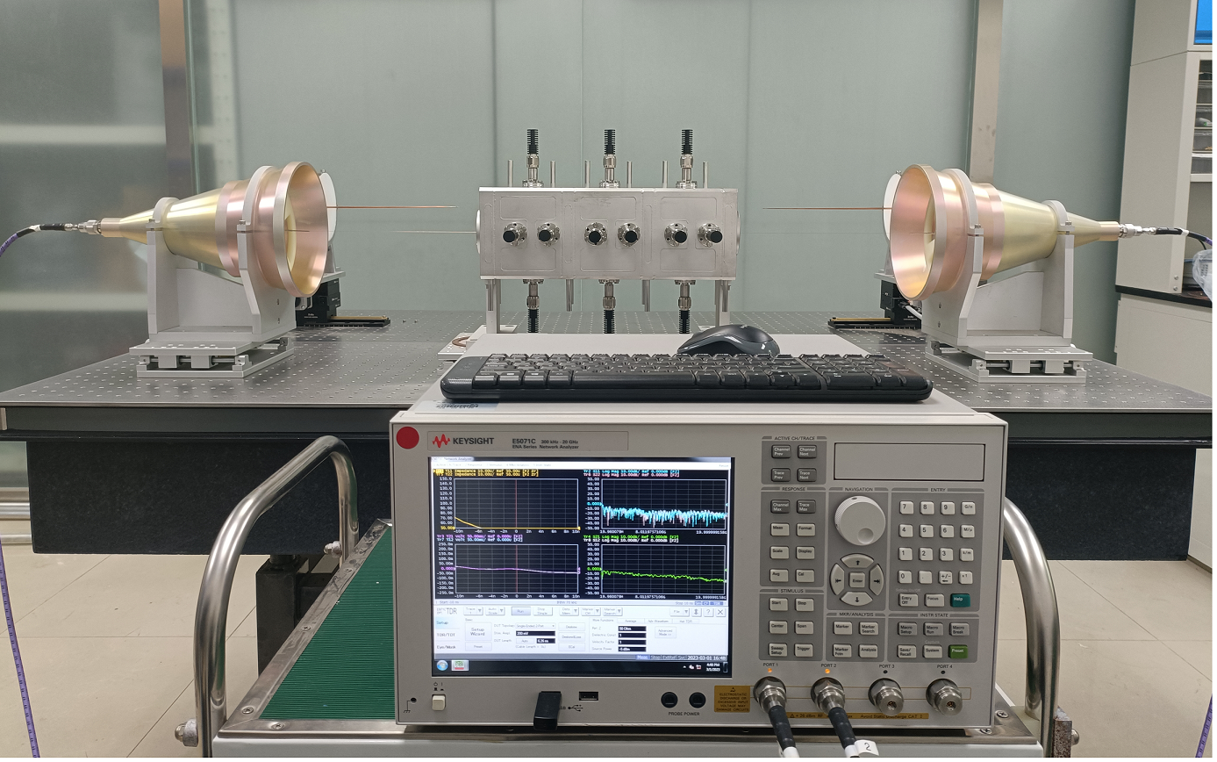
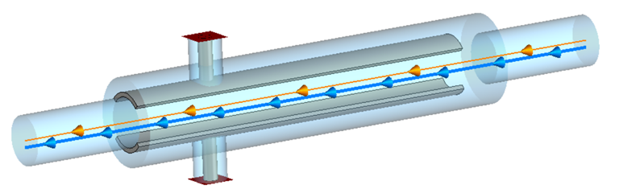
Beam feedback kicker study in EDR
Study of feedback system kicker
Resonant strip-line type longitudinal kicker
130
121.5
108
Resonant strip-line type transverse kicker
85

Slide 19
Design of luminosity tuning system for CEPC
BPM sub-system
  BPM detector
  PT module
  Digital BPM electronics
Luminosity monitor
sub-system
  Luminosity detector
  Front-end electronics
  DAS electronics
Interaction Point fast orbit feedback control system of CEPC
  BPM interface logic
  Luminosity monitor interface logic
  TDC logic
  FOC, Fast Orbit Controller
  Power Supply Controller Interface
  ……

Slide 20
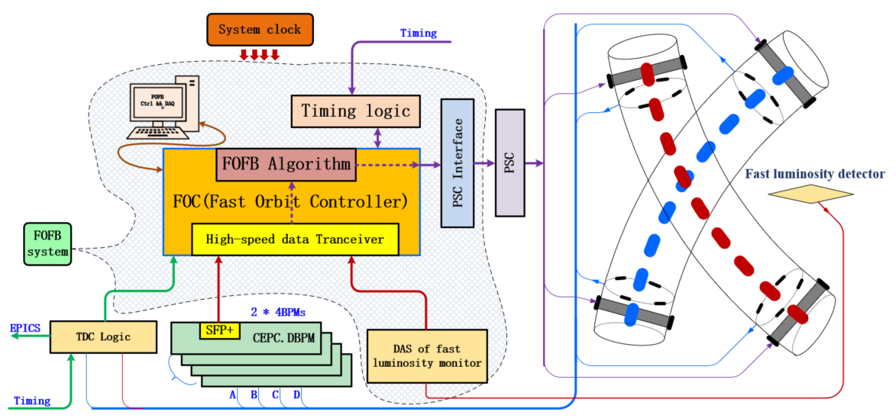
Design of the fast orbit feedback system at IP
Fast Orbit Feedback Controller
  BPMs
  Luminosity Monitor
  TDC logic
  Interface to PSC
  ……

Slide 21
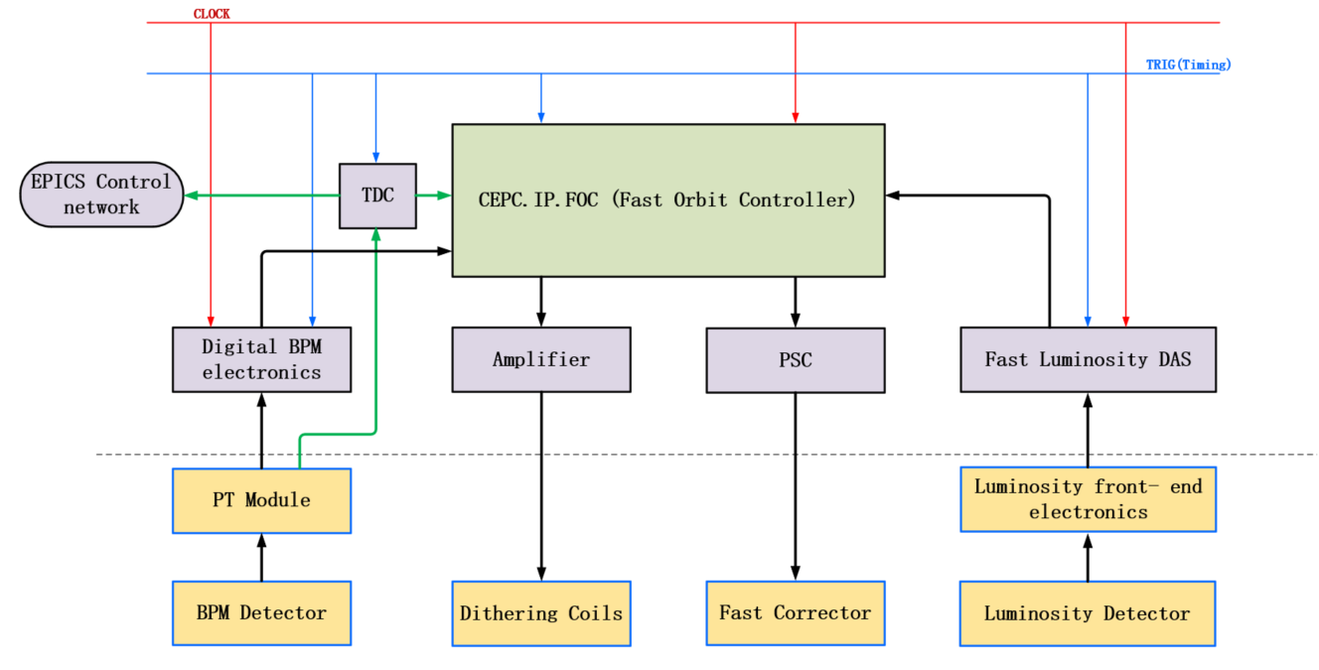
Fast Orbit Controller electronics
FOC Input signals
  Digital BPMs data
  Luminosity monitor data
  Electron and positron beam arriving time
  Clock and Timing signal
FOC output signals
  Fast corrector power supply setting
  Dithering controlling information

Slide 22
Summary
We have thoroughly understood the measurement requirements of CEPC and conducted extensive research on key technologies, in the TDR phase.
In the EDR phase, studies will carry out in industrialization and testing of BPM electronics，beam feedback system，luminosity tuning system and components R&D of synchrotron light based diagnostics.
The beam instrumentation systems aim to be prepared for construction after the EDR phase.
Thank you for attention！

