Slide 1
Beam diagnostics for FCC-ee
Emily Howling (CERN & University of Oxford)
M. Gasior, R. Kieffer, T. Lefevre (CERN)
P. Burrows (University of Oxford)

Slide 2
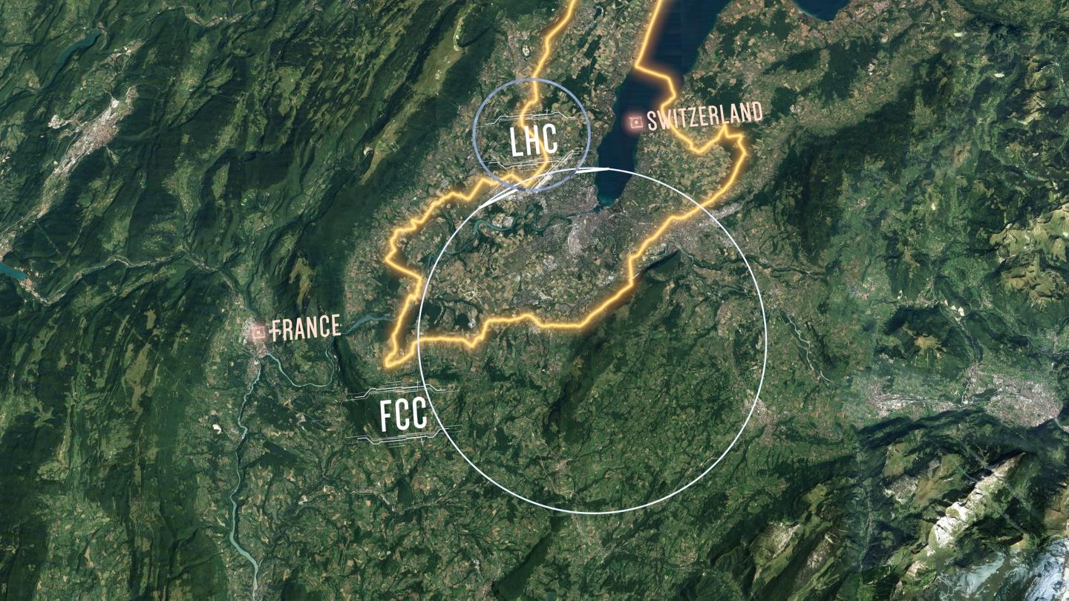
Contents
Overview of the FCC-ee
Overview of Beam Instrumentation for the FCC-ee
Arc Beam Position Monitors for FCC-ee
Beam Position Monitor (BPM) Requirements
Simulated BPM Response to Different Modes
Studies of different Pickup Geometries
Introducing Non-Ideal Materials to Simulations
BPM Bench-marking Studies
Conclusions and Future Plans
Fig 1: Schematic of the FCC tunnel footprint compared to the LHC. It would be underground, in the area around Geneva. [1]

Slide 3
Overview of The FCc-ee

Slide 4
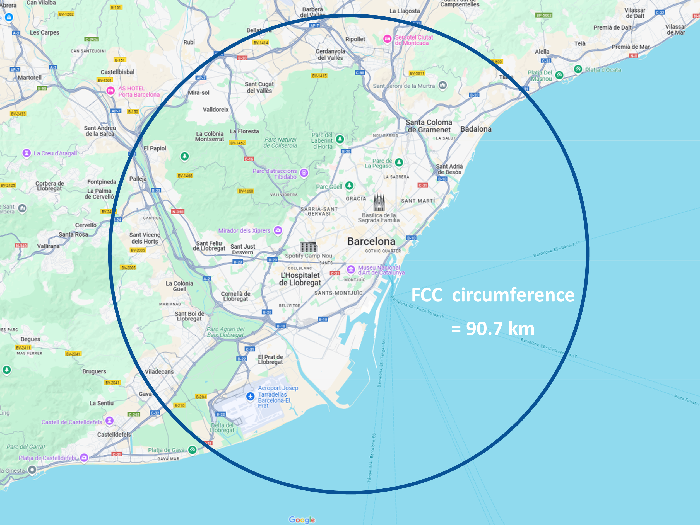
The FCC-ee: Introduction
The FCC-ee is a proposed electron-positron collider at the precision frontier of high energy physics, providing an electroweak and Higgs factory.
It would be 90.7 km in circumference, constructed underground in the Geneva area, where CERN is based.
The FCC-ee would run at four energies and have four interaction points.
The same tunnel could be used to house a hadron collider, FCC-hh, after the FCC-ee has finished.
Fig 3: Circumference of the FCC superimposed over a map of the Barcelona area.
Fig 2: Proposed timeline for the FCC. [2]

Slide 5
Overview of Beam Instrumentation for FCC-ee

Slide 6
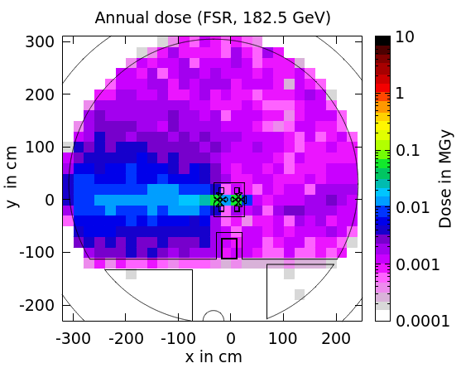
The FCC-ee: Challenges for BI
High levels of synchrotron radiation in arcs (50 MW per beam) – shielding needed.
Large distances – optical fibres must be used, over 300 km of accelerator to be instrumented.
Small emittance and small beam size at interaction point – challenges measuring beam profile and emittance, strict alignment requirements.
Different operating modes – high beam current in Z pole mode means all devices must have very low coupling impedance to minimise beam heating, but function sufficiently at the lowest beam intensities.
<10kGy
Collider center
Fig 4: Dose levels in tunnel cross section at quadrupole, with shielding as detailed in the feasibility study report. Courtesy of B. Humann. [3]
Mode | Z | WW | ZH | ttbar
Bunch intensity, 10^{11} | 2.14 | 1.45 | 1.15 | 1.55
Bunch charge, nC | 34.3 | 23.2 | 18.4 | 24.8
rms bunch length (SR/BS), mm | 5.6/15.5 | 3.5/5.4 | 3.4/4.7 | 1.8/2.2
Number of bunches/beam | 11200 | 1780 | 440 | 60
Bunch spacing, ns | 25
Beam current, mA | 1270 | 137 | 26.7 | 4.9
Table 1: Beam parameters of the different operating modes of the FCC-ee collider. [4]

Slide 7
BI for FCC-ee
Large collaboration with regular meetings focusing particularly on devices related to machine protection, devices with large impact on cost (e.g. BPMs) and systems requiring significant R&D.
Due to large numbers of systems; reliability, automation, and cost optimisation are important considerations.
No show stoppers identified, but lots more to be done by the collaboration!
Instrument | Main tunnel | Injector + TLs | Total
Position | 8855 | 862 | 9717
Losses | 26544 | 200 | 26744
Intensity | 15 | 15 | 30
Transverse profile | 21 | 35 | 56
Longitudinal profile | 6 | 14 | 20
Beamstrahlung monitors | 8 | 0 | 8
Polarimeter | 2 | 0 | 2
Table 2: Numbers of different BI systems needed, to be confirmed. [5]
Some of the institutions contributing to the FCC BI collaboration.

Slide 8
ARC Bpms for FCC-ee

Slide 9
FCC-ee BPM Requirements
The FCC arc BPMs, and most other FCC BPMs, will use button pickups.
Shall provide orbit, turn-by-turn and bunch-by-bunch measurements.
High resolution requirements (see Table. 3).
Small beam impedance → minimise heating, at the expense of smaller signals and resolution.
Need to be reliable, rad tolerant electronics.
Within cost budget.
Need to fulfil requirements at all operational modes and will also be used in commissioning.
BPM Parameter | Requirement
Orbit resolution | 0.1 μm
TxT resolution | 1 μm
Arc BPM accuracy | 20 μm
CDR est. loss factor, 4000 BPMs | 40.1 V/pC
Min bunch spacing | 25 ns
Table 3: Requirements for FCCee arc BPMs.

Slide 10
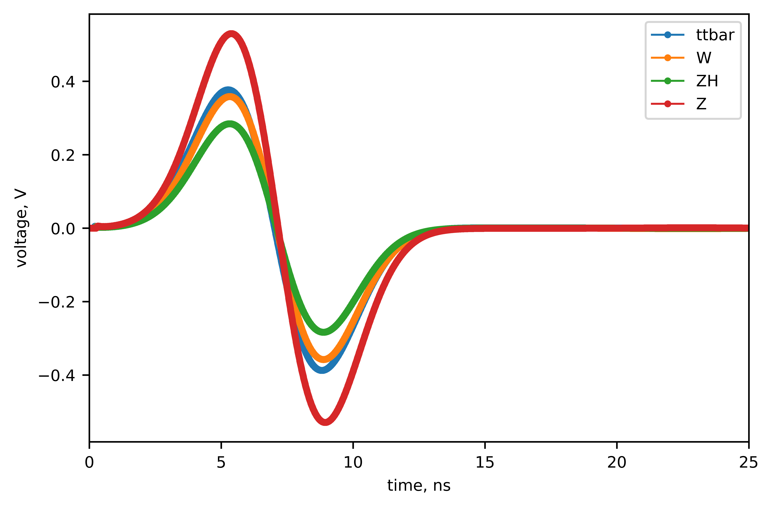
Different modes of FCC-ee
A simplified 8 mm radius pickup was modelled in CST.
This was simulated at the most extreme FCC-ee beam parameters: during injection for ZH mode and at 105% nominal charge before collisions at ZZ and ttbar mode.
Difference of factor 18 between raw peak to peak.
Fig. 5: BPM model used in CST
Table 4: Summary of CST results for extreme cases
Fig 6: Signals from CST simulation of all 4 modes before collisions (SR), convoluted by a 75 GHz filter.
Fig 7: Initial part of raw signals in CST for the extreme beams.
Fig 8: Signals convoluted by a 75 GHz filter.

Slide 11
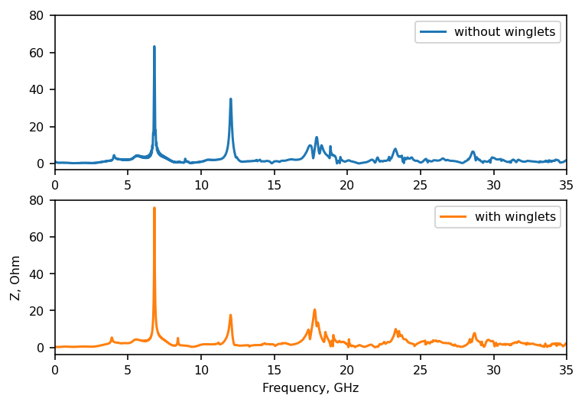
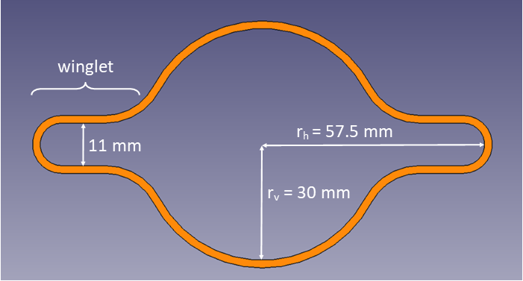
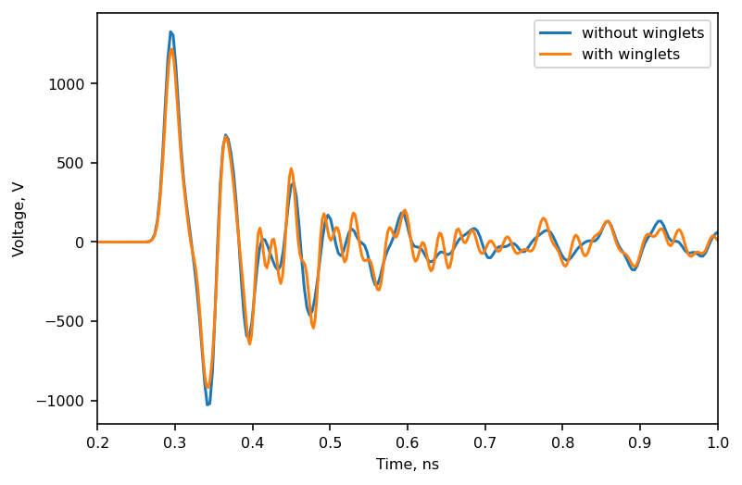
Including Beam Pipe Winglets
Fig 11: Wake impedance with and without winglets
Fig 9: FCC-ee beam pipe cross section
Fig 10: BPM model used in CST, skewed for ease of modelling.
The FCC-ee beampipe has winglets to absorb synchrotron radiation.
Simulating a simplified BPM in a beampipe with and without winglets showed that the winglets make a difference to the amplitudes of the resonances in the impedance, so should be included in future simulations.
Fig 12: Voltage signal with and without winglets

Slide 12
Exploring Geometrical Parameter space

Slide 13
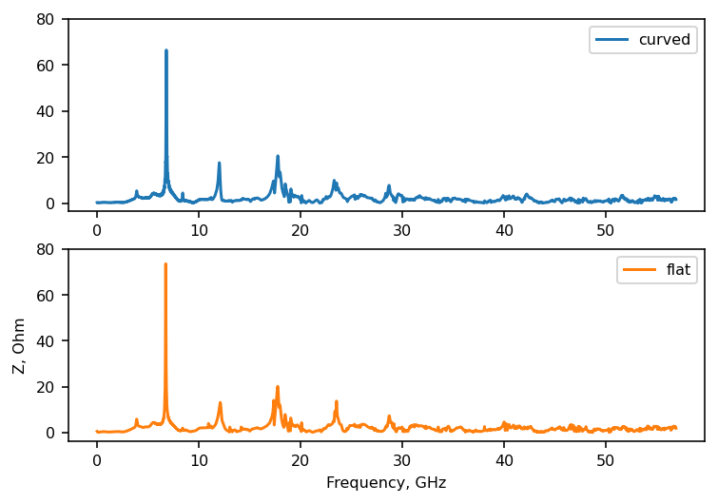
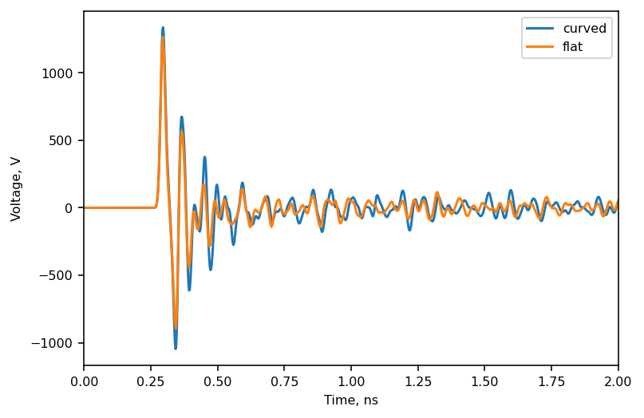
Curved vs Flat Pickups
Whether the pickup is flat, or curved to be flush with the beam pipe makes very little difference to either the voltage or impedance signal in this simulation.
Smaller pickup radii will be considered, but not larger. With a smaller radius, the difference made by the curvature will be even less.
Since flat pickups are easier to manufacture and align, future designs for FCC-ee will all have flat pickups.
Fig 15: CST model of curved and flush pickups.
Fig 13: Wake impedance for curved and flat pickups
Fig 14: Voltage signal for curved and flat pickups

Slide 14
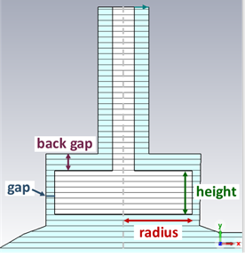
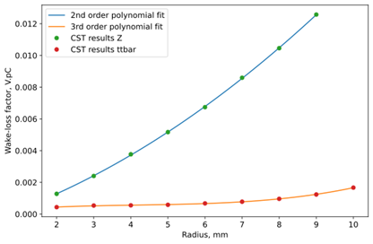
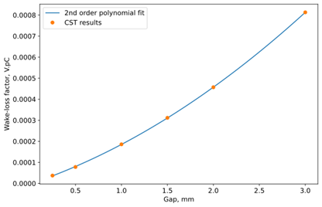
Varying Geometric Parameters of a Flat Pickup
Wake-loss factor increases with both pickup radius and gap size. Back gap and height have negligible effect.
Fig 16: Simplified flat pickup with geometric parameters labelled.
Fig 17: Wake-loss factor calculated within CST vs radius of the pickup
Fig 18: Wake-loss factor calculated within CST vs pickup gap, Z (BS) mode.

Slide 15
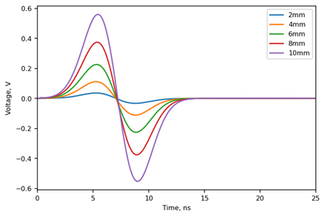
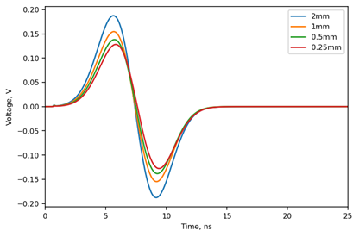
Varying Geometric Parameters of a Flat Pickup
The peak to peak voltage signal (and therefore resolution) increases significantly with radius, increases slightly with gap size, and decreases slightly with back gap size. Height has negligible effect. .
Fig 16: Simplified flat pickup with geometric parameters labelled.
Fig 19: Voltage signal calculated vs time within CST for different pickup radii, ttbar (SR) mode, with a 75 MHz filter applied.
Fig 20: Voltage signal calculated vs time within CST for different pickup gaps, Z (BS) mode, with a 75 MHz filter applied.

Slide 16
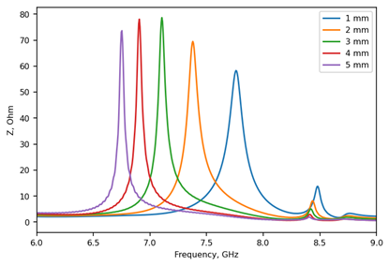
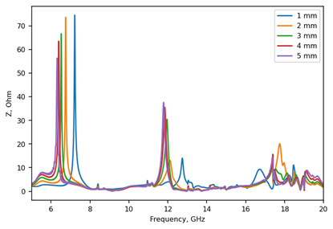
Varying Geometric Parameters of a Flat Pickup
The resonant peak amplitudes in the wake impedance spectrum increase with radius and gap. Increasing the back gap slightly decreases the amplitude of the largest peak. Pickup height has a slight non-linear relation with the amplitudes.
The resonant peak frequencies in the wake impedance spectrum increase as radius decreases, and increase slightly in frequency as height decreases and back gap decreases. Gap size has negligible impact.
Fig 16: Simplified flat pickup with geometric parameters labelled.
Fig 21: The largest peaks in wake impedance as a function of frequency for different pickup heights, ttbar (SR) mode.
Fig 22: Wake impedance as a function of frequency for different pickup back gaps, ttbar (SR) mode.

Slide 17
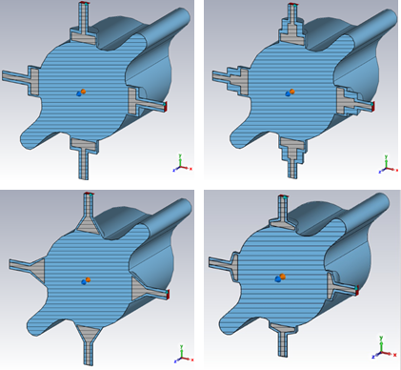
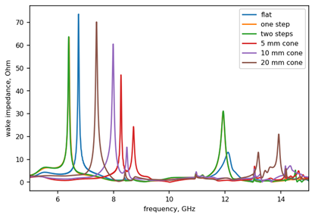
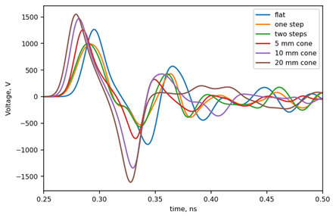
Flat, Stepped and Conical Pickups
Conical, flat and stepped buttons were simulated.
Conical pickups pushed the resonant peaks in the impedance spectrum to higher frequencies compared to a flat pickup, which is beneficial due to the beam spectrum having a lower amplitude at higher frequencies.
Stepped buttons had no advantage.
Fig 25: Cross-sections of some of the geometric models used in CST. From top left clockwise they are flat, stepped, conical and trapezoid.
Fig 23: The largest resonance peaks in the wake impedance frequency spectrum for different pickup geometries, simulated in CST with the ttbar (SR) mode.
Fig 24: The initial voltage signal for different pickup geometries, simulated in CST with the ttbar (SR) mode.

Slide 18
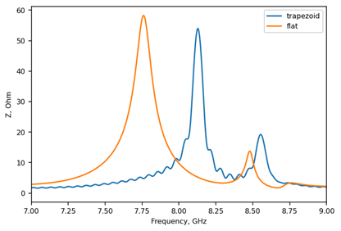
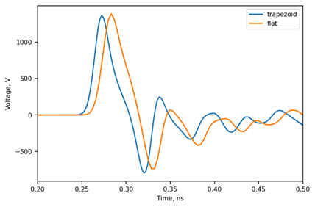
Trapezoid Pickups
Trapezoid pickups had a effect similar to conical pickups, whilst being easier to manufacture.
CST results comparing a 1 mm tall flat button and a trapezoid button with a 1 mm parallel section and 1 mm cone are shown in Figs. 15-16.
The trapezoid has a beneficial effect on the impedance and a similar voltage signal to the flat button.
Fig 26: The largest impedance resonant peaks for a flat and a trapezoid pickup, simulated in CST with the ttbar (SR) mode.
Fig 27: The initial voltage signal over time for a flat and a trapezoid pickup, simulated in CST with the ttbar (SR) mode.

Slide 19
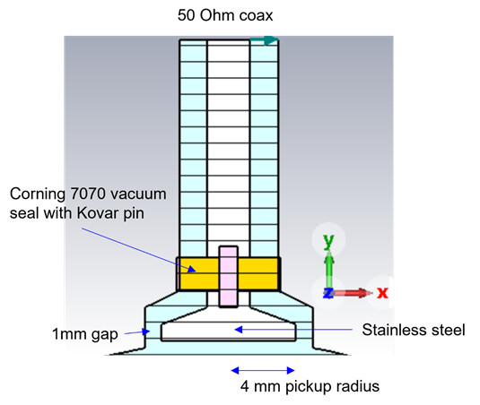
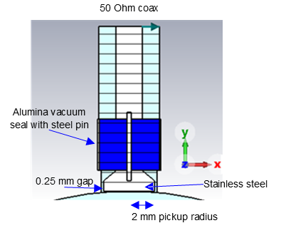
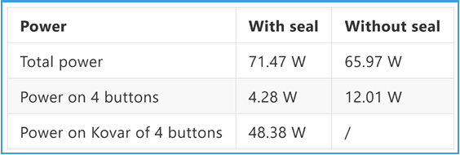
Introducing Non-Ideal Materials
More realistic material models were included in the simulations.
The pickup was changed from PEC to steel, and a borosilicate glass vacuum seal held in place by a Kovar pin was added. The seal was based on a design from the AWAKE eBPMs.
Peak to peak voltage in the ZH (BS) mode after a 75 MHz filter was applied was 0.2 V, suggesting a TxT resolution of 1.6 μm (only thermal noise). A different filter could improve this.
This allowed for power distribution simulations to be conducted. Beam heating simulations are ongoing.
Fig 28: A cross-section of the pickup model used in the first power loss simulations.
Table 5: Summary of initial results from power loss studies using the ZZ (SR) mode, courtesy of Carlo Zannini.
Fig 29: A cross-section of the pickup model currently in power loss simulations.

Slide 20
Bench-Marking Measurements at AWAKE

Slide 21
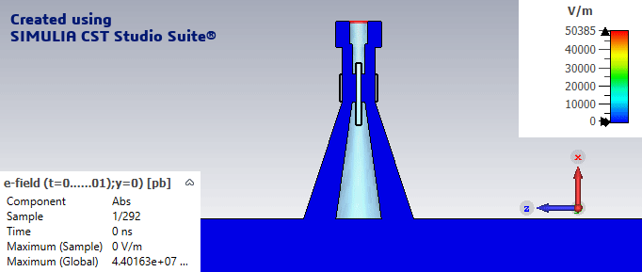
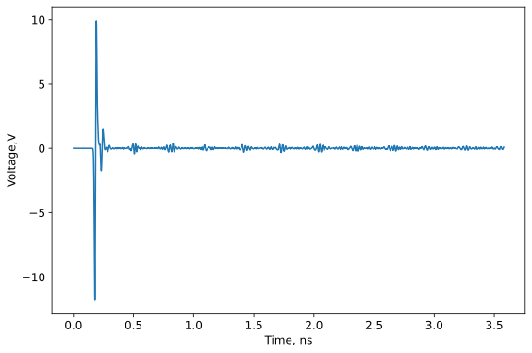
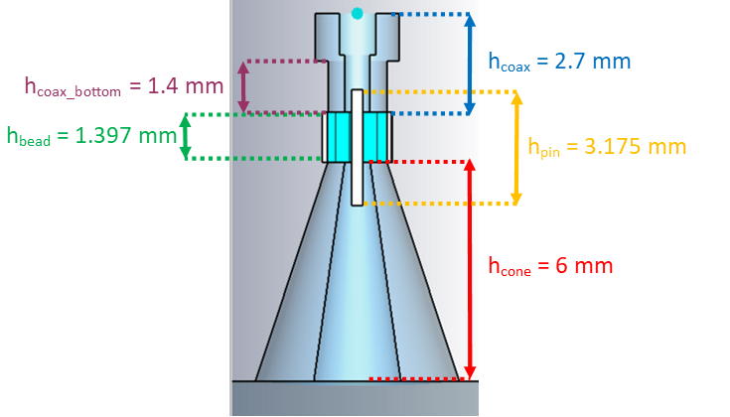
The AWAKE eBPMs in CST
To benchmark CST results against measurements with beam, an existing BPM at AWAKE was used.
Fig 31: Animations of the electric field in CST for the AWAKE eBPM
Fig 30: Voltage signal over time for the AWAKE eBPM simulated in CST.
Fig 32: Cross-section of the CST model of the AWAKE eBPM. Model courtesy Bethany Spear.

Slide 22
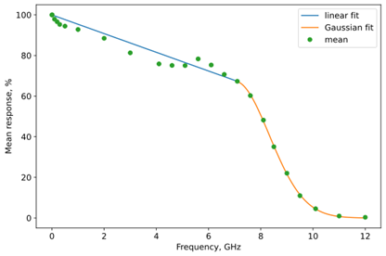
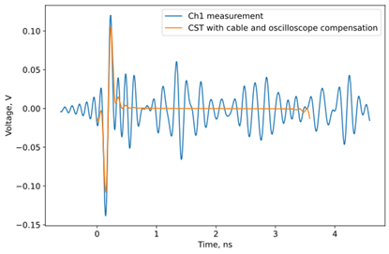
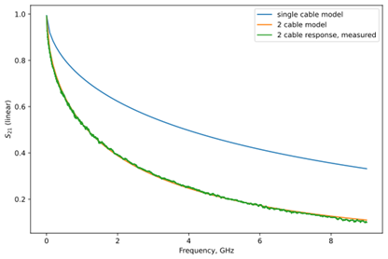
The AWAKE eBPMs in CST
The cable attenuation and oscilloscope response were applied to the CST voltage results.
The result is shown in Fig. 21. The peak to peak voltage is similar, but the beam measurements show significantly more ringing.
Fig 33: Oscilloscope measured response and model fit to it.
Table 6: Summary of the CST and AWAKE eBPM benchmarking.
Fig 35: Measured voltage response over time of AWAKE eBPM compared with CST results, compensated for the cable and oscilloscope responses.
Fig 34: Measurement of cable response and model for half the length of cable.
.

Slide 23
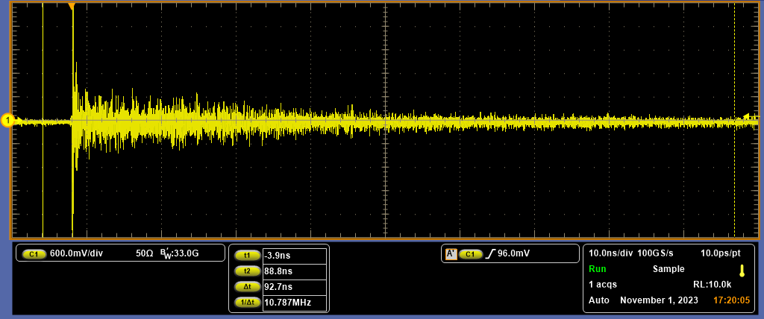
Further Benchmarking with PSI and CLEAR
Broad-Band Pickups (BBPs) developed by N. Vallis at PSI were tested at CLEAR and SwissFEL.
These measurements will both be compared with CST simulations and will benchmark how simulations compare to measurements at two different electron accelerators.
LHC BPM pickups have been installed in CLEAR to test with an electron beam for further benchmarking against CST simulations.
1.05 mm radius antenna
Fig 36: BBP CST model, courtesy N. Vallis.
Fig 37: Signal from one of the BBPs on oscilloscope at CLEAR

Slide 24
Future plans

Slide 25
Conclusions Future Plans
A trapezoid button is the most promising geometry for the FCC-ee arc BPMs.
Further optimisation is needed to reduce power loss to the BPM. This could include making the gap and radius smaller, but care must be taken to ensure resolution is still sufficient at low beam intensities. Alternative materials will also be studied.
Different filters for the voltage signal will be simulated to determine effect on resolution.
More exotic pickup geometries could be explored, such as asymmetric pickups.
Further bench marking will take place using an LHC BPM installed at CLEAR.

Slide 26
Thanks for your attention!

Slide 27
References
[1] CERN’s proposed 100-km particle accelerator would run rings around the LHC. [Online]. Available: https://newatlas.com/future-circular-collider-physics/58068/.
[2] FCC Week 2025 (19-23 May 2025): Welcome and Introduction · Indico. [Online]. Available: https://indico.cern.ch/event/1408515/contributions/6491862/.
[3] B. Humann, FCC Week 2025 (19-23 May 2025): Radiation environment in the FCC-ee arcs · Indico.[Online]. Available: https://indico.cern.ch/event/1408515/contributions/6526980/.
[4] B. Auchmann, W. Bartmann, M. Benedikt, et al., “Future Circular Collider Midterm Report,” Tech. Rep.,2024.
[5] T. Lefevre and R. Kieffer, FCC Week 2025 (19-23 May 2025): Overview of the BI developments for thepre-TDR phase · Indico. [Online]. Available: https://indico.cern.ch/event/1408515/contributions/6514991/.

Slide 28
Colors
Backgrounds
Background Blue
Background Purple
Background Yellow
Background Grey
Use for Layout
Radiant Blue
Flash
Energy
Green
Red
Deep Blue

Slide 29
Graphical Elements
Badges
This information is a badge because it is important!
This information is a badge because it is important!
Separation lines 1.5 pt
Arrows
Use blue badges on light backgrounds
Infographics
This information is a badge because it is important!
This information is a badge because it is important!
Use light badges on dark backgrounds

