Slide 1



CEPC mechanical system development status in EDR
Haijing Wang, on behalf of mechanics system colleagues
2025.6.16-2025.6.19
2025 European Edition of the International workshop on CEPC

Slide 2
Content
Introduction
Development status
  CEPC survey and layout
  Tunnel mockup
  High accuracy automatic adjusting and alignment system
  Vibration test
  Collimators
  MDI mechanics
Conclusion

Slide 3
Introduction
The mechanics system is aiming to carry out technically feasible engineering designs for the equipment it is responsible for during EDR stage.
Requirements on tunnel mockup
  Typical arc and RF section of 60 meters in total, with the TDR tunnel cross-section.
  Adjustment and alignment accuracy: mm-level
Requirements on high accuracy automatic adjusting and alignment system
  We take the dipole and quadrupole supports in Collider as the first step in EDR stage.
Items | Requirements
Adjusting ranges | Y≥±30mm，X/Z≥20mm
Adjusting resolution | ≤10μm
Maximum load | ≥7ton
Calibration field range | 1m~20m
Sampling frequency | ≥15 Hz
Spatial single-point measurement error | ≤ 10μm+10μm/m

Slide 4
Introduction
The mechanics system is aiming to carry out technically feasible engineering designs for the equipment it is responsible for during EDR stage.
Requirements on vibration test
  Test the ground vibration with geological exploration
  Evaluate the vibration performance of the magnet-support assembly when operating
  Determine the support method of the Booster elements with geological exploration
Requirements on collimators
  Follow the accelerator physics colleagues, design the collimator structure
  Safe jaw material for MPS

Slide 5
Introduction
Requirements on MDI mechanics
Items | Requirements
MDI layout and integration | The layout should fulfill the physics and technical requirement with all the devices included. A detailed installation and alignment schedule should be made.
SC quadrupole mechanics | Position accuracy: ≤100 μm (X/Y directions) Vibration of SC quadrupoles: 1-100Hz RMS ≤4nm
RVC | A safe and reliable structure within the detective angle of acos 0.99. RF shielded. Leak rate: ≤2.7 ×10^{–11} Pa·m³/s

Slide 6
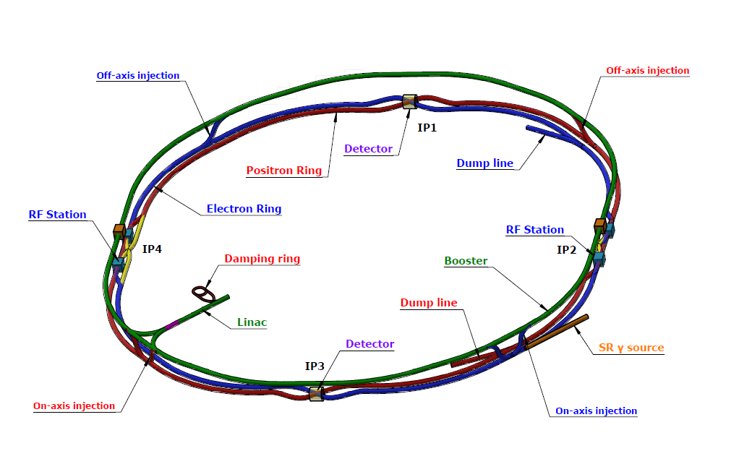
Development status--CEPC survey and layout
The layout is the basis for the engineering design of each equipment.
Physics survey
Equipment model design
Layout design

Slide 7
Development status--CEPC survey and layout
Main progress in EDR
  2024.10 Preliminary 2D layout of arc section of Collider and Booster, designed the vacuum connection dimensions and distributions.
  2025.2 Collider and Booster perimeters updated to 99,955.418 m. Updated surveys of Collider(25.2.14), Booster (25.3.1), Linac, DR, TLs (25.3.7) were sent to Huadongyuan for geological study.
  2025.3 The realization of 2D/3D linkage design
Now, we are mainly working on
  Detailed design of survey, including all the magnets (yokes), BPMs and other main components along beam, with the position accuracy of at micrometer level.
  The physics and 3D model design of the components along beam.

Slide 8
Development status--CEPC survey and layout
Survey and layout status (overall)
Accelerator | Have survey data? | Finish survey design? | Have model design? | Have layout demo? | Complete survey naming?
Collider | √ | × (note 2) | Partial | √ | ×
Booster | √ | × (note 3) | Partial | √ | ×
Linac | √ | √ | Partial | × | √
Damping Ring | √ | × (note 4) | Partial | × | ×
Transport lines | 10/14 (note 1) | × | Partial | × | ×
  Note 1, 14 lines, 10 line have survey data (TLs between Collider and Booster, Linac and DR, Linac and Booster). ~middle in June, 2025
  Note 2, unfinished: single-aperture dipoles, correctors, beam instruments. ~end of July, 2025
  Note 3, unfinished: all adjacent dipoles except ~230 m demo, correctors, beam instruments. ~middle in June, 2025
  Note 4, unfinished: beam instruments.

Slide 9
Development status--CEPC survey and layout
Survey and layout status (equipment status*)
Accelerator | Equipment types | Survey design completed | Physics design completed | 3D model design completed | Layout length can be done** (km) | Layout section can be done**
Collider | 103 | 73 | 17 | 15 | ~ 80km | Arc section Higgs CM
Booster | 32 | 16 | 25 | 10 | ~230m | 230 m arc section Higgs CM
Linac | 68 | 68 | 31 | 1
Damping Ring | 16 | 9 | 2 | 1
Transport lines
*, These data are based on the designs currently available to the layout, the statistics is still in progress.
**, it means the 2D and 3D layouts with detailed designs

Slide 10
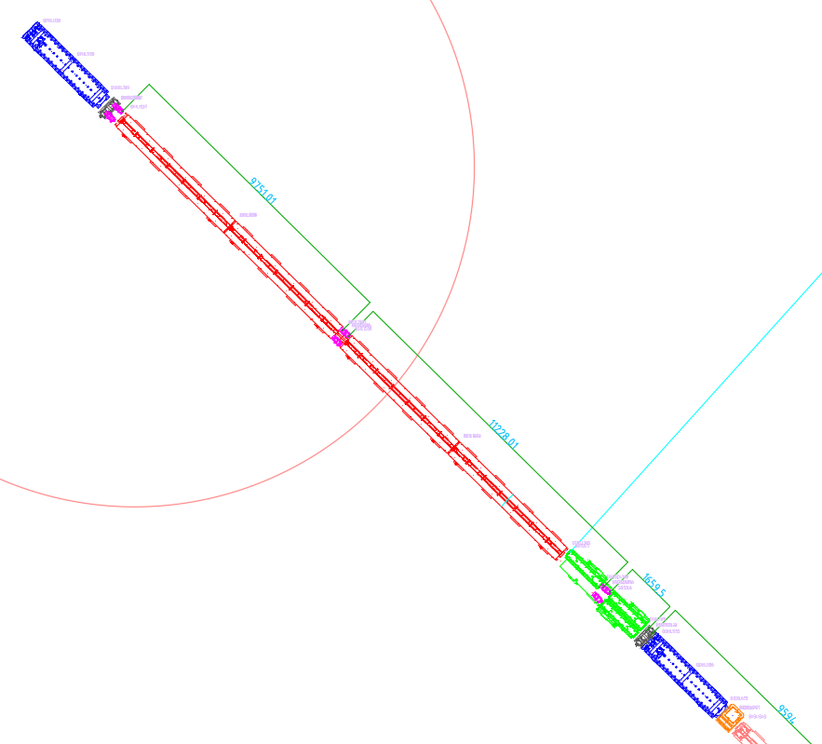
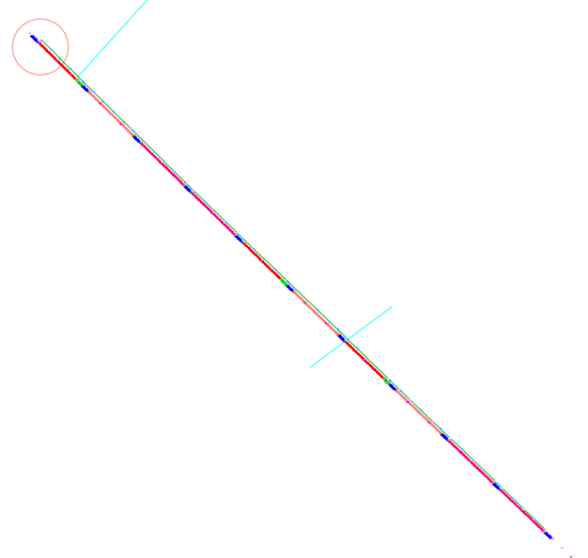
Development status--CEPC survey and layout
An arc section of 276 m layout has been made, with all the components along the beam.
Quadrupole
BPM
Dipole
Inside, tunnel wall
Bellows & pumps
Bellows & pumps
Bellows & pumps
Outside, passageway
BPM
Sextupoles
Quadrupole
Correctors

Slide 11
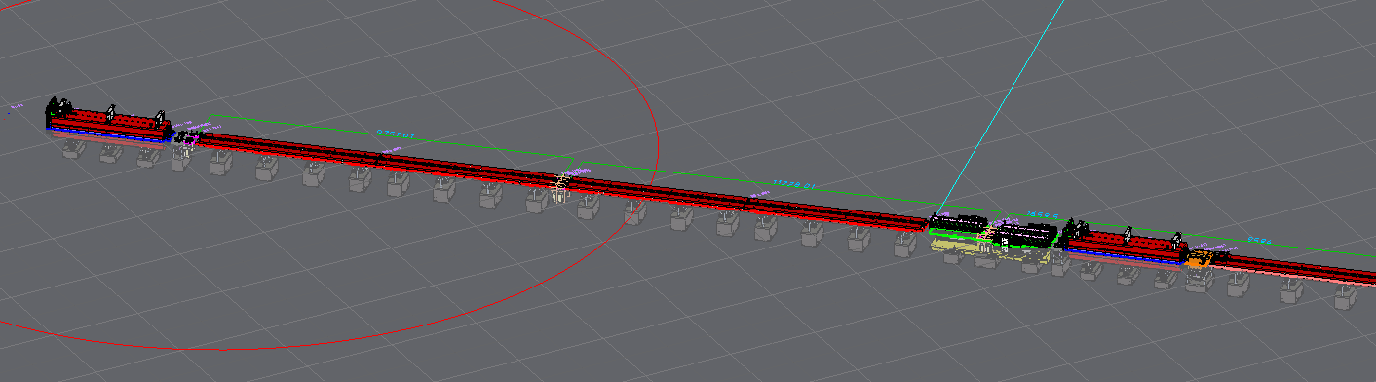
Development status--CEPC survey and layout
2D/3D linkage design for CEPC
  If the 3D model is changed or replaced, the 2D model will be updated.
  If the 2D model is replaced or its location is changed, the 3D model will be updated.
Part of Collider arc section

Slide 12
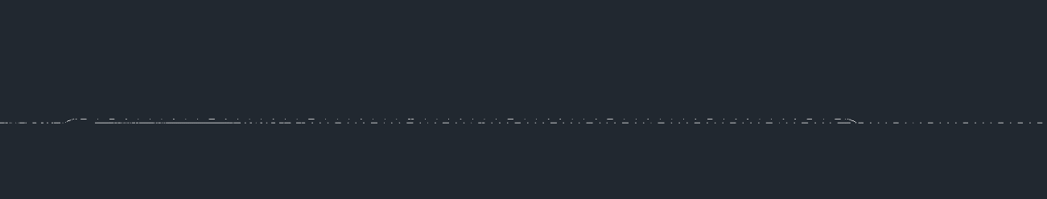
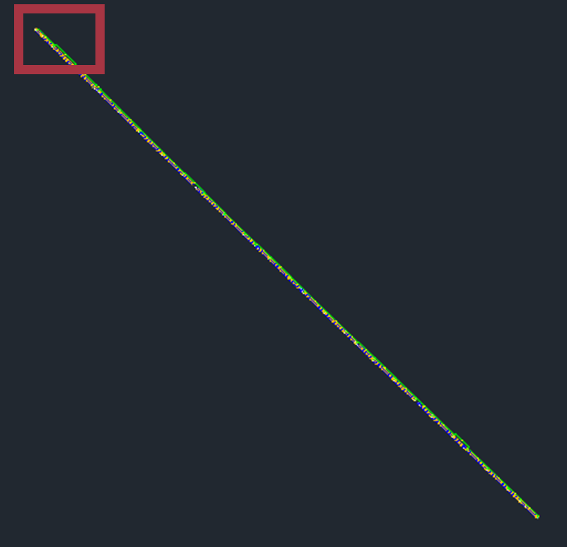
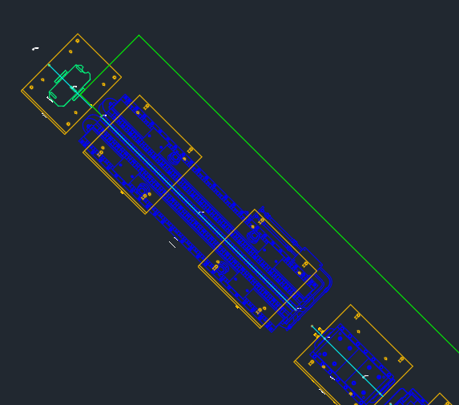
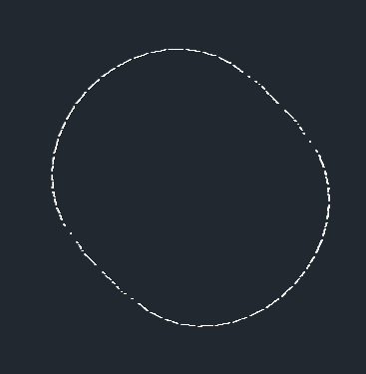
Development status--CEPC survey and layout
Booster: a layout demo has been made, about 230m.
Linac and damping ring: only points now, the 2D and 3D layout is planned.
Linac
Booster
Damping ring

Slide 13
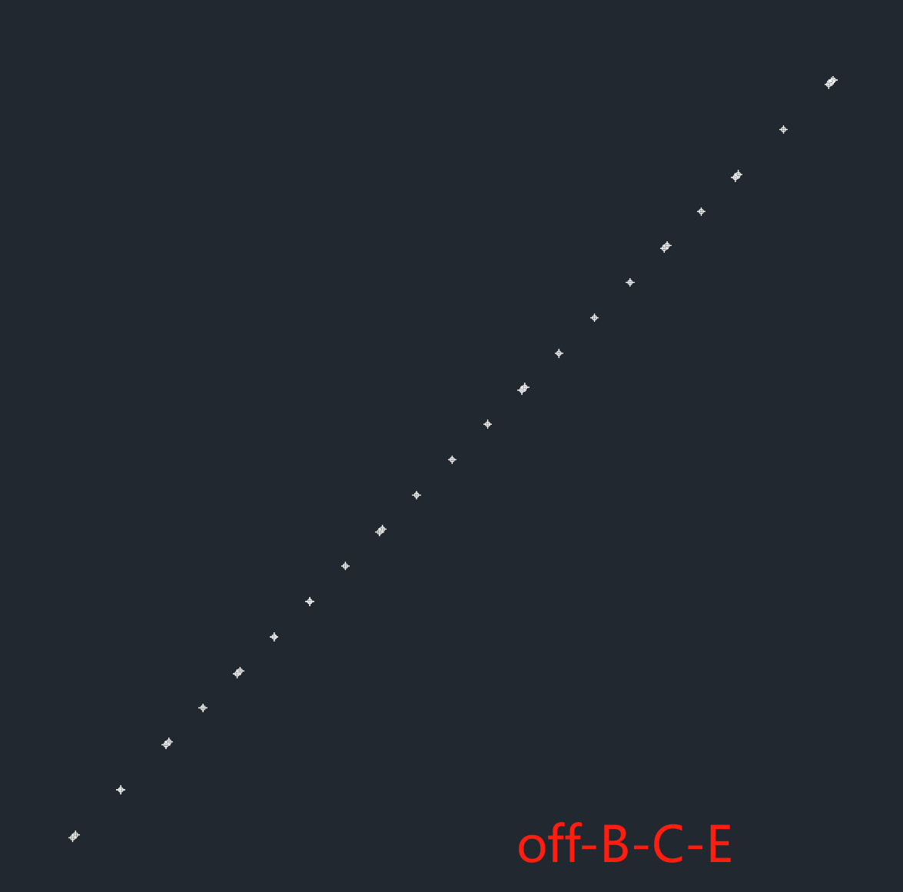
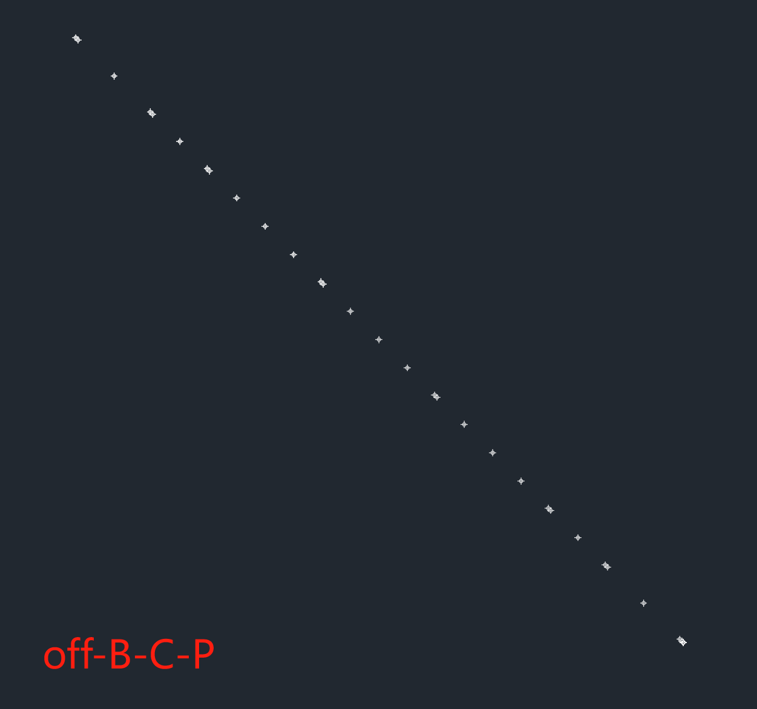


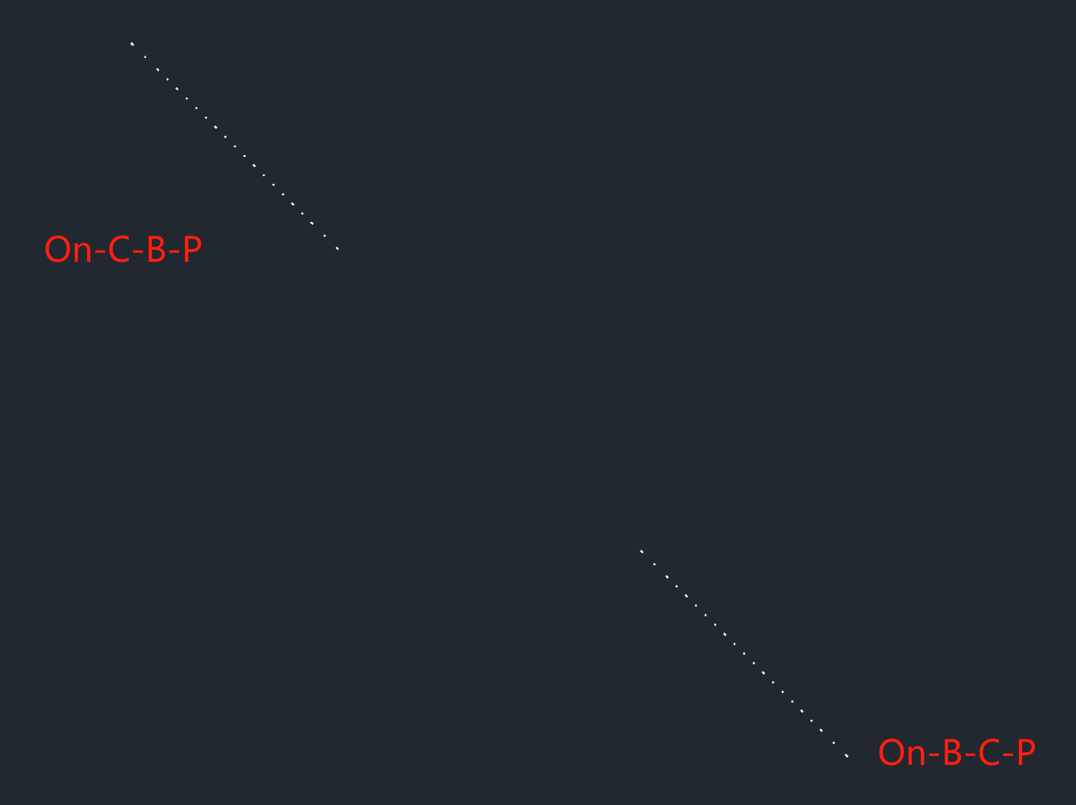
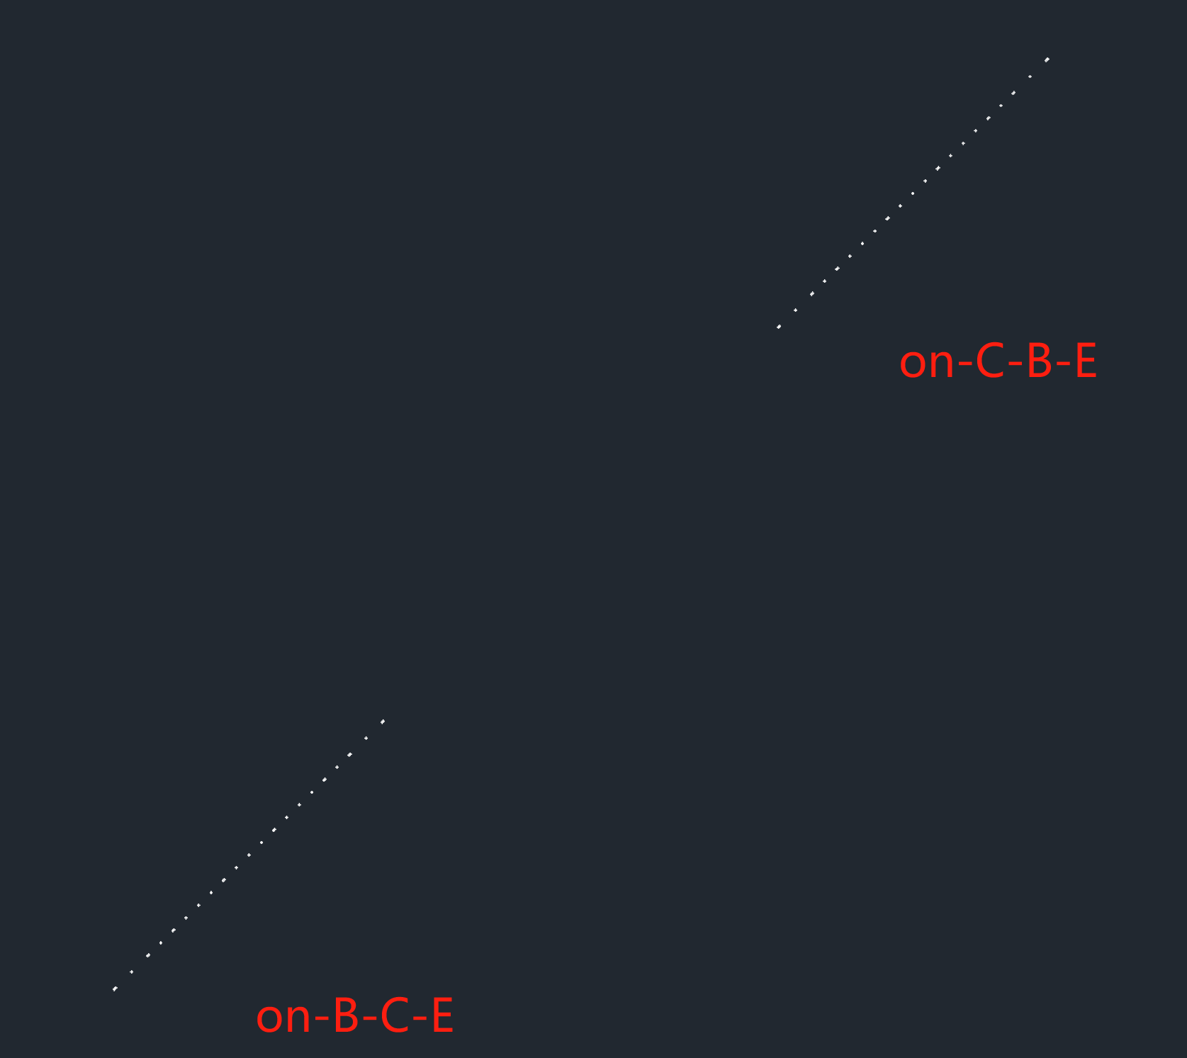

Development status--CEPC survey and layout
Transport lines (points only now)
Linac to Booster (Top view)
Linac to Booster (side view)

Slide 14
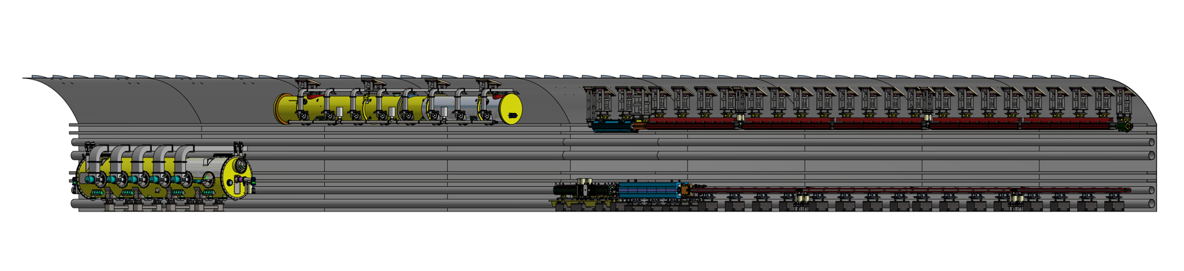
Development status-- tunnel mockup
A 60-meter tunnel with typical arc section and RF section
  Arc section：one FODO cell in both Collider and Booster（including dipole, quadrupole, sextupole, corrector and BPM）
  RF section：one RF module in both Collider and Booster
  Technical verification of installation and alignment for the above-mentioned equipment.
Development progress
  Design review: 24.8.16
  Now: waiting for bidding for the displaying models, under machining for the supports.

Slide 15
Development status-- tunnel mockup
The arc section
  Magnets ：ABS (Acrylonitrile Butadiene Styrene plastic) & steel，dimension tolerance ±2mm. The yoke can be opened and closed to simulate the vacuum tube installation.
  Vacuum devices and BPMs: ABS & steel，dimension tolerance ±4mm in longitudinal direction and ±1mm in radial direction.
  Pedestals in Collider: reinforced concrete & steel plate as designed.
  Support frame in Booster: steel as designed.
  Adjusting mechanism: wedge adjustment or screw adjustment, having the interface to replaced by automatic ones after prototype tests.
  25 mm thick lead shielding for magnets in collider.
  RF modules：ABS & steel，dimension tolerance ±4mm.
  Modules supports: Steel.

Slide 16
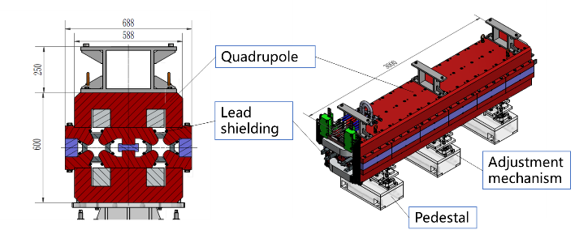
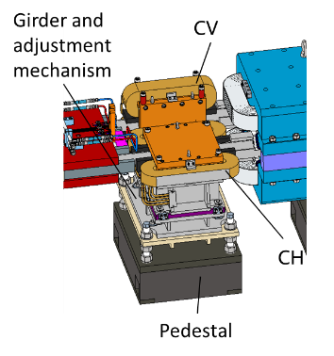
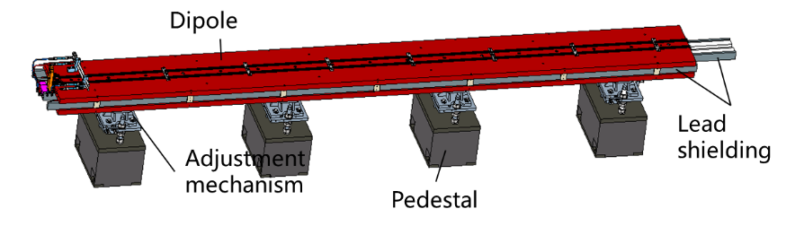
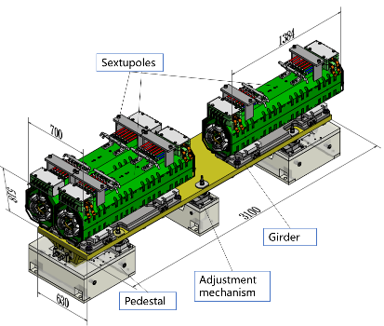
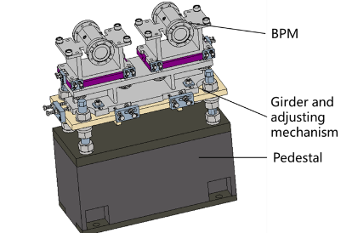
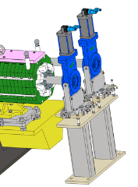
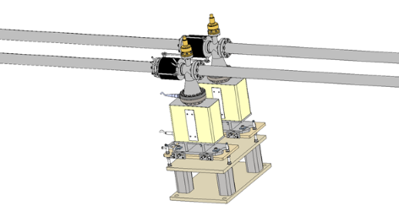
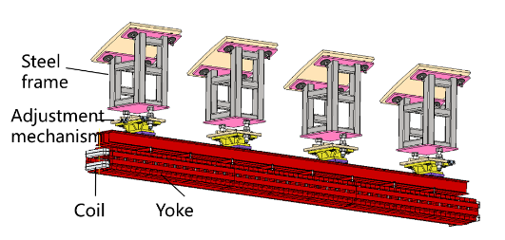
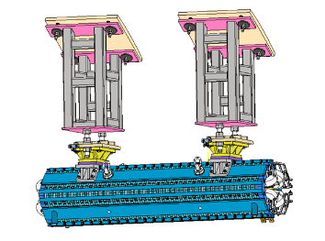
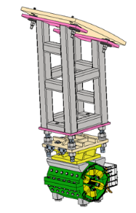
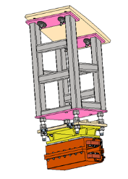
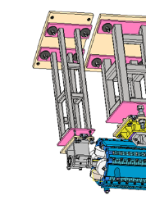
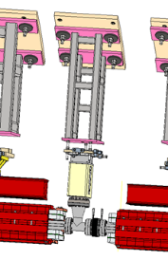
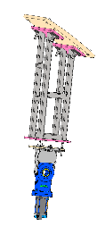
Development status-- tunnel mockup

Slide 17
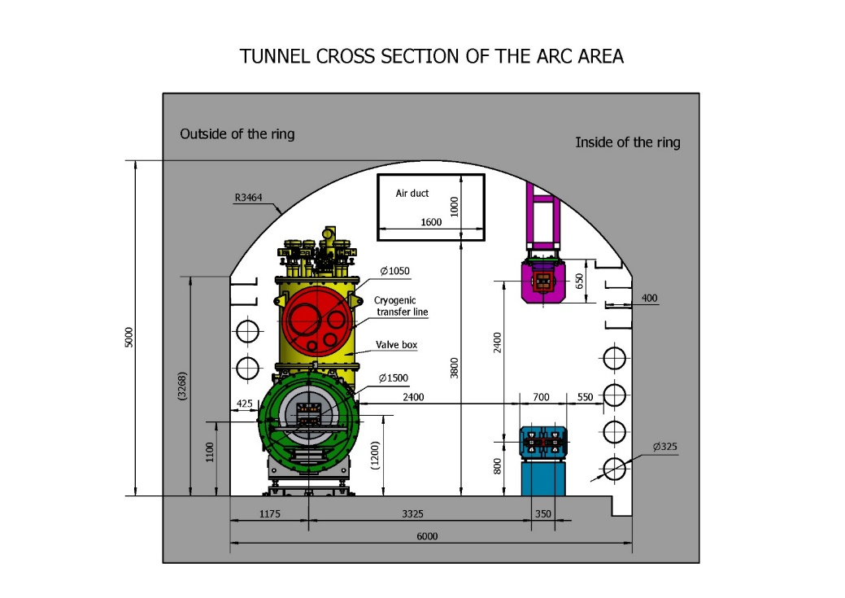
Development status-- tunnel mockup
Optimizing dimensions is one of the important tasks for EDR design.
The aim is to fulfill the space arrangement of TDR tunnel design.
  The water and electricity connections for quadrupole and sextupoles have relocated to the upper side. (The slide above)
  Cryomodule design update: bottom support→ top suspension
Miaofu Xu, CEPC SRF Cryogenic System EDR Design Peer Review, May, 2025

Slide 18
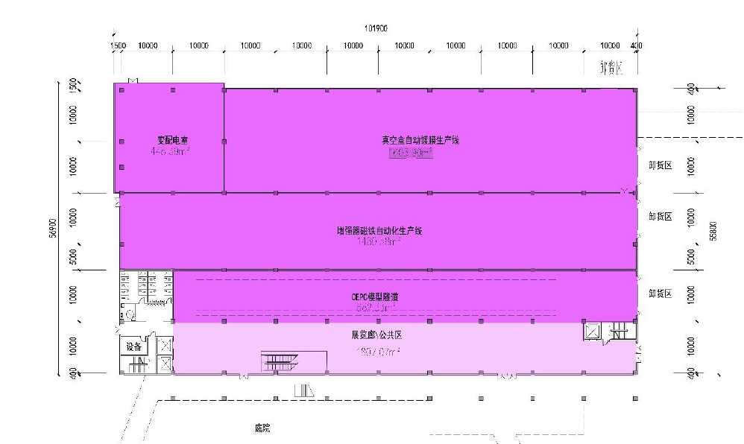
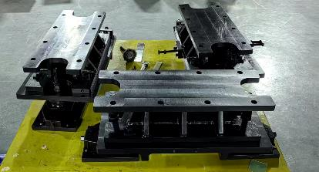
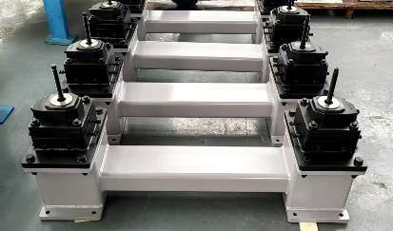
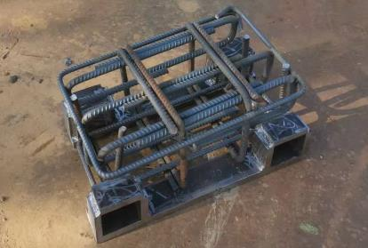
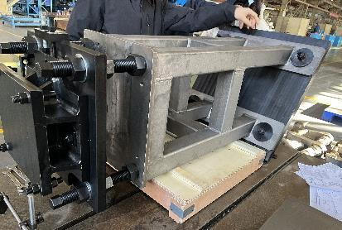
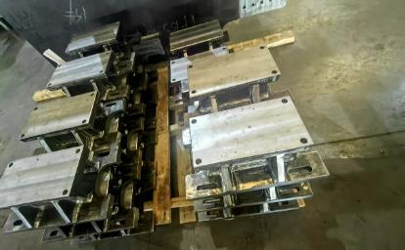
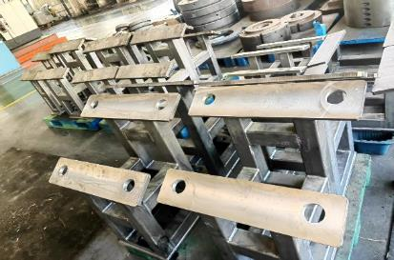
Development status-- tunnel mockup
The site construction design of the tunnel mockup is under-going.
The devices of the mockup is under developing.

Slide 19
Development status-- high accuracy automatic adjusting and alignment system
The amount of CEPC equipment is huge. Therefore, improving alignment and adjusting efficiency while ensuring accuracy is one of the important aspects in EDR stage.
The high accuracy automatic adjusting and alignment system of CEPC
  High-accuracy measurement field: multi-camera photogrammetry, multi-point synchronous monitoring, high efficiency
  Automatic adjustment mechanism: movable drive, unified quick plug-and-play interface

Slide 20
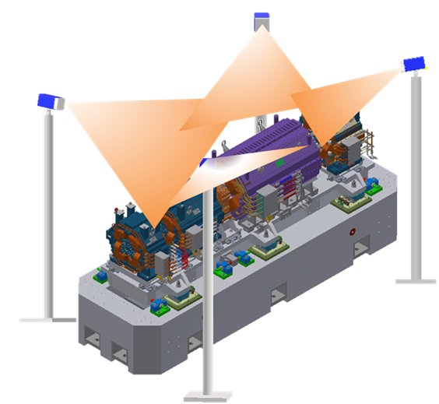
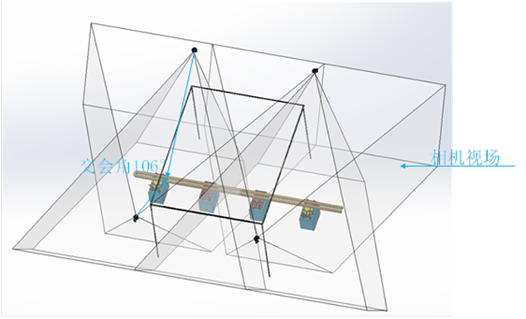
Development status-- high accuracy automatic adjusting and alignment system
High-accuracy measurement field
  Select high-precision CMOS to improve the accuracy of pixel extraction.
  The intersection angle is within the optimal photogrammetric range (60°~120°).
  Select short focal length lenses to reduce the measurement field size.
  Using a 4-camera configuration to meet the measurement range requirements, measurement accuracy will be better than 45μm
From Xiaolong Wang
High-accuracy measurement field
Cameras layout and intersection angle

Slide 21
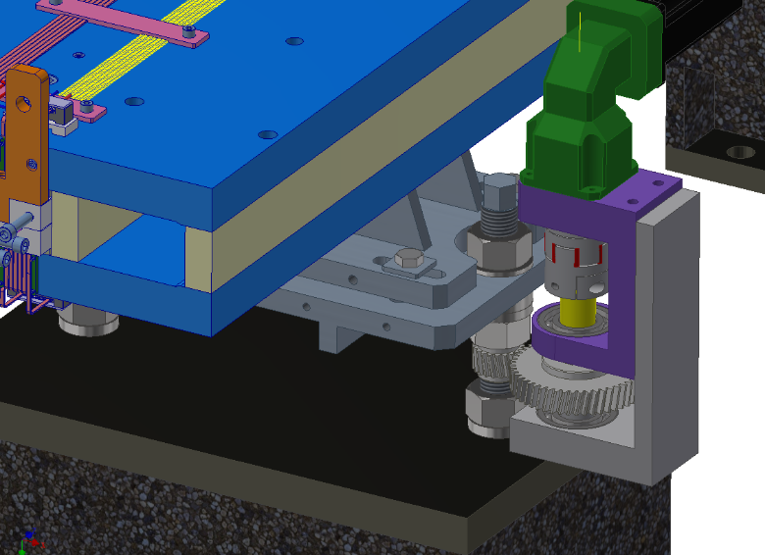
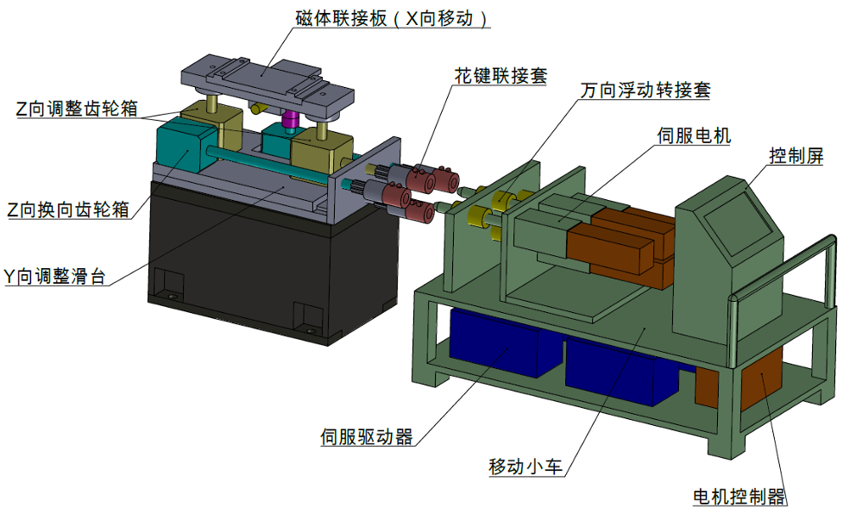
Development status-- high accuracy automatic adjusting and alignment system
Automatic adjustment mechanism
  Dipole magnet: adjustment based on screws, simple structure, wide adjustment range, low cost, low load-bearing capacity
  Quadrupole/Sextupole magnet units: adjustment based on wedges, requiring additional shims to increase the adjustment range, high cost, high load-bearing capacity
  Considered three schemes, currently take the movable drive vehicle as the basic solution.
Three considered schemes

Slide 22
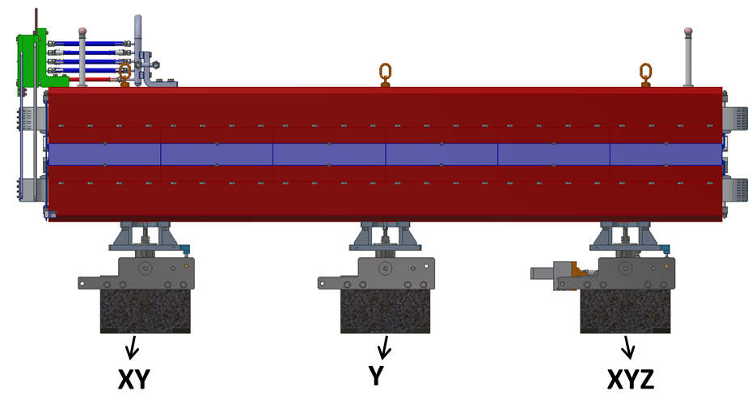
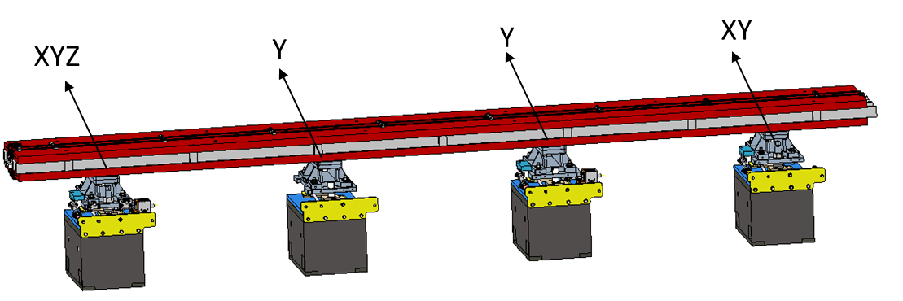
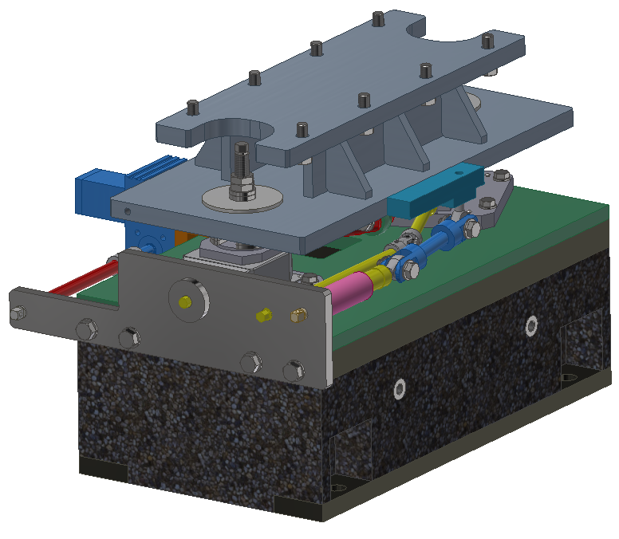
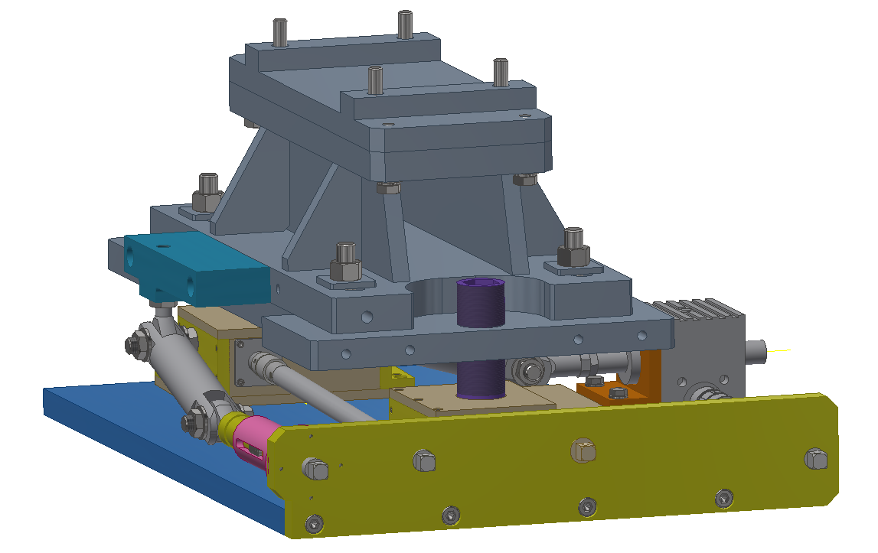
Development status-- high accuracy automatic adjusting and alignment system
Adjustment mechanisms
  Dipole magnet: screw in vertical
  Quadrupole/Sextupole magnet: wedge structure in vertical
  Horizontal: universal joints and connecting rods
  Output shafts at the aisle side
Quadrupole and its support
Dipole and its support
Adjusting mechanism for dipole
Adjusting mechanism for quadrupole

Slide 23
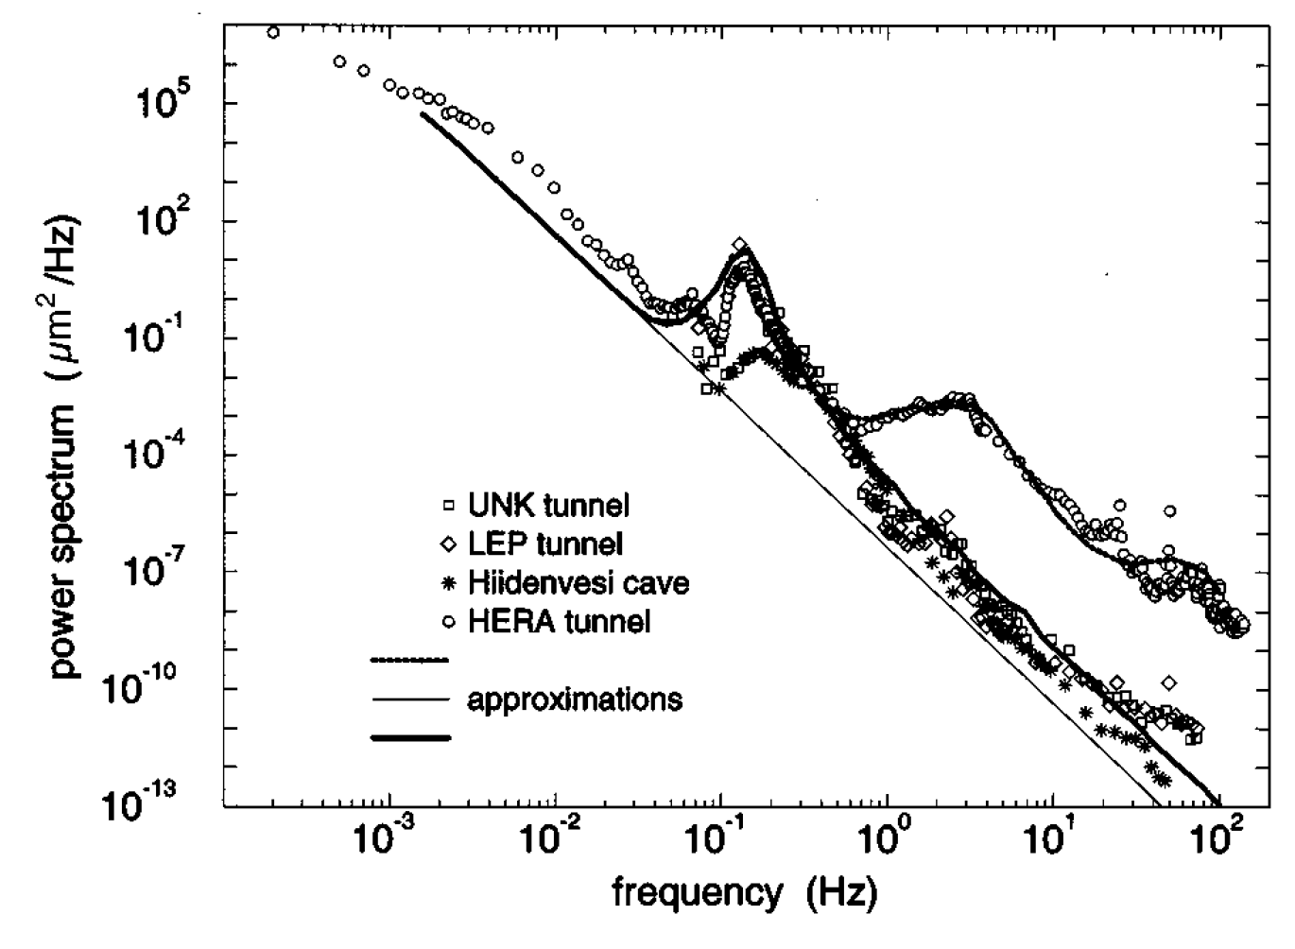
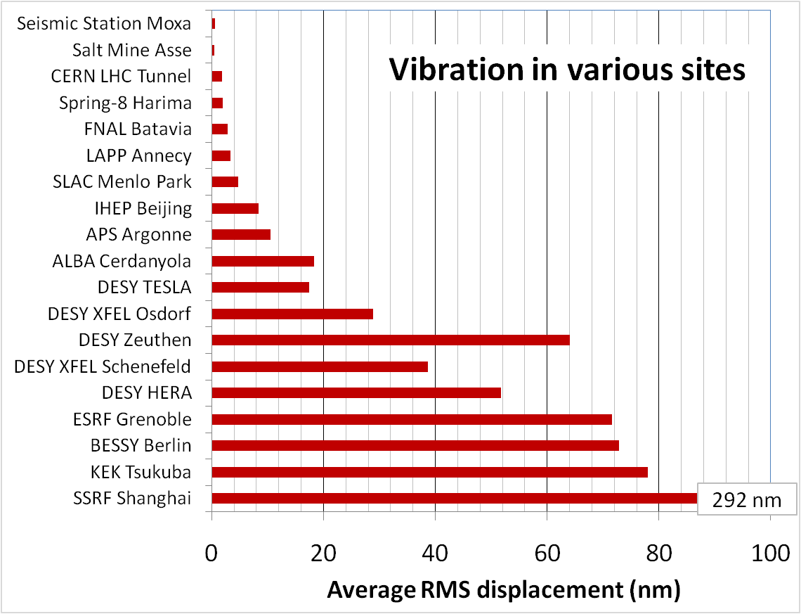
Development status– vibration test
 | Ground motion requirements, RMS, 1-100 Hz displacement integral
MDI | ≤4 nm
Arc and straight section, and RF section in Collider | ≤24 nm
Linac | ≤50 nm
Mechanical dynamic stability (vibration)
  Ground vibration :
  Magnet-support assembly: natural frequency? Amplification factor?
  Damping devices: damping material? active vibration technology?
Enhancing the natural frequency is an effective method to decrease vibration.
HEPS site

Slide 24
Development status– vibration test
Test plan
  13 points, 1 point for each IP and 2 points for each arc section, 1 for Linac
Test contents |  | Site requirements | Current progress
Test on vibration of CEPC site | Amplitude of ground vibration | Geotechnical borehole | Investigate sensors and the required conditions
 | Wave velocity and vertical attenuation.
Modal test on magnet & support assembly | Collider control group | Good and tested slab | Request for quotation
 | Collider magnet & support | Close to a real tunnel site | Searching for sites
 | Booster magnet & support

Slide 25
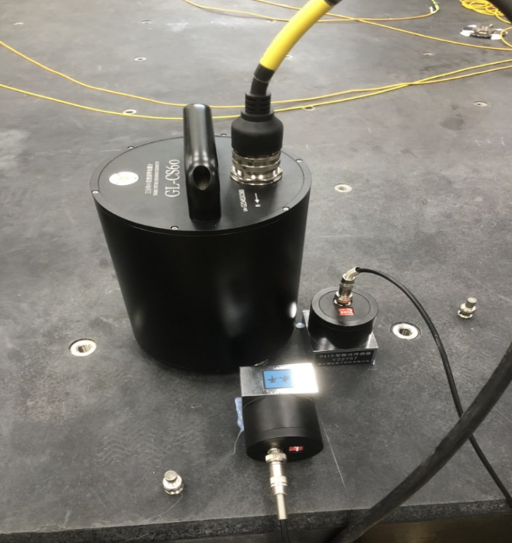
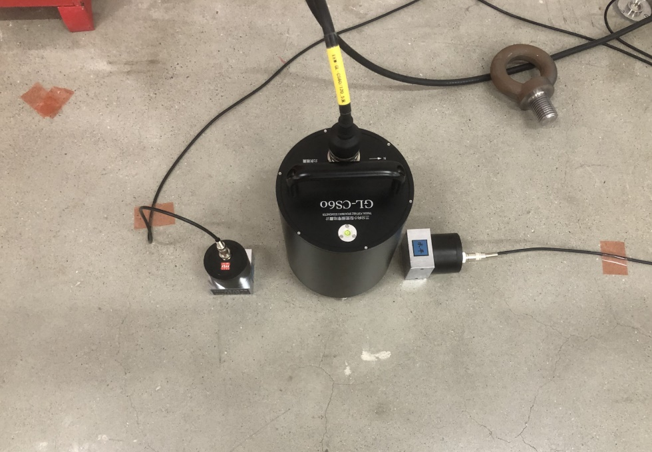
Development status– vibration test
Test of sensors
  Two of the currently best-performing vibration acquisition sensors for underground applications have been tested.
Sensor tests at PAPS and HEPS

Slide 26
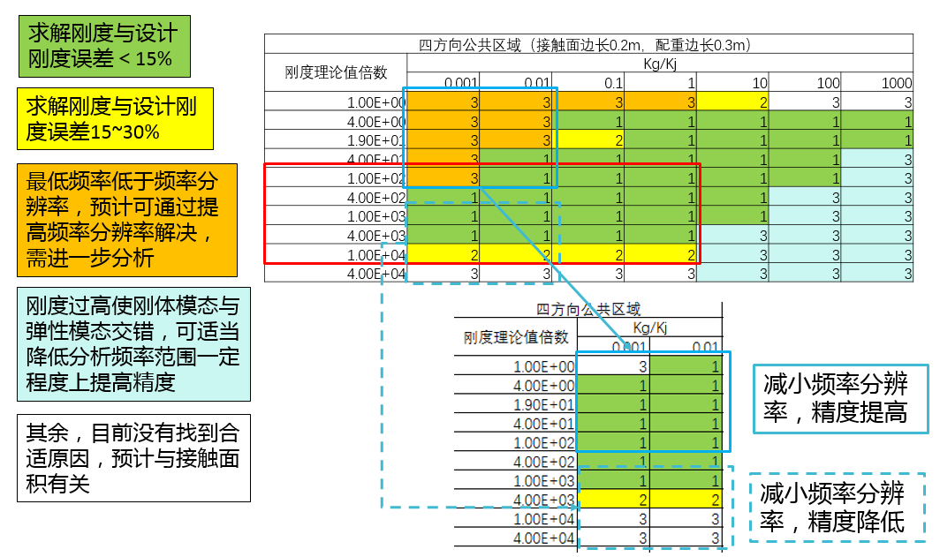
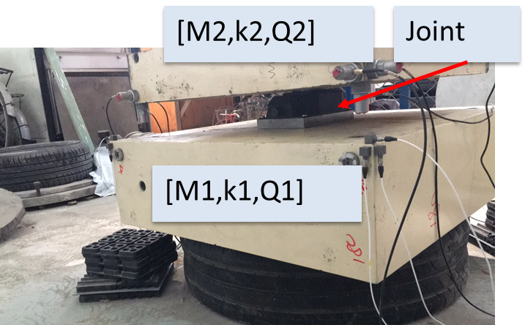
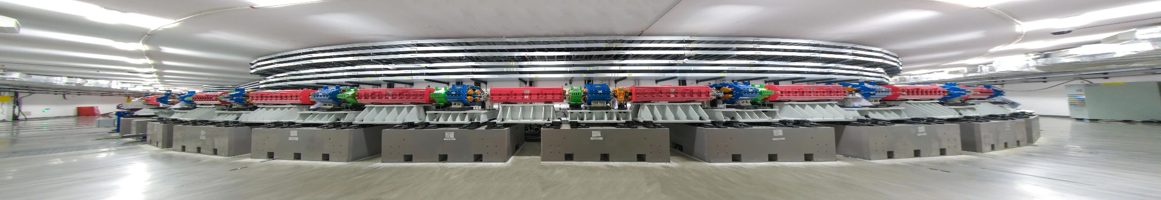
Development status– vibration test
Our experience:
  The pedestal development and grouting experience from HEPS.
  The FEA guided hammer knocking method for stiffness test.
Modes | Tested /Hz | Simulated /Hz | Error
1 | 64.5 | 63.4 | 2%
2 | 74 | 70.6 | 5%
3 | 90.4 | 79.0 | 13%
The FEA guided stiffness test method, the green areas are ideal test conditions
Comparison of mode test and simulation
Joint stiffness test
HEPS Booster, which pedestal is similair to CEPC’s

Slide 27


Development status-- collimators
Horizontal movable collimator for background decreasing (TDR)
For the collimators used for MPS, low-Z, high-melting-point carbon-based materials need to be taken into consideration.
Jointing prototype of copper, graphite and graphene film
Jaw of HEPS collimator with copper body and graphite tip

Slide 28


Development status-- collimators
We have accumulated relevant experience from the HEPS.
  High shear strength: 38.7 Mpa between graphite and copper
  Copper coating to improve conductivity about one level.
  Endure more than 100 thermal shocks higher than 2000 ℃.
Before/after thermal shock
Microscopic observation of copper-graphite brazing
Copper coating on graphite

Slide 29


Development status- MDI mechanics
MDI layout
  Detective angle: acos0.99
  IP chamber：±700mm
  Yoke length：11950mm
Distance to detective angle
  IP chamber flange: 5.3mm RVC: 14.9mm (pressure tube)
  An auxiliary support is in consideration at about 3.3 m from IP

Slide 30



Development status- MDI mechanics
Mechanics and vibration analyses
  Static structure: the displacement of quadrupoles, and their uneven deformation
  Vibration analyses: modal, harmonic responses
  Structure optimization: to decrease deformation and enhance natural frequencies
Analyses model

Slide 31
Development status- MDI mechanics
  Misalignment and vibration of quadrupole can lead to beam emittance growth and luminosity degradation.
  The steps on the inner wall of vacuum can generate HOMs.
* The response now only considers the mechanics aspect.
 | Related requirements | Response now* | Other related factors
Position accuracy (X/Y) of SC quadrupoles≤100μm | Adjusting resolution≤5μm Adjusting accuracy≤30μm | ≤5μm ≤30μm from HEPS experience | Alignment method, ground settlement、correctors…
 | Max. def. and disp. change, ＜ 50μm | FEA，＜40μm
Small vibration, 1-100Hz RMS ≤4nm | High natural frequency | FEA, ~50Hz and 1 (same level to HEPS, and arc section of CEPC) | Damping，installation foundation stability, ground vibration…
 | Low amplification factor
Related requirements | Response now | Other related factors
Deformation at the front of vacuum chamber<0.5mm | FEA，＜0.5mm | Installation error and so on
Notes:
表述修改，更准确

Slide 32
Development status- MDI mechanics
Details in:
Haijing Wang, Mini-Review of CEPC MDI (9-June 10, 2025), https://indico.ihep.ac.cn/event/26255/
Conclusions on mechanical FEA
  Iron-free quadrupole and optimized skeleton has benefits (Max. disp. of SC quadrupoles/cryostat decreased)
  Material optimization，no obvious effect
  Auxiliary support，significant effect (max. change from 2 mm to 84 um, 1st natural frequency from 17.7Hz to 49.2 Hz)
  Thicker vacuum vessel: significant effect (max. change from 84 um to 33 um)→can be considered comprehensively with radiation.
  Support rods: significant effect→ can be optimized further
Works to be done
  Further optimization with collaboration with other colleagues: compromise solution with other aspects of optimization, updated loads (radiation shielding, Lorentz force)
  After above analyses converged, we will taking into account all the relative components and make a whole FEA.

Slide 33






Development status- MDI mechanics
Simulation results, with Lorentz force and gravity
Z disp. of SC quadrupoles, 4.2 K
SC quadrupole displacement
Y disp. of vacuum vessel, 4.2 K
1st order of mode, 4.2 K
2nd order of mode, 4.2 K
Harmonic response, 1-100Hz

Slide 34





Development status- MDI mechanics
    RVC
  Leak rate requirement: 2.7 ×10–11 Pa·m3/s
  Leak rate: $Q=C∙∆P$
  Decrease $∆P$ (experience from CSNS)
  Single-layer → double layer, leak rate can be improved from 1e-6 Pa.m3/s to 8.5e-10 Pa.m3/s.
Inflatable seal
$$\left.C=34A^{2}（L/w）exp{[}−3F/(LwR)\right]$$
  For sealings with the same F/L
  Decrease roughness A, demonstrated by J-PARC
  Decease the perimeter L →almost determined by layout
  Decrease the hardness of gasket materials$R$→using copper
  Decrease the seal width $w$→knife-edge seal
Roughness and conductance, J-PARC

Slide 35


Development status- MDI mechanics
A prototype will be developed (quotation finished, preparing engineering drawings).
The influence of RVC displacement on the leakage rate will be simulated through an adjustment mechanism.
Fake model of vacuum vessel
Fake model of IP chamber, fixed
Adjustment mechanism
RVC

Slide 36
Conclusion
The mechanics system is aiming to carry out technically feasible engineering designs for the equipment it is responsible for during EDR stage.
Some layout demos has been done. We are working on detailed design of survey, the physics and 3D model design of the components along beam.
The tunnel mockup has been designed and is under developing.
A high accuracy automatic adjusting and alignment system is under studying, aiming at high efficiency alignment and adjustment of CEPC.
We will do the vibration test following the geological exploration, from which we can evaluate the vibration performance of the magnet-support system.
We are committed to the mechanical research of MDI. The structure has been optimized to having a much better mechanics and vibration performance.

Slide 37
Thank you for your attention!

