Slide 1
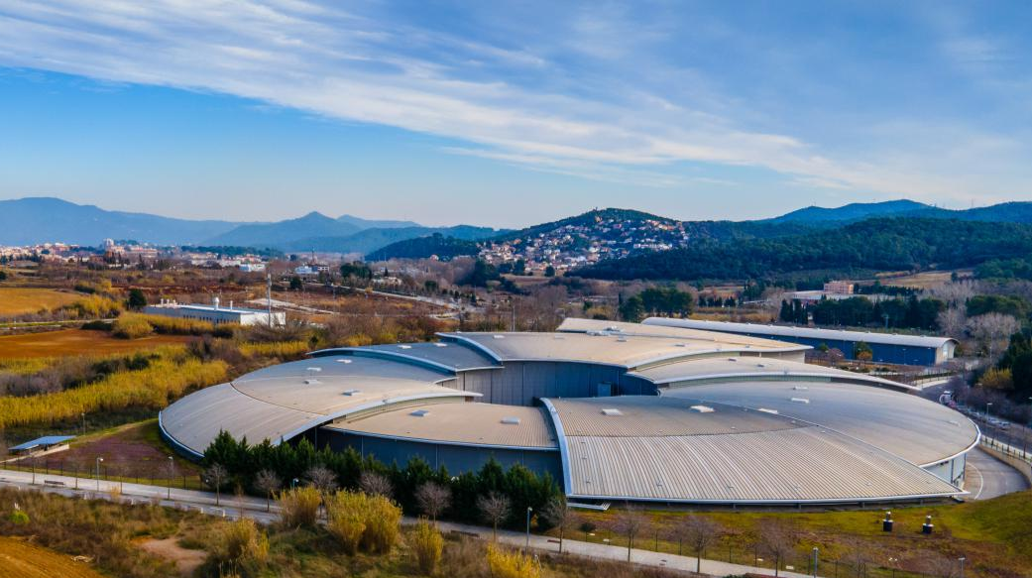
ALBA Synchrotron
Accelerator Activities
Caterina Biscari
17 June 2025

Slide 2
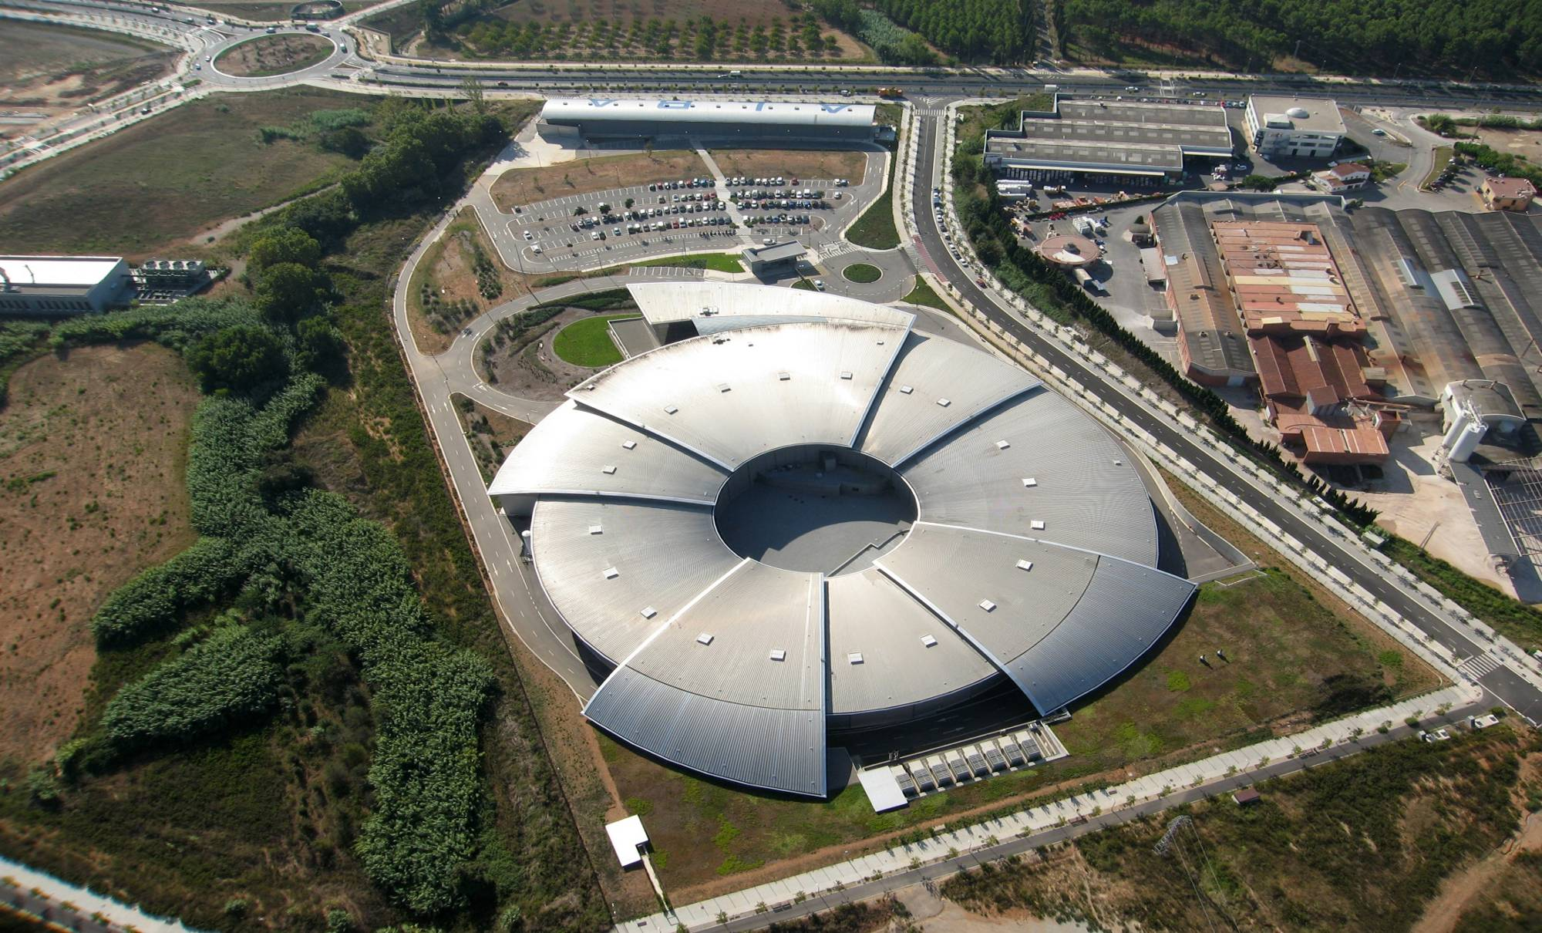
ALBA, the Spanish Synchrotron
National public institution, funded
50% national Government (Ministerio de Ciencia, Innovación y Universidades)
50% regional GenCat (Department de Recerca i Universitats)
User facility open to international academic and industrial communities

Slide 3
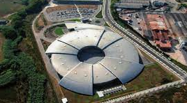
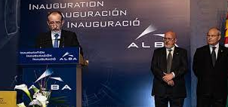
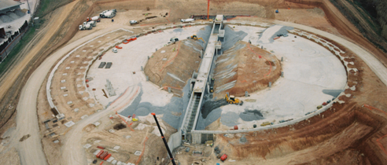
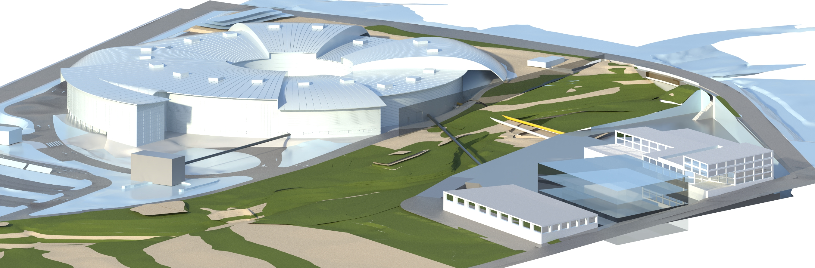
ALBA past and future
2003 – Creation of CELLS Consortium (Spanish Government and regional Catalan Government), and agreement on facility funding for the period 2003 to 2022
2023 – Addendum for 2023 funding
Governments to approve the agreement on facility funding for the period 2025-2038
2003 ALBA Approval
2012 Starting ALBA Operation
2021
Starting ALBA II design
2024
ALBA II project Approval
2032
ALBA II Operation
2006
Starting ALBA construction

Slide 4
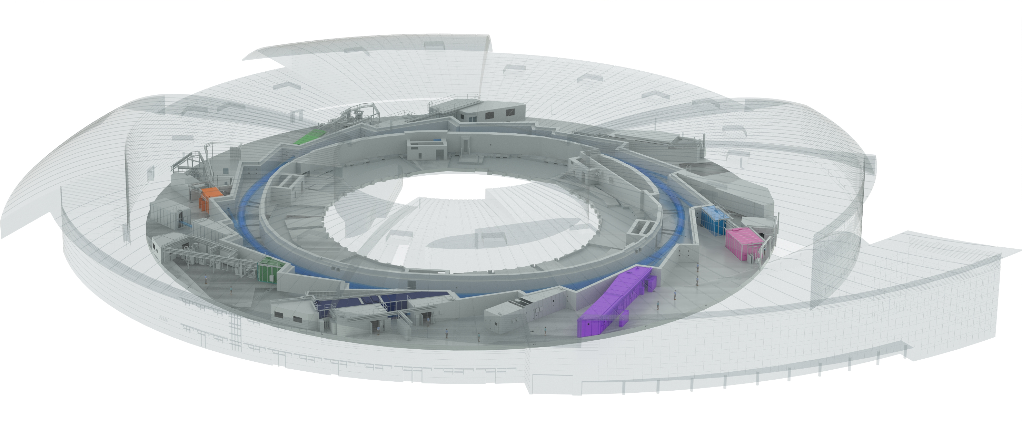
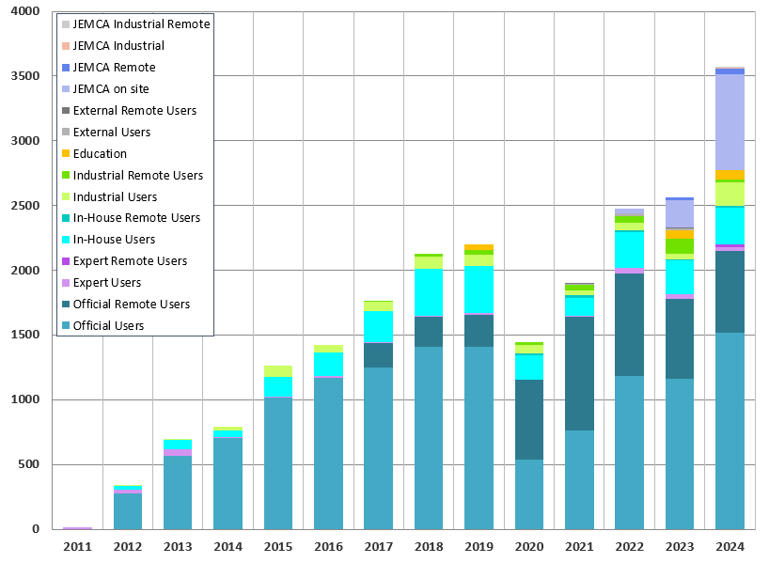
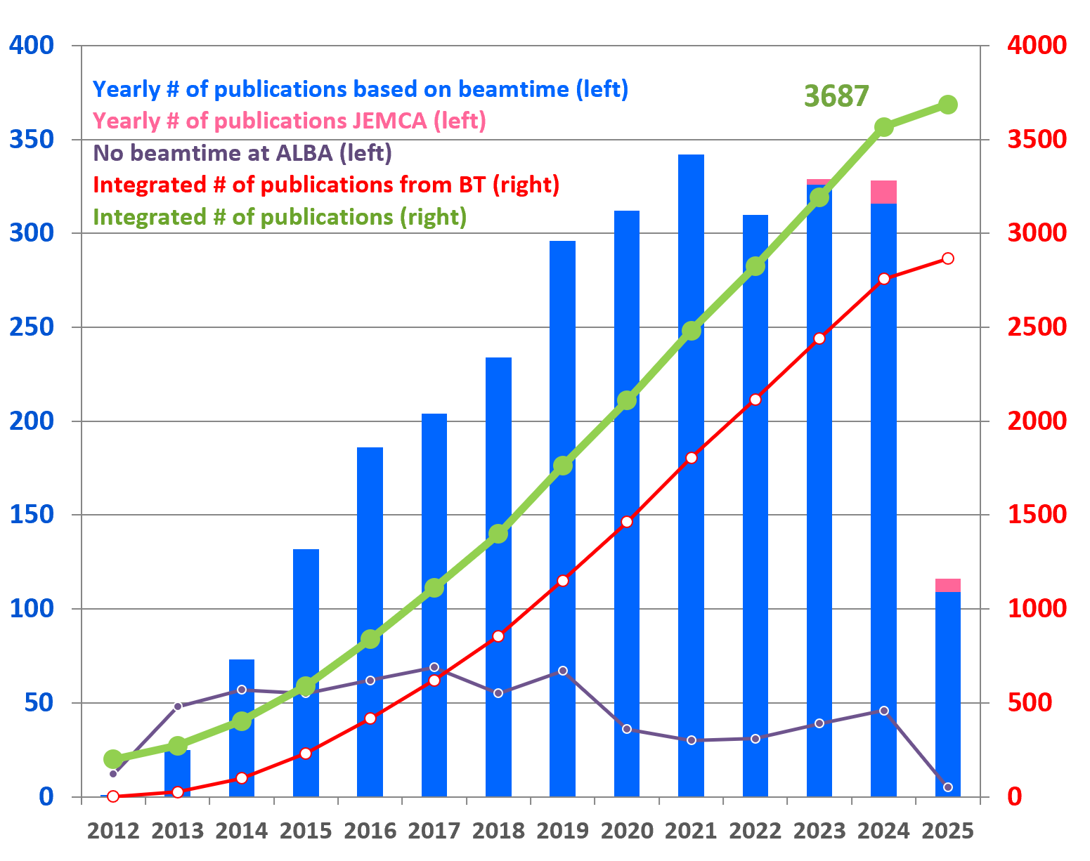
ALBA 2025
Instruments for life science
BOREAS
FAXTOR
Instruments for material science
MIRAS
Instruments for metrology
MINERVA
CIRCE
CLAESS
MSPD
LOREA
XAIRA
Cryo-EM
MISTRAL
TEM
InCAEM
NOTOS
3SBAR
XALOC
NCD-SWEET
User visits
3500
Publications
13 operating beamlines + 1 in 2027
2 electron microscopes + 1 at end of 2025
User dedicated labs

Slide 5
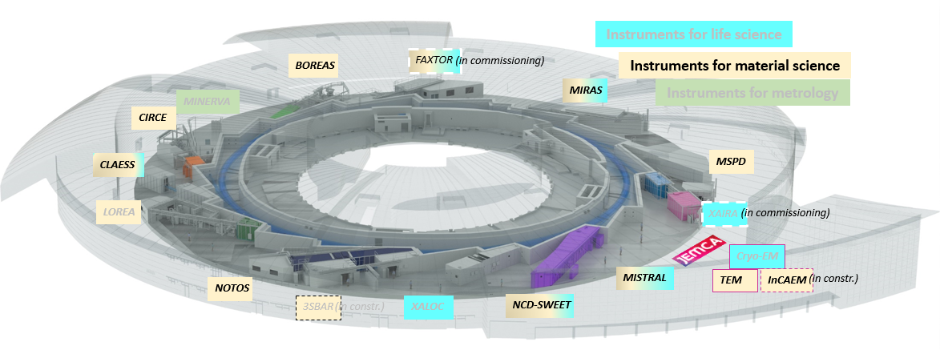
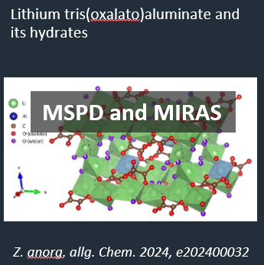
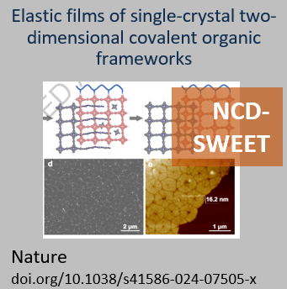
Chemistry and Materials Science for boosting decarbonization and decreasing material footprint
Among many others:
More performing and diverse batteries
Green energy technologies, solar and H
Low footprint materials
Catalysts for low footprint developments

Slide 6
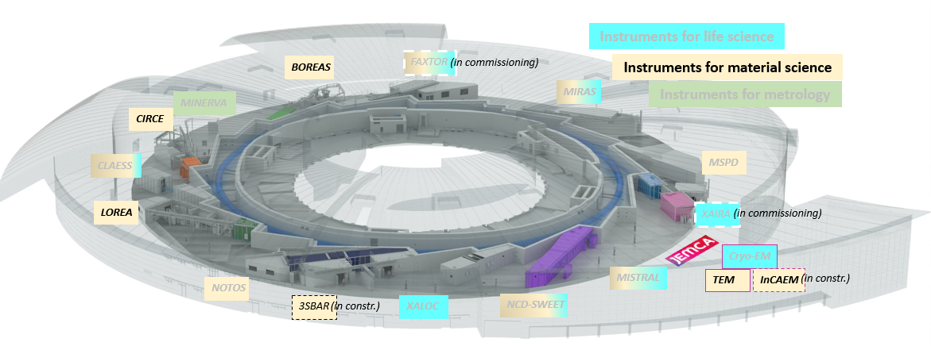
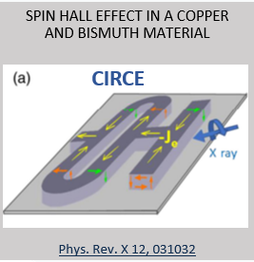
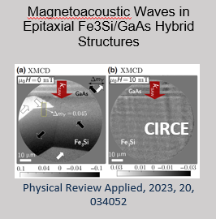
Electronic and Magnetic Structure of Matter for low-consumption new technologies, quantum, spintronics
Among many others:
Magnetism
Spintronic
2D materials
Quantum materials

Slide 7
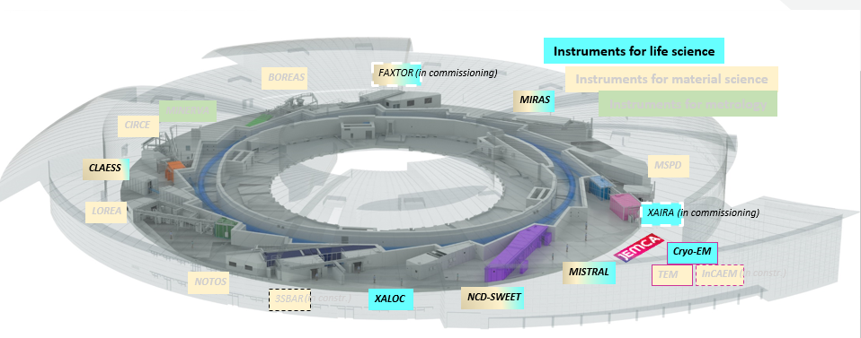
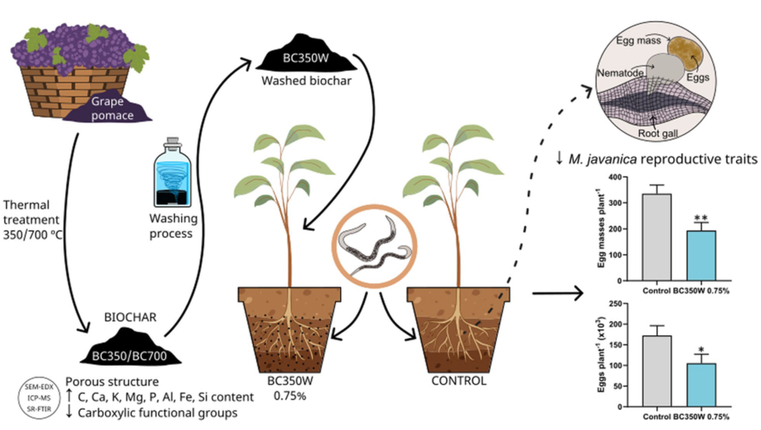
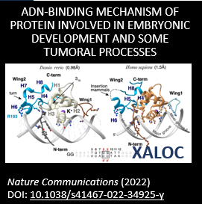
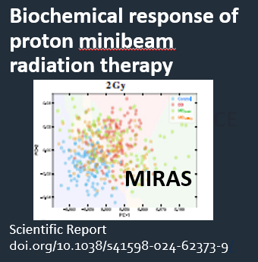
Life Science applications to increase life time and quality
Among many others:
Understanding diseases
Improving food quality and plant resilience
3D HOW SARS-COV-2 REPLICATES IN CELLS
ACS Nano. DOI: 10.1021/acsnano.3c07265
PEST CONTROL ON CROPS
BioChar doi.org/10.1007/s42773-023-00228-8
MISTRAL
MISTRAL
Understanding fundamental properties of life
Advancing in therapies and drug development

Slide 8
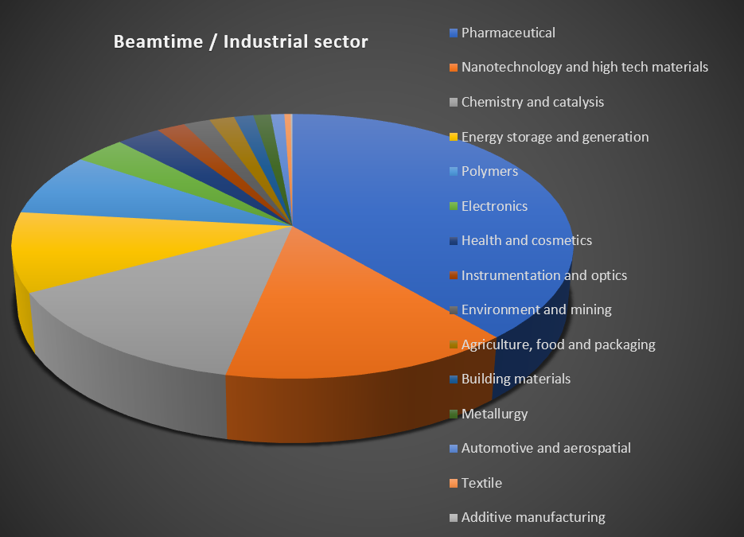
ALBA as DIRECT Industrial instrument
Science and innovation programmes aligned to eliminate gaps between academic and industrial research
Special developments (i.e. on data analysis, automatization) for impact on industrial users
Harnessing a rich industrial networking (European and national projects and clusters)
Publicizing ALBA instruments towards national and international industry (outreach events)
Focusing on key industry sectors based on the strengths and opportunities of ALBA (Pharmaceutical, Steel, Energy)

Slide 9
ALBA accelerators
Linac: 3 GHz, 110 MeV
Booster: 80 MeV to 3 GeV, 260 m,
10 nmrad emittance
Storage Ring: 3 GeV, 270 m,
4.4 nmrad emittance
500 MHz rf frequency
250 mA current
16-fold symmetry
Modified DBA lattice

Slide 10
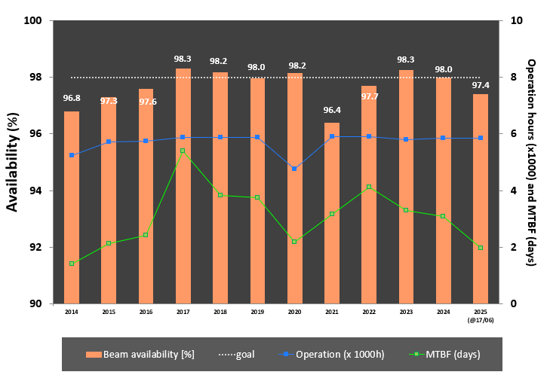
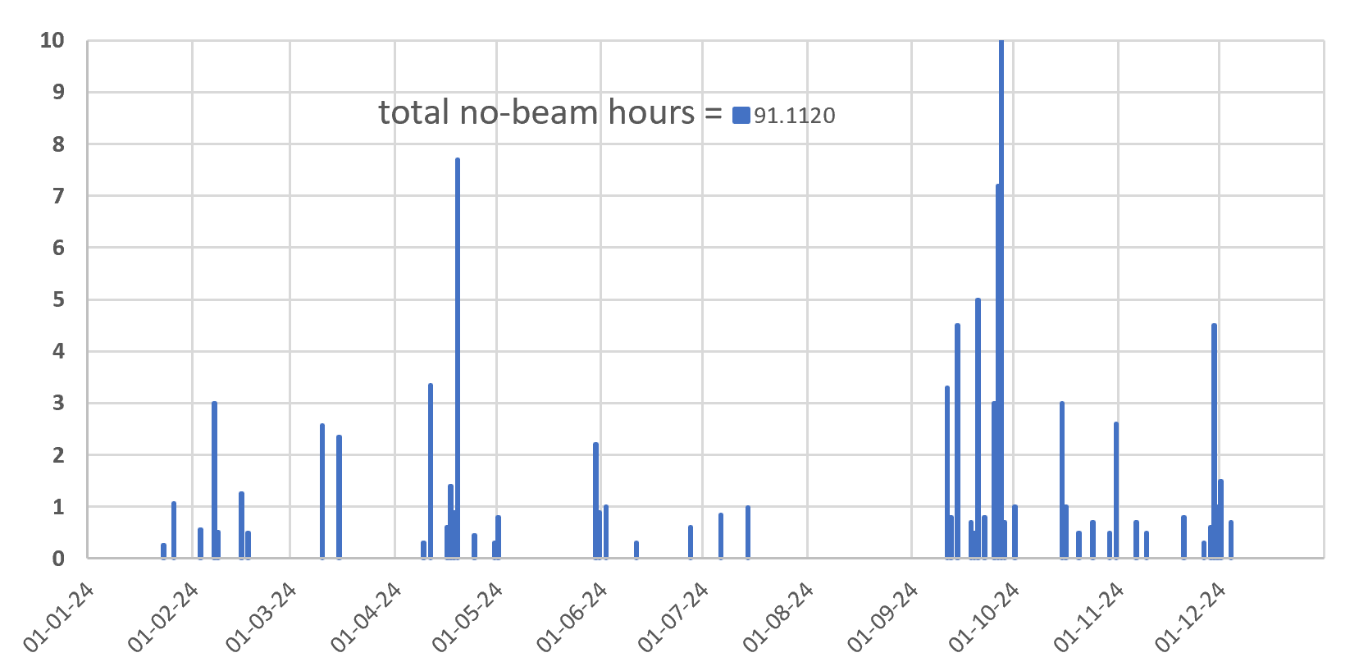
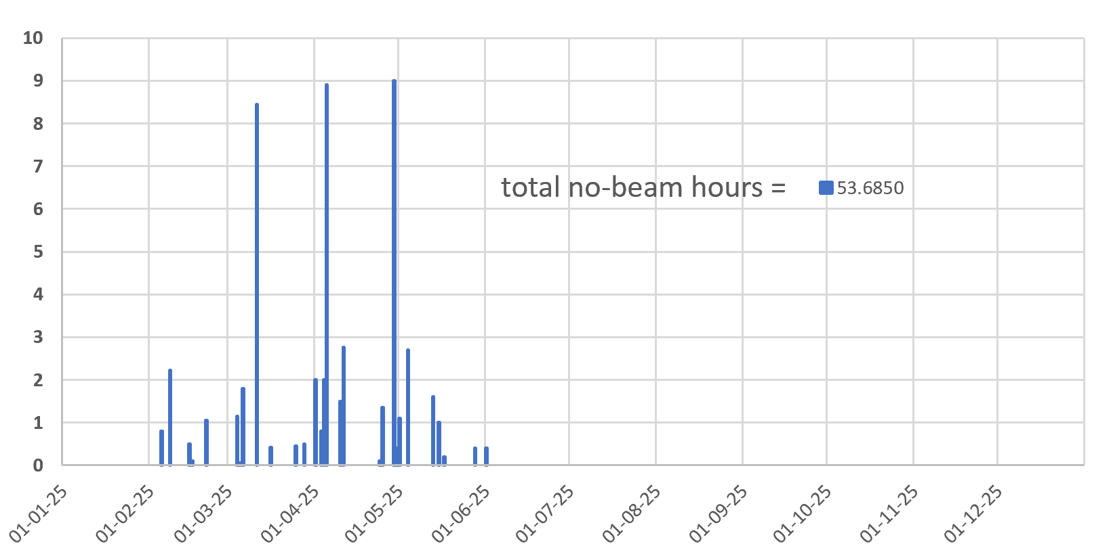
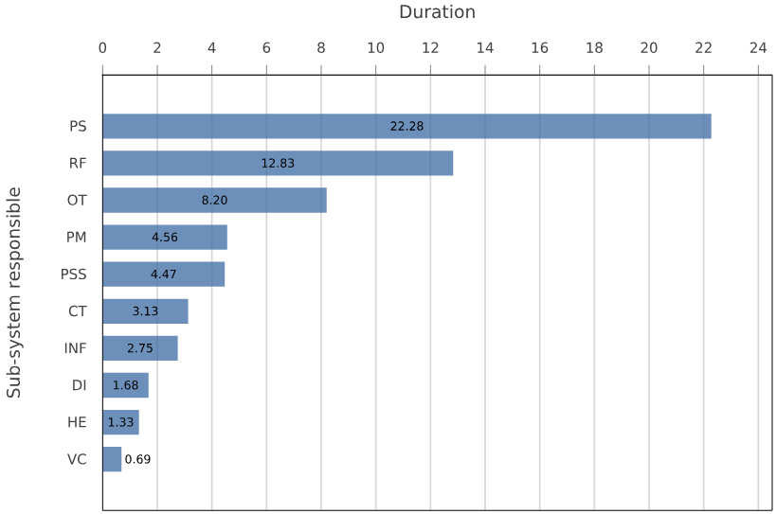
Operation Availability
97.4%
2024
2025
Along first months of 2025: Several and diverse interruptions, three of them longer than 8 hours (problems with power supplies plus blackout in whole Iberian Peninsula)

Slide 11
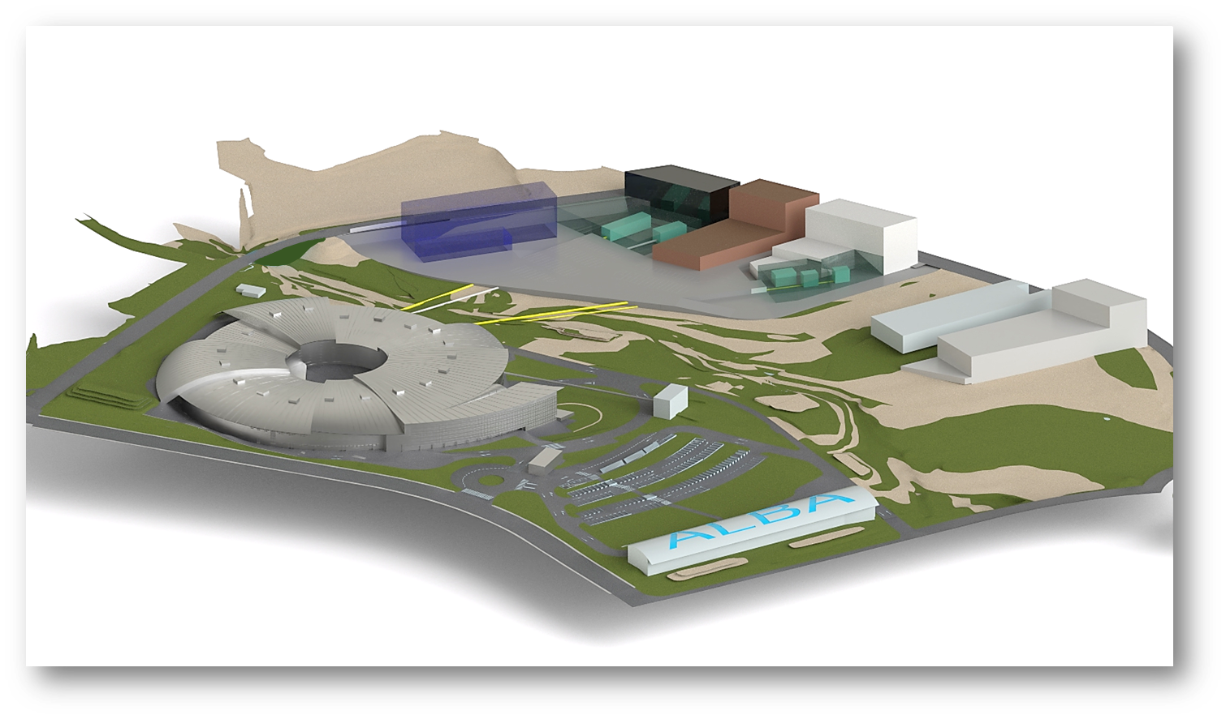
ALBA II – our future
Upgrade of ALBA to the 4th generation
Formally approved by our governing bodies (Jan’25)
Maintain site, infrastructure and existing BLs
New campus (labs, Data, user facilities)
3 new BLs (2 >200 m long)
New low emittance storage ring
Upgrade of existing beamlines
Increase of brilliance by orders of magnitude
Increase of coherence
Advanced properties for imaging, spectroscopy, diffraction
Advanced data management
Reach One Health
CODI
CORUS
InnoFAB
Photon flux on sample - from ALBA to ALBA II

Slide 12
ALBA II - Day One - 2032
Instruments for life science
Instruments for material science
BOREAS
MSPD
FAXTOR
Instruments for metrology
MIRAS
MINERVA
CIRCE
CODI
CLAESS
New Storage Ring
CORUS
LOREA
XAIRA
CALIMA
Cryo-EM
MISTRAL
TEM
InCAEM
NOTOS
3SBAR
XALOC
NCD-SWEET
Upgraded Beamlines

Slide 13
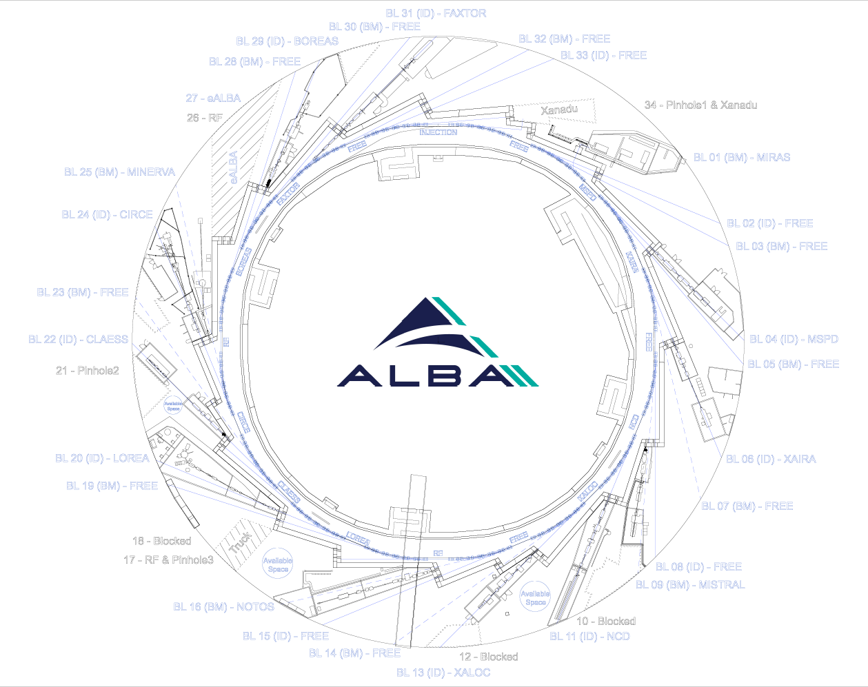
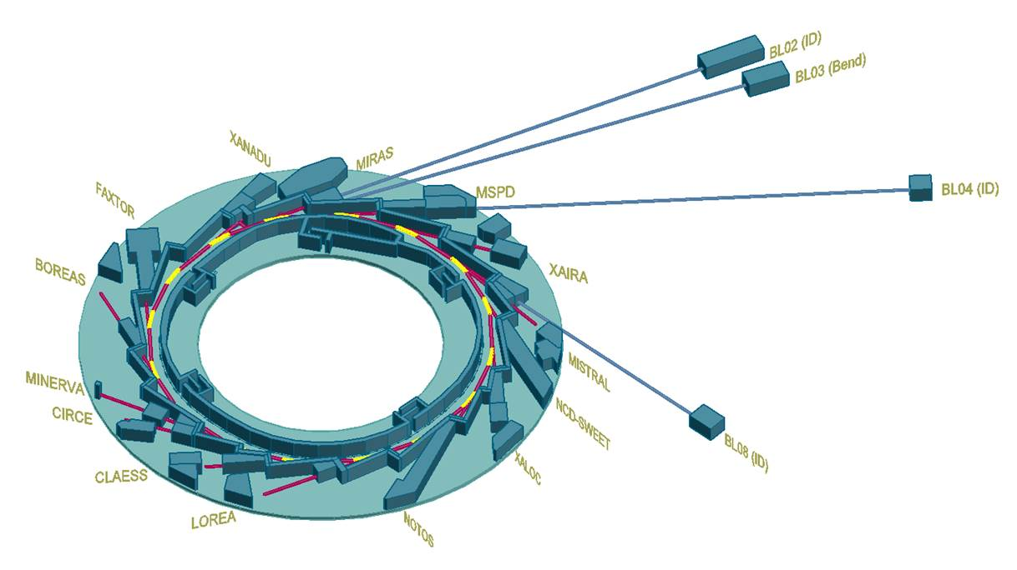
Implementation → 2030-2031
Long beamlines at BL02-ID , BL03-Bend, BL04-ID, BL08-ID
In 2032:
12 (out of 13) ID beamlines
4 (out of 13) Bending beamlines
1 IR beamline
1 Visible diagnostics
3 XR pinhole diagnostics

Slide 14
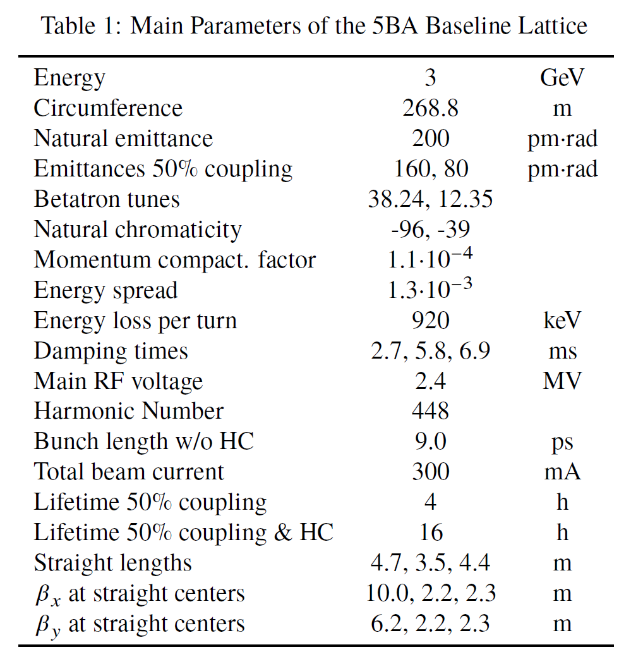
ALBA II Accelerator main parameters and WPs
As per today, around 40 persons,
∼19 FTEs dedication, under the guidance of ALBA Director of Accelerators, Francis Pérez .
# | Work Packages | FTE
WP01 | Magnets | 4,5
WP02 | Vacuum | 2,0
WP03 | Pulsed | 1,0
WP04 | Girders | 1,0
WP05 | Diagnostics & Feedbacks | 1,2
WP06 | Insertion Devices | 0,1
WP07 | FEs | 0,1
WP08 | RF | 0,9
WP09 | PS | 0,1
WP10 | Electronics | 0,0
WP11 | Controls | 0,0
WP12 | IT infrastructure | 0,0
WP13 | Automation | 0,0
WP14 | Radiation Protection | 0,1
WP15 | Alignment | 0,1
WP16 | Cabling infrastructure | 0,1
WP17 | Cooling infrastructure | 0,0
WP18 | Layout & tests coordination | 0,4
WP19 | Integration | 0,8
WP20 | Optics & Beam Dynamics | 2,8
WP21 | Coordination | 0,7
 | Transversal (FEA, Drafman,…) | 3,3
TOTAL |  | 19,2
WEPM105, IPAC 25

Slide 15
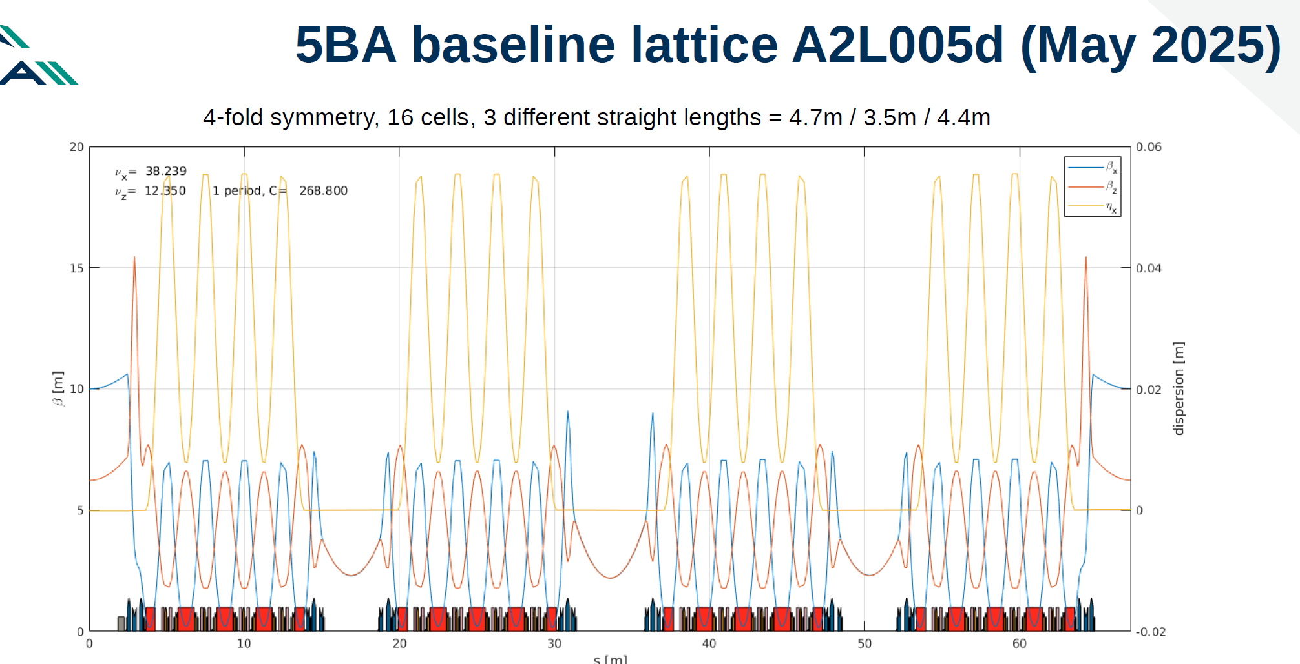
Emittance: 200 pm·rad (160pm·rad / 80pm·rad @50% coupling)
●Mom. Compaction: 1.1·10⁻⁴
●βx at SS: 10.0 / 2.2 / 2.3 m
●βy at SS: 6.2 / 2.2 / 2.3 m
●Tunes: 38.24 / 12.35
●Chromaticity: -96 / -39

Slide 17
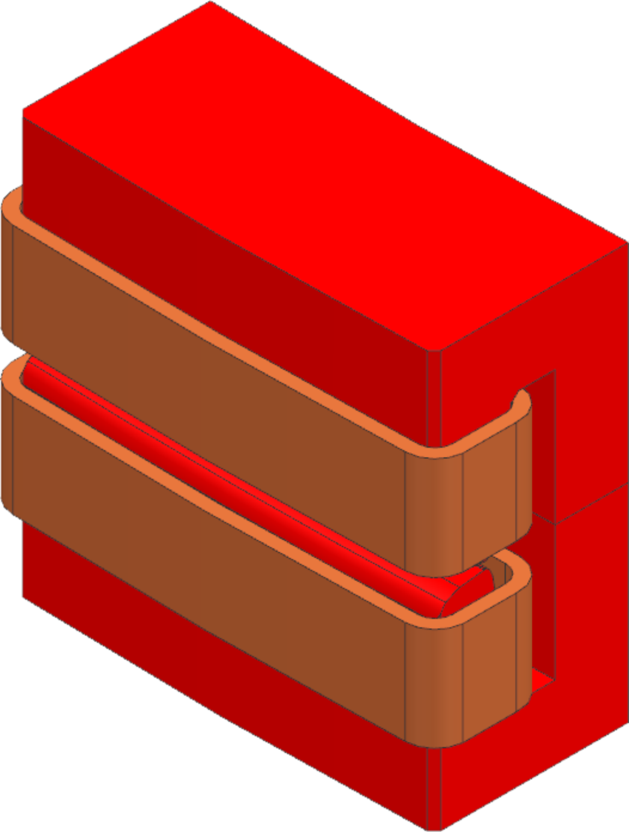
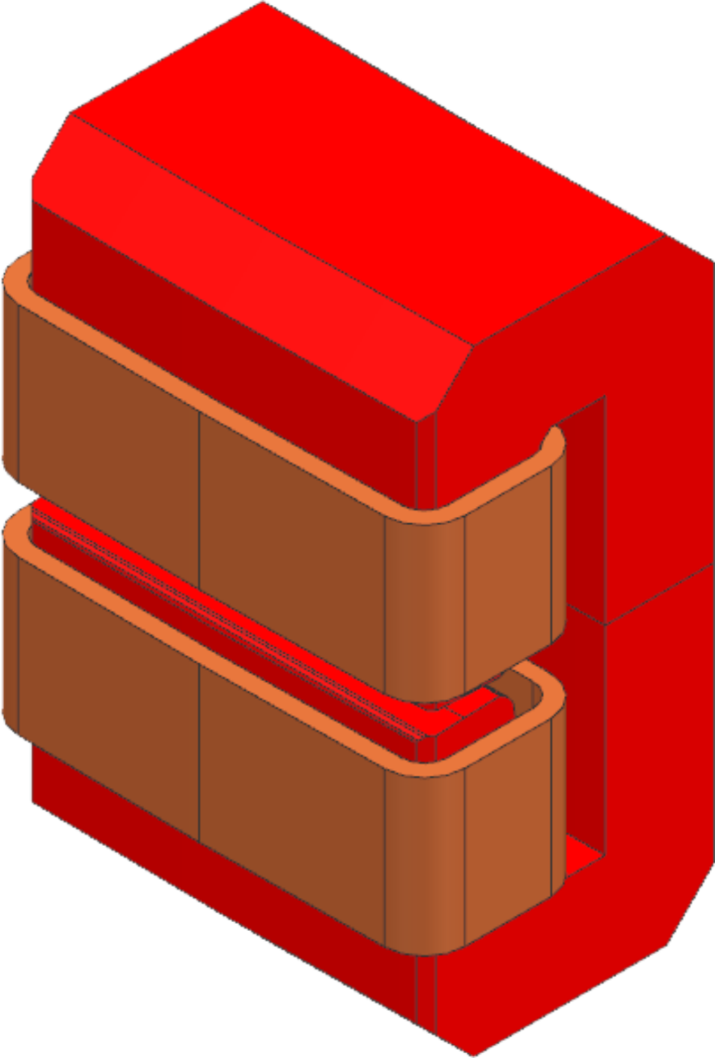
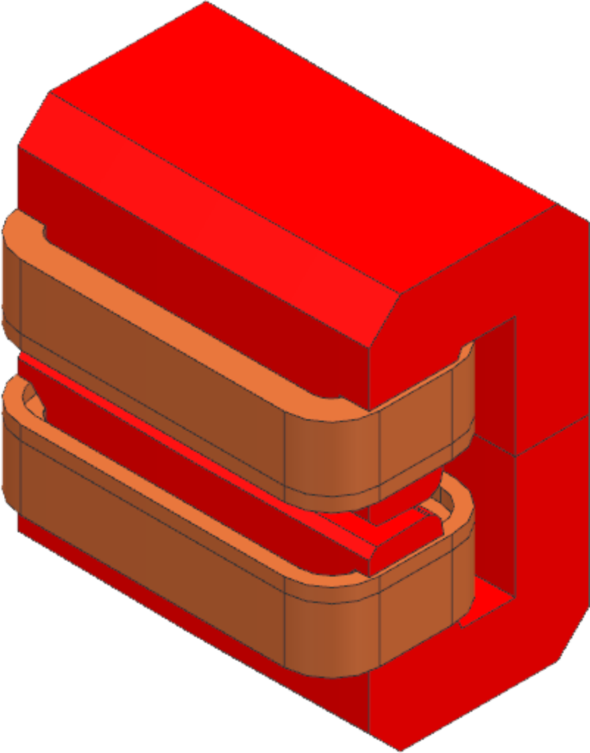
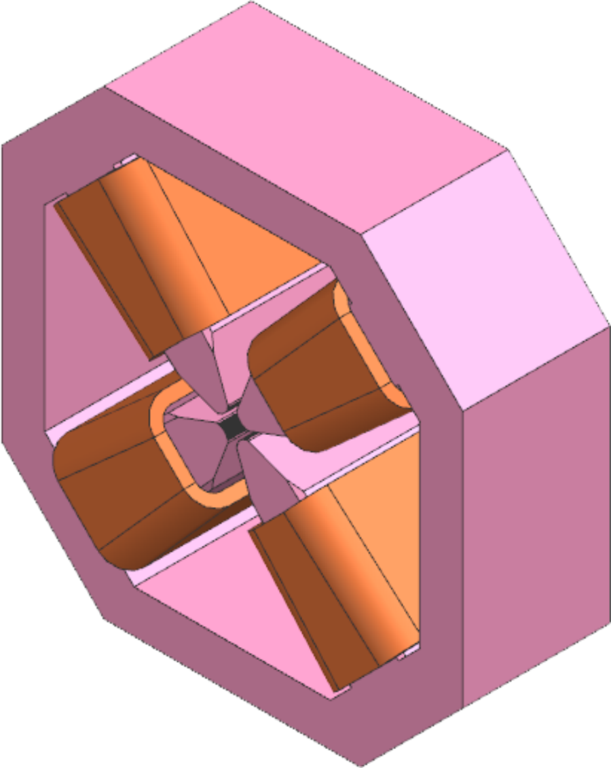
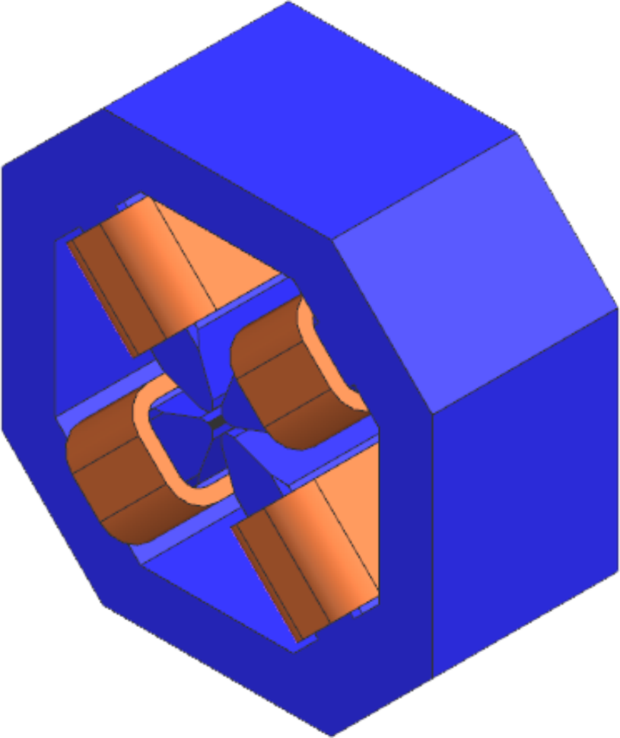
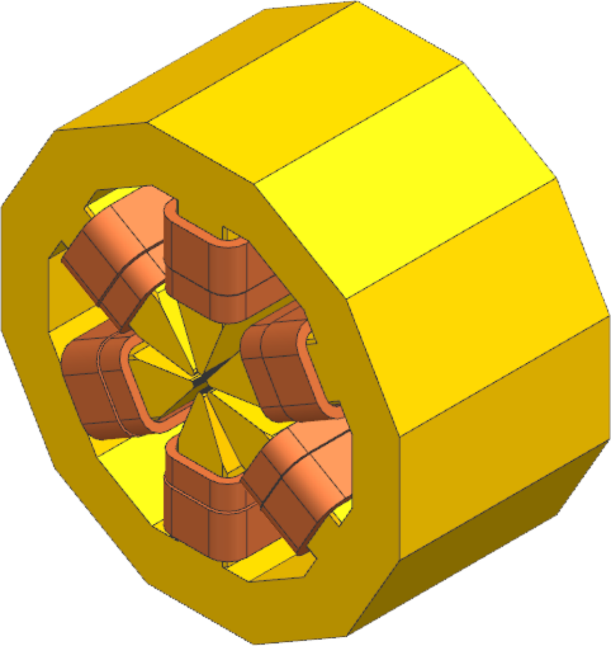
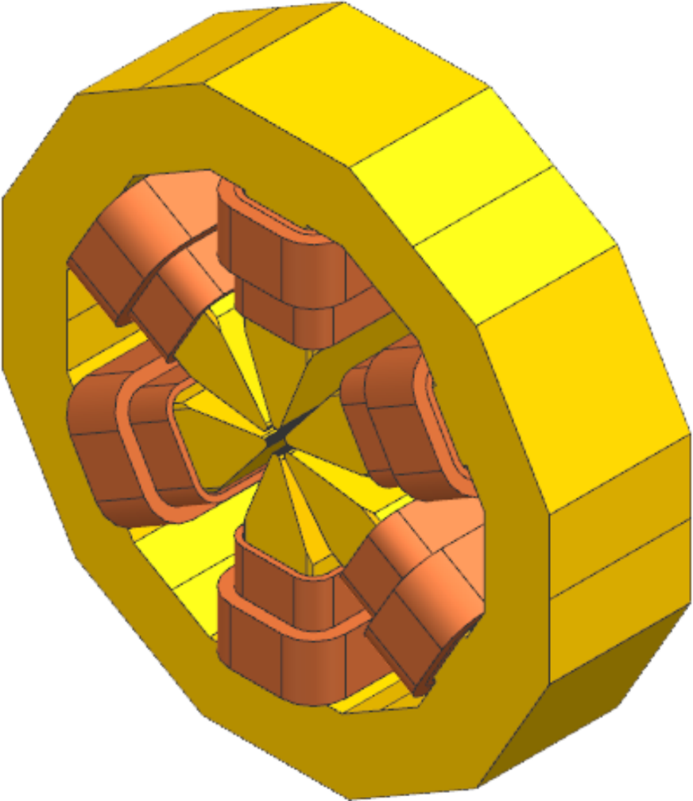
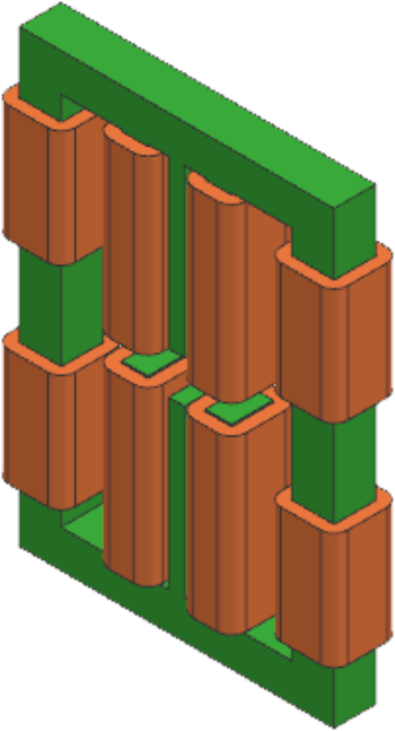
Magnets: EM prototypes
The CfT for resistive prototypes included 8 magnets divided into 4 lots.
Contract for all 4 lots was signed with 1 single company (ANTEC) on 18 Jun’24. The kick-off meeting was held on 05 Jul’24.
Bending magnets
Lot 1 | QD
 | QDS conventional
 | QDS embedded
“quadrupoles”
Lot 2 | Q3
 | QF/QFS
Sextupoles
Lot 3 | SH
 | SV
Correctors
Lot 4 | CORR
MAGNETS

Slide 18
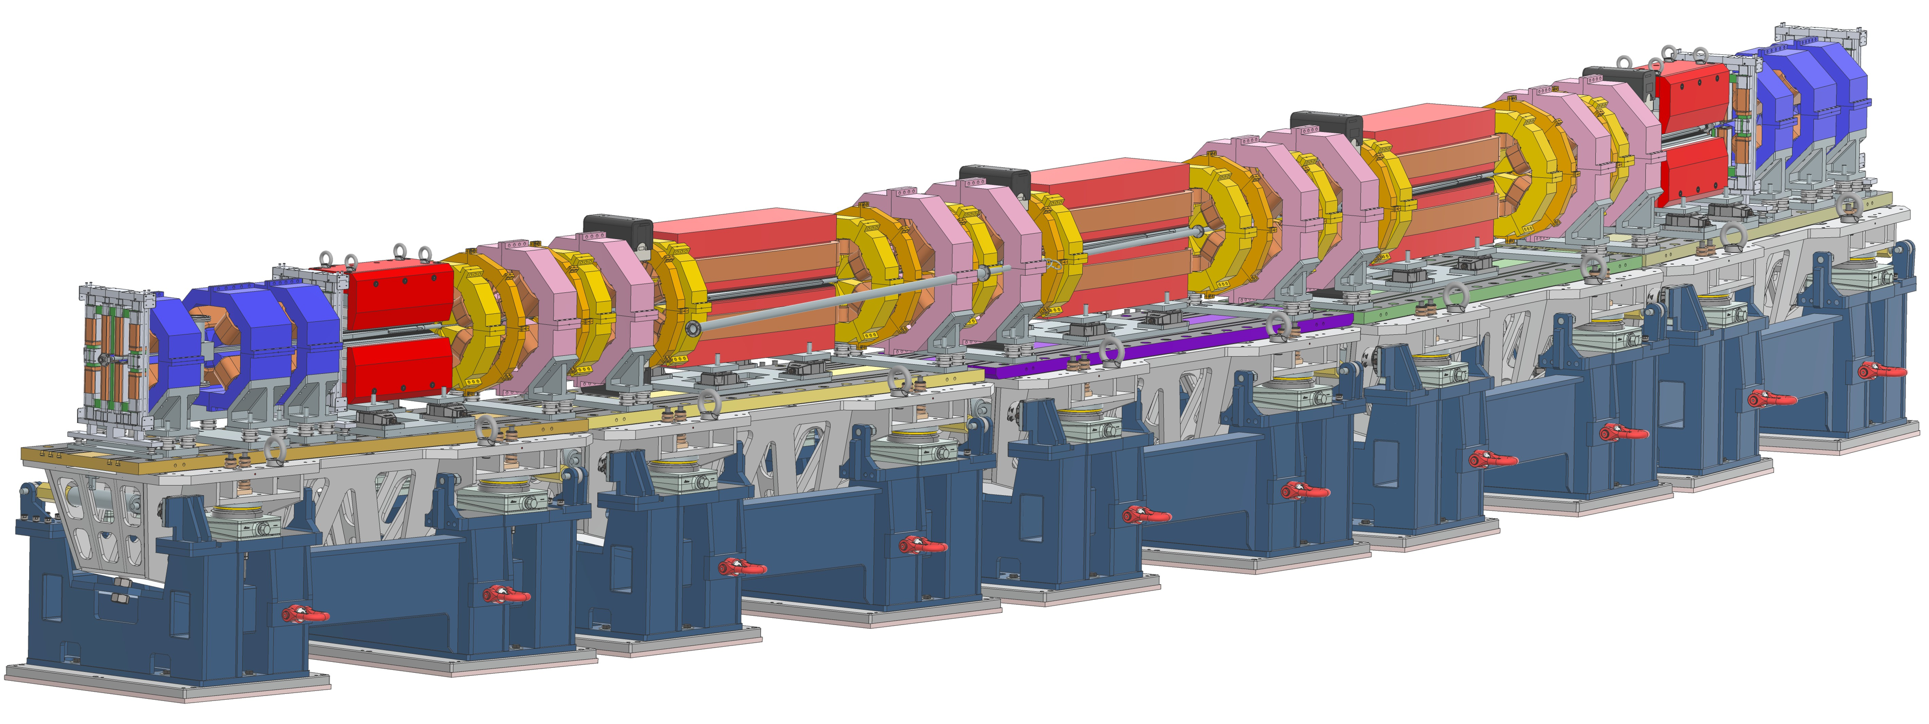
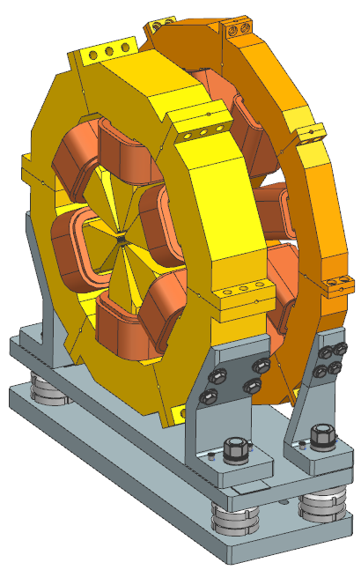
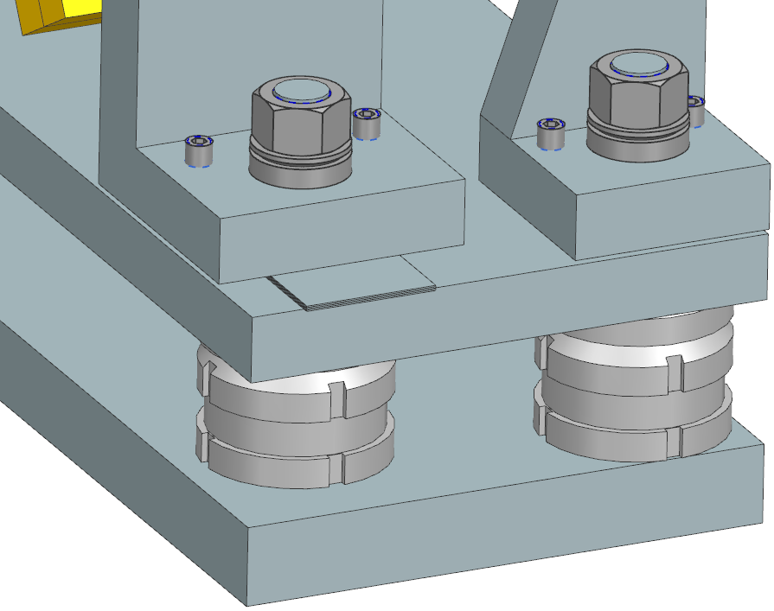
Design of magnets for final lattice
Layout implementation:
Progress in design of magnet supports and alignment system:
Proposal of common baseplate for Sextupole+Octupole
Positioner
Shims
MAGNETS

Slide 19
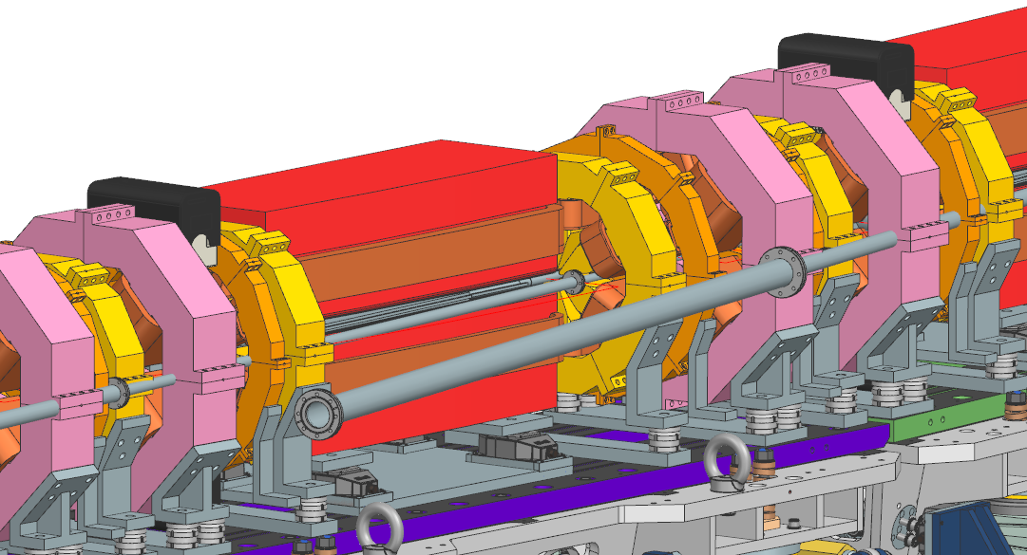
Next steps
Study of photon extraction lines and impact on magnets’ design.
Design of assembly strategy for PM-based magnets (QDS-PM and QD-Superbend) without yoke opening (lateral sliding or similar).
Definition of protocol together with Alignment Group in order to guarantee 30µm rms positioning accuracy.
MAGNETS

Slide 20
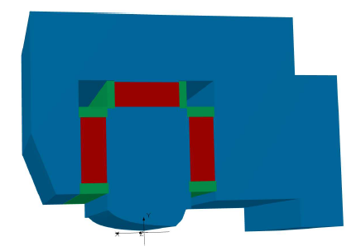
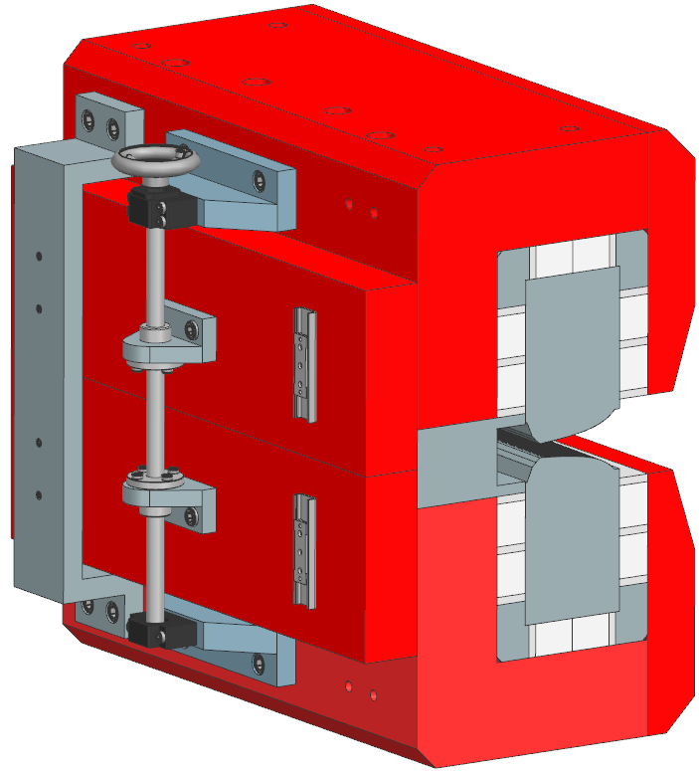
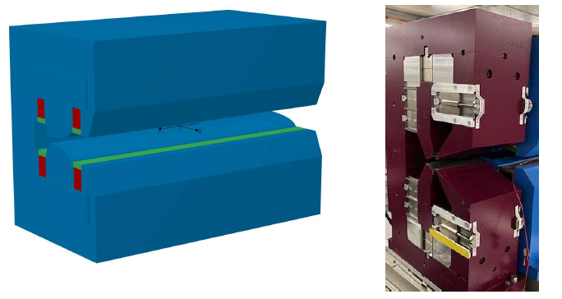
Magnets: PM prototypes
Lot 1 (QDS-PM): New tuning mechanism, consisting of an adjustable gap at the yoke’s backbone, by adjustable shim plates at the ends of the magnet. This will allow an estimated cost reduction for the series magnets of ~10%.
Initial proposal (CfT)
Shim plates
Manufacturer’s proposal
Control gap adjustment mechanism
Estimated cost reduction ~10%
PM material reduced by ~28%
NiFe material reduced by ~10%
PSI
MAGNETS

Slide 21
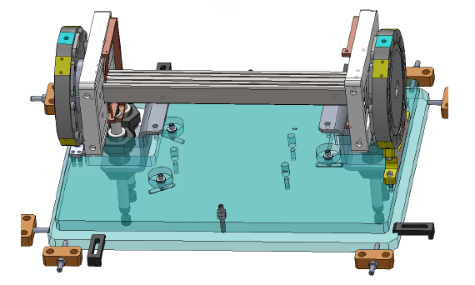
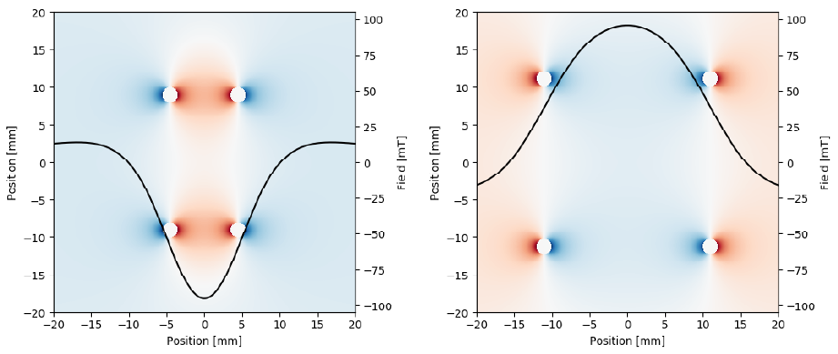
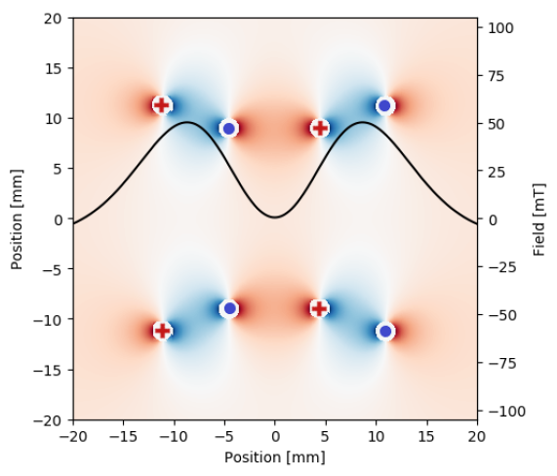
Injection: Double Dipole Kicker
4 inner and 4 outer conductor rods create two opposite dipole fields powered with independent pulsed power supplies
Inner coils field
Outer coils field
Superposition of the inner and outer coils fields
Only 4 outer rods powered
Dipole field for on-axis injection
Useful during commissioning
8 rods powered with independent
Zero field at the stored beam
Field peak at the injected beam
G. Benedetti et al 2023 J. Phys. Conf. Ser. 2420 012017
Notes:
longitudinal field is zero on-axis and non-linear off-axis
Però narrower plateau vs NLK

Slide 22
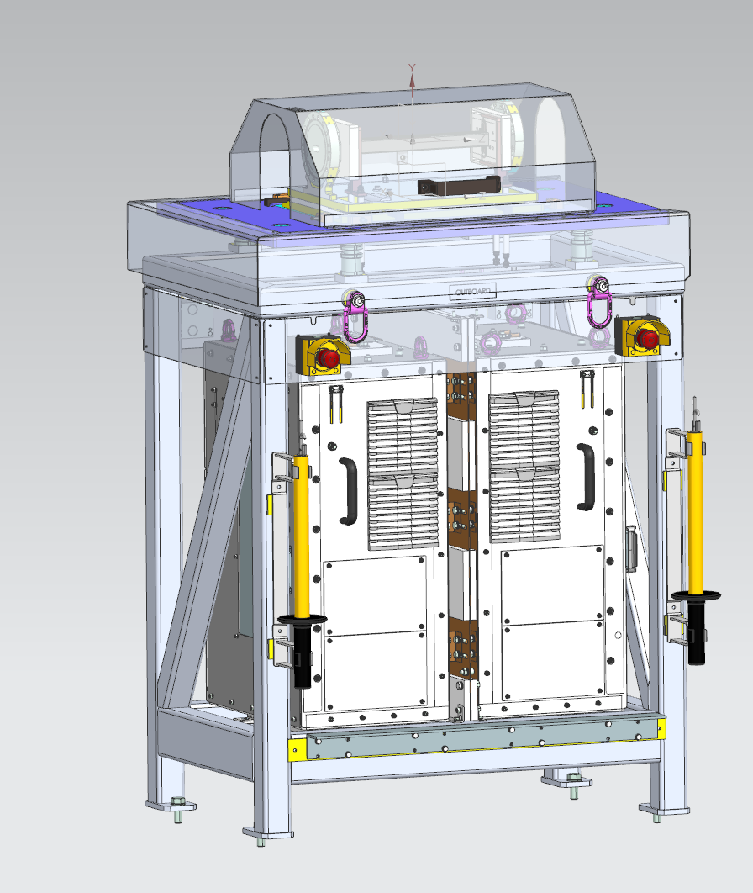
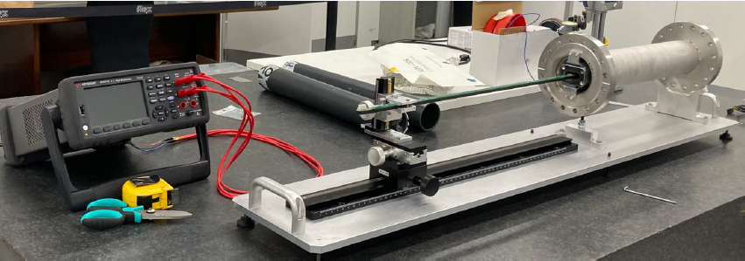
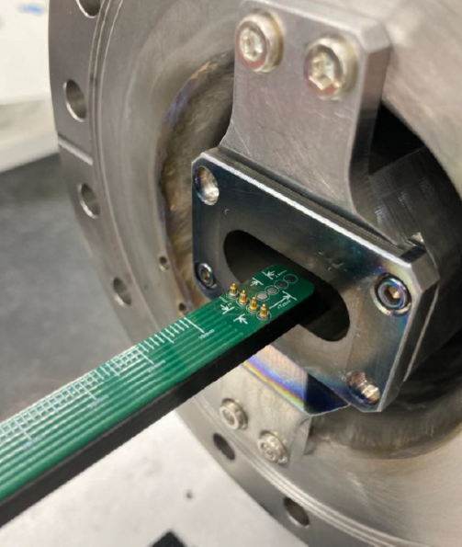
The DDK ALBA prototype to be tested at ALBA
Collaborating with ESRF and Sirius
@ ESRF - Longitudinal and transversal coating uniformity requirement is within 10%
@ SIRIUS - being manufactured at CNPEM lab
5 ceramic chambers produced (Engecer)
First UHV flanges and Nb + Ti transition pieces produced.
First ceramics brazing expected next month
Coating technique studies are ongoing:
Ti-sputtering of one rectangular wire w/o masks
Wire geometry optimized to deliver a ratio coating thickness of at least 1:4
DDK chamber delivery expected by end 2025
A resistance measurement system built by AVS measures the local resistance by four wire measurement.
DDK +
DDKPPS integration

Slide 24
Prototyping BPMs

Slide 26
Girders
Length Optimization
Division on Pumps
3x Different
Top plates
2.070
2.400
2.400
2.400
3.130
3x Different Frame
395
150
150
132
Pros:
Much larger gaps between Girders.
Relatively easier for Girder installation.
Lighter Girders (~5% and ~18%) .
3x SAME magnet distribution:
Same Top plate and complete Girder.
Cons:
3 different lengths for Girders.
1x larger Girder (~25% heavier: ~11.300 kg)
Extra supports for VC, pumps, (…)?
ALBA II Accelerator meeting

Slide 27
Girders

Slide 28
Main RF system
Main RF high power components reused for ALBA-II.
RF main voltage must provide enough RF acceptance and redundancy in case of a cavity trip.
Parameter | Value | Unit
Frequency | 499.654 | MHz
Number of cavities | 6 | -
Voltage | 2.4 | MV
RF acceptance | 7 | %
Loses per turn (bare lattice) | 1.028 | MeV
Transmitter power (300 mA) | 90 | kW
Momentum compaction ${(α}_{c})$ | 9.6·E-5 | -
Synchrotron frequency* | 2.25 | kHz
Bunch length (σ)* | 6.96 | ps
EU-HOM NC cavity
WR1800
ALBA Main RF IOT based transmitters
* w/o harmonic system
Upgrade to SSPA
Short bunches lead to small lifetimes due to high Touschek effect (for ALBA σ = ~17 ps)
P. Solans

Slide 29
Harmonic RF system
An active 3rd harmonic system is foreseen in order to increase the bunch length and Touschek lifetime.
Total voltage present a flat potential region where electrons can spread
Prototype successfully tested in BESSY-II and full system will be tested at ALBA, placed in ALBA II position
ALBA-II total voltage
I. Bellafont
P. Solans

Slide 30
Testing, assembly and storing areas
MA+GI
200m2
Storing
SR components on arrival
Girders assembled with magnets
Spare parts, which are now in the warehouse that will be converted on Lab for testing and assembly
Assembled vacuum arcs (in the EH)
PS
300m2
PS
300m2
ALBA spare parts 2030-32
400 m2
MA+GI
800m2
Definition of requirements is ongoing, we expect to be able to store with minimum services.
Definition of requirements for testing and assembly is being refined.
MA
40m2
assembly & testing
PS
150m2
ready for installation
MA
300m2
storage
GI
550m2
ALBA & ALBA II spare parts: 400m2

Slide 31
Thank you for your attention

