Slide 1
Comparison of Capture Systems Using Flux Concentrator and HTS Solenoid for the FCC-ee Positron Source
Yuting WANG
Laboratoire de Physique des 2 Infinis Irène Joliot-Curie (IJCLab)
CNRS, Université Paris-Saclay
On behalf of the FCC-ee injector study collaboration

Slide 2
Outline
FCC-ee injector
Positron source (Target, matching device, capture linac)
Simulation tools and beam dynamics: FC vs. HTS solenoid MD
Summary and conclusion

Slide 3
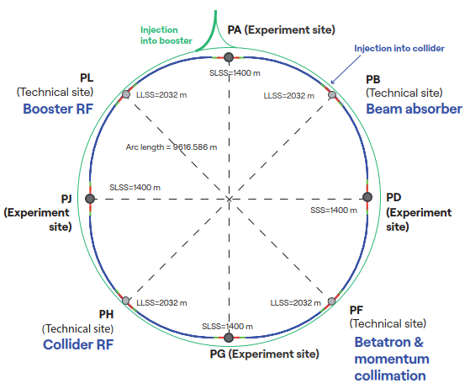
FCC-ee injector
Electron transfer line
e⁺
Electron linac
Positron linac
e⁺
20 GeV
2.86 GeV
e⁻
EC
HE linac
BC
e⁻
parameter | Z | WW | H (ZH) | $$\text{t}\overline{\text{t}}$$
beam energy [GeV] | 45.6 | 80 | 120 | 182.5
synchrotron radiation/beam [MW] | 50 | 50 | 50 | 50
beam current [mA] | 1294 | 135 | 26.8 | 5.1
number bunches / beam | 11200 | 1852 | 300 | 64
total RF voltage 400/800 MHz [GV] | 0.08 / 0 | 1.0 / 0 | 2.09 / 0 | 2.1 / 9.2
luminosity / IP [10³⁴ cm⁻²s⁻¹] | 145 | 20 | 7.5 | 1.4
total integrated luminosity / IP / year [ab⁻¹ / yr] | 17 | 2.4 | 0.9 | 0.17
beam lifetime [min] | 21 | 13 | 9 | 10
FCC-ee functional layout

Slide 4
Positron source : current requirements on positron source
The complete filling for Z running => Requirement ∼ 3 ⨯ 10¹⁰ e⁺/bunch (4.8 nC) at the linac end
or 5 nC accepted in the DR
Beam energy | 2.86 GeV
Bunch charge | ∼5 nC (max)
Bunch length | 1 mm
Bunch transverse size | ≳ 0.5 mm
Nb of bunches per pulse | 4
Bunch separation | 25 ns
Repetition rate | 100 Hz
Beam power | ∼5.7 kW (max)
e⁻ drive beam
N_{e-}/bunch ⨯ η^{e+}_{Accepted} ≥ 5 nC/bunch ⨯ 2.6
~ 13 nC
*A safety margin of 2.6 is currently applied for the whole studies (~50% losses for injection in the DR + ~20 % losses from target up to the end of the e+ linac )
with N_{e-}~5 nC ➔ η^{e+}_{Accepted} ≳ 2.6
Accepted e⁺ yield is a function of primary beam characteristics + target + capture system + DR acceptance
DR acceptance window: (Energy : 2.86 GeV ± 2% ; Time : 20 mm/c)
➜ positron flux of ∼1.2⨯10¹³ e⁺/s (⨯2.6). Demonstrated at SLC (a world record for existing accelerators): ∼ 6 ⨯10¹² e+/s

Slide 5
Positron source : capture system (Feasibility Study baseline)
E = 2.86 GeV
Q = 13 nC (considering 60% losses for transport, collimation and injection into DR)
2.86 GeV electron beam
from e- linac
Capture linac 2 GHz, 13.3 MV/m
100 Hz, 6 RF structures
Positron linac 2 GHz, 13.3 (12.8) MV/m
100 Hz, 20+52 RF structures
Positron/Electron
Separation at 170 MeV
Target & cryostat
DC solenoid
Injection section
E = 2.86 GeV
Q = ~3.8 nC
Damping Ring
E = 2.86 GeV
Q_{b} = 5 nC
DC solenoid
Electron/Photon dumps
Energy collimator
and compressor
Target-converter
Capture system (~ 20 meters)
Thickness [mm] | 15
Production rate [N_{e+}/N_{e-}] | 7.07
Deposited power [kW] | 1
PEDD [J/g] | 5.8
509.5 mm
105 mm
72 mm
3000 mm
200 mm
240 mm
346 mm
Positron production : conventional scheme (e- beam size on target = 1 mm rms) . Target exit located at 40 mm w.r.t. HTS solenoid peak field.
Matching device is based on the SC solenoid (5 HTS coils, 72 mm bore, ∅ 60 mm including shielding)
Capture linac is based on the 6 L-band TW RF structures ( 2 GHz, ∅ 60 mm, 3-m long)
NC solenoid B = 0.5 T (realistic conventional design based on the short coils B = 0.31 T) + short “tuning” solenoid B = 0.25 T before the 1st RF structure

Slide 6
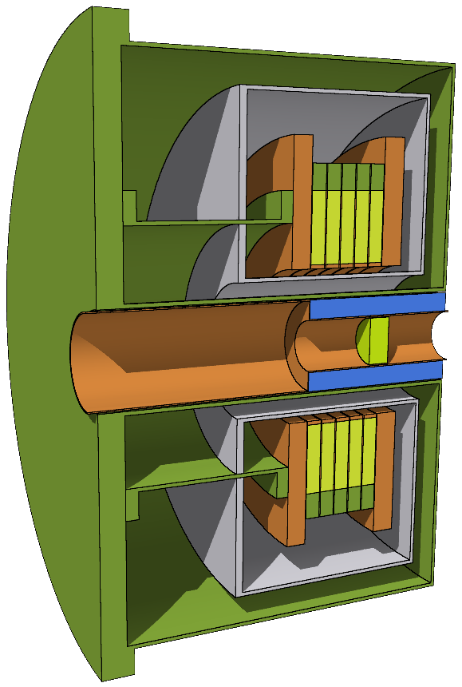
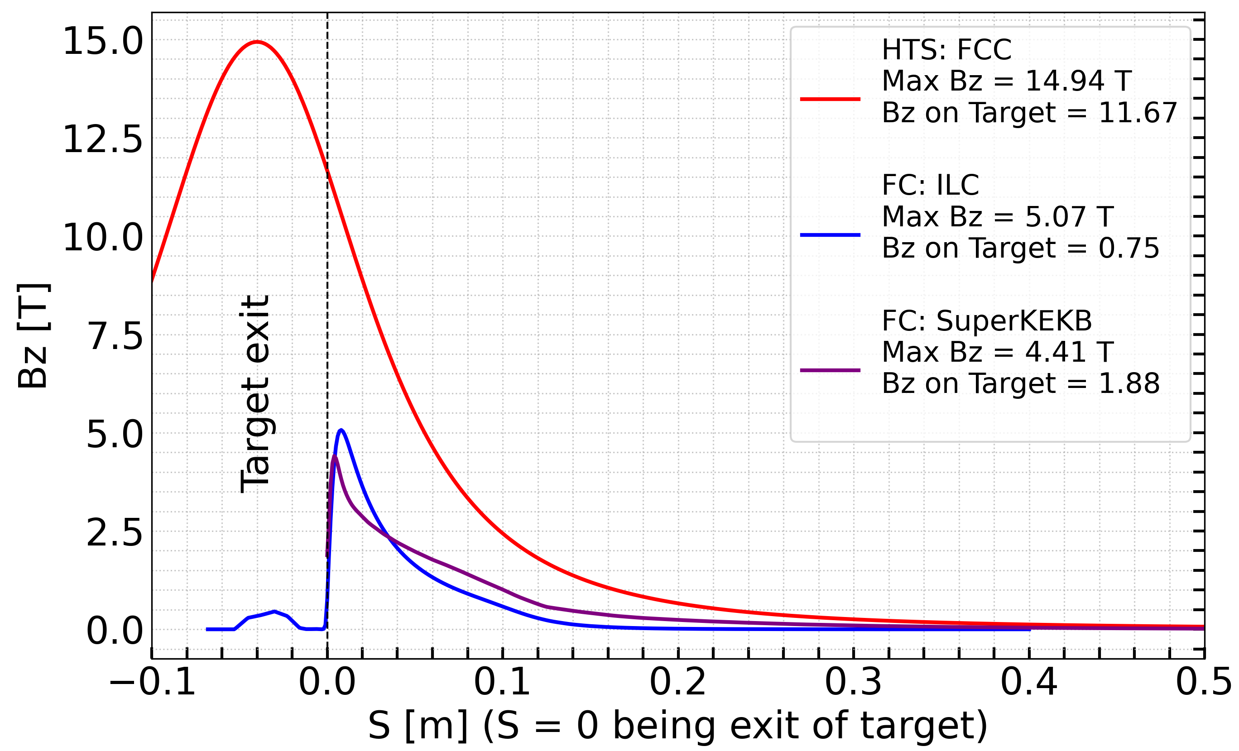
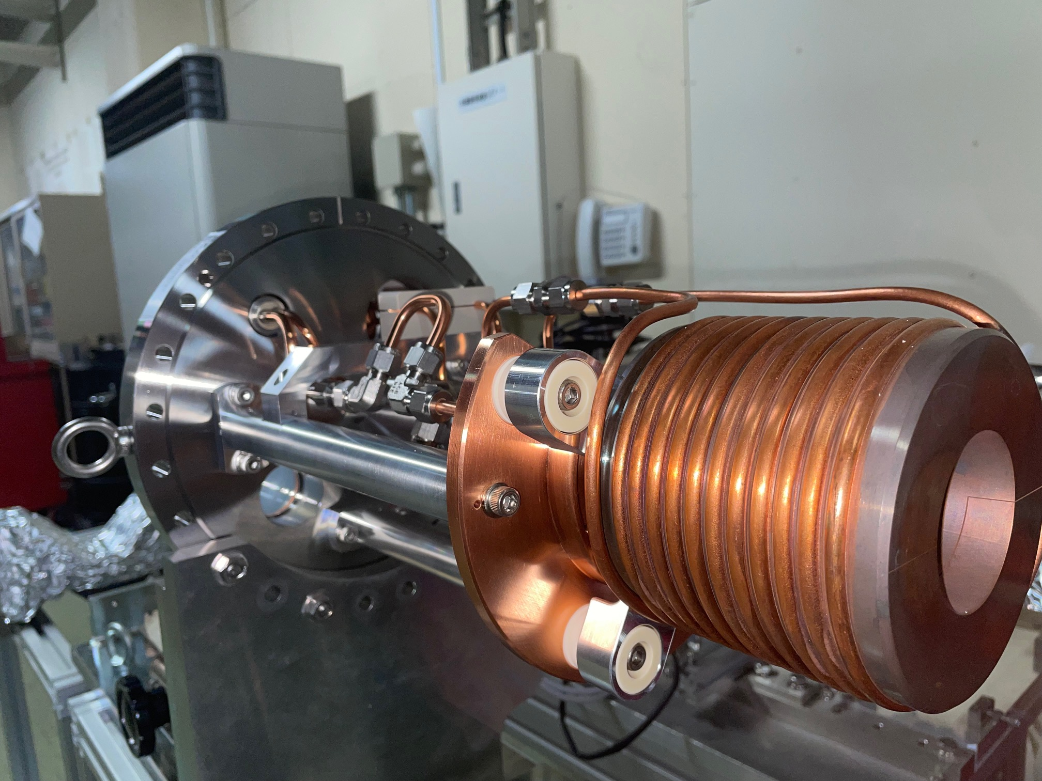
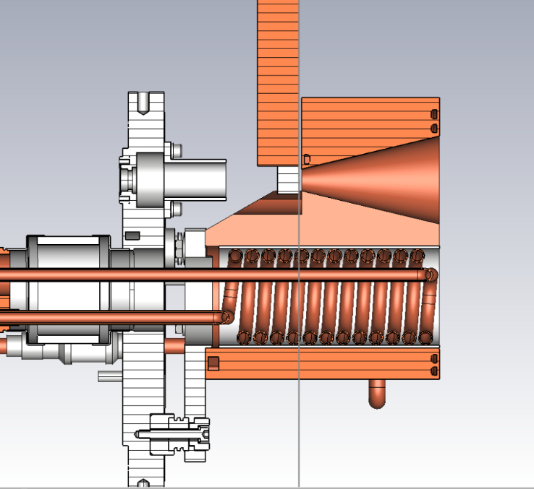
Positron source : matching device
Matching device | Aperture in diameter (mm)
ILC FC | 6-64
SkperKEKB FC | 7-52
HTS solenoid | 60 (72)
High-Temperature Superconducting (HTS) solenoid designed by PSI => HTS:FCC
(Baseline - FCC Feasibility Study Report)
Originally designed by KEK for the SuperKEKB => FC:SKEKB-KEK
Under consideration for the FCC-ee : with and w/o BC
Designed by KEK for the ILC (Y. Enomoto) => FC:ILC-KEK
Under consideration for the FCC-ee

Slide 7
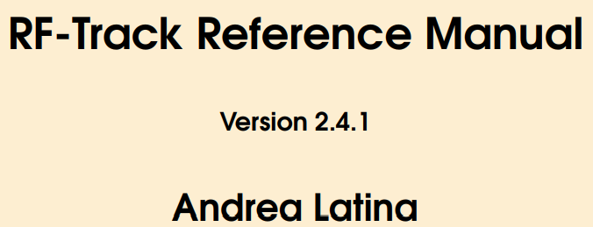
Simulation tools
Capture system (~ 20 meters)
509.5 mm
105 mm
72 mm
3000 mm
200 mm
240 mm
346 mm
Particle-matter interaction for positron production.
Novel tracking code developed for the optimization of low-energy linacs.
Been tested successfully in several cases (CLIC, DEFT facility, Linac4 and etc.)
https://gitlab.cern.ch/rf-track
Flexible optimization of arbitrary problems in Python. DOI: 10.1103/PhysRevAccelBeams.27.084801

Slide 8
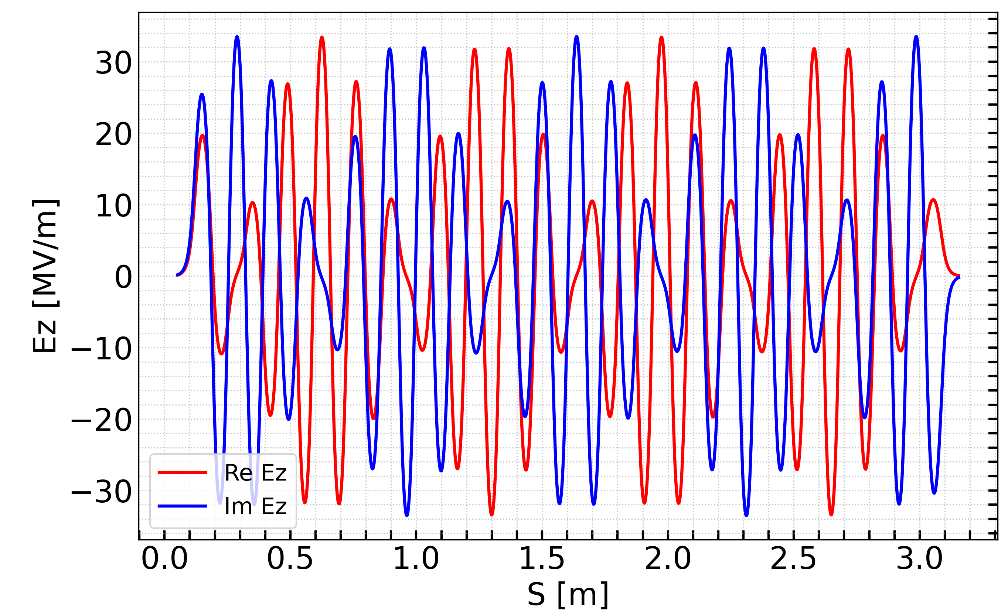
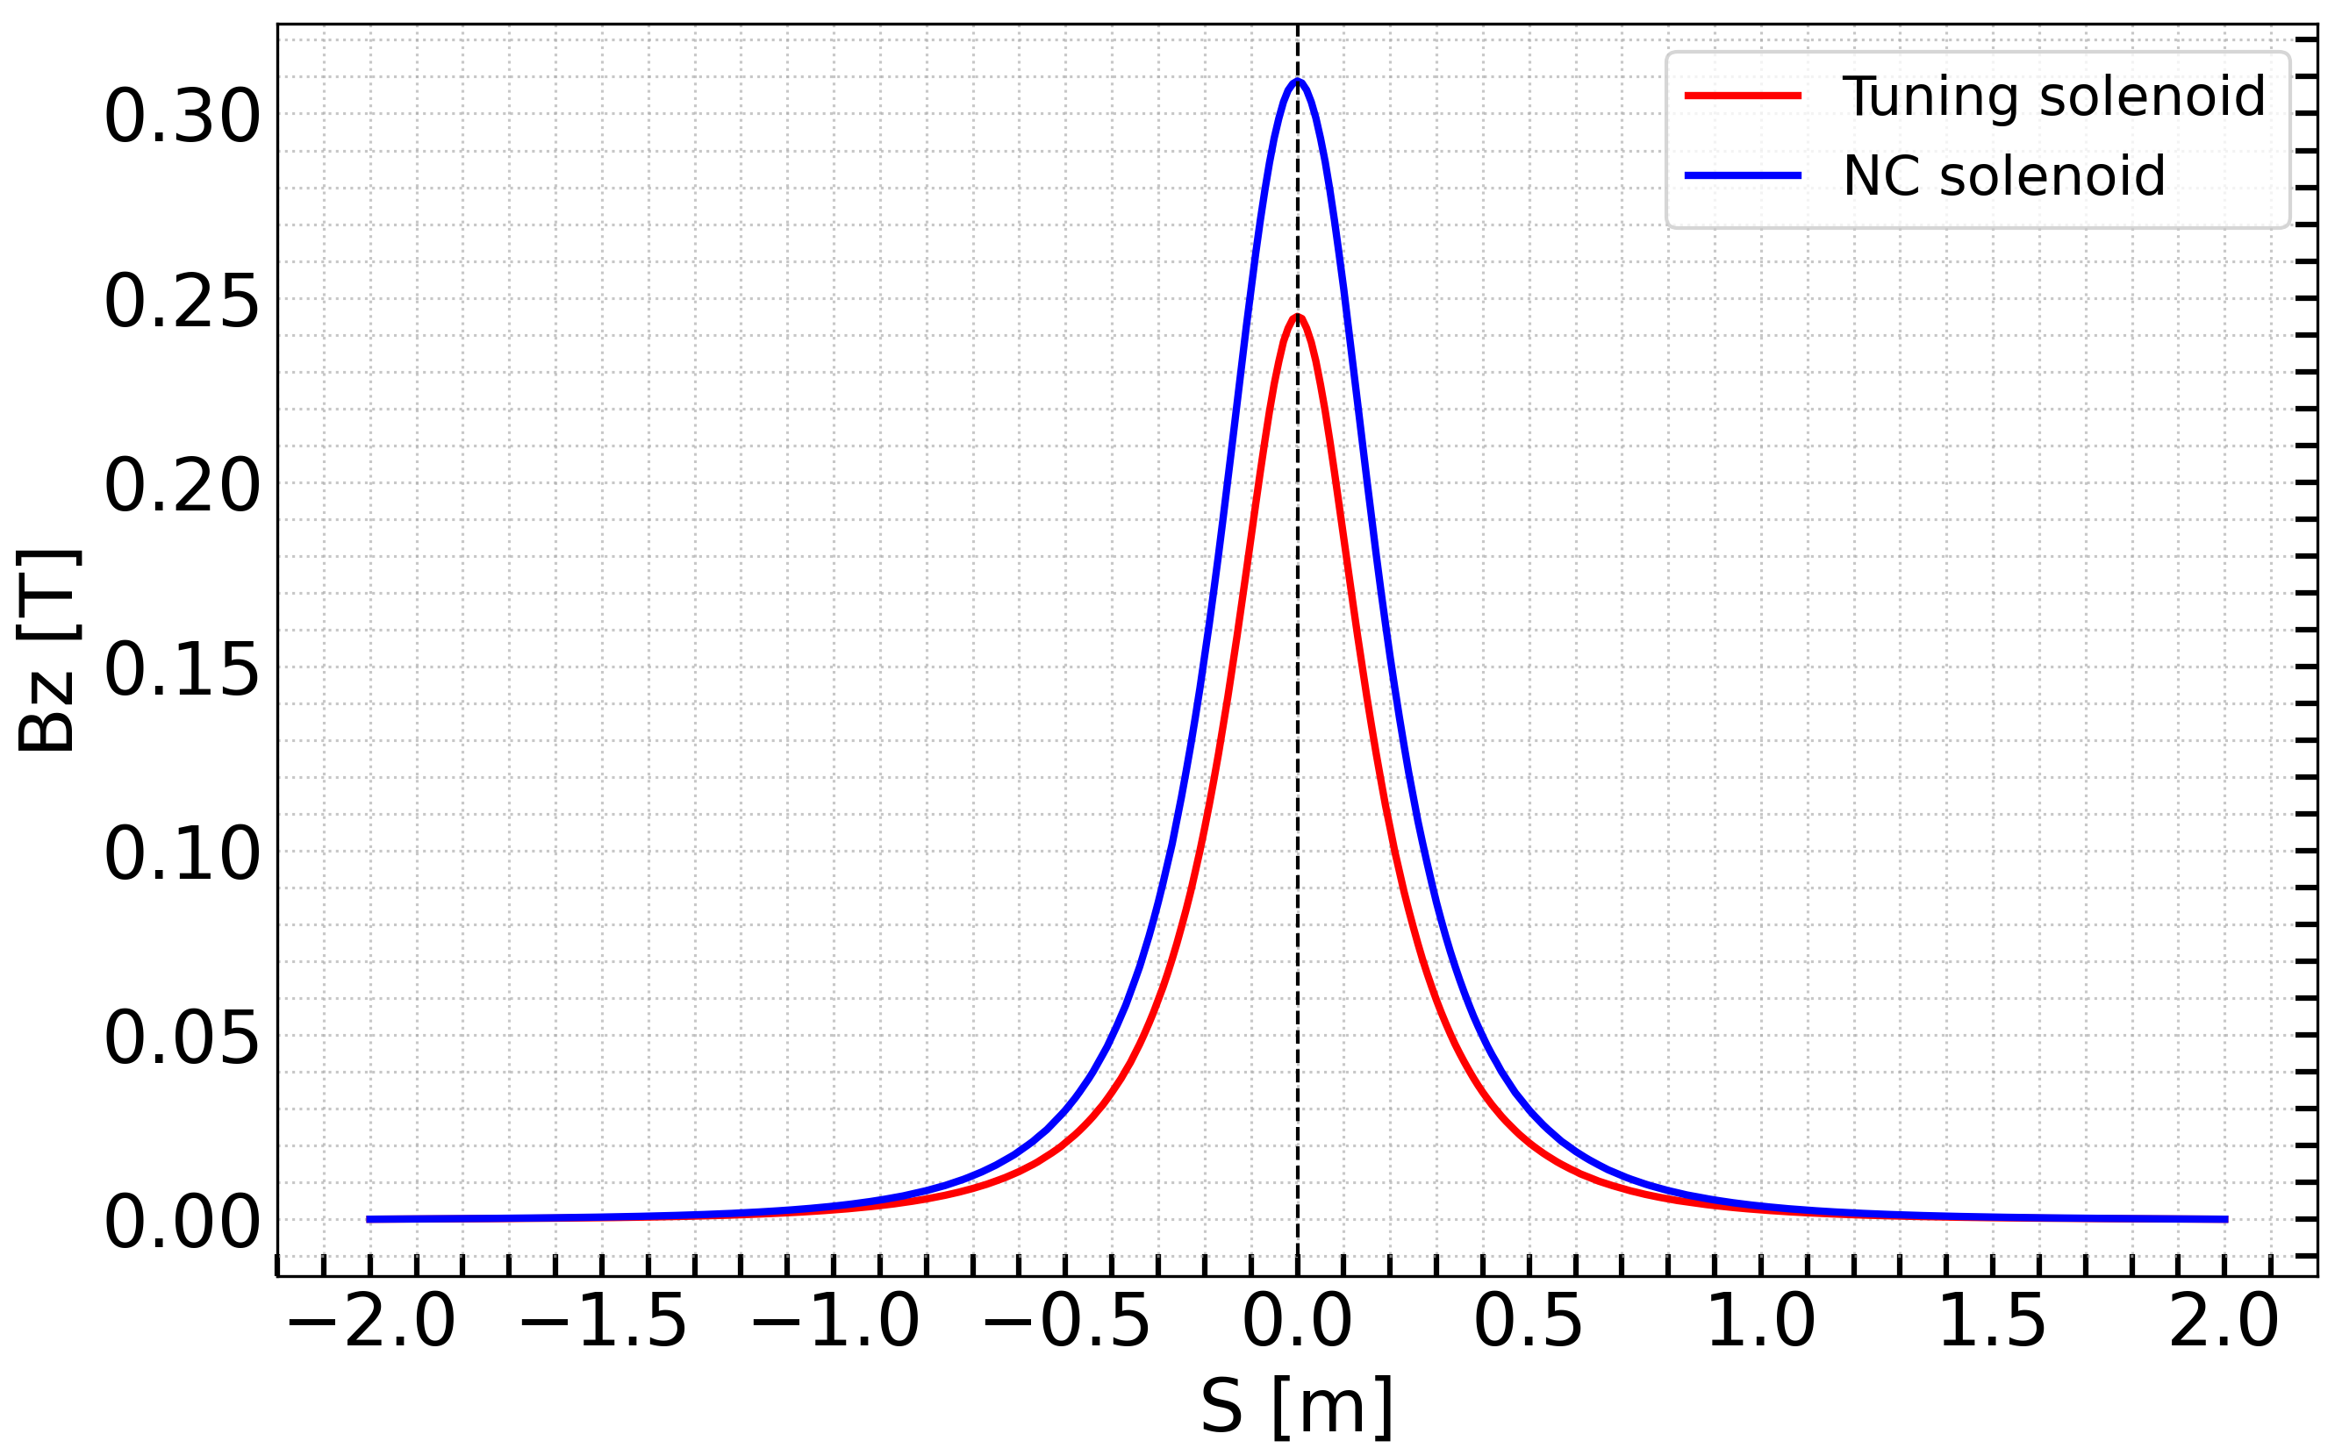
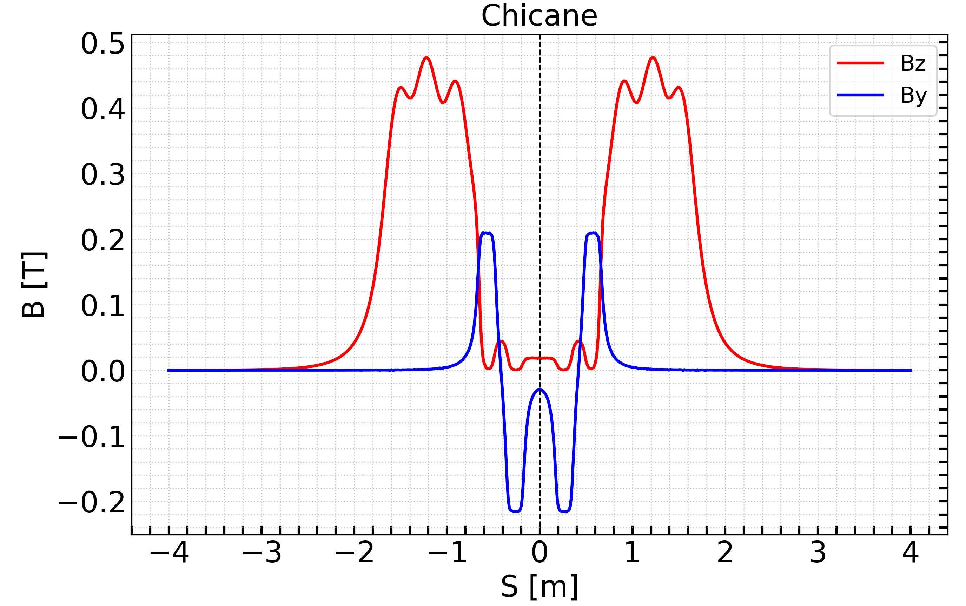
Beam dynamics – based on the field map
- RF structures: 2GHz L-band with aperture (2a) = 60mm , 3m long and 13.3 MV/m.
- Solenoids: 10 NC short solenoids surrounding each RF structure to create 0.5 T magnetic channel.
- Chicane: 4 dipoles (0.2T) to separate e- and e+, with electron stopper at the middle.
Simulation layout:
MD+6 structures + chicane + 2 structures + Analytical formulae.
-Hereafter, we refer to the end of the 8th structure as s1.
-A total of 70,718 macro particles are used in this simulation,
corresponding to an incoming electron population of 10,000.
Each RF structure is embedded with 10 NC solenoid magnets to form a ~0.5 T magnetic channel.

Slide 9
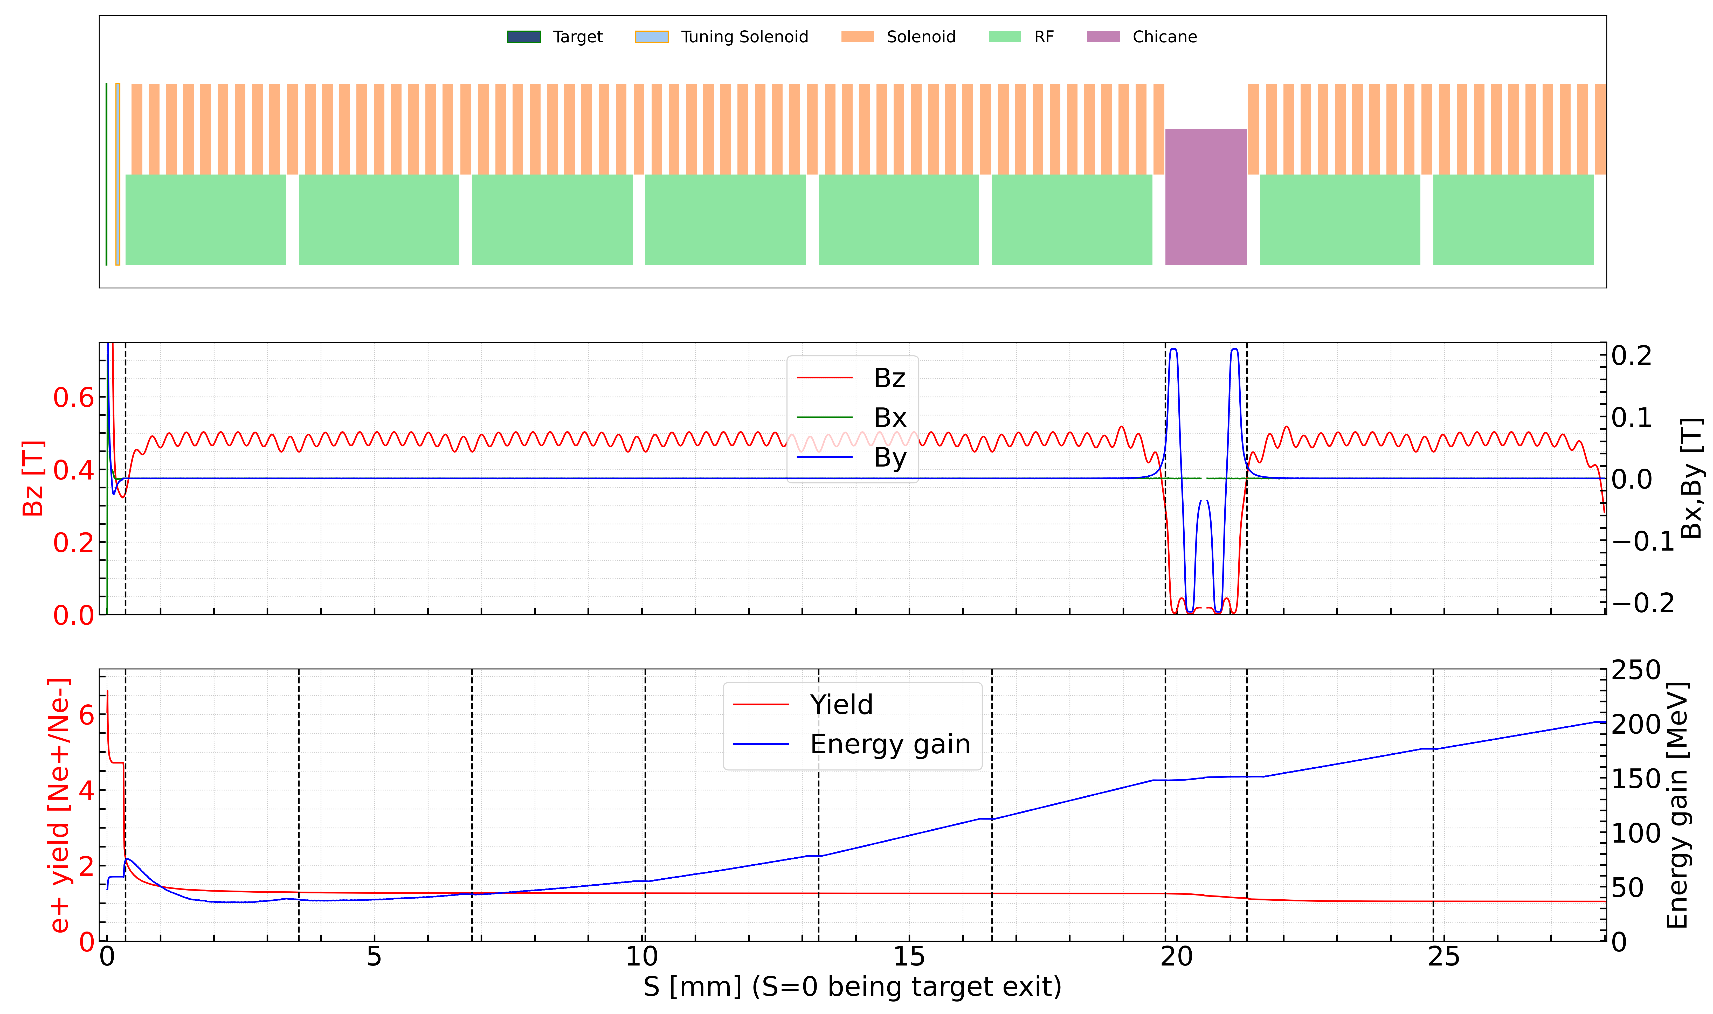
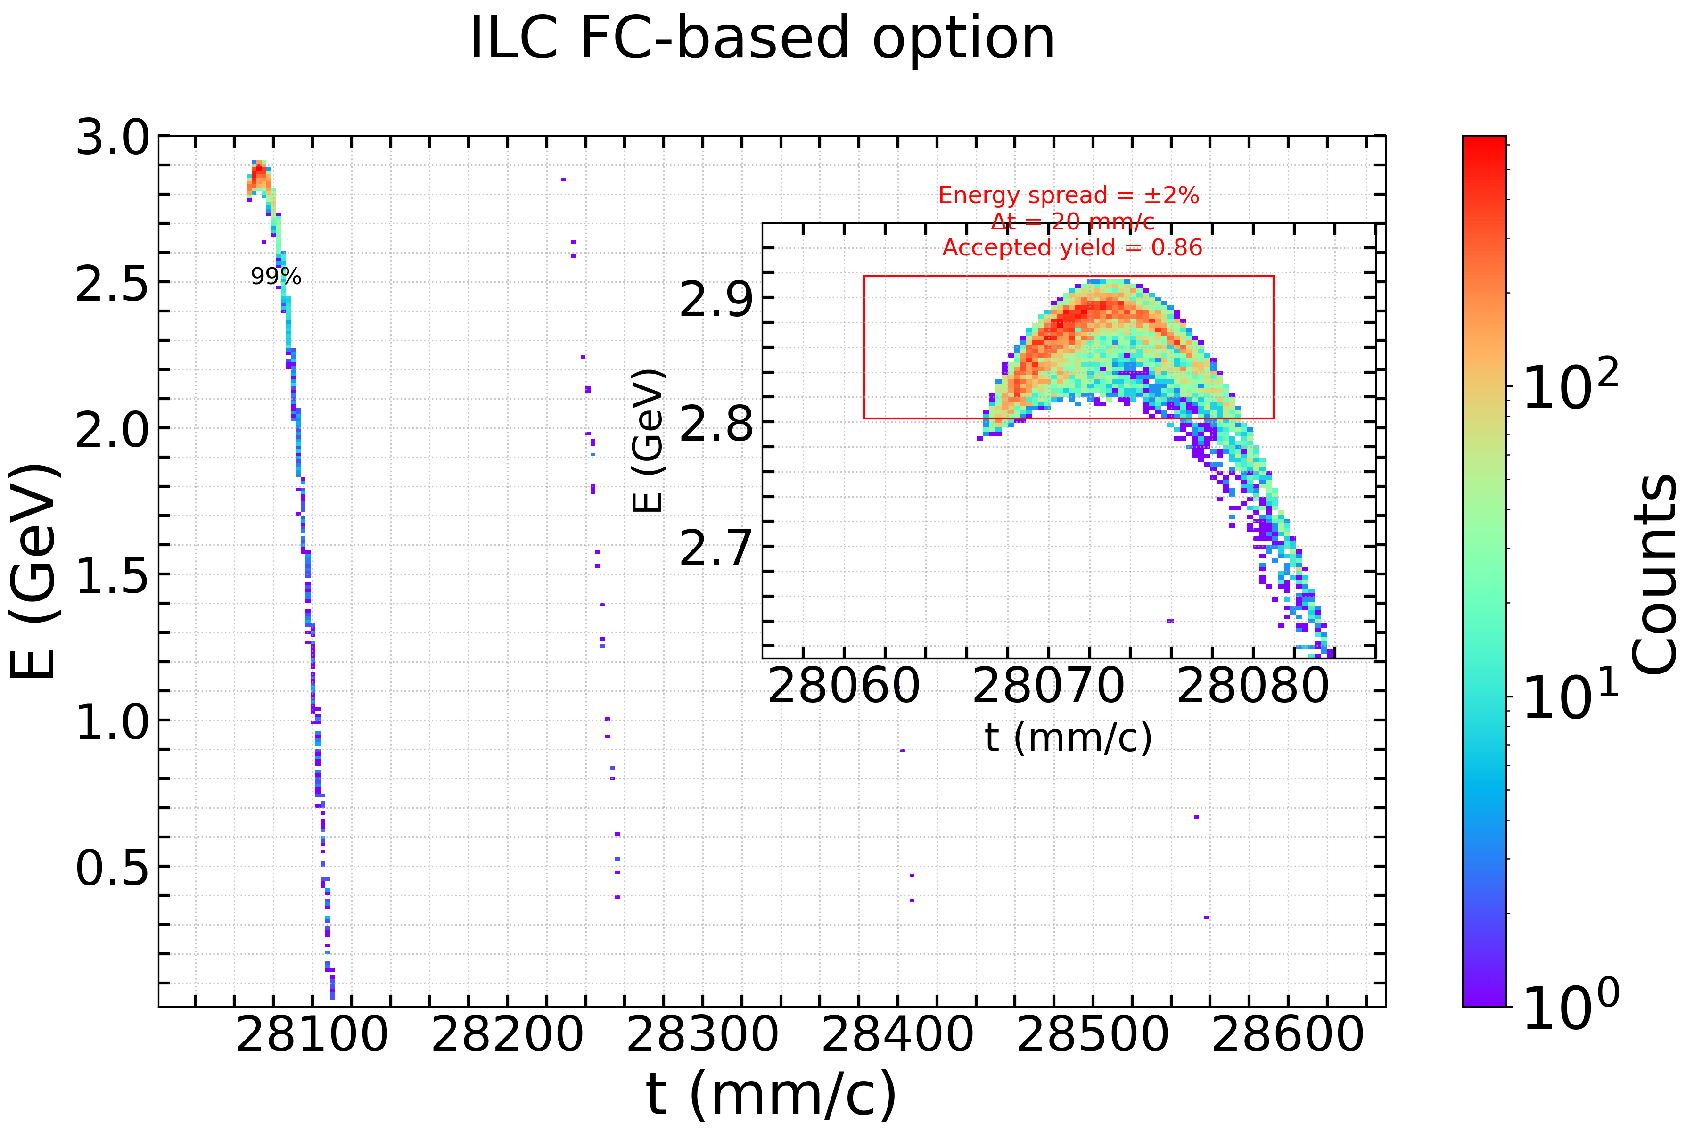
Beam dynamics – ILC FC-based option
The first RF structure operates in deacceleration phase improving bunching and longitudinal phase space.
The accepted yield is 0.86 @DR. Approximately 33% of positrons are lost in the AMD, ~48% between the AMD and the first structure, and ~2% in the chicane.
Notes:
4.71 @ end of AMD
1.29 @ end of 1st structure

Slide 10
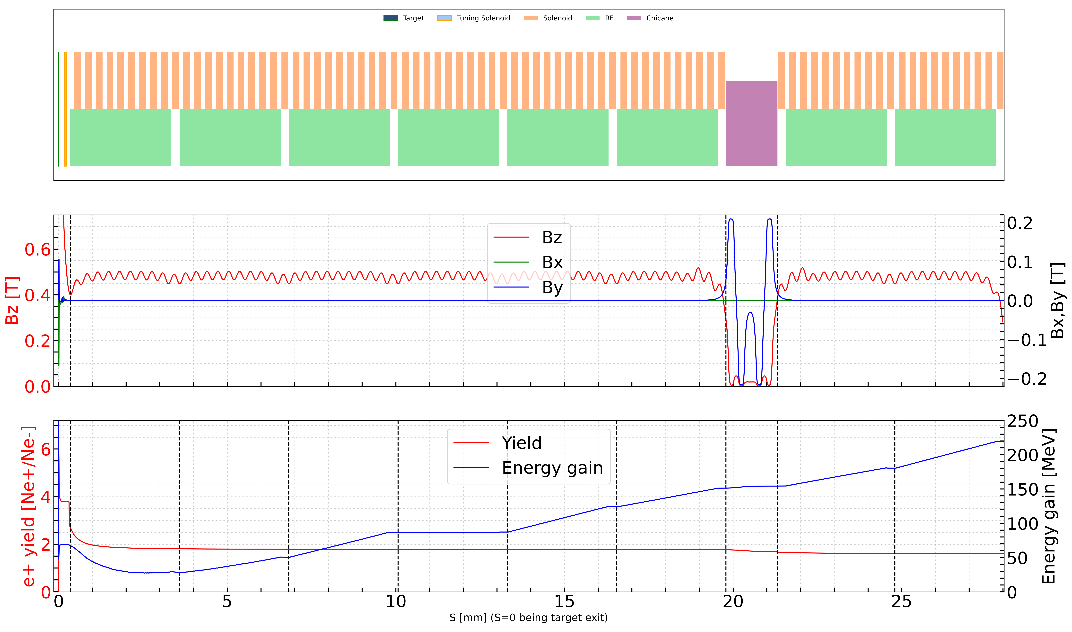
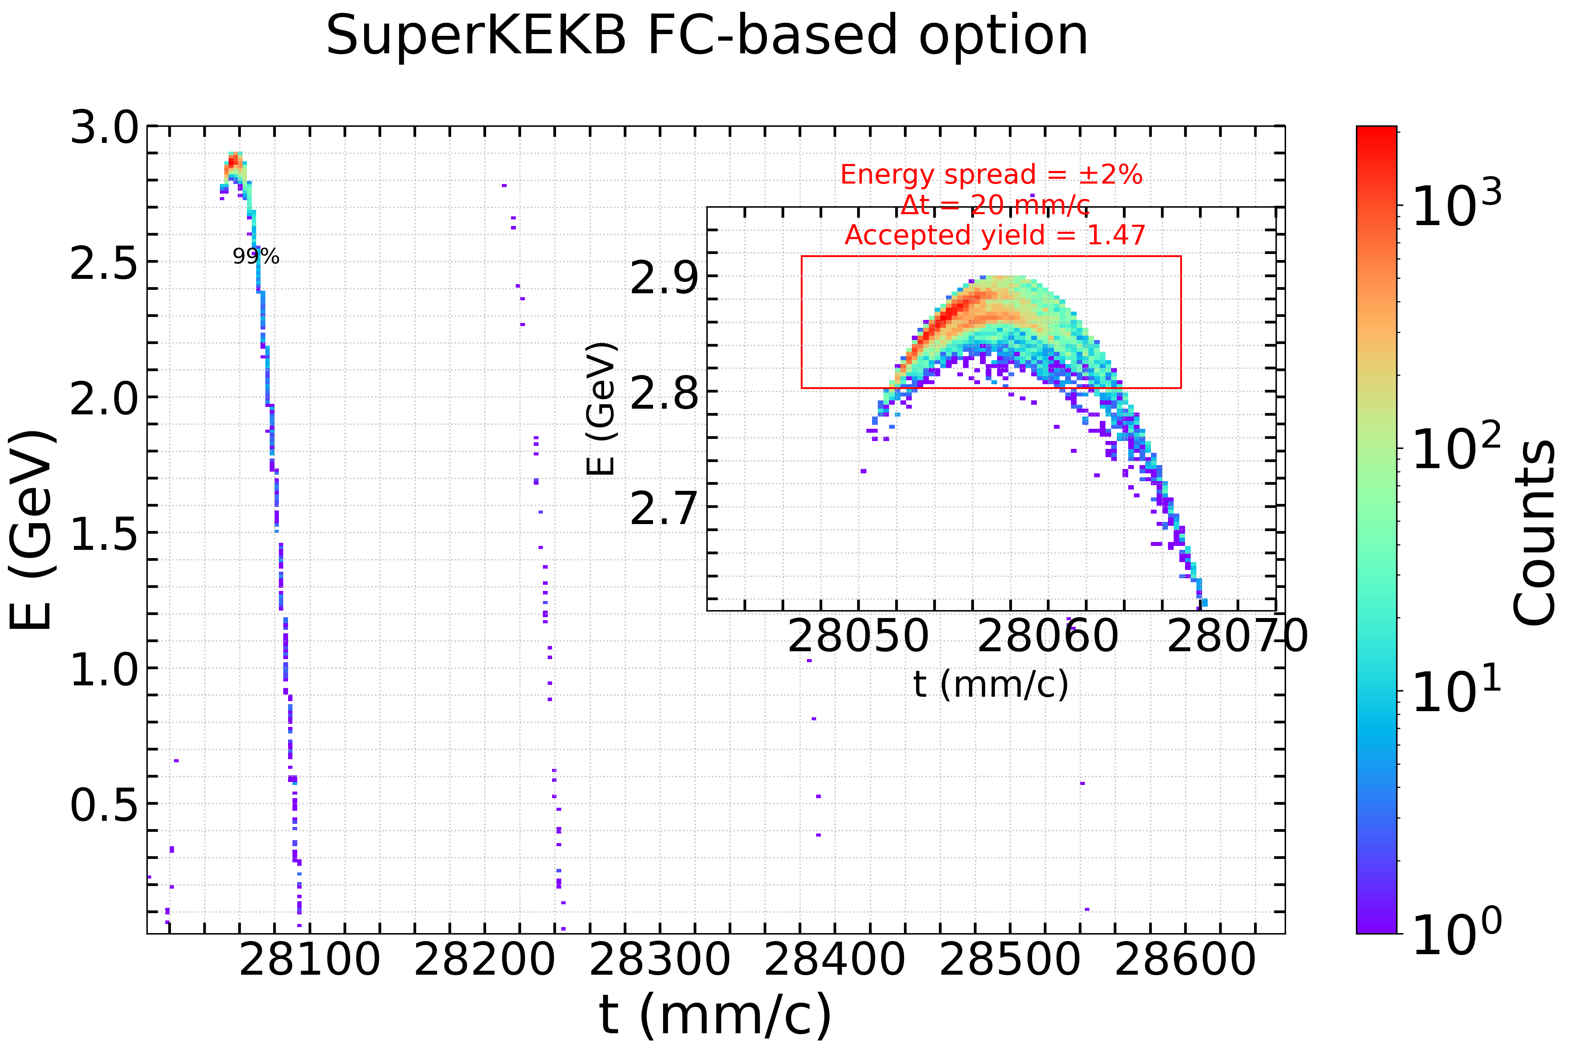
Beam dynamics - SuperKEKB FC-based option
The accepted yield is 1.47 @ DR. Approximately 46% of positrons are lost in the AMD, ~28% between the AMD and the first structure, and ~1% in the chicane.
Notes:
3.79 @ end of AMD
1.81 @ end of 1st structure

Slide 11
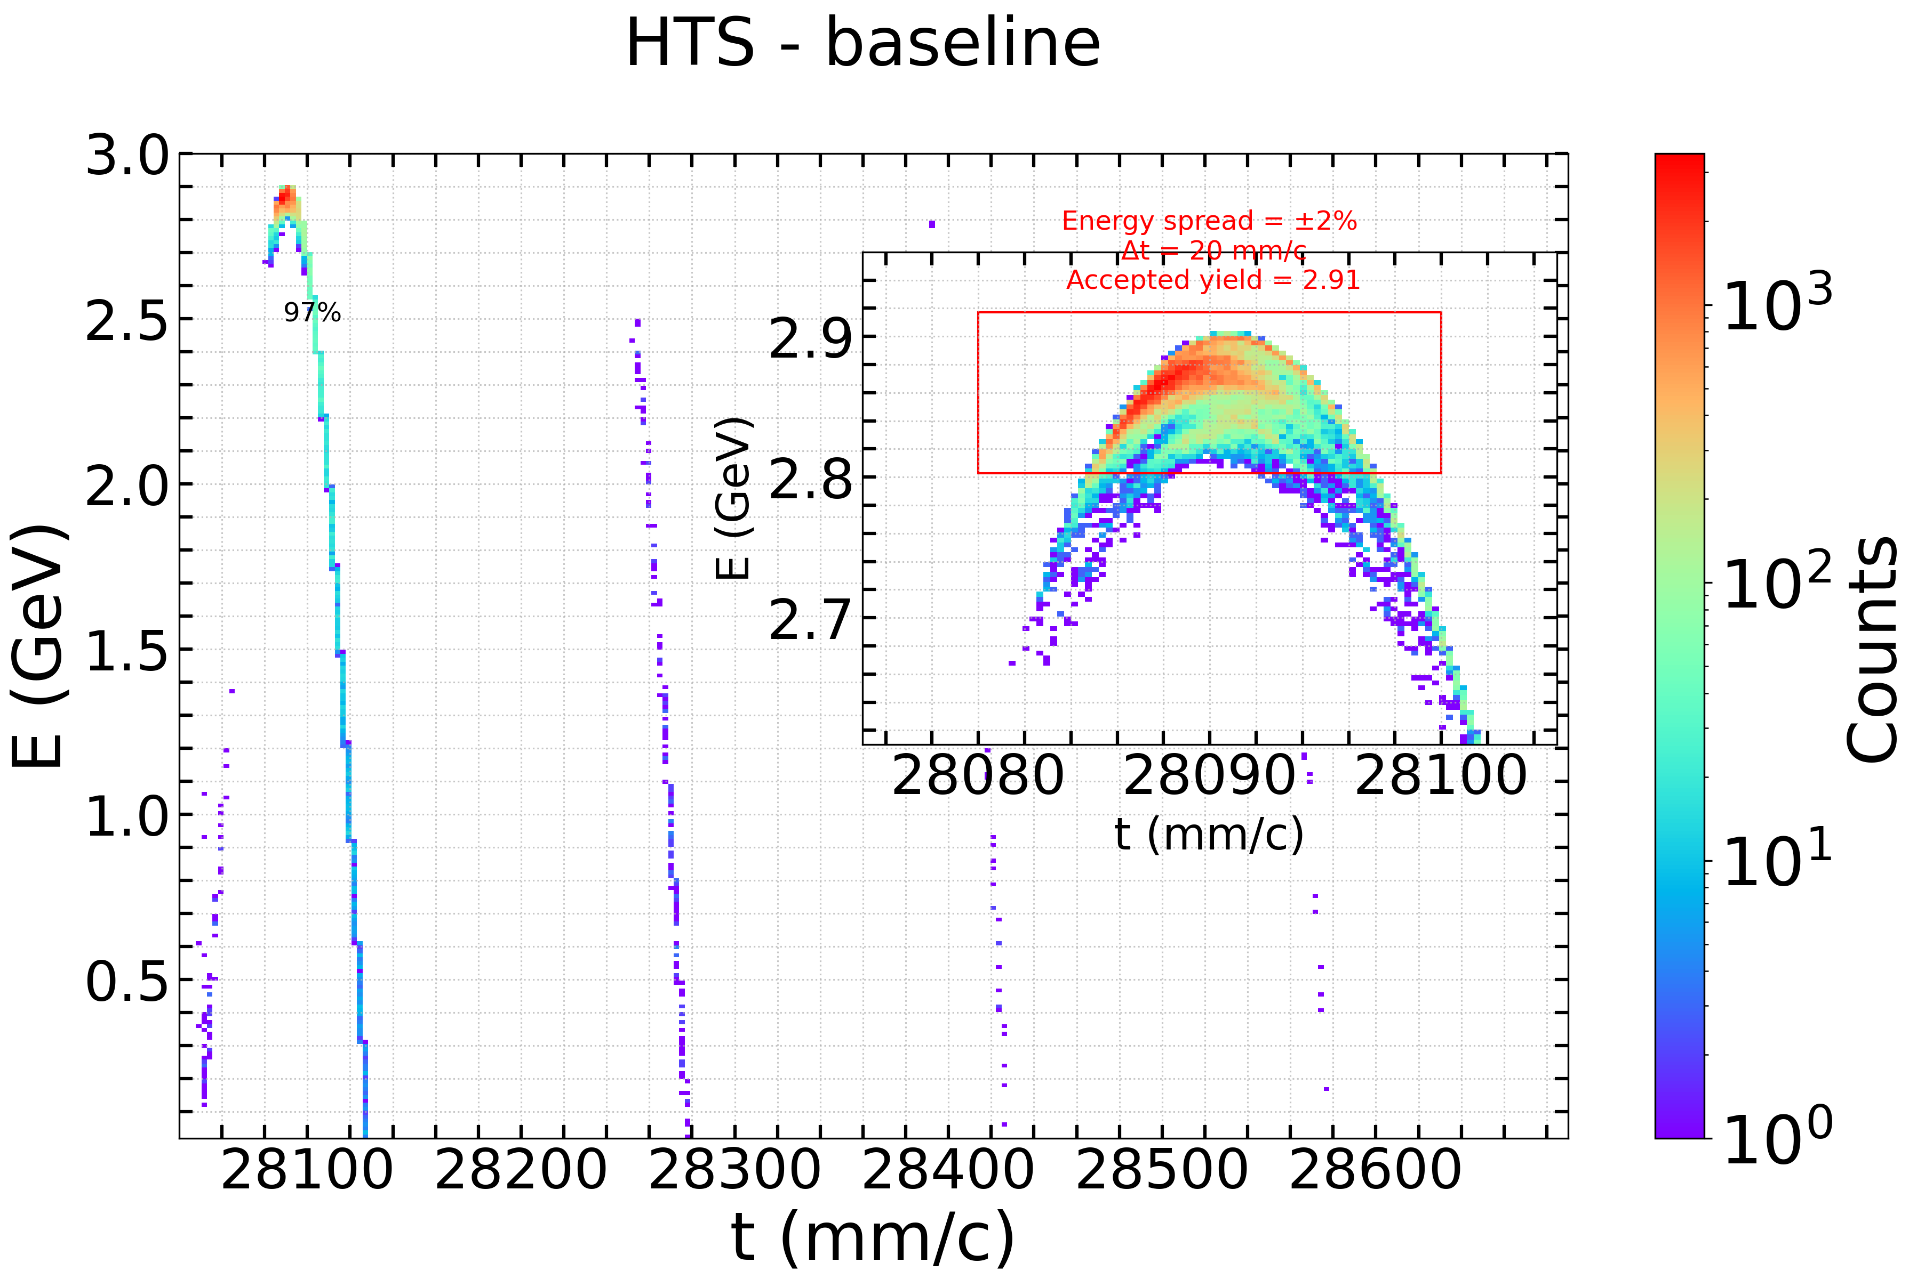
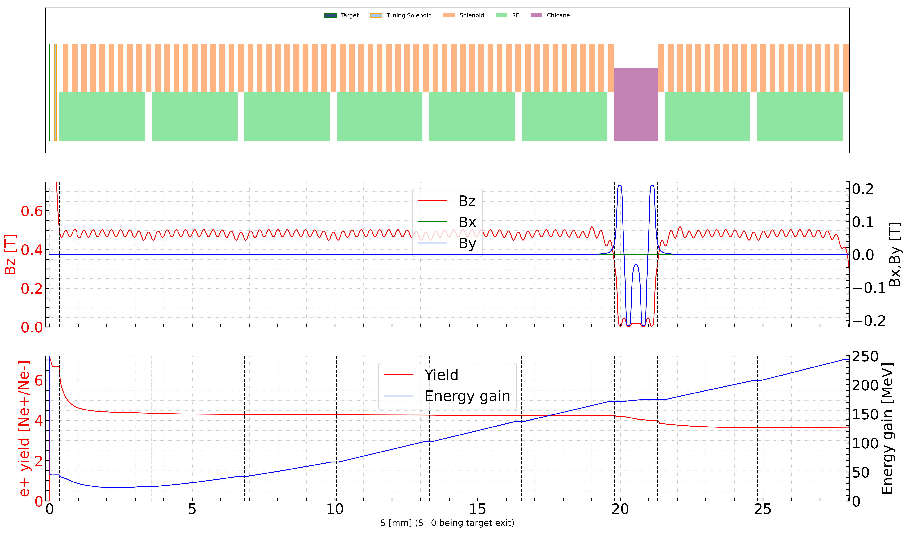
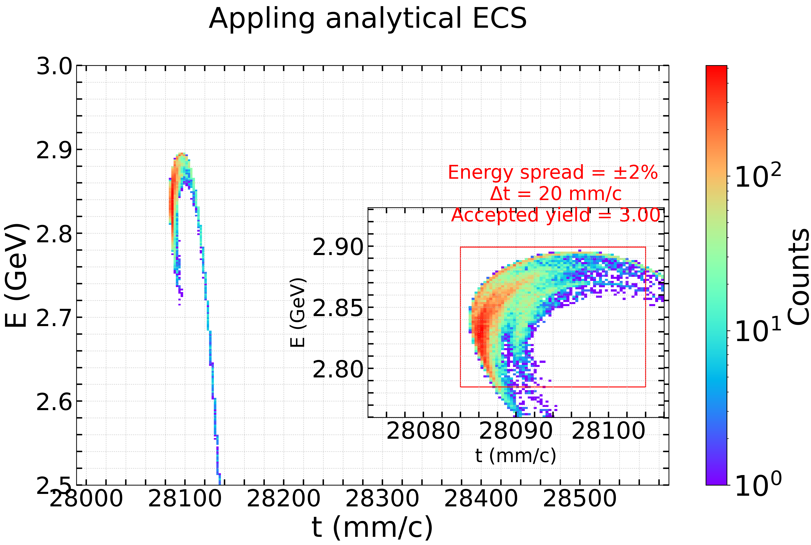
Beam dynamics – HTS solenoid
Example
The accepted yield is ~3 @DR. Approximately 6% of positrons are lost in the AMD, ~32% between the AMD and the first structure, and ~4% in the chicane.
Analytical model of the Energy Compression System (ECS, V₀ = 150 MeV, R₅₆ = –0.22) indicates a 1% increase in accepted yield.
Notes:
6.65 @ end of AMD
4.36 @ end of 1st structure

Slide 12
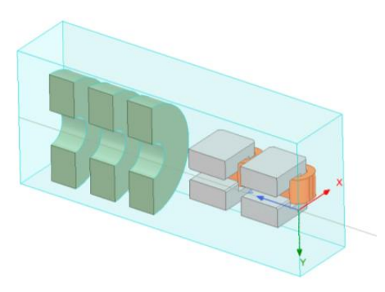
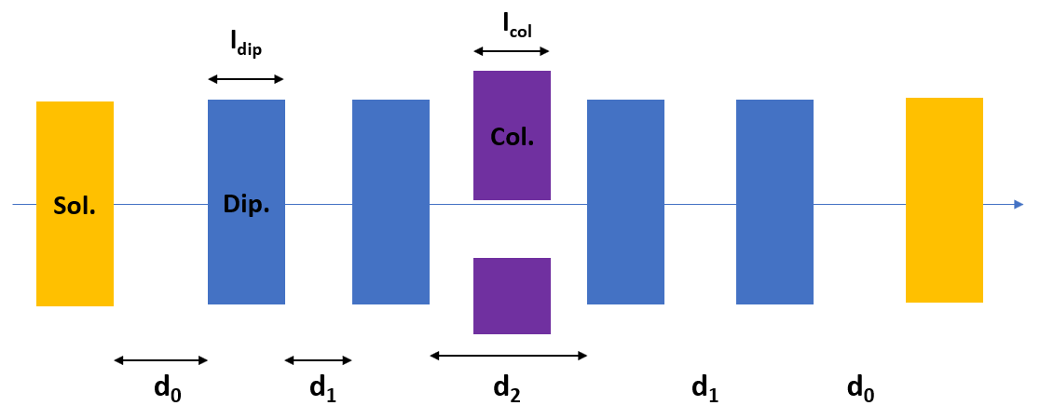
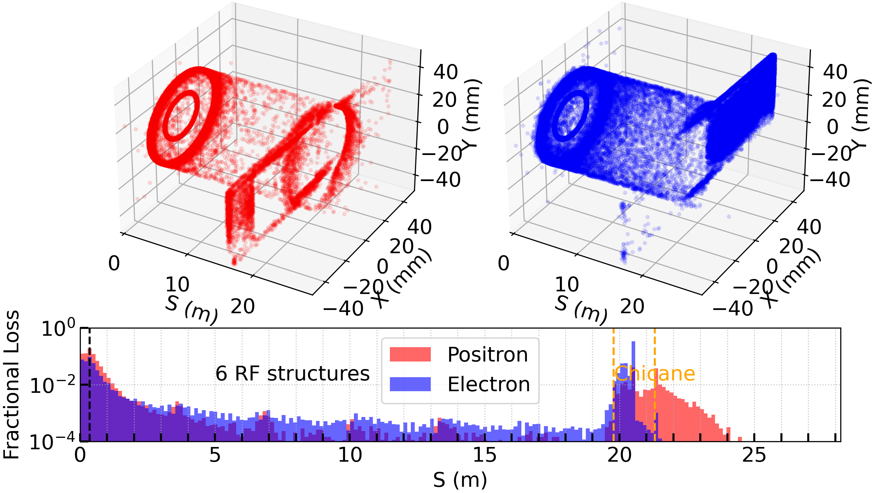
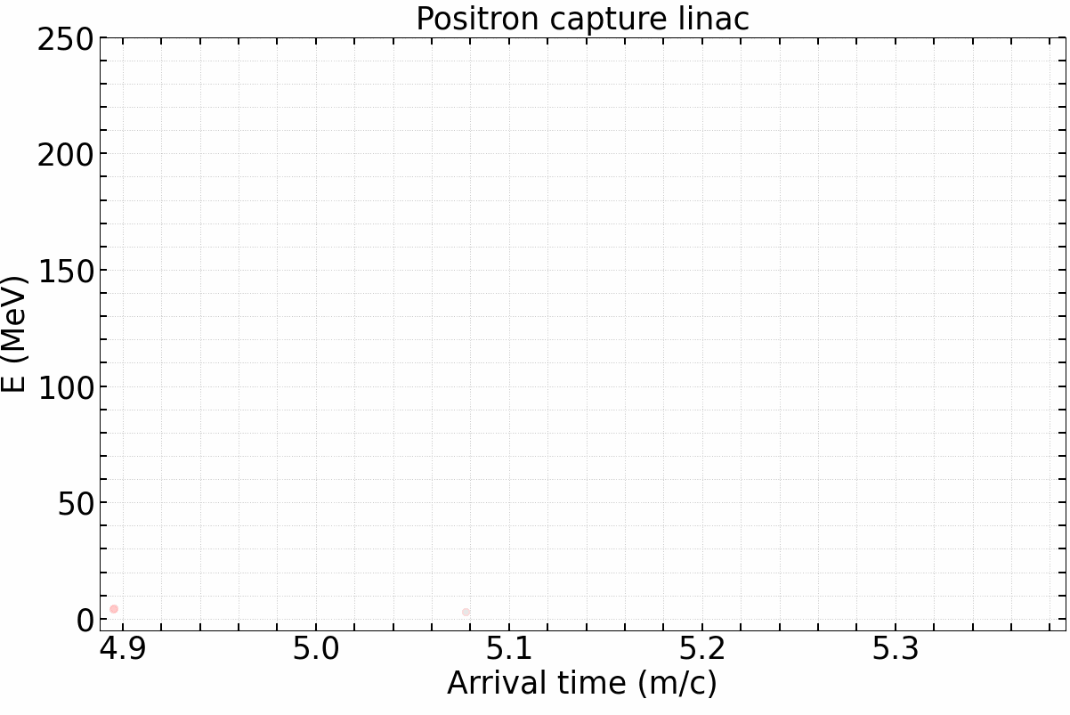
Beam dynamics – HTS solenoid
DOI: 10.17181/CERN.EBAY.7W4X
Chicane and electron stopper:
Dipole whole length: 180 mm
Aperture of beam pipe: Δx=150 mm, Δy=150 mm (Yoke aperture: 70 mm)
Distance between dipole yokes: d1=125, d2=350 mm
Distance between solenoid and dipole：125 mm
$$1/4 view of chicane region$$
Alive particles
Fig. Beam loss map

Slide 13
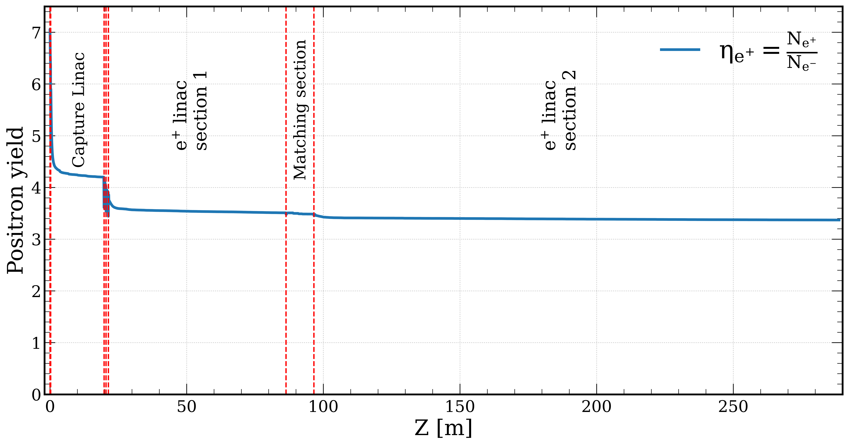
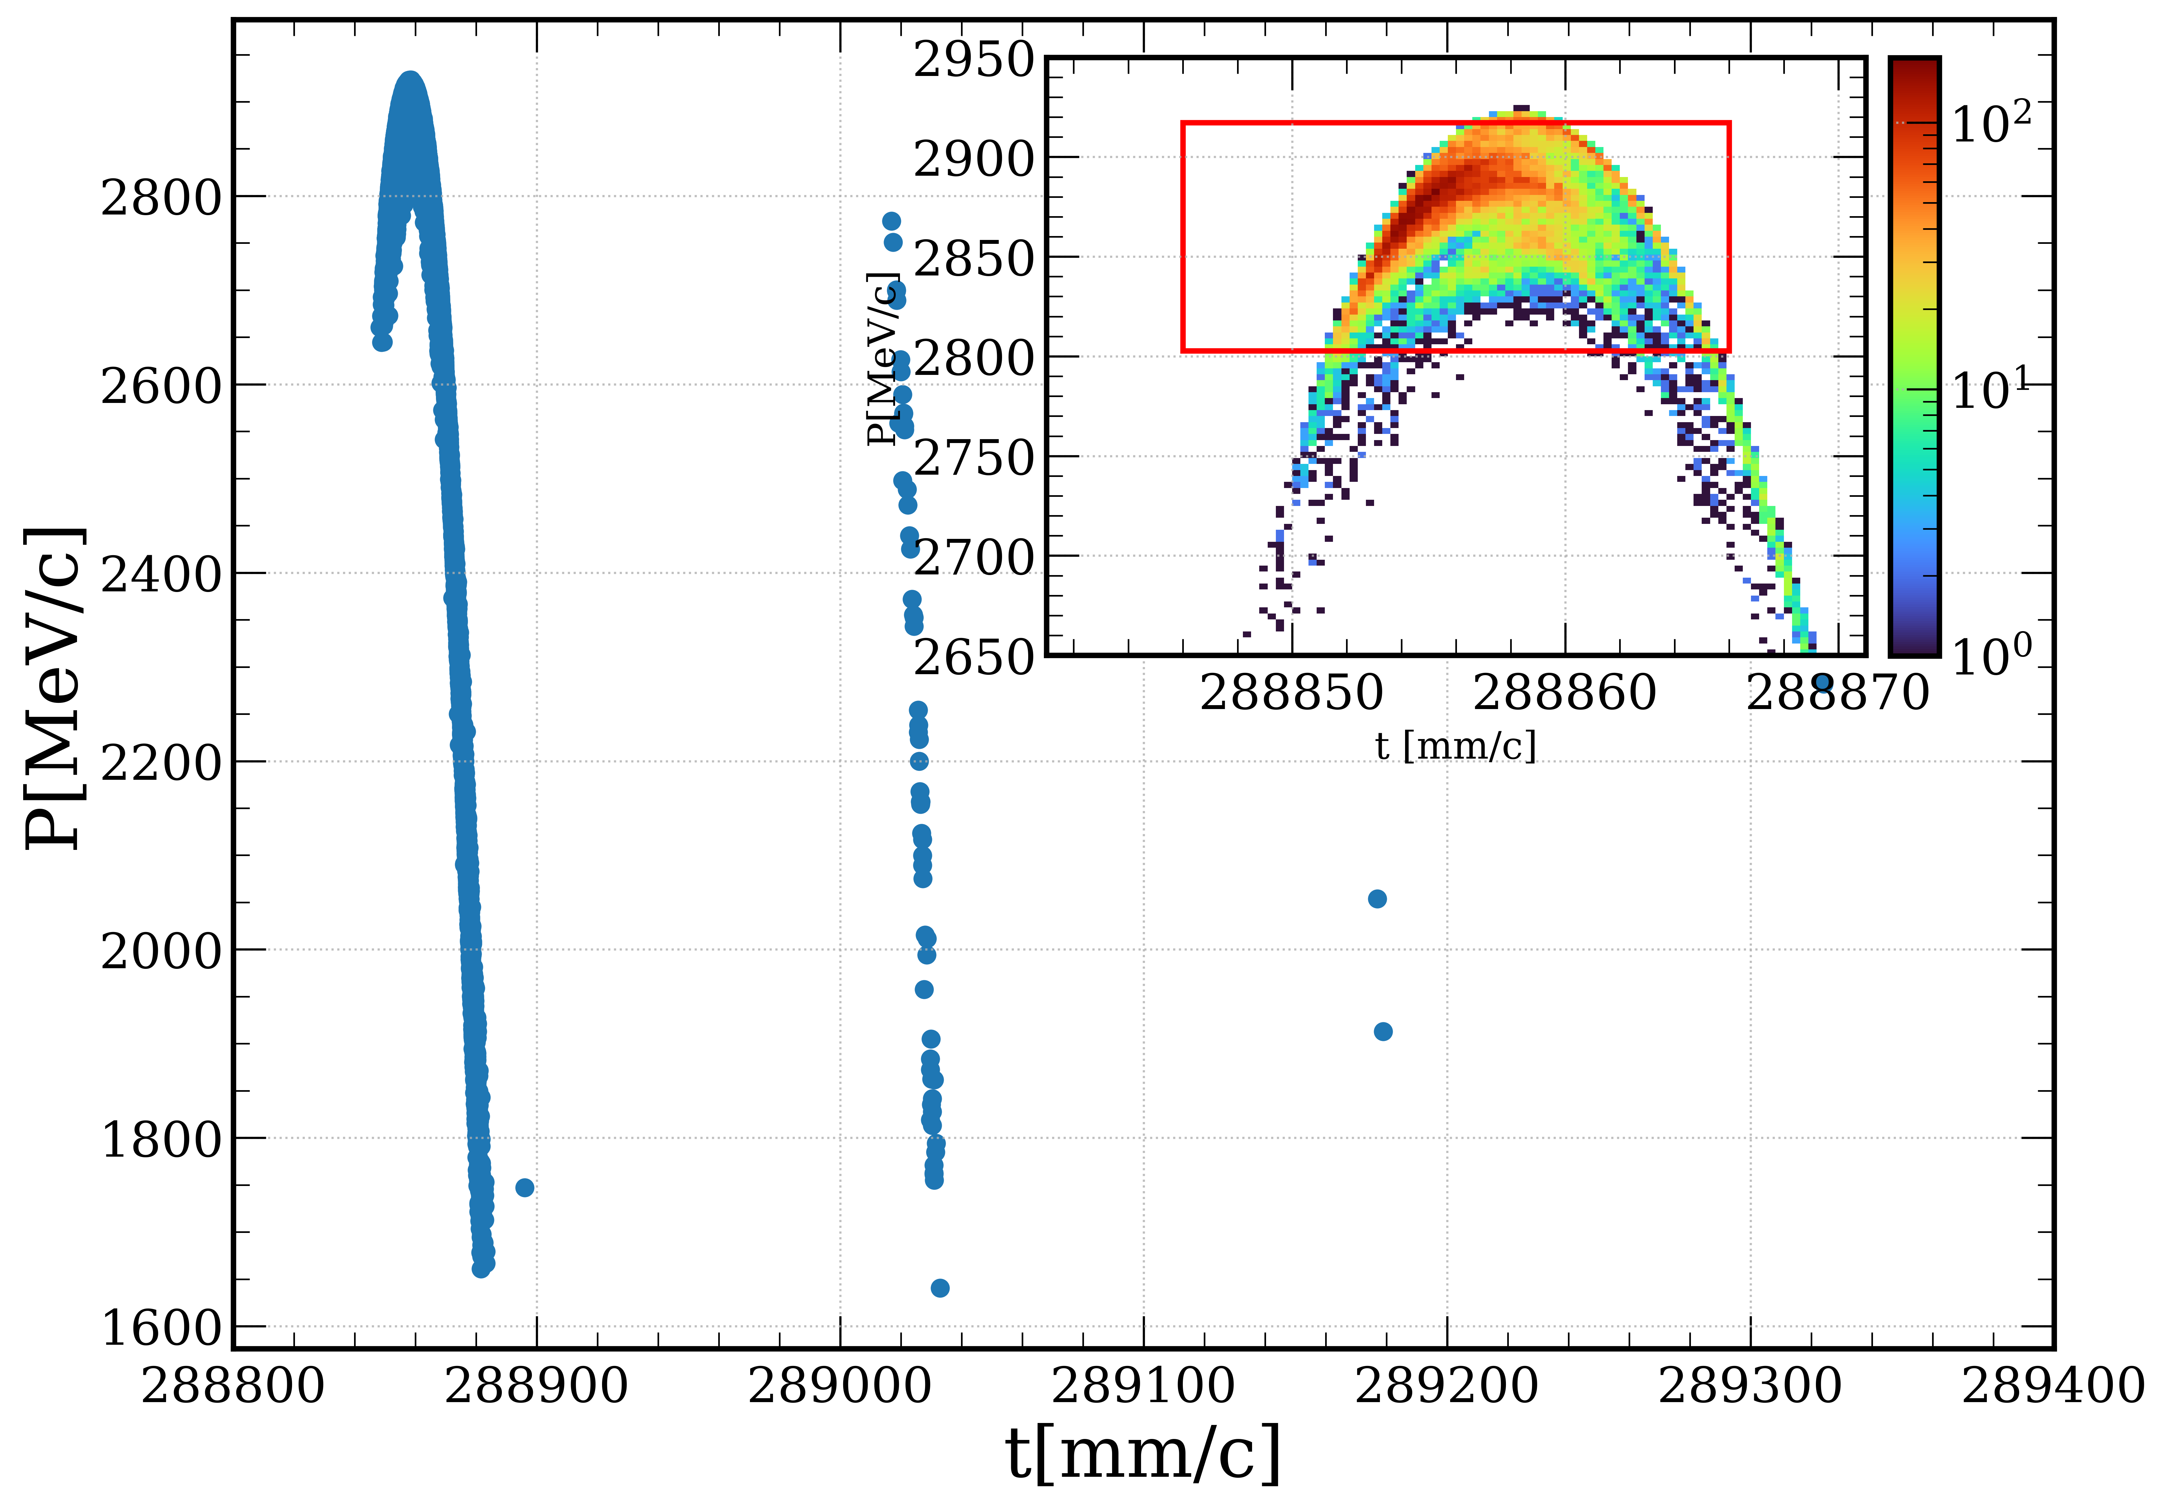
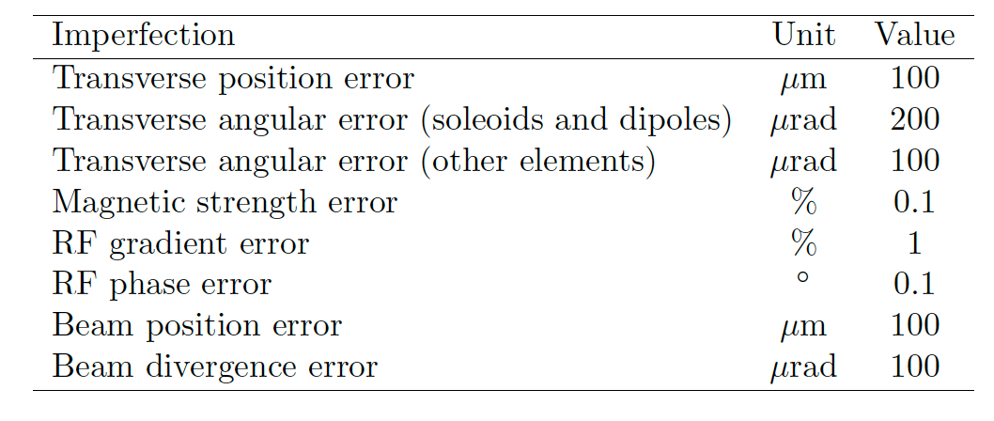
Positron capture and linac overall efficiency (FS baseline)
Iryna’s talk
https://indico.cern.ch/event/1408515/timetable/
to DR
2.86 GeV
CL
PL1
MS
PL2
e⁺ yield ~ 3.4
Accepted yield @ DR ~ 3.0
(ΔE: ±2%, Δt: 20 mm/c)
*Simulations include collective effects
(space charge and short-range wakefield)
Start-to-end simulation (from target to the DR)
FS design ensures reliable e⁺ production and meets the requirements set by FCC-ee (Z-pole) with the safety margins
The impact of these imperfections is found to be negligible: e⁺ yield ↓1.3%, emittance x/y ↓0.4/0.8 %

Slide 14
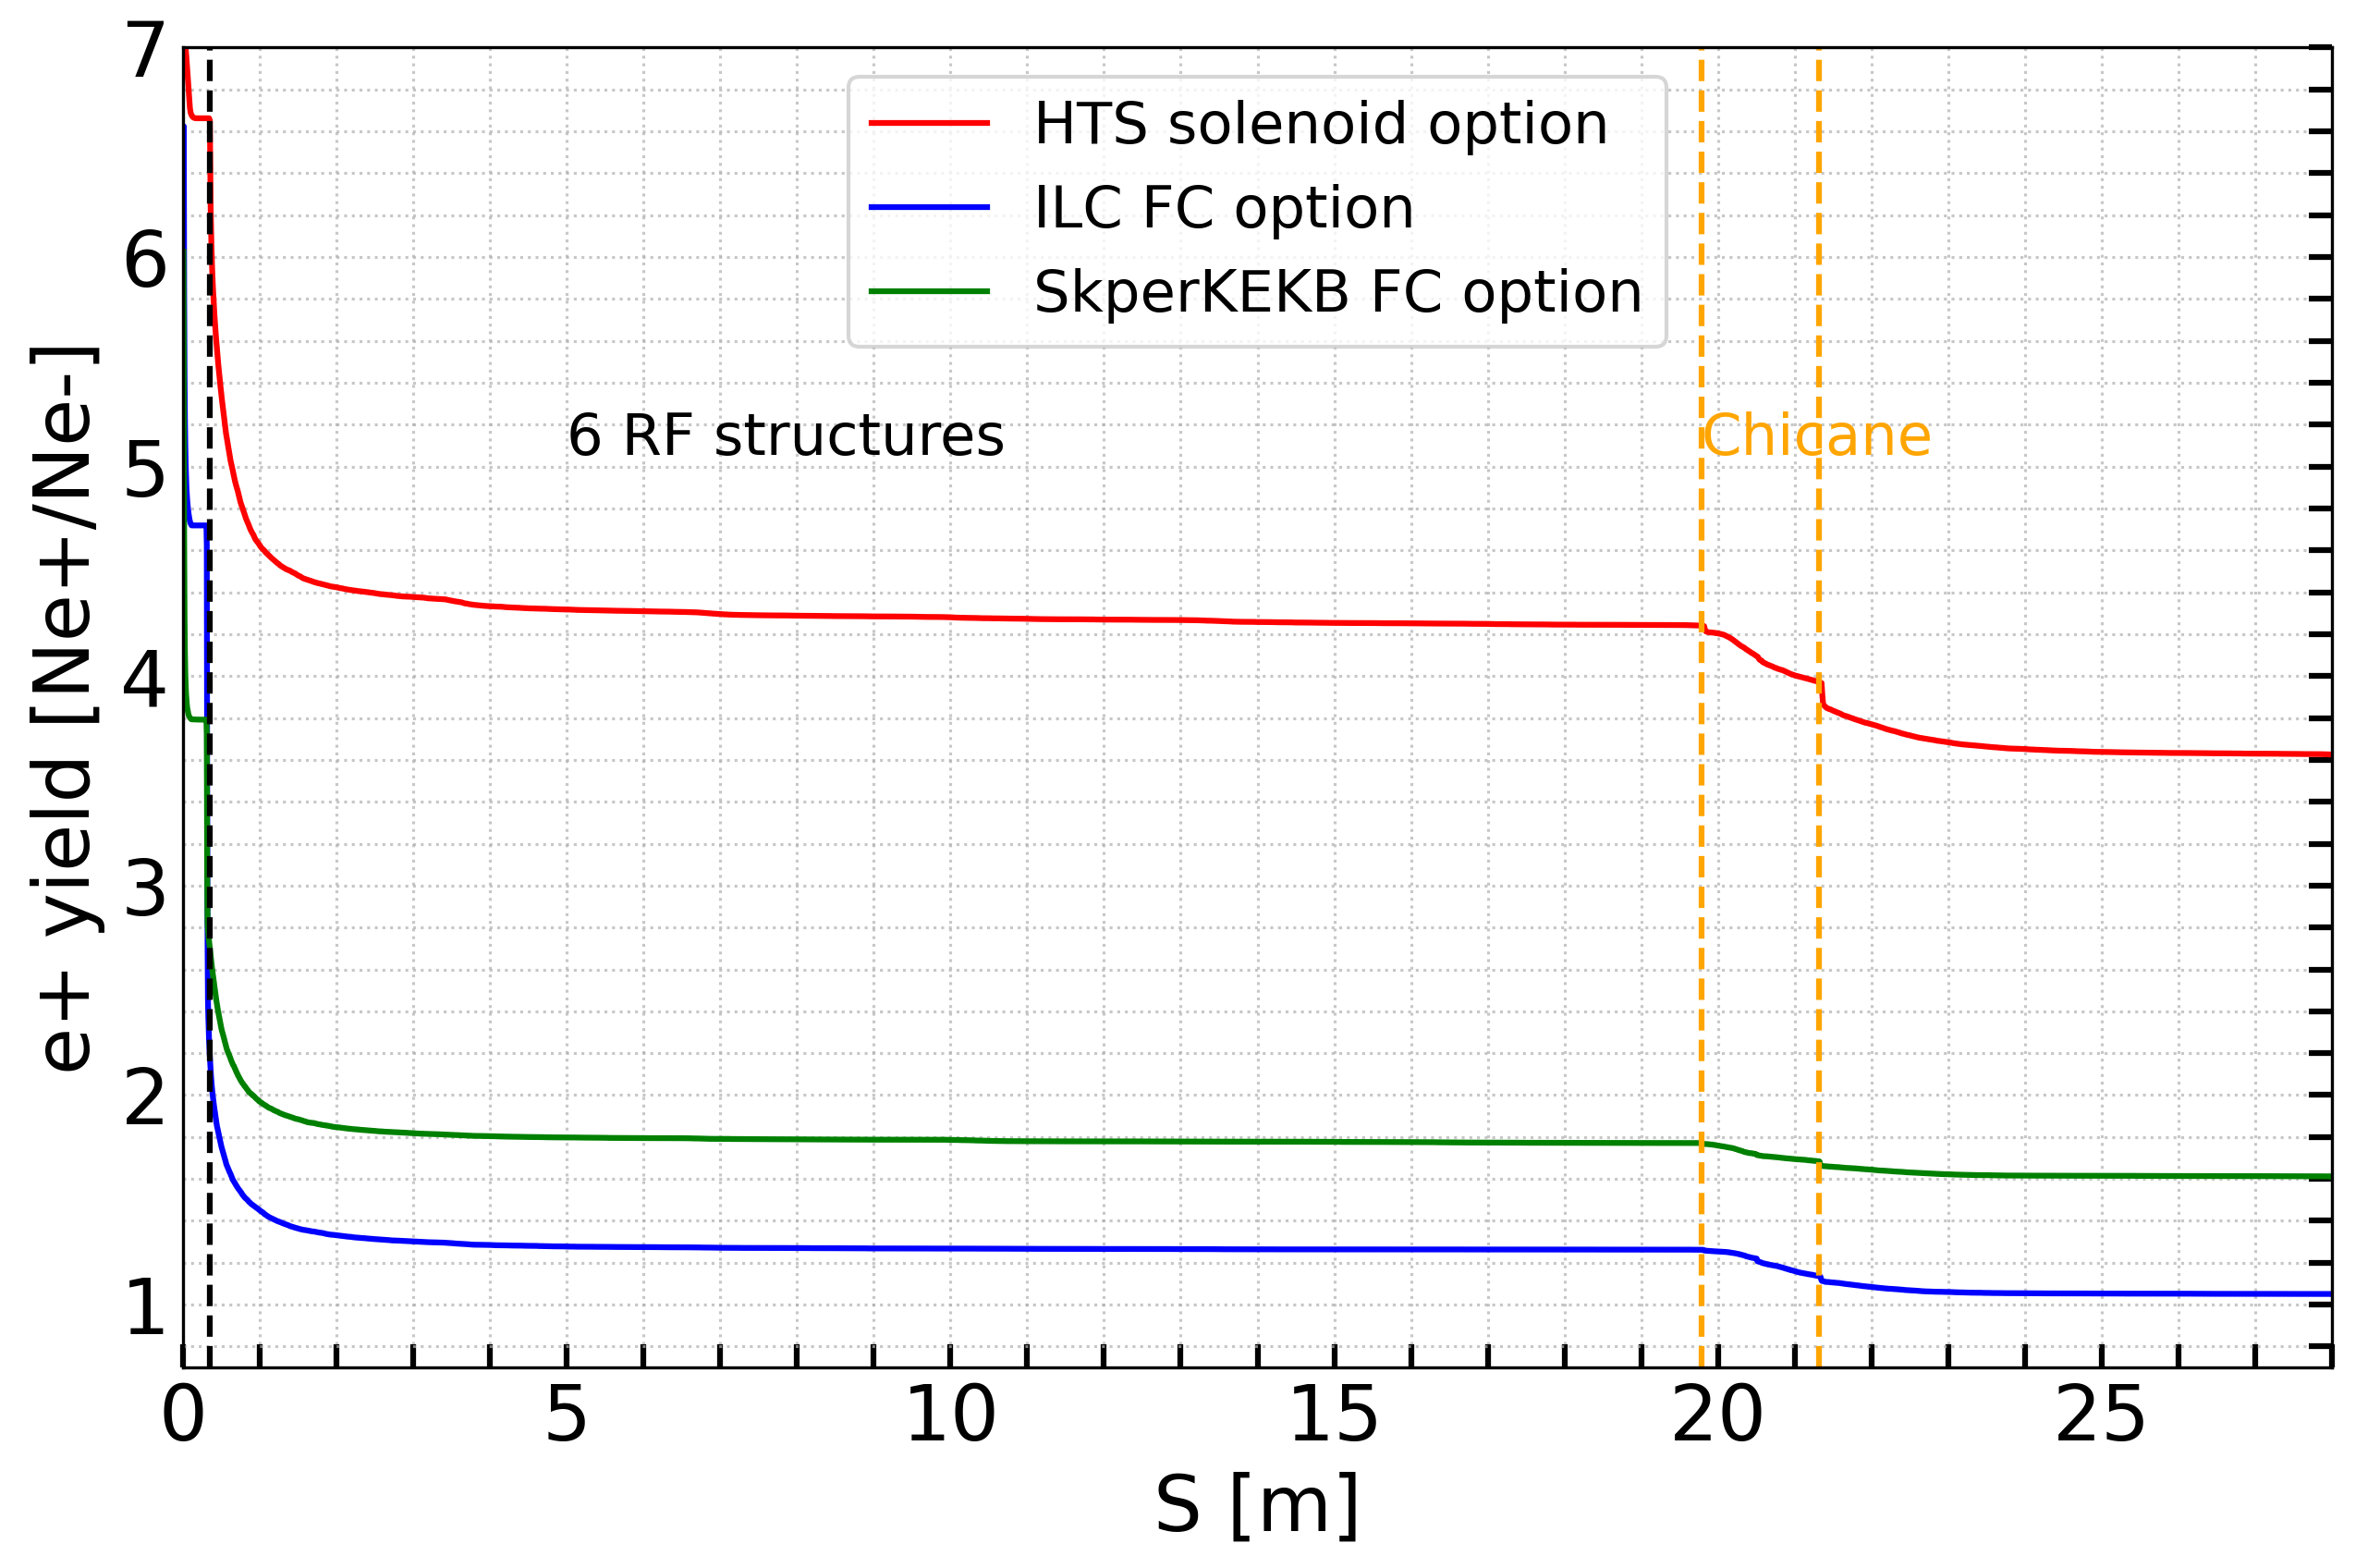
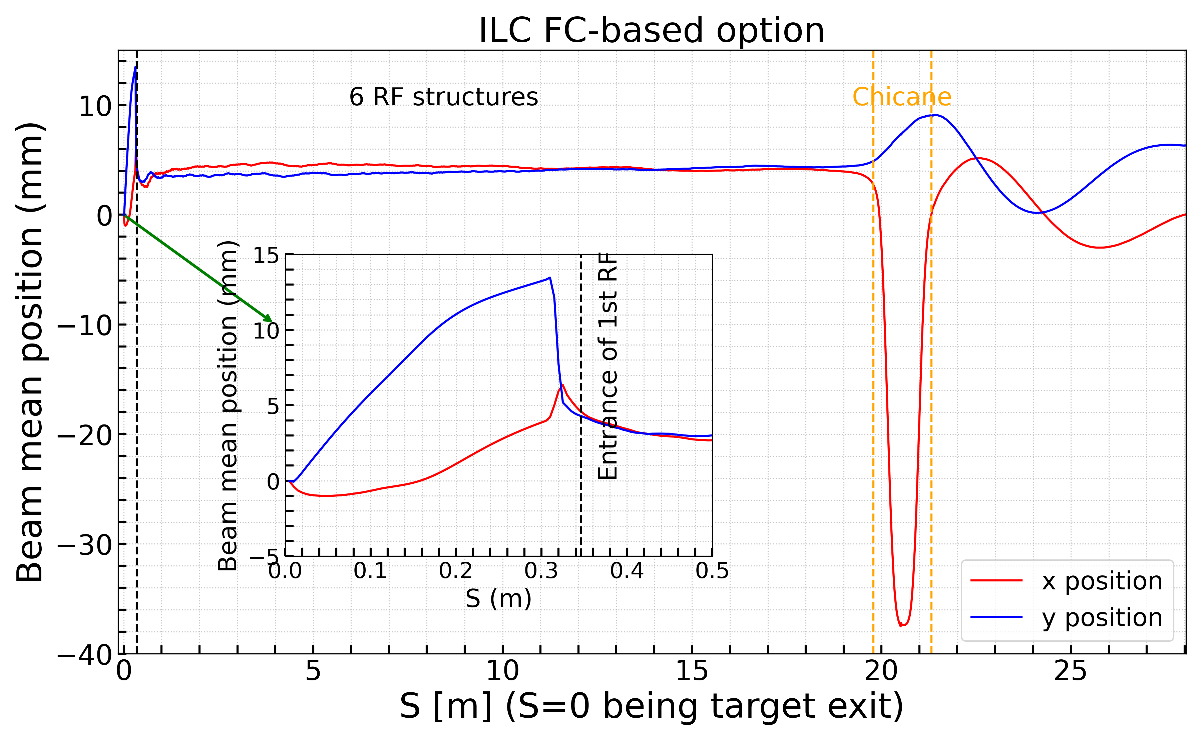
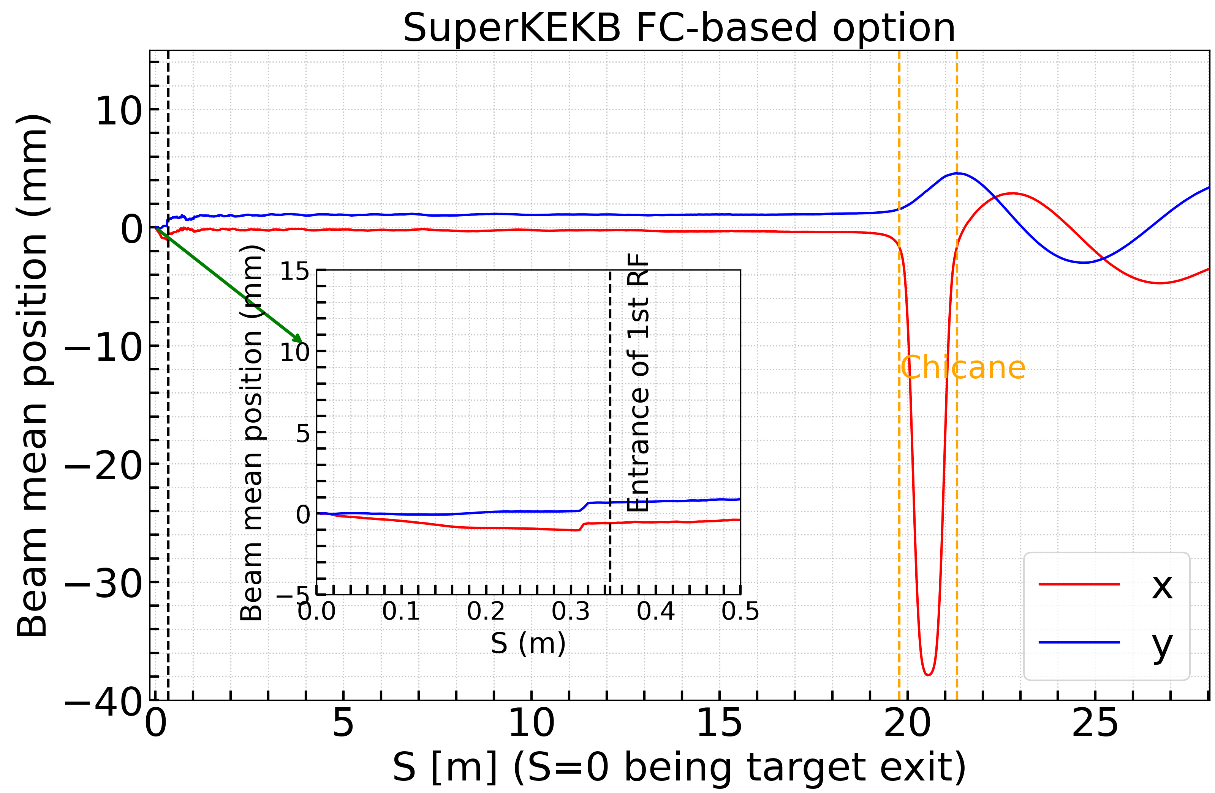
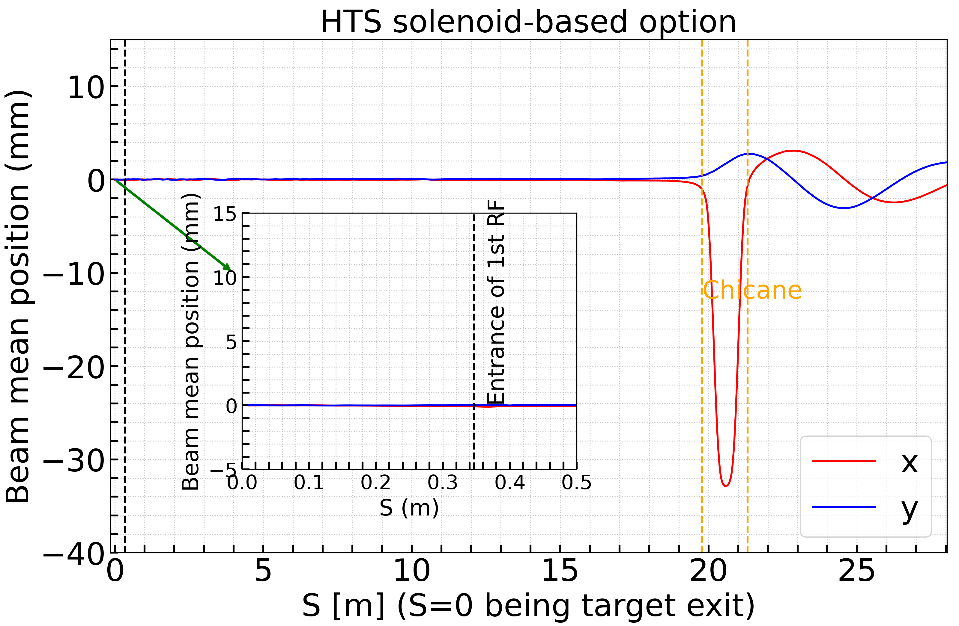
Summary of the simulation results
The peak magnetic field of FC is located downstream of the target, whereas the HTS solenoid provides a high field strength directly at the target exit surface. It also offers a larger aperture and greater flexibility in target positioning.
Compared to the two FC-based alternatives, the HTS solenoid based matching device demonstrates superior particle capture efficiency.
In contrast, FC-based matching devices introduce significant transverse kicks to the beam due to their transverse magnetic fields.
In particular, the smaller aperture of MD contributes to increased beam loss.
 | Loss @ MD | Loss @ 1st RF | Loss @ Chicane
ILC FC-based option | 33% | 48% | 2%
SuperKEKB FC-based option | 46% | 28% | 1%
HTS solenoid-based option | 6% | 32% | 4%

Slide 15
Summary of the simulation results
 | HTS solenoid - Baseline | SkperKEKB FC option | ILC FC option
Bz (T) | 11.80 (Peak) | 4.58 (Peak) | 5.30 (Peak)
Positron yield @ target | 7.07
Beam size x/y (mm) @ s1 | 10.41/8.33 | 8.23/6.28 | 10.23/8.19
Average total energy (MeV) @ s1 | 188.80 | 219.20 | 201.38
Energy spread (MeV) @ s1 | 27.98 | 23.71 | 44.19
Yields before/after chicane | 4.24/3.97 | 1.77/1.69 | 1.26/1.14
Positron yield @ s1 | 3.53 | 1.61 | 1.05
Bunch length (mm) @ PL (Accepted by cut window) | 2.46 | 2.48 | 2.84
Positron yield @ PL (ΔE: 2%, Δt: 20 mm/c) | 2.91 | 1.47 | 0.86
Primary bunch charge (nC) | 4.64 | 9.18 | 15.70
Target deposited power (kW) | 1.21 | 2.40 | 4.12
PEDD (J/g) | 7.04 | 3.94 | 23.84
Normalized x/y emittance (accepted positrons) (mm.rad) @ PL | 12.20/10.87 | 8.51/8.43 | 15.08/13.38
Energy spread (%) @ PL | 0.7 | 0.5 | 1.2

Slide 16
Summary and outlook
The study compares FC and HTS solenoid-based MD approaches
SuperKEKB FC-based and ILC FC-based flux concentrators are evaluated for the FCC-ee positron source design. Due to design limits, the magnetic field peaks downstream of the target, reducing effective field on target and lowering capture efficiency. High transverse fields distort positron trajectories, causing beam offsets that complicate transport.
FCC-ee demands higher repetition rates (up to 100 Hz), stronger fields, and larger apertures, presenting major technical challenges for high-power operation.
To address these challenges, the SC solenoid based on HTS technology was proposed for positron capture to meet the requirements set by FCC-ee (Z-pole) with the safety margins.
The Feasibility Study baseline design of the FCC-ee injector including the positron source is finalized and was published in the FCC-ee Feasibility Study Report.
The MD employing HTS solenoid was selected as the baseline for the FCC-ee positron source, yielding ~3 e⁺/e⁻ @ DR. A proof-of-principle at PSI (P3 experiment) starts in 2026. With safety margins, an e⁻ drive beam charge of 3.8 nC is required to meet FCC-ee specifications.
Next step: The feasibility of 3 GHz RF frequency in positron capture and linac is ongoing.
DOI: 10.17181/CERN.EBAY.7W4X

Slide 17
Credits
PSI | B. Auchmann, I. M. Besana, S. Bettoni, P. Craievich, M. Duda, R. Fortunati, H. Garcia-Rodrigues, D. Hauenstein, R. Ischebeck, P. Juranic, J. Kosse, F. Marcellini, U. Michlmayr, G. L. Orlandi, M. Pedrozzi, J.-Y. Raguin, S. Reiche, R. Rotundo, S. Sanfilippo, M. Schär, N. Strohmaier, N. Vallis, M. Zykova, R. Zennaro, H.H. Braun, M. Seidel all the technical groups involved in the P3 experiment
IJCLab | F. Alharthi, I. Chaikovska, R. Chehab, V. Mytrochenko, Y. Wang
CERN | W. Bartmann, H. Bartosik, M. Calviani, S. Doebert, Y. Duthell, J. L. Grenard, A. Grudiev, B. Humann, A. Kurtulus, A. Latina, A. Lechner, R. Mena Andrade, A. Perillo Marcone, K. Oide, Y. Zhao, F. Zimmermann, Z. Vostrel, M. Benedikt
SLAC | T. Raubenheimer
KEK | Y. Enomoto, K. Furukawa, F. Miyahara
INFN-LNF | C. Milardi, A. De Santis, O. Etisken, S. Spampinati
and L. Bandiera, N. Canale, A. Mazzolari, G. Paternò, M. Romagnoni, A. Sytov (INFN/Ferrara), A. Bacci, M. Rossetti Conti (INFN/Milano) | A. Bacci, M. Rossetti Conti, L. Bandiera, D. Boccanfuso (INFN Naple) , N. Canale, O. Lorio (INFN Naple), A. Mazzolari, R. Negrello, G. Paternò, M. Romagnoni, M. Soldani, A. Sytov
This work was done under the auspices of CHART (Swiss Accelerator Research and Technology) Collaboration, https://chart.ch - CHART Scientific Report 2022: https://chart.ch/reports/
FCCIS: 'This project has received funding from the European Union's Horizon 2020 research and innovation programme under the European Union's Horizon 2020 research and innovation programme under grant agreement No 951754.'

Slide 18
Thanks for your attention!
Thanks for your attention!

