Slide 1


High Field Superconducting Magnet R&D
for the High Energy Particle Accelerators
at IHEP-CAS
Qingjin XU
for the Superconducting Magnet Group
Accelerator Division, IHEP-CAS
June 2025

Slide 2


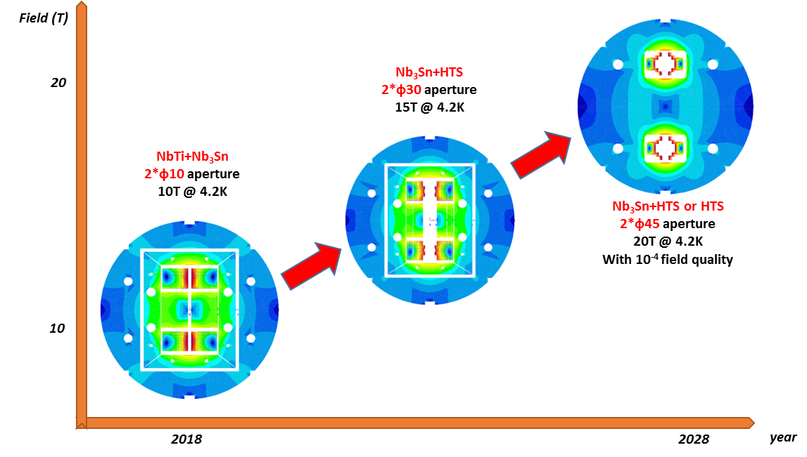
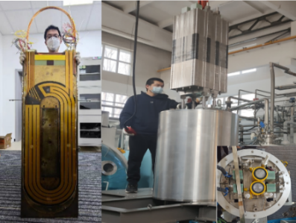
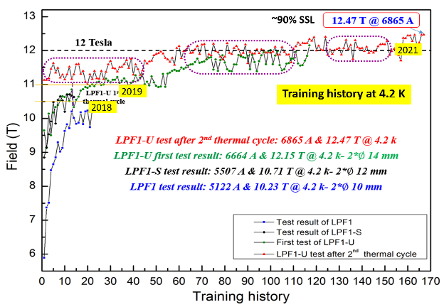
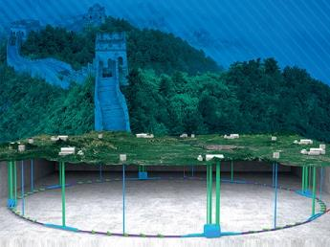
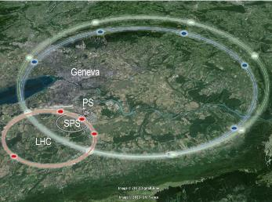
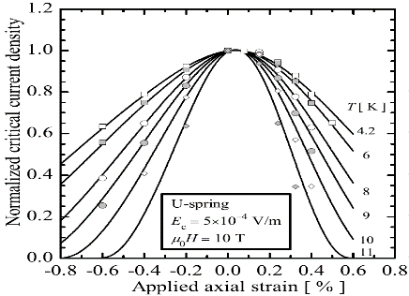
Roadmap of the High Field Magnet R&D at IHEP
2021-2025 16T @ 4.2K
NEXT-GENERATION PARTICLE ACCELERATORS
2018-2021, 12.47T @4.2K
NbTi + Nb₃Sn
CEPC-SPPC
FCC
Challenges: Stress control, quench protection, field quality control,……
2

Slide 3
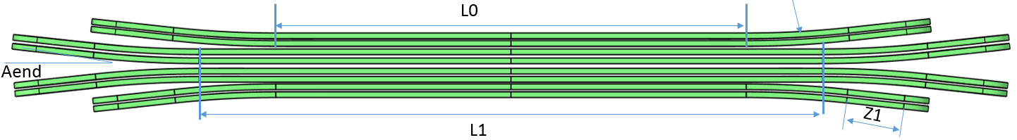
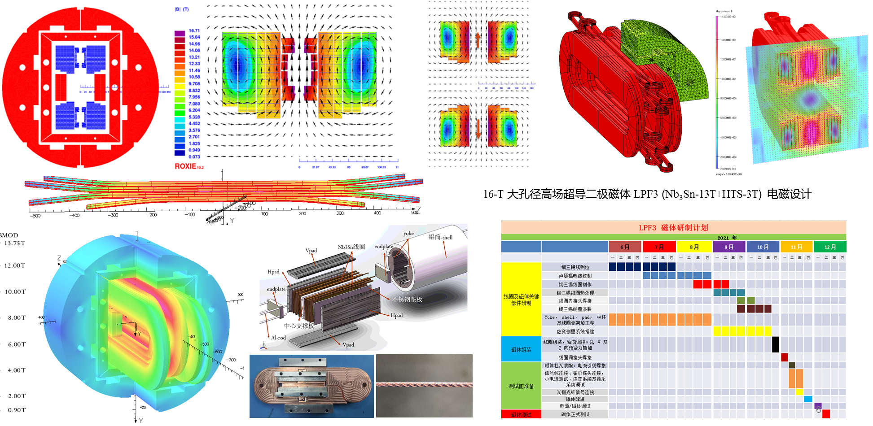
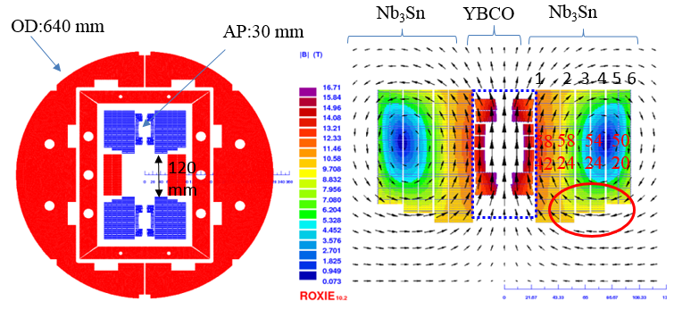
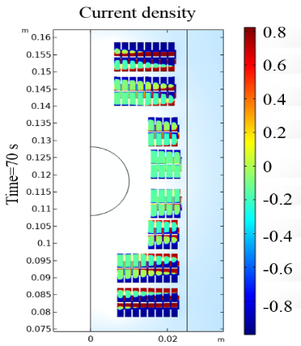
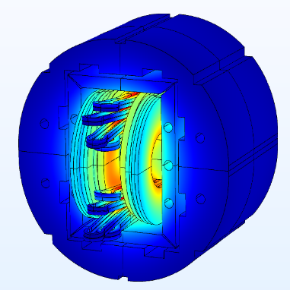
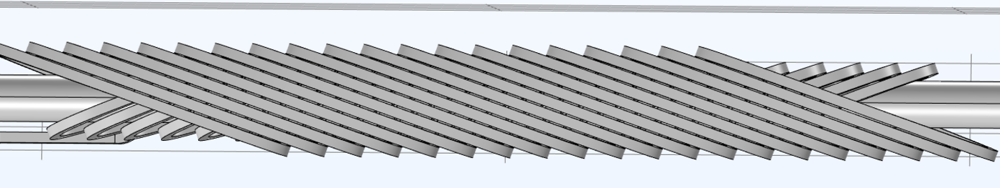
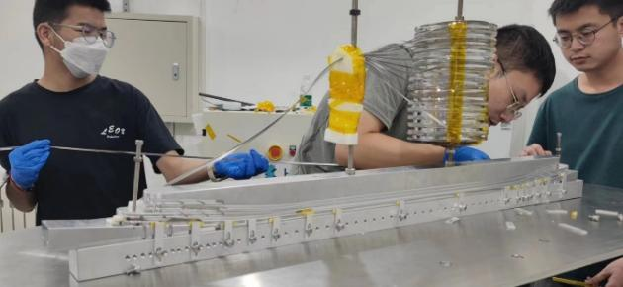
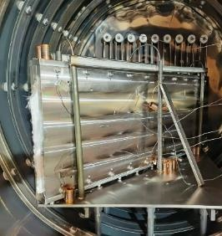
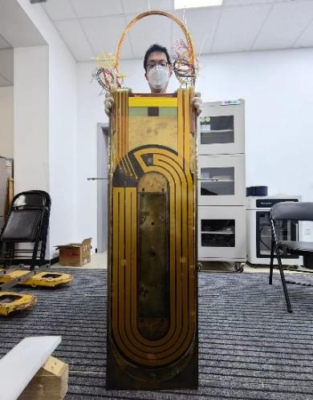
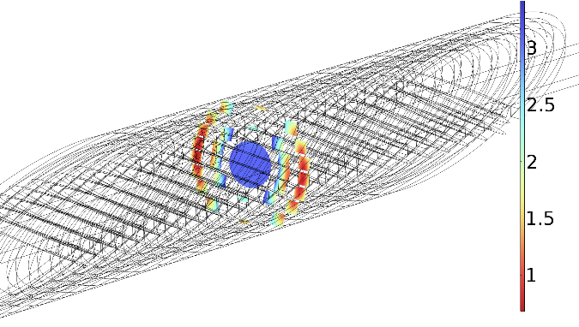
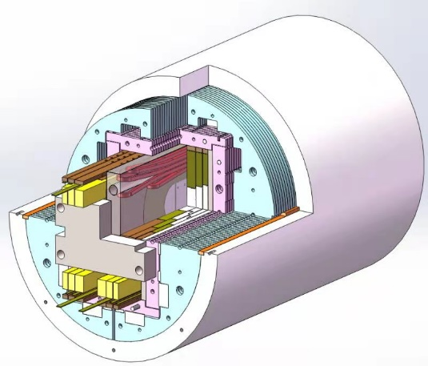
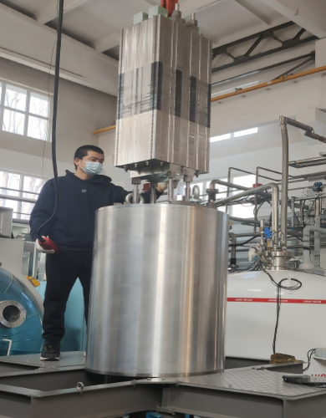
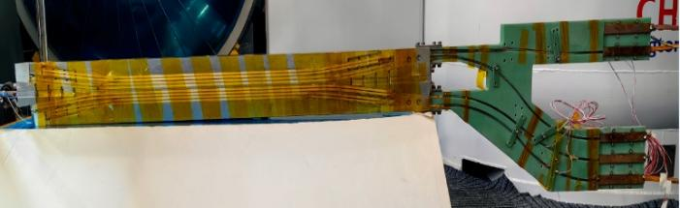
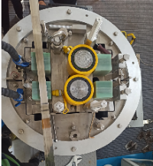
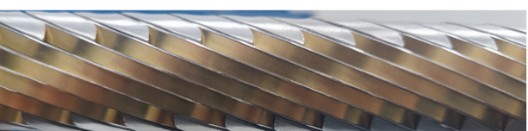
Development of the 16-T Model Dipole LPF3
16 T Model Dipole LPF3: Nb₃Sn 13 T (Common Coil with 55 mm gap) + HTS 3 T inserts (Block & CCT)
3

Slide 4
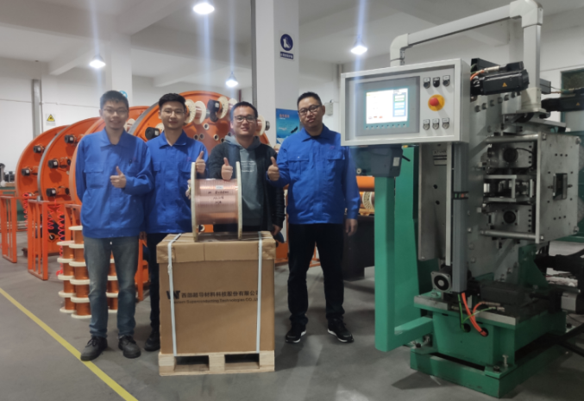

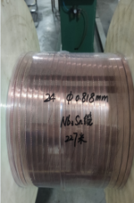
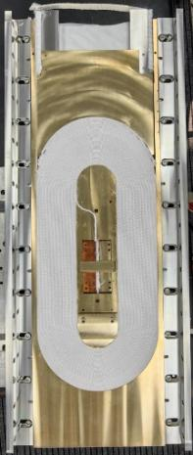
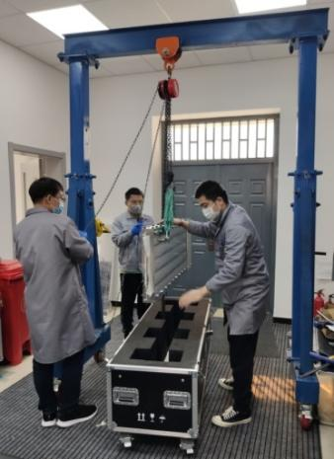
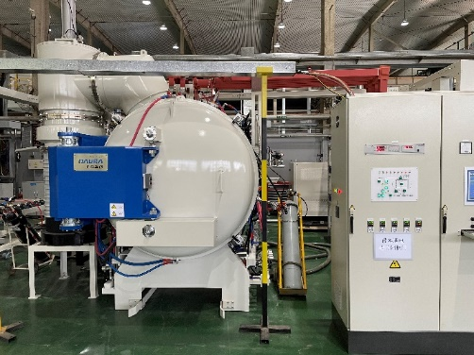
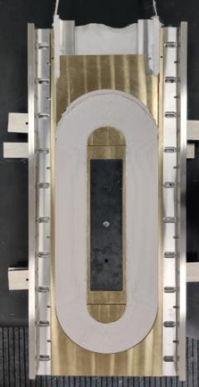
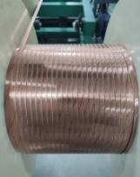
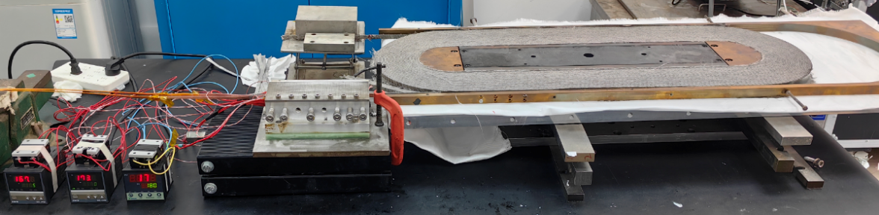
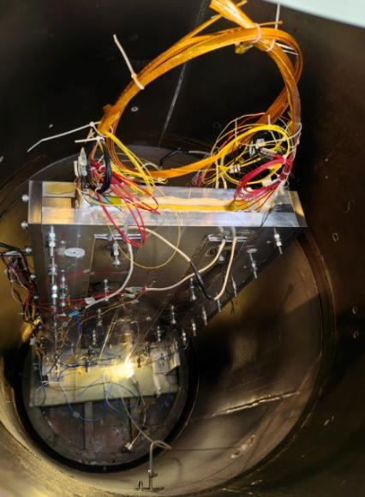
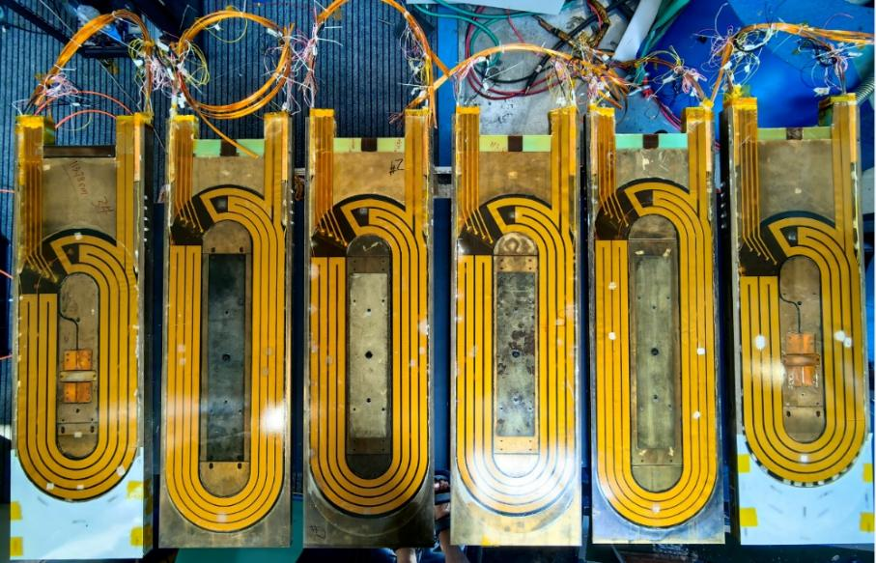
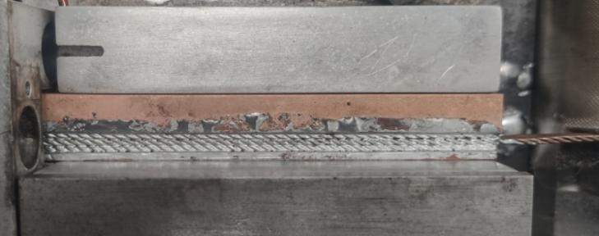
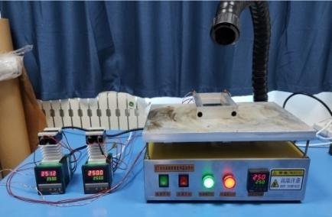
Development of the 16-T Model Dipole LPF3
The Nb₃Sn coils for LPF3
Chengtao Wang et al
4

Slide 5
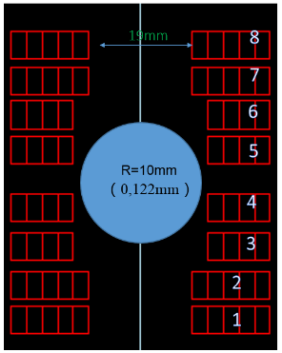
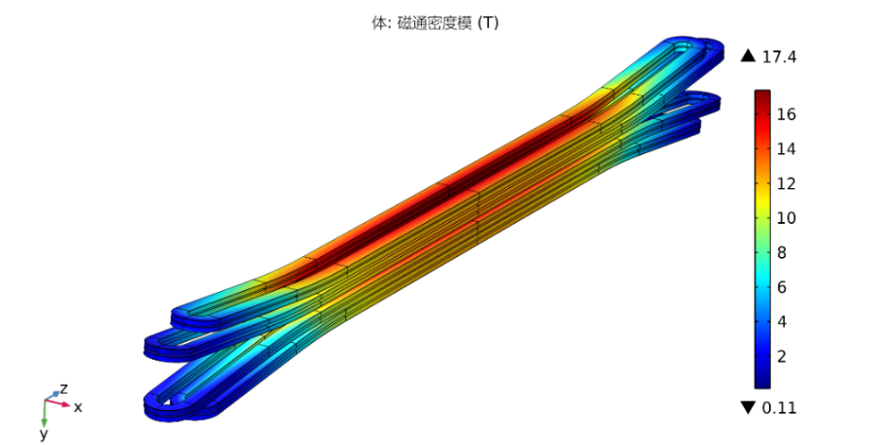
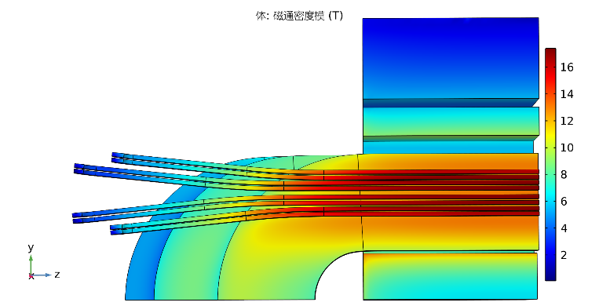

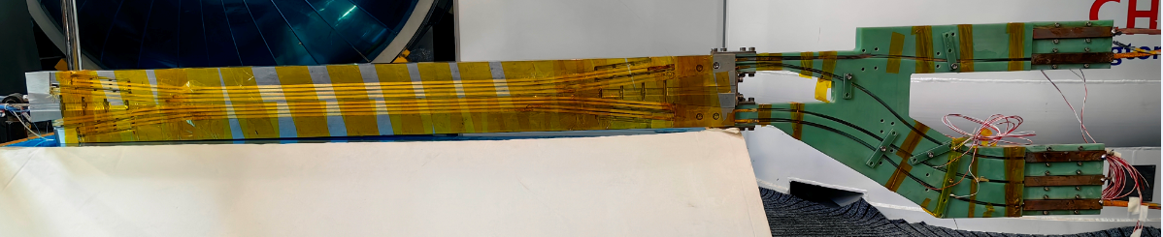
Development of the 16-T Model Dipole LPF3
The ReBCO block insert coils for LPF3
Ze Feng et al
Parameters | Values
L0 | 409.6 mm
L1 | 540.2 mm
Rhard | 800 mm
Aend | 6 °
R1 | 9.5 mm
Z1 | 120 mm
Coils wound with Insulated stacked ReBCO tapes
5

Slide 6

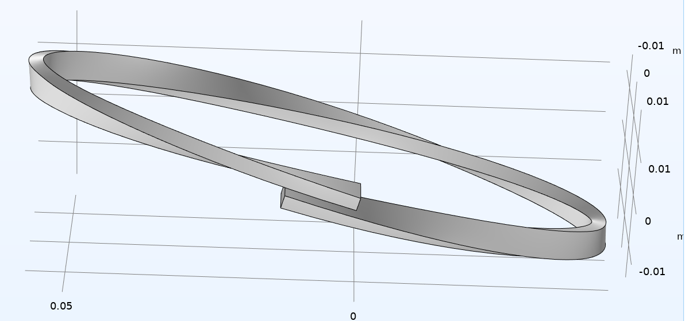
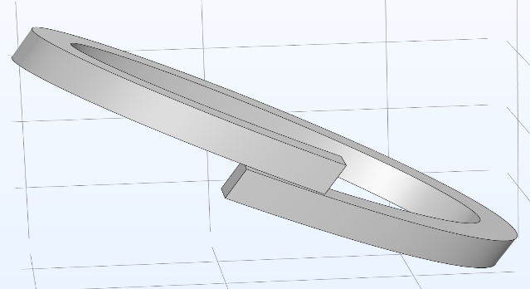
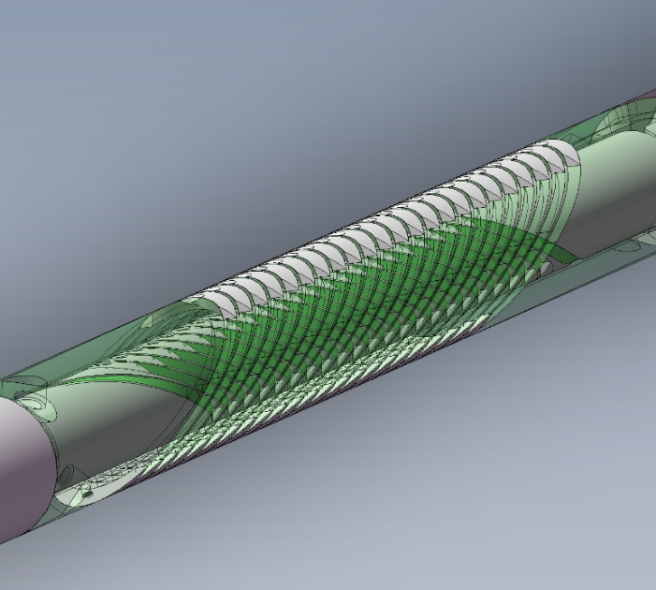
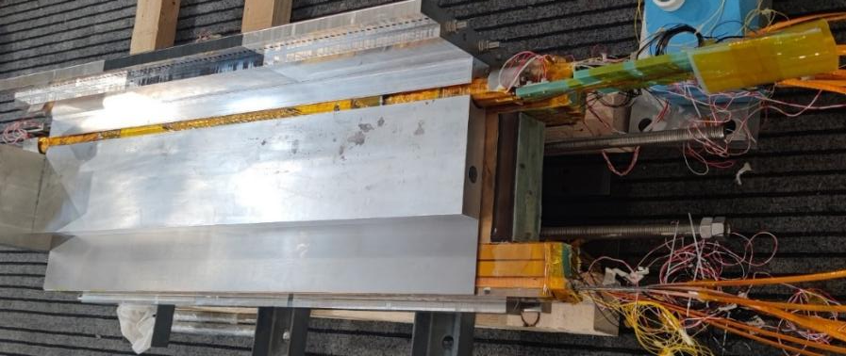
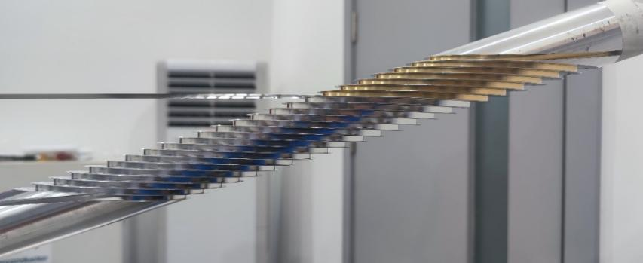
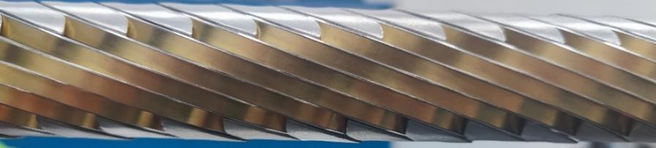
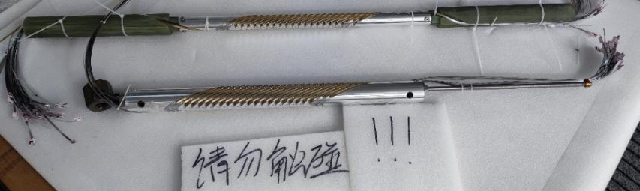
Development of the 16-T Model Dipole LPF3
The ReBCO CCT instert coils for LPF3
Rui Kang et al
典型CCT线圈结构示意
“斜螺线管”型CCT线圈结构示意
6

Slide 7
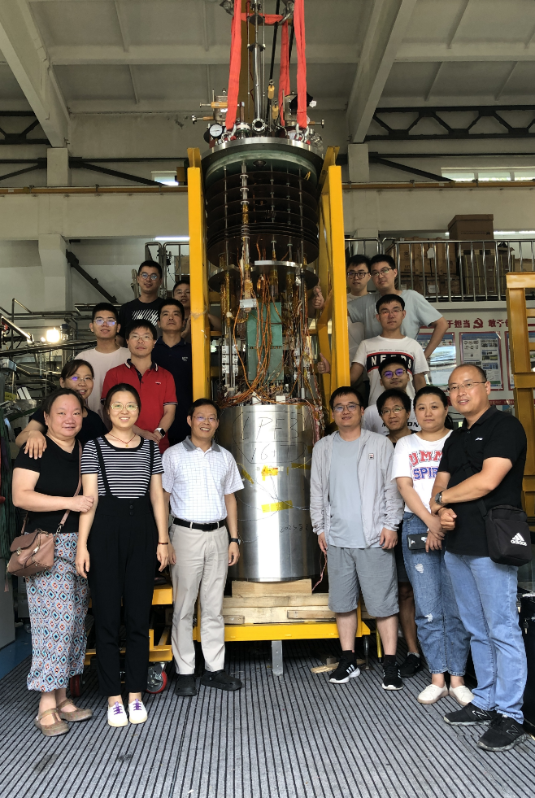
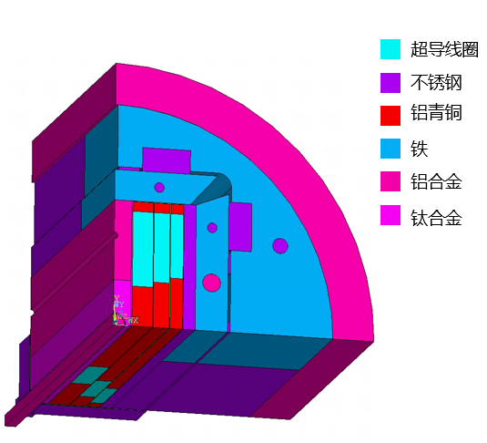
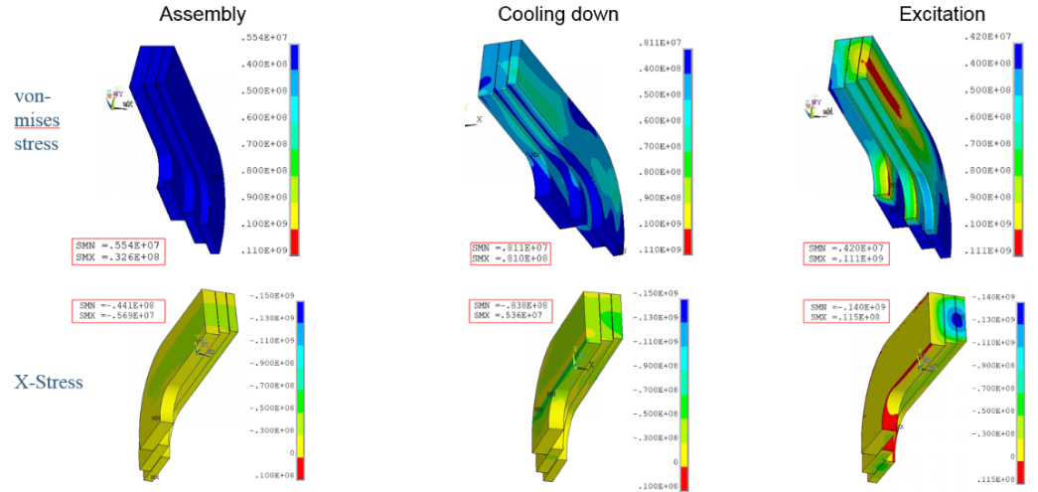
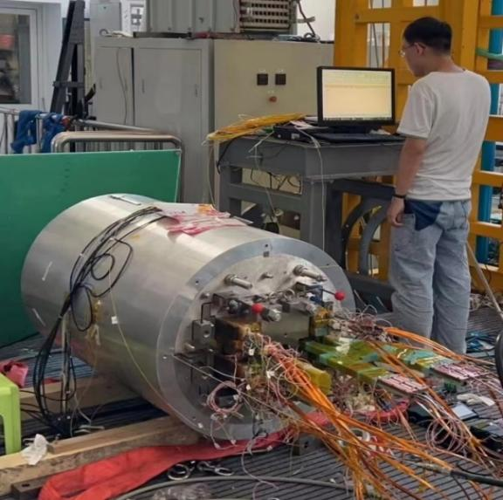
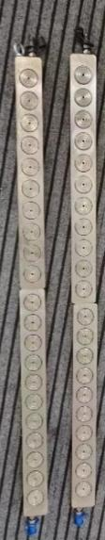
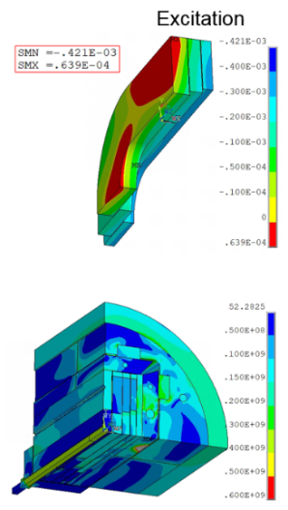

Development of the 16-T Model Dipole LPF3
Pre-stress and assembly of LPF3
Yingzhe Wang et al
Stress monitoring during
assembly with FBG
Pre-stress applied with commercial hydraulic jack
7
7
2023.8.29 Assembly completed

Slide 8




Development of the 16-T Model Dipole LPF3
Quench protection of LPF3
Jinrui Shi et al
Varistor plus CLIQ to protect the Nb₃Sn coils. The maximum hot spot is ~ 230 K
NI configuration plus dump resistor to protect the 2 HTS insert coils
Current decay curve at the operating current
8

Slide 9


Development of the 16-T Model Dipole LPF3
Performance test ongoing from Sep 2023
Wei Li et al
The Nb₃Sn coils were trained firstly, maximum current reached ~85% of I_{op} in Dec 2023, but showed an unstable plateau at 11 T due to one of the outmost Nb₃Sn coil, probably due to insufficient pre-stress during assembly, and enhanced field on most inner Nb3Sn coils due to the HTS screen current!
HTS block coil was ramped independently to 100% of I_{op} with negligible terminal voltage at 9 T background field
55 mm 双孔径
9

Slide 10





Development of the 16-T Model Dipole LPF3
Reassembly of the magnet with enhanced pre-stress
Xin Chen et al
2024 年 1 月
应变片监测磁体组装、降温、励磁过程
光栅光纤监测磁体组装及测试过程
10

Slide 11



Development of the 16-T Model Dipole LPF3
The 2nd Performance test in Feb 2024
The Nb₃Sn coils showed very unstable performance in the 6300-7000 A region due to one of the inner most coils, but finally passed this region and reached ~87% of I_{op} in the beginning of March 2024
HTS block coil was ramped independently to 120% of I_{op} to test its ultimate performance, but one of the leads was damaged due to the quench.
11

Slide 12















Development of the 16-T Model Dipole LPF3
Fabrication of the new Nb₃Sn & HTS Coils Jun. to Oct. 2024
Fabrication of the 2 new Nb₃Sn coils with OST wires
Preliminary test results of the new HTS coils at 77K
AP: 75 mm
75 mm
2180 A
12
Target field：10 T (LTS) + 6 T (HTS)
12

Slide 13








Development of the 16-T Model Dipole LPF3
Reassembly of the LPF3 magnet
LTS 线圈 + HTS 线圈桶外组装
线圈组件竖直吊装
线圈轴向找齐
LPF3-U 磁体组装
13

Slide 14



Development of the 16-T Model Dipole LPF3
Test of the LPF3-U magnet Nov. 2024 to Jan. 2025
Main challenges: The LTS coils are strongly coupled with the HTS coils in magnetic field and stress during LTS training. the HTS induced current enhance the field strength and stress of the adjacent LTS coils, and the frequent training quench of LTS cause irreversible degradation of the HTS coils.
Nb₃Sn coils reached 6905 A、9.6 T after 3 quenches, 97 % of the design value.
Strong coupling between HTS and LTS caused difficulties to the training process of LTS
Most of quenches occured in the most inner Nb₃Sn coils.
LTS still have great potential for performance improvement. More R&D needed on training tests……
Common-coil dipole with 78-mm gap
2024.11.22
LPF3-U 磁体组装完成
14

Slide 15

Development of the 16-T Model Dipole LPF3
Test of the LPF3-U magnet Nov. 2024 to Jan. 2025
LTS：9 T
The HTS coils subjected to several excitation tests in both self-field and 9 T background field, with a maximulatem excitation current of 2.5 kA (115 % of the design current) in 9 T background field.
HTS coils provide a magnetic field significantly below the design value: long delay, current short circuit inside the coil, and irreversible degradation.
15

Slide 16








Development of the 16-T Model Dipole LPF3
Damage of the HTS coils during the test with LTS
After disassembly, Serious damage of the outer coils was observed. could be caused by strong coupling (between LTS and HTS) induced electromagnetic forces during the training of the LTS coils.
Damage in interturn between layers
After testing, the coil surface is uneven
Layer insulation seriously damaged
Delamination in
the outer coils
16

Slide 17

Development of the 16-T Model Dipole LPF3
Refabrication of the new HTS coils
To reduce time constant , the interlayer insulation in the double-pancake coil was replaced from stainless steel to G10, polyimide and G10 were also added between the coil and the former
To mitigate the impact of LTS quench, testing of the HTS coil was conducted before LTS training. Additionally, high-purity copper and HTS tapes were deployed around the HTS coil to prevent rapid magnetic field variations during the quench
17

Slide 18

Development of the 16-T Model Dipole LPF3
Performance of the new HTS coils
The new coil achieved 7.05 T at 4.2 K under self-field, with relatively small field delay (time constant τ = 4 min)
The excellent performance before LTS powering confirms that the pre-stress does not damage the coil
However, when powering with LTS, 2 of 6 HTS coils damaged during an unexpected quench of LTS
HTS coils are being fabricated again with more improvements, to prevent damage during LTS quench, to be tested again in early June 2025
1970 A @ 7.05 T (with 20-mm aperture)
18

Slide 19

IBS Technology: Status and Outlook
19

Slide 20




IBS Technology: Status and Outlook
Quench propagation study of the IBS tapes and coils
Chunyan Li et al
20

Slide 21


IBS Technology: Status and Outlook
Quench propagation study of the IBS tapes and coils
Chunyan Li et al
In 15~17K, when the transmission current of iron-based superconductor is 14-179A, the corresponding NZPV value is 0.4– 7cm/s
21

Slide 22



IBS Technology: Status and Outlook
The First IBS Solenoid Coil at 35 T background field
Chunyan Li et al
I_{c} of Φ34mm-17 turns-DPC reached 49 A at 4.2 K and 35 T, world’s highest record
2024 Supercond. Sci. Technol. 37 015001
Fabricated a series-connected IBS coil consisting of six DP coils and tested at 35T background field
22

Slide 23

IBS Technology: Status and Outlook
Development of the ReBCO and IBS transposed cable
Juan Wang et al
23
J. Wang et al, Superconductivity 3 (2022) 100019

Slide 24





IBS Technology: Status and Outlook
Development of the world’s first 7-kA class IBS transposed cable
Juan Wang et al
24

Slide 25
Summary
Long-term advanced superconducting magnet R&D for future high-energy accelerators is ongoing at IHEP-CAS
16 T (Nb₃Sn+HTS) model dipole are being developed at IHEP-CAS. HTS insert coil has reached record-breaking dipole field, but many lessons learned regarding the strong coupling and protection of HTS and LTS coils during quench; very challenging and some key issues still to be solved
Strong domestic collaboration for the advanced superconductor R&D (HTS & Nb₃Sn): Significant improvement in J_{e} of IBS tape achieved in May 2025, IBS coil I_{c} reached 49A at 35 T. 7kA class IBS transposed cable successfully developed
Worldwide collaboration is expected to challenge the 20-T class accelerator magnets in the next 10~20 years
Thanks for your attention!
25

