Slide 1
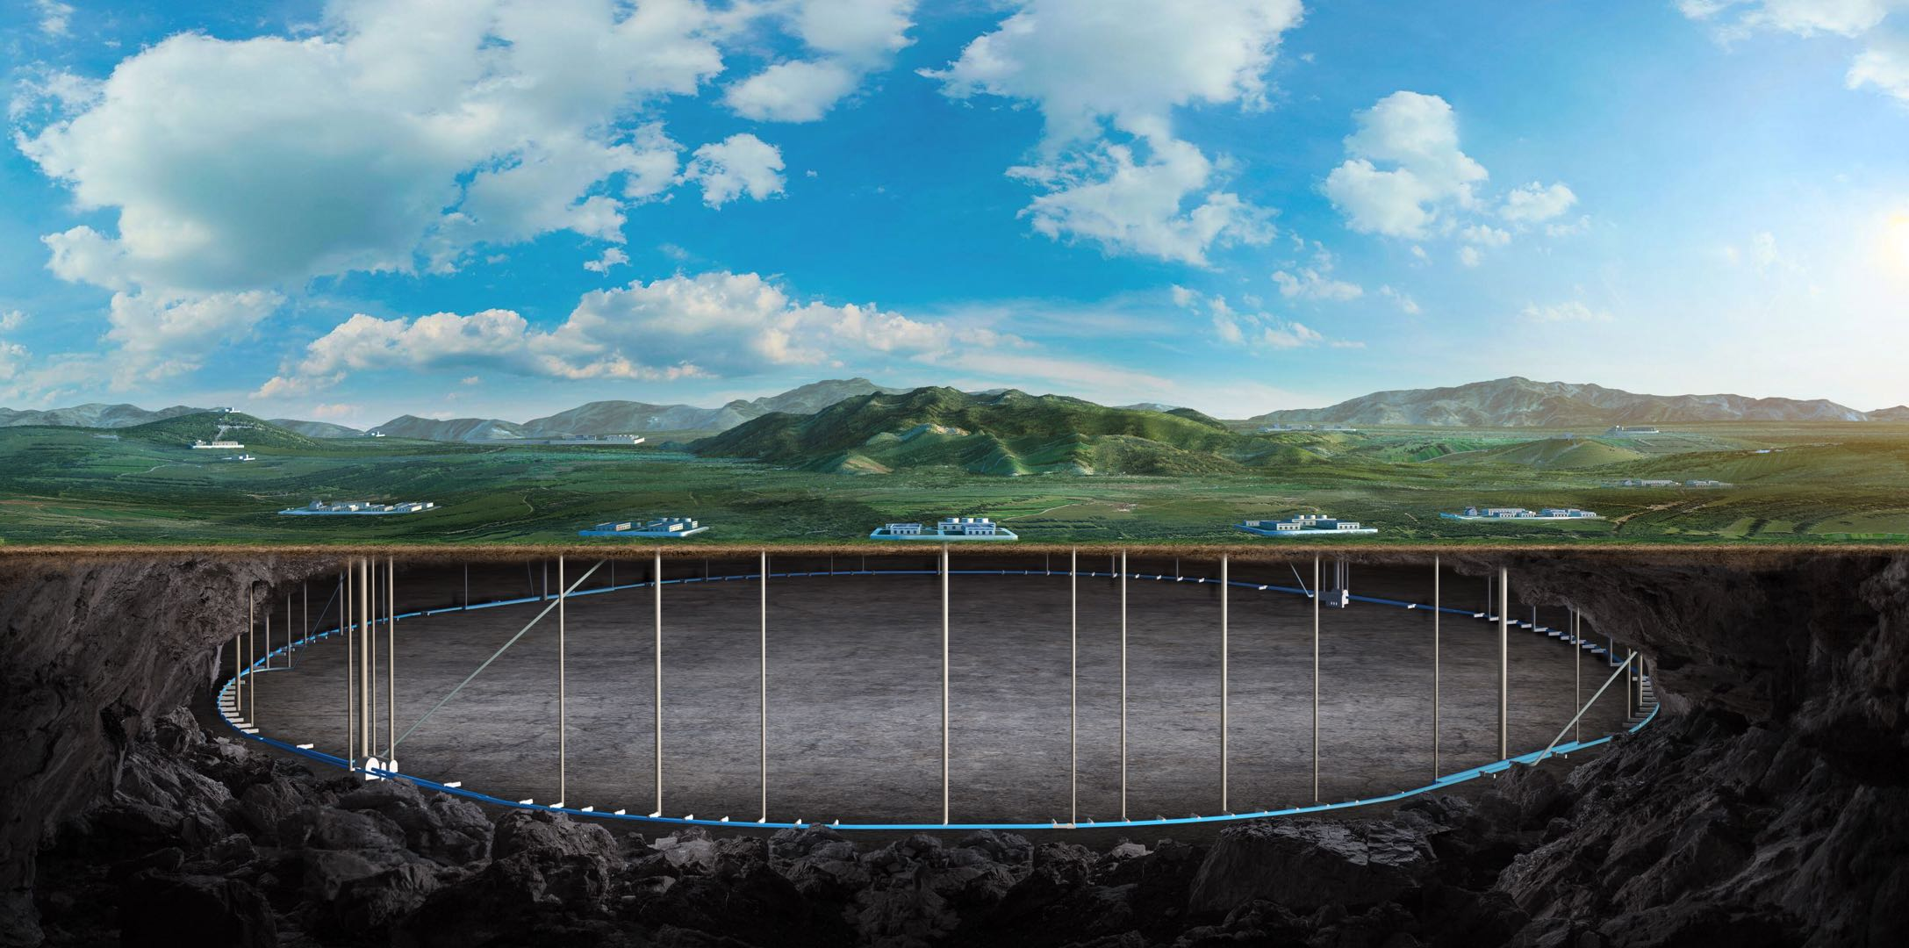
CEPC machine protection and radiation environment studies in EDR
Guangyi Tang
On behalf of CEPC RP Group and MP Group
17 Jun. 2025, Barcelona, CEPC Workshop EU Edition

Slide 2
Content
Radiation protection
EDR goal and scope
Progress in EDR stage
Machine protection
EDR goal and scope
Progress in EDR stage
Summary

Slide 3
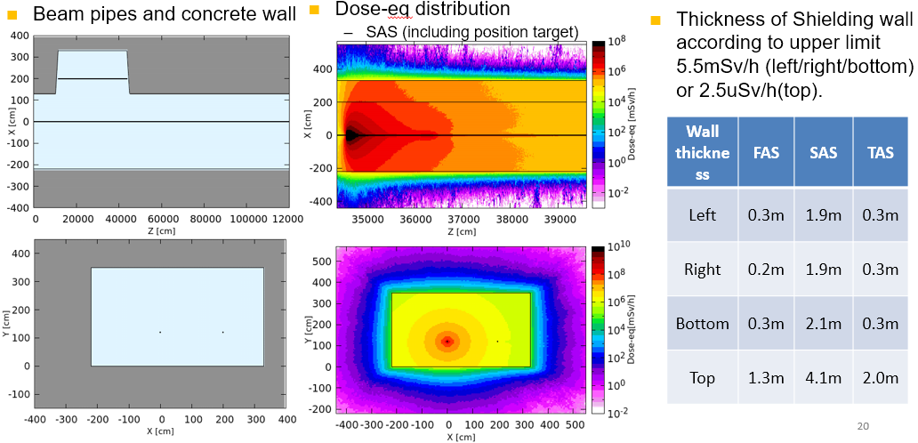
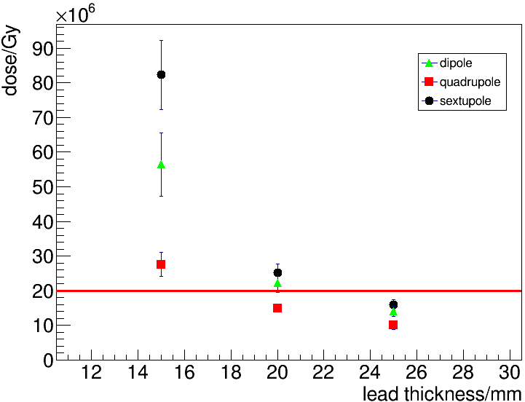
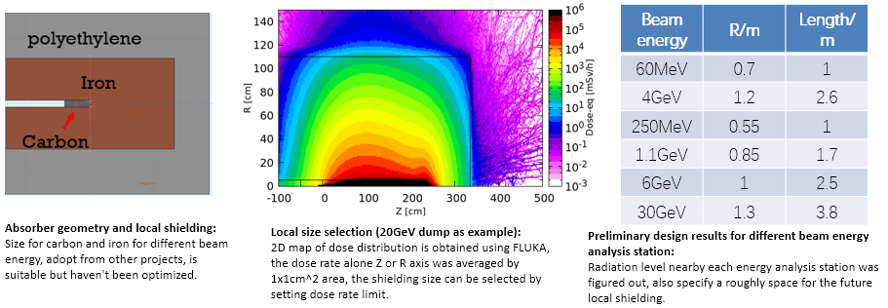
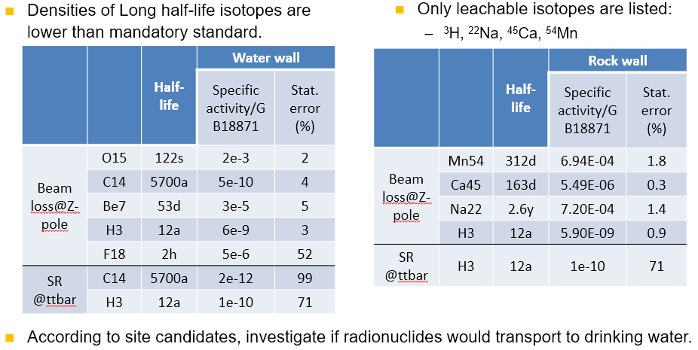
What we did in TDR
Estimate absorbed doses to booster and collider magnets and design lead shielding.
Absorbed dose after 18-year operation
Design linac and collider dumps
Determine linac bulk shielding
Radionuclide Production
In the air/water/tunnel wall in the linac/collider arc/dump hall

Slide 4
EDR goal and scope: radiation protection
Environment impact assessment of CEPC proposal
Prompt radiation estimation
In linac, collider/booster, damping ring, transport line, collimator, RF hall, IR hall, SR hall, dump hall.
Induced radioactivity estimation
In linac, collider/booster, damping ring, transport line, collimator, RF hall, IR hall, SR hall, dump hall.
Design radiation dose monitor system
Design personal protection system
Radiation-sensitive equipment protection for CEPC
Electronics: power supply, BPM, control system, etc.
Optical fiber
Cable/insulation
Engineering design: support, cooling, …

Slide 5
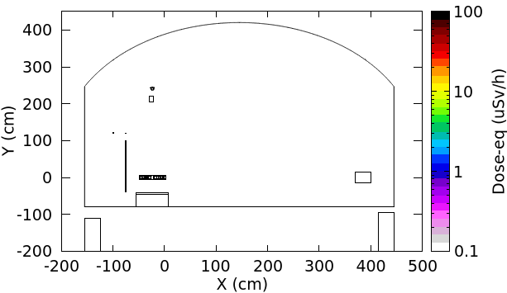
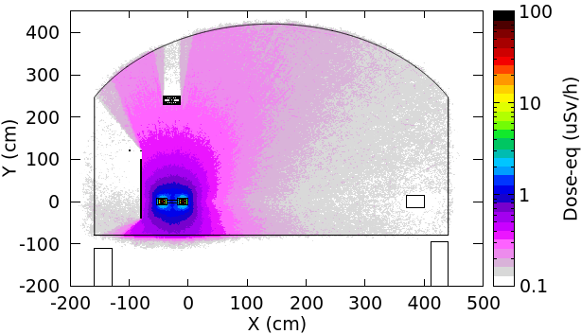
Induced dose-eq in collider tunnel, 10min after shutdown
For 4 operations (120/45.5/80/180 GeV), simulate the induced dose-eq caused by SR and random beam losses.
The dose-eq after 1-year running and 10-min shutdown is shown below
@Higgs operation：1m away from equipment <1 uSv/h，surface of equipment ~10 uSv/h
SR random beam losses
Similar radiation level around the end of BEPCII Linac.

Slide 6
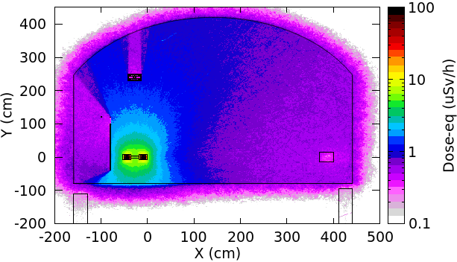
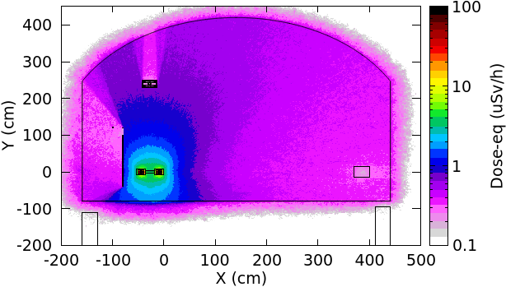
Induced dose-eq in collider tunnel, 10min after shutdown
@Z operation: 1m away from equipment <2 uSv/h， surface of equipment ~ 20 uSv/h
SR can be negligible
A little higher than radiation level around around the end of BEPCII Linac
@ WW operation: 1m away from equipment <1 uSv/h， surface of equipment ~10 uSv/h
SR can be negligible

Slide 7
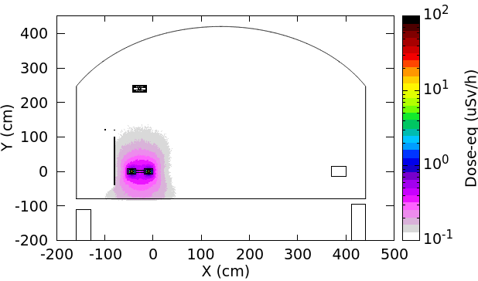
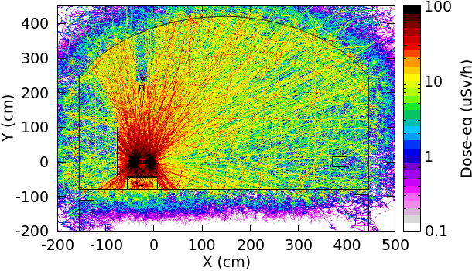
Induced dose-eq in collider tunnel, 10min after shutdown
@ttbar operation： 1m away from equipment <20 uSv/h， surface of equipment >100 uSv/h
SR random beam losses
Higher than the radiation level around BEPCII positron target.

Slide 8
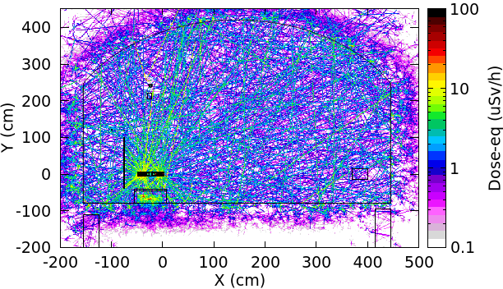
Induced dose-eq in collider tunnel, 1d after shutdown
@ttbar operation： 1m away from equipment <5 uSv/h， surface of equipment >10 uSv/h
SR
Slightly higher than the induced dose-eq @Z/WW operation.
All simulations are included in the environment impact assessment report.

Slide 9
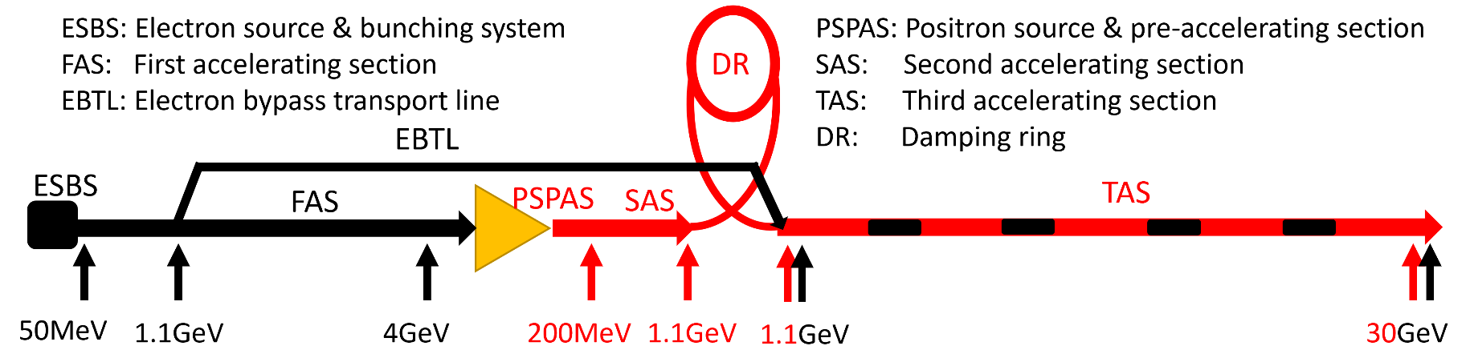
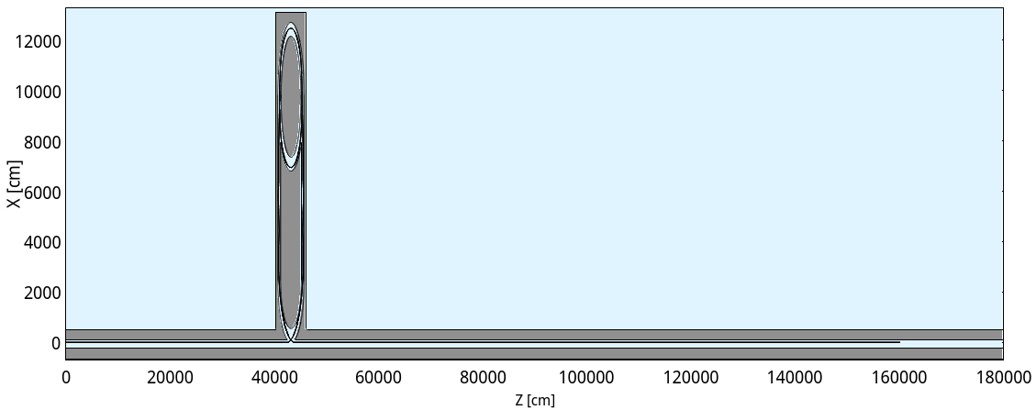
Linac & damping ring & Linac-DR transport line
Damping ring SR critical energy ~ 1 keV，negligible
Estimate
Linac/damping ring/ L-to-DR transport line bulk shielding
Radioactivity
Fluka setup
Damping ring
L-to-DR transport line
Linac

Slide 10
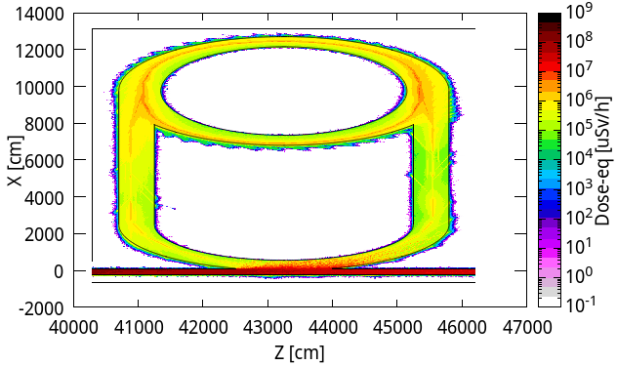
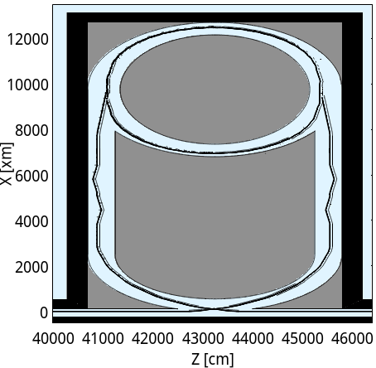
Linac & damping ring & Linac-DR transport line
Damping ring SR critical energy ~ 1 keV，negligible
Estimate
Linac/damping ring/ L-to-DR transport line bulk shielding
Radioactivity
Damping ring shielding
Damping ring and transport line
concrete
Position | Thickness of the wall
Inner | 0.5m
Outer | 3.0m
Bottom | 0.5m
Top | 1.2m
concrete

Slide 11
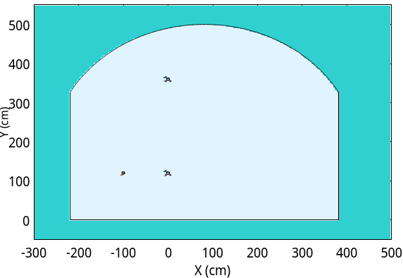
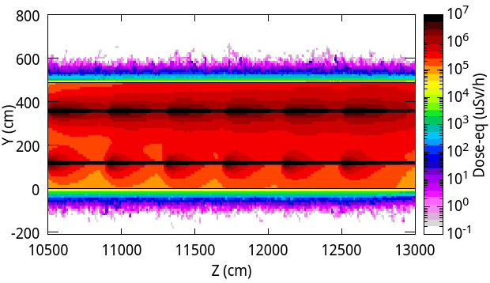
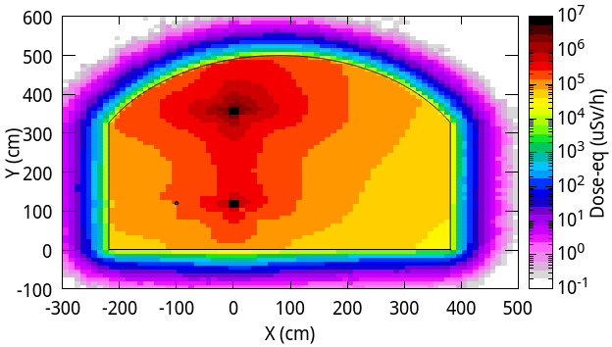
RF hall, transport line, etc.
The prompt radiation level and induced radioactivity are estimated.
The simulations for transport lines are also finished. The simulations for IR/SR hall are close to be finished. Will summary all results in the Environment impact assessment report.
Booster RF cavity
Collider RF cavity

Slide 12
Radiation protection for electronics
For electronics
With a 3-leg maze, radiation in the auxiliary tunnel decreases to a safe level
Alternatively, by shielding with 20cm lead and 20cm concrete, radiation in gaps between supports decreases to a safe level.
 | Upper limit | 3-leg maze with 1m-thick concrete wall | 20-cm lead + 20-cm concrete | 15-cm lead + 15-cm concrete
High energy hadron fluence (${cm}^{−2}{ y}^{−1})$ | $$2×{10}^{10}$$ | $$<3×{10}^{6}$$ | $$\text{< }3×{10}^{8}$$ | $$\text{< }6×{10}^{8}$$
Absorbed dose (Gy/y) | 20 | $\text{< }\text{1}\text{0}$ (1m far from entrance) | <20 | <80
1MeV equivalent neutron fluence (${cm}^{−2}{ y}^{−1})$ | $$2×{10}^{11}$$ | $$<3×{10}^{8}$$ | $$\text{< }3×{10}^{10}$$ | $$\text{< }4×{10}^{10}$$

Slide 13
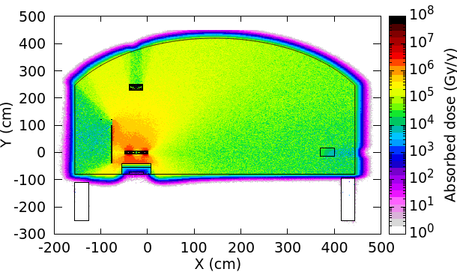
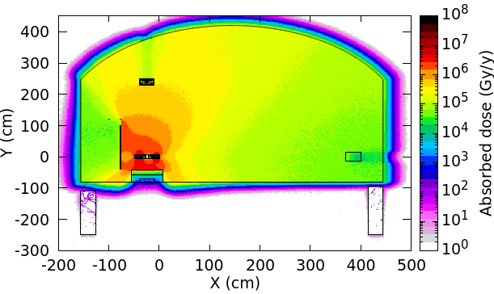
Radiation protection for fiber, cable insulation
Upper limit for ordinary optical fiber: absorbed dose < 100 Gy/y Upper limit for radiation-resistant optical fiber: absorbed dose < 10 kGy/y
Radiation-resistant optical fibers are safe in the inner trench with thicker-than-30-cm concrete cover and safe in the outer trench thinner-than-10-cm concrete cover.
Ordinary optical fibers need thicker cover or deeper trench..
For cables and insulations (polyethylene): absorbed dose <1 MGy
Use 2cm-thick 1m-high lead sheet, or 10cm-thick 1m-high concrete block to shield radiation.
 | Trench with no cover | Trench with 10-cm concrete cover | Trench with 30-cm concrete cover
inner trench | <400 kGy/y | <200 kGy/y | <40 kGy/y
outer trench | <50 kGy/y | <5 kGy/y | <300 Gy/y
Higgs
ttbar

Slide 14
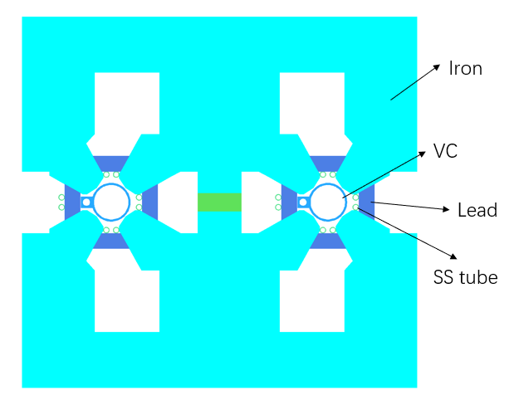
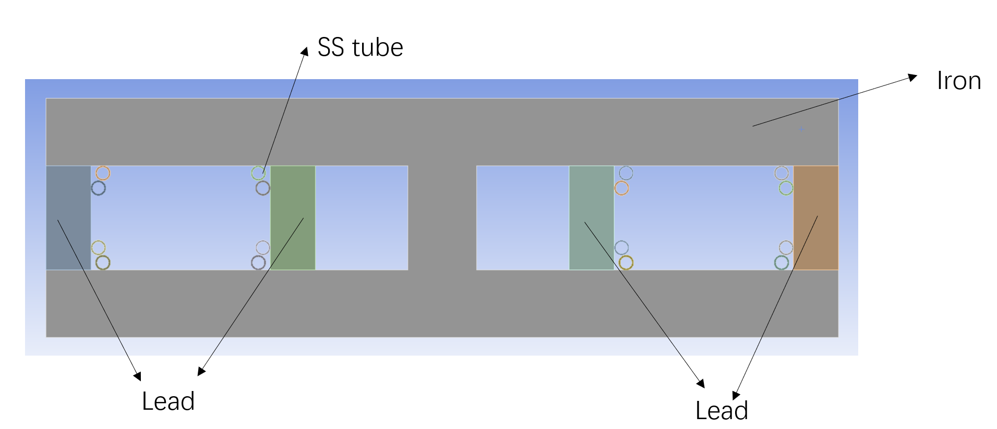
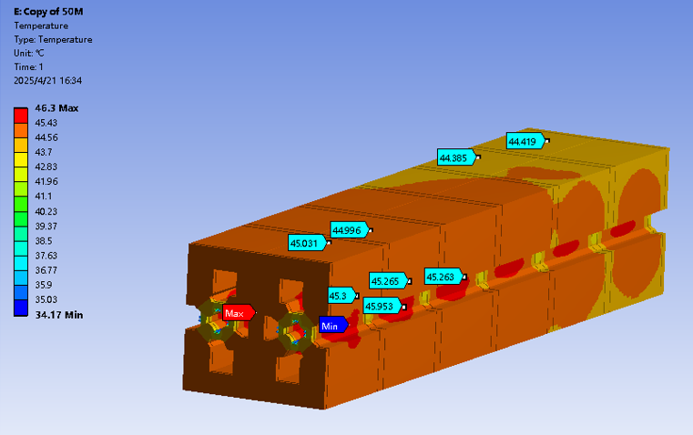
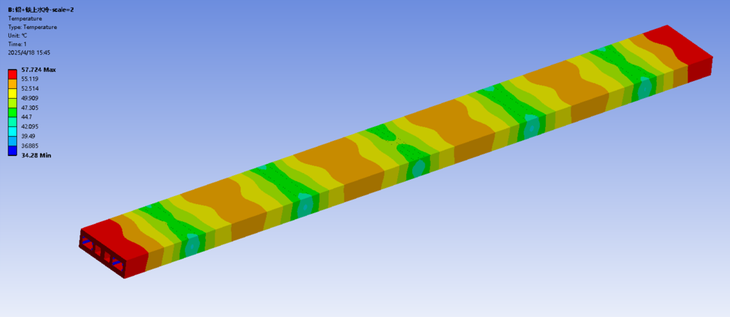
Water cooling in dipole and quadrupole
Mei Yang and Haijing Wang
To absorb deposited energy and cool the magnet core and lead, 8 stainless-steel tubes are used.
72% deposited energy in magnets and lead can be removed. The ventilation system load has been significantly reduced.
The experiment to fix SS tubes on lead is planed.

Slide 15
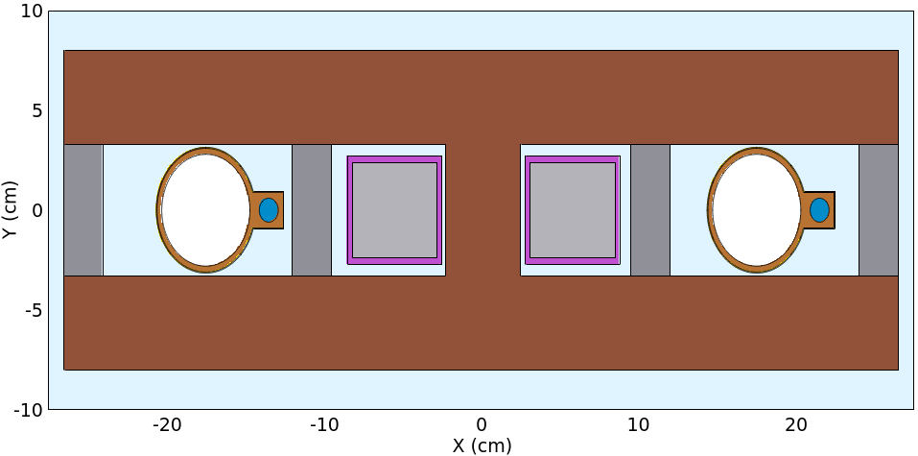
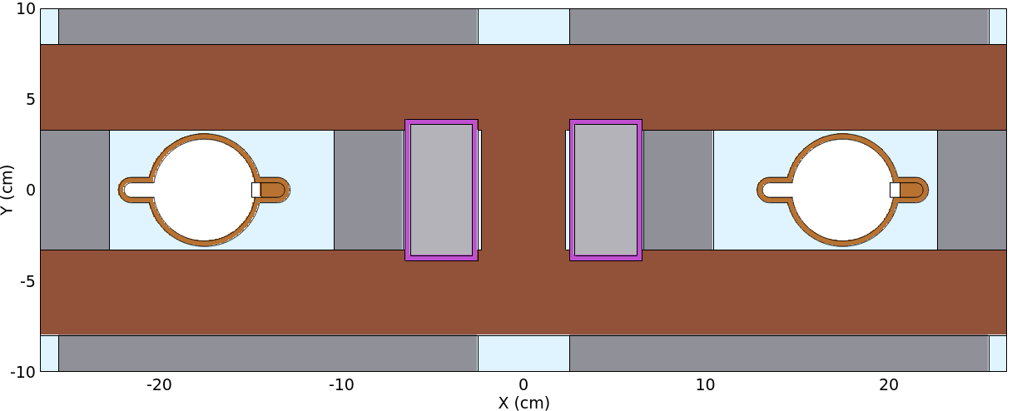
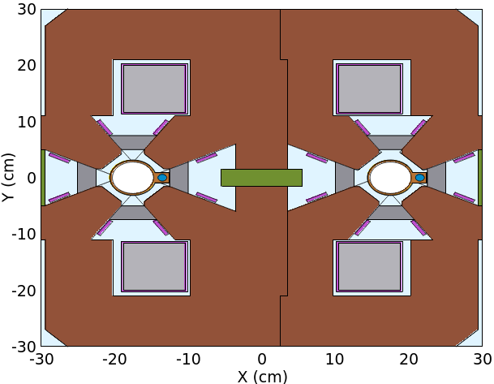
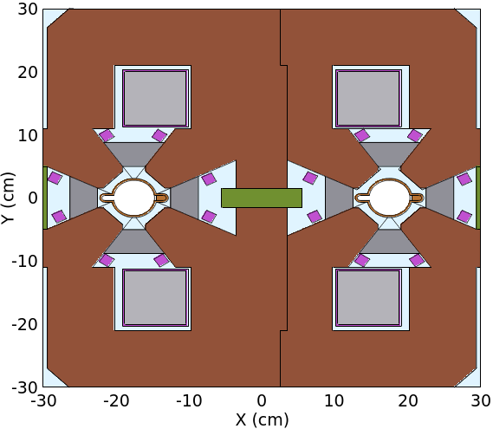
TDR shielding scheme v.s. photon absorber scheme
TDR scheme：25mm lead in magnet
The power and price are almost the same
Photon absorber scheme ：38mm lead in dipole and quadrupole, extra lead cover on dipole
dipole
quadrupole
Mei Yang

Slide 16
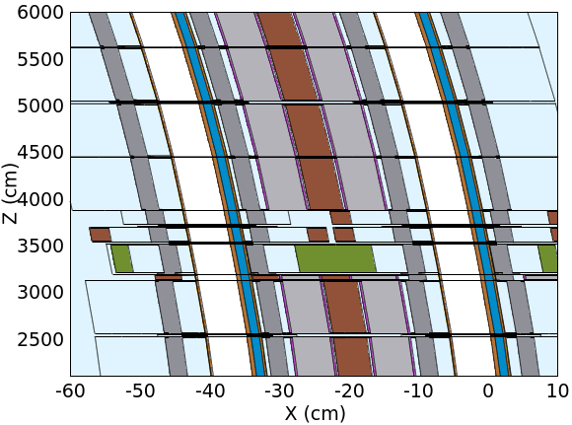
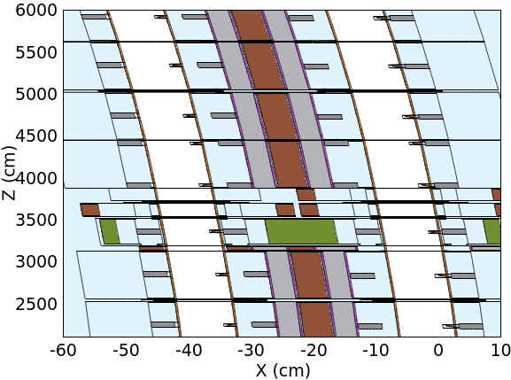
Beamline arrangement
TDR scheme
25mm thick lead
Photon absorber scheme
Photon absorber and lead shields
dipole
Sexto
quadru
dipole

Slide 17
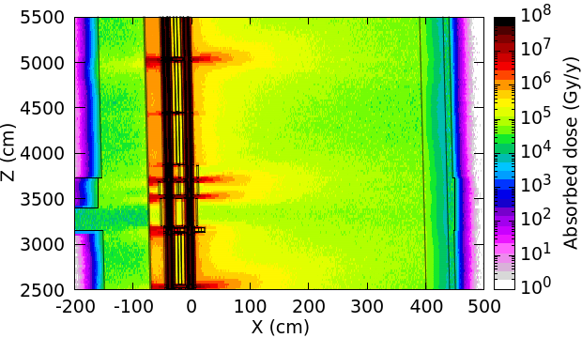
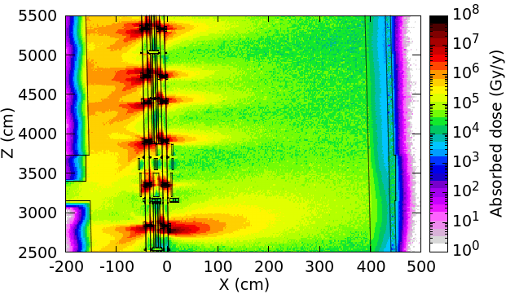
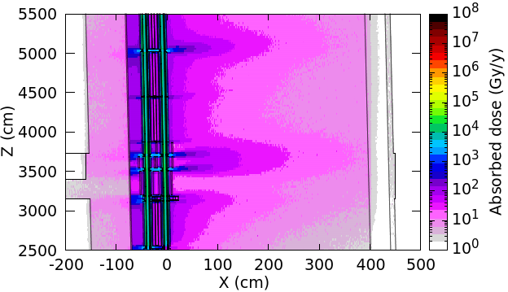
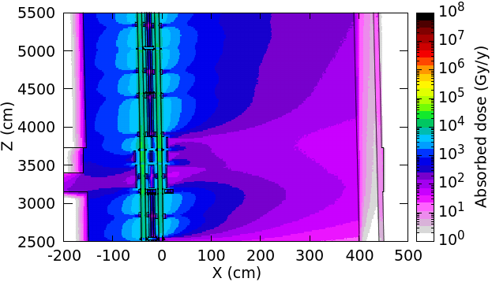
Prompt absorbed dose：@ttbar SR and Z beamloss
TDR @ttbar SR
@Z beamloss
The absorbed dose in the inner side is higher, indicating that need to optimize the lead usage.
Photon absorber scheme

Slide 18
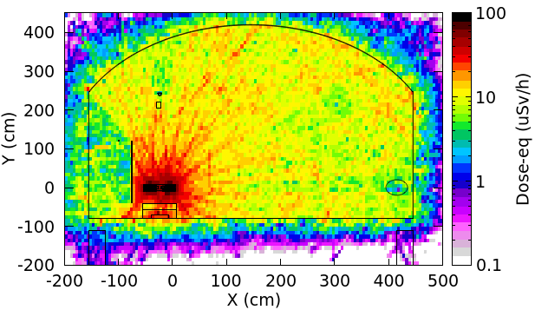
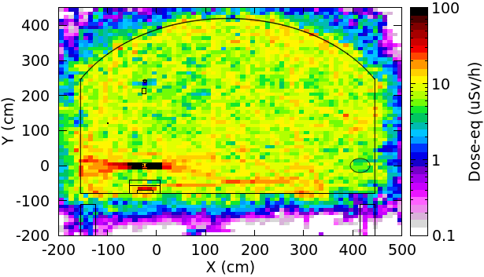
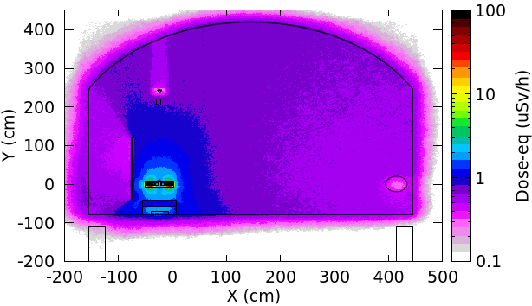
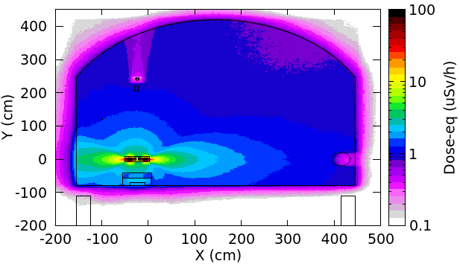
Induced dose-eq in collider tunnel, 10min after shutdown
TDR scheme
@ttbar SR
For TDR scheme, @ttbar operation, the induced dose-eq is higher, it is better to wait more time
@Z beamloss
@Z operation, the radiation level using TDR scheme is better.
Photon absorber scheme

Slide 19
Content
Radiation protection
EDR goal and scope
Process in EDR stage
Machine protection
EDR goal and scope
process
summary

Slide 20
EDR goal and scope: machine protection
Active protection: beam dumps and corresponding transport line
The engineering design for the dumps, kickers and septum.
Design the control system for the collider dump
Passive protection: collimation system
Simulate the beamloss distribution under different beam loss scenarios
Develop tools to simulate beam-collimator interaction
Further study to understand whether MP collimators can help to control beam-induced backgrounds near the IR, combining with MDI collimators and SR masks.
Determine the collimator parameters
Engineering design for collimator.

Slide 21
Design boundary conditions and Beam losses scenarios
Currently, focus on 5 beam loss scenarios:
Superconducting RF cavities/magnets quenching, a power supply of magnets breakdown (affect 1/8 of all dipoles, or several quadrupoles, or several sextopoles)
The fields decays according to an exponential function: $V(t) = V\left(0\right)Exp(−\frac{t}{τ})$. For superconducting RF cavities quenching cases: $τ=773 μs \sim 2 turns$ For superconducting magnets quenching cases: $τ=10 ms \sim 30 \text{turns}$ For magnet power supply breakdown case: $τ=10 ms \sim 30$ turns
The bottom line of the passive protection system is to ensure that the IR is not damaged and protect all equipment except the collimators. If we did better, the collimators can be protected
Hits and deposited energy in IR should be in a low level
The temperature rise should be lower enough. E.g. deposited energy in one bellow should be lower than 10J

Slide 22
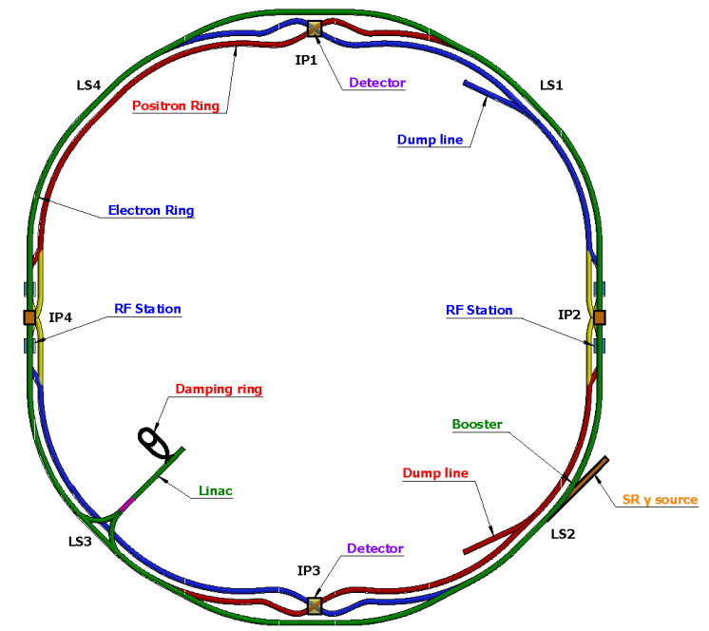
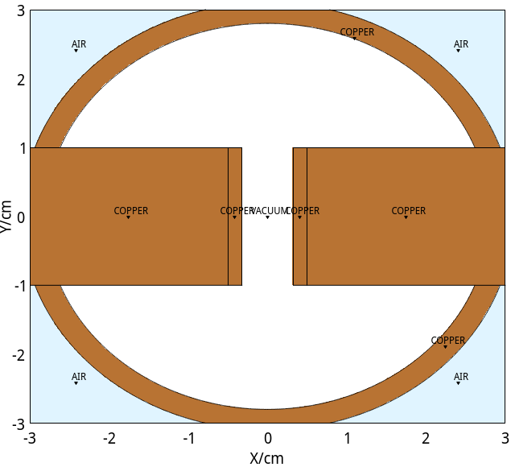
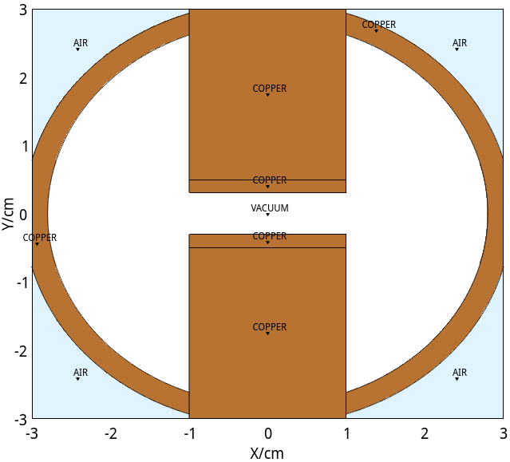
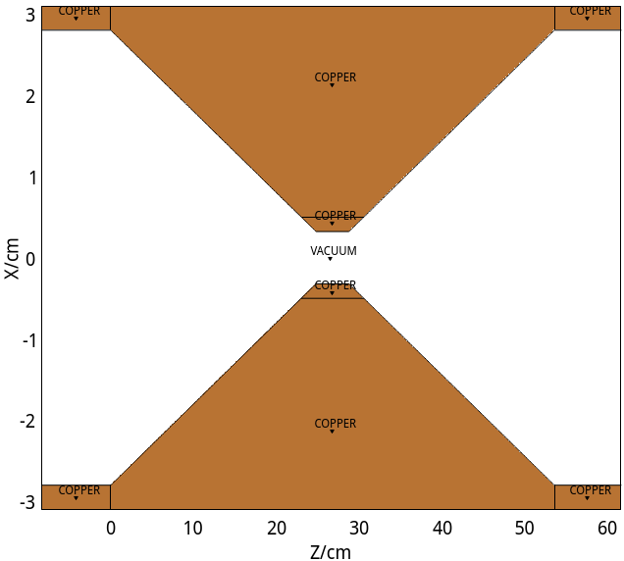
Collimators setup
33 collimators for each ring (@Marseille workshop, the number is 58)
19 MDI collimators and 2 SR masks (see Haoyu’s talk tomorrow)
4 horizontal betatron collimators, , in the straight sections
4 momentum collimators, , in the arc sections
4 vertical betatron collimators, , in the straight sections
Two types: horizontal/vertical collimator
Aperture: 3~4 mm
Material: Molybdenum – Carbon composite
y
y
x
x
horizontal collimator
x
vertical collimator
z

Slide 23
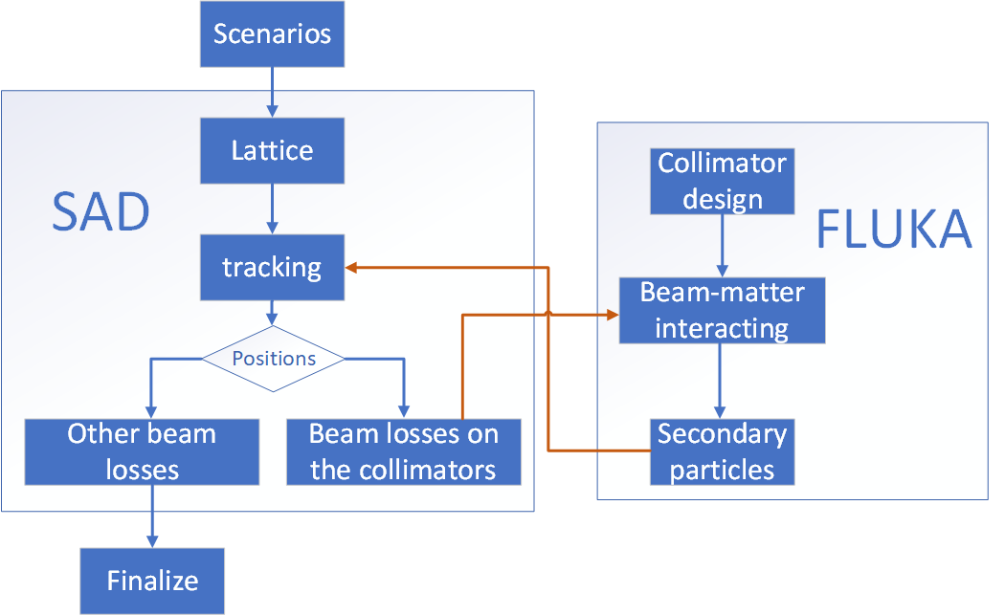
Combine SAD and FLUKA
Different scenarios can be set in SAD simulation.
Beam losses along beam pipe/collimators will be record.
All processes that beam losses hitting collimators would pass to FLUKA simulations, then secondaries send back to SAD.
What’s new: the kicker and septum for the extraction line to collider dump are added in the SAD simulation to study the extraction efficiency.

Slide 24
Primary results: @Z operation
One-power-supply-breakdown case: beams begin to loss after tens of turns.
Have enough time to extract beams
Superconducting-RF-cavities-quenching case: beams begin to loss after 12 turns.
Have enough time to extract beams, too
Superconducting-magnets-quenching case: beams begin to loss at the first turn.
Extract nothing even though the response time of extraction line is set to be 1 turn.
For Higgs/WW/ttbar operations, the similar simulations will be finished soon.

Slide 25
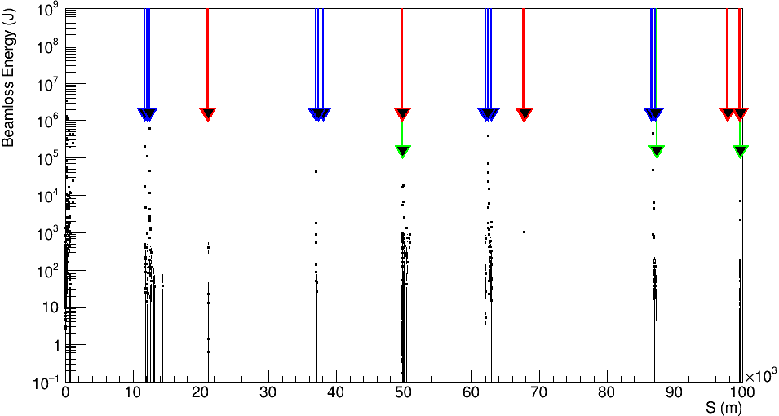
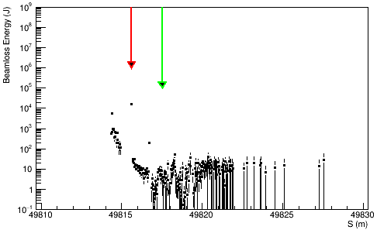
Primary results: @Z operation
SC-magnets-quenching case is the most critical one. In some region, the beamloss energy is around 1MJ.
The collimators are damaged probably, careful simulation is on the way to find out whether the downstream equipment survived or not.
The next version may be coming.
IP and beam dump
MP collimators
MDI collimators and SR masks

Slide 26
Summary
For the environment impact assessment, all shielding designs and radiation level estimations are finished or closed to be finished
Collider arc, Linac, damping ring, transport lines, RF hall are finished.
IP hall and SR hall will be finished soon
Radiation-sensitive shielding design is moving forward with engineering design.
For the machine protection, more simulations for different operations are coming. The radiation level downstream collimators will be carefully studied. The collimator optimization is ongoing.
Thank you

