Slide 1






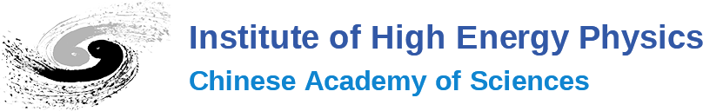



Aurélien MARTENS
Compton polarimetry activities at IJCLab
Aurélien MARTENS
Relying on collaborations with
And partial funding from
The research leading to these results has received funding from the European Union's Horizon Europe MSCA under grant agreement no. 101086276

Slide 2
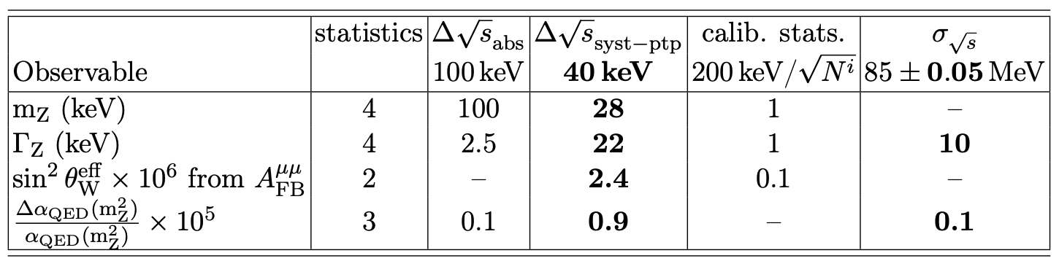
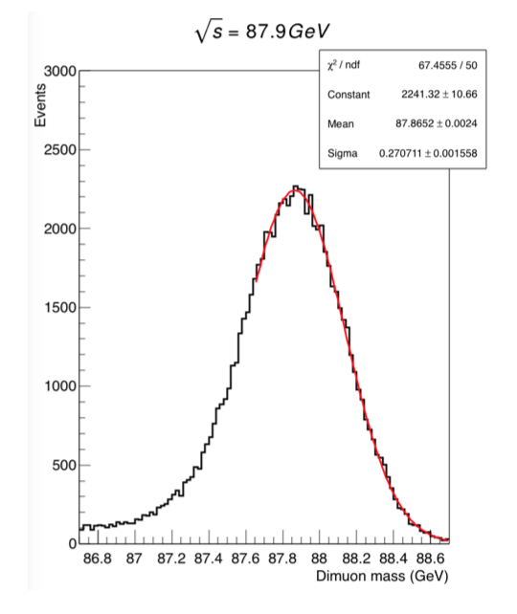
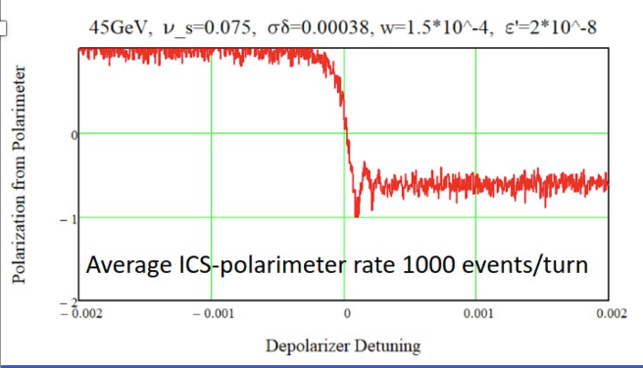
Example: Energy calibration at FCC-ee
Extreme precision on the electroweak bosons masses and widths at the core of FCCee physics program
Required accuracy of ~1ppm
Muon pairs
Blondel et al., arXiv:1909.12245
Resonant depolarization
Wise admixture of precise detector data and 24/7 operable measurement of depolarization

Slide 3
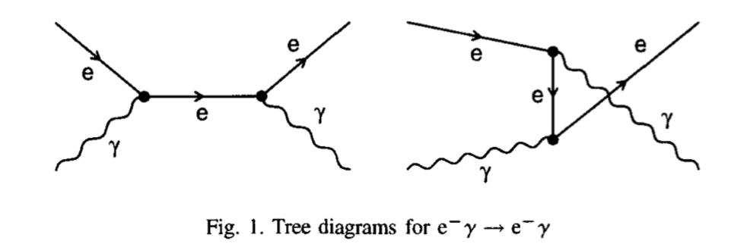
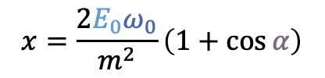
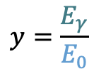
Compton polarimetry
$$x=\frac{2E_{0}ω_{0}}{m^{2}}\left(1+\cos{α}\right)$$
$$y=\frac{E_{γ}}{E_{0}}$$
The Compton cross-section averaged over scattered particles spins:
Differential cross-section
Transverse laser polarisation: nuisance parameter to minimize and keep under control
Transverse electron beam polarisation: intervenes as an asymmetry in the transverse plane
Berestskii & Lfshitz QED textbook
$$\frac{dσ}{dydφ_{obs}}\left(x,y\right)=\frac{dσ_{0}}{dy}\left(x,y\right)+\frac{dσ_{⊥}}{dy}\left(x,y\right)\cos\left(2\left(φ_{obs}−φ_{las}\right)\right)𝒫_{L}^{las}+\frac{dσ_{∥}}{dy}\left(x,y\right)𝒫_{C}^{las}(P_{T}f_{T}\left(x,y\right)\cos\left(φ_{obs}−φ_{elec}\right)+P_{z}f_{z}(x,y))$$
Electron beam polarization independent
Electron beam polarization dependent
⚠️ But small opening angle of scattered particles:
  Electrons → spectrometer
  Photons → difficult to measure asymmetric distribution of a narrow spot → long lever arm needed
Required for energy calibration at colliders but also for polarisation monitoring when polarized beams are colliding (SuperKEKB upgrade, EIC, Linear colliders, CEPC)

Slide 4
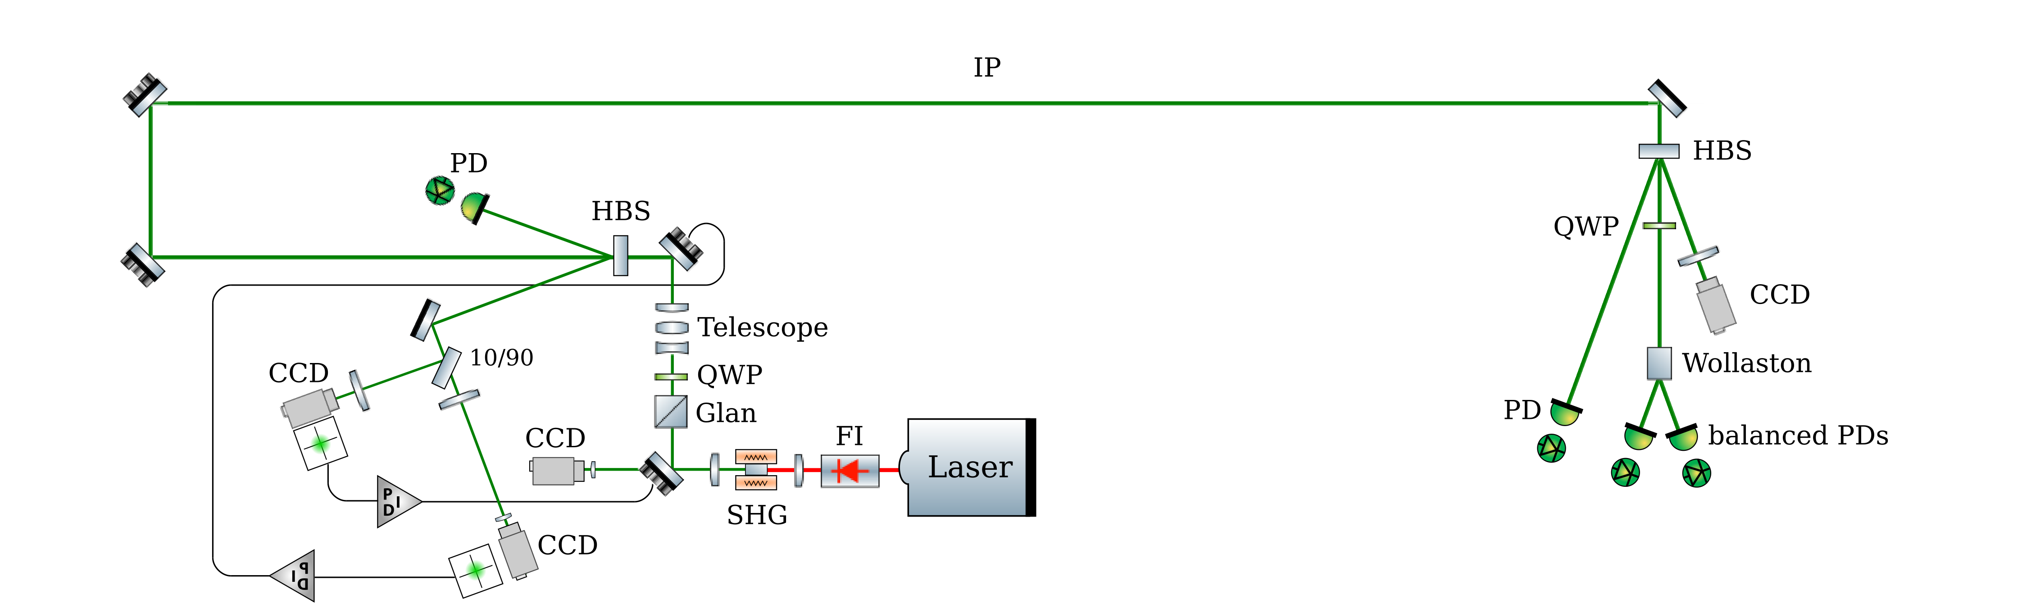
Laser system
Possibility to insert mirror
for laser polarization calibration
250MHz
D. Charlet et al., 2023 JINST 18 P10014; S. Banerjee, M. Roney et al., arXiv:2205.12847
Box with rough temperature control
Box with rough temperature control
design inspired by previous polarimeters
Elliptic beam can be delivered with cylindrical lenses/mirrors
Laser system located in tunnel (SuperKEKB polarization upgrade project) or in nearby laser room (Higgs factories)
24/7 operable laser system, with full monitoring, remote control
Key aspects:
remote operation of the laser system
Keep relatively short laser transport line
Laser e+- beam interaction chamber
Synchronisation
Laser polarization control
Only selected elements discussed in the following

Slide 5
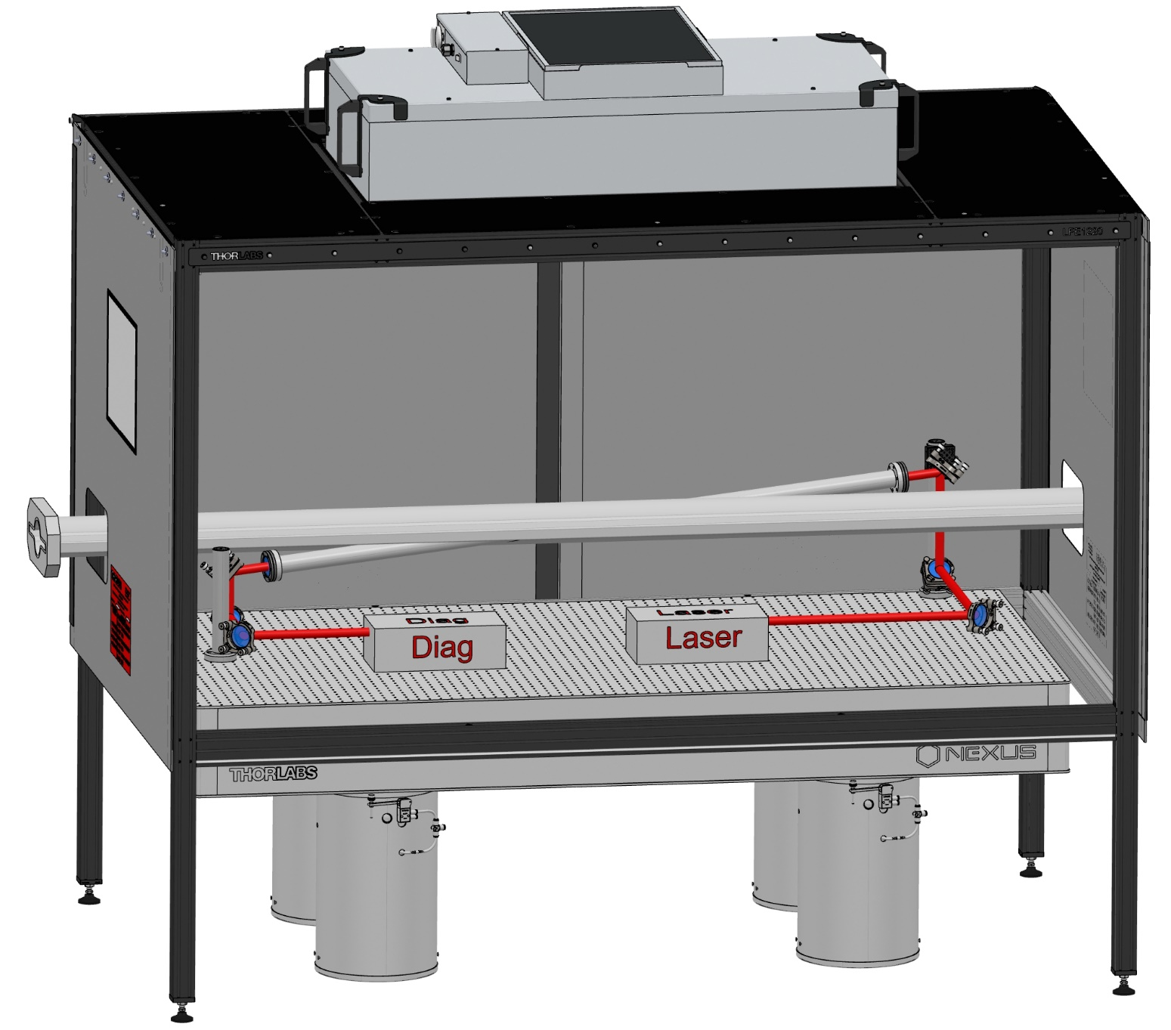
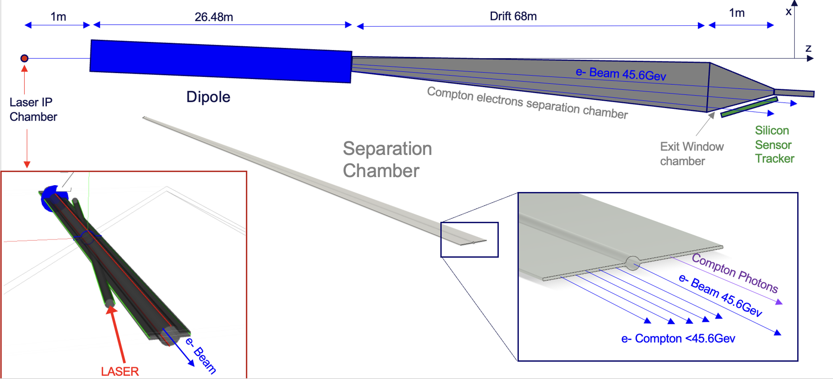
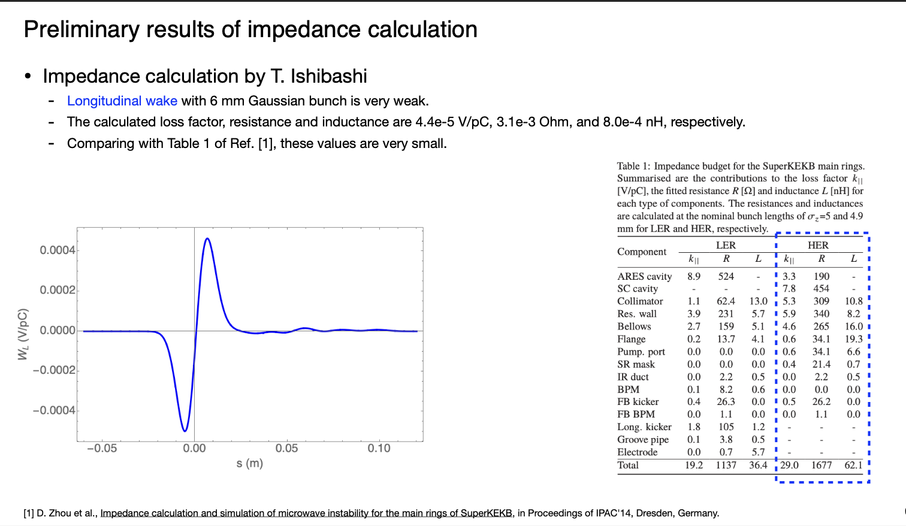
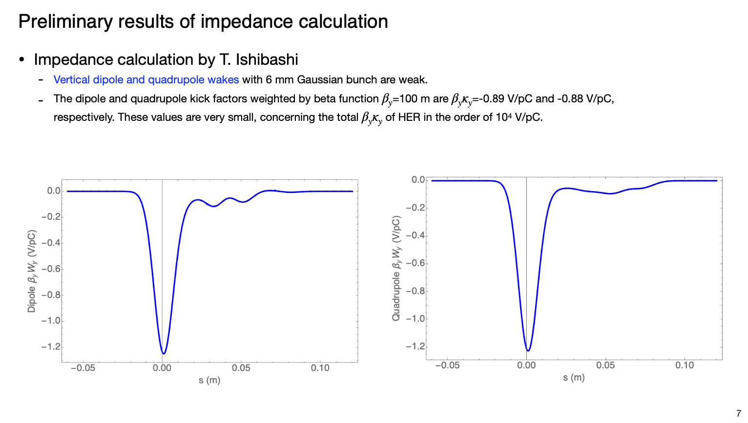
Interaction chamber
inspired
D. Charlet et al., 2023 JINST 18 P10014; FCC-ee Feasibility Study report.
FCC-ee design
SuperKEKB design
Negligible induced wakes : 10⁻⁵-10⁻⁴ relative contribution
(SuperKEKB)

Slide 6
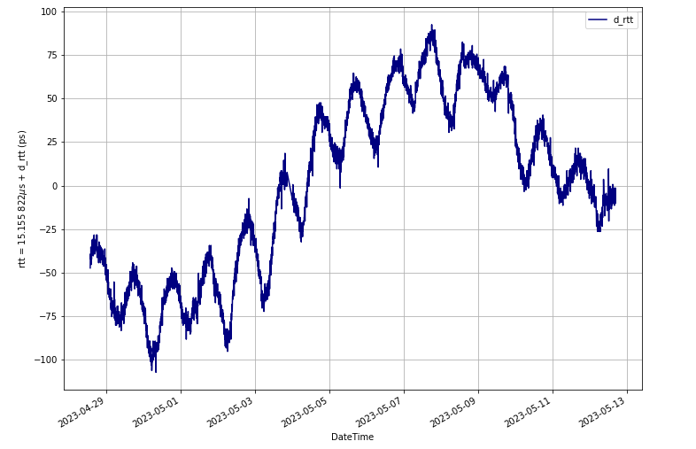
Laser synchronisation
Passive modelocking laser
  10-1000Mhz pulse repetition rates → perfect match to accelerator characteristics
  Picosecond pulse durations → similar to electron beam bunch length
  Easily amplified to several (tens, hundreds) Watts → statistical precision is met
A clock to be synchronized to that of accelerator
  Can be located kilometers away from the accelerator reference clock
Time propagation delay (ps) in optical fiber over time
Very expansive optical interferometric compensation systems
200 ps → too much !
New technologies provide simpler, cost effective solutions to that feature

Slide 7

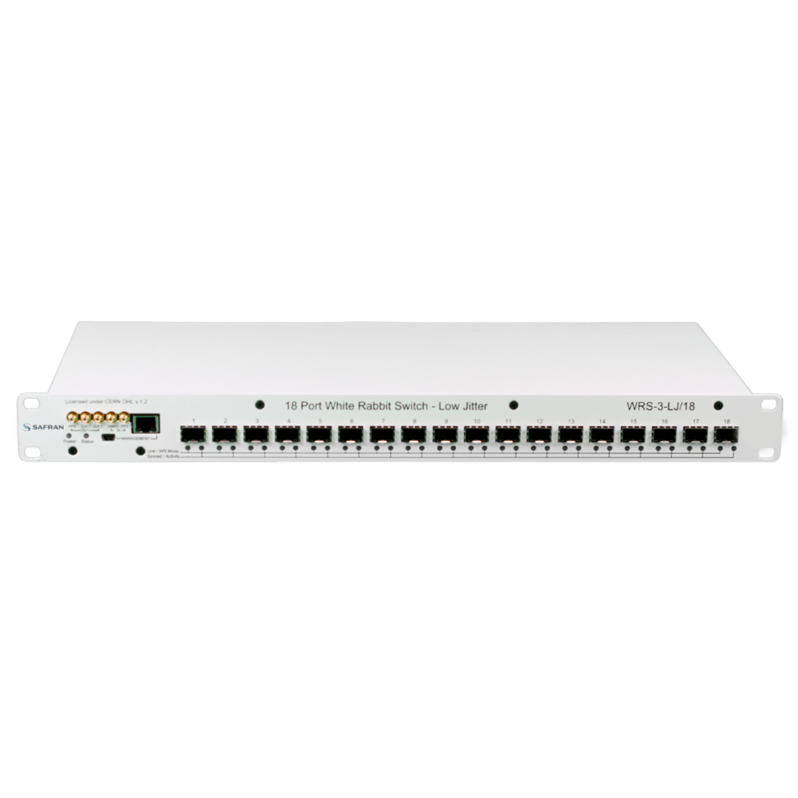
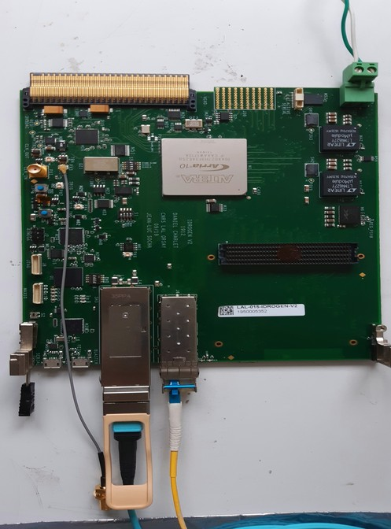
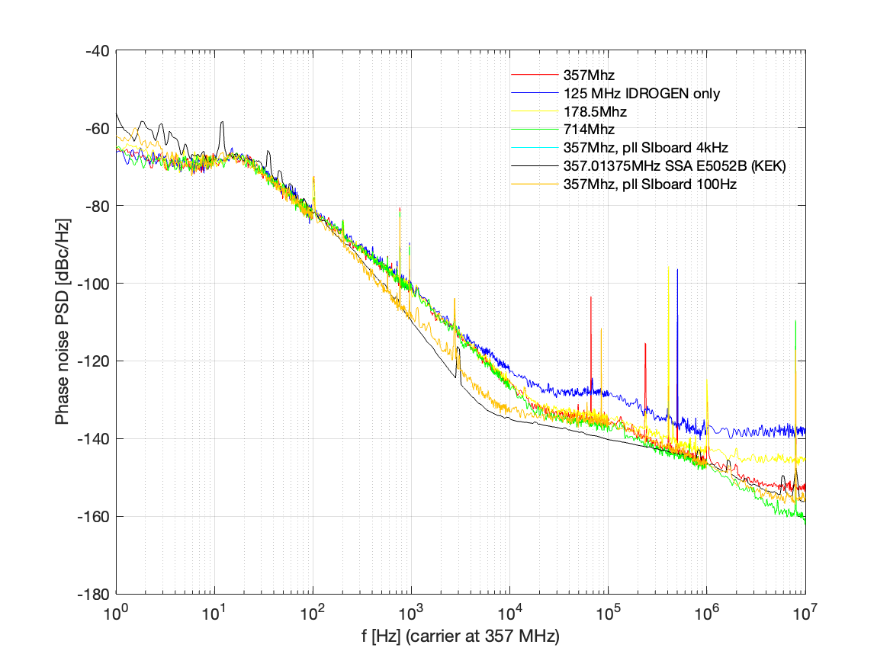
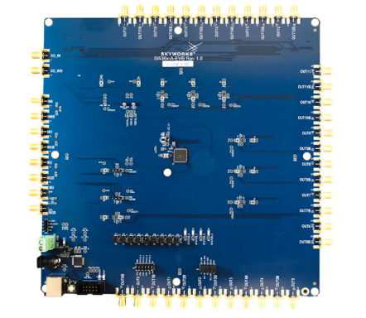
WhiteRabbit synchronisation scheme
Master Oscillator (510MHz/51)
IDROGEN board
tailored for low noise with WR node
FPGA mezzanine card with high speed ADC
Extension board with arbitrary frequency generation chip integrated
WhiteRabbit switch
RF
Several km fibre link
Validated w/ several exprimental setups
Arbitrary frequency
<1.6ps RMS jitter [1Hz, 10MHz]

Slide 8
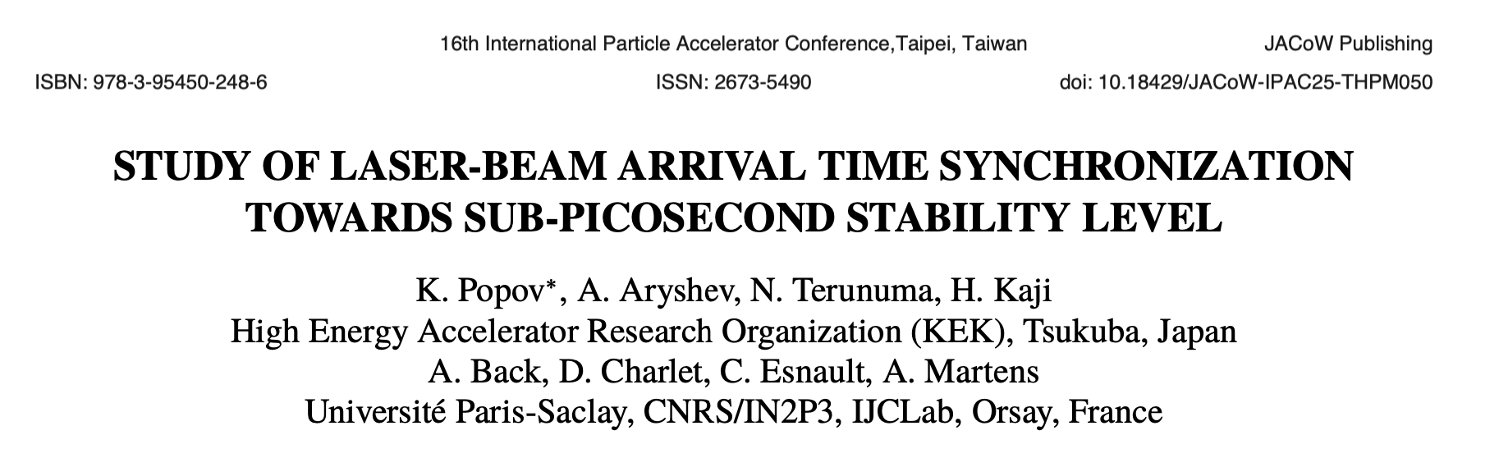
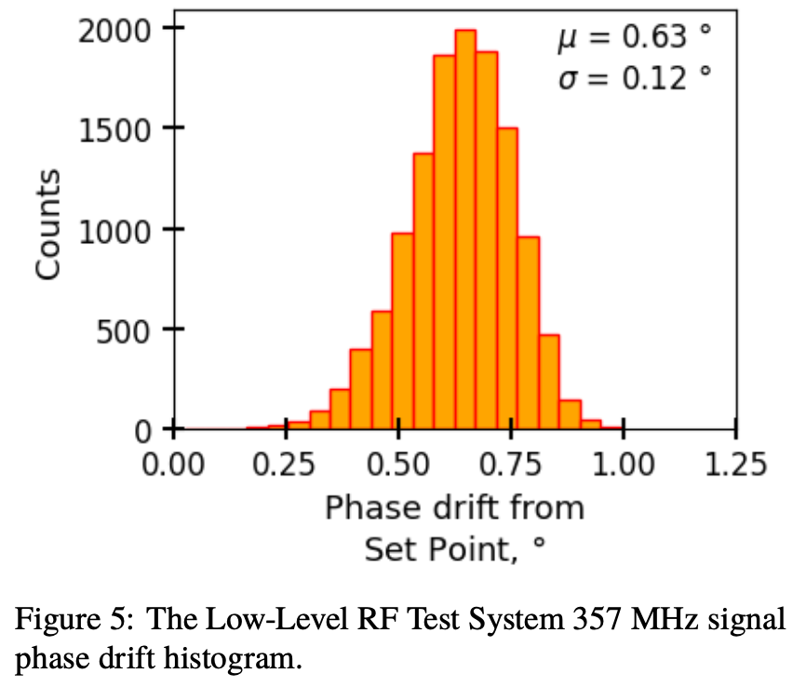
Long term stability
Master Oscillator (510MHz/51)
IDROGEN board
tailored for low noise with WR node
FPGA mezzanine card with high speed ADC
Extension board with arbitrary frequency generation chip integrated
WhiteRabbit switch
K. Popov et al., IPAC25 proceedings, THPM050
RF
Several km fibre link
Real life test in accelerator operation on-going at KEK ATF
Arbitrary frequency
i.e. 0.9ps RMS jitter over 3.5h

Slide 9
Laser polarisation control
Differential cross-section
Transverse laser polarisation: nuisance parameter to minimize and keep under control
Laser degree of circular polarization is a scale factor for the electron beam polarization
$$\frac{dσ}{dydφ_{obs}}\left(x,y\right)=\frac{dσ_{0}}{dy}\left(x,y\right)+\frac{dσ_{⊥}}{dy}\left(x,y\right)\cos\left(2\left(φ_{obs}−φ_{las}\right)\right)𝒫_{L}^{las}+\frac{dσ_{∥}}{dy}\left(x,y\right)𝒫_{C}^{las}(P_{T}f_{T}\left(x,y\right)\cos\left(φ_{obs}−φ_{elec}\right)+P_{z}f_{z}(x,y))$$
Electron beam polarization independent
Electron beam polarization dependent
⚠️ Degree of circular polarization of laser cannot be extracted unambiguously from scattering data:
  Need precision optics tool to control and monitor
⚠️ Degree of linear polarization and orientation enters as nuisance term
  Might be parly extracted from data (very difficult, never done experimentally so far)
  Precision optics tool to control and monitor is necessary
Extremely difficult to control laser polarization state at better than few 0.1%
Reversibility optical theorems (JLAB, optical cavity)
Residual wrong polarisation vs tilt angle
A. Zec, Phys. Rev. C 109, 024323; A. Narayan, Phys. Rev. X 6, 011013 (2016); Poirson et al. Applied Optics 34 6806 (1995), Brisson JINST 5 P06006 (2010); N. Vansteenksite, J. Opt. Soc. Am. A 10 2240 (1993).
About 0.1%
More tricky to put in place when no optical cavity is desired/required

Slide 10
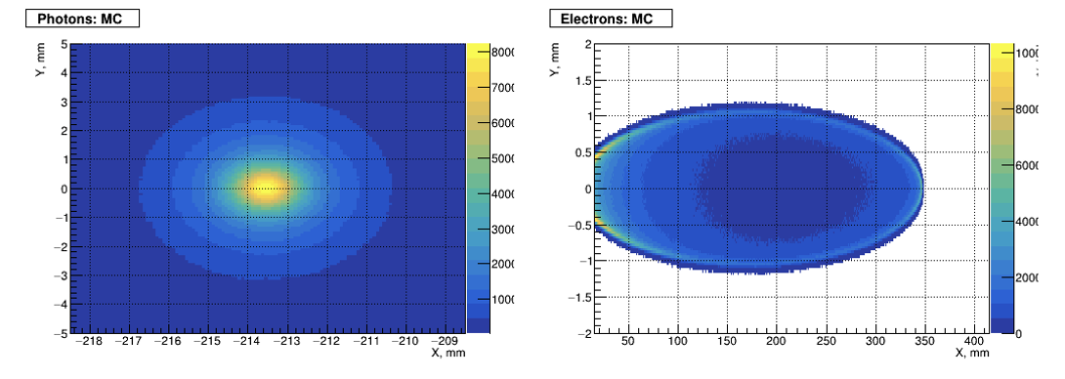
Extracting electron beam polarization
Differential cross-section
Transverse laser polarisation: nuisance parameter to minimize and keep under control
Transverse electron beam polarisation: intervenes as an asymmetry in the transverse plane
$$\frac{dσ}{dydφ_{obs}}\left(x,y\right)=\frac{dσ_{0}}{dy}\left(x,y\right)+\frac{dσ_{⊥}}{dy}\left(x,y\right)\cos\left(2\left(φ_{obs}−φ_{las}\right)\right)𝒫_{L}^{las}+\frac{dσ_{∥}}{dy}\left(x,y\right)𝒫_{C}^{las}(P_{T}f_{T}\left(x,y\right)\cos\left(φ_{obs}−φ_{elec}\right)+P_{z}f_{z}(x,y))$$
Electron beam polarization independent
Electron beam polarization dependent
Longitudinal polarization component → measure scattered particles energies
Vertical polarization component → measure vertical distribution of electrons (and photons ?)
Horizontal polarization component → blurred by horizontal emittance…, except if can measure the scattered photons distribution
Typical for FCC-ee:

Slide 11
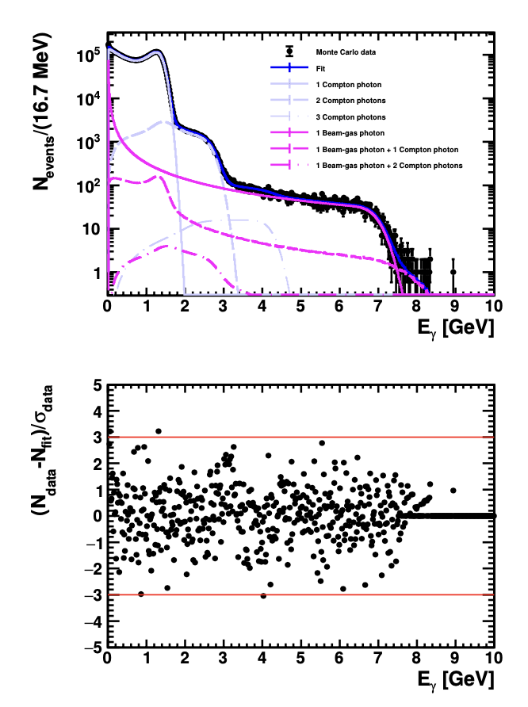
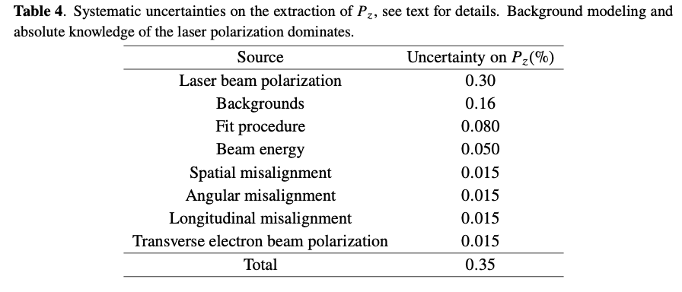
SuperKEKB : Expected performance
NB: Monte Carlo
Similar procedure employed at HERA (LPOL3) : it worked
Need operate in single photon mode (few multiple scattering)
Experimental challenge for SuperKEKB : detect photons every 4 ns
R&D to be funded
D. Charlet et al., 2023 JINST 18 P10014
Systematic uncertainty related to beam transport from Compton IP to Belle 2 IP need to be evaluated → misalignements in beam transport
Next step : prototype detector

Slide 12
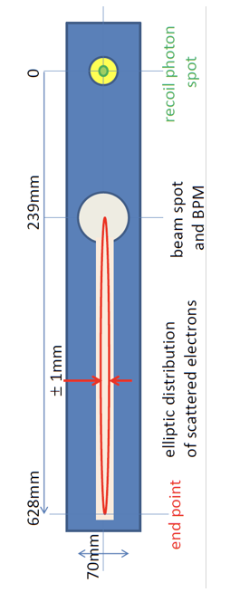
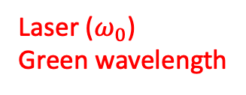


FCC-ee concept
X₀
Laser ($ω_{0}$)
Green wavelength
Scattered photons
$$∝\frac{B}{E_{0}}$$
X₁
Electron beam
Blondel et al., arXiv:1909.12245; Muchnoi, INST 17 P10014 (2022)
Dipole (field B)
$$∝Bω_{0}$$
Lowest energy scattered electrons
Interaction region
X₂
about 100m
New concept (N. Yu Muchnoi) to measure all polarization parameters → 3D polarimeter

Slide 13
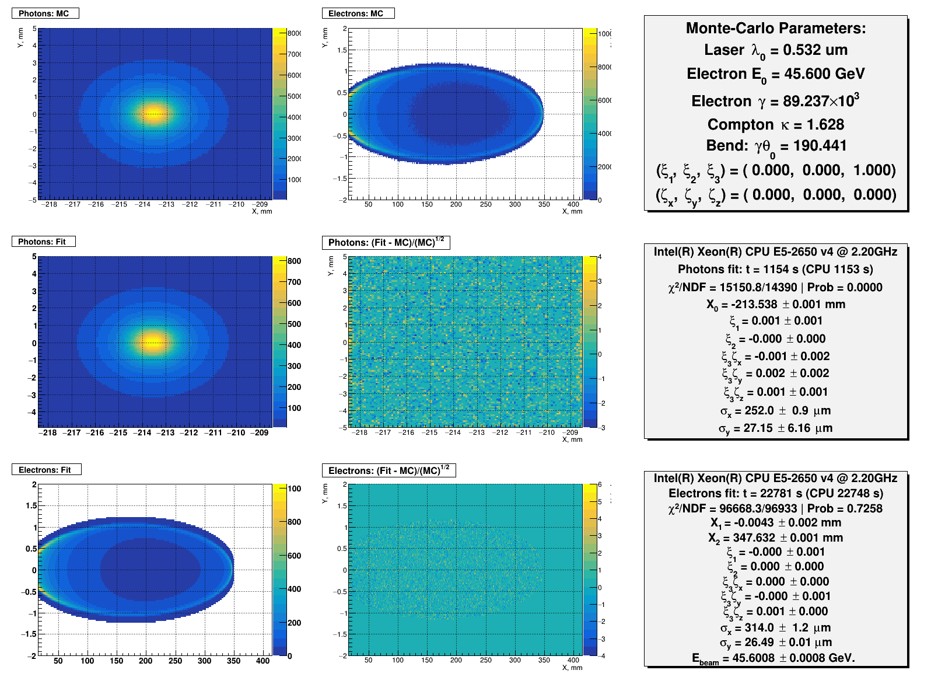
Typical fit result – 1.5min data taking
Blondel et al., arXiv:1909.12245; Muchnoi, INST 17 P10014 (2022)
NB: no backgrounds, realistic detector modeling → start to end simulation being prepared

Slide 14
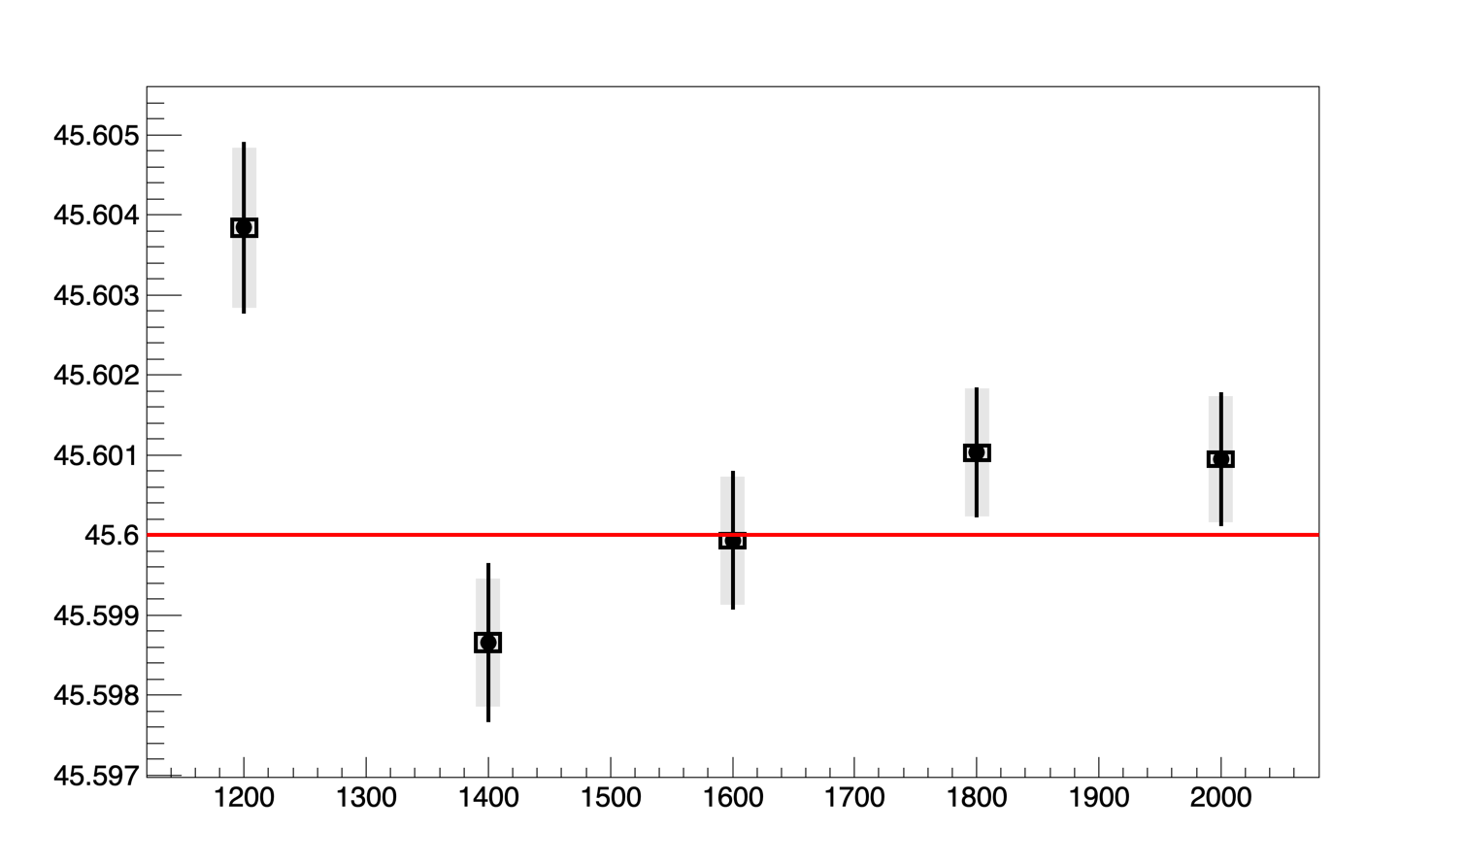
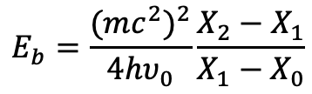
Preliminary performance studies (E_{b})
toy MonteCarlo procedure in place (100 experiments, 10⁸ events each)
$$E_{b}=\frac{{(mc^{2})}^{2}}{4hυ_{0}}\frac{X_{2}−X_{1}}{X_{1}−X_{0}}$$
Dot: average of fit central values
Grey band: average of single fit uncertainties
Black line: std of fit central values
Black box: stat uncertainty on average of fit central values
Red line: generated value
FCC Feasibility study, arXiv:2505.00274
Extracted beam energy [GeV]
Electron detector
4mm
400 mm
Photon detector
10 mm
Npixels for electrons
X: 1200 1400 1600 1800 2000
Y: 40 60 80 100 120
Polarization parameters show <0.1% bias
Fit bias on the extraction of the scattered particle disitributions at µm level
→ Related tight alignement constraints, backgrounds to be evaluated

Slide 15
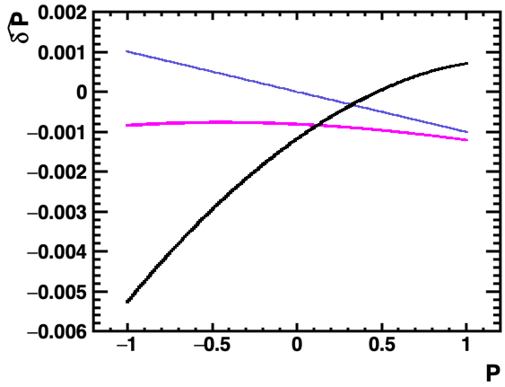
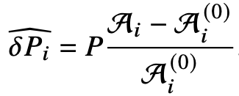


QED corrections
Black: Photon detector
Magenta: Electron detector
Violet: asymmetry
45 GeV
$δP ≈(0.8−1.2)×{10}^{−3}$at 45 GeV
$δP ≈(1−5)×{10}^{−3}$at 45 GeV
NB: curve does not go through 0 !
A. Martens et al., 2023 JINST 18 P10001; Denner & Dittmaier Nucl. Phys. B 540 (1999) 58, Swartz Phys. Rev. D 58 014010 (1998), Veltman Ophys. Rev. D 40 2810 (1989), Veltman Phys. Rev D 42 1856E (1990)
Electron detector is more robust against QED corrections
Accurate measurement of longitudinal polarization is significantly affected at per mille level
Accurate extraction requires either:
- implementation of QED correction in fit (difficult, higher order QED correction ?)
- use of asymmetry measurements → excellent control on experimental conditions when flip-flopping laser polarization (including lumi, backgrounds,…)
NB: Assessed here for an ILC like detector, similar result expected for FCC-like detector.

Slide 16
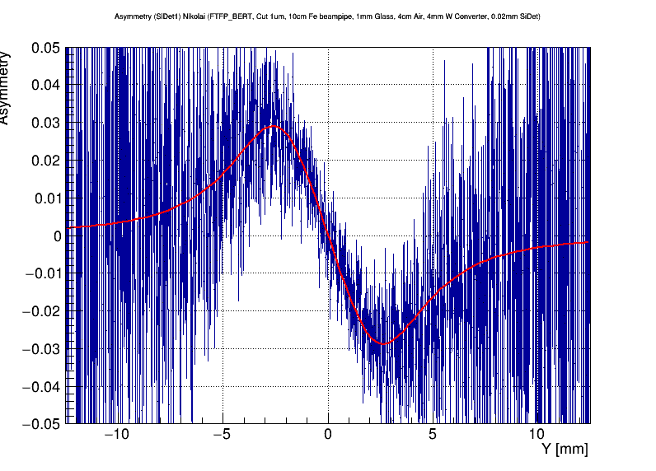
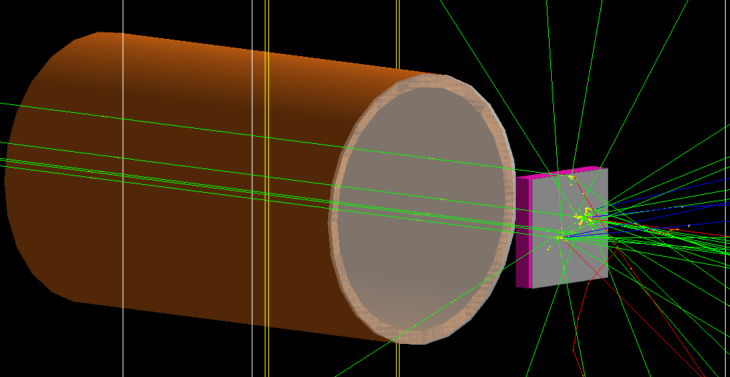
Gaining experience
Starting to prepare the pre-TDR phases of CEPC, FCC-ee with few R&D items on key aspects
Still much work on laser and detectors design and integration
Assessment of performance must be based on more realistic designs
Start of prototyping → collaboration IJCLab/IHEP on polarimetry (Z. Duan et al.)
M. Y. Su, IBIC 2024
Geant 4 simulation
Polarisation extraction

Slide 17
Conclusion
Compton polarimetry is at the crossing of Optics, Accelerator and Particle physics
  A small scale particle physics experiment
  Accelerator integration is a concern, also for performance (backgrounds)
  Laser system precise diagnostics when <1% Compton polarimetry is needed
IJCLab has launched several activities to overcome few current limitations
  Simplification of synchronisation system, parasitically to existing accelerator but precise and low cost
  fast detection of photons (every 4 ns for SuperKEKB)
  Detailed Monte Carlo simulation of detectors, and participation in demo experiments
  Impact studies of QED corrections, (exploit SLC legacy)
  Optical system defects modeling and associated systematics estimation

Slide 18
backup

Slide 19
Laser-beam ellipsometry
PDe
IP
QWP2
PD2
LASER
GLAN
Beam transport
Beam transport
HBS
Wollaston
PD1
QWP
PDi
Minimal optical components to generate (pure) circular laser beam polarisation
Poirson et al. Applied Optics 34 6806 (1995), Brisson JINST 5 P06006 (2010), Zomer HDR (2003), Jacquet HDR (2009), Baudrand PhD thesis (2007)
Residual wrong polarisation vs tilt angle
About 1 per mille wrong polarisation
Extremely difficult to remove wrong polarisation <0.1%
Fine modeling of beam transport is required

Slide 20
Beam impedance (longitudinal)
Zhou, Ishibashi

Slide 21
Beam impedance (vertical)
Zhou, Ishibashi

Slide 22
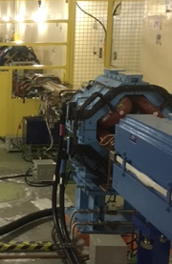
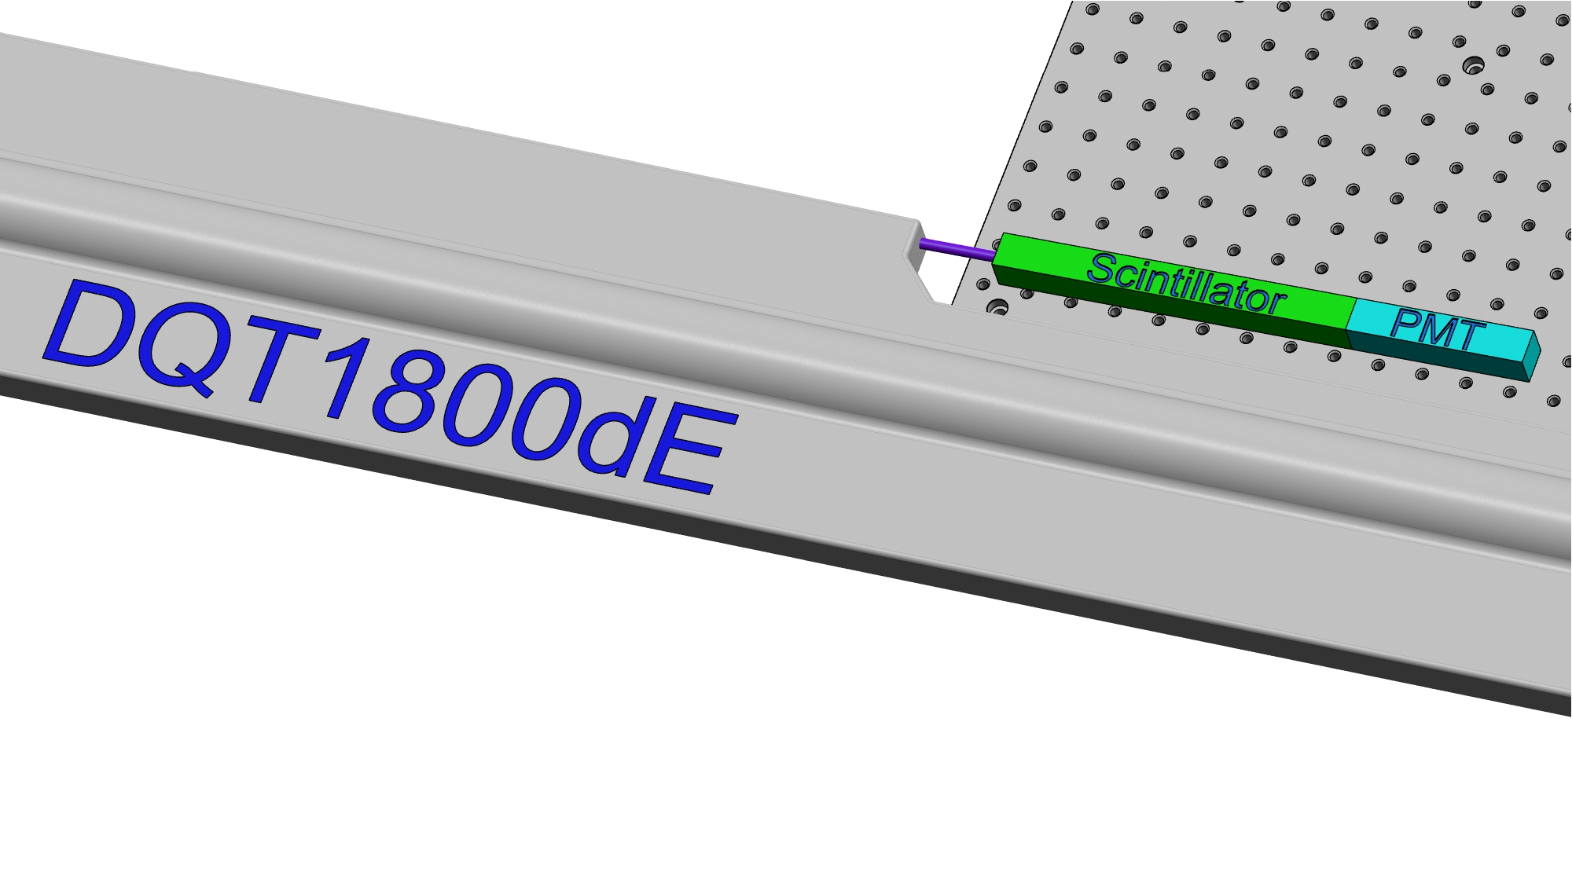
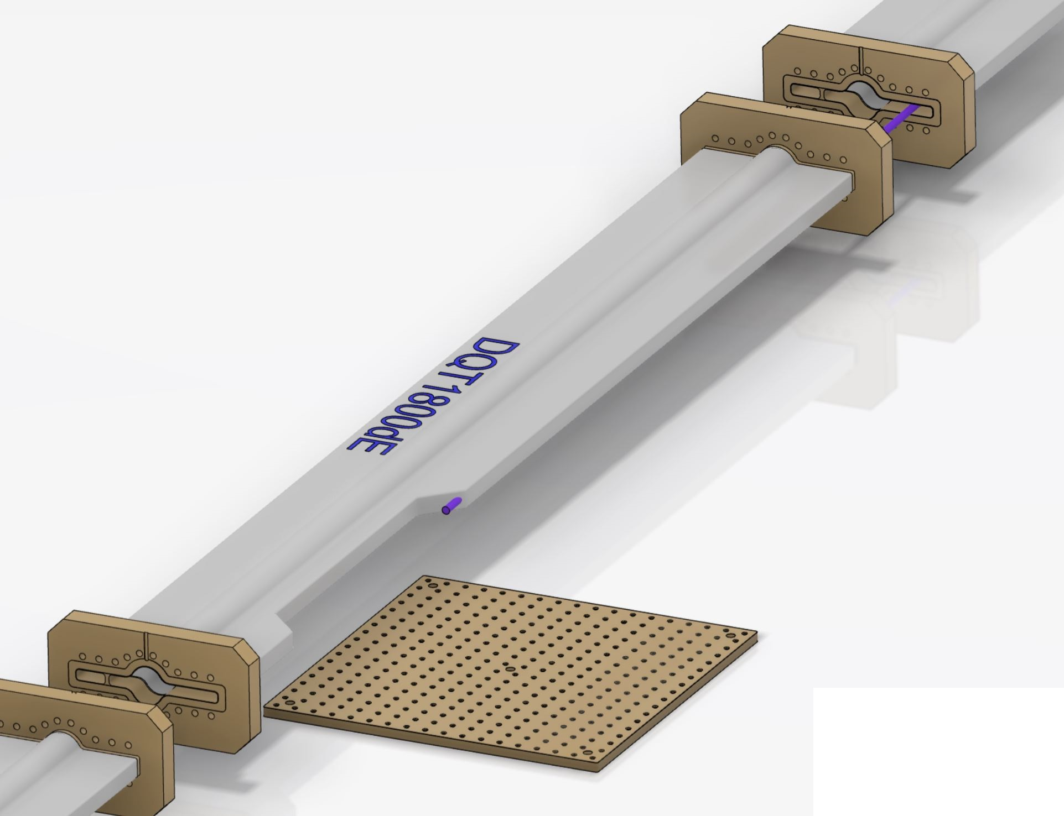
Photon detector integration
‘minor’ modifications of beam pipe modification (validated for impedance)
Beam pipe at ~1m from ground
Electronics can be located and shielded on ground below scintillator +PMT
Xray out : 210 µrad
≈ Ø6 mm at 14,5 meters
BreadBoard 450x450 mm²

Slide 23
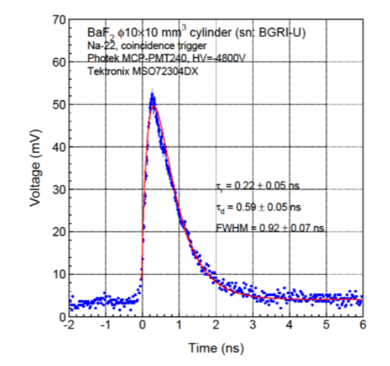
Single channel photon detector
Basic elements
  a VERY FAST radhard scintillating crystal → BaF2
    Need to filter out the slow component → UV optical filters
  a PMT with low transit time dispersion → commercially available (hamamatsu for instance)
  Bunch/bunch measurement
…
Energy measurement
2500 histograms
Currently ‘waiting’ for funding
External collaborators welcome

Slide 24
Conceptual acquisition chain
Optical filter
BaF2
PMT
2500 histograms
Fast treatment: fit
Every 4ns
FPGA
IDROGEN board
White Rabbit node
Reduced data
To online monitoring
Analog Front-end
+ ADC (>=10bits)
clock
To remote storage (10MB/min)
Update program, constants
1rst Bunch identifier
Accelerator RF

Slide 25
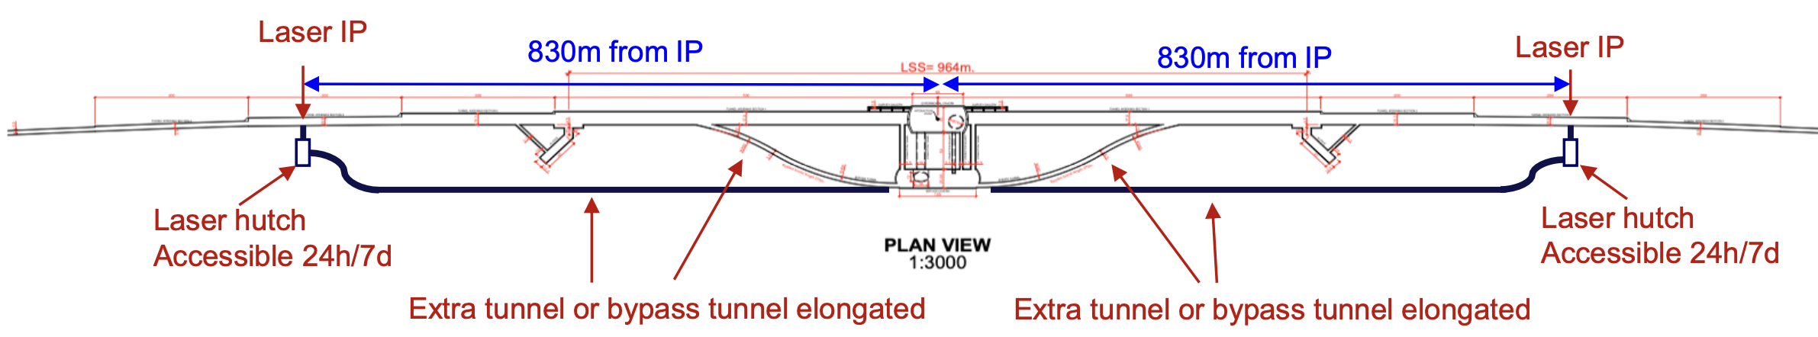
Implementation
Bypass planned for 24/7 access to laser room
Kieffer, FCC Week 2024 report
Integration close to IP, also allows to constrain polarization at IP for colliding bunches
Evaluation of backgrounds (SR, Brem,…) in the Compton polarimeter has started

Slide 26
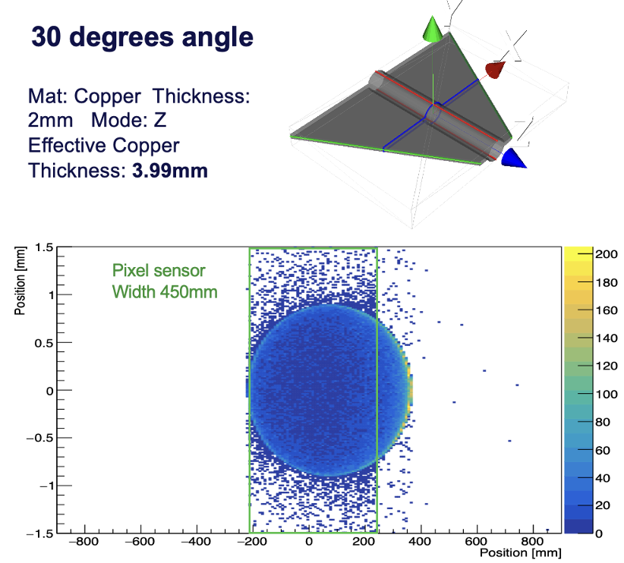
Towards integration
Kieffer, FCC Week 2024 report
Evaluation of tapering need for impedance and impact on parameter estimation on-going

Slide 27
Beam energy model – LEP legacy
Effect of tides !
Leakage currents !
Change fields !
Change circumference
Assman et al., Eur. Phys. J. C 6, 187–223 (1999), Assman et al., Eur. Phys. J. C 39, 253–292 (2005)
1mm over the 27km circumference of LEP
➔ 10MeV shift
A detailed model accounting for tides, parasitic currents, thermal effects in bending magnets,…
FCCee: Recurrent real-time (15min spacing) measurements of beam energy using pilot bunches backed up with instrumentation of few dipoles in ring
~15min

Slide 28
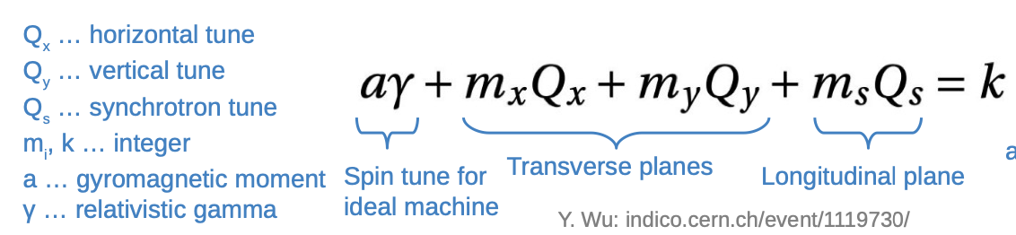
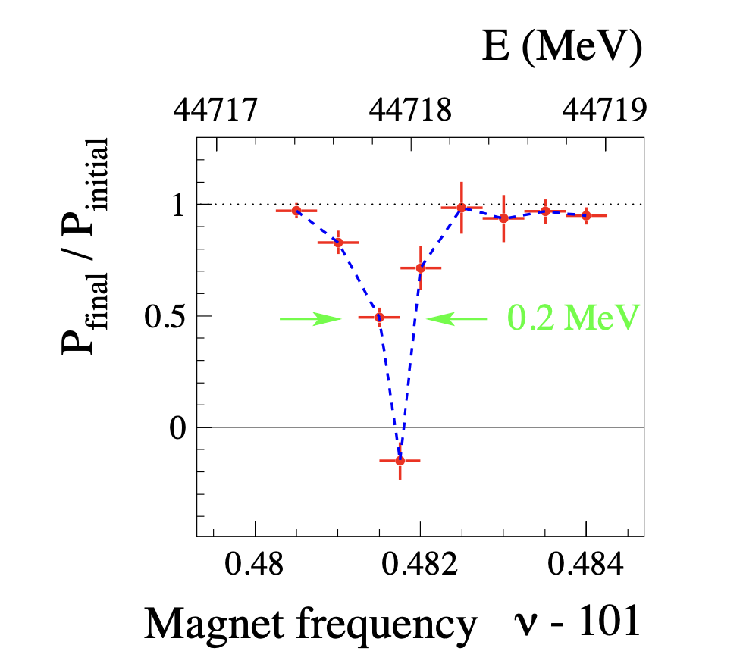
Resonant depolarization
Resonance condition:
Equally-spaced in energy
Assman et al., Eur. Phys. J. C 6, 187–223 (1999), Blondel et al., arXiv:1909.12245;
Baier & Khoze, Sov. J. Nucl. Phys. \textbf{9}, 238-240 (1969)
LEP legacy
Scan spin precession frequency with magnetic kicker
Detect beam depolarization at resonance
Converts a well calibrated frequency scan in RF element into an accurate energy measurement !

Slide 29
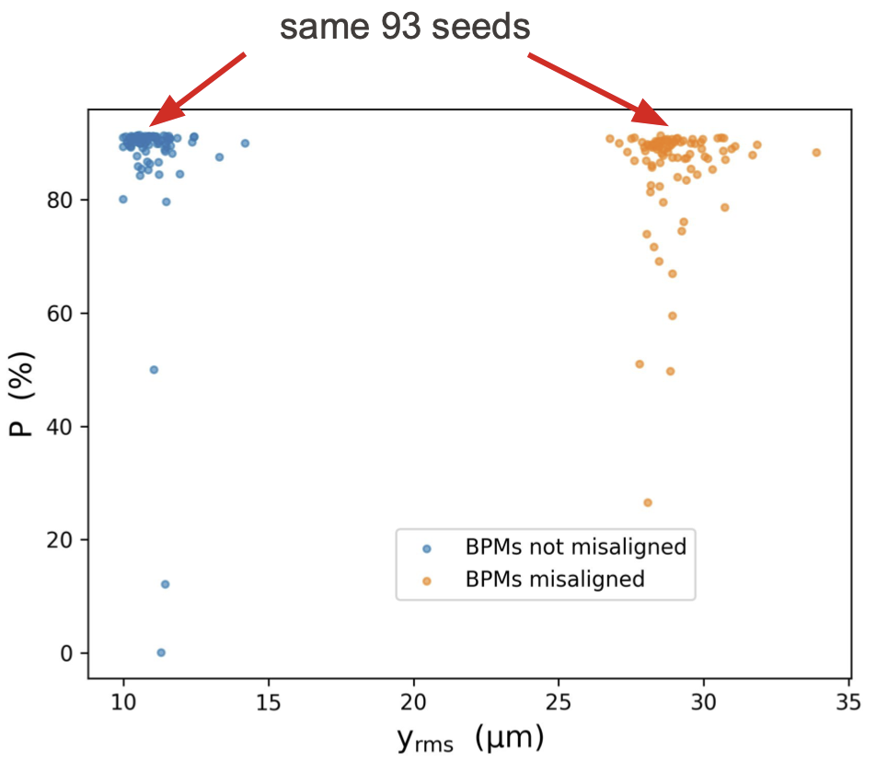
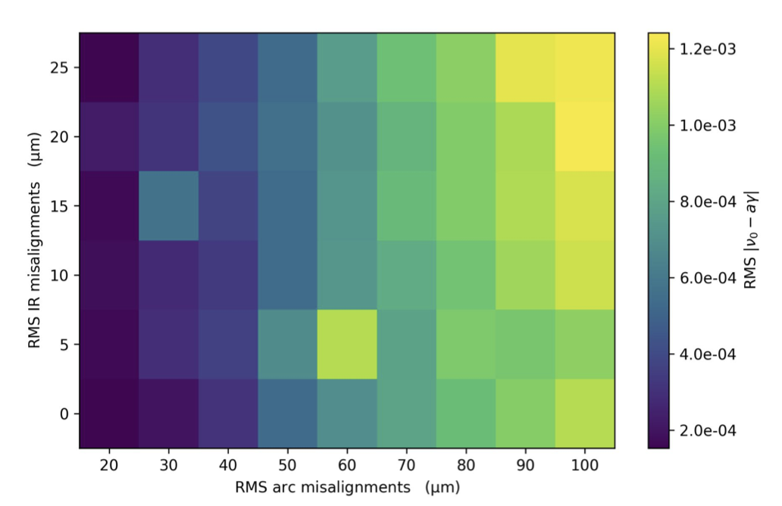
Depolarization sources
Many sources: Stochastic process of quantum emission, Energy dependance of ${\hat{n}}_{0}$, misalignments, beam-beam effects at the collision points,…
Yi, FCC Week 2024 report
Spin tune shift studied for arc and IR misalignements
Also BPM error and scaling
RMS residual orbit much increased
Variance of polarization increased
Polarization can be preserved at high degree in presence of misalignments

Slide 30
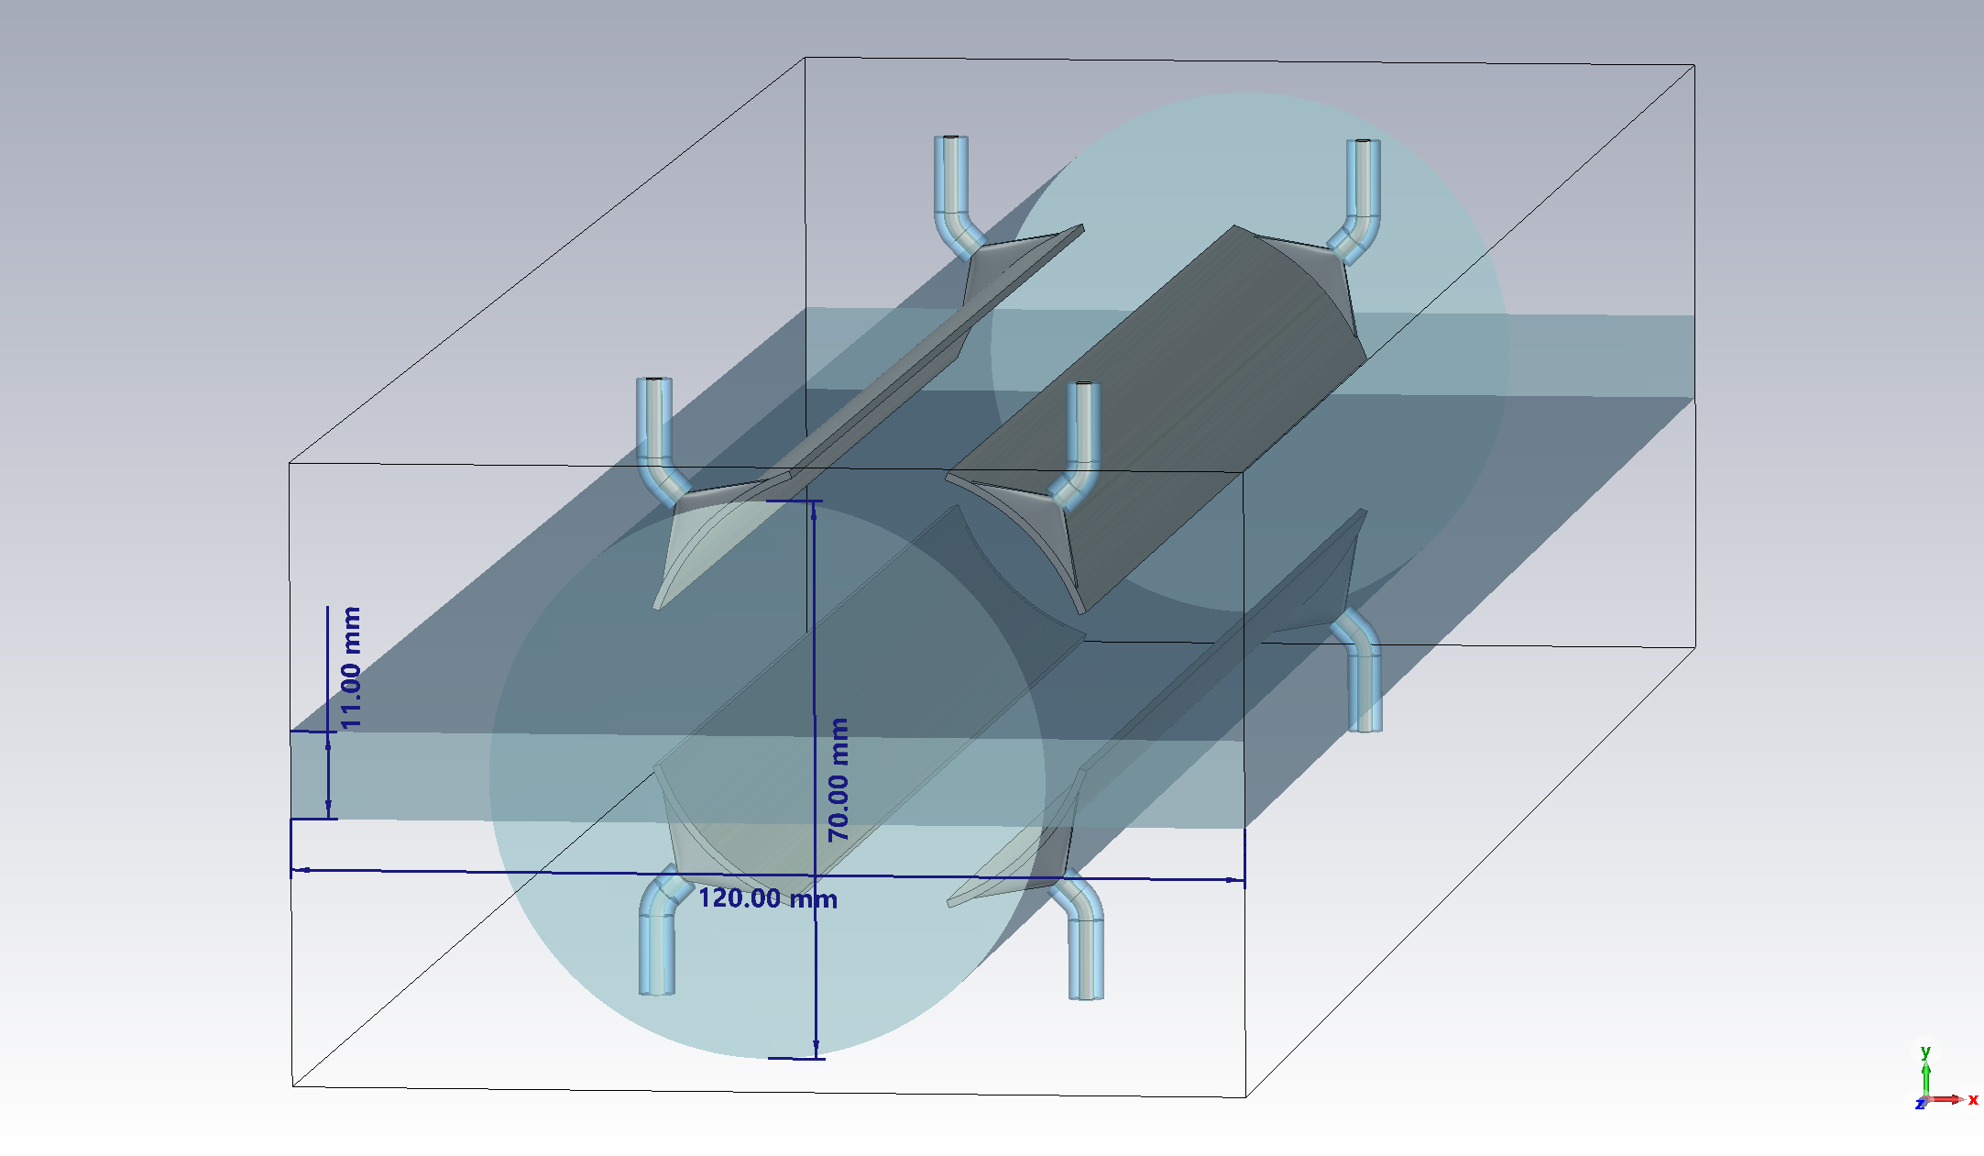
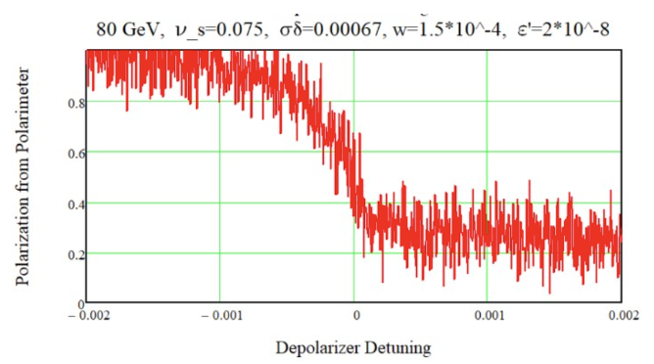
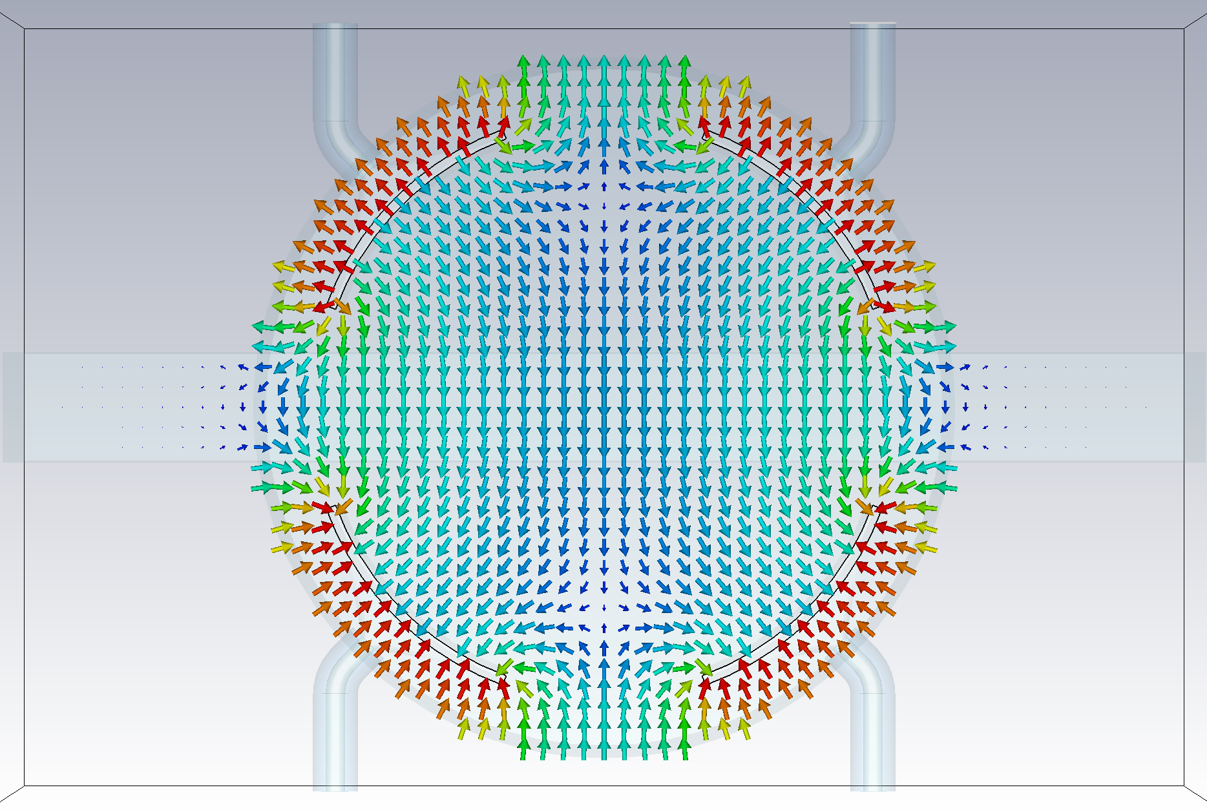

Measurement strategy at FCC-ee
Inject hundreds of pilot bunches in ring.
Switch on wigglers to reach 10% polarization in ~2h
Switch off wigglers
Inject colliding bunches and operate collider
Depolarize a pilot bunch every ~15min to follow energy changes
Alternative:
Injection of pre-polarized pilots
Strip-line depolarizer
Höfle, FCC Week 2024 report; Heron, FCC Week 2024 report
$$\vec{E}$$
Example of depolarisation exercise at 80 GeV

Slide 31
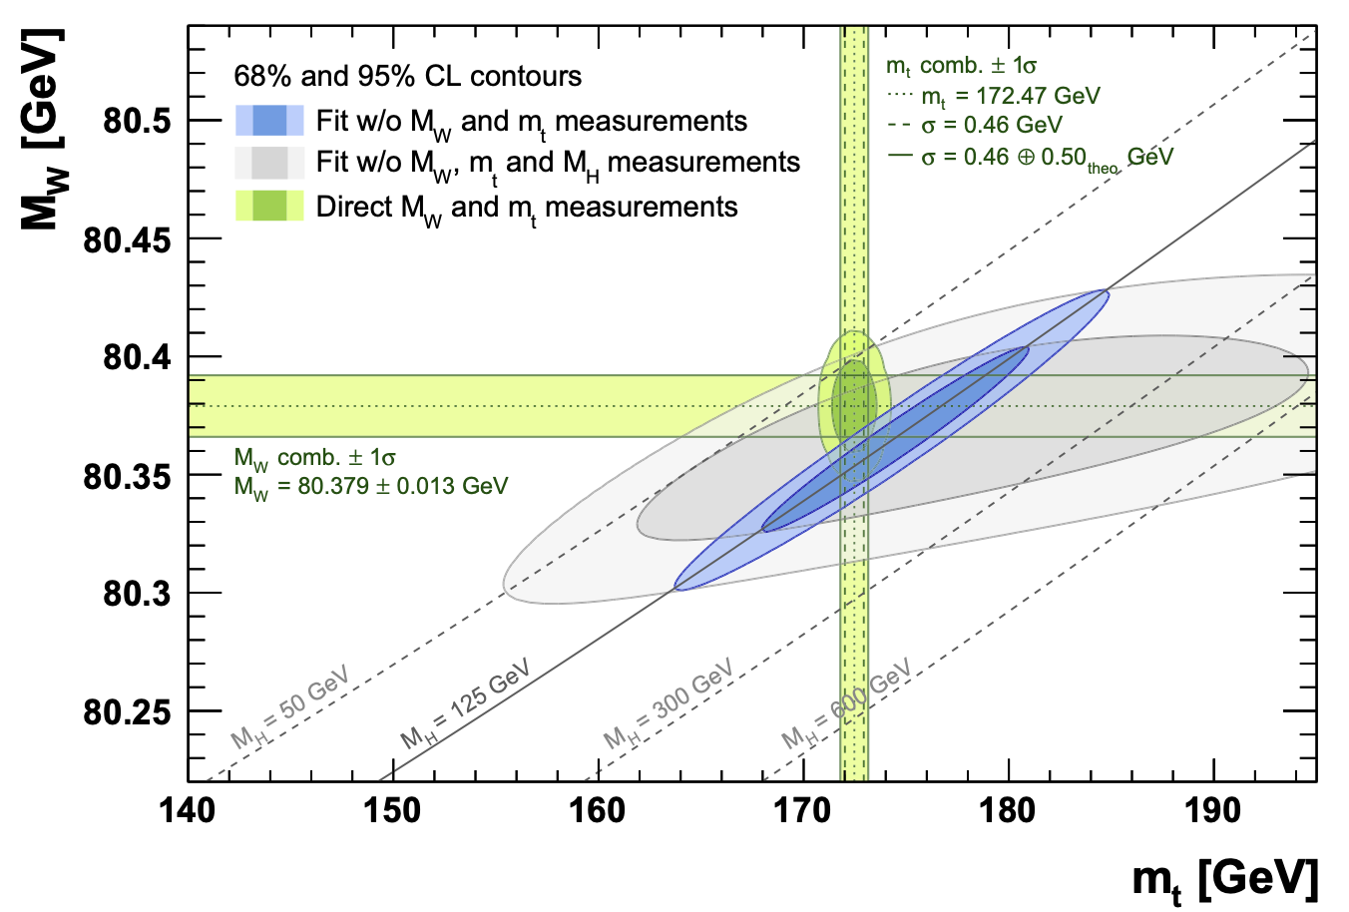
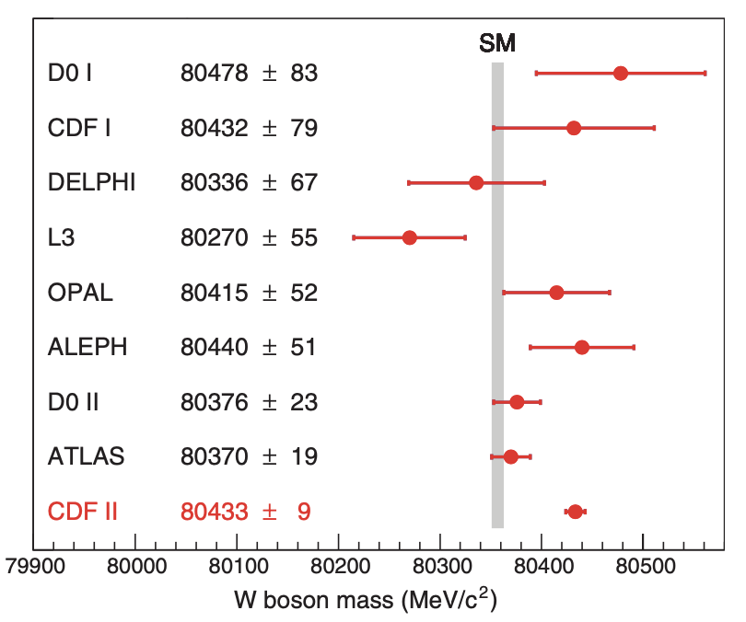
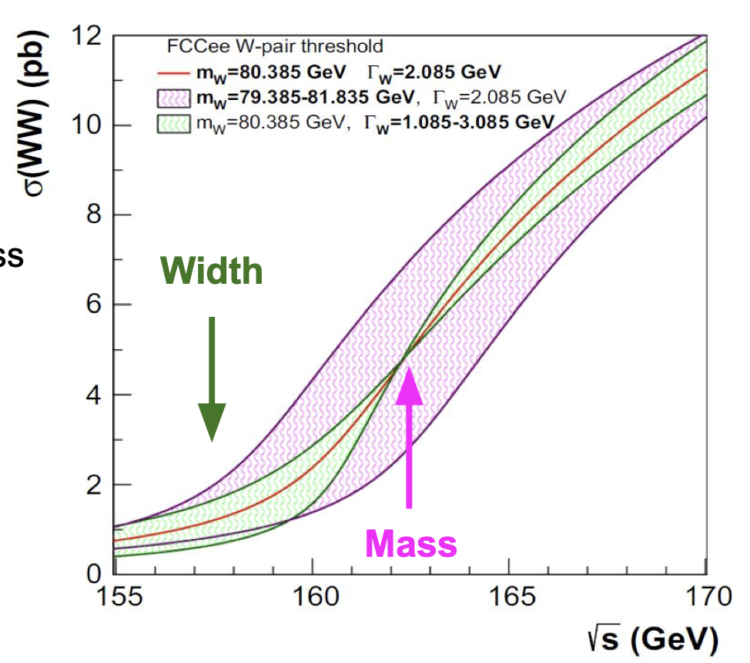



The m_{W} question
NB: initial plot does not include last W-mass measurement from CDF
Gfitter group, Eur. Phys. J. C (2018) 78:675;
CDF Collaboration et al., Science 376, 170–176 (2022)
Blondel et al., arXiv:1909.12245
FCC-ee energy calibration is key for a high precision measurement of W mass and width
Expected accuracies:
$$m_{W}±0.25 \left(stat\right)±0.3 (syst)$$
$$Γ_{W} ±1.2 \left(stat\right) ±0.3 (syst)$$

Slide 32
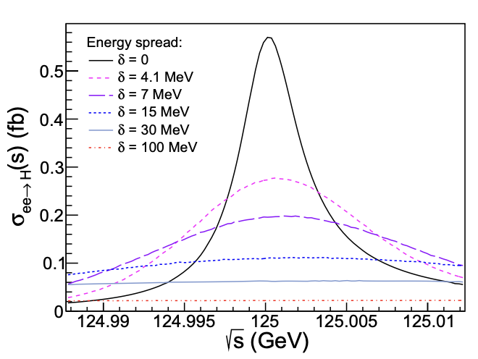
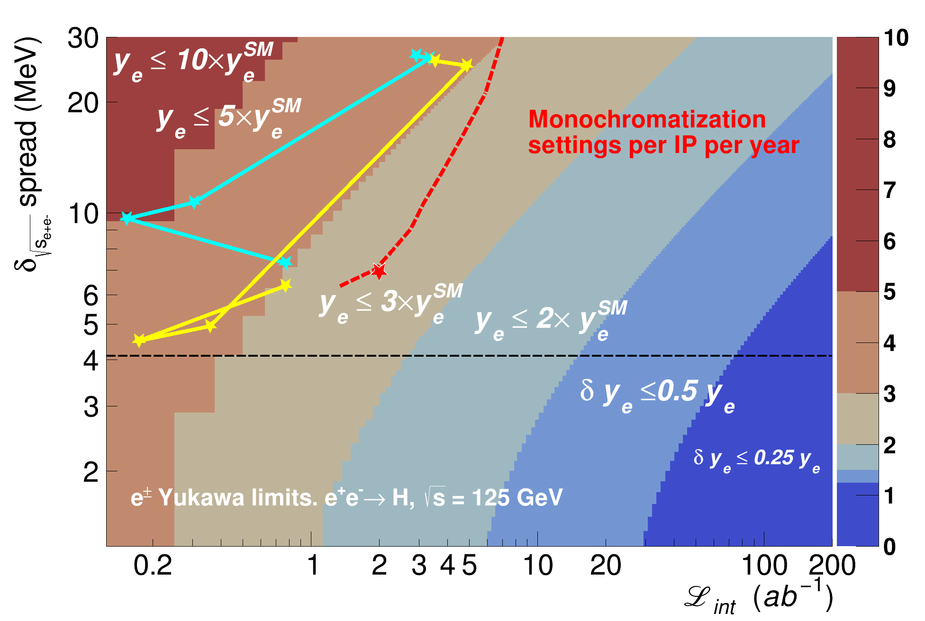
Energy monochromatization at H pole
High luminosity provides unique opportunity to constrain electron Yukawa
with resonant s-channel Higgs production at FCC-ee
Goal
D’Enterria, Eur. Phys. J. Plus (2022) 137:201
Faus-Golfe, Eur. Phys. J. Plus (2022) 137:31; Faus-Golfe, FCC Week 2024 report
Trade luminosity for monochromaticity
Current status of implementation
(before lattice re-optimisation)
Further improvements expected

Slide 33
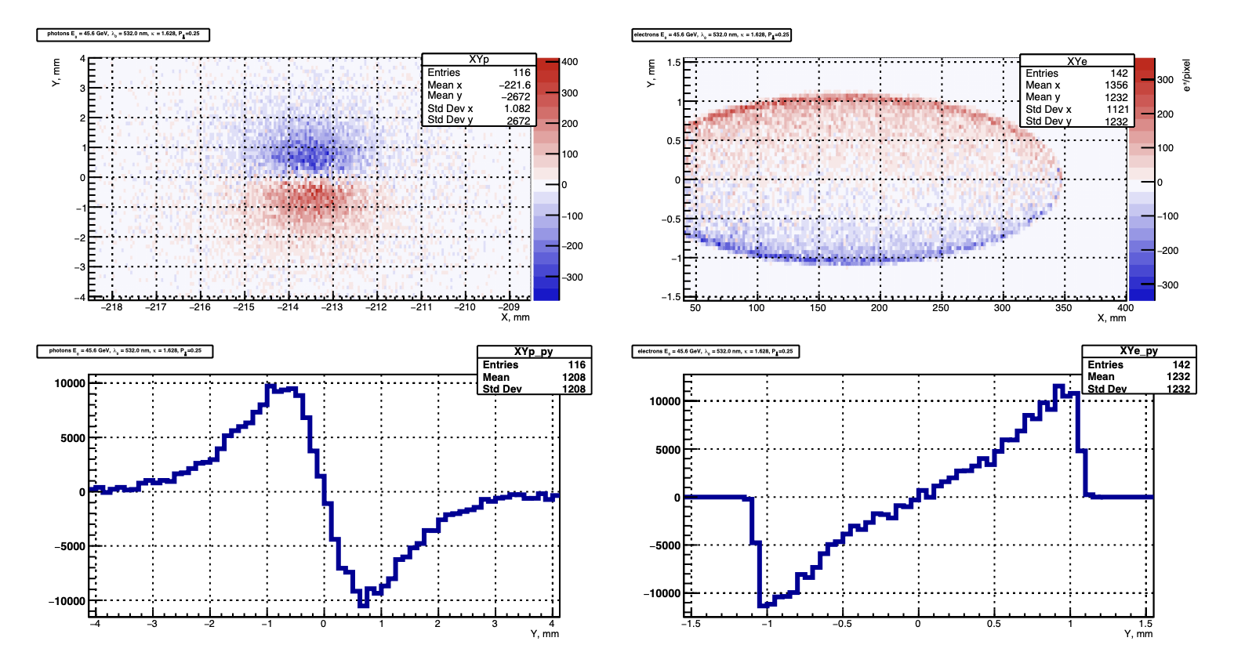
Laser helicity asymmetries
Blondel et al., arXiv:1909.12245
Reproductible and well known laser helicity flip is required

