Slide 1

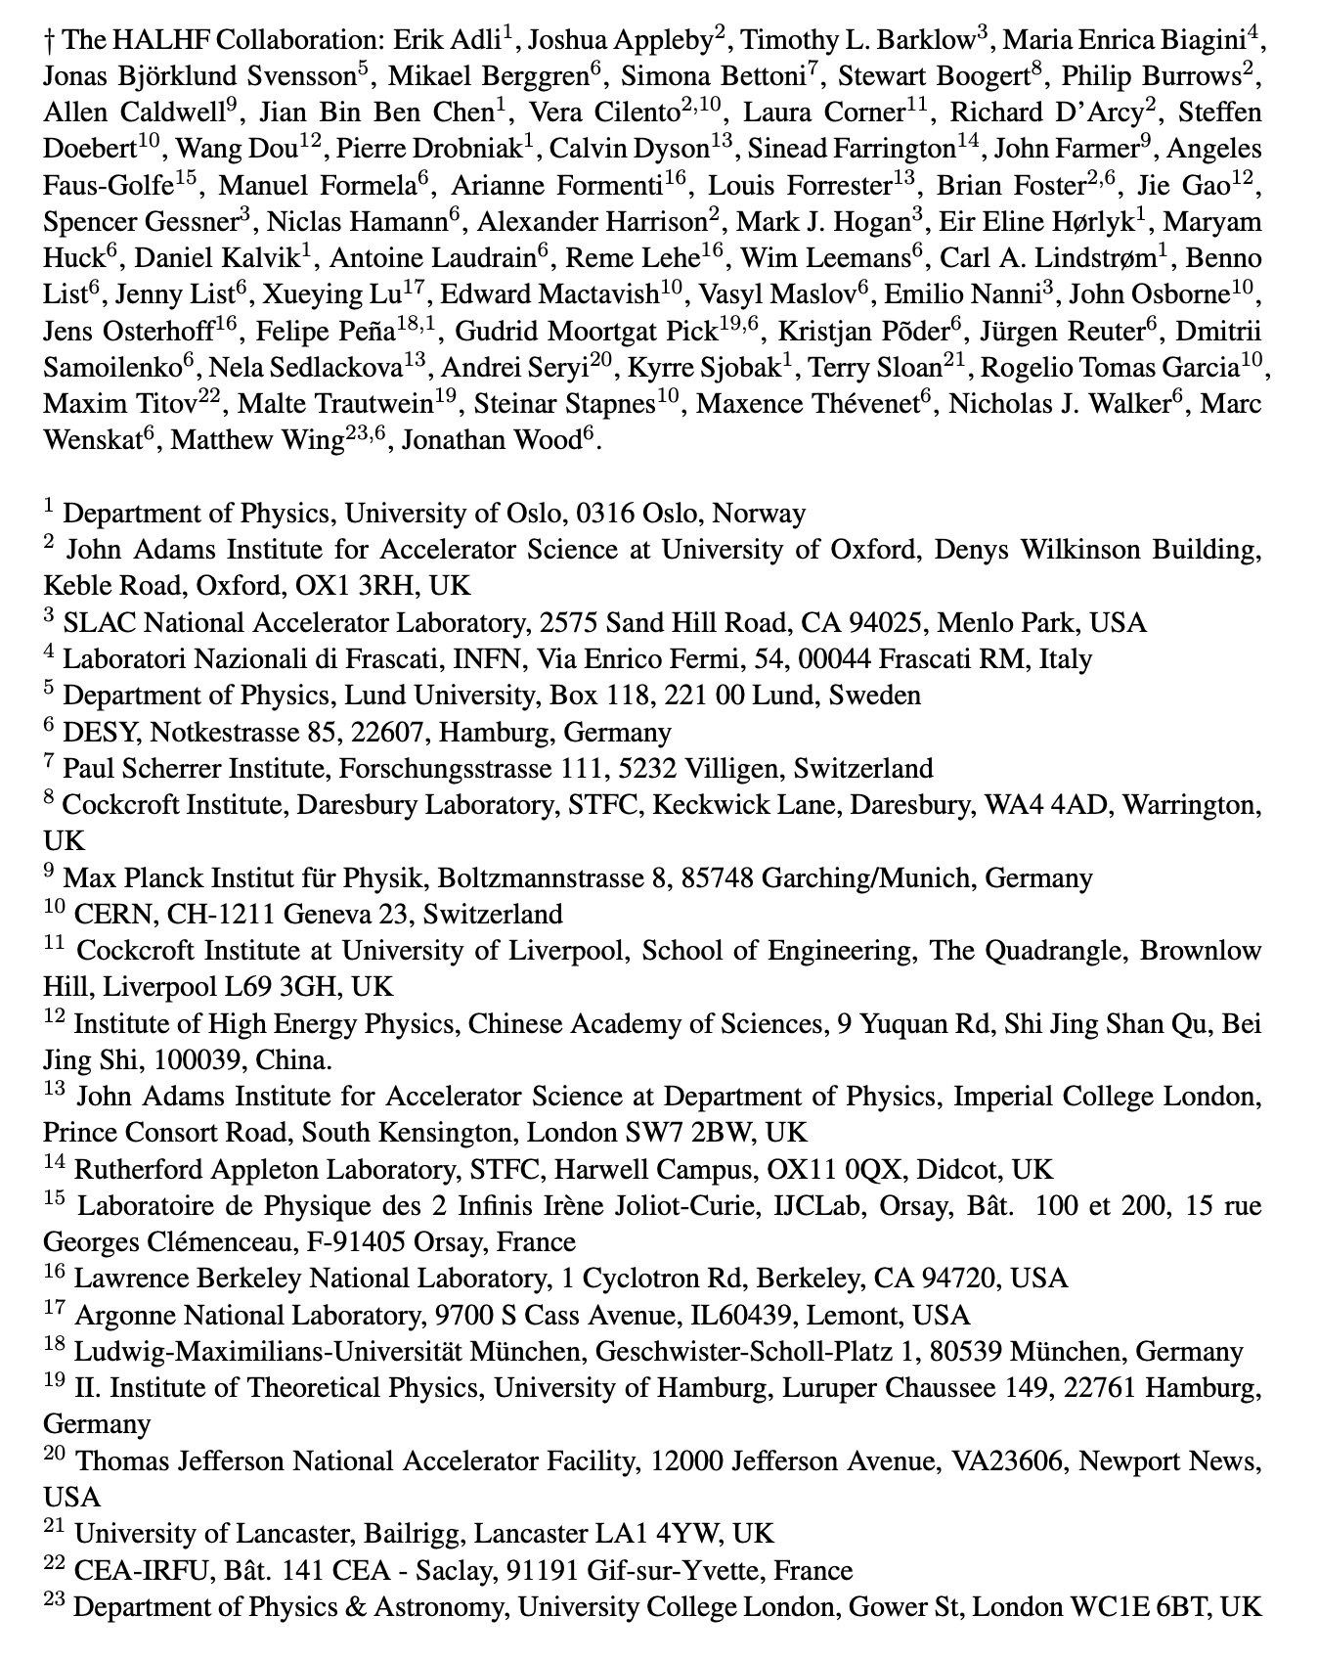
Hybrid Asymmetric Linear Higgs
Factory (HALHF)
Brian Foster (Oxford/DESY)
for the HALHF Collaboration
(April 2025)

Slide 2
Hybrid Asymmetric Linear Higgs
Factory (HALHF)
Brian Foster (Oxford/DESY)
for the HALHF Collaboration
(April 2025)

Slide 3
Hybrid Asymmetric Linear Higgs
Factory (HALHF)
The basic idea is – there are enough problems with a PWFA e⁻ accelerator; e⁺ is even more difficult. Bypass this for e⁺e⁻ collider by using conventional linac for e⁺.
For this to be attractive financially, conventional linac must be low energy => asymmetric energy machine (31 x 500 GeV).
This requirement led to (at least for us) unexpected directions – the more asymmetric the machine became, the better!

Slide 4
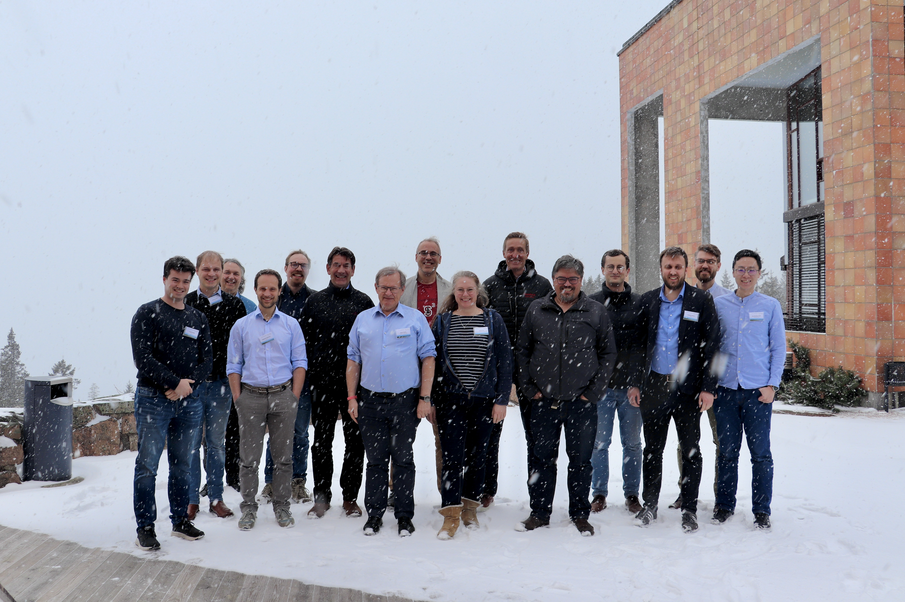


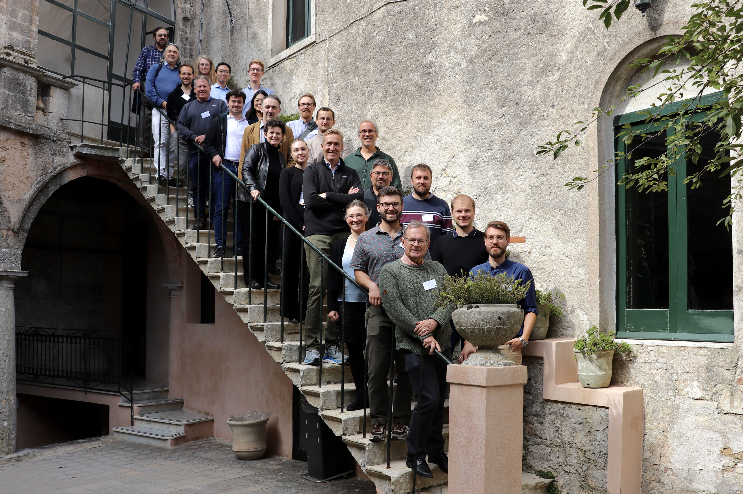
Recent Progress
Workshops in Oslo (April) and Erice (October)

Slide 5

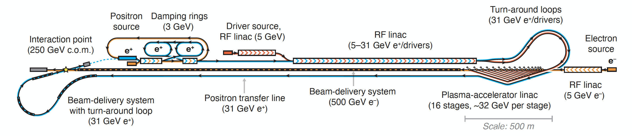
HALHF Status
HALHF workshop 3 – 8.10, Erice dedicated to reassessing baseline in light of comments
from colleagues and progress in design.
Original Baseline:
Principal problems:
“Turn-around” too small to retain required beam quality & scales badly with energy;
“Dual-Purpose” linac difficult to design and inflexible.
Foster, D’Arcy and Lindstrøm, New J. Phys. 25, 093037 (2023)
New Baseline:
Foster et al., Phys. Open 23, 100261 (2025)

Slide 6
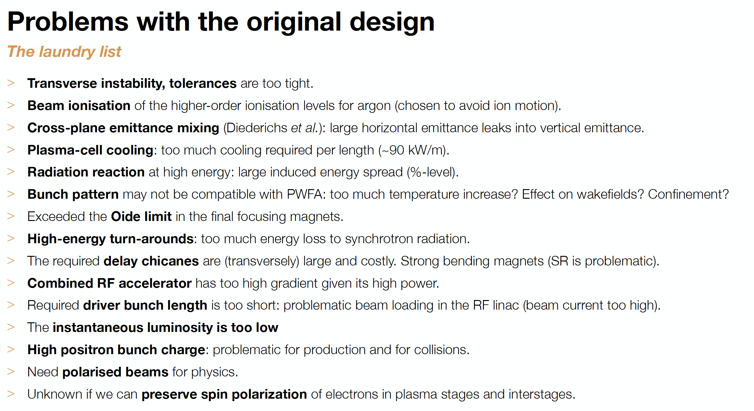
Recent Progress

Slide 7
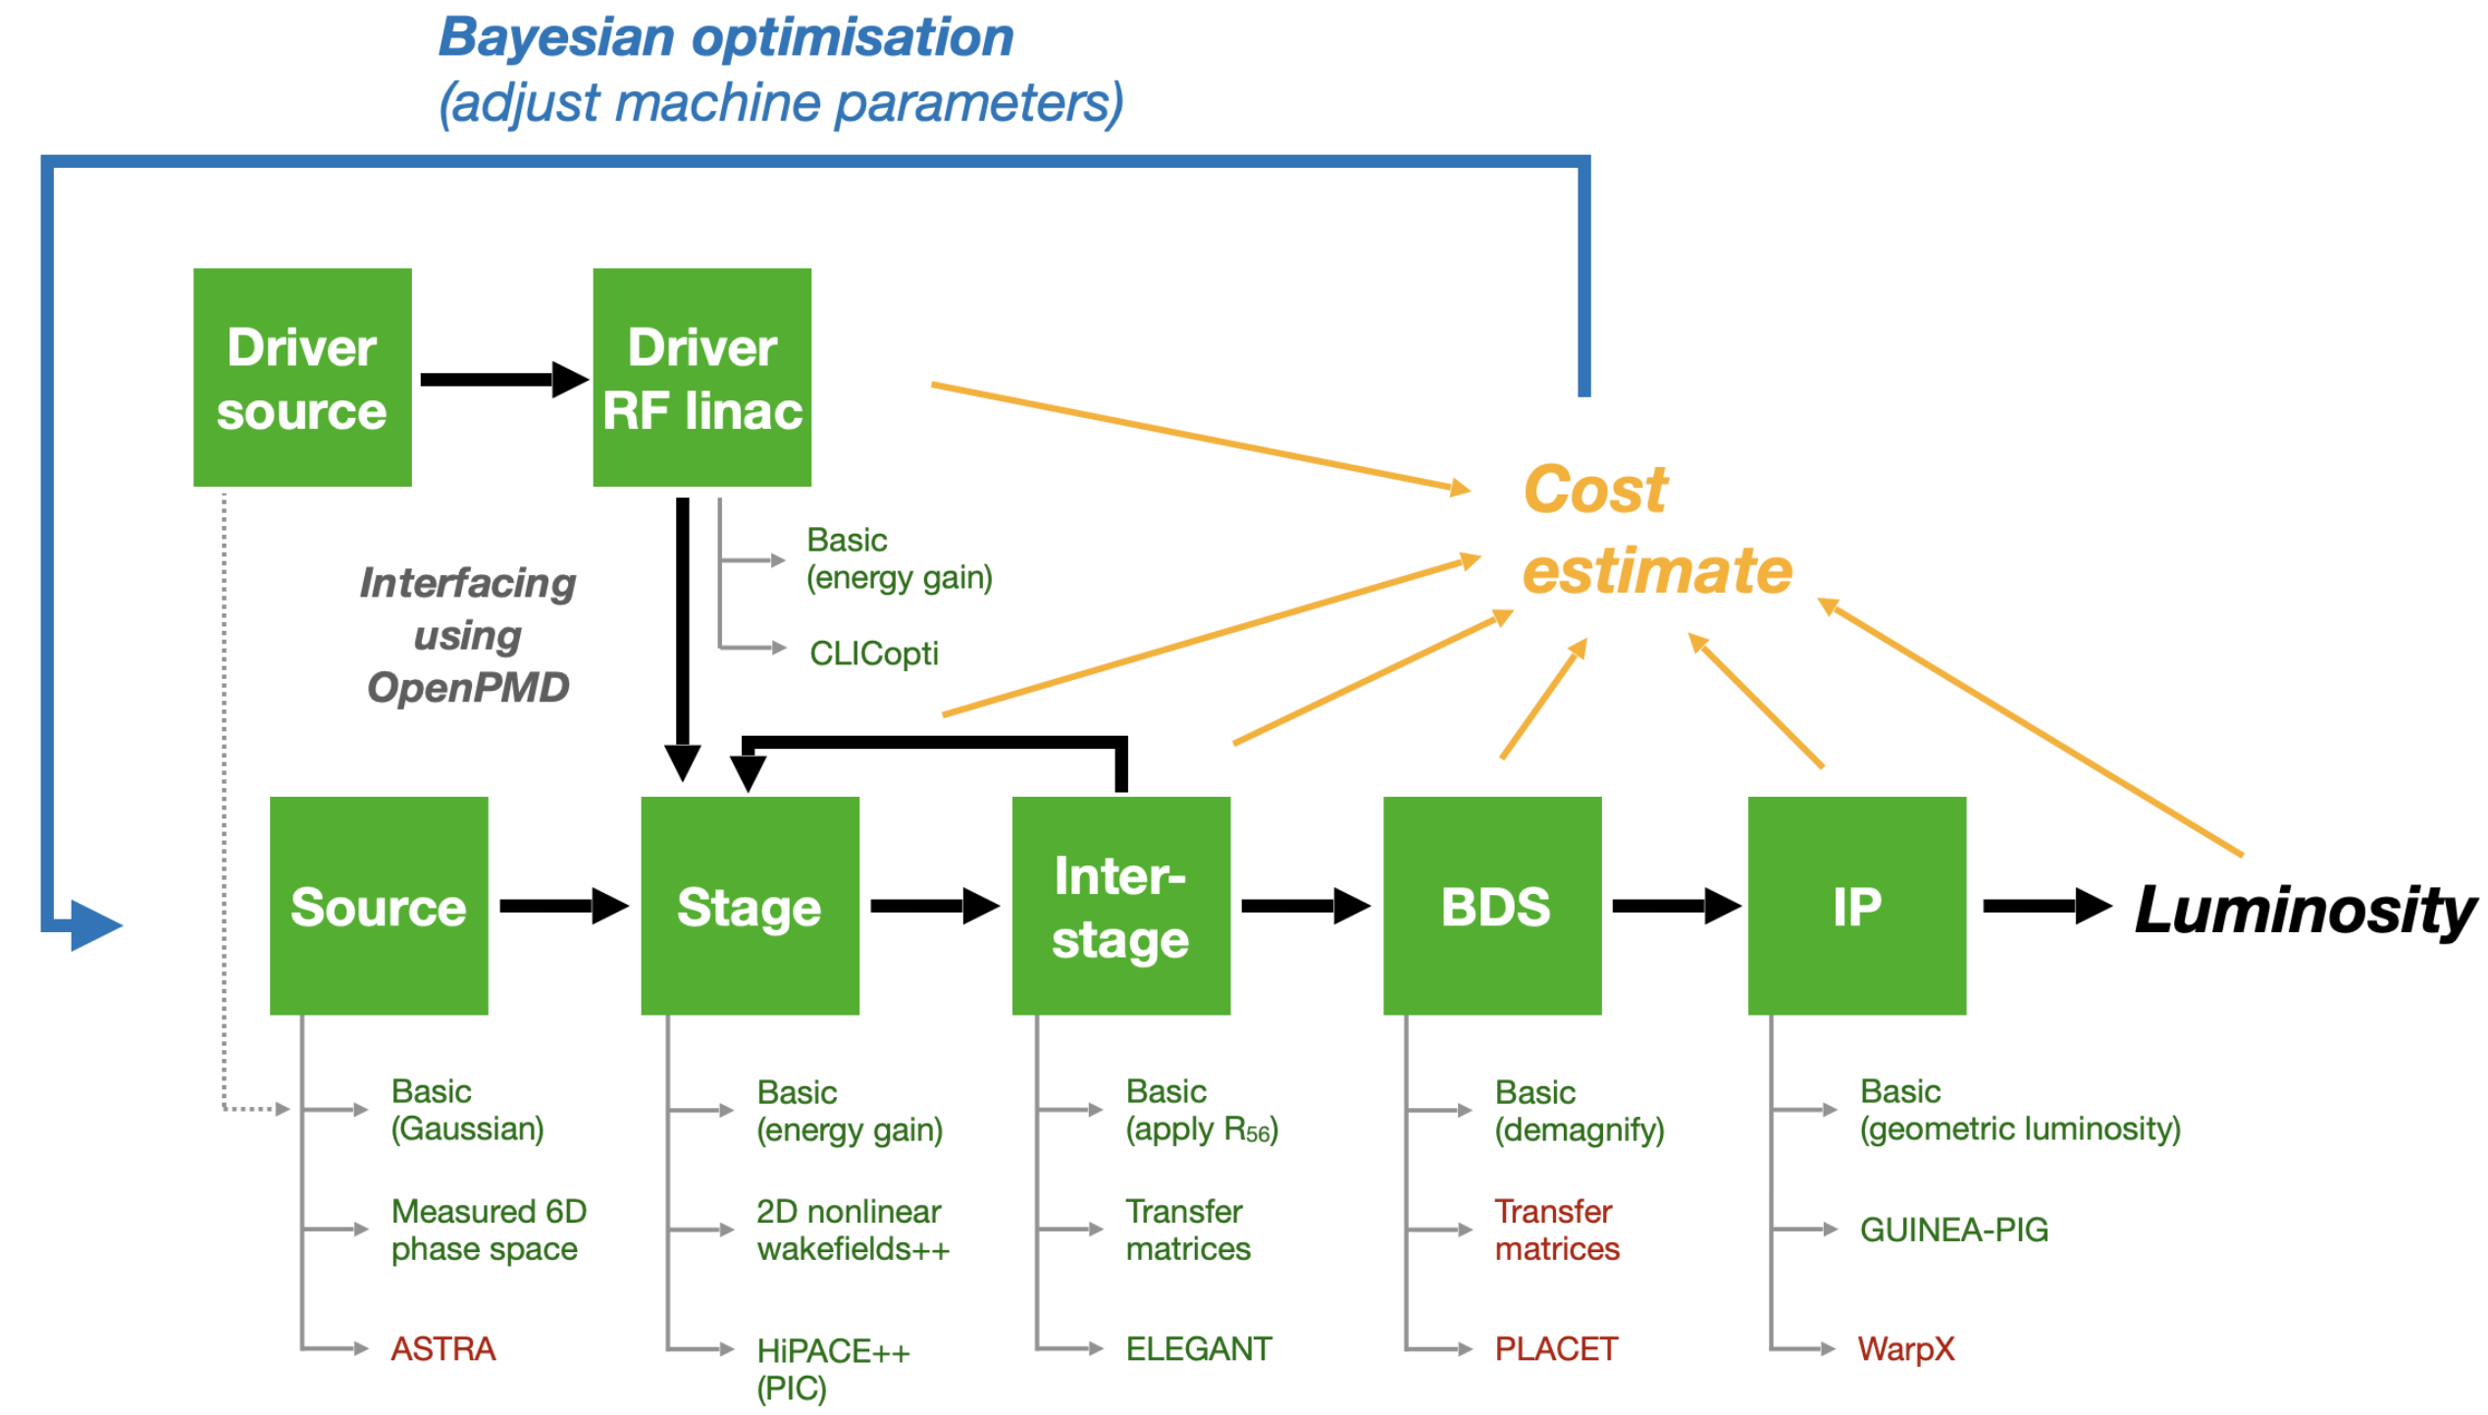
ABEL: The Adaptable Beginning-to-End Linac simulation framework
Facility Optimisation
A start-to-end simulation framework, using OpenPMD
Adaptable implementations
— choose fidelity versus speed for each subsystem
Running other codes via wrappers (also submits HPC jobs etc.)
— HiPACE++, WakeT, ImpactX, GUINEAPIG, ELEGANT, CLICopti
Run simulations as experiments
— run simulations with multiple shots, incl. random jitter
— perform automated scans (one-liner)
— perform parameter optimisations
“System code” (term borrowed from e.g. fusion)
— integrated cost modelling
— machine layouts
Chen et al., TUPS012, IPAC’25
Will be released as open source (GPL 3.0)—aiming for Autumn 2025

Slide 8
ABEL: The Adaptable Beginning-to-End Linac simulation framework
Facility Optimisation

Slide 9
ABEL: The Adaptable Beginning-to-End Linac simulation framework
Facility Optimisation

Slide 10
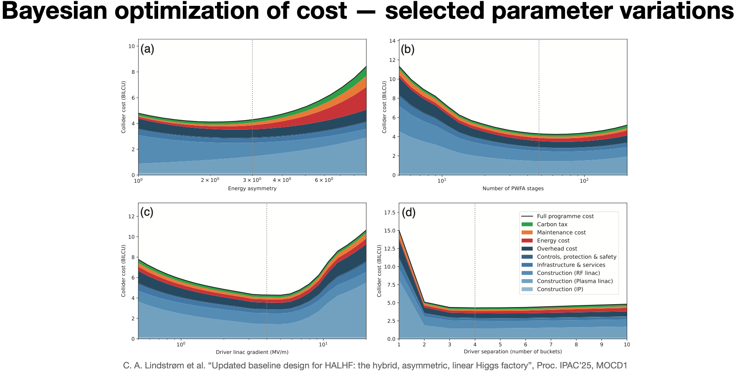
ABEL: The Adaptable Beginning-to-End Linac simulation framework
Facility Optimisation

Slide 11
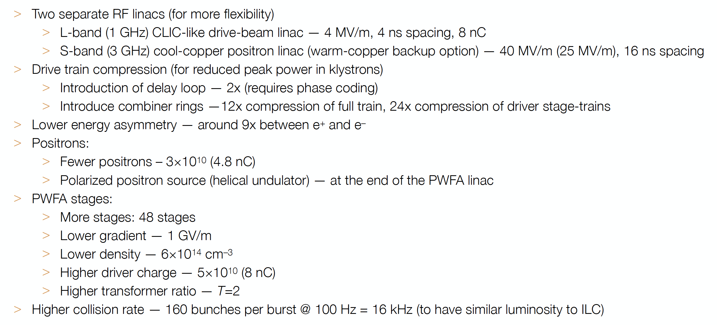
HALHF New Baseline
Foster et al., Phys. Open 23, 100261 (2025)

Slide 12
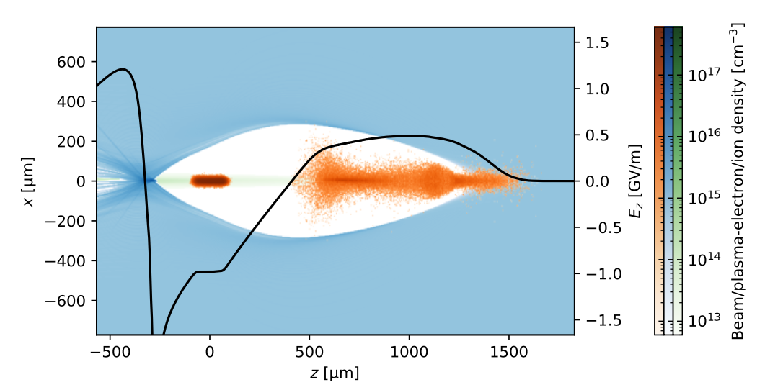
Blow-out simulation
PIC simulation with HiPACE++, He @ 6 × 10¹⁴ cm⁻³ ; driver and main beam (orange) 8 & 1.6 nC. Excess ion density
on axis (green)

Slide 13
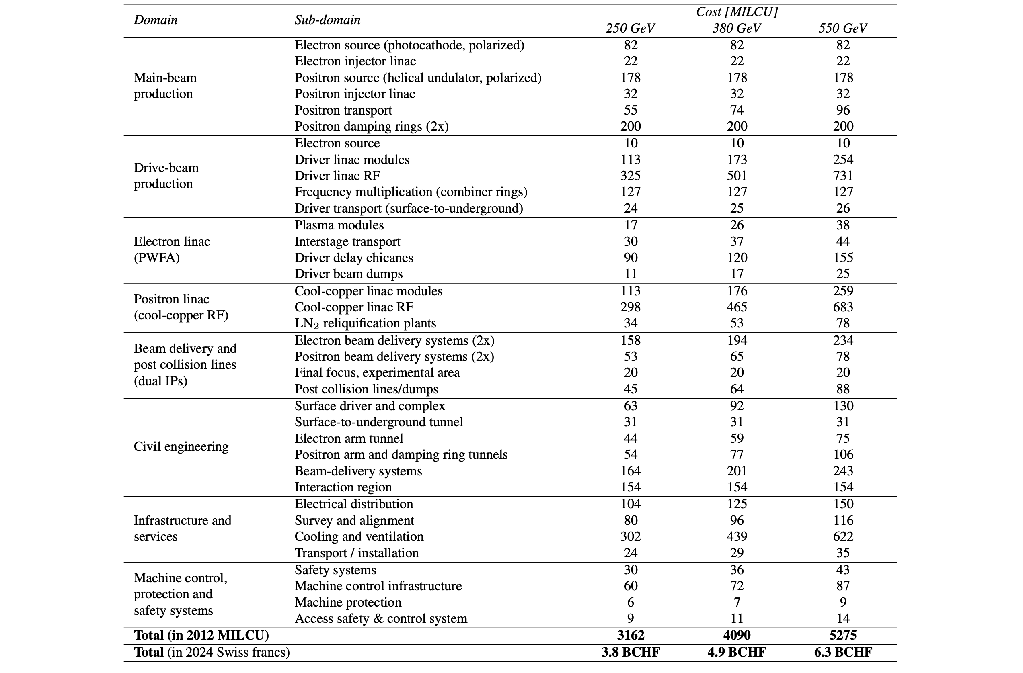
HALHF New Baseline
Cost estimates for HALHF 2.0
E. Adli et al. “HALHF: a hybrid, asymmetric, linear Higgs factory using plasma- and RF-based acceleration”, arXiv:2503.19880
Based on ILC and CLIC
Driver RF linac is a major cost driver
for the machine (~30%; 50% incl. e⁺ linac)
    Drivers: ~22 CHF/watt beam power
    Positrons: ~167 CHF/watt beam power
PWFA linac is not a cost driver (~7%)
    Driver distribution is the cost driver
BDS and IP (~13%) adds
Civil engineering adds ~25% to the machine cost, other overheads ~30%
    Cooling and ventilation is expensive (~3.6 CHF/watt wall-plug power)

Slide 14
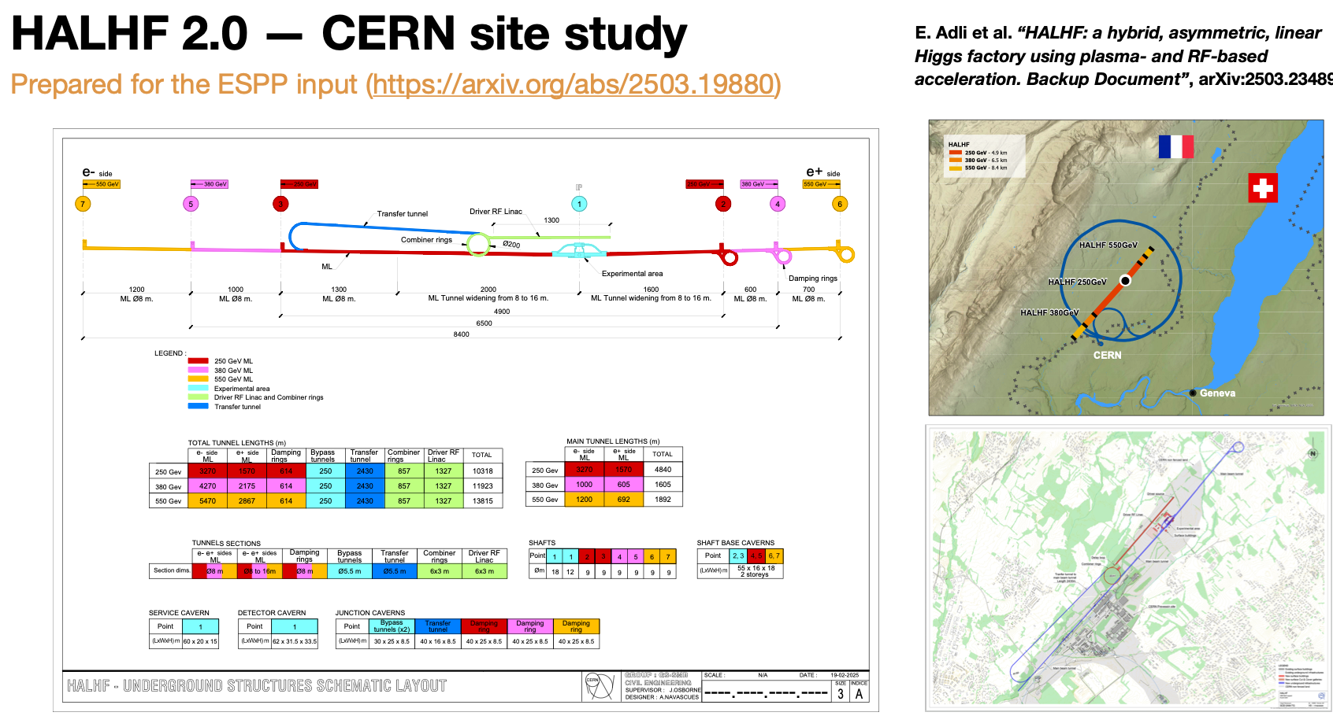
HALHF @ CERN

Slide 15
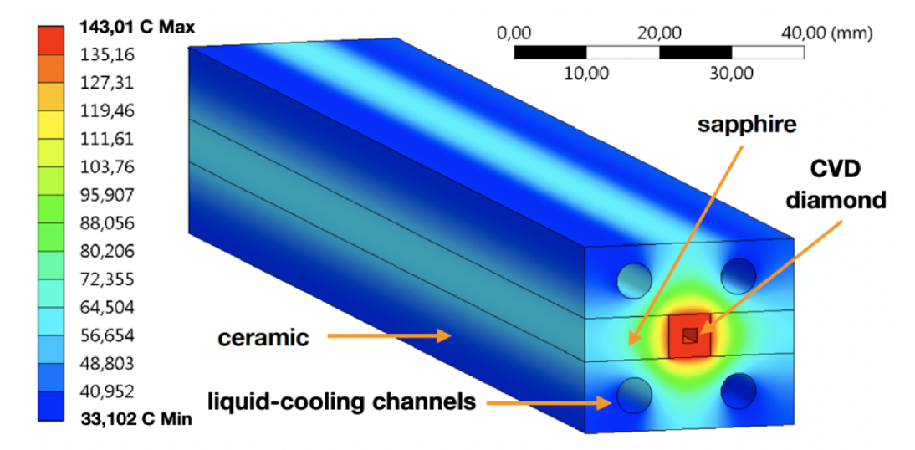
R&D Topics - Plasma Cell
Getting the heat out of the plasma cells given the
power required for colliders is a BIG problem;
Very little is known
about plasmas at these
temperatures in PWFA -
T > 100 keV - although
rather a lot at ITER!
Depending on details of
bunch structure,
extreme cooling is
needed – ~ 100 kW/m –
10* higher than CLIC -> urgent R&D required!

Slide 16
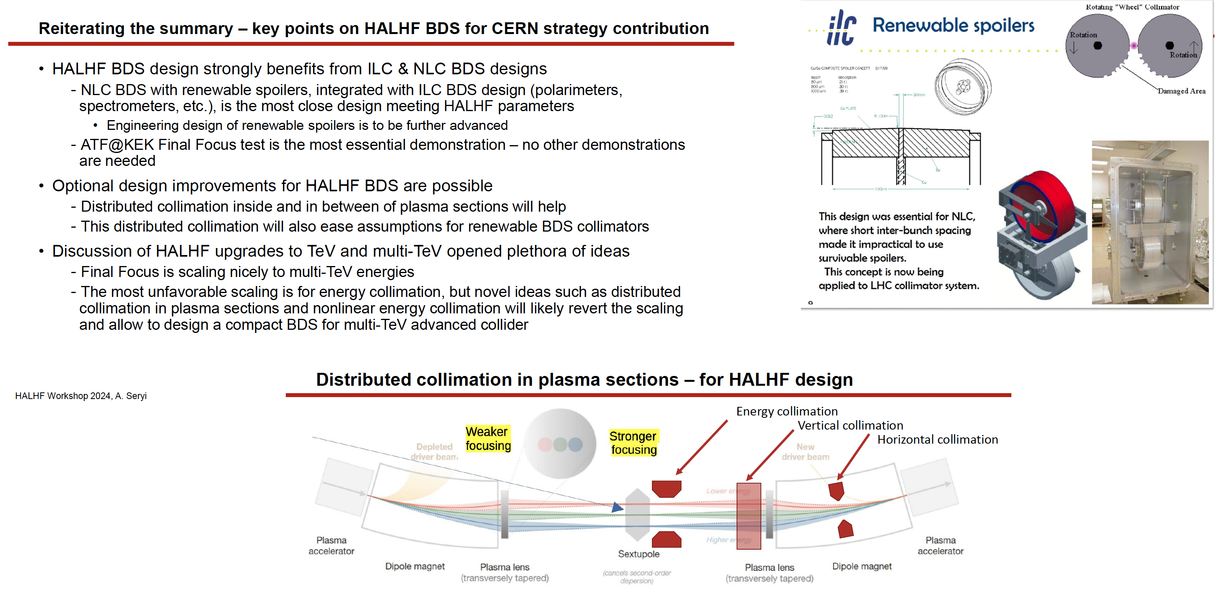
R&D Topics - Beam-Delivery

Slide 17
Towards an advanced LC
Technology being developed for HALHF could also enhance a “conventional” LC design – part of “LCVision”:
Assume: ILC has been built,
-> 2x125GeV linacs available
Goal: upgrade electron arm to 500GeV with plasma
-> 125x500GeV -> 500GeV COM; γ ~ 1.2
-> upgrade a Higgs factory to a tth / Zhh factory
Use electron linac for drive and witness beam:
run a lower gradient but higher current, upgrade RF on electron arm
Use space for undulator source between electron ML and BDS to install plasma booster
Feed boosted electrons into existing BDS (laid out for 500GeV)
Space for
plasma booster
(B. List)

Slide 18
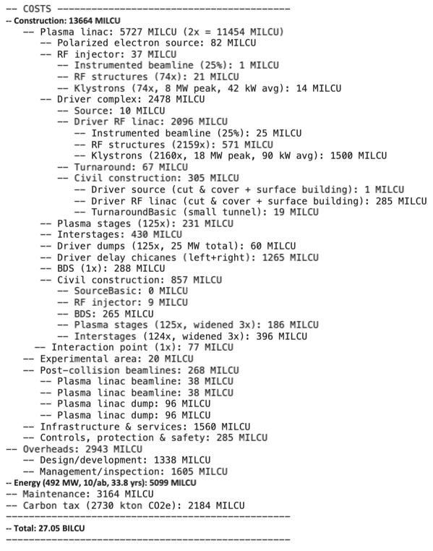
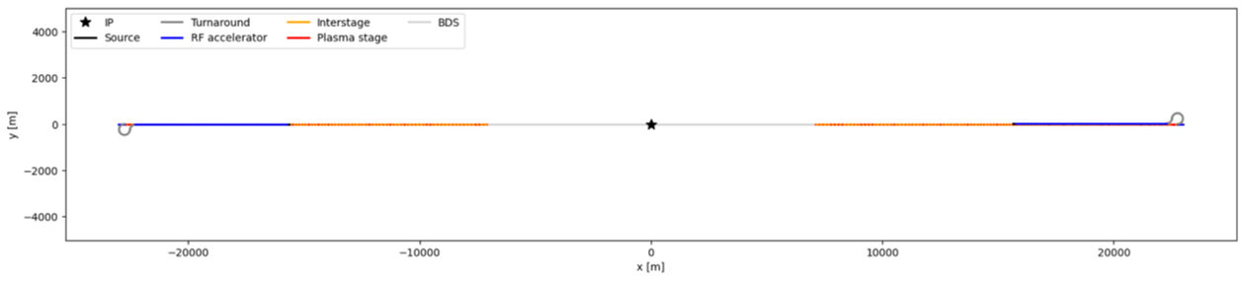
10 TeV Wakefield Collider
Simplified 10 TeV γ–γ collider with “two HALHFs”

Slide 19
10 TeV Wakefield Collider Summary
Challenges
Inefficient acceleration of positrons in plasma
  Proposed solution: Take advantage of large VBF cross-section and utilize gamma-gamma or e⁻e⁻ collisions instead.
Extreme beamstrahlung at high collision energies and beam densities
  Proposed solution: 1) Collide ultrashort bunches to mitigate beamstrahlung and 2) Embrace the broad luminosity spectrum so long as significant fraction of the colliding particles are close to 10 TeV CM.
Detector design and background modeling for high energy collisions
  Proposed solution: Development of new Particle-in-Cell codes, benchmarked against GUINEA-PIG and CAIN, to accurately model backgrounds for high-energy gamma-gamma, e⁻e⁻, and e⁻e⁺ collisions.
10 TeV Design Study sign up @ https://docs.google.com/forms/d/e/1FAIpQLScffLXDxF_8-TUYaWLznL7jAWUGfYOTEzBu4YrOnr8nRS-JQw/viewform

Slide 20
Summary & Outlook
Despite ~ 0 funding, HALHF is making rapid progress;
New baseline & costing carried out;
HALHF input to European Strategy: 10pager:https://arxiv.org/abs/2503.19880
Backup: https://arxiv.org/abs/2503.23489 - ~ 15 year R&D programme before approval
Regular monthly HALHF accelerator meetings;
Longer-term goal: pre-CDR & funding to start R&D programme;
Contribute to 10 TeV design.
  PLEASE JOIN US: https://adams-institute.ac.uk/halhf

Slide 21
BACKUP SLIDES

Slide 22
Hybrid Asymmetric Linear Higgs
Factory (HALHF)

Slide 23
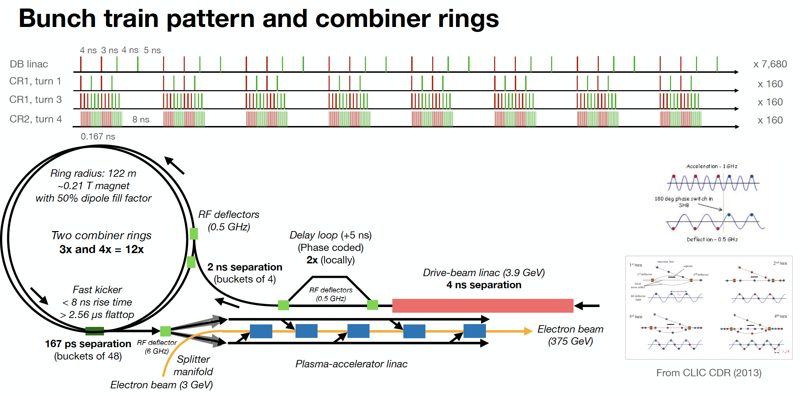
Bunch pattern

Slide 24
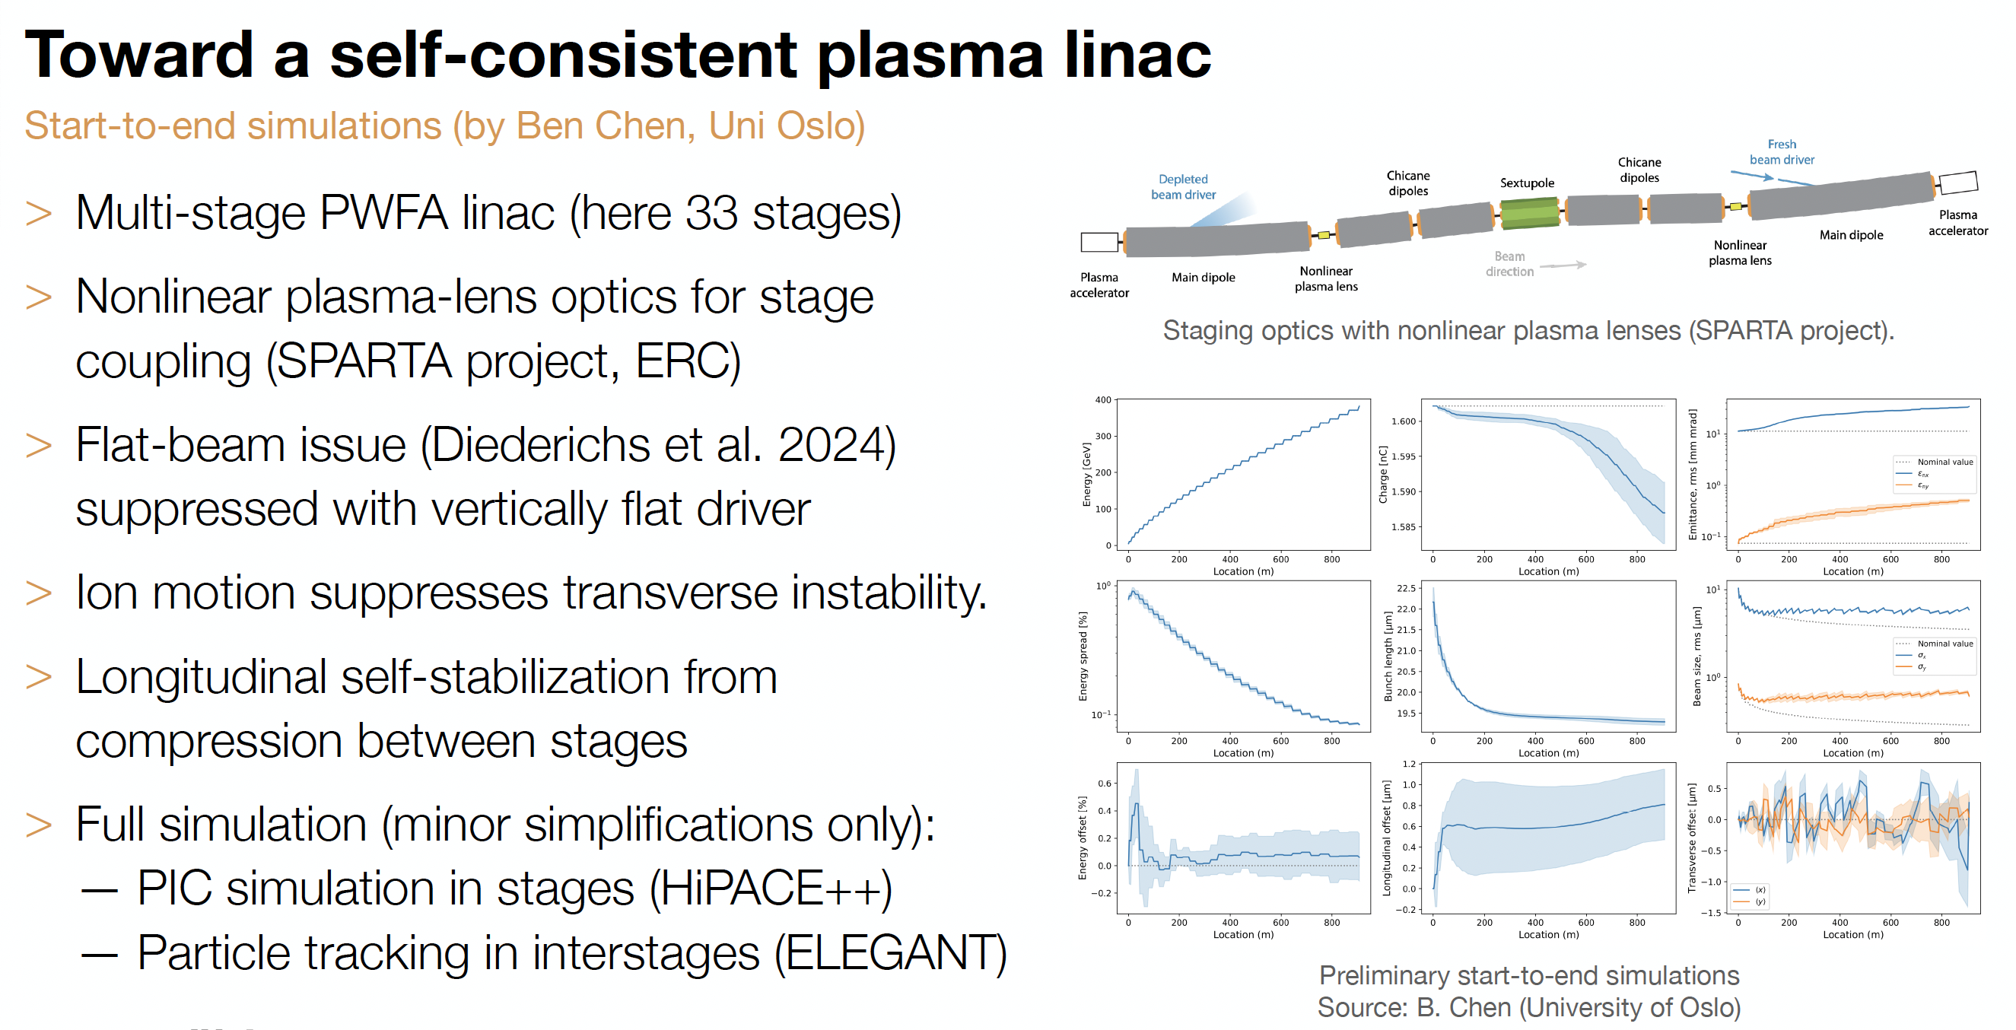
Recent Progress

Slide 25
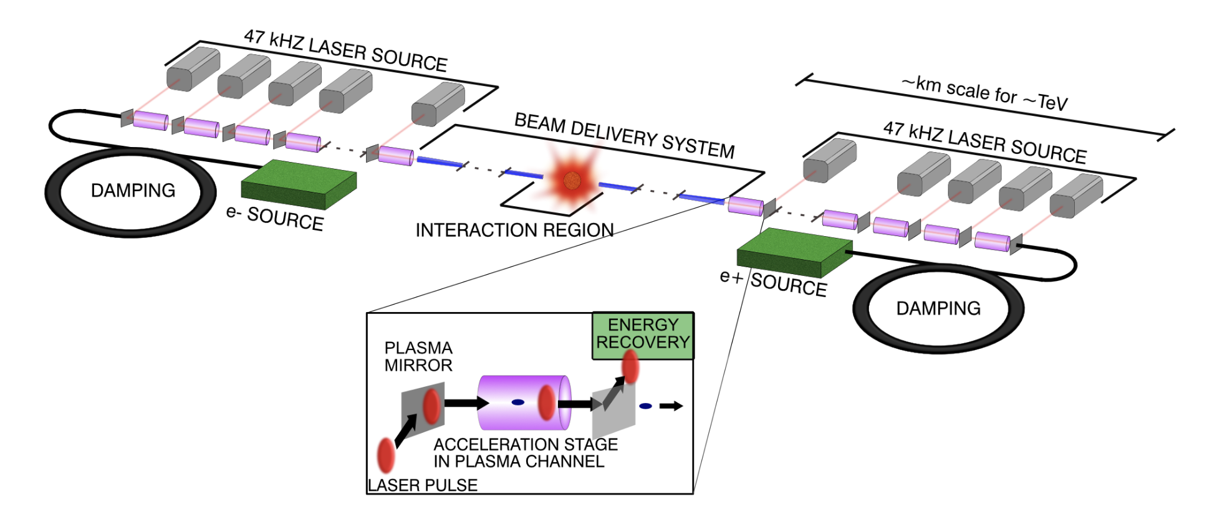
10 TeV Wakefield Collider Summary
Working Groups
System integration and optimization
Beam sources (incl. damping rings)
Drivers
  Laser
  Beams - SWFA
  Beams - PWFA
Linacs
  LWFA
  SWFA
  PWFA
Beam delivery system
Beam-beam interactions
Beam diagnostics
Machine-detector interface
HEP detector
HEP physics case
Environmental impact
Simulations/computing/AI
Green = Broader accelerator community
Orange/blue/purple = AAC specific
Red = HEP and broader community

