Slide 1


Circular Electron Positron Collider
CEPC Polarization Studies in EDR
Zhe Duan
On behalf of the CEPC Polarization Working Group
Jun 17th 2025, CEPC Workshop EU Edition, Barcelona, Spain, email: duanz@ihep.ac.cn

Slide 2
Outline
Updates on beam polarization studies
R&D in the Engineering Design Phase
Concepts of longitudinal polarization at BEPCII
Summary

Slide 3
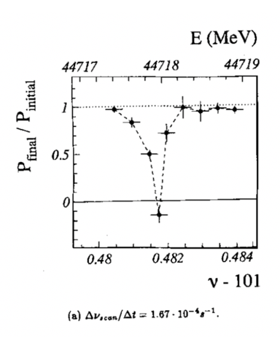
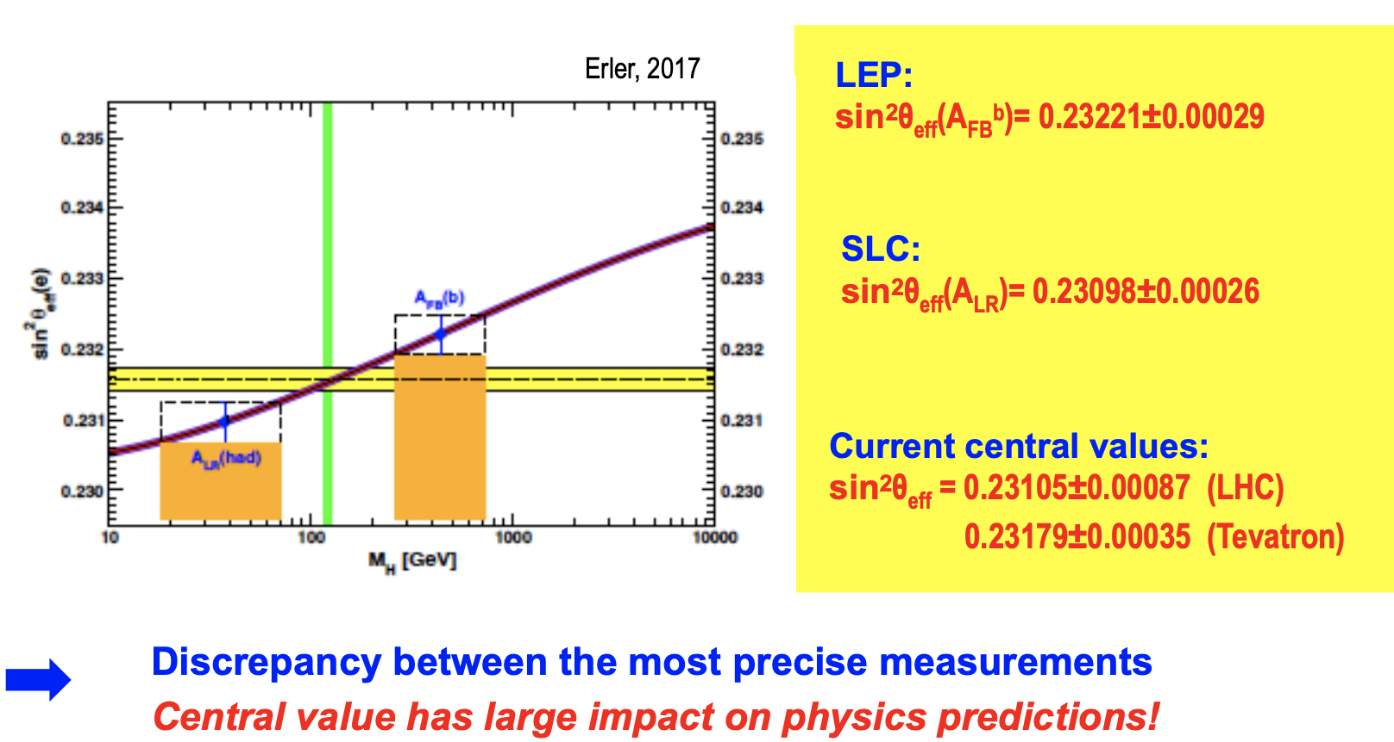
Physics motivation of polarized beams @ CEPC
Precision beam energy calibration @ Z, W (~100keV)
  resonant depolarization with vertically polarized beams
Precision measurement of weak mixing angle @ Z
  Longitudinally polarized colliding beams for measuring A_{LR}
  could resolve the tension between A_{FB} & A_{LR}, by measuring both in the same experiement
CPV with polarized beams in e+e- → HZ. H → ττ etc
ECFA meeting on e+e- to ZH angular measurements
Polarized beam applications @ ILC,
arXiv:2105.09691, 2111.06687, 2202.07385
L. Arnaudon, et al., Z. Phys. C 66, 45-62 (1995).
G. Moortgat-Pick’s talk on CEPC Workshop EU @ Marseille, 2024 April

Slide 4
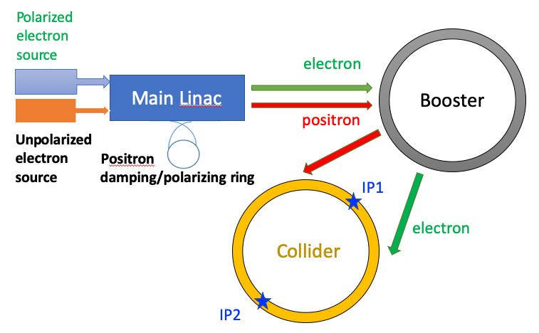
Injecting polarized beams
Polarized source
  Polarized electron gun w/ superlattice GaAs cathode (>85% polarization)
  Positron damping/polarizing ring(>20% polarization, sufficient for RD)
Linac & Transport lines
  no interleaved H & V bendings
  polarization loss is negligible
Booster
  free from intrinsic spin resonances
  polarization can be well maintained for Z & W
T. Chen, Z. Duan, D. H. Ji, D. Wang, Phys. Rev. Accel. Beams, 26, 051003 (2023).
Similar idea is now also seriously considered for FCC-ee
J. Wenninger, Injecting polarized beams , FCC Week 2025

Slide 5
Injecting polarized beams
Polarized source
  Polarized electron gun w/ superlattice GaAs cathode (>85% polarization)
  Positron damping/polarizing ring(>20% polarization, sufficient for RD)
Linac & Transport lines
  no interleaved H & V bendings
  polarization loss is negligible
Booster
  free from intrinsic spin resonances
  polarization can be well maintained for Z & W
T. Chen, Z. Duan, D. H. Ji, D. Wang, Phys. Rev. Accel. Beams, 26, 051003 (2023).
Collider
  solenoid spin rotators @ 45.6 GeV
  ~70% longitudinal polarization for e-
W. Xia et al., Investigation of spin rotators in CEPC at the Z-pole,
Radiat. Det. Tech. Meth. 6:490 (2022).

Slide 6
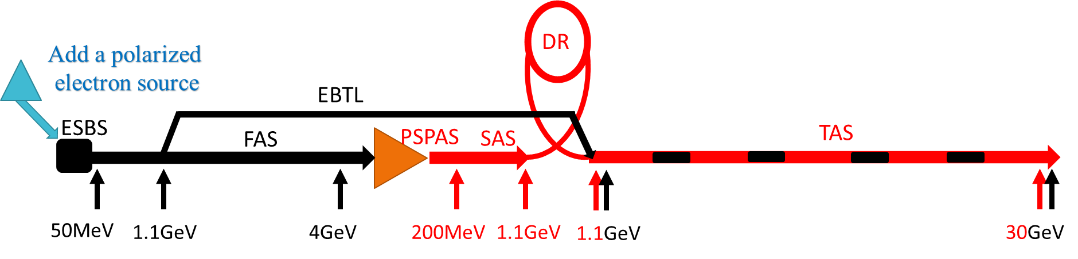
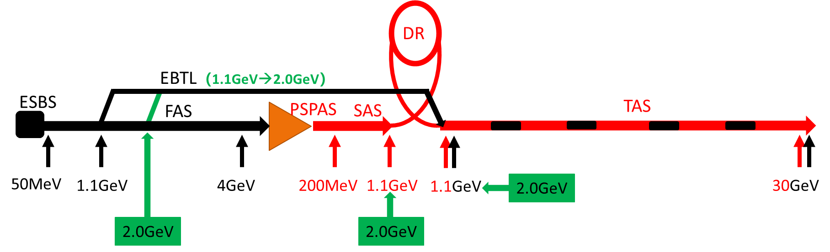
Modification to the linac
For e- linac, only local adjustments are made at the electron source
By Cai Meng
For e+ linac, change in EBTL energy, replaced of C-band power source by S-band, length increase of 30 m

Slide 7
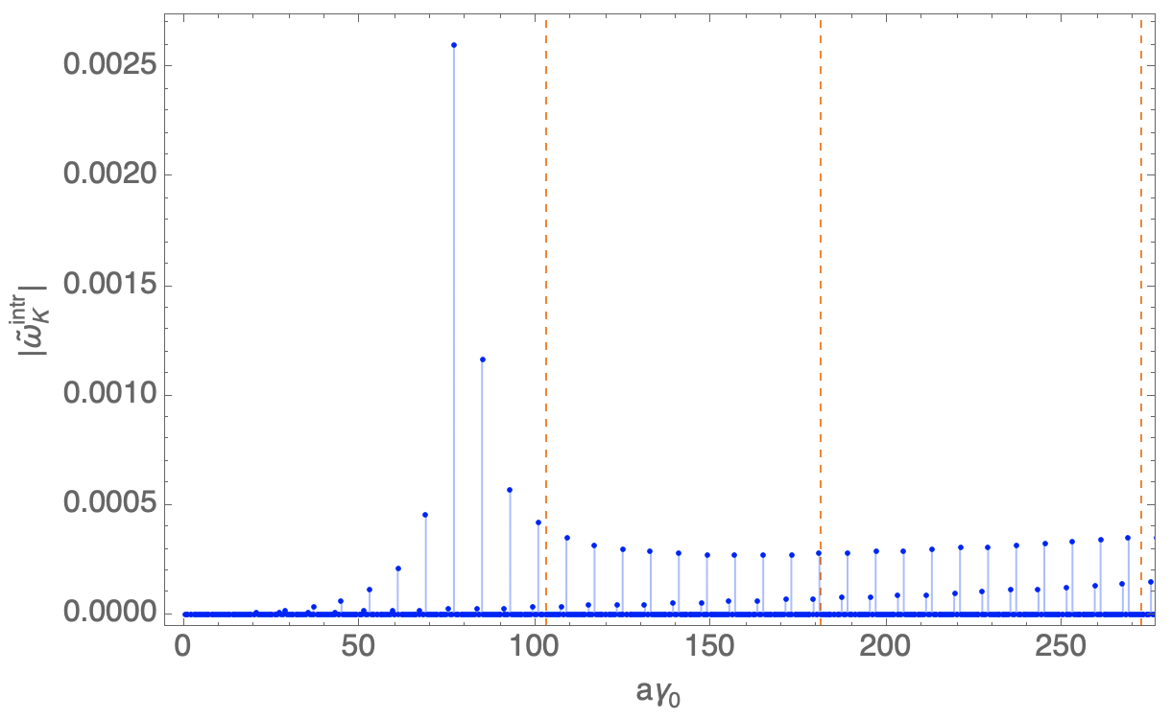
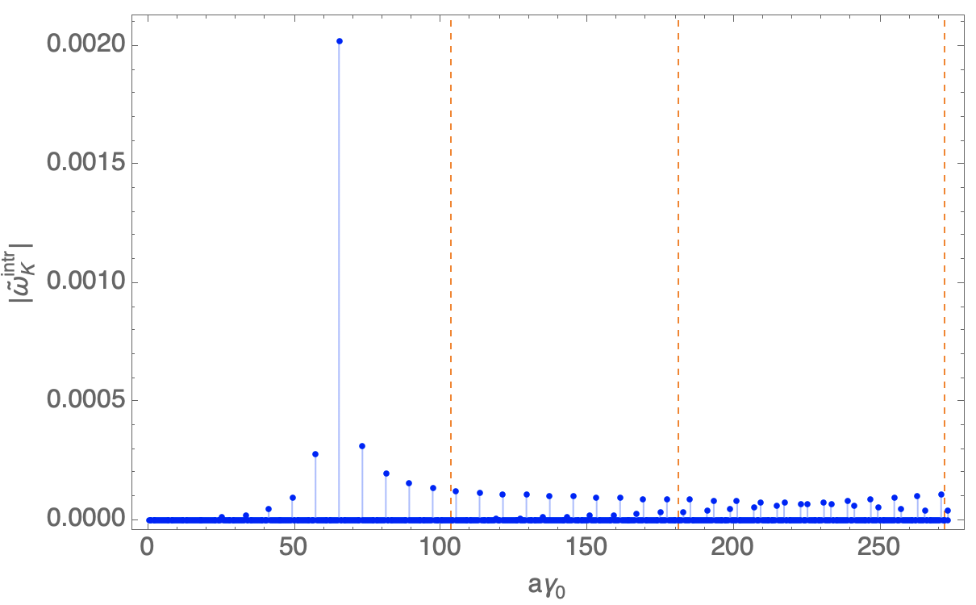
Updates on booster polarization maintenance
By Dou Wang, Daheng Ji
Optimization of polarization transmission for TDR lattice
  Vertical betatron tune changed by ~ -11 units
  W/o change of layout & beam emittance
  Promising for Z & W
  Stronger imperfection resonances for Higgs, under study
TDR lattice
30 GeV
injection energy
45.6 GeV
80 GeV
120 GeV
 | TDR lattice | New lattice
ν_{y} | 116.83 | 105.18
ν_{B}/η_{arc} | 79 | 50
Polarization transmission to Z | ~50% | ~99%
Polarization transmission to W | ~50% | ~95%
Polarization transmission to H | ~20% | ~0%
New lattice

Slide 8
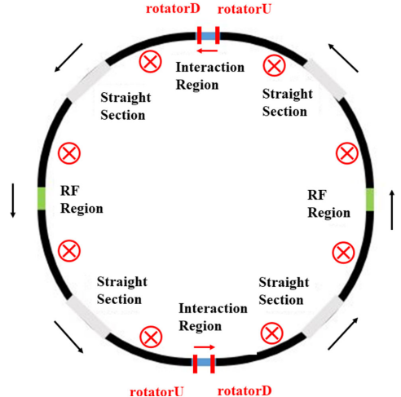
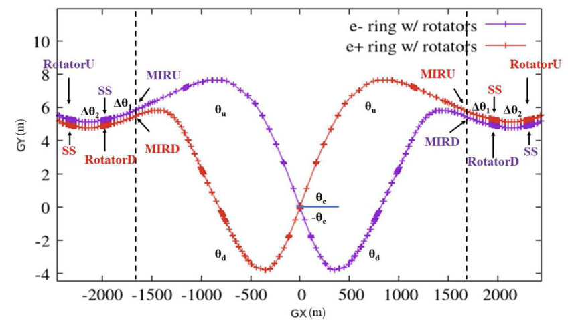
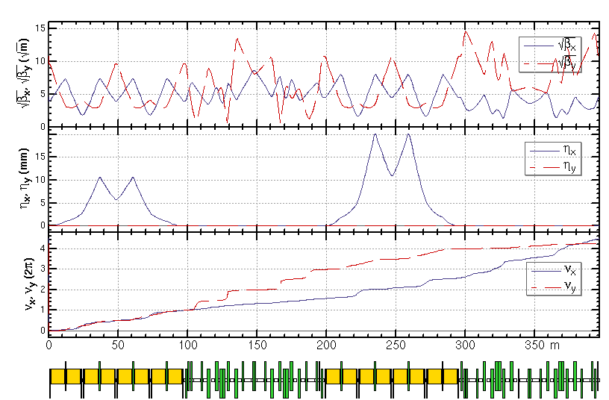
Spin rotator implementation in Colliders
Spin rotators have been implemented into the TDR lattice
  Length of each spin rotator ~ 400m, total length of 4 rotators ~ 1.6 km (reduced from 2.8 km)
  The deflection angles and lengths of ARC dipoles are reduced
  The circumference of the whole ring is 99.913km
  More detailed optics optimization and performance evaluation is under way
By Yiwei Wang

Slide 9
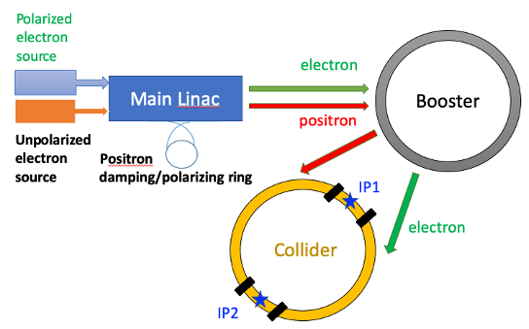
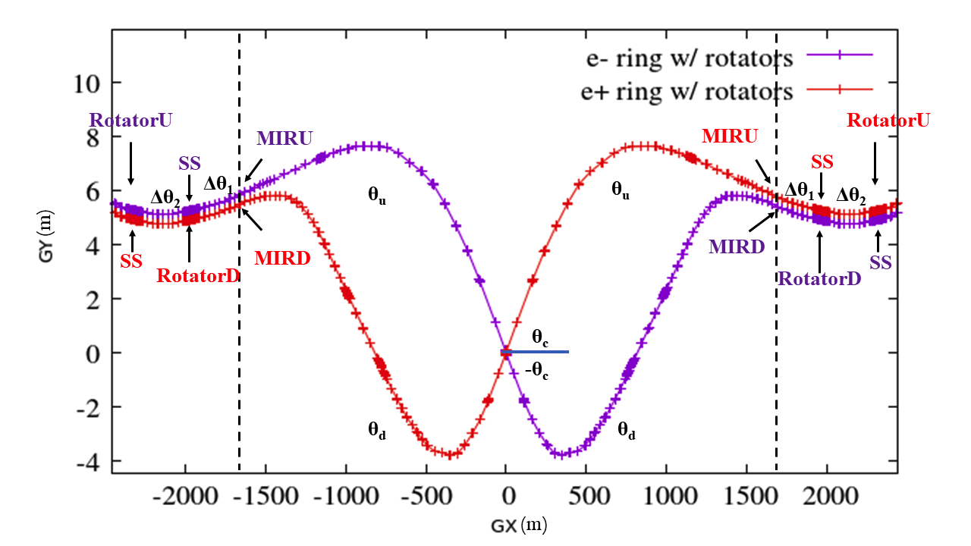
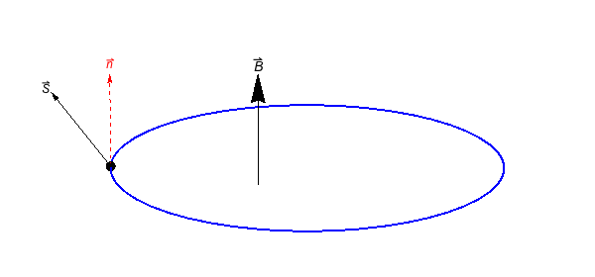
Key aspects of polarization R&D in the EDR phase
Key aspects | Figure of merit | R&D goal
Design study | > 50% polarization for both beams | improve pol e- design, study pol e+ scheme
Polarized electron source | polarization > 85% | polarized DC gun @ PAPS, polarization > 85%
Compton polarimeter | 3D measurements ~ 0.1% | vertical polarization measurement @ BEPCII, ~1%
Resonant depolarization-based beam energy calibration | ~10⁻⁶ for Z & W | demonstration @ BEPCII
Solenoid spin rotator for longitudinal polarization @ Z-pole | Solenid integral field ~ 1000 T.m per IP | HTS SC solenoid, B ~ 12 T, BL > 10 T.m beam test @ a future test facility
Hardware R&D and beam tests
Enable
Experimental studies
Verify
IP/detector
depolarizer
Physics design
polarimeter

Slide 10
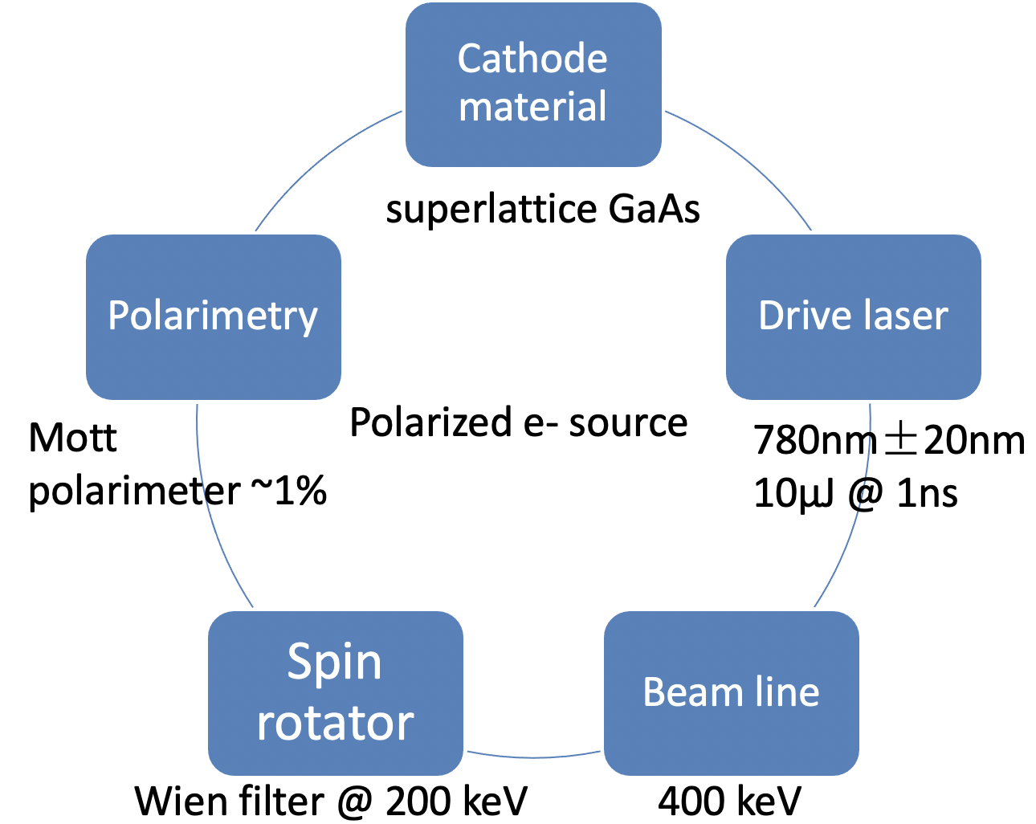
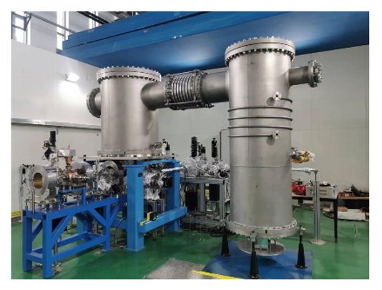
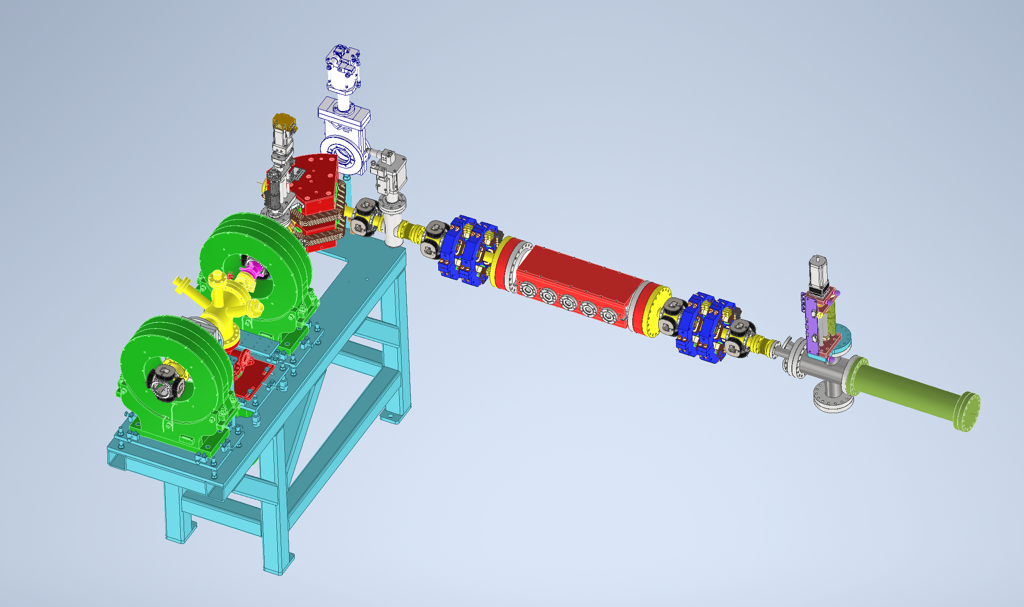
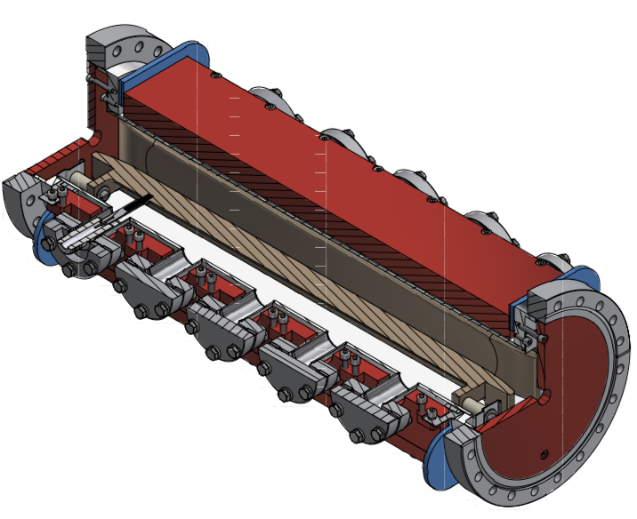
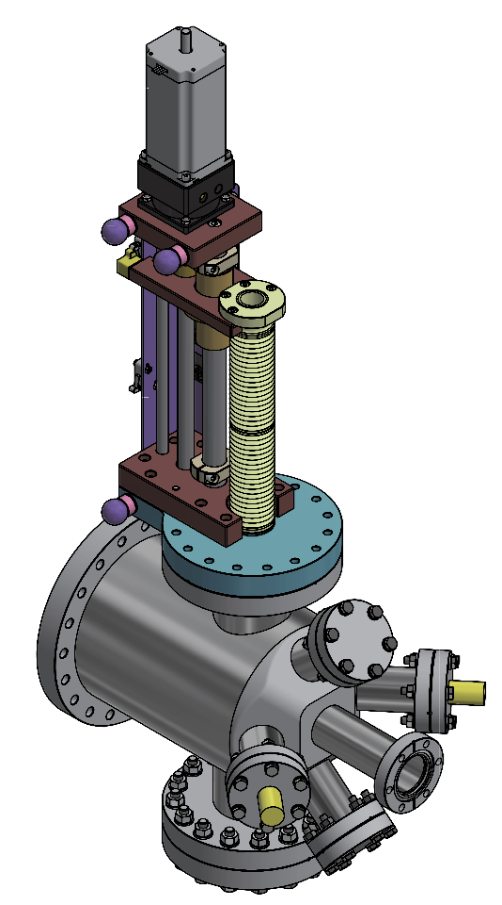
A test facility for polarized electron source
Convert a HV DC gun to a polarized electron source
  Design of Wien filter, Mott polarimeter in collaboration with V. Tyukin (JGU-Mainz)
  Beamline physics design in progress
  Beam commissioning scheduled in 2027
500kV photocathode DC gun @ PAPS
Beamline for polarization measurement
Wien filter
Mott polarimeter
Li Xiaoping, V. Tyukin, Liu Wei, Meng Cai, Wang Jianli, Wang Haijing, Liu Jindong, Liang Zhijun, Liu Zhongtian etc

Slide 11
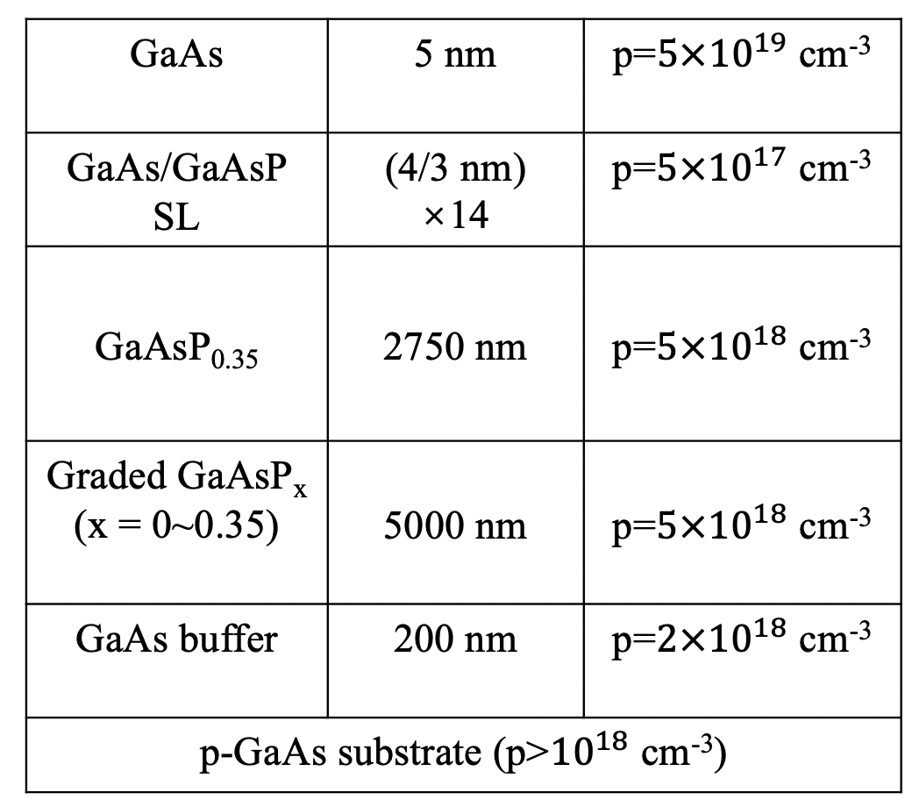
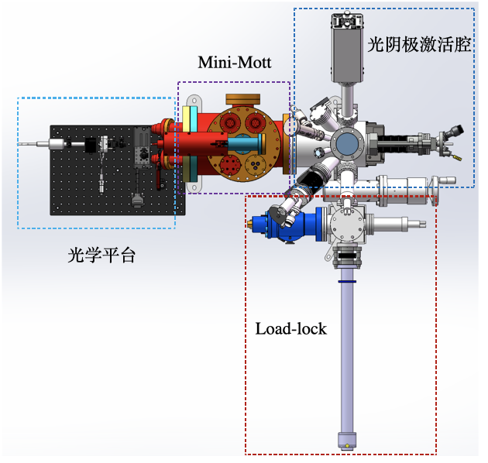
A test facility for polarized electron source
Domestic R&D on superlattice GaAs cathode
  in collaboration w/ Acken Optoelectronics Ltd. @ Suzhou
  goal:
    cathode performance: polarization > 85%, QE > 0.8%
    build a platform for cathode performance test
  First cathode is in production now, will be delivered for test soon
Platform for cathode test:
ESP & QE

Slide 12
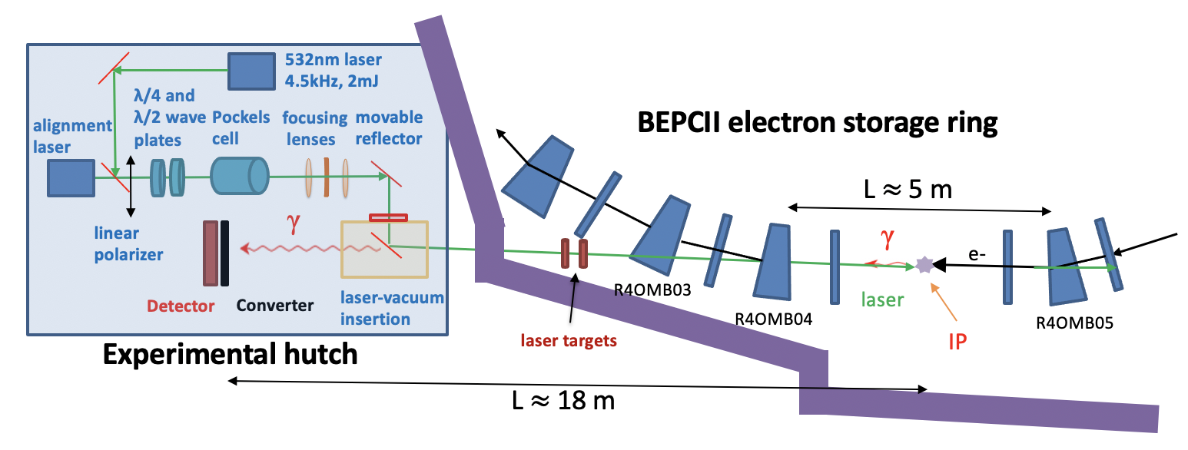
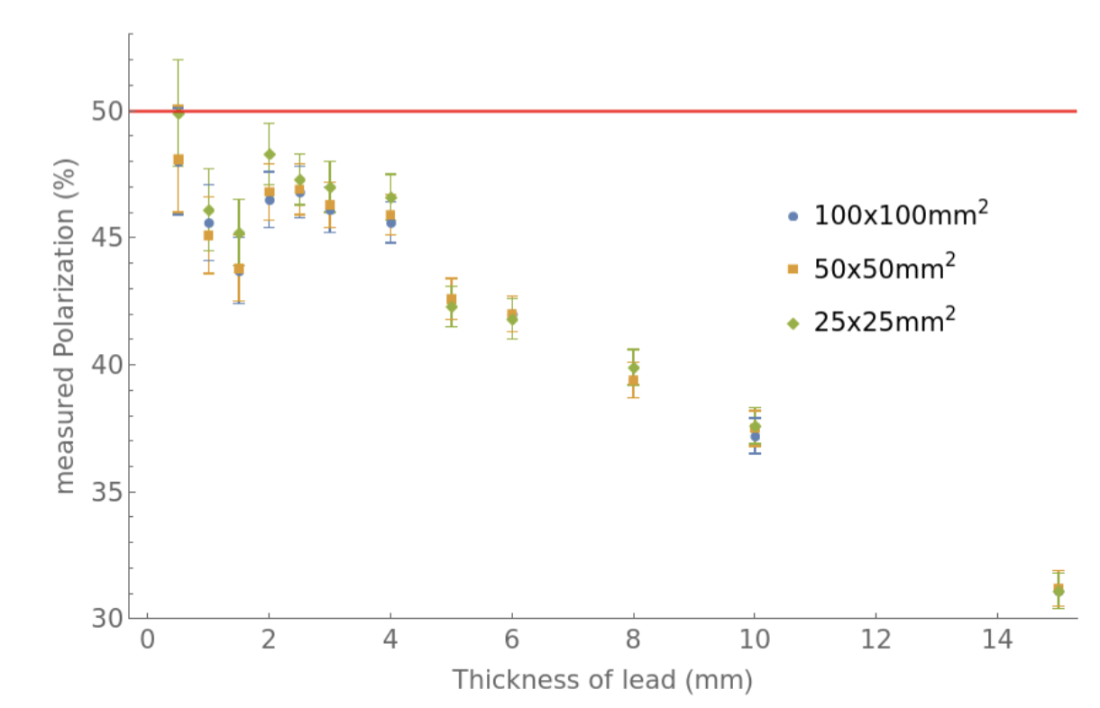
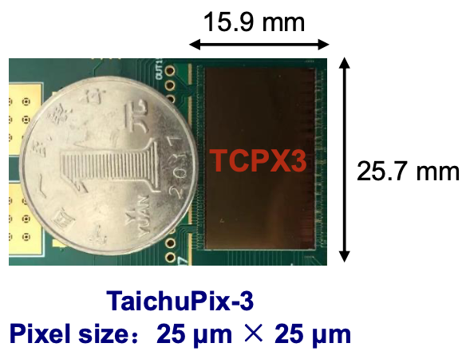
Compton polarimeter @ BEPCII
Design
  Modify the beamline of a dismantled wiggler
  A pulsed laser at 4.5 kHz, 2 mJ
  Detection of backscattered γ position with a lead converter + CEPC vertex detector prototype
In collaboration with A. Martens (IJCLab) with support from FCPPN/L
Asymmetry
Assume 50% vertical polarization
Measured polarization (%)
~1% stats uncertainty in ~ 20 sec
vertical coordinate on detector(mm)
Thickness of lead (mm)
12
Performance simulations (by Guangyi Tang, A. Martens etc)
Liang Zhijun etc

Slide 13
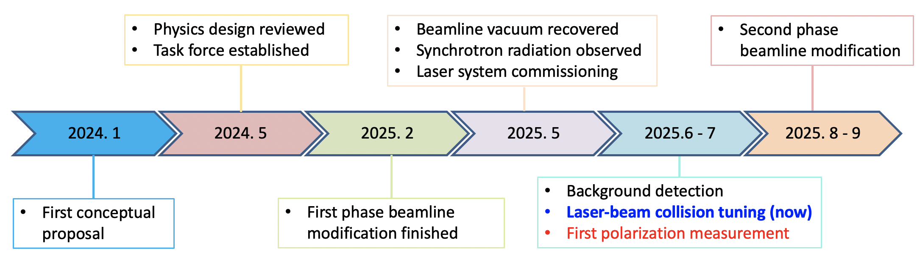
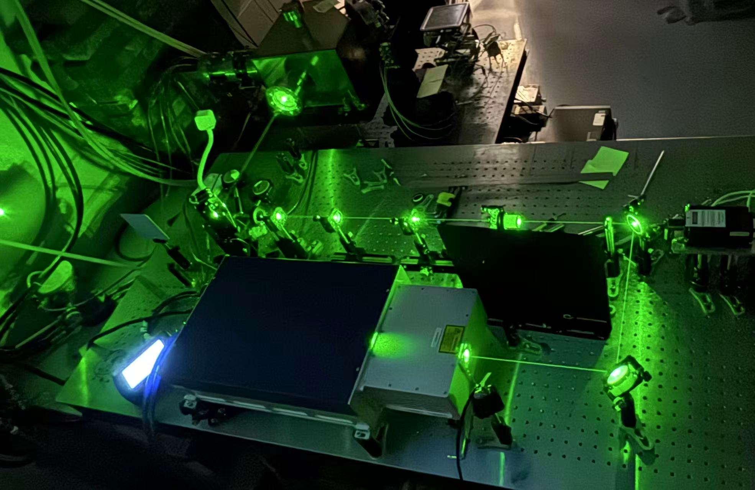
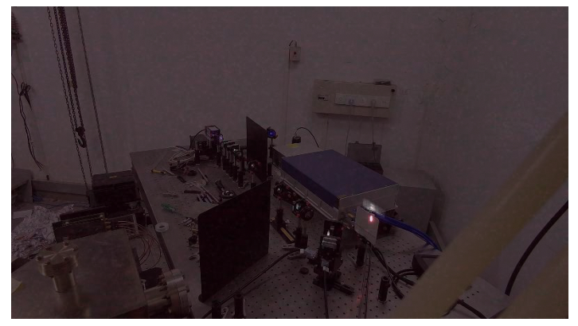
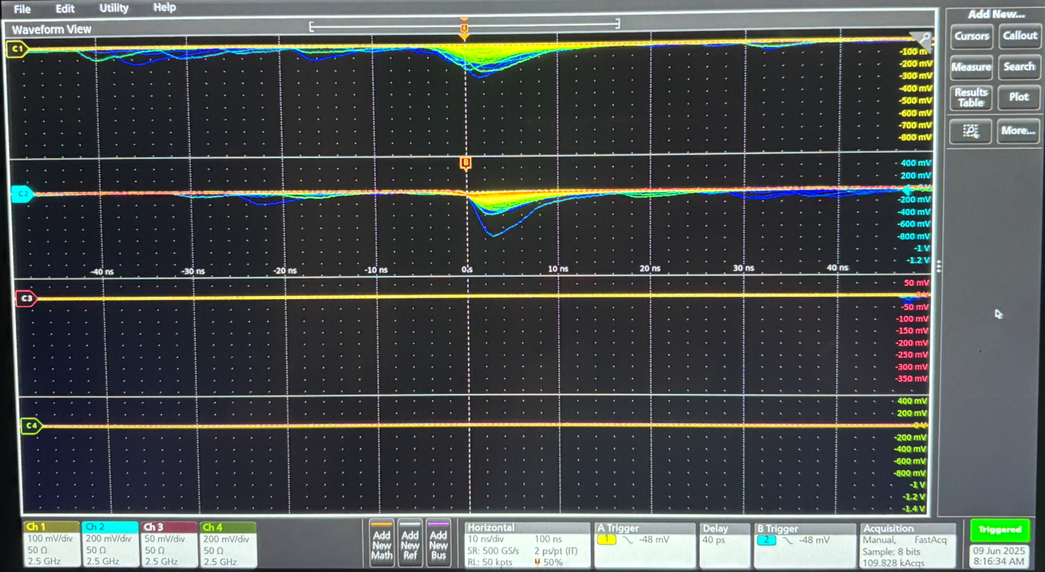
Compton polarimeter @ BEPCII
Visible light part of synchrotron radiation from the reflector mirror
Background measured by lead preshower + scintilator + PMT
Laser optics

Slide 14
Compton polarimeter @ BEPCII
This will facilitate BEPCII as a unique test bed of beam polarization experimental studies for future colliders
Aspects | R&D item
Compton polarimeter | laser polarization measure/control, silicon pixel detector
Resonant depolarization | Operation scenarios, error analysis, colliding bunches & pilot bunches
Depolarization mechanism | Rich data of parameter dependence, beam-beam depolarization
Polarization tuning/optimization | spin matching, machine learning techniques

Slide 15
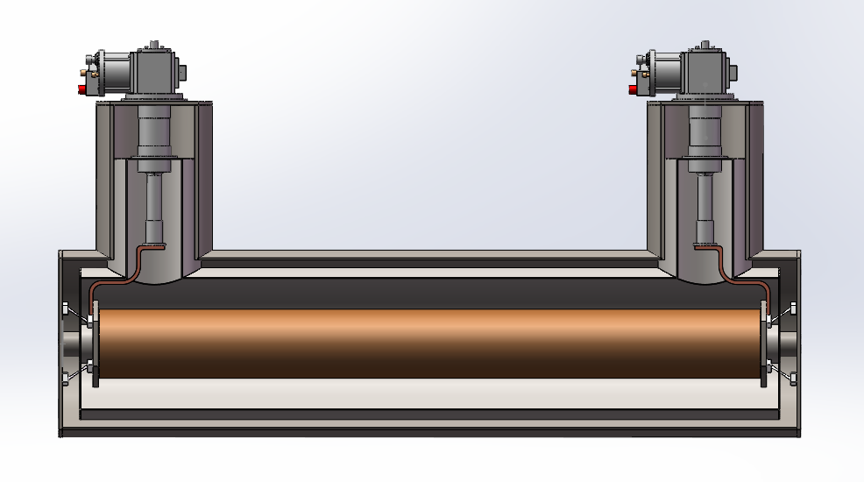
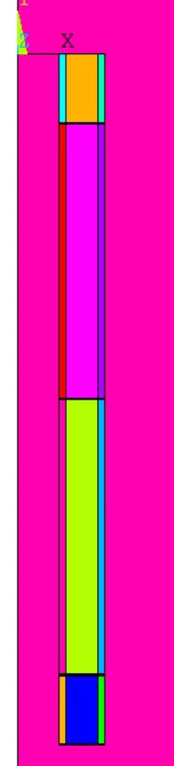
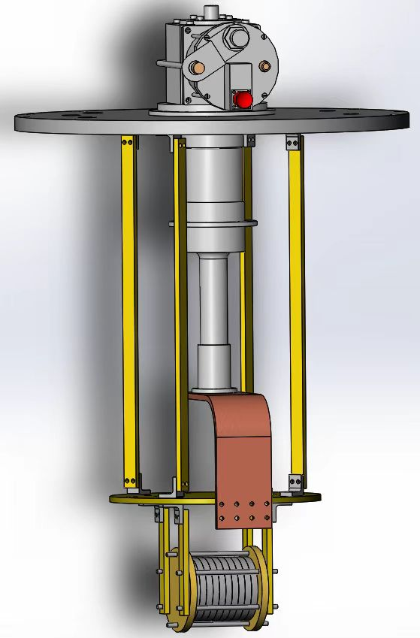
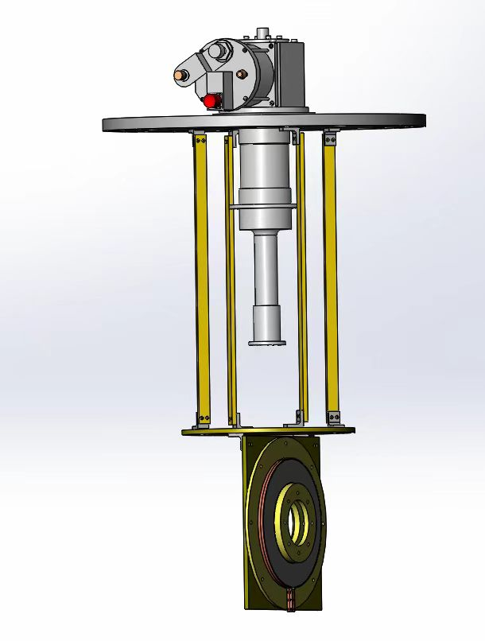
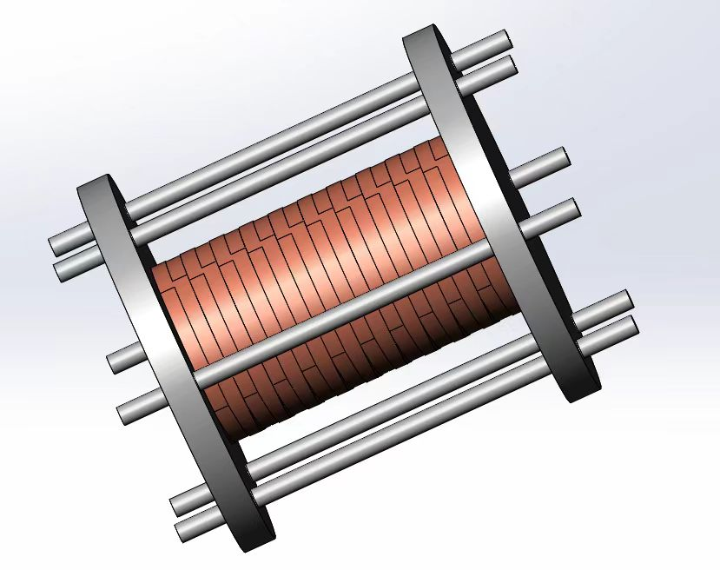
YBCO Superconducting solenoid spin rotator R&D
Concept
  Application of HTS with conduction-cooling
Coil design and optimization
  integral field meets spec
  max strain lower than limit
Experiment studies
  Temperature homogeniety
  Stability of YBCO coils
Measurements & tests scheduled in 2027
Design specs：
Peak field: 12 T
Integral field：10.26T.m
Length：1.018m
Working current：300A
Coil aperture：140mm
magnet aperture > 64mm
Cryo-cooler
Vacuum Dewar
Solenoid
10 Double-winding（12mm宽）
80 Double-winding（4.8mm宽）
10 Double-winding（12mm宽）
Zhao Ling, Xu Qingjin, Hou Zhilong, Zhou Jin, Liu Zhongxiu etc
Experiment studies of key issues with the conduction cooling and YBCO coils

Slide 16
Motivation for longitudinal polarization at BEPCII
2025-2030: BEPCII upgrade to higher luminosity (x3 @ 2.35 GeV) & higher energy (up to 2.8 GeV)
e- longitudinal polarization is one of potential upgrade options after 2030
  Physics motivation (preliminary, under investigation)
    Entangled hyperon-antihyperon pairs for CP tests
    Spin dependent fragmentation function, nucleon form factor
    ...
  Consider 1.55 GeV (J/ψ) as the tentative beam energy for polarization optimization
Could serve a test bed for implementation of e- longitudinal polarization in future colliders including CEPC

Slide 17
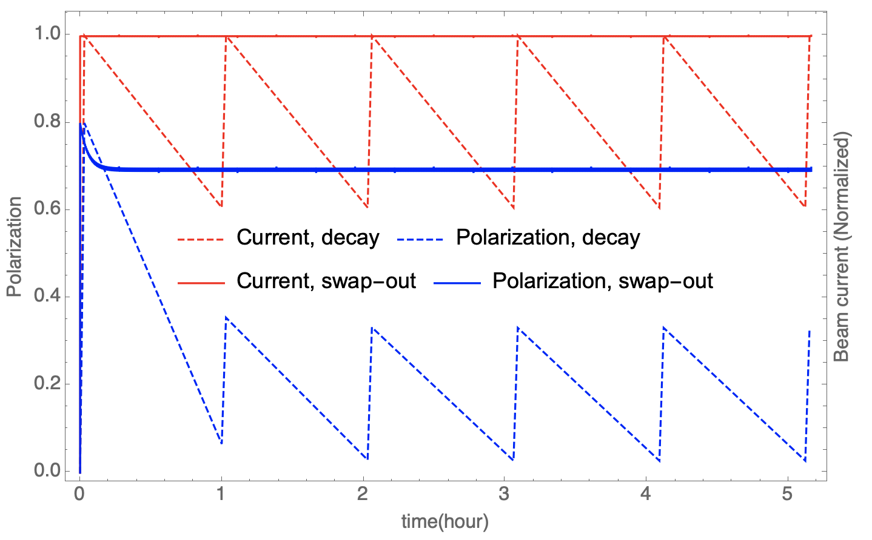
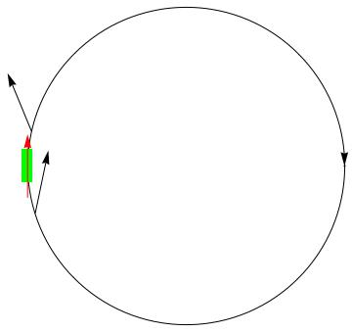
Polarization issues of BEPCII at 1.55 GeV
Sokolov-Ternov time is 10.5 hour, beam lifetime is 1~2 hour
Inserting a Siberian snake to attain longitudinal polarization at IP
Depolarization time is 24 min for a spin matched snake
Frequent extraction of depolarized bunches & injection of fresh polarized bunches (swap-out)
  e.g. replace 1/12 of all 120 bunches every 20 seconds
  for an injected beam polarization 80%, time-averaged polarization ~ 70%
  Note: swap-out injection has been successfully demonstrated in APS-U & HEPS, with potential applications in future colliders
A single full snake

Slide 18
Envisaged modifications
on-axis injection
e- transport line
150kV polarized DC gun
wien filter
Mott polarimeter
spin rotator
Unpolarized gun
Linac
Compton polarimeter
positron source
Siberian
snake
Detailed design is under way
e+ transport line
extraction to beam dump

Slide 19
Summary
Implementation of polarized beams into the CEPC TDR lattices is onging
R&D of key technologies in progress
  Compton polarimeter at BEPCII
  Test facility for polarized electron source
  Prototype of a HTS solenoid spin rotator
Experimental studies at BEPCII and a new TF are planned
Longitudinal polarization is one upgrade option for BEPCII in 5 years’ time
These activities will set the basis for polarization applications at CEPC
Thank you for your attention!

