Slide 1


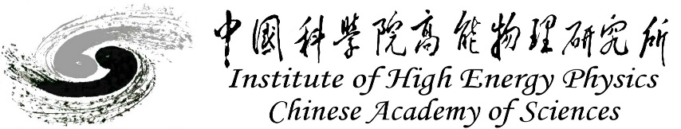
CEPC MDI study status in EDR
Sha Bai
On behalf of CEPC MDI group
June 16th-19th 2025, European Edition of the International Workshop on CEPC

Slide 2
Content
Introduction
CEPC MDI design
  SC magnets
  Cryostat
  Central beam pipe design
  IR vacuum chamber and thermal analysis
  IR BPMs
  Beam background and mitigation
  SC magnet supporting system
  RVC
  MDI alignment
Summary

Slide 3
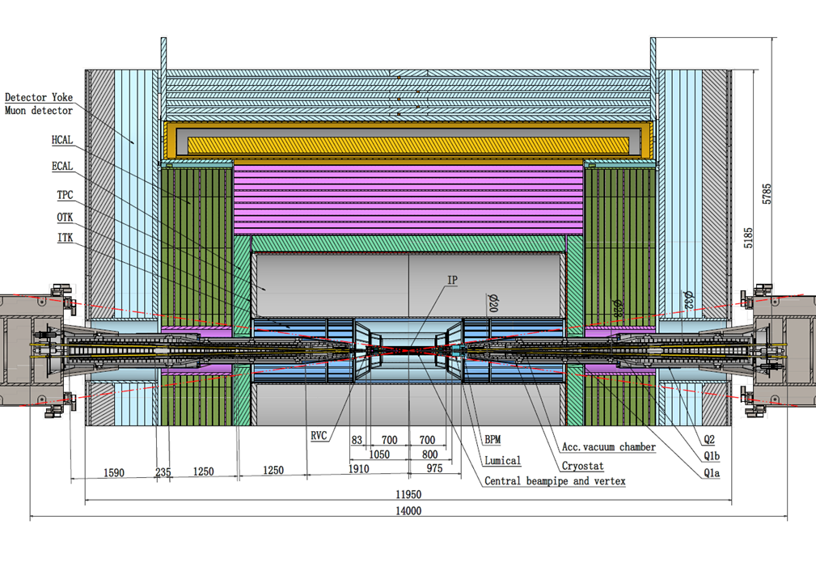
Introduction - MDI layout and IR design
The Machine Detector Interface (MDI) of CEPC double ring scheme is about ±7m long from the IP.
The CEPC detector superconducting solenoid with 3T magnetic field.
The accelerator components inside the detector are within a conical space with an opening angle: acos0.99
The e+e- beams collide at the IP with a horizontal angle of 33mrad and the final focusing length is to 1.9m.
Lumical is between 800mm~950mm from IP, while IP BPM at 950~1050mm.
Cryostat start point at 1050mm from IP, while anti-solenoid starts at 1130mm to 6200mm from IP.

Slide 4
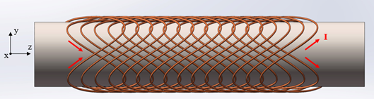
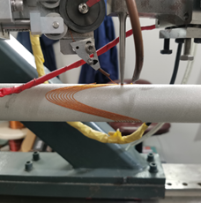
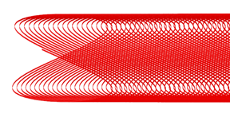
Acc. Superconducting magnets
SC quadrupole design adopted CCT type
1) CEPC Interaction Region quadrupole magnets meet basic requirement.
2) Ratio of multipole field to quadrupole field <2×10⁻⁴
3) Integral dipole field at the center of one aperture is zero
Local dipole field at each longitudinal position ≤ 300Gs
The total weight of each set of SC magnets is ~ 0.4 tons.
ITEM | Q1a | Q1b | Q2 | Anti-solenoid
Central field gradient (T/m) | 142.3 | 85.4 | 96.7
Cooling type | LHe | LHe | LHe | LHe
Operating current (A) | 720 | 640 | 760 | 1300
Magnetic storage energy (KJ) | 16.7 | 15.2 | 36.1 | 740
Cross section parameter (mm) | Φ40~61 | Φ52~78 | Φ62~88 | 70 sections
Magnet mechanical length (m) | 1.23 | 1.23 | 1.53 | 5.1
Net weight (Kg) | 25 | 32 | 43 | 302
Total weight of magnets (Kg) |  |  |  | 402
CCT coil
Peak field in coil Q1a/Q1b/Q2: 4.0T/3.7T/4.1T
Within the aperture of anti-solenoid, the maximum magnetic field is 8.2T, and the maximum magnetic field on anti-solenoid coil is 10.9T.
SC magnets corrector coil：dipole coil(Q1a/Q1b/Q2）≤300Gs
Skew quadrupole coil：
 | Q1b | Q2
L(m) | 1.21 | 1.5
G（T/m) | 0.44 | 0.36

Slide 5
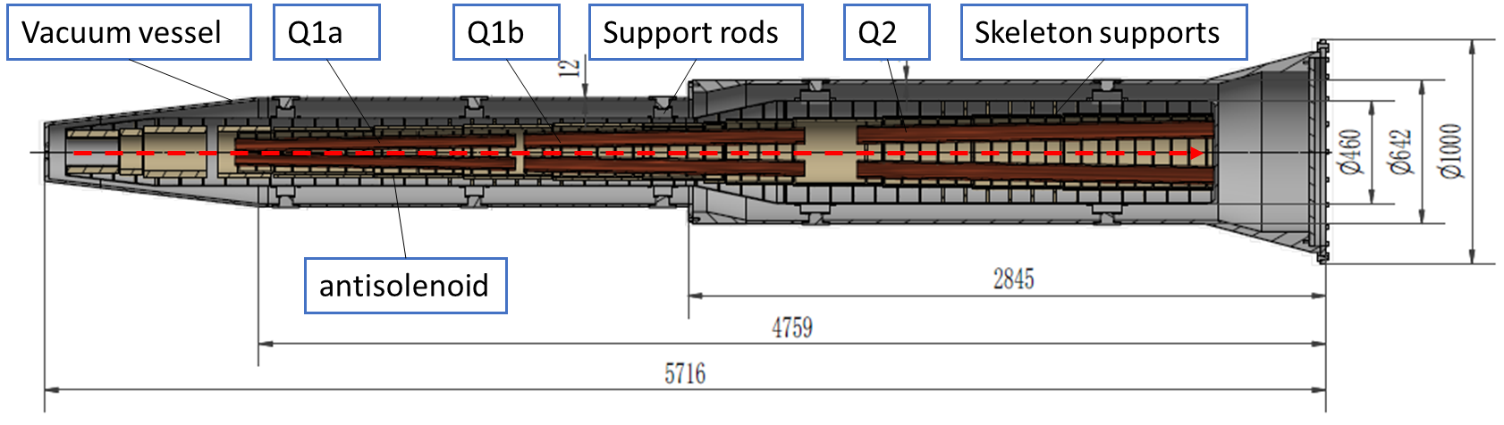
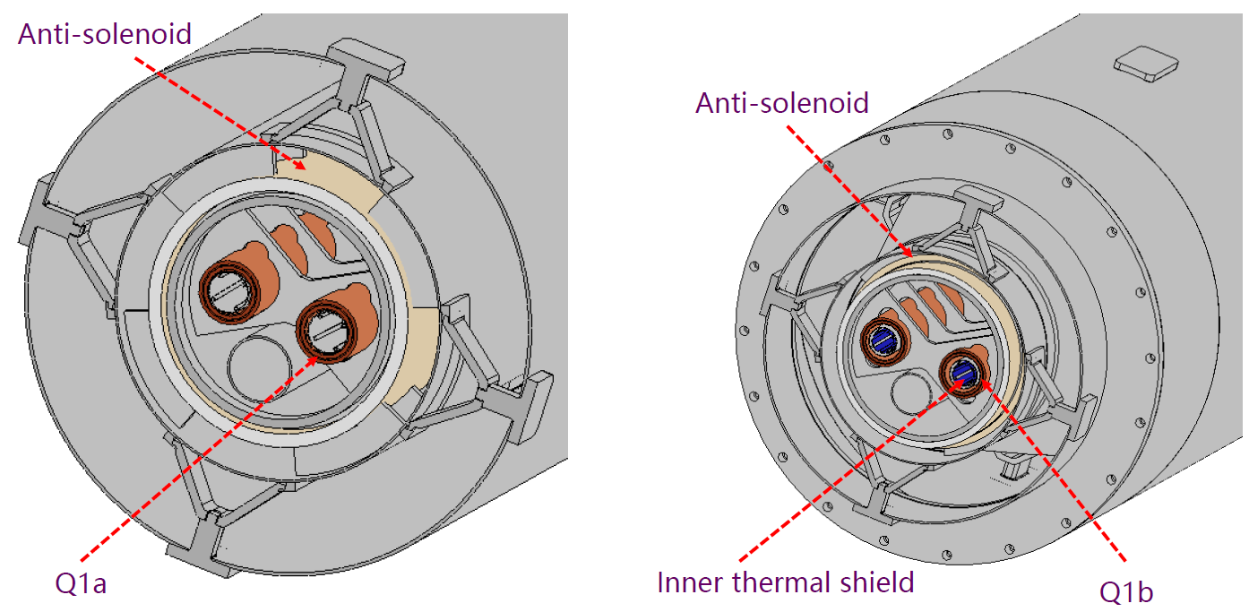
Acc. Superconducting magnets
The cryostat is used to provide the cryogenic environment for SC magnets, which is below 5.0 K.
Working temperature: 2K is the baseline, 4.2K is alternative.
Cryostat: a total weight of ~ 2.4 tons and a total length of ~ 5.7m.
Items | Weight (kg) | Main materials
Vacuum vessel | 869 | SS
Helium Vessel | 510 | SS
Thermal shield and pipes | 43 | Aluminum
SC quadrupoles | 100 | Copper & Aluminum
Anti-solenoids | 302 | Copper & Aluminum
Skeleton supports | 92 | Aluminum
Liquid Helium | 504 | Liquid Helium
Total weight | 2420

Slide 6
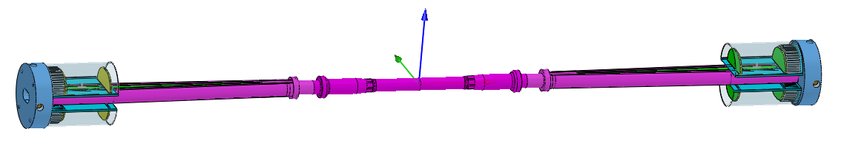
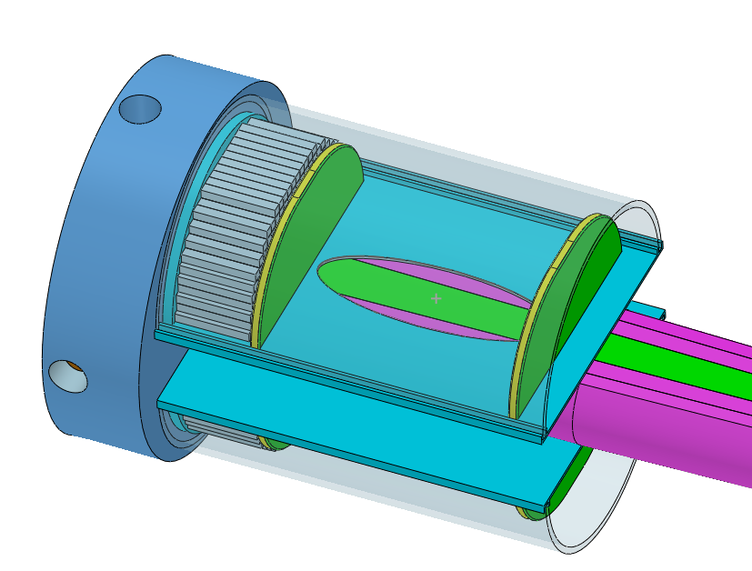
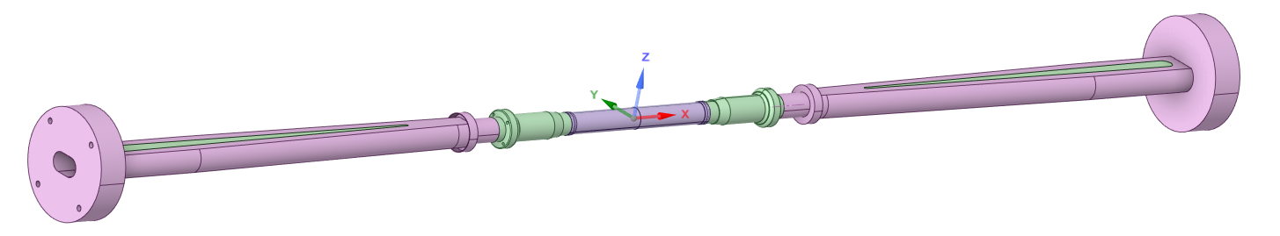
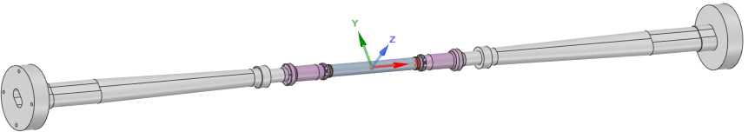
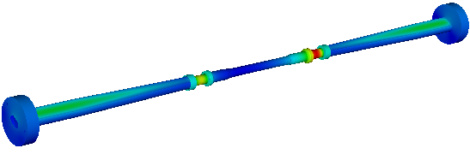

The central beam pipe design
Central Be pipe segment: 380mm, the inner diameter: 20mm
The inner Be layer: 0.2mm
Outer Be layer: 0.15mm (to improve the accuracy of vertex)
the cooling gap: 0.35mm, Paraffin
0.2mm, Water
Si wafer
LYSO bars
Highest temperature position
Water is the basic design and Paraffin is alternative choice.
Dynamic temperature/pressure could meet the requirements.
Highest temperature: 25.7℃

Slide 7
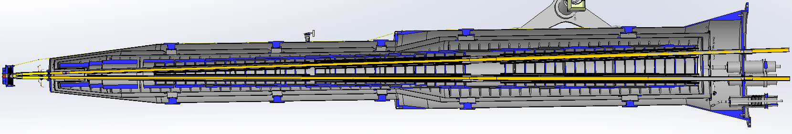
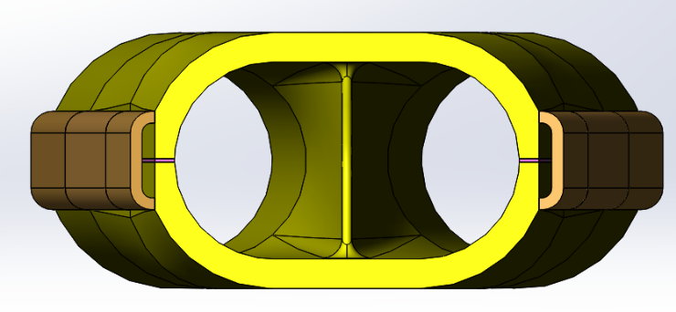
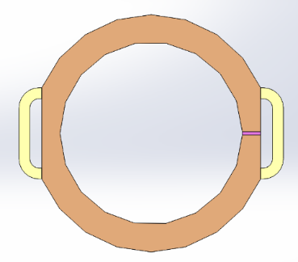
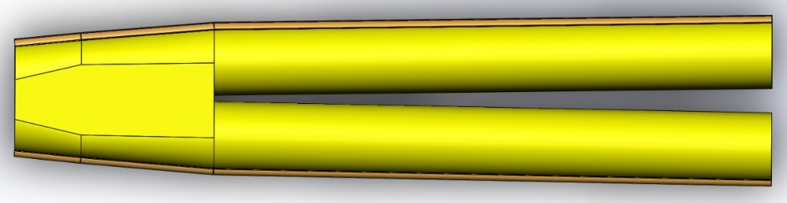
IR vacuum chamber
The total length of MDI vacuum system is about 14m, mainly composed of vacuum chamber, bellows, beryllium pipe, cooling system, support system, etc.
Due to limited space at MDI region, not possible to install a vacuum pump, and NEG coating is chosen.
From IP(mm) | Shape | Inner diameter(mm) | Material | Marker
0-110 | Circular | 20 | Be
110-180 | Circular | 20 | Al
180-655 | Cone | 20~35 | Al | Taper: 1:70
655-700 | Circular | 35 | Al
700-780 | Circular | 35 | Cu
780-805 | Cone | 35~39 | Cu
805-855 | Race-track | 39~20 double pipe | Cu
Q1a-Q1b-Q2：20mm-23mm-32mm
Cone+circular beam pipe structure with gradually increasing aperture
The beam pipe is made of chromium zirconium copper (Cr-Zr-Cu) C18150.
Water channels welded on the outside for cooling the SR heat load.
Cr-Zr-Cu has low photon desorption capacity, high thermal conductivity, and can effectively prevent photons from penetrating the vacuum chamber and damaging magnets and other hardware.
Bellows was installed at the connection of vacuum chamber which can compensate for the thermal expansion, contraction, and offset of the vacuum chamber, and provide continuous RF shielding between two connected vacuum chambers to reduce the impedance.

Slide 8
Thermal analyses – Synchrotron radiation
SR heat load without Masks
Region | ttbar |  | Higgs |  | Z
 | SR heat load | SR average power density | SR heat load | SR average power density | SR heat load | SR average power density
0~780mm | 0 | 0 | 0 | 0 | 0 | 0
780mm~805mm | 11.88W | 132W/cm² | 23.04W | 256W/cm² | 11.8W | 131.1W/cm²
805mm~855mm | 27.53W | 152.9W/cm² | 53.39W | 296.6W/cm² | 27.4W | 152.2W/cm²
855mm~1.9m(Q1a entrance） | 2.22W | 0.59W/cm² | 4.32W | 1.15W/cm² | 2.2W | 0.59W/cm²
Q1a（1900-3110）1210 | 1.69W | 0.38Wcm² | 3.28W | 0.75W/cm² | 1.68W | 0.38W/cm²
Q1a~Q1b（3110-3190） | 11.8W | 40.97W/cm² | 22.92W | 79.58W/cm² | 11.75W | 40.8W/cm²
Q1b（3190-4400） | 2.04W | 0.47W/cm² | 3.96W | 0.91W/cm² | 2.03W | 0.47W/cm²
Q1b~Q2(4400-4700) | 36.6W | 33.9W/cm² | 71.04W | 65.8W/cm² | 36.4W | 33.7W/cm²
Q2(4700-6200) | 3.74W | 0.69W/cm² | 7.26W | 1.34W/cm² | 3.72W | 0.69W/cm²

Slide 9
Thermal analyses – HOM & Resistance wall
HOM & Resistance wall
Position | Position Start-end（mm） | material | Length (mm) | Higgs(w) & (w/cm²) | W (w) & (w/cm²) | Z(w) & (w/cm²) | ttbar（w） & (w/cm²)
Be pipe (w) | 0-110 | Be | 110 | 1.46 & 0.021 | 7.230 & 0.105 | 71.558 & 1.35 | 0.401 & 0.005
Be pipe transition(w) | 110-180 | Al | 70 | 0.45 & 0.01 | 2.173 & 0.049 | 21.574 & 0.491 | 0.127 & 0.007
Transition pipe (w) | 180-655 | Al | 475 | 6.99 & 0.017 | 34.48 & 0.085 | 341.562 & 0.83 | 1.958 & 0.005
Transition （w） | 655-700 | Al | 45 | 0.62 & 0.015 | 2.95 & 0.071 | 29.28 & 0.701 | 0.172 & 0.004
RVC bellow（w） | 700-780 | Cu | 80 | 0.52 & 0.007 | 2.532 & 0.034 | 25.002 & 0.337 | 0.14 & 0.002
Transition on Y-crotch | 780-805 | Cu | 25 | 0.16 & 0.007 | 0.785 & 0.032 | 7.822 & 0.316 | 0.05 & 0.002
Y- crotch (w) | 805-855 | Cu | 50 | 0.33 & 0.005 | 1.572 & 0.024 | 15.626 & 0.241 | 0.091 & 0.002
Quadrupole pipe(w) | 855-1100 | Cu | 245 | 1.58 & 0.005 | 7.735 & 0.024 | 75.594& 0.24 | 0.434 & 0.002
Total | 0-1100 | - | 1100 | 12.0 &0.011 | 58.594 &0.056 | 580.46 & 0.56 | 3.331 & 0.003

Slide 10
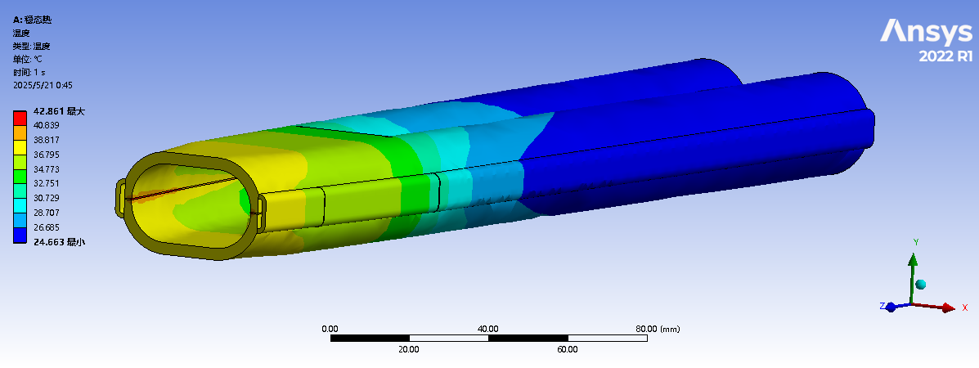
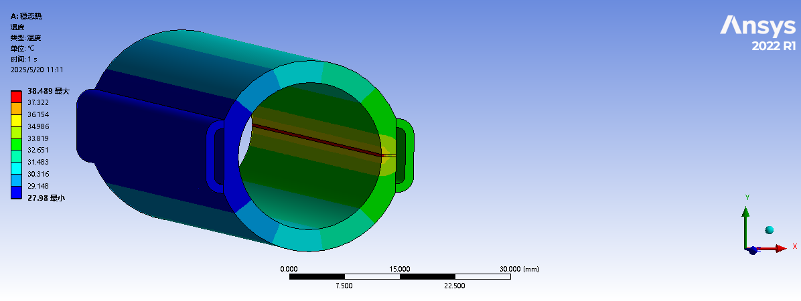
Thermal analysis of IR beam pipe
Thermal analyses of beam pipe at cryostat @Higgs, 50MW
Two masks at 1.9m and 7.2m respectively, and the power density is highest at masks.
The power density of SR at Mask-1 is ~ 2.966 W/mm², and the power density of SR at Mask-2 is ~3.2 W/mm².
The power density at the crotch part is 2.97 W/mm², while the power density at other positions is less than 0.8 W/mm².
The highest temperature at crotch part is 42.86 ℃; The highest temperature at Masks is 38.5 ℃.

Slide 11
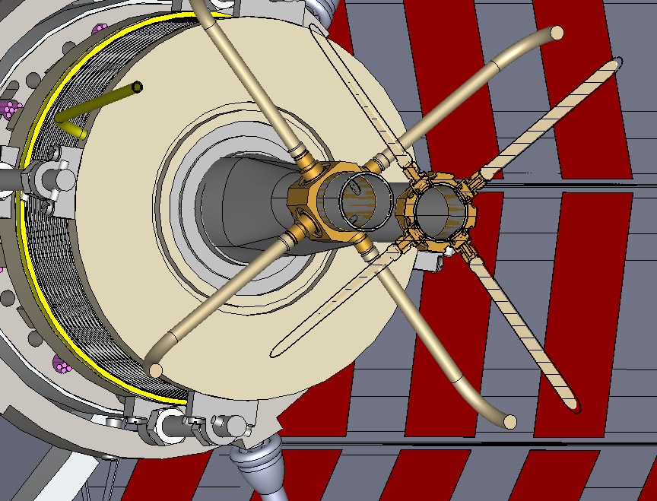
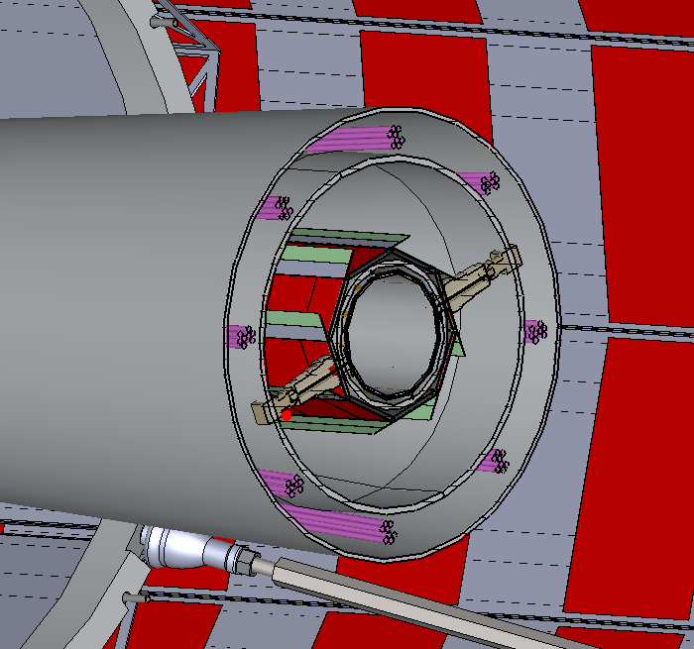
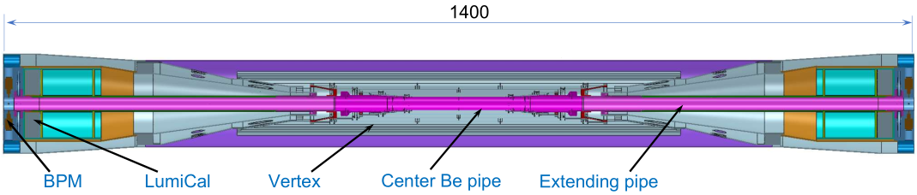
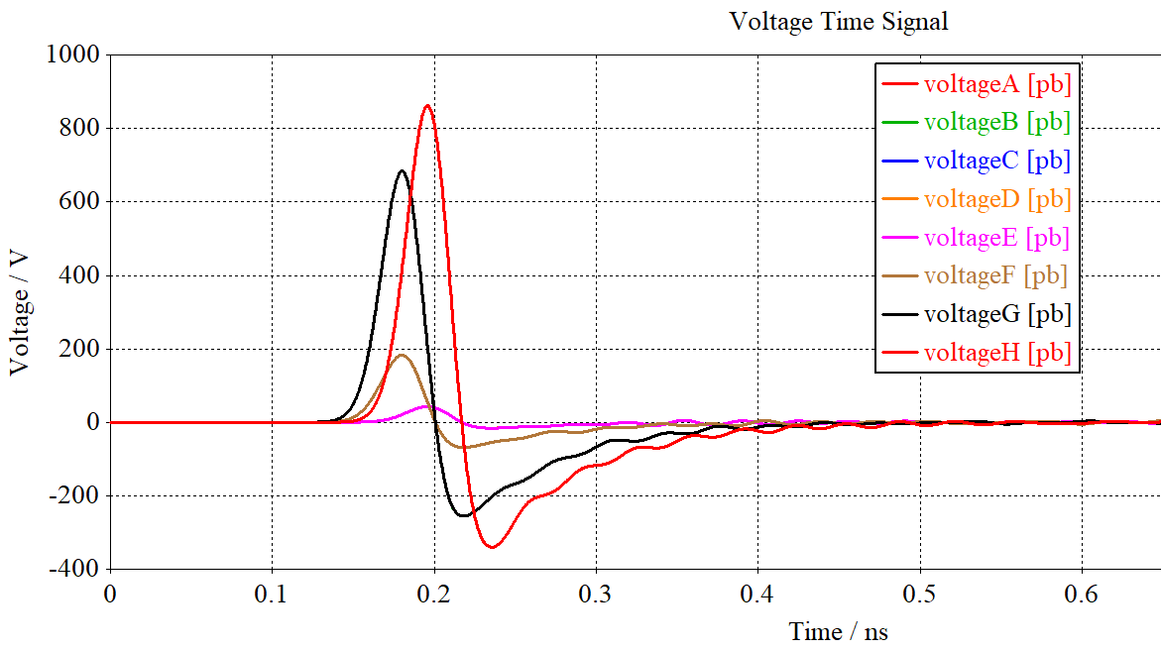
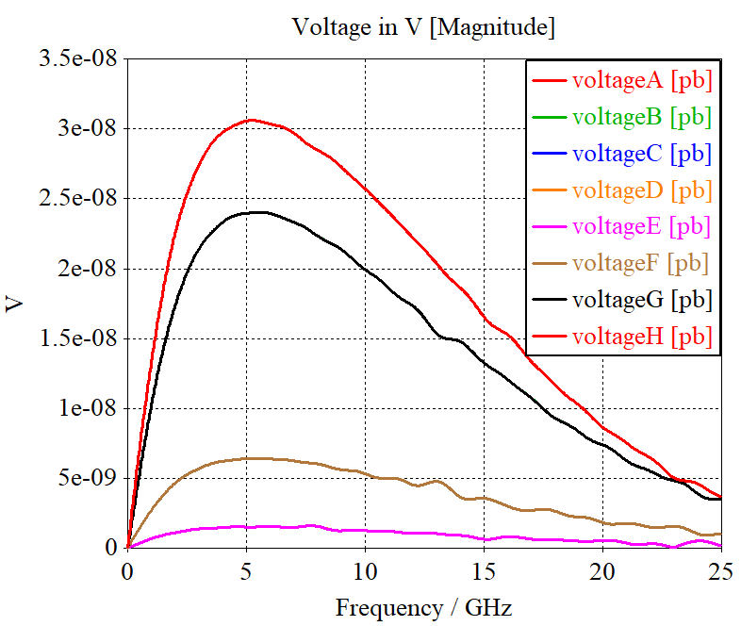
IR BPMs
Considering response time and calibration difficulty, two 4 button electrodes BPM in double pipe and one 2 button electrodes BPM in single pipe at each side of CEPC IR are adopted.
2 button electrodes BPM for measuring the arrival time.
Utilize a pair of BPMs for vertical beam orbit feedback (fast lumi monitor for horizontal), placed at symmetric positions on each side of the IP, located at 950mm~1050mm from IP.
BPM
 | Bunch charge | Bunch length | Current peak | Current average | 650MHz | K_{loss}
 | nC | mm | A | A | dBm | mV/pC
Higgs | 20.8 | 4.1 | 607 | 0.208 | -11.9 (-20.2) | 6.76 (0.16)
Z | 22.4 | 8.7 | 308 | 0.974 | 1.5 (-6.8) | 0.30 (0.15)
W | 21.6 | 4.9 | 527 | 0.216 | -11.5 (-19.8) | 3.4 (0.25)
ttbar | 32.0 | 2.9 | 1315 | 0.320 | -20.2 (-16.4) | 15.1 (0.017)

Slide 12
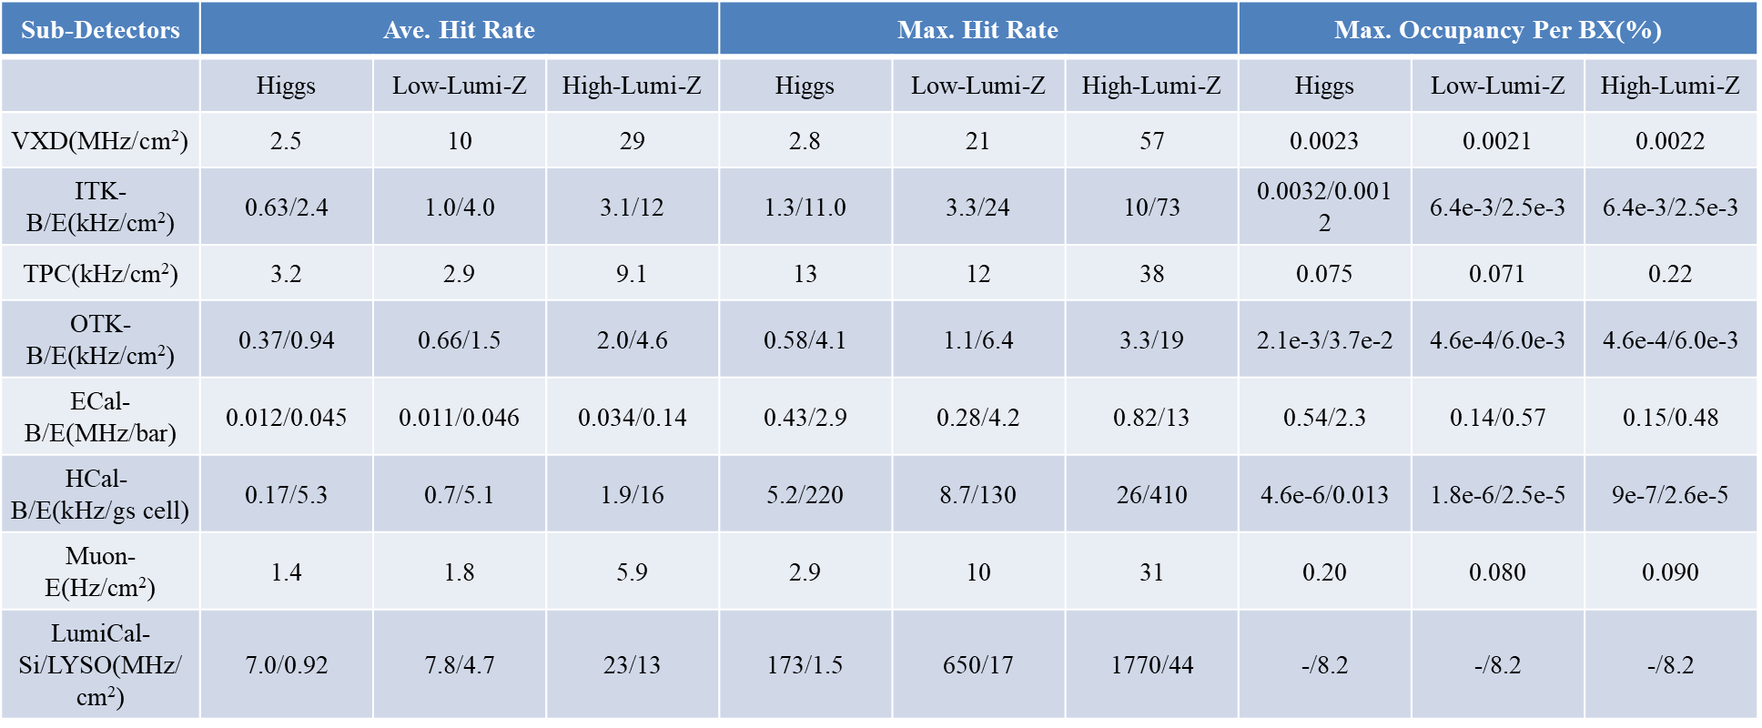
Radiation background
  Background sources:
  Photon backgrounds: SR, Pair production
  Beam loss backgrounds
    Radiative Bhabha scattering
    Beam Gas scattering
    Beam Thermal photon scattering
  Injection background
We have obtained a preliminary estimate of the beam-induced background levels in all 3 mode with latest CEPCSW
  The VXD results taken the SR into account.
  The BG level is acceptable by detectors and other related systems concerning the 50MW Higgs/Z and 10MW Z mode.

Slide 13
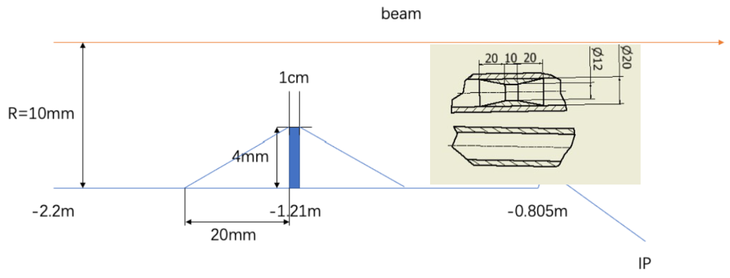
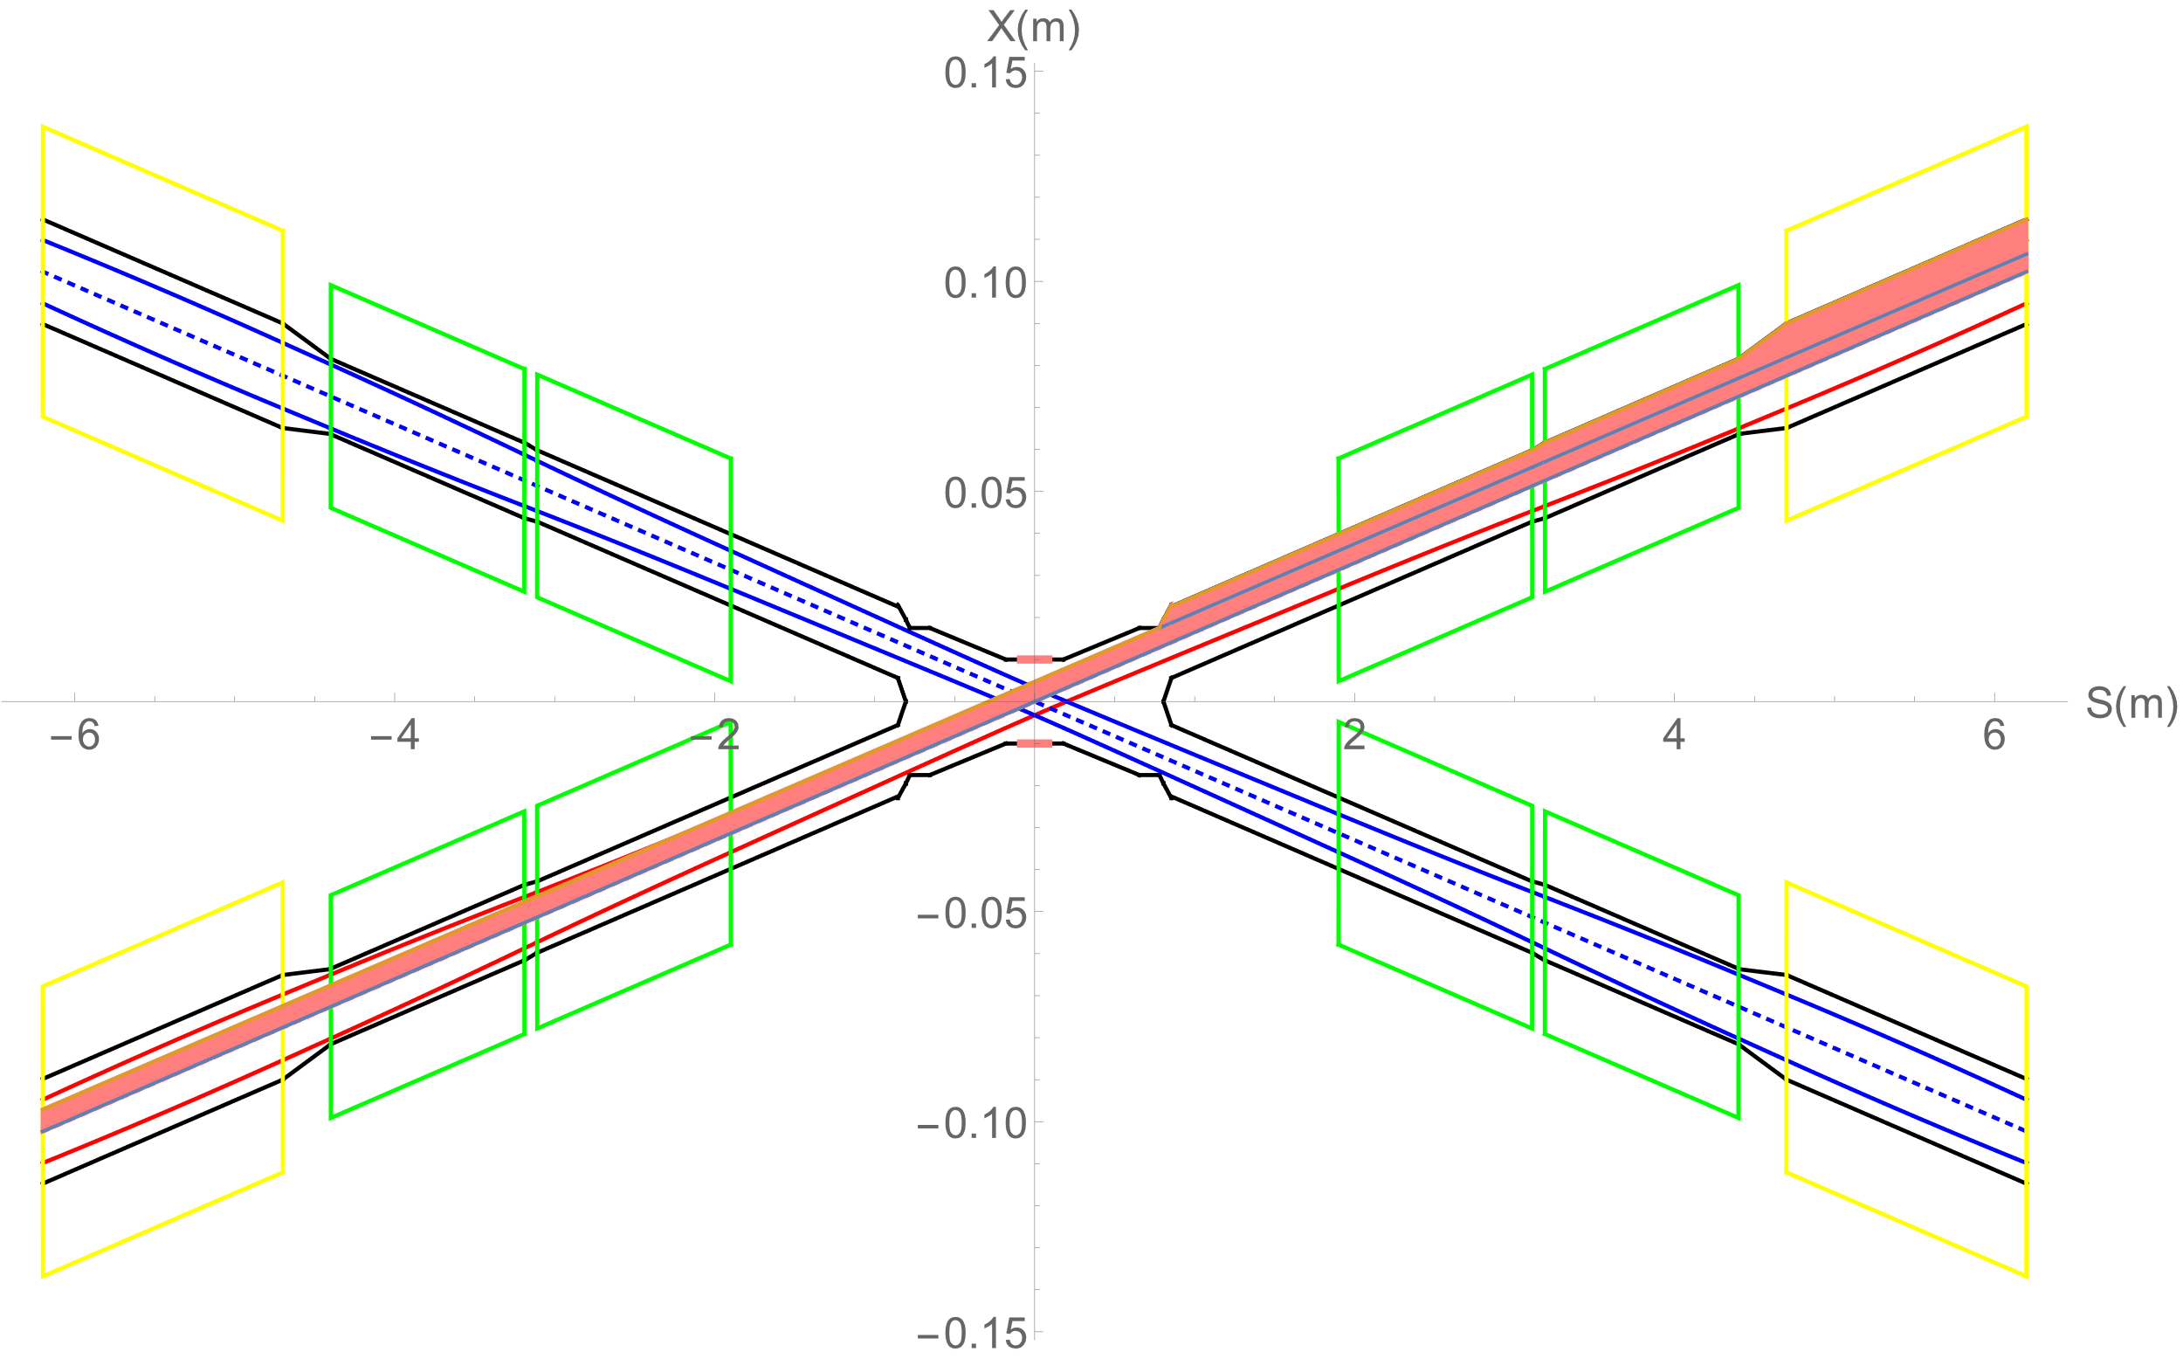
SR mitigation – mask and gold plating
The central beam pipe was carefully designed to avoid the direct hitting of the SR photons.
The masks are implemented to further mitigate the secondaries, the design is still on going.
  Several ways has been attempted, including different position/material/design of the mask, parts of them are listed here in the table. (We only simulated 1e12 electrons, the scale to 1s)
Shielding Methods | SR Backgrounds Level at VXD(MHz/cm²)
Original | 117,191.0
-1.9m mask | 91.2
-1.9m mask+5um Au | 61.7
-1.9m+-4.3m mask + 5um Au | 9.4
-1.9m+-7.2m mask + 5um Au | <1
Masks design(two masks/IP/ring) :
  Copper
  One locates at -1.9m with 4mm height and 10mm long
  The other at -7.2m with 4mm height
Photons hitting number on Be/BX reduced by five orders of magnitude
Hit density on Be pipe suppressed to acceptable level by vertex detector

Slide 14
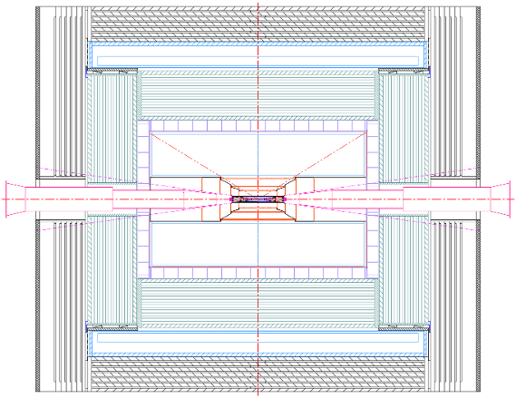
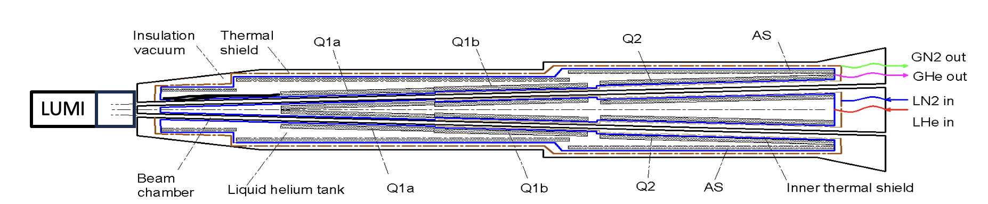
Shielding
Shielding is designed to prevent beam background from damaging detector.
Shielding has been implemented at both ends of the yoke using the 10 cm of paraffin, and also 10mm W outside of the LumiCal-LYSO. The vacuum vessel (stainless steel) of cryostat also used as shielding. The shielding has reduced the ~20%-50% of the BG level.
10cm Paraffin
15mm vacuum vessel and Shielding
10mm Tungsten
To protect SC magnets: cumulative dose should be less than 100MGy
To avoid quench of SC magnets: heat load density should be less than 100mJ/cm³
The IR beam pipe is made of chromium zirconium copper (Cr-Zr-Cu) C18150.

Slide 15
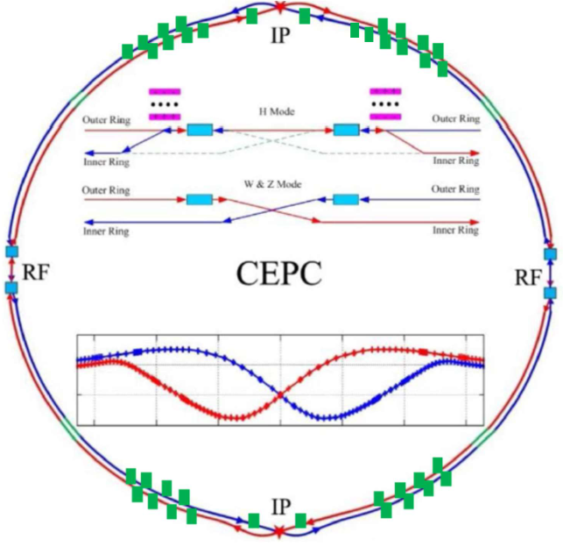
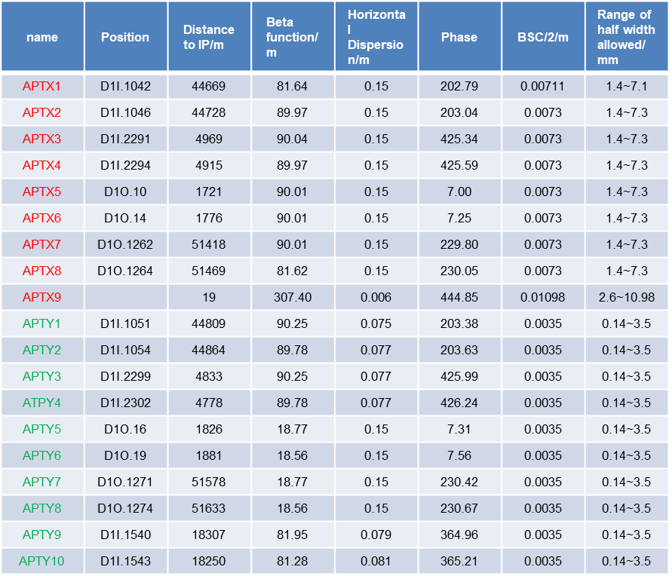
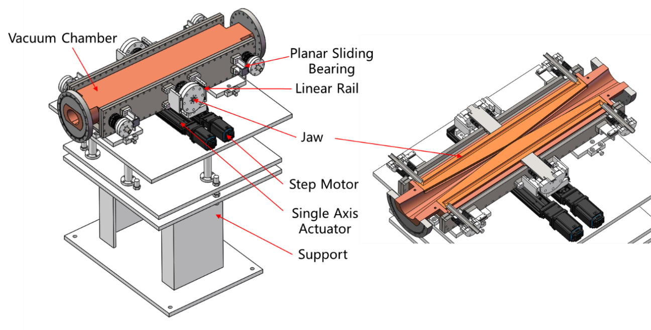
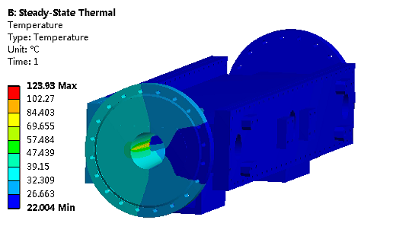
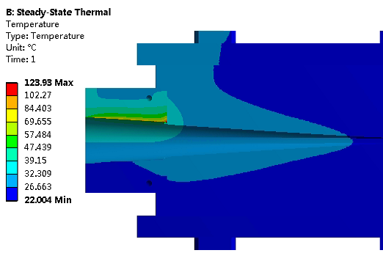
Background collimators
  Movable collimators are designed for beam background mitigation(totally 38 for two rings).
  Jaw and vacuum vessel material: Glidcop Al-15, can endure the SR and HOM power in normal operation.
Highest temperature: 124 ℃

Slide 16
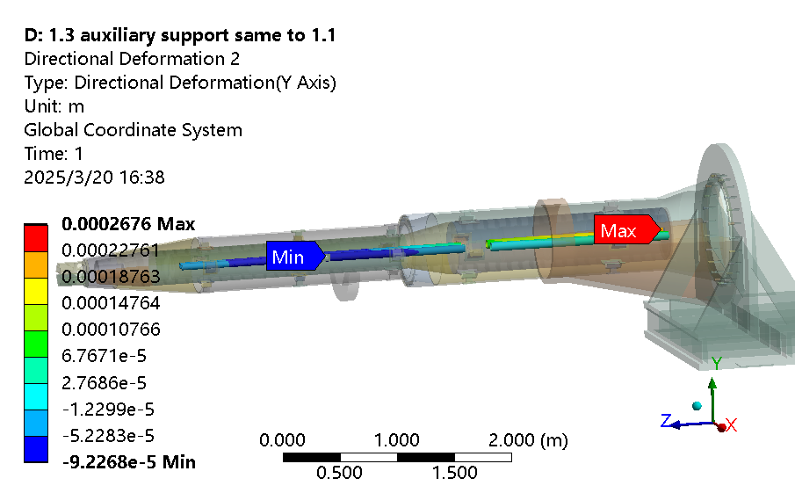
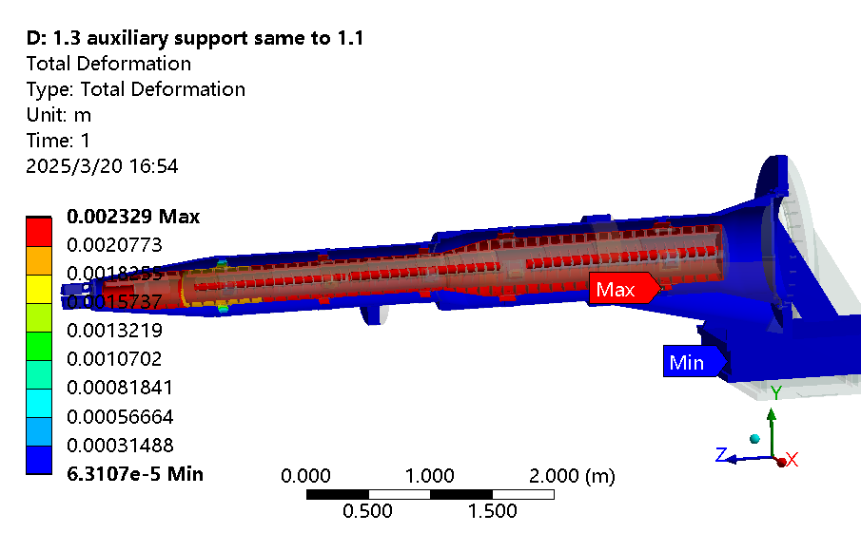
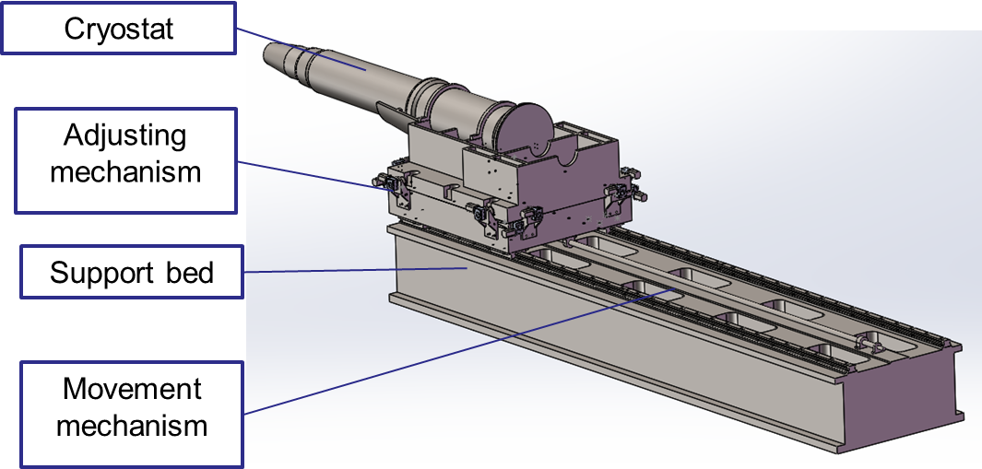
SC magnet support system
  After the optimization of the supports in the cryostat, the total weight of the cryostat and the devices inside is ~2.4 ton.
  The cryostat is about 5.7m long. The cantilever length is ~5.2m.
  The resolution requirement of the adjusting mechanism < 5 μm.
Mechanical FEA
With Lorentz force
Conclusions on mechanical FEA:
  The thicker model with SS vacuum vessel is preferred
  max. uneven deformation: 12 µm (Q1b)
  max. displacement change after applying Lorentz force: 33 µm (Q2)
  1st sensitive modal frequency: 60.9 Hz (The 1st natural frequency is 52.5 Hz, in Z direction). The modal analyses is related to the support connected to detector, but the trend should be unchanged, can be considered qualitative analysis

Slide 17
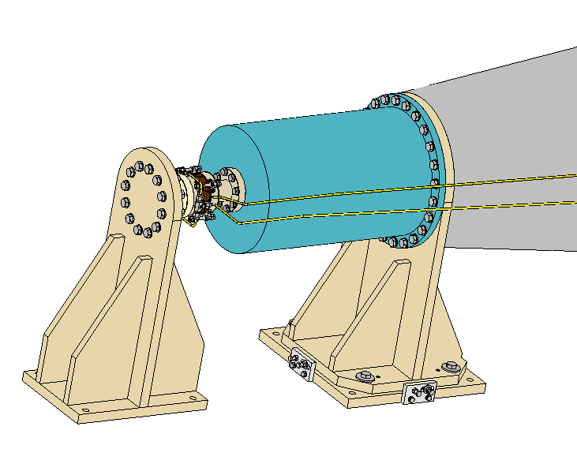
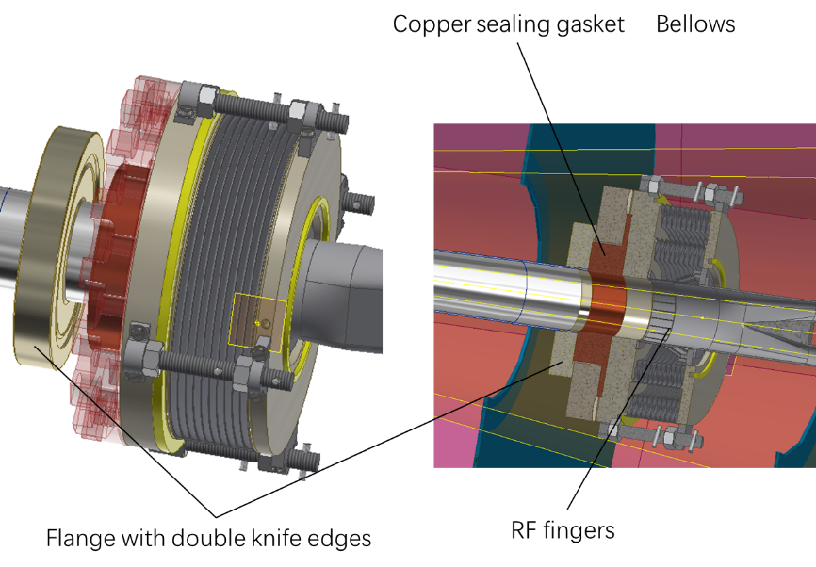
Remote Vacuum Chamber(RVC)
A prototype will be developed (quotation finished, preparing engineering drawings).
The influence of RVC displacement on the leakage rate will be simulated through an adjustment mechanism.
Fake model of vacuum vessel
Fake model of IP chamber, fixed
Adjustment mechanism
RVC

Slide 18
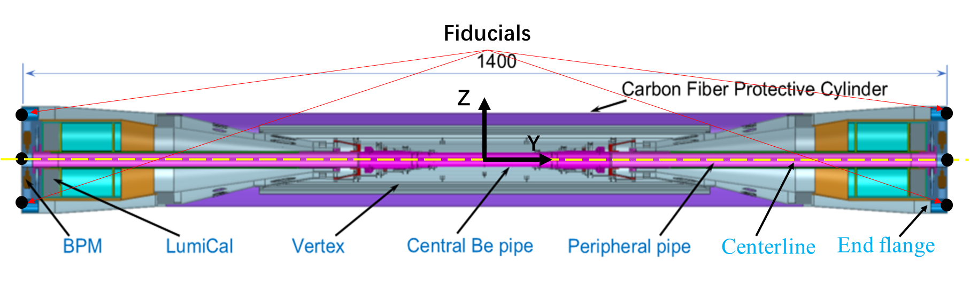
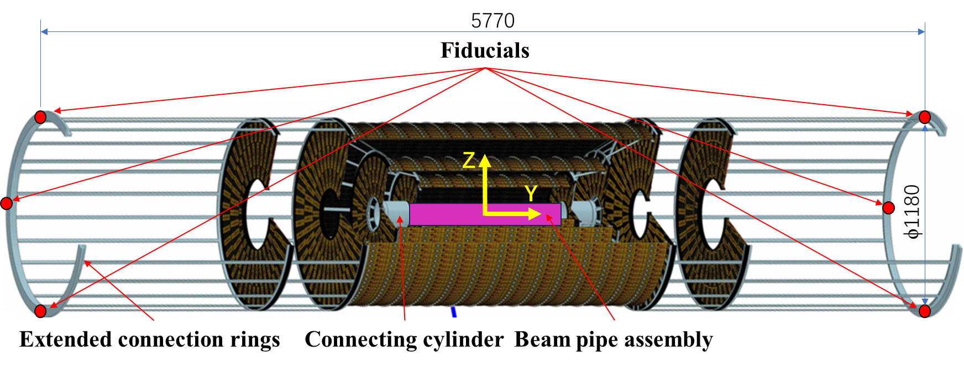
MDI alignment
  Components in MDI need to be aligned mainly include Beam pipe, LumiCal, BPM and Cryostat (final focusing magnets).
  Beam pipe assembly integrates beam pipe, vertex detector, LumiCal, and BPM.
  Beam pipe assembly installed in ITK, its finally alignment accuracy is 100um.
Beam pipe assembly
ITK
Cryostat internal structure
Cryostat alignment scheme
  LHe-tank module fiducialization
  Cryostat pre-alignment
  Cryostat installation alignment
Alignment accuracy of the SCQs on both sides ≤ 100μm

Slide 19
Summay
MDI progress toward EDR are presented.
  The MDI layout is compatible and no interference for the design.
  Iron free CCT quadrupole coil is selected in CEPC EDR SC quadrupoles design. Basic magnetic design of CCT quadrupoles is finished, and can meet the requirement at four modes.
  Φ20mm~ Φ20mm IR beam pipe is well designed. Dynamic temperature/pressure could meet the requirements.
  The thermal analysis including HOM heating, synchrotron radiation, beam loss background and beam pipe thermal analysis meet the requirement.
  IR BPMs are designed.
  The estimation of the radiative background has been estimated. The BG level is acceptable by detectors and other related systems concerning the 50MW Higgs/Z and 10MW Z mode.
  The mitigation efforts of every kinds of background dedicated to the mask, collimator and shielding has been designed.
  The SC magnet supports inside the cryostat are designed and optimized. The engineering design of RVC has been started.
  CEPC MDI alignment mainly include Beam pipe, LumiCal, BPM and Acc. Superconducting magnets alignment. An elevation position monitoring scheme for IR is designed. The monitoring plan will be further improved in the future.

Slide 20
Thank you for your attention!
June 18th, 2025, CEPC MDI Mini-Review

Slide 21
Back up

Slide 22
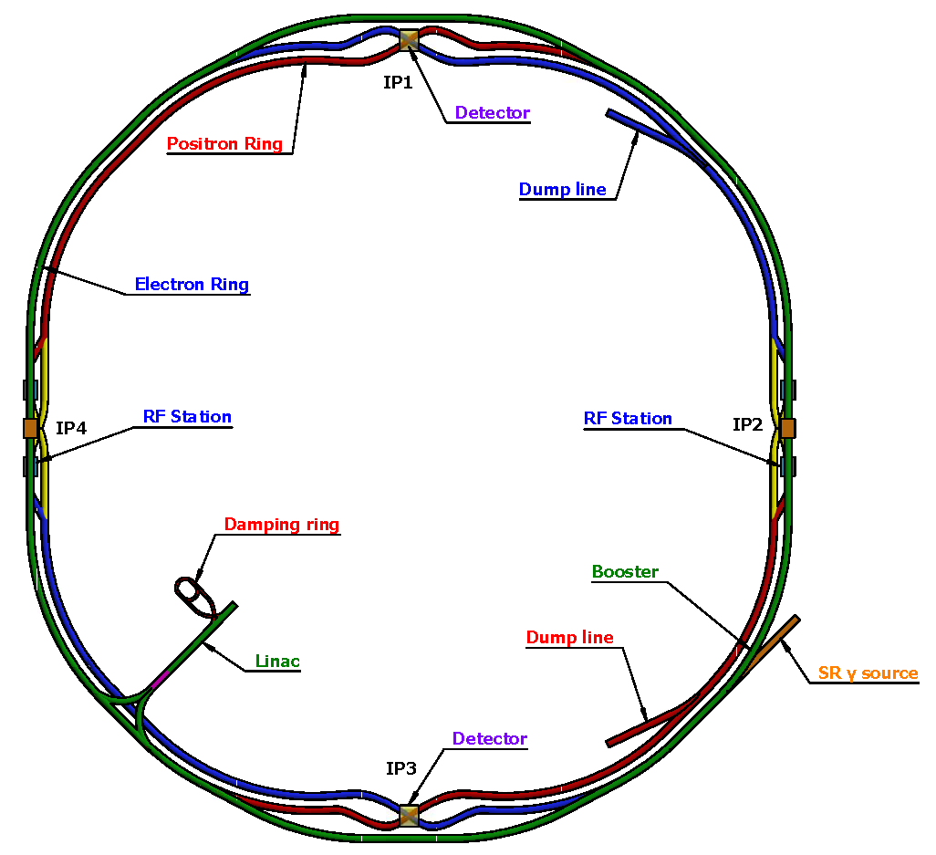
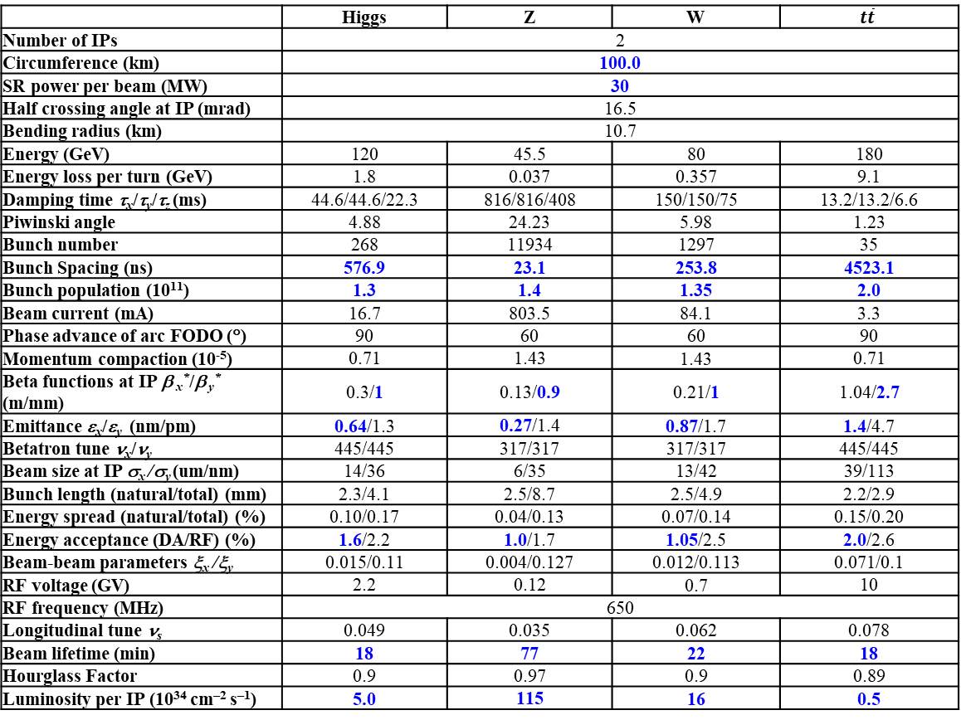
CEPC Collider ring
 | Higgs | Z | W | $$t\overline{t}$$
Number of IPs | 2
Circumference (km) | 100.0
SR power per beam (MW) | 30
Half crossing angle at IP (mrad) | 16.5
Bending radius (km) | 10.7
Energy (GeV) | 120 | 45.5 | 80 | 180
Energy loss per turn (GeV) | 1.8 | 0.037 | 0.357 | 9.1
Damping time τ_{x}/τ_{y}/τ_{z} (ms) | 44.6/44.6/22.3 | 816/816/408 | 150/150/75 | 13.2/13.2/6.6
Piwinski angle | 4.88 | 24.23 | 5.98 | 1.23
Bunch number | 268 | 11934 | 1297 | 35
Bunch Spacing (ns) | 576.9 | 23.1 | 253.8 | 4523.1
Bunch population (10¹¹) | 1.3 | 1.4 | 1.35 | 2.0
Beam current (mA) | 16.7 | 803.5 | 84.1 | 3.3
Phase advance of arc FODO (°) | 90 | 60 | 60 | 90
Momentum compaction (10⁻⁵) | 0.71 | 1.43 | 1.43 | 0.71
Beta functions at IP β _{x}*/β _{y}* (m/mm) | 0.3/1 | 0.13/0.9 | 0.21/1 | 1.04/2.7
Emittance ε_{x}/ε_{y} (nm/pm) | 0.64/1.3 | 0.27/1.4 | 0.87/1.7 | 1.4/4.7
Betatron tune ν_{x}/ν_{y} | 445/445 | 317/317 | 317/317 | 445/445
Beam size at IP σ_{x} /σ_{y} (um/nm) | 14/36 | 6/35 | 13/42 | 39/113
Bunch length (natural/total) (mm) | 2.3/4.1 | 2.5/8.7 | 2.5/4.9 | 2.2/2.9
Energy spread (natural/total) (%) | 0.10/0.17 | 0.04/0.13 | 0.07/0.14 | 0.15/0.20
Energy acceptance (DA/RF) (%) | 1.6/2.2 | 1.0/1.7 | 1.05/2.5 | 2.0/2.6
Beam-beam parameters ξ_{x} /ξ_{y} | 0.015/0.11 | 0.004/0.127 | 0.012/0.113 | 0.071/0.1
RF voltage (GV) | 2.2 | 0.12 | 0.7 | 10
RF frequency (MHz) | 650
Longitudinal tune ν_{s} | 0.049 | 0.035 | 0.062 | 0.078
Beam lifetime (min) | 18 | 77 | 22 | 18
Hourglass Factor | 0.9 | 0.97 | 0.9 | 0.89
Luminosity per IP (10³⁴ cm^{–2} s^{–1}) | 5.0 | 115 | 16 | 0.5
SS4
SS1
SS3
SS2
Ref: CEPC TDR; Radiation Detection Technology and Methods (2024) 8:1–1105, https://doi.org/10.1007/s41605-024-00463-y;

