Slide 1

PICOSEC Micromegas: A Scalable Solution for
Precise Timing Applications
Tuesday, 17th June 2025
CEPC 2025 – 2025 European Edition of the International Workshop
on the Circular Electron-Positron Collider
${\text{Alexandra} \text{Kallitsopoulou}}^{(1)}$, Thomas Papaevangelou⁽¹⁾
on behalf of the DRD1-PICOSEC Micromegas Collaboration
(1)CEA/IRFU/Université Paris – Saclay

Slide 2













The PICOSEC Micromegas Collaboration
AUTH (Greece) I. Angelis, K. Kordas, C. Lampoudis, I. Maniatis, I. Manthos, K. Paraschou, D. Sampsonidis, A. Tsiamis, S. E. Tzamarias
CEA-IRFU, LIST, LIDYL(France) S. Aune, D. Desforge, I. Giomataris, T. Gustavsson, F. Jeanneau, A. Kallitsopoulou, M. Kebbiri, P. Legou, T. Papaevangelou, M. Pomorski, E. Scorsonne
CERN (Switzerland) J. Bortfeldt, F. Brunbauer, C. David, D. Janssens, K.J. Floethner, M. Lupberger, M. Lisowska, H. Müller, E. Oliveri, G. Orlandini, F. Resnati, L. Ropelewski, L. Scharenberg, T. Schneider, M. van Stenis, R. Veenhof
HIP (Finland) F. Garcı́a
Jefferson Lab (USA) K. Gnanvo
LIP (Portugal) M. Gallinaro
NCSR Demokritos, (Greece) G. Fanourakis
NTUA (Greece) Y. Tsipolitis
Ruder Boškovic Institute(Croatia) : A. Utrobicic
Stony Brook University (USA) J.Datta
USTC (Hefei, China) J. Liu, B. Qi, X. Wang,
Z. Zhang, Y. Zhou
University of Zagreb(Croatia) M. Kovacic
University of Pavia (Italy) D. Fiorina, M. Brunoldi, I.Vai, P.Vitulo
Univeristy of Virginia (USA) S. White

Slide 3
What is our motivation?
Timing with a few 10’s of Picosecond
Tracking challenges for HL-LHC:
      LHC will go to higher energy & luminosity
        5x nominal instantaneous luminosity → Increased particle densities
        20x current integrated luminosity → Increased radiation damage
      What are the needs:
        Reduction of mixing different events due to pile-up
        Track to vertex association → 3D tracking with timing information
      Extra detector requirements:
          Large area coverage
          Resistance to aging effects
          Multi-pad readout tracking
Giant improvement ~
3 orders of magnitude
compared to standard MPGDs
      Detector technologies → Mainly Solid State
  Gaseous detectors
    Resistive Plate Chambers (RPCs) (σ_{t} ~ 30 ps)
    Micro-Pattern Gaseous Detectors (σ_{t} ~ 1 ns)

Slide 4
Outline
Towards an engineered PICOSEC MM module :
multiple directions in detector development
Proof of Concept
  Prove the performance in single channel prototypes
  Achieved 24 ps !
R&D for Applications
  Two possible application scenarios ( ENUBET, Muon Collider)
    R&D Depending on application requirements
    Robustness
    Research on alternative gas mixtures
Optimization R&D
  Detector design
    Signal Integrity
  Research on alternative photocathode materials
  Scalability
    Detector & Electronics

Slide 5
The PICOSEC Micromegas Technology

Slide 6
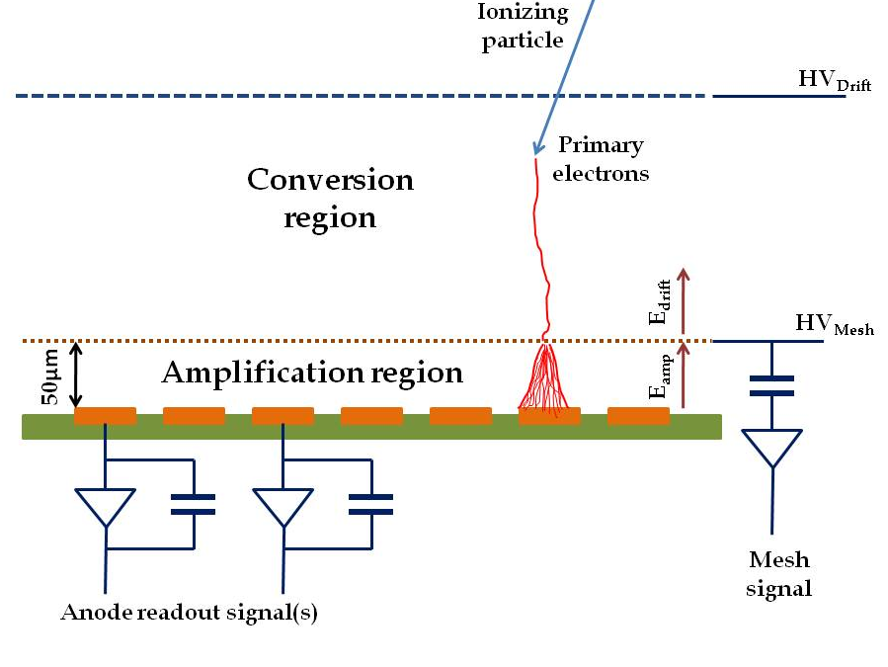
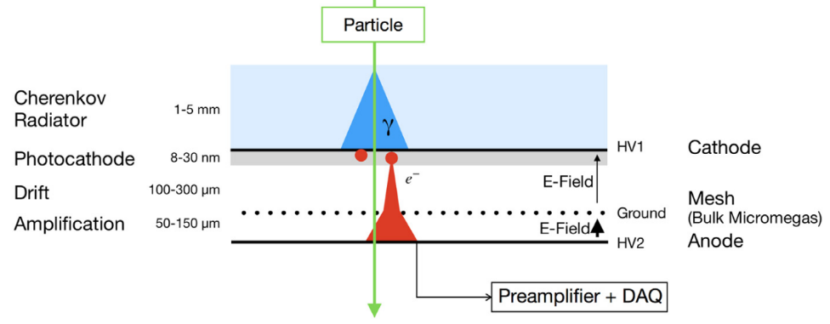
The PICOSEC Micromegas Technology
Timing limitation factor
  Stochastic nature of ionization
    Randomness of last ionization
    Time jitter of a few ns
Timing performance improvement
  Simultaneous creation of the electrons
  Minimization of the direct ionization probability
Y. Giomataris, P. Rebourgeard, J.P. Robert and G. Charpak,
“Micromegas: A high-granularity position sensitive gaseous detector for high particle-flux environments”,
Nuc. Instrum. Meth. A 376 (1996) 29
Additional components in MM geometry
  Cherenkov radiator → replace ionization mechanism
  Solid Converter → prompt photoelectrons
      well-defined location
Timing MM geometry
  Smaller drift gap → eliminate ionization
    Higher electric field → eliminate diffusion
    → pre-avalanche
J.Bortfeldt, et al., “PICOSEC: Charged particle timing at sub-25 picosecond precision with a Micromegas based detector”, https://doi.org/10.1016/j.nima.2018.04.033

Slide 7
Proof of Concept

Slide 8
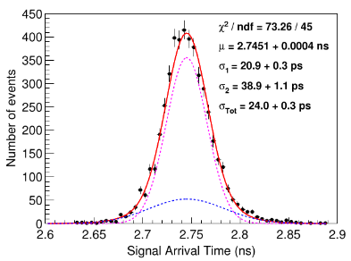
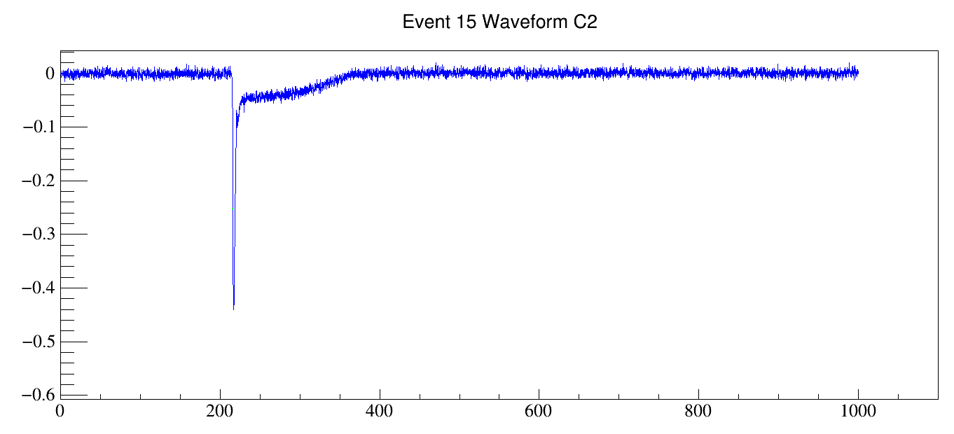
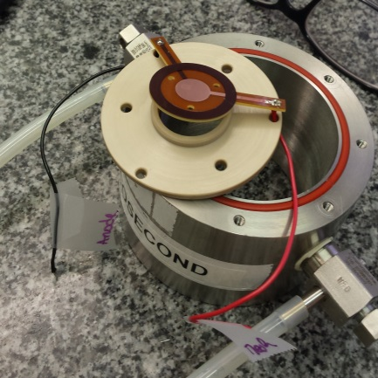
The Single anode prototype
  The Sensor:
First timing measurement @
Particle Beam results – 2017
  Muon Beam of 150 GeV/c
  Single channel prototype :
    Drift Gap (200 μm)
Detector technology
  Bulk Micromegas ∅ 1cm
Crystal & Photocathode material
  MgF2 crystal (3 mm) +
  Metallic substrate (Cr) + CsI → 11 p.e./track
11 p.e.
Gas Composition
  COMPASS Gas : 80% Ne – 10% CF₄-10%C₂H₆
V[V]
Ion tail
J.Borteldt, et al. “PICOSEC: Charged particle timing at sub-25 picosecond precision with a Micromegas based detector”, Nuc. Instrum. Meth. A (2021)https://doi.org/10.1016/j.nima.2018.04.033
Electron peak
Timing Resolution →
RMS of Signal Arrival Time Distribution
T[ns]
Record for MPGDs 24 ps !
Notes:
Bulk?

Slide 9
Optimization R&D

Slide 10
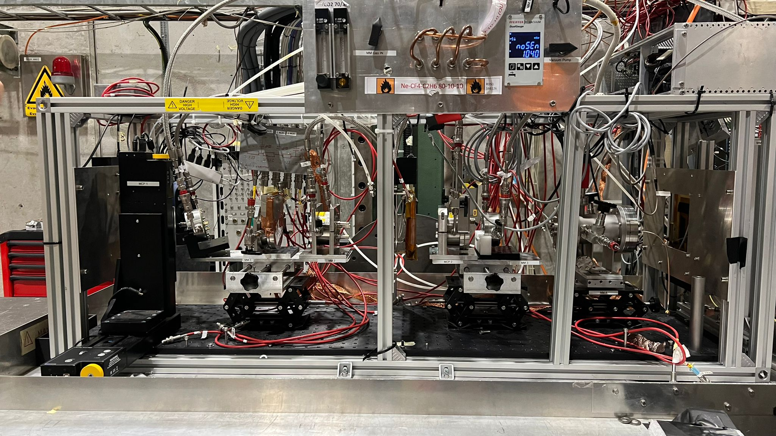
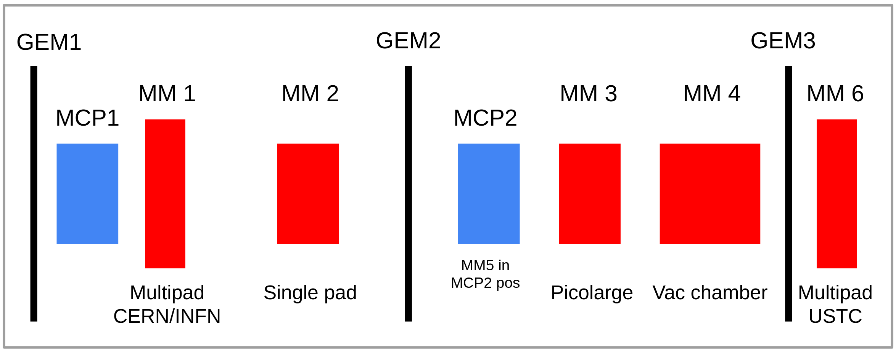
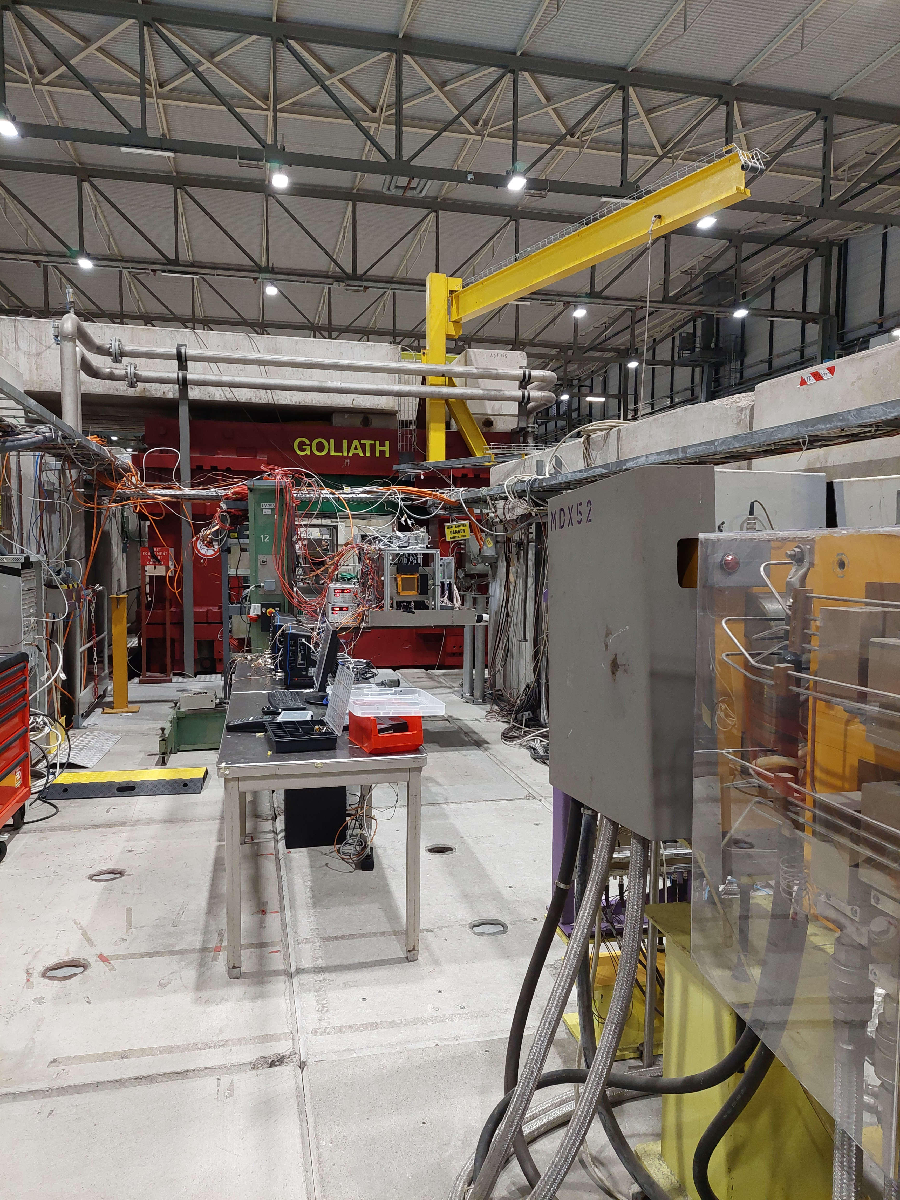
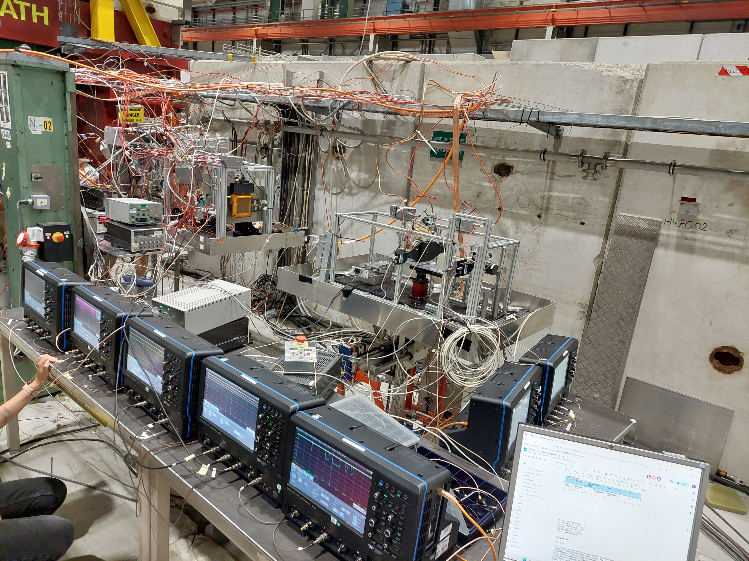
Detector Testing - Particle beams
Particle Beams @ CERN SPS H4 Beamline
  Highly energetic muons (80-150 GeV)
The Setup
  Use GEMs for tracking
  Use MCP PMTs as timing reference
  devices and for triggering
  Different PICOSEC Micromegas Prototypes
  Electronics: Commercial/Custom-made preamplifiers
  Digitizers – Lecroy scopes

Slide 11
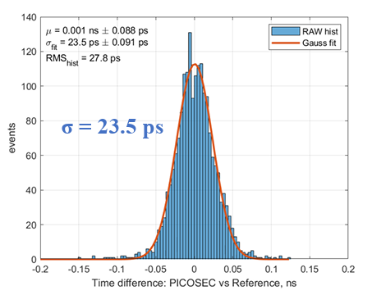
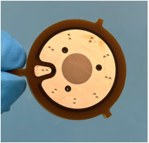
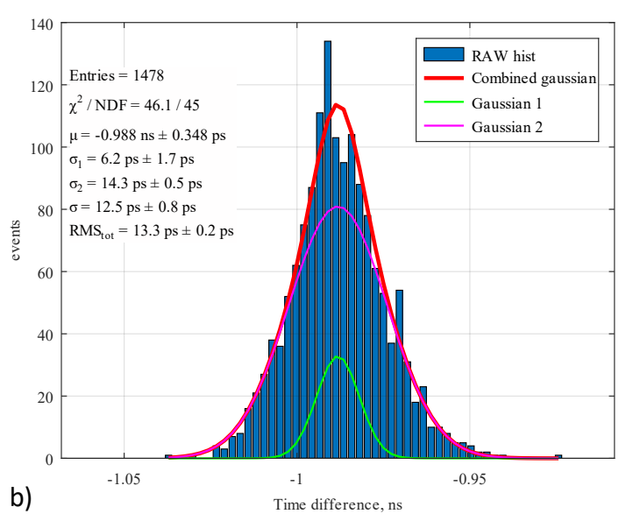
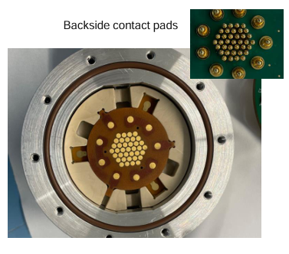
Optimization of geometry and connectivity
Focus on Operation Stability
  Signal Integrity (different prototypes ∅ 10,13,15 mm)
      Noise reduction
      Reassembly feature
  Parasitic influence
    Capacitance and inductance
Based on the same design
  Investigating the μRWELL technology for the amplification region
Best Result
P120-D100
& CsI ➔ 23.5 ps
∅ 10 mm
New Record
10 mm & CsI ➔ 12.5 ps
(drift gap reduced to 125μm)
A.Pandey. Precise Timing with PICOSEC μRWELL detector-DRD1 Collaboration Meeting https://indico.cern.ch/event/1413681/contributions/5993207/
  Investigating the spatial resolution response
Best Result
∅ 15 mm
& CsI ➔ 0.5 mm
(central region)
    More info @ → Utrobicic, A., et al. "Single channel PICOSEC Micromegas detector with improved time resolution." NIM A 1072 (2025): 170127 https://doi.org/10.1016/j.nima.2024.170127
D. Janssens, Robust photocathodes and spatial resolution studies of resistive PICOSEC Micromegas precise-timing detectors- The 8th International Conference on MPGDs https://indico.cern.ch/event/1453371/contributions/6146435/
Notes:
The design overview of the single-channel PICOSEC Micromegas detector includes the following key points:
Comprehensive Design Elements: The design encompasses the detector board, the vessel, auxiliary mechanical parts, and electrical connections for high voltage (HV) and signal transmission.
Stability Improvement: The design focuses on enhancing operational stability to better utilize the detector’s capabilities and minimize issues that could arise from external factors.
Noise Reduction: Special emphasis is placed on reducing electronic noise, which is critical for maintaining the integrity of signals and optimizing timing performance.
Signal Integrity: Ensures that the detector’s design maintains signal quality, which is essential for accurate measurements and timing resolutions.
Ease of Reassembly: A streamlined assembly process is implemented, allowing for rapid replacement of detector components, which facilitates efficient testing and measurement with different configurations.
Parasitics Influence: The design takes into account the impact of parasitic capacitance and inductance on output signal integrity, making it a focus area during the design process to mitigate any potential negative effects.

Slide 12
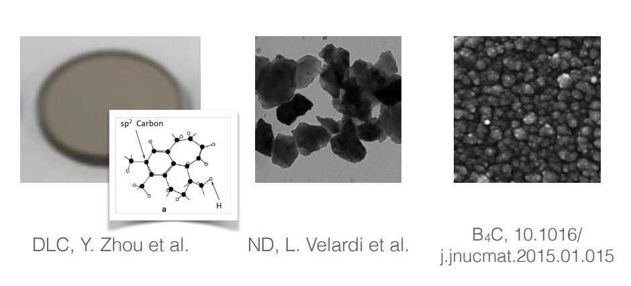
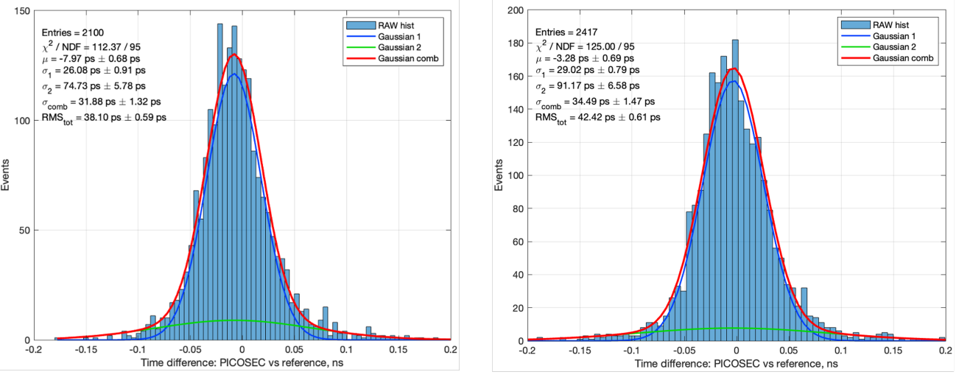
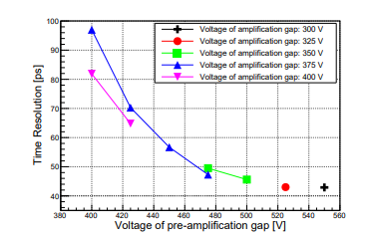
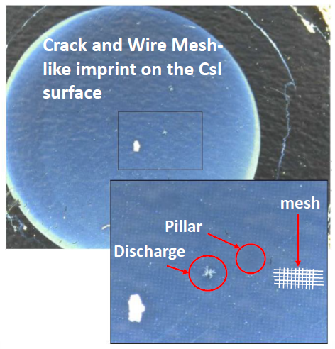
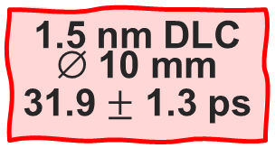
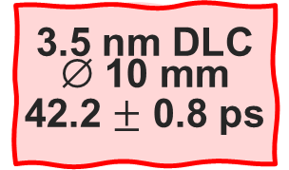
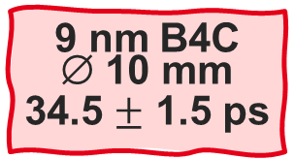
Photocathode Robustness
  New materials under test (B4C, DLC)
In the research of photocathode materials
  Standard photocathode:
  18 nm CsI +3 nm Cr ~ 11 pe/MIP
  CsI sensitive to humidity/ion
  backflow & sparks
Depositions at different Labs
  DLC with magnetron sputtering
  at USTC, China
  DLC with DC magnetron vacuum
  deposition machine at CERN
  B4C with sputtering at CEA Saclay, France
  B4C with sputtering at ESS, Sweden
1.5 nm DLC
∅ 10 mm
31.9 $±$ 1.3 ps
3.5 nm DLC
∅ 10 mm
42.2 $±$ 0.8 ps
9 nm B4C
∅ 10 mm
34.5 $±$ 1.5 ps
https://doi.org/10.1016/j.nima.2011.10.019
X.Wang,et al. – A Novel Diamond-like Carbon based photocathode for PICOSEC Micromegas Detectors https://arxiv.org/abs/2406.08712
M. Lisowska, et al. – Photocathode characterization for robust PICOSEC Micromegas precise-timing detectors https://arxiv.org/abs/2407.09953

Slide 13
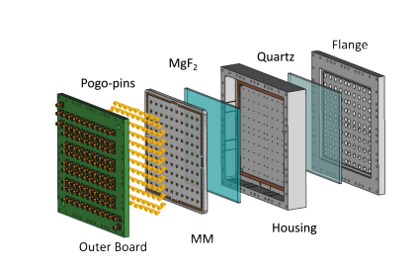
Scalability – The 10x10cm2 PICOSEC Prototypes
Rigid, ceramic-core PCB for the MM readout (CERN)
  Crystal decoupled from the MM board
  ◻ of 1cm
  First proof of concept that influenced the next generation designs
A.Utrobicic: A large area 100 channel PICOSEC Micromegas detector with sub 20ps time resolution, The 7th International Conference on Micropattern Gaseous Detectors (2022), https://iopscience.iop.org/article/10.1088/1748-0221/18/07/C07012

Slide 14
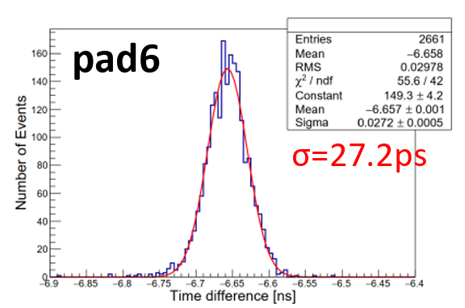
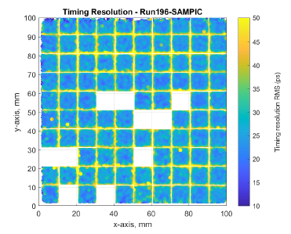
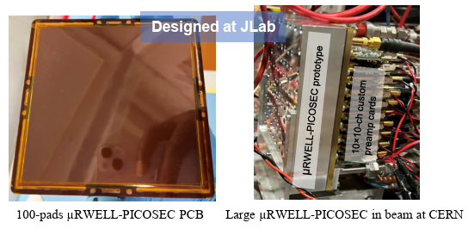
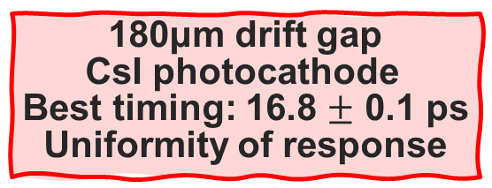
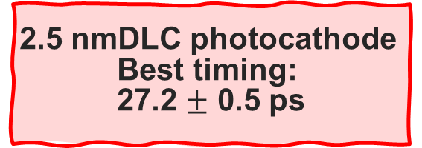
Scalability – The 10x10cm2 PICOSEC Prototypes
Rigid, ceramic-core PCB for the MM readout (CERN)
  Crystal decoupled from the MM board
  ◻ of 1cm
  First proof of concept that influenced the next generation designs
Thermal Bonding method for the MM readout (USTC)
2.5 nmDLC photocathode
Best timing:
27.2 $±$ 0.5 ps
Y.Meng: PICOSEC Micromegas Precise Timing Detectors; Development towards Large-area and Integration, The 8th International Conference on Micropattern Gaseous Detectors (2024), https://arxiv.org/abs/2501.04991
The μRWELL PICOSEC-Micromegas Prototype (JLab)
  P120-D100 prototype with the best performance
  in the single channel prototype used as the basis
  for this design
→ Best timing resolution with CsI photocathode 50 ps
180μm drift gap
CsI photocathode
Best timing: 16.8 $±$ 0.1 ps
Uniformity of response
A. Utrobicic, et al., A large area100-channel PICOSEC Micromegas detector with time resolution at the 20 ps level, JINST 18 (07) (2023) C07012. https://iopscience.iop.org/article/10.1088/1748-0221/18/07/C07012

Slide 15
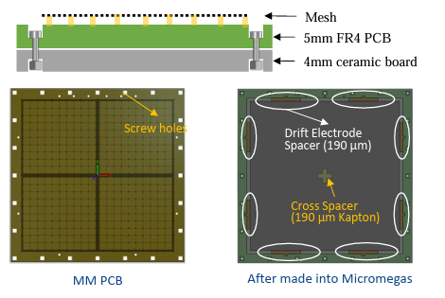
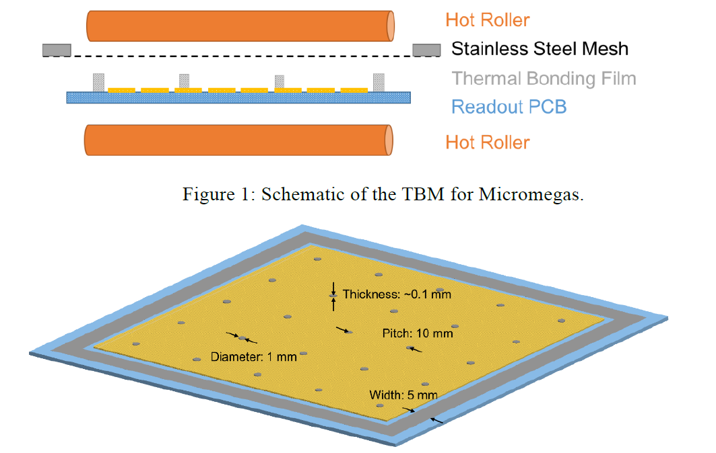
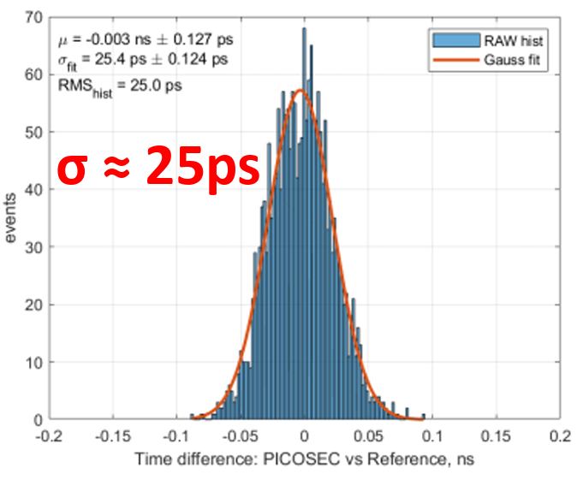
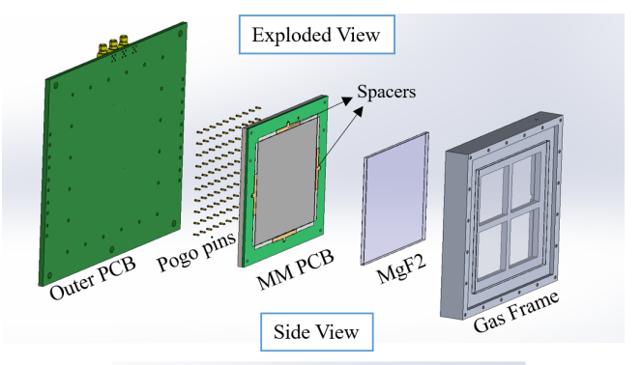
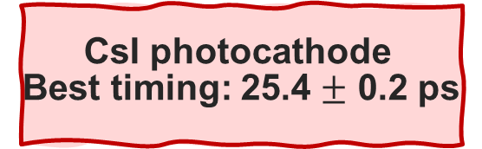
Scalability – The 20x20cm² PICOSEC Prototype
Thermal Bonding method for the MM readout (USTC)
  Coating of Germanium on PCB to form the resistive anode →Resistivity 50 MΩ/◻
  Alternative method of Micromegas construction
    Looking forward to achieve high-rate capabilities
Following the same principle
  Similar assembly as the 10x10 cm²
  Using (4) MgF₂ crystals on a frame
  Kapton films underneath to compensate thickness variations between crystals
CsI photocathode
Best timing: 25.4 $±$ 0.2 ps
  The 10x10 prototype
Y.Meng: PICOSEC Micromegas Precise Timing Detectors; Development towards Large-area and Integration, The 8th International Conference on Micropattern Gaseous Detectors (2024), JINST https://arxiv.org/abs/2501.04991
Notes:
Basic Principle: The TBM fabricates the avalanche structure of the Micromegas detector by bonding a stretched stainless-steel mesh directly onto a readout printed circuit board (PCB). This is done using hot rollers that melt and press spacers made from a thermal bonding film, which has a triple-layer adhesive-polyester-adhesive configuration , .
Spacer Arrangement: The spacers, which support the mesh and define the micro-gap necessary for operation, are typically arranged with a diameter of less than 1 mm. They are positioned at approximately 10 mm intervals on the PCB, ensuring effective support and minimal dead space .
No Chemical Processes: Unlike traditional methods that require etching and chemical agents, TBM is an etching-free process. The adhesive layers in the spacers solidify upon cooling, fixing the mesh in place and creating the required micro-gap while avoiding the complications associated with chemical processes .
Temperature and Pressure Control: Precise control over the conditions during the thermal bonding process, particularly temperature and pressure, is crucial. The spacer materials must be fully compressed while being heated to achieve uniformity in the final structure .
Construction Process:
Heating: The thermal bonding film is heated using hot rollers to melt the adhesive layers.
Pressing: The spacers are pressed against the PCB and mesh during the heating to form a solid bond as they cool down.
Solidification: As the adhesive cools, it hardens, securing the mesh in place and forming the necessary avalanche gap.
Advantages: This method provides several advantages, including simplicity in operations, reduced equipment requirements, enhanced flexibility for designing new detector configurations, and the potential for high gain and low ion backflow , .
Overall, the thermal bonding method streamlines and enhances the production of Micromegas detectors, making them easier to manufacture while maintaining performance standards.

Slide 16
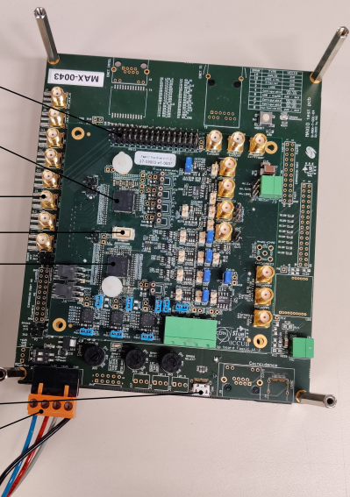
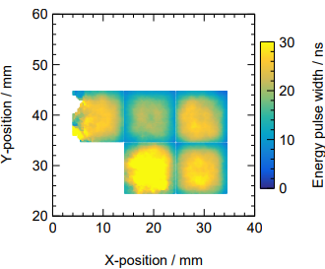
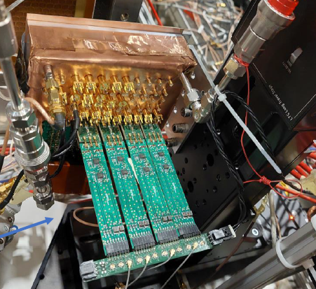
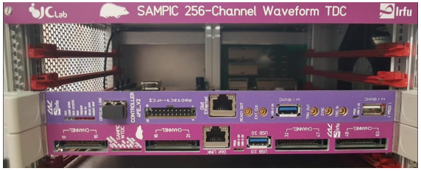
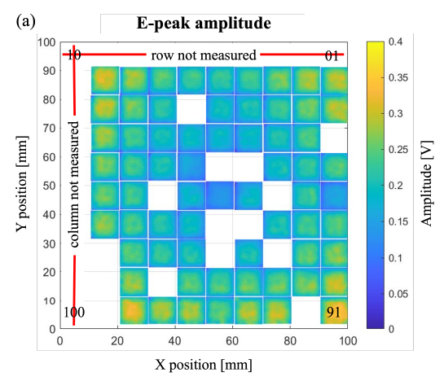
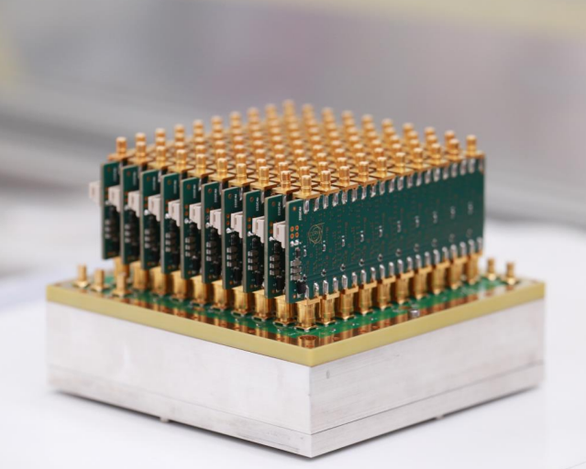
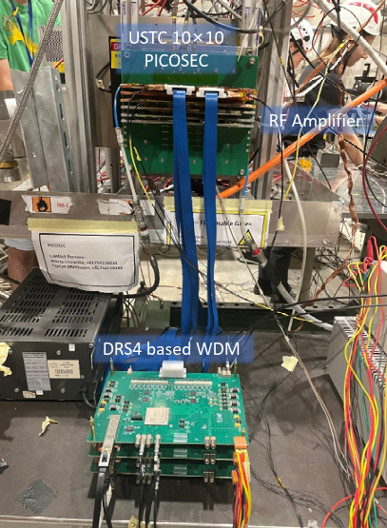
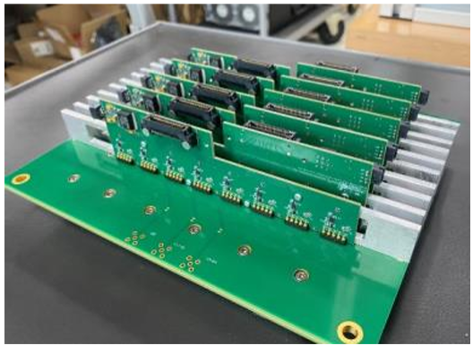
Scalability – The Electronics
FastIC ASIC (CERN)
  Aiming for a binary
  output of the SAT and signal amplitude
  8 readout channels
Towards a large-scale prototypes, we need to develop appropriate frond-end & back-end electronics
Discrete current preamplifiers (CEA)
  8 ch amplifier boards
  High gain >30 dB
  Bandwidth > 1GHz
SAMPIC digitizer (IJCLab)
  8.5 GS/s sampling frequency
  1.6 GHz bandwidth
  Up to 128ch per single digitizer
  16-channel modules
RF current preamplifier
(CERN/RBI)
  10 ch amplifier boards
  High gain 38.5 dB @ 100 MHz
  4 MHz<Bandwidth<650MHz
DRS4 based digitizer (USTC)
  5.12 GS/s sampling frequency
  950 MHz bandwidth
  Dedicated SAMTEC cables for connectivity
RF current preamplifier (USTC)
  16 ch amplifier boards
  25 MHz<Bandwidth<700 MHz

Slide 17
R&D for Applications

Slide 18
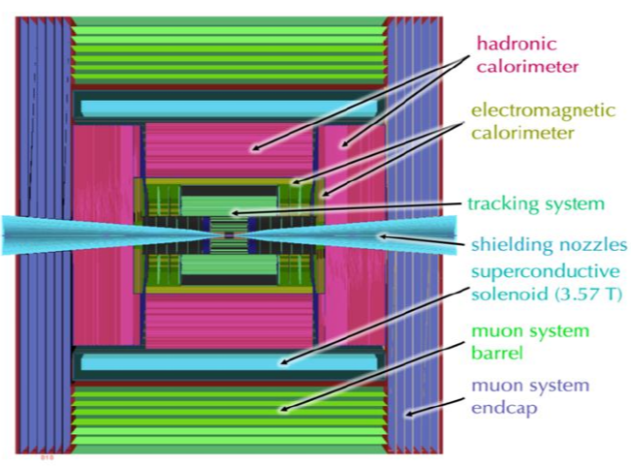
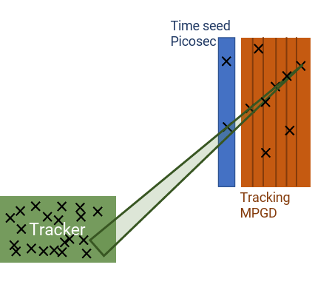
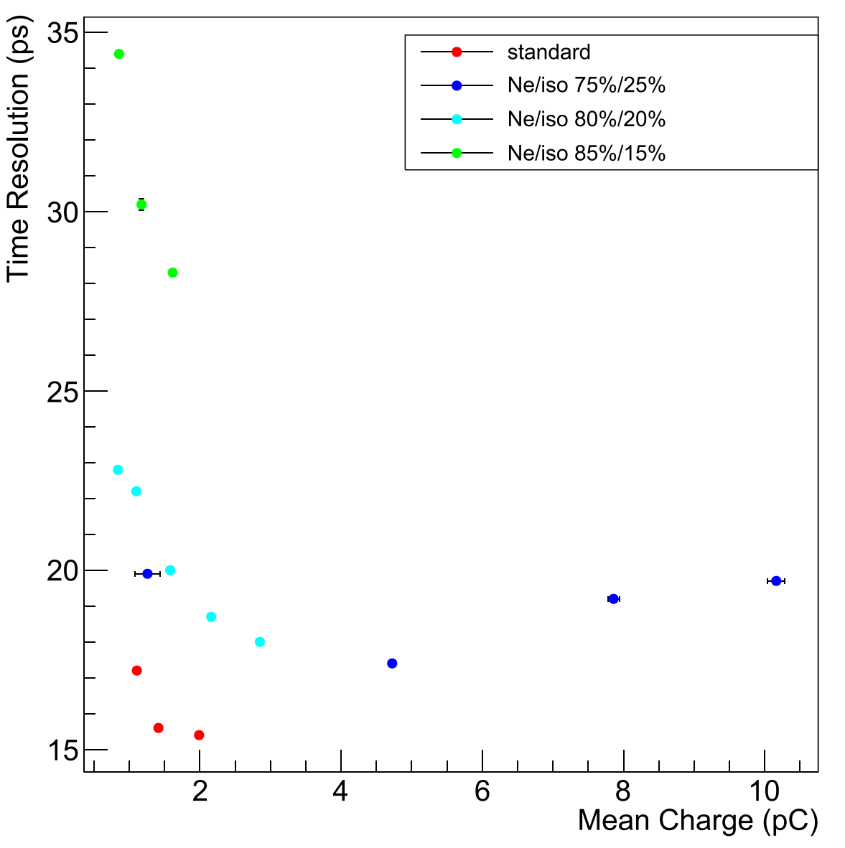
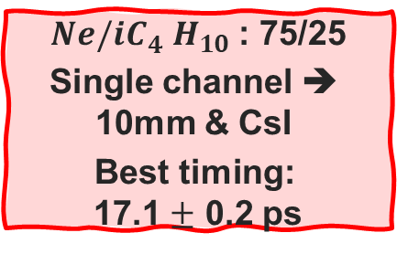
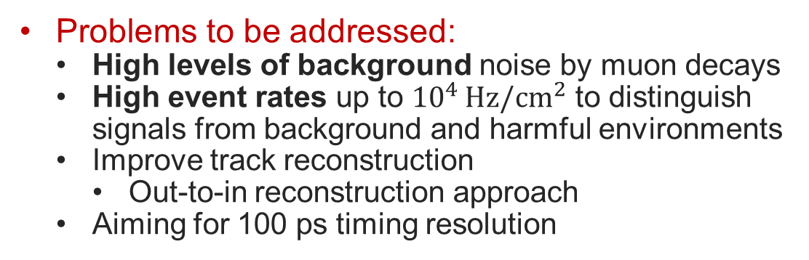
The Muon Collider Detector ( INFN, University of Pavia)
Problems to be addressed:
  High levels of background noise by muon decays
  High event rates up to ${10}^{4 }Hz/cm^{2}$ to distinguish signals from background and harmful environments
  Improve track reconstruction
    Out-to-in reconstruction approach
  Aiming for 100 ps timing resolution
Main Goals : Stability, Sustainability and Durability
R&D focus:
  Eco-friendly gas mixtures
  Resilient photocathode materials
${Ne/iC}_{4}^{}H_{10}$ : 75/25
Single channel ➔
10mm & CsI
Best timing:
17.1 $±$ 0.2 ps
More Info @ Aimè, C., et al. "Simulation and R&D studies for the muon spectrometer at a 10 TeV Muon Collider." NIMA(2024): https://doi.org/10.1016/j.nima.2024.169903

Slide 19
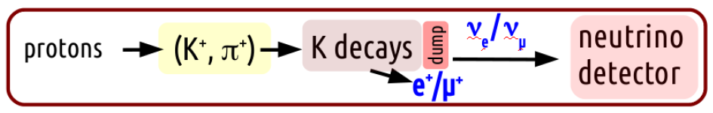
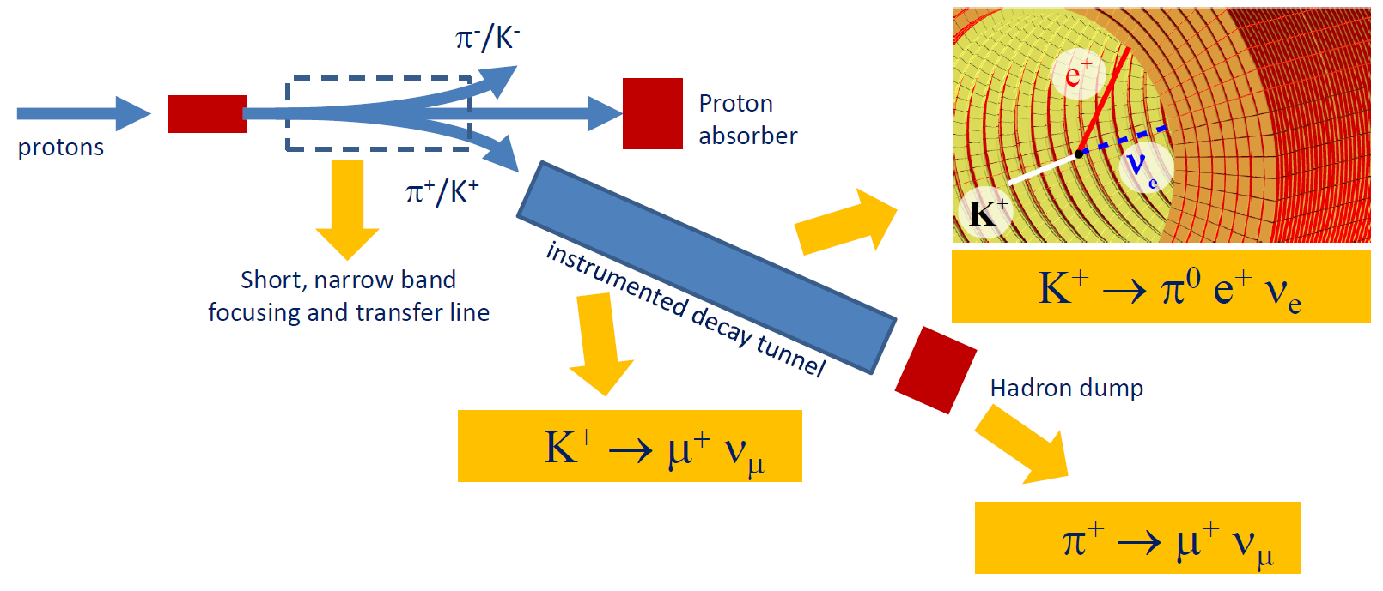
Event Triggering and Tagging Context (CEA Saclay)
Follow up on Cross-section measurements
CERN NP06/ENUBET(Enhanced NeUtrino BEams from kaon Tagging)
ENUBET is aimed:
  At designing a narrow-band beam @ GeV scale
  Having control of the neutrino flux & energy
Embed a PICOSEC-Micromegas layer inside the instrumented hadron damp
ENUBET characteristics facility
  Monitored neutrino beam
  with no one-to-one correlation
  between positrons tagged
  in beamline and neutrinos tagged
  in the far detector
1
Sub-ns sampling would offer this correlation
  On an event-by-event basis
  Determine the flavor of neutrino
2
The ENUBET experiment: F. Terranova, F. Acerbi, G. Ballerini, M. Bonesini, A. Branca, C. Brizzolari
https://doi.org/10.22323/1.390.0182

Slide 20
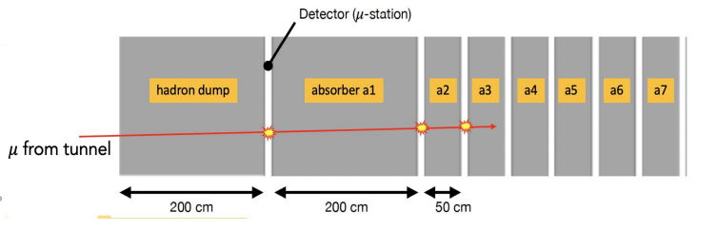
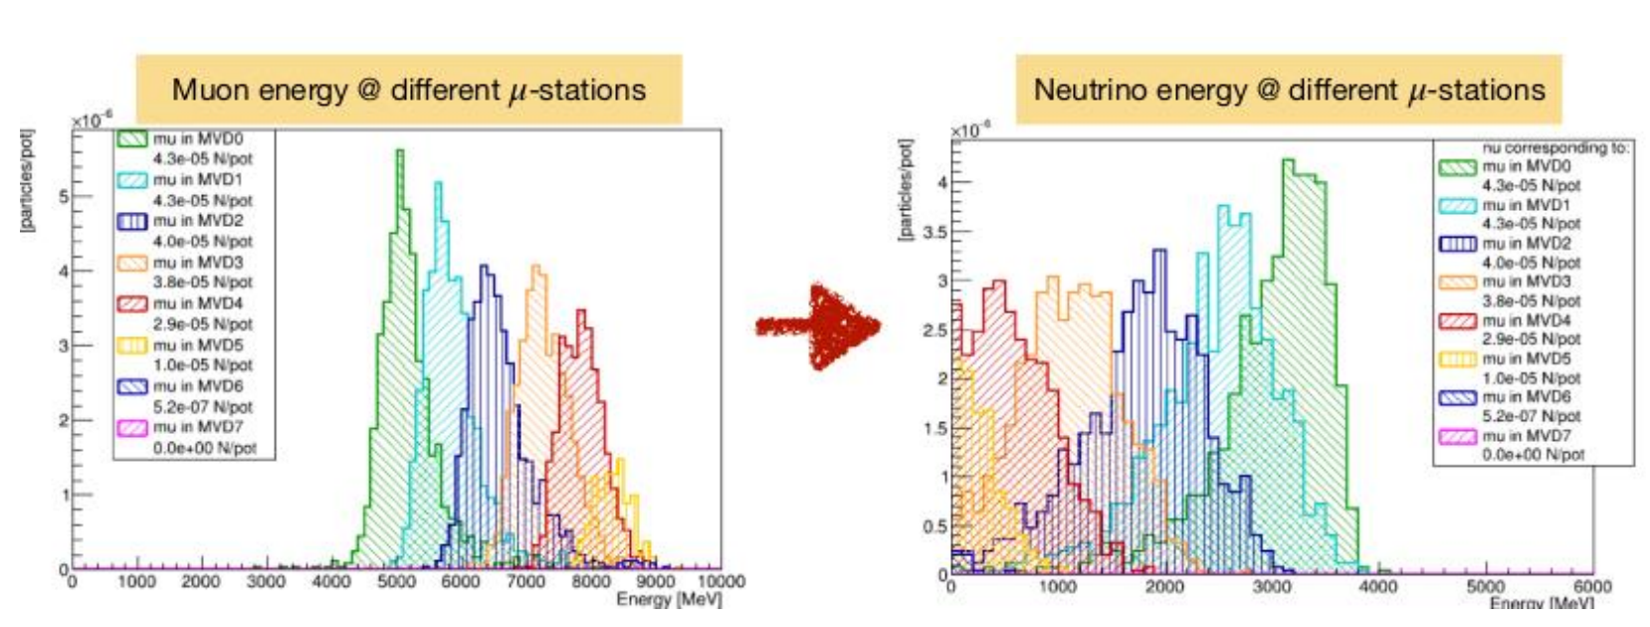
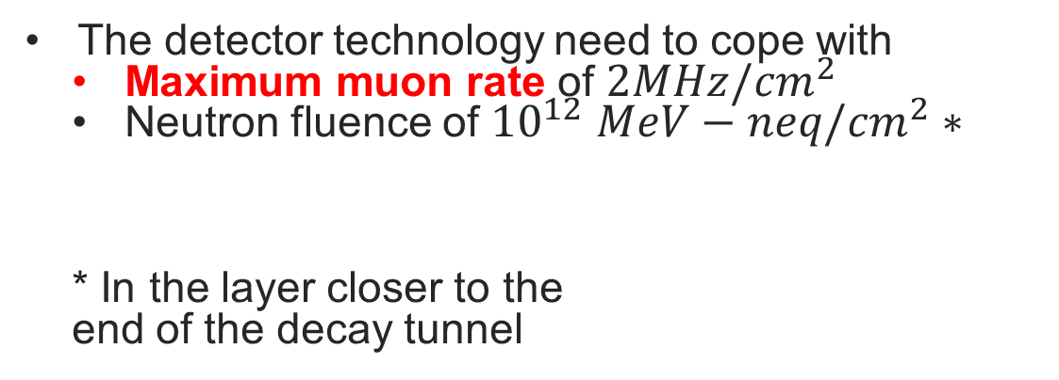
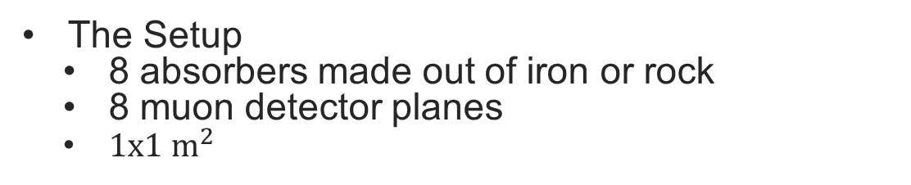
Detector requirements on the hadron dump
The Setup
  8 absorbers made out of iron or rock
  8 muon detector planes
  ${1x1 m}^{2}$
The detector technology need to cope with
  Maximum muon rate of ${2MHz/cm}^{2}$
  Neutron fluence of ${10}^{12}$ ${MeV−neq/cm}^{2}∗$
  * In the layer closer to the
  end of the decay tunnel
ENUBET: the first monitored neutrino beam F. Terranova https://indico.cern.ch/event/1353517/attachments/2772398/4831052/terranova_cern_enubet_15dec2023.pdf

Slide 21


Robustness & Efficiency ≡ Resistive prototypes
Advantages of the resistive technology
  Elimination of destructive effects of discharges
  Stable operation in harmful environment (e.g. pions)
  Possibility to improve position reconstruction
  -HV
  GND
  +HV
  Resistive Layer : DLC
  Insulating layer
  Read-out pads

Slide 22


Robustness & Efficiency ≡ Resistive prototypes
mimimum for protection
Advantages of the resistive technology
  Elimination of destructive effects of discharges
  Stable operation in harmful environment (e.g. pions)
  Possibility to improve position reconstruction
mimimum for timing
rate capability
The goal is to exploit these advantages
while maintaining precise timing resolution
The surface resistivity should be chosen to ensure that :
  The leading edge of the signal is minimally affected
  by the delayed component
  The estimated rate capability
  The protection against discharges
D. Janssens, PhD dissertation, https://cds.cern.ch/record/2890572

Slide 23






Detector R&D for the resistivity value
  Beam
    Muon's energy (80-150 GeV)
    8 cm diameter of beam
    ${10}^{5}$muons/spill
    (measured rate ~ kHz/${cm}^{2}$)
Multi-Pad Prototype (7-pad)
  200 kΩ,10 MΩ/◻ resistive, and capacitive sharing
  Hexagonal pads ø 1 cm
  MgF₂ crystal
  CsI photocathode
  150 μm/128 μm drift/ampl. gap

Slide 24



Detector R&D for the resistivity value
  Beam
    Muon’s energy (80-150 GeV)
    8 cm diameter of beam
    ${10}^{5}$muons/spill
    (measured rate ~ kHz/${cm}^{2}$)
Muons of 150GeV ~ 11p.e/track in DUT
PRELIMINARY
Multi-Pad Prototype (7-pad)
  200 kΩ,10 MΩ/◻ resistive, and capacitive sharing
  Hexagonal pads ø 1 cm
  MgF₂ crystal
  CsI photocathode
  150 μm/128 μm drift/ampl. gap
Best timing 10MΩ/ ◻ : 23.3 $±$ 0.002 ps

Slide 25


Diving Into the Details of Our Top-Performing Prototype 10MΩ/◻
Uniform Timing Performance
Timing below 30 ps over all area
PRELIMINARY

Slide 26

Signal Sharing
Uniform Timing Performance
  Timing remains below 28 ps during signal-sharing events at the six common corners of the central pad, where signals are usually distributed over three readout pads.
PRELIMINARY

Slide 27


Spatial Resolution of 1.1 mm
First indications
  Combined tracks in a 20 mm diameter from the central pad.
  Resulted on a spatial resolution of 1.19 mm on X and Y direction

Slide 28


Facing some ENUBET Requirements
Particle Beams @ CERN SPS H4
  Electrons 30 GeV
  Calculated rate ~1 MH/cm²
Multi-Pad Prototype (7-pad)
  10 MΩ/◻ Resistive prototype
  Hexagonal pads ø 1 cm
  MgF₂ crystal
  B4C (12min) photocathode
A. Kallitsopoulou : PICOSEC Micromegas Detector, An Innovative solution for Lepton Time Tagging, The 8th International Conference on Micropattern Gaseous Detectors (2024), JINST https://arxiv.org/abs/2501.04991

Slide 29


Facing some ENUBET Requirements
Particle Beams @ CERN SPS H4
  Electrons 30 GeV
  Calculated rate ~1 MH/cm²
Average 30ps timing resolution on EM showers
Picosec Pad’s
response
Max Amplitude value ~ 175mV
A. Kallitsopoulou : PICOSEC Micromegas Detector, An Innovative solution for Lepton Time Tagging, The 8th International Conference on Micropattern Gaseous Detectors (2024), JINST https://arxiv.org/abs/2501.04991

Slide 30




The 96-pad Detector design
Search on Alternative Low Material Budget Approaches
  The ATLAS NSW-like approach
Z[mm]
RMS Distance: 9um
Advantage:
  Allow the fabrication of large flat boards
Y[mm]
X[mm]
  96 pad prototype
    1cm single cell size
  Custom-made amp. cards in 6 x 16 connector groups compatible for SAMPIC digitizer
  Extended R&D on the PCB design as well as QA/QC
  Preliminary planarity measurements → 9um uniformity over full PCB area using stiffener

Slide 31





The 96-channel prototype single-cell performance
Rise time → 1.12ns
Single cell ➔
◻ 1cm & 2.5 nm DLC
Best timing:
43.2 $±$ 0.0052 ps
PRELIMINARY

Slide 32


Combined response over different pads of the 96-pad prototype
PRELIMINARY
Single cell ➔
◻ 1cm & 2.5 nm DLC
Best timing:
43.2 $±$ 0.0052 ps

Slide 33

Conclusions
Proof of Concept
  PICOSEC detection concept overcomes timing limitations of gaseous detectors
  Gain can affect robustness and timing resolution
Optimization R&D
  Focus on improving HV stability, preserving signal integrity ( $σ_{single_channel}=$12.5 $±$ 0.5 ps )
  Established a consistent way of performing accurate measurements
    Alternative readout geometries (${ σ}_{μRWELL}$ = 23.5 $±$ 0.1 ps )
    Photocathode studies ($σ_{DLC →1.5 nm}$ = 31.9 $±$ 0.1 ps & $σ_{B4C→9 nm}$ = 34.5 $±$ 0.1 ps )
    Spatial resolution studies ($σ_{15 mm}$ = 0.5 mm )
    Alternative gas studies ($σ_{Ne/iso}$ = 17.1 $±$ 0.2 ps )
  Large scale developments
    Designed and commissioned successfully different approaches for large scale prototypes up to 20x20 cm²
      ($σ_{10x10}$ = 16.8 $±$ 0.2 ps )
      ($σ_{20x20}$ = 23.5 $±$ 0.4 ps )
    Different solutions for readout electronics and digitization are also mentioned
R&D Toward Applications
  Successful design and commissioning of 96-pad aiming to face the ENUBET requirements
    Detector stability over electromagnetic showers ($σ_{}$ = 30.5 $±$ 0.8 ps )
    Detector stability in high intensity pion beam ($σ_{}$ = 60.0 $±$ 0.1 ps )

Slide 34
Key Takeaway
Advantage
Deliverable detector up to 20 × 20 cm² with uniform response
and timing below 30 ps
Large pad size → Less electronic channels
Challenge
Ageing of the photocathode material →
Requires Dedicated study

Slide 35
Thank you
CEA SACLAY
91191 Gif-sur-Yvette Cedex
France
thomas.papaevangelou@cea.fr
alexandra.kallitsopoulou@cea.fr

Slide 36




In the end, it’s all a matter of timing…

Slide 37


The Physics of Ionization offers the means for precise spatial measurements (high spatial resolution) but inhibits precise timing measurements
1977
Notes:
There were already some very well-established thoughts about timing and the limits we can achieve, due to the physics of ionization. Based on the statistical properties of ion pair production Sauli has stated that there is no hope of improving the time resolution in a gas counter. This was 1977 and several years later Yannis proved him wrong.

Slide 38



Optimization of geometry and connectivity
Focus on Operational Stability
  Signal Integrity
      Noise reduction
  Parasitic influence
  Capacitance and inductance
Bonus! Reassembly Feature
∅ 10 mm
∅ 13 mm
∅ 15 mm
Protyping and Testing
  Three boards → ∅ 10, 13, 15 mm
  Best timing performance with the 10mm metallic prototype 12.5 $±$ 0.8 ps at the central region
    Thin gap of 125 μm drift gap and CsI photocathode
New Record! 12.5 ps
    More info on Antonija’s Presentation → Design and performance of a new single channel PICOSEC Micromegas detector with metallic and resistive anodes
A. Utrobicic, et al. “Single channel PICOSEC Micromegas detector with improved time resolution, Nuc. Instrum. Meth. A (2024) https://arxiv.org/pdf/2406.05657
Notes:
The design overview of the single-channel PICOSEC Micromegas detector includes the following key points:
Comprehensive Design Elements: The design encompasses the detector board, the vessel, auxiliary mechanical parts, and electrical connections for high voltage (HV) and signal transmission.
Stability Improvement: The design focuses on enhancing operational stability to better utilize the detector’s capabilities and minimize issues that could arise from external factors.
Noise Reduction: Special emphasis is placed on reducing electronic noise, which is critical for maintaining the integrity of signals and optimizing timing performance.
Signal Integrity: Ensures that the detector’s design maintains signal quality, which is essential for accurate measurements and timing resolutions.
Ease of Reassembly: A streamlined assembly process is implemented, allowing for rapid replacement of detector components, which facilitates efficient testing and measurement with different configurations.
Parasitics Influence: The design takes into account the impact of parasitic capacitance and inductance on output signal integrity, making it a focus area during the design process to mitigate any potential negative effects.

Slide 39



The μRWELL Approach (JLab)
Based on the same design
  Uses the μRWELL technology for the amplification region
Cherenkov
Radiator
photocathode
∅ 10 mm
!
50μm
Protypes and Testing
  Different boards with pitch-diameter sizes
    P120-D100, P100-D80, P80-D60
  Best timing performance with the P120-D100 prototype 23.5 $±$ 0.09 ps at the central region
    Drift gap of 170 μm drift gap and CsI photocathode
A.Pandey. Precise Timing with PICOSEC μRWELL detector-DRD1 Collaboration Meeting https://indico.cern.ch/event/1413681/contributions/5993207/attachments/2879400/5043954/DRD1_talk.pdf
Notes:
The design overview of the single-channel PICOSEC Micromegas detector includes the following key points:
Comprehensive Design Elements: The design encompasses the detector board, the vessel, auxiliary mechanical parts, and electrical connections for high voltage (HV) and signal transmission.
Stability Improvement: The design focuses on enhancing operational stability to better utilize the detector’s capabilities and minimize issues that could arise from external factors.
Noise Reduction: Special emphasis is placed on reducing electronic noise, which is critical for maintaining the integrity of signals and optimizing timing performance.
Signal Integrity: Ensures that the detector’s design maintains signal quality, which is essential for accurate measurements and timing resolutions.
Ease of Reassembly: A streamlined assembly process is implemented, allowing for rapid replacement of detector components, which facilitates efficient testing and measurement with different configurations.
Parasitics Influence: The design takes into account the impact of parasitic capacitance and inductance on output signal integrity, making it a focus area during the design process to mitigate any potential negative effects.

Slide 40



Increase readout granularity for spatial resolution
Based on the same design
  Uses the ∅ 15mm
    Segmented with different pad sizes (3.5mm and 2.2mm pitch)
  To potentially improve the spatial resolution
  Both timing and spatial resolution are mitigated for higher granularity readout (smaller signal amplitudes)
D. Janssens, Robust photocathodes and spatial resolution studies of resistive PICOSEC Micromegas precise-timing detectors- The 8th International Conference on MPGDs https://indico.cern.ch/event/1453371/contributions/6146435/

Slide 41



A very well understood detector
2019
  Modeling Aspects:
  SAT time walk seen in single pe data is explained:
    SAT reduces with avalanche length
    Long avalanches → big e-peak charge
    SAT reduces with e-peak charge
  SAT & Timing resolution are determined by:
    The drift path of the primary photoelectron
            → number of photoelectrons in avalanche and its length
A well understood detector
Modeling the behavior:
  Phenomenological model describing the dynamical and statistical properties of the detector signal
Simulation Studies using GARFIELD++:
Agreement between simulation & experimental data
J.Borteldt, et al. “Modeling the timing characteristics of the PICOSEC Micromegas Detector”, Nuc. Instrum. Meth. A (2021) https://doi.org/10.1016/j.nima.2021.165049
Notes:
Physics
Synchronous Cherenkov photons
Synchronous Photoelectrons from the photocathode
Photoelectron conversion(Townset Coeff)
Preamplification Avalanche
Transport through the mesh
Amplification Avalanches

Slide 42



Detector Testing
2018
Pulsed Laser Beam (IRAMIS/CEA)
  UV Ultra short laser pulses
  Single Photoelectron response
  Perform measurements
  independently of the
  photocathode material
  Understanding the properties
Data taking & Output
  Timing reference device – fast photodiode (σ_{Τ} ~ 3ps)
  Attenuator meshes to control the number of photoelectrons
  Signal Arrival Time has a dependence on Electron peak charge
  Timing resolution improves with higher drift field & smaller gap(<50ps for 120μm for single pe)
L.Sohl-PhD Thesis “Development of a PICOSEC Micromegas for fast timing in high rate (archives-ouvertes.fr)
J.Borteldt, et al. “PICOSEC: Charged particle timing at sub-25 picosecond precision with a Micromegas based detector”, Nuc. Instrum. Meth. A (2021)https://doi.org/10.1016/j.nima.2018.04.033
Notes:
Continuing the collaboration with IRAMIS laser Facility, the way of better understanding of the detector was open. Some detailed studies having the control of number of photoelectrons, resulted to very important statements of detector response.
And say which one are those…
Great achievement of those measurements was that we observed some important statements of the detector response.
The dependence of SAT with electron peak charge in different operation Voltages, The grater the drift voltage the smaller the SAT
In parallel it is evident that timing resolution improves with higher field and smaller gap reaching even a resolution of 50 ps for 120μm gap and

Slide 43



Simulations
  Modeling Aspects*:
    Phenomenological model describing the dynamical and statistical properties of the detector signal
    SAT time walk seen in single photoelectron data is explained:
      SAT reduces with avalanche length
      Long avalanches → big electron peak charge
    SAT & Timing resolution are determined by:
        The drift path of the primary photoelectron
            →number of photoelectrons in avalanche and its length
  Mesh Transparency
  Predicting the transparency of Micromegas meshes
  The arrival time on the mesh is sensitive to initial avalanche fluctuations
J.Borteldt, et al. “Modeling the timing characteristics of the PICOSEC Micromegas Detector”, Nuc. Instrum. Meth. A (2021) https://doi.org/10.1016/j.nima.2021.165049
D. Janssens, Simulating Timing Performance of Micromegas Detector with Garfield++- The 8th International Conference on MPGDs
https://indico.cern.ch/event/1453371/contributions/6146435/

Slide 44








Scalability…The importance of planarity
2018
The importance of planarity
  1st multichannel prototype tested
  19-hexagonal pad prototype, MgF2, CsI, 200μm drift gap
All tracks passing within R<2mm from the center of any pad
σ = 25.8 ps
19 channel anode 1 cm
Variation on timing resolution
  Non uniformity of the drift field gap
  Different gain in single pad area
σ = 32.2 ps
S. Aune et al, "Timing performance of a multi-pad PICOSEC-Micromegas detector prototype", Nucl. Instrum. Meth.A 993 (2021) 165076,https://doi.org/10.1016/j.nima.2021.165076
*AUTh-Spyros Tzamarias

Slide 45





Ensure the planarity
2024+
Tree possible approaches for modular prototypes with 10x10${cm}^{2}$ active zone :
The ATLAS NSW Approach
2021
Rigid, ceramic-core PCB for the MM readout
  Crystal coupled to the PCB with spacers
  MgF2 crystal & MM board will be decoupled from the chamber
  Second PCB will be used for signals towards the amplifiers
Advantage:
  Low material budget on the detector
  Allow the fabrication of large flat boards
Longer pillars MM module
Ready and operational from CERN-GDD Group
Notes:
Investigating new approaches to build large, robust prototypes

Slide 46








100channel PICOSEC Micromegas
“Global” behavior ➔
excellent homogeneity of the detector
2021&2022
100 channel anode ◻ 1 cm
A.Kallitsopoulou-Master Thesis: Development of a Simulation Model and Precise Timing Techniques using Picosec Micromegas Detectors: https://doi.org/10.48550/arXiv.2112.14113
1st prototype tested
  200μm drift gap
  CsI photocathode
  Timing resolution ~25ps
Recovering the resolution in the common corner, for signal-sharing events.
Using Artificial Intelligence- Training a Neural Network
Analytical way of signal Processing
Reducing the drift gap
  180μm drift gap
  CsI photocathode
  Timing resolution ~17ps
    Analysis by Alexandra Kallitsopoulou, Ioannis Maniatis and Spyros Tzamarias. More info in the contribution to the RD51 Collaboration Meeting and “Wide Dynamic Range Operation of MPGDs” workshop, CERN(15-19 November 2021) https://indico.cern.ch/event/1071632/sessions/408832/#20211116

Slide 47



Signal Processing for Precise Timing
V[V]
The Standard CDF Technique
  Adjust a curve to the experimental data
    Fitting the leading edge of the waveform
    with a logistic function
    $f\left(x;p_{0}, p_{1},p_{2},p_{3}\right)=V\left(t\right)=p_{3}+\frac{p_{0}}{1+e^{−\left(x−p_{1}\right)p_{2}}}$
Ion tail
Electron peak
T[ns]
  Timing at 20% of peak amplitude for all signals (SAT – Signal Arrival Time)

Slide 48



Signal Processing for Precise Timing
The Standard CDF Technique
  Finding the total charge of the electron peak
    Fitting additional the falling edge with a normalized logistic function
    $f\left(x;p_{0}, p_{1},p_{2},p_{3}\right)=V\left(t\right)=p_{3}+\frac{p_{0}}{1+e^{−\left(x−p_{1}\right)p_{2}}}$
  Timing at 20% of peak amplitude for all signals (SAT – Signal Arrival Time)
  Create calibration curves
  Subtract the PICOSEC signal from the reference signal

Slide 49

Signal Processing for Precise Timing
The Standard CDF Technique
  Finding the total charge of the electron peak
    Fitting additional the falling edge with a
    normalized logistic function
    $f\left(x;p_{0}, p_{1},p_{2},p_{3}\right)=V\left(t\right)=p_{3}+\frac{p_{0}}{1+e^{−\left(x−p_{1}\right)p_{2}}}$
Muons of 150GeV ~ 11p.e/track in DUT
PRELIMINARY
  Timing at 20% of peak amplitude for all signals (SAT – Signal Arrival Time)
  Create calibration curves
  Subtract the PICOSEC signal from the reference signal
  Correct for dynamical errors
  Timing resolution ~
  RMS of the SAT distribution

Slide 50




Monitoring Plots – Full area detector
Gain Comparison
Uniformity of response
  Timing Runs with MCP-PMT (trigger) centered on each pad center
MCP-PMT
PICOSEC
Pedestal of Detector Baseline noise
Track Mapping over active Area over MCP and PICOSEC alignment

Slide 51



The role of PICOSEC MM in Muon Monitoring
Sources of muons in ENUBET
  2-body decays of $K^{+}/π^{+}$
Muons from $K^{+}$
  Emitted at large angles with respect to the beamline
  Can be identified inside the calorimeter
Muons from $π^{+}$
  Emitted almost collinear with the beamline
  Can be identified with downstream detectors to the hadron-dump
Embed a PICOSEC-Micromegas layer inside the instrumented hadron damp

Slide 52



Detector Stability on Pion Beam
80GeV/c pion beam ~ ${10}^{4}$ to ${10}^{7}$ particles per spill
Beam Size ~2.3 cm x 1.5 cm
B4C 12nm photocathode, achieving timing resolution of 65 ps
Timing resolution degradation due to adjustment of the gain both for the DUT and the reference
Low rate up to 200kHz:
High rate up to 1MHz:
The detector observed to be stable over the full run

