Slide 1
Science in Catalonia
Prof. Andreu Mas-Colell
President of the BIST Board of Trustees
Barcelona, June 16th 2025

Slide 2
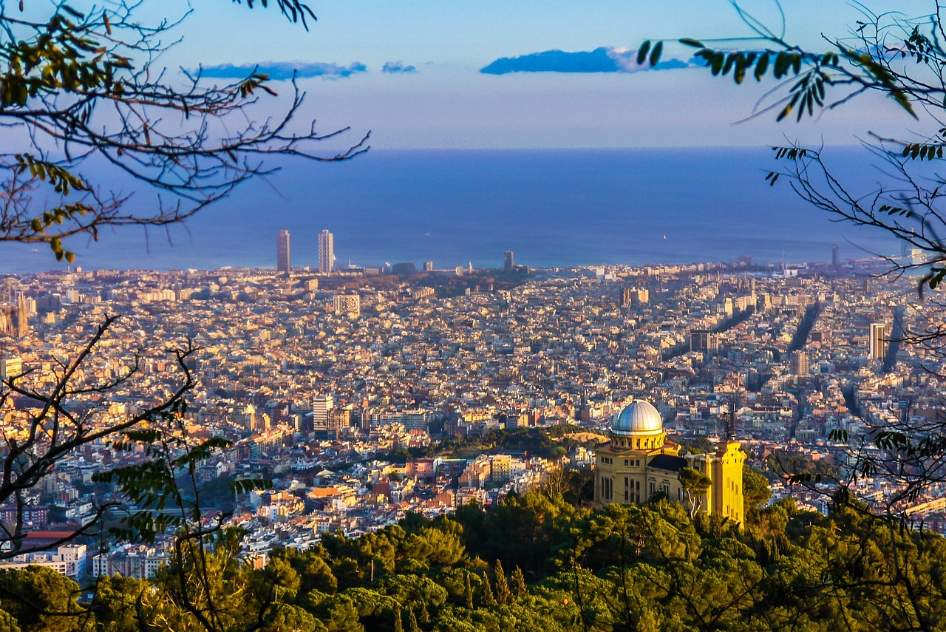
A blurb about Barcelona for a very recent science conference:
“Barcelona is well known for its world class soccer team, stunning architecture, vibrant night-life, sandy beaches, and world class cuisine. Not to mention a thriving cultural heritage and vibrant neighborhood festivals that draw visitors from all over the world”
All true but not the whole truth.

Slide 3
The Barcelona Metropolitan Ecosystem
EU-27 cities
Position | City/Metropolitan Area
1 | Paris MA
2 | Berlin MA
3 | Munich
4 | Barcelona
5 | Copenhagen
6 | Stockholm
7 | Vienna
https://www.nature.com/nature-index/supplements/nature-index-2023-science-cities/tables/overall

Slide 4
In terms of Horizon program funds received:
The Catalonia region is third in EU-27, after Ille de France and Obervayen.
Funds collected: around 1.500M€

Slide 5
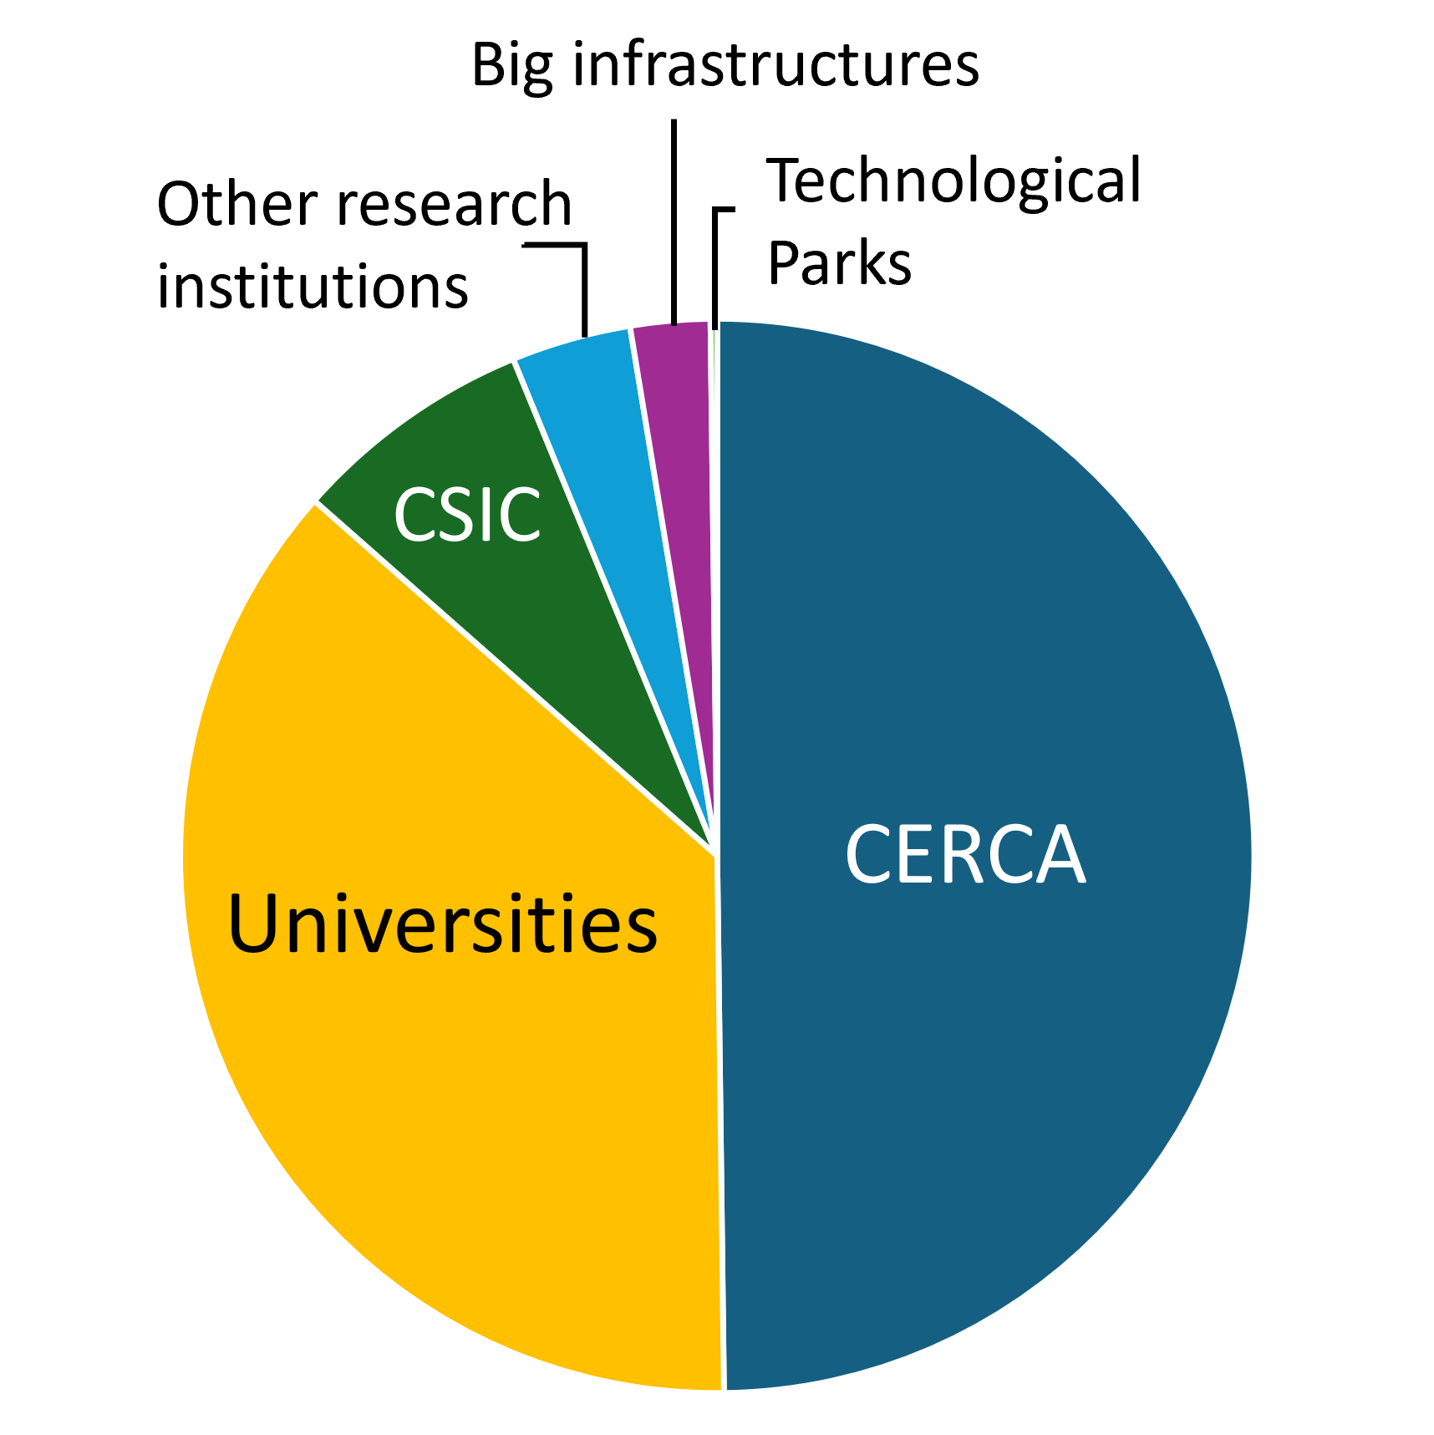
Excellent science
3.3%
total Catalonia grants/total ERC grants
ERC grants in Catalonia (since 2007)
Grant type | N. Grants | M€
Total | 480
StG | 152 | 221 M€
CoG | 101 | 197 M€
AdG | 98 | 223 M€
PoC | 106 | 16 M€
SyG | 23 | n/a
Source: AGAUR (Feb 2023)

Slide 6
The composition
Hospitals
Research Centres
Syncrotron ALBA
BIST
CERCA & CSIC
Universities
ICREA
International
institutions
Barcelona Supercomputer Center
22@
The technological district

Slide 7
Universities
5 Public Universities in the Barcelona MA: UAB, UB, UPC, UPF and UOC
3 Private Universities: URL, UIC, UAOCEU
∼17,500 researchers
All categories, all Catalan public universities
∼1,500 PhD thesis in STEM disciplines defended/course
UB is a LERU member
UPF is a The Guild member
Source: Informe L’Estat de la Ciència a Catalunya 2023

Slide 8
Research Centres
42 CERCA centres in Catalonia
14 CSIC centres in Catalonia (+ participation in 7 others)
∼16,500 people CERCA
∼1,750 people CSIC
Source: Informe L’Estat de la Ciència a Catalunya 2023. CERCA website. El CSIC en datos 2020-2021. AGAUR.

Slide 9
Barcelona Institute of Science and Technology (BIST)
A multidisciplinary community: from high energy physics to biomedicine
2,664 people
175 ERC projects (Since 2007)
∼1,400 publications/year
33 mean citations/article
73% with international col.
50+ Spin-off companies
10th Position in Nature Index in Europe (Universities excluded)
Source: BIST website. AGAUR

Slide 10
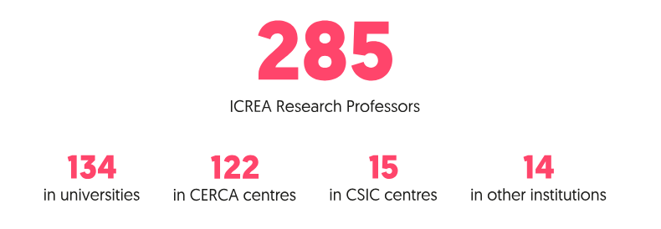
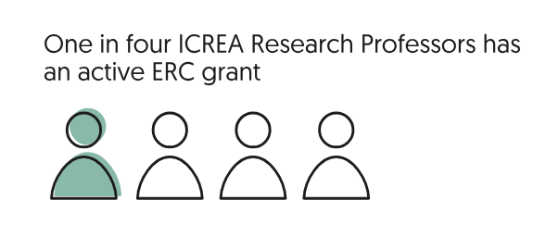
Source: ICREA report 2023

Slide 11
Hospitals
13 Research Institutes associated to Hospitals in Catalonia.
All of them are CERCA institutions.
Spain ranks 5th in Europe and 8th worldwide in participation in active clinical trials. Catalonia participates in 88.5% of the clinical trials done in Spain.
Important support infrastructures such as CNAG (genomic analysis)
Catalonia excels in oncology CT (34% of the total)
Source: 2023 BioRegion Report. Biocat.

Slide 12
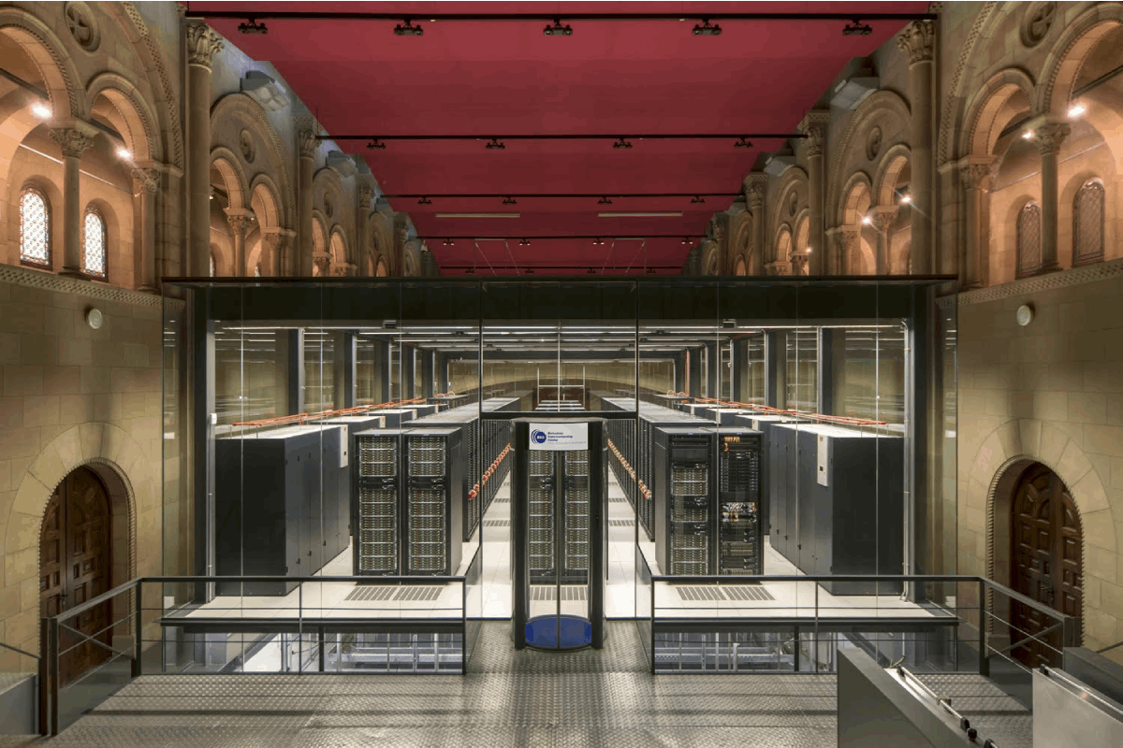
900 people
It is part of the European Inniative on high performance computing (HPC).
It is one of six hosting partners in the PRACE distributed European supercomputing infrastructure.
Manages MareNostrum 5, one of the most powerful supercomputers in Europe.
BSC is both a research infrastructure and a research centre.

Slide 13
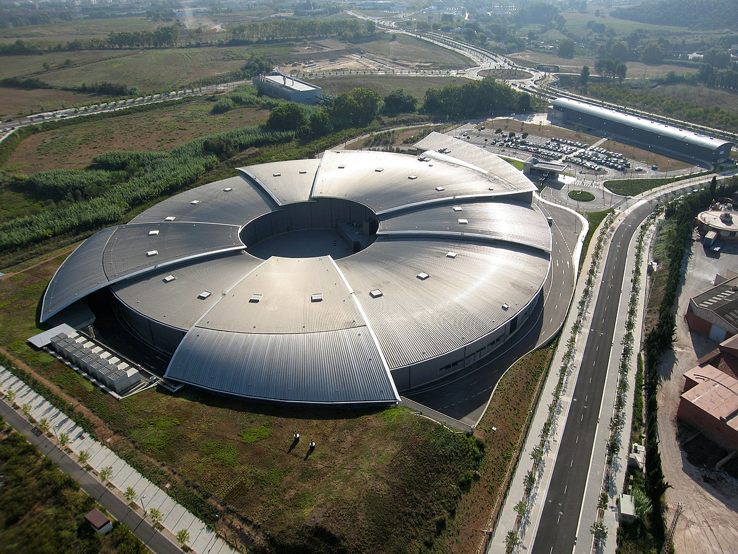
Synchrotron
It is a pillar of the Spanish −and European− research arena, offering to academic and industrial users a wide variety of state-of-the-art instrumentation. ALBA-2 expected to be operative in 2032

Slide 14
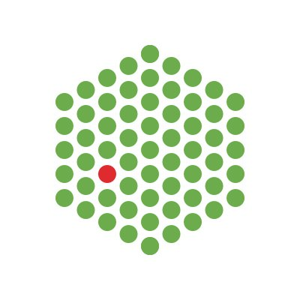
International Institutions
EMBL has 6 sites
Barcelona, Grenoble, Hamburg, Heidelberg, Hinxton, and Rome

Slide 15
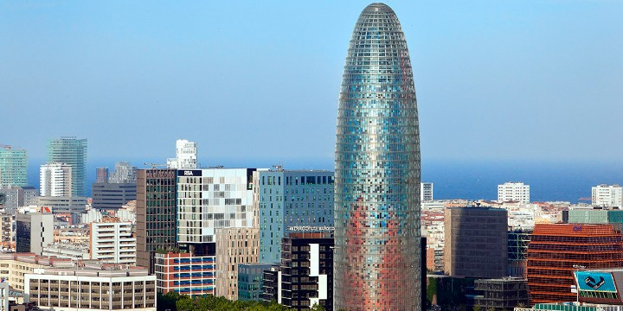
22@ Technological District
>200 hectares of what used to be industrial sites.
1,500 companies linked to the media, IT, energy, design and scientific research.

