Slide 1
ET-PP WP5 2nd review meeting (RP2)
Project: 101079696 — ET-PP — HORIZON-INFRA-2021-DEV-02
Horizon Europe:
Coordination and Support Actions
15/05/2025
Grant agreement: Nº 101079696

Slide 2
WP 5: Introduction and objectives
Preparatory Phase for the Einstein Telescope Gravitational Wave Observatory
2nd review meeting (RP2) — 15.05.2024
The objective of Work Package 5 (WP5) is to establish the ET Project Office and the corresponding Engineering Department.
This work package is responsible for creating a structured organizational project environment for the construction of the ET research infrastructure.
This environment will be supported by both consultative and executive bodies, equipped with the necessary tools to monitor, control, coordinate, and report on various aspects including technical design, engineering, specifications, risk management, budgeting, and scheduling.
WP5 co-chairs:
Christian Olivetto, CNRS
Patrick Werneke, Nikhef
Alessandro Variola, INFN
Project: 101079696 — ET-PP, 2nd review meeting

Slide 3
WP 5: Tasks
Preparatory Phase for the Einstein Telescope Gravitational Wave Observatory
2nd review meeting (RP2) — 15.05.2024
WP | Task | Objectives for the period | Activities carried out in this period with short description of the activities carried out | Significant results (e.g deliverable submission, milestoned, achievement, publication etc..)
5 | 5.1 | Establishing and create document with the Project Office structure and mandate | Hold regular Project Office management meetings in coordination with the TEO and ET-PP management teams. | Submission of D5.1 deliverable and validated
5 | 5.2 | Establish a tool evaluation process and create documentation outlining tool requirements to support Project Management | Coordinate Project Office management meetings and define the evaluation criteria for tools used in each area of expertise covered by the Project Office | Submission of D5.2 deliverable and validated
5 | 5.3 | Establishing and create document with the Engineering Department structure and mandate | Hold regular Engineering Department management meetings in coordination with the TEO and ET-PP management teams. | Submission of D5.1 deliverable and validated
5 | 5.4 | Establish and document the functional description of the Engineering Department | Hold regular Engineering Department management meetings in coordination with the TEO and ET-PP management teams. | Submission of D5.4 deliverable in the process of being validated
5 | 5.5 | Establish and document the functional description of the Project Office | Hold regular Project Office management meetings in coordination with the TEO and ET-PP management teams. | Submission of D5.5 deliverable in the process of being validated
Project: 101079696 — ET-PP, 2nd review meeting

Slide 4
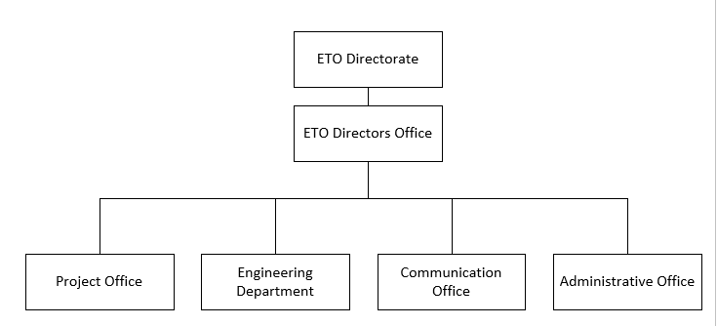
WP 5: Organisation and interfaces of WP5 with the ETO organisation
Preparatory Phase for the Einstein Telescope Gravitational Wave Observatory
2nd review meeting (RP2) — 15.05.2024
ET-PP, and consequently WP5, are included in the ETO organization by the
integration of the ET-PP Project leader in the ETO Directorate
Project: 101079696 — ET-PP, 2nd review meeting

Slide 5
WP5: Critical risks, deviations from Annex I, contingency plans
Preparatory Phase for the Einstein Telescope Gravitational Wave Observatory
2nd review meeting (RP2) — 15.05.2024
Risk Number | Description of the risk | WP | Proposed risk-mitigation measures | Did your risk materialise ? | Did you apply risk mitigation measure ? | Comments
1 | Delay in completing process for new full-time engineering positions (low, medium) | 5 | Assign existing part-time personal from partner institutes to assist in the start-up phase | YES | YES
2 | Difficulty to find personnel in the participant institutions for the leadership and the collaborator positions required for the Project Office and the Engineering Department (low, medium) | 5 | Provide temporary support from the collaboration and invite experts from external institutes | YES | NO | This worked for the Engineering Department with the collaboration agreement with CERN, but not in the Project Office
Project: 101079696 — ET-PP, 2nd review meeting

Slide 6
WP5: Critical risks, deviations from Annex I, contingency plans
Preparatory Phase for the Einstein Telescope Gravitational Wave Observatory
2nd review meeting (RP2) — 15.05.2024
Risk Number | Description of the risk | WP | Proposed risk-mitigation measures | Did your risk materialise ? | Did you apply risk mitigation measure ? | Comments
3 | Funding continuity: funding may end before completing the Preparatory Phase | 5 | Find internal solution of national instutions in order to maintain development activity and expansion of ETO Funders Group by ETO Directors. | YES | YES | Work has started and ETO Funders Group is established.
4 | Late with ETO Legal Entity: ETO and ET-PP persons leave because of ending contracts Specificaly for expertise on temporary position | 5 | Find internal solution of national institutions to maintain these expertises | YES | YES | Discussion will be started as soon as possible in the ETO Funders Group to maintain these expertise inside ET project for potential intermediate phase.
Project: 101079696 — ET-PP, 2nd review meeting

Slide 7
WP5: Critical risks, deviations from Annex I, contingency plans
Preparatory Phase for the Einstein Telescope Gravitational Wave Observatory
2nd review meeting (RP2) — 15.05.2024
Risk Number | Description of the risk | WP | Proposed risk-mitigation measures | Did your risk materialise ? | Did yopu apply risk mitigation measure ? | Comments
5 | Timeline slippage: Underestimating the amount of work / complexity / dependencies | 5 | Setting up groups of experts organised into task forces on identified subjects in order to remove as many uncertainties as possible. Organise risk assessement and set-up risk response strategy on the plans to mitigate risk. | Yes | Yes | The ET project setting up these task forces and the results would mitigate these risks
Project: 101079696 — ET-PP, 2nd review meeting

Slide 8
WP5: Deliverables and milestones
Preparatory Phase for the Einstein Telescope Gravitational Wave Observatory
2nd review meeting (RP2) — 15.05.2024
The schedule of deliverables and milestones
The main deliverables are described in this schedule. Internal deliverables
and milestones for Project Office and Engineering Department are illustrated in the following slides.
Project: 101079696 — ET-PP, 2nd review meeting

Slide 9
WP5: Internal Project Office,Deliverables and milestones
Preparatory Phase for the Einstein Telescope Gravitational Wave Observatory
2nd review meeting (RP2) — 15.05.2024
Deliverable | Expected Result/outcome | Date | Deliverable-Milestone
ET Roadmap document | Document describing the roadmap of the ET project in phase 1 | Q1 2025 | Deliverable
ET roadmap methodology document | Document describing the methodology followed to establish the ET roadmap | Q1 2025 | Deliverable
ET nomenclature document | Document describing the project nomenclature | Q3 2025 | Deliverable
ET PBS (Product Breakdown Structure) update provided | ET PO coordinate the establishment of the new PBS version after the review phase | Q4 2025 | Milestone
ET WBS (Work Breakdown Structure) validated | The final version of the WBS, and consequently of the project OBS is approves by stakeholders | Q4 2025 | Milestone
ET change process validated | The process for the generic change request for PBS and parameters | Q4 2025 | Milestone
Project: 101079696 — ET-PP, 2nd review meeting

Slide 10
WP5: Internal Project Office,Deliverables and milestones
Preparatory Phase for the Einstein Telescope Gravitational Wave Observatory
2nd review meeting (RP2) — 15.05.2024
Deliverable | Expected Result/outcome | Date | Deliverable-Milestone
ET Scheduling Management Plan - document | Document describing the process, the methodologies and the roles associated to the scheduling management in ET | Q2 2026 | Deliverable
ET Risk Management Plan - document | Document describing the process, the methodologies to the risk managmeent in ET | Q2 2026 | Deliverable
ET Requirements Management Plan document | Document describing the process, the methodologies associated to the requirements management in ET | Q2 2026 | Deliverable
ET Quality Assurance Management Plan - document | Document describing the process, the methodologies associated to the quality assurance management in ET | Q2 2026 | Deliverable
ET Project Management Plan 1st release document | Document describing all the processes defined to ensure the succeful realization of the Project Office Mandate | Q4 2026 | Deliverable
Preliminary Cost Book - document | Document describing the costing guilines and providing and approximate cost estimate | Q3 2027 | Deliverable
Project: 101079696 — ET-PP, 2nd review meeting

Slide 11
WP5: Internal Engineering Dpt,Deliverables and milestones
Preparatory Phase for the Einstein Telescope Gravitational Wave Observatory
2nd review meeting (RP2) — 15.05.2024
Deliverable | Expected Result/outcome | Date | Deliverable-Milestone
The preliminary TDR for research infrastructure | For the Civil Engineering, the main ETO milestone is the delivery of the Preliminary TDR for the research infrastructure, including a cost overview, by the end of 2026. For ET-PP, a first version of the Preliminary TDR is planned for mid-2026 | Q2 2026 Q4 2026 | Deliverable
TDR for the vacuum beampipe | As part of the ET-PP framework, the Preliminary TDR was completed in January 2025, while the TDR is scheduled for completion in the fall of 2025. Extensive testing and optimization efforts are planned in the updated framework collaboration agreement [5]. A final update of the TDR and cost assessment are foreseen at the end of the agreement in September 2027. | Q4 2025 Q3 2027 | Deliverable
Technical Infrastructure TDR | For the technical infrastructure the main milestones do not align yet with the milestones of the civil engineering works. The Preliminary TDR, including a costing overview is expected to be available by September 2027 | Q3 2027 | Deliverable
Civil Engineering TDR | For the Civil Engineering, the main ETO milestone is the delivery of the Preliminary TDR for the research infrastructure, including a cost overview, by the end of 2026. For ET-PP, a first version of the Preliminary TDR is planned for mid-2026. An updated overall schedule for ET is currently being developed. | Q4 2026 | Deliverable
Project: 101079696 — ET-PP, 2nd review meeting

Slide 12
WP5: Contribution from each partner
Preparatory Phase for the Einstein Telescope Gravitational Wave Observatory
2nd review meeting (RP2) — 15.05.2024
INSTITUTION |  | PM as per Annex I | PM in the RP2 period | PM in the RP1 period
IFAE | CONTRIBUTIVES | 24 | 9 | 6
 | REQUESTED EC | 0 | 0 | 0
NIKHEF | CONTRIBUTIVES | 124 | 51,82 | 7,9
 | REQUESTED EC | 36 | 36,10 | 11,76
INFN | CONTRIBUTIVES | 141 | 32 | 25,5
 | REQUESTED EC | 36 | 7 | 0
CNRS | CONTRIBUTIVES | 121 | 20,91 | 13,3
 | REQUESTED EC | 108 | 49,92 | 12,81
UAntwerpen | CONTRIBUTIVES | 5 | 3 | 1
 | REQUESTED EC | 0 | 0 | 0
Total Person Months | CONTRIBUTIVES | 415 | 116,73 | 53,7
Total Person Months | REQUESTED EC | 180 | 93,02 | 24,57
TOTAL |  | 595 | 209,75 | 78,27
Project: 101079696 — ET-PP, 2nd review meeting

Slide 13
WP5: Outlook and perspectives
Preparatory Phase for the Einstein Telescope Gravitational Wave Observatory
2nd review meeting (RP2) — 15.05.2024
For Project Office and Engineering Department lots of progress has been done during this phase 1 and during this period.
All deliverables have been produced and validated or in the process been validated. (D5.1 to D5.5)
Lots of process/tools have been deployed for the Project Office and in process been evaluated or validated, a positive feedback from ET collaborators and ETO management of these project management deployments. (PBS, WBS in progress, does not exist for the moment, Configuration Data-Base,Risks assessment, Schedule, QA,…)
The Engineering Department has made significant progress in establishing itself as a functional entity. While not yet fully operational, it is on the right trajectory. The primary focus remains on Preparatory Phase 1, which ends with the site selection and principal approval for the Einstein Telescope’s construction.
The risks are identified and mitigation actions in progress.
Project: 101079696 — ET-PP, 2nd review meeting

Slide 14
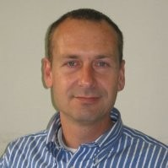
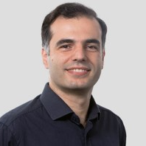
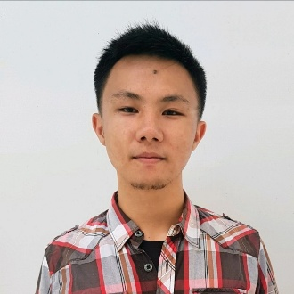
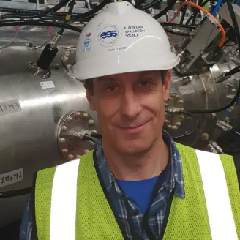
WP5: Engineering Department
Preparatory Phase for the Einstein Telescope Gravitational Wave Observatory
2nd review meeting (RP2) — 15.05.2024
Project: 101079696 — ET-PP, 2nd review meeting

Slide 15
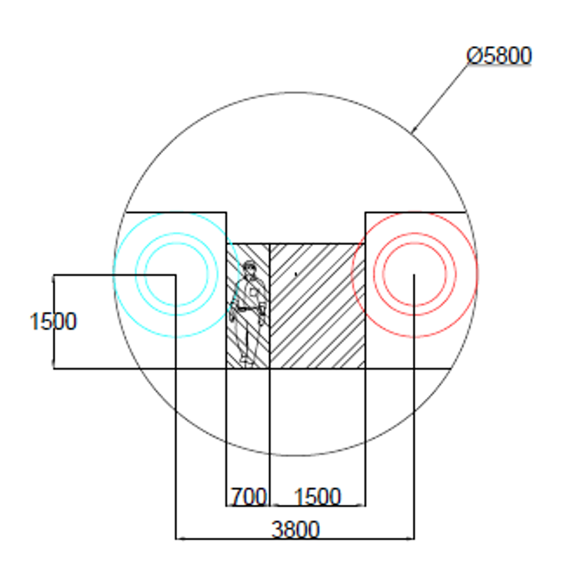
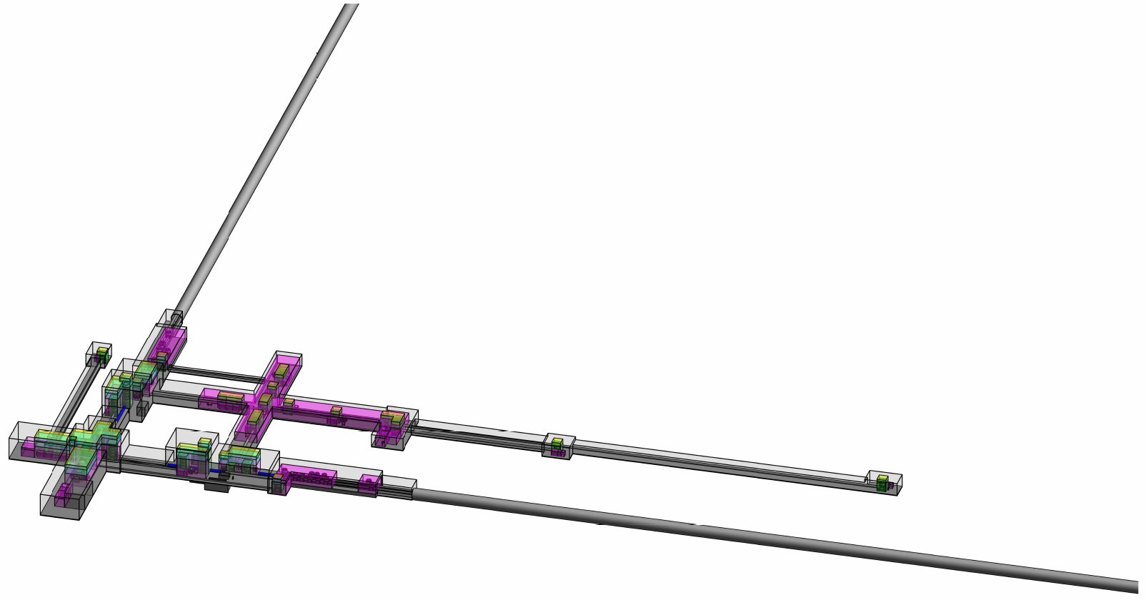
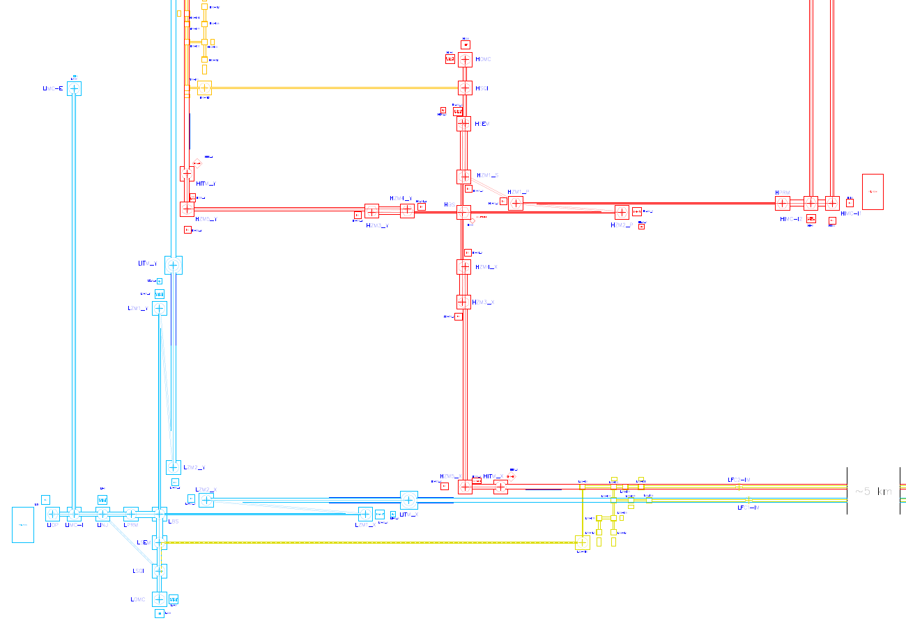
WP5: Engineering Department (Configuration)
Preparatory Phase for the Einstein Telescope Gravitational Wave Observatory
2nd review meeting (RP2) — 15.05.2024
Detector Layout Update 2025 for the 2L Configuration
Optical Layout → Detector Layout
Result ETO Task Force to be reviewed in June
Baseline design for Local Teams - minimal requirements
2L Optical Layout
2L Tunnel Envelope 5 – 15 km
2L Detector Layout
Project: 101079696 — ET-PP, 2nd review meeting

Slide 16
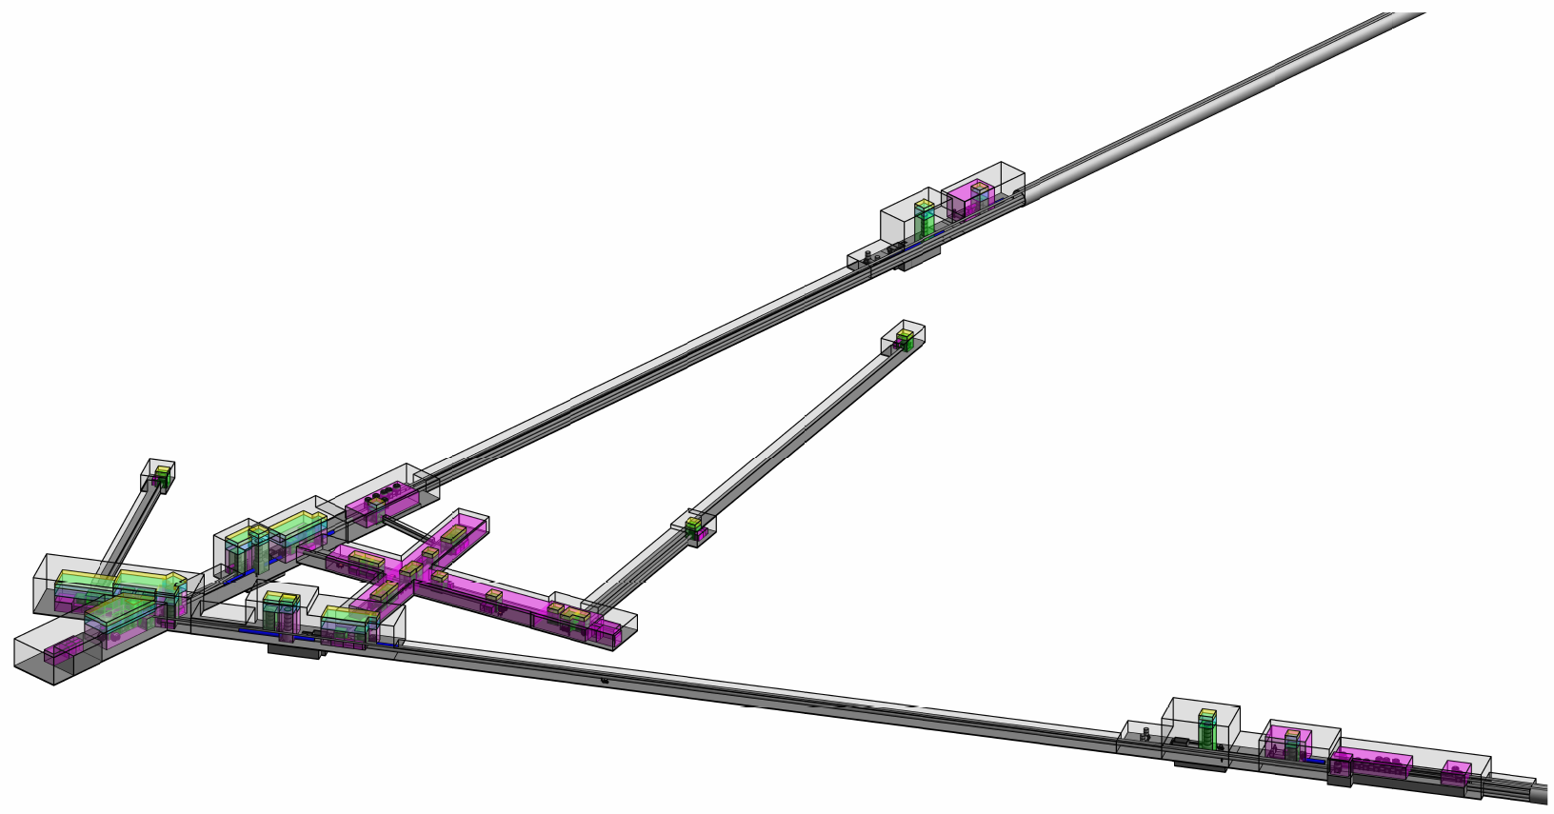
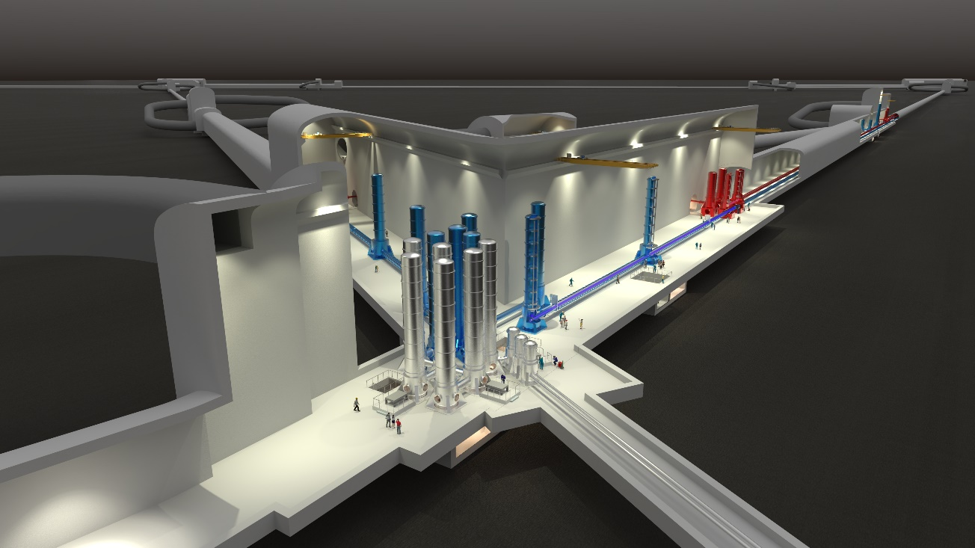
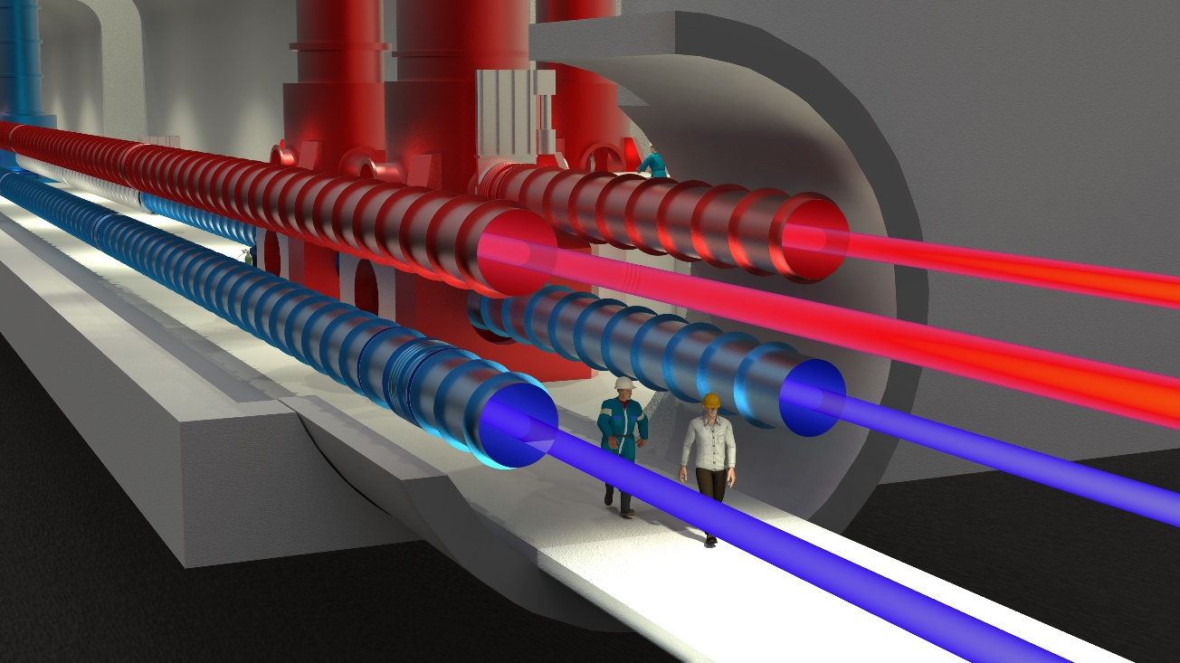
WP5: Engineering Department (Configuration)
Preparatory Phase for the Einstein Telescope Gravitational Wave Observatory
2nd review meeting (RP2) — 15.05.2024
Detector Layout Update 2025 for the Triangular Configuration
Optical Layout → Detector Layout
Result ETO Task Force to be reviewed in June
Baseline design for Local Teams - minimal requirements
3D images of ET (2020)
Project: 101079696 — ET-PP, 2nd review meeting

Slide 17
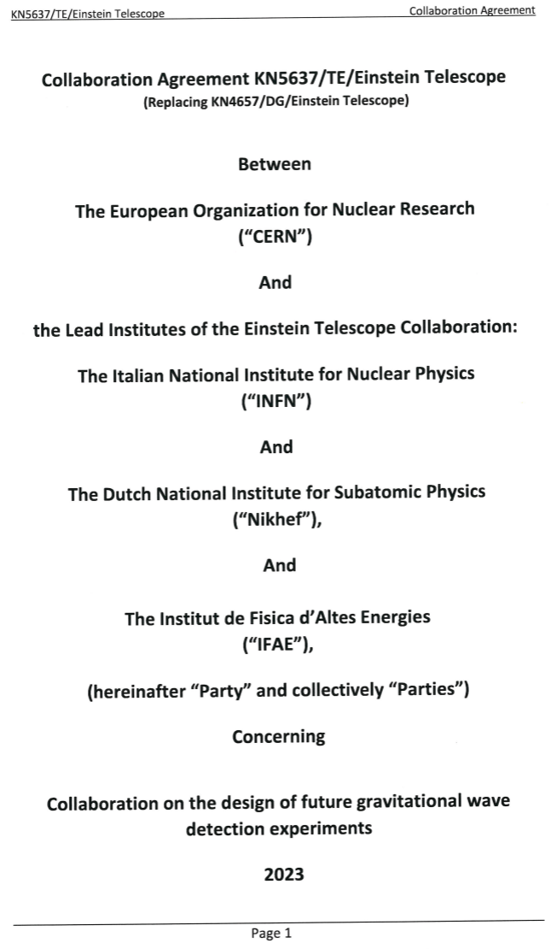
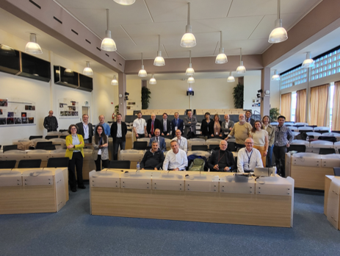
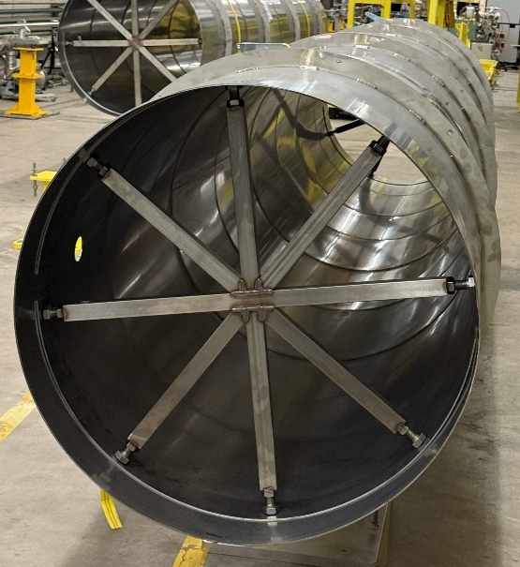
WP5: Engineering Department (MoU with CERN)
Preparatory Phase for the Einstein Telescope Gravitational Wave Observatory
2nd review meeting (RP2) — 15.05.2024
Several similarities between ET and CERN projects. Specifically related to vacuum and underground infrastructures.
ETO has a MoU with CERN for their support on technical topics:
Arm vacuum pipe
Civil Engineering
Technical Infrastructure
HVAC, Electricity, Access & Alarms
Safety
Integration
Project: 101079696 — ET-PP, 2nd review meeting

Slide 18
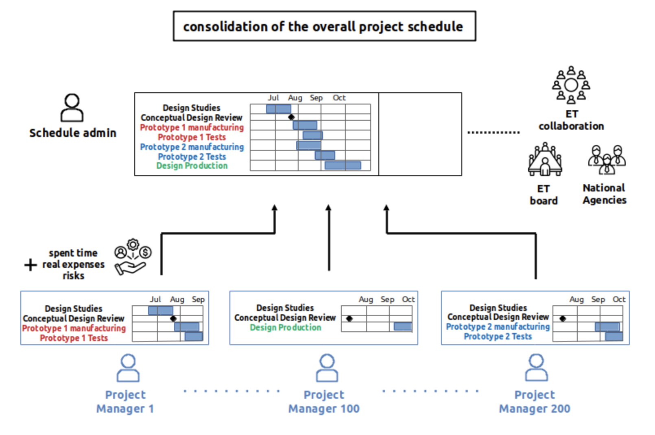
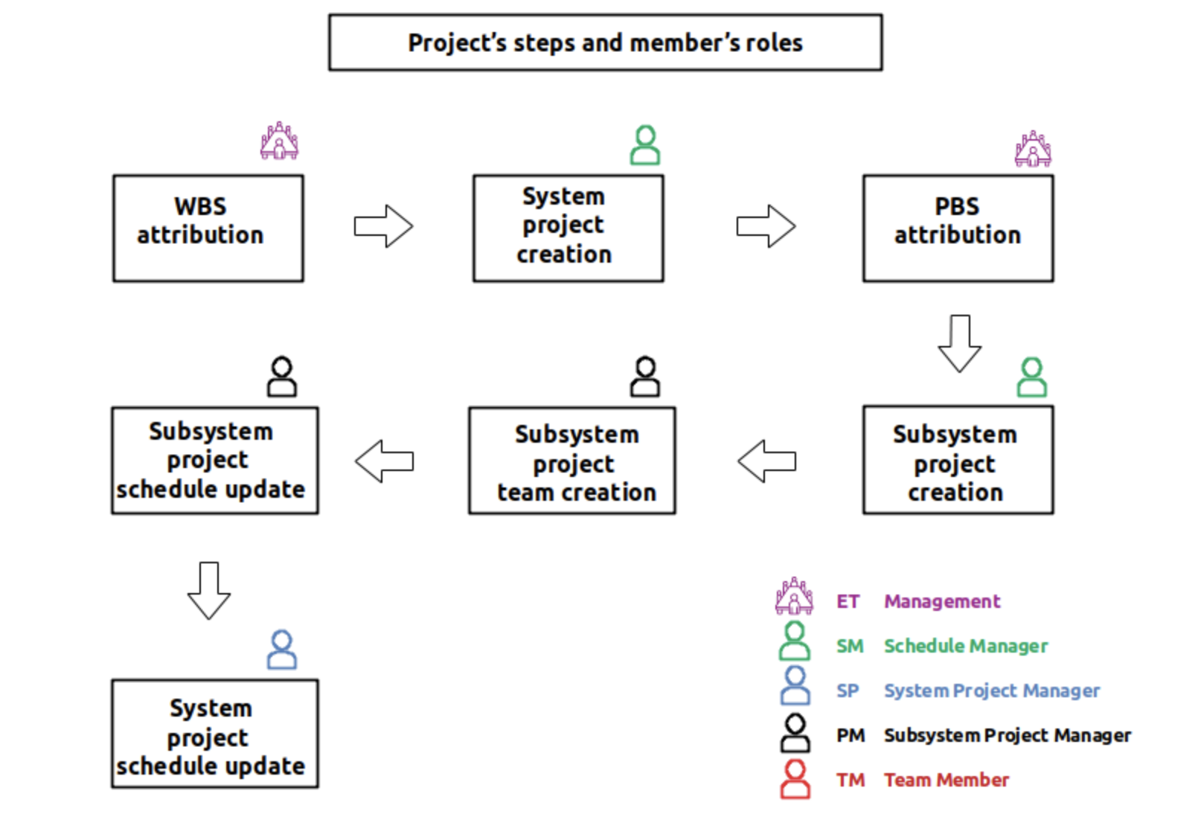
WP5: Project Office (Scheduling Methodology)
Preparatory Phase for the Einstein Telescope Gravitational Wave Observatory
2nd review meeting (RP2) — 15.05.2024
For ET scheduling process we identified and
deployed a common methodology to answer
Of ET project requirements.
We identified potential tools
We deployed some of them
We communicate to collaboration with
a) Wiki page
b) Training Session
c) Youtube channel with video tutorials
Project: 101079696 — ET-PP, 2nd review meeting

Slide 19
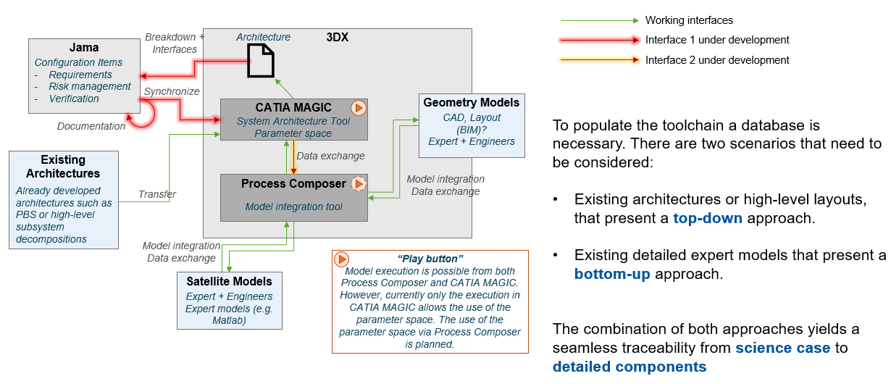
WP5: Project Office (MBSE exercise scope - toolchain)
Preparatory Phase for the Einstein Telescope Gravitational Wave Observatory
2nd review meeting (RP2) — 15.05.2024
Focus on three tools: 1) 3DExperience (3Dx):“Hub” | Engineering Platform 2) CATIA Magic (on 3Dx): System architecting
3) JAMA Connect: Requirements Management
Project: 101079696 — ET-PP, 2nd review meeting

Slide 20
WP5: Project Office (Risk Assessment)
Preparatory Phase for the Einstein Telescope Gravitational Wave Observatory
2nd review meeting (RP2) — 15.05.2024
Score | Likelihood | Likelihood of occurrence
L5 = 5 | Maximum | Very likely | > 50 %
L4 = 4 | High | Likely | 10 % to 50 %
L3 = 3 | Medium | Unlikely | 2 % to 10 %
L2 = 2 | Low | Very unlikely | 0,1 % to 2 %
L1 =1 | Minimum | Rare | < 0,1 %
Likelihood | CRITICALITY ( C = P x S )
L5 | 5 | 10 | 15 | 20 | 25
L4 | 4 | 8 | 12 | 16 | 20
L3 | 3 | 6 | 9 | 12 | 15
L2 | 2 | 4 | 6 | 8 | 10
L1 | 1 | 2 | 3 | 4 | 5
Severity | S1 | S2 | S3 | S4 | S5
Criticality (C = L x S) | Type of Risk | Review Frequency
10 to 25 | UNACCEPTABLE RISK Develop and implement a detailed risk mitigation plan. Escalate to senior management and prioritize resource allocation. Communicate regularly with stakeholders and prepare contingency measures as needed. If unresolved, this risk may necessitate major project adjustments. | Bi-Monthly
5 to 9 | TOLERABLE RISK under control Monitor and plan: Develop a response plan to manage this risk, but active mitigation can be minimal. Regularly review and reassess to catch any changes in risk conditions. Keep stakeholders informed. | Every 6 Months
1 to 4 | ACCEPTABLE RISK Routine Monitoring: No significant action required other than periodic monitoring. Include in regular risk assessments, and be prepared to adjust if project conditions shift or if the risk level increases. By convention, the risk is said to be CLOSED when the various project actions are closed. | Annually or Phase Review
Score | Severity | Severity Description
S5 = 5 | Catastrophic | Critical failures that severely compromise project objectives, with potential project abandonment. Severe safety incidents or regulatory issues. Financial impact >20%.
S4 = 4 | Serious | Major issues that require significant rework, delays up to 2 years, or financial impacts of 10-20%. May impact critical project objectives or require safety interventions.
S3 = 3 | Moderate | Significant issues requiring additional resources or changes but manageable within project constraints. Delays of up to 6 months; financial impact 3-10%.
S2 = 2 | Minor | Minor technical or operational issues that slightly affect project outcomes but can be managed within the current budget and schedule. Financial impact of 1-3%.
S1 =1 | Negligible | Minor issues easily resolved with minimal impact on cost, schedule, or performance. No safety risks, and no delays beyond minor, routine adjustments. Financial impact <1%.
Project: 101079696 — ET-PP, 2nd review meeting

Slide 21
ET-PP WP5 2nd review meeting (RP2)
Project: 101079696 — ET-PP — HORIZON-INFRA-2021-DEV-02
Horizon Europe:
Coordination and Support Actions
15/05/2025
Grant agreement: Nº 101079696

