Slide 1



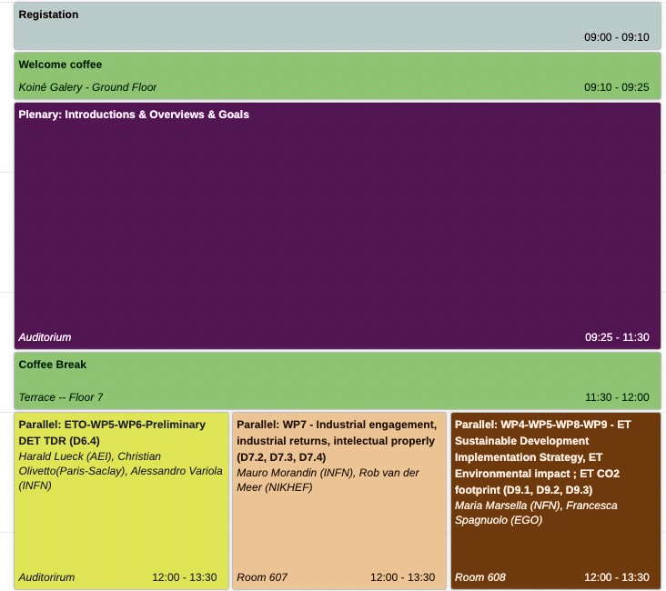
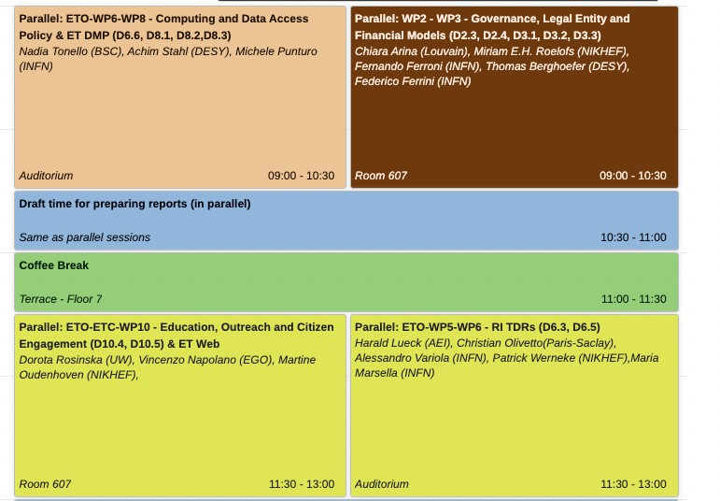

ET-PP INFRA-DEV Annual Meeting 2025
ETO-WP5-WP6
Preliminary Detector TDR (D6.4)
July, 22nd 2025
https://indico.ifae.es/event/2183/
Tuesday, 22/07
Wednesday, 23/07
https://etpp.ifae.es
1

Slide 2
Pre Det TDR – where are we?
Due date for pre Det TDR was Sept. 2024
Postponed to July 2025
Postponed to end 2025 (draft), pre TDR Feb 2026
Prerequisites for Preliminary Detector TDR:
Product Breakdown Structure (PBS)
  With parameter tables, dependencies, and descriptions
  → relational database
Optical layout (for D and 2L)
Detector layout (built on optical layouts)
Writing Team: not operative yet (good progress in some subsystems).

Slide 3
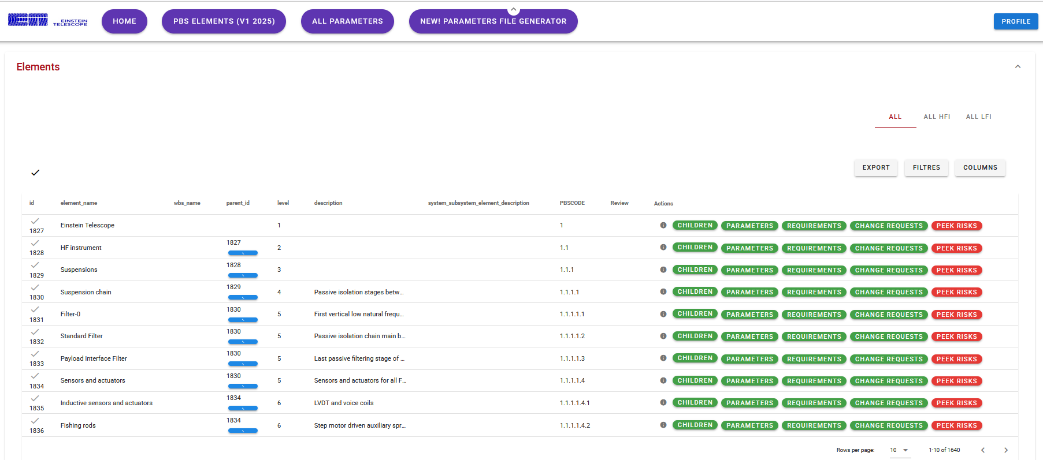

PBS Database - Elements
  Issues:
  1096/1640 without parameter file
  1129 elements without a text description
  No TRLs declared/foreseen.
  In many cases probably low

Slide 4
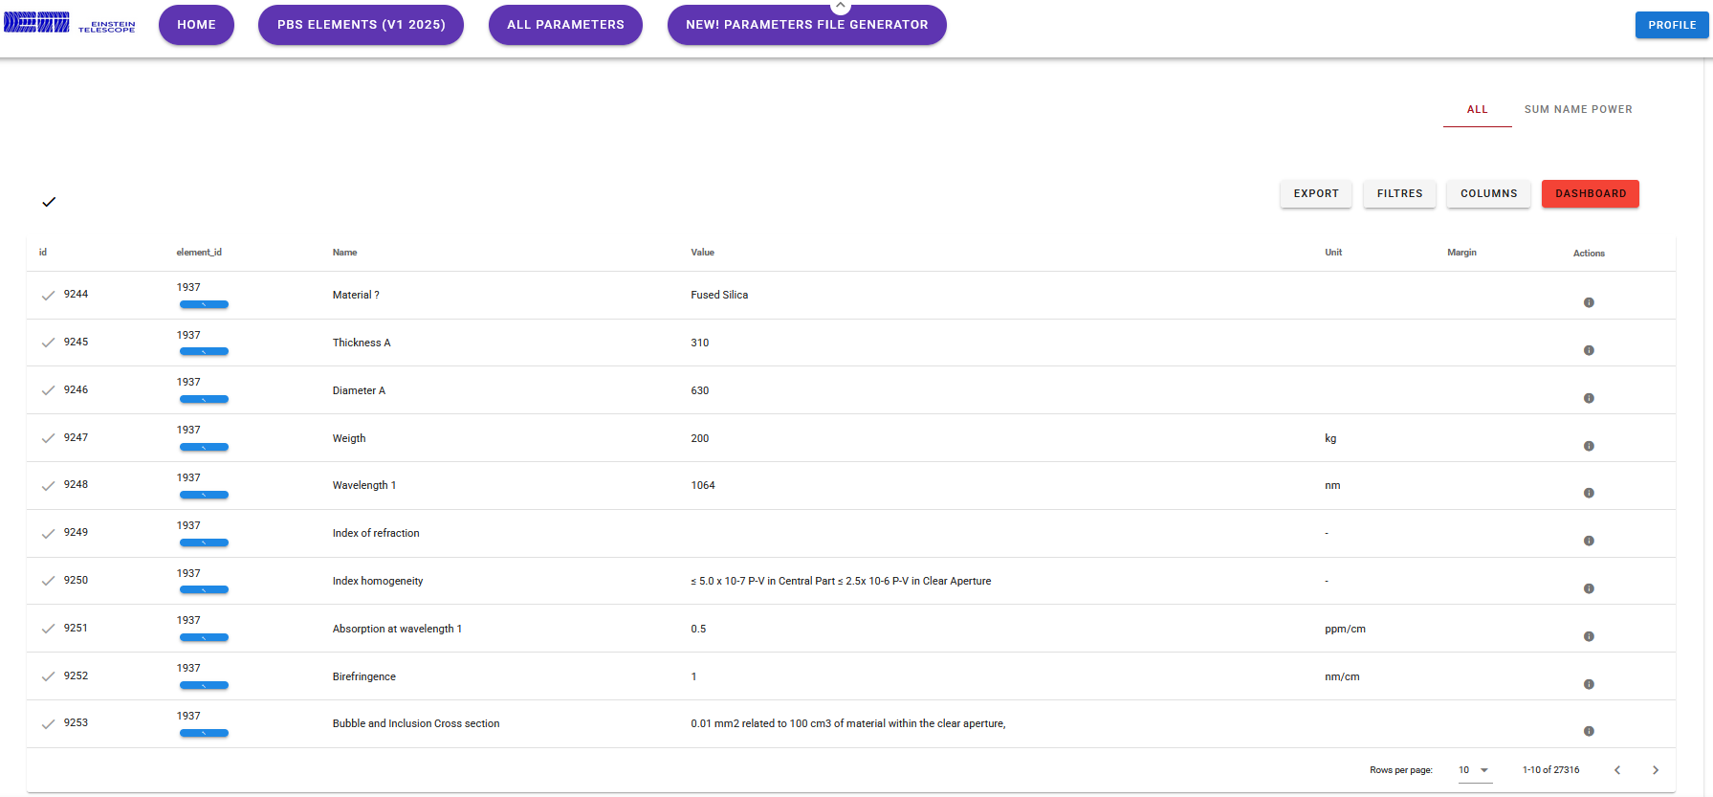

PBS database - Parameters
  Issues:
  25659/27316 parameters have no numerical value associated

Slide 5
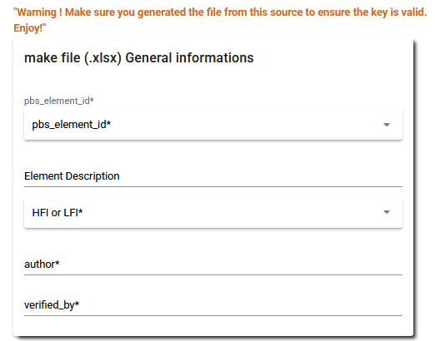
Parameter Generator in Database
Thousands of descriptions missing
Many inserted parameters without value
Interfaces between elements or subsystems missing

Slide 6
ET PBS Database
Discussion with Oussama and Patrice
What does it contain?
What can it do?
Which features are still missing?
Who can access it?
How can information be retrieved?
How to insert new information?
How to change/update information? Change request procedure?
Do we see it as a preliminary tools to be exported to some standard?
If so, what would that be?
…

Slide 7
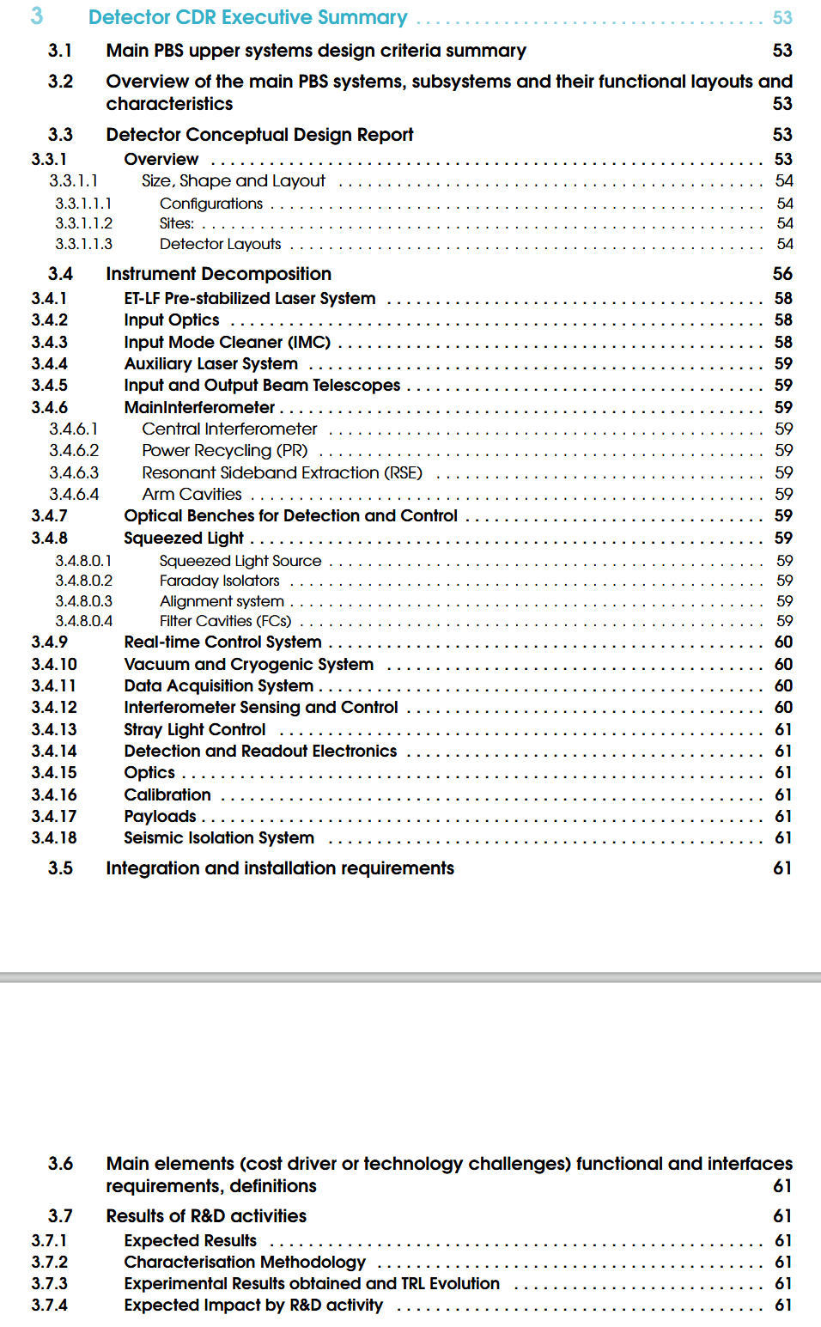
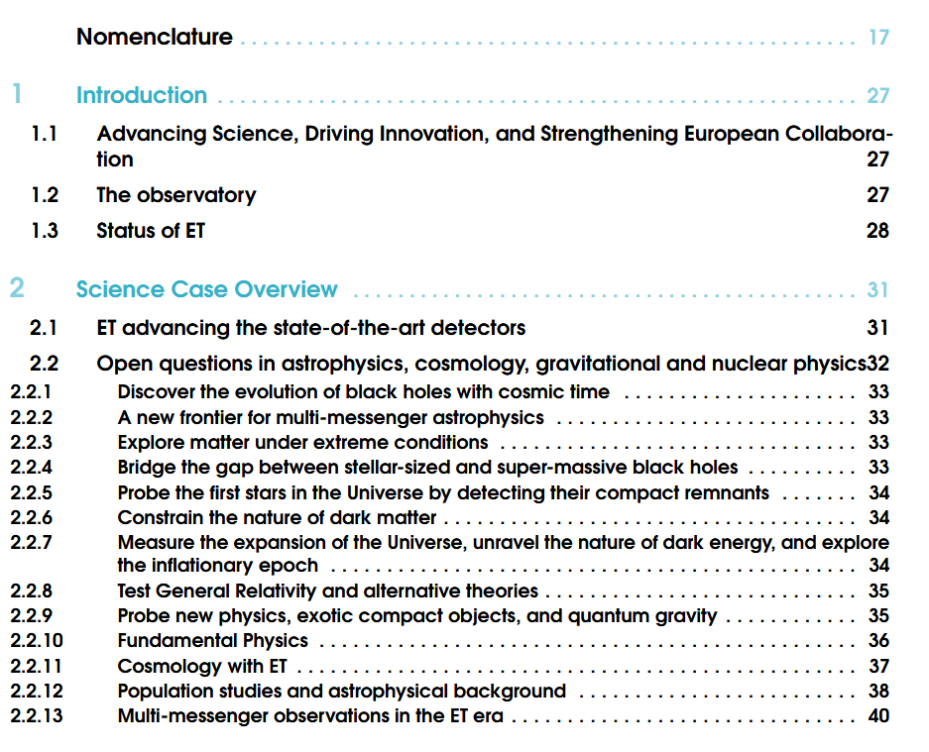
Preliminary Detector TDR ToC

Slide 8
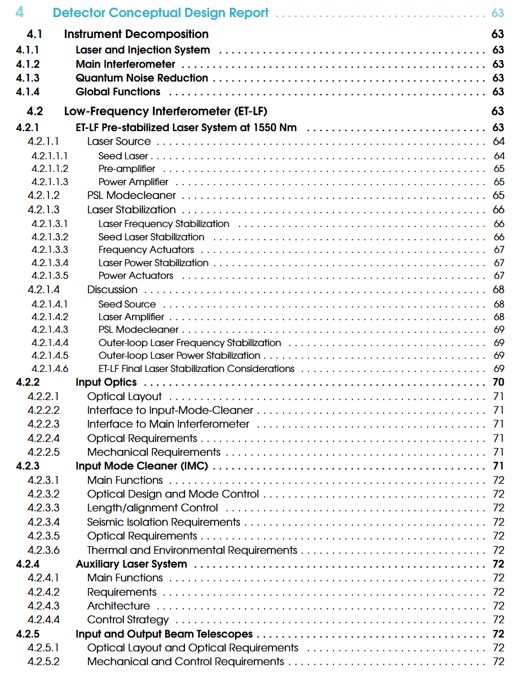
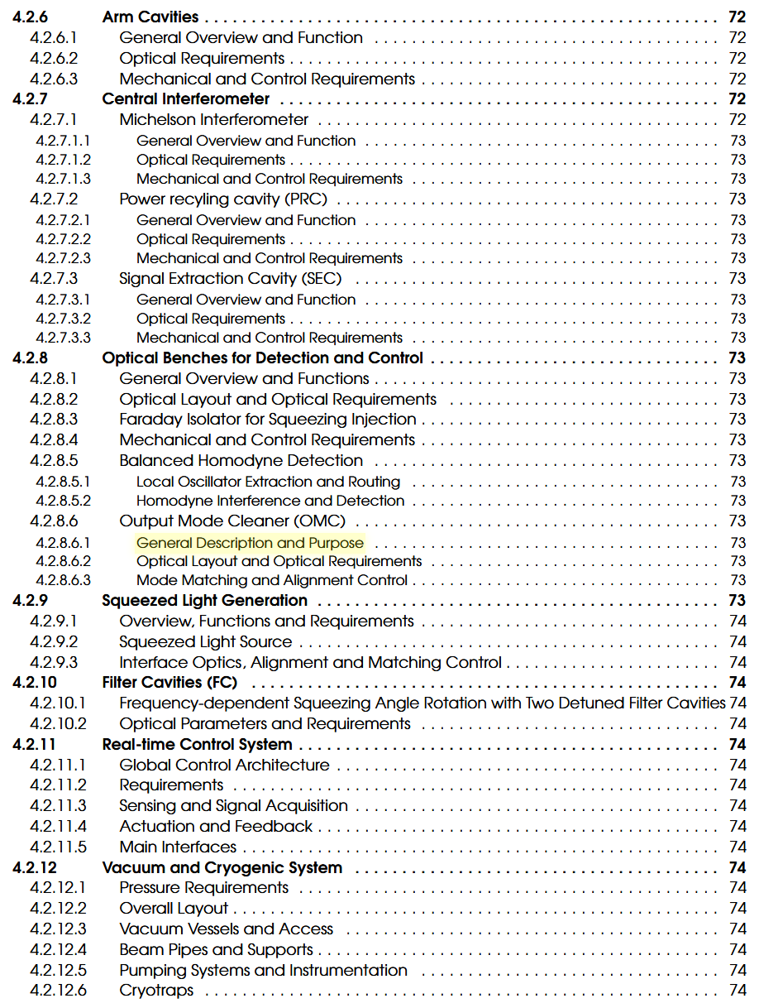
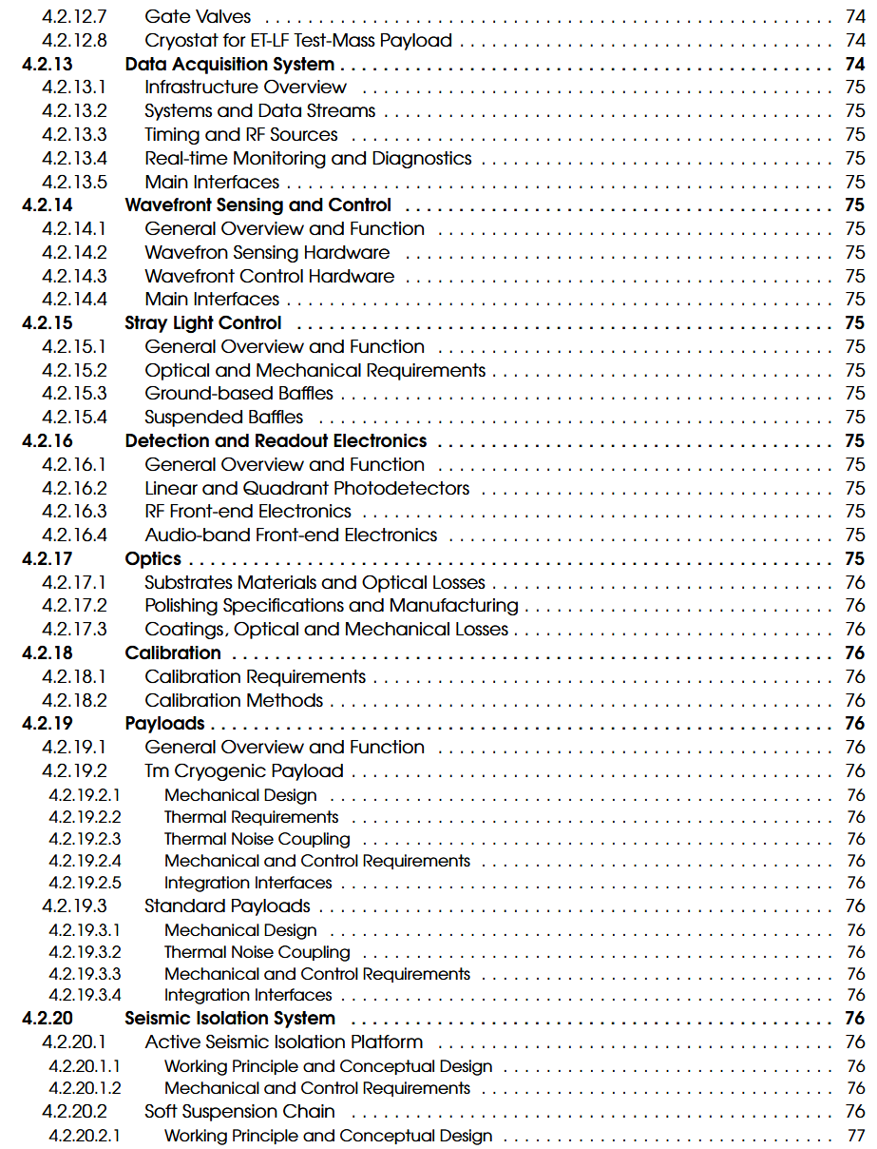
Preliminary Detector TDR ToC

Slide 9
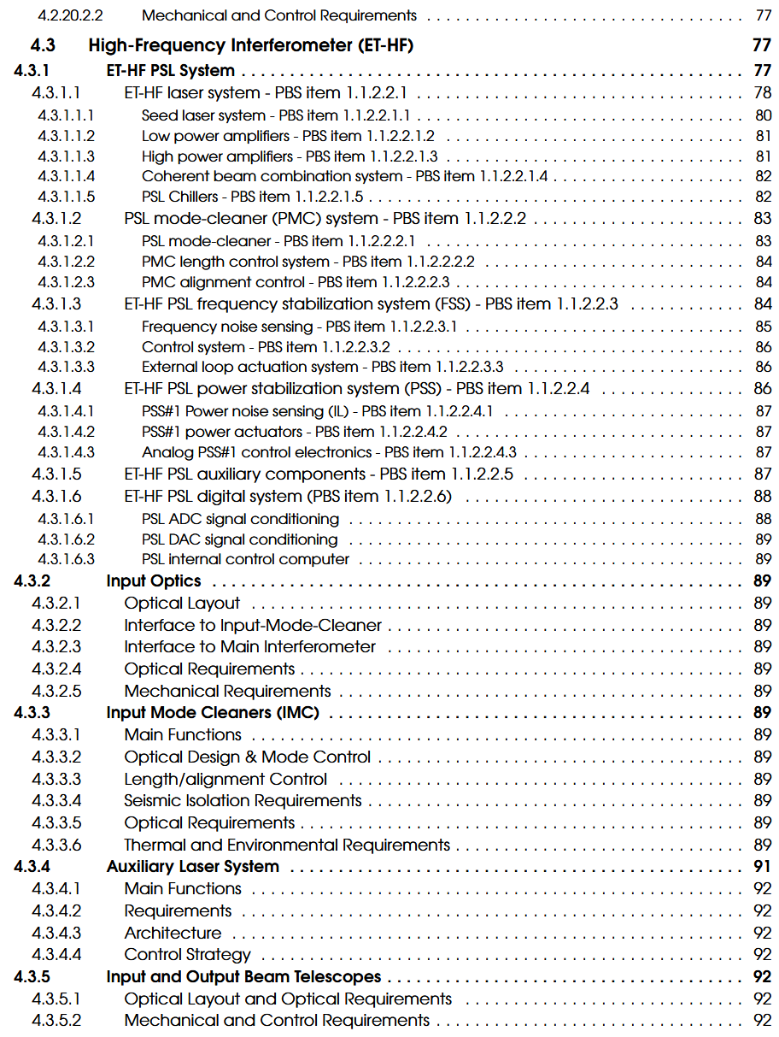
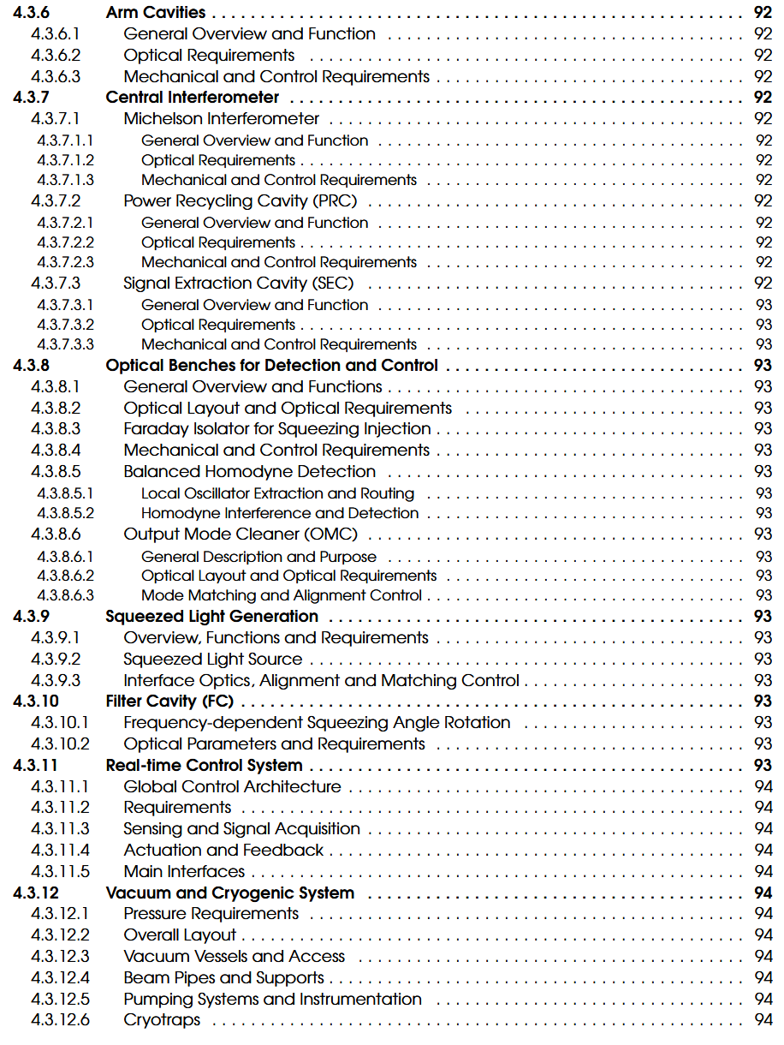
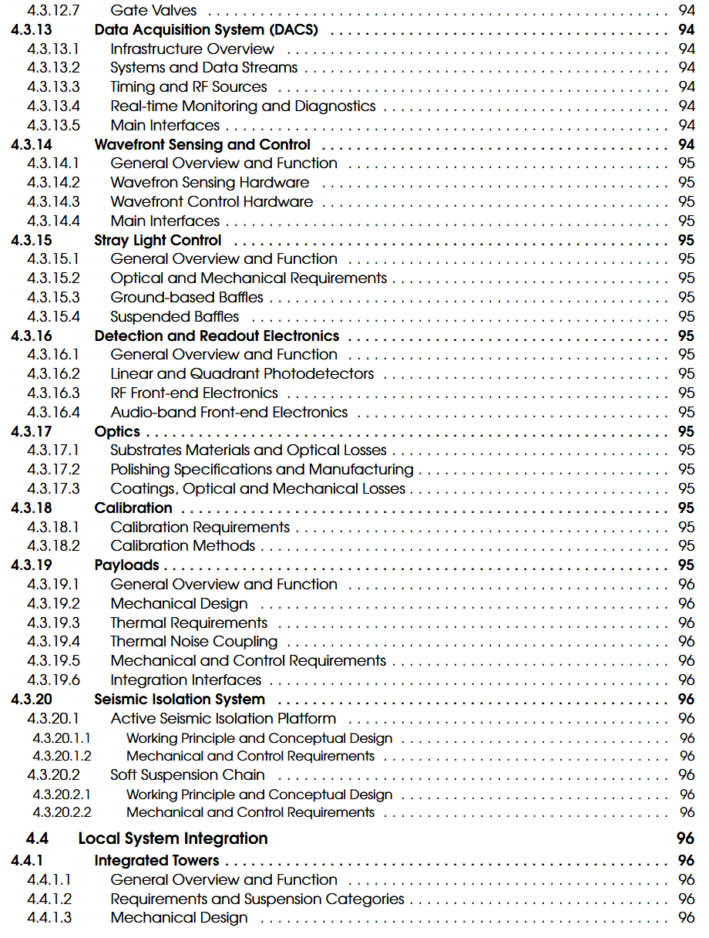
Preliminary Detector TDR ToC

Slide 10
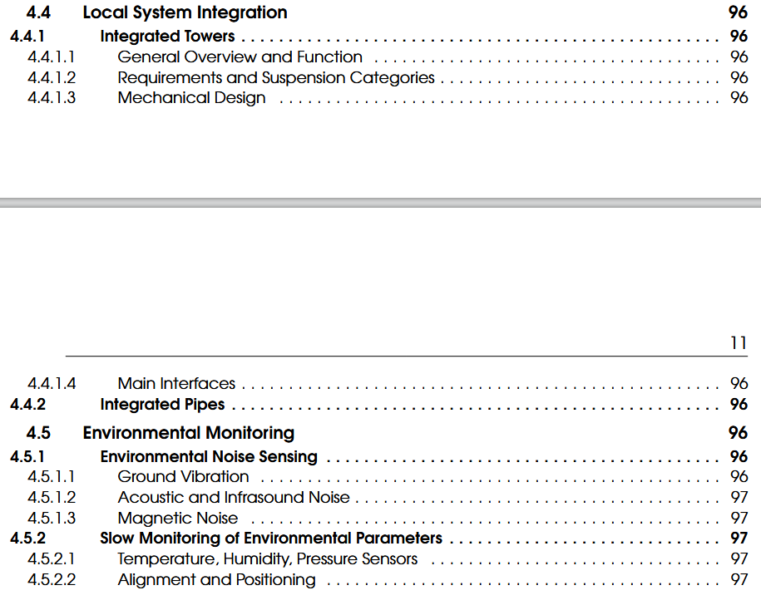
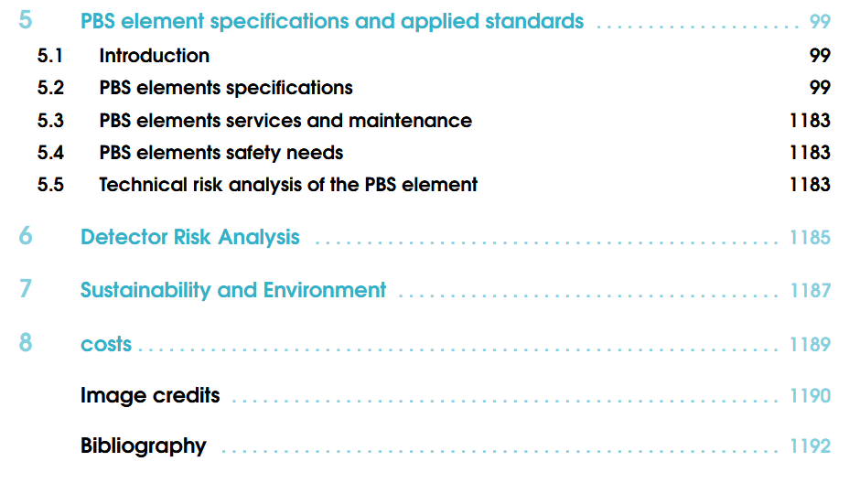
Preliminary Detector TDR ToC

Slide 11
Which documents do we have?
ETO Task Force Detector Layouts [Presentation]:
https://apps.et-gw.eu/tds/?call_file=ET-0216A-25_ETOTaskForceDetectorLayoutsPre.pptx
Laser
Input optics
Filter cavities
… list to be completed by ISB divisions

Slide 12
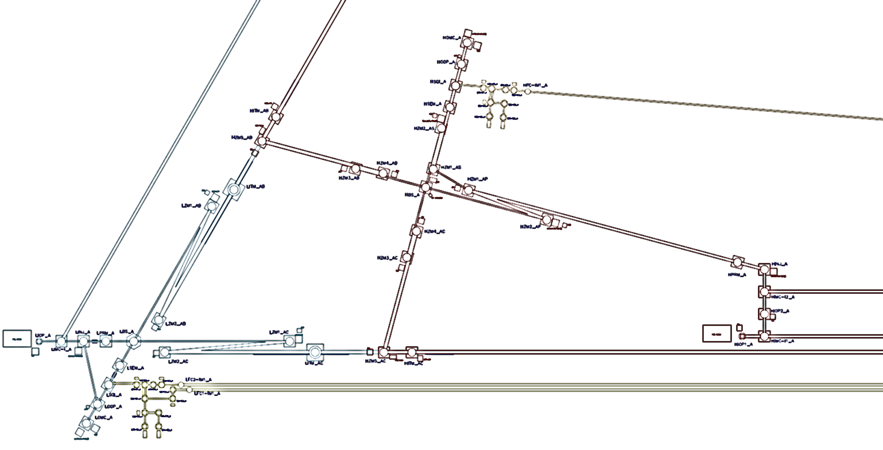
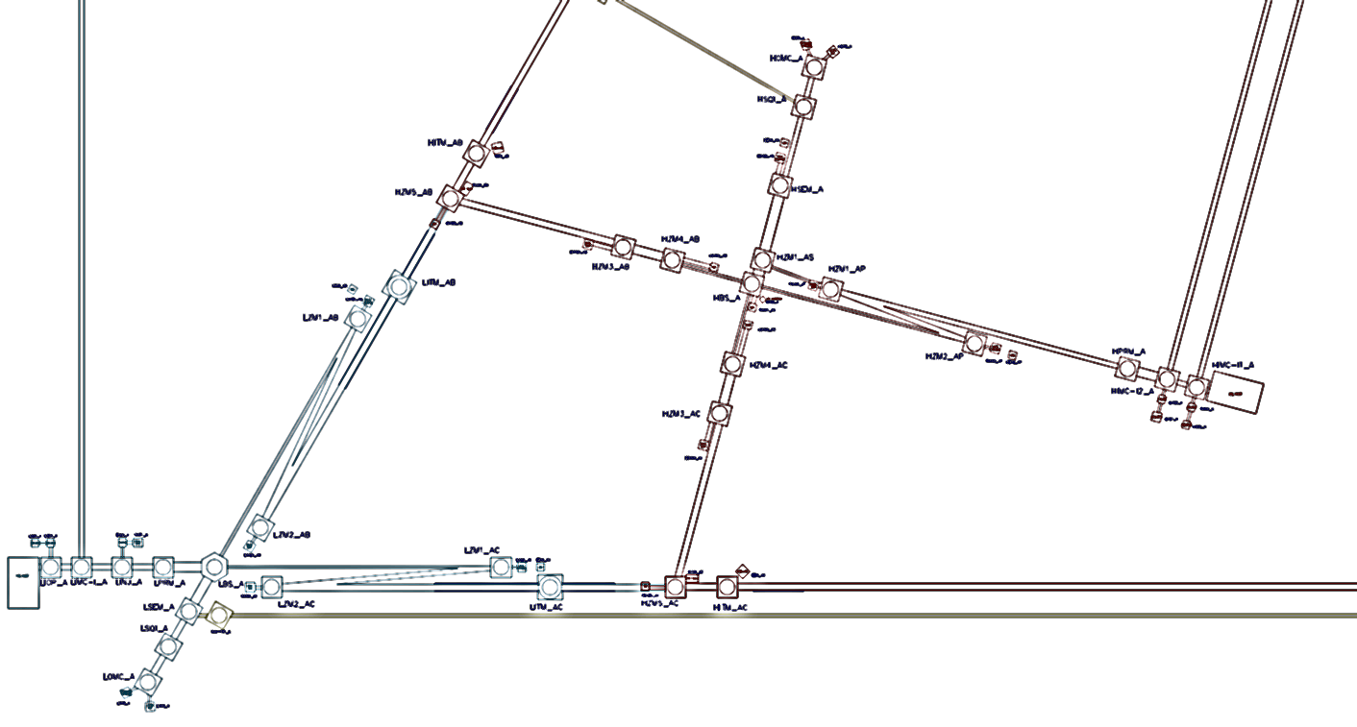
Optical Layout changes summarized
Summary of optical layout changes:
LF filter cavities placed in the X / AC arm, with periscope coupling
HF filter cavity relocated to the Y / AB arm with periscope coupling
2-mirror filter cavity design adopted, allowing reduced pipe diameter
Shortened length of the LF input mode cleaner (IMC)
HF IMCs merged into a single tunnel
Beam routing for the Balanced Homodyne Detection (BHD) system passing through the beam splitter
Additional reconfiguration of components, primarily by assuming that multiple major optics can be hosted in the same vessel ("tower merging")
Re-assessment of auxiliary sensing systems, their requirements, and the implementation of these requirements, resulting in smaller, more accessible optical bench footprints.
ET Symposium Bologna [26-05-25]
M. Majoor

Slide 13
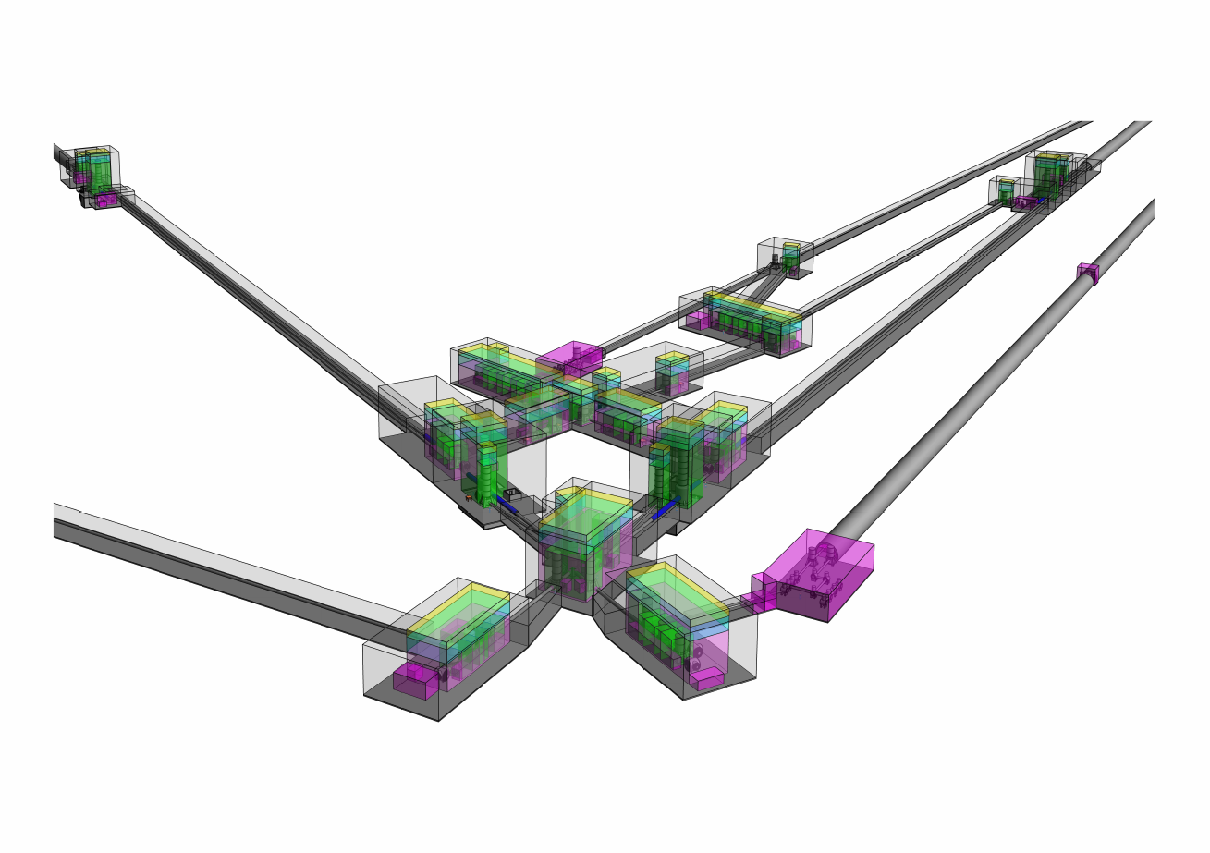
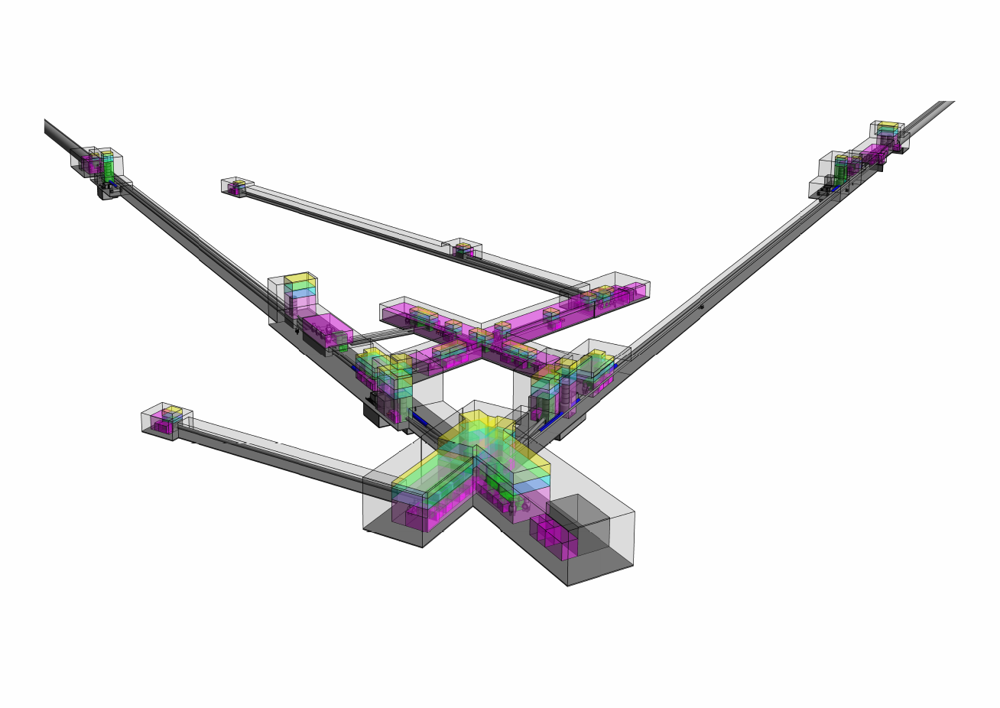
Detector Layout comparison (Δ)
2024 reference
New baseline
ET Symposium Bologna [26-05-25]
M. Majoor

Slide 14
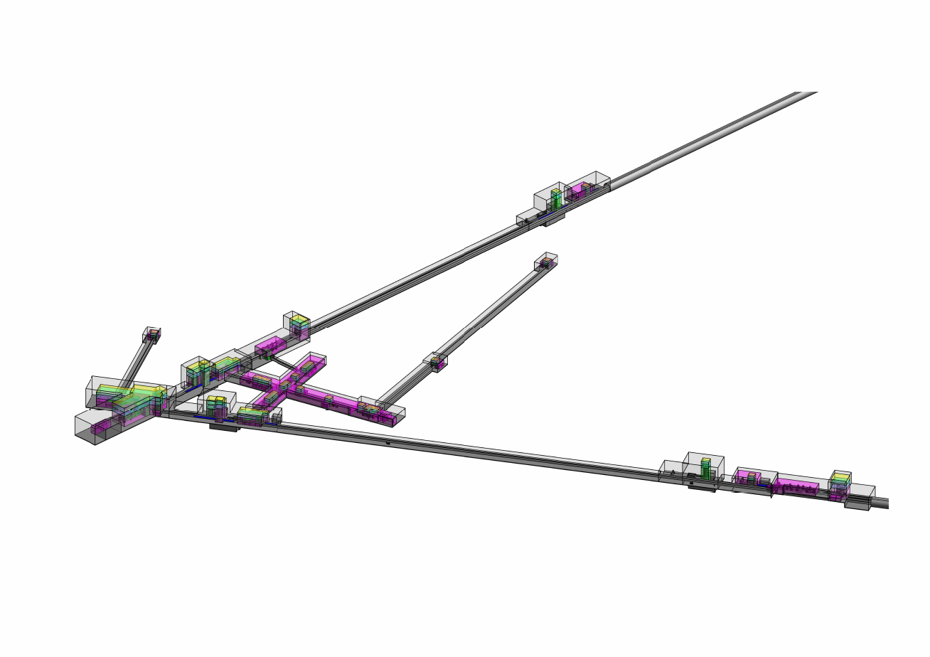
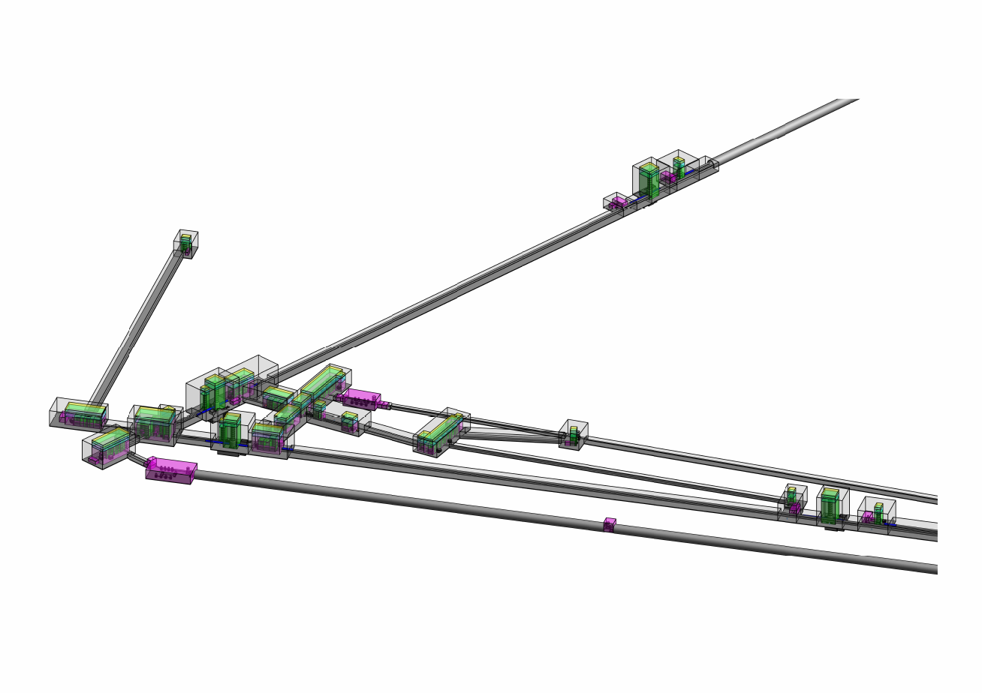
Detector Layout comparison (Δ)
2024 reference
New baseline
ET Symposium Bologna [26-05-25]
M. Majoor

Slide 15
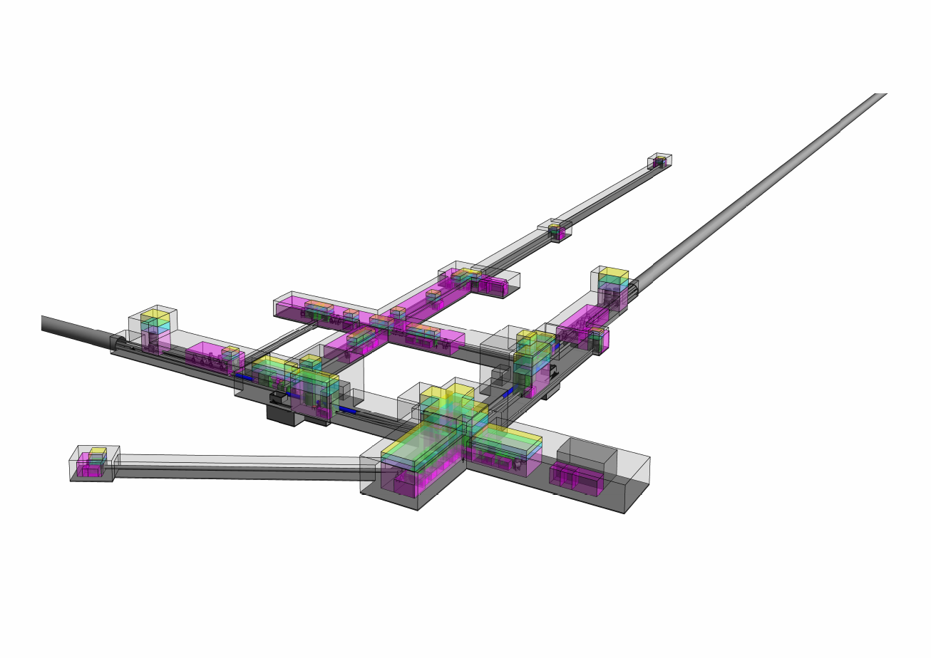
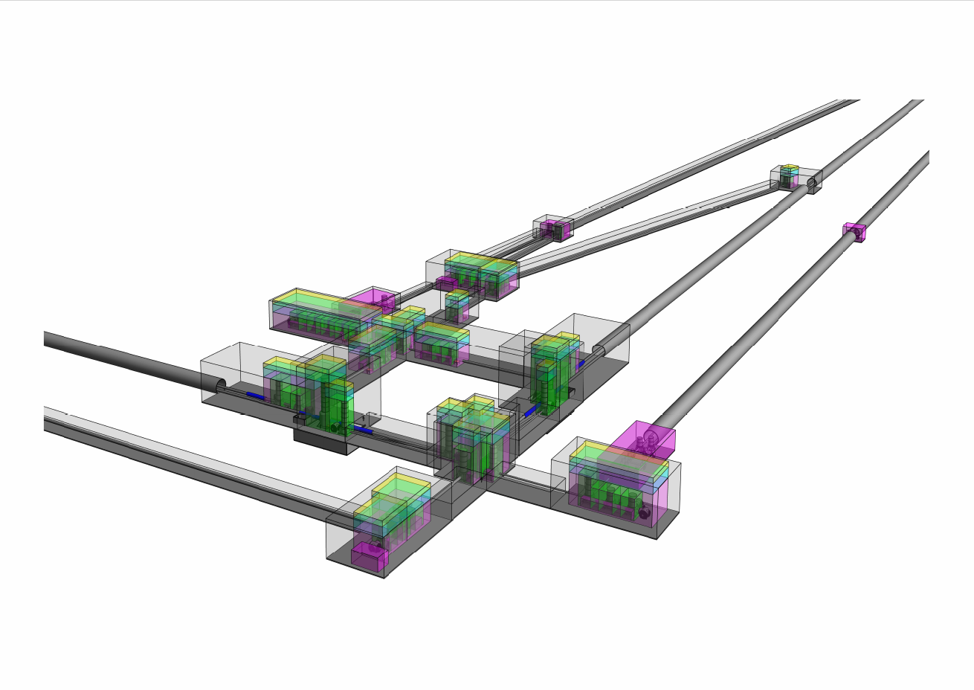
Detector Layout comparison (2L)
2024 reference
New baseline
ET Symposium Bologna [26-05-25]
M. Majoor

Slide 16
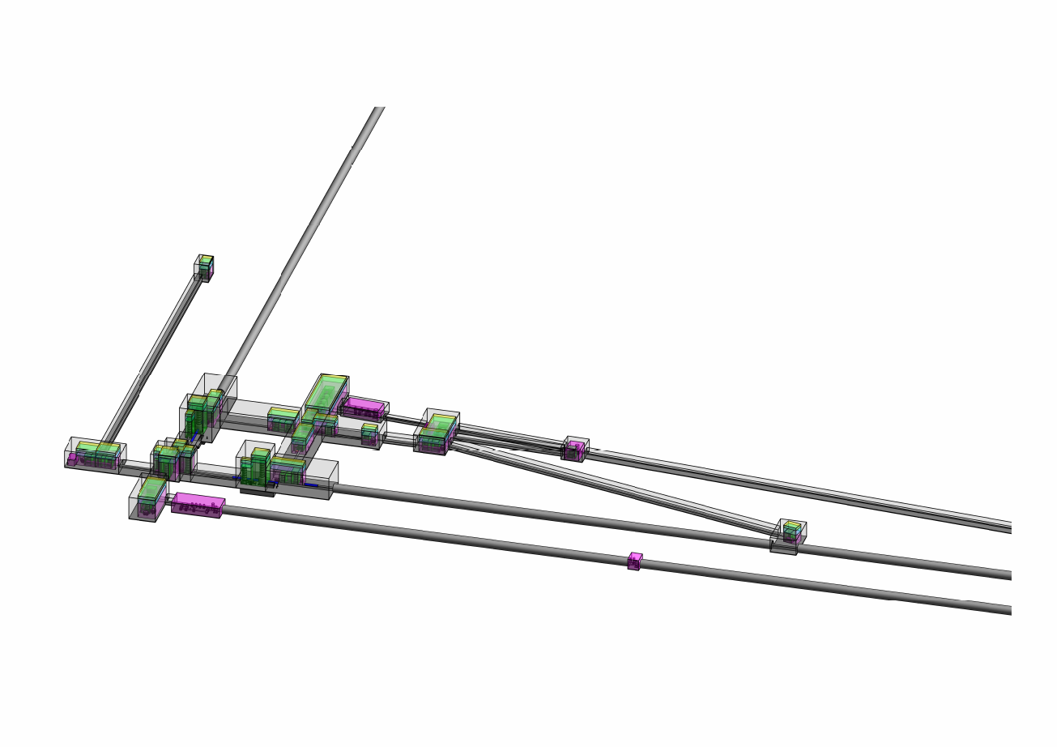
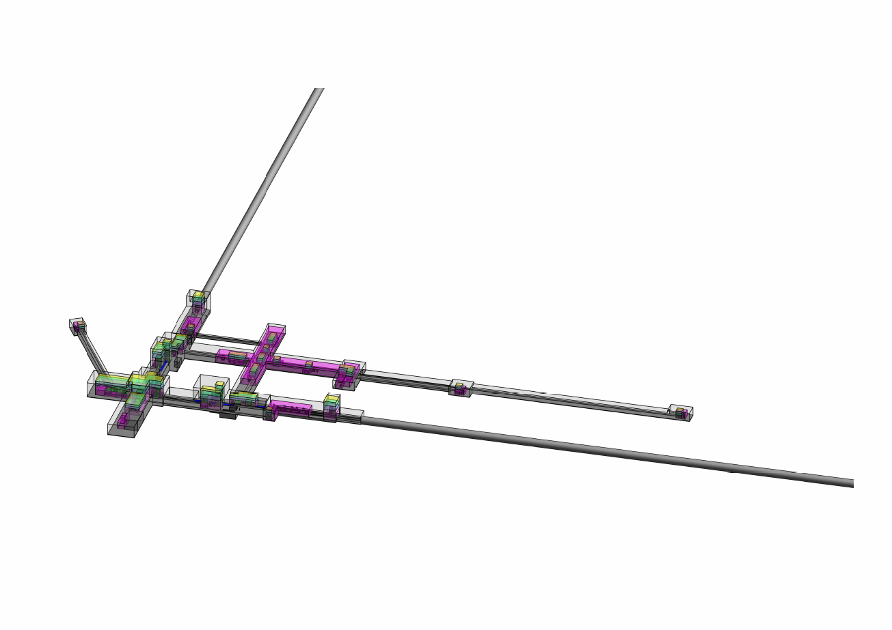
Detector Layout comparison (2L)
2024 reference
New baseline
ET Symposium Bologna [26-05-25]
M. Majoor

Slide 17
Discussion on TDR
What are our goals for the Pre-TDR and the TDR?
  Satisfy EU deliverable requirements
  Move towards a full TDR. With the preliminary one as draft?
What is a Preliminary TDR? Different definitions of a TDR
What do we wish to be contained in the Pre TDR?
Include all interfaces?
Transversal (to PBS) view of Pre-TDR might ease this.
What is realistic until the end of the year? Ill-definedness of Pre-TDR gives us some freedom.
Include R&D status – i.e. what still needs to be researched?
Usually also includes:
Implementation Plan: Outlines the steps for building or implementing the design, including timelines, resources, and dependencies.
Verification and Validation: Explains how the design will be tested and verified to ensure it meets the specified requirements.

Slide 18
Ask Google…
Purpose of a TDR:
Communication: Facilitates communication among project stakeholders, including engineers, designers, clients, and management.
Guidance: Provides a blueprint for development and implementation.
Justification: Explains the rationale behind design choices and ensures alignment with project goals.
Verification: Ensures that the design meets the specified requirements and is feasible to implement.
Knowledge Transfer: Documents the design for future reference and maintenance.

Slide 19
One Definition of a Technical Design Report
A Technical Design Report (sometimes called a Detailed Design Report)
follows once a concept is chosen and
answers the “how” in full engineering detail.
It typically contains:
System Architecture & Subsystem Decomposition: Detailed block diagrams showing modules and interfaces.
Design Rationale: Justification for choices (e.g. component selection, algorithms, materials) based on analysis and standards.
Integration & Interfaces: Data formats, mechanical attachments, control signals and physical connectors.
Detailed Specifications: Exact dimensions, materials, tolerances, electrical schematics, software API definitions.
Validation & Test Plans: How each module will be verified and how the integrated system will be validated.
Manufacturing/Implementation Instructions: Assembly sequences, tooling requirements, software build procedures.
This document is intended for engineers, manufacturers, and integrators who will build and verify the system.

