Slide 1
News from Sardinia
G. Bisoffi, INFN
on behalf of TETI
ET-PP INFRA-DEV Annual Meeting, July 22 2025

Slide 2
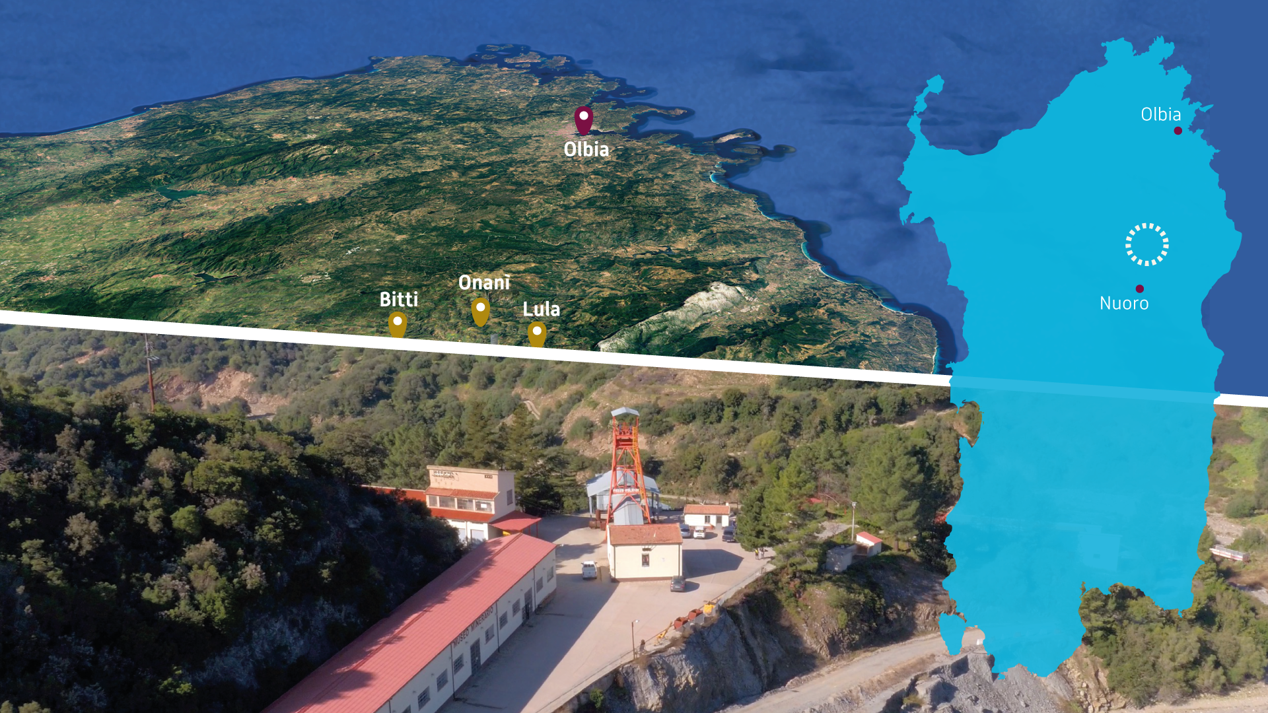

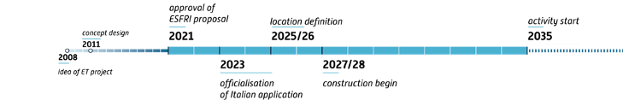
The Italian candidate site for ET:
Sos Enattos, Sardinia
INFN leads the proposal, for either a 2L or Δ configuration
INAF and INGV support the proposal with complementary science and expertise
A ready-to-tender, civil engineering study - delivered by 2025, compliant with the ESFRI timeline
we will be ready
from ESFRI proposal

Slide 3
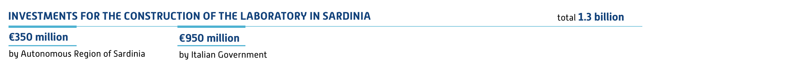
NATIONAL SUPPORT
The Italian and Sardinia regional goverments provide strong and continuous financial support (1.45 B€ granted)
Investment for site development (already allocated) |  |  |  |  |  |  | Total € 146 M
€3.5 million | €17+15 | €4+2 milions | €50 milion | €2.5 + 12 milion | € 6 milion | €10+10 milion | €14 milion
SAR-GRAV lab By Autonomous Region of Sardinia (RAS) | ET Project By Ministry of University and Research (MUR) | PRIN/FIS ET Tech and Science (and post-docs NRRP) by MUR | NRRP ETIC project By MUR | NRRP MEET and TERABIT By MUR | Earth Telescope initiative By INGV | SUNLab by RAS, INFN, INAF, INGV | Requalification of roads to the site and SUNLab By RAS

Slide 4
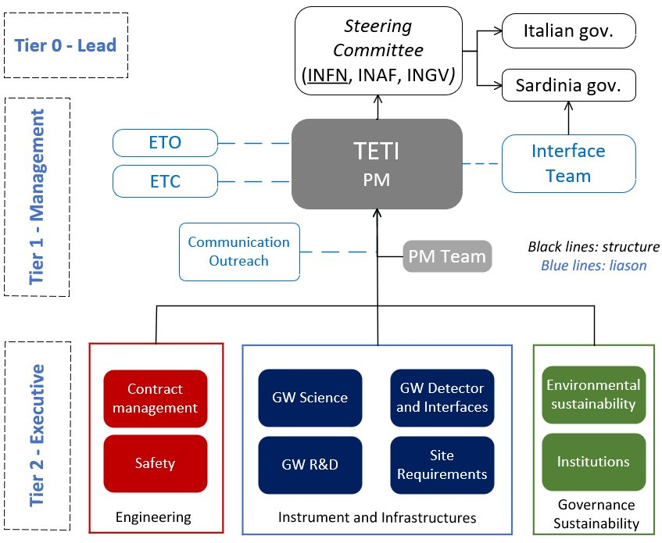
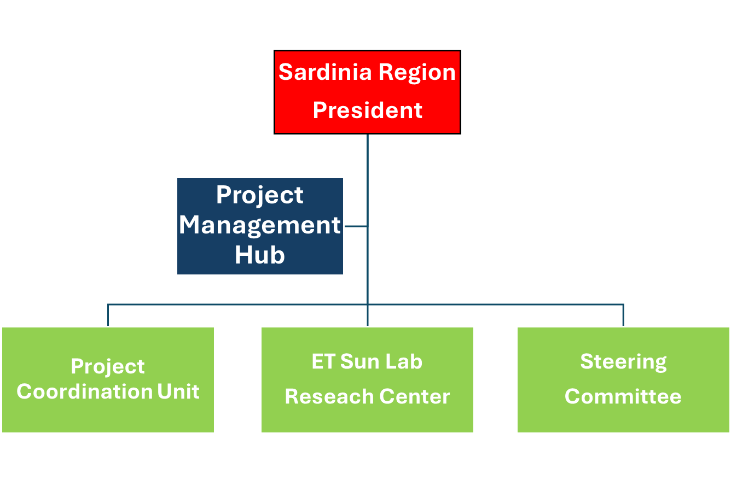

Team for ET in Italy Sardinia Region Support Unit

Slide 5

Very busy 12 months in Sardinia
3 mar. 2025
Public call for interest to companies to develop Key Enabling Technologies for ET
~100 positive responses
19 Dec 2024
Agreement for Candidacy support Committee (Sardinia Region, Universitiies of Caligliari and Sassari, INAF, INGV, INFN)
Feb-March 2025
Kick-off technical meetings with regional offices in charge of environment authorizations
Closeout by December 2025
2 Jul 2024
Cooperative Scientific agreement Italy - Spain
28-30 Oct 2024
G7 Science and Technology
23 Oct 2024
DEL. 41/9
Candidacy Support actions defined
13 Nov 2024
DEL. 43/72
Sos Enattos site handed-off to INFN for SUNLab construction
22 jan 2025
DEL. 4/11
ET Project Support Unit created
19 Mar. 2025
DEL. 15.26
Agreement to rule access to TERABIT ultra-high bandwidth to regional community
ET Website translated in Sardininan
4 Apr 2025
DEL 17/9
Resources allocated for
Minghetti dam rework
Vertex V1 access road refurbishment
Steering committee work
Italian national law 41, Apr. 21 2023 binding authorizations of new industrial activities in the ET area to Ministry of Research approval with INFN consultancy

Slide 6

ITALIAN PROPOSAL SCOPE
All relevant aspects covered in detail
Socio-economic impact of the project
Experimental site
Civil engineering of underground areas
Environmental impact and sustainability
Involvement of industrial ecosystem
Internal doc in preparation

Slide 7
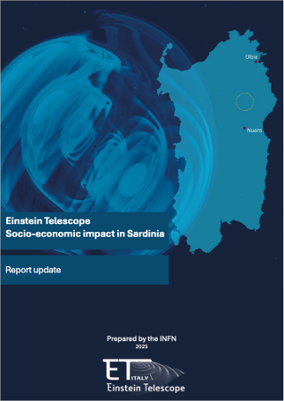
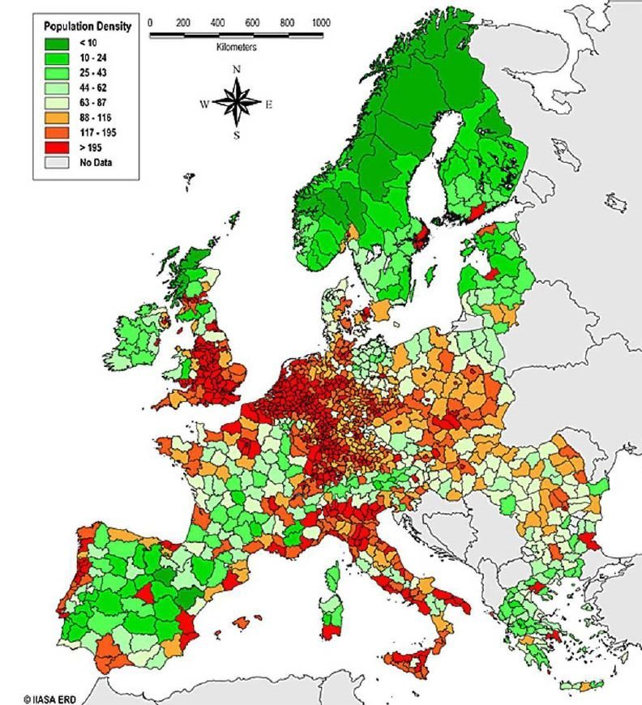
Study on the Economic impact of hosting ET in Sardinia
In-depth study on:
Economic-relevant features of the site
Estimates of global and local effects
  both for 2L and Δ
  separately for construction and operation phases
Impact on local communities

Slide 8
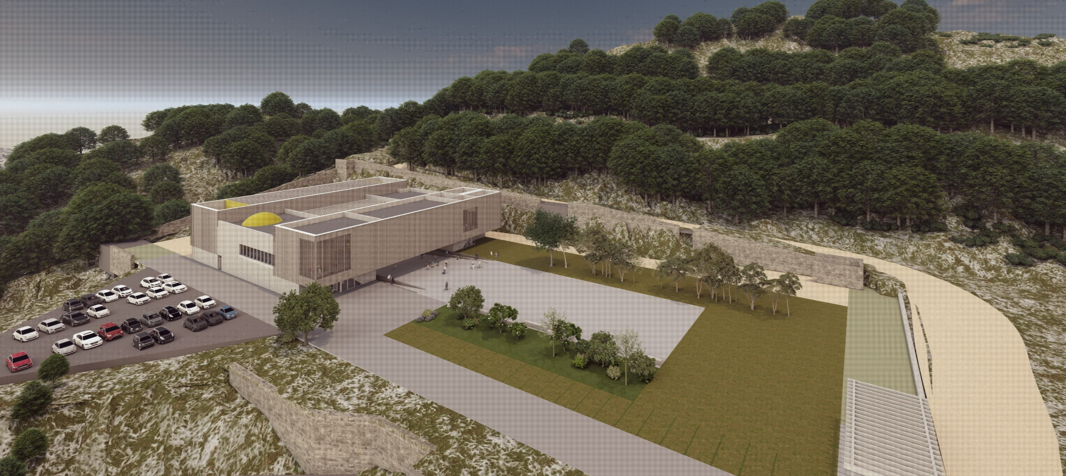
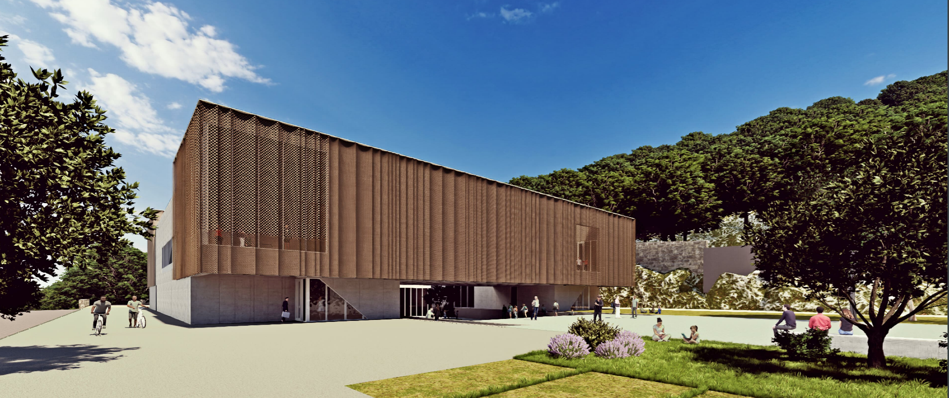
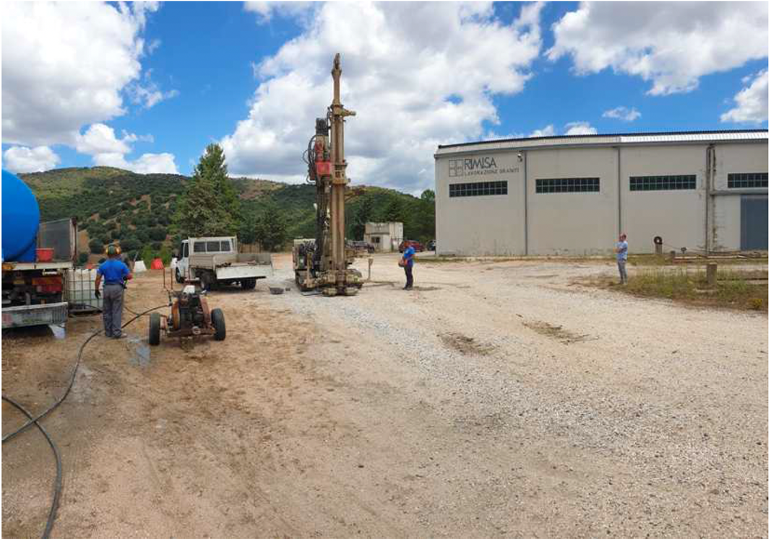
The Sos Enattos UNderground Lab
In view of the installation of the ET infrastructure:
Realization of a Research Center in the Sos Enattos former-mine (10M€ from RAS + 10M€ from INFN-INAF-INGV) for:
noise-related experiments, ET validation tests in low noise condition, ET prototypes
Earth Telescope, to study mechanisms impacting the seismic activities, plate tectonics, magnetic field
dissemination, outreach and training

Slide 9
TETI Activities Timeline
ETO input
TETI done
TETI in progress
2024 |  |  |  | 2025 |  |  |  | 2026
Q1 | Q2 | Q3 | Q4 | Q1 | Q2 | Q3 | Q4 | Q1 | Q2
Contract starts
Survey plan defined
Engineering study completed
Authorizations plan
DNHS compliance
Environmental impact
Construction logistics
Rock disposal/valorisation
Cost estimate
Surface infrastr., plants, envir. impact study released
Underground infrastructure concept defined
100% survey completed
ETO Δ optical layout
Engineering study update
New optical design
Cost update
READY TO BID
ETO L optical layout
ETO Design Task Force Δ and L updated optical layout

Slide 10
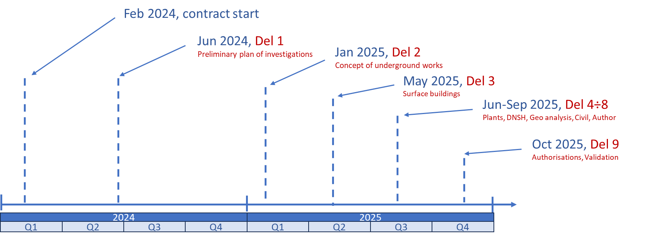
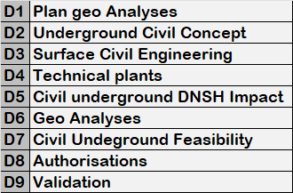
Main deliverables of the pre-feasibility study (confirmed)
Consortium of 7 highly professional companies, led by Rocksoil, and funded by MUR/INFN with NextGenEU (PNRR)

Slide 11
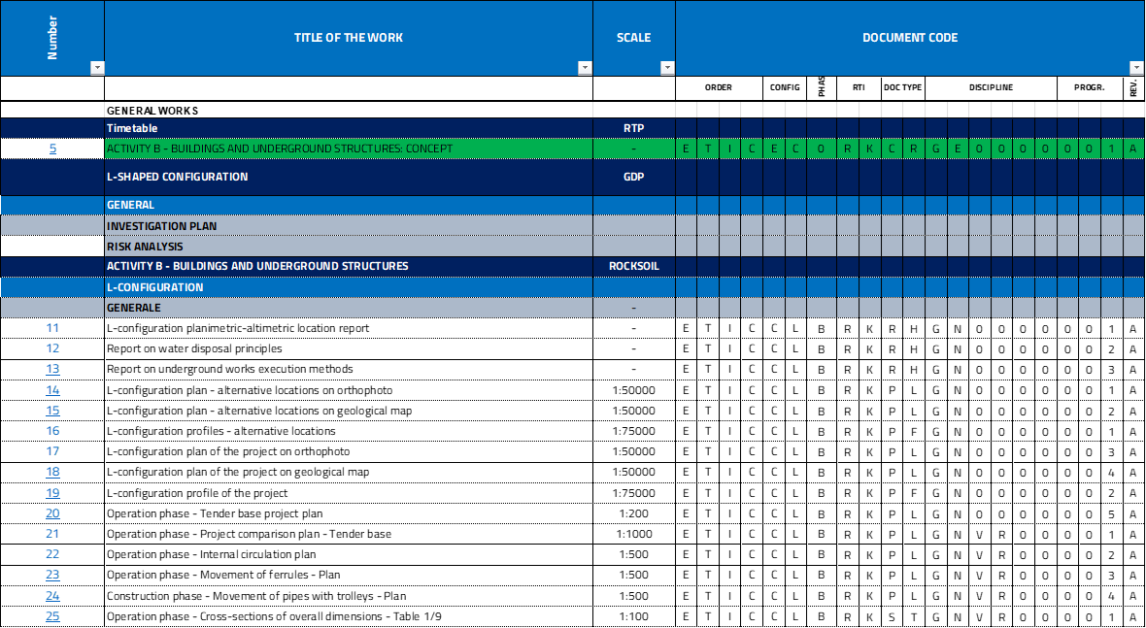
~900 Documents planned
~400 delivered so far on underground excavation, surface engineering, technical plants

Slide 12
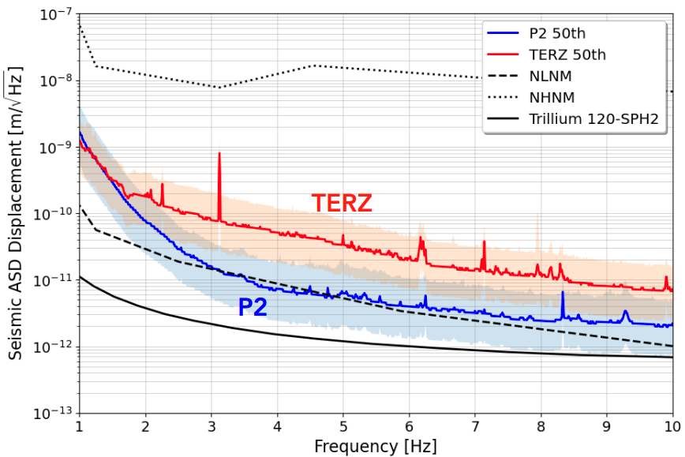
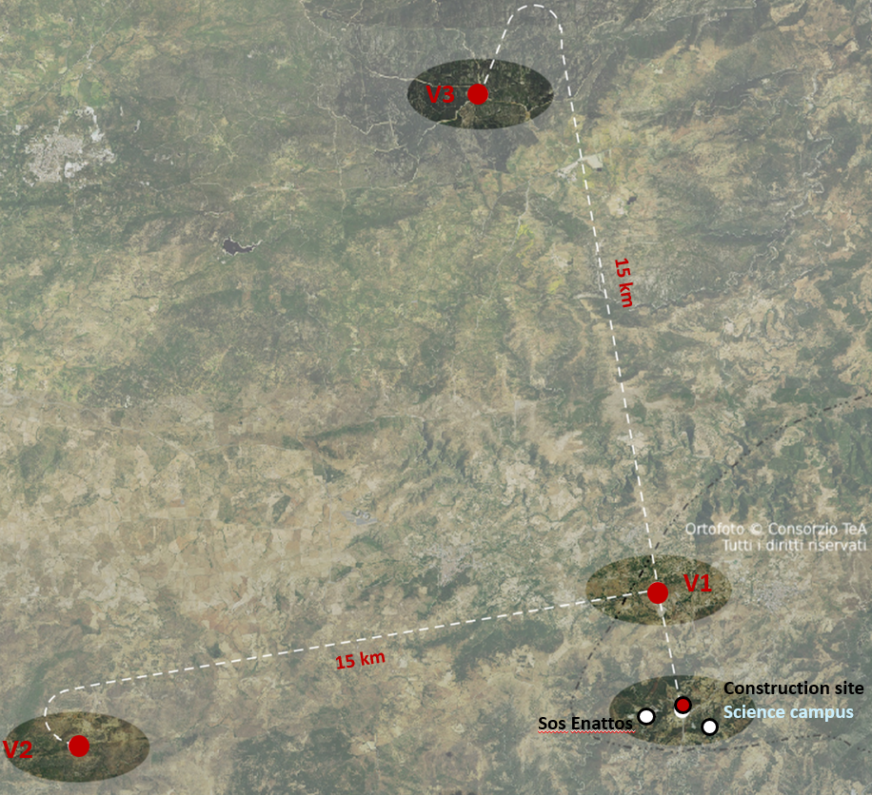
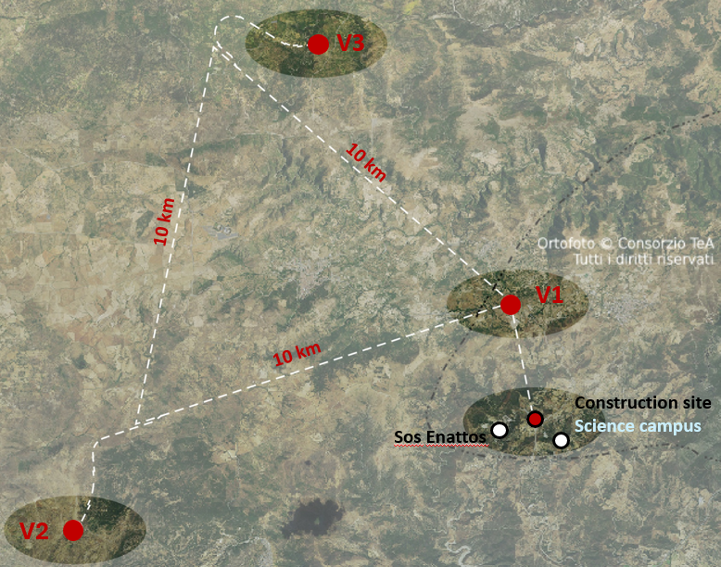
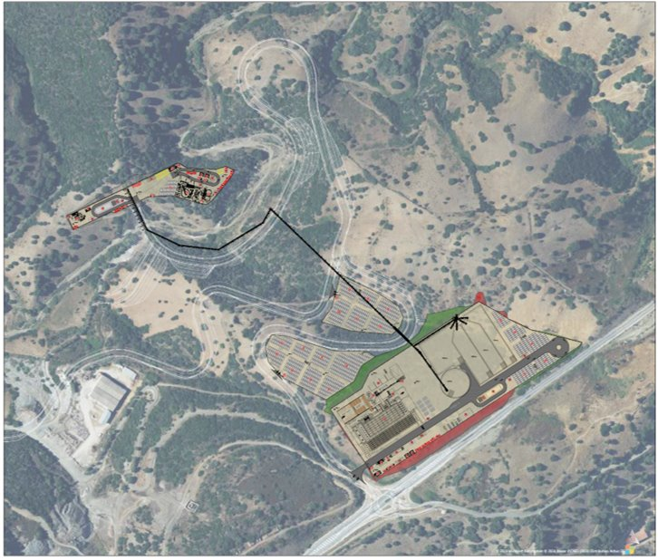
Sos Enattos site has unique advantages
Extremely quiet
  very low seismic and anthropic noise
Single access point for construction
  lower cost, environmental impact, overall shorter construction
One construction site - minimum impact
Worksite to be converted into science campus at the end of the construction
A single accessible tunnel to extract material and insert excavation machinery
Water drainage by gravity
  no pumps during science run, mechanical noise disturbance minimized
Notes:
(ideal during construction and lab lifetime, with minimum energy consumption)

Slide 13
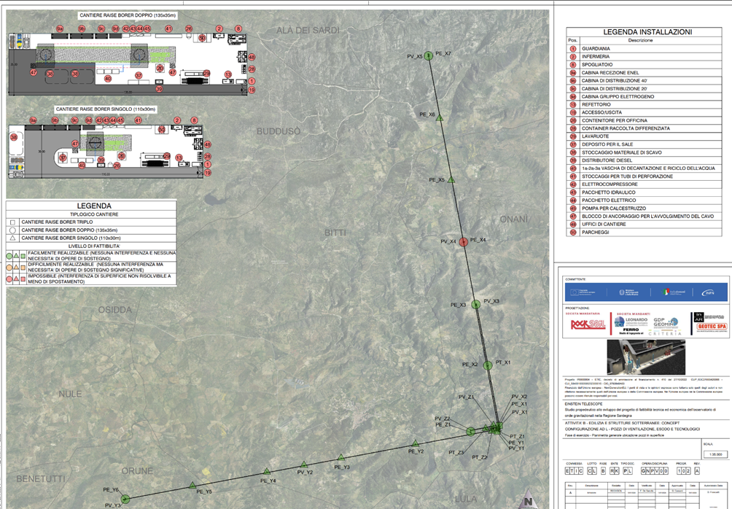
Surface well site plan
Exact location of wells, identified also according to local surface conditions (properties, water catchment area, …)
The few sensitive ones impose minimum displacements

Slide 14
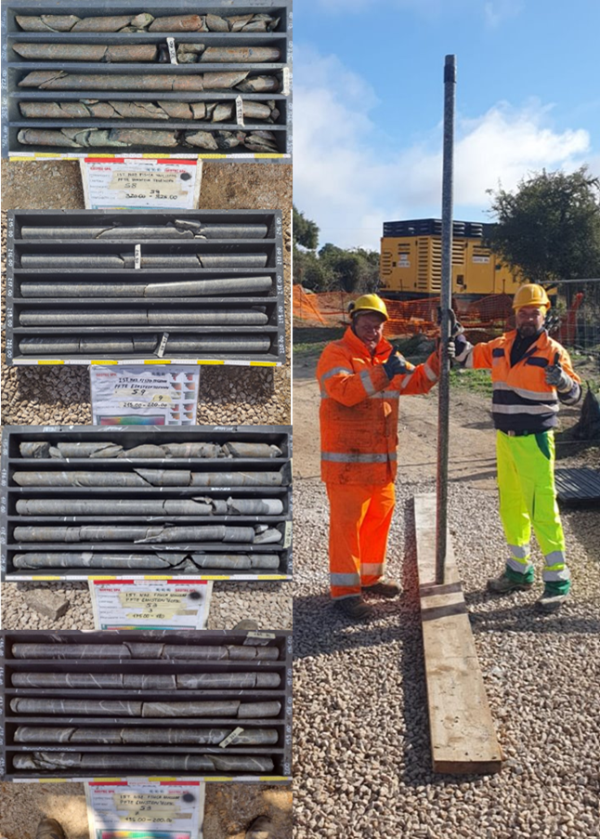
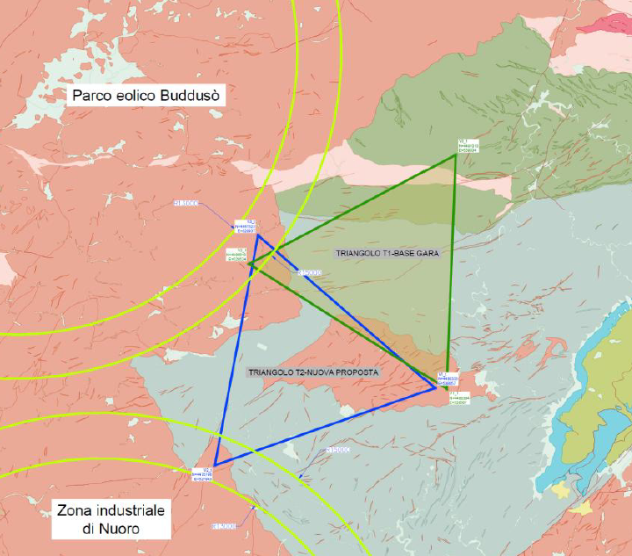
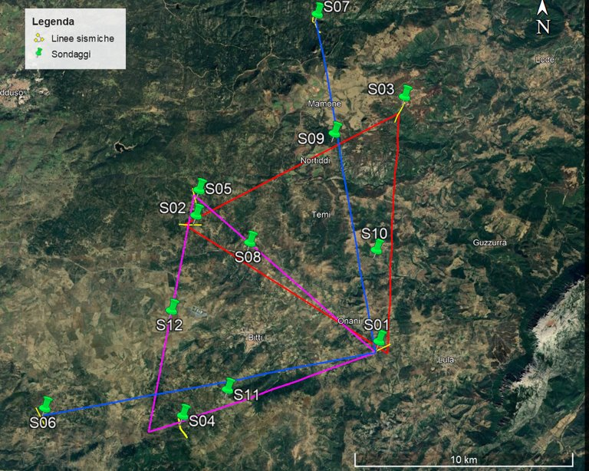
A site with unique properties for ET
Extremely low sismicity and anthropic noise
Outstanding soil and rock quality (structural stability and hydrogeology)
No water issues
A government ruling established a buffer zone around the observatory
Wind park
Industrial area
9 surveys done, 1in progress
Granodiorites on all vertices

Slide 15
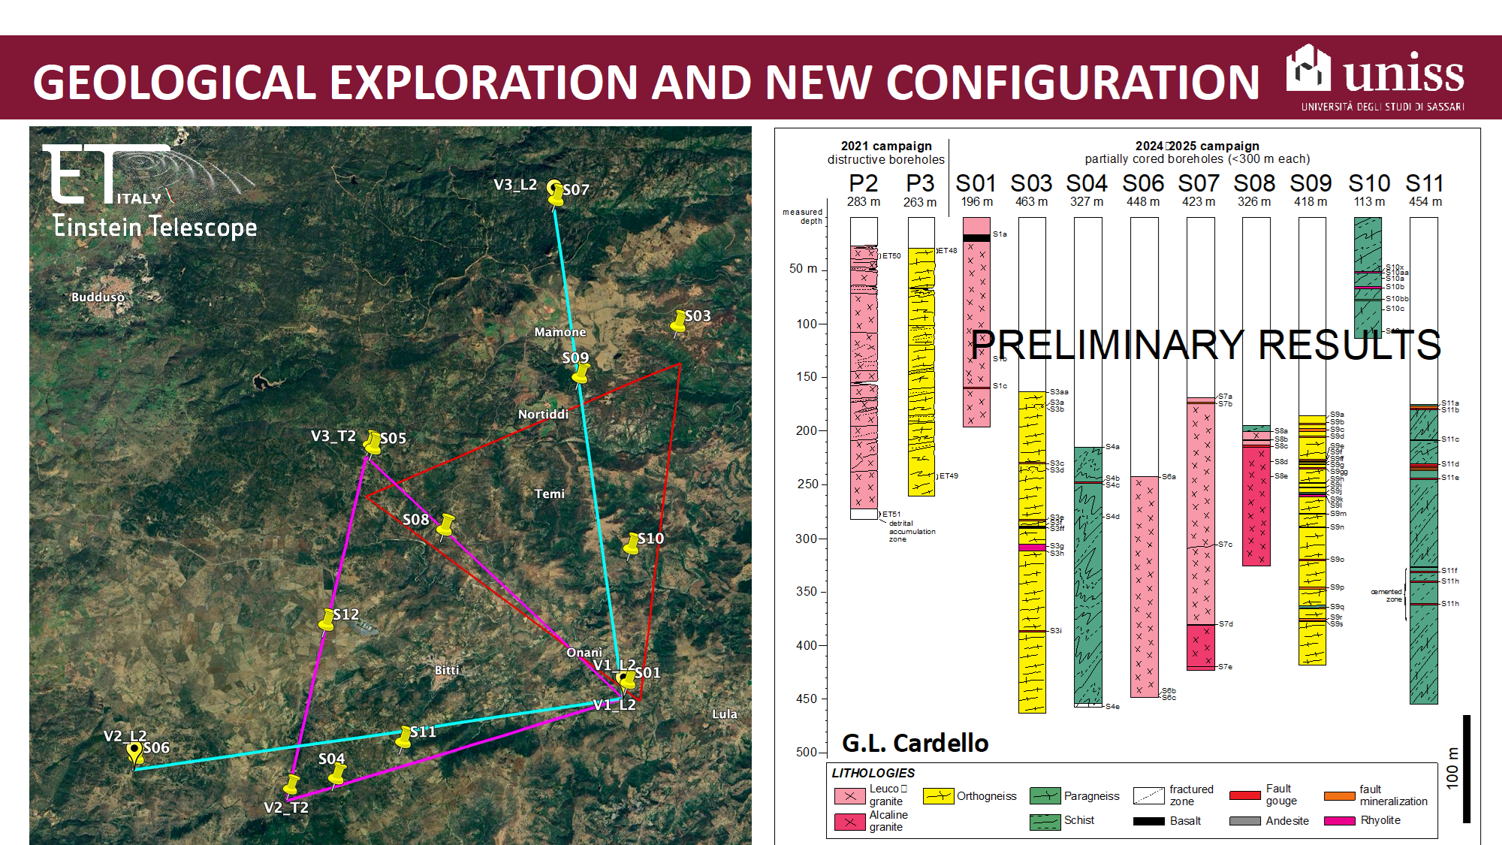

Slide 16
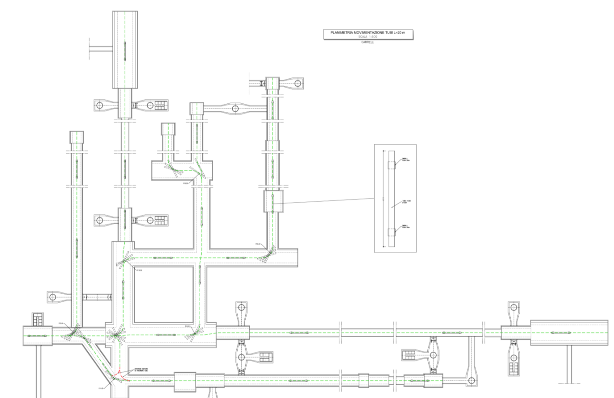
Logistics
The transportation and handling sequence for 20-meter vacuum pipes in all tunnels and caverns has been studied and optimized to ensure safe and efficient installation

Slide 17
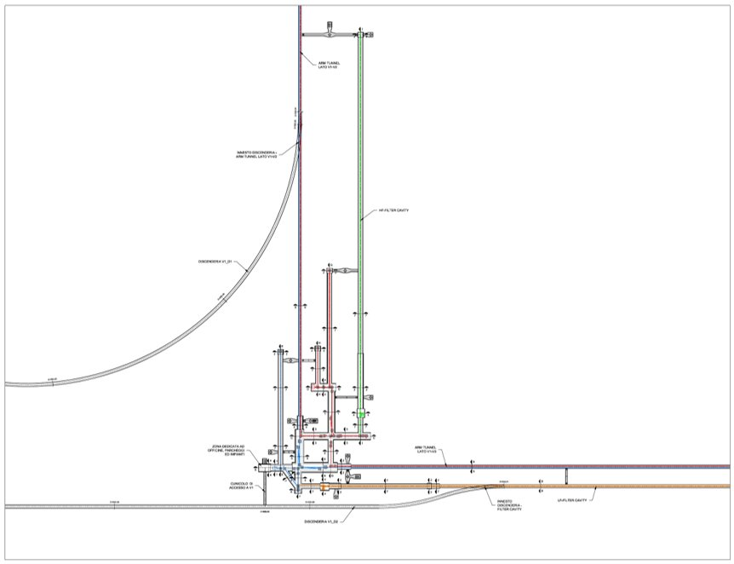
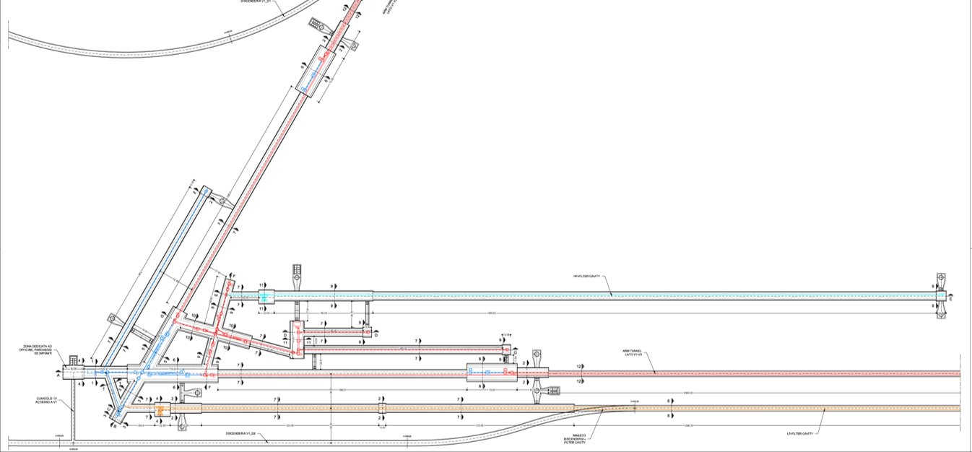
Underground infrastructure concept being developed in detail
Compliant with 2024 ETO design – will accommodate Task Force layout
L configuration
Triangle configuration
Examples of preliminary detailed engineering drawings (preliminary)

Slide 18
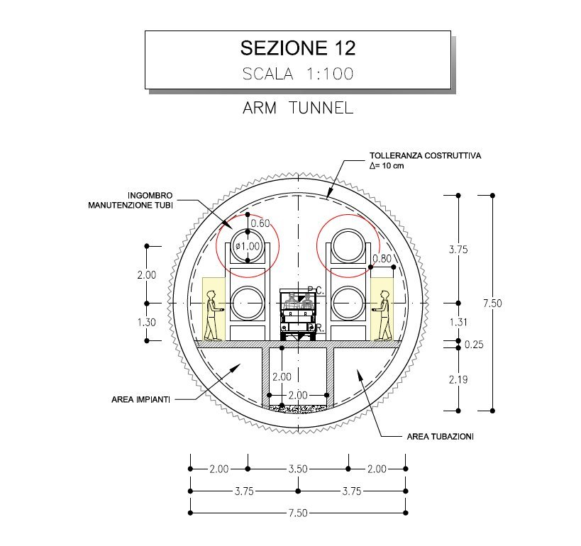
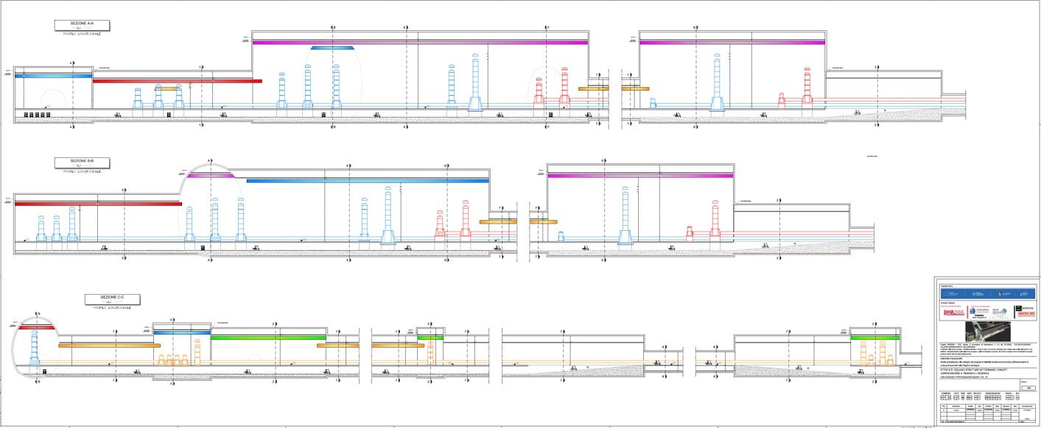
Underground infrastructure concept being developed in detail
Compliant with 2024 ETO design – will accommodate Task Force layout
Examples of preliminary detailed engineering drawings (preliminary)
Number and size of caverns and tunnels have a substantial impact on
global cost and construction schedule – Task Force outcome will be beneficial

Slide 19
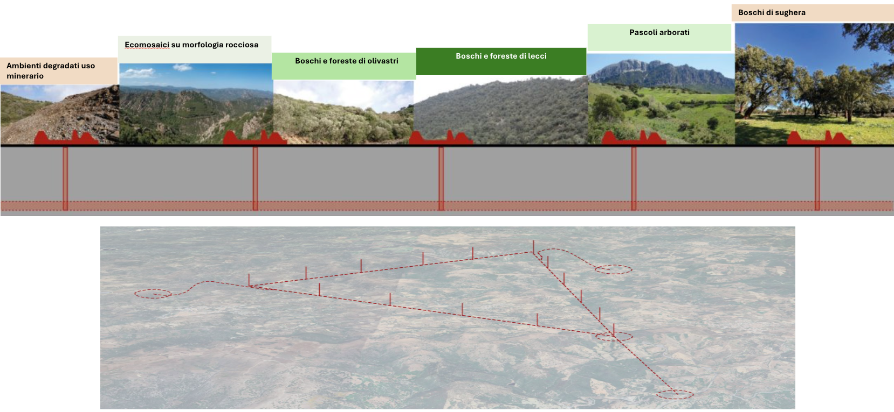
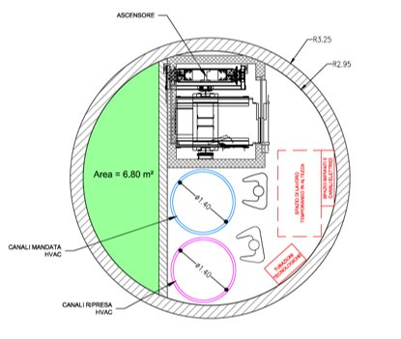
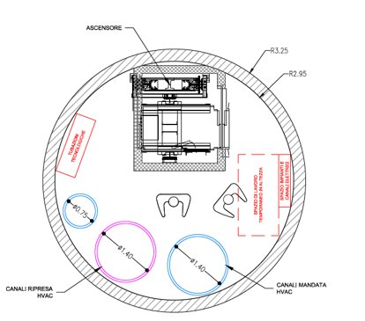
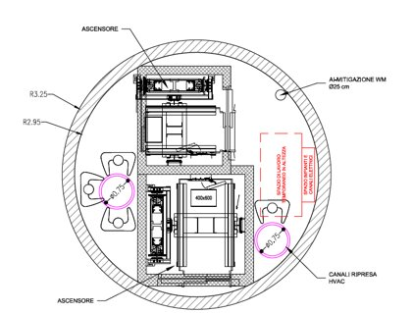
Underground infrastructure concept being developed in detail
Safety concept derived from CERN and vetted by Italian fire brigade
Venting shaft
Technical shaft
Escape shaft

Slide 20
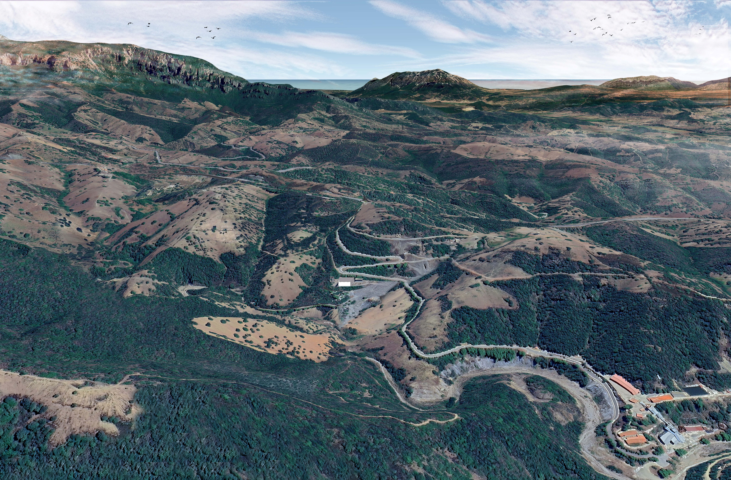
2025 ….

Slide 21
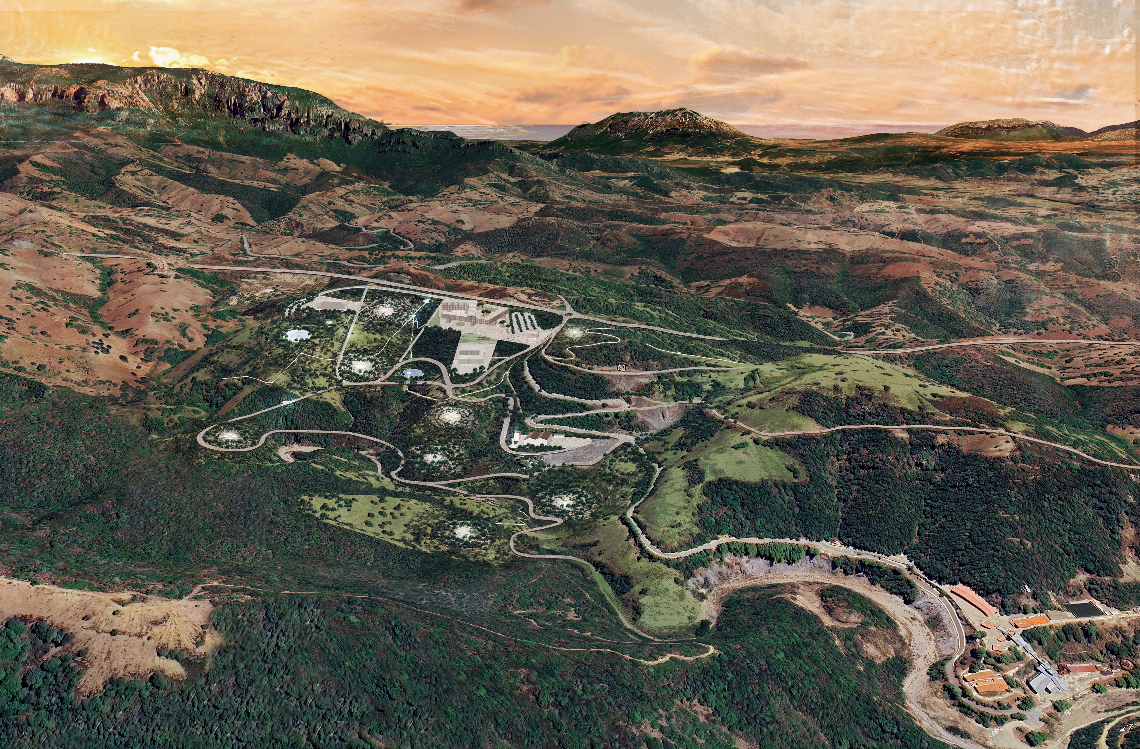

Slide 22
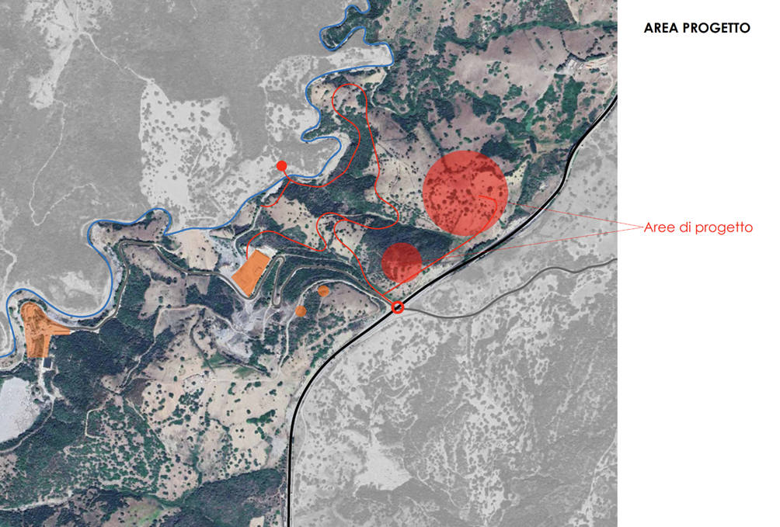
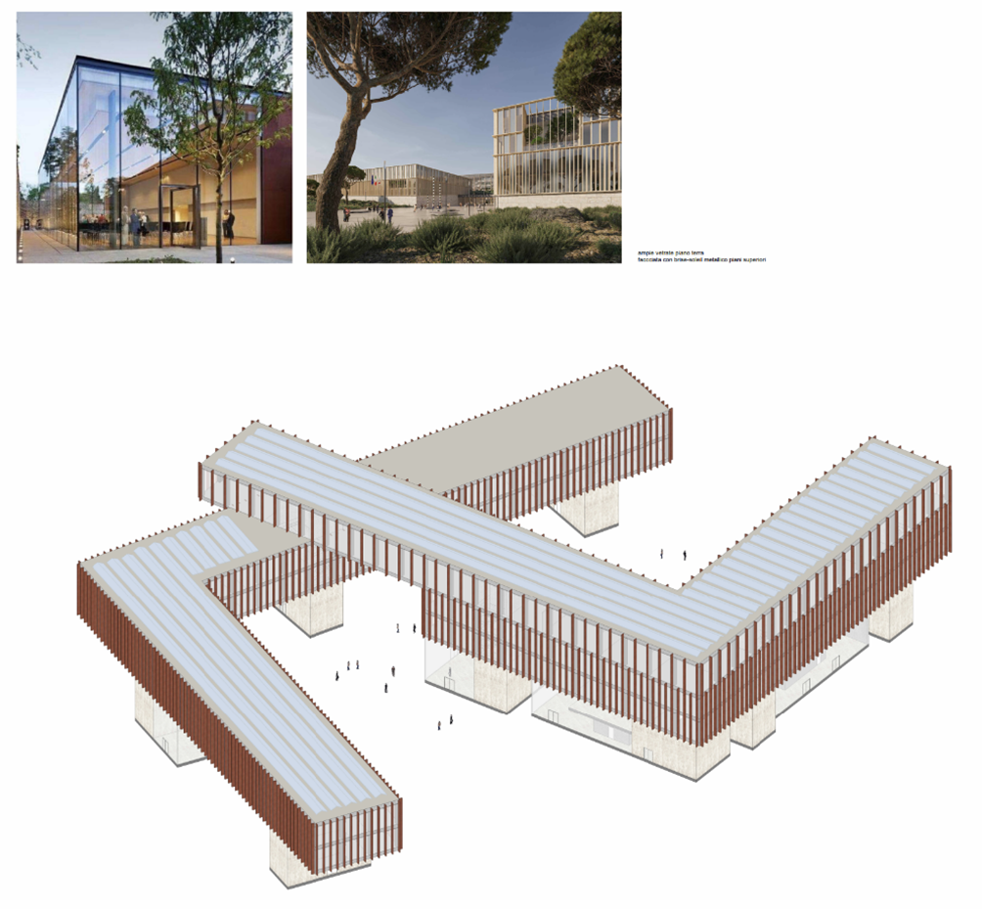
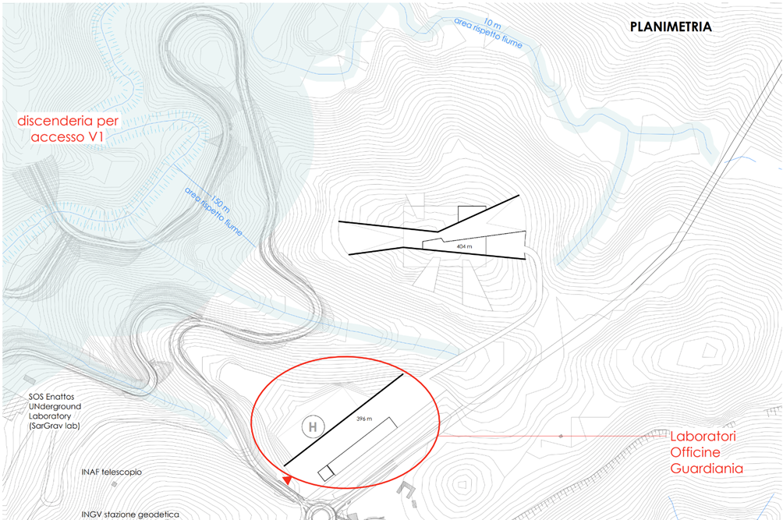
Main construction yard and then research center

Slide 23
Environmental Impact & Sustainability
Building science with respect for nature.
The ET project in Sardinia is designed with a strong focus on minimizing environmental impact and adhering to the Do No Significant Harm (DNSH) principles. Among other topics:
Underground Works:
Responsible excavation material management
Protection of groundwater and aquifer systems
Controlled water flow and reuse strategies
Monitoring and mitigation of gas emissions
Compliance with eco-sustainability standards and green procurement (MEC*)
Surface Works:
Minimal land acquisition (expropriations and easements)
Architectural integration and landscape harmony
* Minimum Environmental Criteria

Slide 24
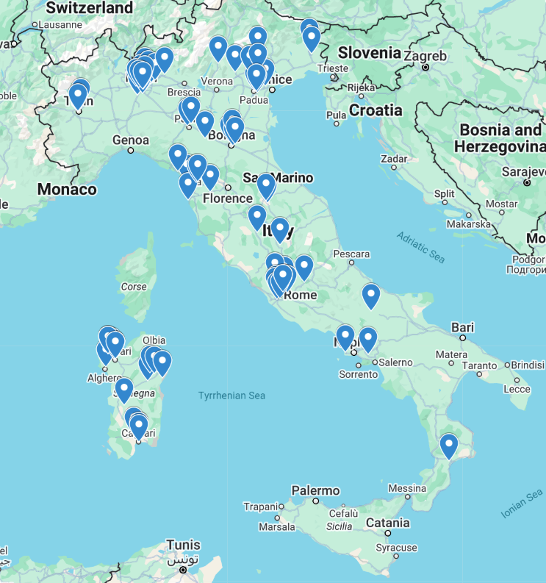
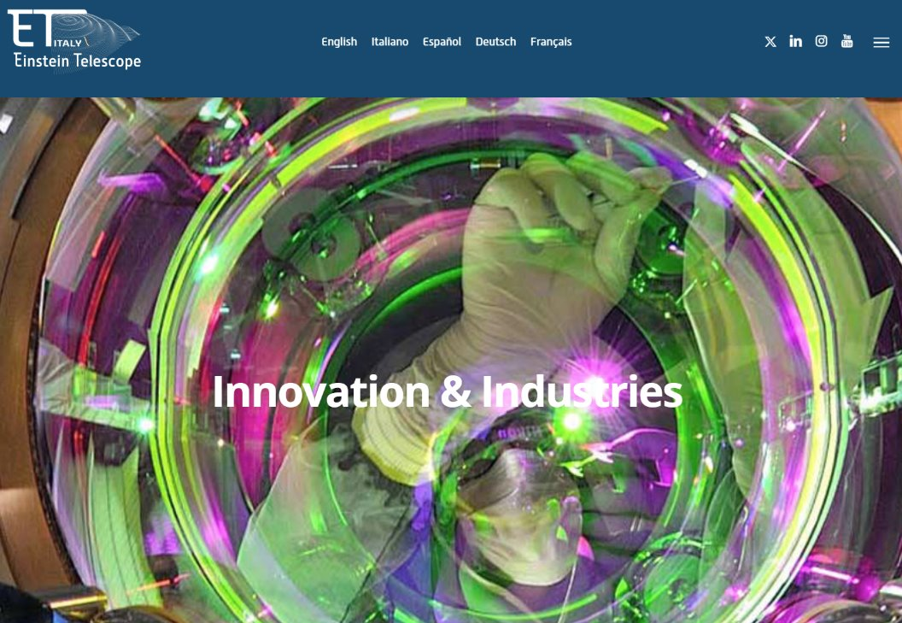
ET meets industries in Italy
~100 Italian companies involved in R&D and procurements for ET as of today

Slide 25

Local industry involvement
Vacuum pipe insulation
Virtual Reality and Artificial Intelligence
O-Ring manufacturing
Electromagnetic compatibility
Development of magnetometer instruments or new technologies
Indoor and outdoor environmental monitoring
Acoustic design of underground infrastructures
Logistics
Other activities related to the Einstein Telescope (ET) project and Key Enabling Technologies
A call for expressions of interest for the development of innovative technological solutions in the field of Key Enabling Technologies (KETs), in connection with the Einstein Telescope (ET) project.
~70 companies From Sardinia applied, with ~90 projects
https://www.sardegnaricerche.it/index.php?xsl=370&s=462248&v=2&c=3169&nc=1&sc=&archivio=2&qr=1&qp=3&vd=2&sb=1

Slide 26

Take home
The Sos Enattos has outstanding unique advantages
  Noise, geology, environment, economic growth
The comprehensive project for ET in Sardinia is advancing quickly
  For L and T configurations
  Ready by end of 2025, in line with ESFRI
  It will be updated to Task Force design
  It will release a ready-to-tender study for civil engineering infrastructures

