Slide 1


ET-PP Annual meeting 2025
WP7 session
Introduction and proposed events with industry participation
WP7
Project: 101079696 — ET-PP — HORIZON-INFRA-2021-DEV-02
Horizon Europe:
Coordination and Support Actions
22/07/2025
Grant agreement: Nº 101079696

Slide 2
Summary
Project obligations
Past industry events
Planned industry events, where we need your input

Slide 3
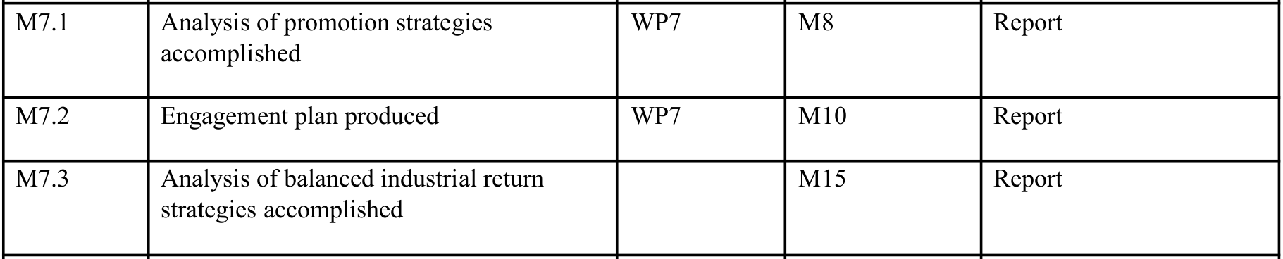
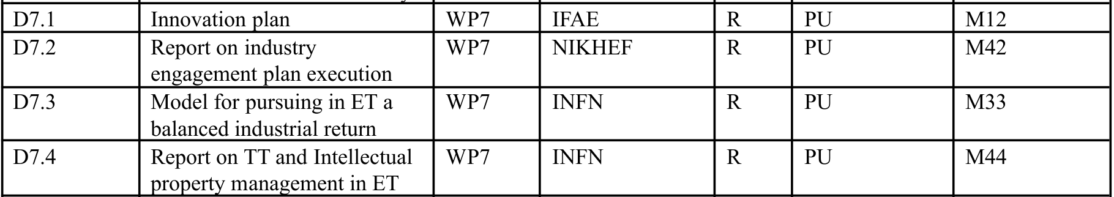
WP 7: Deliverables and milestones

M11

Document in internal review process
M42
We aim at producing this report earlier than anticipated (M40)

Slide 4
WP7.3 – Technology Transfer
Current Deliverable Status
Main deliverable: "Report on TT and Intellectual property management" (M44)
Status: Report validated by WP 7.3 working group
Next Steps
• Evaluate further technologies of interest to enhance the Report
• Target release: End of 2025 (~M40)

Slide 5
Further work WP7.3
Comprehensive TT Services Framework
Protection and Exploitation Strategy Design
Advanced Market Intelligence
Case studies:
The Instrumented Baffle
Looking for a second case study (several proposals)

Slide 6
Sustainability Workshop
"The Einstein Telescope Large Underground Research Infrastructure: Environmental Challenges and Solutions for Long-Term Sustainability,"
An academia-industry workshop aiming to bring together leading experts to address sustainability challenges related to large underground scientific infrastructures, focusing on the Einstein Telescope project as a case study,
Organized by WP9 in cooperation with WP7, ...
proposed venue: Chiostro San Pietro in Vincoli – Sapienza University, Rome.
1.5 days
originally planned for Nov. 13-14 2025, but conflicting with ET collab. meeting, looking for a suitable date in Jan.- Feb. '26

Slide 7
Sustainability Workshop (II)
Tentative list of sessions:
  Session 1 - Introduction
  Session 2 - Life cycle sustainability assessment
  Session 3 - Sustainable transportation and smart energy
  Session 4 - Efficient operation
  Session 5 - Solutions for underground construction (including scientific equipment)
  Session 6 - Environmental and social Impact
  Session 7 - Industry engagement and sustainable procurement

Slide 8
Sustainability Workshop: industry engagement
from industry: contributions by industry in the technical sessions:
  either invited talks by the program committee
  or selection via an open call, distributed also through ILOs
to industry: Session 7 - Industry engagement and sustainable procurement
  ~ 2h:30'
  talks on:
    sustainable procurement (WP7, ILO contributions)
    perspective of industry engagement in the R&D phase (WP7, ET experts)
    the engagement of suppliers in the construction phase (WP7, ETO experts)
    round table discussion

Slide 9
Computing technologies workshop (II)
Focus: The goal is to gather experts and companies to discuss the exploitation of computing technologies to address ET challenges and to explore opportunities for collaboration.
Timing: Delivery of the computing model, that should clarify the ET requirements and technical challenges, is scheduled for the end of this year; the workshop could follow next year
Topics: evolution of hardware technologies (processors, storage systems, networking), software, exploitation of artificial intelligence in view of the exploitation by ET
ET computing experts and WP8 involvement: preliminary investigation has confirmed their interest in the workshop
Industry involvement:
  engage companies working at the cutting edge of technology, particularly in processor development, to present their view of the technology evolution and how they could benefit ET
    first survey to check the interest of a sample of companies carried out at the end of June was encouraging
  present possible opportunities of collaborations in the coming years

Slide 10
Computing technologies workshop (II)
Venue and possible dates: to be defined
Program committee to be set up
This annual meeting can be a good opportunity to make progress

Slide 11
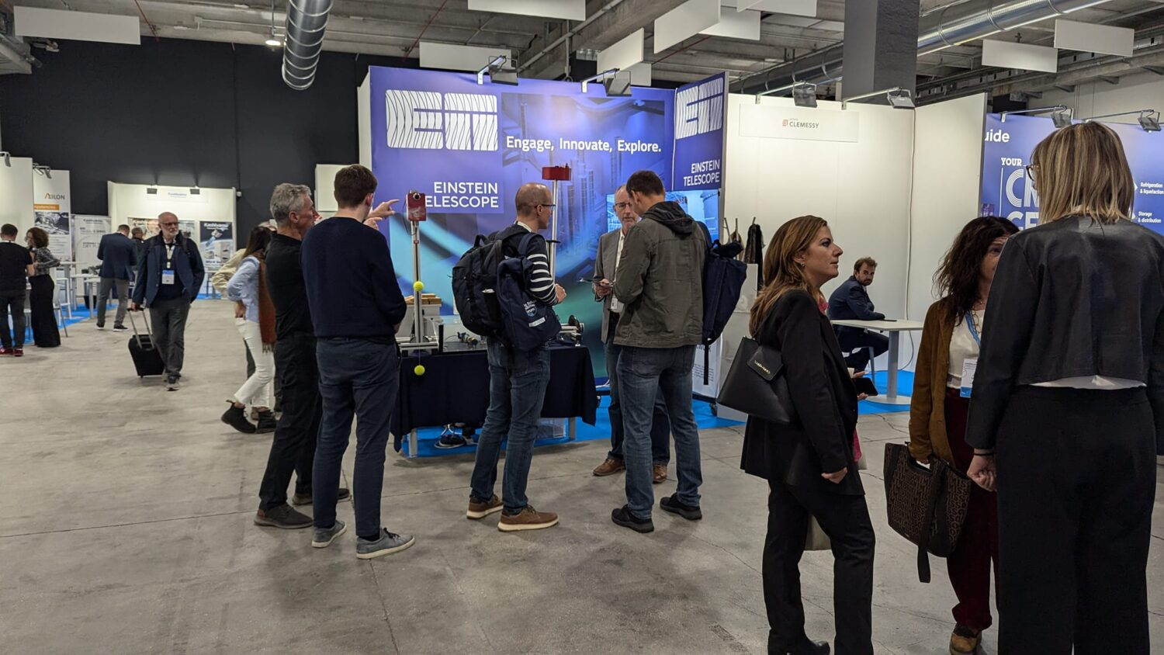
1. Past events since last meeting
The main event was BSBF2024 in (Trieste, 1-4 October 2024)
            Included talks by INAF/INFN President and Nikhef’s outgoing director
            1300 delegates from over 500 organizations across 32 countries
            245 exhibitions, 14 national pavillions

Slide 12
2. Other events during the last year
Einstein Telescope webinar (25 June, 2025). Organised by ET EMR. Focused on developments surrounding the Einstein Telescope and heard more about the opportunities for companies from Belgium, Germany and the Netherlands
Industrial Opportunitiy Days (Turin, 12-13 June). One of the presentations during the IOD event was dedicated to Einstein Telescope and included an update to businesses on the status of the project and prospects for industrial involvement.
IUVSTA workshop 102: Ultra Clean Vacuum (Delft, February 3 – 6 2025). Included discussions about the challenges related to the stringent ET vacuum requirements for the beam pipe and mirrors operating at cryogenic temperatures
Einstein Telescope Project Seminar (Turin, 11 December 2024). The event focused on Italy’s proposal to host the site in Sardinia and also included discussions on the procurement process and the involvement of Italian companies in the construction and technological development of the infrastructure.

Slide 13
3. Forthcoming events with ET presence
APPEC Tech Forum (November 24-26, 2025). Organised by IUVSTA, Maastricht University, NIKHEF and KIT . Programme definition in progress, will incljude talks featuring the ET. Exhibition and sponsorship options available
Big Science Industry Forum Spain 2025 (Madrid, 3-4 December). The ET will be featured in Themeatic Session “Particle Physics and Study of the Universe” and in parallel one to one meetings.
Swedish Big Science Forum 2026 (Lünd, 11-12 March, 2026). Programme definition in progress.
Big Science Business Forum 2026 (Maastricht, 27-30 Oct. 2026). Will include sessions about the ET and planned visits to ET Pathfinder.

Slide 14
Detector technology workshop planning
Rob van der Meer– Nikhef – WP7
ET-PP anual meeting
Parallel session WP7

Slide 15
Introduction
Several local R&D activities, sometimes with industry.
Organise workshop EU-wide to inform industry on status and challenges.
Why would companies travel 1000 km for such a workshop?
  Because there is money for them there. Is it? What can we offer them?
    EU-calls?
    Can we streamline local calls and combine them in some way?
  Because they can exchange ideas and discuss in depth with technicians?

Slide 16
R&D challenges
Vibration damping
Vibration free cooling
Mirrors
Coatings
Lasers
Sensors
Controls
Etc. etc…

Slide 17
Workshop setup
Long workshop setting information exchange sessions 2-3 hours
1,5 day workshop
  Start with network dinner
  Early morning plenary session with pitches
  Morning blocks 2 hours - 4 parallel sessions
  Lunch
  Early afternoon plenary session with conclusion of morning and pitches
  afternoon blocks 2 hours - 4 parallel sessions
  Closing conclusions from sessions
  Network drinks and bites.

Slide 18
Workshop preparation
To attract as much companies as possible
Inform them in advance. Common language is key so we have to get to know each other and understand problems and opportunities.
  Webinars?
    General
    Follow-up
  And more follow-up
Learn boundary conditions to participate.

Slide 19
Time line
Webinars – October - November
Follow-up – November - January
Workshop – March 2026
Follow-up – April - May

