Slide 1


Project: 101079696 — ET-PP — HORIZON-INFRA-2021-DEV-02
WP10
SOCIAL MEDIA AND WEB PAGE UPDATES
Horizon Europe: Coordination
and Support Actions
Yuliya Hoika on behalf of ET-PP WP10
Barcelona, 22-24/07/2025

Slide 2



Einstein Telescope Preparatory Phase
ET-PP InfraDev Annual Meeting — 22-24.07.2025
WP10: Deliverables and Milestones
DONE (Sept ‘22 - Aug ‘23):
D10.1 (University of Warsaw)
Initiate strategic media and communications plan (report)
M10.1 (University of Warsaw)
Appointing comm/outreach officer
NEXT (March ‘25 - Aug ‘26):
D10.4 (IFAE) 36M: Complete bank of graphics and multimedia resources
D10.5 (UKRI) 44M: Launch ECR mentorship and training programme
M22 (UW) 44M: Mentorship and Training programme established
DONE (Sept ‘23 - Feb ‘25):
D10.2 (EGO) 24M: Launch consortium website and social media accounts
D10.3 (Nikhef) 24M: Formulate strategic media and communications plan
M21 (EGO) 24M: ET Consortium website and social media launched

Slide 3
SOCIAL MEDIA AND WEBPAGE UPDATES

Slide 4
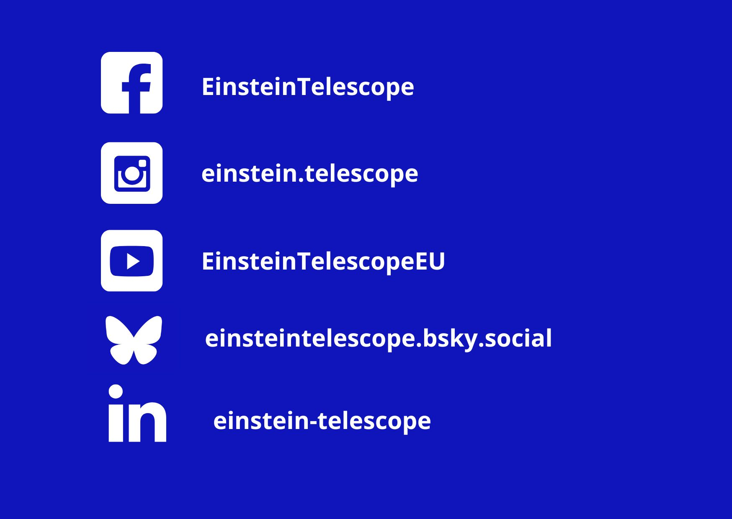
SOCIAL MEDIA
Einstein Telescope Preparatory Phase
ET-PP InfraDev Annual Meeting — 22-24.07.2025

Slide 5
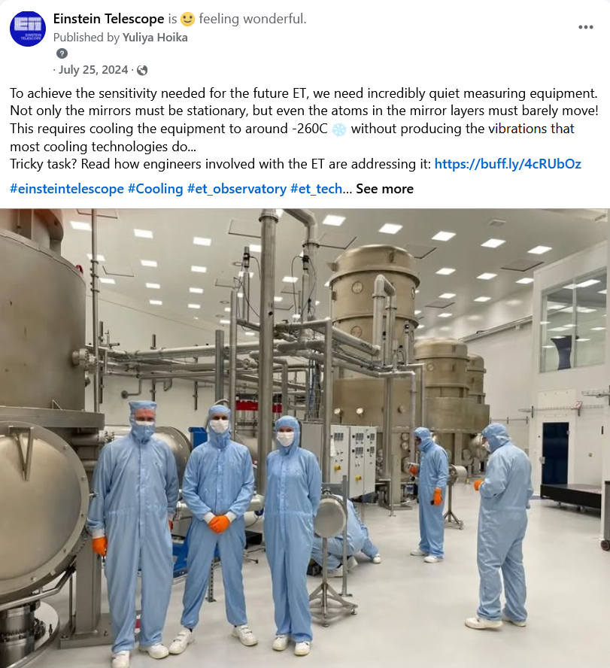
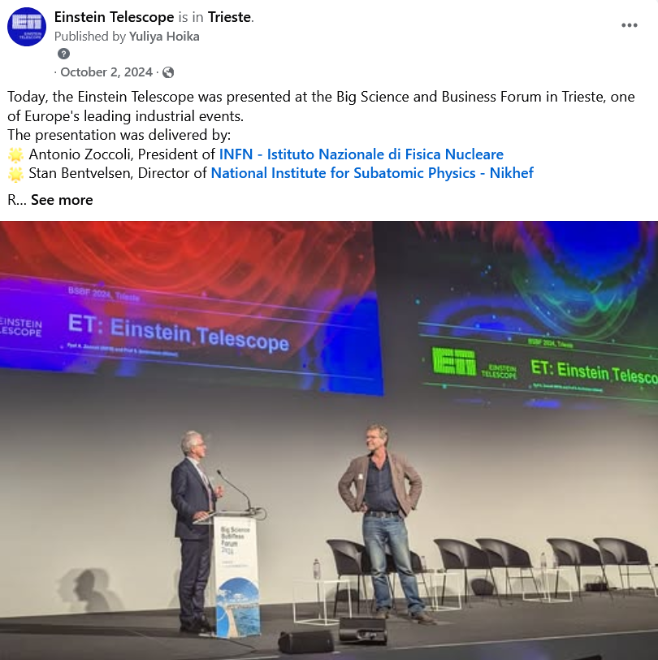
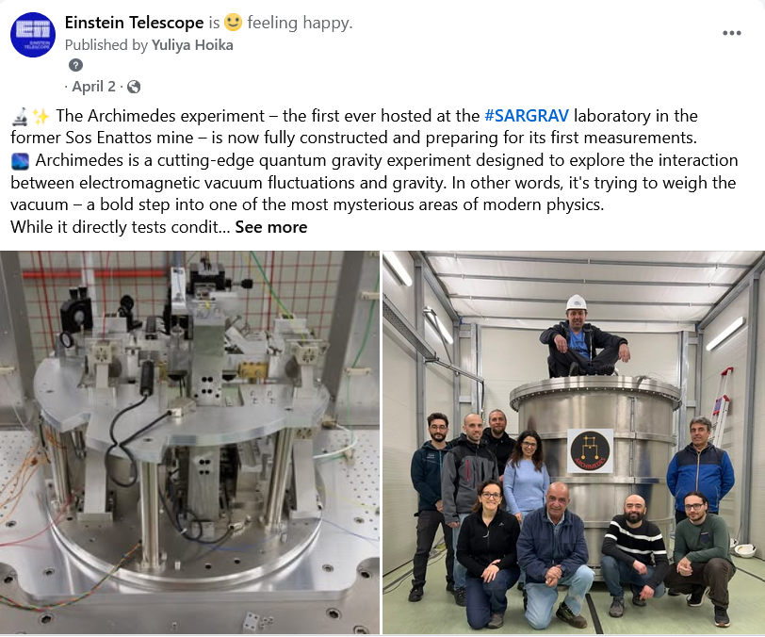
SOCIAL MEDIA
Einstein Telescope Preparatory Phase
ET-PP InfraDev Annual Meeting — 22-24.07.2025
We strive to maintain balance and serve as a neutral source of credible information
Notes:
Balance: in content, in sites presentations, countries participation, stakeholders, groups of ET (scientists, engineers, managers, young researchers…)

Slide 6
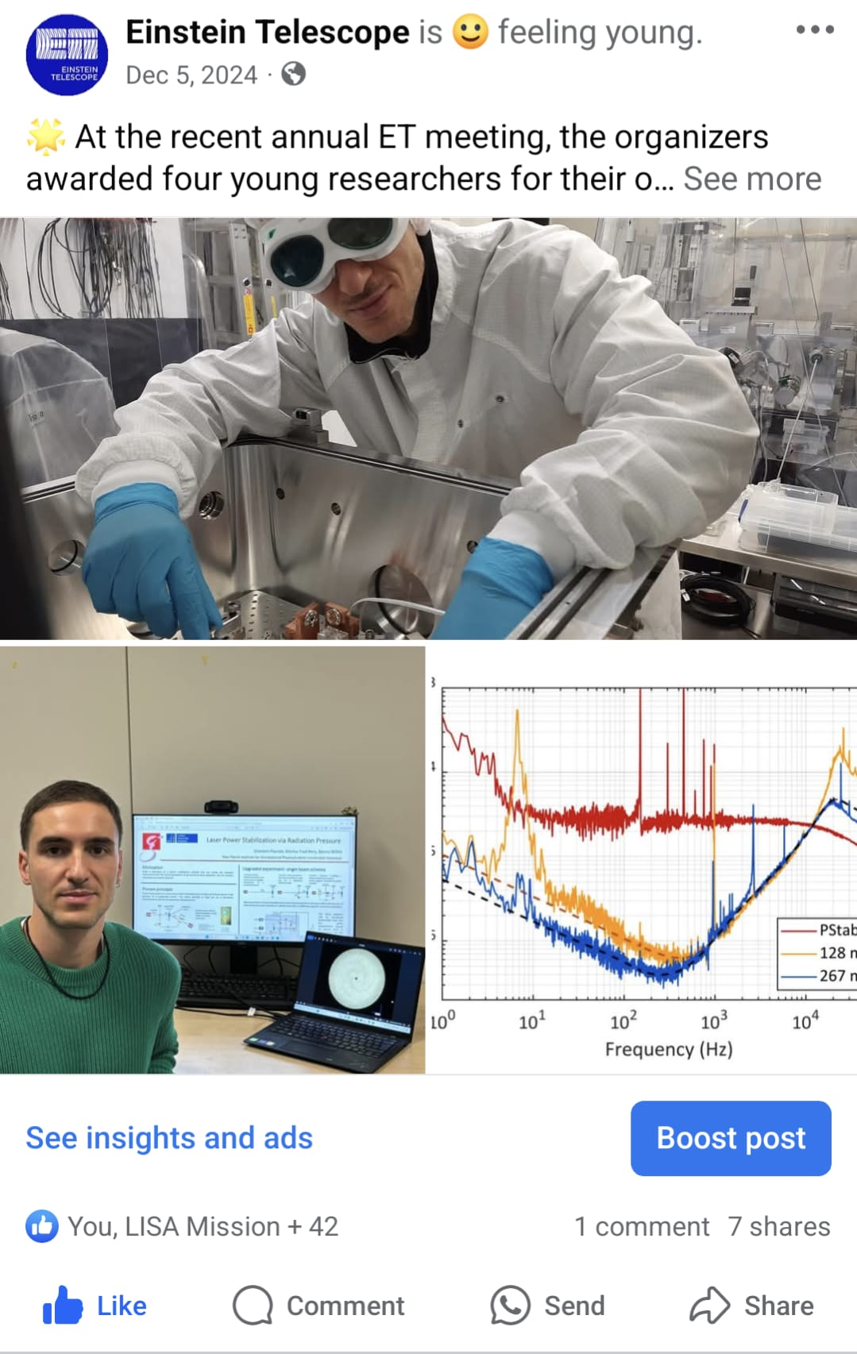
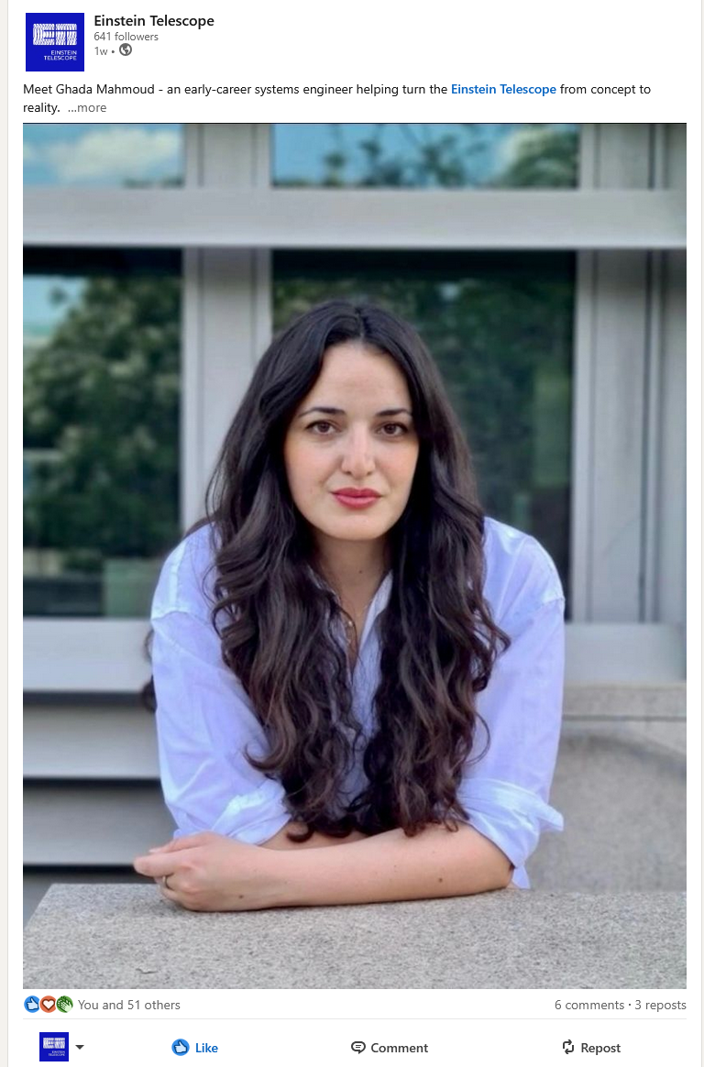
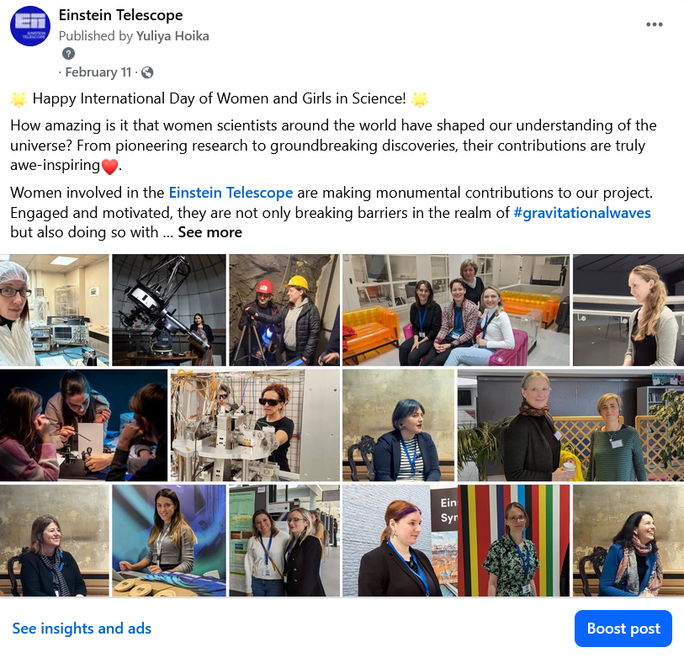
#ET_young
#WomenInSTEM
Einstein Telescope Preparatory Phase
ET-PP InfraDev Annual Meeting — 22-24.07.2025
Notes:
To align with both EU and ET values, we regularly spotlight early-career researchers and women in science - tagging those posts with #ET_young and #WomenInSTEM when we share their stories.

Slide 7
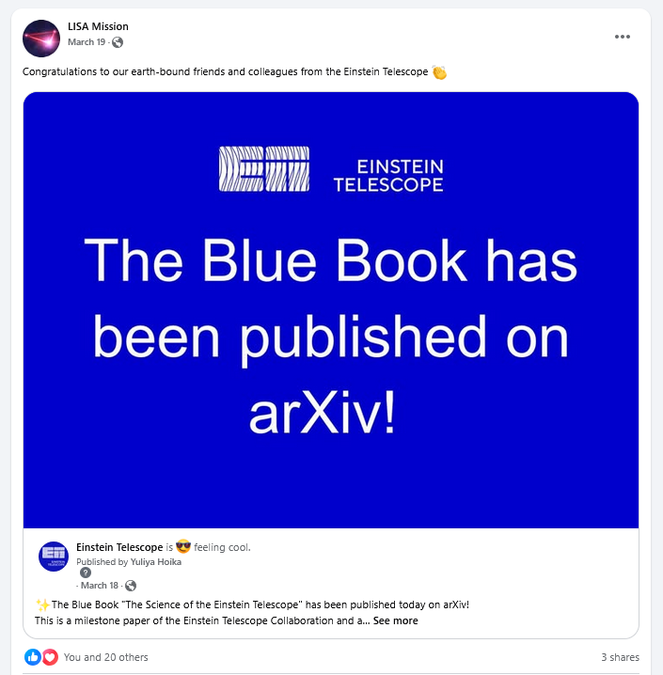
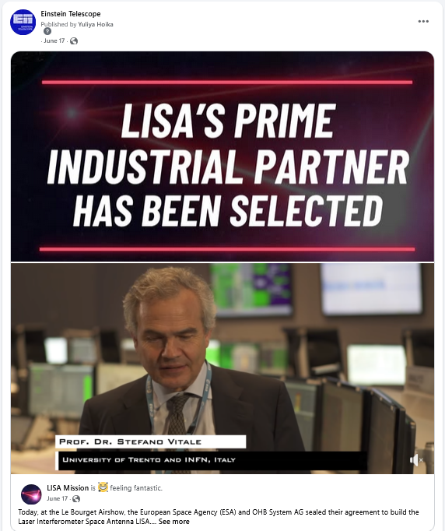
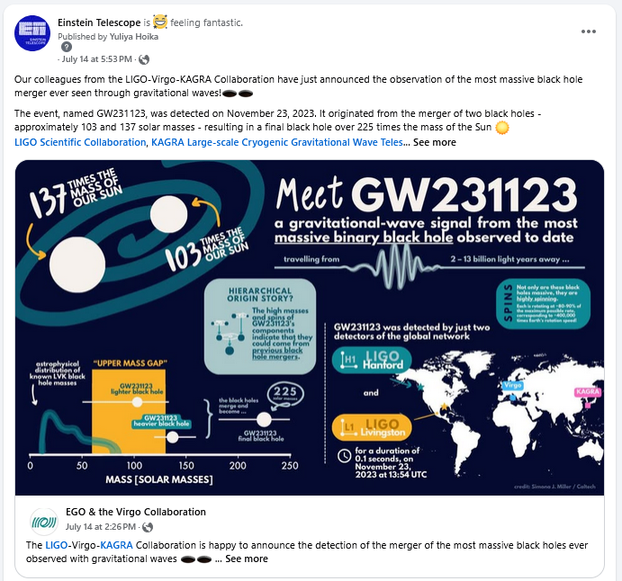
SOCIAL MEDIA
Einstein Telescope Preparatory Phase
ET-PP InfraDev Annual Meeting — 22-24.07.2025
CROSS-POSTING
Notes:
Cross posting - to build networking and information flow

Slide 8
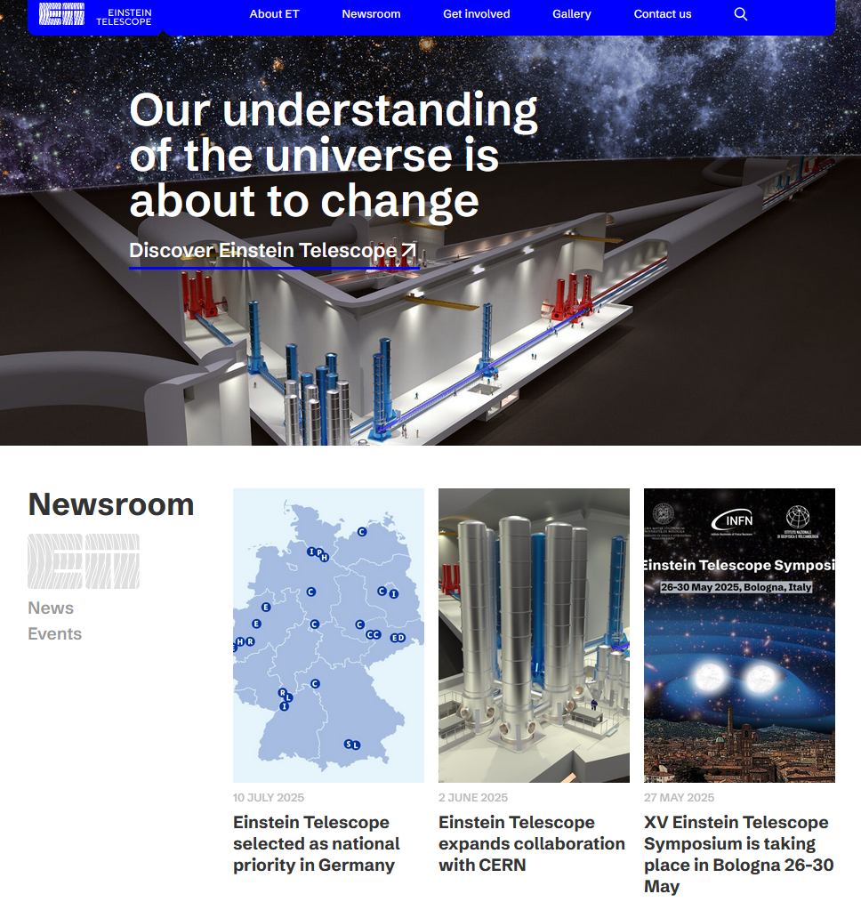
Einstein Telescope Preparatory Phase
ET-PP InfraDev Annual Meeting — 22-24.07.2025
WEBPAGE
WEBPAGE: PROGRESS
The page is live from 10 April 2025 (after Management review and improvements implementation coordinated by M. Oudenhoven): https://einsteintelescope.eu
Officially presented at the XV ET Symposium in Bologna
Now Management is working on further procedures definition (ETO+ETC)
Collaboration with other ET (PP) groups
Notes:
Website is meant to contribute to strengthening whole ET community, and providing support for ‘ET entities’ and stakeholders in their communication about ET.
Website is important factor in our virtual presence, can also easily go wrong (remember, ET is a high profile project for Europe and many stakeholders are watching us closely). Content must be carefully managed, taking sensitivities and strategic importance into account.
Publishing the site is only the first step. We will continue to expand it with new functionalities, additional sub‑pages and the content requested by stakeholders.
This is our shared tool and it must serve us all. (WP7 (Innovation and Industrial Engagement) is already supplying industry‑focused materials, while WP9 (Sustainable Development Strategy) has assisted with the current content.) We welcome constructive feedback and invite every group to contribute.
A transnational content strategy + work flows will be developed, in line with the earlier developed Strategic Media and Communications Plan (October 2024).
The performance of the website will be evaluated regularly, ensuring it is meeting its goals.

Slide 9
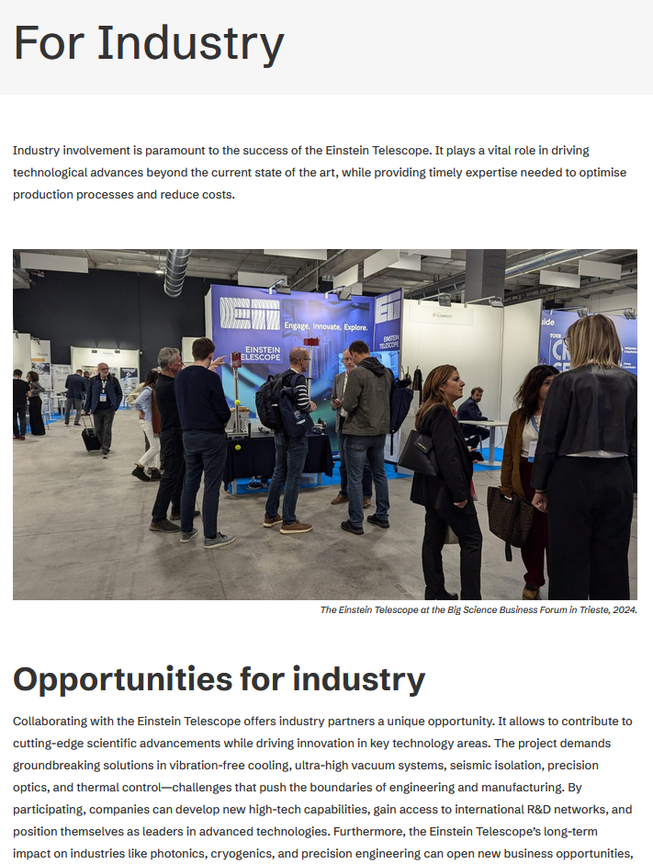
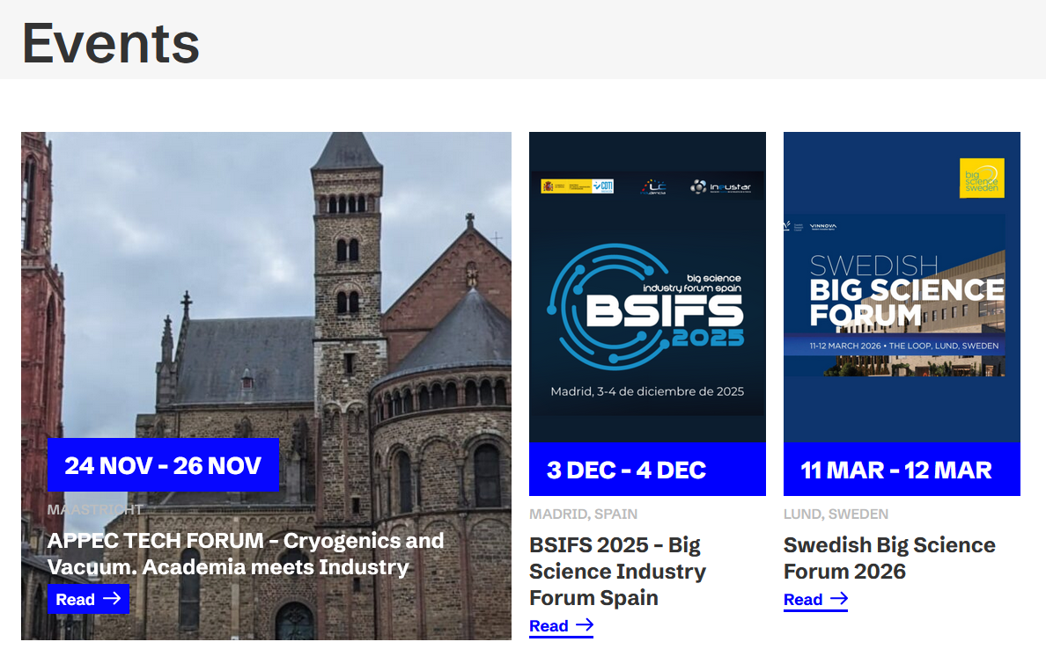
Website
Building community through the page
Einstein Telescope Preparatory Phase
ET-PP InfraDev Annual Meeting — 22-24.07.2025
This subpages are alive thanks to WP7-WP10 cooperation:
This is our shared tool and it must serve us all.
Events, For Industry
Job opportunities:
There is a good potential for cooperation and networking
Notes:
Website is meant to contribute to strengthening whole ET community, and providing support for ‘ET entities’ and stakeholders in their communication about ET.
Website is important factor in our virtual presence, can also easily go wrong (remember, ET is a high profile project for Europe and many stakeholders are watching us closely). Content must be carefully managed, taking sensitivities and strategic importance into account.
Publishing the site is only the first step. We will continue to expand it with new functionalities, additional sub‑pages and the content requested by stakeholders.
This is our shared tool and it must serve us all. (WP7 (Innovation and Industrial Engagement) is already supplying industry‑focused materials, while WP9 (Sustainable Development Strategy) has assisted with the current content.) We welcome constructive feedback and invite every group to contribute.
A transnational content strategy + work flows will be developed, in line with the earlier developed Strategic Media and Communications Plan (October 2024).
The performance of the website will be evaluated regularly, ensuring it is meeting its goals.

Slide 10
DISCUSSION “WORKFLOWS: STATUS AND FIELDS FOR IMPROVEMENT”
Einstein Telescope Preparatory Phase
ET-PP InfraDev Annual Meeting — 22-24.07.2025
Key gaps/challenges to discuss
We are not widely recognized as a Central Communication Hub.
WP10 all group is shrinking…
Missing content from non-candidacy countries.
Missing scientific content.
Lack (very few) info from the community (we have to “hunt” for the information)
Contribution from editorial group - more input/ideas are needed.
Lack of professional content management tool and dedicated communication app.
Personpower / roles are not well defined
…
Outcomes
Move to the establishing of the Central Communication Office (collaborating with CEC/ETC and local comm groups)
Define and strengthen the role of the editorial group/board
Establish a structured information flow (more channels are needed): other countries, ET groups…
Ensure inclusion of content from non-candidacy countries and scientific topics.
Implement and enforce the use of a content management tool (or choose a better alternative).
Assign additional people for backup and support.
…

Slide 11
2. D10.4: Complete bank of graphics and multimedia resources

Slide 12

D10.4: Complete bank of graphics and multimedia resources: status and next steps (IFAE, 36M)
Einstein Telescope
ET-PP meeting — 23.07.2025
REPOSITORY
MATERIALS
Project: 101079696 — ET-PP, 2nd review meeting

Slide 13
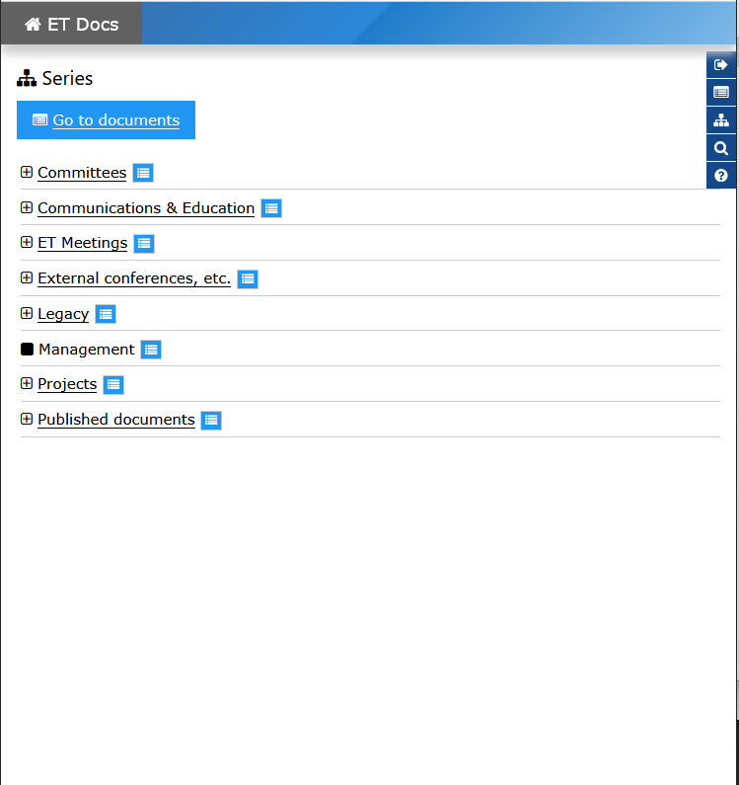
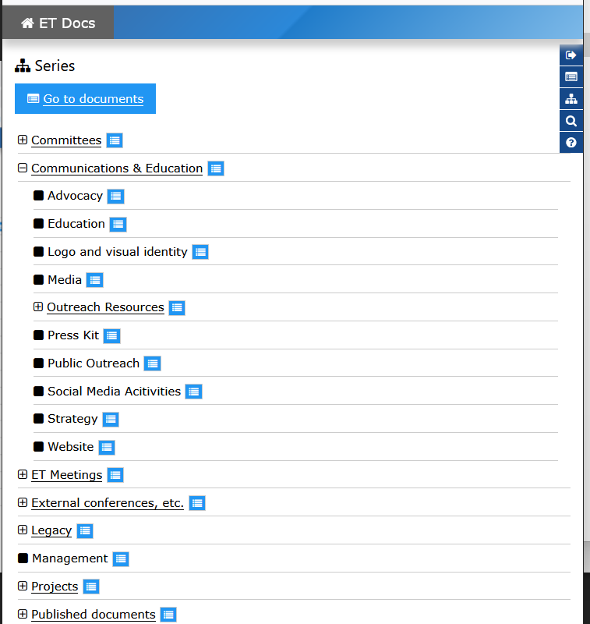
Einstein Telescope
ET-PP meeting — 23.07.2025
The Outreach Repository is:
ET TDS settled
20.06 - workshop with Gary Hemming on how to use it. We are organising existing materials and will upload them
there is an additional content type Outreach Material
additional Cutreach Material information for each file:
Credits, Licenses & use restrictions, Captions & descriptions
additional features requested:
- preview thumbnails and grid view for images & videos
- flag icons in file preview to indicate language versions
- more generous size limitations for video files (workaround currently needed)
files are organised by series:
e.g. keywords (linked to Blue Book chapters?), file type < exisiting, others are possible. Discussion needed on structure.
ET-PP Annual Meeting 2025 / Barcelona

Slide 14
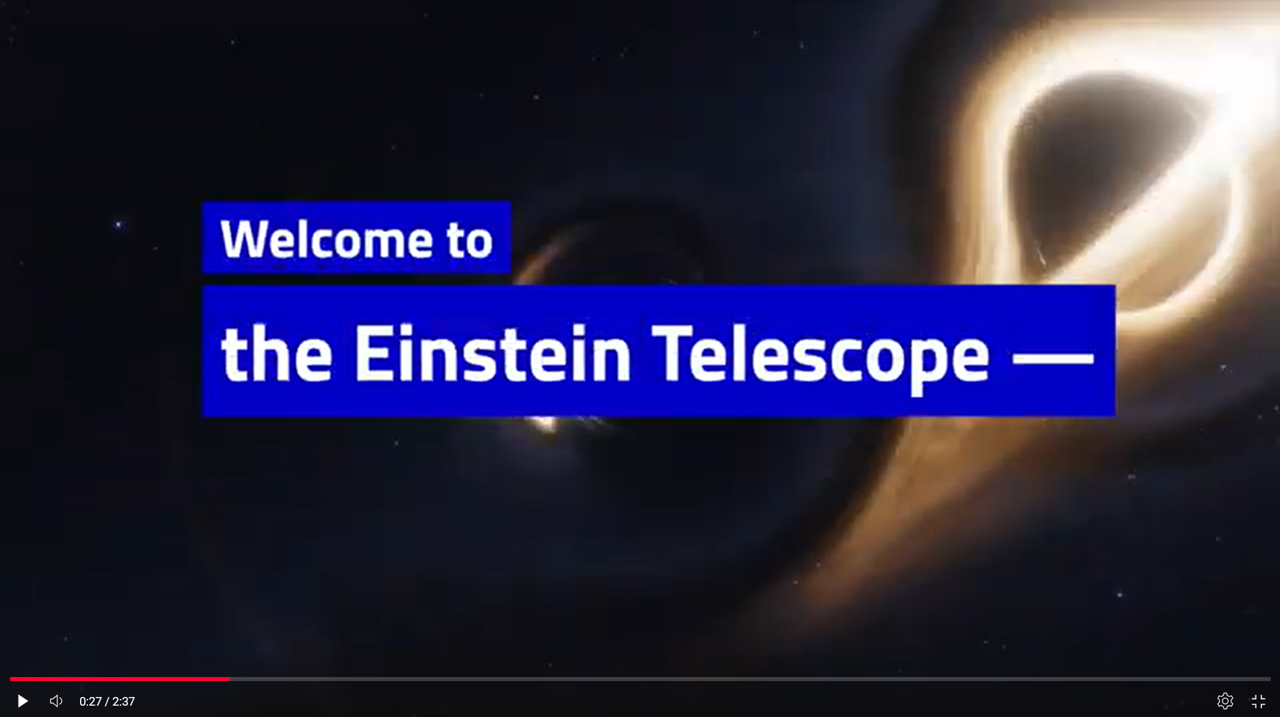
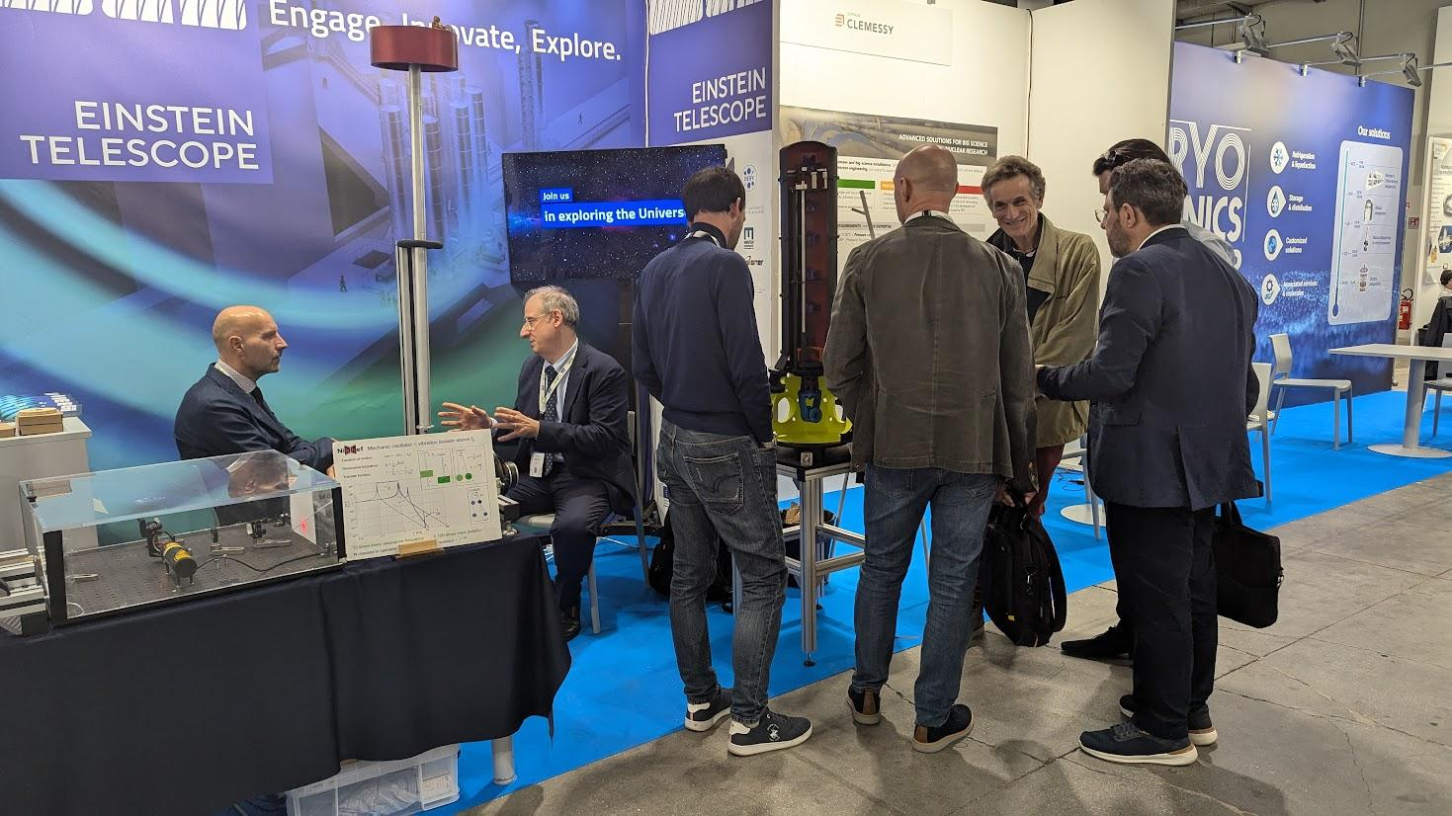
Einstein Telescope
ET-PP meeting — 23.07.2025
D10.4: Complete bank of graphics and multimedia resources: status and next steps (IFAE, 36M)
Materials collection in progress
Einstein Telescope visual identity:
BrandBook,
graphics and logo files (multiple formats),
Communication templates (presentations, documents, digital materials),
mockups for various promotional materials
Social media and digital communications
ET Social Media Content Plan, coordinated via Asana
Promotional multimedia content
Official Einstein Telescope promotional video (on YouTube)
Photo albums capturing highlights from significant events
Video recordings documenting key ET events and conferences
4. Printed and digital promotional materials (WP7 & WP10)
Brochure highlighting ET technologies and innovations
Design and implementation of the ET exhibition booth (debuted at the Big Science Business Forum event, October 2024, Trieste, Italy)
Working group: S. Rieger, D. Rosinska, I. Cordero-Carion, L. Conti, Y. Hoika, M. Jakubiak

Slide 15
Einstein Telescope
ET-PP meeting — 23.07.2025
D10.4: Complete bank of graphics and multimedia resources: status and next steps (IFAE, 36M)
NEW
Infographics project: dissemination of
BlueBook - Science of ET
Group D10.4 is now cooperating with OSB members (conceptual/content input) and graphic designer
we have funds for 10 infographics
some infographics are specifically for chapters of the Blue Book, some more general
designer has been selected (UW)
Working group: S. Rieger, D. Rosinska, I. Cordero-Carion, L. Conti, Y. Hoika, M. Jakubiak

Slide 16
Einstein Telescope
ET-PP meeting — 23.07.2025
Open questions:
which keywords should be included?
- top-level categories could include Astrophysics, Detector Technology, Data Analysis
- sub-topics could include chapters of the Blue Book, specific technology e.g. cryogenics, vacuum, suspension
- a coherent & comprehensive system should be defined before the repository is filled
naming convention
Ideally, file names should also be systematic.
which additional infographics could we produce?
who could work on more infographics?
ET-PP Annual Meeting 2025 / Barcelona

Slide 17
3. Educational activities: from Science to Society

Slide 18
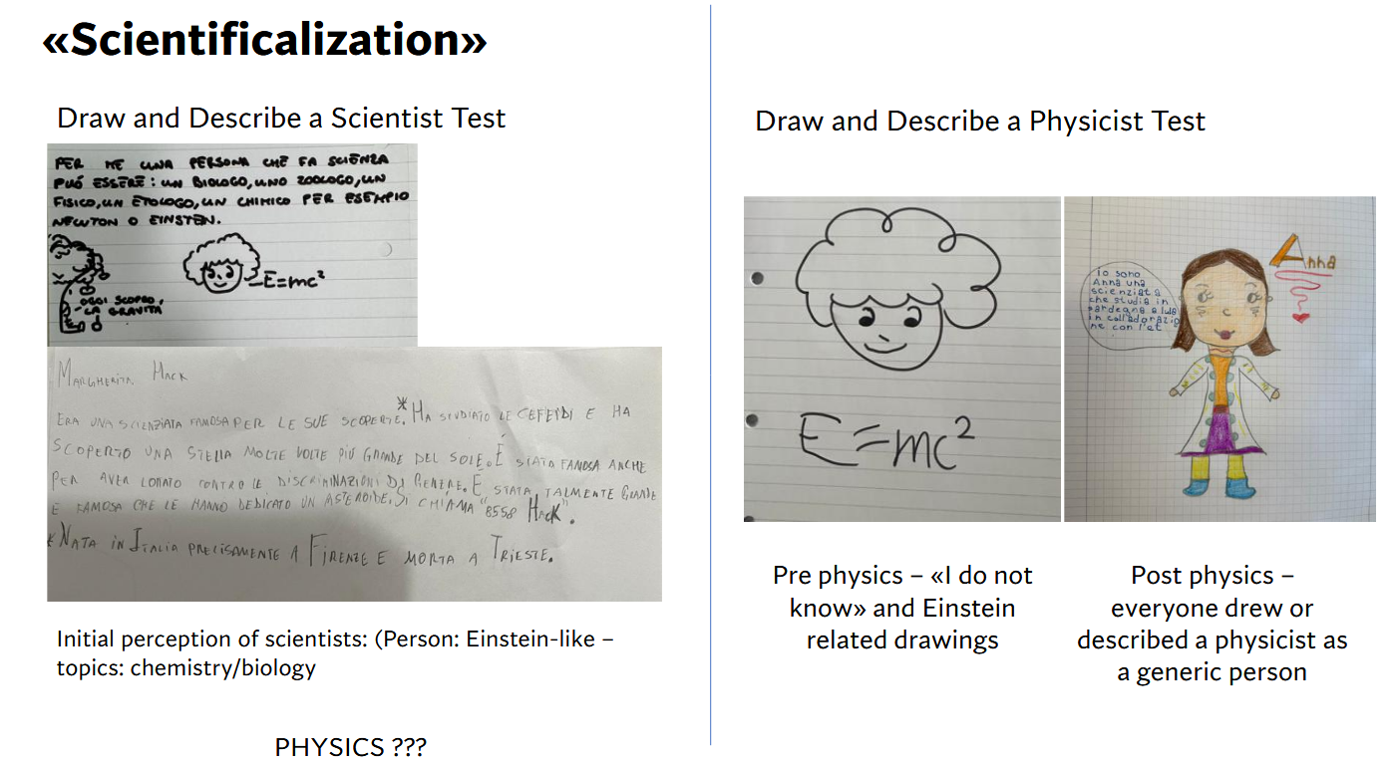
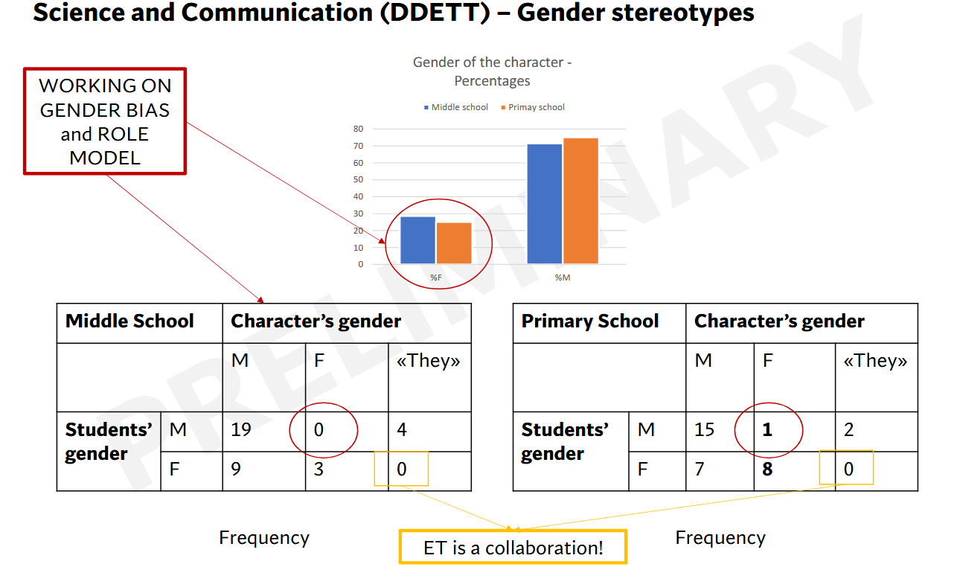
Einstein Telescope
ET-PP meeting — 23.07.2025
3. Educational activities: from Science to Society (Matteo Tuveri)
GRAVIS Project: science + connecting ET with schools and society:
ET physics (embodied and visual activities); drawings and descriptions; Storytelling; Meeting with ET scientists (real stories)
Scientificalisation
Metaphorically visualizing of the invisible
OUTCOMES:
Communication
• Use metaphors to make ET concepts accessible
• Address students’ and society’s need for scientific knowledge
• Engage with local communities to integrate ET into the territory
• Promote active public involvement through citizen science approaches
• Use digital and social tools to narrate ET through students' words and ideas, mediated by researchers
ET-PP Annual Meeting 2025 / Barcelona

Slide 19
Einstein Telescope
ET-PP meeting — 23.07.2025
3. Educational activities: from Science to Society (Matteo Tuveri)
DISCUSSION
How to use this methodology for ET in other communities
ET-PP Annual Meeting 2025 / Barcelona

Slide 20
4. Launch ECR mentorship and training programme

Slide 21
Einstein Telescope Preparatory Phase
ET-PP InfraDev Annual Meeting — 22-24.07.2025
D10.5: Launch ECR mentorship and training programme: status and next steps (UKRI, 44M)
Mentorship and training programme (MTP)
  A dedicated group of six members meets bi-weekly.
  Information on similar MTPs is currently being collected, including those from LISA (LECS), GWECS, LAAC, ESO, IMPRS, the EuroPlanet Network, CERN, RAS, AGU, AHEAD2020, and various medical and engineering professional bodies. IMPRS Lecture weeks in Germany in Sept 2024 - a lot of input.
  Several meetings with colleagues from different organisations have been held.
  An informal body, the MTP Council, is planned to be established. This Council will assist in drafting the proposed training programme, including timelines, proposed content, guidance documentation, and more. It will also define success criteria for the mentorship and training programme and determine how progress should be monitored.
  A draft of the final report is expected to be completed by November 2025.

Slide 22
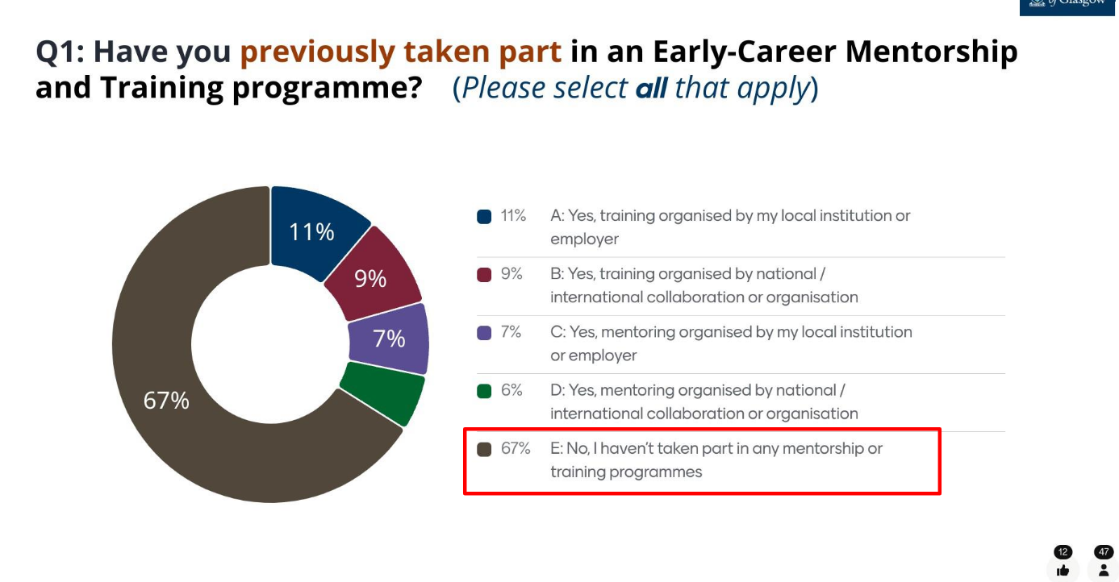
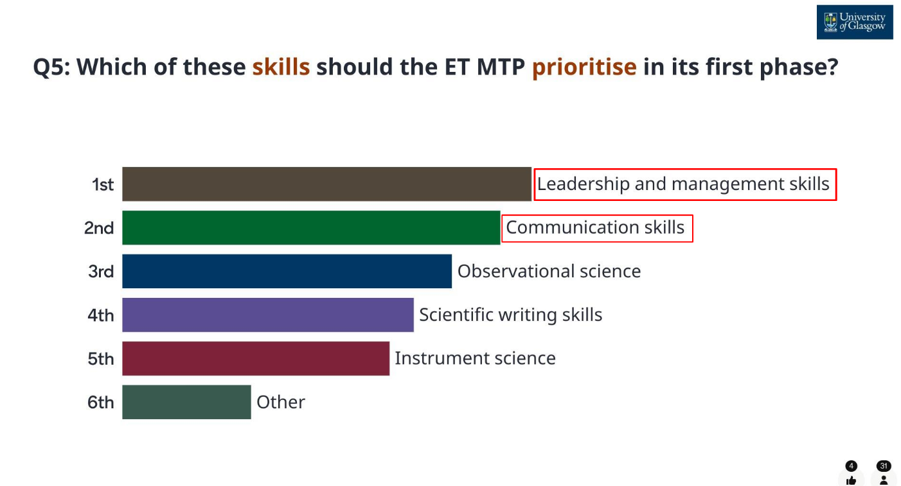
Einstein Telescope Preparatory Phase
ET-PP InfraDev Annual Meeting — 22-24.07.2025
D10.5: Launch ECR mentorship and training programme: status and next steps (UKRI, 44M)
Promotion of the idea of MTP / Engaging potential mentors & mentees / Menti survey conducting
LVK meeting in Melbourne (24-27 March 2025):
presenters from WP10: Martin Hendry, Dorota Rosinska
presentations about MTP and communication in ET in general
a meeting with ECR
ET Symposium in Bologna
parallel session dedicated to MTP (M. Hendry)
Amaldi Conference (Glasgow, July 2025):
  A dedicated ECR workshop - from 10 to 12 July, ahead of the main conference.
Working group: M. Hendry; M. Biesiada, G. Koekoek, S. Rieger, D. Rosinska, Y. Hoika

Slide 23
Einstein Telescope Preparatory Phase
ET-PP InfraDev Annual Meeting — 22-24.07.2025
D10.5: Launch ECR mentorship and training programme: status and next steps (UKRI, 44M)
DISCUSSION:
The Deliverable itself is meant to be a Programme/Plan. Implementation is not our part.
The MTP should be introduced to the ETC and ETO. They may be interested in implementing this, especially in the light of the future proposal.
Resources should be secured to implement the programme.
We are aware of other existing programmes. The intention is not to duplicate but to create different MTP for ET.
We also shouldn’t recreate a wheel, but join the existing initiatives.
Working group: M. Hendry; M. Biesiada, G. Koekoek, S. Rieger, D. Rosinska, Y. Hoika

Slide 24


Thank you!
Email address
et_comm@astrouw.edu.pl

