Slide 1




EUROPEAN RESEARCH EXECUTIVE AGENCY (REA)
REA C – Future society
C4 – Reforming European R&I and Research Infrastructure
GRANT AGREEMENT
Project 101079696 — ET-PP — HORIZON-INFRA-2021-DEV-02
ET–PP INFRA-DEV ANNUAL MEETING
ET–PP WP4/WP5/WP8/WP9
Sustainable Development Implementation Strategy:
ET Environmental impact, ET CO2 footprint
(D9.1, D9.2, D9.3)
Maria Marsella (NFN), Francesca Spagnuolo (EGO)
22–24 lug 2025
UPF Barcelona School of Management - Barcelona
22–24 lug 2025
UPF Barcelona School of Management - Barcelona

Slide 2


Session organization
WP 9 OF THE
WP 9 O THE
12:00- 12:15 - Presentation of situation and on-going activity, our plan, timeline, involvement of stakeholders, need to identify contact persons - Chair: Maria Marsella, Francesca Spagnuolo
12:15 - 12:30 - The economic importance of sustainable ways for the management of excavated materials for the ET (WP9) - Robert Galler
12:20 -12:40 - Focus on D9.2 (Chair - Maria Marsella, ARUP)
13:00-13:30 - Focus on D9.3 (Chair - Disha Sawant, ARUP)
ET–PP INFRA-DEV ANNUAL MEETING - 22–24 lug 2025 - Barcelona

Slide 3
Overview
WP 9 OF THE
Description of the team with relevant expertise - Activity started with EGO and INFN working with ARUP
The summary in the preliminary sustainability plan revision activity (PSP) outlines the key updates and proposed changes to enhance environmental, social, and economic practices. It focuses on aligning goals with sustainable development principles, improving resource efficiency, and fostering stakeholder collaboration for long-term impact.
Description and schedule for D9.2, D9.3 and D9.1 (possibly revised content)
Stakeholder Involvements – proposed approach
Meeting in CERN 4-5 sept and Workshop in February 2026 in Roma
Task 2. 3 Excavation strategy will propose a separate document more quantitative and a general strategy in D9.2 (to be discussed with Galler)
(plus details in following slide) for the general session
ET–PP INFRA-DEV ANNUAL MEETING - 22–24 lug 2025 - Barcelona

Slide 4
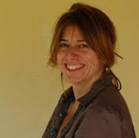


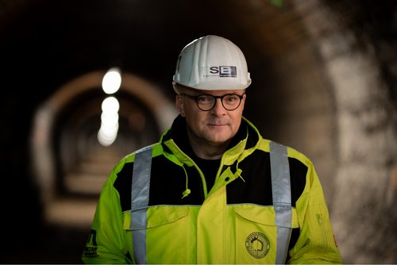

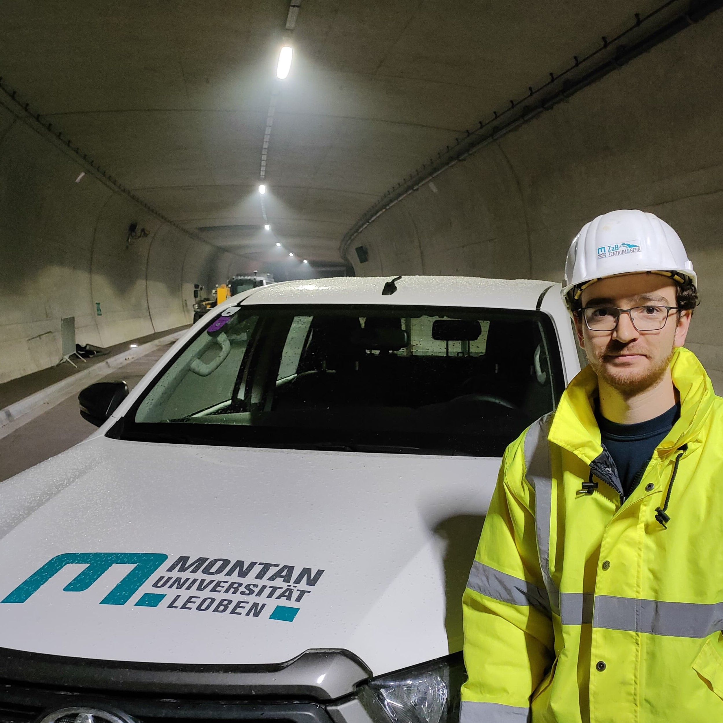
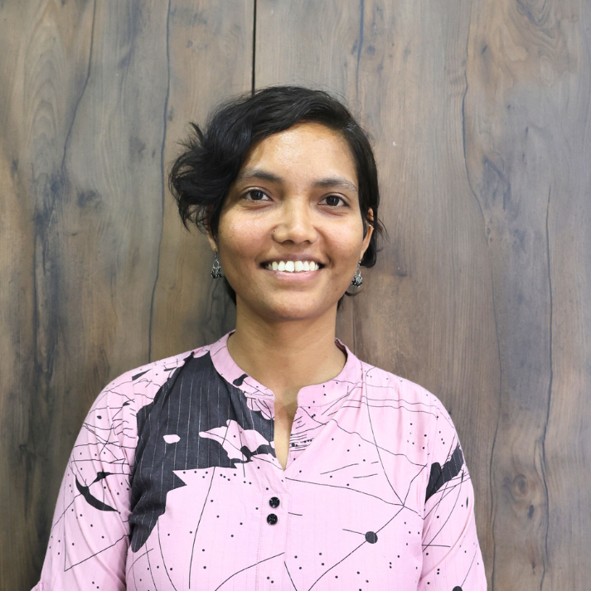


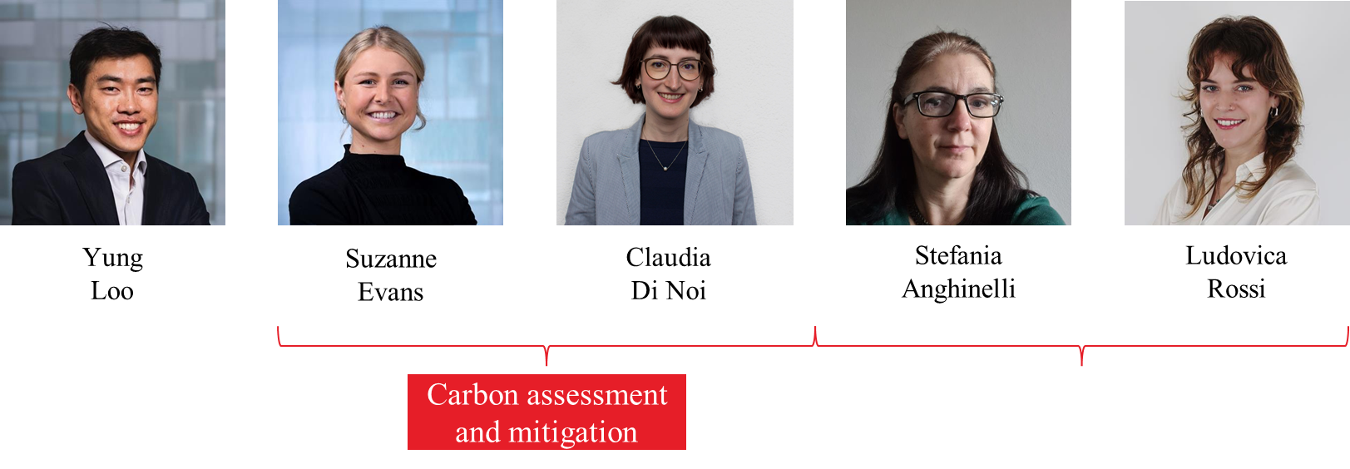
WP9: Introduction and objectives
WP 9 OF THE
WP9- Sustainable Development Strategy
Co-Coordinators
Objectives
EGO
Lead beneficiary and Co-Cordinator - Responsible for:
M17, M18, M19, D9.3
Develop a strategy for the realization of a Sustainable RI, including:
Study and minimize the carbon footprint of ET, including computing and travel
Evaluate and minimize the landscape and environmental impact
Evaluate the contribution of the infrastructure to the UN sustainable goals
Maria Marsella
Francesca Spagnuolo
INFN
Co-coordinator
Responsible for:
D9.1, D9.2
WP9 Team
MUL
Participant (excavated material treatments)- Contributor to D9.2
Robert Galler
Monica Marzario
Gabriel Loucky
CNRS has withdrawn its direct involvement in WP9 after reaching M18 and will now serve as reviewer for WP9 milestones & deliverables
Disha Sawant
Francesca Scipione
ARUP

Slide 5
Ongoing Improvement on the Preliminary Sustainability Report (August 2025)
WP 9 OF THE
Index | Details | Remarks
Executive Summary | Brief overview of goals, changes, and context
Sustainability Assessment for ET | Concise, ET-specific issues: site, power, excavation, access
Excavation & Material Reuse Strategy | Volume estimates, reuse pathways, transport footprint | Rough assumption can be considered and details can be taken from task document
Sustainability Action Plans by Theme | Action tables for: Low-Carbon and Energy-Efficient Infrastructure Climate Change Resilience Soil Preservation and Excavation Reuse Sustainable Water Use and Quality Protection Maximizing Socio-Economic Benefits | Emission numbers from LIGO and VIRGO can be referred and broad ranges can be added Electricity consumption with preliminary figure of around 6 GWh had circulated in the past, this indication has since been removed, as it could not be supported by solid technical data.
Integration with Technical WPs | How WP9 coordinates with other WP teams
Timeline, KPIs, & Deliverables | Milestone chart, Gantt preview, data dependencies
Annex | References, workshop attendee list, data templates

Slide 6
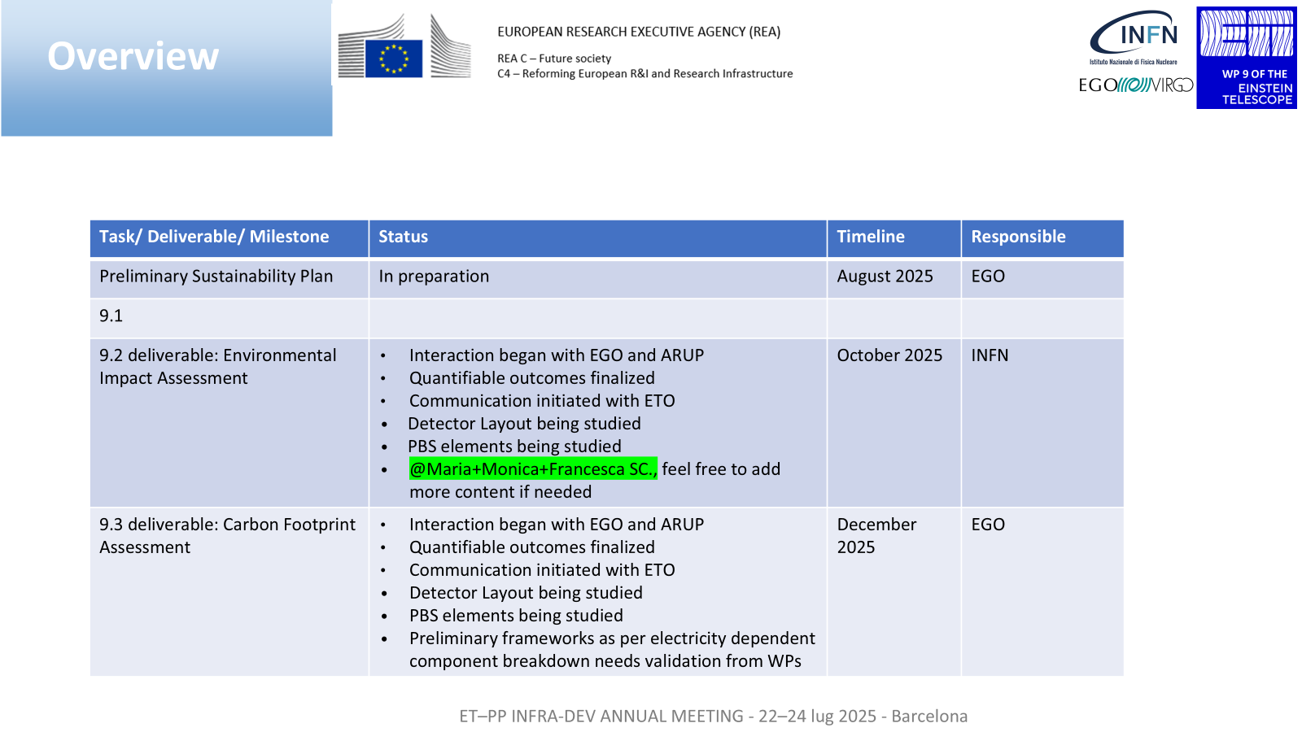

Slide 7
Deliverables Structure
WP 9 OF THE
WP 9.2
  Scoping and Baseline Assessment
  Alternatives and Mitigation
  Public Participation and Transparency
  Monitoring and follow-up
Deliverable by
October 2025
(Version 1 - TBD)
WP 9.3
  Compute the key Carbon and Environmental Impacts, Findings and Mitigation Strategies
  Highlight the most critical insights and recommendations for decision-makers
Deliverable by December 2025
(Version 1 - TBD)
Strategy for following sessions
Data Framework will be discussed and shared with other WPs
Following session for clarifications and follow-ups

Slide 8
WP 9.2 Tasks: Landscape, Environmental and Societal impact
WP 9 OF THE
9.2.1: Assessing and minimizing the ET impact on its environment
9.2.2: Environmental management approach
9.2.3: Analyse and define an overall strategy for reclamation, reuse and recycling of the excavated materials
Data Required:
Preliminary design drawings from the different possible alternative ET-sites, consisting of:
  Layout in a bird’s eye view, including the shafts and caverns
  Longitudinal sections throughout the whole system
  Cross sections of the different tunnels, shafts, cavern
Additional information on:
  Geological info
  Geotechnical info
  (Geo)chemical info
  Mineralogical info
  Construction methodologies if available
Actions
Contacts Persons within WPs to be identified and Data interaction to start based on templates
Extra session can be planned by Robert Galler to conduct a more site-dependent analysys - to be included in a specific document
Option: Preliminary broad level studies available from INFN-Sapienza Mitigation Strategy Document (TBD)

Slide 9
Deliverable by October 2025
Summarized Work Plan from EIA Strategy (D9.2)
WP 9 OF THE
Objective
Develop a robust and integrated Environmental Impact Assessment framework aligned with EU EIA Directive (2011/92/EU as amended by 2014/52/EU)
Key Activities
Define Sustainability Strategy with environmental, social, and economic themes
Establish Baseline conditions using site-specific data (air, water, soil, noise, biodiversity, etc.)
Conduct detailed Impact Assessments for both construction and operational phases
Develop and implement Strategic KPIs (for site comparison) and Specific KPIs (for mitigation & performance tracking)
Identify and evaluate Alternatives and Mitigation Measures across EIA themes
Sustainability Themes Covered
Energy, Carbon Footprint, Air Quality
Climate Change Adaptation
Soil, Water, Biodiversity
Materials & Waste
Human Health and Socio-Economic Factors

Slide 10
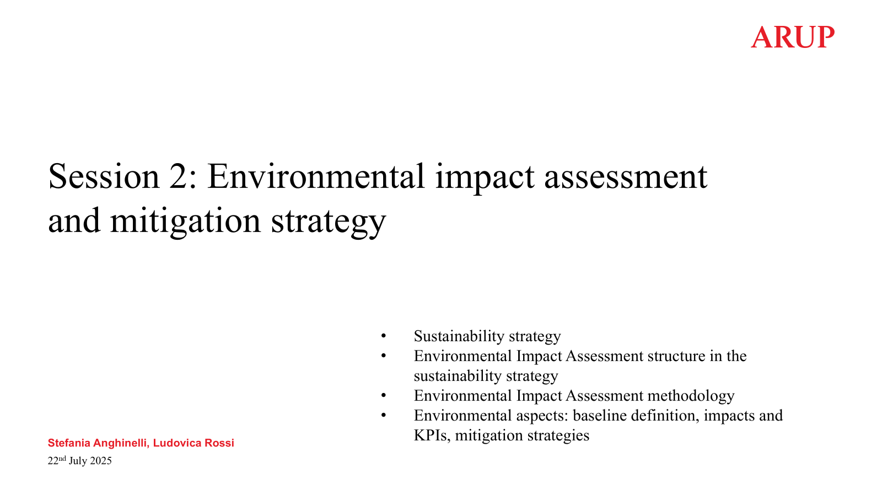
EIA Strategy (D9.2) – ARUP presentation following
WP 9 OF THE

Slide 11
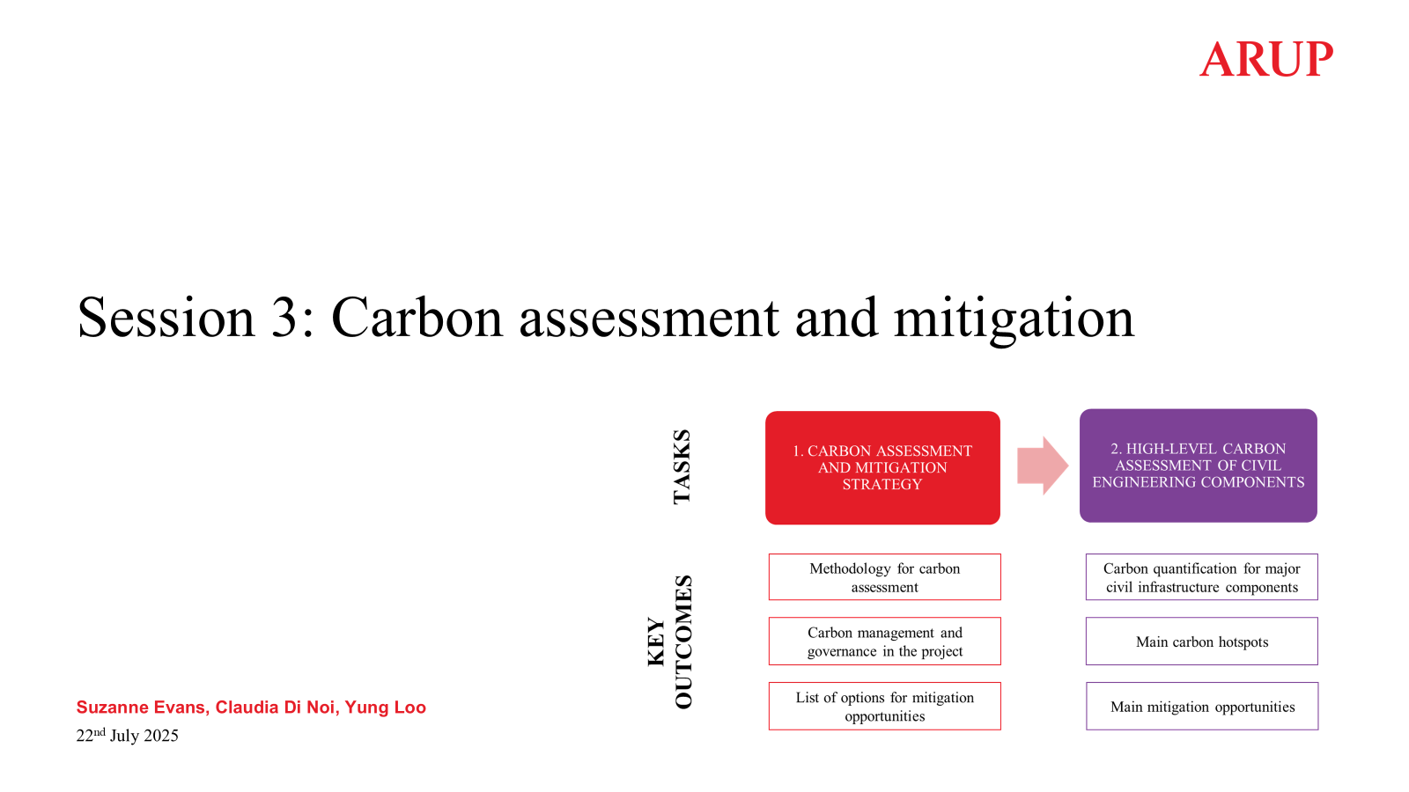
Carbon Assessment (D9.3) – ARUP presentation following
WP 9 OF THE

Slide 12




Strategy and Stakeholders
WP 9 OF THE
WP9 +ARUP
PBS (ETO Project Office) Prof. Alessandro Variola
Engineering Dept
(ETO CERN) Dr. Patrick Werneke
EGO VIRGO & INFN
Local Teams
Other WP Teams
Dashboards
Interviews
Online/ Offline Meetings
Google Docs
Data Collection and Updates: Templates
Data dashboards being shared
Data files being shared
Computation and analysis underway
Reporting TBD
Database
MS Office Docs

