Slide 1




EUROPEAN RESEARCH EXECUTIVE AGENCY (REA)
REA C – Future society
C4 – Reforming European R&I and Research Infrastructure
GRANT AGREEMENT
Project 101079696 — ET-PP — HORIZON-INFRA-2021-DEV-02
ET–PP INFRA-DEV ANNUAL MEETING
ET–PP WP4/WP5/WP8/WP9
Sustainable Development Implementation Strategy:
ET Environmental impact, ET CO2 footprint
(D9.1, D9.2, D9.3)
Maria Marsella (INFN), Francesca Spagnuolo (EGO)
22–24 lug 2025
UPF Barcelona School of Management - Barcelona
22–24 lug 2025
UPF Barcelona School of Management - Barcelona

Slide 2


Session organization
WP 9 OF THE
WP 9 O THE
12:00- 12:15 – WP9 activity summary and planning - Chair: Maria Marsella, Francesca Spagnuolo
12:15 - 12:30 - Management of excavated materials for the ET - Robert Galler
12:20 -12:40 - Focus on D9.2 (Chair - Maria Marsella, ARUP)
13:00-13:30 - Focus on D9.3 (Chair - Disha Sawant, ARUP)
ET–PP INFRA-DEV ANNUAL MEETING - 22–24 lug 2025 - Barcelona

Slide 3
Overview
WP 9 OF THE
Description of the team/expertise - Activity started with EGO and INFN working with ARUP
M17- Preliminary Sustainability Plan (PSP) revision – Key aspects to aligning goals with sustainable development principles, improving resource efficiency, and fostering stakeholder collaboration for long-term impact.
Description and schedule for next deliverable D9.2, D9.3 and D9.1
Stakeholder Involvements – proposed approach
Task 2. 3 Excavation material strategy – understand if a site-dependent quantitative assessment is feasible or include a general strategy in D9.2 (Robert Galler)
Meeting in CERN 4-5 sept and Workshop in February 2026 in Roma
ET–PP INFRA-DEV ANNUAL MEETING - 22–24 lug 2025 - Barcelona

Slide 4
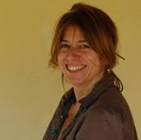

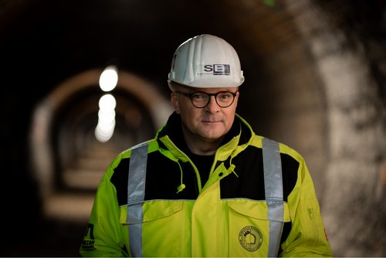

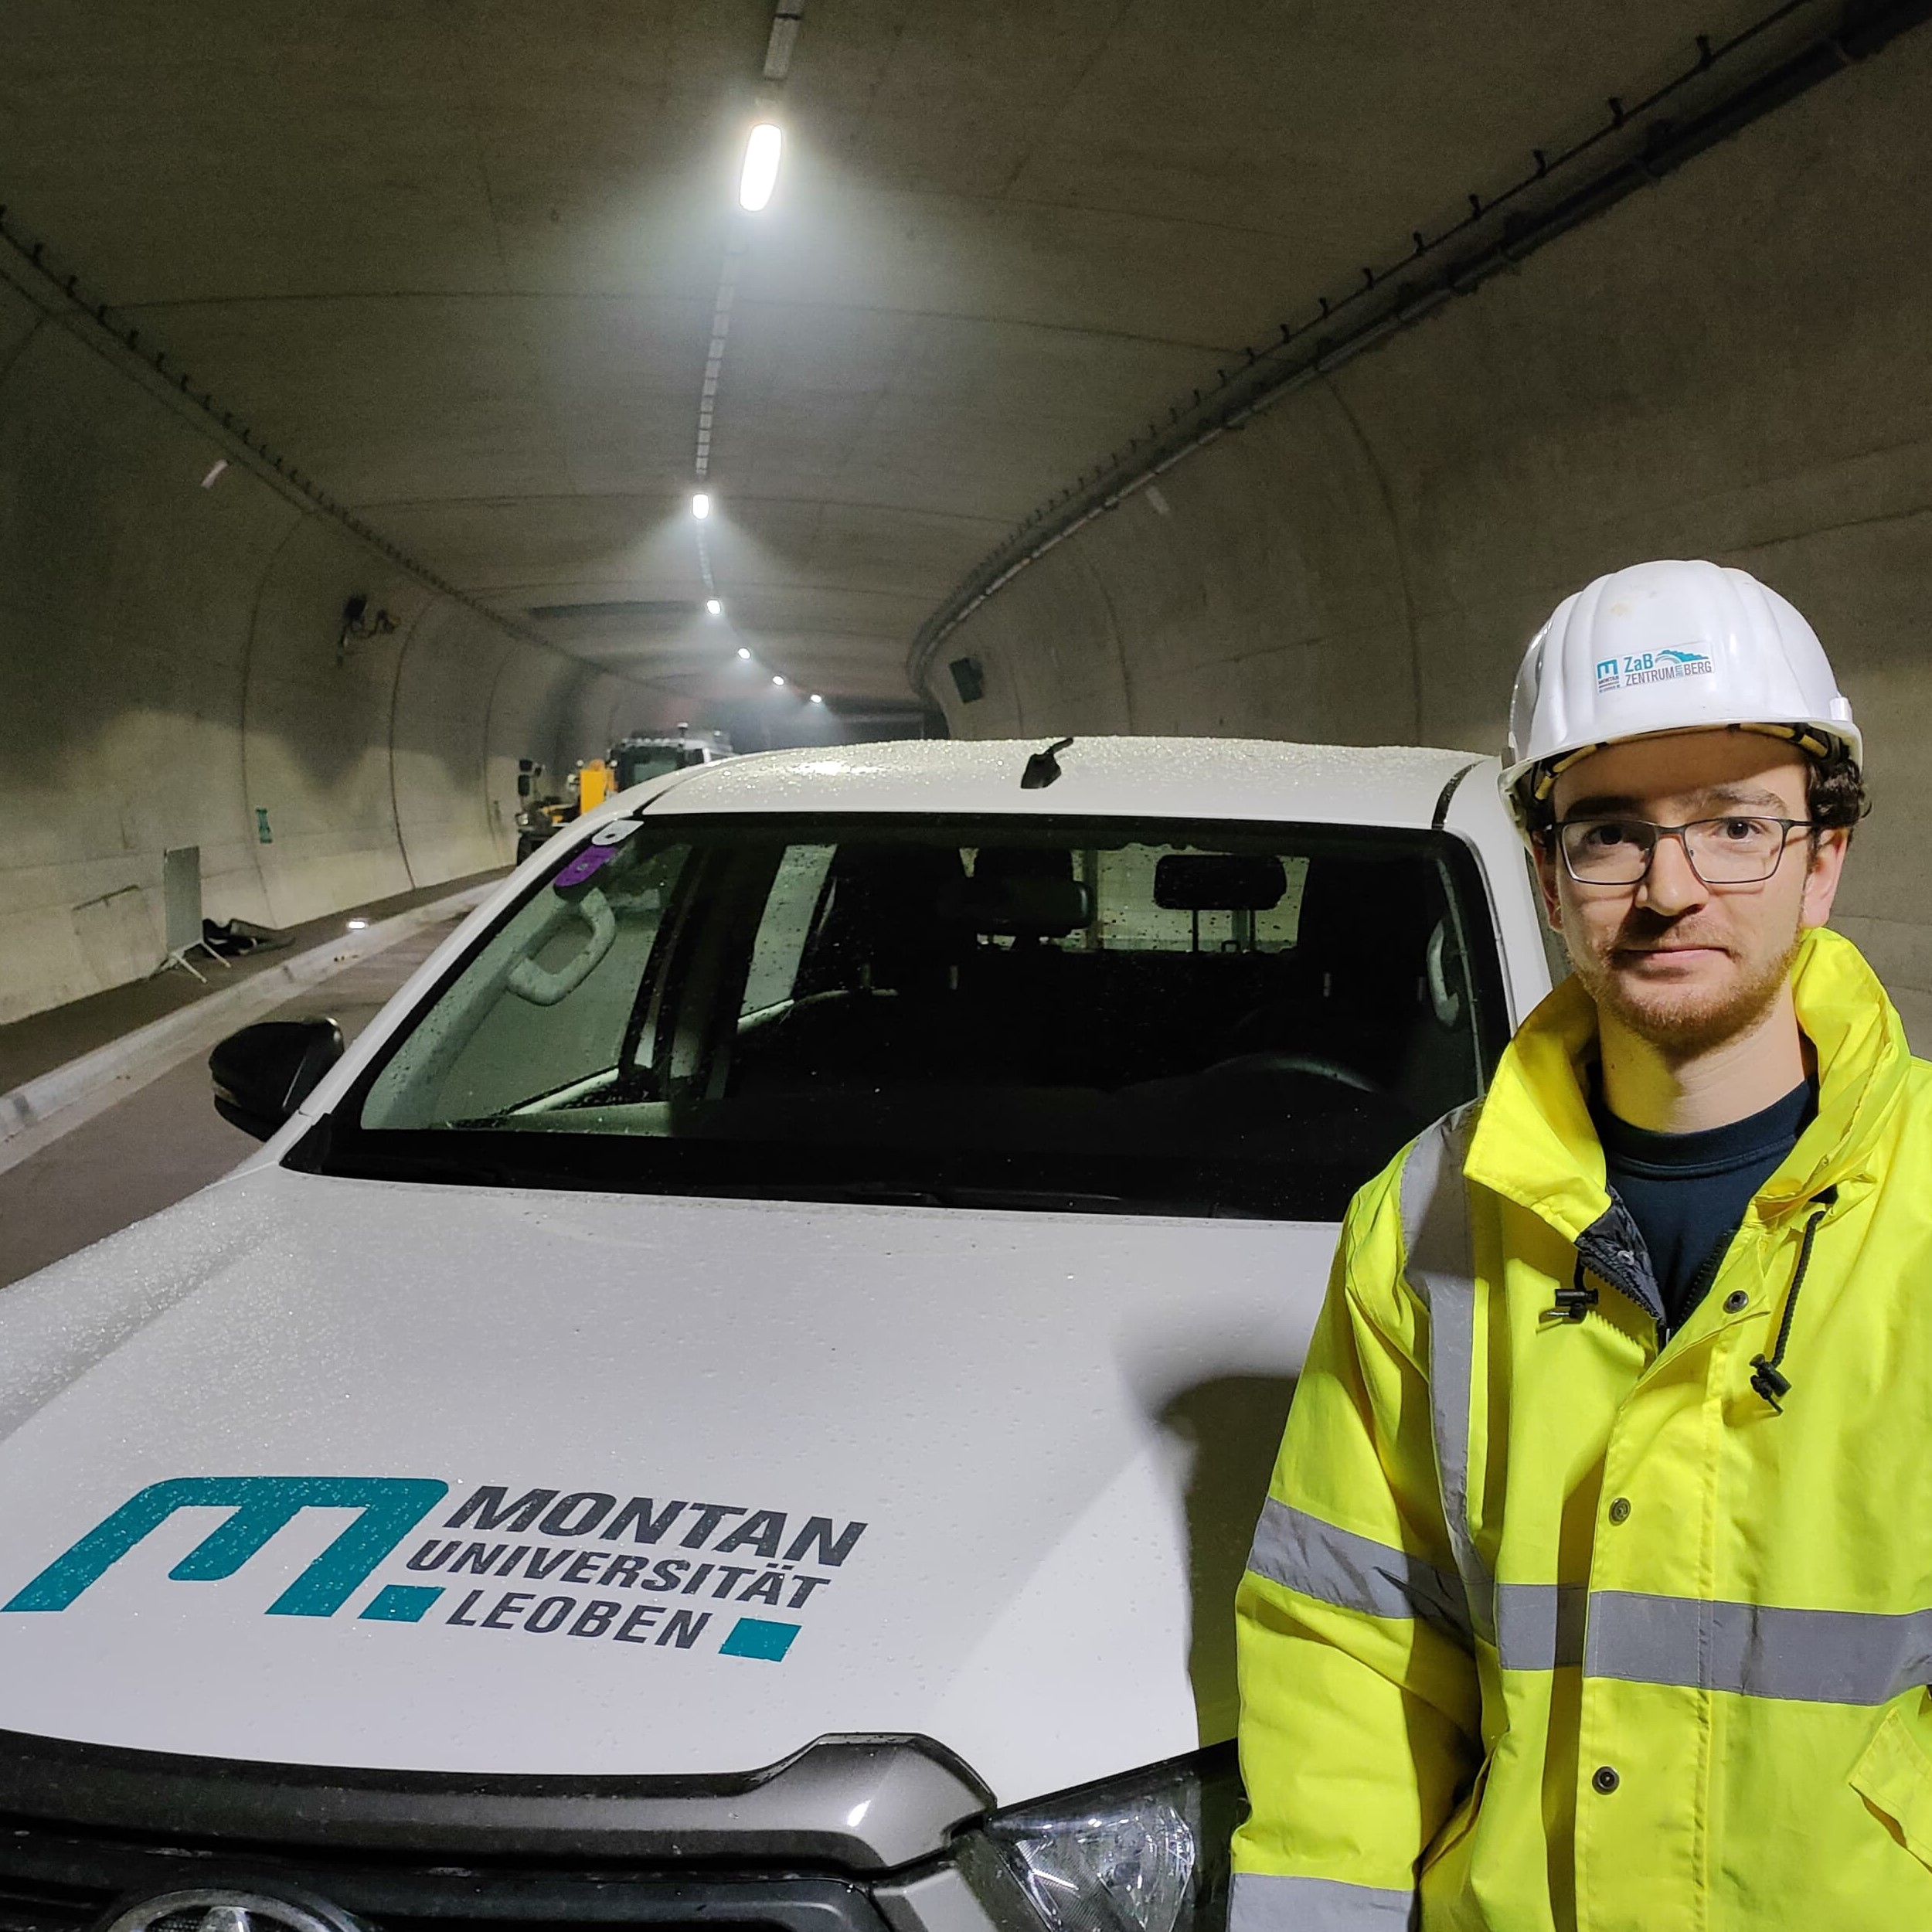
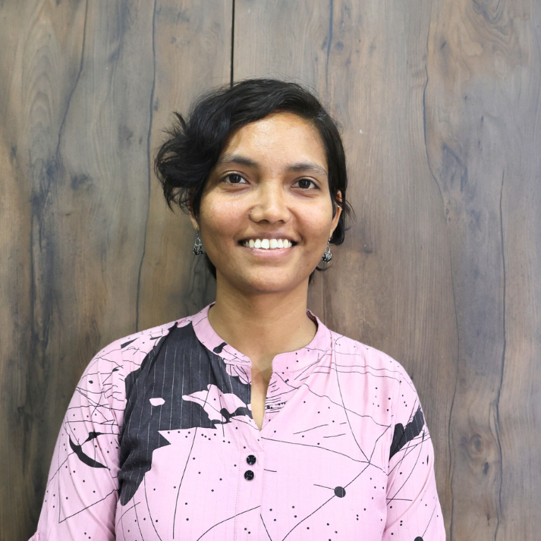


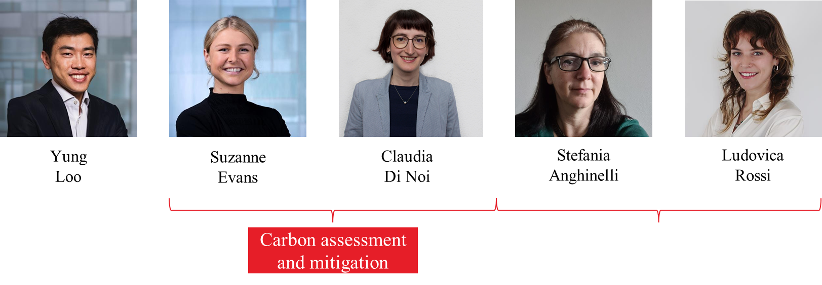
WP9: Introduction and objectives
WP 9 OF THE
WP9- Sustainable Development Strategy
Co-Coordinators
Objectives
Develop a strategy for the realization of a Sustainable RI, including:
Study and minimize the carbon footprint of ET, including computing and travel
Evaluate and minimize the landscape and environmental impact
Evaluate the contribution of the infrastructure to the UN sustainable goals
EGO
Lead beneficiary and Co-Coordinator - Responsible for:
M17, M18, M19, D9.1, D9,3
Maria Marsella
Francesca Spagnuolo
INFN
Co-coordinator
Responsible for:
D9.2, D9.1, D9.3
WP9 Team
MUL
Participant (excavated material treatments) - Contributor to D9.2
Robert Galler
Monica Marzario
Gabriel Loucky
Disha Sawant
Francesca Scipione
ARUP
CNRS has withdrawn its direct involvement in WP9 after reaching M18 and will now serve as reviewer for WP9 milestones & deliverables

Slide 5
WP9 - Summary of activities
WP 9 OF THE
Task/ Deliverable/ Milestone | Status | Date | Responsible
M17- Preliminary Sustainability Plan | Revision / in preparation | August 2025 | EGO
D9.1: ET Sustainable Development Implementation Strategy | Define content for D9.1 including the outcomes of D9.2 and D9.3 Carbon assessment fulfils D9.1 criteria (partially supports implementation but doesn’t fully cover the project's sustainability strategy) D9.2 and D9.3 will include a short section on implementation, to support alignment with D9.1 if required | February 2026 (TBC) | INFN&EGO
D9.2 : Environmental Impact Assessment | Interaction began with EGO and ARUP Quantifiable outcomes finalized Communication initiated with ETO Detector Layout being studied PBS elements being studied | October 2025 | INFN
D9.3 : Carbon Footprint Assessment | Interaction began with EGO and ARUP Quantifiable outcomes finalized Communication initiated with ETO Detector Layout being studied PBS elements being studied Preliminary frameworks as per electricity dependent component breakdown needs validation from WPs | December 2025 | INFN
ET–PP INFRA-DEV ANNUAL MEETING - 22–24 lug 2025 - Barcelona

Slide 6
M17- Preliminary Sustainability Plan– RP2 - Revision
WP 9 OF THE
Index | Details | Remarks
Executive Summary | Brief overview of goals, changes, and context
Sustainability Assessment for ET | Concise, ET-specific issues: site, power, excavation, access
Excavation & Material Reuse Strategy | Volume estimates, reuse pathways, transport footprint | Rough assumption can be considered and details can be taken from task document
Sustainability Action Plans by Theme | Action tables for: Low-Carbon and Energy-Efficient Infrastructure Climate Change Resilience Soil Preservation and Excavation Reuse Sustainable Water Use and Quality Protection Maximizing Socio-Economic Benefits | Emission numbers from LIGO and VIRGO can be referred and broad ranges can be added Electricity consumption with preliminary figure of around 6 GWh had circulated in the past, this indication has since been removed, as it could not be supported by solid technical data.
Integration with Technical WPs | How WP9 coordinates with other WP teams
Timeline, KPIs, & Deliverables | Milestone chart, Gantt preview, data dependencies
Annex | References, workshop attendee list, data templates
ET–PP INFRA-DEV ANNUAL MEETING - 22–24 lug 2025 - Barcelona

Slide 7
D9.1 - Sustainable Development Implementation Strategy
WP 9 OF THE
Study and minimize the carbon footprint of ET, including computing and travel
Tasks
Evaluate and minimize the landscape and environmental impact
Evaluate the contributions of the infrastructure to the UN sustainable goals
Activity
    Review of D9.1 including the outcomes of D9.2 and D9.3 and including:
  Documentation that may serve as underpinning information
  Making sure that the structuring and topic and themes advice provided is in line with current good practice of documents of similar nature for a major infrastructure project at the preliminary phase
  Expecting to align with what is understood to be ET-PP’s overall objectives for these documents i.e. consideration of: landscape, environmental and societal impact, assessing and minimizing the ET impact on its environment, environmental management approach, reuse and recycling of the excavated materials…
Aims:
Developing a methodology, approach and structure that helps enable delivery by the strategy documents owner and consistency across the strategies.
To establish and define their scope for delivery of these documents and support that is required.

Slide 8
D9.2 – EIA & D9.3 - Carbon
WP 9 OF THE
Deliverable by
October 2025
(Version 1 - TBC)
D9.2
  Scoping and Baseline Assessment
  Alternatives and Mitigation
  Public Participation and Transparency
  Monitoring and follow-up
Deliverable by December 2025
(Version 1 - TBC)
D9.3
  Compute the key Carbon and Environmental Impacts, Findings and Mitigation Strategies
  Highlight the most critical insights and recommendations for decision-makers
Strategy for following sessions
Data Framework will be discussed and shared with other WPs
Following session for clarifications and follow-ups
ET–PP INFRA-DEV ANNUAL MEETING - 22–24 lug 2025 - Barcelona

Slide 9
D9.2 – Environmental Impact Assessment (EIA)
WP 9 OF THE
Objective - Develop a robust and integrated Environmental Impact Assessment framework aligned with EU EIA Directive (2011/92/EU as amended by 2014/52/EU)
9.2.1: Assessing and minimizing the ET impact on its environment
9.2.2: Environmental management approach
9.2.3: Analyse and define an overall strategy for reclamation, reuse and recycling of the excavated materials
Data Required
Actions
ET-PP WP Contact Person
Interaction with stakeholders
Approach for site-dependent analysis

Slide 10
D9.2 – Environmental Impact Assessment (EIA)
WP 9 OF THE
Key Activities
Define Sustainability Strategy with environmental, social, and economic themes
Establish Baseline conditions using site-specific data (air, water, soil, noise, biodiversity, etc.)
Conduct detailed Impact Assessments for both construction and operational phases
Develop and implement Strategic KPIs (for site comparison) and Specific KPIs (for mitigation & performance tracking)
Identify and evaluate Alternatives and Mitigation Measures across EIA themes

Slide 11
D9.2 – Environmental Impact Assessment (EIA)
WP 9 OF THE
Energy, Carbon Footprint, Air Quality
Climate Change Adaptation
Soil, Water, Biodiversity
Materials & Waste
Human Health and Socio-Economic Factors

Slide 12
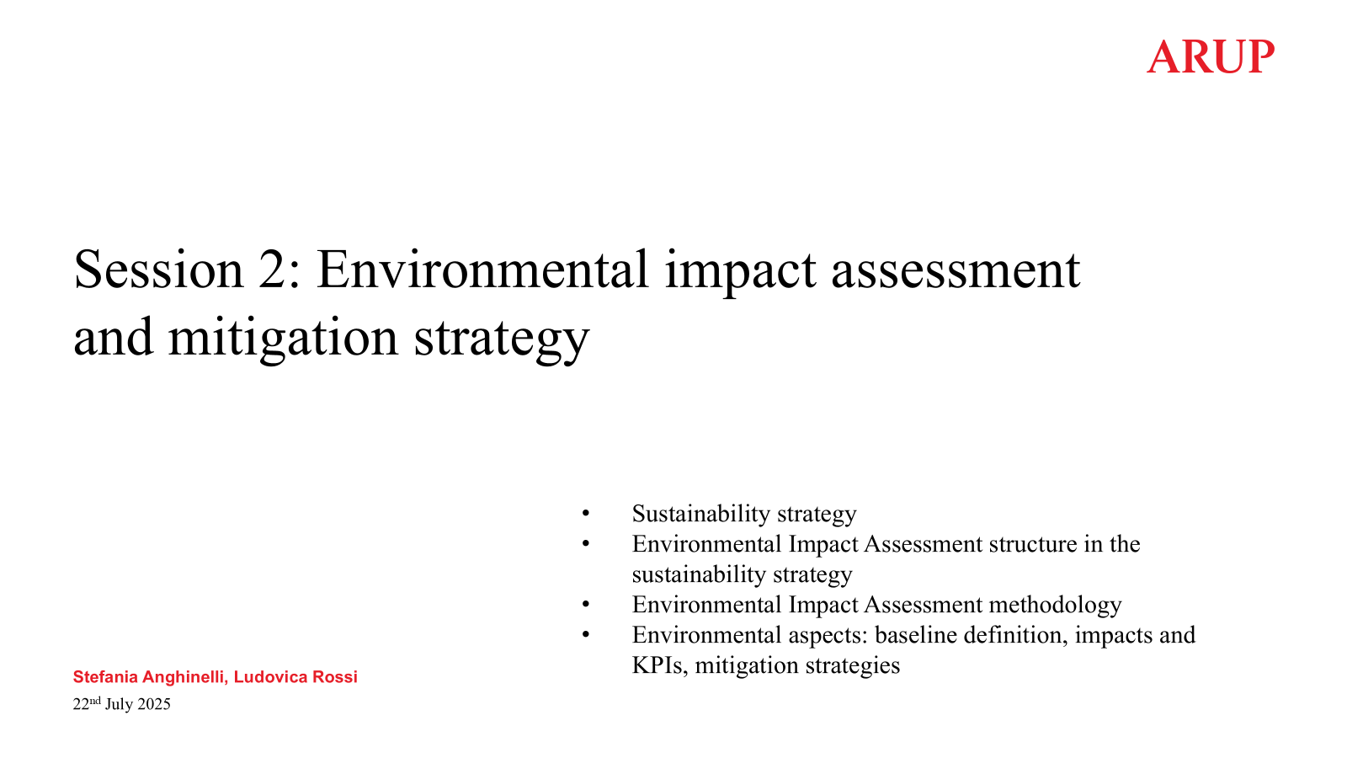

EIA Strategy (D9.2) – ARUP presentation following
WP 9 OF THE

Slide 13
D9.3 – Carbon Footprint Assessment (CFA)
Objective - Define a structured strategy for carbon footprint assessment and mitigation measures for the Einstein Telescope project
WP 9 OF THE
Methodological Framework - standards, boundaries, modelling, data sources, and digital tools
Governance and Strategy for carbon management - objectives, defined stakeholder roles, and integration into project-wide decision-making
Life Cycle Assessment Strategy - project alternatives, carbon budgets, benchmarks, data quality, and scenario analyses
Carbon Mitigation Strategy with sector-specific measures, circular economy principles, energy efficiency, and real-time monitoring integration
Alignment with EU policy to ensure compliance on materials, waste, resilience, decarbonization, and logistics
National Legislation in candidate countries to ensure compliance at potential project sites
Monitoring, Reporting & Verification -carbon tracking, data protocols, reporting, and third-party assurance

Slide 14
D9.3 - ET Carbon footprint assessment and mitigation
WP 9 OF THE
Objective - Develop a robust and integrated Environmental Impact Assessment framework aligned with EU EIA Directive (2011/92/EU as amended by 2014/52/EU)
9.3.1: ET carbon budget
9.3.2: ET Energy consumption optimization
Data Required
Actions
ET-PP WP Contact Person
Interaction with stakeholders
Approach for site-dependent analysis

Slide 15
D9.3 - ET Carbon footprint assessment and mitigation
WP 9 OF THE
Activities by EGO
Goal | Timeline | Task | Status
Preliminary Sustainability Plan | Mid August 2025 | Review of the last submitted version Scan and survey of relevant ET-PP and ARUP documents Identifying and noting gaps and improvements to be ET- specific Identifying broad sections of the PSP Drafting of first version of PSP based on comments and suggestions from WP9 members | Done Done Done Done Ongoing
Carbon Footprint Assessment | December 2025 V1 | Coordinating with ETO – Project Office for understanding ET -PBS Creating a clear and comprehensive mapping of all critical elements at the forefront of the detector Clustering these components based on dependencies and details as per their energy needs Creating frames to categorize data requisites Coordinating with ETO – Engineering Department | Ongoing Ongoing TBD TBD TBD
Overall Coordination and Assistance |  | Working with INFN and ARUP for updates Developing coordinator role for future data collection and coordination | Ongoing TBD

Slide 16
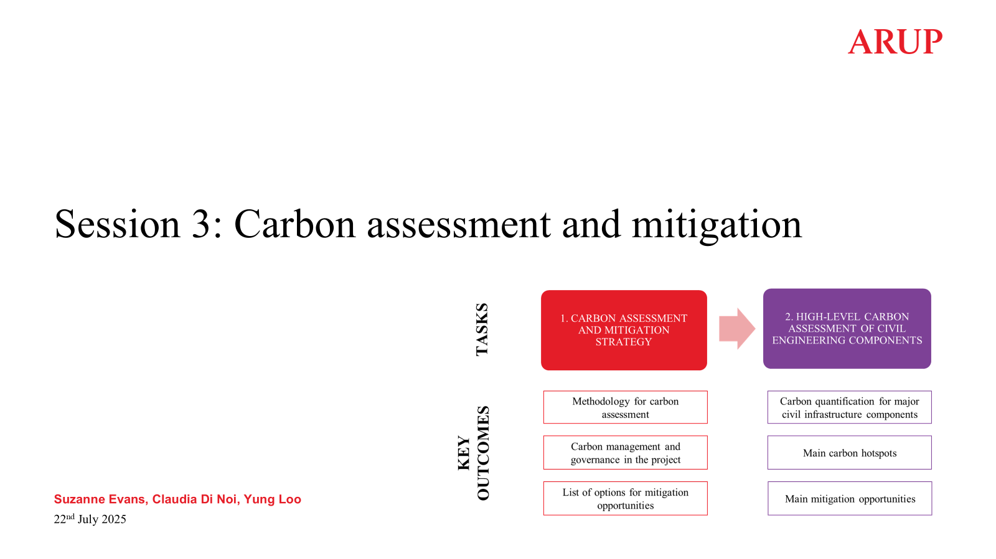
Carbon Assessment (D9.3) – ARUP presentation following
WP 9 OF THE

Slide 17
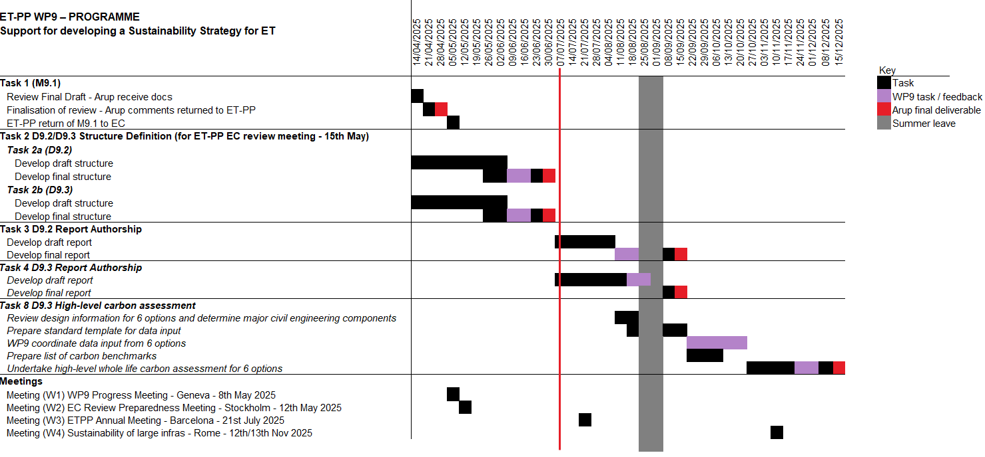
Timeline – in progress
WP 9 OF THE

Slide 18




Strategy and Stakeholders
WP 9 OF THE
WP9 +ARUP
PBS (ETO Project Office) - Alessandro Variola
Engineering Dept
(ETO –ED - Patrick Werneke
LVK community - Alessio Rocchi
Other WP Teams
Local Teams
Dashboards
Interviews
Data dashboards being shared
Data files being shared
Computation and analysis underway
Reporting TBD
Online/ Offline Meetings
Google Docs
Data Collection and Updates: Templates
Database
MS Office Docs
ET–PP INFRA-DEV ANNUAL MEETING - 22–24 lug 2025 - Barcelona

