Slide 1

INFRADEV-02: Early phase implementation of ESFRI Projects that entered the ESFRI Roadmap in 2021
Proposal preparation
Monique Bossi
ET PP Meeting – Barcelona, 24.07.2025

Slide 2
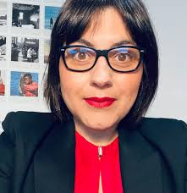
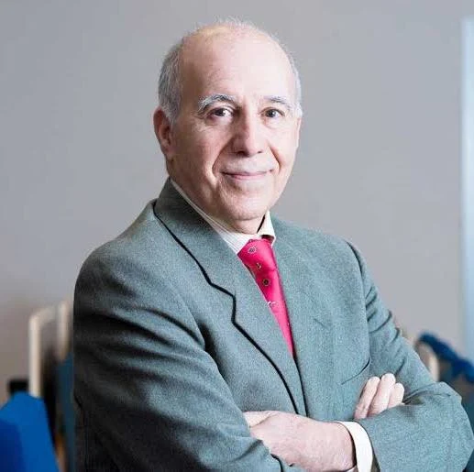

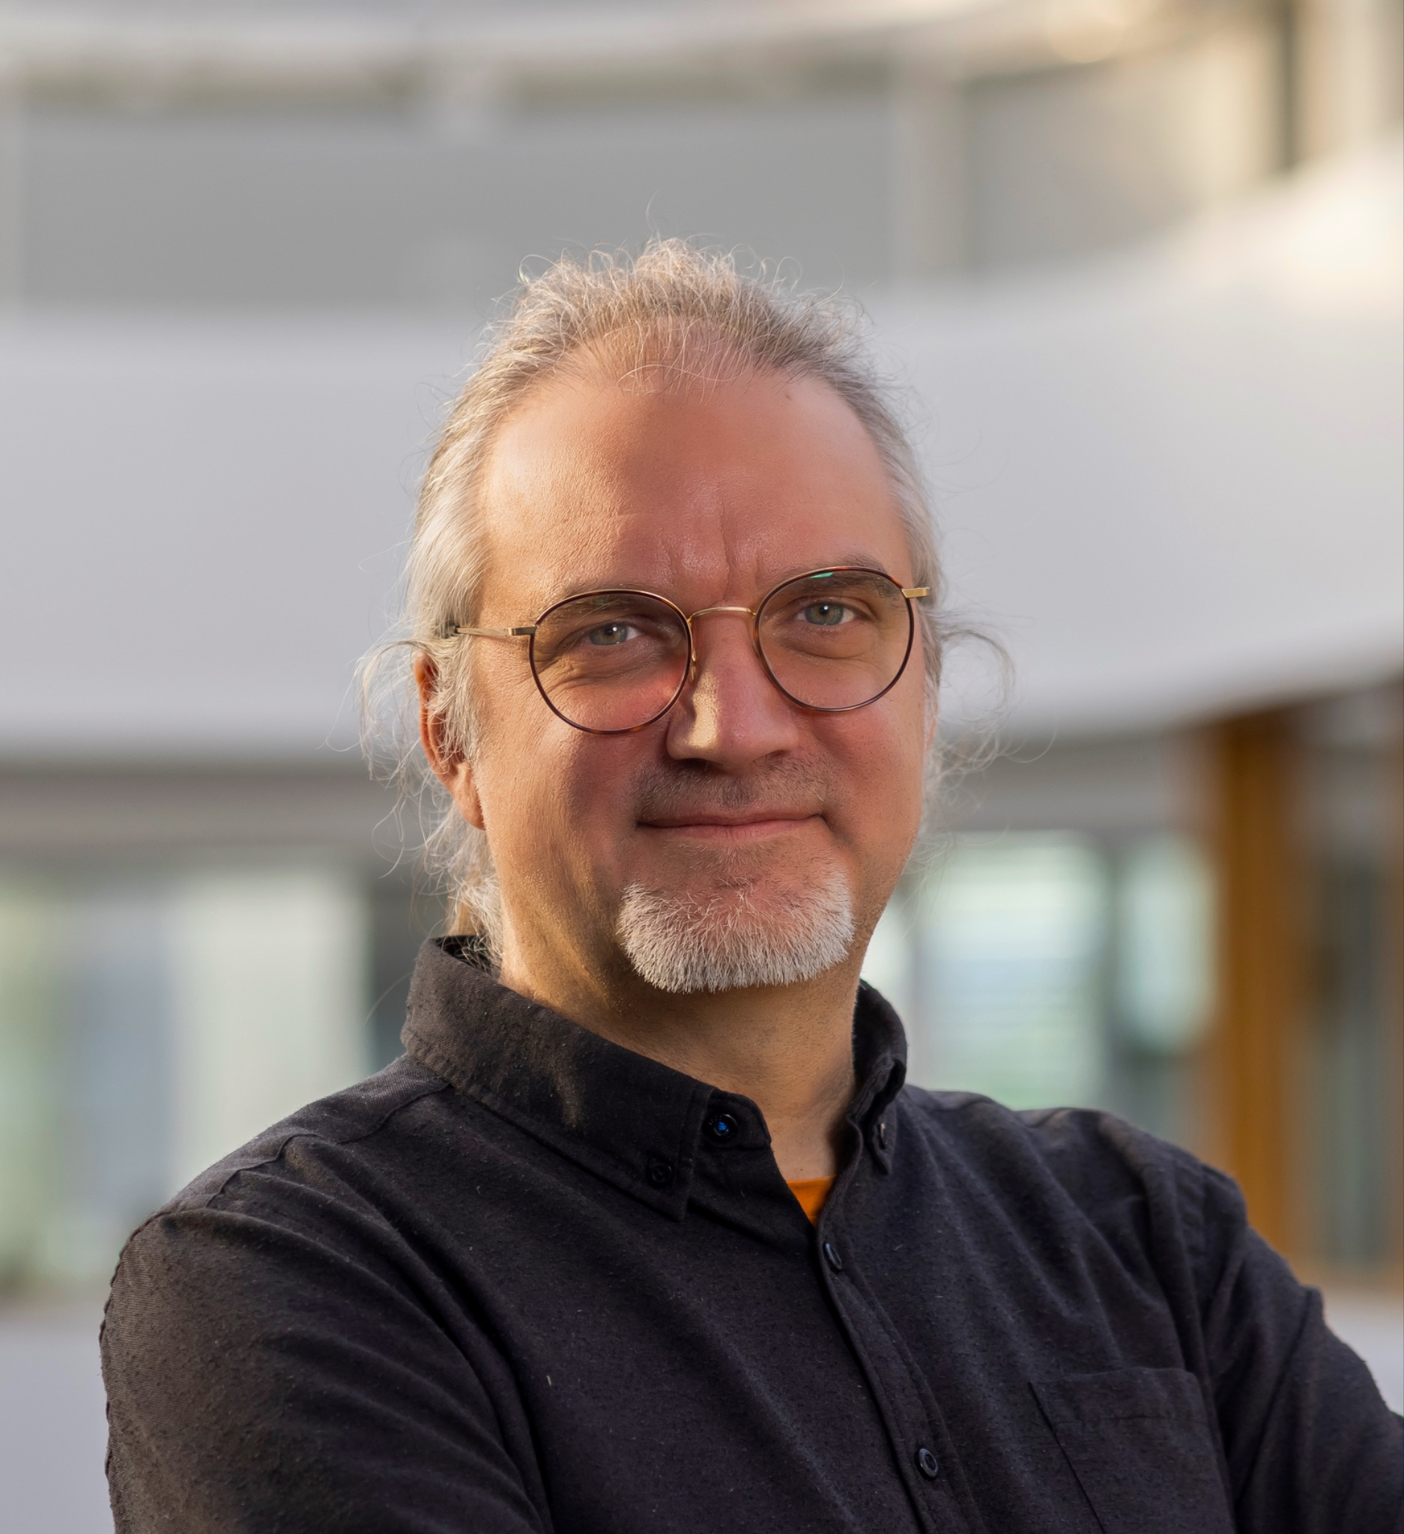
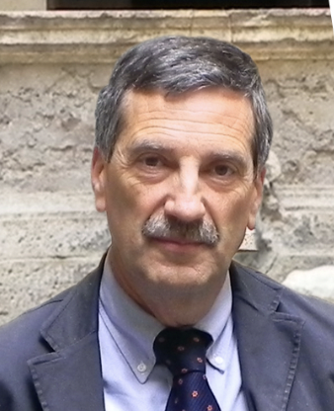
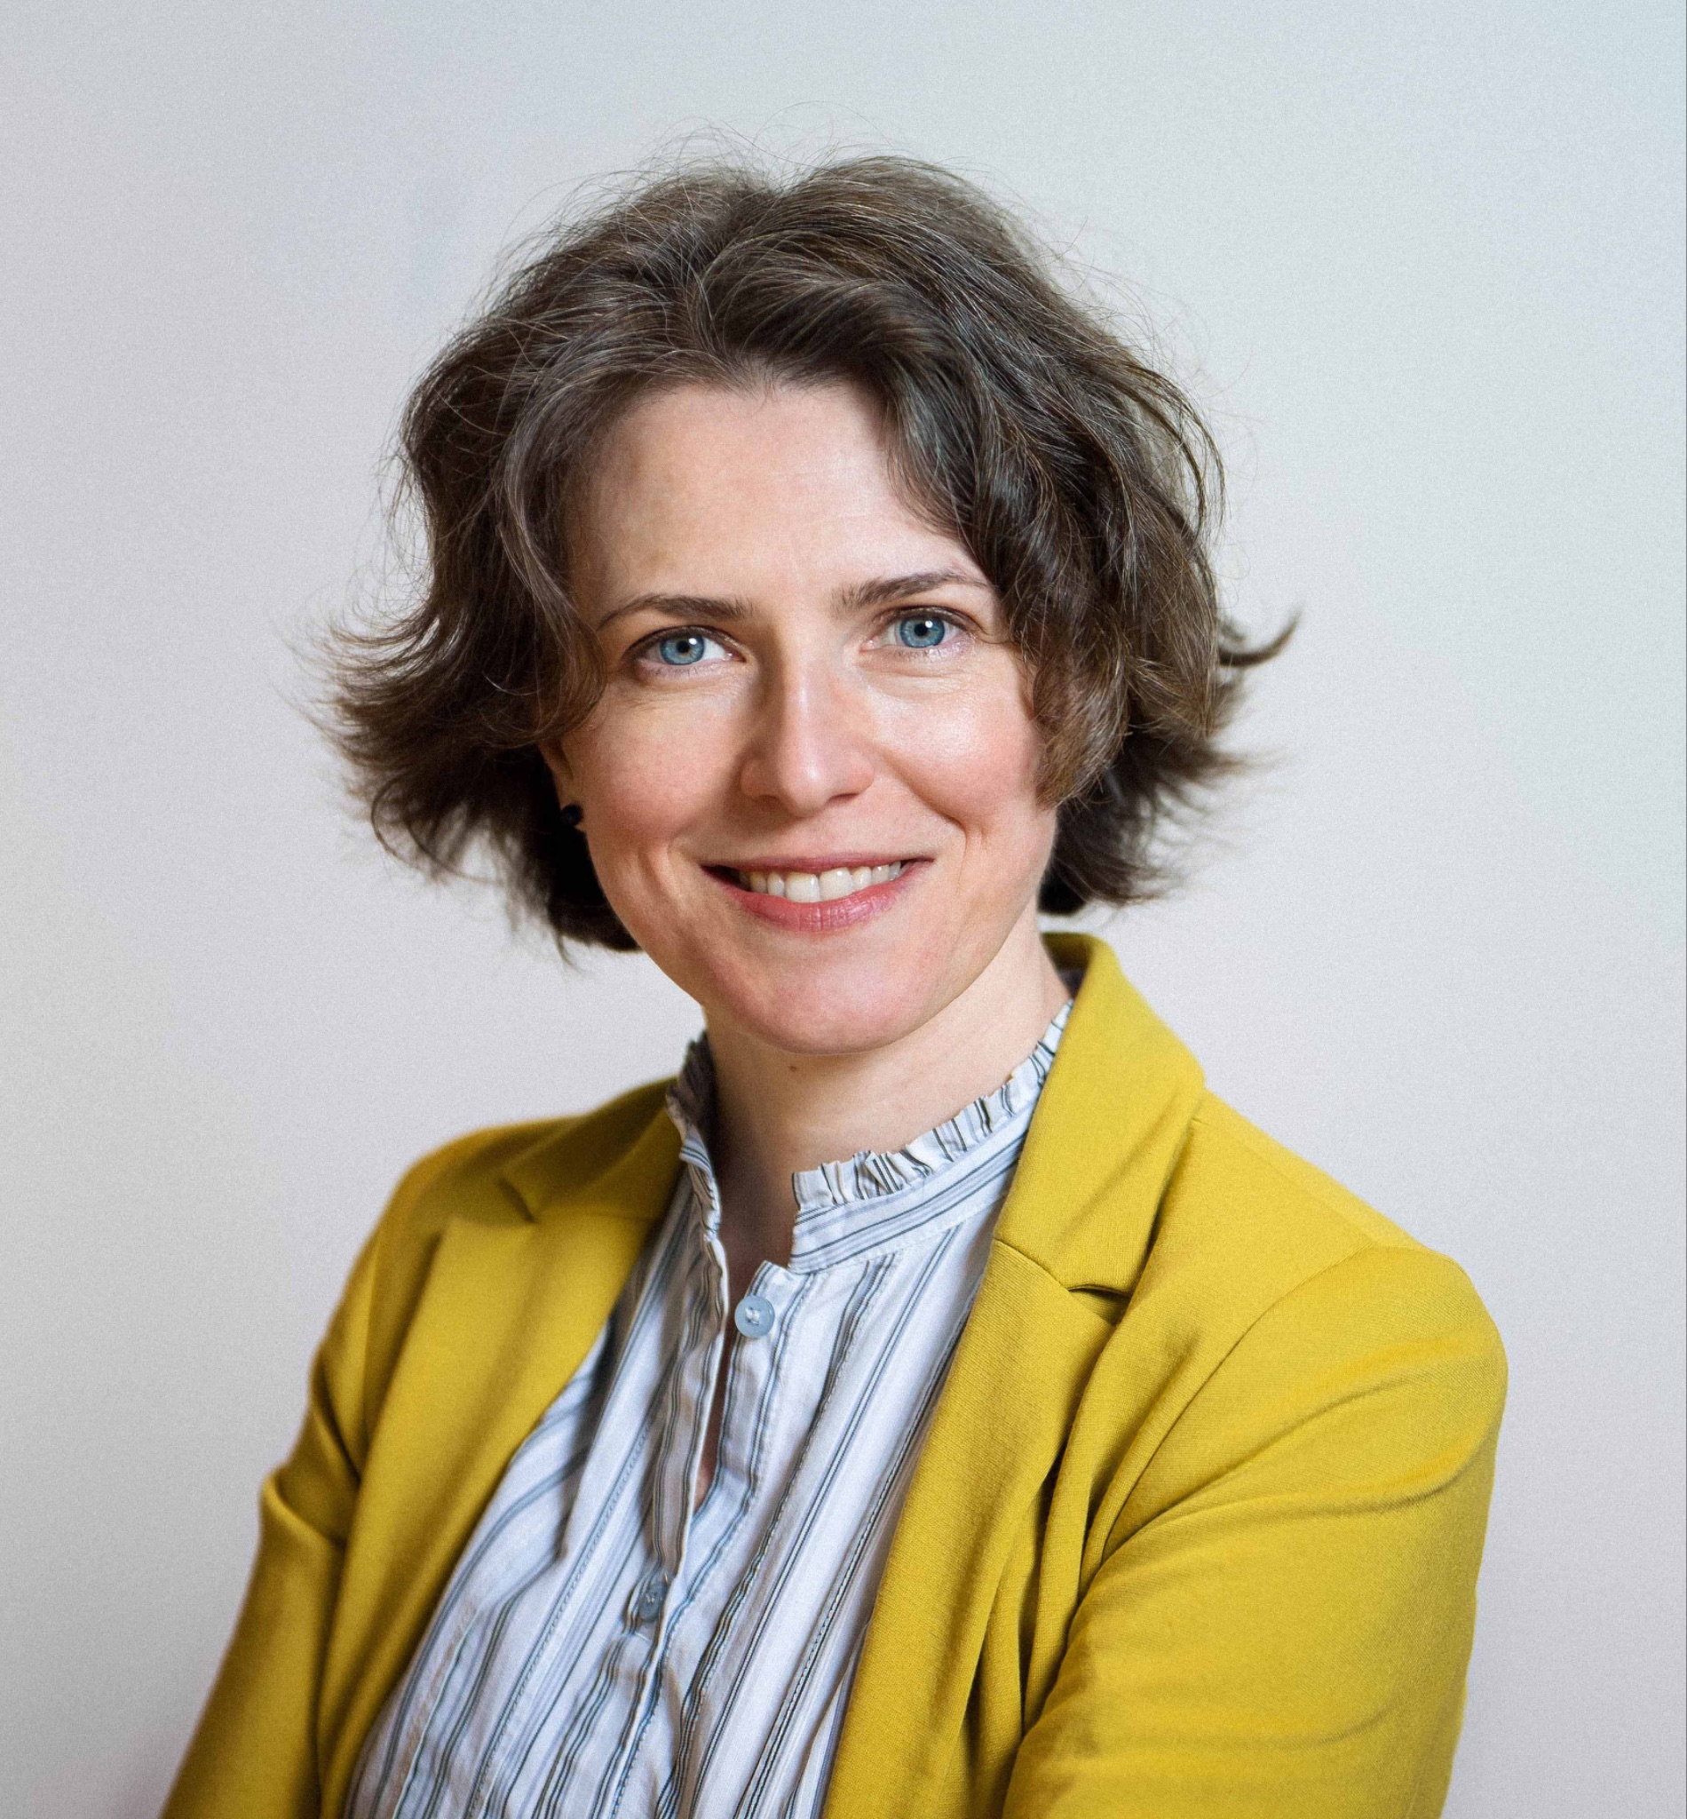



Einstein Telescope
ET PP Meeting – Barcelona, 24.07.2025
Coordination Team: who we are
Monique Bossi
Project coordinator
Federico Ferrini
Scientific advisor
Manuela Schisani
Project manager
Andreas Freise
ETO director
Fernando Ferroni
ETO director
Daniela Trani
ETO associate director
INFRADEV2 as ESFRI project: sound expertise in large RIs establishment and EC grant.
INFRADEV2 as instrument to support ETO’s further establishment and growth

Slide 3

INFRADEV-02: Early phase implementation of ESFRI Projects that entered the ESFRI Roadmap in 2021
Expected Outcome
Faster and larger implementation of the ESFRI Projects that entered the ESFRI Roadmap in 2021*.
Enhanced ERA excellence and attractiveness through the availability of additional capacities from the targeted ESFRI Projects.
Solid Member States/Associated Country engagement in pan-European research infrastructures, leading to their full implementation.
Long-term perspective for investments in research infrastructures.
Synergies and complementarities between new and existing research infrastructures.
Scope
Enlargement of the membership.
Establishment of the governance structure and legal entity.
Securing the funding.
Finalisation of the distributed architecture.
Development of ICT and data management solutions.
Development of access policies and users’ strategies.
Consolidation of the international dimension.
Consolidation of the service offer.
Assessing possible expansion to new user communities/new needs.
Addressing staff and procurement related issues.
* EBRAINS, SLICES, SoBigData++, MARINERG-I, EIRENE RI, ET, EuPRAXIA, GGP, GUIDE, OPERAS, RESILIENCE
Proposals should focus on activities addressing identified bottlenecks
Credits:

Slide 4




Submission Key elements
Keep close to topic scope, objectives, expected impacts and indicated budget. Proposal can be resubmitted: plan final submission 48 hours before deadline to avoid congestion and errors.
Proposal template (Lump Sum CSAs limit is 33 pages)
Part A: web-based forms fed by information entered by the participants.
Part B is the narrative part (includes B1 Excellence, B2 Impact, B3 Implementaton) to be uploaded as a PDF
Detailed budget table as an annex to the Part B
EUR 16,5M€/11 projects, expected EU contribution per project: EUR 1 – 1,5M€*
+ 3 months for GAP
Credits:

Slide 5

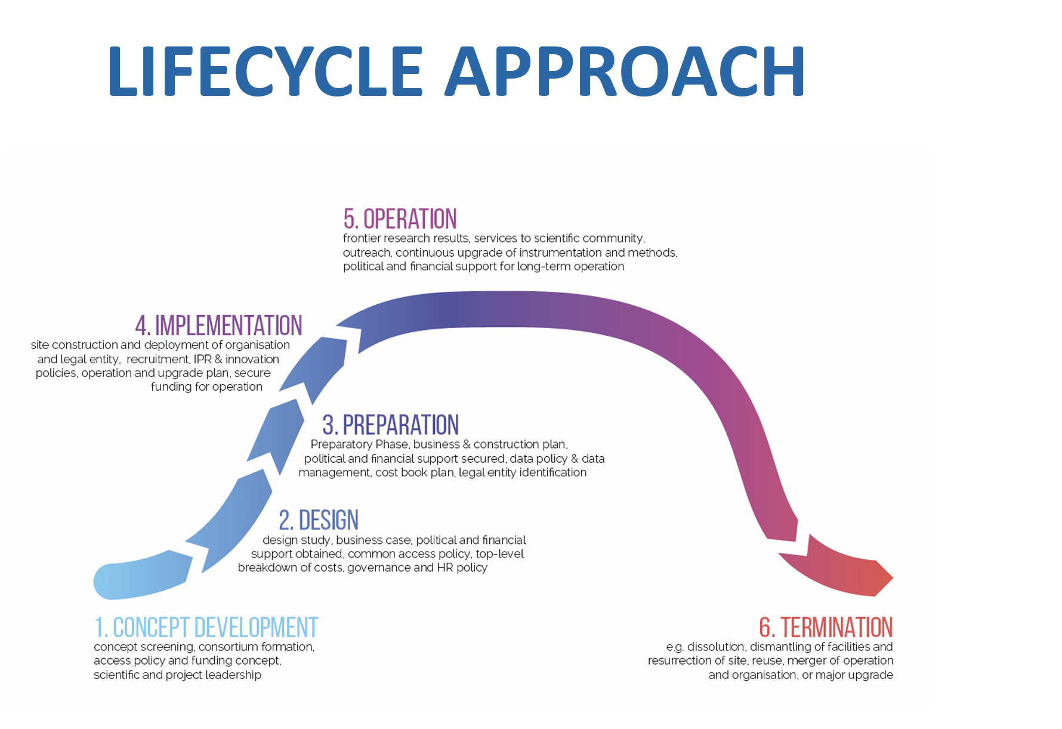




Einstein Telescope
ET PP Meeting – Barcelona, 24.07.2025
Site Infrastructure Design and Planning
Deployment Planning and Pre-Production Testing
Legal and Governance Framework
Outreach and Host Country Engagement
ET as an ESFRI project
In-Kind Contribution Coordination
Communication and Stakeholder Engagement
Innovation and Industry
Neutron Ecosystem Development
Data Management and User Access
Legal Entity and Governance
Technical Implementation
Data Management and Open Science
Sustainability and Long-Term Operation
Outreach and Communication
Civil Engineering and Site Infrastructure Design
Power Distribution Systems
Specialist Building Design
Computing and Data Infrastructure
Tender Documentation Preparation

Slide 6
Einstein Telescope
ET PP Meeting – Barcelona, 24.07.2025
Consortium formation
Country | Name | Affiliation | Name | Affiliation | Name | Affiliation
ETO | Fernando Ferroni | ETO - INFN | Andreas Freise | ETO - Nikhef | Daniela Trani | ETO - Nikhef
Italy | Monique Bossi | INFN | Federico Ferrini | CTAO | Manuela Schisani | INFN
Austria | Jochen Schieck | Austrian Academy of Science
Belgium | Tjonnie Li | KULeuven | Sabien Vanlangendonck | KULeuven R&D | Birgit Peeters | KULeuven R&D
Croatia | Senka Maćešić | University of Rijeka | Tea Dimnjašević | University of Rijeka
France | Nicolas Leroy | IN2P3
Germany | Katharina Henjes-Kunst | DESY | Michèle Heurs | Uni Hannover | Achim Stahl | RWTH Aachen
Greece | Pending
Netherlands | Stan Bentvelsen | Nikhef
Poland | Leszek.Roszkowski | Astrocent
Spain | Inmaculada Fiegueroa | Ministry
UK | Sheila Rowan | University of Glasgow | Angus Bell | University of Glasgow | Alberto Vecchio | University of Birmingham

Slide 7
Einstein Telescope
ET PP Meeting – Barcelona, 24.07.2025
Milestones
July 25th: Finalisation of the Consortium (Beneficiaries and Affiliates)
→ Contact list
July 25th: first draft WBS and WP and Task allocation (50%)
August 1st: finalisation of WBS and WP and Task allocation (90%)
August 6th: 1st draft of part B1 and budget → interaction with partners
August 18th: 1 draft of part B3 →interaction with partners
: consolidated B1
August 25th: 1 draft of part B2 →interaction with partners
: consolidated B3
September 1st: Participant portal complete (90%)
: Consolidated proposal and budget
: inform BGR
September 8th: first submission
September 16th: final submission

Slide 8

Thank you!

