Slide 1
Strategic Innovation Procurement
Kazimierz Anhalt, Innovation Procurement Expert
University of Warsaw (Einstein Telescope Member)

Slide 2

1. Background & Context
Event: Strategic Procurement Training for Public Buyers
Organizer: EISMEA / European Commission
Location: Vienna, Austria
Dates: 16–20 June 2025
Goal: Enhance uptake of strategic innovation procurement across the EU

Slide 3
2. Objectives of the Programme
Promote a cultural shift towards innovation in public procurement
Empower public buyers with legal and practical skills
Enable SME/startup-friendly procurement ecosystems
Support strategic collaboration across public, private, and scientific sectors

Slide 4
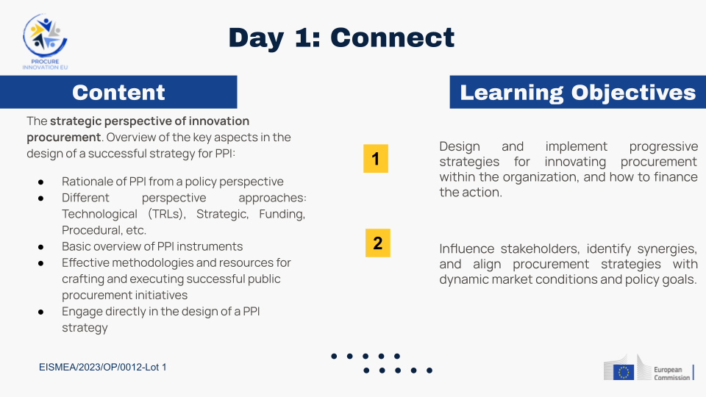

Slide 5
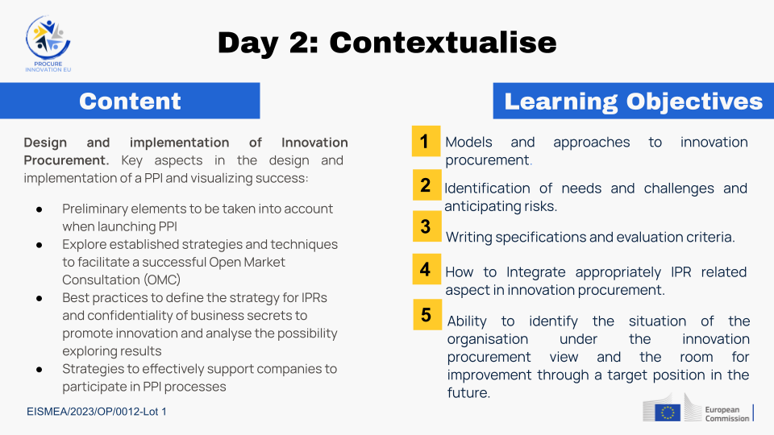

Slide 6
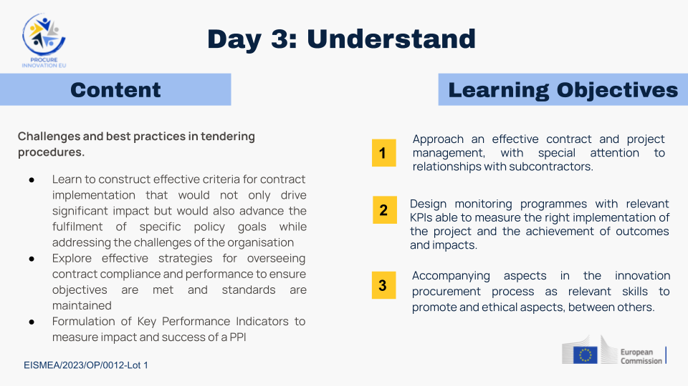

Slide 7
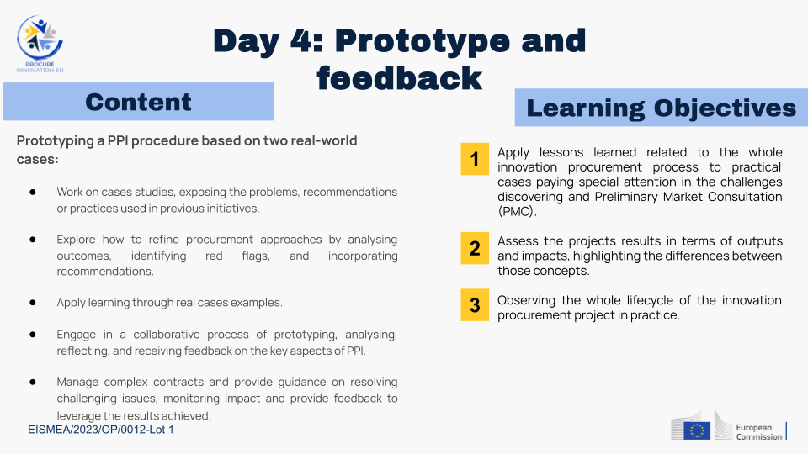

Slide 8
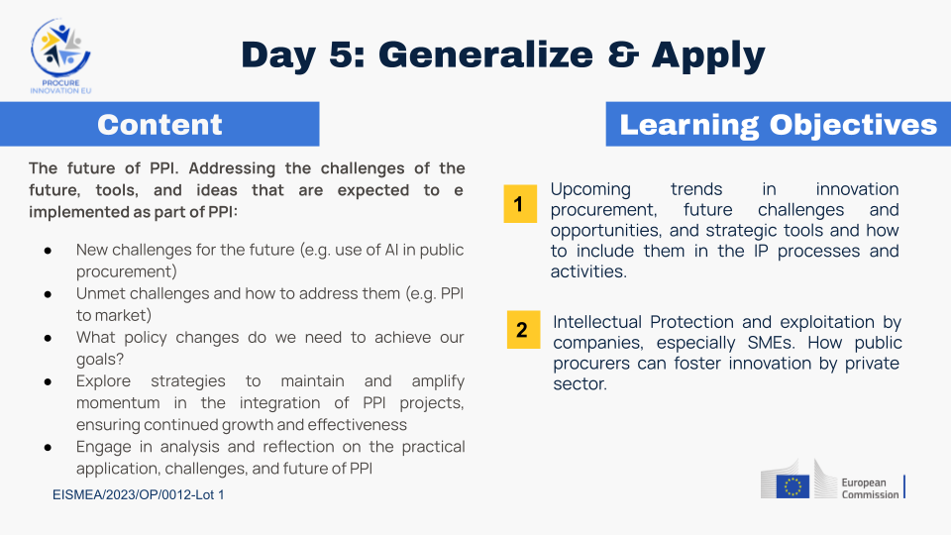

Slide 9
3. Training Summary
Participants: 30 attendees from 19 EU countries
Focus Areas:
• EU regulatory and policy framework for PPI
• Innovation procurement strategies
• Real-world case studies (e.g. 'All-Around the World' session)
Outcome: Deeper understanding of motivation and processes behind innovative procurement in EU public sector

Slide 10
4. Key Insights
Innovation procurement is a powerful tool for collaboration between public institutions, SMEs, startups, and citizens
Legal compliance with EU regulations enables cross-border procurement
A centralized knowledge base can support consistent practices

Slide 11
5. Recommendations for ET-PP
1. Disseminate PPI knowledge across all ET-PP work packages
2. Engage with Innovation Procurement Hubs (EU-funded) led by DG GROW & EISMEA for the purpose of PPI knowledge absorption
3. Engage with SPIN4EIC for the purpose of EIC awardee SME’s identification
4. Support, training, and networking for innovation procurement @ public-buyers-community.ec.europa.eu

Slide 12

SPIN4EIC Programme overview
DEMAND
SUPPLY
Academies and Toolkit
Pitching events
Organisation of online Innovation Procurement Academies to boost innovation procurement knowledge and skills in the European and Global contexts
Building and sharing a toolkit on innovation procurement to be accessible on the SPIN4EIC Helpdesk
For Private and Public procurers;
Identification of relevant procurers and development of a common challenge
Matching EIC beneficiaries with buyers' needs based on the defined challenges
Private
SPIN4EIC Community
Pitching events
Selection of EIC Awardees to match procurers’ needs and challenges
Provision of pitching coaching and feedback on pitch decks
Public
Assistance to public procurers
Identification and assessment of the needs of the public procurer
Support with conducting an open market consultation
Support in the drafting of tender documents and building a business case
Assistance
Identification of European and international opportunities matching EIC Awardees’ solutions
Assisting EIC Awardees throughout the tendering cycle (guidance on elaboration of tender strategy, storyline, pipeline management, opportunities follow-up and feedback loops, IP and legal matters, etc.) based on tailored needs of each assisted EIC Awardee

Slide 13
6. Suggested Next Steps
Establish ET-PP Cloud and Automated Repository:
EU PPI regulatory, policies, strategies, good practices
Regularly updated and searchable
Access granted to authorized Staff throughout WPs
Use repository to enable collaborative innovation within ET-PP

Slide 14
7. Conclusion
The training provided strategic tools to advance innovation in procurement
Strong case for embedding PPI principles throughout ET-PP
Leveraging EU networks and knowledge bases will maximize impact

