Slide 1
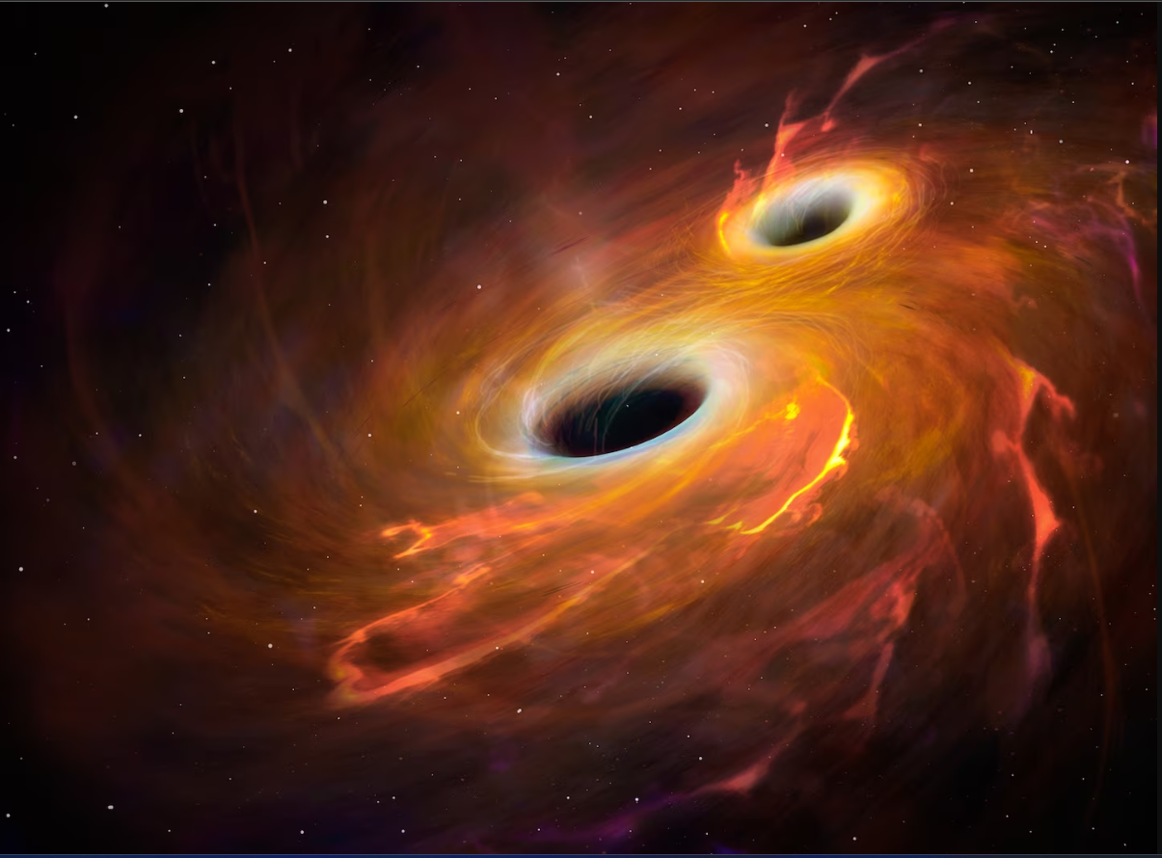


IFAE Seminar
Beyond GR Tests with the Einstein Telescope
Andrea Begnoni
University of Padua
13/6/25

Slide 2
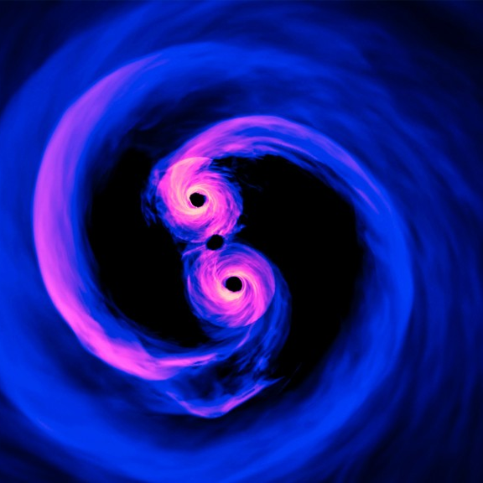
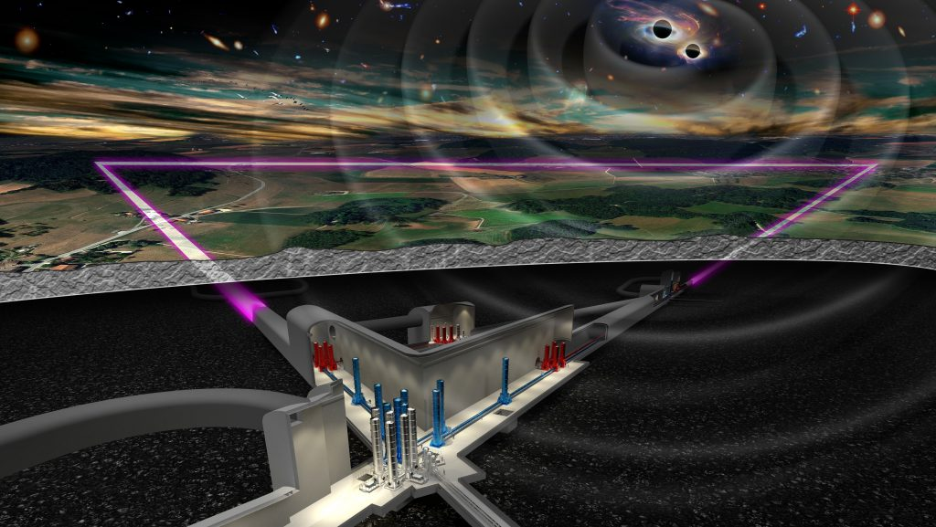
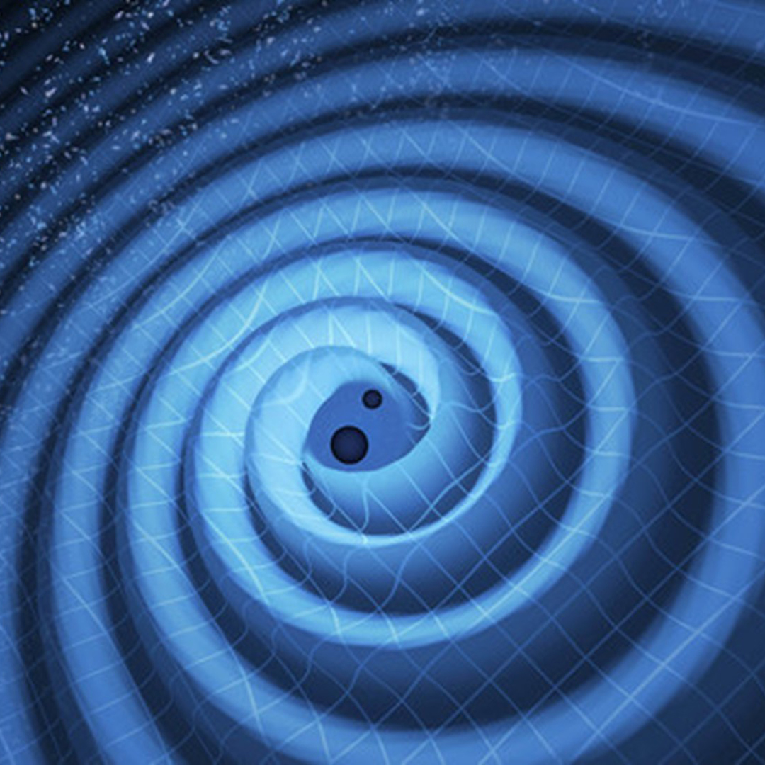
Collaborators
All the work presented was done in collaboration with:
Stefano Anselmi, Unipd
Walter Del Pozzo, Unipi
Matteo Pegorin, Unipd
Mauro Pieroni, IEM
Joachim Pomper, Unipi
Alessandro Renzi, Unipd
Angelo Ricciardone, Unipi

Slide 3
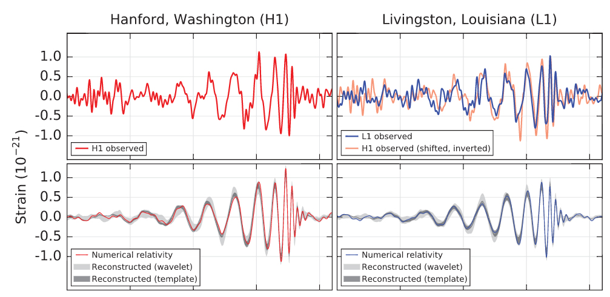
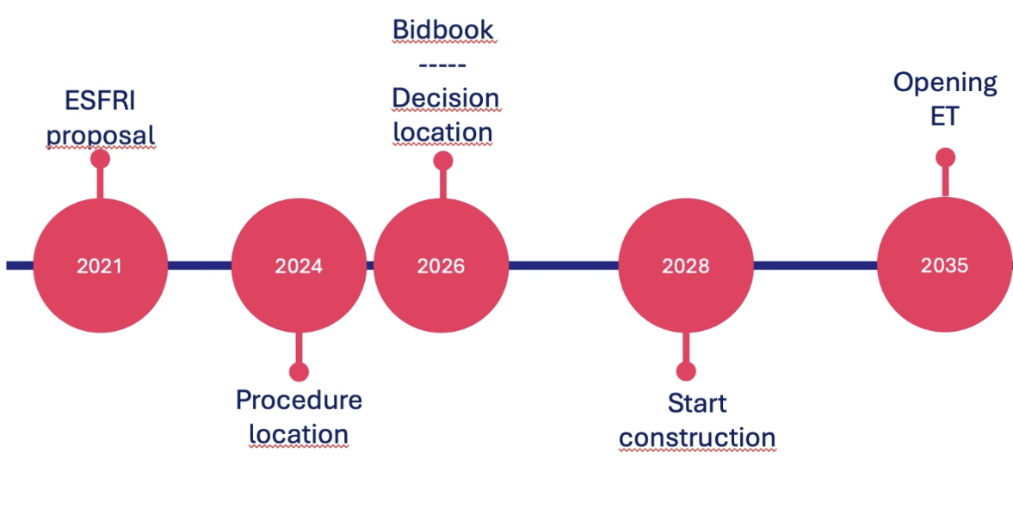
The dawn of GW astronomy
- Are we getting closer to noon? -
The first GW detection was almost 10 years ago
During the O4 run from Ligo Virgo Kagra (LVK) detected more than 200 sources in 2 years
PTA discovery of a Stochastic GW background (SGWB)
ET procedure location is ongoing
LISA entered the hardware implementation phase (B2)

Slide 4
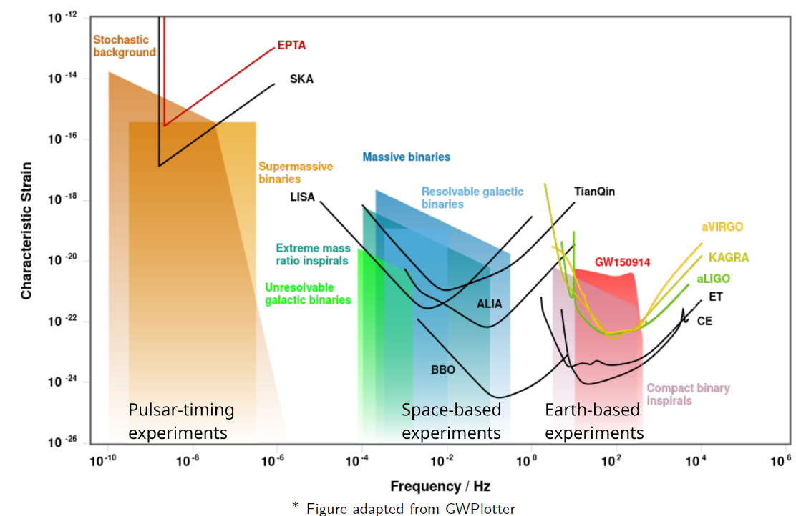
Present and future GW experiment
Different types of detectors will probe different frequency bands (and sources).
High-frequency GW experiments are missing from the plot
13/6/25
Andrea Begnoni

Slide 5
Einstein Telescope
ET will be part of the third generation of ground-based interferometers
Will be operative in the late 2030s
The design is still under scrutiny (triangular vs 2L) [1-2]
[1] Branchesi et al. 2023
[2] Abac et al, 2025

Slide 6
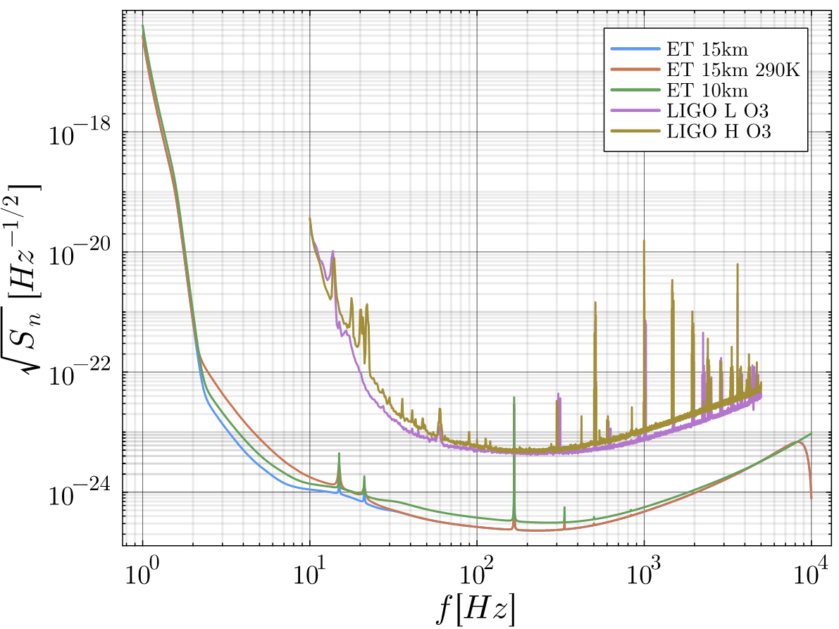

What ET brings to the table
Larger frequency space
Detections up to 50k BBH per year
Detections up to $z\sim 10$
SGWB:

Slide 7
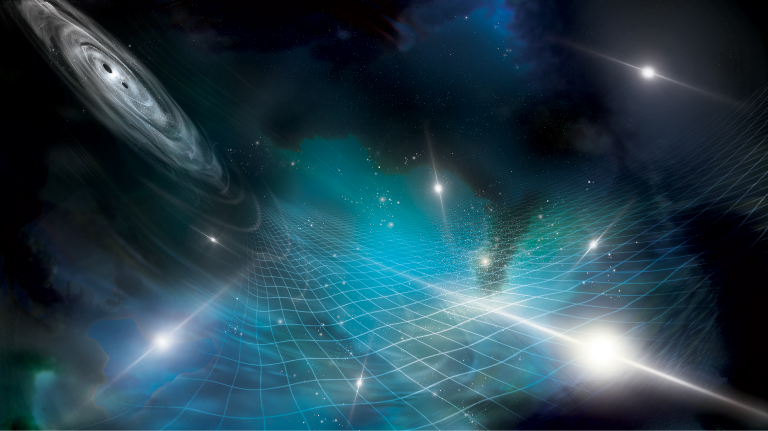
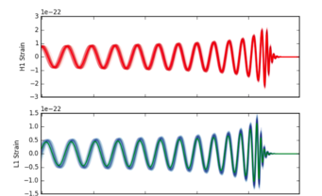
Waveforms
The measured data consists of the GW signal plus a noise
Where the signal is the projection of the strain onto the detector
A waveform is a function that associates to the source parameters the, in time or frequency domain
Here we use the IMRPhenom waveforms [3-8] (up to XHM) that work in the frequency domain.
[3] Khan et al. 2015
[4] London et al. 2018
[5] García-Quirós et al. 2020
[6] Pratten et al. 2020a
[7] Pratten et al. 2020b
[8] Dietrich et al. 2019

Slide 8
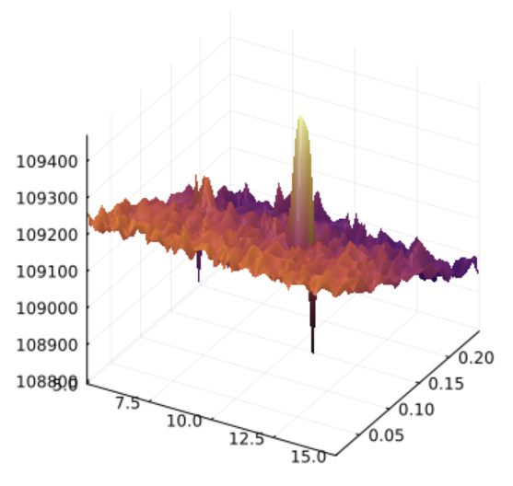
Bayesian analysis
The gaussian likelihood is expressed as
It is very hard to sample (extremely multimodal and long evaluation)
In LVK nested sampling is used

Slide 9
Fisher Matrix
To compute the Fisher Matrix which is defined as
where we need to derive the likelihood of the
data realization
Each derivative requires calling the expensive waveform function at least a few times (for numerical diff methods)

Slide 10
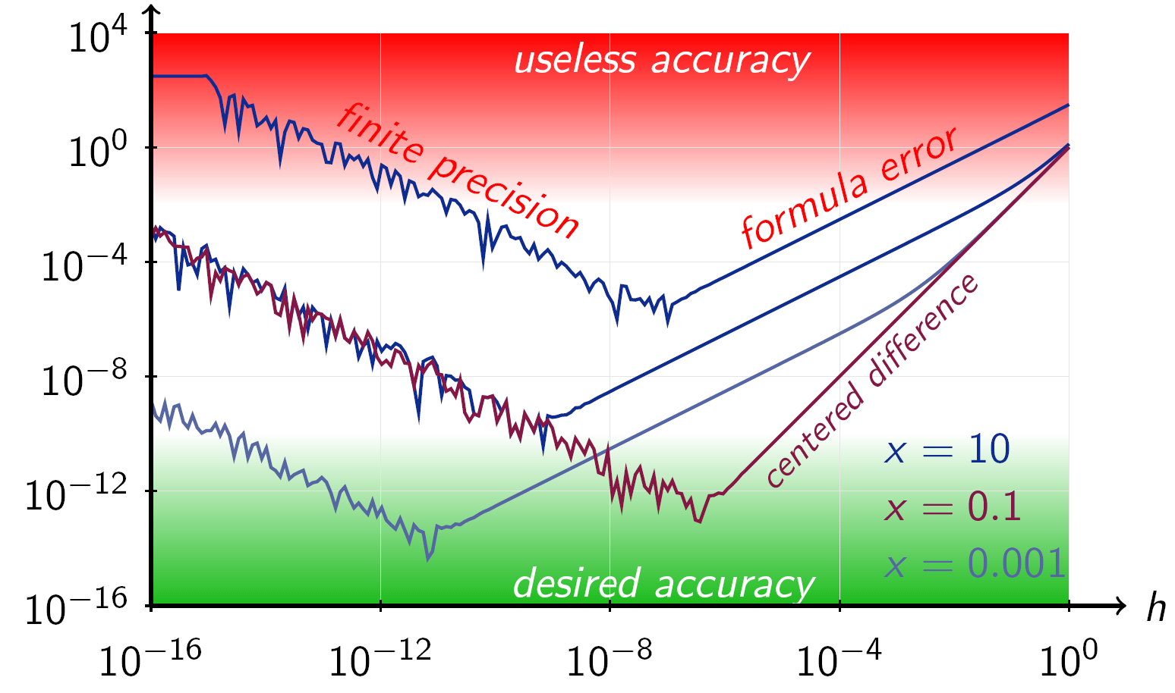
Numerical derivatives
There is an optimal step size to maximize the accuracy
The step size is usually dependent on both the function and the point where the derivative is calculated
There are better alternatives to finite difference methods
Credits: Wikipedia
13/6/25
Andrea Begnoni

Slide 11
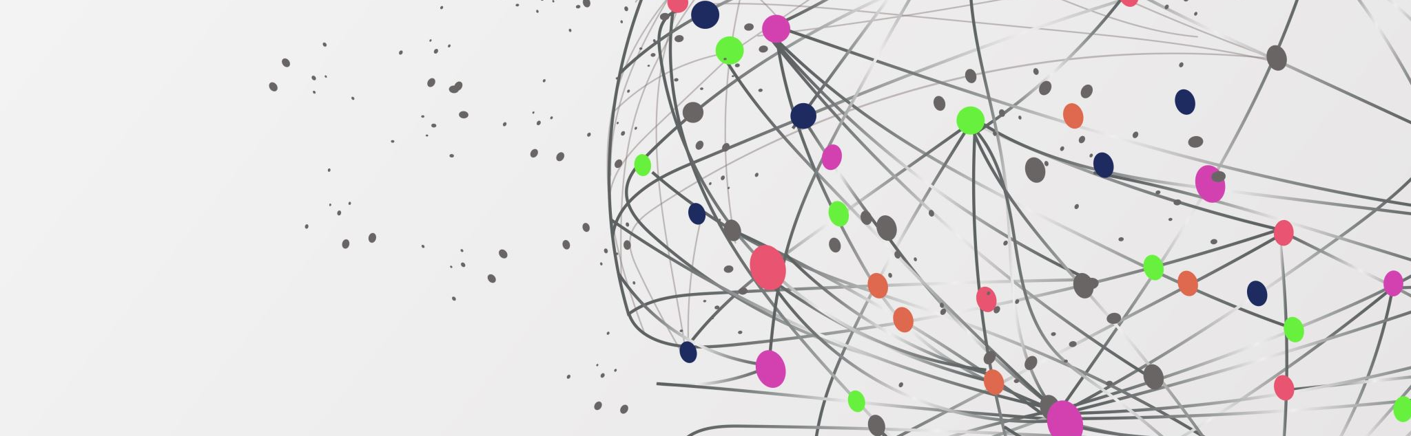
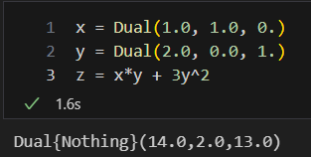
Automatic Differentiations

Slide 12
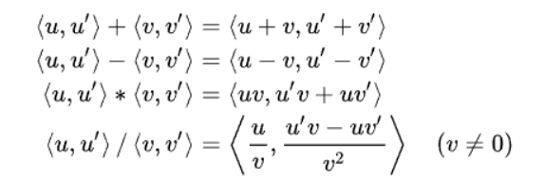

Automatic Differentiations
Variable = [ value, ${ ∂}_{x}$variable$, ∂_{y}$variable ]

Slide 13
Automatic Differentiations
Accurate (at machine level)
If a derivative exists, it will find it
Very fast (2x the evaluation of the target function in our case)
Adopted from ML

Slide 14
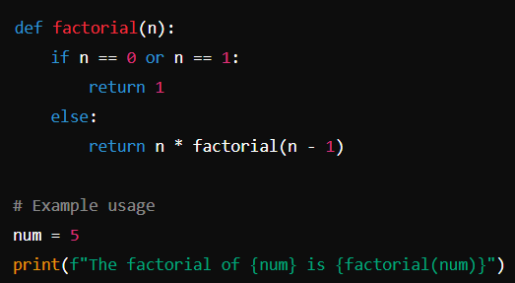
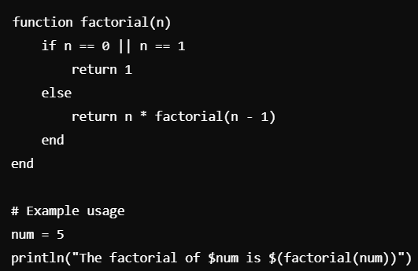
Julia
Compiled (Python is interpreted)
Designed for scientific computing
As easy to write as Python

Slide 15
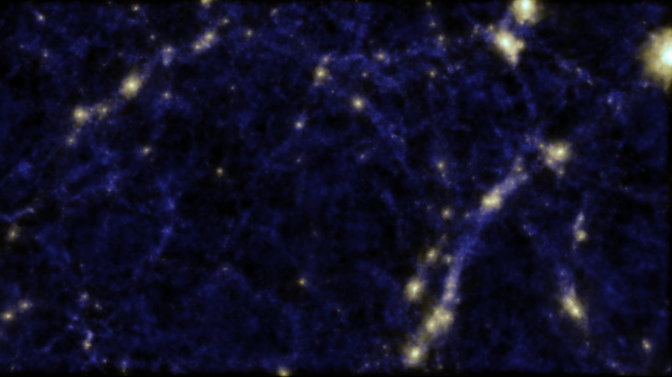

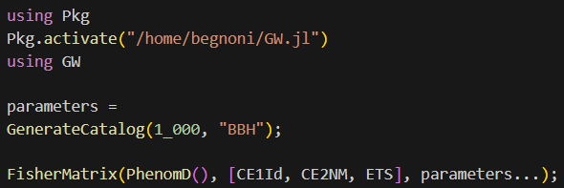
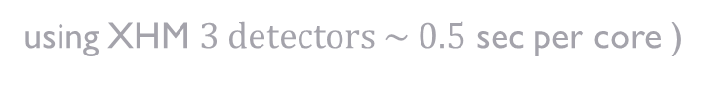
Easy to learn
Using automatic differentation (superior to numerical differentation)
Features advanced waveforms (e.g. PhenomXHM, PhenomD), all written in Julia
Very fast, e.g.,
Does not rely on external packages (all is written in Julia)
using XHM $3 detectors \sim 0.5$ sec per core )

Slide 16
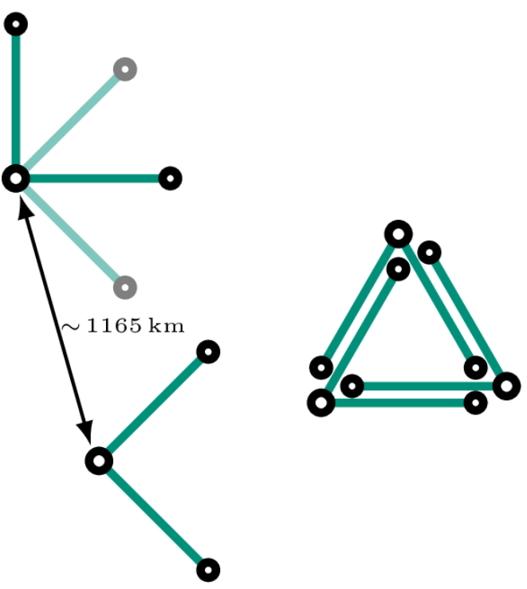
Case study – Detector design comparison
• T: triangular ET with 10 km arms featuring cryogenic technology.
• 2L_0: two aligned 15 km L-shape interferometers one in Sardinia, one in the Meuse–Rhine (MR) Euroregion, both with the cryogenic technology.
• 2L_45: same as 2L_0 with the exception that the orientations lead to β = 45◦.
• 2L_290K_0: same as 2L_0, only one detector features the cryogenic technology.
• 2L_290K_45: same as 2L_45, only one detector features the cryogenic technology.
Credits: [1]
[1] Branchesi et al. 2023
[2] Abac et al, 2025

Slide 17

Detector design comparison - What to expect
What are we interested in?
Cosmology with CBC
Multimessanger with CBC
Source properties of CBC
SGWB
Detector preferences: [1,2]
CBC : 2L_45 > 2L_0 > T
SGWB : T $≈$ 2L_0 > 2L_45
[1] Branchesi et al. 2023
[2] Abac et al. 2025

Slide 18
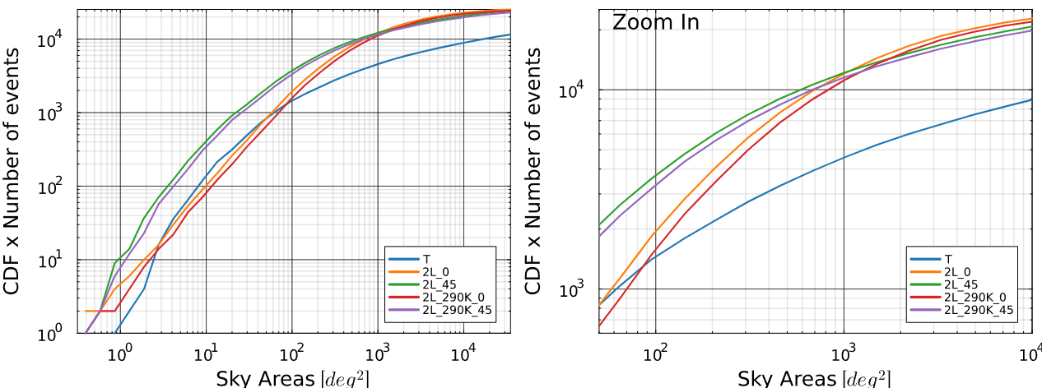
Case study – Angular Precision
Cumulative density function times the number of events as a function of the 90% sky area. Right: zoom in of the left plot

Slide 19
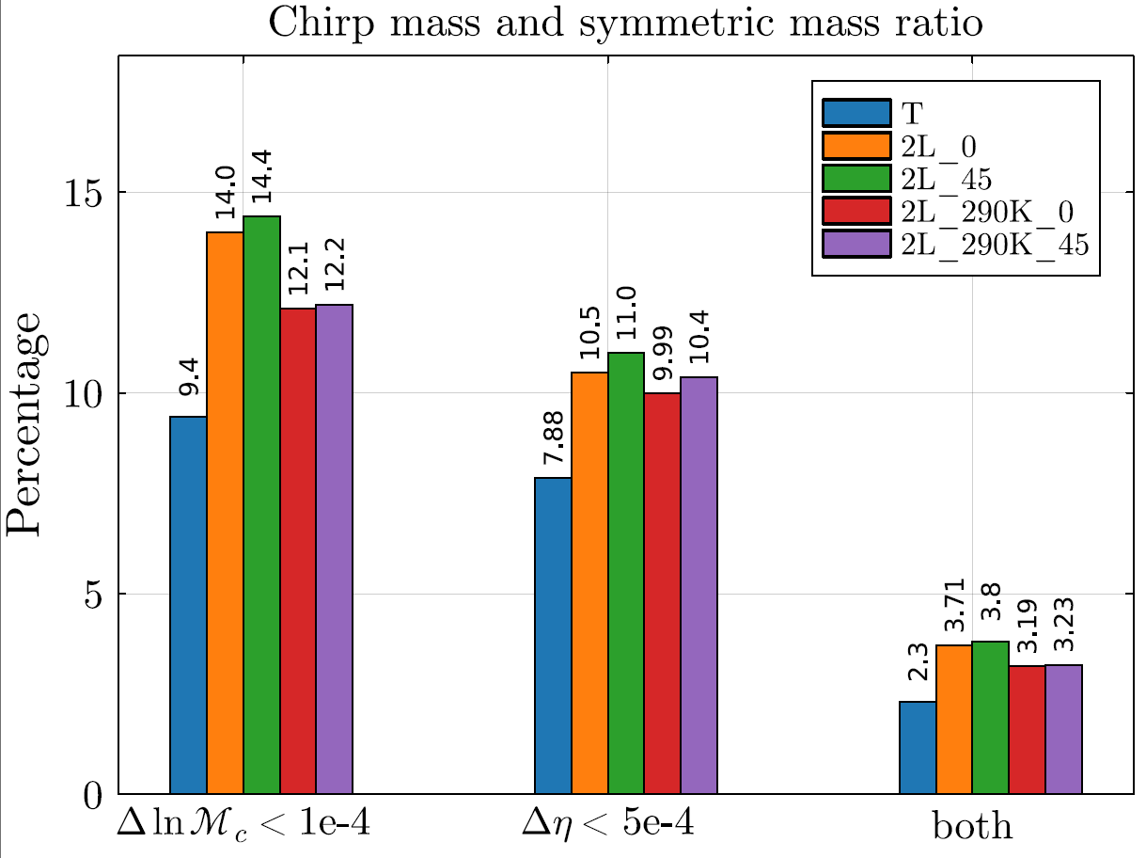

Source properties
The plot represents the percentage of events of which the 1-sigma error is below 1e-4 for the detector chirp mass and 5e-4 for the symmetric mass ratio. Only $\sim 1/3$ of sources that satisfy the mass ratio requirement satisfy both requirements.

Slide 20
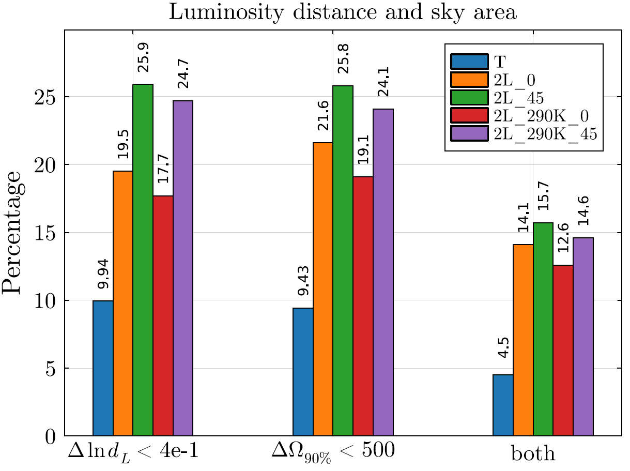
Cosmology
The advantage of the 2L_45 over 2L_0 in the luminosity distance and in the sky area is erased when we require both requirements to be satisfied at the same time.

Slide 21
Future plans – Fisher informed HMC
Bayesian data analysis of CBC is very computationally demanding (e.g., using nested sampling)
If we are interested in future observations, we can simplify the inference problem, i.e., we know an approximate location of the maximum posterior
With automatic differentiation we can perform fast and accurate gradients
We can perform Hamiltonian Monte Carlo sampling, injecting information from the Fisher Matrix

Slide 22
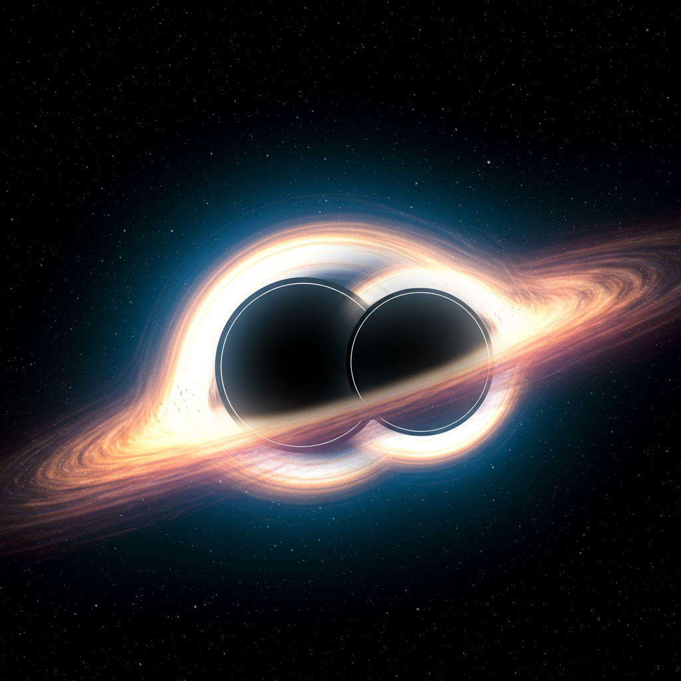
Beyond GR
GW from CBC can be important test of GR
Many possible aspects of GR can be tested, e.g., tidal deviations, spin-induced quadrupole moment
In this work, we focus on the Post-Newtonian terms
13/6/25
Andrea Begnoni

Slide 23
Post-Netwonian expansion
Approximation valid for weak gravitational fields and low velocities
Used for the inspiral phase of comparable mass CBC
Expansion in terms of (v/c)
Analytical GR predictions for
where the index represents two times the PN order
13/6/25
Andrea Begnoni

Slide 24
Post-Netwonian terms
In frequency domain the phase of a GW can be expressed as
13/6/25
Andrea Begnoni

Slide 25

TIGER framework
In the TIGER framework[9], one PN term at a time is modified as
We modified accordingly the waveforms PhenomD and PhenomHM, ensuring that they remain $C^{1}$.
[9] Agathos et al. 2014
13/6/25
Andrea Begnoni

Slide 26
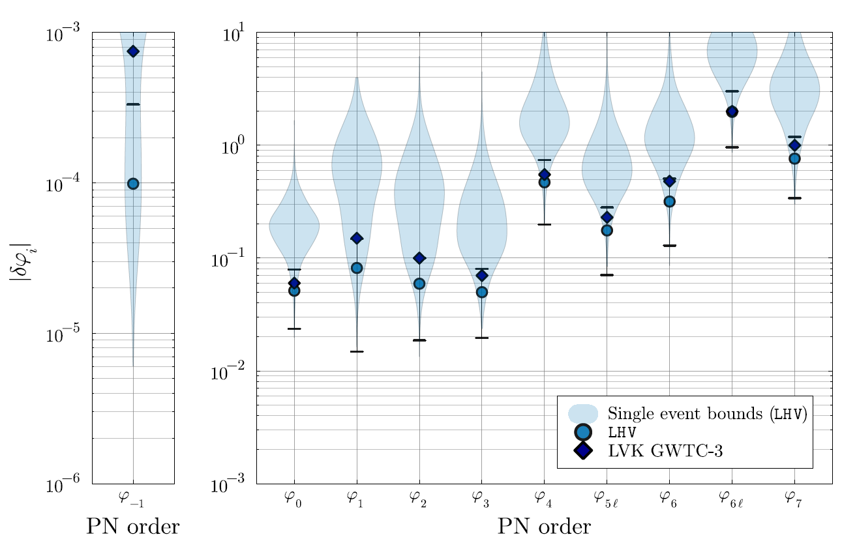

Comparison with LVK
We test the 90% upper bound from the Fisher analysis with the actual LVK results. The events analyzed are 12 and the different realizations give the error bars. The violin plots are obtained by the single events bounds.
LHV indicates that the detectors used are Livingston, Hanford and Virgo.
There is great agreement between the Fisher and the collaboration results
13/6/25
Andrea Begnoni

Slide 27
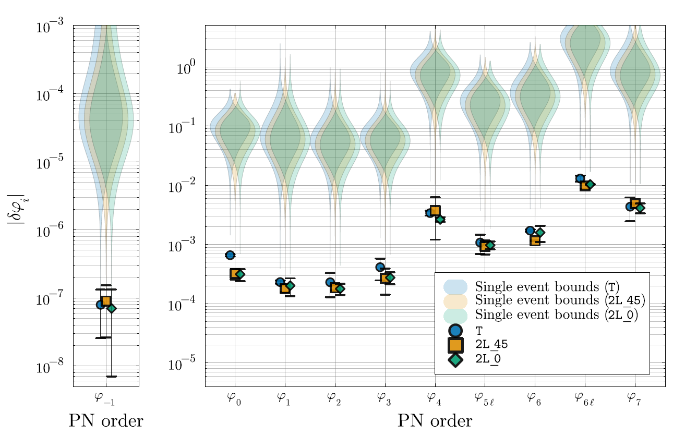
Forecast for ET
We test 3 detector designs for ET
All the detectors improve significantly the LVK constraint and the difference is inside the error bars
These results corresponds to 5/6 months of observations
13/6/25
Andrea Begnoni

Slide 28
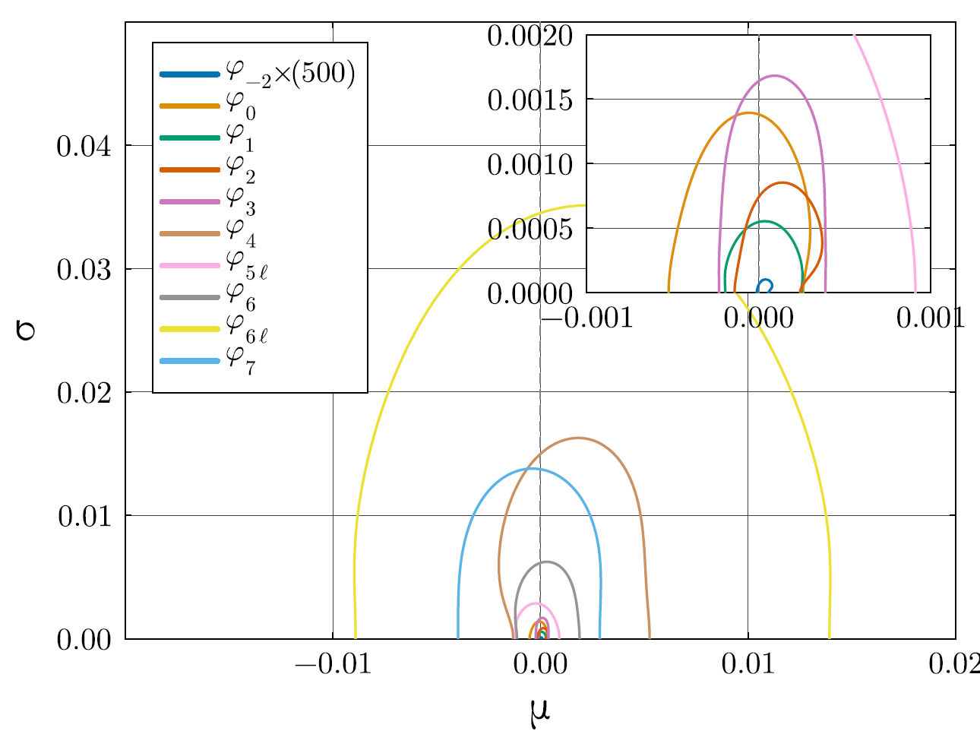
Forecast for ET
We model the deviation as a gaussian with mean μ and std σ.
We inject events with no GR deviations, and we recover the hyperparameters (μ, σ).
These results corresponds to 4/5 months of observations
13/6/25
Andrea Begnoni

Slide 29
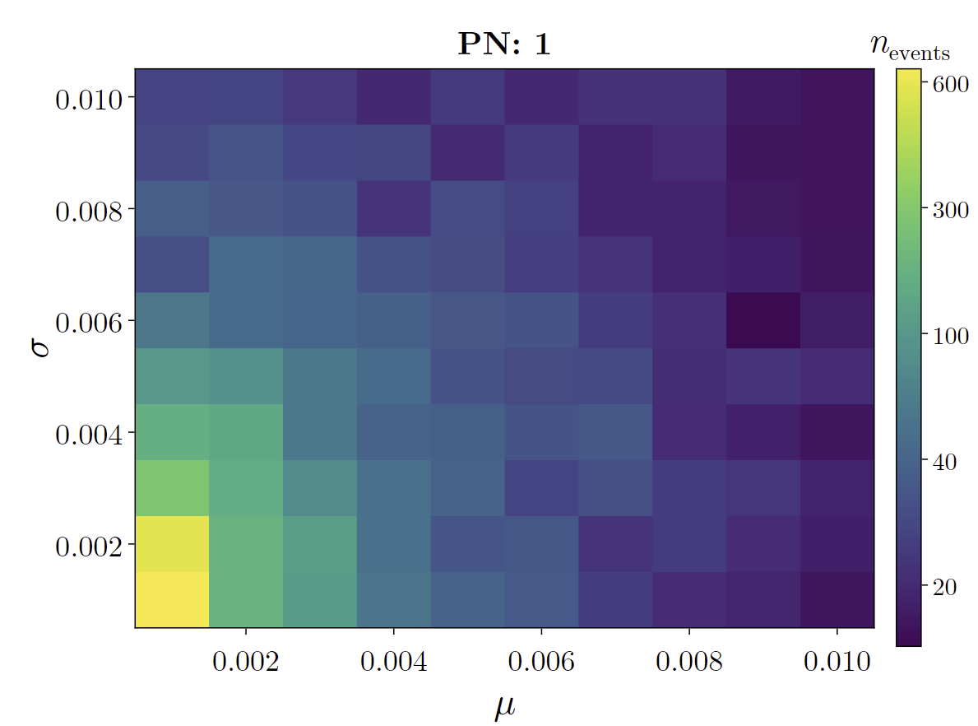
Forecast for ET
How many detections are needed to detect a GR deviation at 90% confidence level?
We inject events with GR deviations drawn from a gaussian with given μ and σ
These constrains can be achieved in weeks or days of observations
We used 2L_45 and the PN 1 term
13/6/25
Andrea Begnoni

Slide 30
Take home messages
GWJulia is a fast open-source tool to evaluate Fisher matrices of CBC
2L_45 is the best network for CBC with a slight margin over 2L_0, at the cost of losing SGWB
With ET, BGR test of the PN terms will reach an unprecedented level of precision with just a handful of sources

Slide 31
Future prospects
We aim to do a comprehensive study of the capabilities of ET considering the different comsological science cases
We plan to use the Fisher Matrix to inform a HMC sampler

Slide 32
Thank you!

Slide 33
Case study – SNR
The table represents the percentage of events above the threshold written on top of the column

Slide 34

Case study – Angular Precision
The table represents the percentage of events of which the 90% sky areas are less than the threshold indicated in each column. The 45° networks outperform the other networks and the T configuration. In particular, the T is comparable when considering the few high-precision sources, however, the performance degrades significantly for sources with precision worse than 1000 $\deg^{2}$.

Slide 35
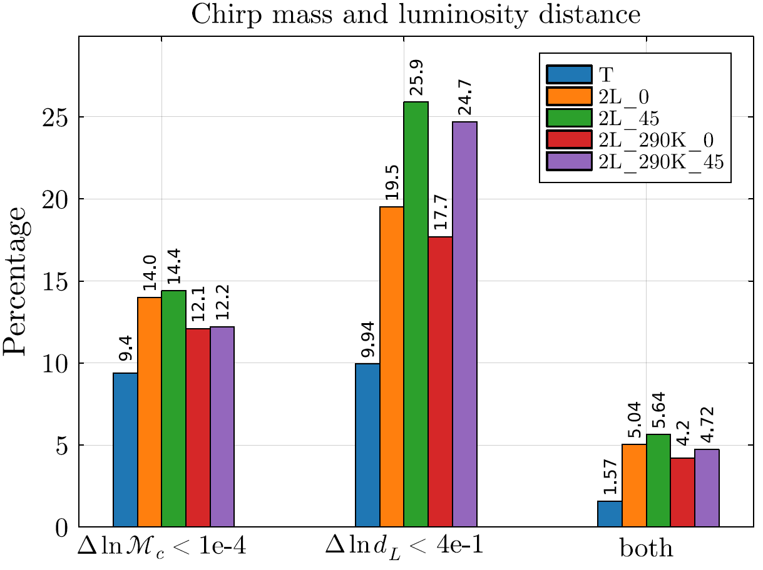
Source properties
The advantage of the 2L_45 over 2L_0 in the luminosity distance is erased when we require also the chirp mass to satisfy the requirement.

Slide 36
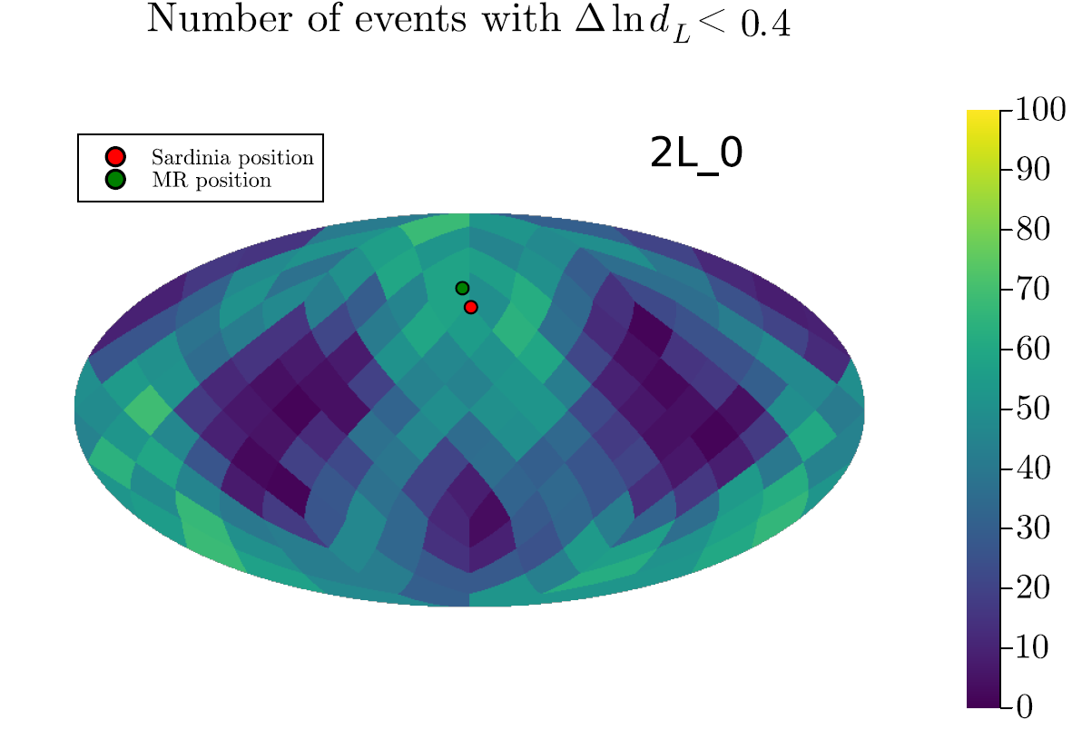
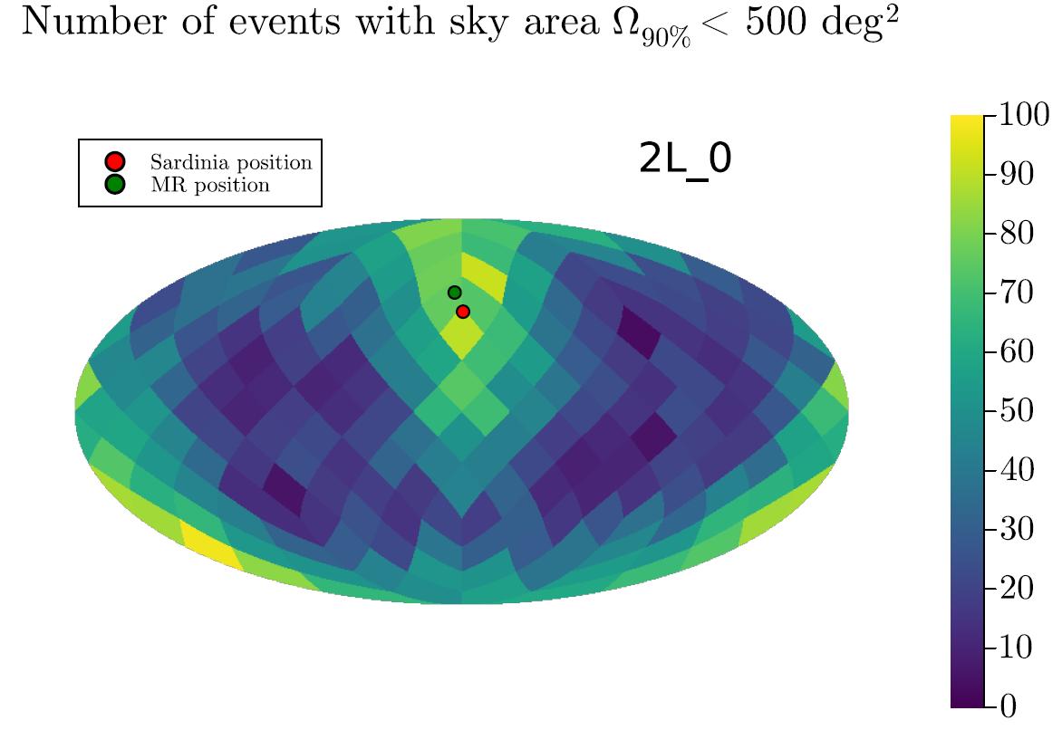
Sky area and luminosity distance – 2L_0
Sky maps in the detector frame for 2L_0.
Left: number of events for which the relative luminosity distance1-sigma error is under 40%
Right: number of events for which the 90% sky area is under 500 sqdeg.

Slide 37
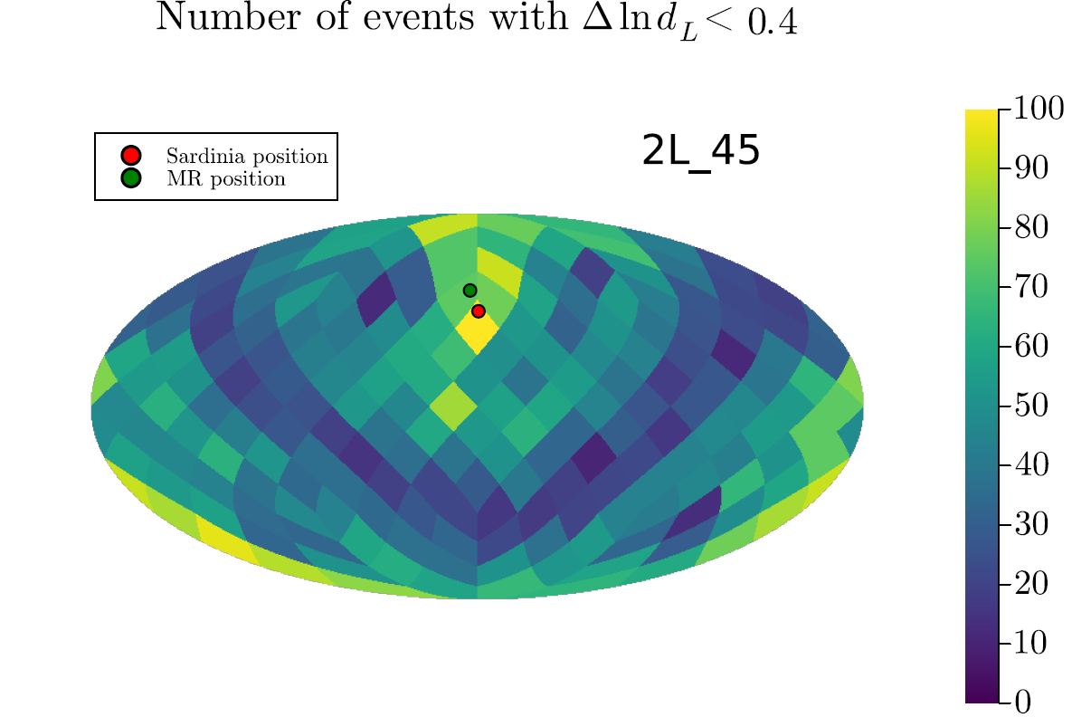
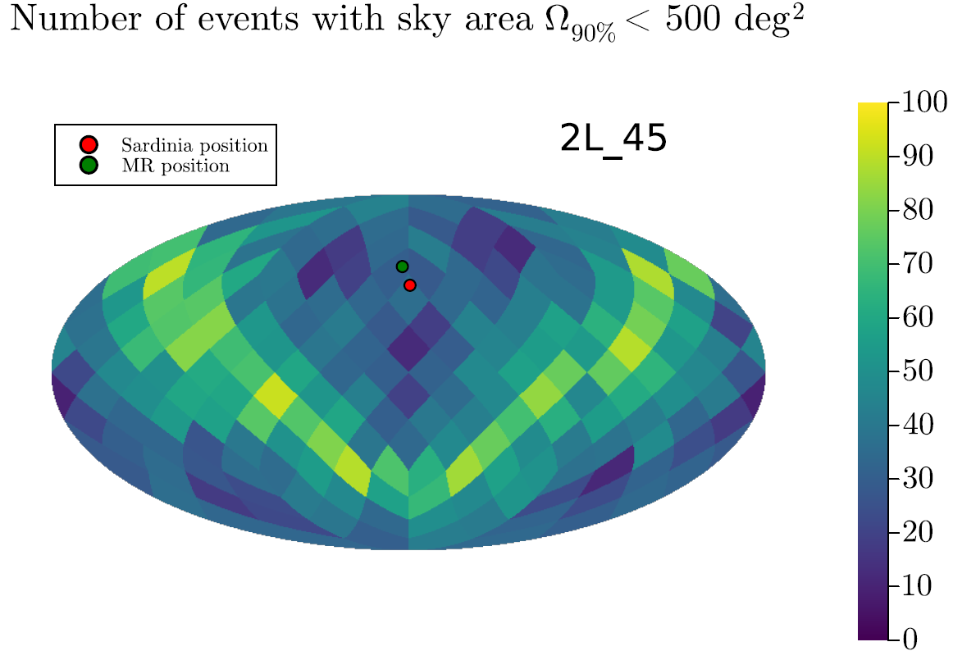
Sky area and luminosity distance – 2L_45
Sky maps in the detector frame for 2L_45.
Left: number of events for which the relative luminosity distance1-sigma error is under 40%
Right: number of events for which the 90% sky area is under 500 sqdeg.

