Slide 1

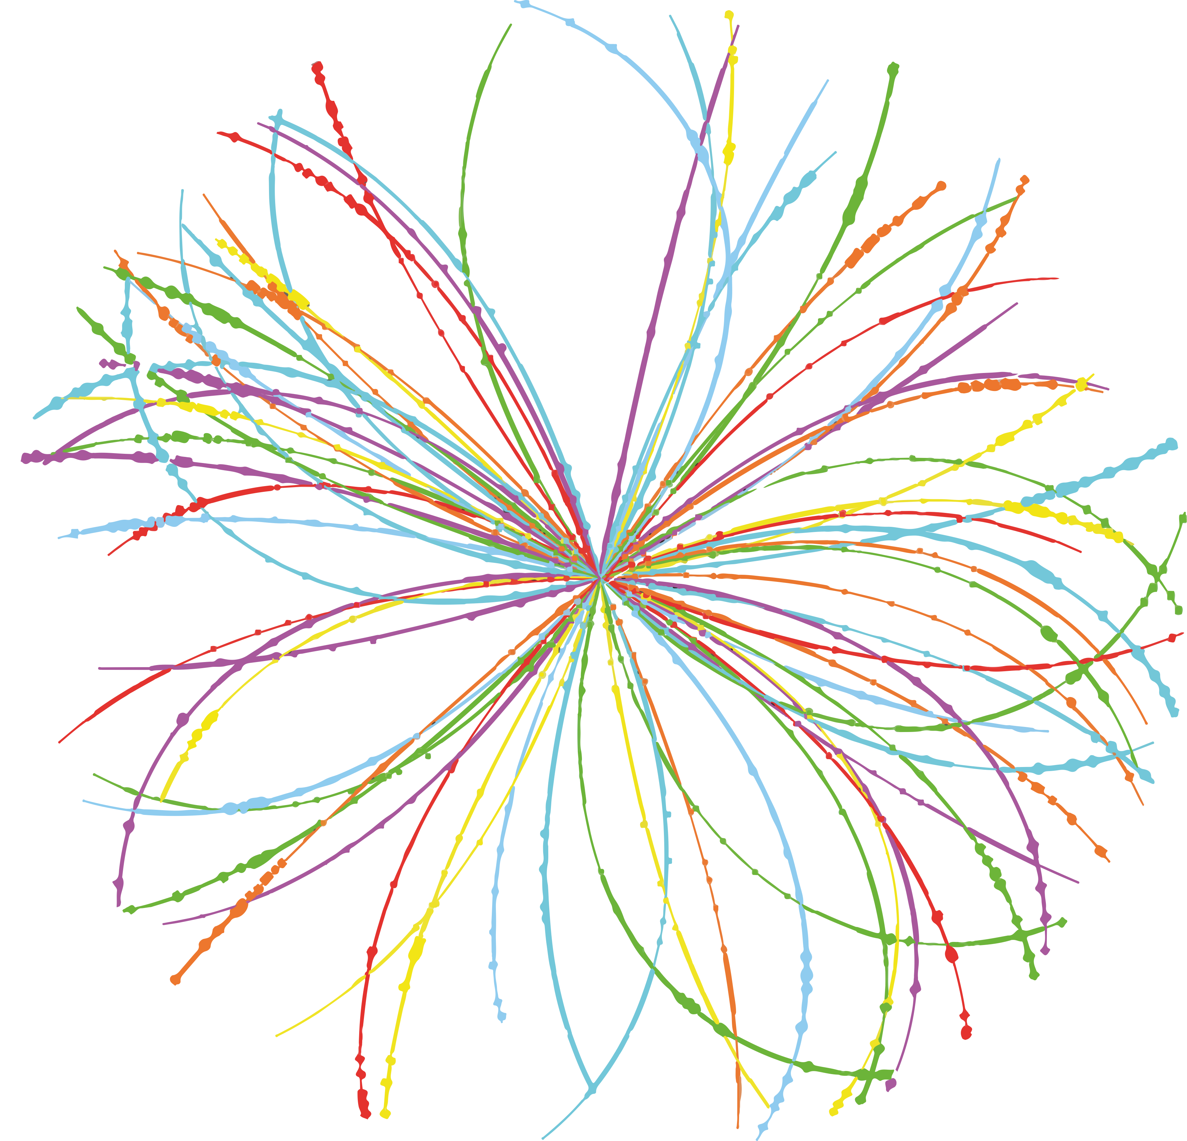


Menu of possible investments to position IFAE as leaders in technical facilities for instrumentation
Cristobal Padilla
June 13, 2025

Slide 2
Purpose
I present here a menu
  Some ideas coming from the groups I have been talking with
  Other come from Javi and Mario
It is just to list possibilities
  No particular order or preference
  I have tried to foresee what also implies for construction work
  Some of the things will not fit
We need to think long-term strategy
  Any action should help us to get the next SO also
  We should build the argumentation that “after the investments, IFAE has now better capacities that allow us to contribute in more attractive projects”

Slide 3
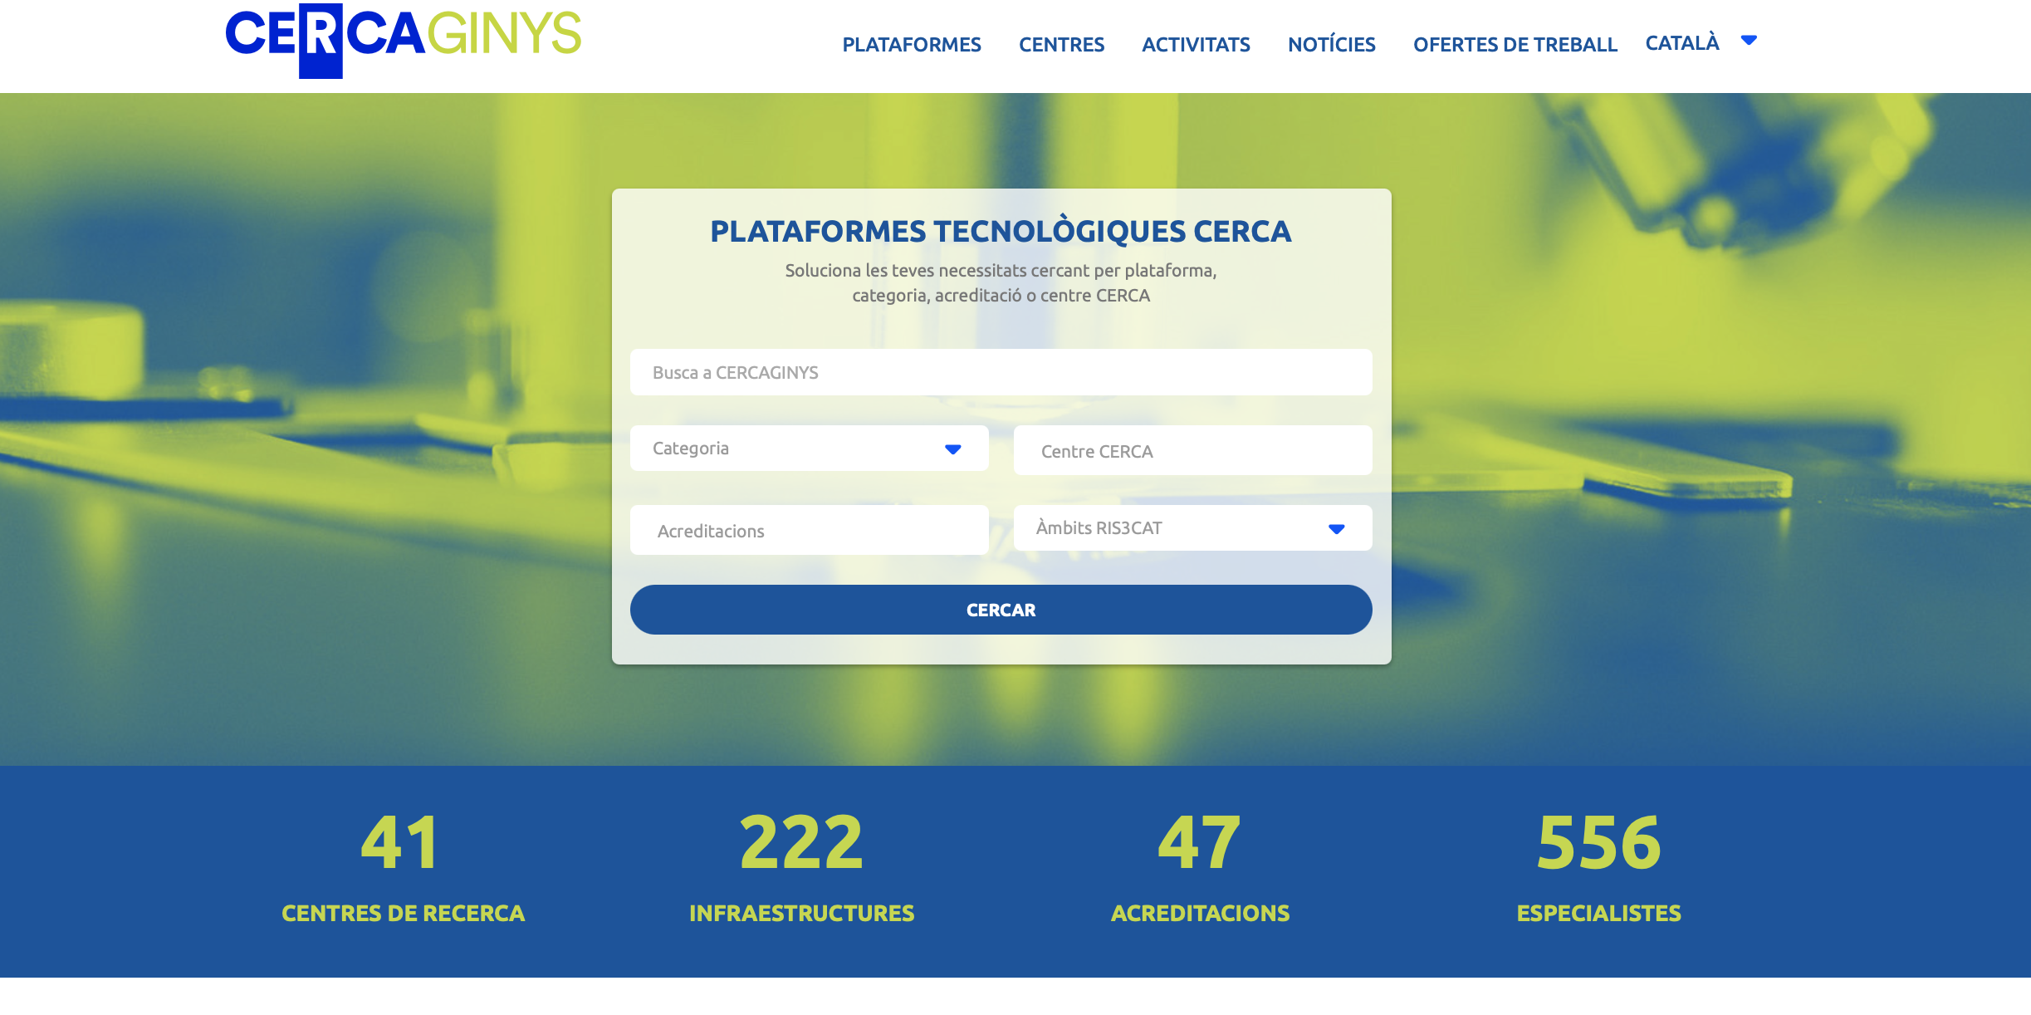
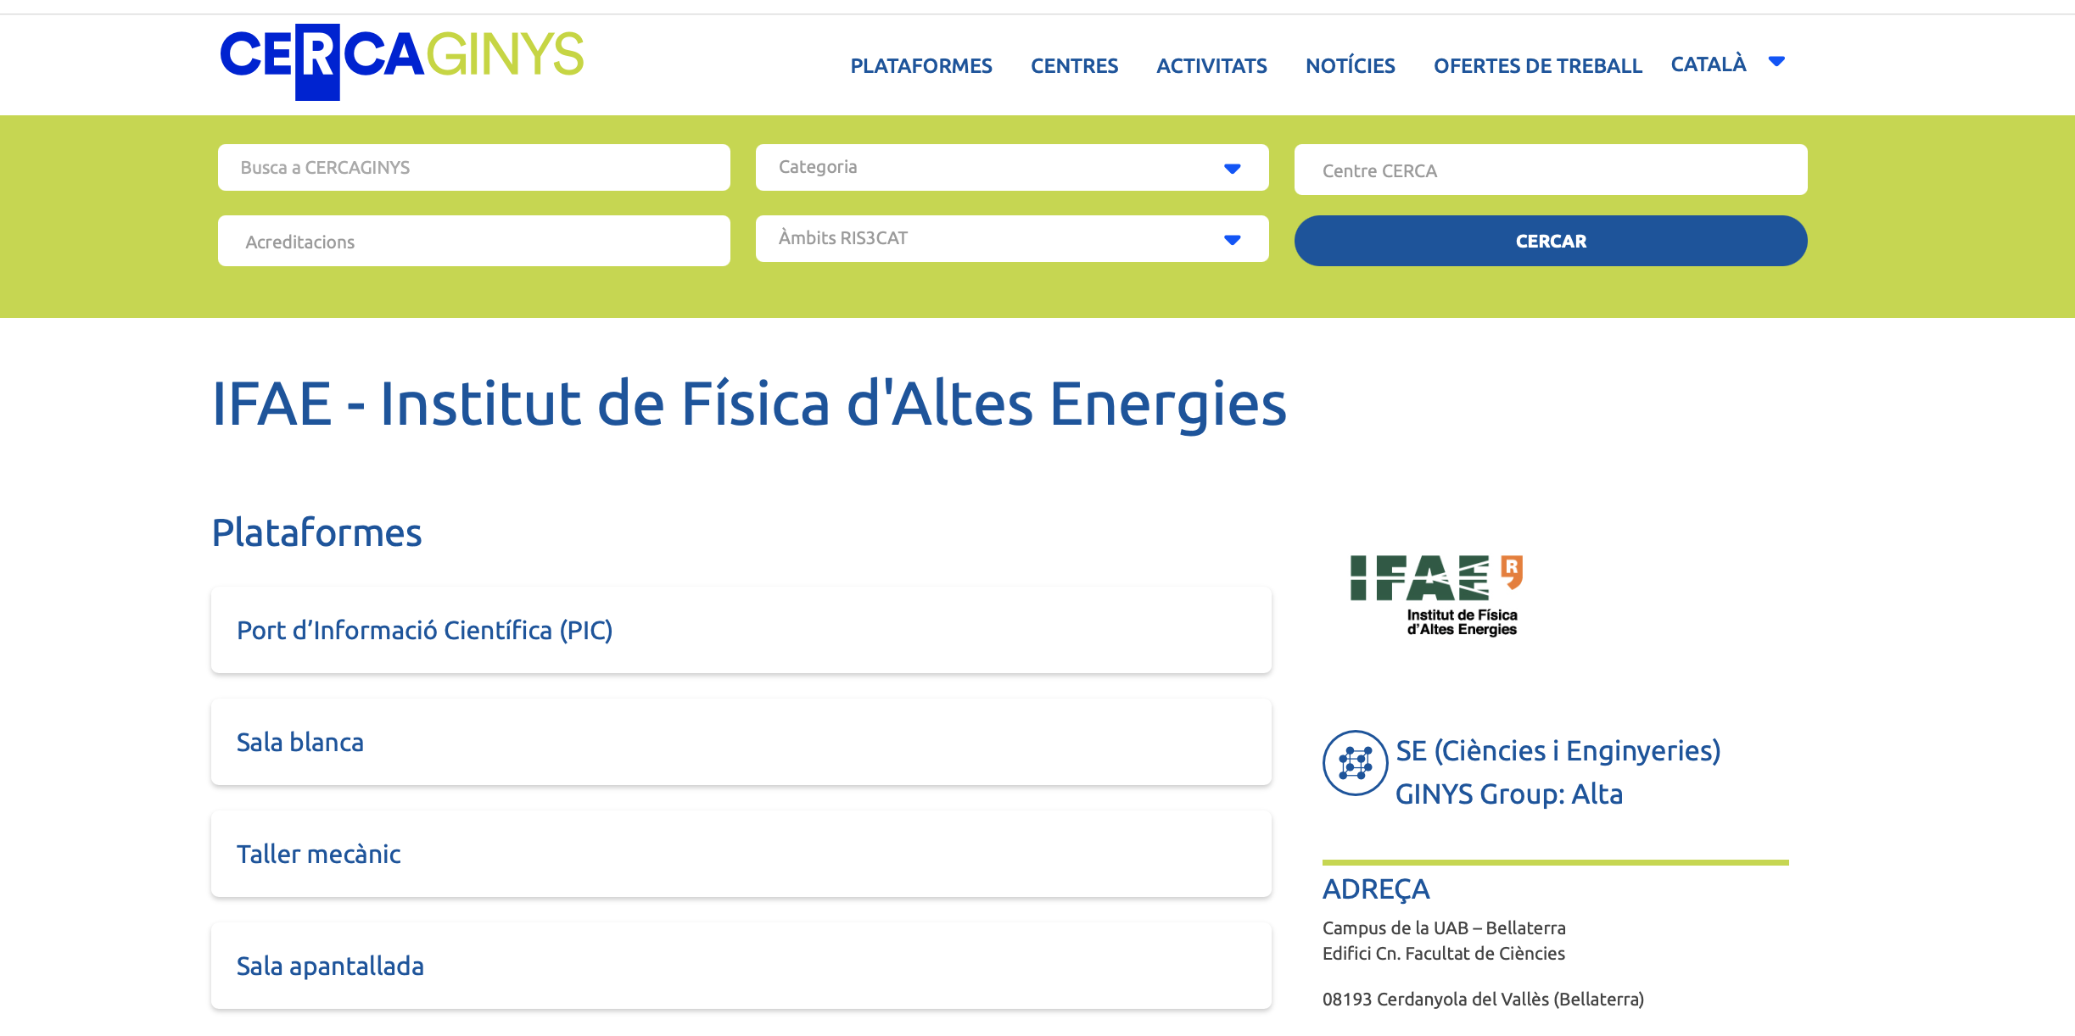
CERCA GINYS

Slide 4
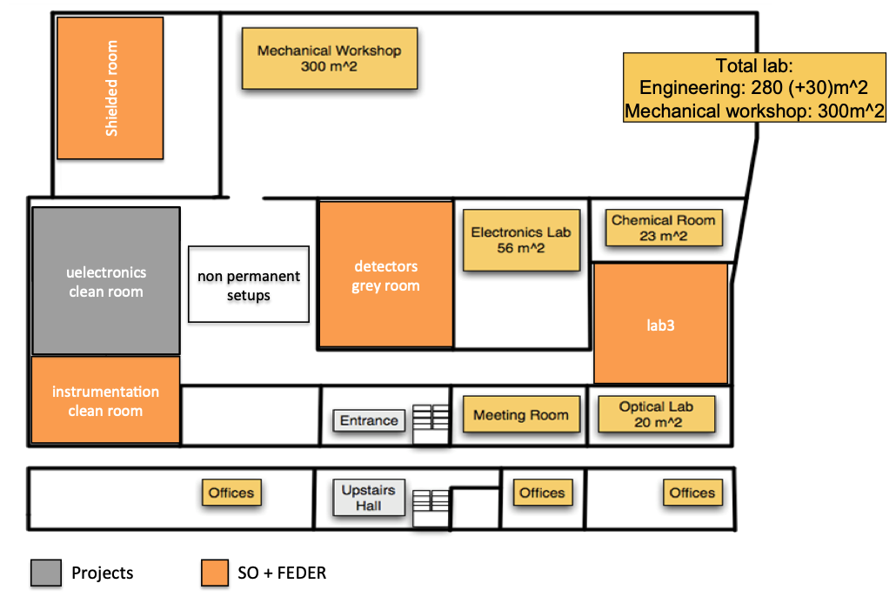
Microelectronics Infrastructure
Microelectronics infrastructure
Seve many lines (pixels, space applications, detectors, medical physics
Need upgrade if we want to continue saying is the best assembly room
We need to replace the microelectronics infrastructure:
They are obsolete and not supported anymore
They induce large costs because of repairs
We would need a technician/engineer that becomes an expert in their operation
Courses and giving work to experiment
Expect that the transition from different works is smooth
  Does not affect our main projects
Target to be self-financed (with external projects?)
Will need to coordinate very well to not affect the ATLAS pixels production
Equipment/Personnel | Approx Cost
New Flip chip machine with smaller pitch | 1 MEUR
New Wire bonding machine | 500 kEUR?
New dedicated operator | 150 kEUR/3Y

Slide 5
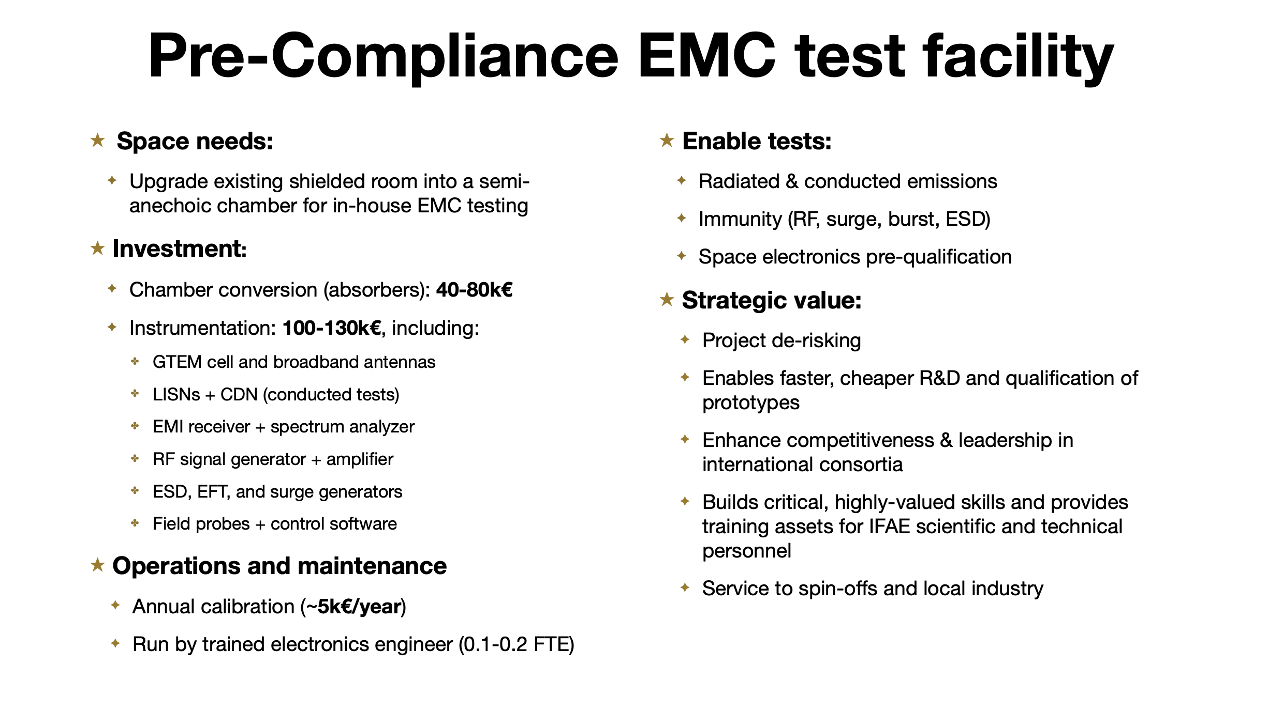

Slide 6
Shielded Room Upgrade
Possible tests
Radiation and Conducted emissions
Immunity (RF, surge, burst, ESD)
Space electronics pre-qualification
Strategic value:
May serve to many projects
Faster, cheaper R&D qualification of prototypes
Enhance competitiveness & leadership in international consortia
Builds critical, highly-valued skills and provides training assests for IFAE scientific and technical personnel
This is one of the infrastructures that could be used by other companies.
Only issue is that is not inside a grey/clean room and might be a problems for some special space applications
Equipment/Personnel | Approx Cost
Absorbers to convert it in anechoic room | 40-80 kEUR
Instrumentation for EMC | 150kEUR
Calibration | 5 kEUR/y

Slide 7
Upgrade of Mechanical Workshop Machines
Some of our CNCs are old and their repair is expensive
Manual lathe with problems or repeteability and tolerances
Old CNC (bought for PAU second hand) does not machine to the required precision
For some pieces even the HAAS machine bought for the minidrawers production is “small”
New equipment should allow
More project opportunities (ET large pieces?, VIRGO baffles and structure currently at the limit
Control and foreseeable schedules
More projects to external institutes (we had already to reject 2 good offers)
Any of these machines has served well to future projects.
The old CNC and whte wire cutting was bought for PAU
The electroerosion machine for Euclid
The HASS CNC for the minidrawers
Equipment/Personnel | Approx Cost
CNC Lathe | 112 kEUR
CNC VF-8/40 | 202 kEUR

Slide 8
3D metal printing machine
A metal 3D printing machine needs a dedicated room
Only possibility would be in the place where the “mechanical technicians” are?
Needs building a new room and another room on top?
A metal 3D printing machine will continue positioning our mechanical workshop as a “prototyping centre”
Allow geometries that ae impossible with normal CNCs
Lighter constructions with hollow but robust structures
A small machine can be in a “table” and can already be a small prototyping machine
Equipment/Personnel | Approx Cost
3D printing machine | 500 kEUR?
Room and installation | 150 kEUR
3D prototype printing (plastic+metal) | 10 kEUR

Slide 9
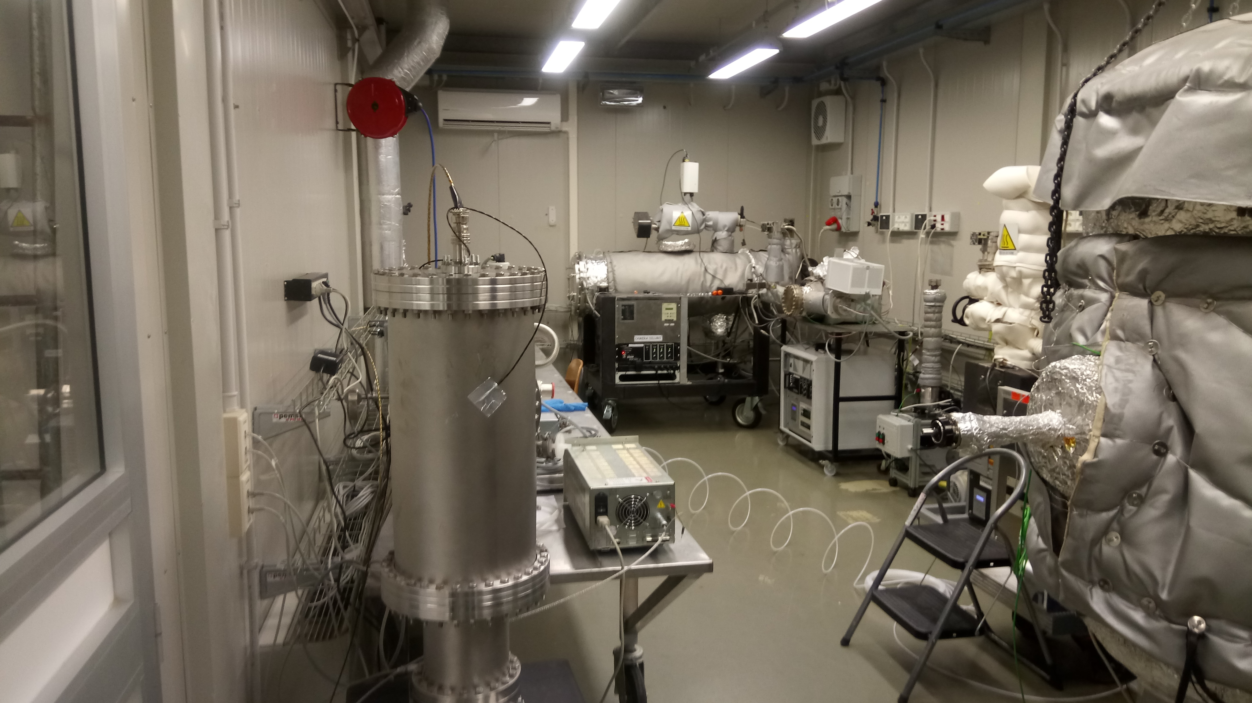
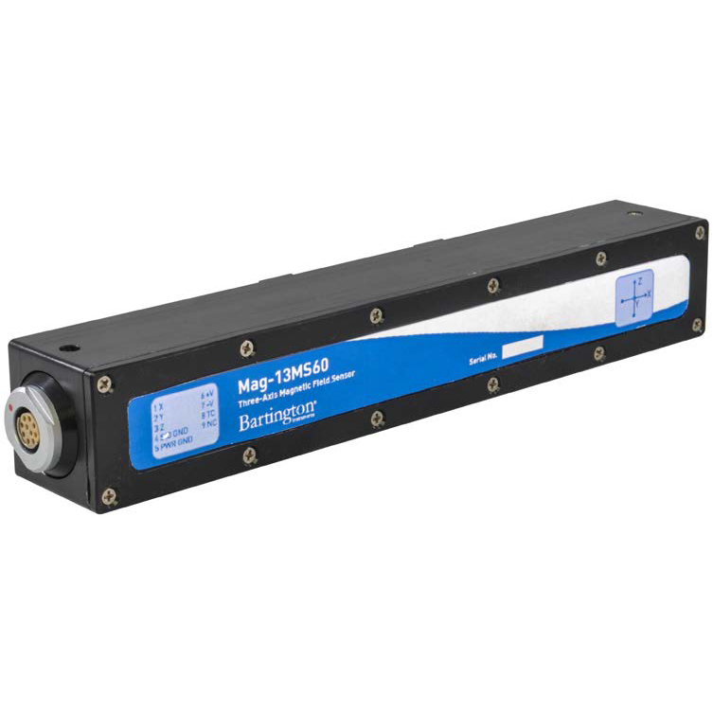
Infrastructure (GWs)
Caltech
Hardware in precise optics is all very expensive….
Possible hardware improvements (just an inclusive list) — we cannot aim for all
  Upgraded existing optical setups [50k€ - 80k€] — some overlap with items below
    Better and more stable lasers, calibrated photosensors, filters, optical tables, collimators, etc…
  Dedicated setups for BRDF , BSDF and TIS measurements - IR Scatterometer Setup [200k€ - 250k€]
    Nothing good enough is now in IFAE — we rely on measurements in Madrid, EGO and Padua
    Caltech setup (great angular precision and robotic/automatic) - serves industries as well
    Might be of interest for other centers and industries
  UHV setup including RGA capacities [150k€ - 200k€]
    Totally new capacity — we now rely on voluntary work done at CERN and EGO
    Might be of interest for other centers and industries
    Complementary to the TVAC but with higher vacuum requirements — 10^-9 — 10^-11 mbar
  Optical table 1m x 3 m with a FP resonating cavity under UHV [150k€ - 200k€]
    A capacity to understand whether our detector devices affect the performance of cavities in LVK/ET
    In combination with the UHV setup allow us to carry out a full characterisation in house
    Used at LMA to characterise the performance of new mirrors, coatings, etc..
    Might be of great interest for other centers and industries
  3-axes Magnetometers to fully characterise the EM emissions of instrumentation [20k€ - 30K€]
    Instrumental to determine our instrumentation does not inject noise to LVK/ET
    Might be also of global interest for other groups
Technical personnel. — mandatory — 300k€
  Support for vacuum tests 1FTE
  Support for optical setups 1FTE
EGO
LMA-Lyon

Slide 10
Optical Setup
Upgraded optical setup
Stable lasers, calibrated photosensors, filters, optical tables, collimators
Dedicated setups for BRDF, BSDF and TIS measurements: IR scatterometer
Optical table (1m x 3m) with FP resonanting cavity under UHV
Although all is driven by GW needs, we all know that this might be useful for other projects and can also be sold as services to other institutes/companies
Equipment/Personnel | Approx Cost
Upgraded Optical setup | 50-80 kEUR
IR Scatterometer Setup | 150-200 kEUR
Optical table and FP resonating cavity | 150-200 kEUR
Convert to gray/clean room | 80-100 kEUR

Slide 11
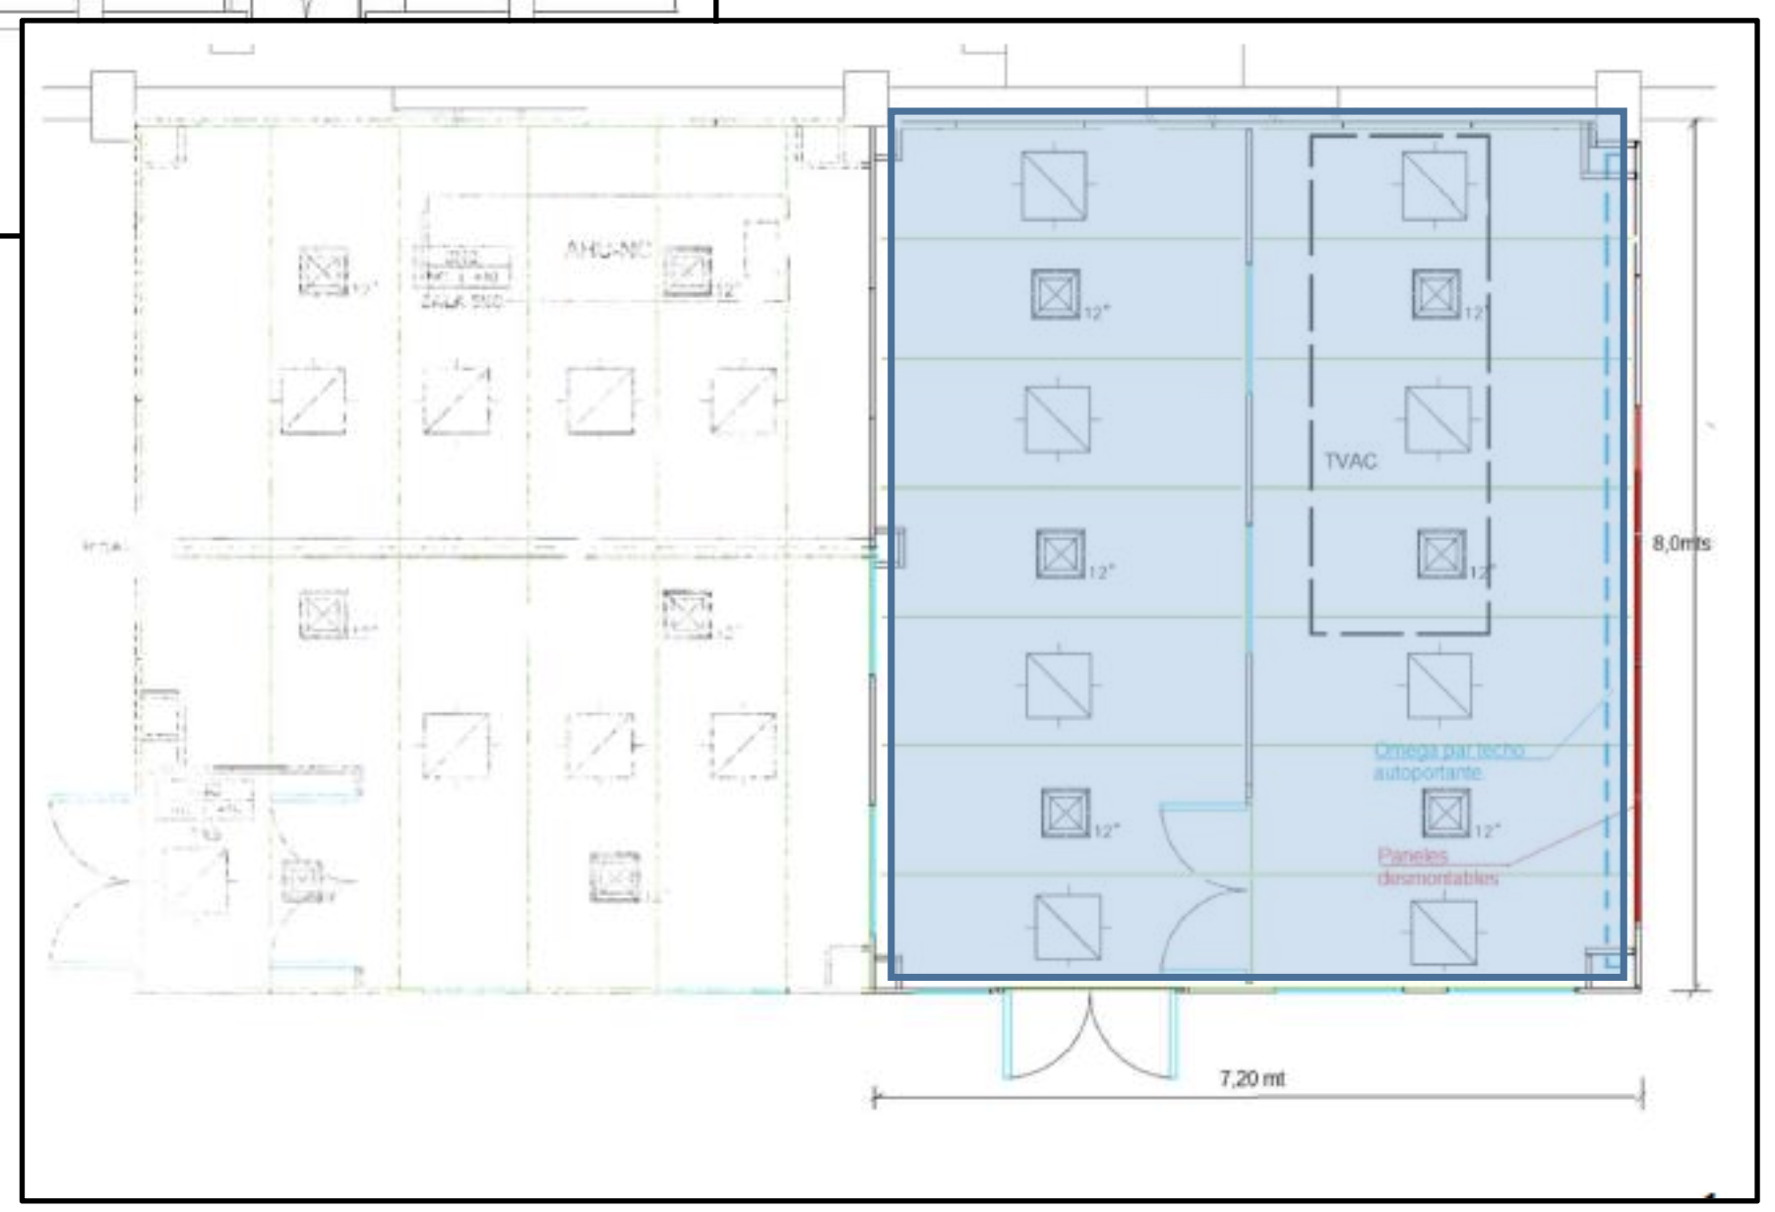
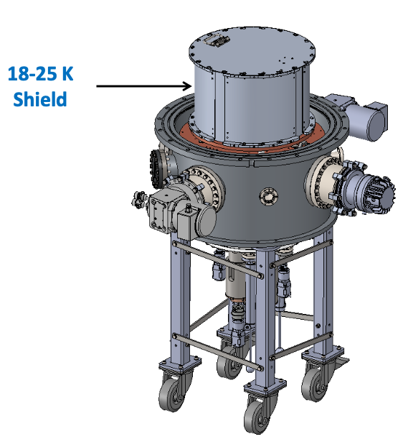
UHV setup
UHV setup
With capacity to 10⁻⁹ - 10⁻¹¹ mbar
RGA and leak detector, which is anyhow needed because the one we have does not work
We thought this area to be a place for setups needing temperature stability
Cryostat for LWIR detectors and others
Removing the electronics laboratory (for optical or UHV laboratory) requires
Move part of it to the open setup area
Build a new room for light setups on top
Equipment/Personnel | Approx Cost
UHV setup | 150-200 kEUR
Magnetometer for EM | 20-30 kEUR
Technical personnel UHV | 150 kEUR
Technical Personnel Optica | 150 kEUR
Build new light setups on top of gray room | 100 kEUR

Slide 12
Shaker for Space applications
?
Absolutely needed for space applications
Needs to be in a clean room and with a crane
Possible strategic positioning
Enhance competitiveness and leadership
Can complement the TVAC as leading institute in this area
It is an infrastructure that, together with the TVAC and the Anechoic room might be a technical facility for space and other application (and the excuse for another building!)
Equipment/Personnel | Approx Cost
Shaker system | 400 kEUR
Consumables | 20 kEUR/y
Construction of room | 150 kEUR
Technician | 150 kEUR

Slide 13
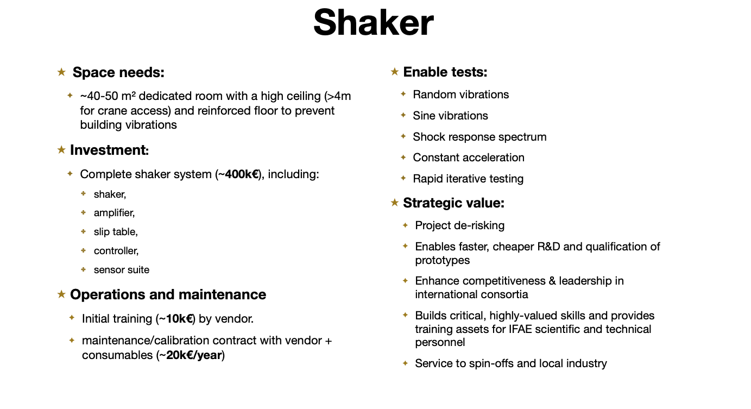

Slide 14
Other Items
Electronics engineers keep complaining about the lack of a modern oscilloscope to arrive to larger frequencies
Some of the electronics designs we have considered cannot be tested with the current oscilloscopes
There might be more needs
Laser Cutting machine
Remember that PC is finishing
We need 450 kEUR/y (from all projects) until the Generalitat agrees to fund these persons
To this we need to add the personnel that we have been listing in some of the other areas (that should self-sustaine?)
Equipment/Personnel | Approx Cost
Modern Oscilloscope | 120 kEUR
Laser Cutting | 50 kEUR
Personnel TD | 450 kEUR/y

Slide 15
Summary table
Item | Equipment | Construction | Personnel (3y) | Maintenance/y
Microelectronics Infrastructure | 1500 |  | 150 | 5
Anechoic Room | 230
Workshop machines | 314
3D metal printing machine | 500 | 150
Prototyping 3 D machine | 10
Optical laboratory upgrades | 450 | 200 | 150
UHV laboratory | 200 |  | 150
Shaker | 400 | 150 | 150 | 20
Other equipment | 170
Personnel |  |  | 1300
TOTAL | 3774 | 500 | 600 | 25
COFUND (40%) | 1510 | 200
TOTAL from our funding | 2264 | 300 | 600

Slide 16
Globalization Trilema
Dani Rodrik, an economist in Harvard and candidate for Nobel Prize
A nation-state can only achieve two out of three key goals:
Deep international economic integrations (globalization)
National sovereignity
Democratic politics
Pursuing all three simultaneously is inherently unsustainable
Democractic Politics
National Sovereignity
Globalization

Slide 17
Technical Division Trilema
Cristobal Padilla, director of the IFAE Technical Division (but not a candidate for a Nobel Prize)
Our division can only achieve two out of three key goals:
Highly Trained Personnel
Ultra Fast reaction to new projects
Low Personnel Costs
Pursuing all three simultaneously is inherently unsustainable
Highly Trained Personnel
Low Personnel Costs
Ultra Fast Reaction

