Slide 1

Search for NEW PHYSICS IN ATLAS
… or how to look for a possible needle in a real haystack ...
Loïc Valéry (ATLAS @ IFAE)
lvalery@cern.ch
IFAE seminar
14th September 2016

Slide 2
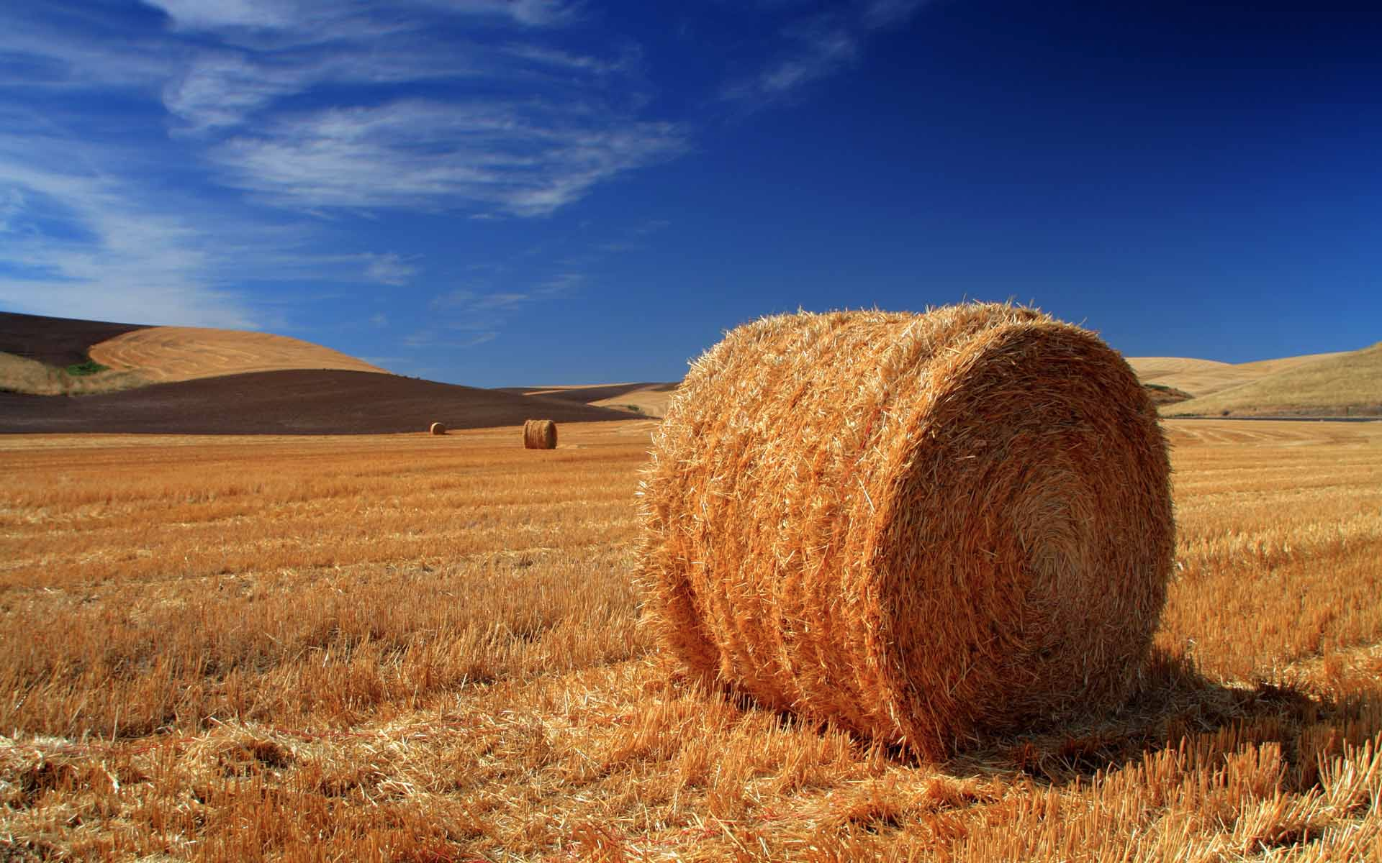
Things would be easier if only there were just one …

Slide 3

New Physics ?
Standard Model
  1960’s theory to describe elementary particles and interactions
  Pretty successful (predictive theory, precision tests, …)
  But not the end of the story
    Gravitation not described
    Dark matter not predicted
    Naturalness problem
    …
New Physics
  Theories that propose (tentative) solutions to some of these problems
    Ex: extra-dimension theories, supersymmetry, …
  Predict new possible particles
➔ Many possible needles to look for !

Slide 4
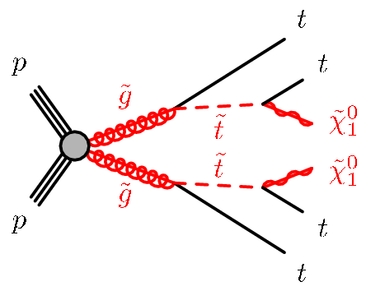
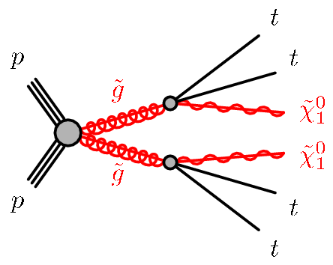
Which particles ?
Choice based on discovery potential @ LHC Run 2
  Processes initiated by strong interaction (8 →13 TeV x-sec increase a lot)
  Clear experimental signature, theory-motivated
This talk: focus on top-quark-related signatures
  Top quark
    Heaviest Standard Model particle
    Large coupling expected with new particles
  Vector-like top (T) ➔ vector-like confinement theories, little Higgs, …
  Gluinos & Scalar top (stop, t) ➔ supersymmetry
~

Slide 5
Which signatures ?
Top quark signatures extremely rich
  W decay products
    leptons + missing energy ➔ electron, muon
    quarks ➔ reconstructed as jets
  b-jets (identified with specific algorithm)
    77% identification efficiency
Vector-like top (VLT) pair-production
  Focusing on signatures with
    ≥ 1 top quark
    ≥ 1 Higgs boson (decaying to bb)
  ➔ many jets (up to 10) and b-jets (up to 6)
    = 1 lepton
Gluino-mediated stop production
  4 top quarks in the final state !!
  2 invisible particles (neutralinos) ➔ large missing energy

Slide 6
… and so what ?
LHC: millions of collisions every second … but not only signal ☹
  Need to apply online and offline selection to enhance fraction of signal compared to other processes (backgrounds)
All events are required to contains:
  A large number of jets (≥6)
  A large number of b-jets (≥2 but often much more)
  Very large missing transverse energy (MET) fur SUSY search
    Not for VLQ search
  Lepton selection or veto
After pre-selection: still not only signal ☹
  Standard Model processes can mimic the same signature as signal
    Background processes
  Dominated by production of tt+jets background

Slide 7
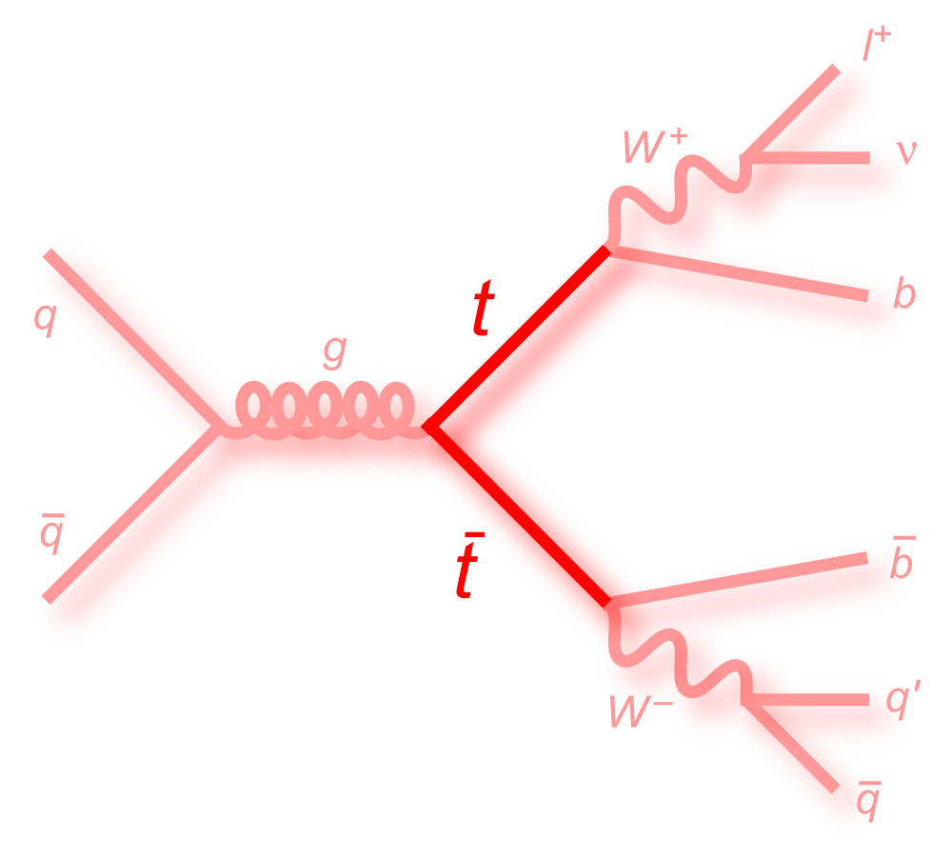
Background
tt + jets background
  Associated production of a top-antitop pair with jets
  Dominated by single-lepton tt production
  But ….
    Require a large number of b-jets (quite often ≥3, ≥4)
    But only 2 coming from top decays (tt)
      Other ones coming from radiations
Monte Carlo (MC) samples
  Processes modeled by simulated events
  Use of Monte Carlo generators to produce events
    MC samples tuned to match previous data/measurements
    NLO accuracy for most generators
      Particularly useful for tt + ≥1b background
  Generated events introduced in detector simulation
    e.g. Geant4

Slide 8
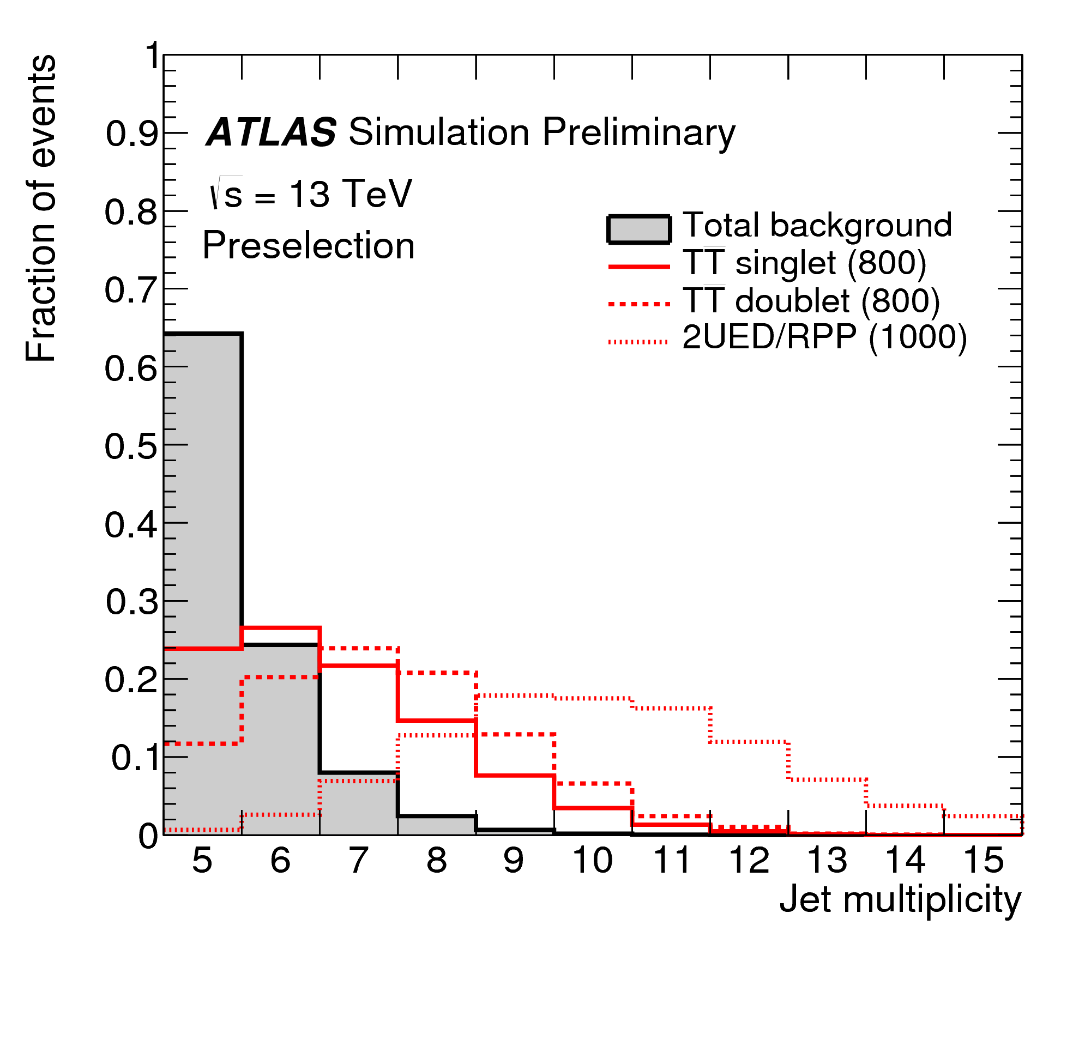
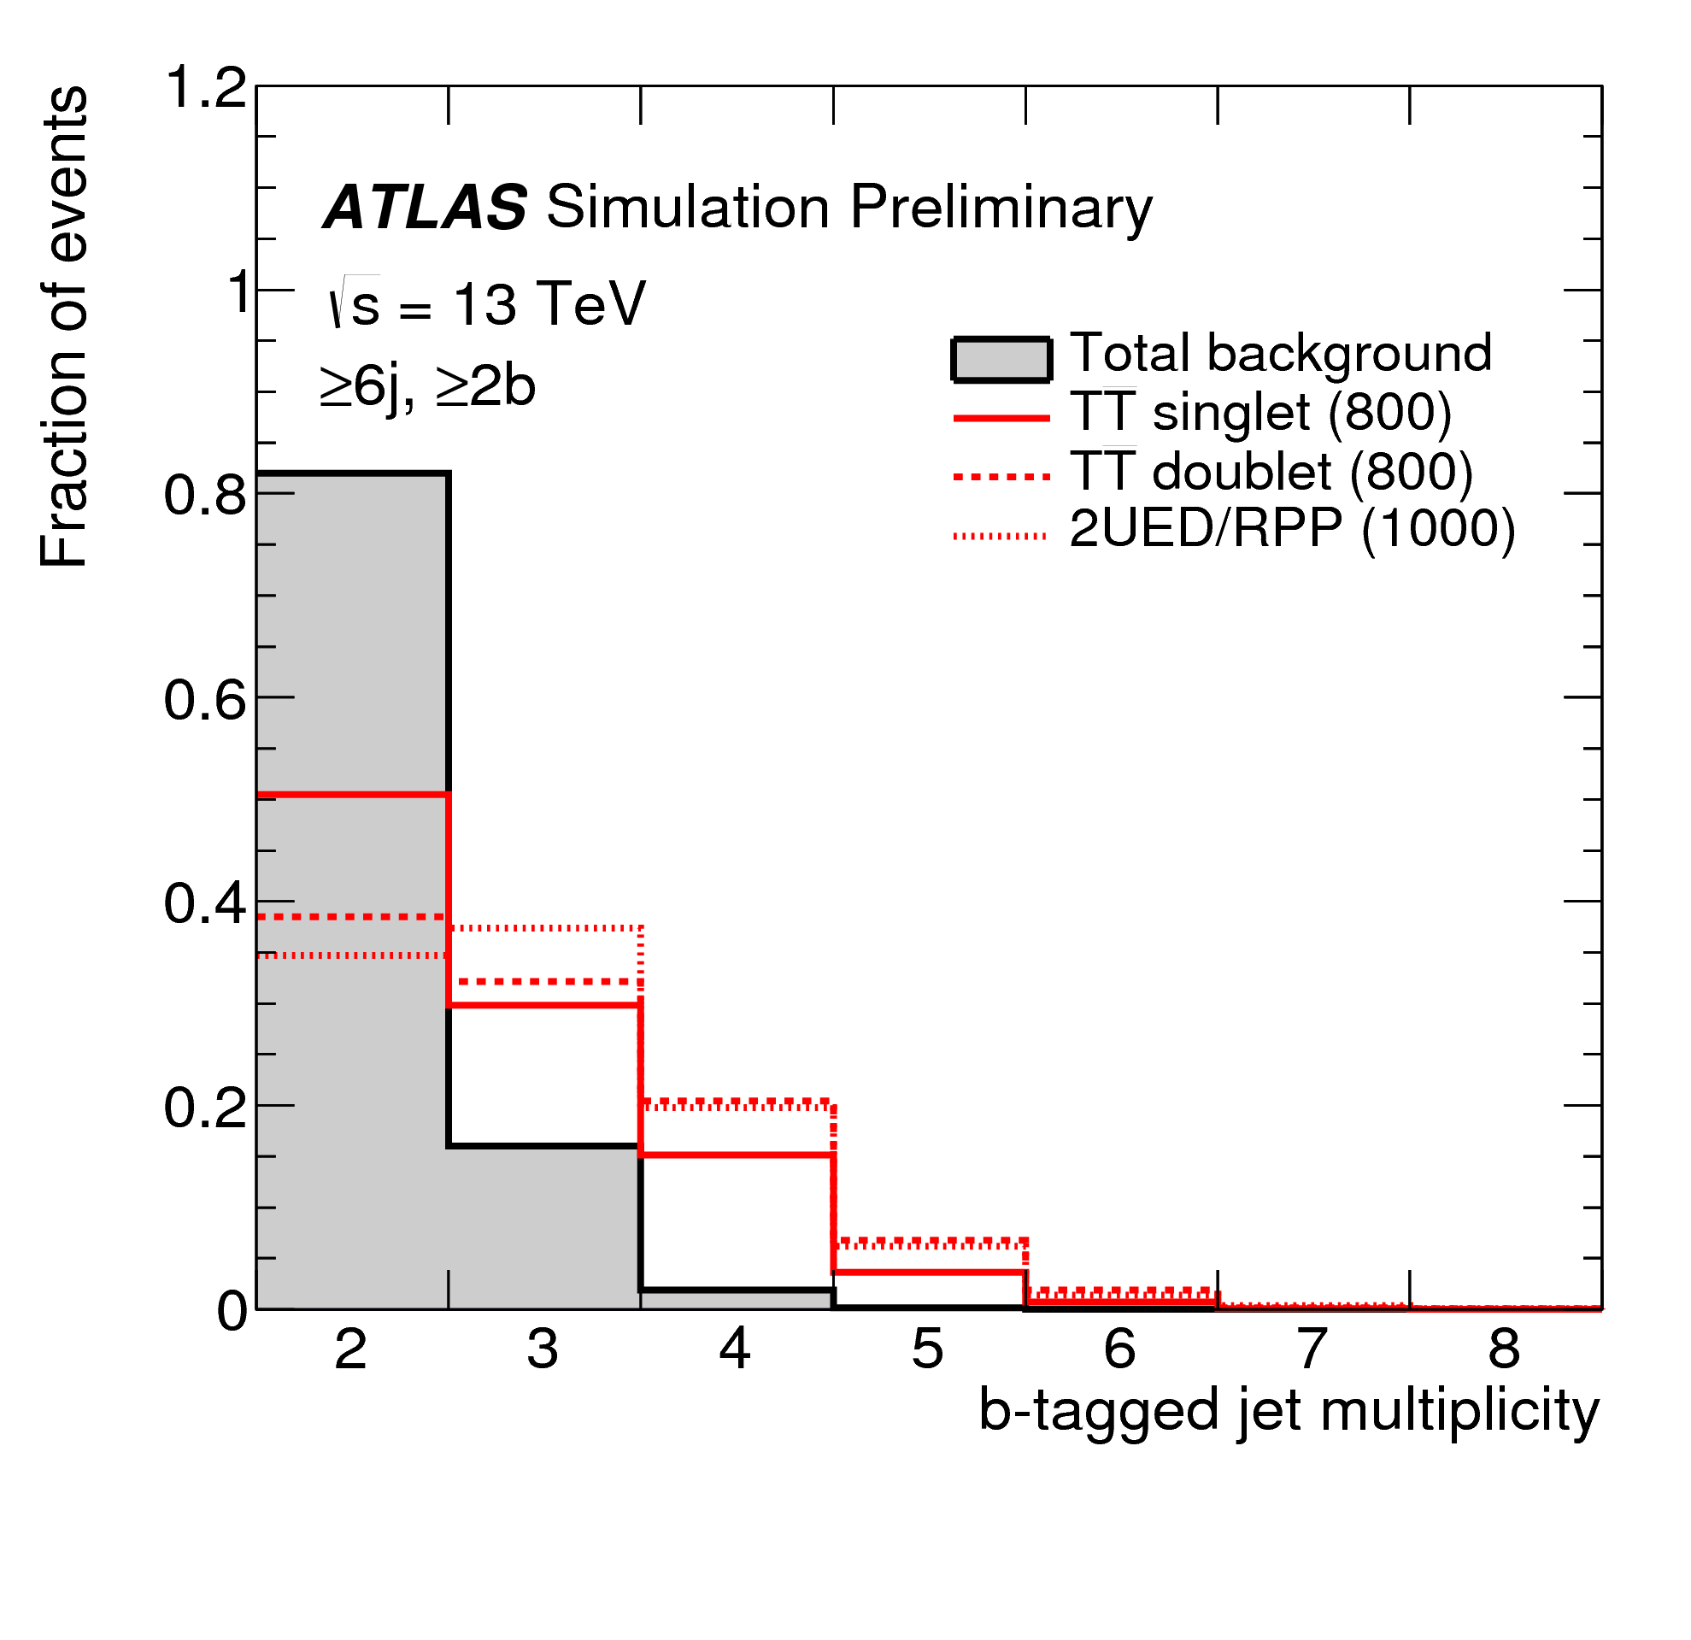
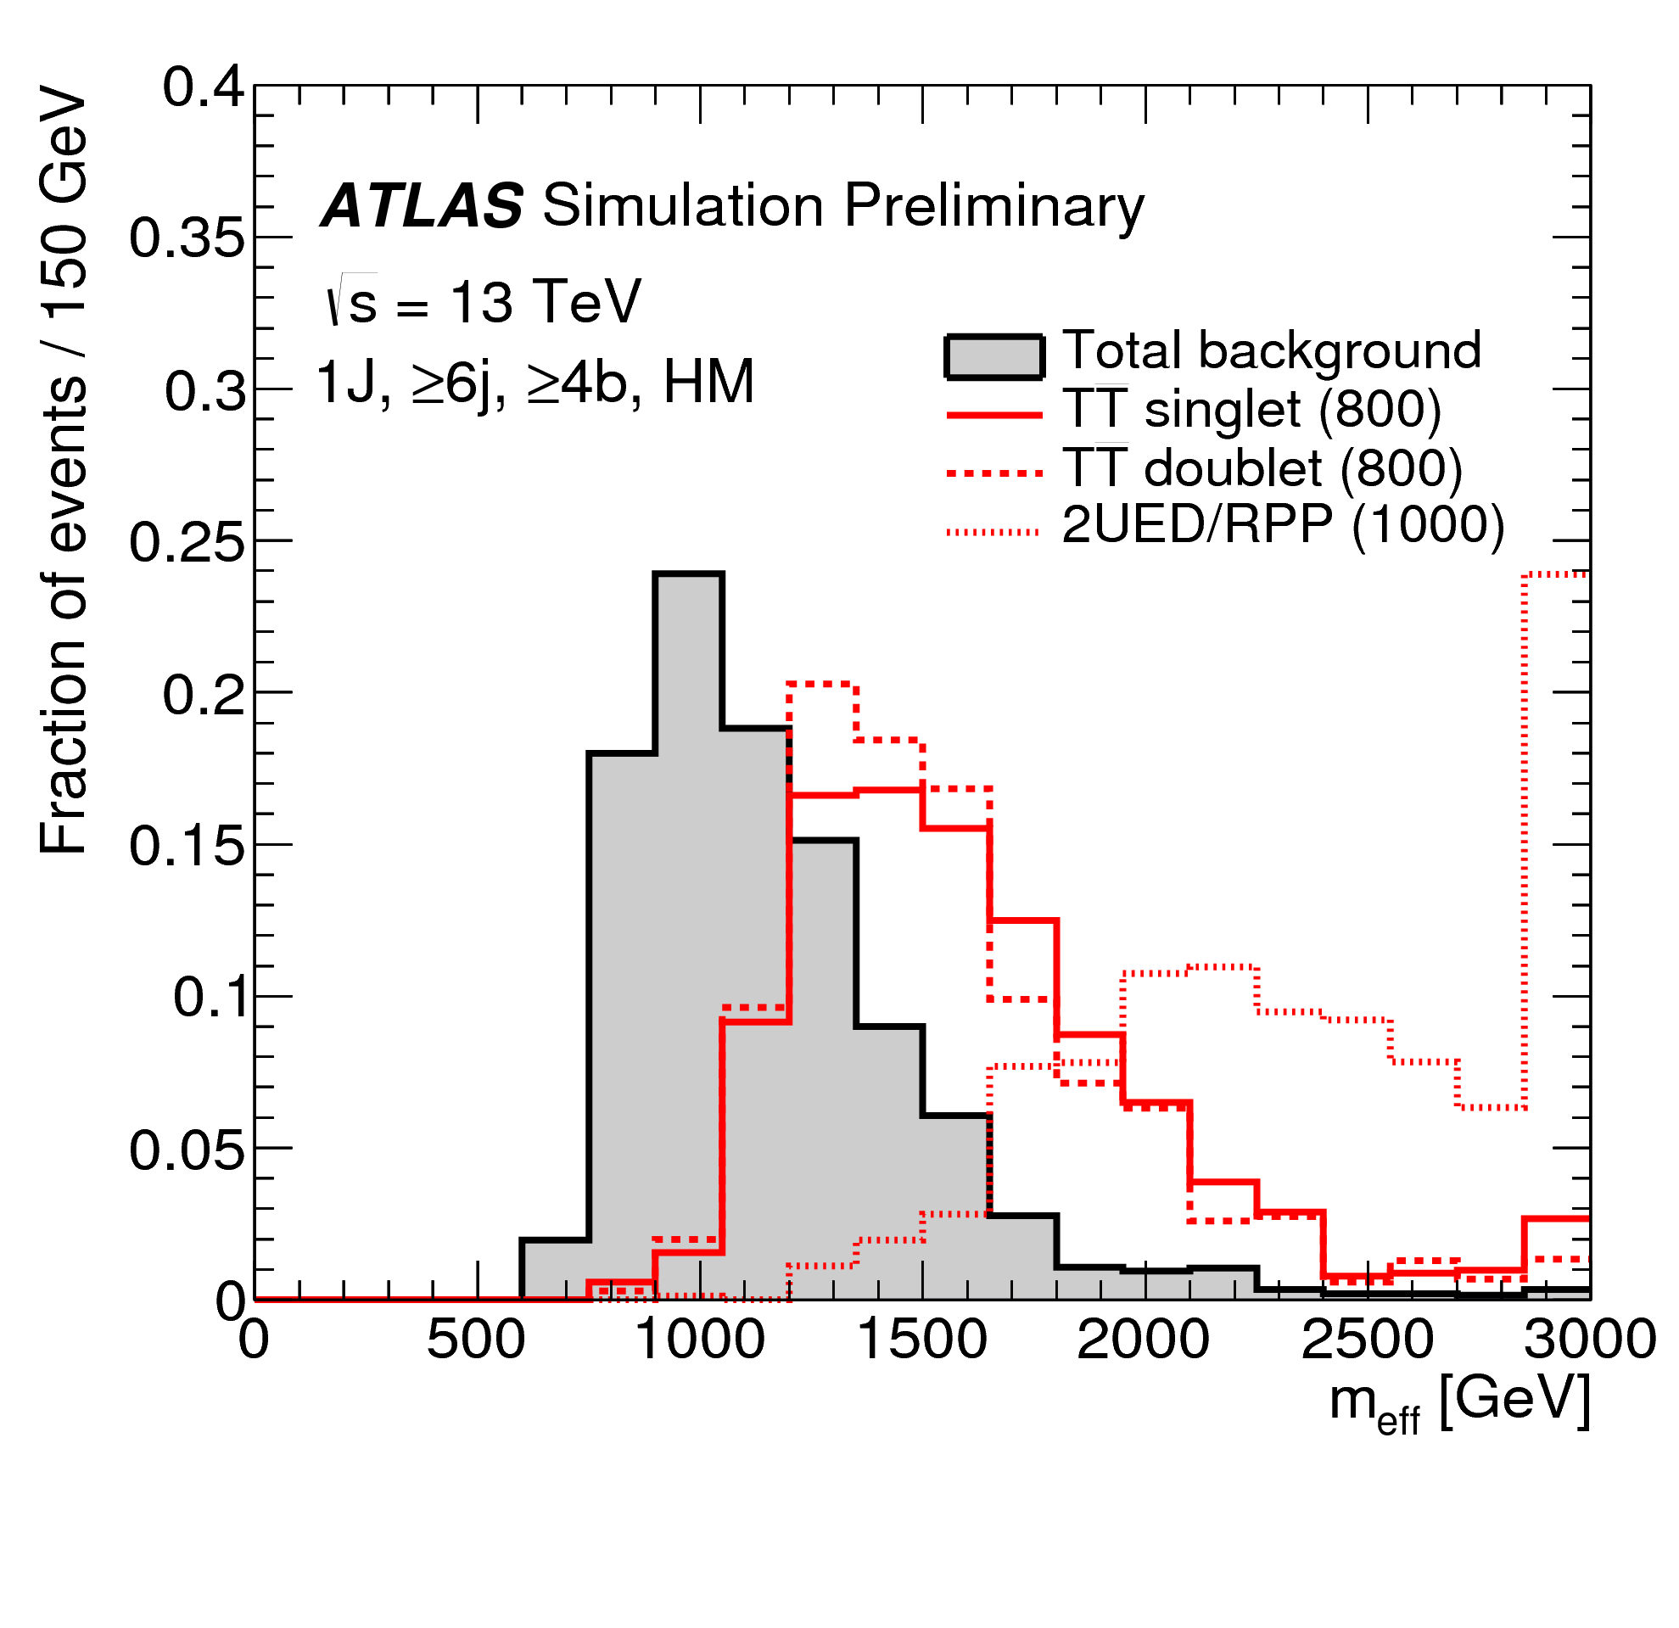
Signal vs Background
After pre-selection signal and background expectations compared
  Allow to design more precise/refined selections
Effective mass
N(jets)
N(b-jets)
Surely discrimination power for those variables
  Some others too … but just 20’ today ...
Two techniques shown (many others exist)
  Very tight selection on some variables ➔ Counting experiment (used in SUSY)
  Sufficiently loose selection ➔ Shape-based analysis (used for VLT)

Slide 9
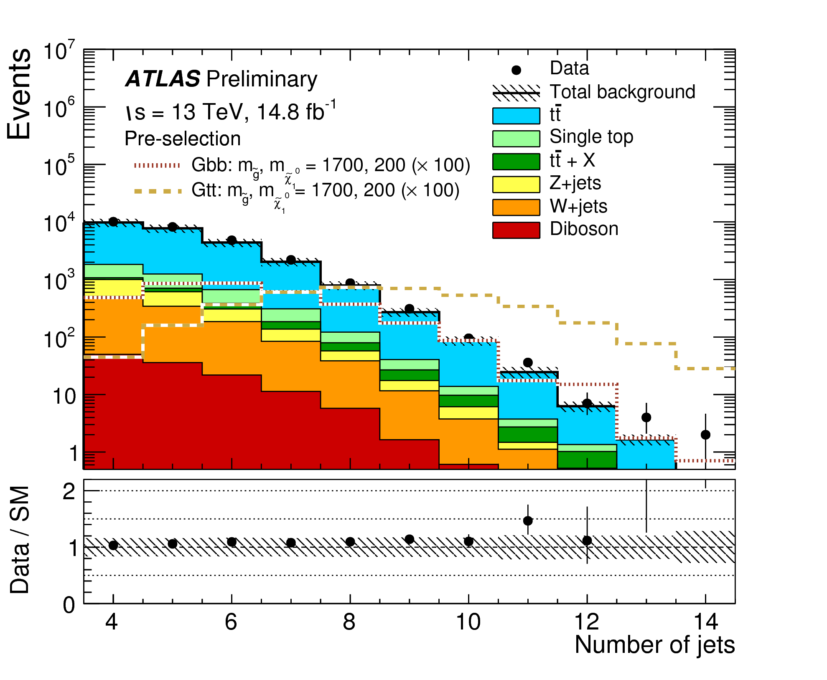
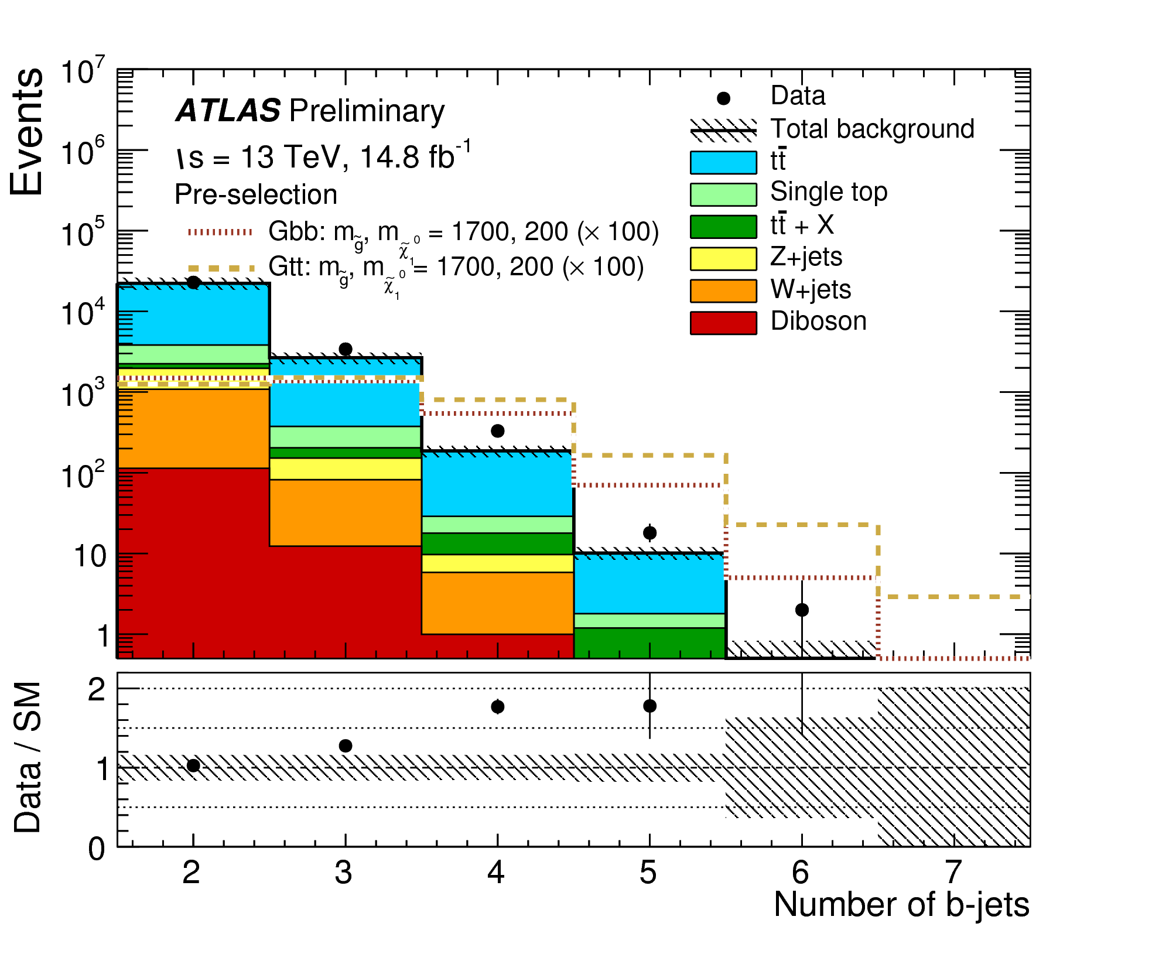
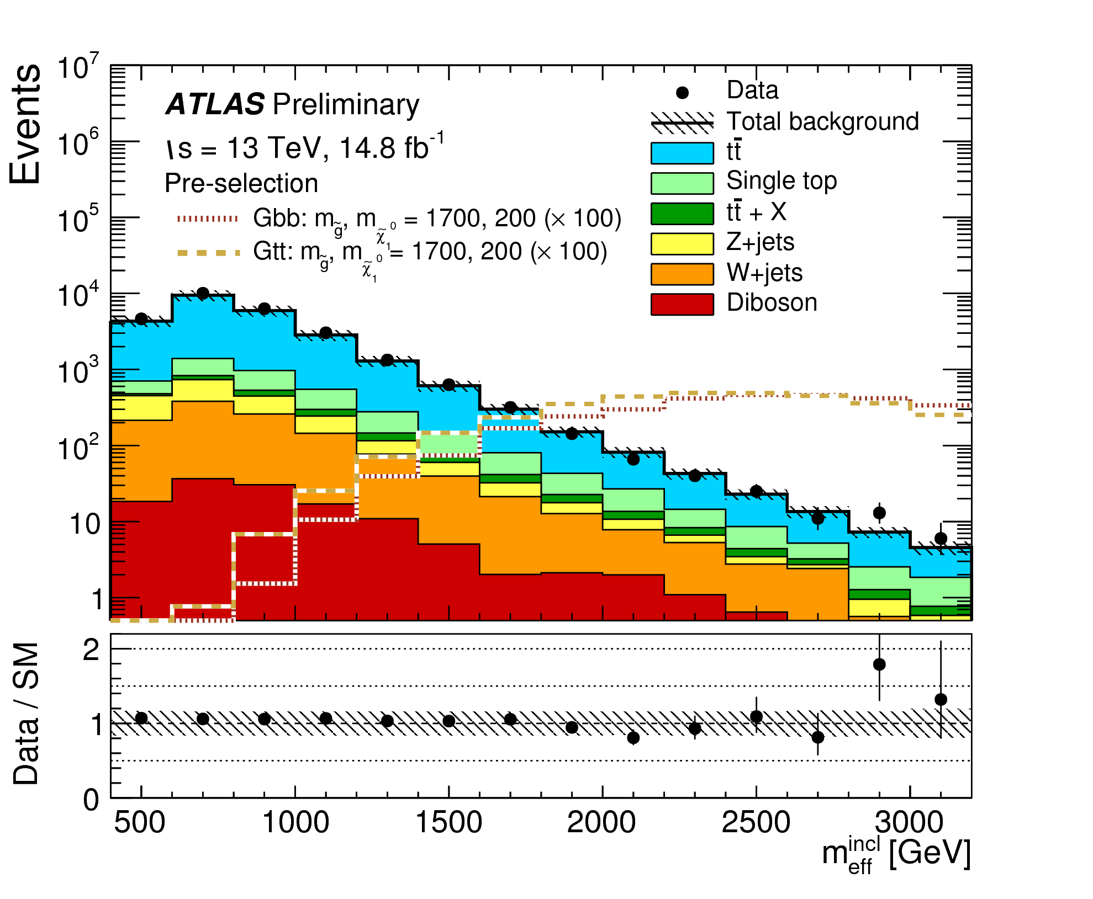
Background modeling
Before any further selection: variables well-modeled in simulation ?
✓
✗
✓
N(jets) and m_{eff} well described by simulation ! ☺
Obvious (but understood) mis-modeling of N(b-jets) 😐
  Related to underprediction of tt + ≥1b in simulation
  Need to correct this prediction based on data

Slide 10
Haystack: ~yellow-ish
Needle: ~silver-ish (or absent)
Not so close to the answer yet

Slide 11
Counting experiment (I)
Principle
  Very tight selection on kinematic variables (m_{eff}, objects’ momenta, …)
  Left with O(1) background event expected in signal regions (no shape)
  Then count number of background events and compare with data
Background estimation
  Control regions (CR) ➔ to normalize tt + jets background
    similar background composition/kinematics as in signal regions (SR)
      in particular, same N(b-jets)
    small signal contamination (<5%)
    tt + jets background scaled until prediction = data in the CR (1 equation + 1 unknown)
  Validation regions (VR) ➔ to check tt + jets background
CR
VR
SR
x α
x α
x α

Slide 12
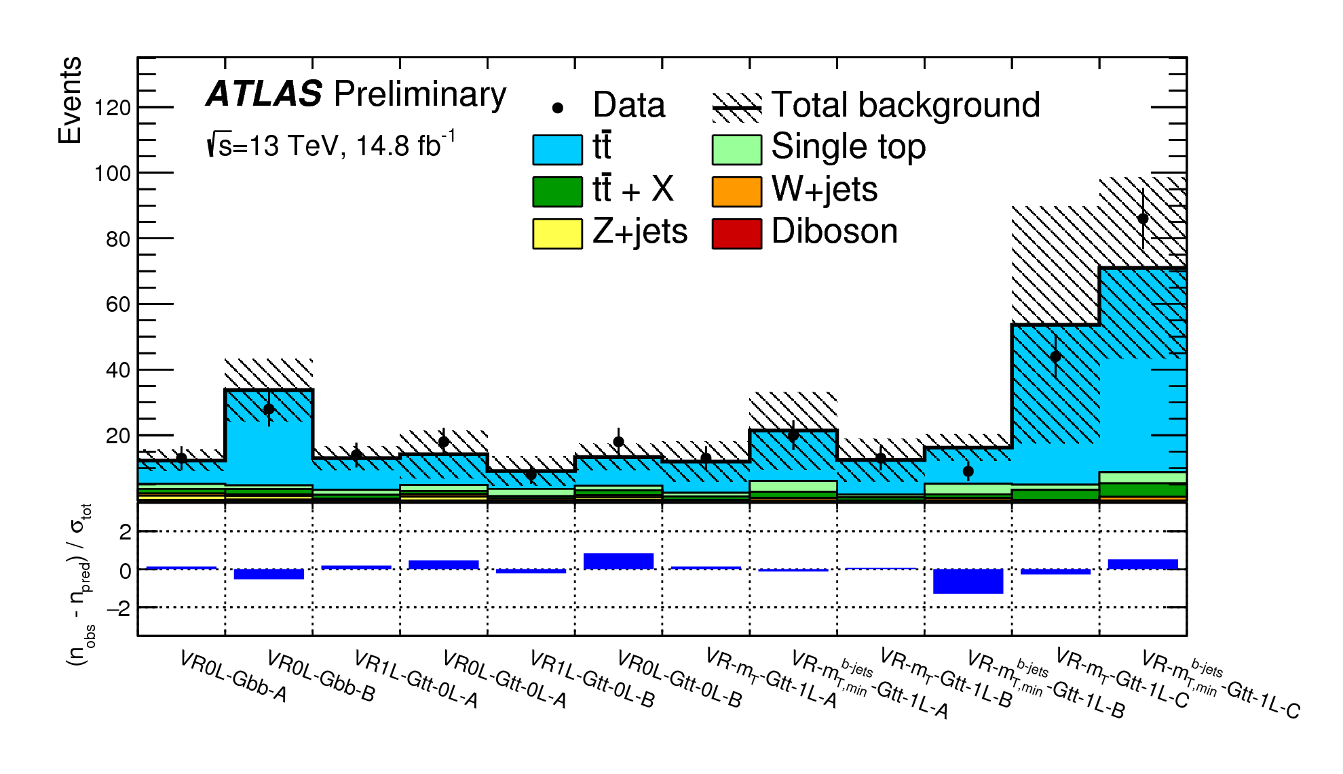
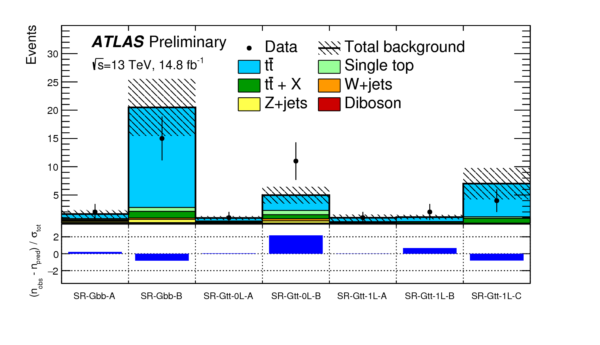
Counting experiment (II)
Validation regions results
All regions with ≥3/≥4 b-jets
  Before correction
    expect 25% - 50% excess in all channels
  After correction
    all validation regions are very nice !
  Normalisation works well ☺
Validation regions
Signal regions results
After background normalisation
Data in good agreement with background expectations
No hint for SUSY yet ☹

Slide 13
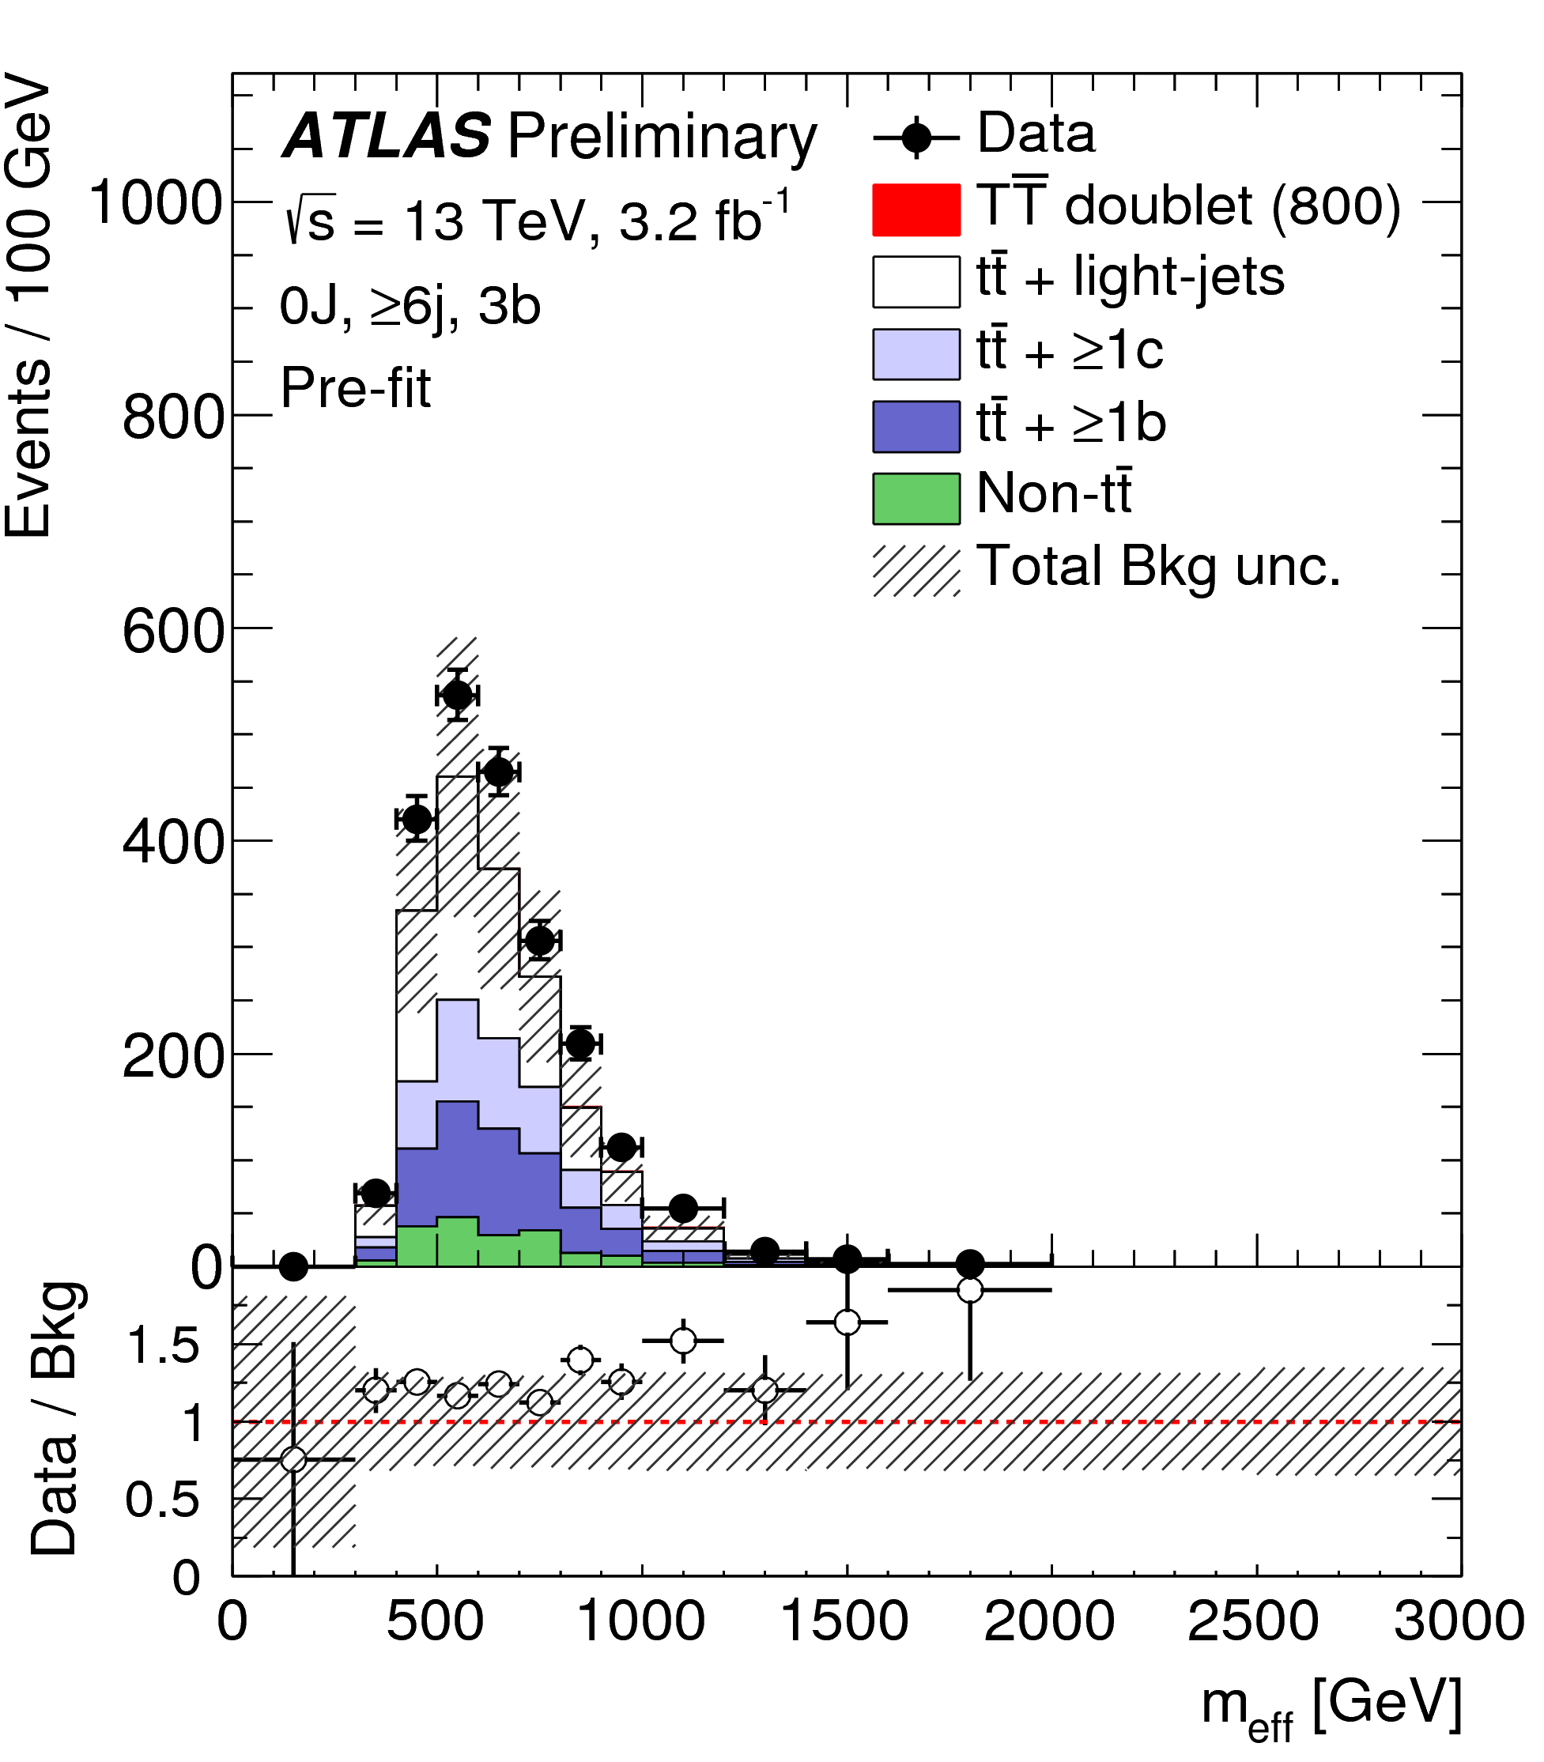
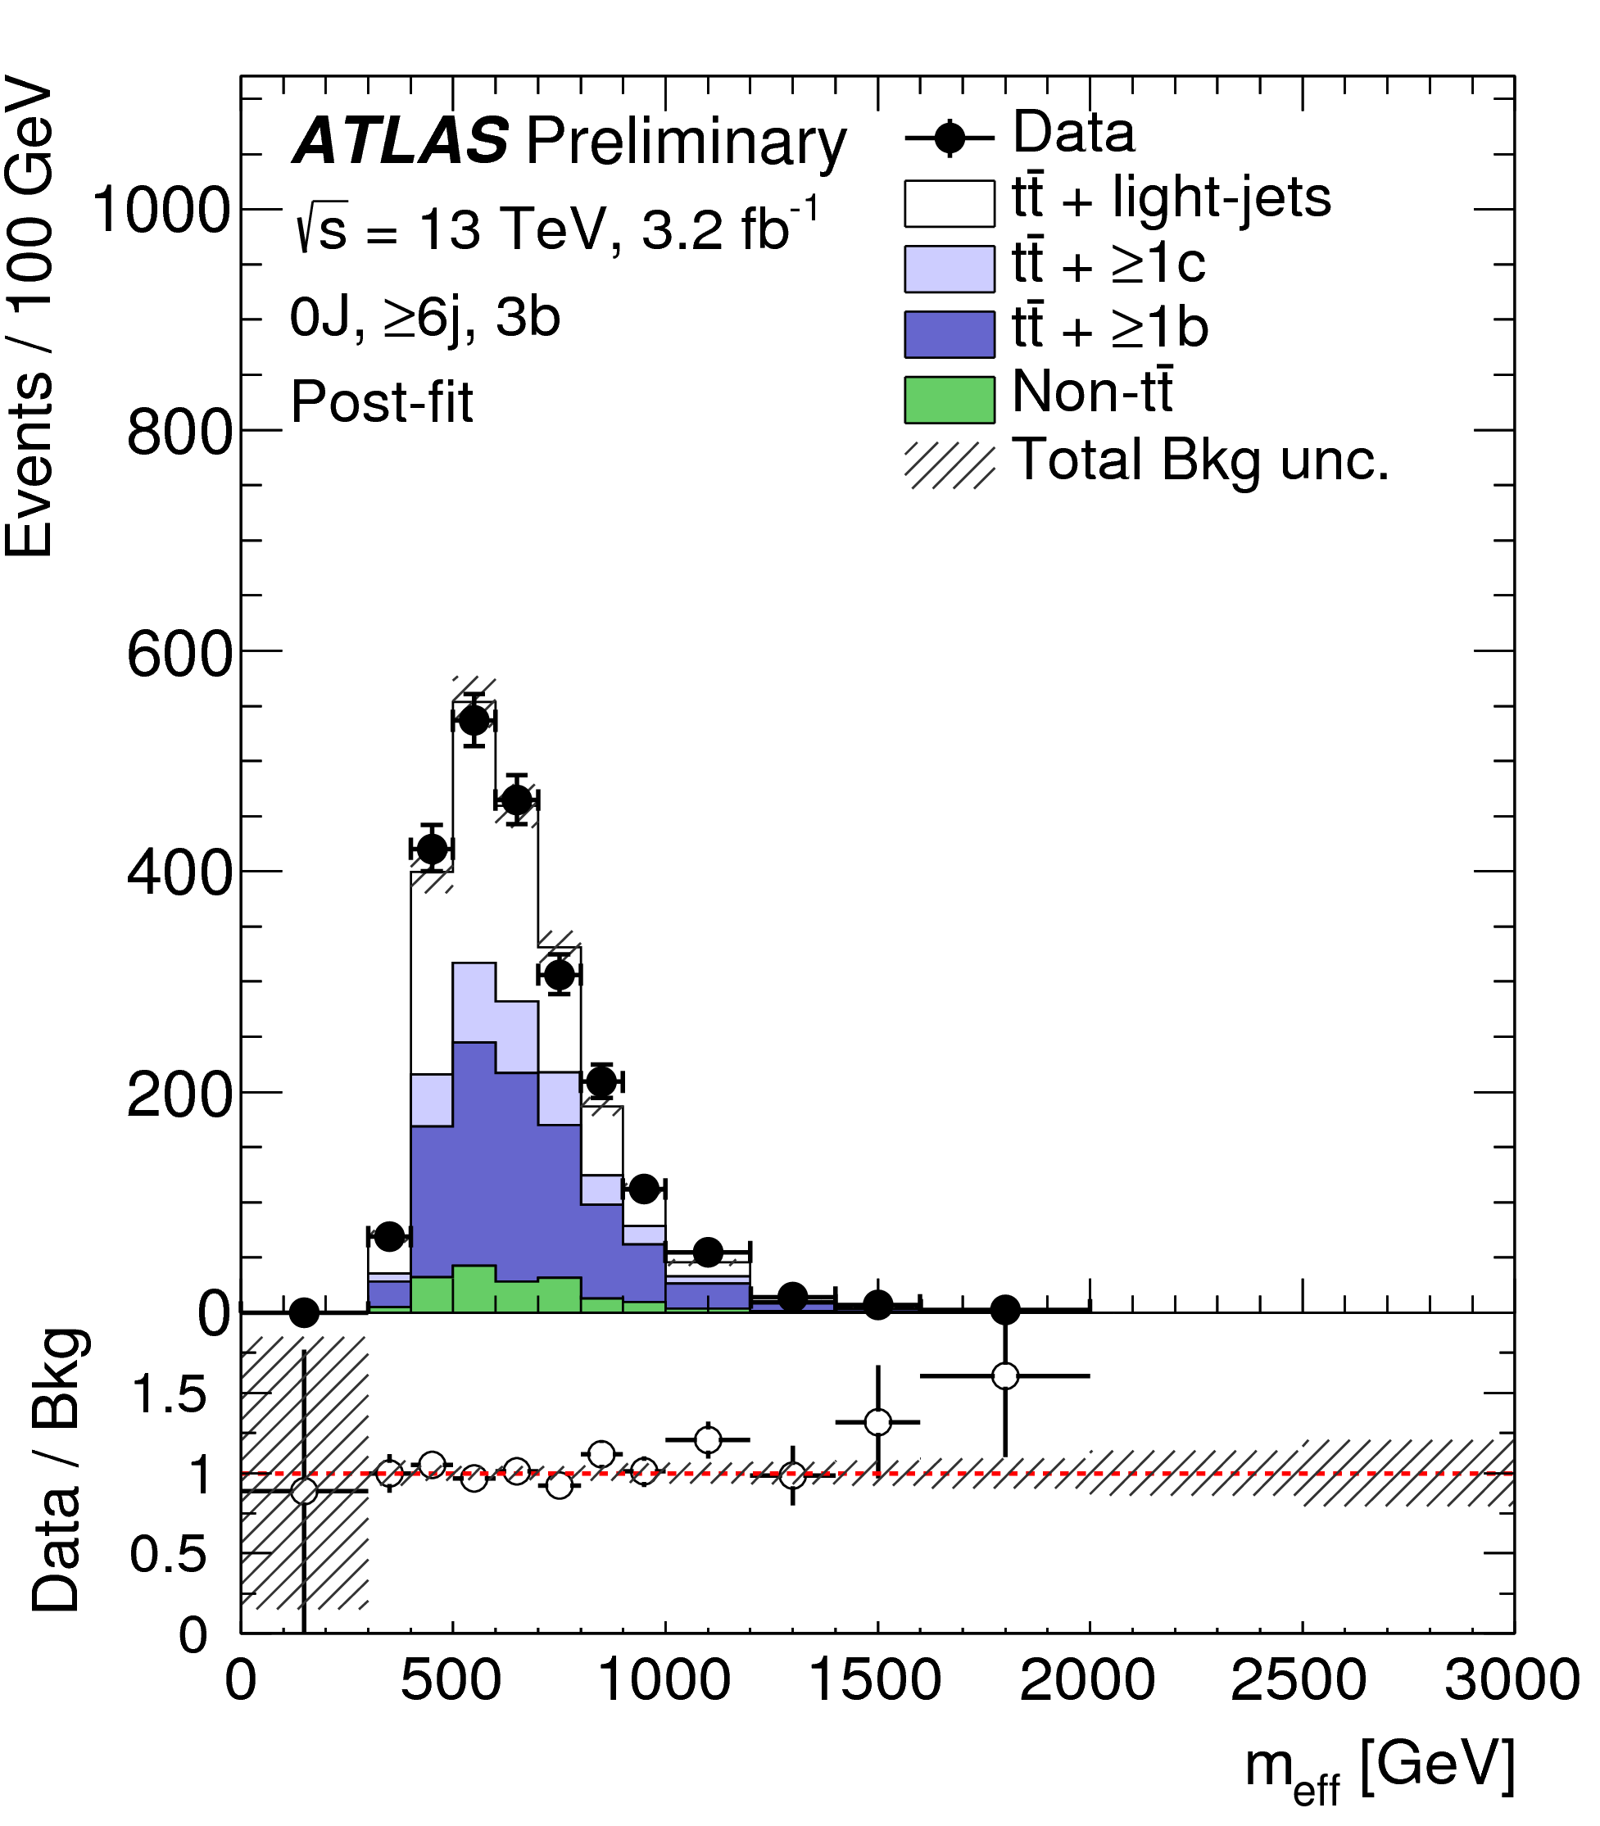
Shape analysis (I)
Principle
  Looser selection: shape information available
  Backgrounds normalized in CRs as well, but shapes can be changed as well
Background estimation
  General idea: similar as for counting experiment
  But: need to describe shape distorsions (systematic uncertainties)
    NB: also needed for counting experiment but effect is marginal
  Means that system has more unknowns … and more equations
    Multi-dimensional fit
And it works !!
Before fit
After fit

Slide 14
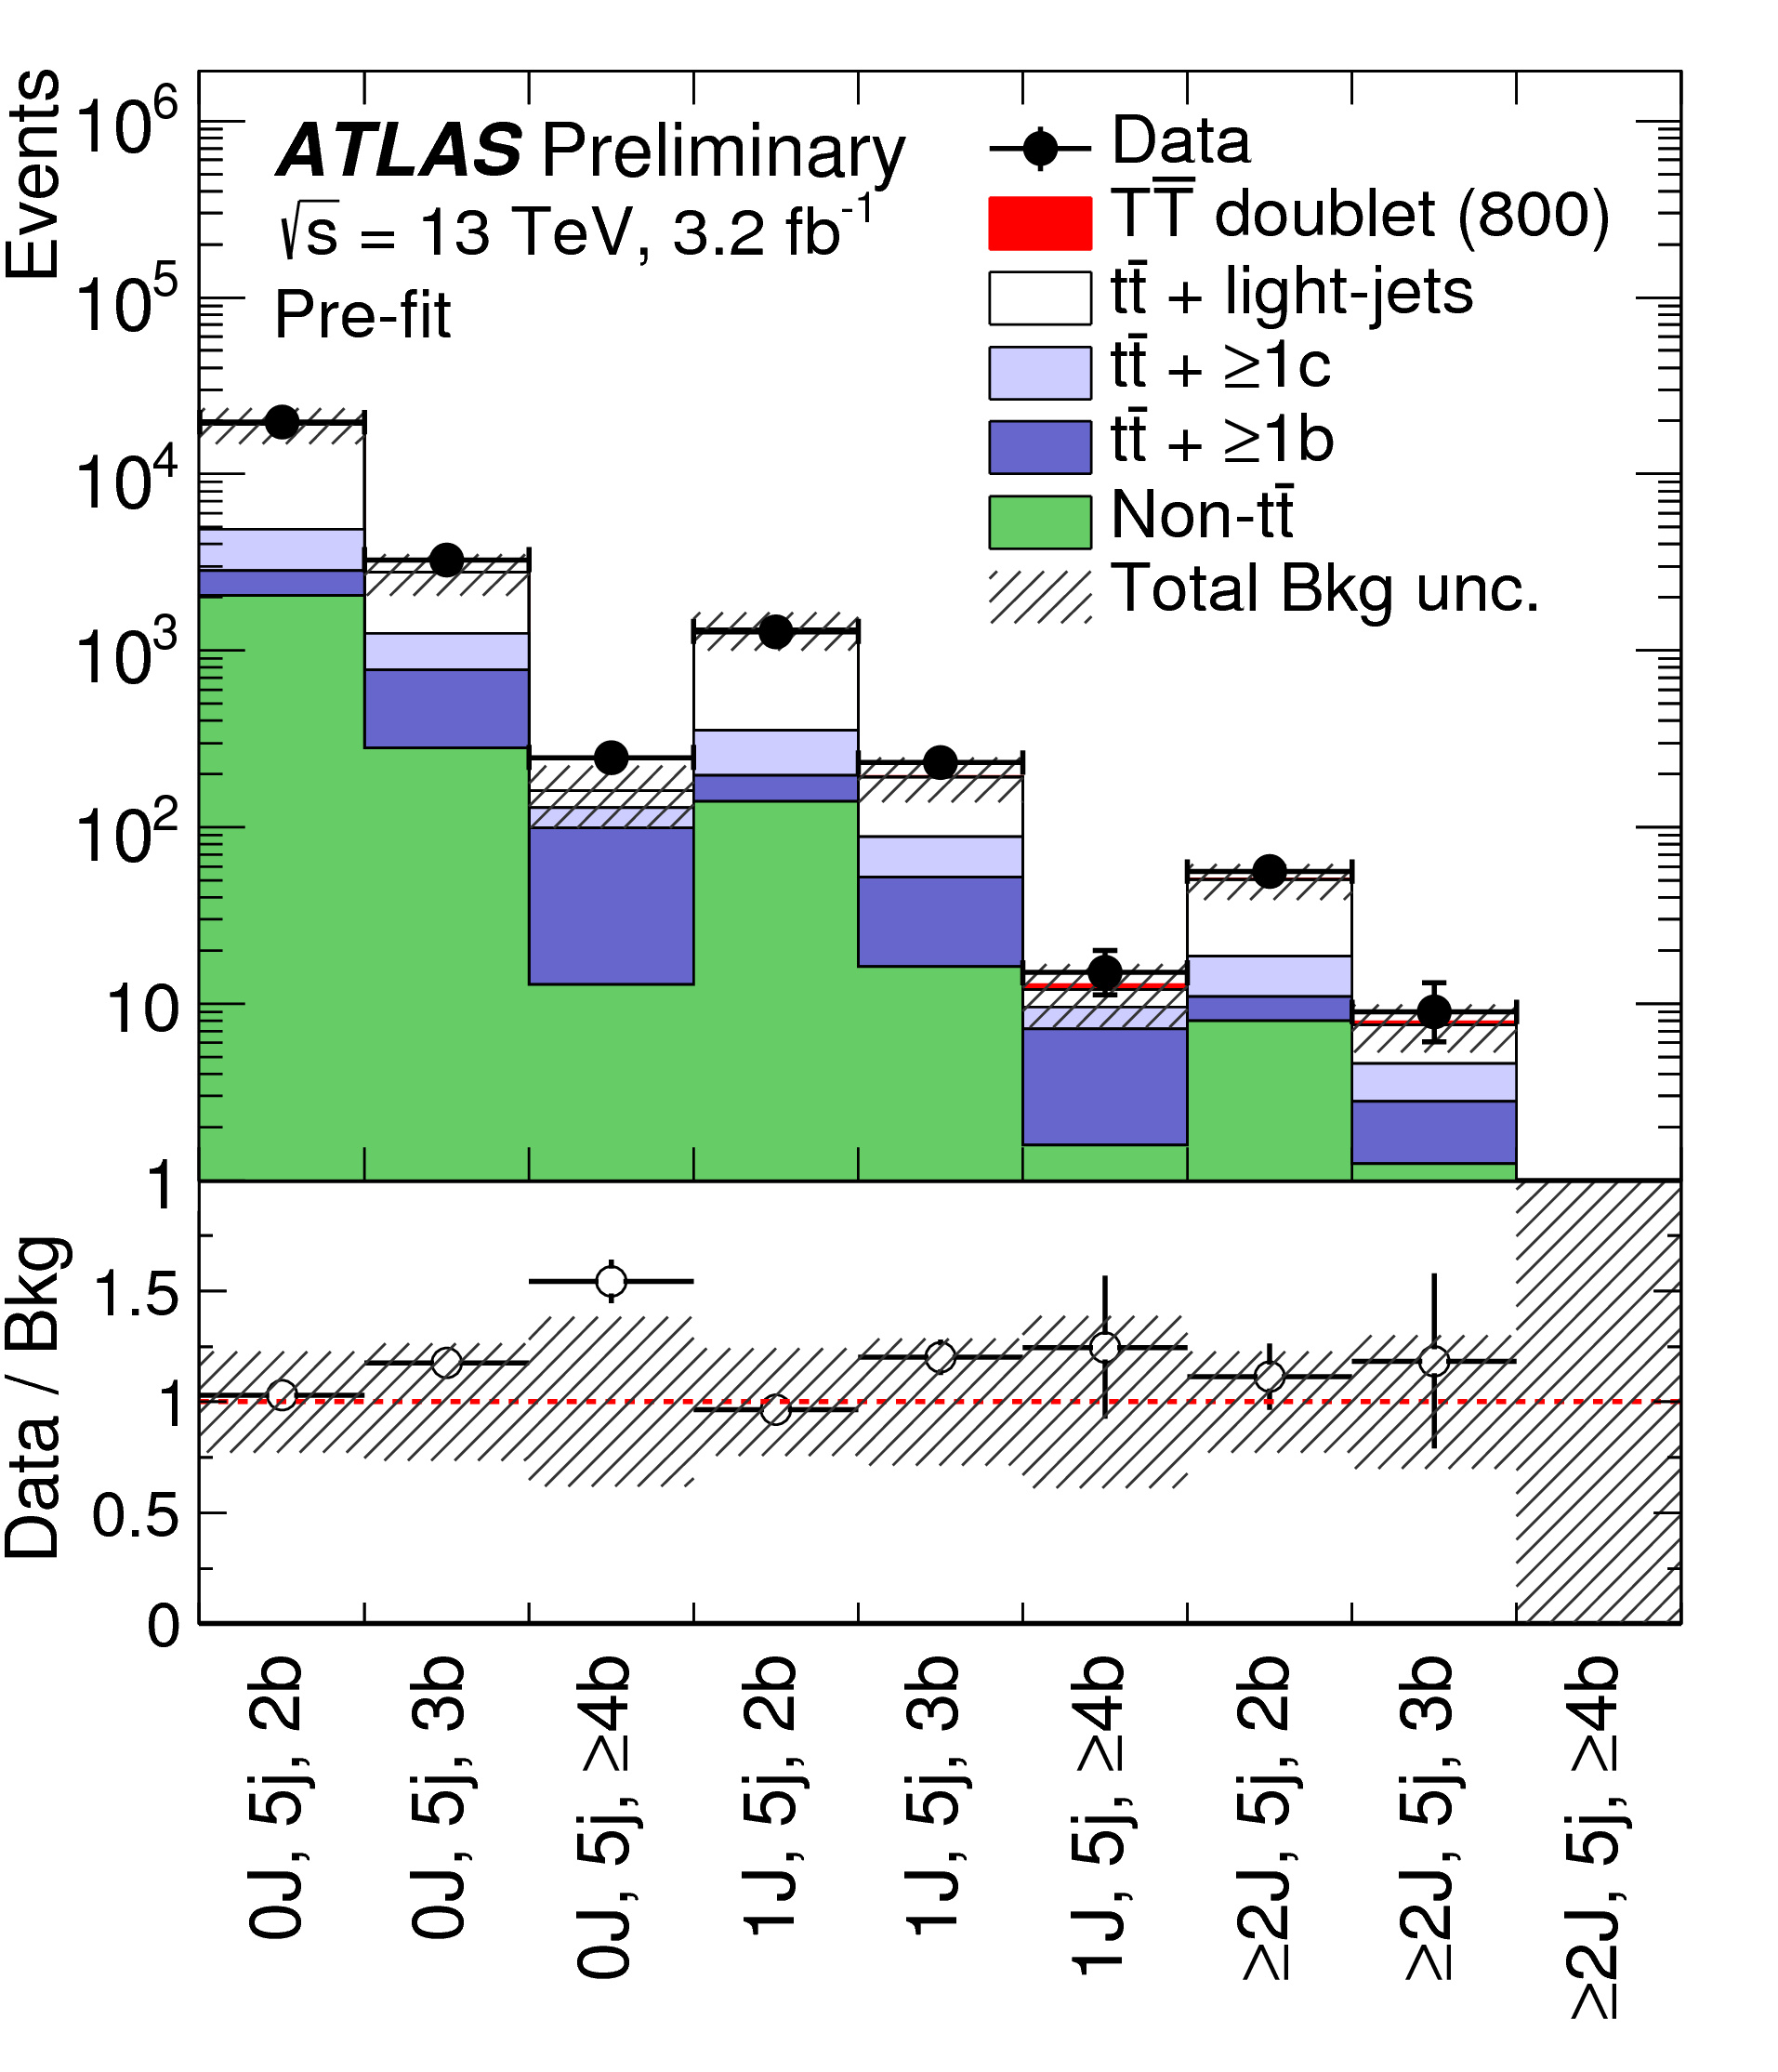
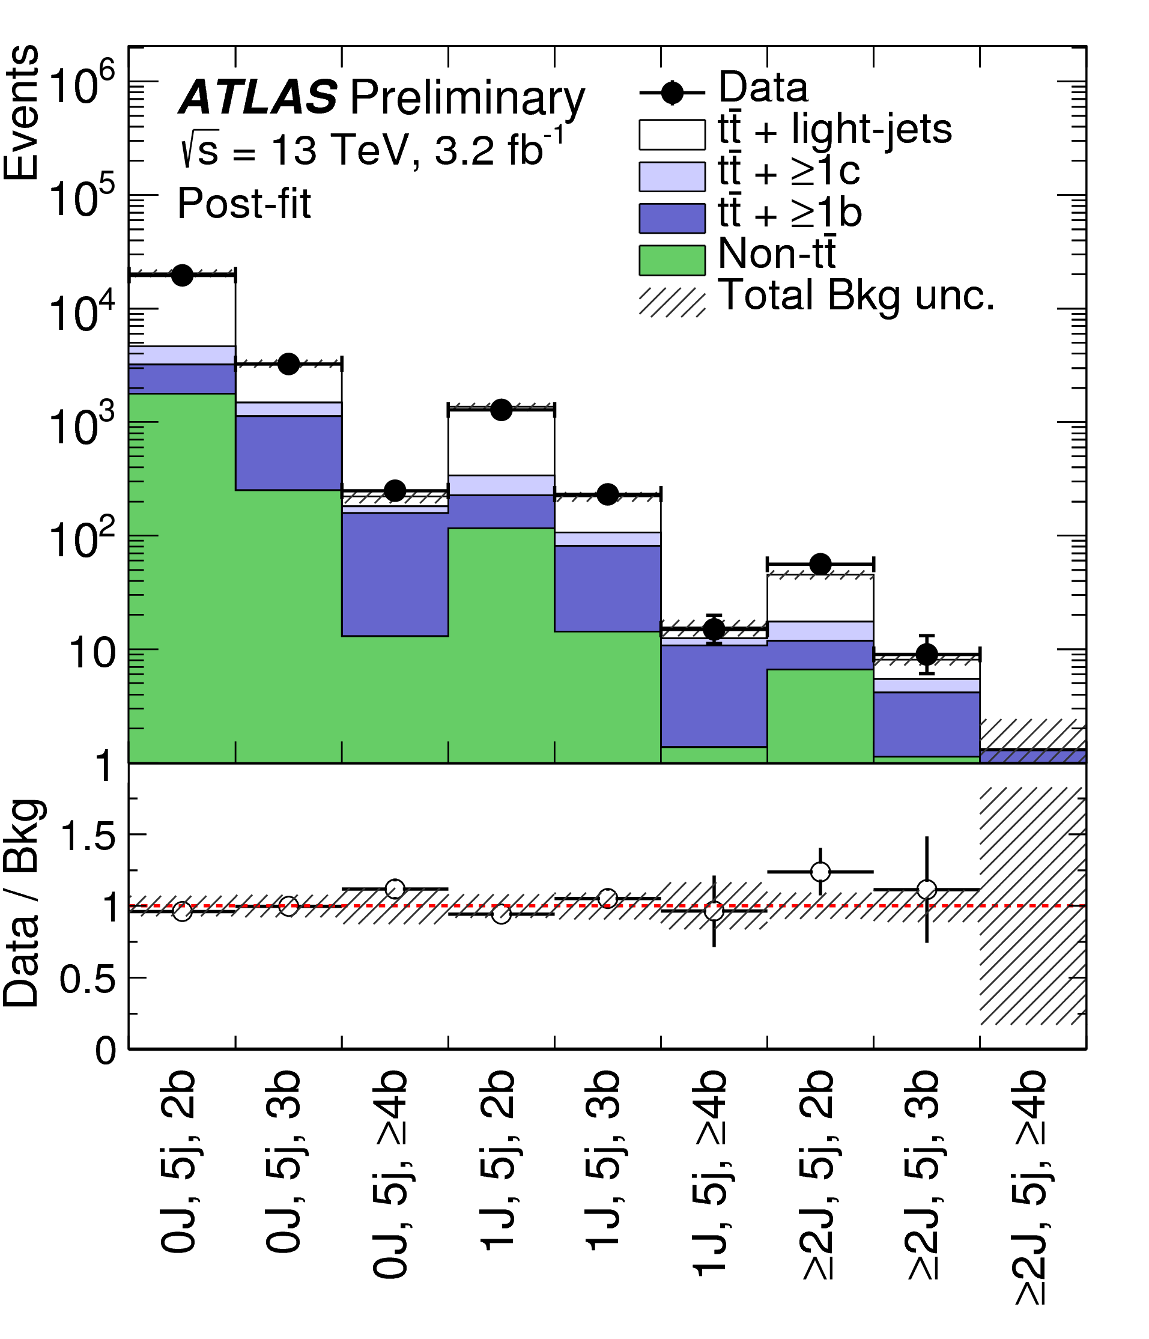
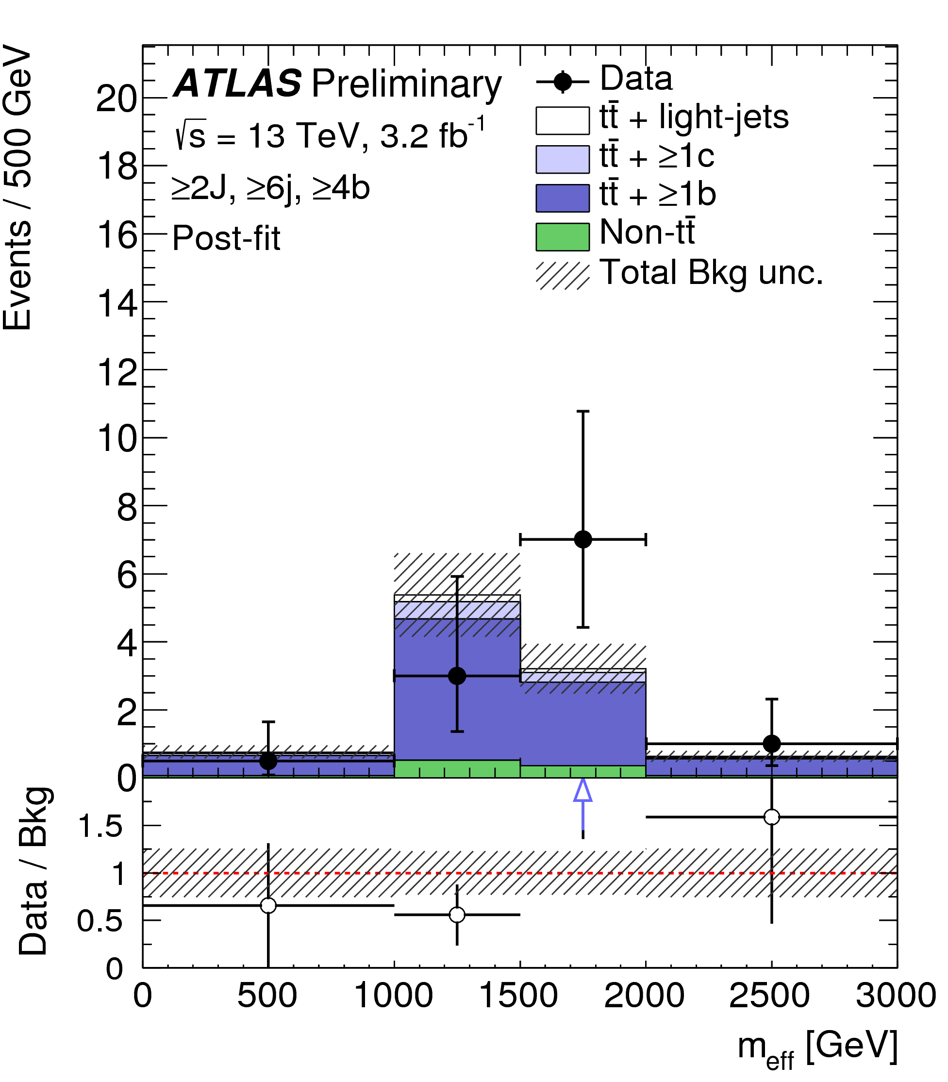
Shape analysis (II)
Validation regions
  Test whether “corrected” background is correct in orthogonal regions
  Data / prediction agreement VERY nice after correction !!
Signal regions
  No significant excess observed ☹
Most sensitive signal region
Before fit
After fit

Slide 15
Looking in the haystacks … no evidence for needle ☹
Could we have missed it ? How confident are we ?

Slide 16
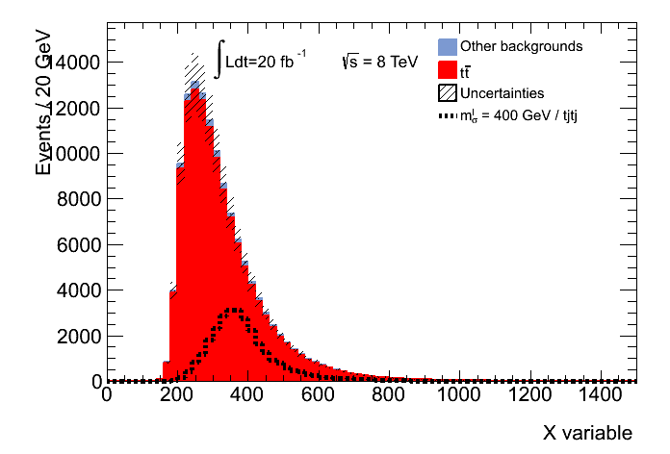
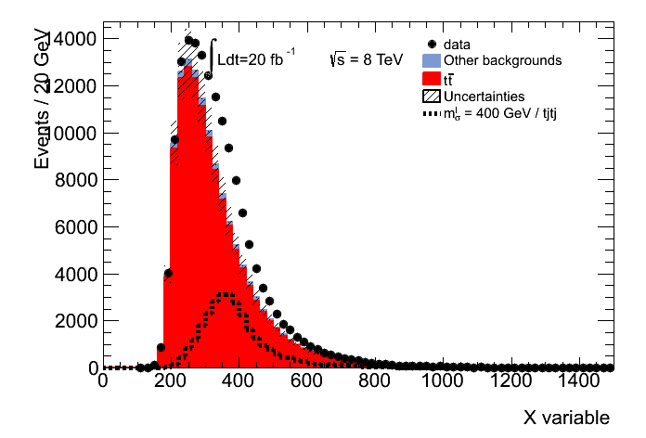
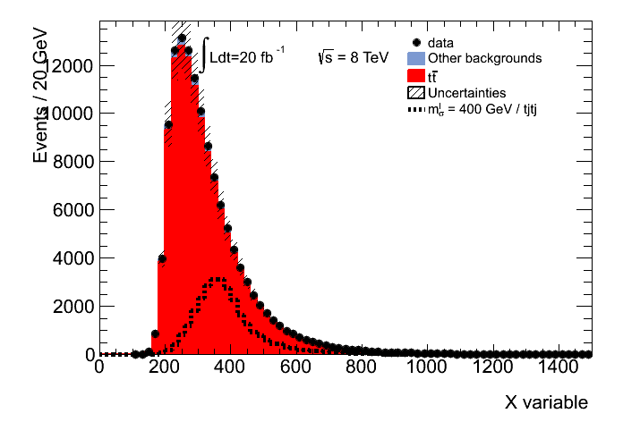
Hypothesis test – Limits (I)
How big should be an existing signal to be seen ?
Let’s assume that our signal has a large production rate
No new physics ☹
Discovery ☺
  If this signal existed … we would have seen it !
  If we don’t see anything ➔ signal likely doesn’t exist
    This signal (at this rate) is excluded

Slide 17



Hypothesis test – Limits (II)
How big should be an existing signal to be seen ?
Let’s assume that our signal has a tiny production rate
New physics in !
No new physics
  Even if this signal existed … we couldn’t have seen it !
  No sensitivity for this signal (at this rate)

Slide 18
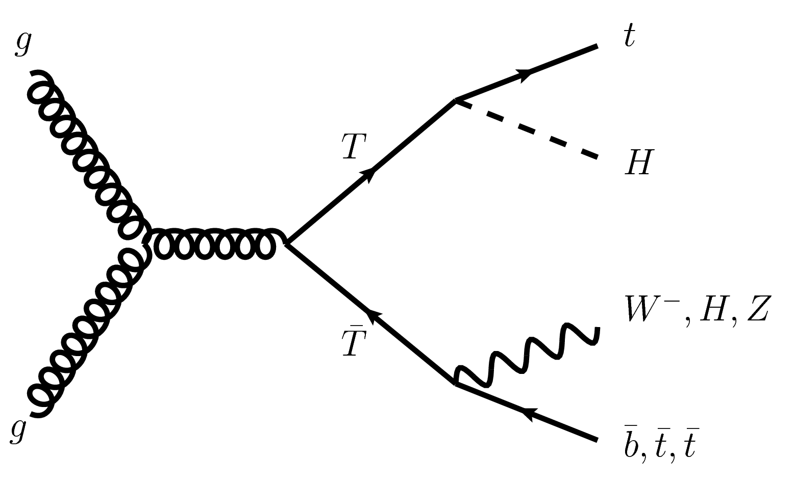
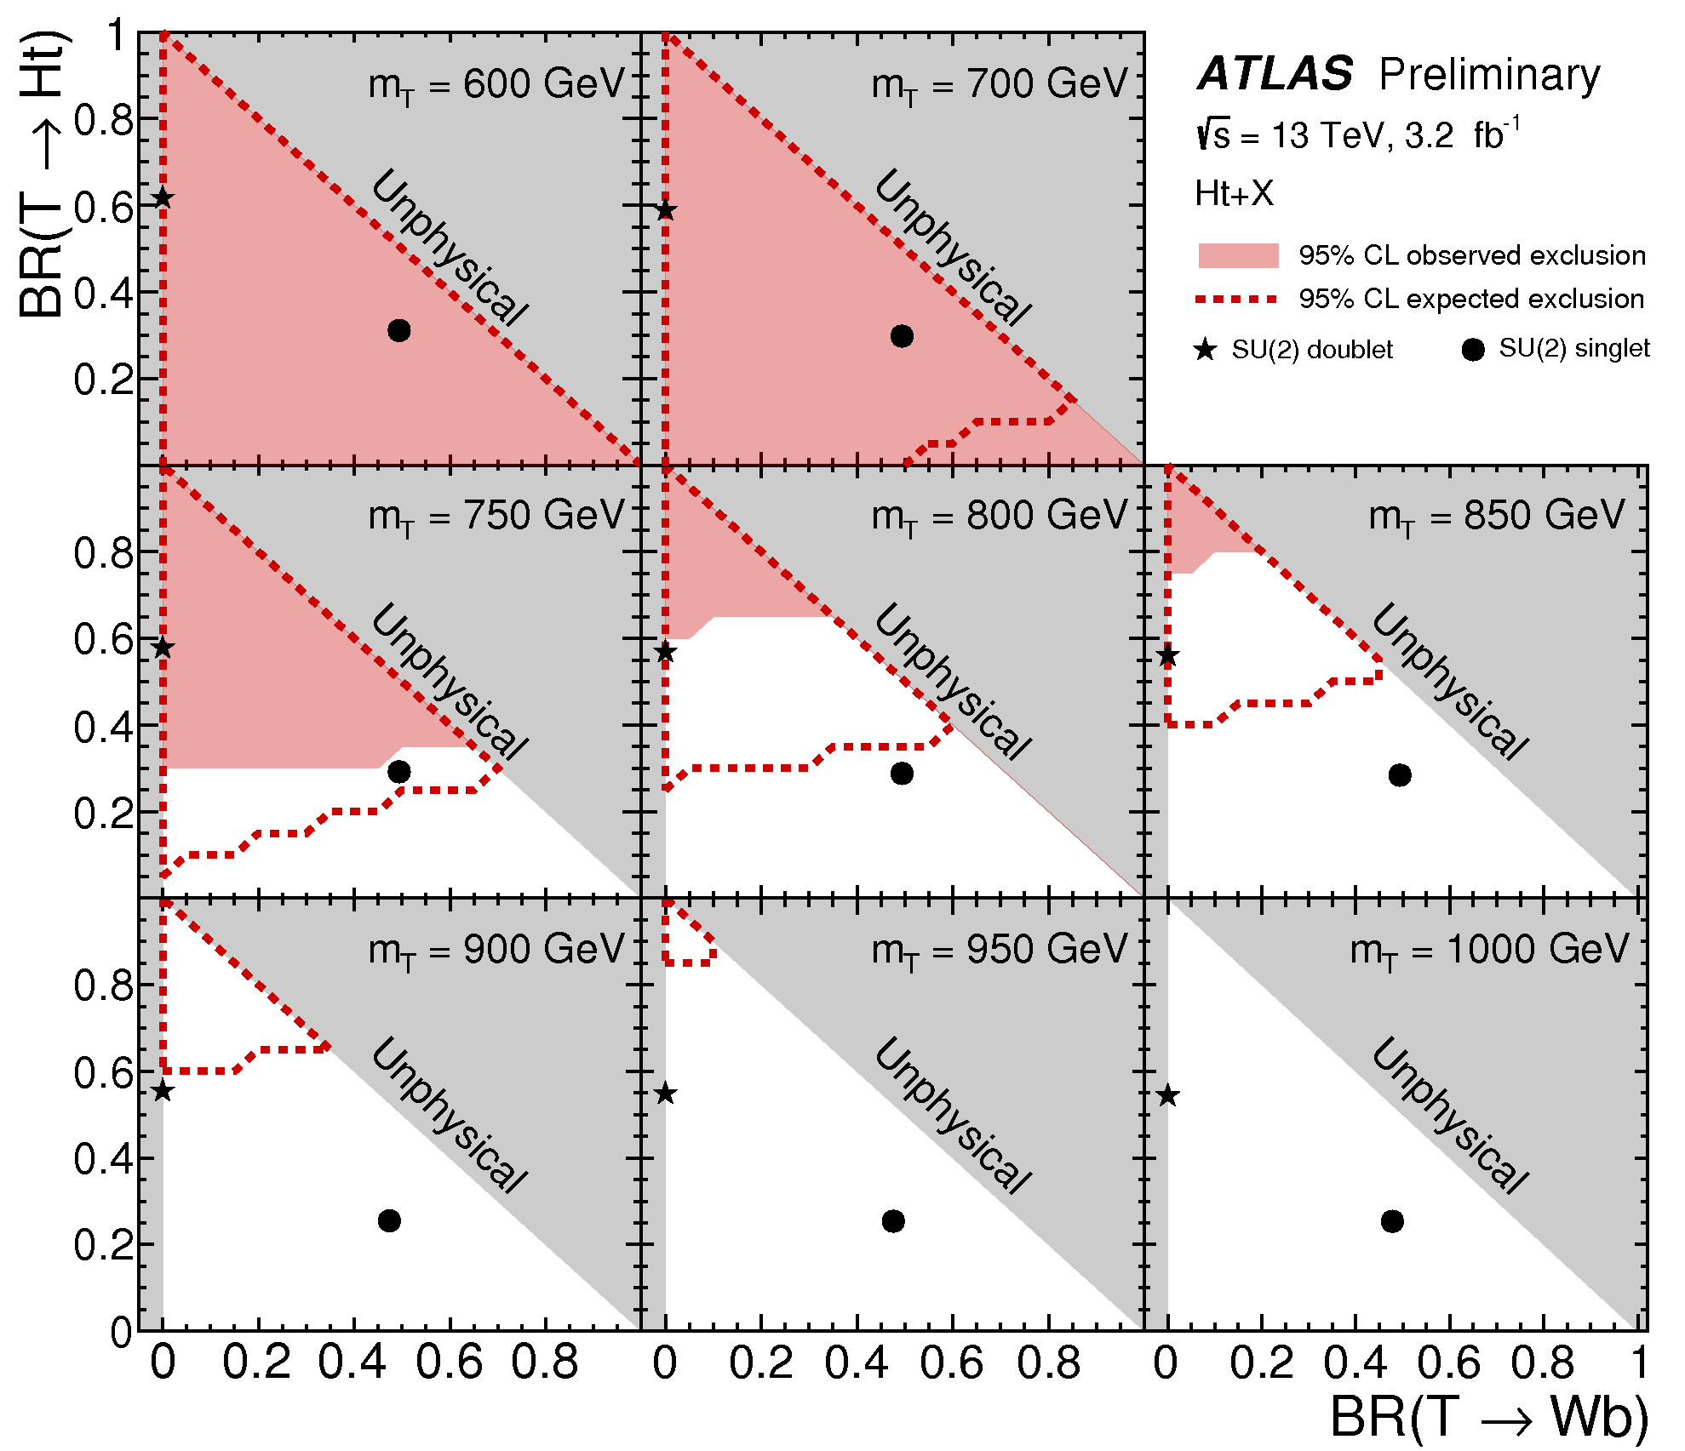
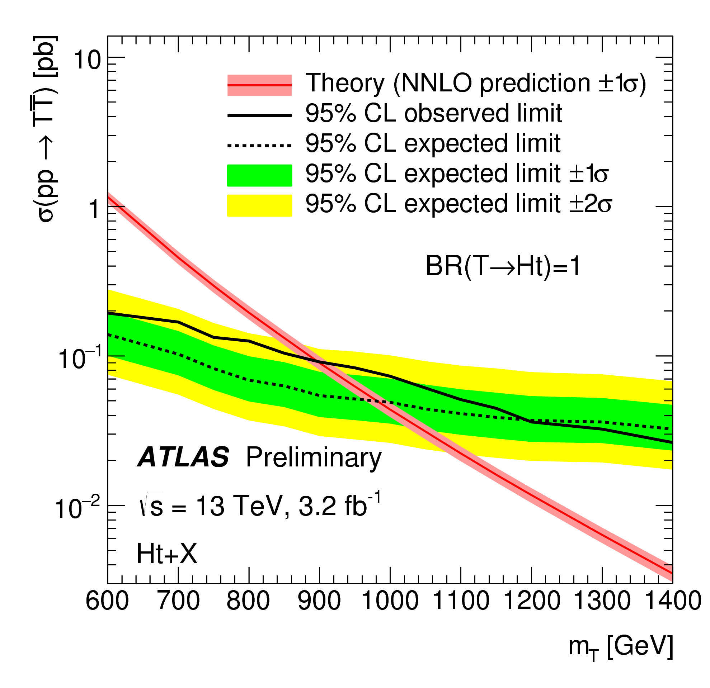
Interpretations – VLQ
95% CL excluded cross-section shown for multiple interpretations
Excluded
Not excluded
- - - -
Exclusion if data = background
____
Exclusion for real data
Most sensitive VLT analysis @ 13 TeV … as of today
  [ATLAS-CONF-2016-013]

Slide 19
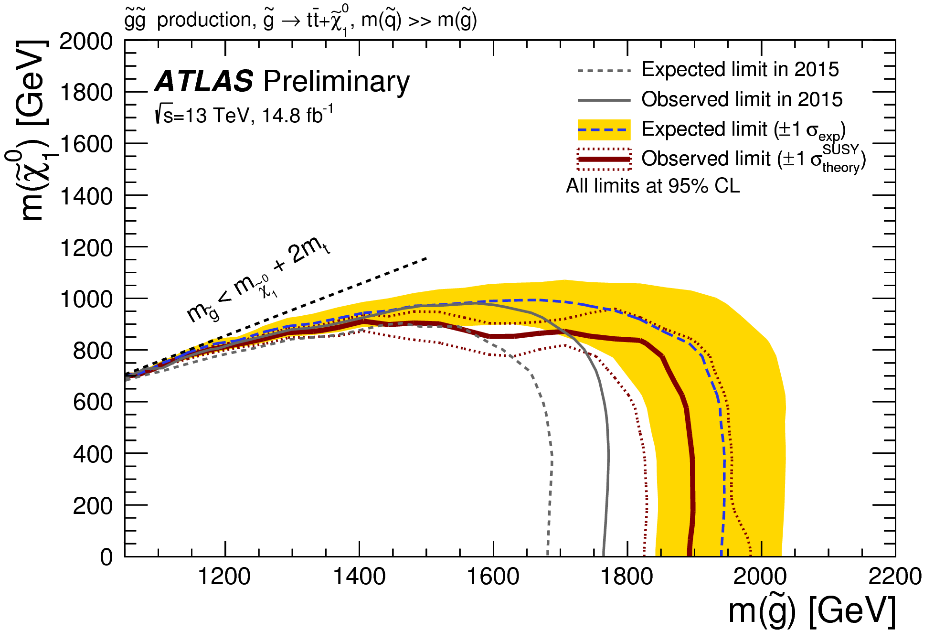
Interpretations – SUSY
Not excluded
Excluded
No hint for any unexpected behaviour ☹
Analysis simple (counting), but optimized for high mass scenarios
Most competitive result for this signal benchmark !
  arxiv:1605.09318

Slide 20
Summary – Outlooks
Searches for top partners presented
  Very high-profile searches
    Crucial interest for early LHC Run 2
  Need specific background estimation techniques
    tt + jets normalisation
    Shapes
  Hypothesis testing
But many other techniques …
  Multivariate analyses, background data templates, …
… and improvements ...
  Addition of new channels to improve sensitivity
  Choice of other discriminating variables
So far, no discovery ☹
  But don’t loose hope !
  Still many improvements to do and new signatures to explore
  Stay tuned !

Slide 21
And now, pizza ?
Thank you !

Slide 23
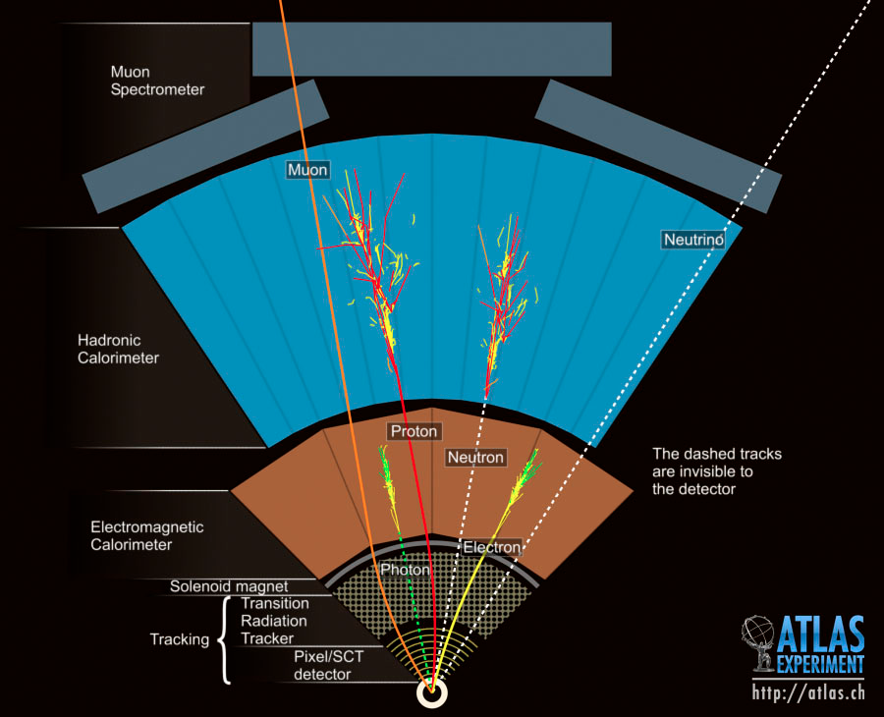
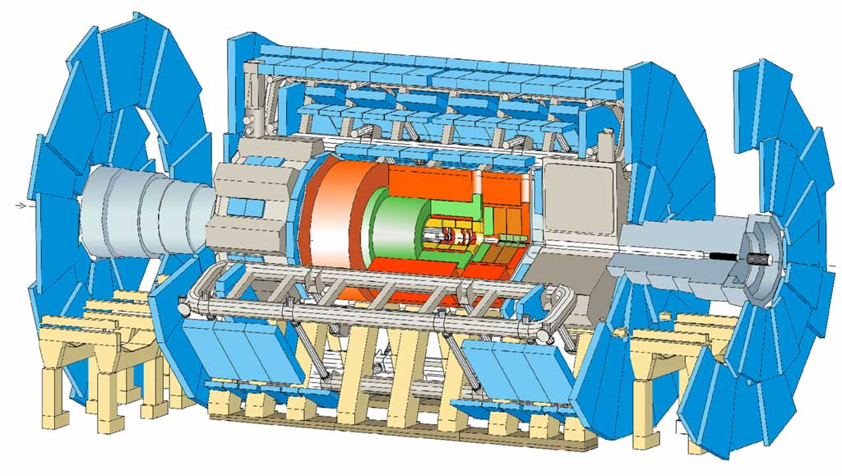
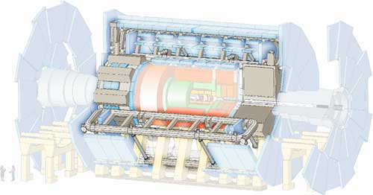
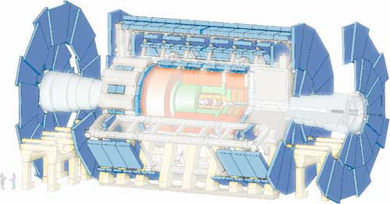
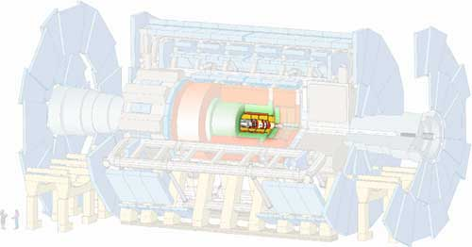
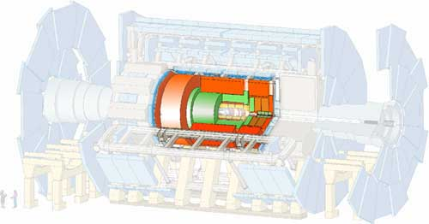
A Toroidal LHC Apparatus : ATLAS
Generalist detector: ~4π sr
Multiple sub-detectors
Transverse plan: perpendicular to beam
45 metres
y
η
x
22 metres
z
Notes:
----- Notes de la réunion (20/09/13 11:58) -----
* ajouter les dimensions d'atlas
* virgule après généraliste
* angle au faisceau … merdique
* système coordonnée

Slide 24
N-1 plot (SUSY)

Slide 25
Extension of VLT analysis
If T → Zt and Z → vv
  Possibly large MET
  Target other phase space in the BR plane

Slide 26
Temperature plots

