Slide 1
Report from Sardinia
G. Bisoffi
on behalf of TETI
ET-PP INFRA-DEV Annual Meeting 2026
Barcelona, 05 May 2026

Slide 2
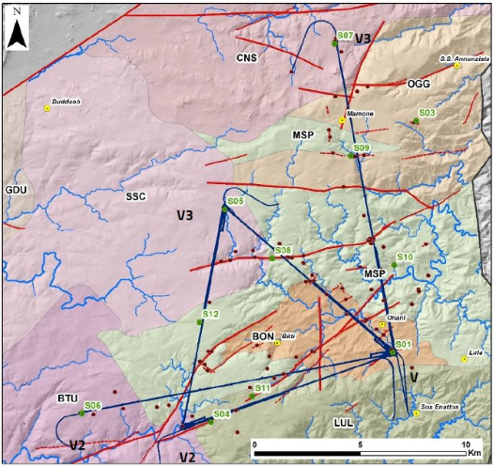
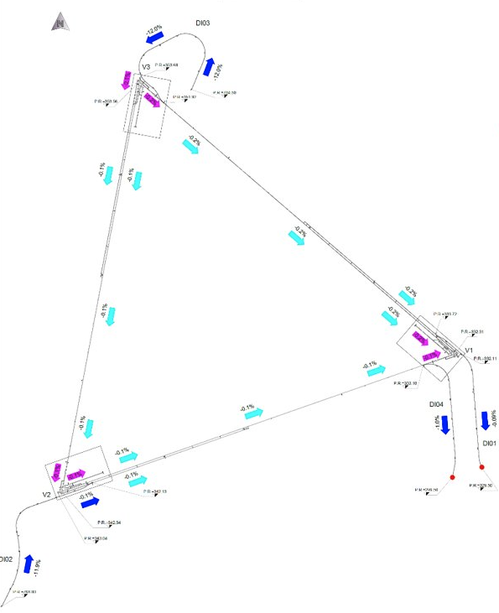
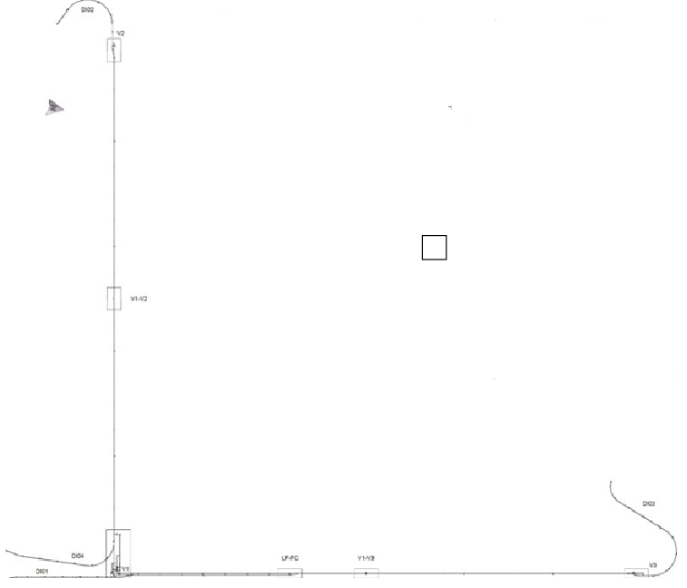
The infrastructure design was completed on October 24, 2025
2024-Optical-Layout

Slide 3
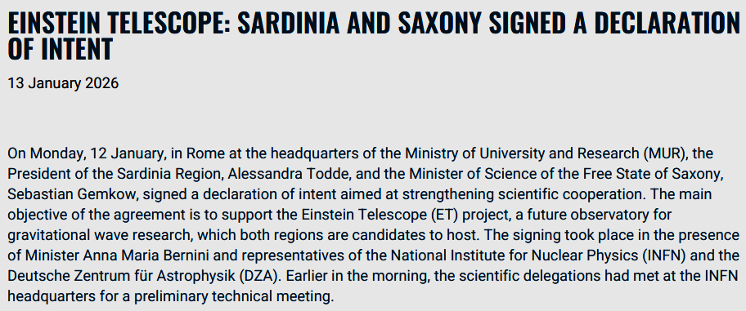
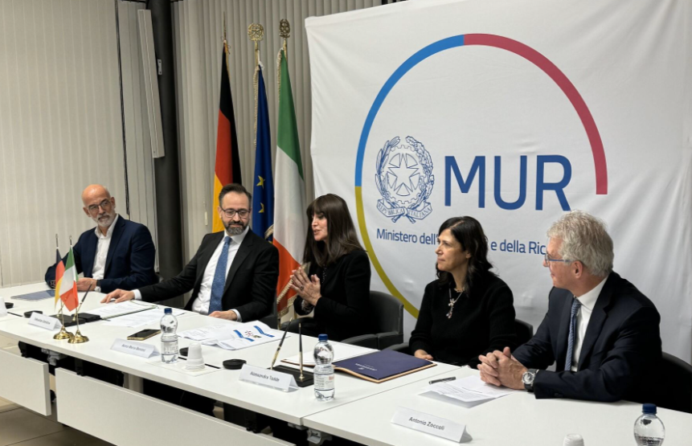
PRESS RELEASE 2026
Free State of Saxony and Autonomous Region of Sardinia have signed a joint declaration of interest,
supported by the Italian Ministry of Research and acknowledged by the corresponding German ministry.
Scientific teams are now working together to define and detail its implementation.

Slide 4
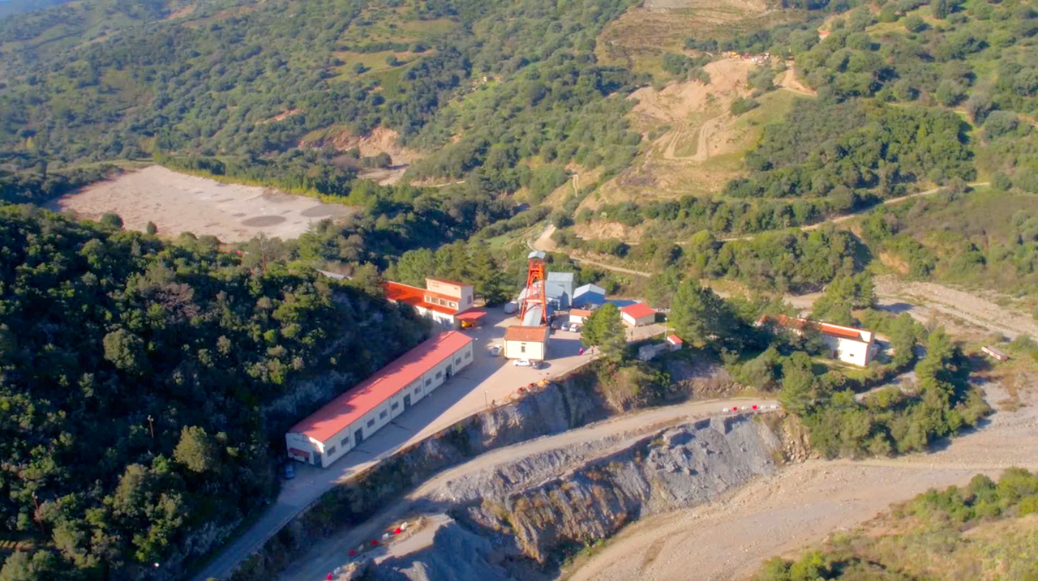


Preparation of a joint bid book
The TETI and Lusatia teams have agreed to prepare a bid book on a comprehensive proposal of a 2L configuration on the Sardinia and Lusatia sites
A MoA is close to formal approval
A Joint Proposal Coordination Team (JPCT) is going to work on topics such as:
  Engineering
  Site characterisation
  Costs and schedule
  Governance
  Socio-economic and industrial impact,
  External relations
  Bid book editing
The JPCT will report to an International Steering Committee, with members from the scientific Institutions and the local Regions

Slide 5
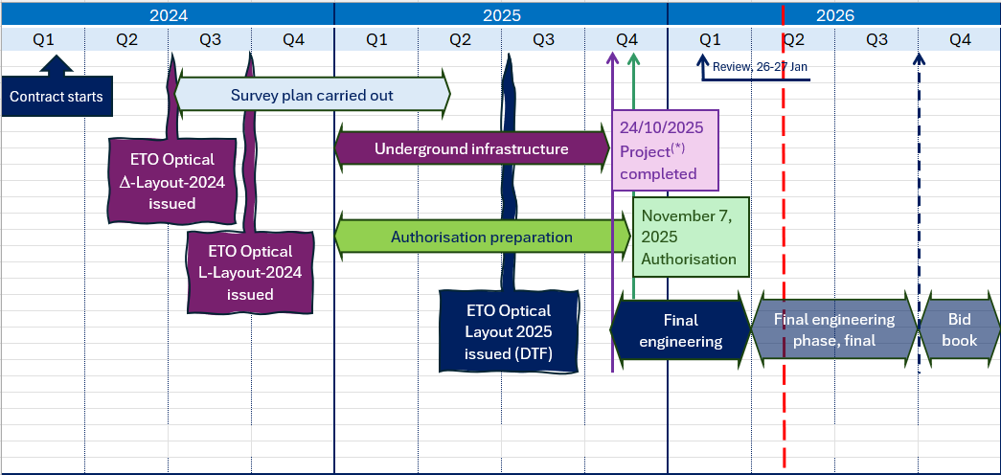
TETI timeline for local infrastructure engineering and costing
(*) Underground CE and technical infrastructure, Surface infrastructures, Buildings and plants, Authorization plan, Environmental impact and DNHS compliance, Construction logistics, Rock disposal/valorisation, Cost book

Slide 6
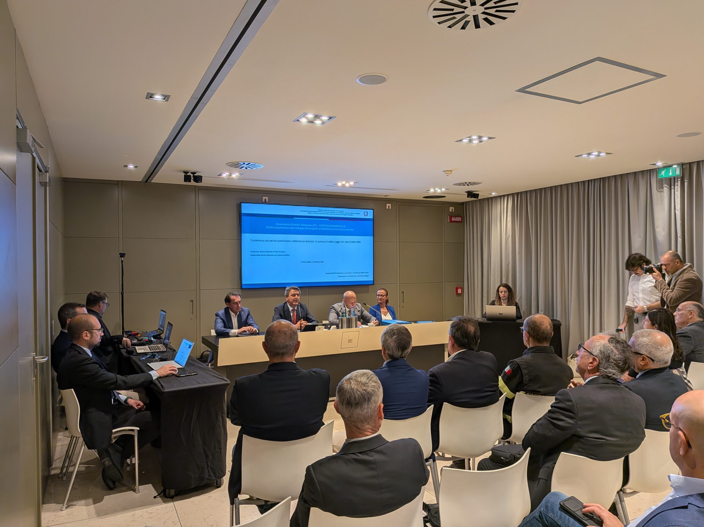
«Conferenza dei Servizi» (single PoC),
54 stakeholders together
Cagliari, November 7, 2025 – 10.00-14.00
Chaired by: Superintendency of Public Works
Autonomous Region of Sardinia – Presidency
Regional Hydrographic District Agency, Soil and Flood Risk
Forestry and Environmental Surveillance Corps
Department of Environmental Protection - EIA
Department of Agriculture and Agropastoral Reform
Department of Landscape and Urban Planning
Regional Environmental Protection Agency (ARPAS)
Ministry of Culture – Archaeology, Arts and Landscape
Ministry of Infrastructure and Transport – Public Works, Civil Engineering, Road Safety
Department of Industry
Ministry of Justice – Onanì-Mamone Prison
Ministry of Defence
State Property Agency
  Urban development
  Environmental impact and cultural heritage
  Excavation permits
  Safety regulations
Both the L and Δ configurations have been formally preliminarily approved, with only minor recommendations.

Slide 7
Engineering studies and cost assessments are ongoing and continuously updated
All activities related to the 2024-layout were concluded in October 2025.
A comprehensive cost book covering the local civil engineering works and technical infrastructures for the L and D configurations has been completed.
A preliminary update aligning this cost book with the 2025 layout has also been carried out.
In parallel, further in-depth assessments are ongoing, addressing both engineering solutions and detailed cost analysis.
This activity will be completed by summer 2026, after which preparation of the bid book(s) will commence.

Slide 8
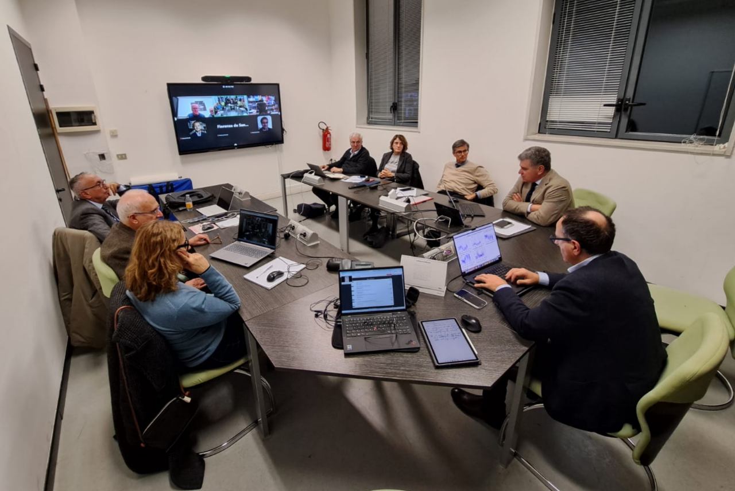
Review of the Rocksoil concept for further design optimisation
Milan, 26–27 January 2026
A Technical Review Committee, chaired by INFN–LNGS Director E. Previtali, examined the technical proposals submitted by RTI–Rocksoil, ahead of the final phase of the preliminary engineering design for the ET infrastructure in Sardinia.
The topics addressed included:
the changes to be introduced in relation to the new layout defined by the ETO Design Task Force;
additional ideas aimed at optimising the overall outcome from both the civil engineering and electromechanical perspectives.
Report delivered: 23 February 2026
Premises of INFN-Milano- Bicocca

Slide 9
Host Consortia (HC) and ETO shared technical baseline – action plan
The Host Consortia (HC) needed guidance from ETO to establish a common technical baseline to guide the engineering designs at the local sites.
19-20 @ CERN
2-3 @ EGO
2025
Jan.
Feb.
Mar.
2026
Technical specifications from ETO Task Force presented to HC
HC safety concepts described
FCC safety implementation proposal presented by CERN
Virgo operational heritage presentation
HC view on tech spec to be illustrated
Workout shared baseline
Requirements definition
Engineering design update

Slide 10
Safety and technical spec – TETI priorities
Prioritize cost-critical requirements now
  Minimize distances between vacuum tubes
  Minimize dimension and weight of largest components underground
  Realistic crane capacities and cleanliness requirements
  Proven safety concepts consistent with shared principles of risk assessment
Postpone uncertain technical requirements after site selection
  Clean room dimensions and their ISO level
Leave implementation details to the local engineering effort
  Minimum distance between caverns
  Caverns aspect ratio
  Cavern lining details
  Isolation of noisy equipment (rooms vs filters)

Slide 11
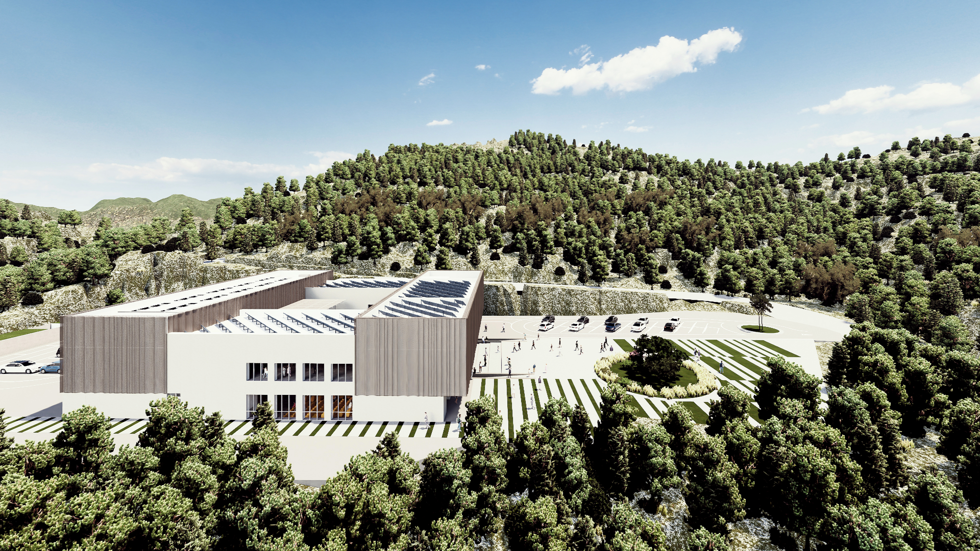
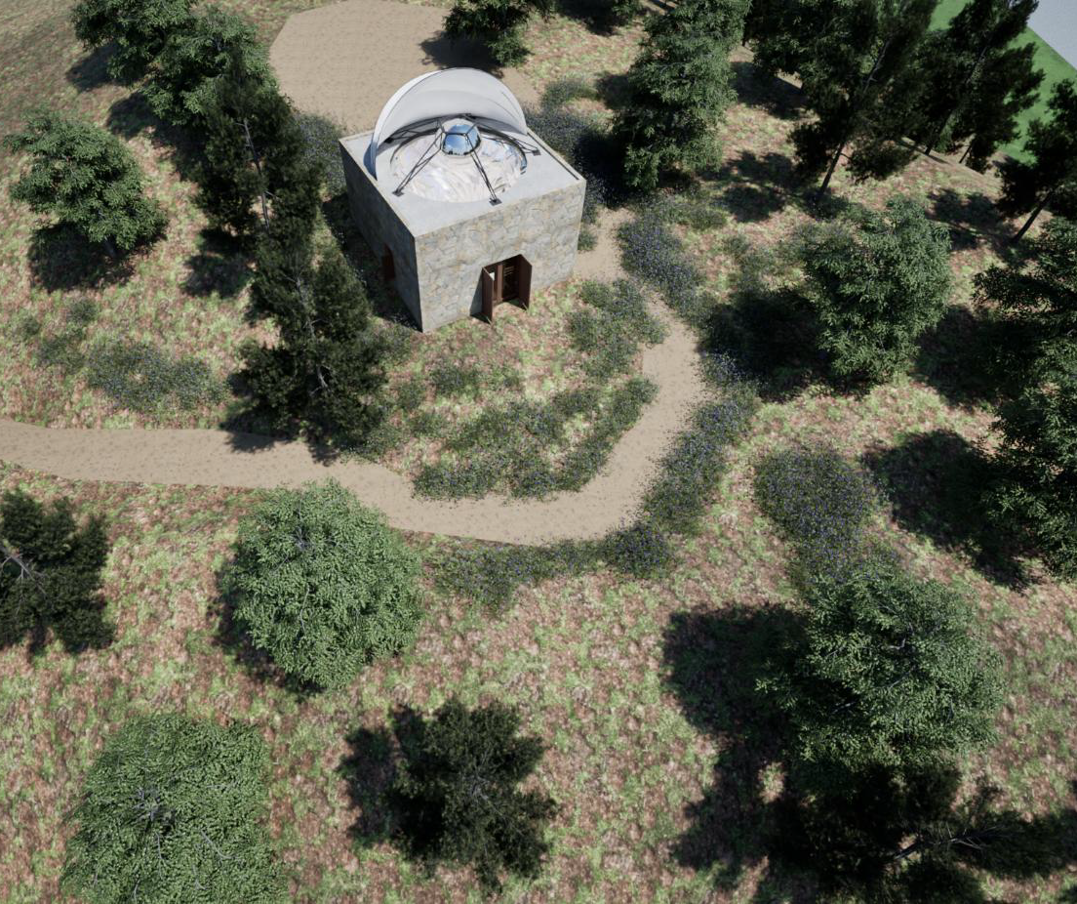
The Sos Enattos UNderground Lab
ET validation tests in low noise condition, noise-related experiments, ET prototypes
A local seismic network to enhance weak signal detection for ET, study deep Earth structures from a low-noise site.
Mezzocielo: “All-sky telescope” for sky monitoring.
Dissemination, outreach and training

Slide 12
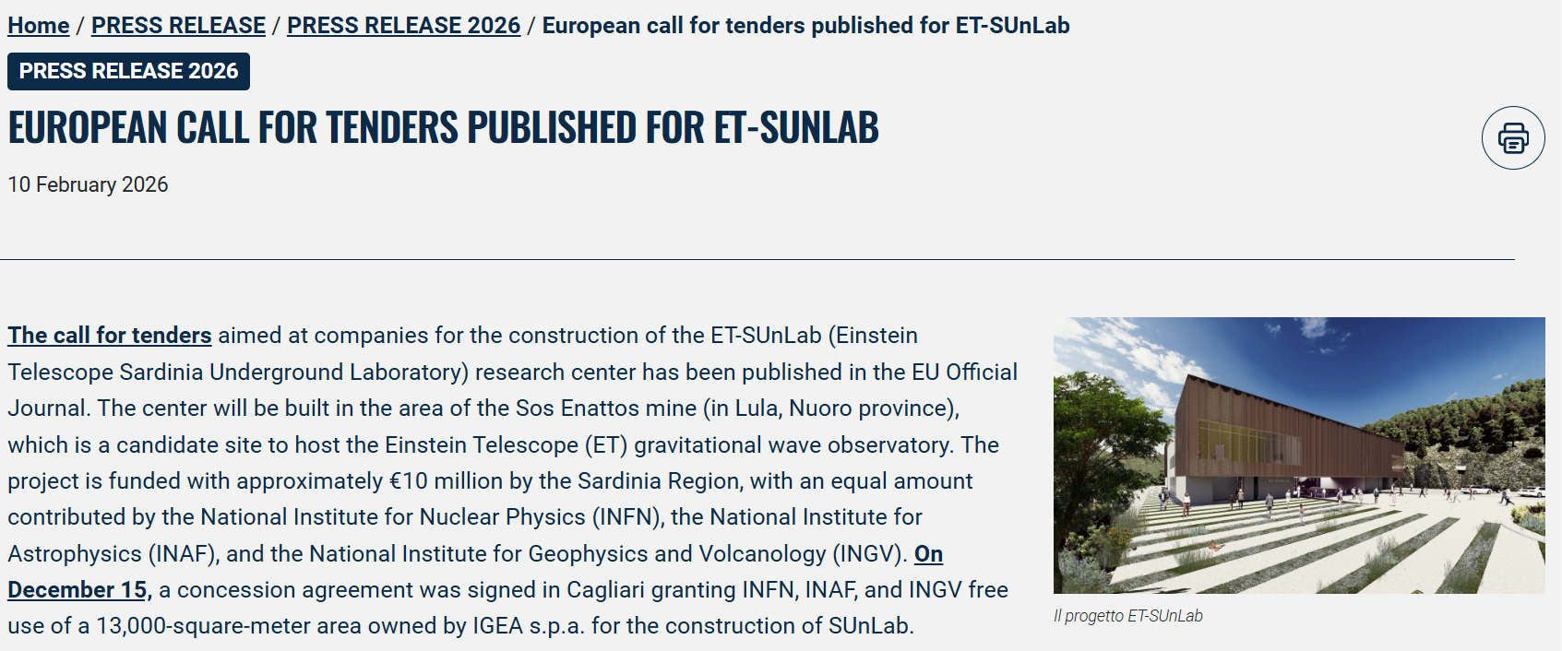
From Vision to Construction: ET-SUnLab Takes Shape

Slide 13
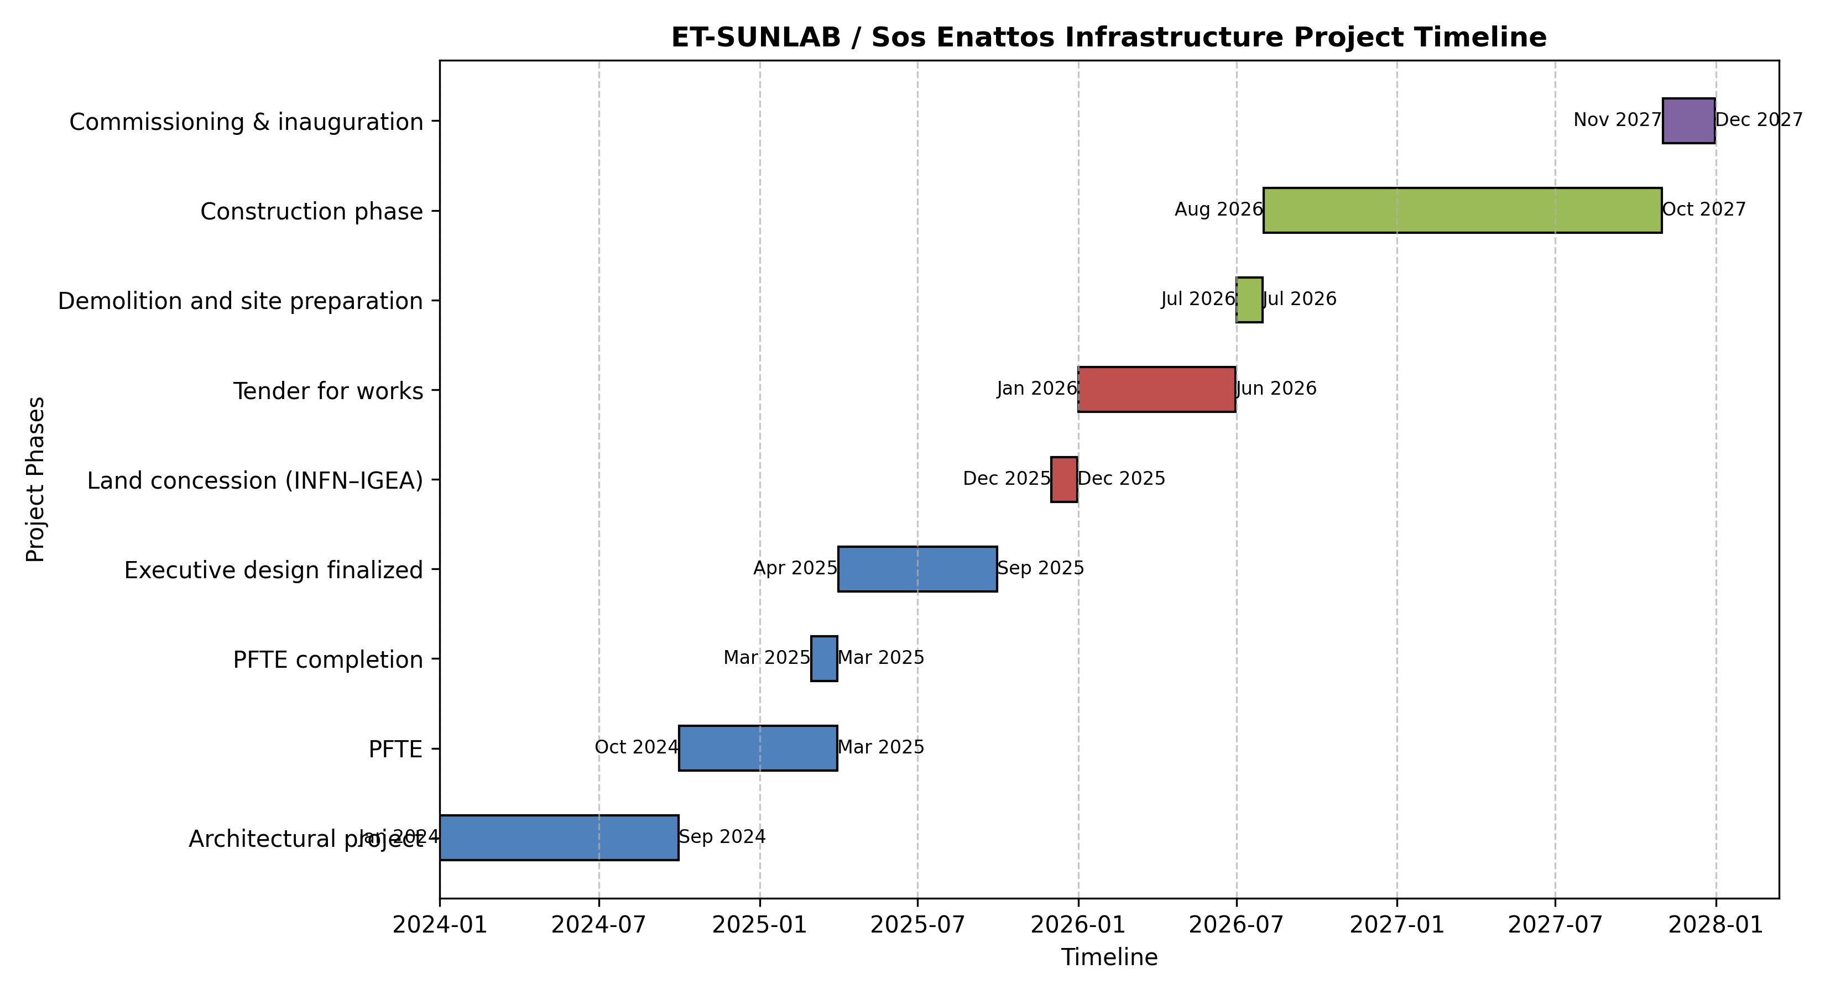
ET-SUnLab completion in 2027

Slide 14
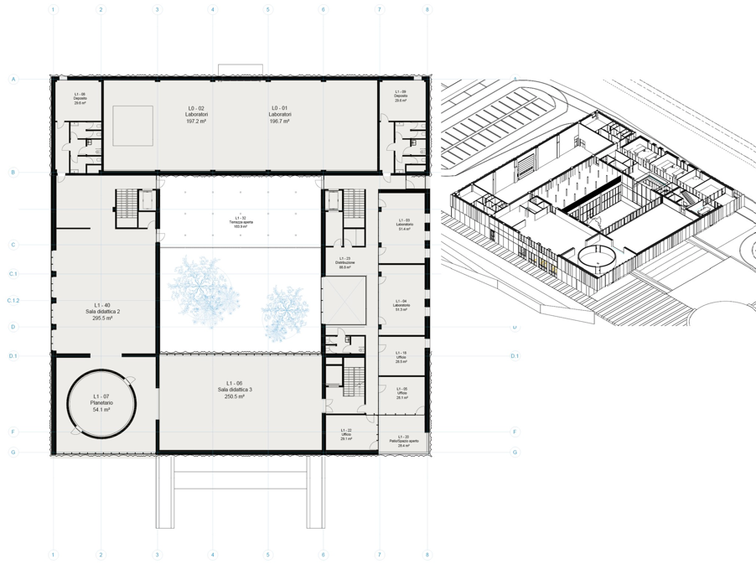
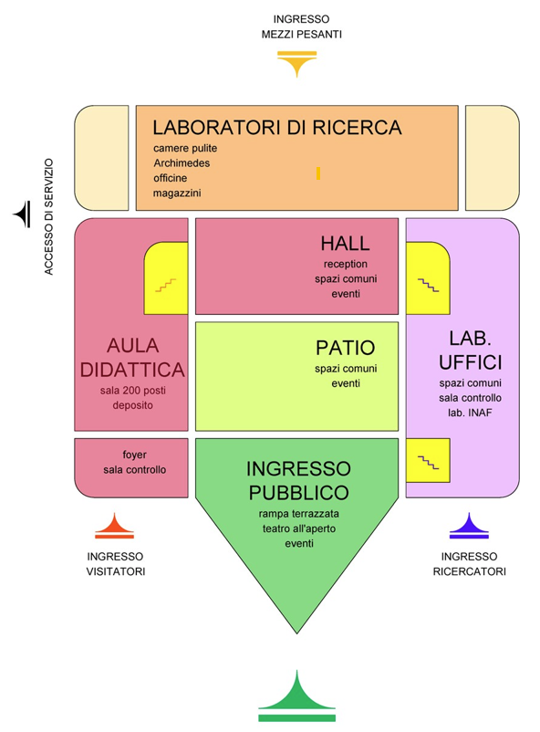
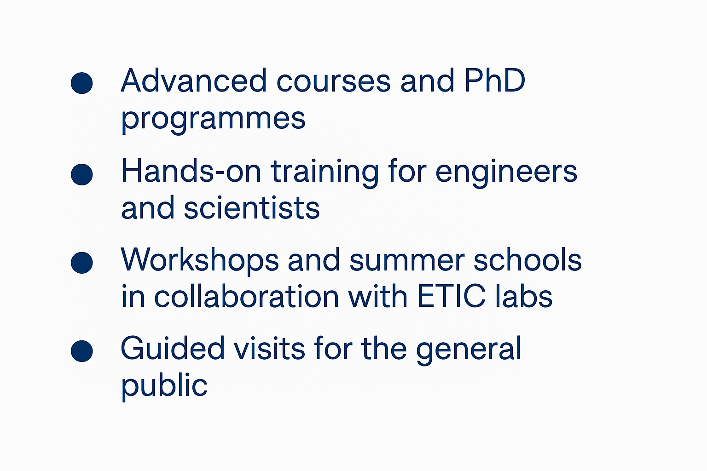
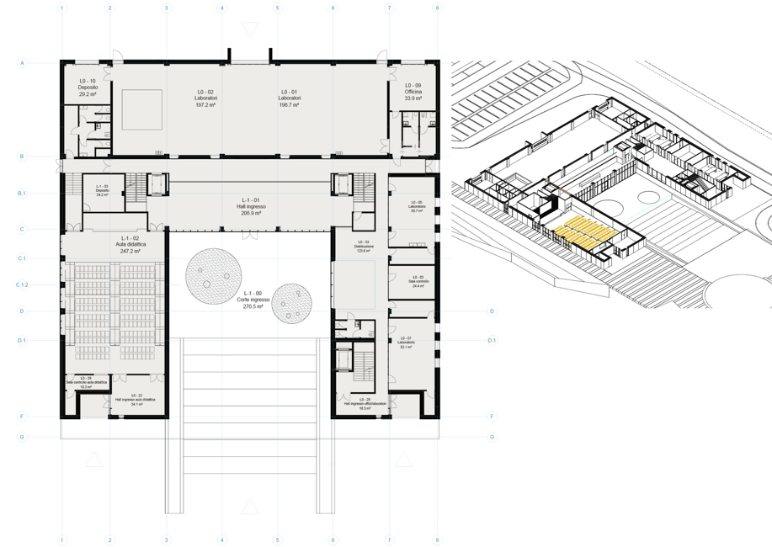
Research, but also training and outreach
Main lab areas
Labs and rooms
Planetarium
Lecture rooms
Main conference hall
Entrance courtyard

Slide 15
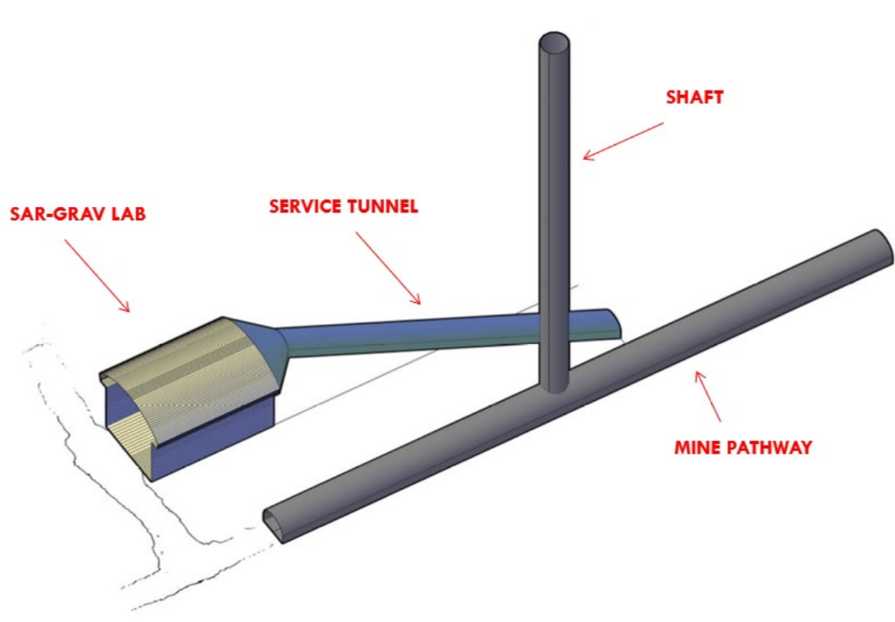
ET SUnLab Underground Space
+60 M€ have been allocated by Sardinia for civil-technical intrastructure, scientific infrastructure and personnel
Expansion of the existing 18×12×6 m cavern at 130 m depth.
Main use: integration and assembly of the two low‑frequency ET towers.
Enables 24/7 underground data‑taking for the Archimede experiment.
Equipped with cold fluid supply via the shaft connecting to the surface SUnLab.
Development of low-noise seismic sensors supporting the seismic network for Earth geodynamics and Einstein Telescope site monitoring (+ 30M€)

Slide 16
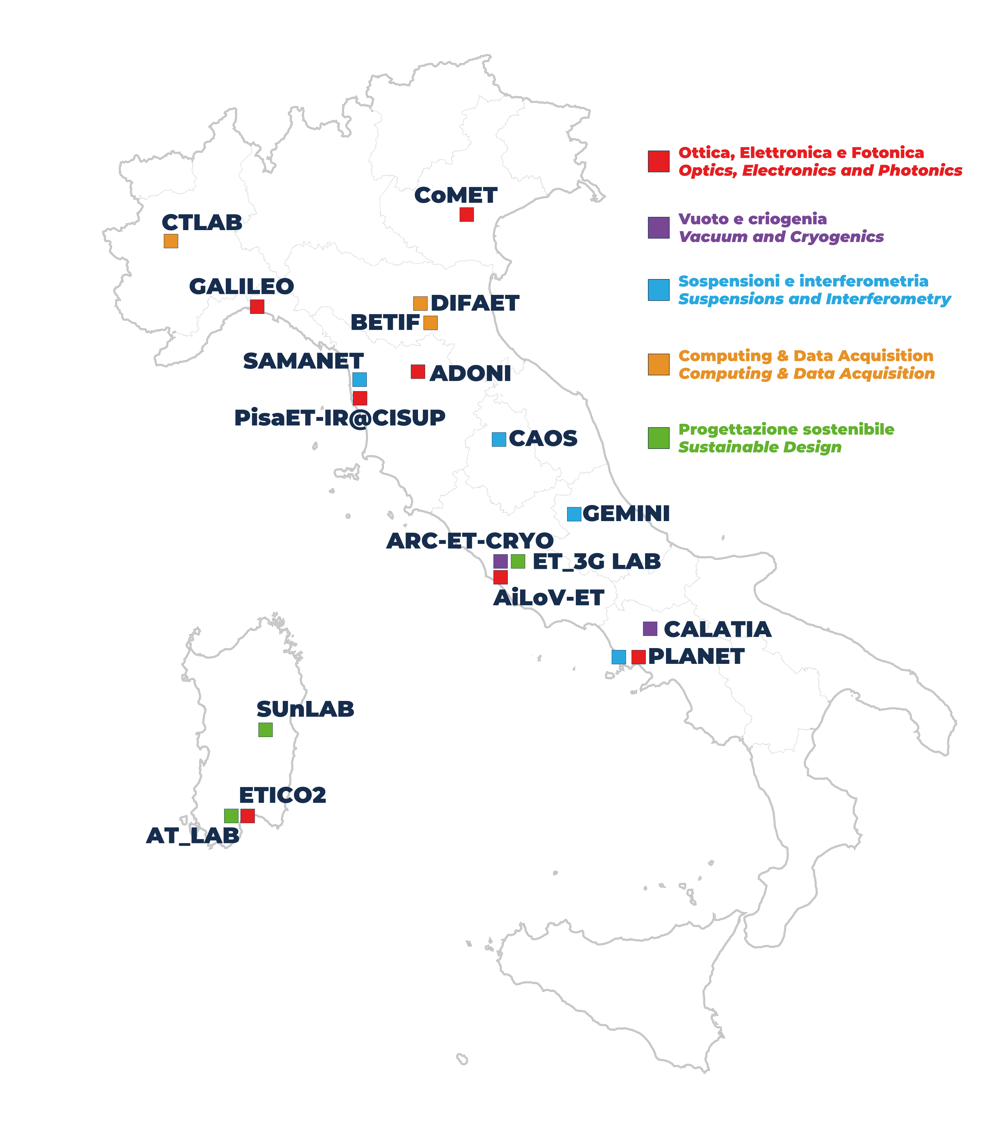
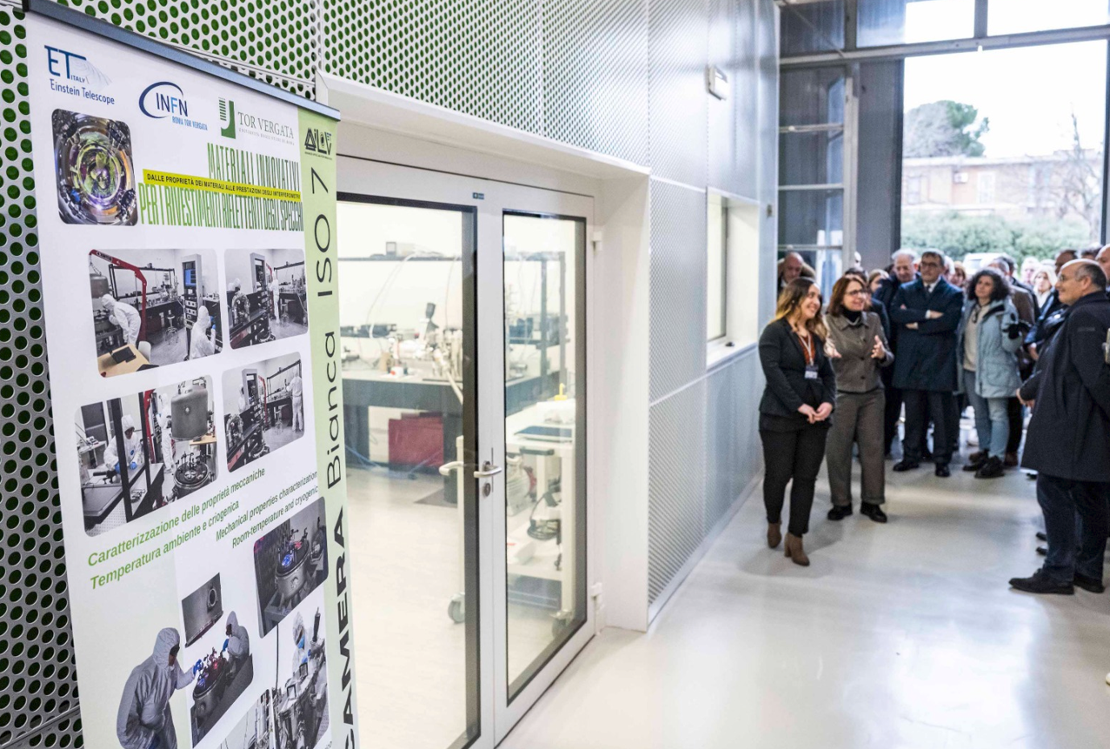
The scientific and technical ecosystem, with SUnLab as a hub
CoMET (Padova)
GALILEO (Genova)
PLANET (Napoli)
AiLoV-ET (Roma)
ETICO2 (Cagliari)
ADONI (Firenze)
PisaET-IR@CISUP (Pisa)
ARC-ET-CRYO (Roma)
CALATIA (Caserta)
CAOS (Perugia)
GEMINI (L’Aquila)
PLANET (Napoli)
SAMANET (Pisa)
BETIF (Bologna)
DIFAET (Bologna)
CTLAb (Torino)
~ 640 members from 81 institutions for 27 RU
Site Characterization
R&D enabling technologies
Science case
SUnLAB (Sos Enattos)
ET_3G LAB (Roma)
AT_LAB (Cagliari)

Slide 17
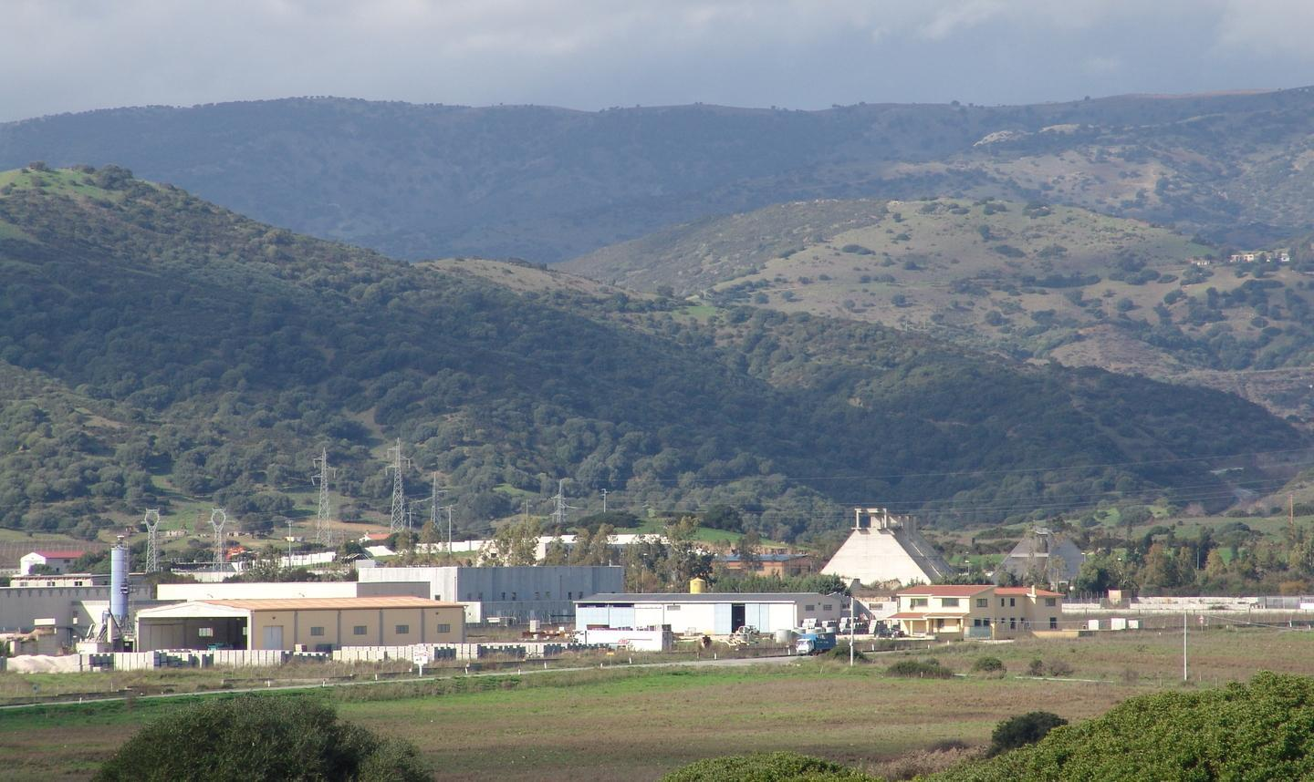
Sardinia strengthens local infrastructures
Urban regeneration at Sos Enattos: 7 M€ + investment
4.4M€ initial allocation for the redevelopment of the area’s municipalities.
3M€ for “diffused hospitality”: upgrading private homes for workers, starting with the SUnLab site.
This is a first intervention to gauge local availability; additional funds are available.
Sologo industrial zone: €8M investment.
8M€ (Development and Cohesion Fund) have been allocated for the primary infrastructure works of a new industrial zone, located about 10 km from Sos Enattos.

Slide 18
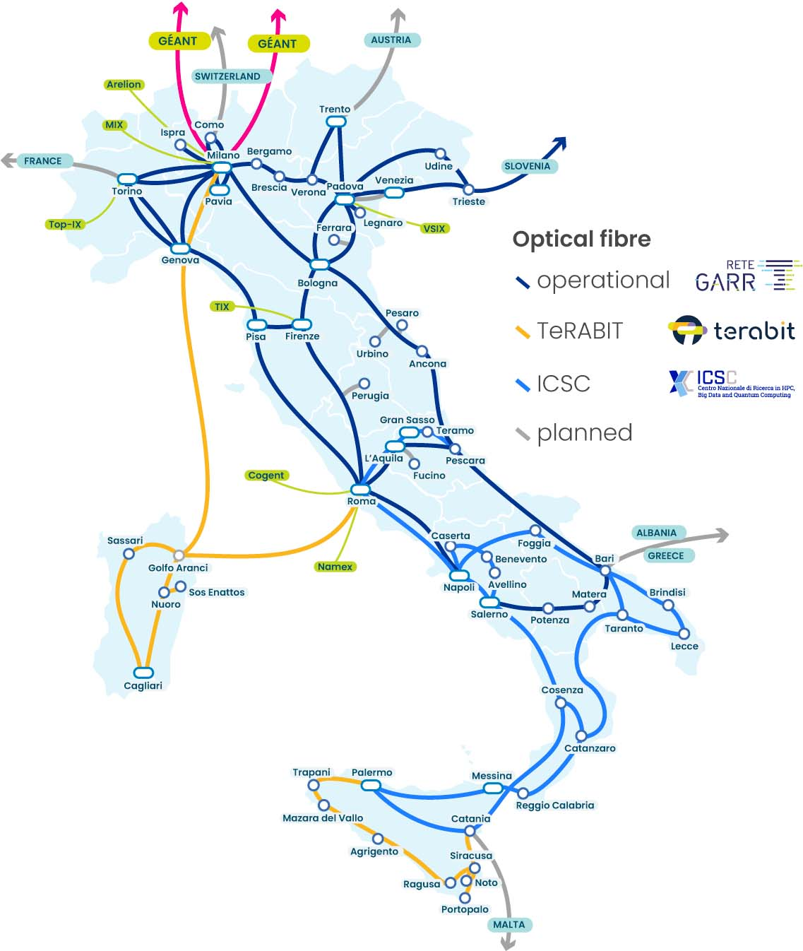
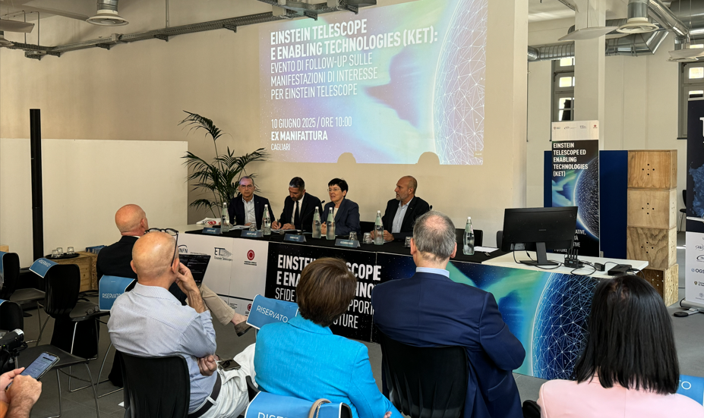
Advancing the High-Speed Data Network - Enabling Local Innovation
A Terabit‑Class Network for Sardinia
TeRABIT (PNRR) delivered a 1,100 km fiber-optic ring across Sardinia, built by GARR and integrated into the national GARR-T research network, providing ultra-high-performance connectivity (1.6 Tbps regional capacity).
The Region (€2M) and INFN (€1M) funded its extension to Industrial Consortia, hospitals, and courts.
Call for high-tech ideas for ET
The Sardegna Ricerche call is launched, following the previous expression of interest.
Open throughout 2026: new proposals can be submitted, evaluated, and funded progressively.
Initially €200k per project, with a current total budget of €4M, to be increased later.

Slide 19
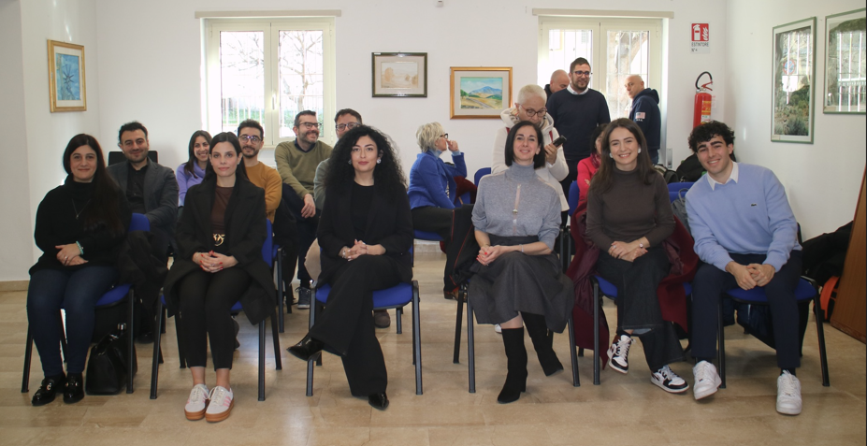
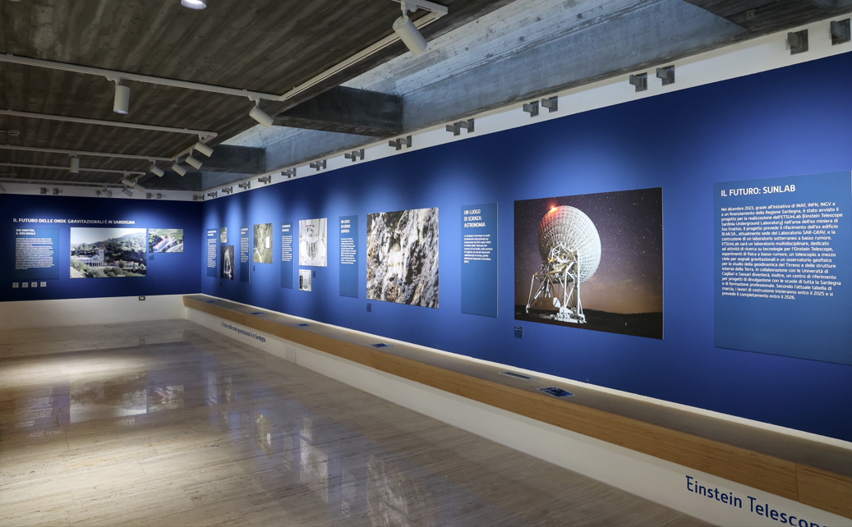
Sardinia support to community engagement
Training, information, community liaison
Investments in Nuoro will create an exhibition–museum center, to evolve into an education center.
Sardinia appointed a team for training, information, and local mediation in Lula and Nuoro.
The newly designated ET resident “ambassadors”
engaging the local community
ET engages with the community
Preparation of gazebos and logistics for 50 events in northeastern Sardinia (April–December 2026).
Organized by teams from the Universities of Cagliari and Sassari, INFN, INAF, and INGV.

Slide 20
Take away
TETI local infrastructure project completed and costed
Further investigations underway, in coordination with ETO and other HC
Tender for SUnLab launched, to be completed 2027
Support to improved local infrastructures, high-speed network, enhancement of regional industry, strengthened community engagement continues
We continue working at full steam towards the launch of the call for bids, following the BGR roadmap – working on both the 2L and the triangle configurations

