Slide 1


Einstein Telescope Organisation
P. Werneke | ETO – 05.05.2026
Status Report of the ET Research Infrastructure
May 5, 2026
Patrick Werneke, Einstein Telescope Organisation
Engage. Innovate. Explore.

Slide 2
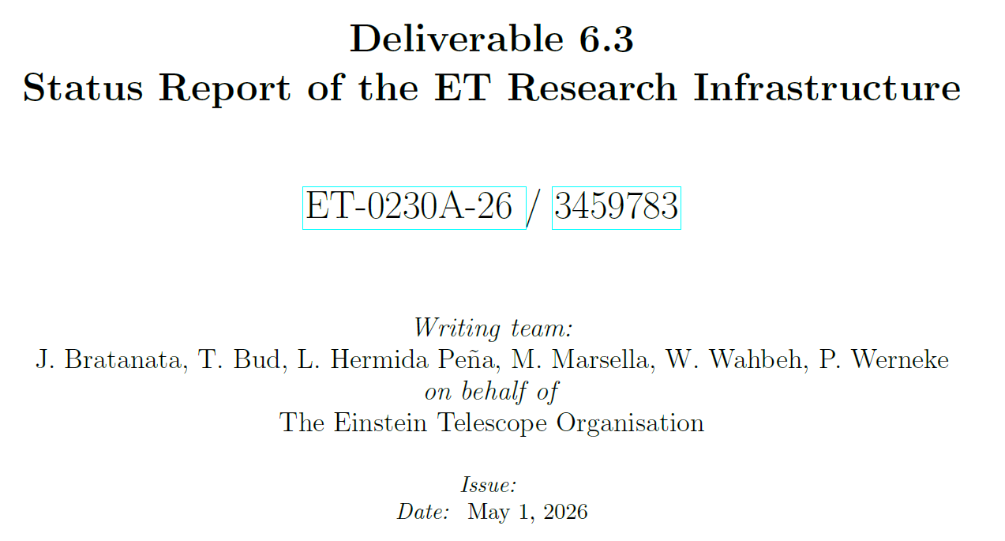

ETO Engineering Department
ET Research Infrastructure Status Report - 05.05.2026

Slide 3
ET Research Infrastructure Status Report – Deliverable 6.3
ETO Engineering Department
ET Research Infrastructure Status Report - 05.05.2026
D6.3: Preliminary RI TDR → Status Report of the ET Research Infrastructure
Scope:
Introduction: history and current status: roles of ETO, ETC and Host Consortia
Civil Infrastructure: caverns, tunnels, shafts
Focus on feasibility and cost optimisation (2025 Baseline Detector Layout)
Technical Infrastructure: HVAC, electrical, health and safety systems
3D Spatial Integration
Timeline Phase 1:
Host bids by end of 2026
Next Phase 2 → detailed design

Slide 4
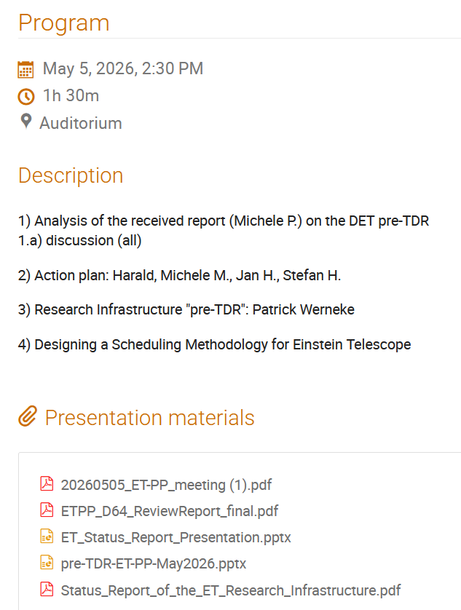
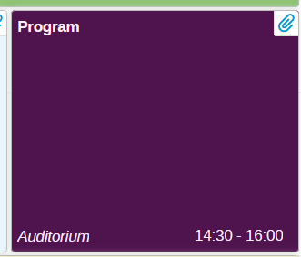
ET Research Infrastructure Status Report – Deliverable 6.3
ETO Engineering Department
ET Research Infrastructure Status Report - 05.05.2026
Comments during session:
Link to noise budget
Introduce self-inflicted noise from technical infrastructure
What is not mentioned in the report:
i.e. dewatering pumps (HC), …
Timeline + Phase 1: reconsider can cause confusion
Link to the report is on Indico

Slide 5
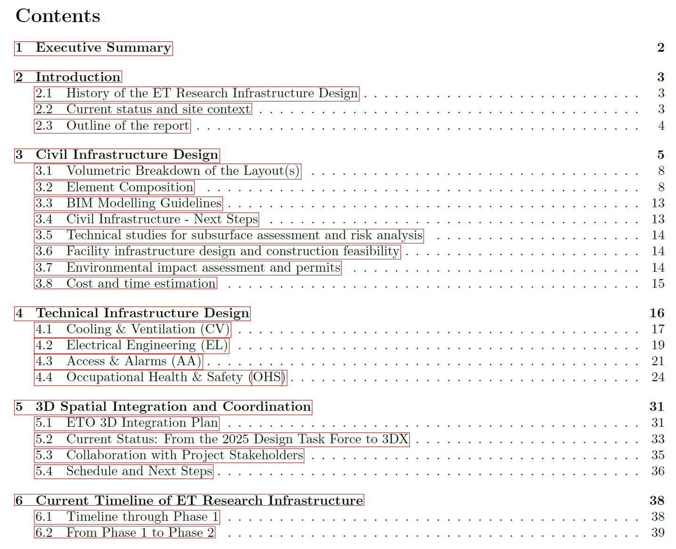
ETO Engineering Department
ET Research Infrastructure Status Report - 05.05.2026

Slide 6
Einstein Telescope Organisation
P. Werneke | ETO – 05.05.2026
Thank you
Engage. Innovate. Explore.

