Slide 1
Pte-TDR report analysis
Michele Punturo

Slide 2
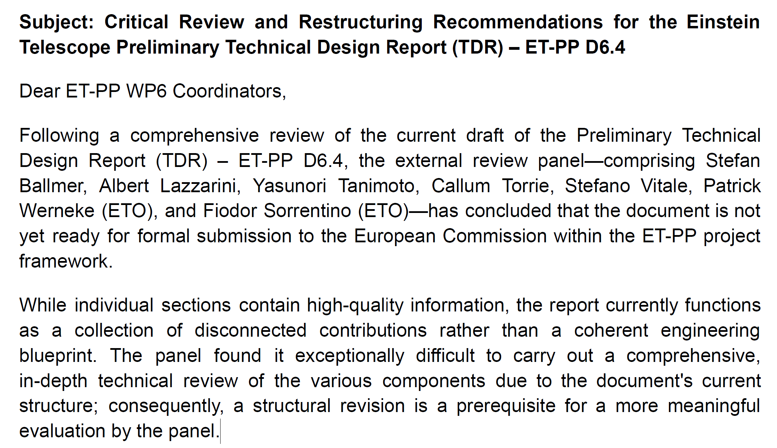
Obviously «a coherent engineering blueprint» is a TDR, not a pre-TDR
This is a surprising request, considering that the TOC was pre-agreed with a member of the review panel

Slide 3
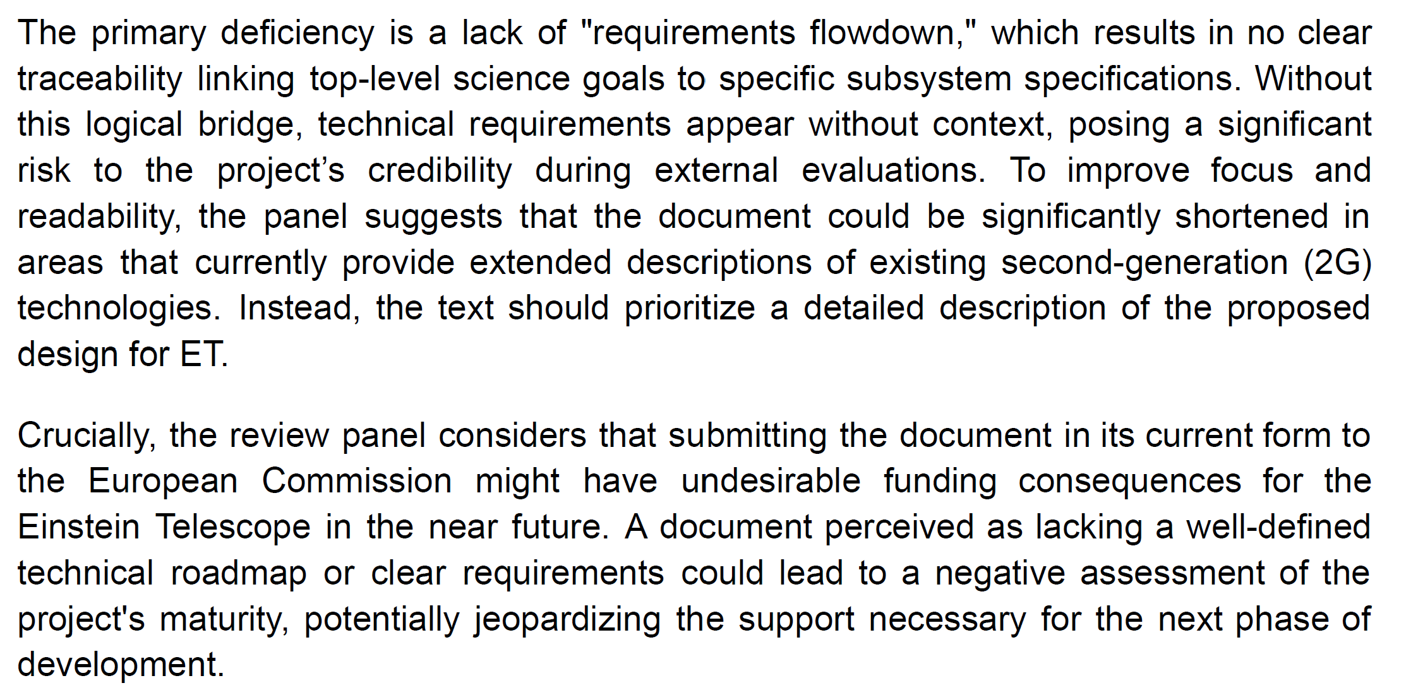
This is important but in some cases difficult to implement without additional information. For example, for IMBH physics and early warning MMA we need to match the low frequency performances of ET. The specifications of the seismic filtering sub-system, of the control system and of the NN subtraction are depending by the seismic noise of the selected site

Slide 4
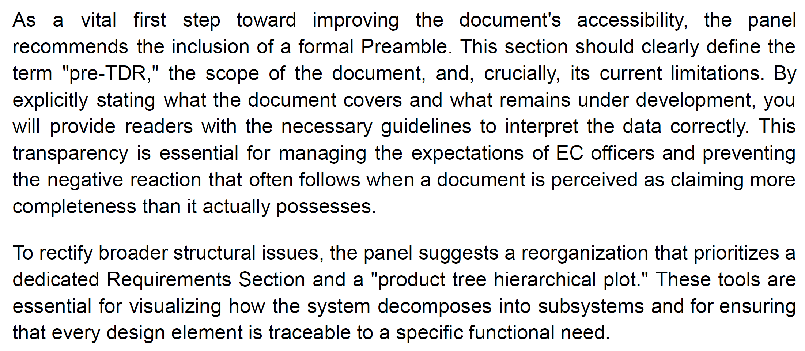
I totally agree, this is really missing. In my mind «The pre-TDR should be a panoramic view of the current know how on how ET should be realized. It contains the current understanding on available solutions, on missing enabling technologies and on design fundamentals. It is the launching platform to realize the TDR», that, according to the BGR’s ETO mandate, should be realized in coordination by ETO and ETC
A full requirements-to-specifications diagram is matter of the TDR, but we can try to realize a graph working at the level of frequency ranges.
It is unclear to me what the reviewers mean with “product tree hierarchical plot”: PBS tree?

Slide 5
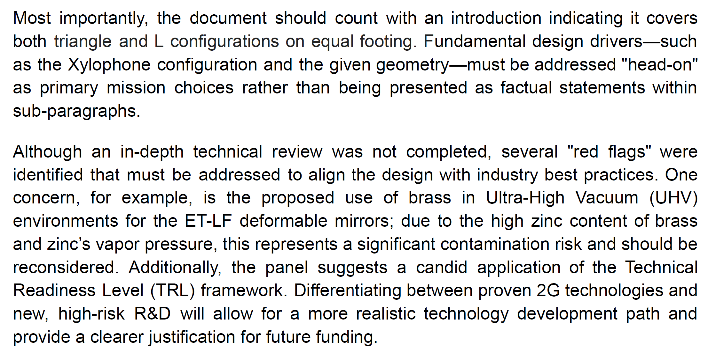
OK
OK, relativelyeasy to implement, related to the low and wide frequency range requirements
I believe this goes beyond the mandate of the pre-TDR review team, but it is right to point the risk
TRL application is ongoing, but not ready. But a flag «2G» could be introduced.

Slide 6
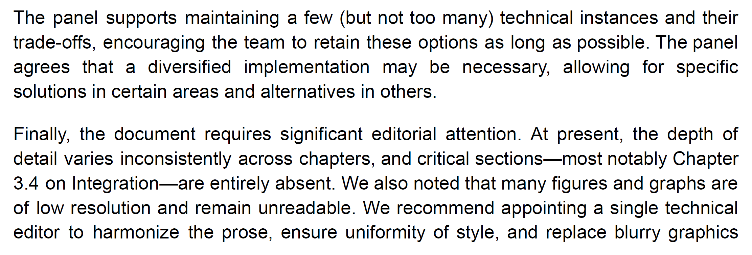
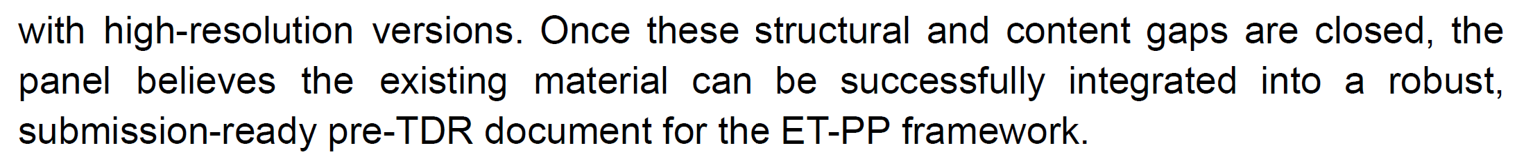
OK
I believe it is beyond the scope of the pre-TDR

