Slide 1



Einstein Telescope Research Infrastructure
ET-COMPASS, Task 2.3
Prof. Dr. Robert GALLER & Dipl.-Ing. Daniel Schneider
Chair of Subsurface Engineering &
Underground Research Center ZaB - Zentrum am Berg
Montanuniversität Leoben, Austria
5–7 May 2026
ET-PP, Barcelona

Slide 2
Consideration of uncertainties related to cost estimation
Project
phases

Slide 3
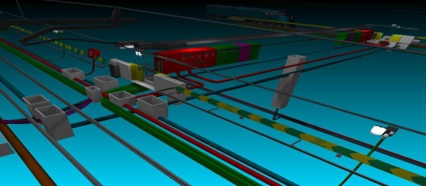
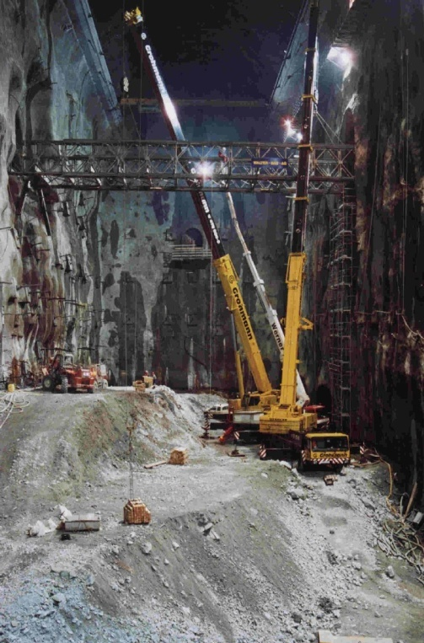
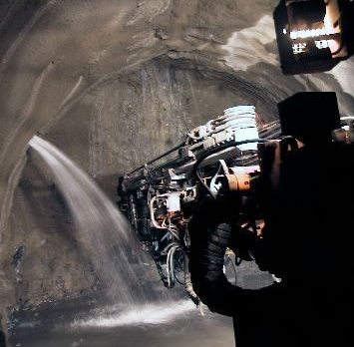
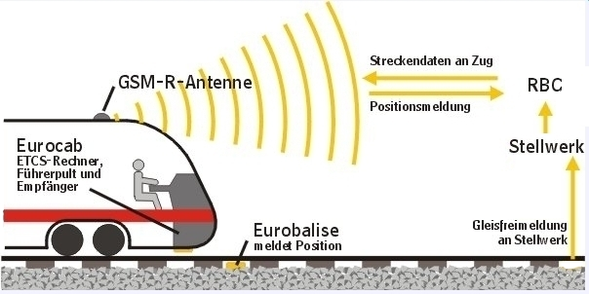
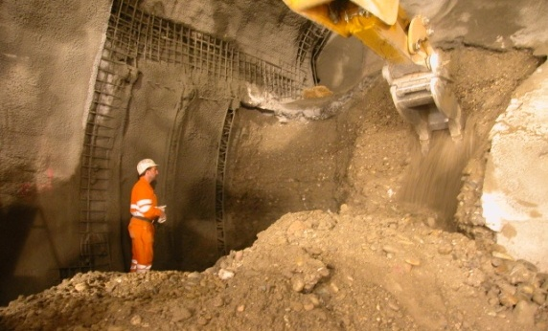
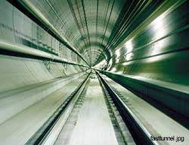
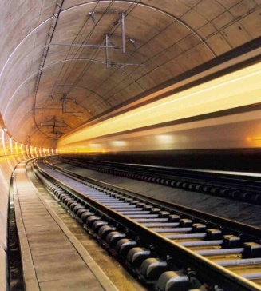
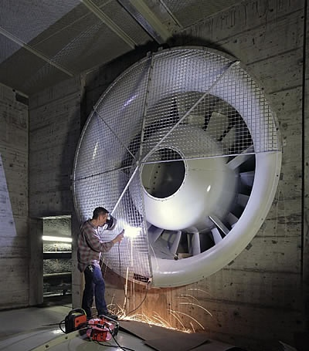
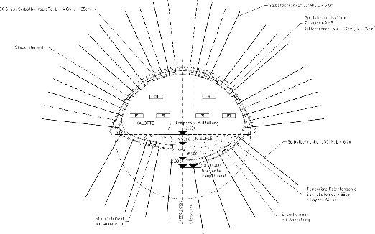
Where are uncertainties coming from?
Safety
And many more…
Aerodynamics
Construction method
Alignment
Underground construction
Hydrogeology
Vibrations
Geology
Equipment

Slide 4
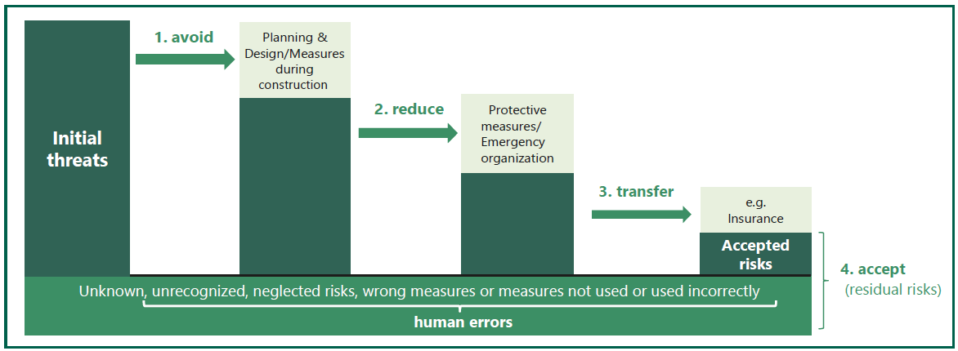
    How to deal with uncertainties
No construction project is risk free. Risk can be managed, minimised, shared, transferred or accepted.
It cannot be ignored.
Sir Michael Latham, 1994
www.riskcon.at

Slide 5
Mangement of uncertainties in tunneling – design & construction
Geotechnical design is an ongoing process also during construction to be able to do adjustments following the real geotechnical conditions
Design Process
Alignment
Excavation Method
Construction logistics
Hydrogeological data
Geotechnical data
Geological data

Slide 6
Cost components
Schematic illustration of cost components to determine forecasted project costs
Identified risks
+ unknown
= risk costs (R)

Slide 7
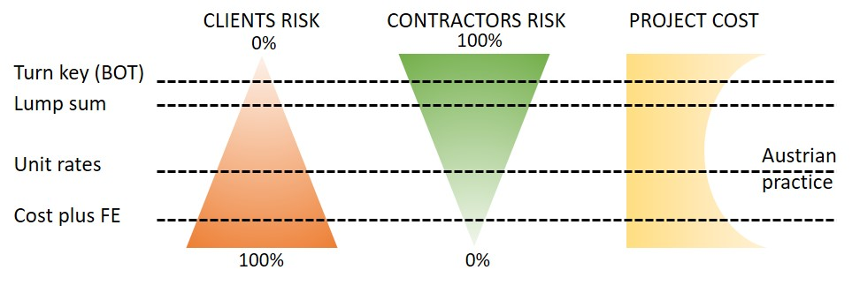
Types of Contract considering uncertainties
Lumpsum contract
Unit price contract
Cost plus fee contract
Turn key contracts
Risk Distribution
[E. KLEIVAN, adapted by R. Galler]

Slide 8
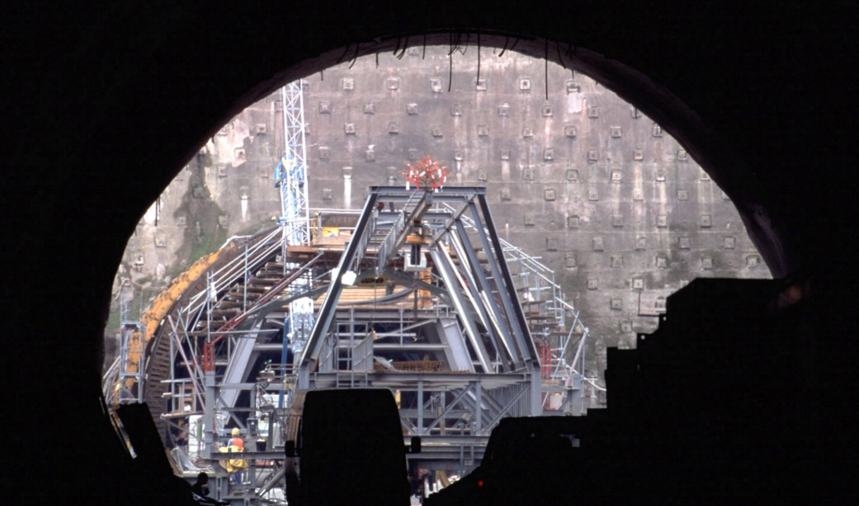




Questions?
Robert.Galler@unileoben.ac.at
www.zab.at
Efficient and modern tunnelling
19 – 20 April 2024, Shenzhen

