Slide 1


What is innovation procurement?
Jozef Kubinec, INPROCAP

Slide 2


WHAT IS INNOVATION PROCUREMENT?
Innovation procurement refers to any procurement that has one or both of the following aspects:
buying the process of innovation – research and development services with (partial) outcomes
buying the outcomes of innovation
*the EC definition of Innovation Procurement

Slide 3
Innovation procurement
“Innovation means the implementation of a new or significantly improved product, service or process, including but not limited to production, building or construction processes, a new marketing method, or a new organisational method in business practices, workplace organisation or external relations inter alia with the purpose of helping to solve societal challenges or to support the Europe 2020 strategy for smart, sustainable and inclusive growth.”
EU Public Procurement Directives​
Directive 2014/24/EU, Article 2 (22)

Slide 4
Innovation procurement
Within the public procurement context, the word innovation procurement can have different meanings, including:
the purchase of innovation: buying cutting-edge technology in public procurement markets.
A second meaning of ‘innovation in procurement’ is encouraging innovative suppliers in the procurement process.
A third meaning is innovation in the procurement process itself: new methods and approaches for the procurement process*
*G. M. Racca & C. R. Yukins, Introduction: The Promise and Perils of Innovation in G. M. Racca – C. R. Yukins, eds., Cross-Border Procurement, in Joint Public Procurement and Innovation: Lessons Across Borders. Bruylant, 2019, available - https://papers.ssrn.com/sol3/papers.cfm?abstract_id=3486897 (September 28, 2020).

Slide 5

Pre-commercial procurement (PCP)
PCP is a specific approach to procuring R&D services.
It involves competitive development in phases and a clear separation between the PCP and procurement - potential follow-up PPI.

Slide 6
Pre-commercial procurement
R&D is split into phases
  1st phase - solution design,
  2nd phase - prototyping, original development
  3rd phase - and validation/testing of a limited set of first products
with the number of competing R&D providers being reduced after each R&D phase.
Exempted from public procurement rules
IPR ownership rights are kept by the participating R&D providers, while the public procurers keep license free rights to use the developed solutions

Slide 7
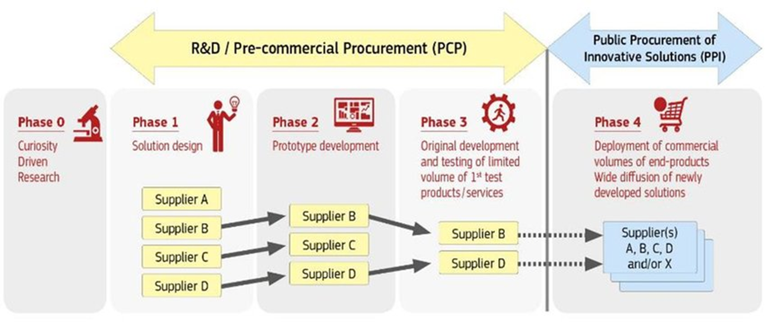
Pre-commercial procurement
Innovation procurement is a tool for addressing pressing societal challenges across various sectors: Health care, climate change, energy efficiency, transport, security etc.
Goal: To identify and implement new solutions in sectors where current commercially available products do not meet the specific needs of the public sector.

Slide 8
Innovation partnership vs. PCP (PPI)
 | Two separate PCP - PPI procurements | Innovation Partnership procedure
Can be used in which cases? | where the procurer needs a solution that is not so unique or specialized that it has to be developed exclusively for him, but instead there is a wide range of potential customers for the solution beyond the procurer. Typically many providers are interested to develop solutions for wide markets | when the procurer needs products or services that are so unique / specialised that the procurer is the only potential customer for the solution and there are no other potential providers on the market outside of the innovation partnership, that could be disadvantaged When the procurer is the only customer, he has no other choice but to keep himself the IPR

Slide 9
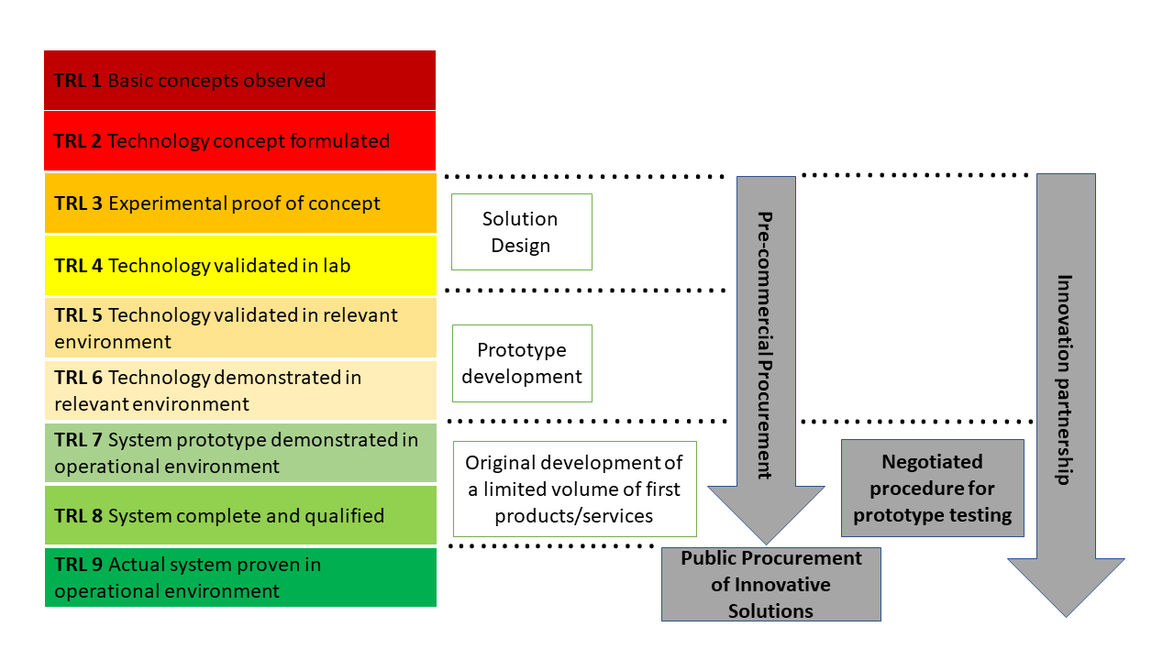
Technology Readiness Level (TRL)

Slide 10
When to use PCP
✅ PCP is the right instrument when no existing market solution can meet your need and you want to fund the development — without being locked into a single vendor from the start.
✅ PCP is suitable when: | ⚠️ PCP is less suitable when:
The need is clear but no off-the-shelf solution exists | A solution already exists → use standard procurement
Technology is not yet commercially validated at the required scale | You need a finished product now → consider PPI or competitive dialogue
Multiple R&D approaches are worth exploring in parallel | The need is still unclear → go back to Needs Assessment and OMC first
You want to stimulate the market and create a new supply base

Slide 11
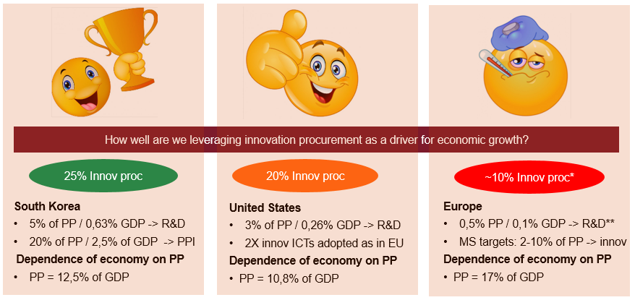
Strategic importance for Europe
Innovation procurement investments in Europe are 2 times lower than in other parts of world. Underinvestment is biggest in R&D procurement (5 X lower) and in innovative ICTs (3 X lower).
      * EU wide Benchmarking
      ** EC report
Need to mainstream innovation procurement to strengthen Europe’s competitiveness, increase resilience in the supply chain, reinforce EU strategic autonomy and contribute to recovery.
Notes:
Let’s take a closer look at why innovation procurement is so important for Europe.
Public procurement spending represents 17% of GDP in Europe, when all types of public buyers: the classical public authorities, the utilities and the defense sector. Public procurement investments therefore have a really big impact on the ‘healthiness’ of the EU economy. As innovation procurement is a driver for public sector modernization as well as industrial competitiveness, it is vital for economic growth.
But how well is Europe really leveraging innovation procurement to drive forward economic growth, compared to other parts of the world like Asia and the United States?
EU wide benchmarking (study SMART 2016/0040) show that innovation procurement investments in Europe are 10% of total public procurement investments. This is 2 times lower than in the US and in South Korea (who invest every year respectively 20% and 25% of their total public procurement spending in innovation procurement).
Underinvestment is the biggest in R&D procurements: Europe invests 0,5% its total public procurement in R&D procurement, while the US and South Korea respectively 3% and 5%. Europe is thus underusing public procurement to prepare itself for challenges of the future.
The average European public procurement investments in the adoption of digital solutions are also 3 times less (3,5% of total public procurement) than in leading economies (10%).
There is thus a clear need to mainstream innovation procurement across Europe to strengthen Europe’s competitiveness and to boost economic recovery while increasing the resilience in the supply chain and reinforcing EU strategic autonomy.

Slide 12
Impact of EU funded PCP´s
61,5% of the total value of all PCPs goes to SMEs
(29% average in traditional public procurement)
33,1% of contracts are won by bidders that are not from a country of any of the procurers in the buyers group
(1,7% average in traditional public procurement)
Cross
Border
SMEs
R&D
19% of contracts won by consortia of larger companies plus SMEs
73,5% of the contracts won by SMEs (SMEs alone, or as lead bidder)
99,5% of contractors do 100% of R&D activities in Europe

Slide 13



Benefits
For contracting authorities
For suppliers
For the society
Improves the quality and efficiency of the public services.
Helps to achieve the desired degree of interoperability from the beginning and reduce the risk of vendor lock-in.
Allows obtaining better quality products at lower prices.
Reduces risk of failure in follow-up PPI procurements.
License-free usage for procurers.
The right of the Public Buyers to request licenses to third-party suppliers
Accelerates the process of bringing scientific results to market.
Shortens time-to-market for innovative products and services.
Facilitates the access of new innovative players (e.g., start-ups, SMEs) to the public procurement market.
Stimulates company growth and attracts private investment.
Better use of taxpayers’ money, to buy innovative products that improve the quality and efficiency of protection of public spaces.
Helps tackle environmental and social challenges through new and innovative practices.
Creates high-added-value jobs in Europe and contributes to sustainable economic growth.

Slide 14
Impact for companies
Opens a route-to-market for new players/SMEs
  More than doubles contracts going to SMEs/startups (>70% vs 30%)
Quadruples commercialisation success rate
  20 times more contracts awarded cross-border (86% of phase 3, 75% of phase 2 and 30% of phase 1 contractors commercialise already 1Y after PCP)
Fosters access to finance
  Doubles chances to win further procurements, increases access to VC funding, partnerships with large corporates, mergers/acquisitions, IPOs
Stimulates cross-border company growth
  20 times more contracts awarded cross-border (33,1% vs 1,7%)
Creating growth and jobs /strategic autonomy in Europe
  99,7% of contractors do 100% of R&D activities for PCP in Europe
  More info: impacts of EU funded PCPs and brochure with results EU funded PCPs and PPIs in the ICT sector

Slide 15
PCP in the BSO Context
For Big Science Organisations, PCP is particularly relevant when:
Cutting-edge scientific instruments or components are needed that no supplier currently offers at scale
Niche technical requirements (e.g. cryogenics, high-temperature superconductors, specialised detectors) go beyond standard market capabilities
BSOs want to engage SMEs and innovators who cannot respond to a traditional tender
There is a strategic interest in stimulating a new industrial capability in Europe

Slide 16
Examples of PCP from BSO

Slide 17


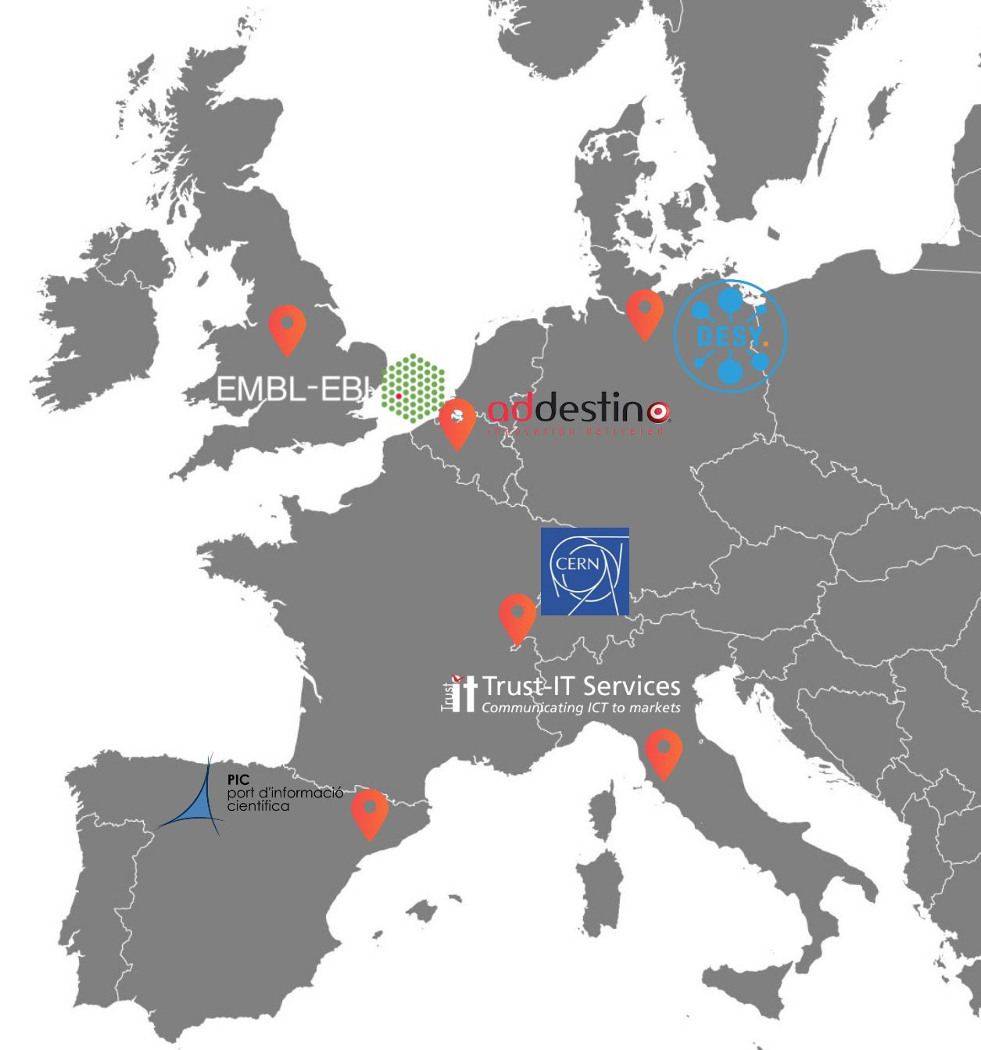







ARCHIVER Project
Focus: Archiving and Data Preservation Services using cloud services available via the European Open Science Cloud (EOSC) Procurement R&D budget: 3.4M euro; Total Budget: 4.8M
Starting Date: 1st of January 2019 Duration: 42 Months
Coordinator: CERN (Lead Procurer)
Buyers Group (BG) - Public organisations committing funds to contribute to a joint-R&D-procurement, research data use cases and R&D testing effort.
Buyers
Consortium
Experts
Experts - Partner organisations bringing expertise in requirement assessment and promotion activities

Slide 18
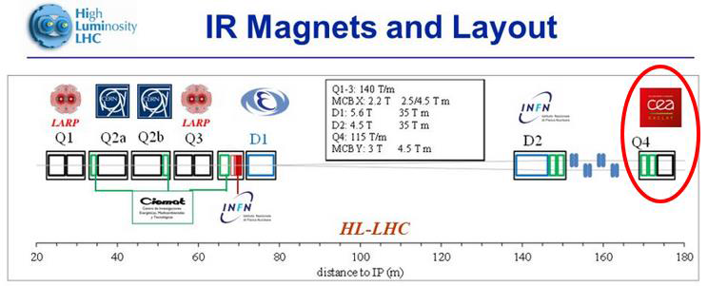

The problem
The scope of the QUACO project was to develop and procure 2 pilot superconductive quadrupole magnets valid for possible use in the frame of the HiLumi project, the Q4.
Notes:
Why the Q4 and no other magnets
Why HL-LHC took this decision
Importance of the support of the DG

Slide 19
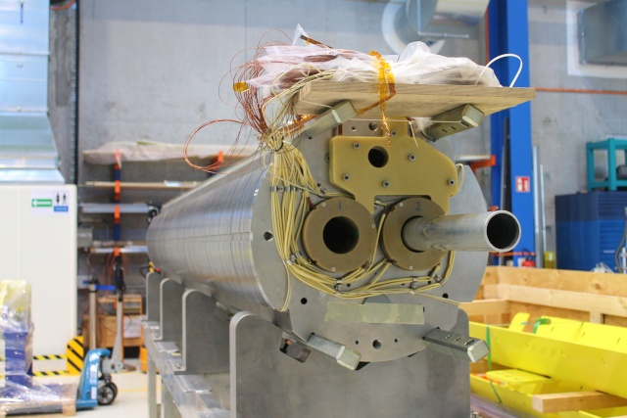




QUACO – PCP INNOVATIVE MAGNETS
QUACO was the first Pre-Commercial Procurement (PCP) scheme adopted in the accelerator sector, entailing a gradual and collaborative approach to procurement in accelerator research and development.
QUACO project paved the way for academia-industry partnerships by engaging small companies in complex and risky R&D projects, deploying an effective Technology Transfer methodology, from different laboratories to industry, therefore enlarging the European industrial capacity in the accelerator sector.
Four companies were qualified for the first phase. The project delivered two 90-mm-aperture quadrupole magnet with a magnetic length of 3.67 metres and an operating gradient of 120 T/m at 1.9K

Slide 20
Innovation Procurement Training Journey

Slide 21
1. Intro and training manuals (Webinar · 17 October 2025)
Introduction to INPROCAP and training pathway
2. Needs Assessment (Webinar · 21 November 2025)
Identifying, structuring & prioritising procurement needs
3. Market Analysis (Hybrid Training · 9 December 2025)
SOTA analysis, supplier identification & landscape mapping
4. Open Market Consultation (Webinar 24 February 2026)
Legal basis, methods, formats & best practices
5. OMC & Business Case exercise Onsite Training · 23 March 2026)
We worked through an OMC exercise using real BSO procurement scenarios
A well-defined need is the foundation of every successful innovation procurement.
The gap between what exists and what you need justifies innovation procurement.
We then tackled the business case — what does it take to justify innovation procurement to management?
Equal treatment and documentation are non-negotiable.
The INPROCAP Training Pathway

Slide 22
From foundations to procedures
Date | Title | Priority Audience
23rd of April 2026 | Pre-commercial procurement | BSO Priority + companies
11th of May 2026 | Innovation partnership | BSO Priority + companies
30th of June | Onsite training for BSO staff on innovation procurement procedures | BSO priority /ILOs
18th september 2026 | Competitive dialogue | BSO Priority
20th October 2026 | Competitive procedure with negotiation | BSO Priority
11th November 2026 | Management of Intellectual Property Rights | BSO Priority
The first five sessions built the strategic foundation: needs assessment, market analysis, OMC, and business case.
Now we move into the procurement procedures themselves
Register here:
https://www.inprocap-procurement.eu/

