Slide 1












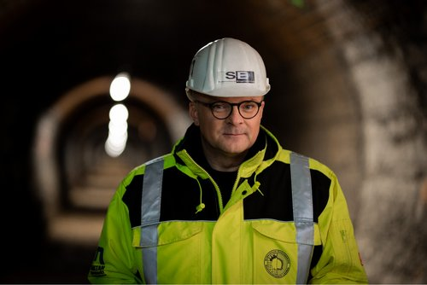
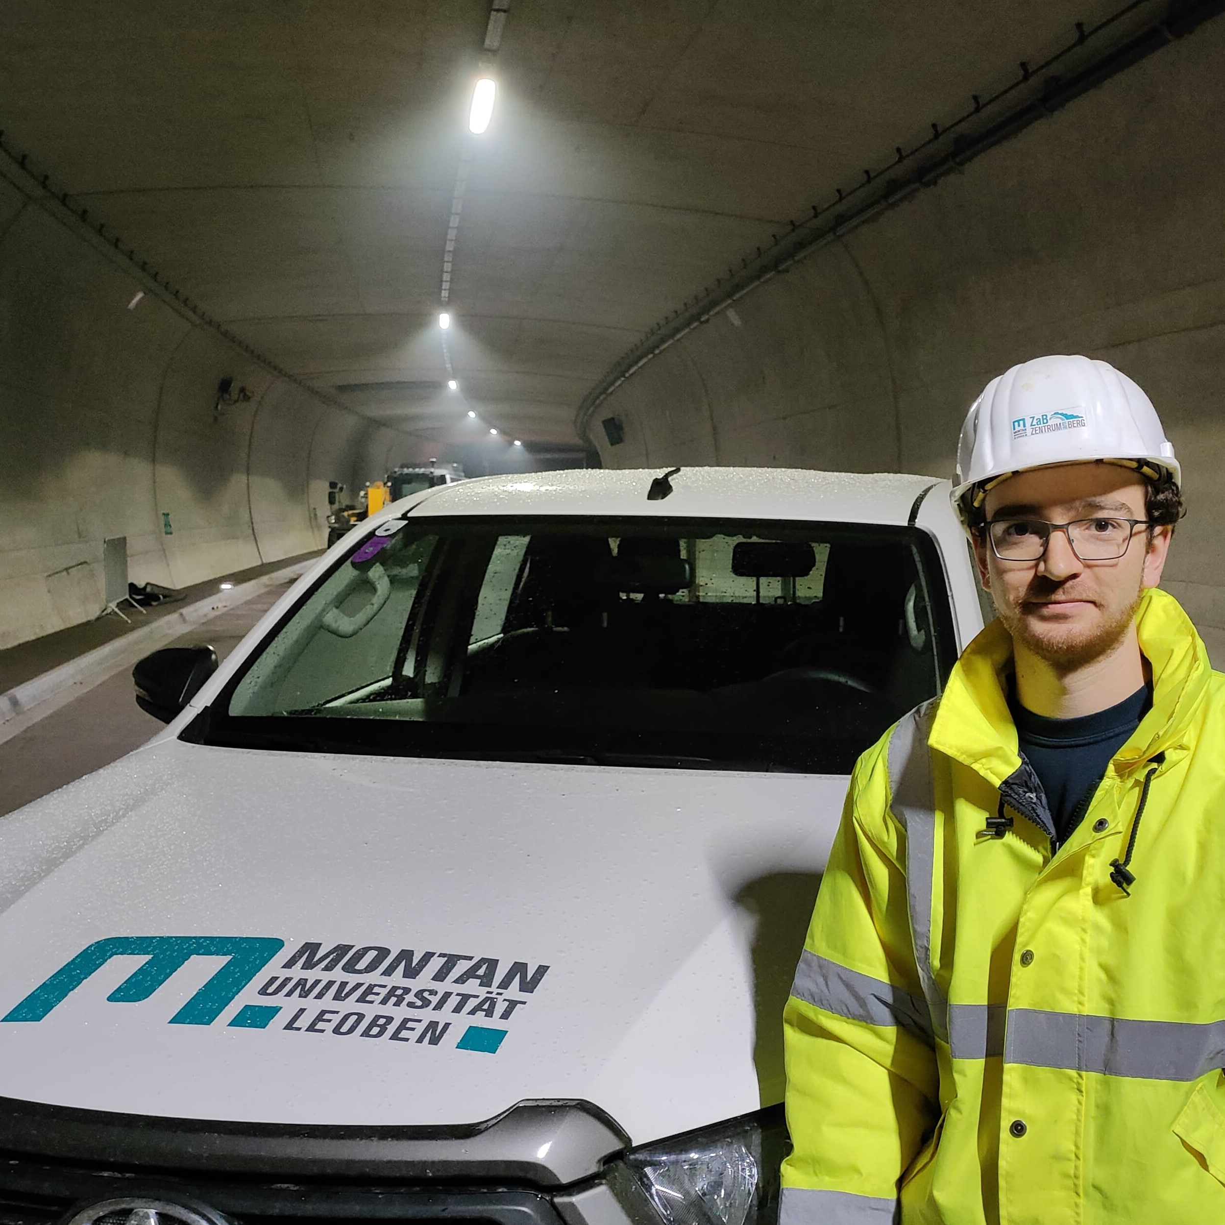
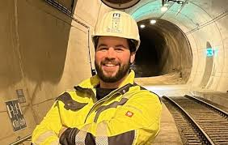

EUROPEAN RESEARCH EXECUTIVE AGENCY (REA)
REA C – Future society
C4 – Reforming European R&I and Research Infrastructure
GRANT AGREEMENT
PROJECT 101079696 – ET-PP - HORIZON - INFRA - 2021 - DEV - 02
ET–PP INFRA-DEV ANNUAL MEETING 2026
ET–PP WP9
Sustainable Development Implementation Strategy:
ET Environmental Impact, ET CO2 Footprint
(D9.1, D9.2, D9.3)
Maria Marsella (INFN), Disha Sawant (EGO)
May 5 – 7, 2026
UPF Barcelona School of Management - Barcelona

Slide 2




Vision
ET-PP is committed to fulfilling
Long-term operational requirements while minimising environmental impact
Adhering to EU and national sustainability directives, as well as international best practices
Develop a strategy for the realization of a long-term sustainable research infrastructure - 3 Deliverables
D9.2: Environmental Impact Assessment & Mitigation Strategy including - Annex: Strategies for excavation and material reuse
D9.3: CO2 Footprint assessment and mitigation roadmap
D9.1: Sustainable Development Implementation Strategy
Design & Preparation Phase
Construction Phase
Operation Phase
Decommissioning
Phase
Sustainability principles are incorporated from the initial conceptualisation and design stages
Carbon reduction is prioritised through the adoption of environmentally responsible construction practices and procurement of sustainable materials.
Resource usage - especially fossil-based resources is optimised and efforts are made to minimise the environmental impact during operation and maintenance
Plans for decommissioning emphasise the reuse of the infrastructure and responsible site restoration methods
Incorporation of responsible sourcing and circular economy principles
Ref: Horizon Europe Framework Program for Research & Innovation, Strategy Report on Research Infrastructure Roadmap by *European Strategy Forum on Research Infrastructures

Slide 3

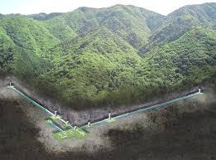
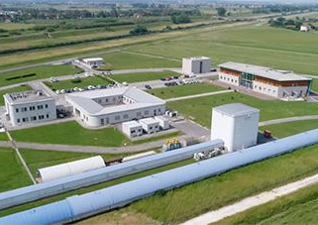


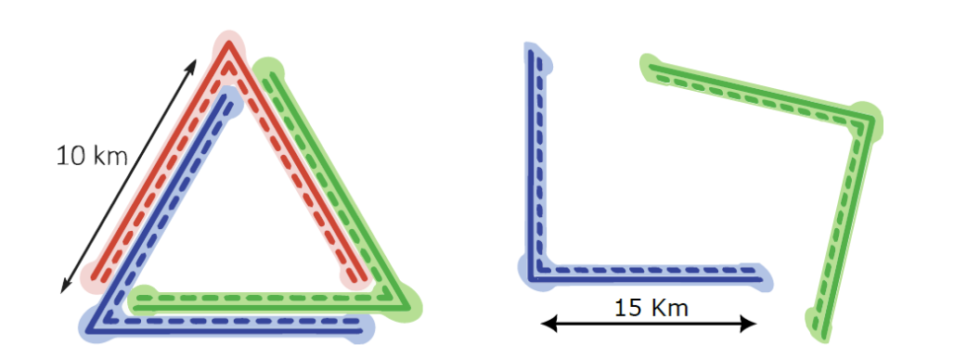

ET Sustainability Development Implementation - Challenges
It is an underground infrastructure (second only to KAGRA in Japan)
Geometry and characteristics are still under definition, with many assumptions currently in place
Ongoing activities include site selection and geometry definition, with a strong focus on sustainability considerations
KAGRA GW Site - Kamioka mines, Hida city - Japan
EGO-VIRGO GW Site - Cascina (Pisa) - Italy
Preparatory phase of ESFRI roadmap - pre-feasibility studies managed by candidate sites to prepare technical and economic proposal for candidacy

Slide 4
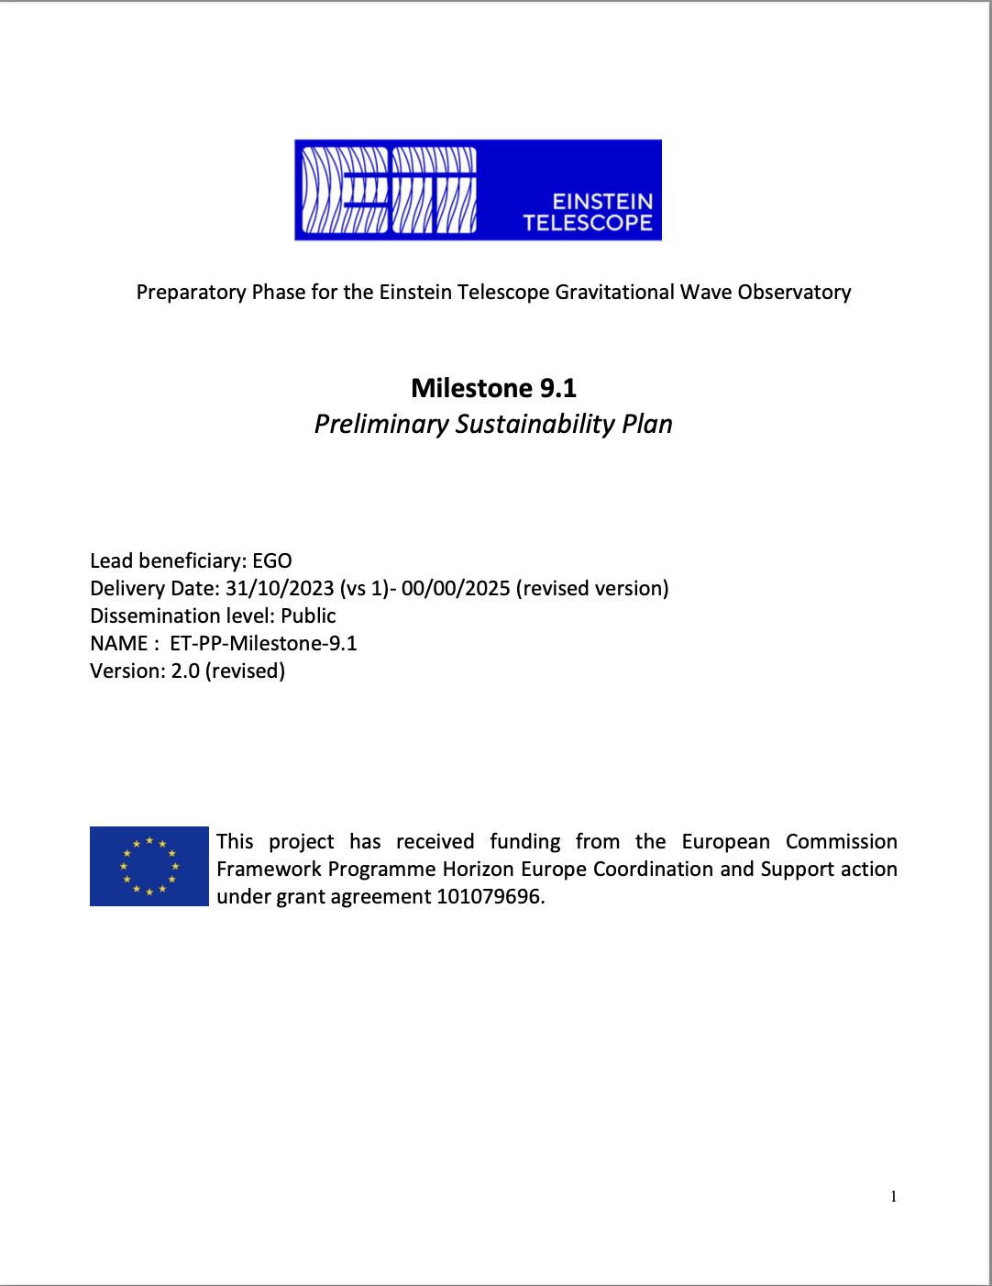
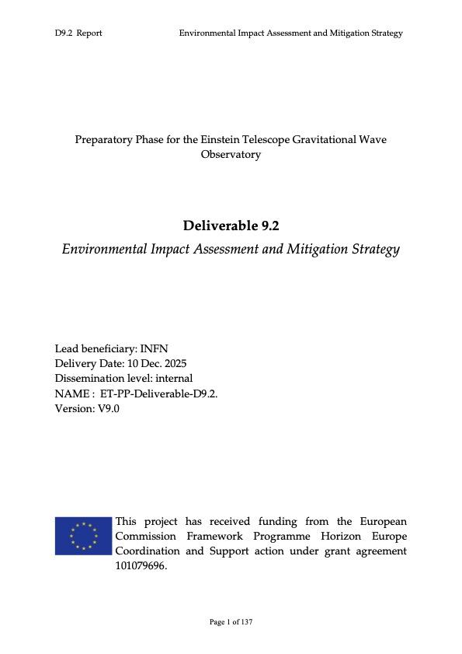
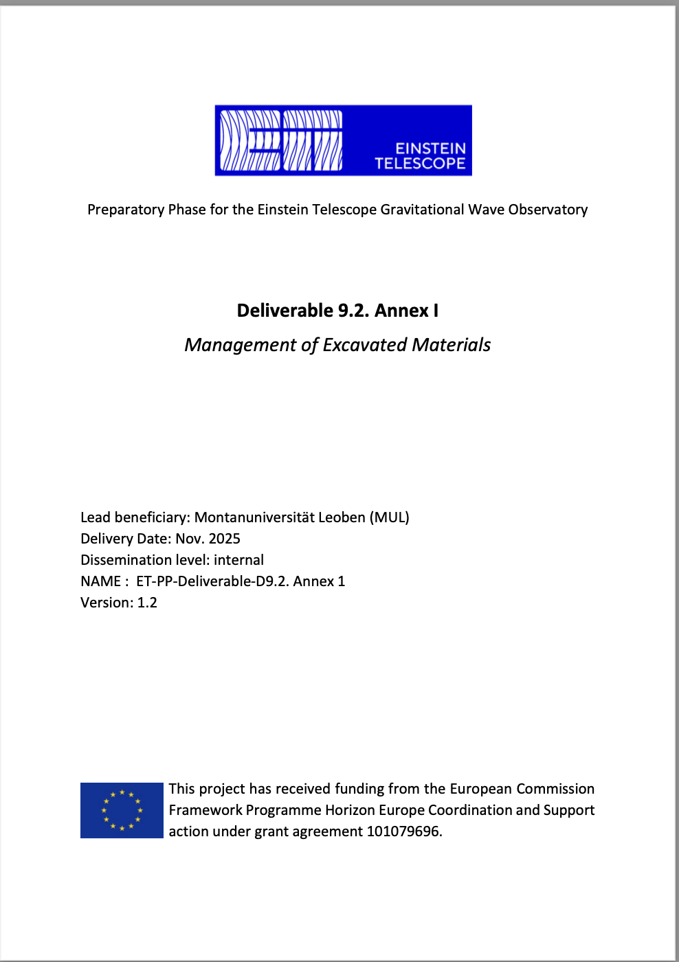
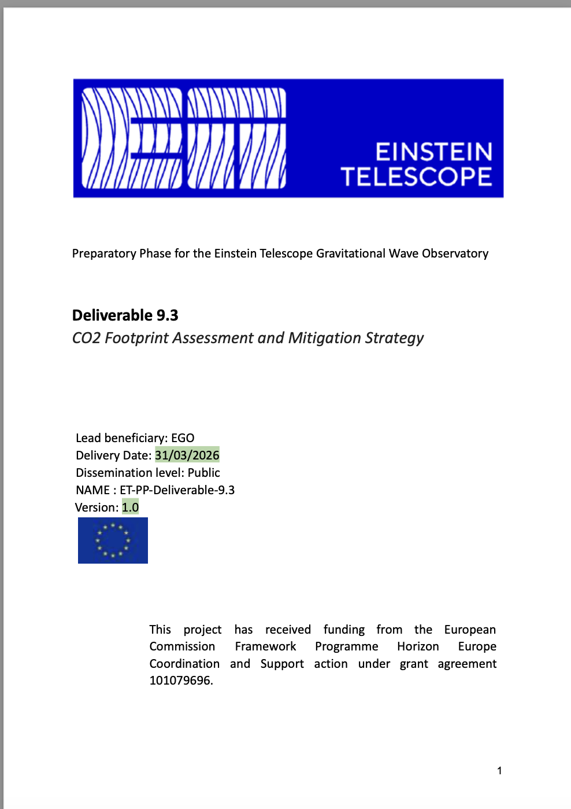
ET Sustainable Development Strategy - Reports
  ET Environmental Impact Assessment & Mitigation Strategy
  Scoping and Baseline Assessment
  Alternatives and Mitigation
  Public Participation and Transparency
  Monitoring and follow-up
  ET CO2 Footprint Assessment & Mitigation Strategy
  Compute the key Carbon and Environmental Impacts
  Findings and Mitigation Strategies
  Highlight the most critical insights and recommendations for decision-makers

Slide 5
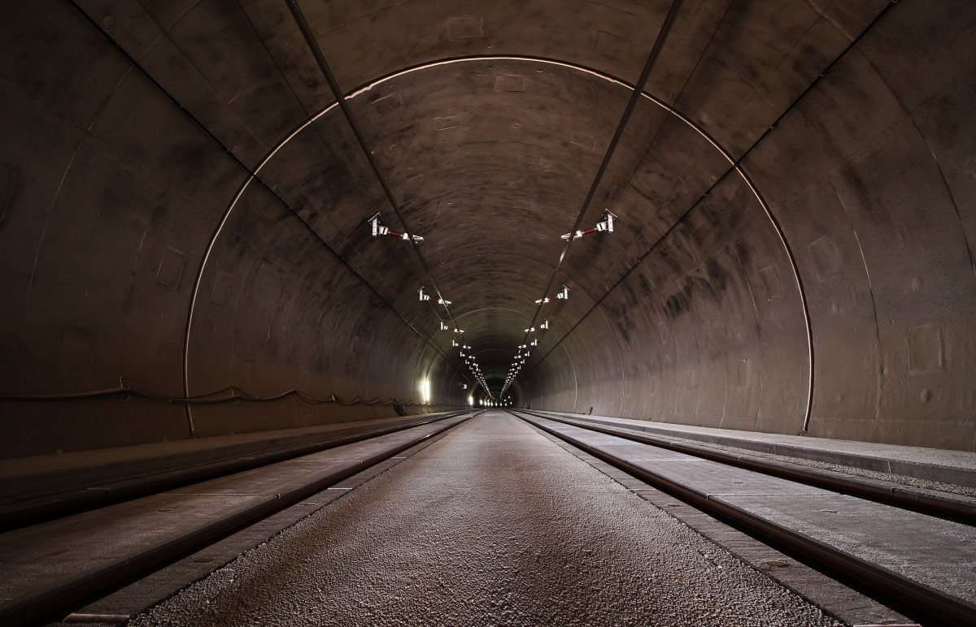
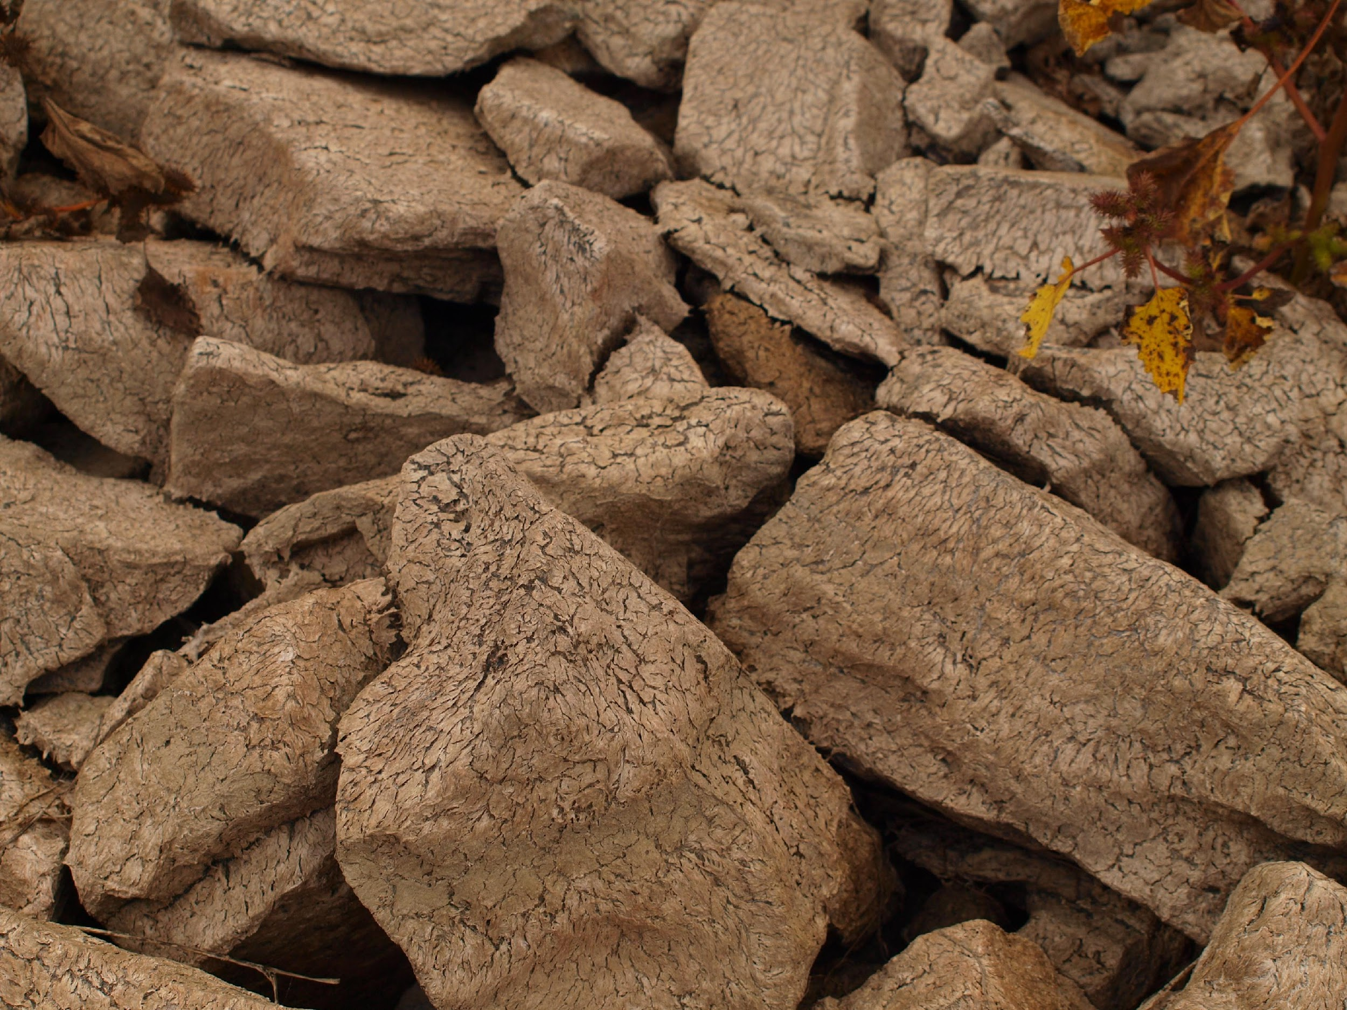


Annex 1 - Reclamation, Reuse and Recycling of Excavated Materials
Technical
# Tunnel advancing method, dimensions
# Site organisation
# Material yield parameters
# Material analysis
# Processing technology
Geological
# Geological situation
# Chemistry/ Mineralogy/ Strength properties of excavated materials
# Project specifications
# Processability
Legal
# Ownership
# Regional Waste law
# End of waste character
Economic
# Supply and demand
# Raw material price vs. Landfilling costs
# Transport route/ -range between end points
WP9 Deliverable D9.2 Annex

Slide 6
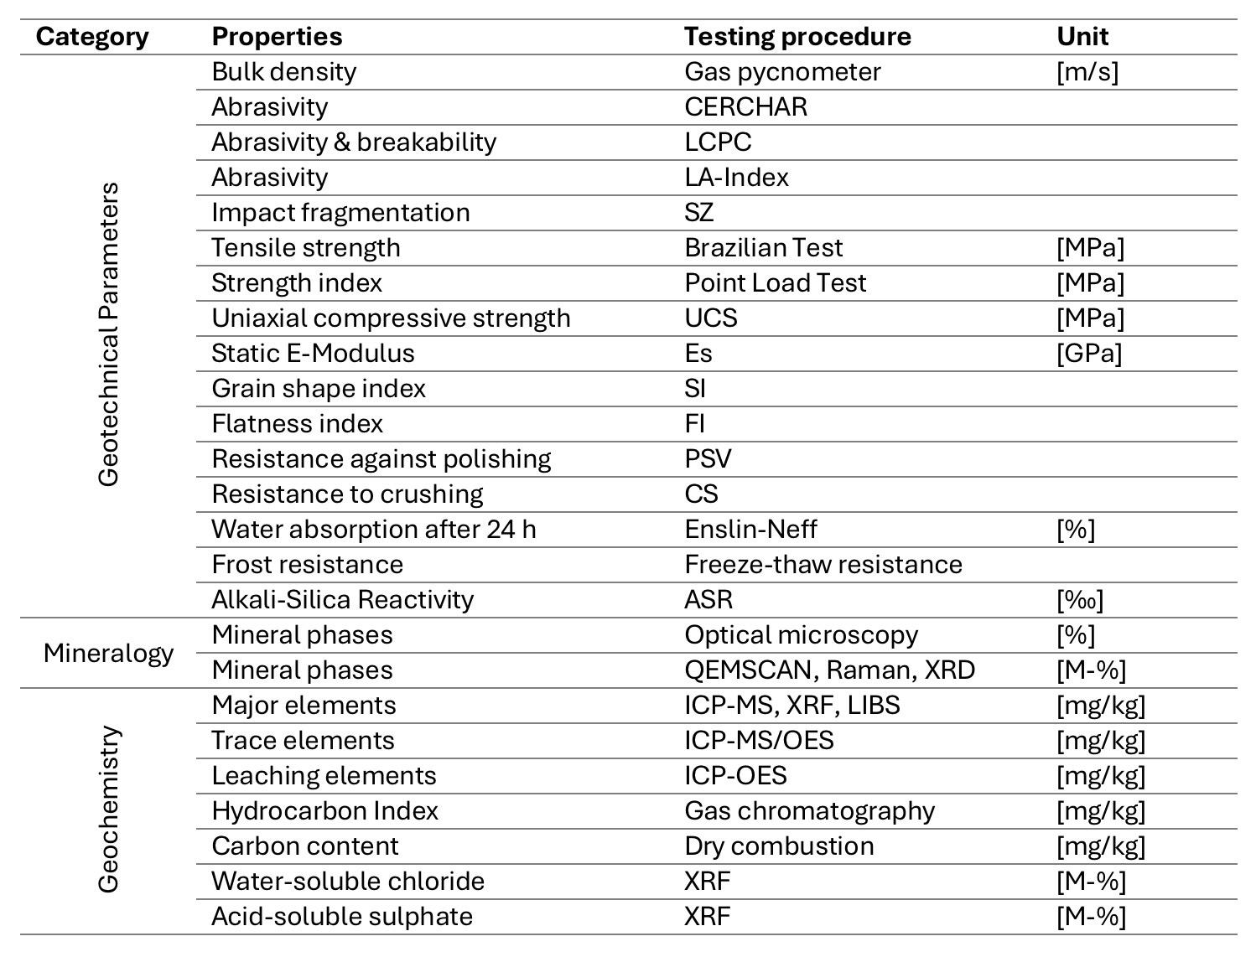
Reclamation, Reuse and Recycling of Excavated Materials
Assessment approach
Site-specific geochemical and geotechnical characterization (Mechanical strength, mineralogy, petrography,…)
Cross-border environmental compliance and contamination screening (Thresholds, …)
Define potential reuse pathways, prioritize high-volume, on-site or near-site options (Match material properties to realistic technical as well as legal applications)
Assess processing and logistics requirements, integrate material characterization and processing into construction concept
Perform sustainability evaluation
Quantify environmental impact in line with ETs scientific mission

Slide 7
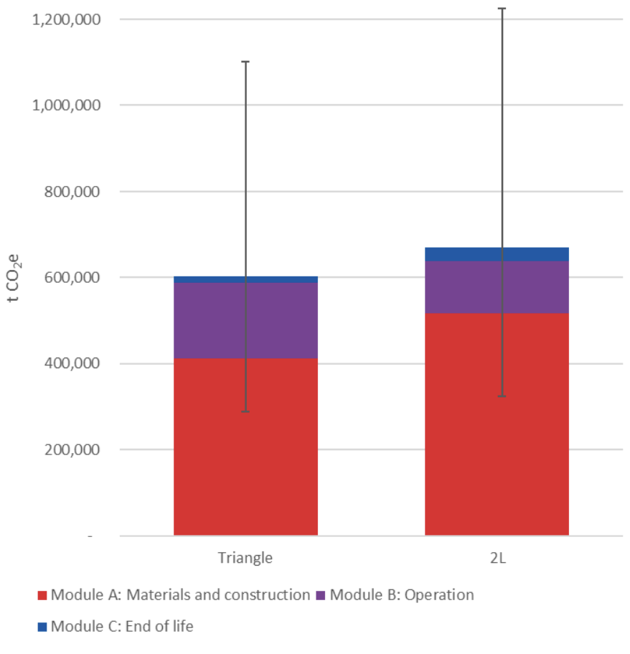
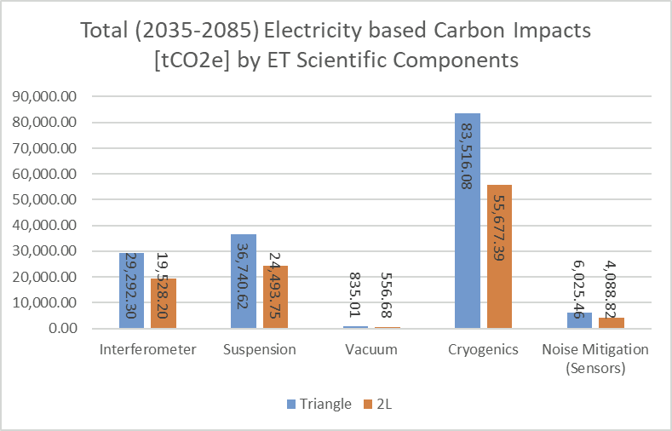
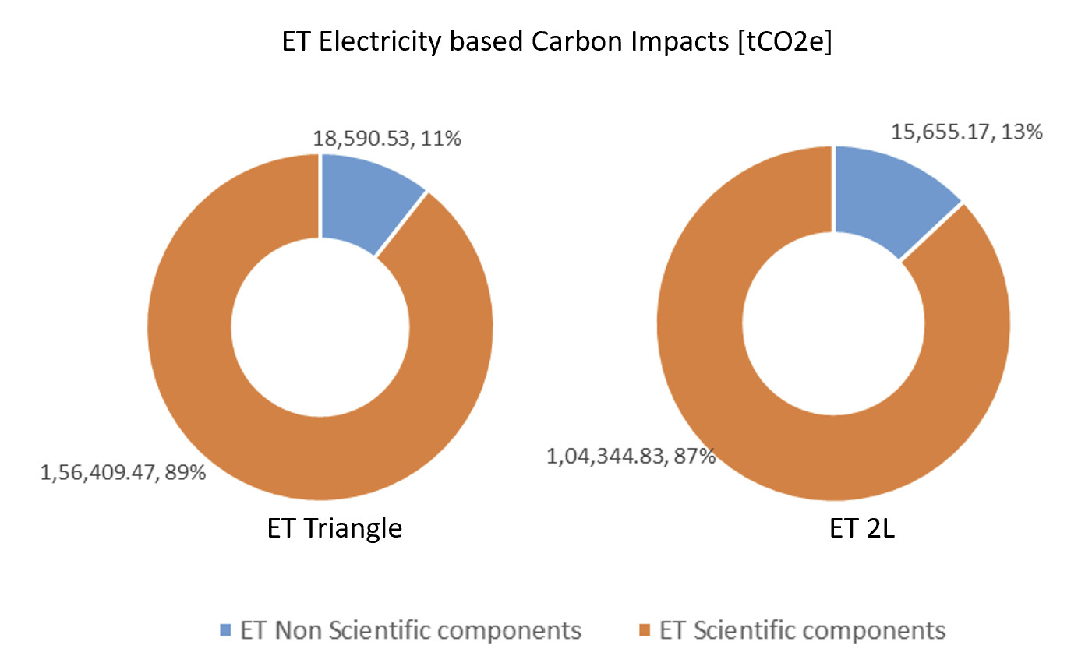
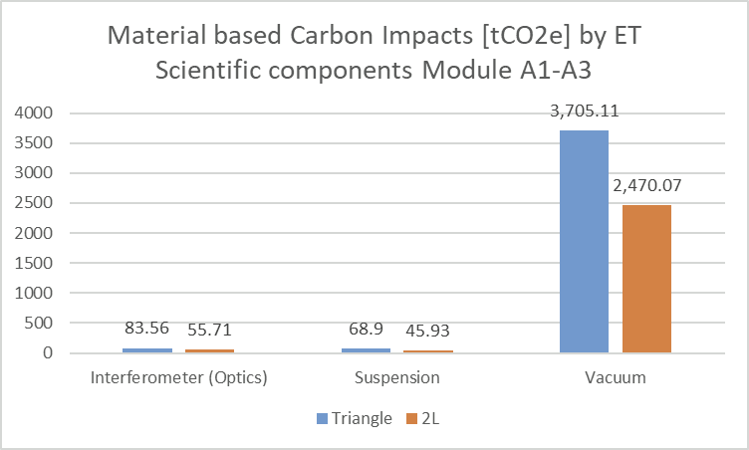
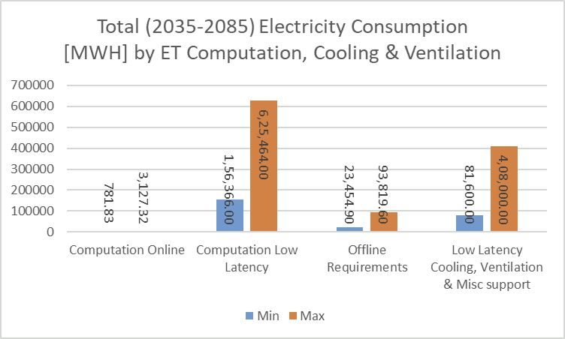
Baseline Whole Life Carbon Assessment
Carbon impacts of ET underground and surface infrastructure including uncertainty
WP9 Deliverable D9.3

Slide 8
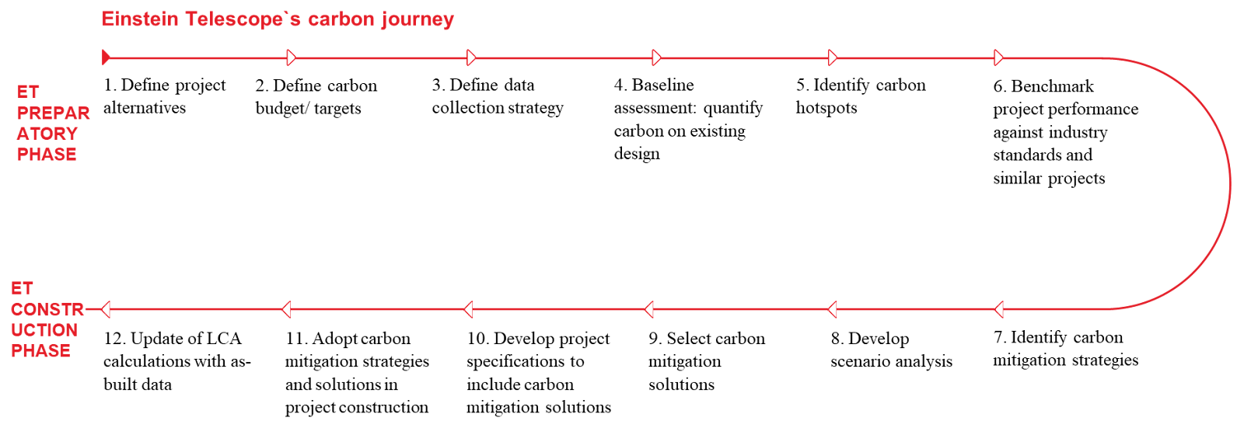
Key Steps for the Life Cycle Assessment during ET Phases
ET Preparatory Phase
ET
Construction Phase

Slide 9




ET Sustainable Development Implementation Strategy -
Opportunities
Addressing the path toward sustainability is crucial and can be prioritized proactively rather than reactively.
It can serve as a guide for decision-making in various sectors.
Support next step for ESFRI roadmap in the preparation of the technical and economic proposal
An iterative process identified to determine technologies, sizing, geometry, financial aspects, and environmental impact.

Slide 10
Outcomes reached & moving forward
Preliminary assessment and actions to define baseline for future selected sites and layout for planning and permit documentation
Preliminary assessment and actions for meeting Carbon Monitoring & Management Targets
Refinements in information for scientific/civil/technical components
  Established current status and data requisites
  Organizing advanced data collection to improve quality and granularity
Leveraging ET-PP outcomes for site-specific assessment to carry out Environmental Assessment and Carbon baselining
  Document published on TDS
  To be shared with stakeholders (SISE, ETO, HC,...)

