Slide 1


Project: 101079696 — ET-PP — HORIZON-INFRA-2021-DEV-02
ETO
Communication Office
updates
Horizon Europe: Coordination
and Support Actions
Barcelona, 5-7/05/2026

Slide 2
The Einstein Telescope Organisation
Professional organisation to get the Einstein Telescope approved and built.
Includes project management, (civil) engineering, strategy, coordination, communication, finance, etc.
Two directors: Fernando Ferroni & Andreas Freise
~43 colleagues, ~24 FTE
5 ETO funders: INFN, Nikhef, Belspo, FWO, IFAE
Staff: in-kind personnel contributions from various research institutes.

Slide 3
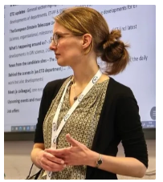
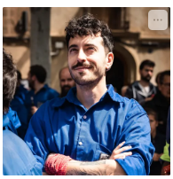
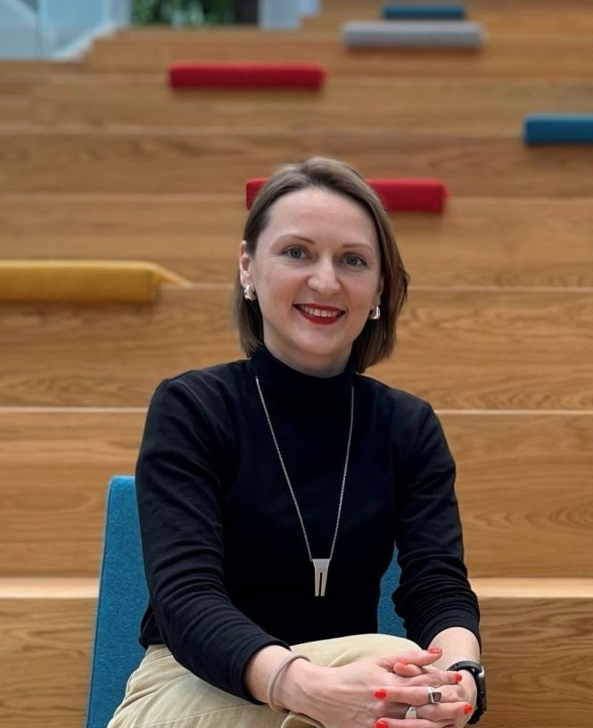
Communication Office
Martine Oudenhoven
Postion: Head of Communication
Based at: Nikhef, Amsterdam, NL
3 persons (Martine: mainly management, strategy, policy, when things get very complex or sensitive, jump in when necessary; Yuliya: for now mainly focused on managing website and coordinating social media; Pep: working on specific tasks, mainly focused on ETO internal comm.)
Collaborating and co-working with various ET stakeholders, both within and outside ETO:
ETO Directorate
ET Coordinators
ET Collaboration
ET Spokespersons
ET candidates sites comm teams (ET Italy, ET EMR, ET Lusatia)
Yuliya and Pep are still members of ET-PP InfraDev project ensuring regular and constant communication with WP10.
Josep (Pep) Freixanet
Position: Communication Officer
Based at: IFAE, Barcelona, Spain
Yuliya Hoika
Position: Communication Coordinator
Based at: Astrocent/NCAC PAS, Warsaw, PL

Slide 4

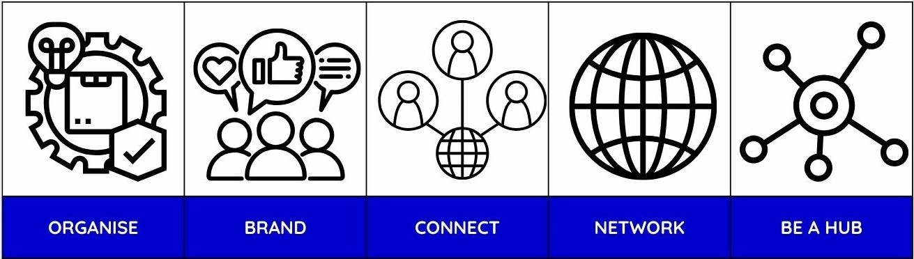
Communication Office: How we work
We implement the Strategic Communication and Media plan (ET-PP D10.3, 5 strategic pilars) on the basis of the ETO mandate endorsed by the Board of Governmental Representatives.
We have a year plan, that serves as a compass.
We started working with a communication calendar.
We are pragmatic in planning meetings.

Slide 5
ETO responsibilities for Communication
Mandate endorsed by the Board of Governmental Representatives in December 2025 and signed by the ET coordinators in early February 2026.
Managing strategic communication activities for the ET project (in coordination with the ET Coordinators, BGR, Funding Agencies, and ETC).
Supporting the ET Coordinators in preparing inputs to strategic and policy documents.
Supporting the ET Coordinators in the reporting to ESFRI and the European Commission.
Managing ET website and social media.
Promoting ET’s visibility within the European Research Area, particularly in relation to education, research, and innovation policy developments.

Slide 6
EXTERNAL COMMUNICATION

Slide 7
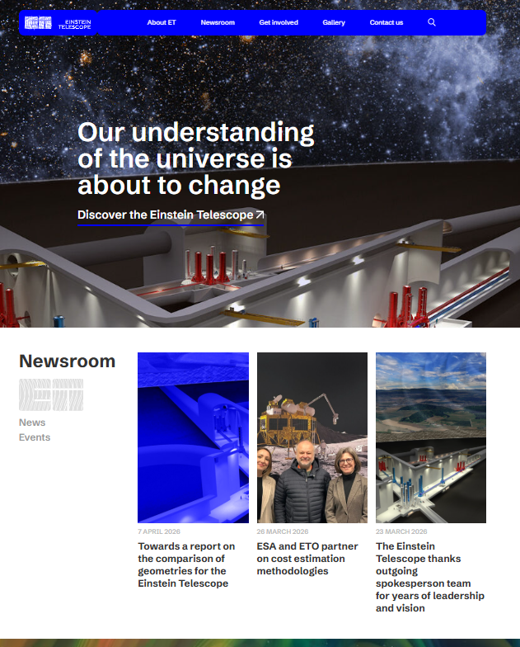
WEBSITE
neutral transnational hub of information
aimed at a wide audience and range of stakeholders
pages with general information, vacancies, information for industry, how to join the collaboration, events, and more
long read articles providing context about important aspects of ET, processes, collaborations (CERN, ESA), interviews

Slide 8
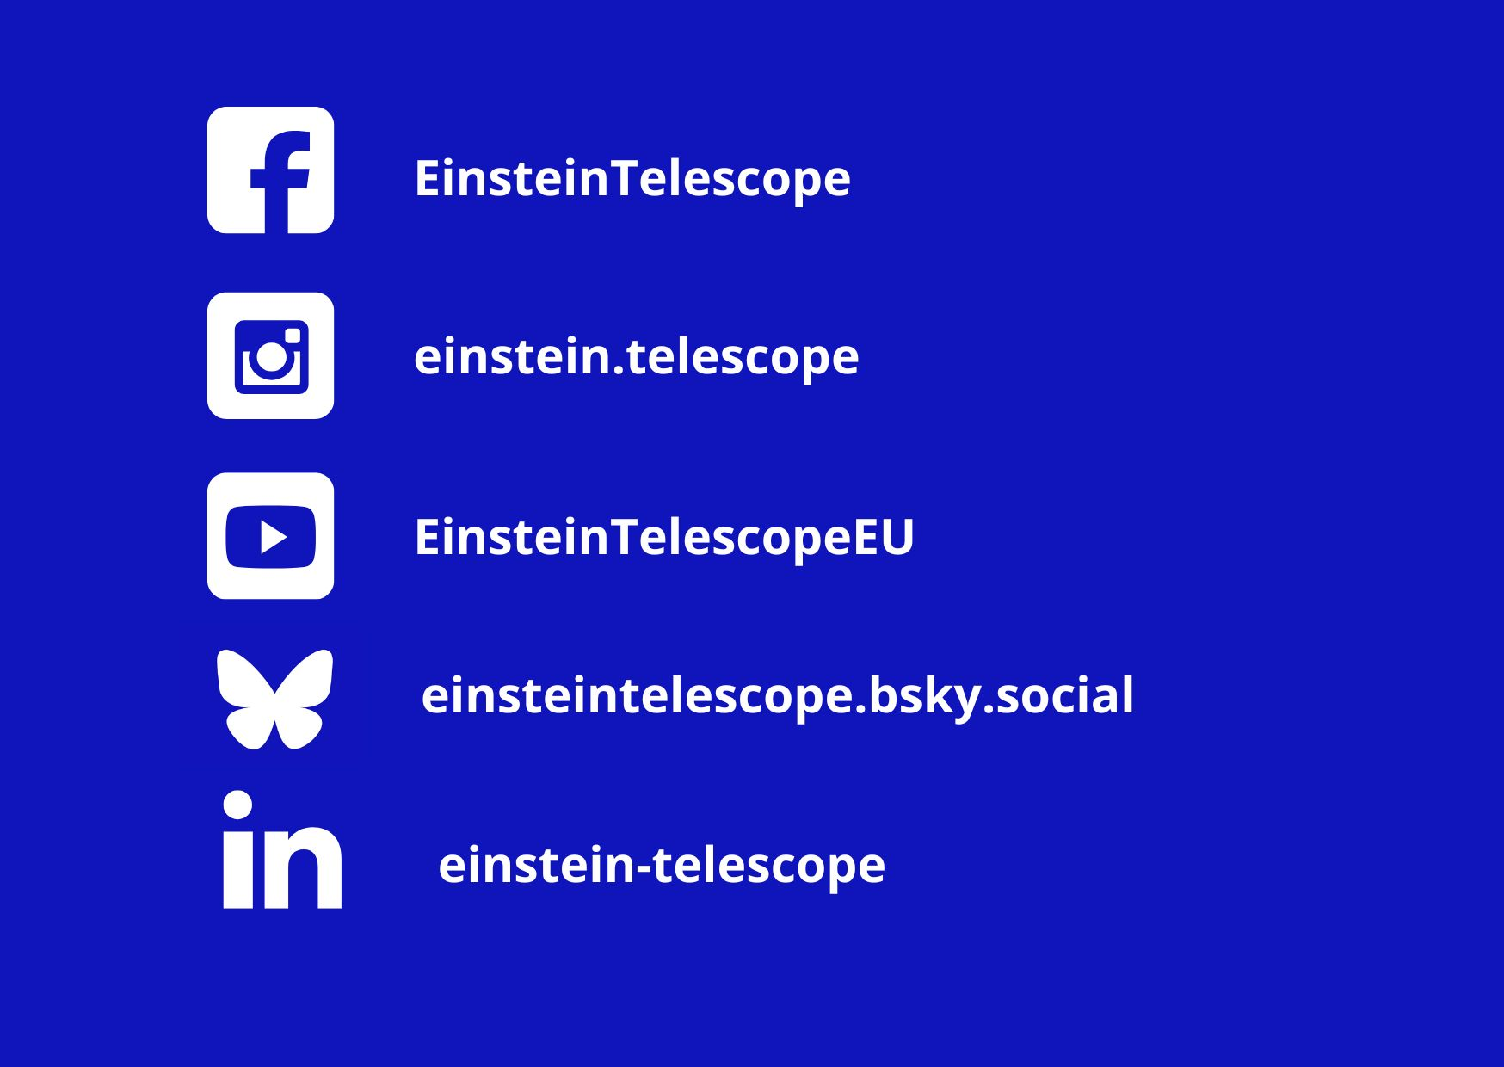
SOCIAL MEDIA

Slide 9
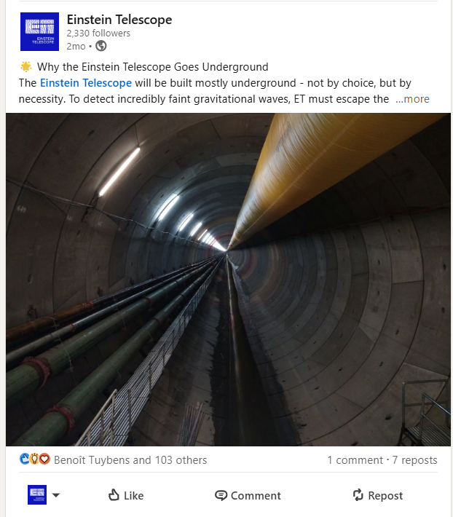
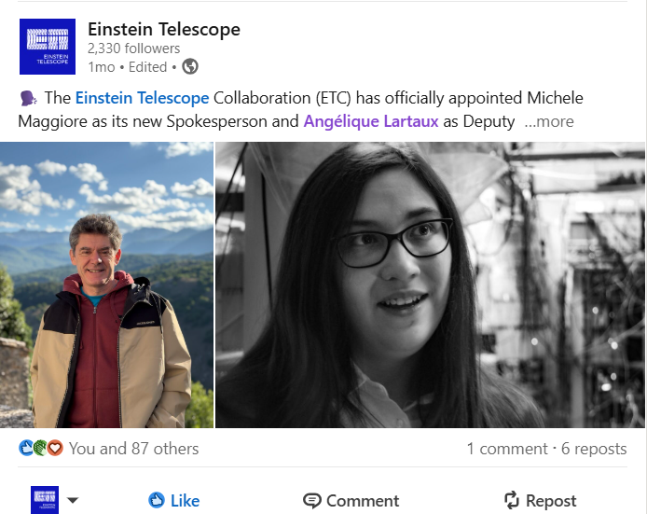
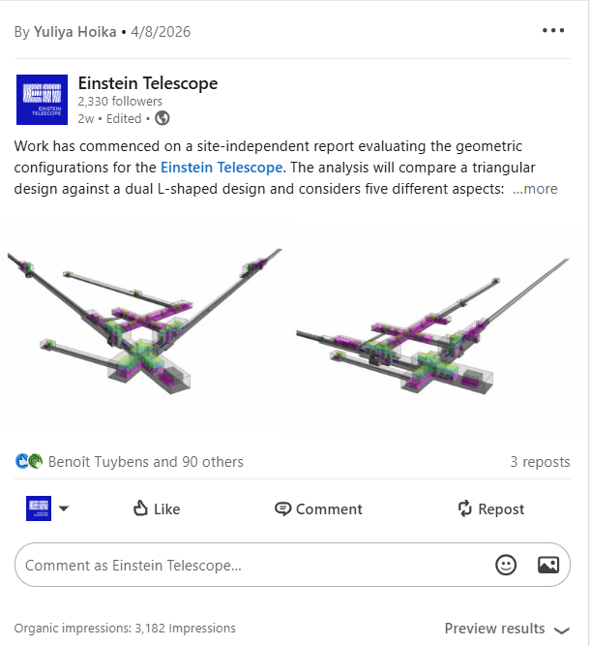
SOCIAL MEDIA
We strive to maintain balance and serve as a site-neutral source of credible information

Slide 10
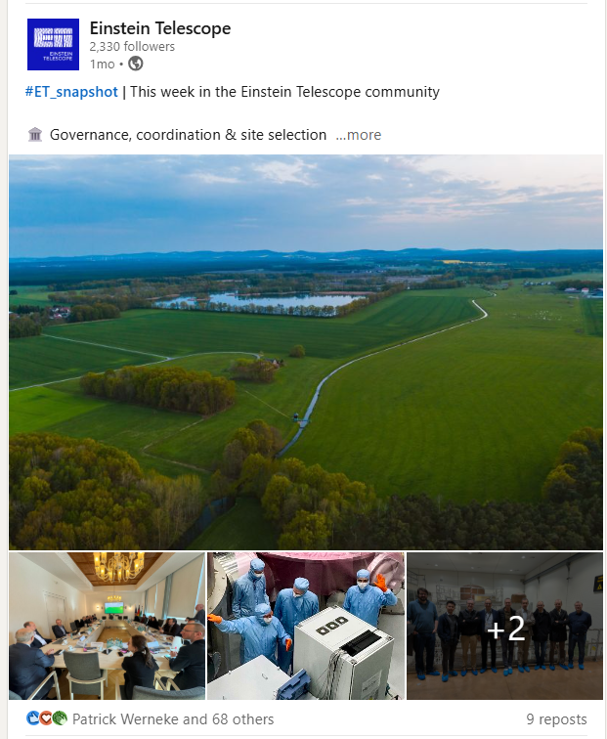
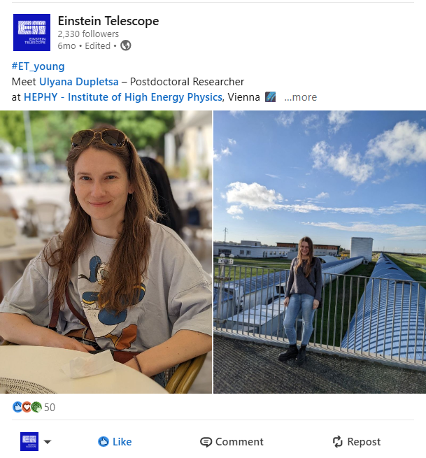
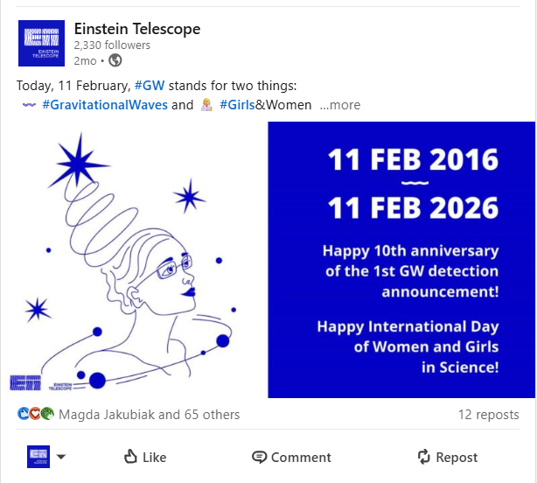
#ET_young
#ET_snapshot
#WomenInSTEM

Slide 11
Recent contributions to ET-PP

Slide 12
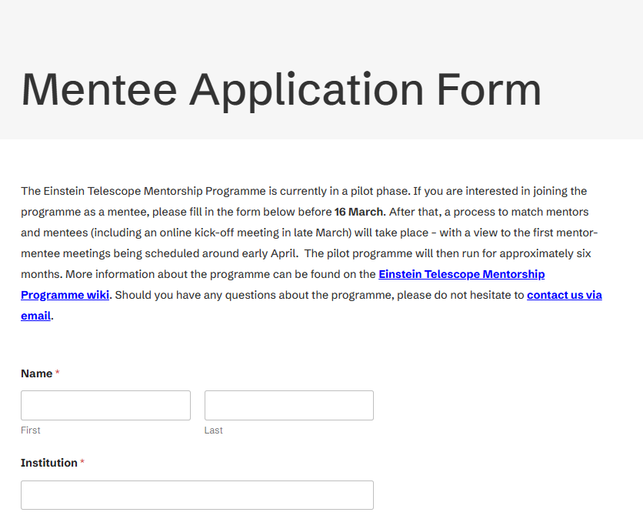
D10.5: Launch ECR mentorship and training programme
ET Comm Office contribution
Piloting stage of ET Mentorship Programme
Application forms created on ET webpage
Dedicated mail created in ET supranational domain mentorship@einsteintelescope.eu
Mentorship & Training Council membership
PLANS:
- to explore creation of a dedicated page for ECR to serve as a central point for ECR activities

Slide 13
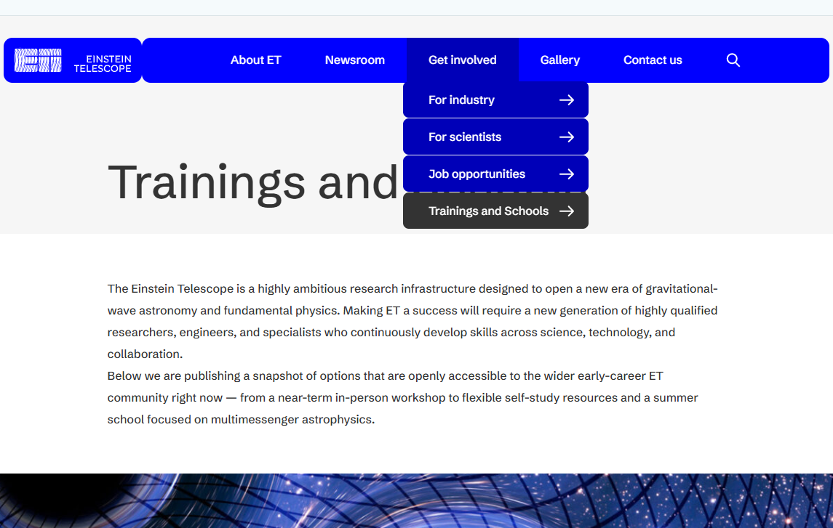
D10.5: Launch ECR mentorship and training programme
ET Training Programme
NEW SUBPAGE created in the D10.5 framework to share training opportunities for ECR.
The page is curated and updated by ETO in cooperation with MTC.
Send the info to ET Comm Office if you want them to be shared.

Slide 14
ETO Newsletter

Slide 15
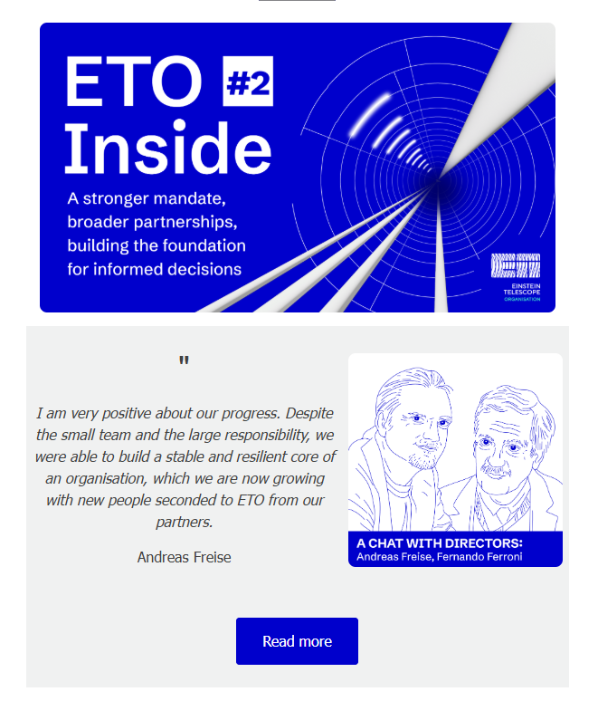
ETO Newsletter
Started in October 2025
ETO Inside #2 - 9 April 2026
Audience: semi-internal (ETO, other stakeholders interested in ETO’s updates)
Topics:
A chat with Directors
ETO breaking news
News from the Candidate Sites
Behind the scenes
Spotlight on:
Upcoming events
Beautiful implementation of ET official visual identity created within ET-PP project.

Slide 16

Thank you!

