Slide 1
Plans for this week
MWPC: wire stretching today
Analysis of DNA setup data
Measurement of light at end of 30 m fiber
Look into charge readout options of gas detectors (AGET/DREAM chips)
Clarify if workshop available to contribute to ND T2K upgrade
Finish Master course on Monday

Slide 2
Alternative Idea
About 10 cm
Put LED with Kaputschinsky driver directly in front of SMA feedthrough to shine on fibers inside the cryostat

Slide 3
First Tests without Fiber
Kaputschinsky with blue LED
Measured power released with Kaputschinsky
Result: 11.5 nW
Amazing result: E(465 nm)=430*10**-21 J => 11.5 nW correspond to 27 billion photons
1 kHz pulsing => each pulse 27 million photons which will directly go to fiber bundle
next step measure no of photons at end of 30 m fiber
Advantages of this approach:
much cheaper than laser approach
no safety issues at CERN
Question: Do we really need a reference sensor?
2 mm
SMA feedthrough
Black coat
45 mm
Powermeter

Slide 4
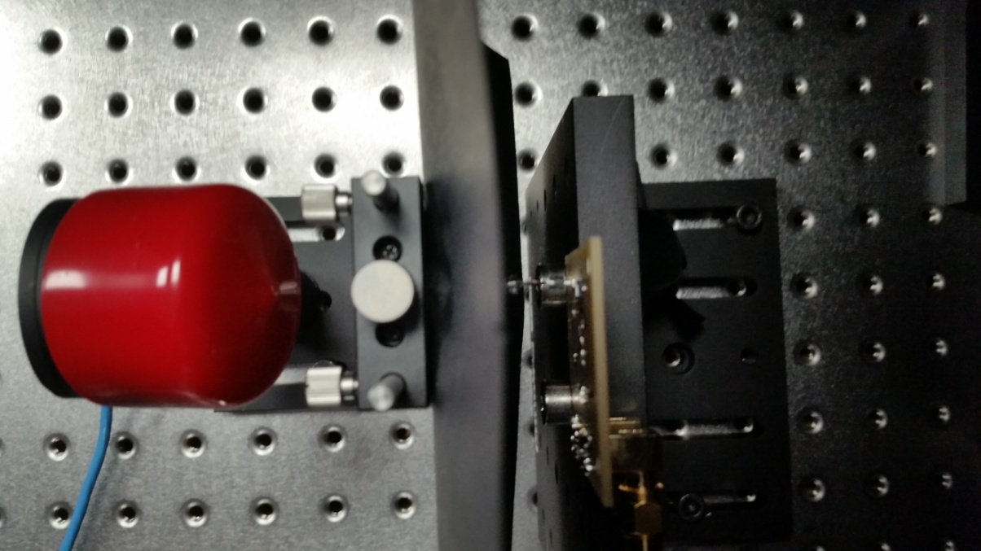
45 mm
1-2 mm
Photodiode with protection

Slide 5
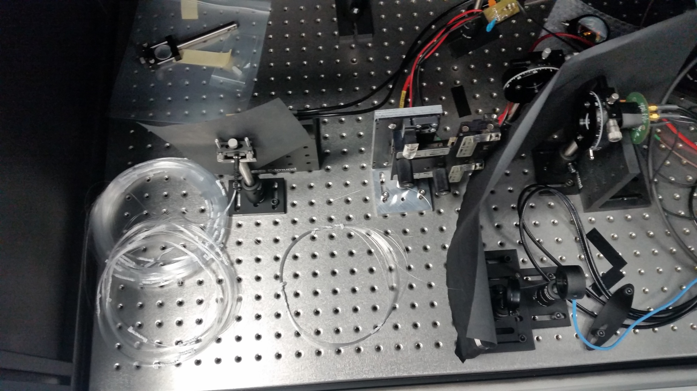
Tests with Fiber and Powermeter
SMA connector with stray light shield
2nd stray light shield
19 Fiber not used
Tested Fiber (30 m)
End of fiber + powermeter

Slide 6
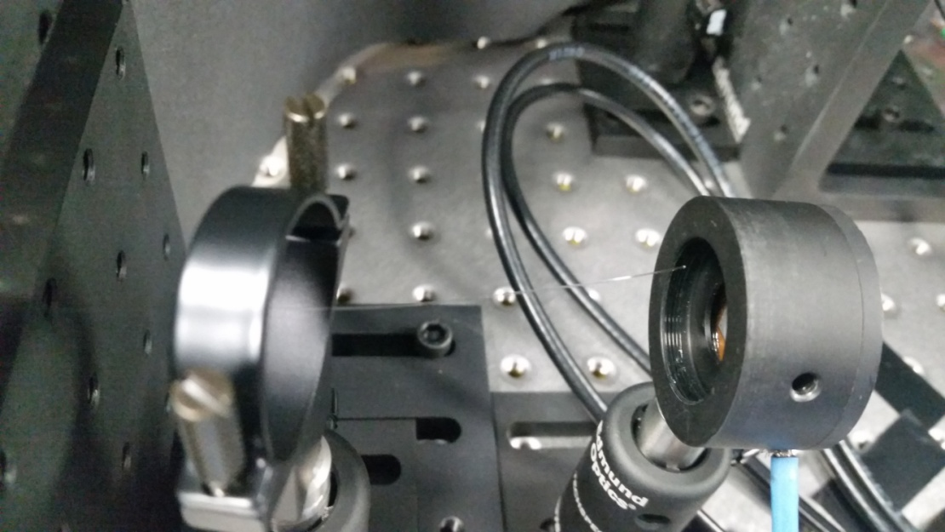
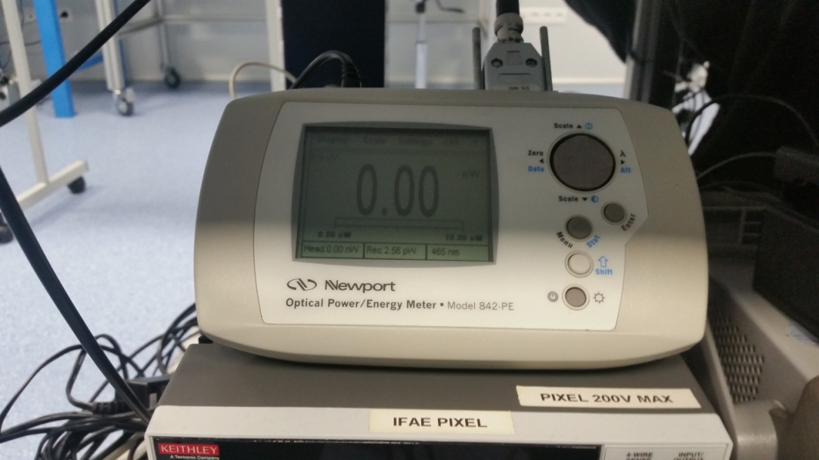
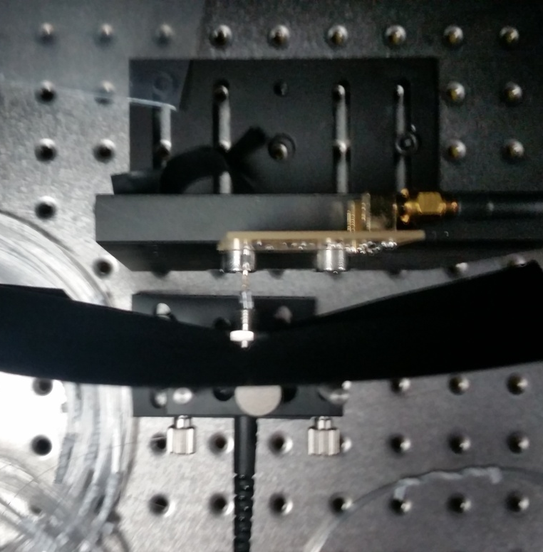
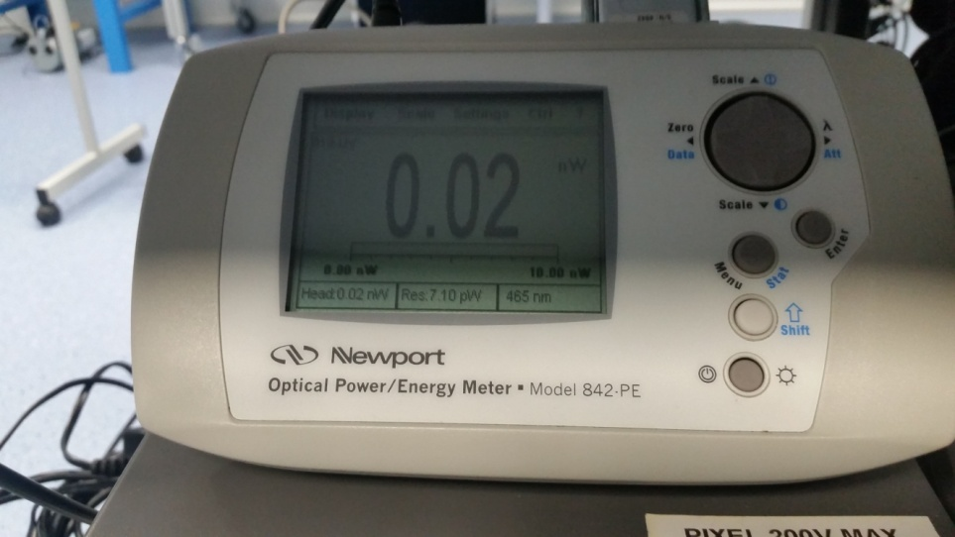
Fixing of fiber end not very stable and not optimal
LED off or fiber removed as control
Measured power should correspond to about 30.000 photons per pulse (10 ns) assuming 0.01 nW
reduction by factor 1000 compared to direct pulsing without fiber
Seems Still a factor 100 reduction possible and needed to get photon range of 0 to about 250 photons per pulse
LED moved into SMA helps a bit
LED pulsed with 1 kHz

Slide 7
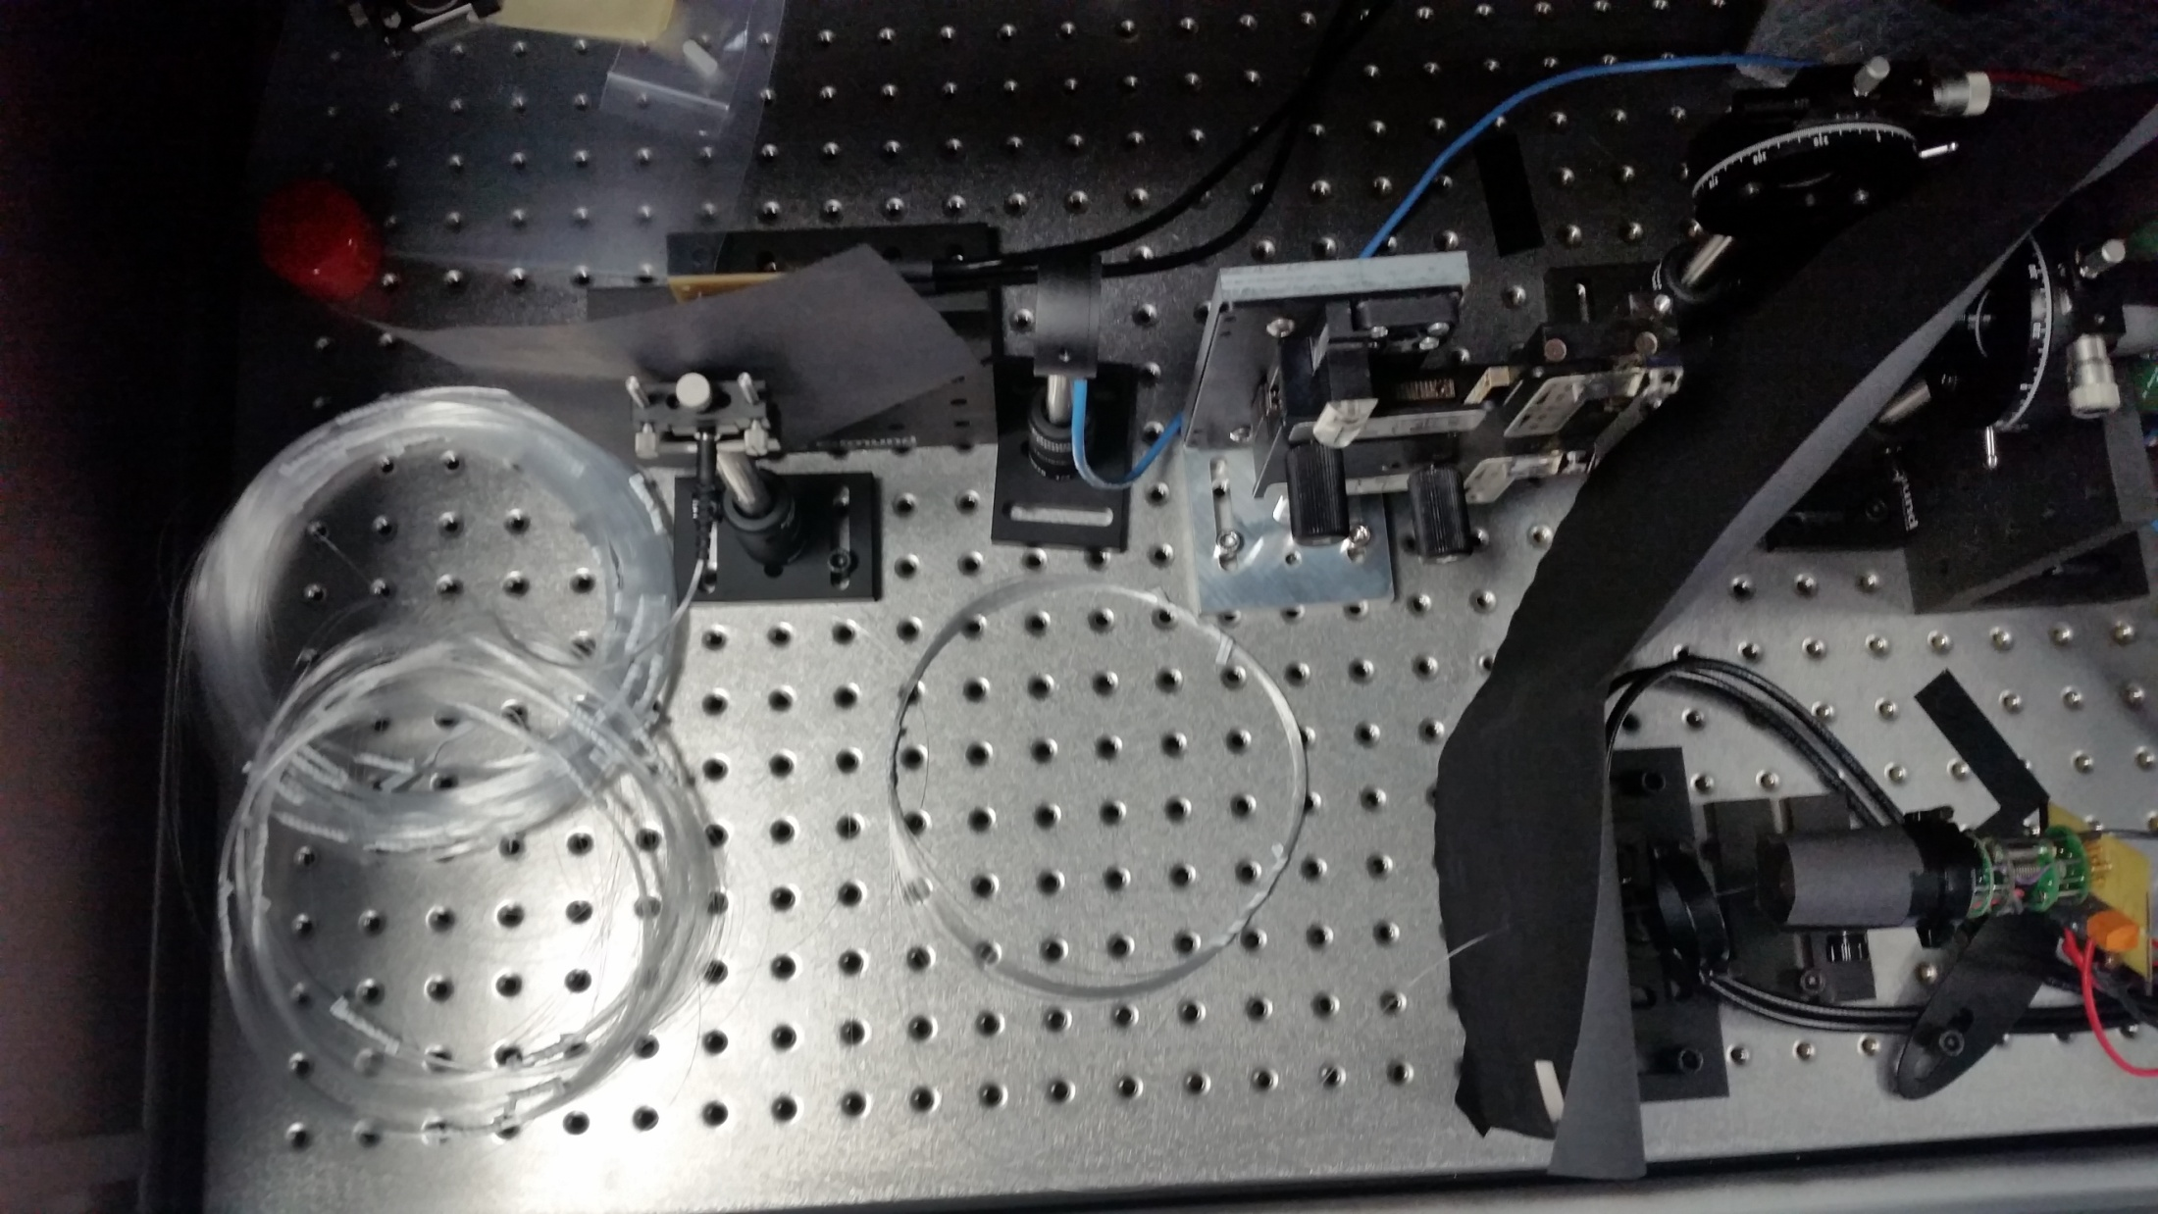
Tests with Fiber and PMT
Powermeter to check feasibility of reference sensor
End of fiber + MAGIC PMT (+ preamp)

Slide 8
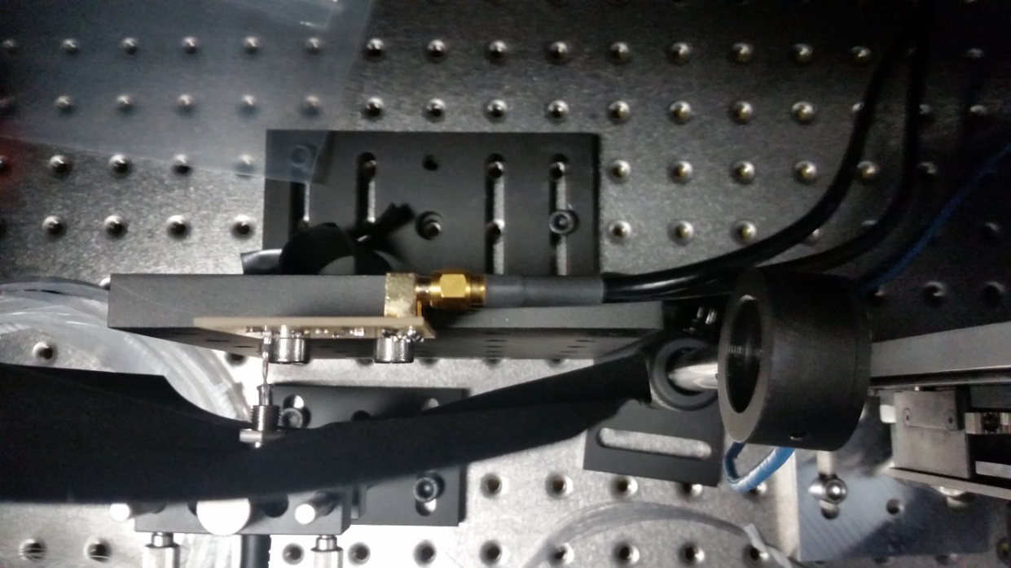
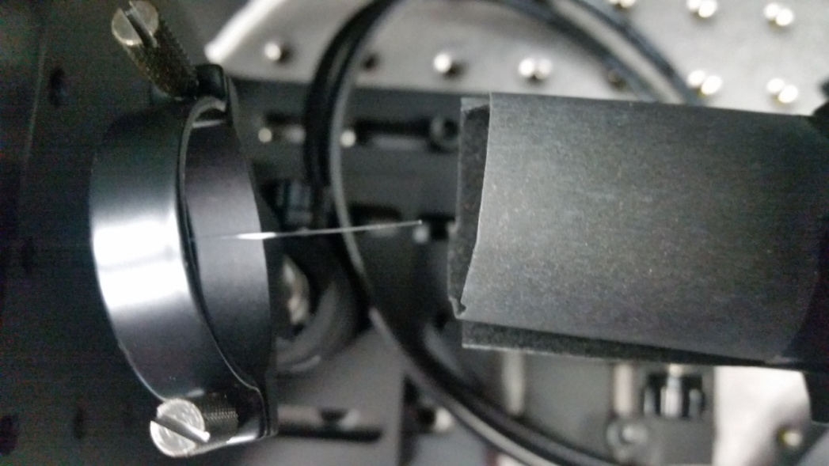
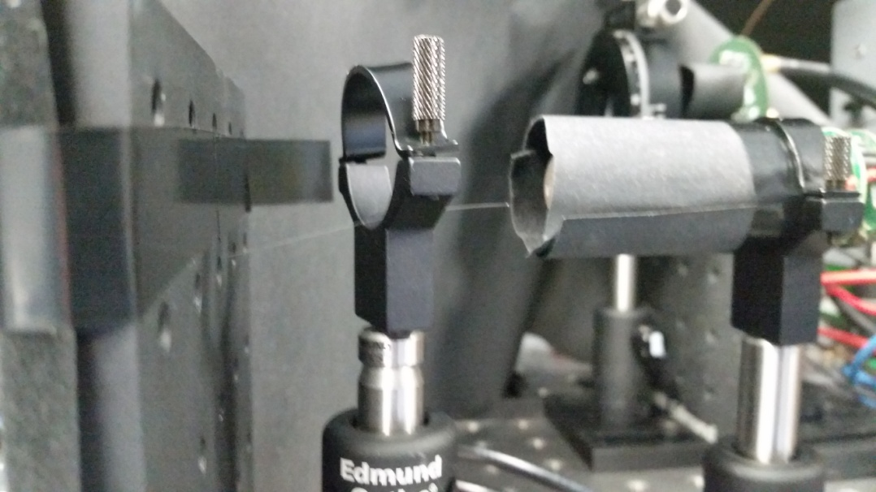
powermeter detects light, about 0.03 pW
geometry obvious not optimal
reference sensor in alternative approach should be feasible if desired
Powermeter
LED as before
PMT

Slide 9
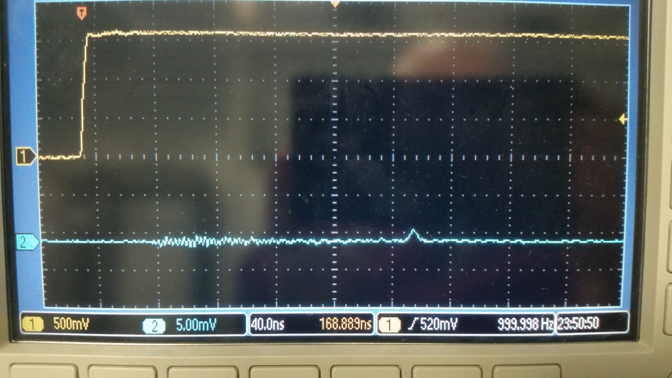
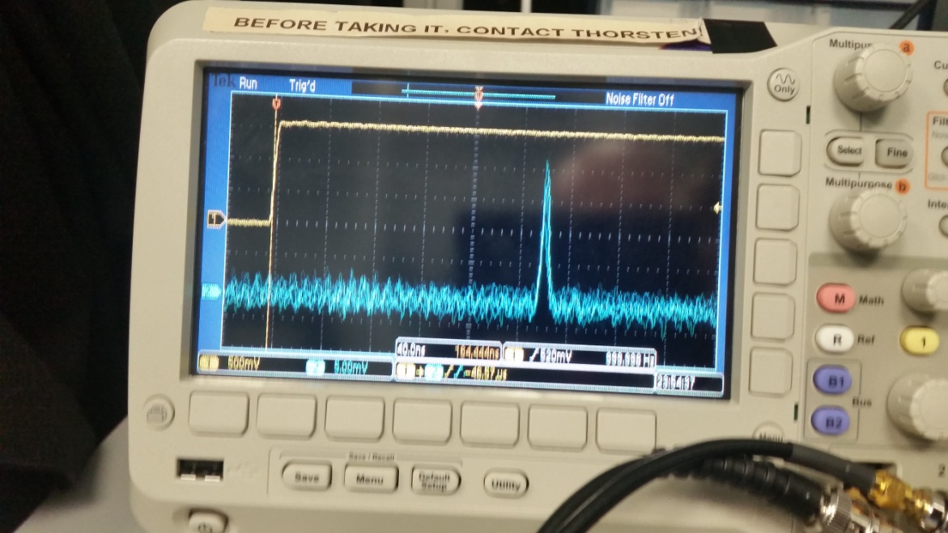
PMT sees clearly the light from the end of the fiber
Single photons at around 6.9 V bias voltage on the LED
With powermeter was necessary to go to 18 V to get a signal
Signal at 18 V smaller than expected, probably of the order of 1000 pe
electronic effect?
difference in Qeff powermeter and PMT?
mistake and photon estimation?
mis-calibration of powermeter?
delay of 220 ns between trigger and PMT pulse expected (60-80 ns delay without 30 m fiber and fiber should add roughly “100 ns * n” from the refractive index of the fiber
pulse width at end of fiber around 12 ns
Average over 256 pulses:
Yellow: “TTL” trigger
Blue: PMT signal

Slide 10
Possible improvements discussed with CIEMAT:
current fiber has 0.3 dB/m (650 nm) => 9 dB over 30 m => at least 90% loss of the light inside the fiber
Other fibers used by Miniboone has 10 times less attenuation and that at 470 nm => only 20% loss
current fibers 200 um diameter => using 400 or 600 um fiber could increase coupling efficiency by factor 4 to 9
or use 15 m optical fiber from top to bottom (with low attenuation) and <10 m long multi-fibers on the bottom => also advantage from construction point of view
modify Kaputschinsky to provide more light from LED or use green LED with 8 times more luminosity

Slide 11
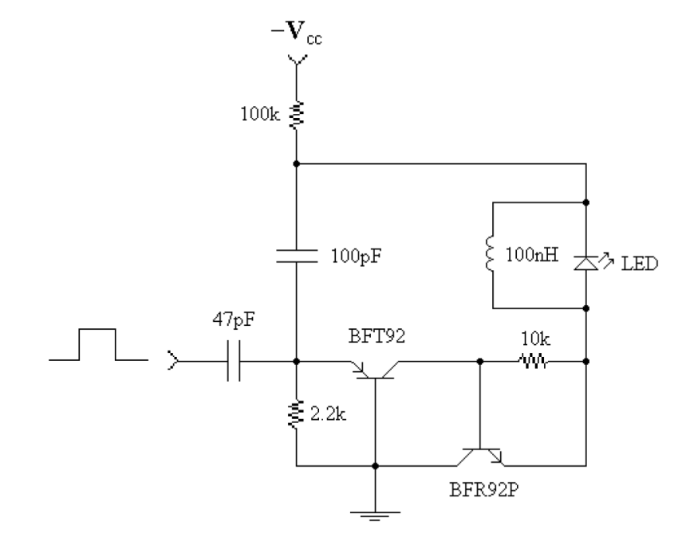
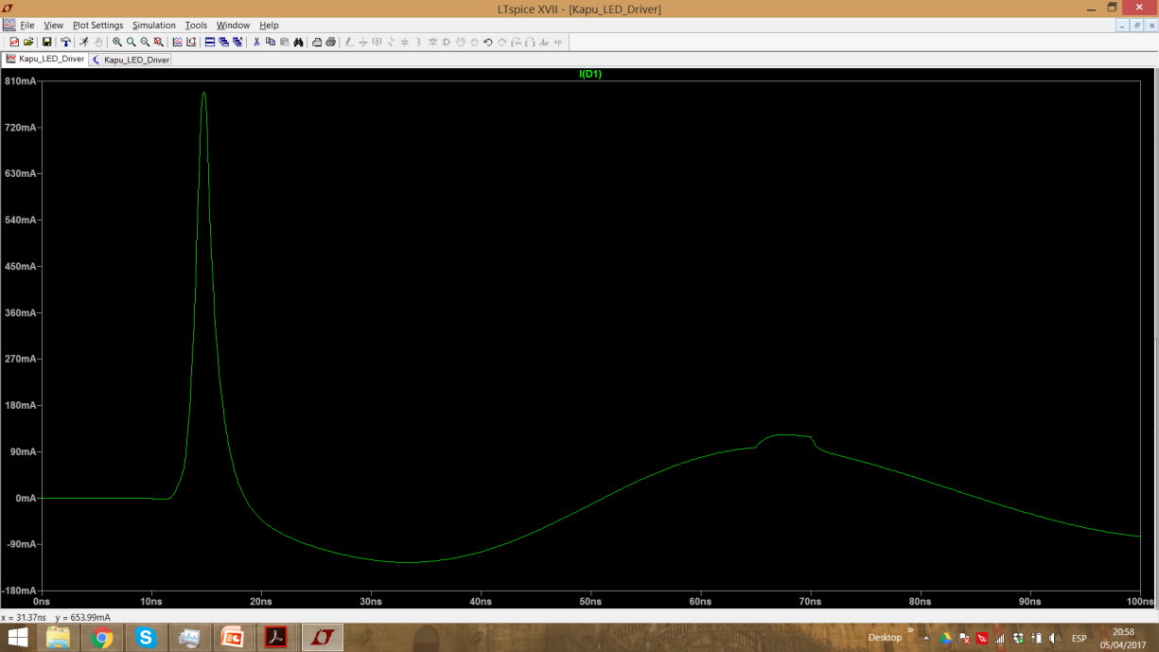
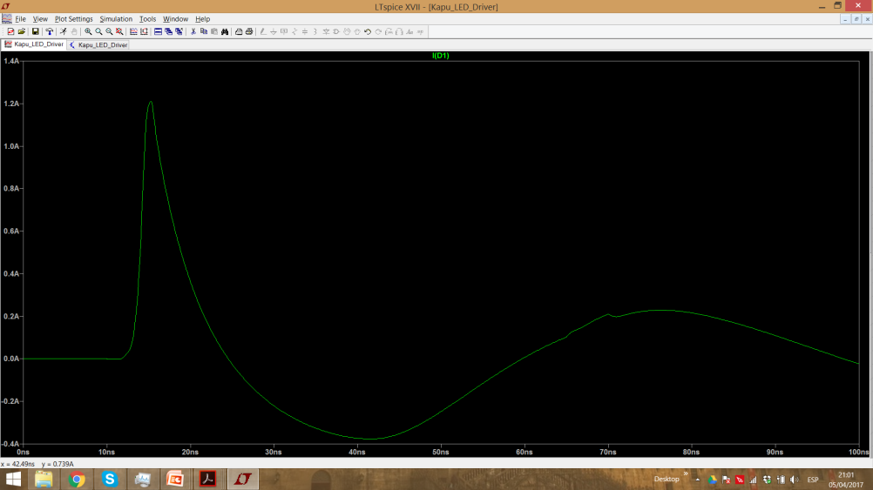
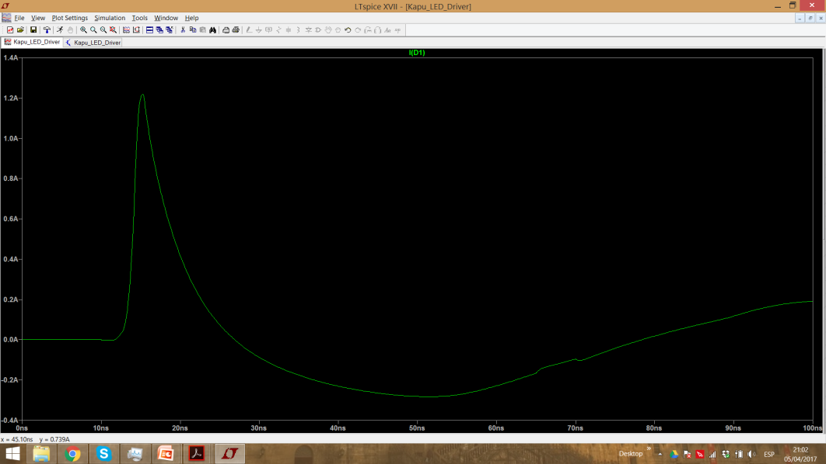
100 pF, 100 nH result
470 pF, 100 nH result
470 pF, 200 nH result
larger capacity => more current and longer pulses
larger inductivity => longer oscillation and with smaller amplitude
new Kaputschinsky ordered from workshop to test these ideas

Slide 12
Other Stuff
WA105: Compromise found for delay of construction of 666 => if confirmed this Friday might give other 3 months to take final decision
WA105/DUNE: Meeting tomorrow at CIEMAT to discuss plans for DUNE
MWPC: Sebastian/Alicia (PR) stretched 40 wires during one afternoon => gives hope that it is not too much work to do full detector
T2K ND Upgrade: Meeting with Juli this morning to discuss possibility to participate in prototype construction:
Juli available for Design second half of 2017
Worskhop still free for first half of 2018
Lab: Linde installs N2, air, vacuum and tubes for our gas system today
Done with IWORID proceedings

Slide 13
Plans for next weeks
Analysis of DNA setup data + improvements of setup
Look into charge readout options of gas detectors (AGET/DREAM chips)
Test new Kaputschinsky + modify it
Put laser in RF mode and repeat fiber tests with laser (since Andrea is on vacation next week)
Prepare talk about light readout of WA105 for protoDUNE DP review (24/25th of April at CERN)

Slide 14
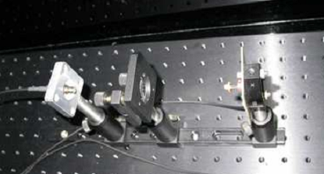
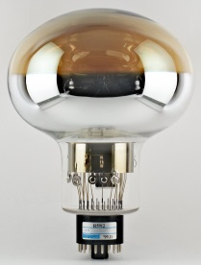
Light Monitor System
Air
X2
X2
Cryostat
black box with light source outside of cryostat
2 fibers going to cryostat
each splitting into 20 micro fibers (~200 μm thick)
either directly on top of cryostat or at bottom of cryostat

