Slide 1
Situation after last DNA tests
Kaputschinsky with blue LED
Saw direct light with PMT which should not be the case since we used blue (465 nm) LED
No clear signal neither with SiPM nor with PMT
Polarisor
Polarisor
DNA+ Scintillator
SiPM
500 nm filter
PMT

Slide 2
Some Possible Problems Identified
LED peaks at 465 nm but has long tails to shorter and longer wavelength
Small fraction even above 500 nm => not filtered by longpass filter
Solution: acquired short pass filters which let pass light below 475 and 500 nm pass

Slide 3
Some Possible Problems Identified
Light sensors, especially SiPM, only covers tiny solid angle => very few photons might only reach SiPM
Decay time of scintillator might be long (micro- to miliseconds) compared to chosen time window on oscilloscope (about 80 ns) => very few photons from scintillator might be within time window

Slide 6
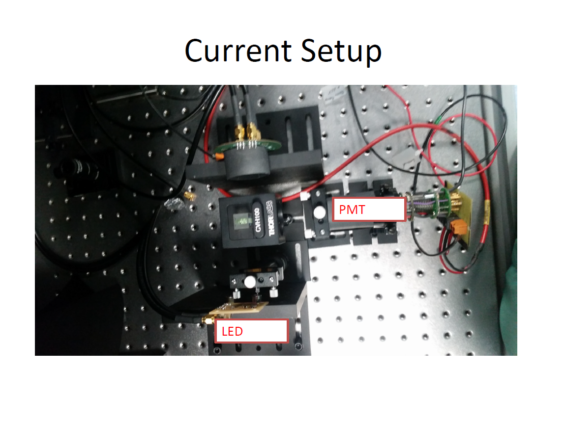

Slide 11
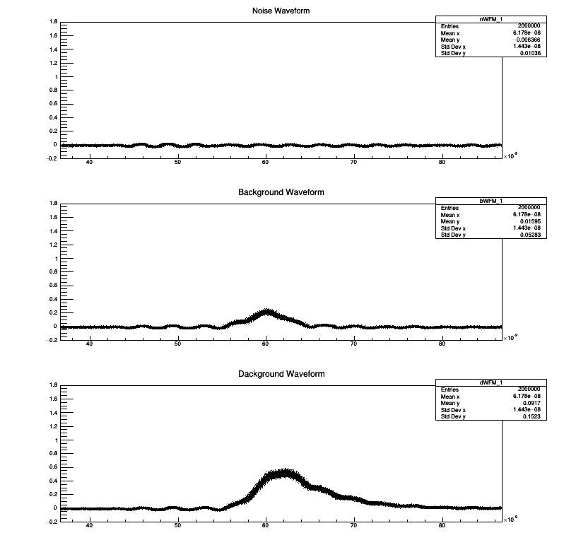
Prelimary Analysis
2000 events without light, with light but no scintillator and with scintillator
ripple from ground when Kaputschinsky is switched on
small signal without scintillator in the range of 45 to 65 ns and symmetric
large signal with scintillator, asymmetric between 55 and 80 ns
plots show overlay of the 2000 events

Slide 12
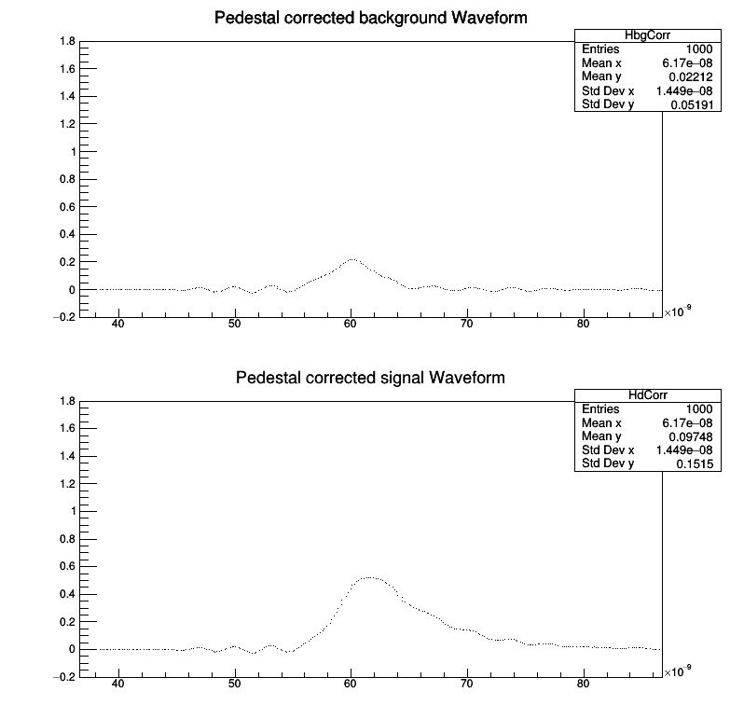
Prelimary Analysis
tried to substract noise ripple from background and signal but time structure had changed
plots show mean values of each X bin for background and signal
Ratio of integrals calculated for each region:
no difference in 1st region
factor 3 in 2nd
factor 43 in 3rd
high concentration of scintillator
What is the minimum concentration?
Improved analysis to calculate probability that distributions are identical?

Slide 13
Next Steps
Current samples does not work anymore (perhaps freezing same is not the right thing)
Will have to ask for new samples but first:
Improve noise ripple to be able to detect single photons
Work on improved analysis
Will now first give feedback to other people involved

Slide 14
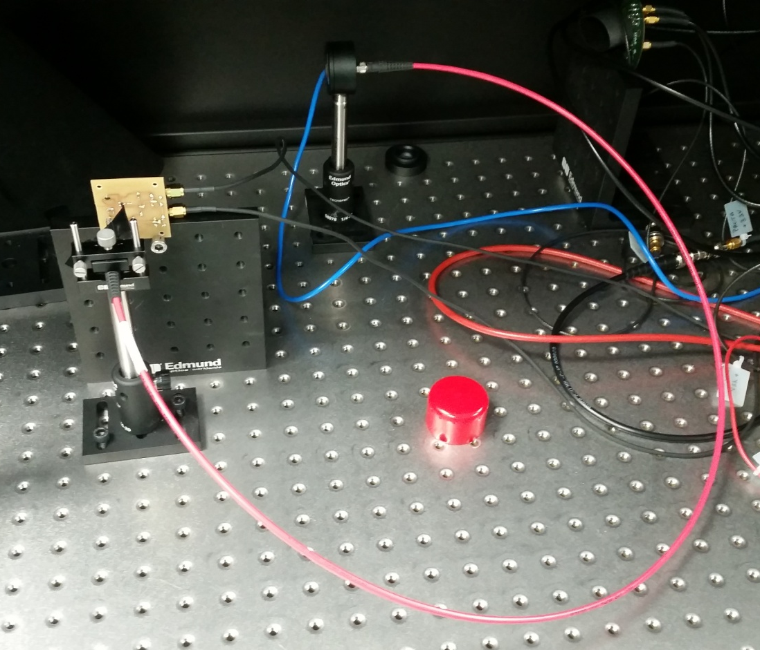
WA105 Task
More tests about light calibration system necessary
Testing of additional LEDs ( preferred wavelength 430 nm)
Also test of reference sensor necessary
Talk to be given on Monday

Slide 15
Plans for next week
Priority tests for light calibration system
Work on PMT noise (for light calibration and DNA tests)
Clarify a few things:
Stay at CIEMAT? When? How long?
Contribution to PMT characterization
Learning assmbling and disassembling of PMT support (Silvestro)
Ion Transmission measurement
Status IFAE contribution to T2K ND upgrade?
Electronics
Mechanics
What is needed for Ignite project from Joan?

