Slide 1
Light Calibration System
Thorsten Lux

Slide 2
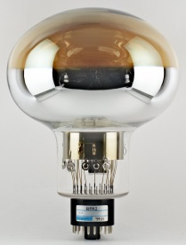
Overall Conceptual Design
Black Box
X2
Air
Cryostat
Inside:
Clara’s talk 2 weeks ago
2 feedthroughs CF40, each with 3 optical feedthroughs
6 SMA optical fibers from feedthrough to black box
black box containing light source
black box on top of cryostat

Slide 3
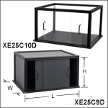
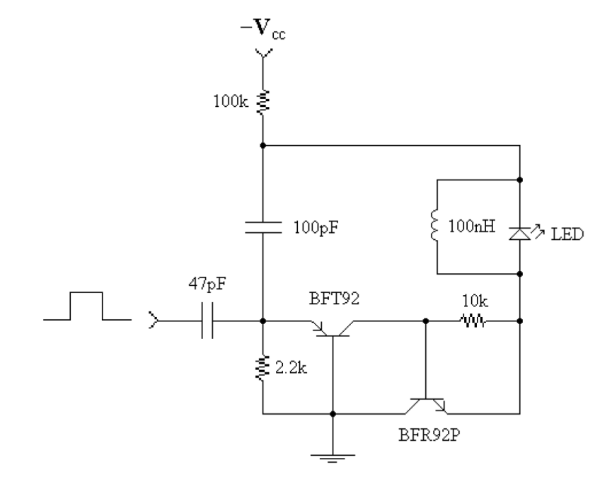
Components
Commercial box from Thorlabs: 525 mm x 375 mm x 300 mm (L x W x H)
Kaputschinsky LED drivers as light source (https://arxiv.org/ftp/physics/papers/0410/0410281.pdf)
Provides fast pulses of few ns
Rate: 1 kHz (possible to increase to around 10 kHz)
2 voltages needed:
DC between 0 and -20 V for intensity
pulsed to trigger light pulse
Default LED: NSPB300B (465 nm) (more later)
BeagleBoard (BeagleBoard.org)
Easy control via ethernet e.g. with Python
8 outputs to provide pulses for Kaputschinsky and also TTL signal for trigger
7 ADC channels e.g. to read temperature sensor

Slide 4
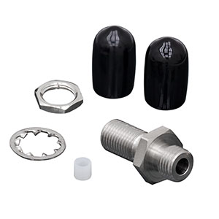
Components
SMA-SMA fiber from Thorlabs (1000 um diameter): M59L
SMA-SMA feedthrough from Thorlabs: ADASMA
Optical fiber on one side – LED directly on other side
Reference sensor still open point
Powermeter seem not to work (see later)
Either SiPM or PMT
In contact with Cayetano to check if spare readout channel is available to digitize reference sensor
Alternative: use ADC of BeagleBoard

Slide 5
Black Box
6 Kaputschinsky LED driver
All 6 controlled by 1 BeagleBoard
LEDs can be switched on individually, in groups or all together
each LED coupled to an individual SMA optical fiber
3 fibers going to one CF40 flange
One DC voltage for all 6 Kaputschinsky
Kaputschinsky PCB
1
Reference Sensor
2
3
BeagleBoard
4
6
5
Optical fiber

Slide 6
LED Coupling to Optical Fiber
Kaputschinsky with blue LED
Stray light used for reference sensor
PMT/SiPM
Black box
Optical fiber

Slide 7
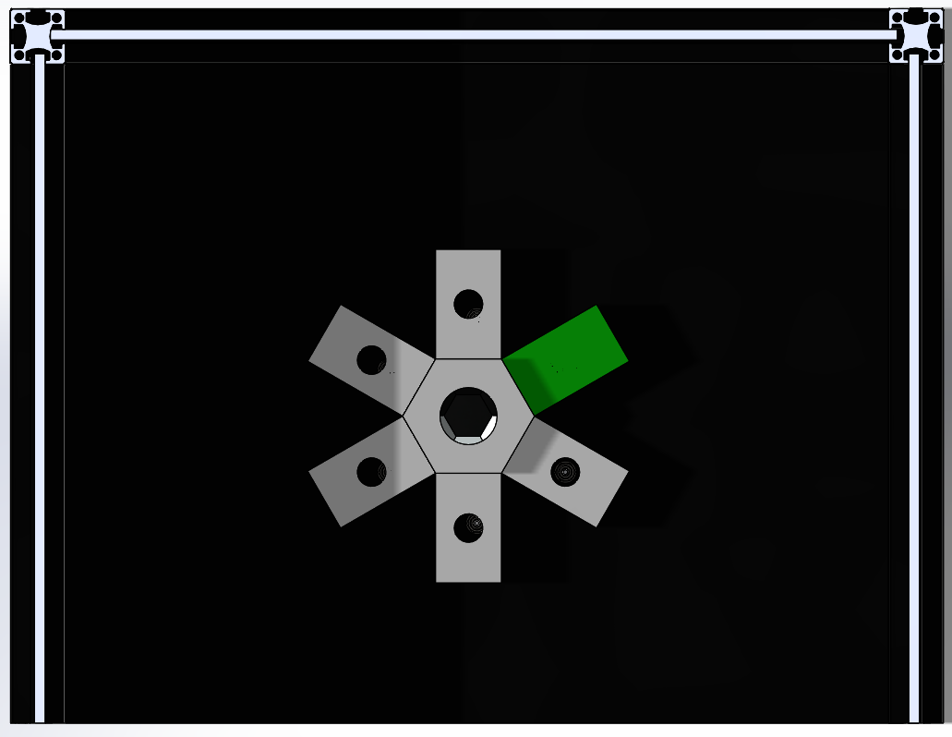
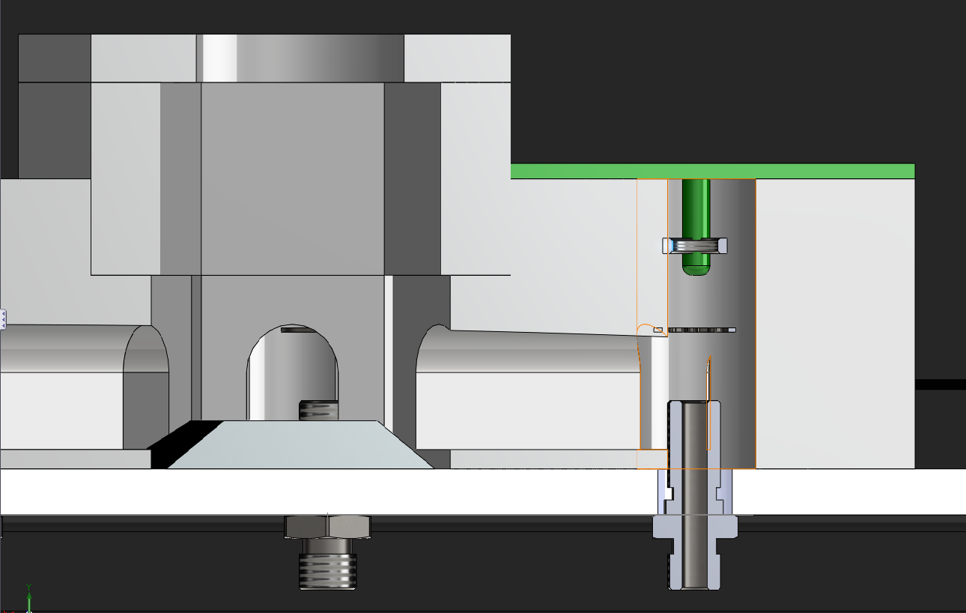
Implementation (Conceptual)
central reference sensor
6 Kaputschinsky PCBs around
each Kaputschinsky with light cavity to guide light to reference sensor
material: either 3D printed plastic or aluminium
Kaputschinsky PCB
Reference Sensor
Reference sensor
Position of LED adjustable
Stray light
LED
Feedthrough
Fiber

Slide 8
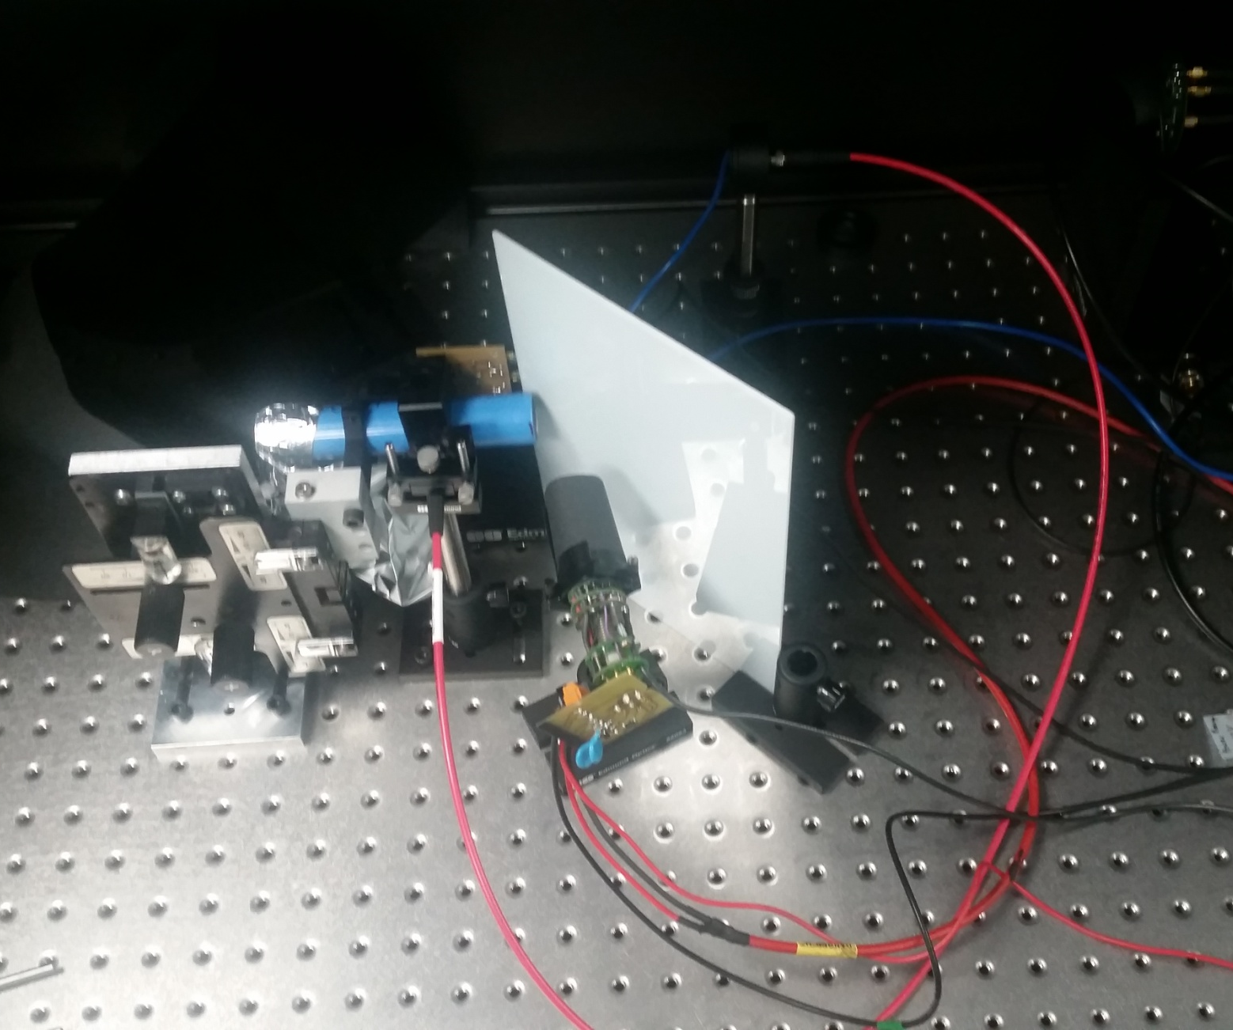
Proof-of-Principle Tests
Powermeter (measuring light reaching feedthrough)
LED
reflector
Reflective tube
Optical fiber
PMT

Slide 9
Comparison PMT and Powermeter
Signal from PMT compared with signal from powermeter
normalized to largest signal
similar shape (amplitude of PMT read by eye from oscilloscope => large error)
=> “stray light” detected by reference light will allow to estimate injected light to PMTs

Slide 10
Testing various LEDs
Testing various LEDs: 465 nm, 525 nm, 3 of 430 nm
the 3 LEDs of 430 nm do not/ almost not work with Kaputschinsky
Trying to find other 430 nm LEDs
Green LED more power than blue LED
15 nW (blue) correspond to 3.5E10 photons of 465 nm per pulse (1 kHz) reaching the feedthrough on top of the cryostat

Slide 11
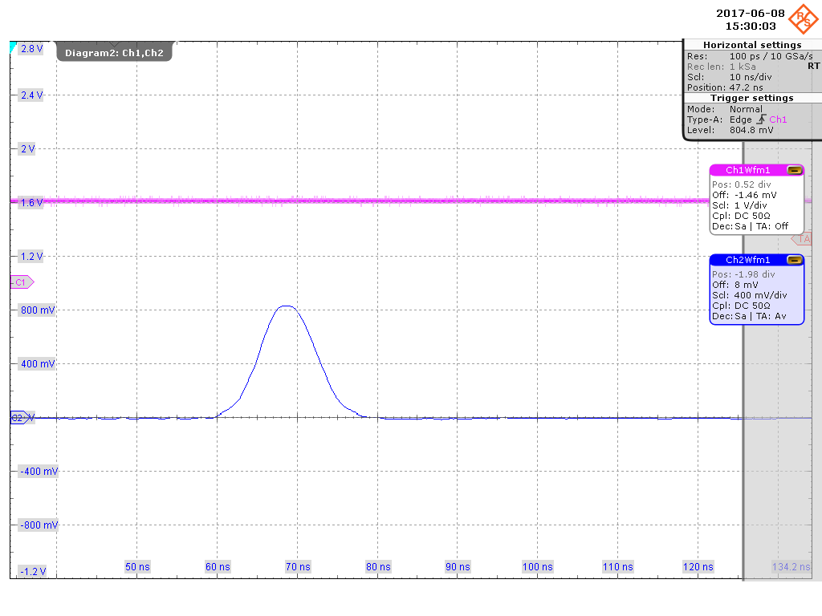
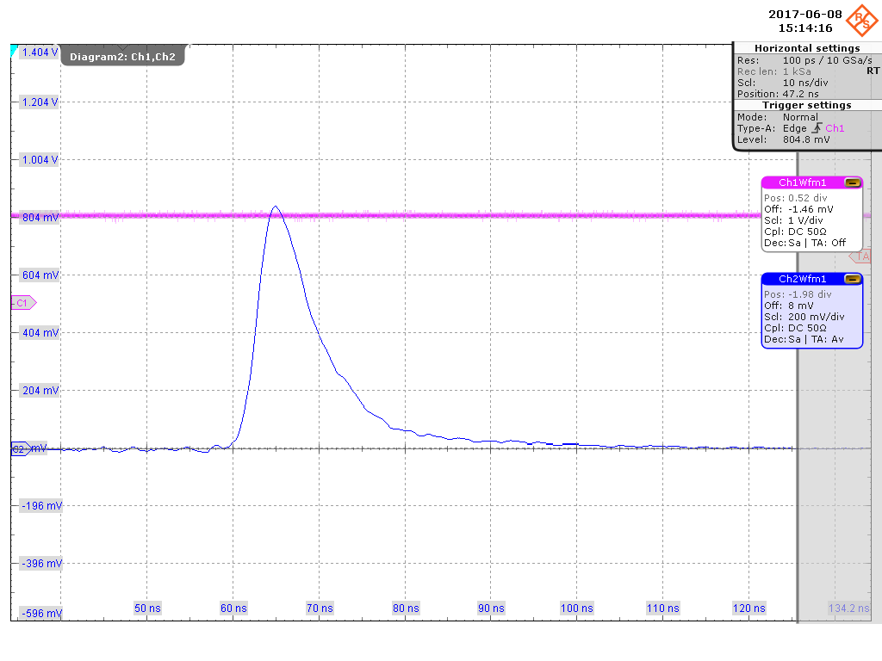
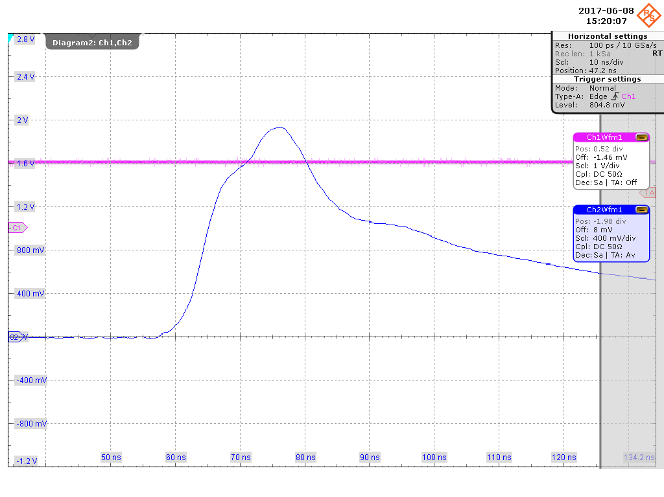
Time Structure of Light Pulse
Old blue LED
Old green LED
Green LED with longer tail than blue LED
New green LED with much longer tail than old green LED (same model)
No difference for blue LEDs
Pulse width: 15 ns for blue LED
New blue LED
New green LED

Slide 12
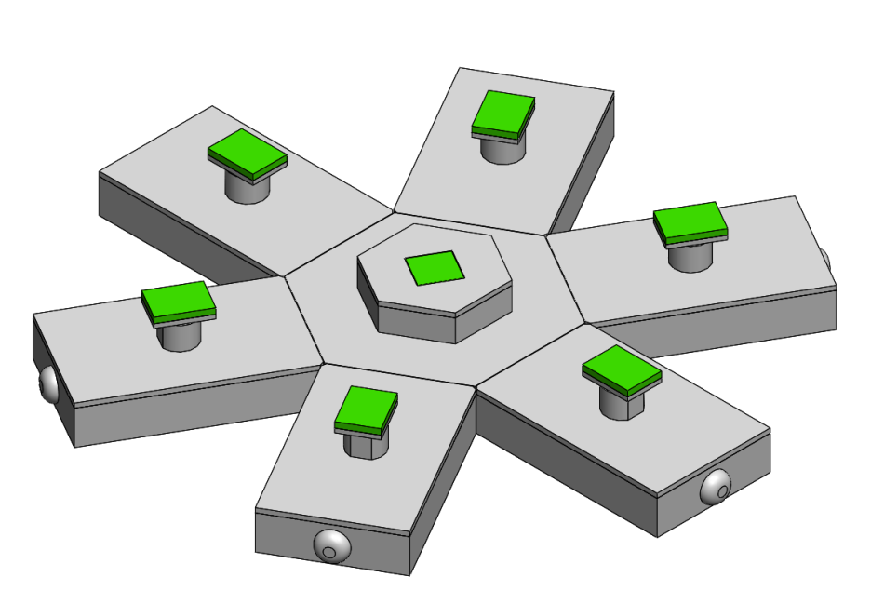
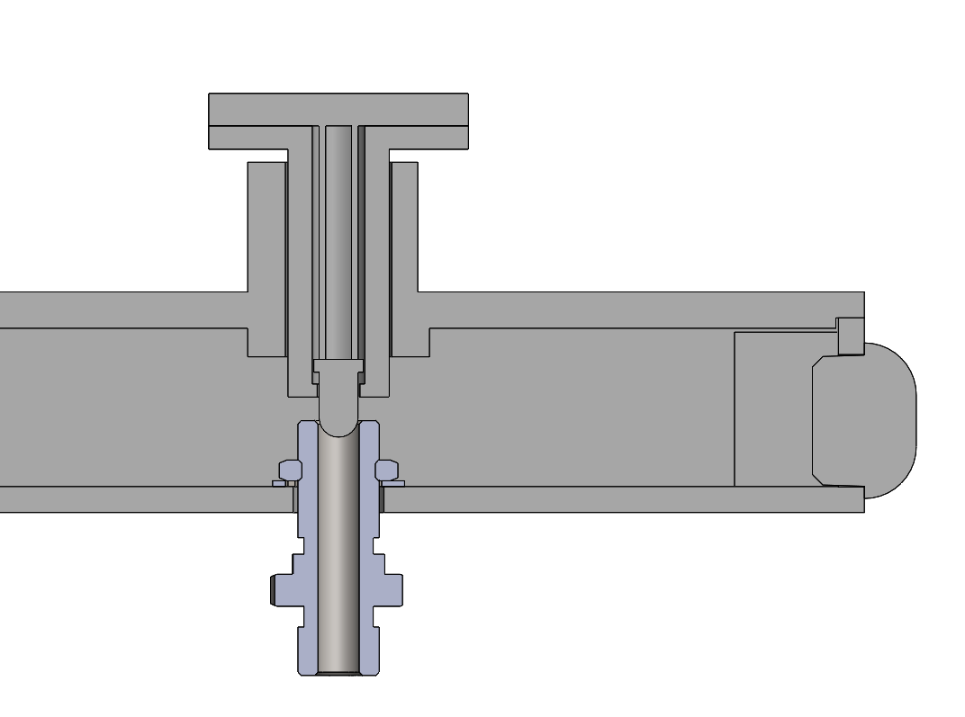
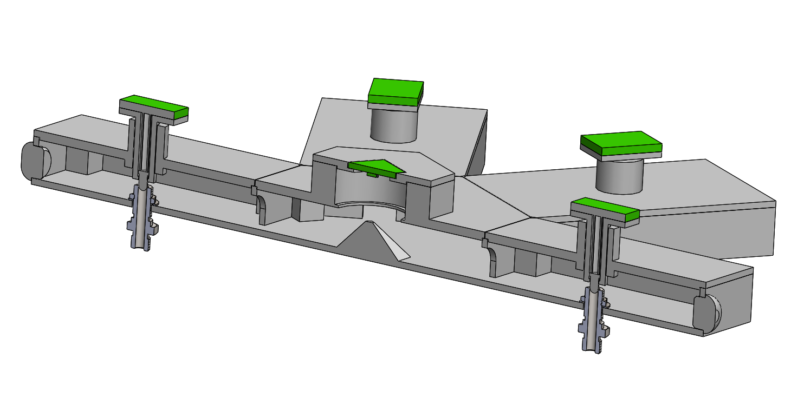
CAD Drawings from Juli
drawings from Juli already done
small changes to light cavity necessary
if Joan agrees on PCB size, soon being printed full system
central part flexible so that can be adjusted to SiPM or PMT choice for reference sensor

Slide 13
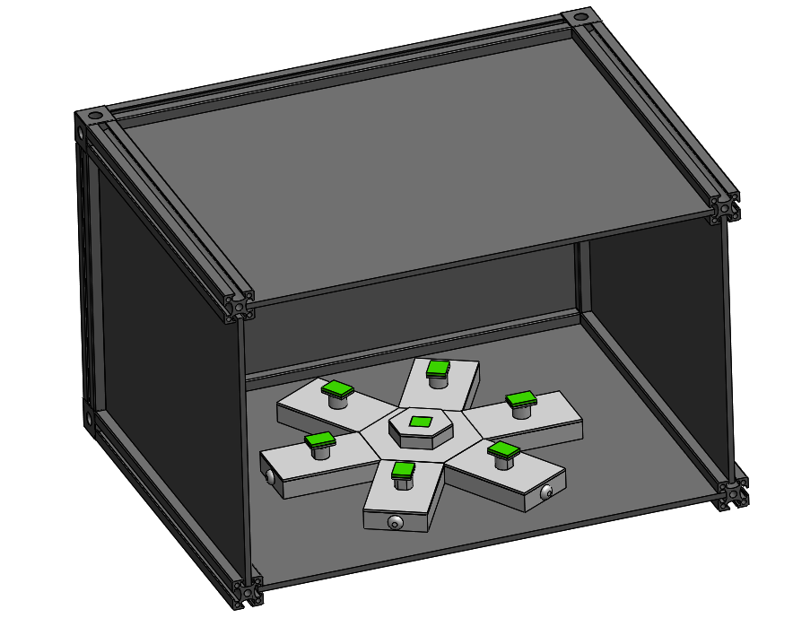
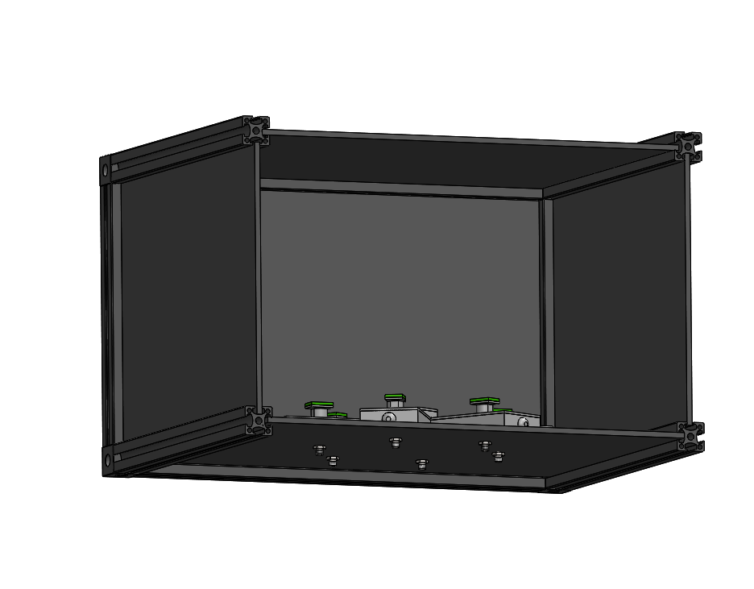
CAD Drawings from Juli

Slide 14
Summary
The light calibration system be based on 6 Kaputschinsky LED driver
Blue LED (465 nm) default choice currently
BeagleBoard will allow to control drivers (individually, groups, all together)
1 reference sensor: SiPM or PMT
Either standard ADC to digitize signal or built-in ADC
Simplified test of the principle performed successfully
Most of the commercial parts ordered
Production drawings in process for light cavity and LED driver PCB
MWPC: CO2 gas will arrive this week, mixture in 3 weeks
DNA Setup: will try to use EL PMTs to avoid noise ripple

