Slide 1
DNA Setup: Further Progress 16th to 20th of June

Slide 2
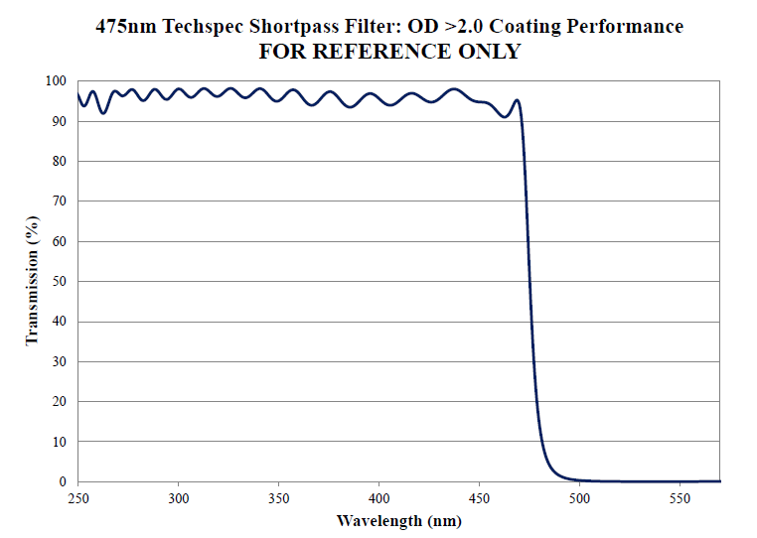
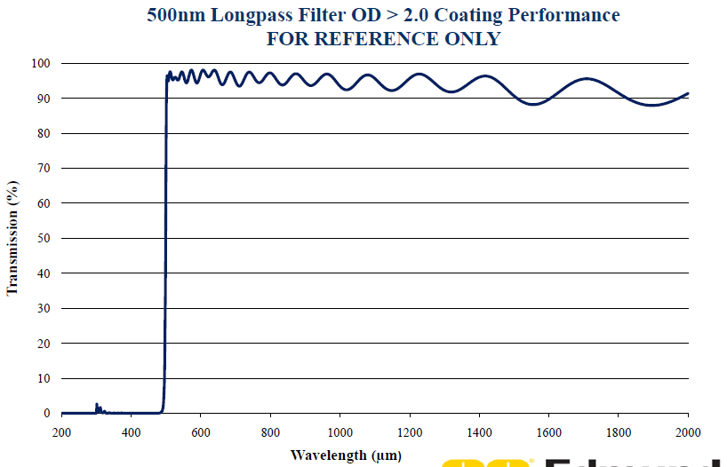
Testing the Filters
Open question: Why we have a direct signal from the LED with short- (SP) and longpass (LP) filter between LED and PMT?
Naively a shortpass filter of 475 nm combined with longpass filter of 500 nm should block “all” light

Slide 3
Test Setups
Direct: 800 uW
SP 475 nm: 536 uW
SP 475 nm + LP 500 nm: 0.14 uW
SP 475 nm + LP 500 nm + LP 550 nm: 0.22 uW
SP 475 nm + LP 500 nm + LP 550 nm + SP 500 nm: 0.04 uW
=> Filter reduce light by factor 4000-20000
Sensor
LED
Sensor
LED
Sensor
LED
Sensor
LED
Sensor
LED
SP Filter: 500 nm
LP Filter: 550 nm
LP Filter: 500 nm
SP Filter: 475 nm

Slide 4
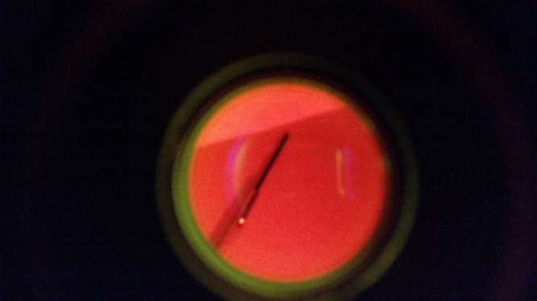
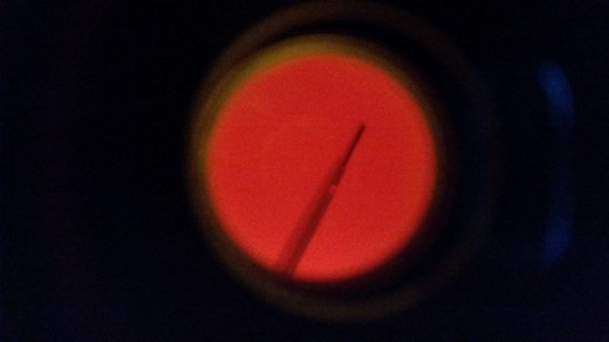
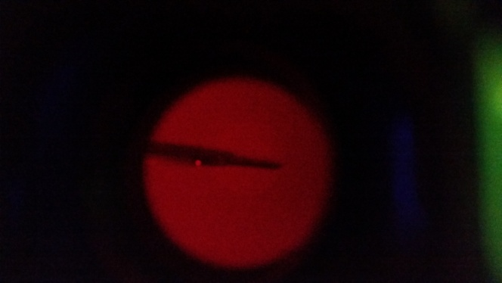
Results
Which wavelength has the light which passes?
Answer by eye: probably red! (=> > 600 nm)
2 questions now:
What is the source of the red light when we use a blue LED?
Why is the red light not filtered out?
SP 475 + LP 500
SP 475 + LP 500 + LP 550
SP 475 + LP 500 + LP 550 + SP 500

Slide 5
Source of the red light
Emission spectrum of LED
tiny emission at about 625 nm following official data sheet

Slide 6
Why is the red light not filtered out?
Curve from slide 16 misleading since ends at 570 nm
Plot below: SP filter works only from edge wavelength + 100 nm
Transpartent for higher wavelength
SP 475 nm (and even SP 500) highly transparent to 625 nm

Slide 7
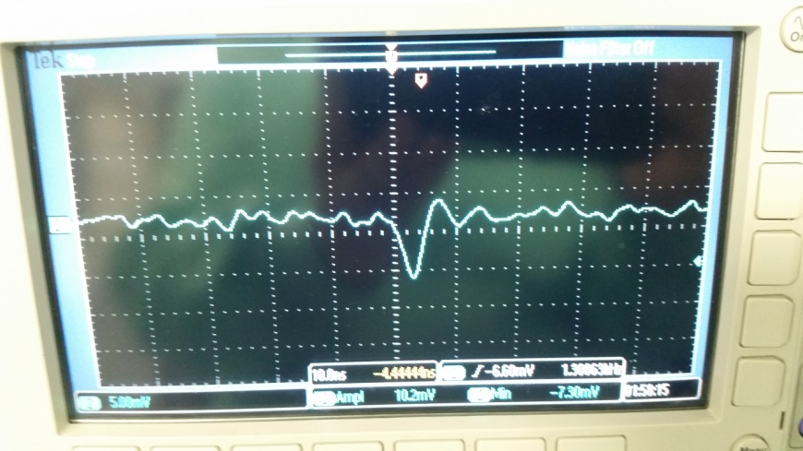
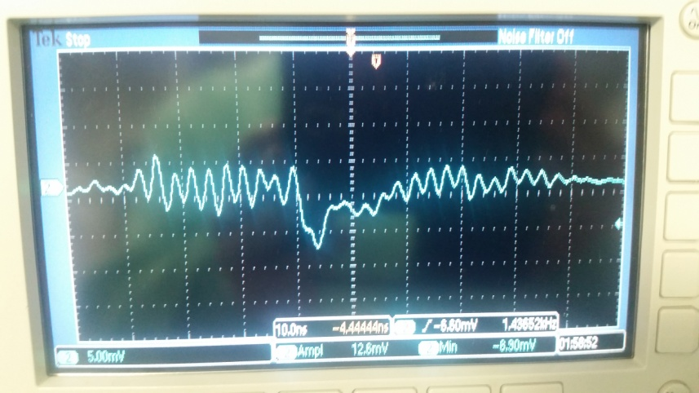
Signal-to-Noise Improvements
Problem during previous measurements:
Noise ripple has amplitude of some 10s of mV
Single photon amplitude about 1 meV
Tried Solutions:
Using in addition another PMT: more gain => single photon amplitude about 7 mV
Understanding better origin of noise ripple and reduce it to minimum => successfully done: 1) old PMT now: +/-4 mV 2) new PMT: +/-2 mV
Noise ripple reduced to 2 mV (amplitude)
Single photons can be detected
Kaputschinsky induced single photon (same amplitude as DC signal but overlaid by noise ripple)
Dark count signal (== single photon)

Slide 8
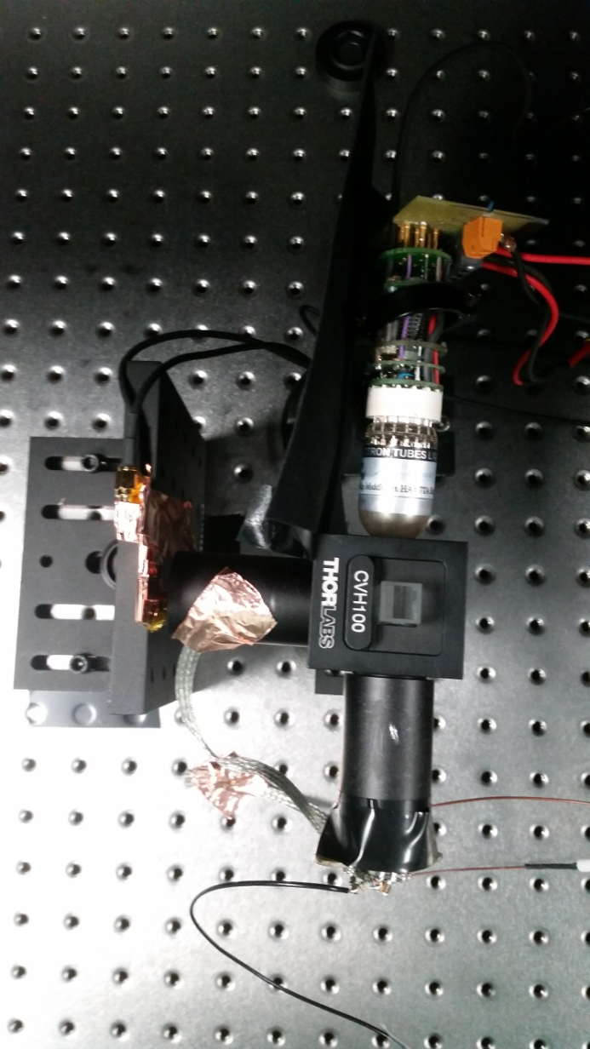
New Tests
Setup:
Short pass filter: 500 nm
PMT1
Long pass filter: 550 nm
Sample holder
Blue LED
PMT2
Long pass filter: 500 nm
Short pass filter: 475 nm

Slide 9
Setup Motivation
2 short pass filter behind each other to reduce light around 625 nm
Testing old and new PMT in parallel
500 nm long pass filter provides probably more signal but also possibly more background
550 nm long pass filter better signal to background separation
Seeing spectrum of Mitori Green probably 525 nm long pass filter would have the best choice but not available at IFAE

Slide 10
Measurements
3 different modes:
Completely empty, not even the sample holder
The sample holder but no sample
With small sample
Sample used for the current tests
Roughly such a sample was used in the previous tests from slide 10

Slide 11
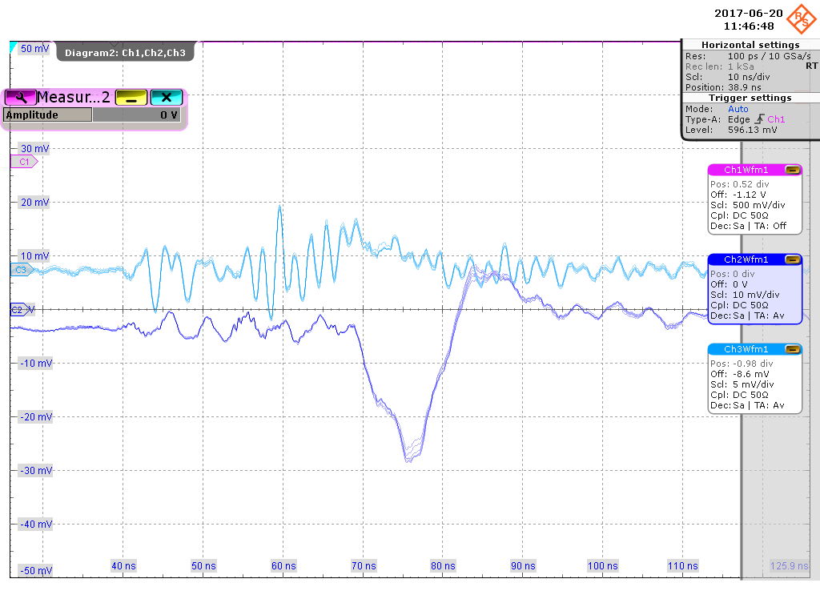
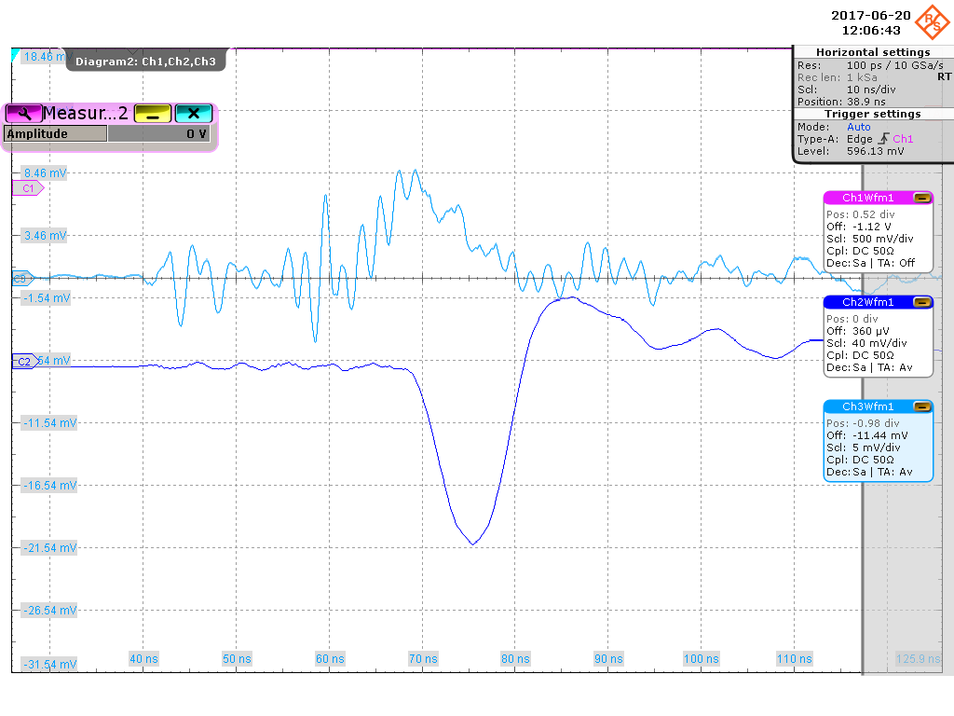
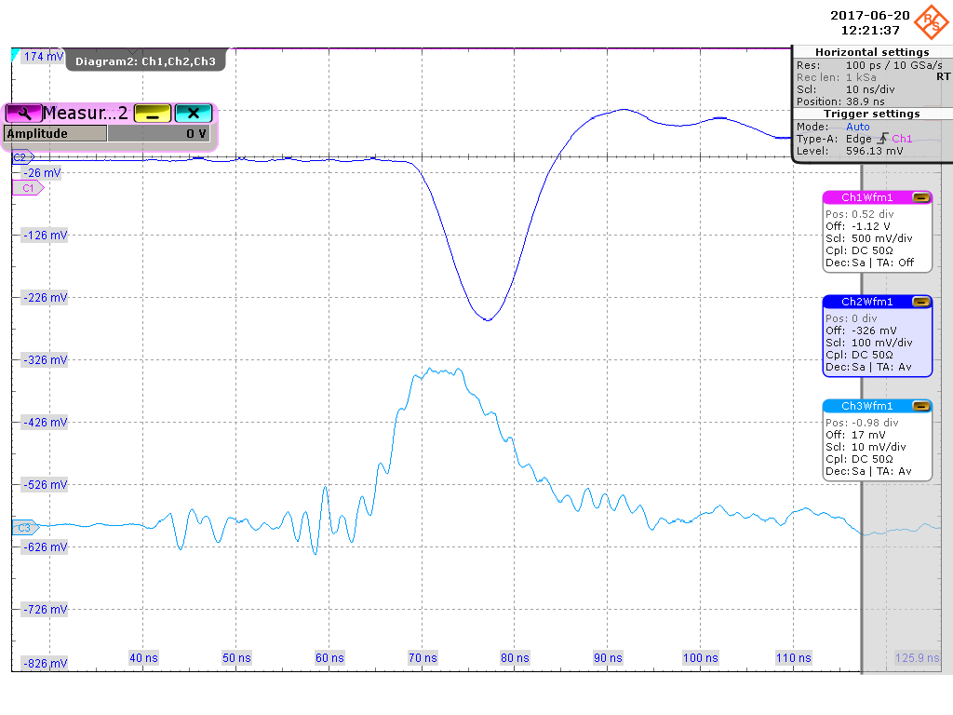
Results
LED voltage: 19.5 V like in the past
empty
holder
Old PMT/ PMT1: positive signals
NewPMT/ PMT2: negative signals
S/N ratio from amplitude: ~2 (LP 500 nm), 2.5-3 (LP 550 nm)
In previous tests was ~3
BUT: sample now much smaller
System much improved and works with less minimum light compared to previous tests
Statistical analysis ongoing
sample

Slide 12
Conclusions
New PMT detects more background light than old => due to 500 nm versus 550 nm long pass filter? => for systematic study one could swap both to verify this hypothesis
Impression is that new PMT better in respect of gain but worse from timing (positive overshot after signal)
In general background light strongly reduced compared to previous tests with single short pass filter at light entrance
S/N ratio significantly improved accordingly
Operating PMTs in parallel causes interference
Asked for new round of measurements

Slide 13
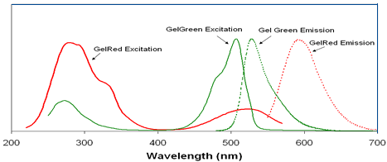
Possible future Improvements
Optimized light sensor:
Midori Gel Green emission peaks at about 540 nm (bottom plot)
Currently used PMTs have low quantum efficiency above 500 nm (left plot) => find sensor with high quantum efficiency plateau between 500-600 nm
Optimized long pass filter: further S/N improvement by using long pass filter between 500 and 550 nm

Slide 14
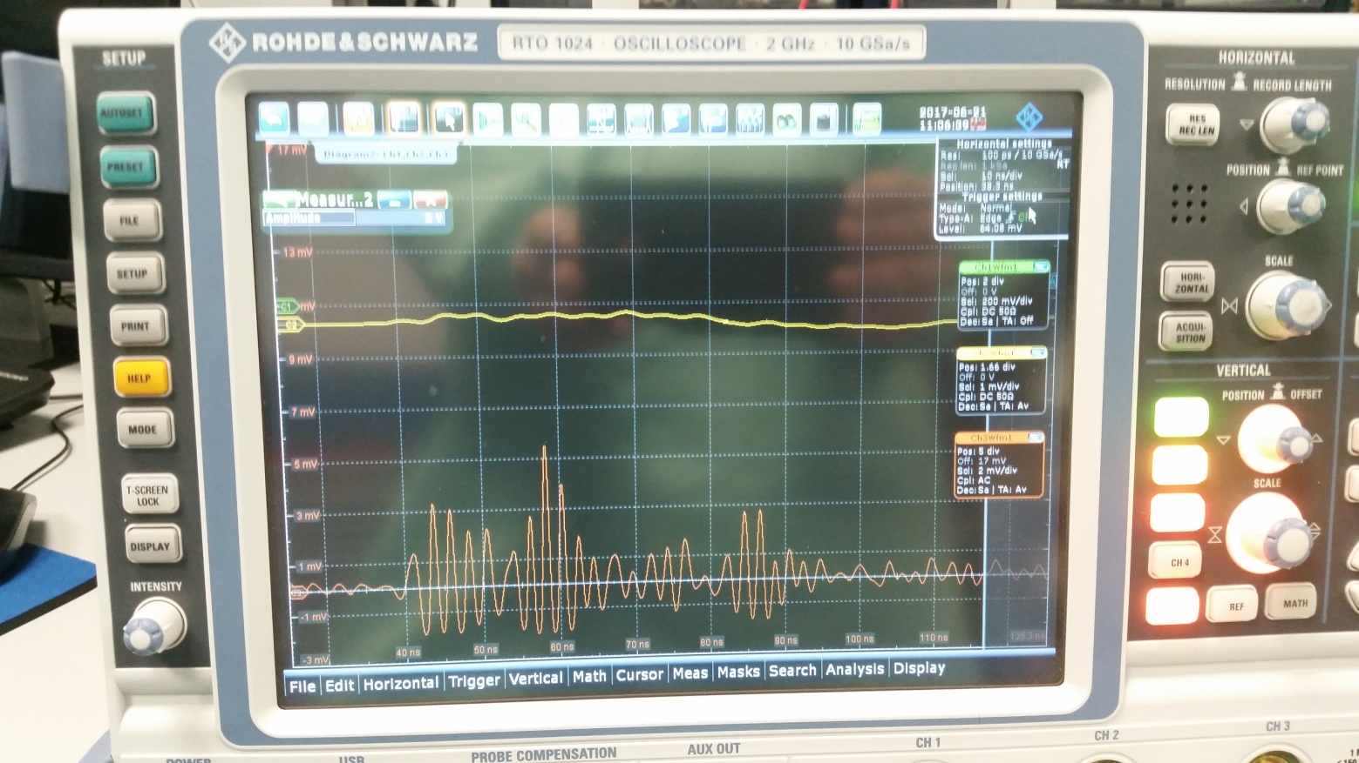
Noise
from one to the next day noise in EL PMT disappeared and increased slightly in the old MAGIC PMT (could reduce it again to the previous values)

