Slide 1
DNA Setup

Slide 2
Visit 11.07.2017
Marc and Ruta passed by for other series of test
Improved setup compared to previous test (much lower noise, everything more compact)
Various samples (1 mL): pure DNA, pure water, pure scintillator, several DNA + small fraction of scintillator
Goals:
  Some electronics test (no signal filter vs 100 MHz filter)
  Minimum fraction of scintillator detectable (commercial device DNA + 1/2000 addition of scintillator)

Slide 3
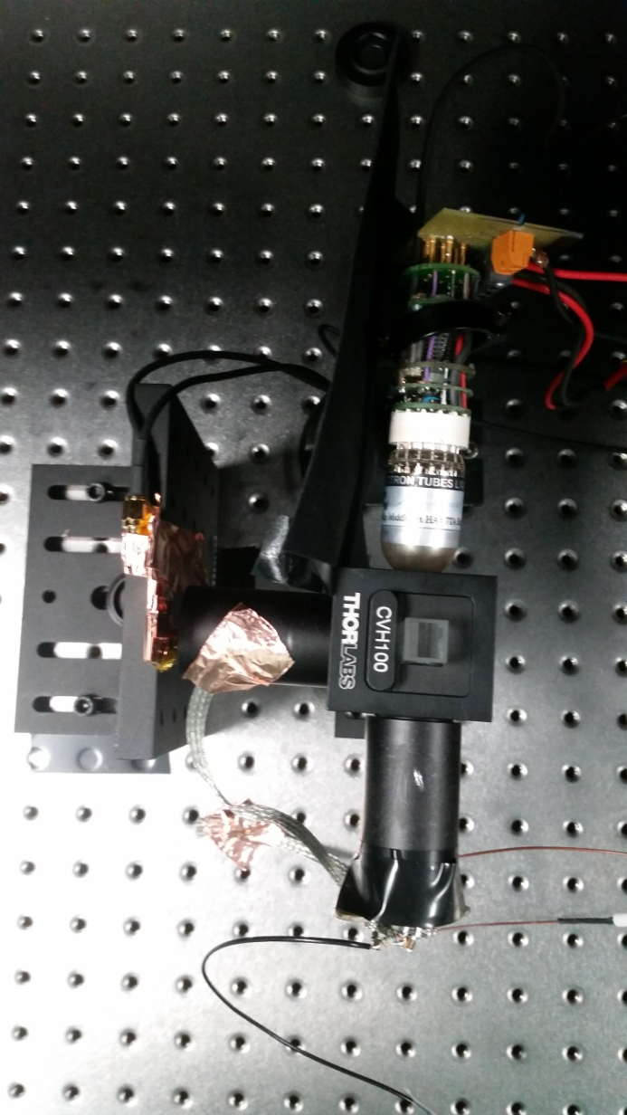
Setup
Short pass filter: 500 nm
MAGIC PMT
Long pass filter: 500 nm
Short pass filter: 550 nm
Sample holder
Blue LED
EL PMT
Long pass filter: 550 nm
Short pass filter: 475 nm

Slide 4
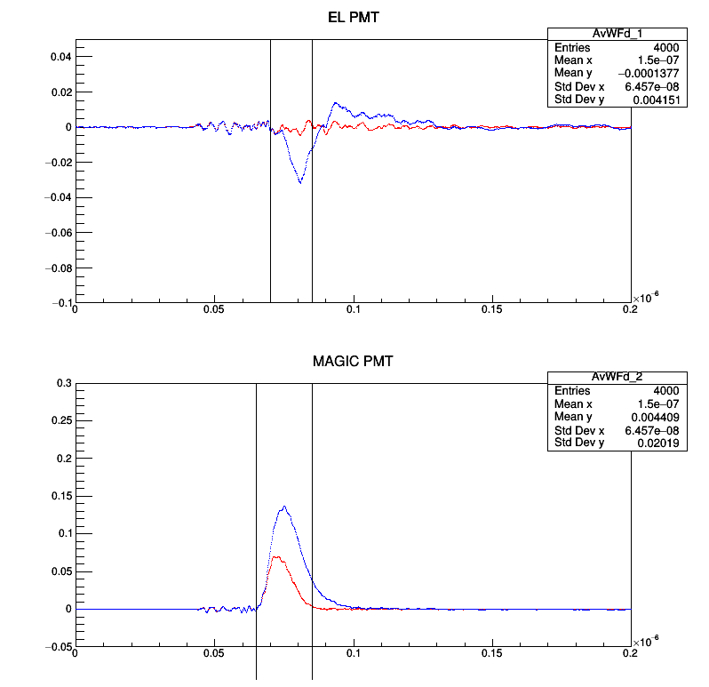
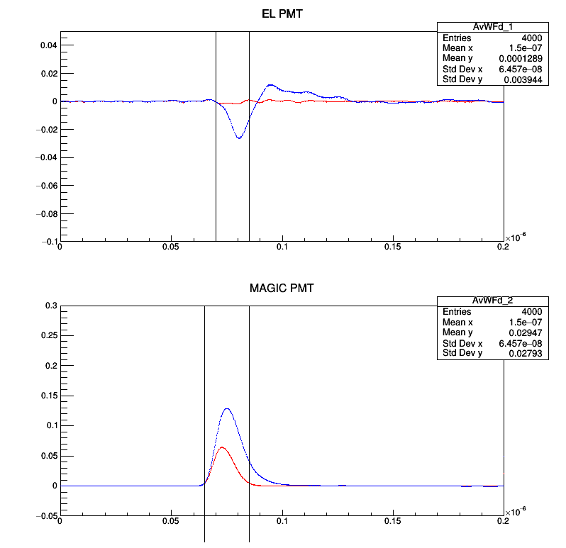
DNA+1/10000 vs DNA
Red: pure DNA
Blue: DNA + 1/10000 scintillator
Left: No filter
Right: 100 MHz digital filter
Average waveforms over 5000 events each
Still simple integral analysis
Clear difference visible in both PMTs:
signal above 550 nm with scinitllator
signal longer with MAGIC PMT
550+ nm
Region 2
Region 3
Region 1
500+ nm

Slide 5
DNA+1/10000 vs DNA
No Filter
550+ nm (EL PMT):
Ratio region 1 (Signal to background): 1.00341
Region 2: 13.5768
Region 3: -21.9035 (problematic due to overshoot)
500+ nm (MAGIC PMT):
Region 1: 1.78613 (both integrals close to 0)
Region 2: 2.28086
Region 3: 27.5077
Ratio of both PMT signals defined as:
R= (Int2_MAGIC+Int3_MAGIC)/(Int2_EL)
Pure DNA: 44.4
DNA + 1/10000 scintillator: 8.2
100 MHz Filter
550+ nm (EL PMT):
Region 1: 1.05805
Region 2: 14.2617
Region 3: -27.3453
500+ nm (MAGIC PMT):
Region 1: 0.89875
Region 2: 2.31177
Region 3: 19.5243
Ratio of both PMT signals:
Pure DNA: 47.3
DNA + 1/10000 scintillator: 8.8

Slide 6
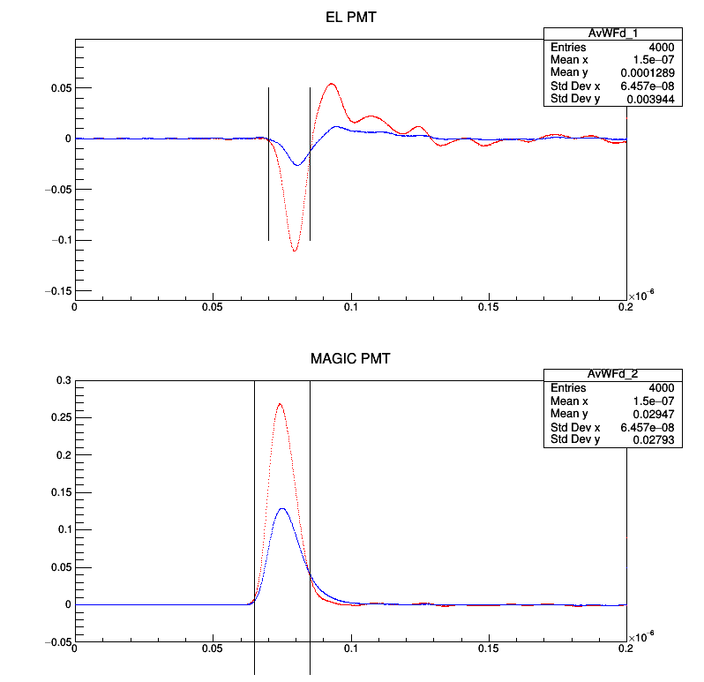
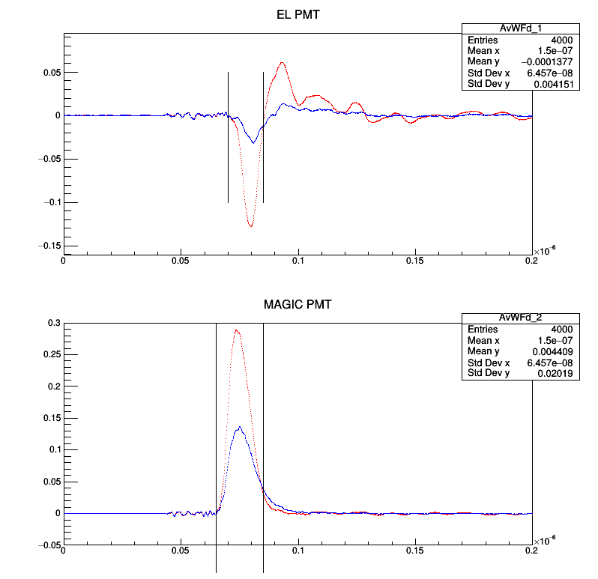
Scintillator vs DNA+1/10000
Red: pure scintillator
Blue: DNA+1/10000 Scintillator
Overall more light with pure scintillator
But more light in region 3 for dilution
Can be observed with both PMTs with and without filter

Slide 7
Scintillator vs DNA+1/10000
No Filter
550+ nm (EL PMT):
Ratio region 1 (Signal to background): 1.23835
Region 2: 0.242027
Region 3: 0.235367 (problematic due to overshoot)
500+ nm (MAGIC PMT):
Region 1: 1.28463 (both integrals close to 0)
Region 2: 0.527026
Region 3: 2.749470
Ratio of both PMT signals:
DNA+1/10000: 8.2
Pure scintillator: 3.45
100 MHz Filter
550+ nm (EL PMT):
Region 1: 10.6996
Region 2: 0.246137
Region 3: 0.255705
500+ nm (MAGIC PMT):
Region 1: 0.530792
Region 2: 0.53307
Region 3: 2.29346
Ratio of both PMT signals:
DNA+1/10000: 8.8
Pure scintillator: 3.6

Slide 8
Concentration Extrapolation
DNA+1/10000 extrapolated with factor from previous slide to DNA+1/1000 and DNA+1/500 data
Result is obviously not linear at all
more points would be necessary to find equation describing curve
trendline for the moment is logarithmic (without physics motivation)

Slide 9
Status
Analysis still primitive but results strong indication that 1/10000 can be easily detected => plans for August
Light yield not linear with concentration
Digital filter helps the eye but does not bring improvement, more likely is worsening the ratio result in the 3rd region
Open question afterwards was: What is the background? Pure DNA or pure scintillator? => None of these as I learned since then but
We need to understand better the sample preparation procedure, especially for the real case => crash course in September (already learned not broken DNA but free DNA and increase compared to normal levels is relevant)
More tests in autumn with full set of samples => will need to buy cube from Thorlabs
 | Sample 1 | Sample 2
 | DNA+1/10000 | 1/10000
DNA, mL | 0,2 | 0
Scintillator, mL | 0,0001 | 0,0001
Buffer, mL | 0,7999 | 0,9999
Total volume, mL | 1 | 1

Slide 10
WA105 Light Calibration

Slide 11
What happened until now?
Black box has arrived
Light cavity printed and cleaned from rests at workshop
New Kaputschinsky PCB designed, tested and production of 20 PCBs ordered
“Full” setup tested with powermeter and SiPM/PMT

Slide 12
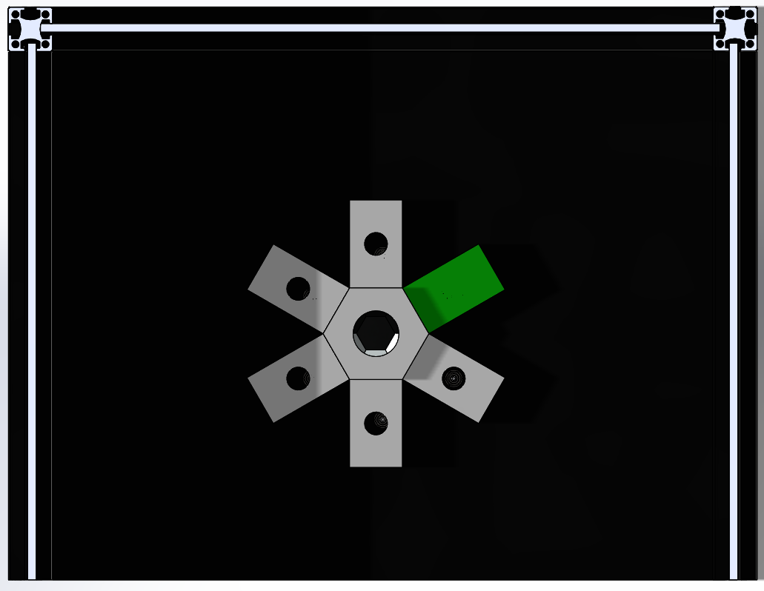
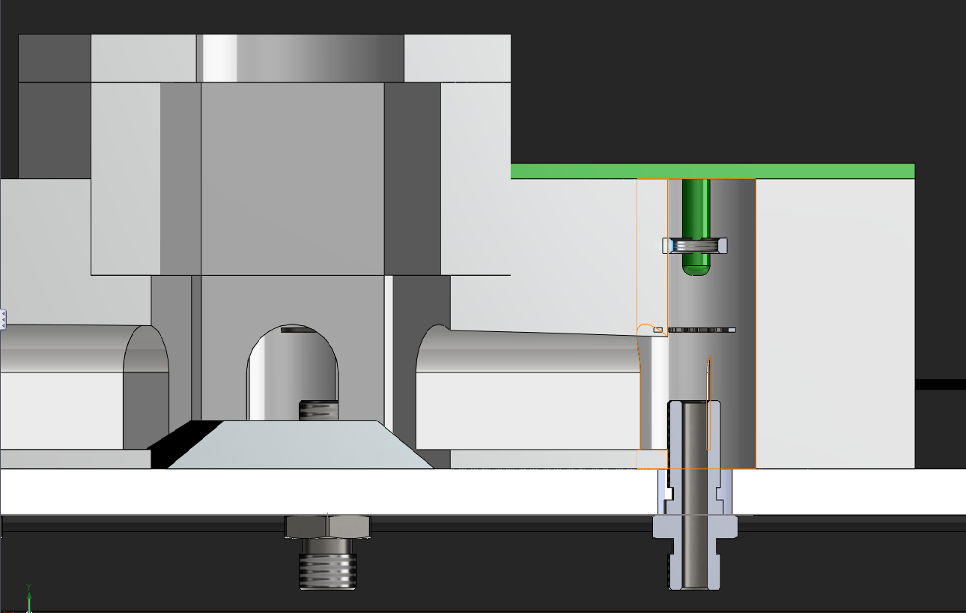
Implementation (Conceptual)
central reference sensor
6 Kaputschinsky PCBs around
each Kaputschinsky with light cavity to guide light to reference sensor
material: either 3D printed plastic or aluminium
Kaputschinsky PCB
Reference Sensor
Reference sensor
Position of LED adjustable
Stray light
LED
Feedthrough
Fiber

Slide 13
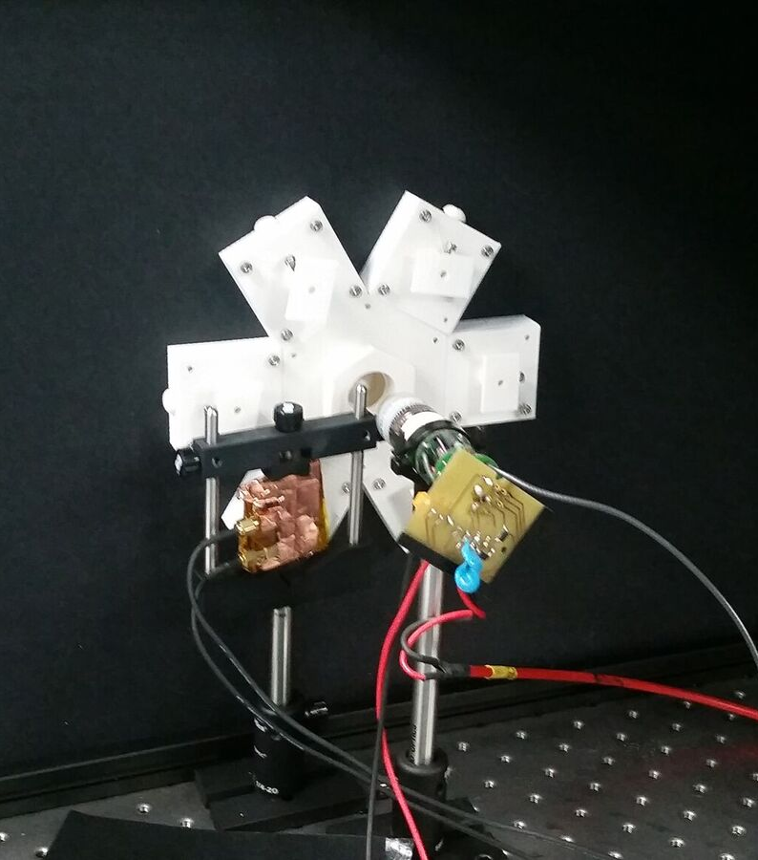
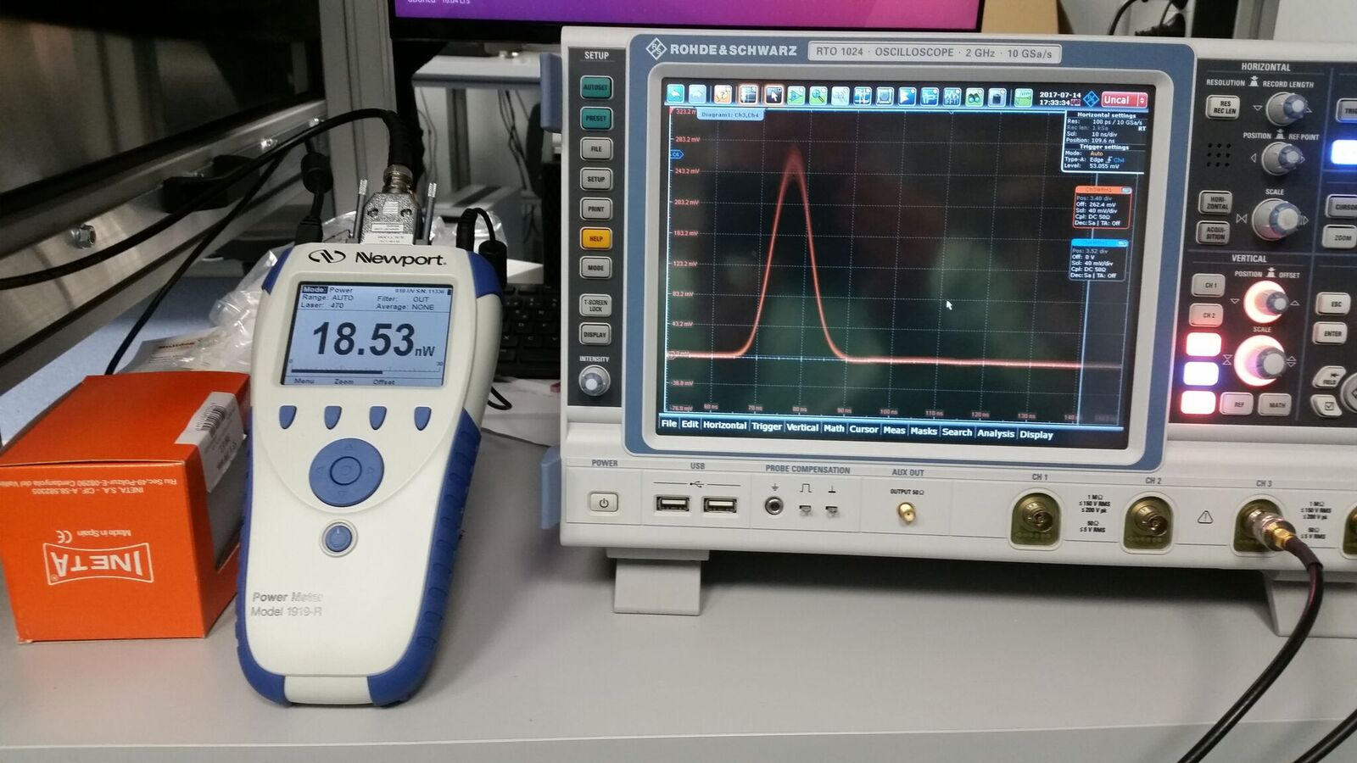
Now Reality
first tests with old Kaputschinsky + MAGIC PMT
worked perfectly with large PMT signal and large output power

Slide 14
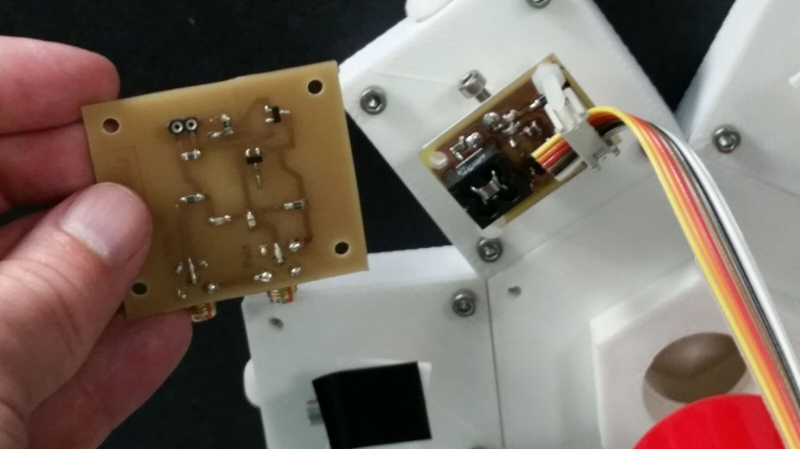
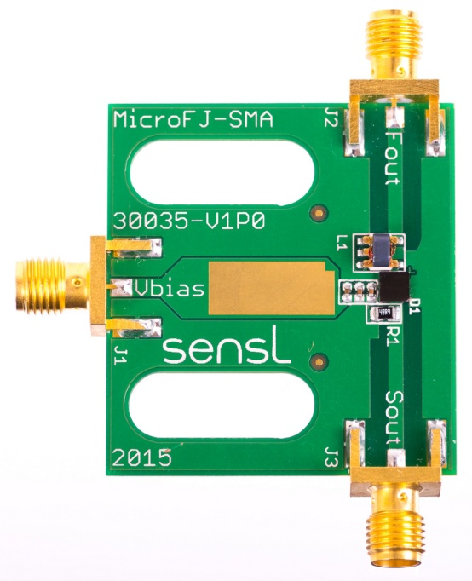
More Detailed Characterization
new Kaputschinsky PCB prototype used => smaller, less power (1/3), bit narrower pulse, larger noise ripple with PMT, some saturation at high LED bias voltage
Sensle SiPM instead of PMT => no noise ripple, 2 outputs: fast and slow, powered by standard LV power supply

Slide 15
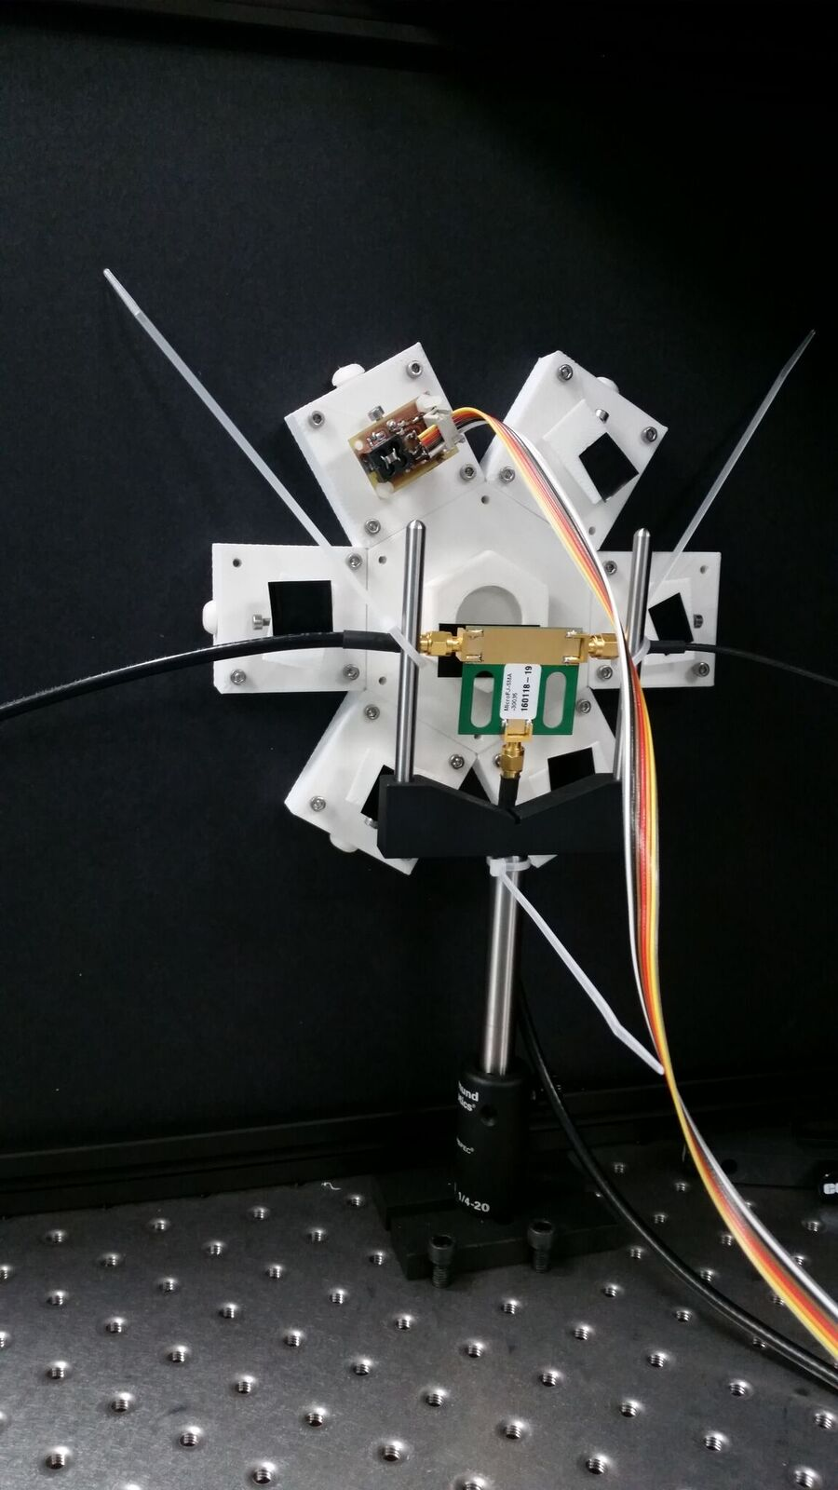
Measuring All Positions
tested Kaputschinsky in all 6 positions and measured power entering fiber with powermeter
large variations from position to position: ~2 factor
Tested same position several times: roughly the same
=> Sensitive to placing of Kaputschinsky PCB but might be better with final PCBs and long LEDs (by mistake legs of these was cut)

Slide 16
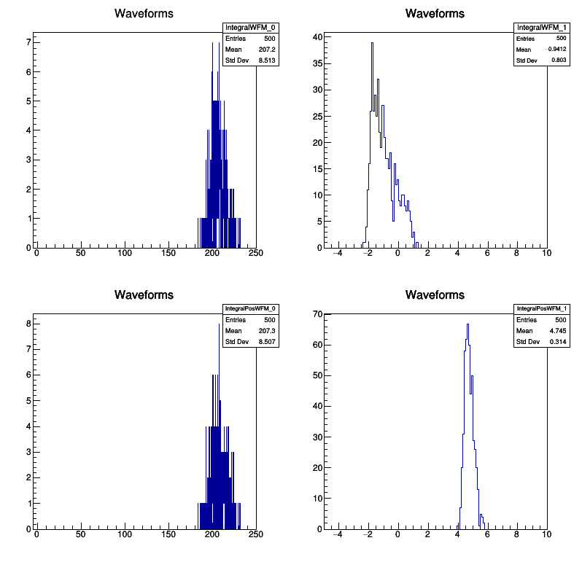
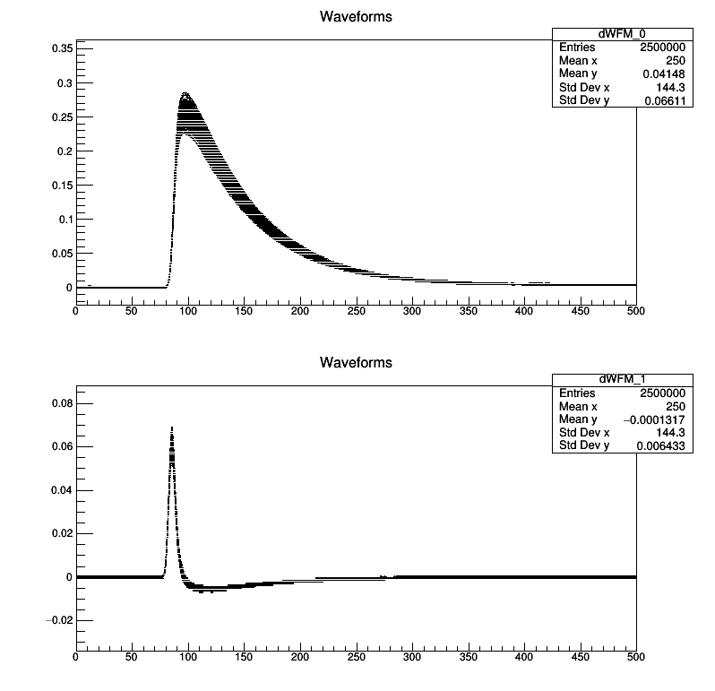
Results

Slide 17
Results

Slide 18
Results

Slide 19
Status
Light cavity works in all positions
New Kaputschinsky PCBs ordered (although not so good as mine XD)
Lot of light for reference sensor (in fact too much almost for SiPM/PMT but not enough for powermeter)
Some non-linearities in the system
Each Kaputschinsky will have to be characterized in-sitiu during the installation process
Next steps: BeagleBoard to control Kaputs + readout ADC, central PCB design to distribute voltages + SiPM, simple DAQ

Slide 20
T2K TPC Upgrade: Mechanics

Slide 21
What happened?
Got in contact with Emilio Radicioni (Bari) to evaluate collaboration in field cage design of new TPC prototype
Bari, Padua and IFAE
Kick-off meeting in Padua 13.07.2017

Slide 22
The baseline design for the upgraded ND280
4 new Horizontal TPCs
* Design still under optimization

Slide 24
HTPC
* From Marco Zito

Slide 25
“old” T2K field-cages
create panels from rohacell + Cu-clad G10 foils and G10 bars
cut field-shaping strips by milling the Cu surface
  only 1 strip layer → larger volume wasted because of distorted field
  ... but easy construction

Slide 26
dual gas volumes
  outer: CO₂ for insulation
  inner: active
  inner field-cage panels must not
    degrade the E field
    provide gas tighness
    stand overpressure

Slide 27
“new” field-cages
no outer volume
  Electrostatic insulation
  gas tightness
  overpressure
minimal wasted volume
  thin
  light
  multiple strip layers
light + thin + overpressure + own weight → panel deformation → E-field dis-uniformity

Slide 28
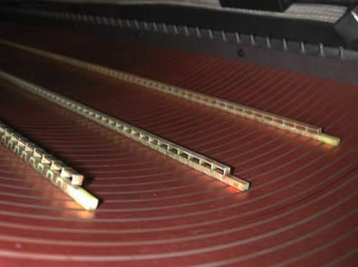
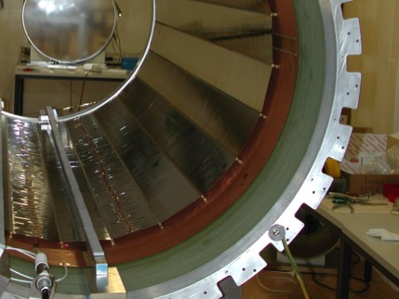
Aleph / ILC scheme:
Strip layers glued / embedded in the mechanical structure (typically: composite materials)
HARP scheme:
One strip layer is glued to the mechanical structure, additional layers as mylar strips stretched on light supports

Slide 29
First stage?
TO BE DISCUSSED
Prototype with final technical choices
Smaller size but large enough to fit 2 readout modules
To be used as verification of the construction technique
And also useful for integration tests
Timeline: 10/2018
A=2 modules
B=1 module
100 cm
  AxBx100cm
  Can host 2 MM chambers
  Realistic drift length
  Integration tests @ CERN (?)

Slide 30
IFAE Contribution (amont other)
Panel deformation
  perform calculations for gravity- and overpressure-induced deformations
    top and bottom TPCs not symmetrical w.r.t. gravity deformations
    do initial calculations for ILC-style structure
    carbon fiber is attractive for the possibility of orienting fibers in a favorable way but difficult to evaluate by end of July
    pre-compressed panels?
  Regarding carbon fiber: ask to simulate in G4 what is the advantage of thinner (but more dense) panels VS thicker (honeycomb-like) ones.
  2 options: 5 and 10 mbar overpressure, for the moment. Not clear if more will be needed or if – on the contrary – is irrelevant.
Juli started to work on this: first results beginning of October!

Slide 31

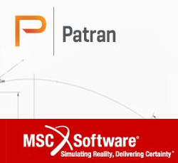
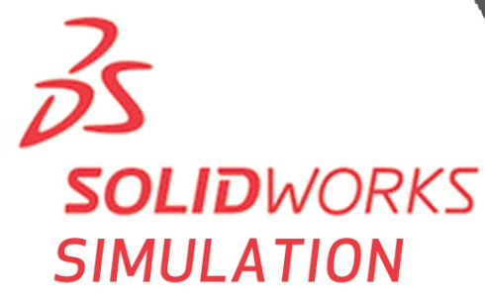
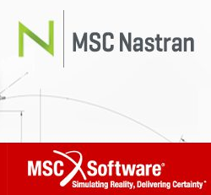

3. COMPOSITES SIMULATION PLAN
- IFAE CAE SIMULATION EXPERTISE IN: SOLIDWORKS & PATRAN/NASTRAN
- PATRAN/NASTRAN is a more reliable software for structural analysis.
- Supports composite material modeling to perform a variety of analyses.
An advanced training course in PATRAN/NASTRAN composites is scheduled for September’17 at IFAE.
First simulations are planned by early October’17.
COURSE PAID BY SO MONEY!

Slide 32
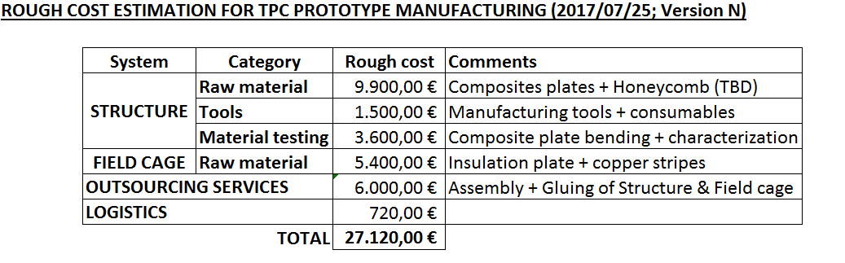
Since Padua Meeting
Juli provided cost estimation for Italian call (40 kEuro)
Meeting in September (at CERN) with MM and end cap guys to ensure integration for prototype

Slide 33
Status
Finally starting to move and with good momentum
Agreed on basic concept for FC structure
Strong preferences for HARP FC if possible
IFAE contribution:
  Juli: mechanical simulations
  Possible tests at APPLUS of samples
  Silvestro probably going to join the efforts from the simulation point of view
  If double sided copper coated Kapton is needed for FC, Joan might help the design (asked already LabCircuit if they could produce these)
  Participate in part production in first half of 2018
Design should be ready end 2017/beginning 2018 latest
Prototype: Mid 2018

Slide 34
Other Stuff

Slide 35
Rest
WA105: stayed 4 days at CIEMAT for R&D projects (another time) + PMT handling
WA105: 1st PMT for testing arrives today at CERN => Fits it in coating device with cable?
DUNE: IFAE signed up for Photo Detection System of DP Far Detector => have to propose Consortium leader until Monday

