Slide 1
Radius disco
Radius agujero
Motor Controller
Sensor
Motor
soporte

Slide 2
Radius disco
Radius agujero
Motor Controller
Sensor
Motor
servo
soporte

Slide 3
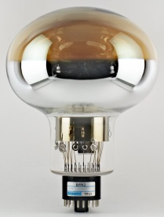
Overall Conceptual Design
Black Box
X2
Air
Cryostat
2 feedthroughs CF40, each with 3 optical feedthroughs
6 SMA optical fibers from feedthrough to black box
black box containing light source
black box on top of cryostat

Slide 4
Black box concept
pulsed light
Test pulser
LED coupling to optical fiber
Test pulser
Test pulser
Test pulser
light to SMA0
Test pulser
Test pulser board 5
light to SMA1
Voltage: 0~20V
light to SMA2
Outside black box
light to SMA3
Trigger 0
Trigger 1
Trigger 2
Trigger 3
Trigger 4
Trigger 5
light to SMA4
Bias voltage led pulsed
Power supply
Reference sensor/
Distribution board
reflected light
light to SMA5
Bias voltage reference sensor
Ehernet comunication
Integrated light signal
Trigger 0..5
Control

Slide 5
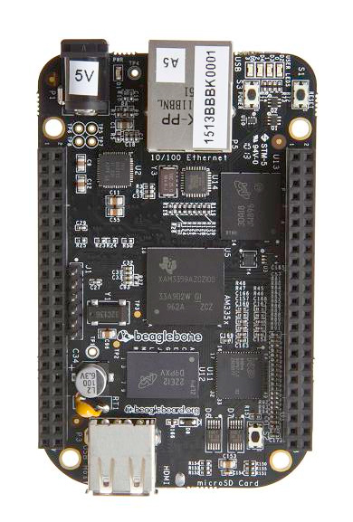
Control board
Beagle bone black
Embedded linux inside
7 Channels ADC
Reference ouput sensor
Temperature
Comunication with Power supply
Python library
PWM to trigger pulsed LED boards
Control integration window.
Timing has to be improved
Developing code for real time units inside beaglebone
To be develop the user control software.
Web server interface through wireless (general network)
OPC-UA server though tehcnical network (evaluating)

Slide 6
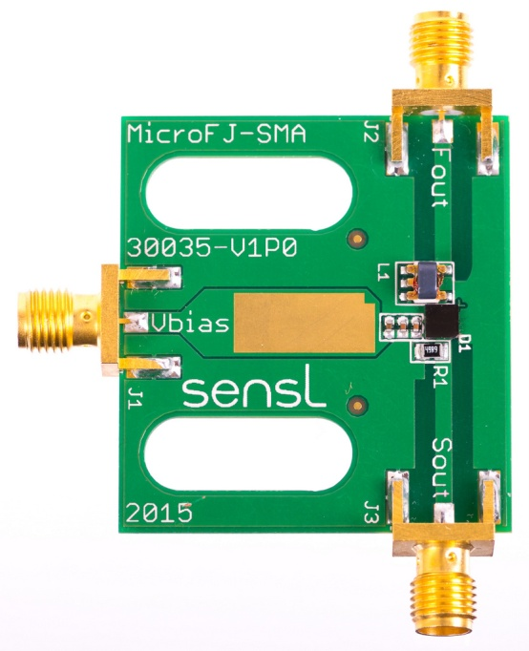
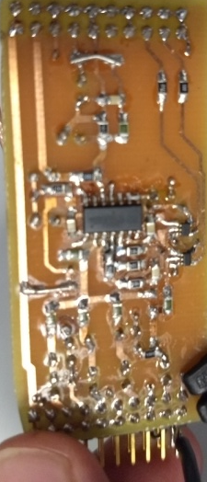
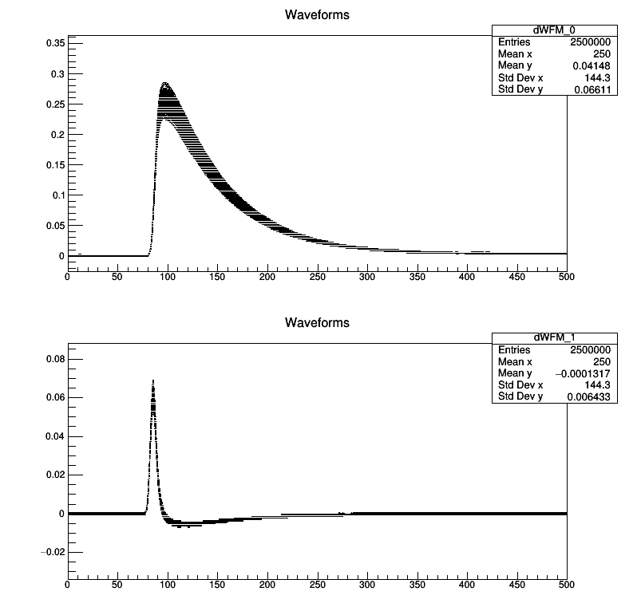
Reference sensor/ distribution board
Reference sensor
SensL SiPM (up left)
Fast output (down)
Slow output (to be used)
Integrator (up right)
Limited sampling rate in control board (200kS)
Developing control for integrator window.
Analog output to control board
Developing test to adquire the full channel (sensor + integrator + ADC)
Distribution board
Distribute Bias voltage
Common to all LED pulser boards
Distribute trigger
From the control board to each connector to LED pulsed board.
TTL trigger for the charge readout
Control comunication through TTL signals
6 trigger, 2 for integrator, 2 analog signals
Both functionlities will be implemented in one board
To be designed as soon as finished the test with the full chanel

Slide 7
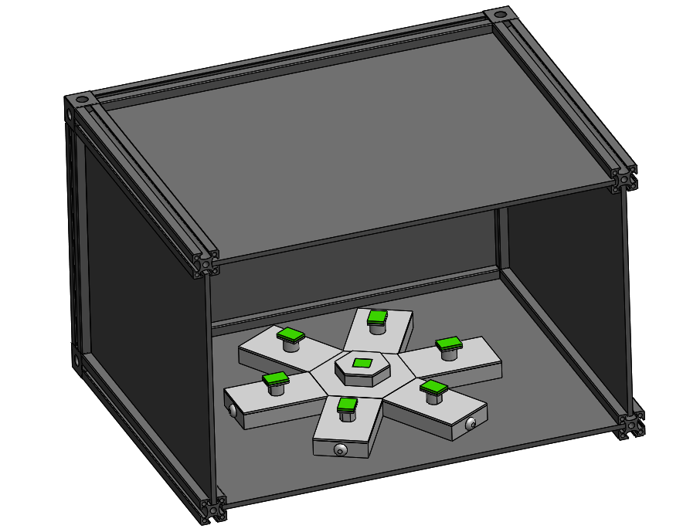
LED coupling cavity
Kaputschinsky with blue LED
PMT/SiPM
Based on Thorsten idea
3D printed
Tested in all 6 positions and measured power entering fiber with powermeter
Large variations from position to position: ~2 factor
Tested same position several times: roughly the same
=> Sensitive to placing of Kaputschinsky PCB but might be better with final PCBs and long LEDs (by mistake legs of these was cut)
Black box
Optical fiber

Slide 8
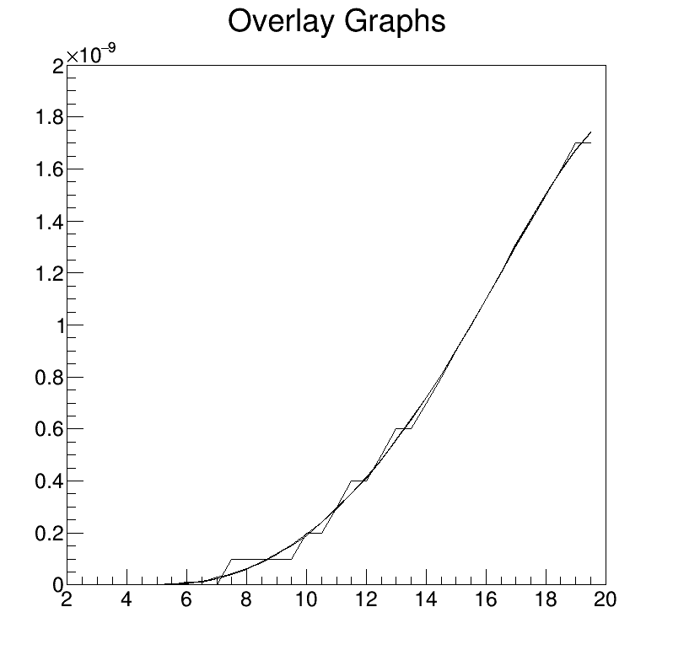
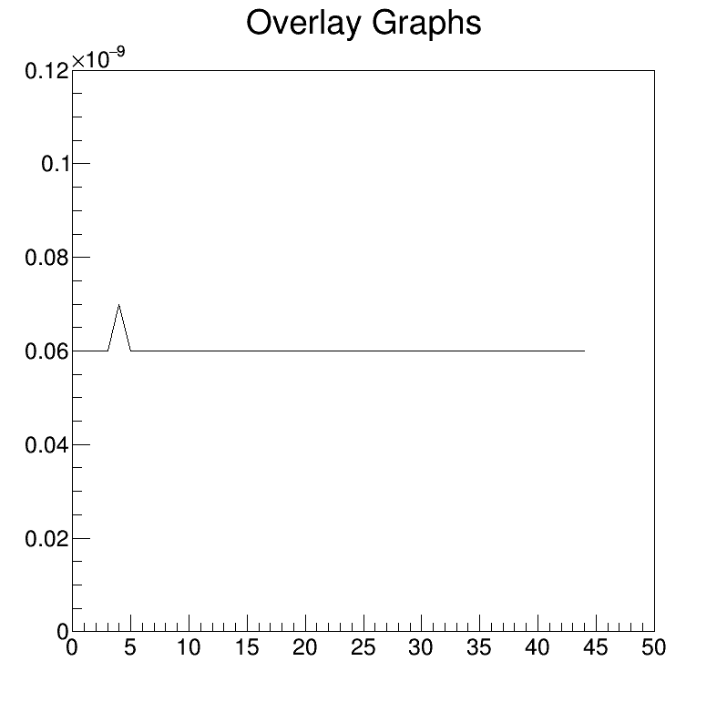
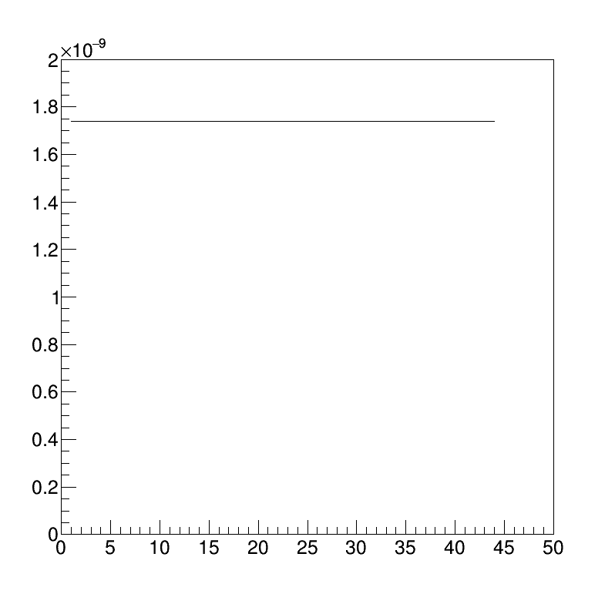
LED pulsed light board result
Power vs voltage
All measurements has been done with a powermeter bought for the test
Overlayed measurements for diferent frequencies (100 .. 10kHz)
Power normalized to 1kHz
It doesn’t depend of pulse frequency
There are not time dependency
at 1 kHz up to 1.8 nW
Power vs time (h)
7 V
8 V
19.5 V

Slide 9
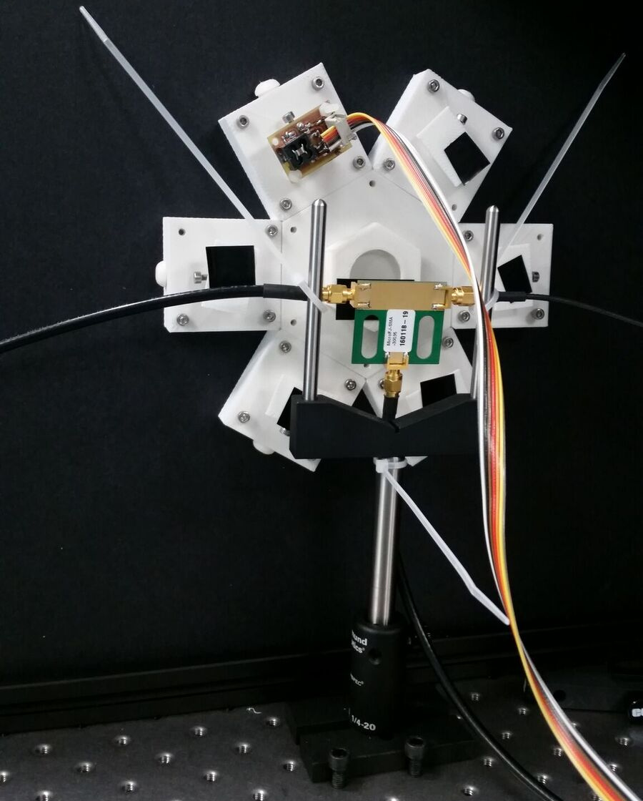
Powermeter vs SiPM Output
SiPM ouput is measured with an oscilloscope
Powermeter is at the end of optical fiber after LED coupling
Positive integral by computing
Slow output is no lineal at high power

Slide 10
Results from CIEMAT:

Slide 11
Results from CIEMAT:
If true, calibration will take long => All PMTs should be calibrated simultaneously
Although still not sure how this should work in a LAr TPC with Ar-39 + Saturation sets in a very small Nphe values

Slide 12
Status and Plans
Pulsing all 6 LEDs at the same time makes idea of reference sensor useless in principle
Options:
Measure power for each LED first and then switch on all LEDs at the same time
Use only one of the LEDs and a 1-7 splitter as in the cryostat => 1 LED to rule them all
Will continue to develop the system for 6 LEDs

