Slide 1
3D printed MPGDs
3 samples finally arrived last week
Produced at different temperatures
Pure ceramic without copper plane
Aim: Check holes and HV stability

Slide 2
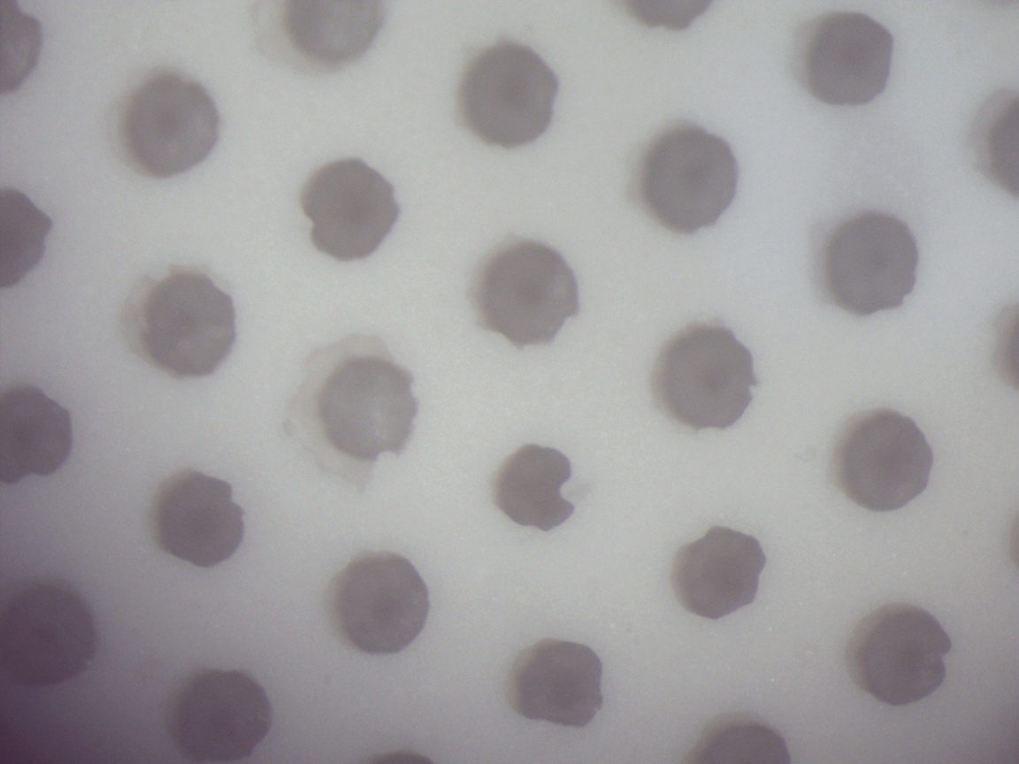
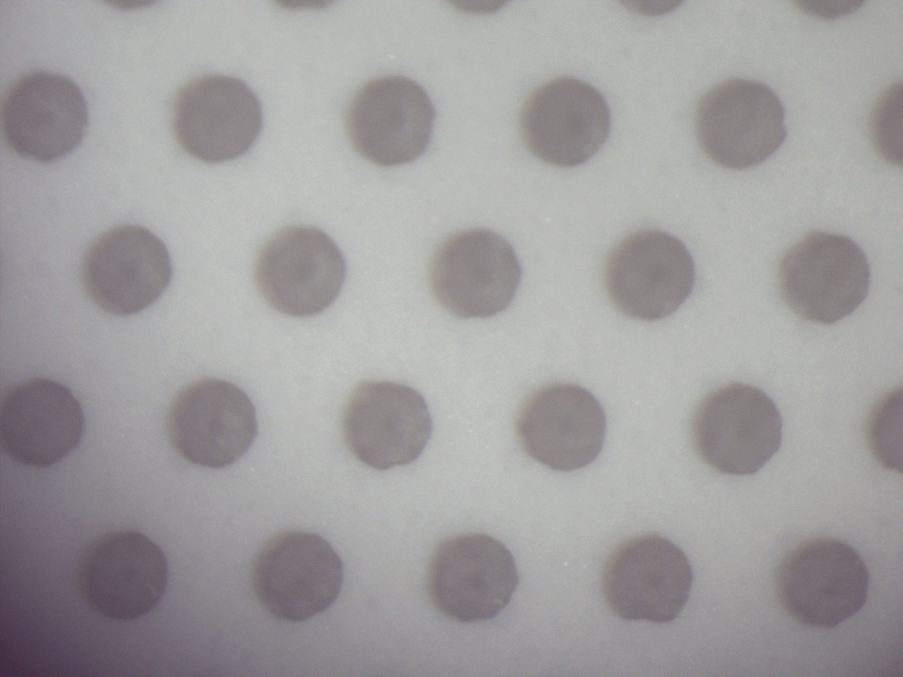
First scan with microscope with wide angle
large differences between the 2 sides of the samples
from the production problem seem to be in one side
difference between sides depends on sample

Slide 3
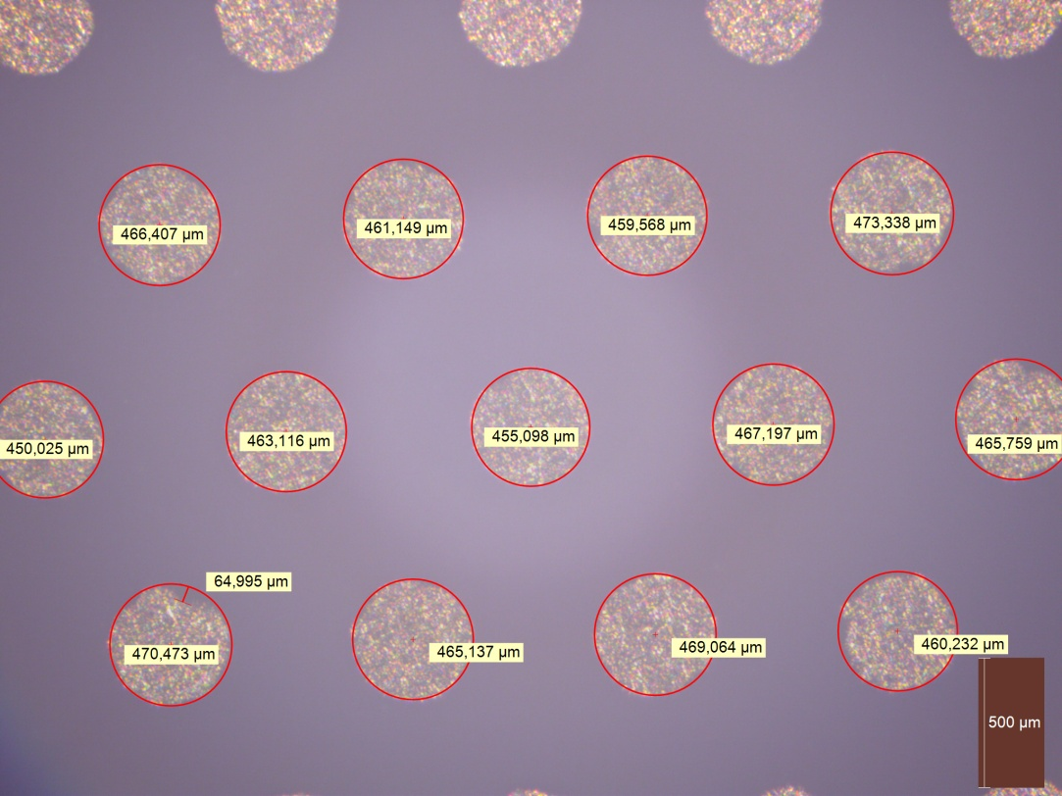
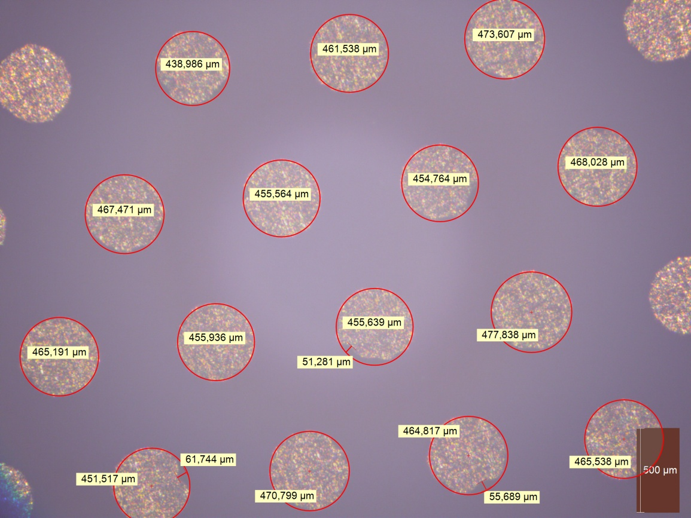
Second microscope with measurement possbility
measurement not so easy sometimes due to non-uniform holes
nominal diameter seems to be 470 um (to be checked with Dresden)
mean and error still to be calculated
some deformations of up to 60 um in some holes
thickness: 570 um (to be checked with Dresden)

Slide 4
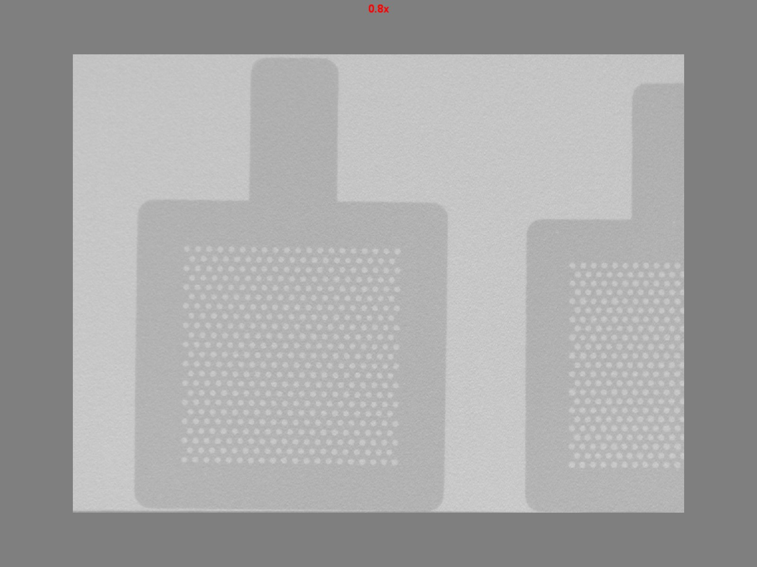
X-ray device to look for cracks and non-uniformities in density
density looks very homogenous
very few tiny variations were seen with zoom
holes also not perfectly round with X-rays but seem to be more uniform than with light => hole deformations mainly at the edges of the holes? Could the sides be polished to remove these?

Slide 5
HV Tests
HV tested in gas detector with dry air (some one stole my N2)
not optimal configuration: electrodes should be smaller than sample and better sample without holes
first 2 samples sparking at 2-2.8 kV but sparks seem through air at the edges of the copper block
last sample with longer time under air flow before HV test started stable for 40 hours at 3 kV and now without current at 3200 V
Copper block
Sample
PCB with copper

Slide 6
Conclusions
First samples have arrived and were tested
HV stability of the ceramic itself should be more than fine
Hole quality is an issue and possible improvements of production process have to be discussed with Fraunhofer (Dresden) and Weizmann Institute
Now: write short report about findings

